Slide 1


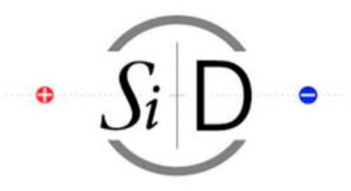
Measurement of A_{LR} in the e⁺e⁻ -> Zγ at the 250 GeV ILC TOHOKU UNIVERSITY Experimental Particle Physics Labo. M2 Takayuki Ueno Tim Barklow, Hitoshi Yamamoto, Ryo Yonamine, Jan Strube

Slide 2
Outline
● Motivation
・Previous studies
・SiD
・Higgs Effective Field Theory
● Simulation
・Set up
・Signal Process
・Method
・Event Selection
● Results
● Conclusion and Future Plan

Slide 3
Motivation - Previous studies -
Why Z boson?
Z boson can be produced ‘on resonance’ in very large numbers giving low statistical errors and with a sensitive energy dependence
-> That makes it much easier to fit its parameters with very high precision
-> It is possible to predict other physical parameters
Z boson parameters have served as good references
SLC
・longitudinal polarization electron beam was established
・the first e+e− linear collider
・600 thousand Z decays collected by the SLD experiment
LEP
・an electron-positron circular collider with a circumference of approximately 27 km
・17 million Z decays accumulated by the ALEPH, DELPHI, L3 and OPAL experiments
- Current Value -
A⁰_{LR} = 0.1514 ± 0.0022

Slide 4
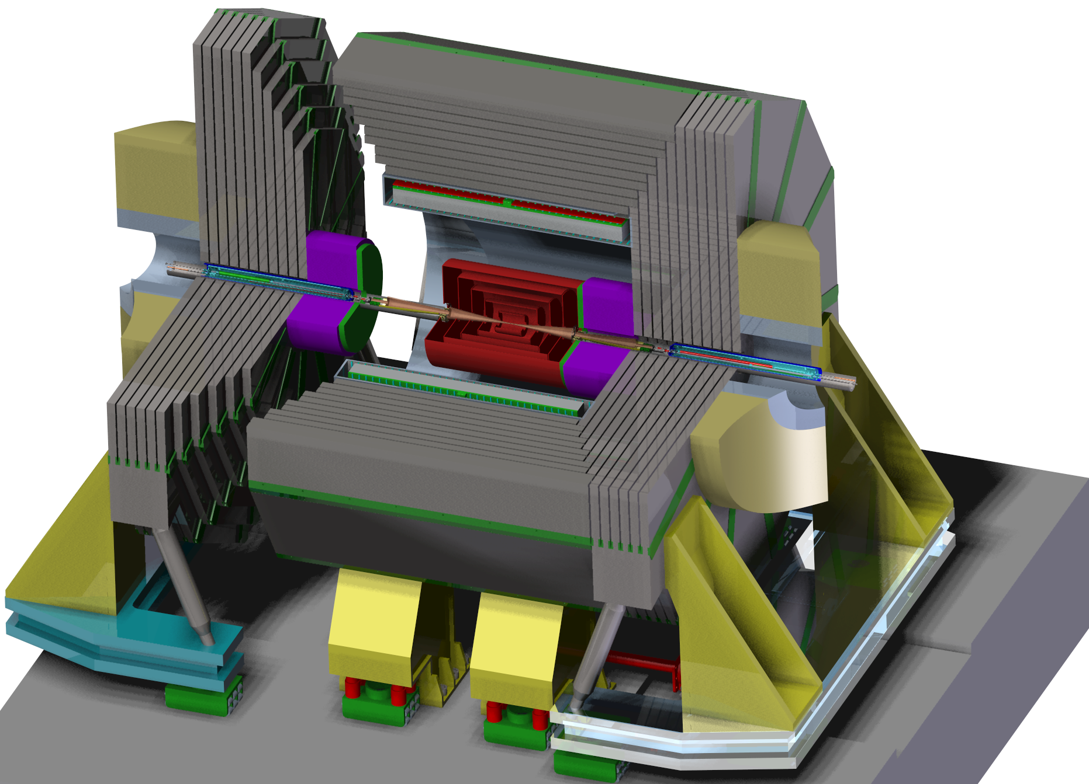
Motivation - SiD overview-
SiD
provides excellent momentum and energy resolution over the broad range of particles energies expected at the ILC
due to
・ 5T solenoidal magnetic field,
・ a vertex detector with silicon pixels
・ a main tracker with silicon strips
et al.
The ILC baseline design includes 80% polarized electron and 30% polarized positron
Especially for quantities where beam polarization is needed, exactly A_{LR},
huge progress compared to the present precision can be expected

Slide 5
Motivation - Higgs Effective Field Theory -
General SU(2)×U(1) gauge invariant Lagrangian with dimension-6 operators in addition to the SM
If the incoming beams can be polarized,
A_{LR} is the most sensitive variable to the effective weak mixing angle

Slide 6
Set up
Simulation setup
Event Generation : WHIZARD 1.95
- Samples : Mixed DBD sample
・ Signal Process : e⁺e⁻ => γ*/Z* => fermion-pair
・ Background Processes :
e⁺e⁻ => W⁺W⁻, ZZ, single W, single Z => 4f, γγ, γe => X
・ ISR & Beamstrahlung ON
・ E_{CM} = 250 GeV
・ Integral luminosity
250 fb⁻¹ for 80L30R / 80R30L
25 fb⁻¹ for 80L30L / 80R30R
Detector Simulation : DSiD (a fast simulation Delphes detector)

Slide 7
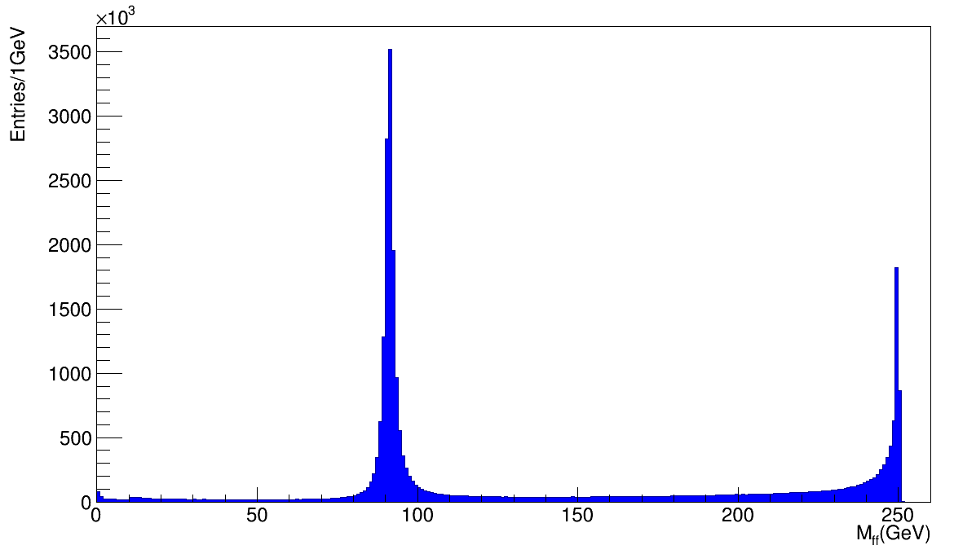
Signal Process Definition
f : e, μ, τ, u, d, c, s, b
Cross section
σ_{80L30R} = 50.67 pb
σ_{80R30L} = 34.40 pb
Signal
Background
M_{ff} distribution
DBD sample
MC truth (250fb⁻¹)
80L30R

Slide 8
Signal Process Definition
f : e, μ, τ, u, d, c, s, b
Mixed DBD Samples
Signal Definition
e⁺e⁻ -> fermion pair
86 GeV < M_{ff} (truth) < 96 GeV
Signal
Background

Slide 9
Method
Precise measurement of the beam energy at LEP
Motivation
The direct measurement of the W mass with an accuracy of 30-50 MeV at LEP2
-> It requires a precise determination of the E_{COM} (below 30 MeV)
Signal
e⁺e⁻ => Zγ => hadrons events (2jets)
θ₁, θ₂ : the angles of the 2 jets with respect to the direction of Z boson’s velocity
θ₁, θ₂ ⬄ Effective Center-of-Mass Energy
arxiv.org/abs/hep-ex/9810047
This method was actually applied for the data collected with the ALEPH detector

Slide 10
Method
COM frame
θ
y
Particle1
Particle2
θ
x (the direction of the Z boson’s velocity)
COM frame
Particle1
E₁ = E
P_{1x} = Pcosθ
P_{1y} = Psinθ
Particle2
E₂ = E
P_{2x} = Pcosθ
P_{2y} = Psinθ
Rest frame of Z boson
Particle1
E₁’ = γE + ηPcosθ
P_{1x}’ = ηE + γPcosθ
P_{1y}’ = Psinθ
Particle2
E₁’ = γE - ηPcosθ
P_{1x}’ = ηE - γPcosθ
P_{1y}’ = -Psinθ
Lorentz
transformation

Slide 11
Method
ISR Photon
COM frame
xE (= E_{γ})
E₁ (= E)
E - xE
E₂ (= E)
Beam1
Beam2
No ISR case
ISR case

Slide 12
Event Selection
Signal
(quark pair)
Background
(others)
Signal
(μ+μ-)
Background
(others)
Signal
(τ+τ-)
Background
(others)
quark selection
Njet = 2
0.8 < x < 0.917
Nchargedtrack ≧ 7
70GeV < M_{2jet} (reco) < 94GeV
ρ < 2
μ selection
Nchargedtrack = 2
Nmuon = 2
87.7GeV < M_{μμ} (reco) < 94.7GeV
τ selection
Njet = 2
Nchargedtrack = 2 or 4
20GeV < M_{2jet} (reco) < 85GeV
Nmuon ≦ 1
1 ≦ Nmuon + Nchargedhadron ≦ 4
selected
quark pair
selected background
for quark pair
selected
μ+μ-
selected background
for μ+μ-
selected
τ+τ-
selected background
for τ+τ-

Slide 13
Cut Table
- 250fb⁻¹ 80L30R -
quark channel | a quark pair (Signal) | e+e- | μ+μ- | τ+τ- | 4 fermions | γγ, eγ → X | 2 fermions (outside 86GeV~96GeV)
All Events | 11231604 | 309825 | 560775 | 564725 | 9973613 | 683678308 | 16390759
Njet = 2 (FastJet) | 6684573 | 159725 | 444425 | 293275 | 3088438 | 19553477 | 8205156
0.8 < x < 0.917 | 5372922 | 121625 | 399075 | 233163 | 1152063 | 2673250 | 1373289
Nchargedtrack ≧ 7 | 5161634 | 0 | 0 | 150 | 1023450 | 425750 | 1000579
70 GeV < M_{2jet} (reco) < 94 GeV | 4185979 | 0 | 0 | 100 | 585463 | 138500 | 553972
ρ < 2 | 4181347 | 0 | 0 | 100 | 491688 | 107625 | 540974
Efficiency | 37.23% | 0% | 0% | 0.02% | 4.93% | 0.02% | 3.30%
Selected Event Total | 4181347 | 1140387

Slide 14
Cut Table
- 250fb⁻¹ 80L30R -
μ channel | μ+μ- (Signal) | e+e- | τ+τ- | a quark pair | 4 fermions | γγ, eγ → X | 2 fermions (outside 86GeV~96GeV)
All Events | 560775 | 309825 | 564725 | 11231604 | 9973613 | 683678308 | 16390759
Nchargedtrack = 2 | 477463 | 211663 | 333413 | 48701 | 808738 | 127384064 | 4794373
Nmuon = 2 | 459000 | 0 | 12850 | 0 | 62750 | 46700356 | 820293
87.7GeV < M_{μμ} (reco) < 94.7GeV | 375425 | 0 | 0 | 0 | 5875 | 4875 | 4063
Efficiency | 66.95% | 0% | 0% | 0% | 0.06% | 0.0007% | 0.02%
Selected Event Total | 375425 | 14813

Slide 15
Cut Table
- 250fb⁻¹ 80L30R -
τ channel | τ+τ- (Signal) | e+e- | μ+μ- | a quark pair | 4 fermions | γγ, eγ → X | 2 fermions (outside 86GeV~96GeV)
All Events | 564725 | 309825 | 560775 | 11231604 | 9973613 | 683678308 | 16390759
Njet = 2 (FastJet) | 293275 | 159725 | 444425 | 6684573 | 3088438 | 19553477 | 8205156
Nchargedtrack = 2 or 4 | 266300 | 147488 | 440613 | 43990 | 748350 | 4144375 | 3715344
20 GeV < M_{2jet} (reco) < 85 GeV | 249075 | 2088 | 3463 | 29008 | 175775 | 3990125 | 376505
Nmuon ≦1 1 ≦ Nmuon + Nchargedhadron ≦ 4 | 238913 | 0 | 150 | 28965 | 128800 | 412500 | 161346
Efficiency | 42.31% | 0% | 0.03% | 0.26% | 1.29% | 0.06% | 0.98%
Selected Event Total | 238913 | 731761

Slide 16
tau decay branching ratio
leptonic decay : 35.21%
τ → e + ν_{e} + ν_{τ} : 17.82%
τ → μ + ν_{μ} + ν_{τ} : 17.39%
hadronic decay : 64.79%
τ → π± + π⁰ + ν_{τ} : 25.52%
τ → π± + ν_{τ} : 10.83%
τ → π± + π⁰ + π⁰ + ν_{τ} : 9.30%
τ → π± + π⁰ + π⁰ + π⁰ + ν_{τ} : 1.05%
τ → π± + π± + π± + ν_{τ} : 8.99%
τ → π± + π± + π± + π⁰ + ν_{τ} : 2.70%

Slide 17
A_{LR} Table
 |  | N_{LR} (250fb⁻¹) | N_{RL} (250fb⁻¹) | N_{LR}-N_{RL}/N_{LR}+N_{RL} | A_{LR}
All Events |  | 6682646 | 4263275 | 0.22103 | 0.24916
All Signal |  | 4795685 | 3237963 | 0.19390 | 0.21858
All Background |  | 1886961 | 1025312 | 0.29587 | 0.33352
quark channel | Signal | 4181347 | 2819863 | 0.19446 | 0.21921
 | Background | 1140387 | 453013 | 0.43139 | 0.48629
muon channel | Signal | 375425 | 256800 | 0.18763 | 0.21151
 | Background | 14813 | 9613 | 0.21289 | 0.23998
tau channel | Signal | 238913 | 161300 | 0.19393 | 0.21861
 | Background | 731761 | 562686 | 0.13062 | 0.14723
For equal luminosity,

Slide 18
The Statistical Error of A_{LR}
The propagation of the errors
 |  | N_{LR} (250fb⁻¹) | N_{RL} (250fb⁻¹) | r_{L} | A_{LR} | ΔA_{LR}(500fb⁻¹) | ΔA_{LR}(2000fb⁻¹)
All Signal |  | 4795685 | 3237963 | 1 | 0.21858 | 0.00055 | 0.00028
quark channel | Signal | 4181347 | 2819863 | 1 | 0.21921 | 0.00059 | 0.00030
muon channel | Signal | 375425 | 256800 | 1 | 0.21151 | 0.00197 | 0.00099
tau channel | Signal | 238913 | 161300 | 1 | 0.21861 | 0.00246 | 0.00123

Slide 19
A_{LR} correction
Using the same scheme as SLD analysis,
A_{m} | Measured left-right asymmetry
f_{bkg} | Fraction of background
A_{bkg} | Background asymmetry
A_{L} | Luminosity asymmetry
A_{P} | Polarization asymmetry
A_{E} | Center-of –mass energy asymmetry
A_{eff} | Efficiency asymmetry

Slide 20
A_{LR} correction
 |  | N_{LR} (250fb⁻¹) | N_{RL} (250fb⁻¹) | A_{m} | f_{bkg} | A_{bkg} | A_{LR}
All Signal |  | 4795685 | 3237963 | 0.22103 | 0.36251 | 0.29587 | 0.21858
All Background |  | 1886963 | 1025312
quark channel | Signal | 4181347 | 2819863 | 0.23839 | 0.22759 | 0.43139 | 0.21922
 | Background | 1140387 | 453013
muon channel | Signal | 375425 | 256800 | 0.18857 | 0.03863 | 0.21289 | 0.21151
 | Background | 14813 | 9613
tau channel | Signal | 238913 | 161300 | 0.14557 | 3.2344 | 0.13062 | 0.21861
 | Background | 731761 | 562686

