Slide 1
News from Saclay
P.Colas

Slide 2
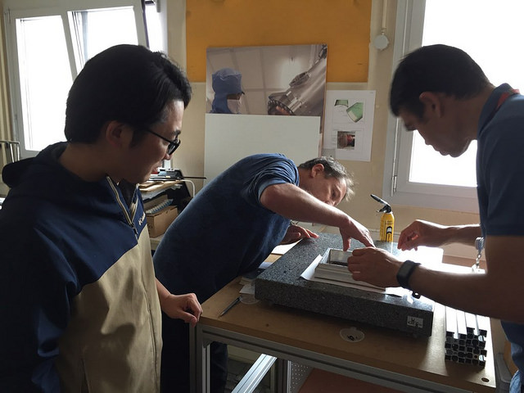
Tomohisa Ogawa arrived on October 2 and stays 2-2½ months
Preparation of the Micromegas test at DESY (November 13 to November 29)
- Will use LP2 endplate and 2PCO2 cooling (one loop)
- 4 detector modules manufactured at CERN (encapsulated res. anode)
- 3 arrived at Saclay, all working well (see presentation by Tomohisa) 1 glued on frame.
- electronics and DAQ working (installed on the new computer)
- preparation well advanced, radioprotection paperwork, travel, etc… in progress. (David Attié, Xavier Coppolani, PC, Sandrine Emery, Serguei Ganjour, T. Ogawa, Marc Riallot, Maxim Titov, Huirong Qi, Jan Timmermans). Important contribution from Ralf Diener and Oliver Schäfer at DESY (endplate, moving table, gas, CO2 compressor, trigger, supplies…)
- Mounting and commissioning on Nov. 14-17, beam might start on Nov. 18, dismounting November 28
ILD TPC Mechanical studies
ILD news
Gluing the E1 detector on frame on October 17

Slide 3
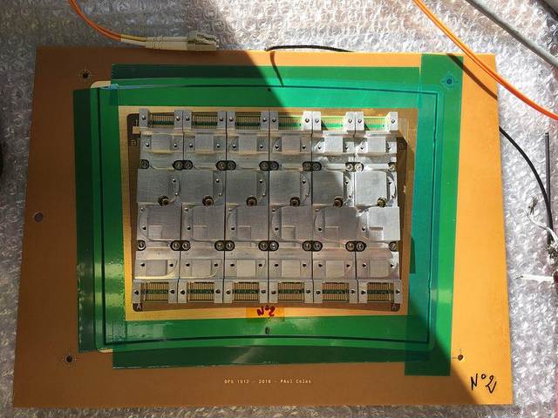

Slide 4
TPC mechanics
P.C., Julie Elman, Zhihong Sun

Slide 5
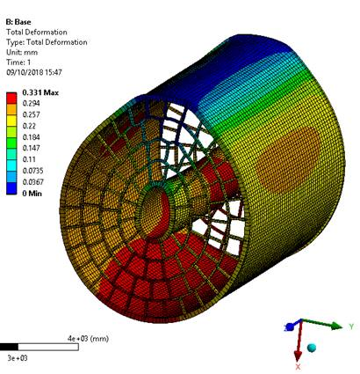
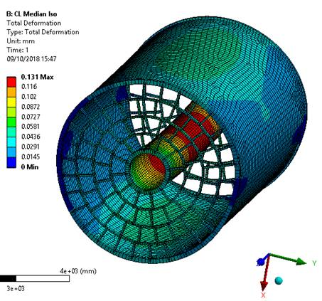
Proposal : support laterally
Gain a factor of 2.5 on the maximal scalar deformation

Slide 6
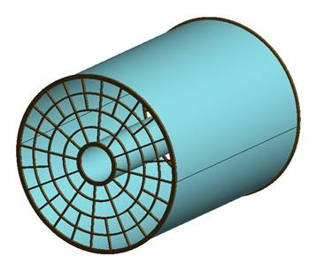
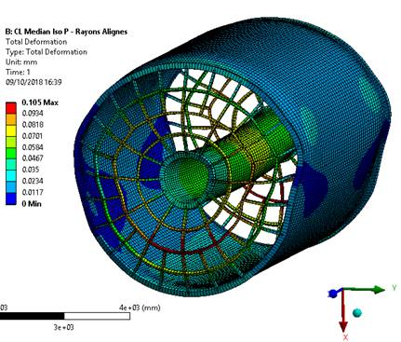
New proposals and recent deformation calculations
Radial enplate support : was not considered so far, because of fear for projective cracks. But maybe cracks can be avoided by staggering at the PCB level.
Gain another 30% on the maximal deformation : 105 µm

Slide 7
Progress on the WBS
Also preparing a mounting scheme. Will require a support tool (stiffeners) to hold the shape of the field cage to include the two endplates.
The modules cannot be mounted horizontally. So jigs have to be placed in place of the modules to stiffen the structure during the endplate mounting, and exchanged one by one with real modules (or supermodules) once the endplates are integrated with the cage.

Slide 8
LC-TPC beam test preparation Nov. 2018
Paul Colas

Slide 9
New Micromegas modules (4 in preparation)
Inverted grounding : mesh at ground and encapsulated resistive anode. Advantages (better shielding, less distortions, better voltage flexibility)
New modules status : 4 manufactured, 3 delivered and tested for connections and HV.
HV stability: one excellent, one medium (250 nA) current, one problematic, to be cleaned up.

