Slide 1




Future projects for
SDHCAL
I.Laktineh

Slide 2
2019-2021
Construction of the SDHCAL Module0:
- Conception and Construction of a few large detectors 2-3 m²
Conception and realization of their cassette
Conception and realization of a self-supporting mechanical structure using EBW
Conception, production and test of third generation HARDROC ASICs
Conception and realization of the 2-3 m² of embedded readout electronics (ASU chain)
Development, realization of a new generation DIF and the associated new DAQ.
Test of the new electronics on the the large detectors
Test of the SDHCAL module0 with the SDHCAL

Slide 3
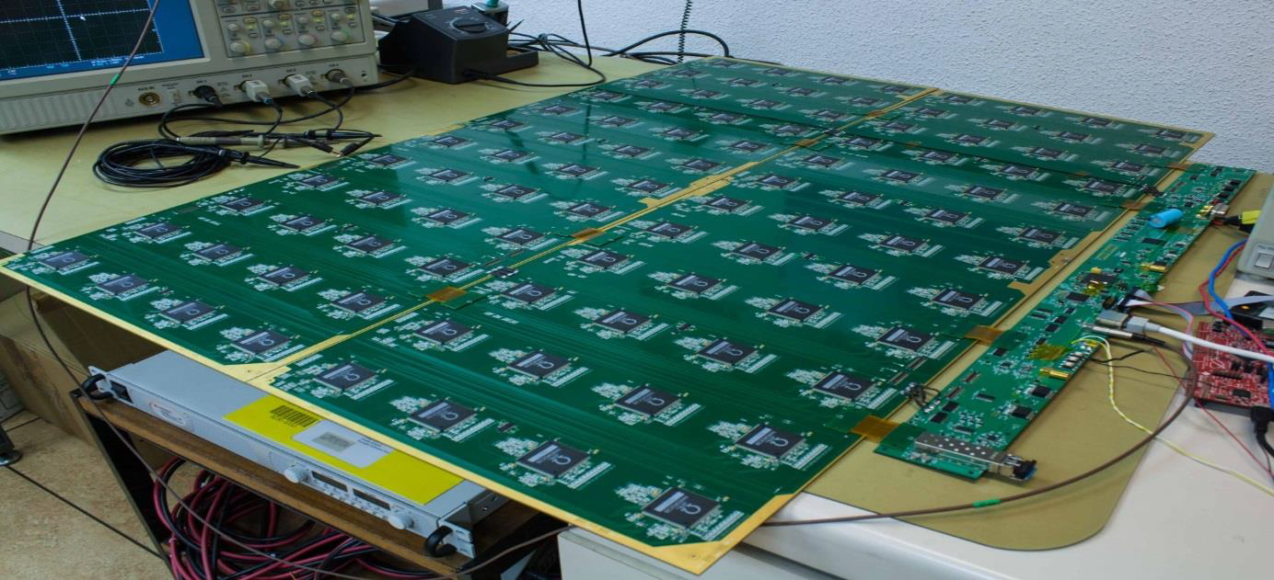
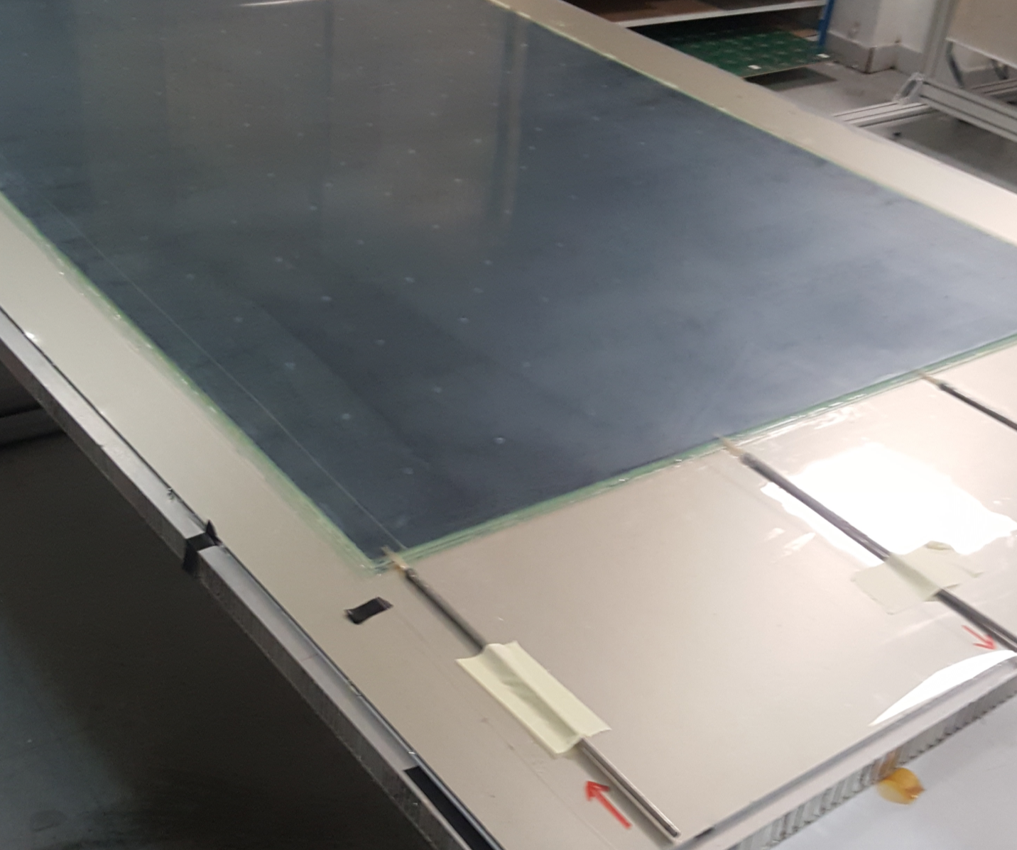
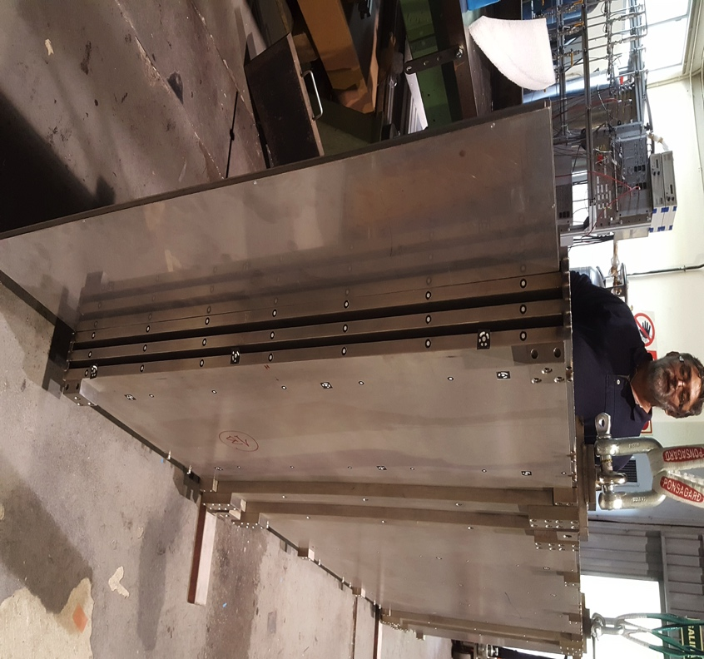

Slide 4
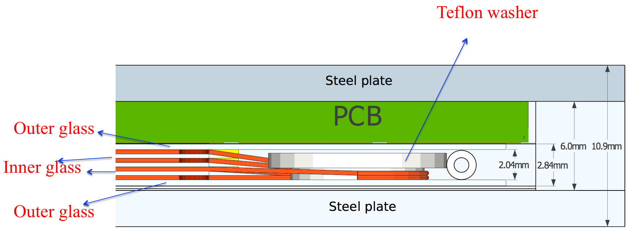
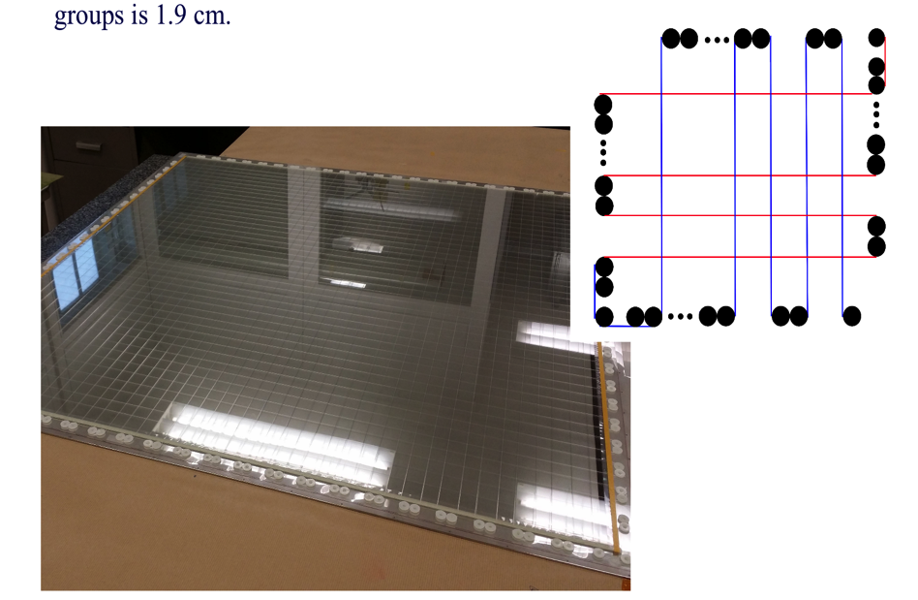
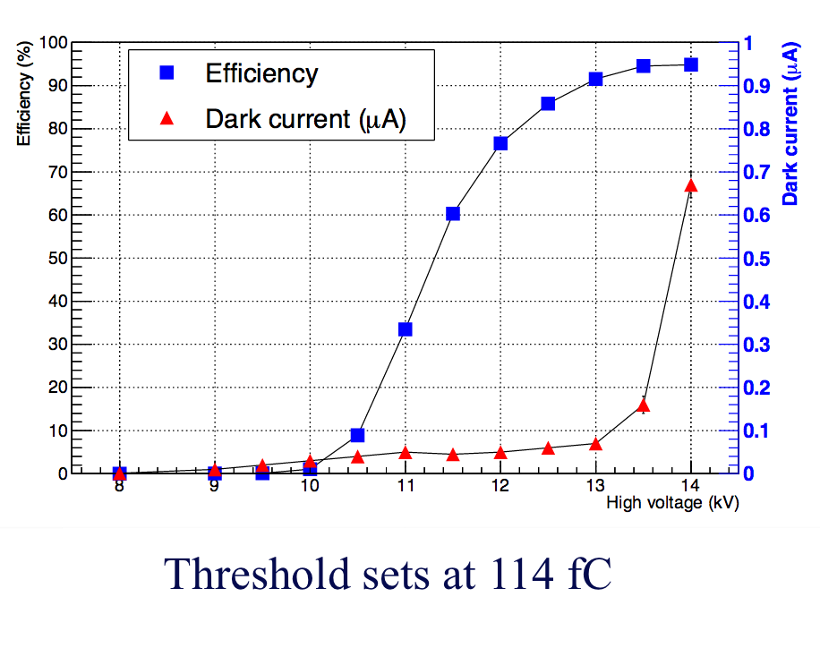
2019-2021
Timing : the new dimension
- Build large MRPC (fast timing detectors)
- Develop fine timing readout (PETIROC or equivalent ASIC) of 10-100 ps
- Develop appropriate TDC ( for time measurement and ToT)
- Conceive ASUs with pads of 1x1 cm²
- Develop a new DAQ system with the time information.
- Build a small prototype

Slide 5
2019-2021
Woven strips
Use/develop better the concept of woven strips for calorimeters
This could be an answer to circular collider such as CEPC or FCC

Slide 6
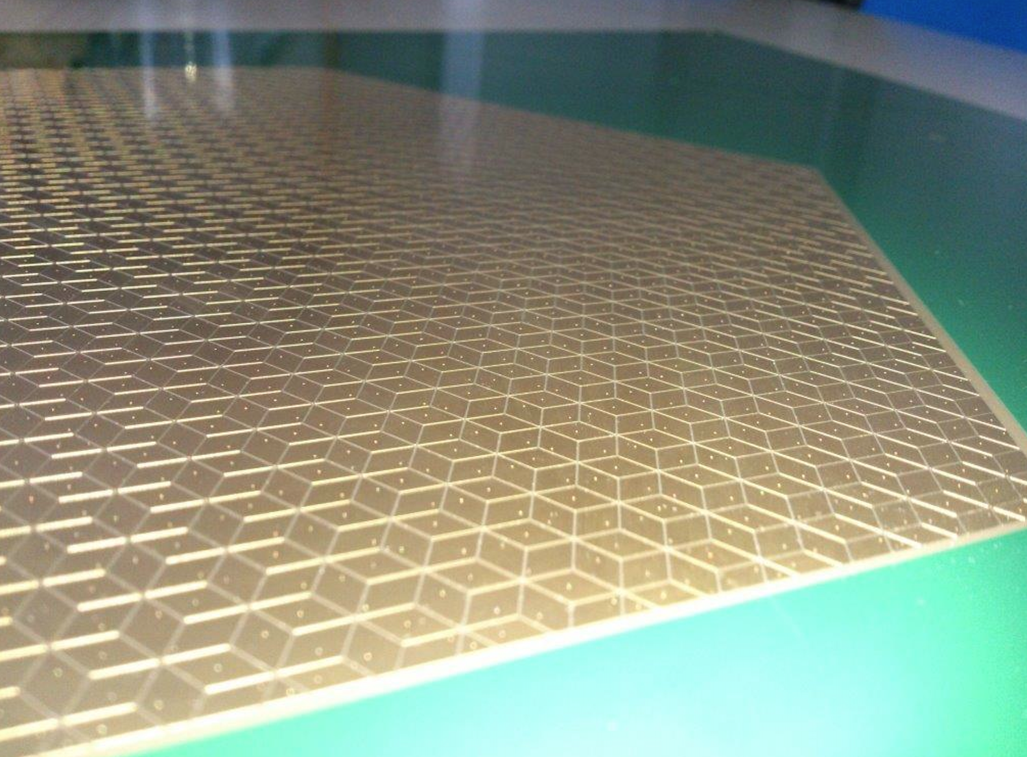
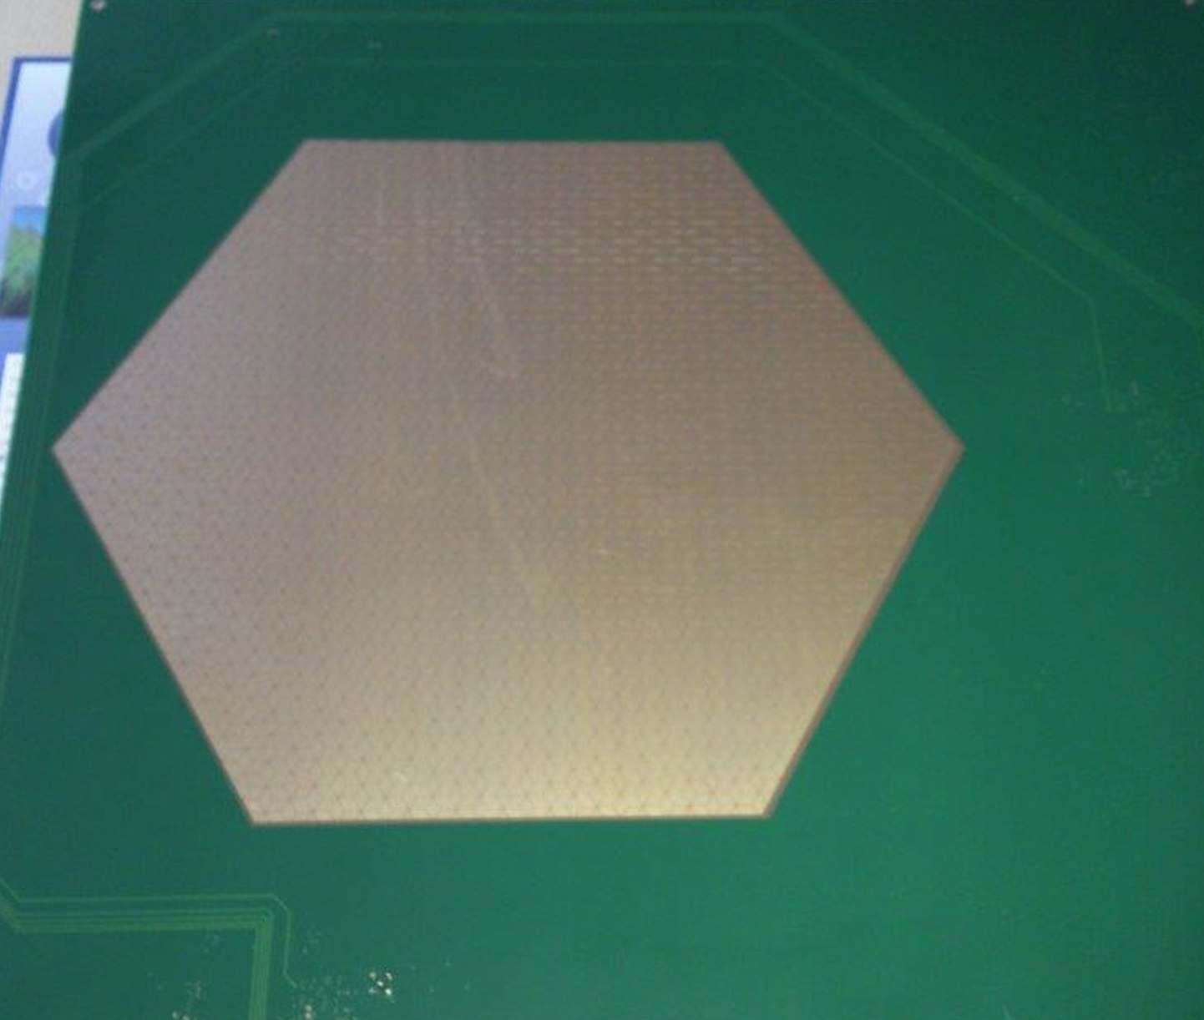
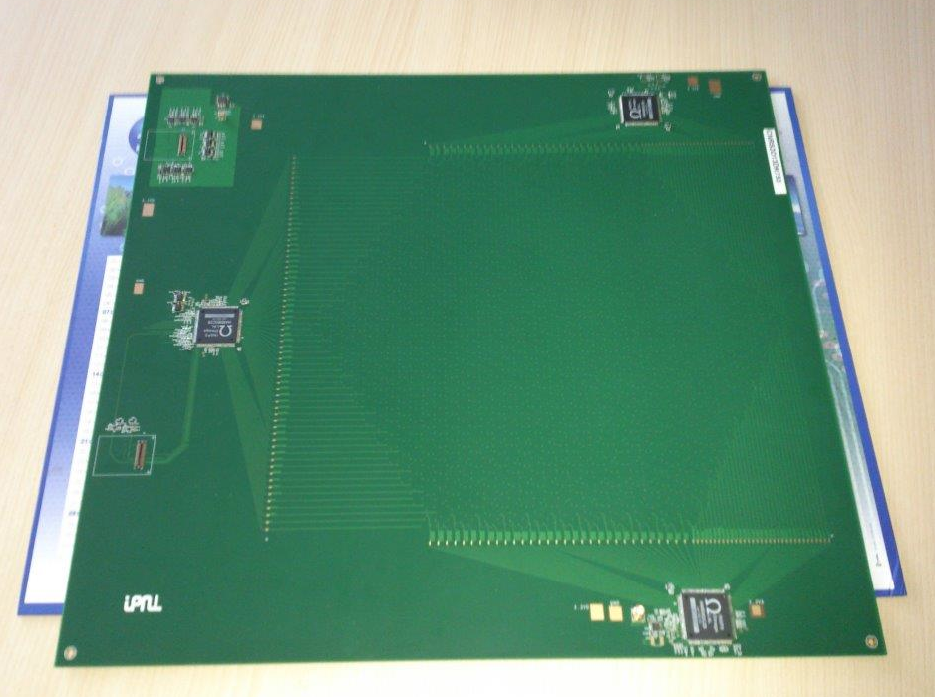
The principle is simple: the charge is shared among several pads/pixels. The pads/pixels are inter-connected in a smart way so one can identify the position of the impinging particle by identifying the fired strips and thus find the hit as the crossing points.
In addition there is no ambiguity as far as the number of particles crossing the particles is not very high thanks to the use of at least 3 directions strips.
Patented:
(PCT/EP2018/053561-FR3062926: I.Laktineh)
Avalanches
3 HR2 ASICs rather than 20 for the same surface
Lozenge’s large diagonal : 1 cm

Slide 7
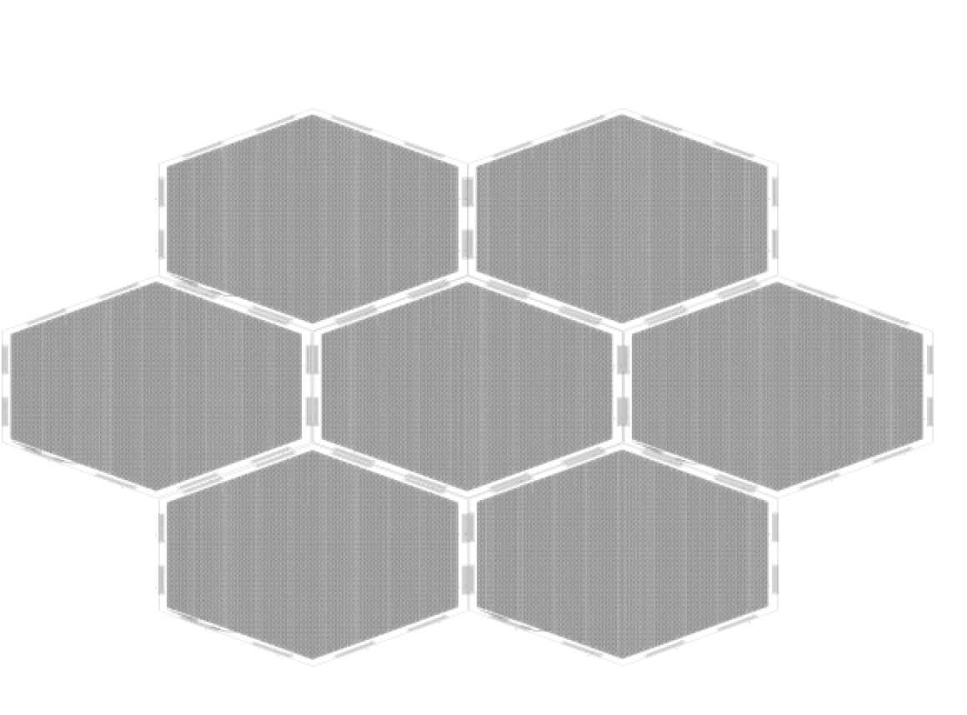
We would like to use the scheme to instrument very large gaseous detectors.
Well controlled inductance and well matched impedance will help to keep the signal in good shape for long distances.
This scheme that was successful for RPC could be easily applied to resistive MM and GEM.
FEB

Slide 8
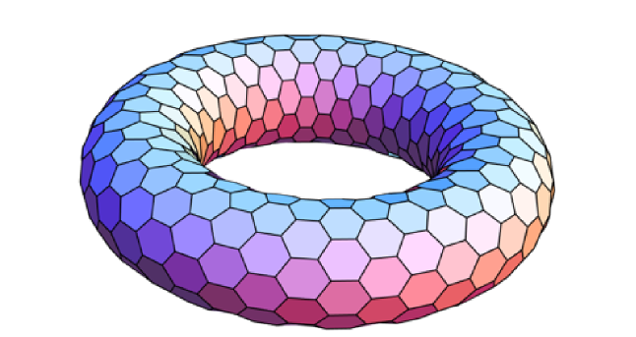
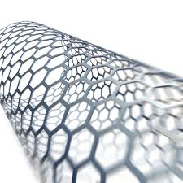
Many shapes of calorimeters could use the 3-direction woven strips structure
But 4-D direction structure ( but also 5-D and 6-D) can be used for rectangular shapes
But also
Improve on the simulation
Reconstruct the energy using MVA techniques
Characterize the hadronic showers using MVA techniques

Slide 9
Conclusion
We have a lot of projects for the near future. However this could not be achieved without a support (funding and manpower) from our institutions….

Slide 10
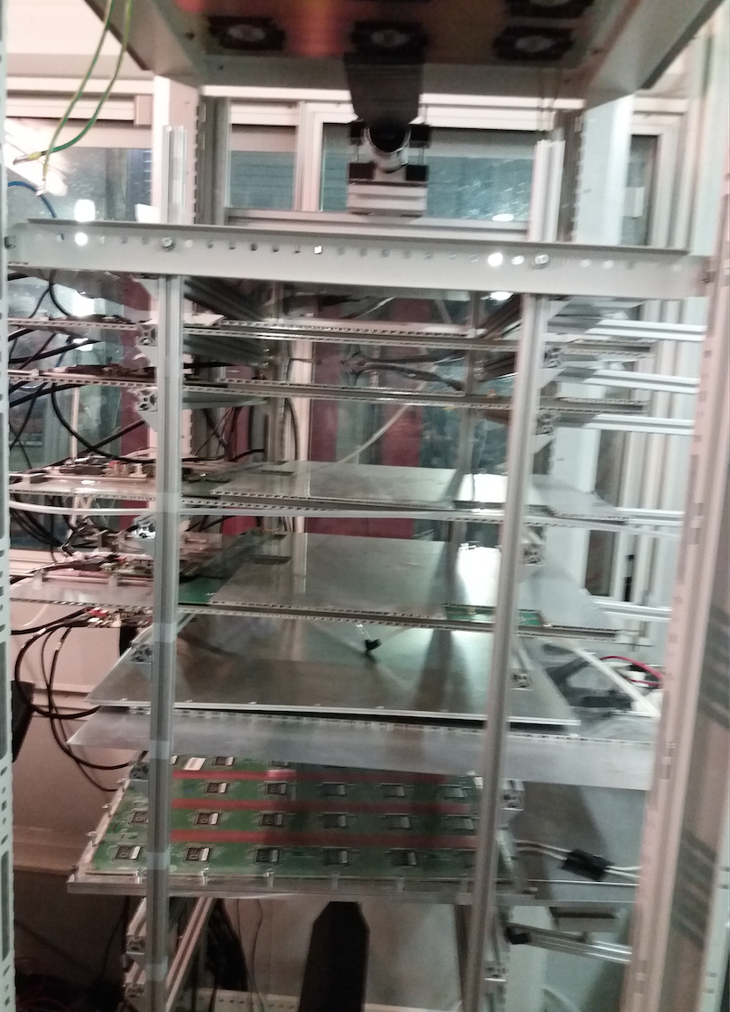
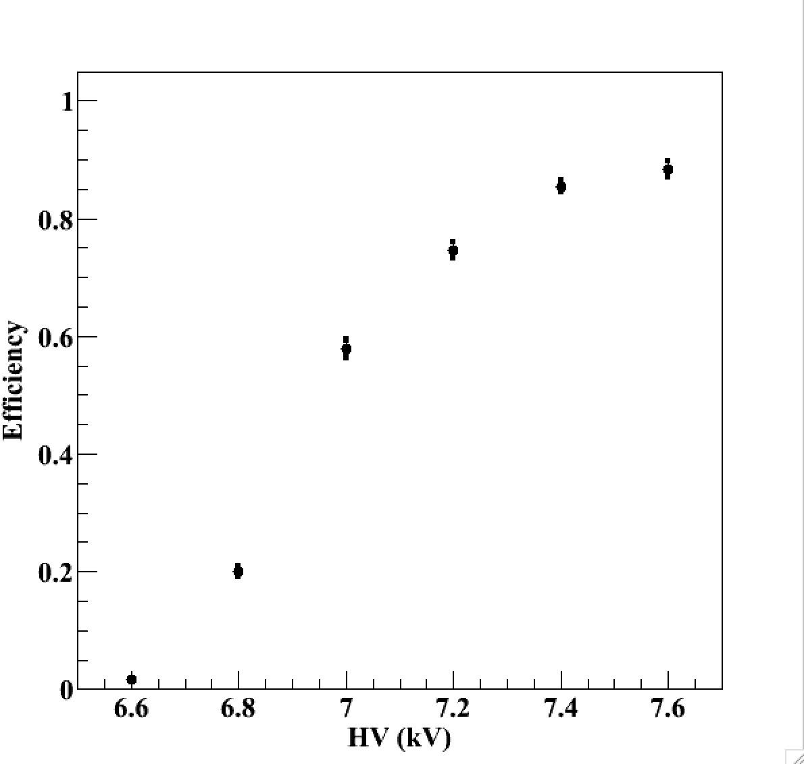
Setup with 5 detectors equipped with the new scheme
I.Laktineh

