Slide 1
Optimization of the track reconstruction algorithm in a pixel based calorimeter for proton computed tomography
Author:
Alba García Santos
April 10, 2019

Slide 2
Index
Introduction

Slide 3
Index
Introduction
Proton CT

Slide 4
Index
Introduction
Proton CT
Research Objective

Slide 5
Index
Introduction
Proton CT
Research Objective
Current Algorithm

Slide 6
Index
Introduction
Research Objective
Current Algorithm
New Ideas
Proton CT

Slide 7
Index
Introduction
Research Objective
Current Algorithm
New Ideas
Proton CT
Conclusions

Slide 8
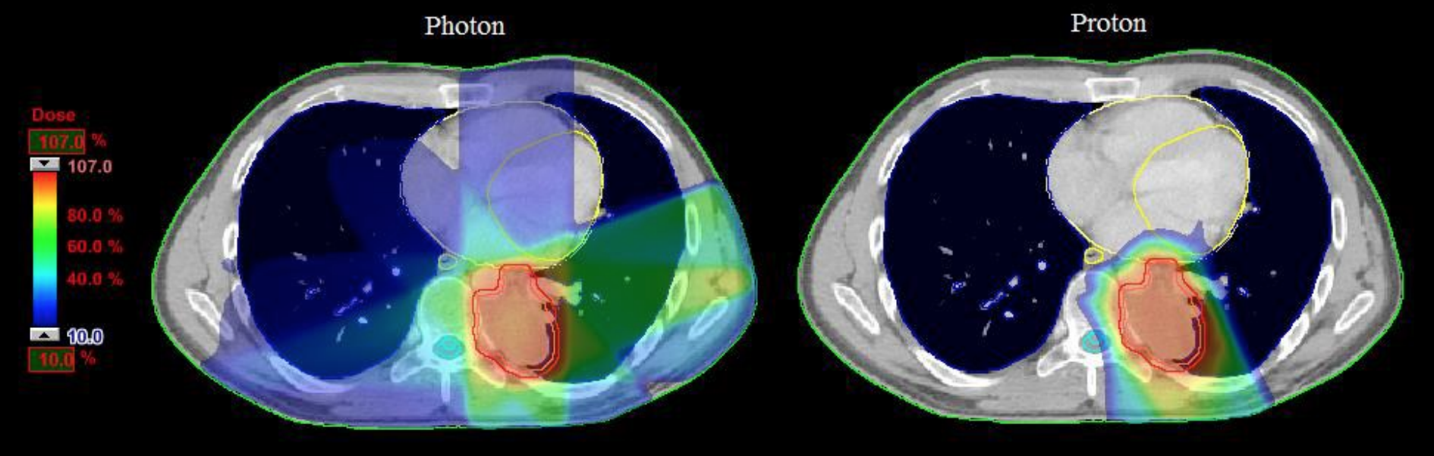
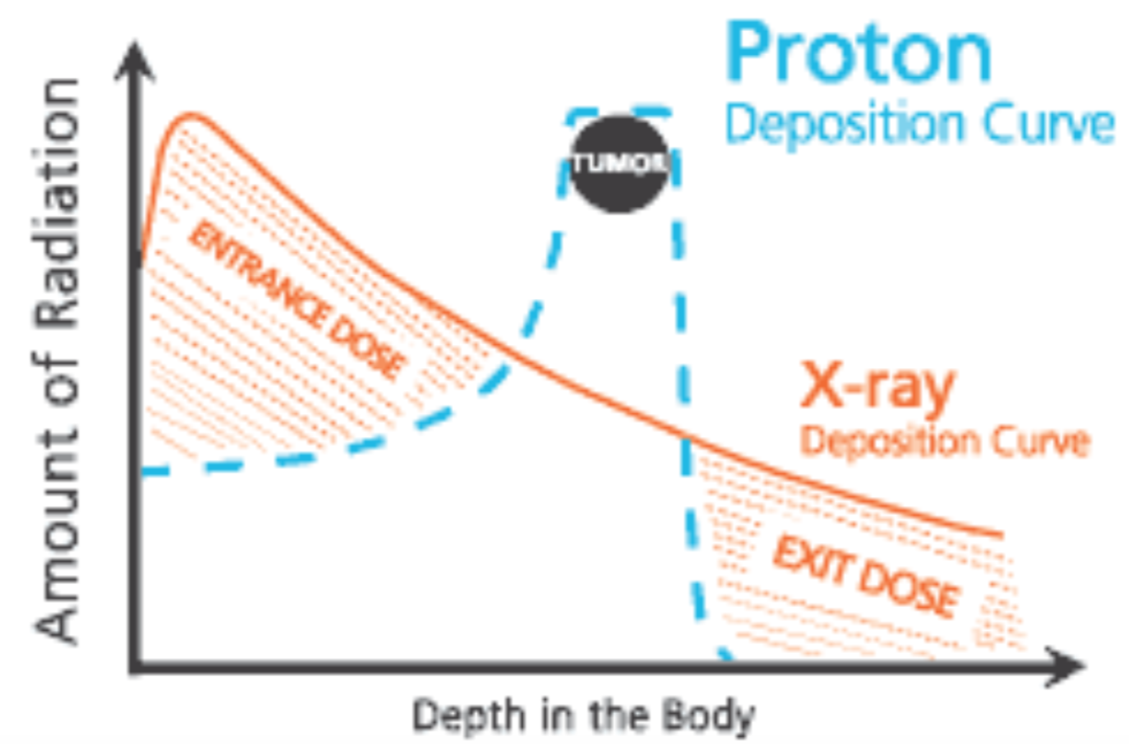
Introduction
Introduction
Proton CT
Research Objective
Current Algorithm
New Ideas
Conclusions
Cancer is a destructive disease, in which tumor cells grow-out-of-control, halting organ function
Different treatment depending on:
  cancer type, stage, organs at risk adjacent to the tumor…
Increase in the number of patient treated with particle therapy→ Protons

Slide 9
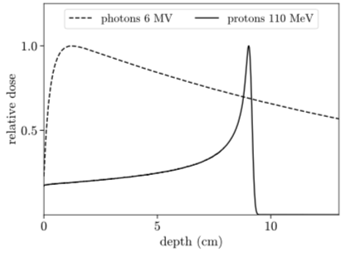
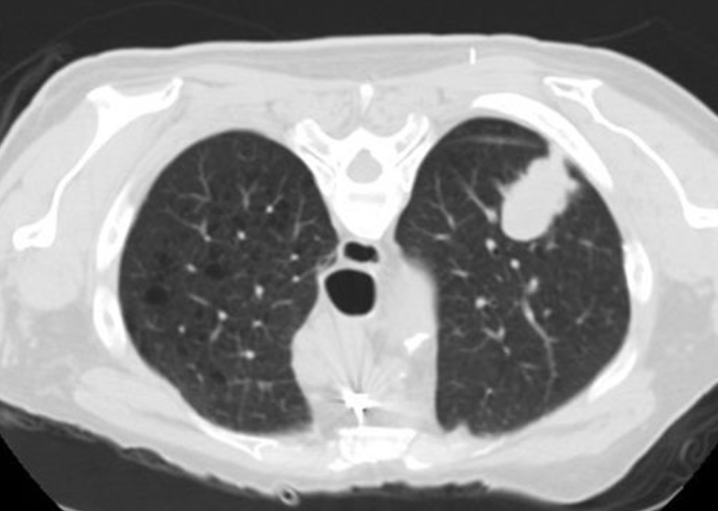
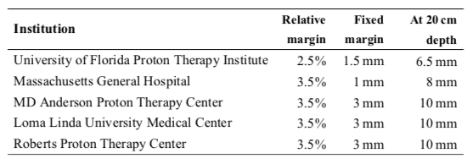
Introduction
Introduction
Proton CT
Research Objective
Current Algorithm
New Ideas
Conclusions
Narrow Bragg peak
  Localized treatment possible
  High susceptibility to uncertainty in the treatment planning
Safety margins
  Tumor is fully covered
  Increase irradiation of healthy tissue

Slide 10
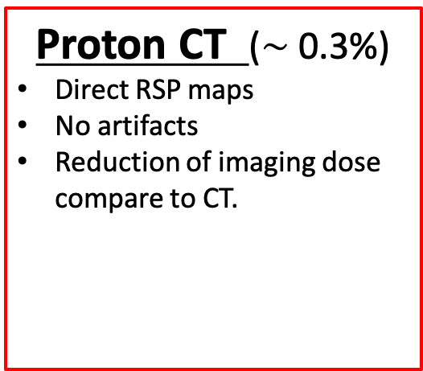
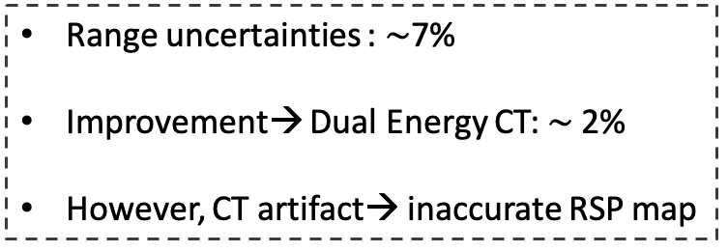
One of the causes of this uncertainty…
Introduction
Proton CT
Research Objective
Current Algorithm
New Ideas
Conclusions
CT Hounsfield Units (HU)
Relative Stopping power (RSP)
Treatment planning
Calibration curve
Dose calculation
RSP
Proton CT ($\sim$0.3%)
Direct RSP maps
No artifacts
Reduction of imaging dose compare to CT.
HU
Range uncertainties : $\sim$7%
Improvement→ Dual Energy CT: $\sim$2%
However, CT artifact→ inaccurate RSP map
Reduction of treatment margins

Slide 11
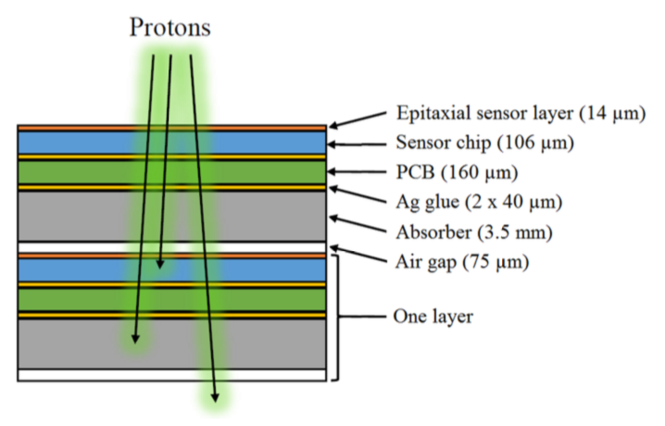
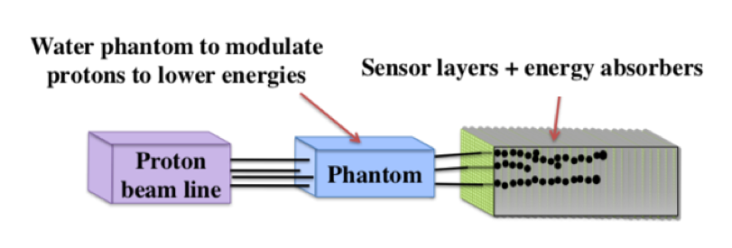
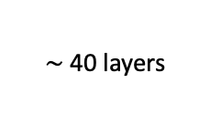

Proton CT
Introduction
Proton CT
Research Objective
Current Algorithm
New Ideas
Conclusions
For RSP maps calculation:
Using a Digital Tracking Calorimeter → many protons’ residual energies can be measured at the same time.
  $∼$40 layers
ALice PIxel Detector (ALPIDE) chip:
  Active area: 15 x 30 mm² (1024 x 512 pixel array of 28 x 28 $μ$m² pixels).
  Readout rate:$\sim$ 5-10 $μ$s.
Used sensors + sensor layer design = ALICE FoCal em calorimeter → Synergy in R&D

Slide 12
Proton CT
Introduction
Proton CT
Research Objective
Current Algorithm
New Ideas
Conclusions
For RSP maps calculation:
Using a Digital Tracking Calorimeter → many proton’s residual energies can be measured at the same time .
Aluminum
Multiple Coulomb scattering → stochastic trajectories
Proton intensities + high level of scatter between layers → track reconstruction algorithm

Slide 13
Research objective
Introduction
Proton CT
Research Objective
Current Algorithm
New Ideas
Conclusions
A proton track reconstruction algorithm has already been developed.
However, it has some limitations on the track density that can be reconstructed correctly.
A more efficient algorithm will allow a reduction of the scan time.
Optimization of the current method

Slide 14
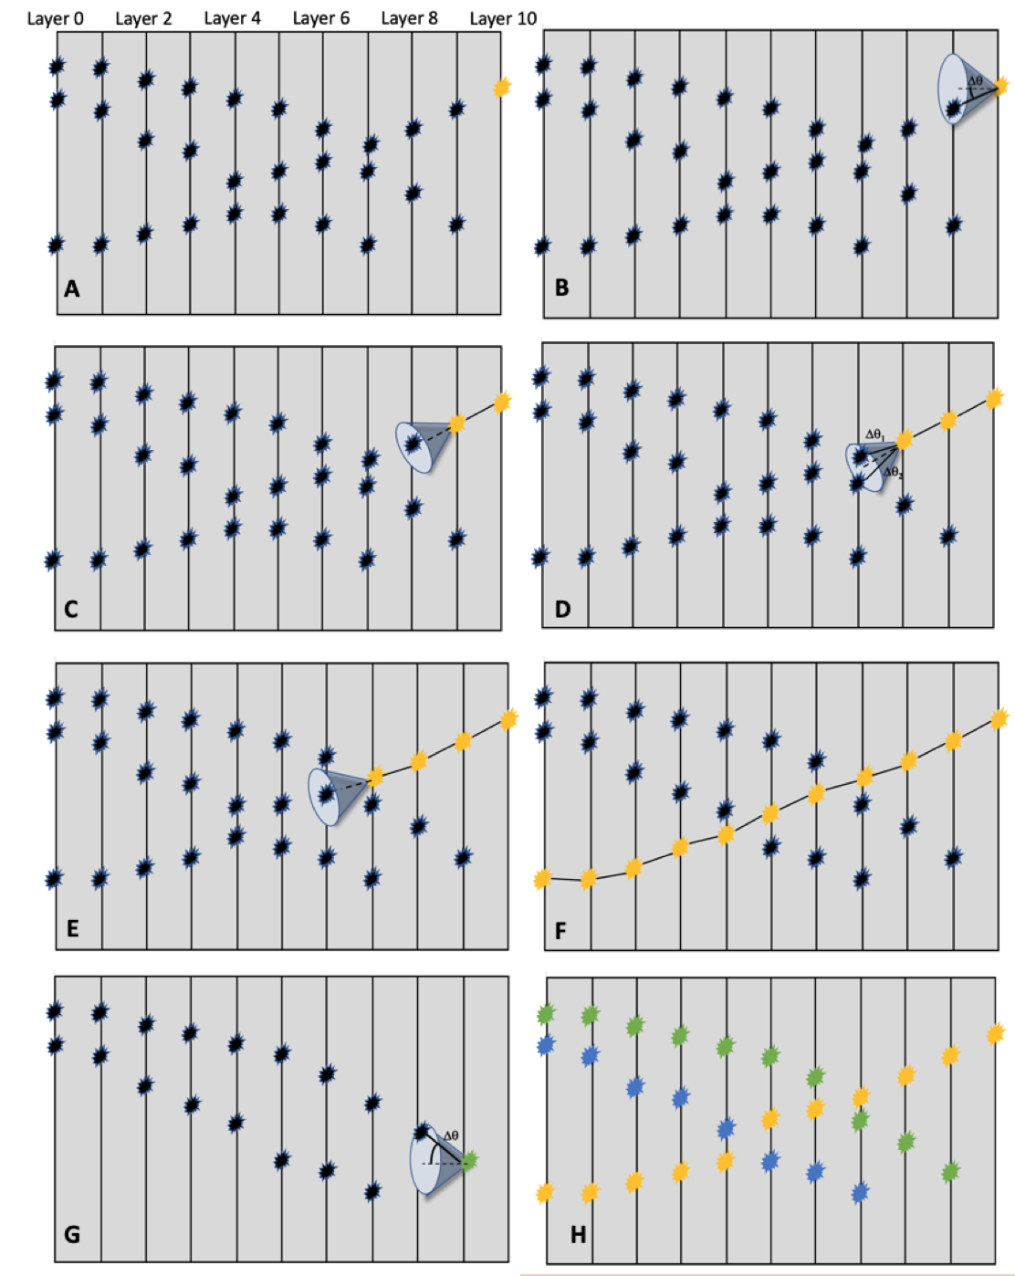
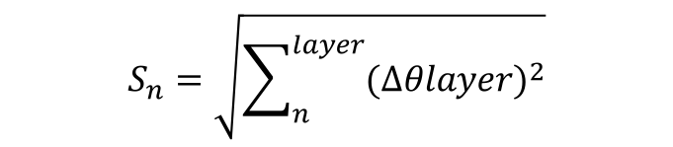
Current Algorithm
Introduction
Proton CT
Research Objective
Current Algorithm
New Ideas
Conclusions
Based on the track-following scheme
Search cone size depends on S_{max}
  Determine the of curvature
  Constant value
S_{n} is calculated for each candidate
If S_{n} < S_{max} → the candidate is added to the track
$$S_{n}=\sqrt{\sum_{n}^{layer}{({∆θlayer)}^{2}}}$$

Slide 15
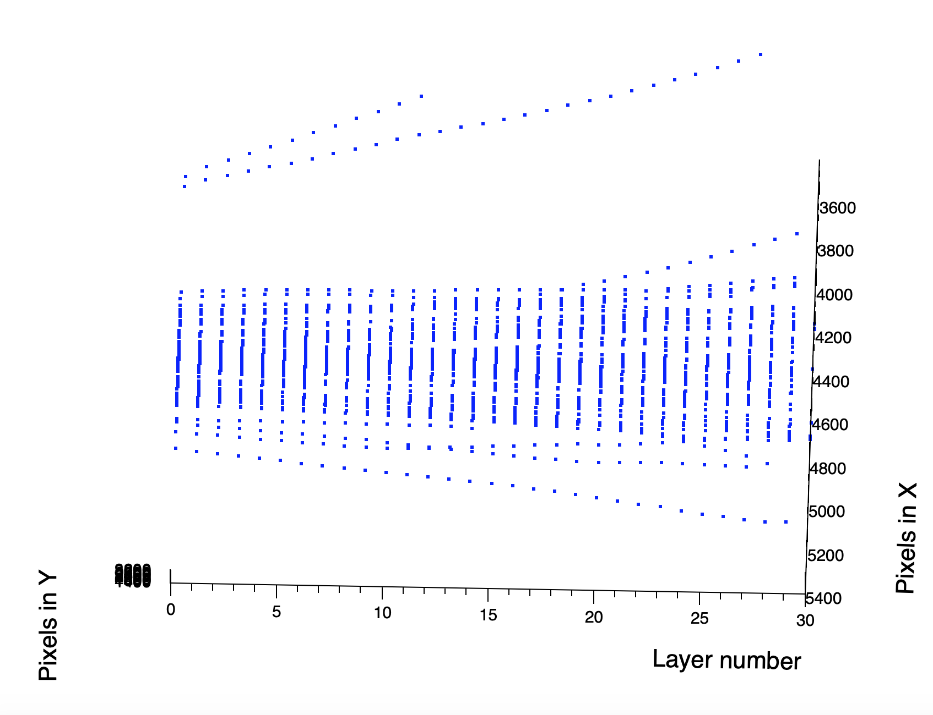
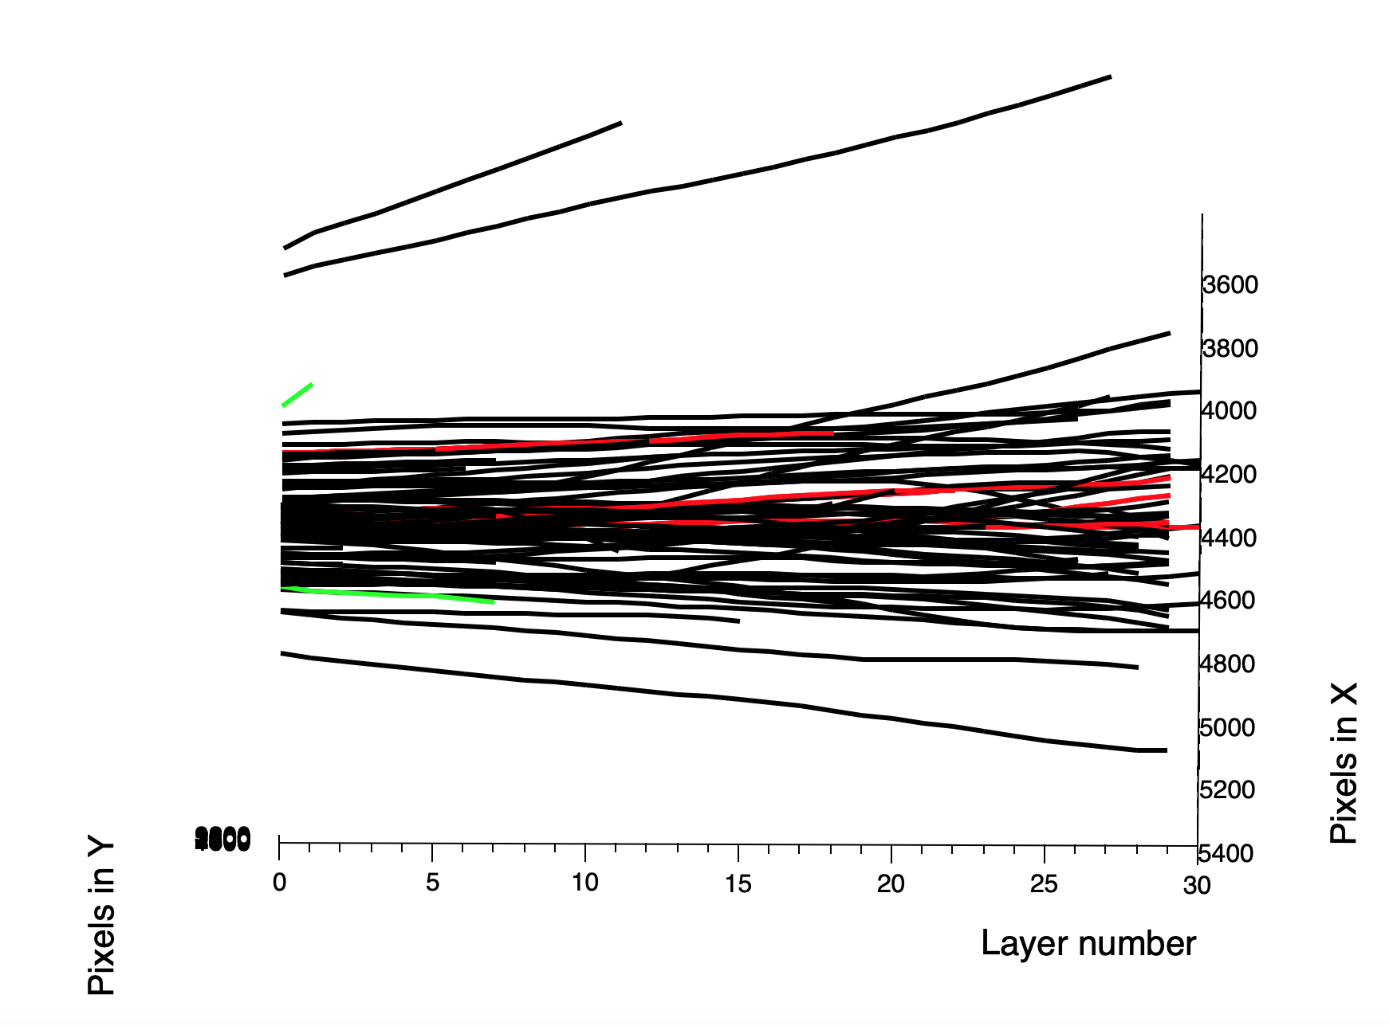
Introduction
Proton CT
Research Objective
Current Algorithm
New Ideas
Conclusions
Current Algorithm
Geant4
+
GATE

Slide 16

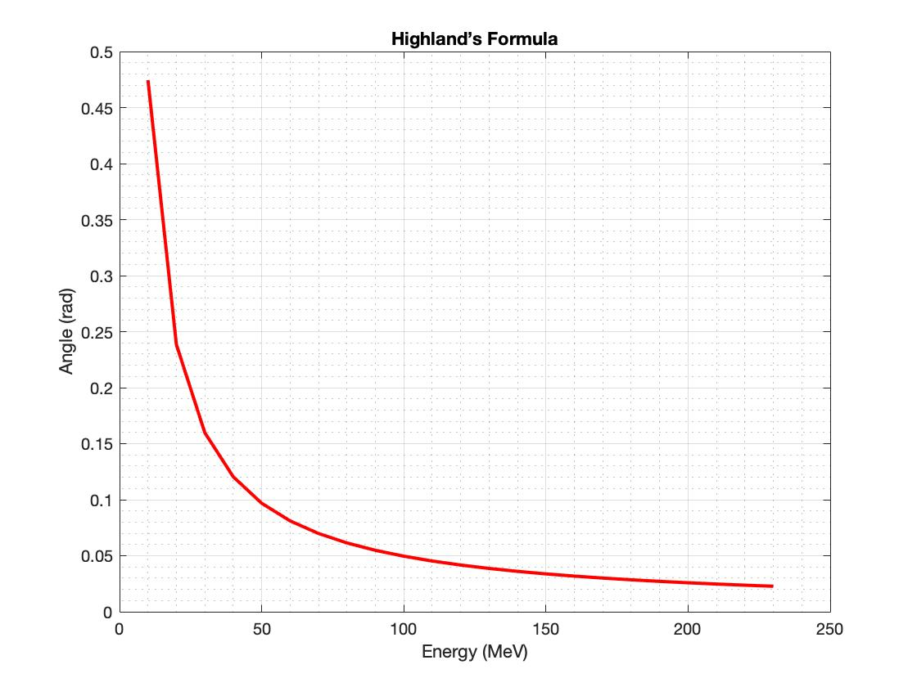
Idea 1: Variable S_{max}
Introduction
Proton CT
Research Objective
Current Algorithm
New Ideas
Conclusions
Calculate expected scatter →Highland’s Formula
x: target length (3.5mm Al)
X₀: radiation length of the target material (Al)
P₁v₁: proton’s kinematic properties for momentum and velocity.

Slide 17
Efficiency
Introduction
Proton CT
Research Objective
Current Algorithm
New Ideas
Conclusions
Only marginal improvement of the algorithm by using Highland’s formula
Using constant S_{max} (current algorithm)
Using Highland’s formula

Slide 18
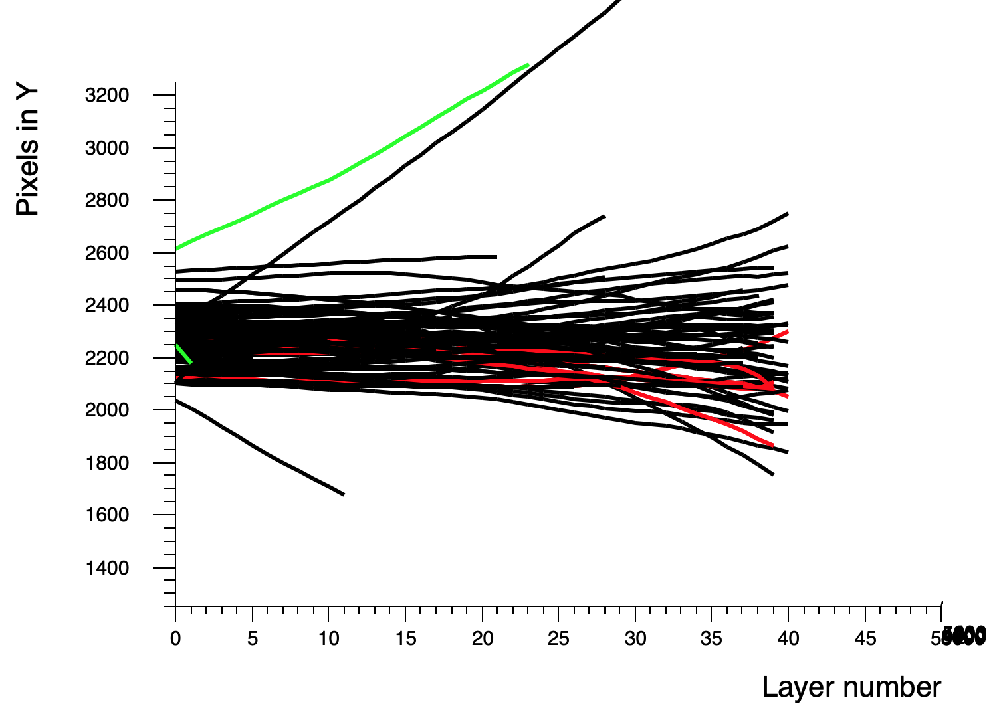
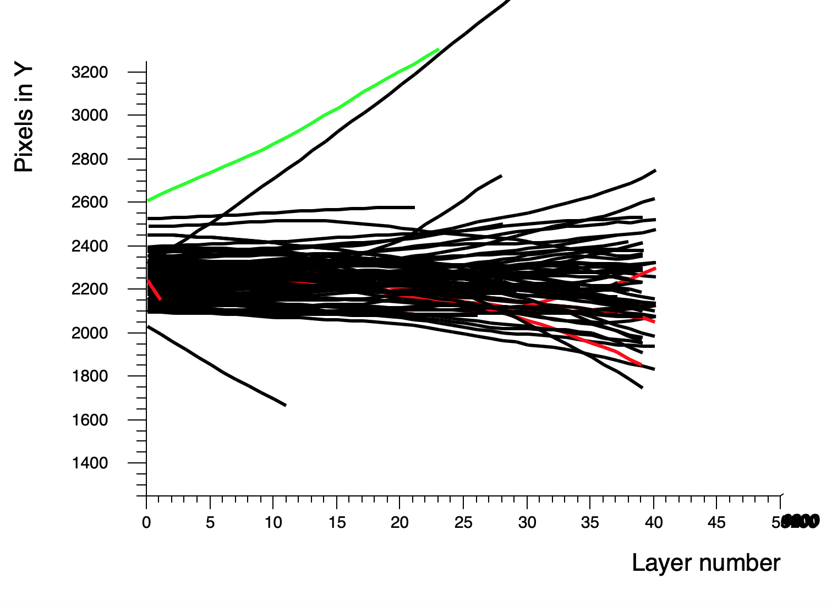
Idea 1: Variable S_{max}
Introduction
Proton CT
Research Objective
Current Algorithm
New Ideas
Conclusions
Different starting point = Different efficiency
Starting point
Starting point
Tracks with same first/last ID | All clusters same ID | Tracks with close match (0.5mm,1 degree) on first/last cluster
84.96% | 75.22% | 96.4%
Tracks with same first/last ID | All clusters same ID | Tracks with close match (0.5mm,1 degree) on first/last cluster
90.09% | 81.08% | 98.2%

Slide 19
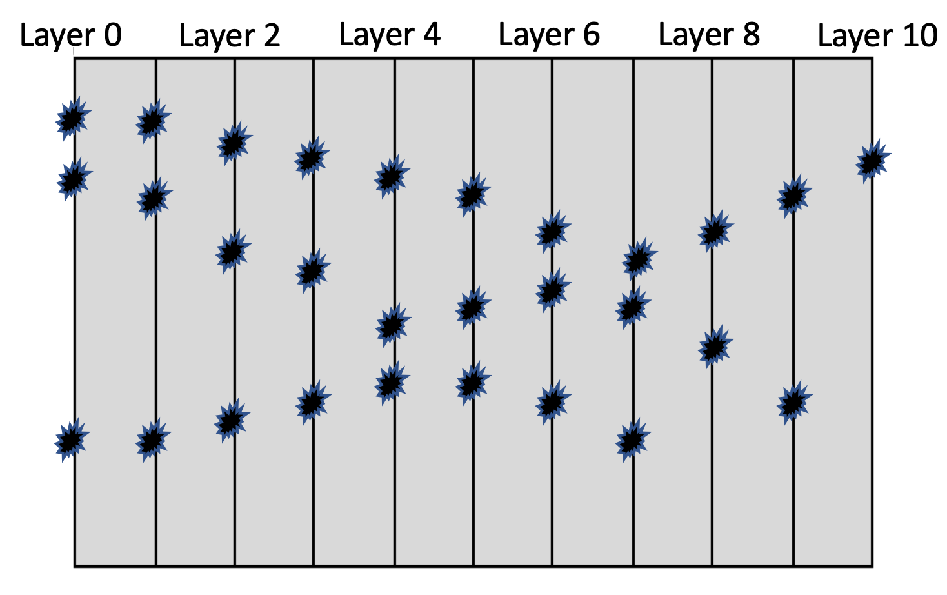
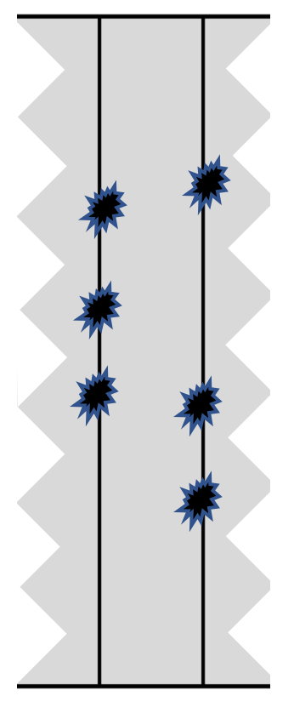
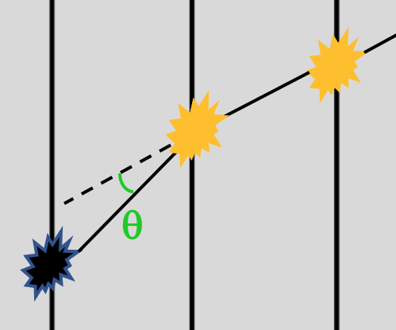
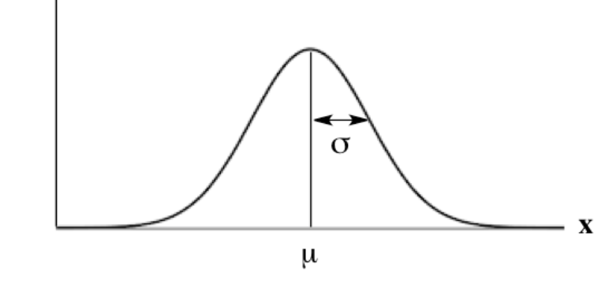
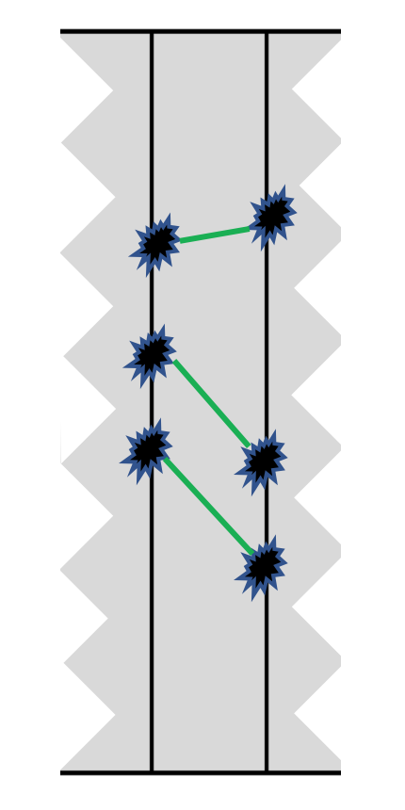
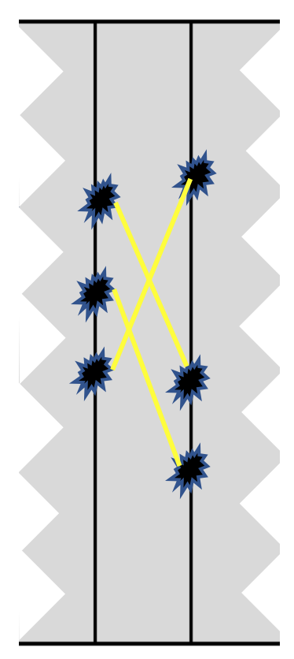
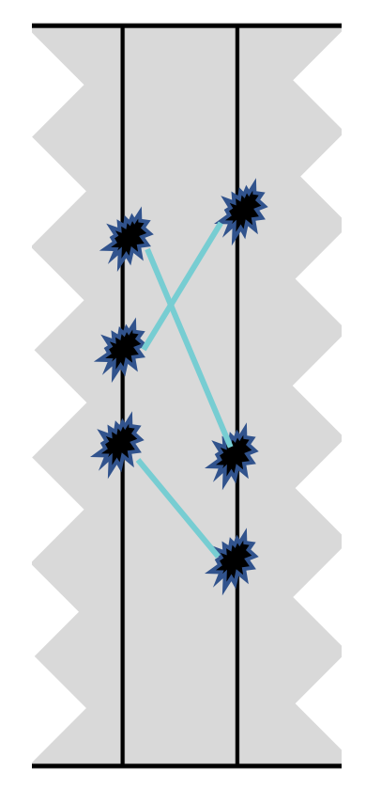
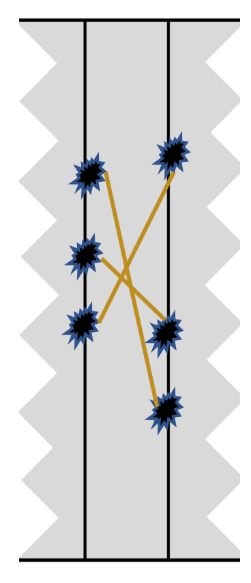
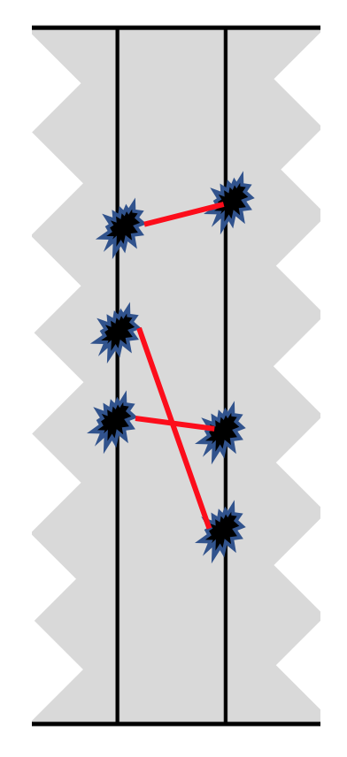
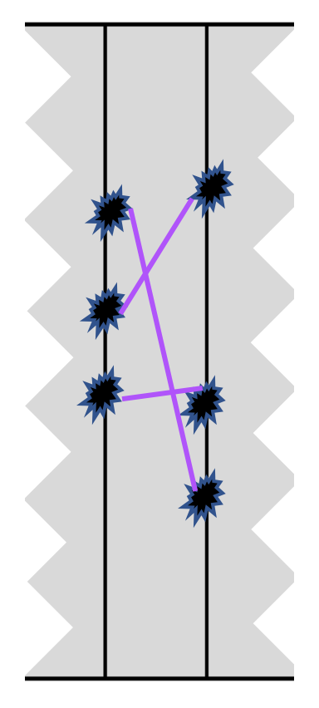




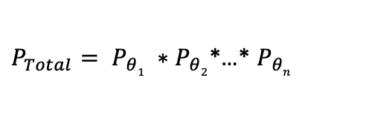
Idea 2: Calculate best scenario
Introduction
Proton CT
Research Objective
Current Algorithm
New Ideas
Conclusions
$σ=\frac{14.1 MeV}{p_{1}v_{1}}\sqrt{\frac{x}{X_{0}}}$ $\left(1+ \frac{1}{9}\log_{10}\frac{x}{X_{0}}\right)$
p($θ)$
$$θ1$$
$$θ$$
$P_{Total}= P_{θ1} ∗P_{θ2}$*…* $P_{θn}$
P₁
P₆
P₂
P₃
P₄
P₅
Best Option!

Slide 20
Conclusions
Introduction
Proton CT
Research Objective
Current Algorithm
New Ideas
Conclusions
Proton therapy treatment can optimize the dose delivery to patient
The use of a proton CT will increase the accuracy of the treatment planning
To this end, protons’ residual energies can be measured using Digital Tracking Calorimeter → many protons can be detected at the same time
However, protons follow stochastic trajectories in the detector→ track reconstruction algorithm.
The current track reconstruction algorithm has some limitation, especially at higher beam intensities
Optimization of this algorithm → better performance
  Idea 1: Adapt the algorithm to the expected scatter depending on the energy
    Small improvement
    Low robustness
  Idea 2: Calculate the best scenario per layer
    More robust
    More computationally expensive
    Better results???

Slide 21




Acknowledgement
Thomas Peitzmann
Dieter Röhrich
Helge Egil Seime Pettersen
Naomi van der Kolk
Rene Barthel
Ton van den Brink

Slide 22
Thank you for your attention!

