Slide 1
HCAL status
I.Laktineh & F.Sefkow
On behalf of the ILD hadronic calorimeter groups

Slide 2
Outline
SDHCAL technological prototype
R&D for SDHCAL ILD:
Detectors
Readout electronics
Mechanics
Gas recycling
AHCAL technological prototype Design
Construction
Testbeam experience
Large layers
Future plans
Conclusion

Slide 3
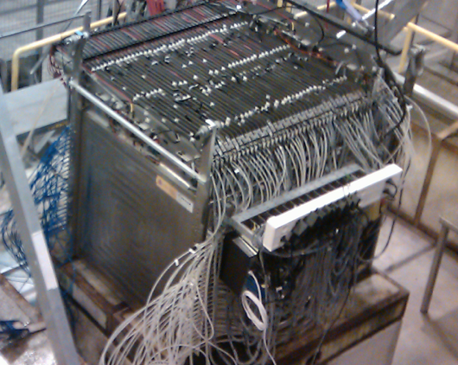
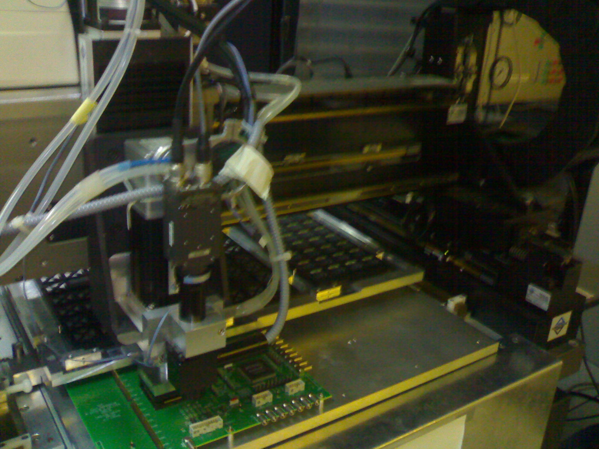
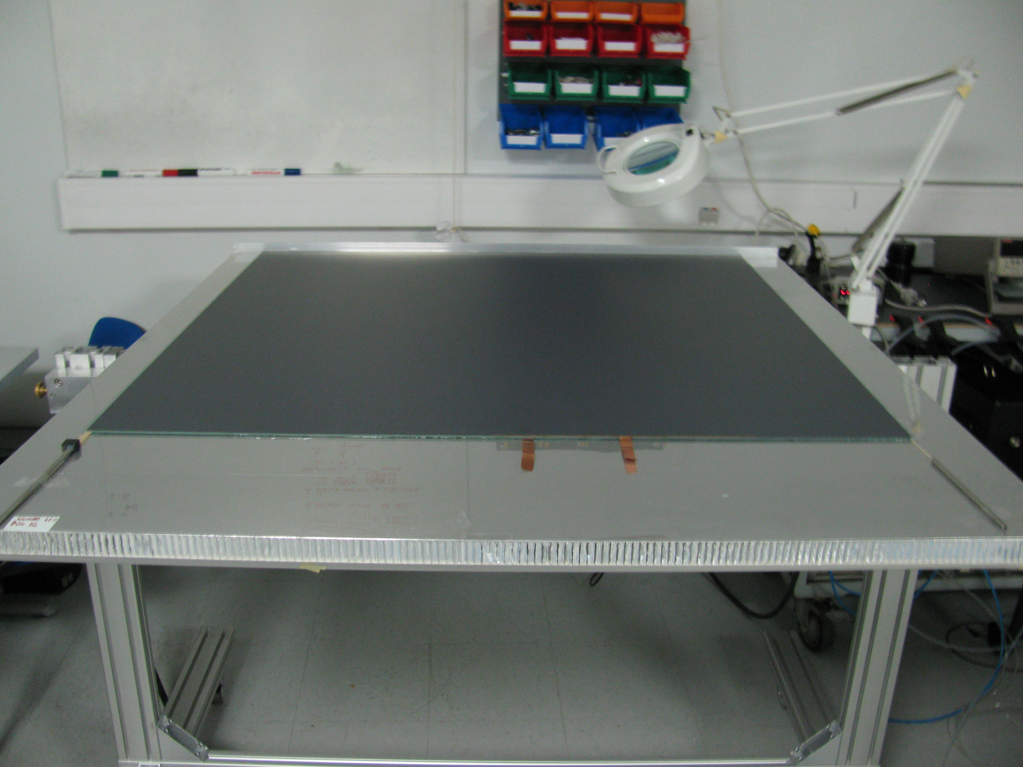
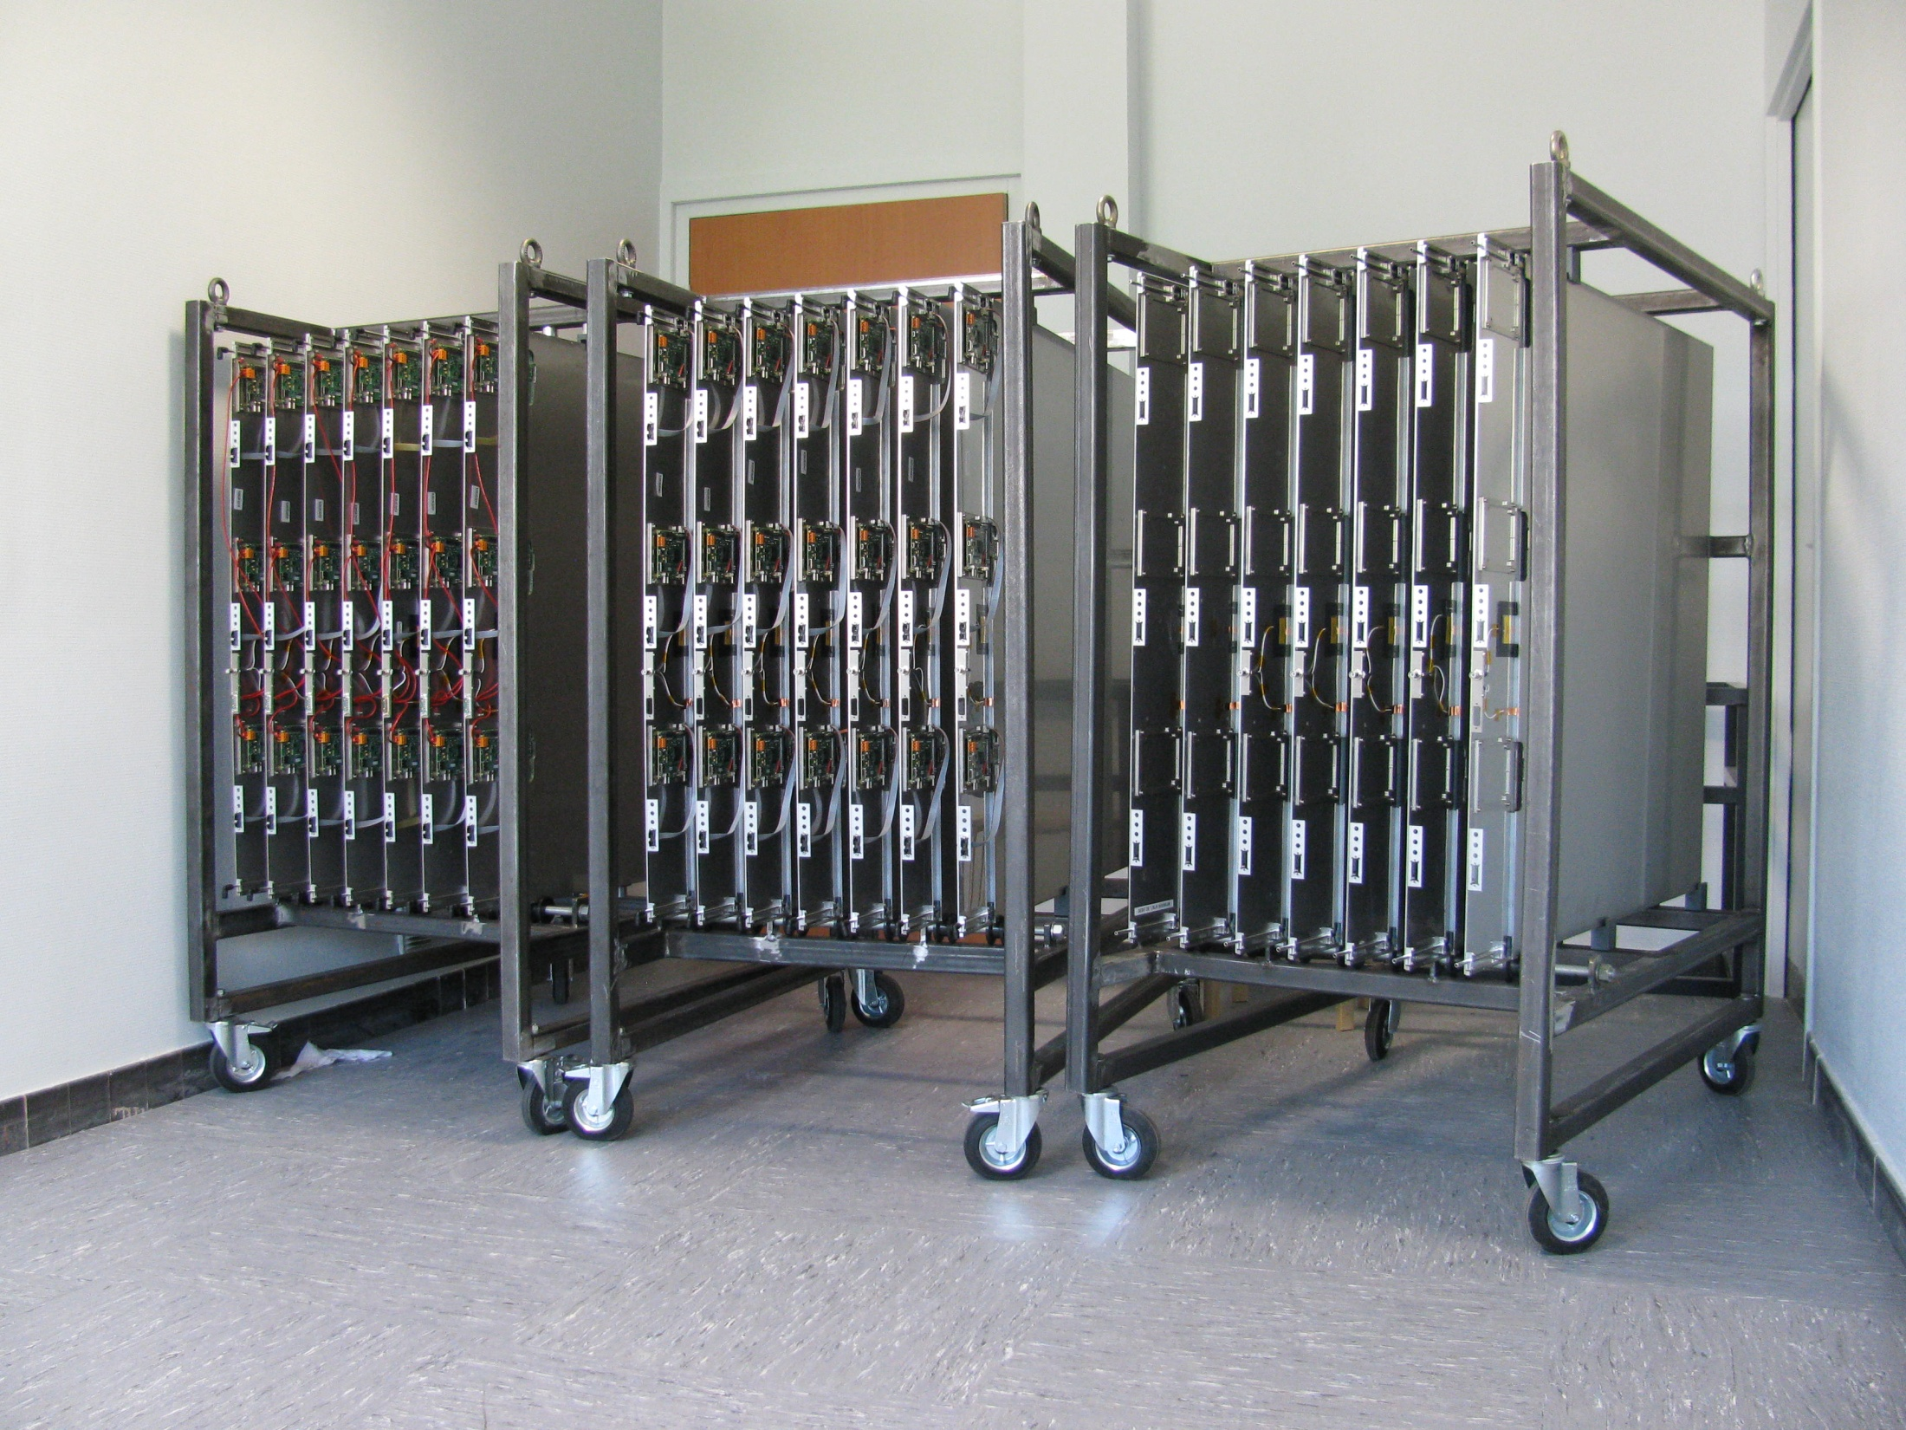
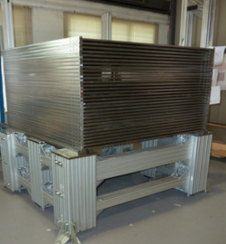
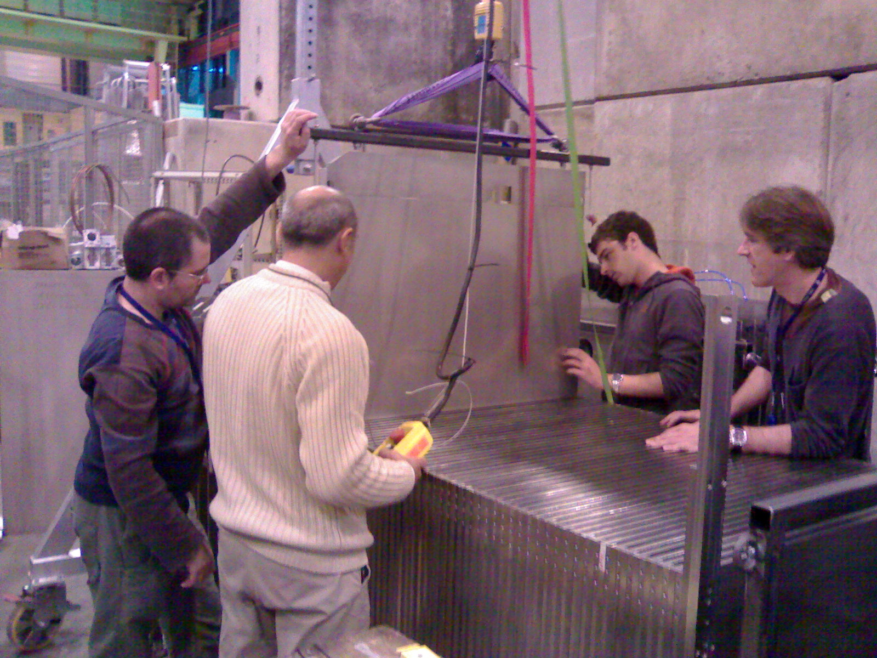
SDHCAL Since 2011
SDHCAL prototype construction
10500 64-ch ASIC were tested and calibrated using a
dedicated (ASICs layout : 93% ).
310 PCBs were produced, cabled and tested.
They were assembled by sets of six to make 1m² ASUs
170 DIF, 20 DCC were built and tested.
50 detectors were built and assembled with
their electronics into cassettes.
Self-supporting mechanical structure.
DAQ system using both USB and HTML protocol
was developed and used.
Full assembly took place at CERN.
1 cm x 1 cm pads, 48 layers, power-pulsed, mechanical self-supporting structure
TB: 2012,2015, 2016, 2017 and 2018 with ECAL

Slide 4
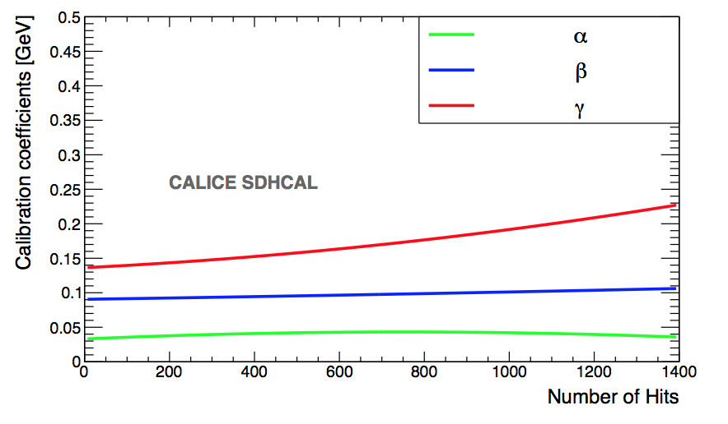
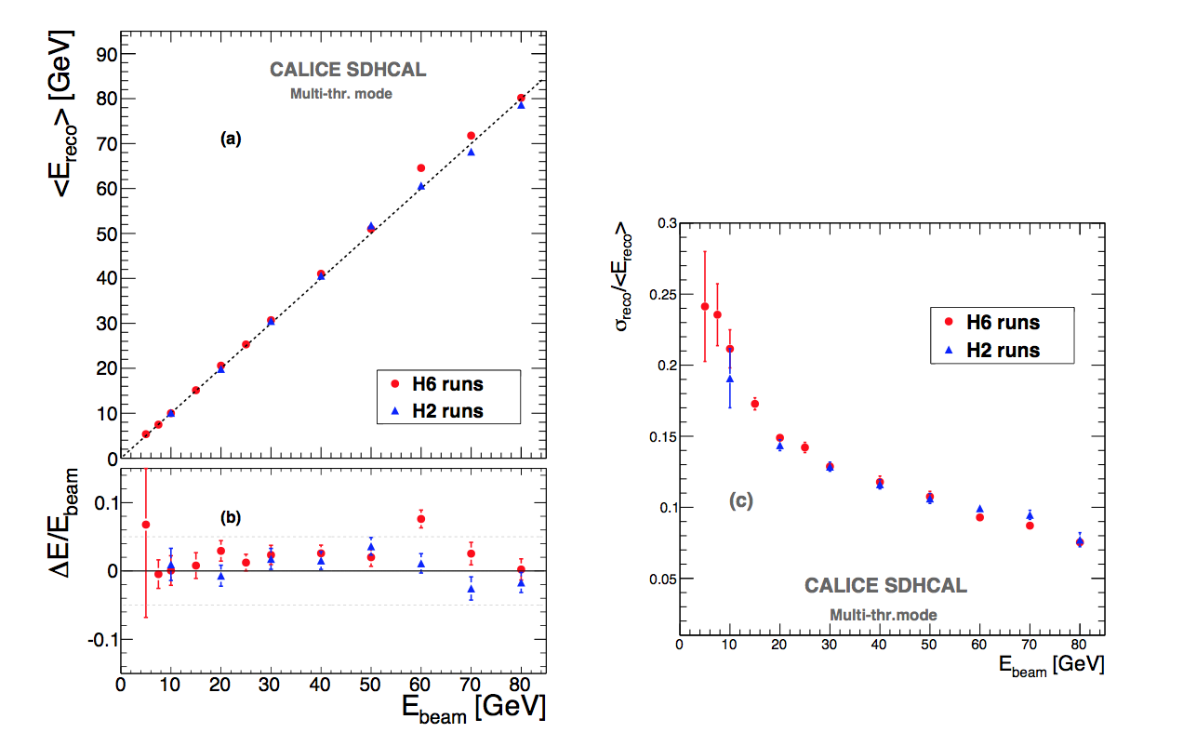
Energy estimation
The thresholds weight evolution with the total number
of hits obtained by minimizing a χ²
Χ² = (E_{beam}-E_{rec})²/E_{beam}
E_{rec =} α (N_{tot}) N₁ + β(N_{tot}) N₂ + γ(N_{tot}) N₃
N₁,N₂ and N₃ : exclusive number of hits associated to first,
second and third threshold.
α, β, γ are quadratic functions of the total number of hits (N_{tot})
Events of H2 runs corresponding to energies : 5, 10, 30 , 60
and 80 GeV were used to fit the 9 parameters.
Then the energy of hadronic events in
both H2( only pions) and H6 (presence of protons)

Slide 5
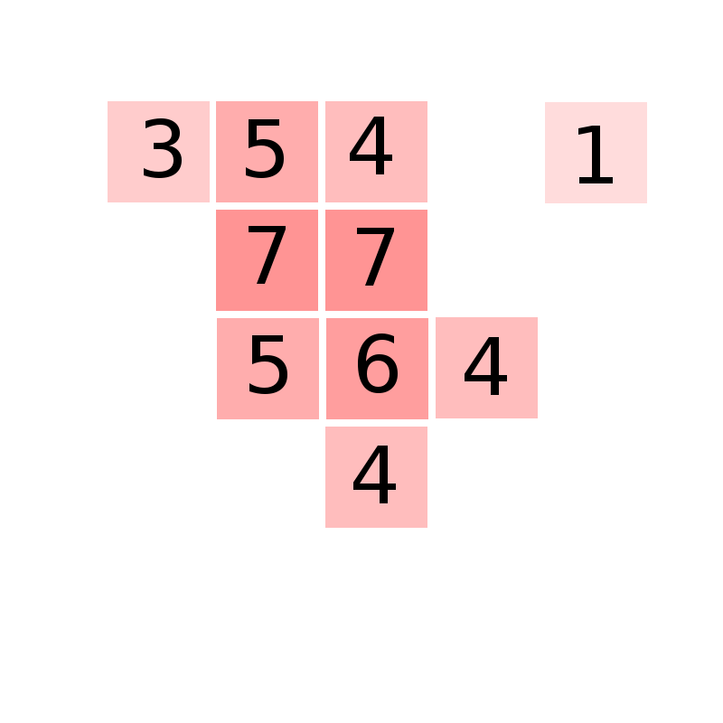
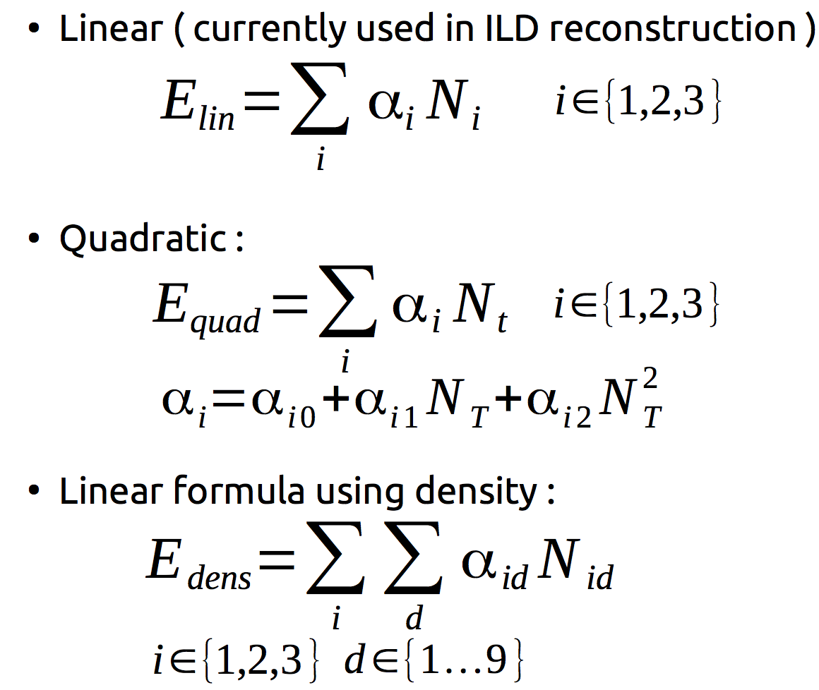
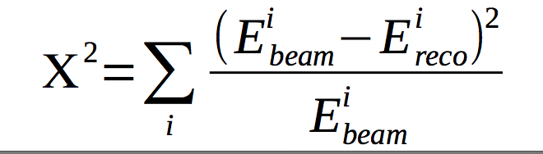
Energy reconstruction
The density of each hit is the number of hits in the surrounding 3x3 cells (including itself)
It can vary from 1 (lone hit) to 9 (completely surrounded)
  For these 3 formulas, the α parameters are found using a chi2 minimisation :

Slide 6
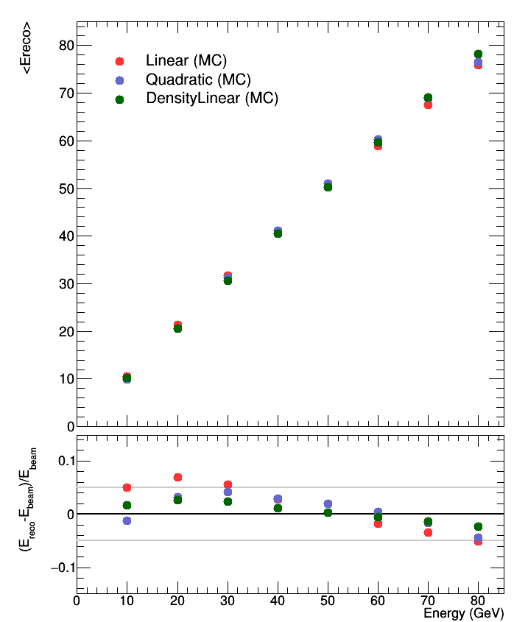
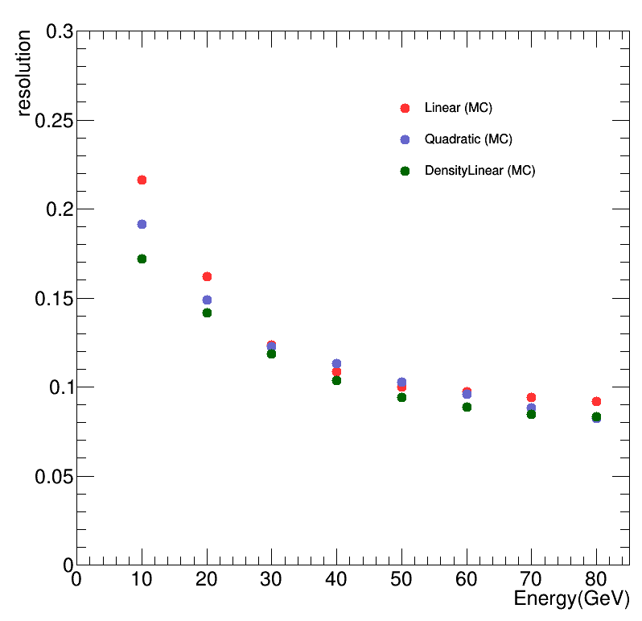
SDHCAL Simulation
G.Garillot
Linear formula shows bad linearity at low energy
The Density formula seems to improve linearity and resolution compared to Linear/Quadratic formulas

Slide 7
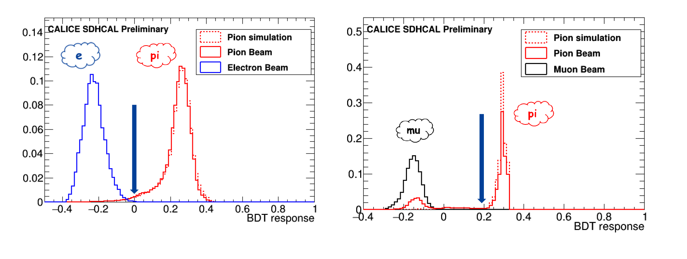
SDHCAL is a powerful tool to identify particles: muons, electrons and hadrons
B. Liu

Slide 8
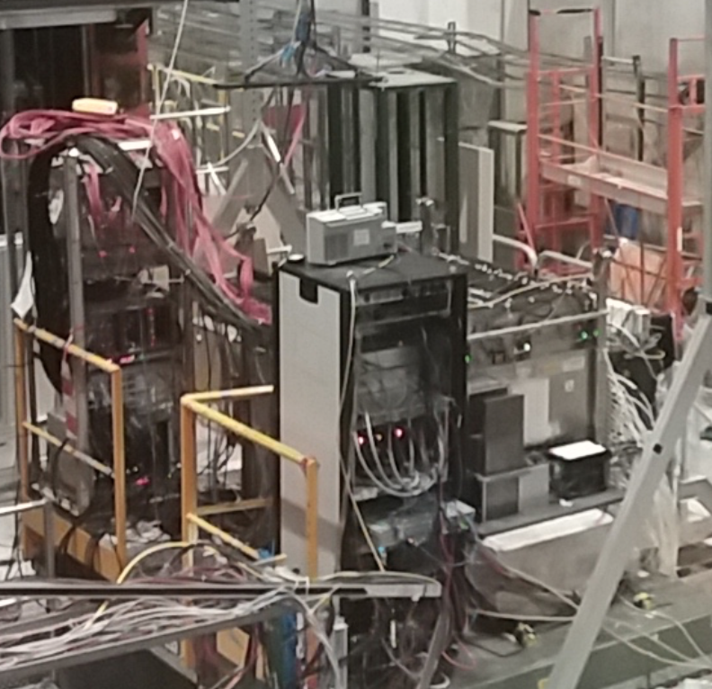
First common test with the technological SiW ECAL prototype

Slide 9
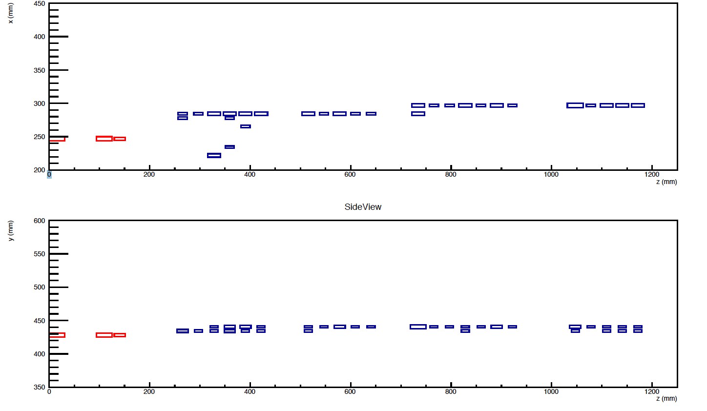
First common test with the technological SiW ECAL prototype
Still some work to associate the events of the two prototypes.

Slide 10
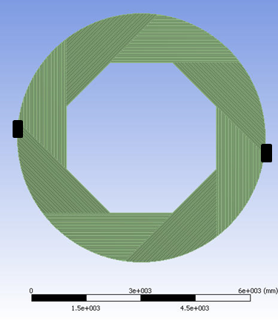
SDHCAL for ILD
We propose the videau structure as a baseline for the SDHCAL

Slide 11
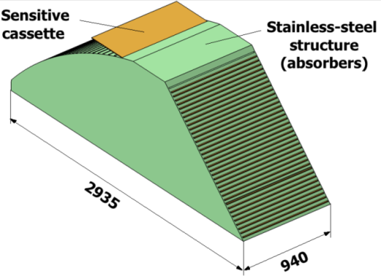
SDHCAL R&D for ILD
Detectors as large as 3m X 1m need to be built
Electronic readout should be the most robust with
minimal intervention during operation.
DAQ system should be robust and efficient
Mechanical structure to be similar to the final one
Envisage new features such timing, etc..
GRPC
Glass Resistive Plate Chambers
SDHCAL
ILD Module
Goal: to build new prototype with few but large GRPC with the new components
→ ILD Module0

Slide 12
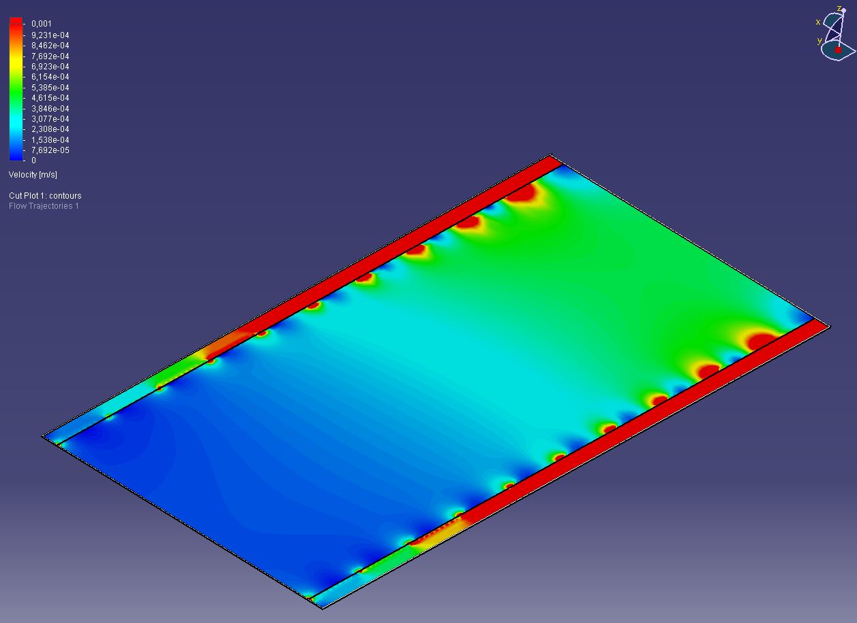
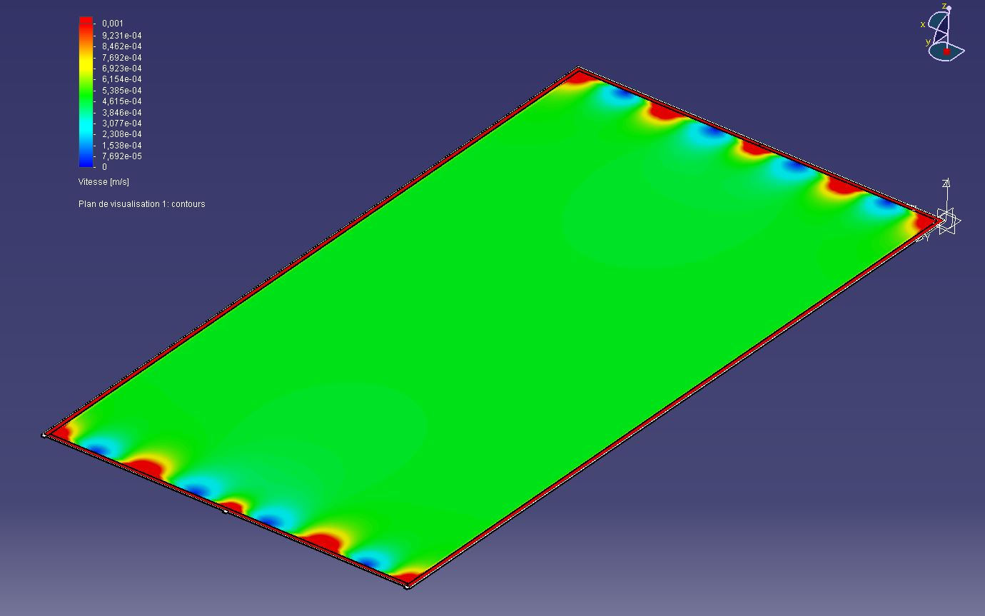
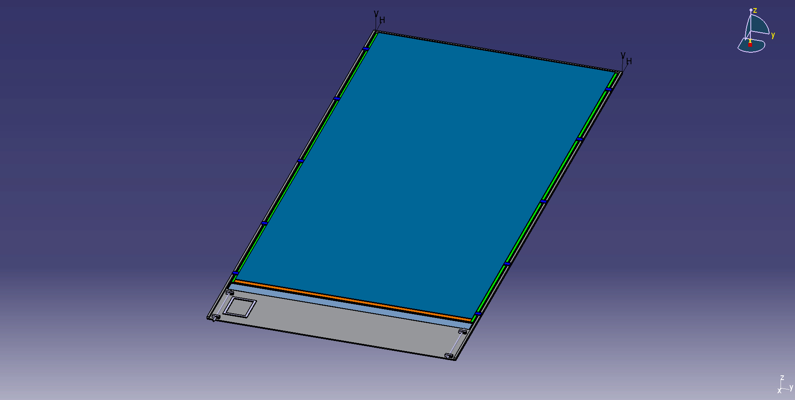
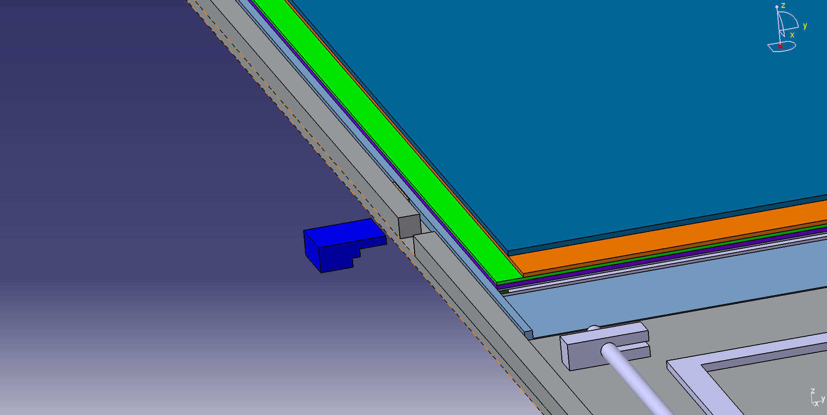
Detector conception
Construction and operation of large GRPC necessitate some improvement with respect to the present scenario.
Gas distribution : new scheme is proposed
Prototype circulation system
New circulation system
inlet
outlet
1 m
2 m
Cassette conception to ensure good contact between the detector and electronics is to be improved

Slide 13
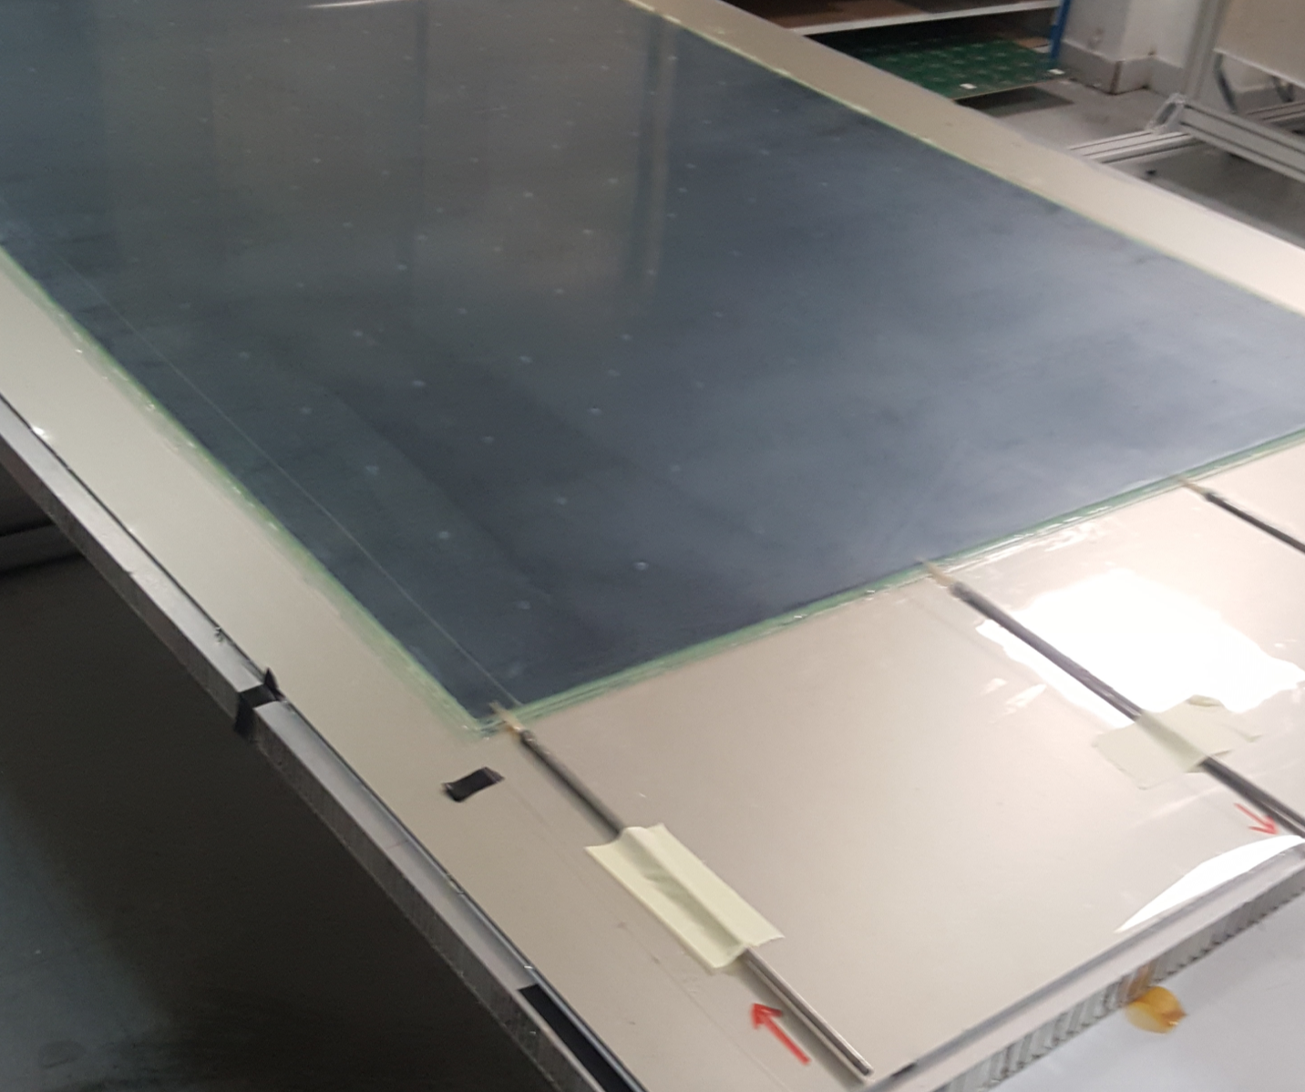
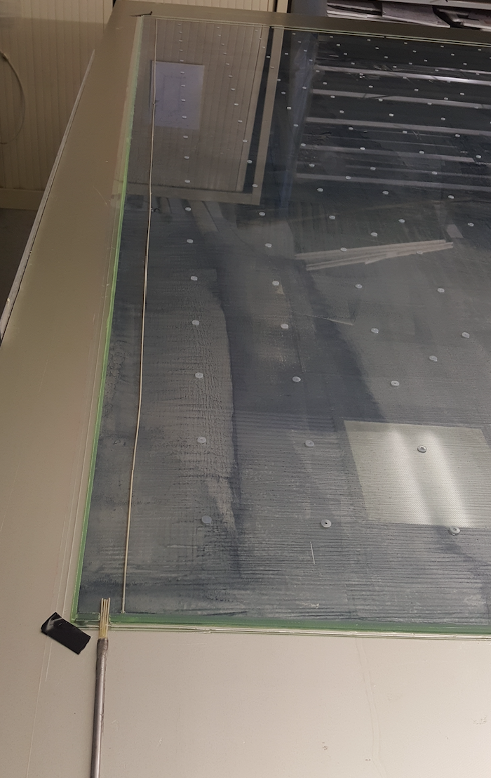
Detector conception
First 2x1 m² RPC chamber was successfully built with a new gas circulation system

Slide 14
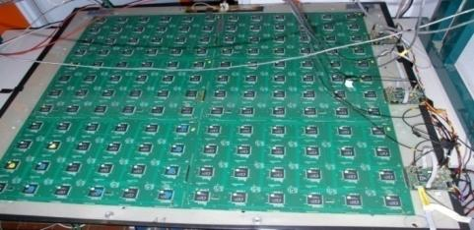
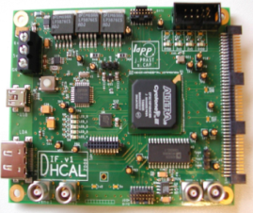
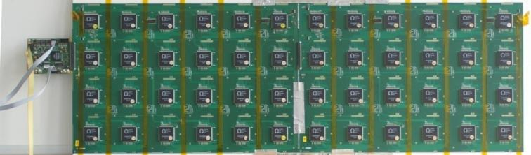
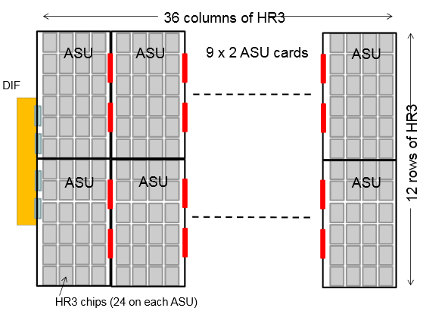
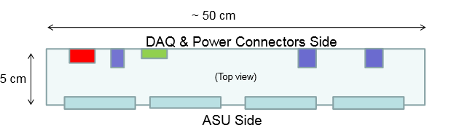

New electronics
Electronics readout for the 1m³ prototipo
HADROC chip
(ASIC)
1m² board ➔ 6 ASUs hosting 24 ASICs
3072 ch
DIF #1
144 ASICs= 9216 channels/1m²
USB
ASU1
ASU2
33 cm
DIF #2
HDMI
DIF
100 cm
DIF #3
1 DIF (detector InterFace) for 2 ASU (Active Sensor Unit.- PCB+ASICs) ➔ 3 DIFs for ONE 1m2 GRPC detector
Electronics readout for the final detector
Only 1 DIF per GRPC (any size) with small dimensions to fit in the small space available at the ILD detector
Uo to 9
DIF dimensions

Slide 15
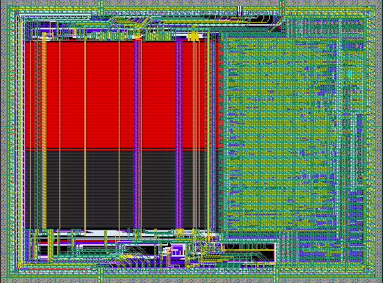
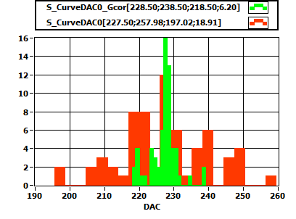
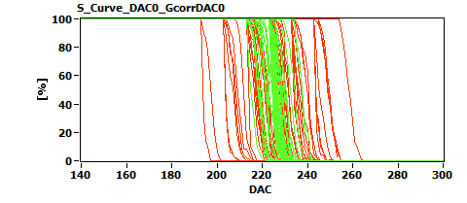
6,3 mm
New electronics: ASIC
HARDROCR3 main features:
  Independent channels
  Zero suppress
  Extended dynamic range (up to 50 pC)
  I2C link with triple voting for slow control parameters
  packaging in QFP208, die size ~30 mm²
  Consumption increase (internal PLL, I2C)
4,7 mm
H3B TESTED : 786, Yield : 83.3 %

Slide 16
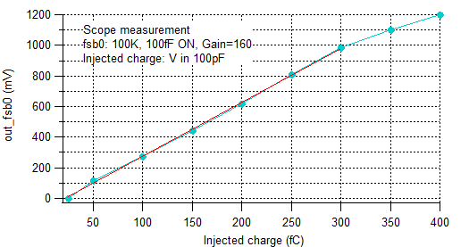
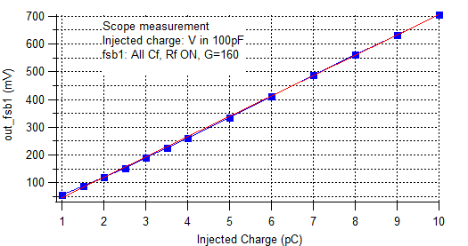
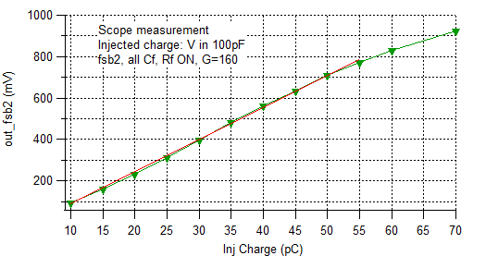
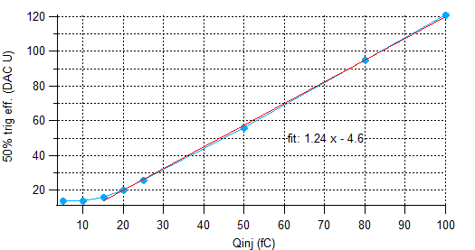
HARDROC3: Analog linearity
Fast shaper outputs (mV) vs Qinj (fC)
FSB0
FSB1
Up to 10 pC
50% trig. Eff. (DAC units) vs Qinj (fC)
FSB0: 5σ noise limit= 15 fC
FSB2
Up to 50 pC
Dynamic range: 15fC - 50 pC

Slide 17
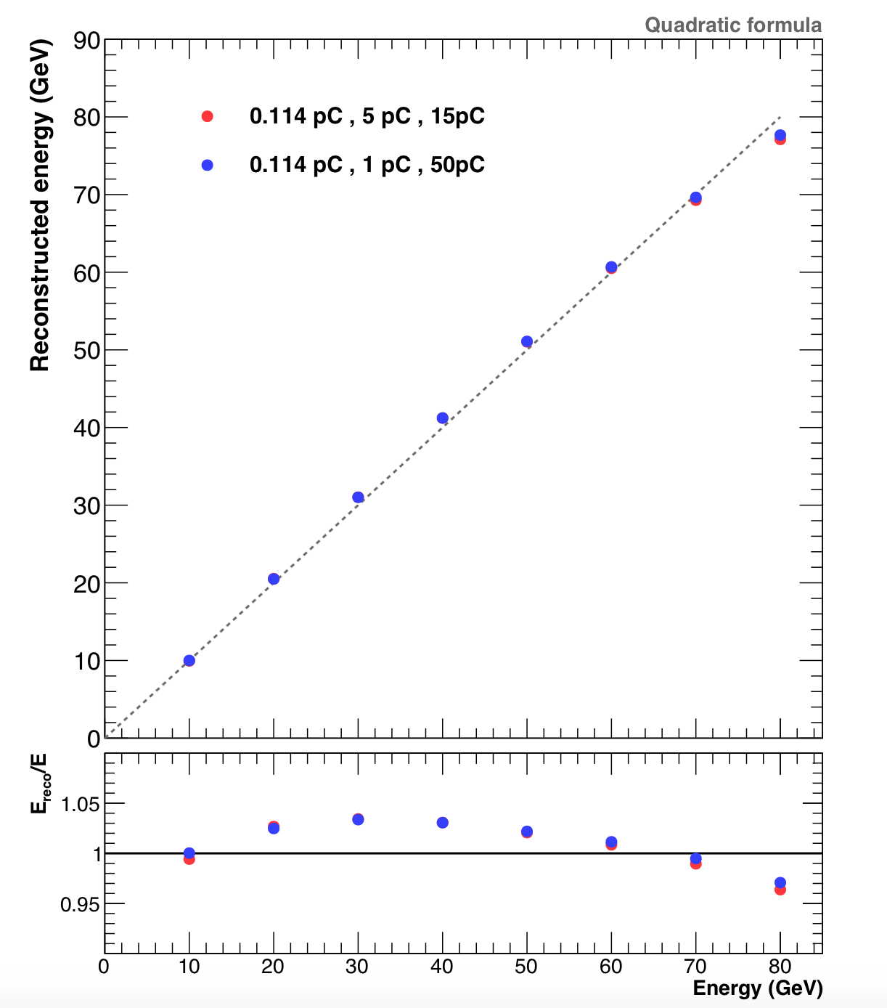
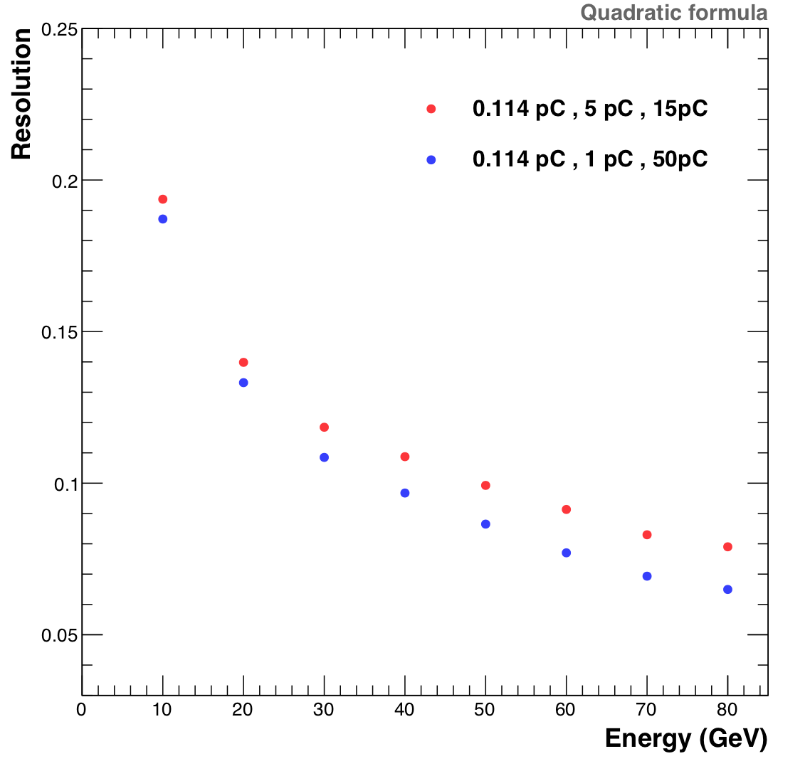
SDHCAL Simulation
G. Garillot
Up to 20% improvment is expected

Slide 18
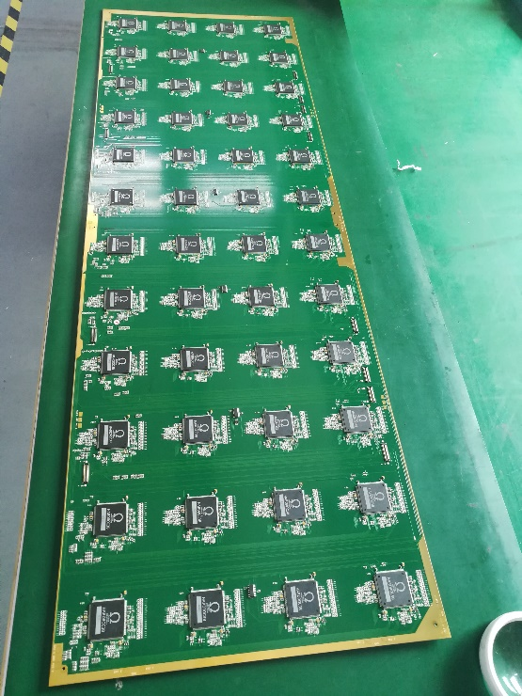
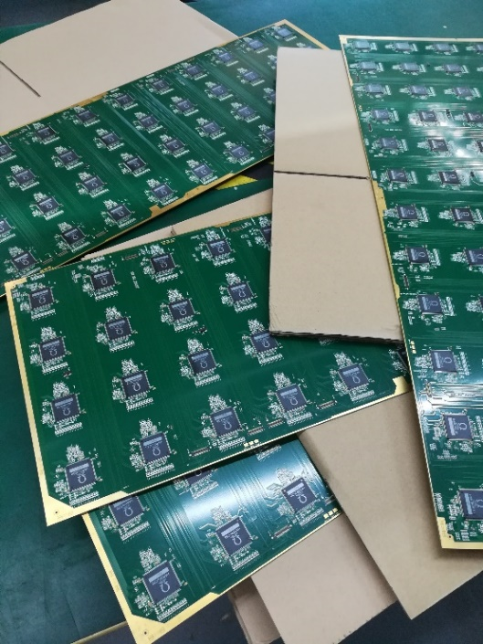
ASU (Active Sensor Unit)
An important challenge is to build a PCB up to 1m length with good planarity to have a homogeneous contact of pads with RPCs in order to guarantee an uniform response along all the detector.
A company was found and 1x0.33 m2 with 13 layer ASUs have been built.
ASU
HR3
ASICs
PCB
The ASU-ASU (= ASU-DIF) connections also produced

Slide 19
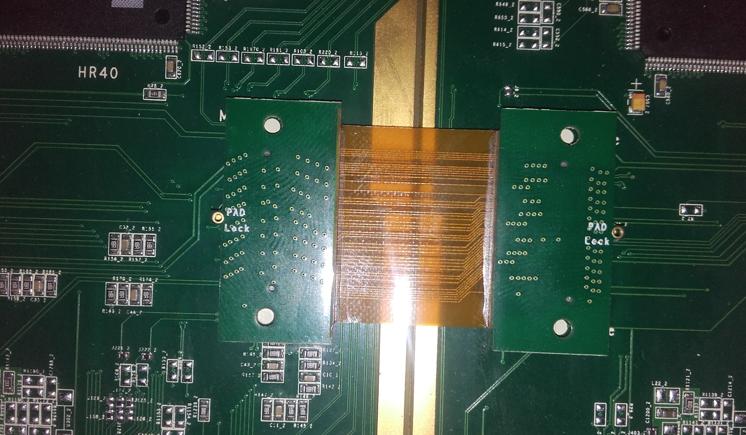

Slide 20
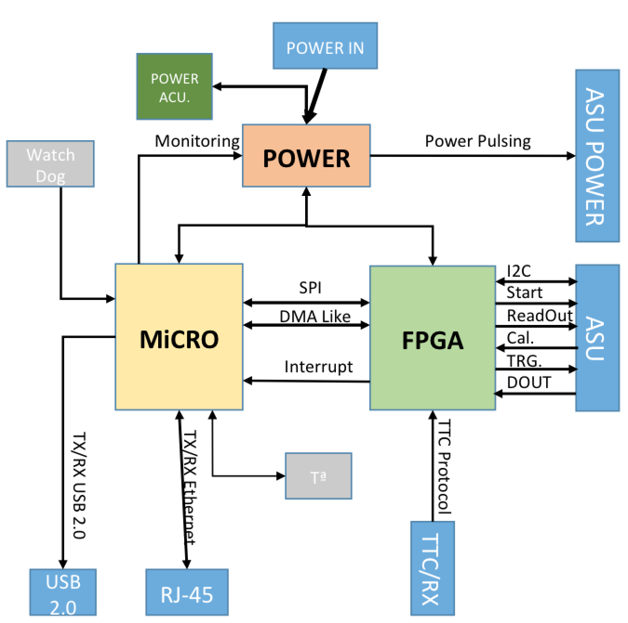
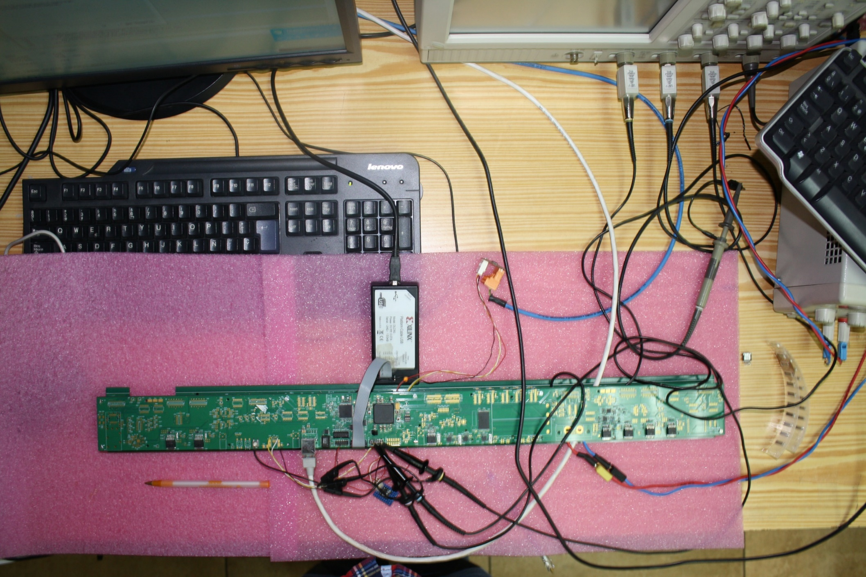
New electronics : DIF
DIF sends DAQ commands (config, clock, trigger) to front-end and transfer their signal data to DAQ. It controls also the ASIC power pulsing
• Only one DIF per plane (instead of three)
• DIF handle up to 432 HR3 chips (vs 48 HR2 in previous DIF)
• HR3 slow control through I2C bus (12 IC2 buses).
Keeps also 2 of the old slow control buses as backup & redundancy.
• Data transmission to/from DAQ by Ethernet
• Clock and synchronization by TTC (already used in LHC)
• 93W Peak power supply with super-capacitors
(vs 8.6 W in previous DIF)
• Spare I/O connectors to the FPGA (i.e. for GBT links)
• Upgrade USB 1.1 to USB 2.0
TEXAS TM4C1294U
FPGA XC7A35TFGG484
POWER
POWER
POWER

Slide 21
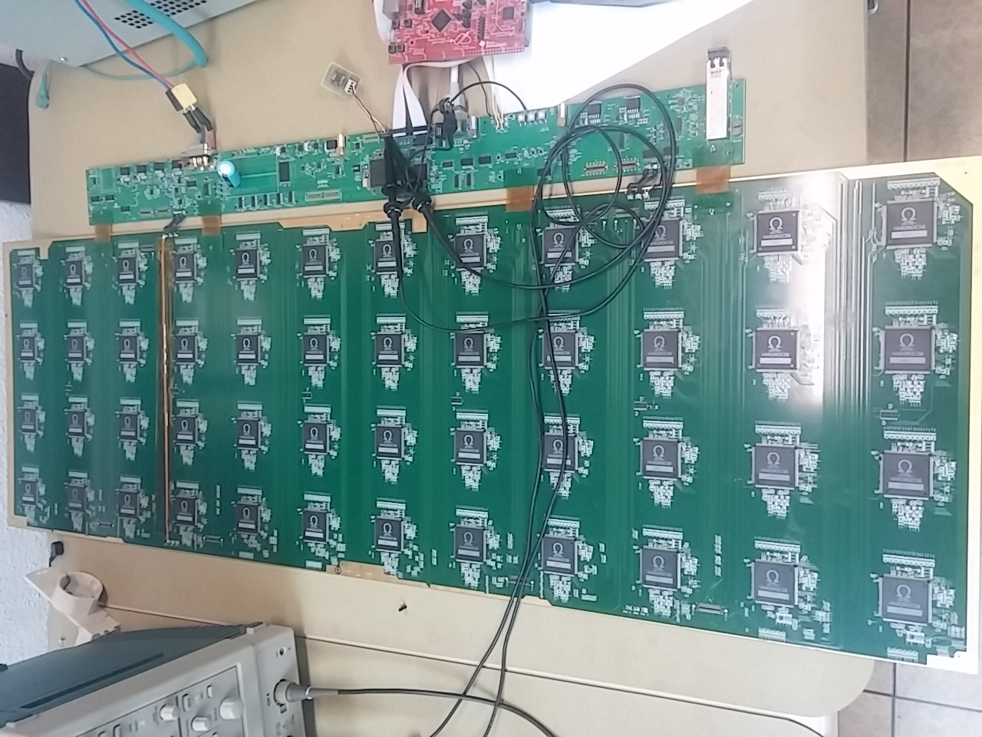
New electronics
New readout electronics is being tested
100 cm
6 cm
33 cm
Firmeware is almost fianlized

Slide 22
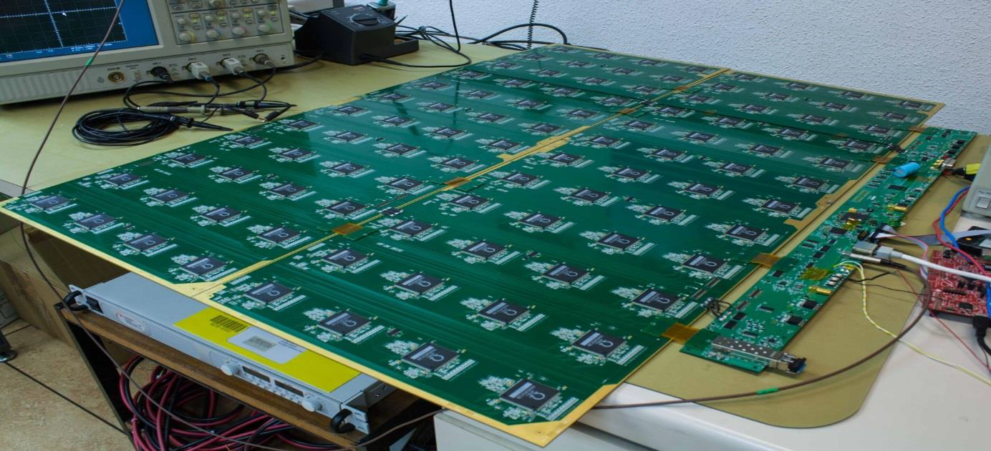
New electronics
33 cm
Two ASUs are being connected and tested

Slide 23
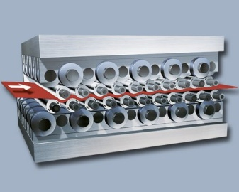
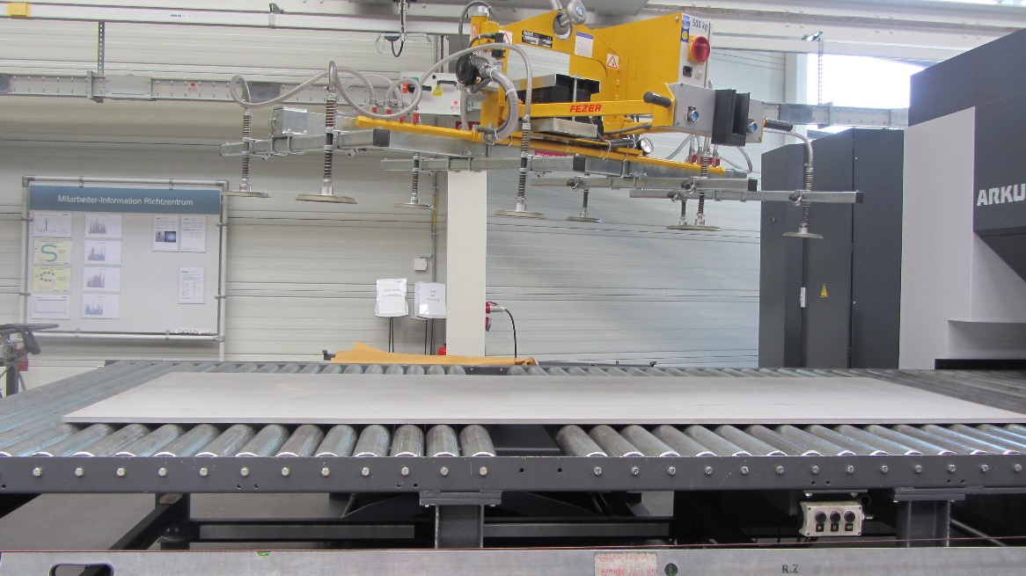
Mechanical Structure
Industrial production of flat large absorber plates (3 m X 1 m) by roller leveling process
mm
before
after

Slide 24
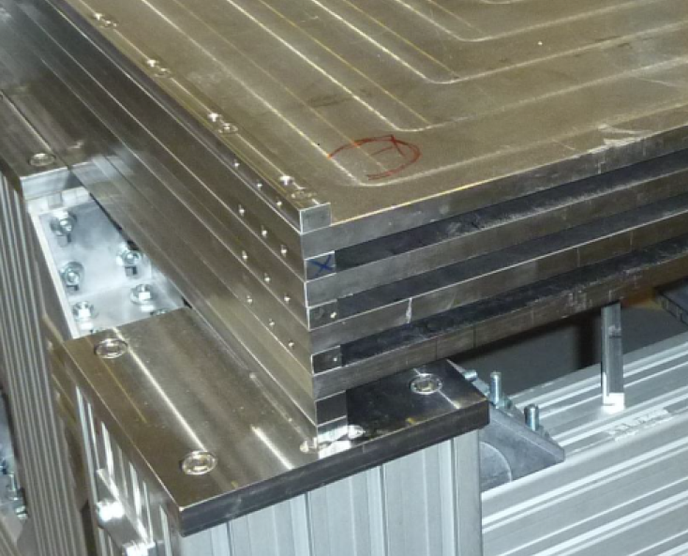
Mechanical Structure
To assembly the technological SDHCAL prototype, bolts were used on 1 cm width bars were used for this. For larger prototype, bigger bolts and thus wider bars are needed. This represents a “dead” zone.

Slide 25
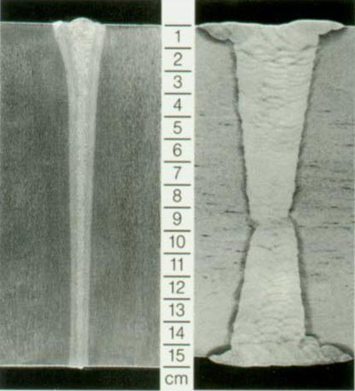
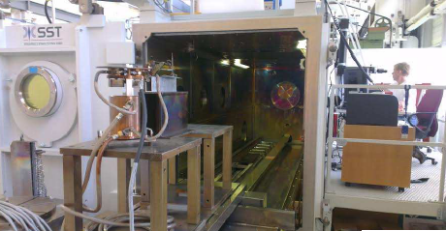


Mechanical Structure
Improvement on the present system is being made by using Electron Beam Welding rather than bolts to reduce the deformation and the spacers thickness.

Slide 26




Welding tests
Mechanical Structure
Two identical small prototypes (PT4): 2x (4 plates 0.4x1 m²)
Complete Penetration ~10 mm
Greater strength of the structure.
Welding will be performed following the results of the previous welding tests:
(Plates for the PT3)
(PT4)
(PT4)
(PT4)
+ 1 mm
- 1 mm

Slide 27





Next Welding tests
Mechanical Structure
‘Final’ calorimeter prototype : 4 plates 3x1 m²
Complete Penetration ~10 mm
Greater strength of the structure.
photogrammetry measure
(PT3)
(PT3)
Pieces for this prototype produced and the preliminary assembly test & measures are done at CIEMAT.

Slide 28



Mechanical Structure
EBW@CERN

Slide 29


Mechanical Structure
< 1 mm

Slide 30


Slide 31

Gas system
Gas recycling is necessary to reduce cost :
-Goal: reduce the gas consumption to reduce the cost.
-Gas renewal of 5-10% rather than 100%
-Conceived by the CERN gas group and successfully used.

Slide 32
Summary and plans for SDHCAL
Technological protoype running successfully since 2012
Many results validate the potential of the concept
Large prototype with the new generation of readout electronics is on the rails
Mechanical structure optimized for ILD
We intend to introduce timing since RPC is a fast timing detector we collaborate with CEPC colleagues to achieve this.

Slide 33




AHCAL
design
construction
testbeam experience
large layers
future plans

Slide 34



AHCAL Design
ILD barrel
HBU
highly granular scintillator SiPM-on-tile hadron calorimeter, 3*3 cm² scintillator tiles
fully integrated design
  front-end electronics, readout
  voltage supply, LED system for monitoring
  no cooling within active layers
scalable to full detector (~8 million channels)
HCAL Base Unit: 36*36 cm², 144 tiles, 4 ASICs
  slabs of 6 HBUs
  up to 3 slabs per layer

Slide 35


AHCAL Technolgical Testbeam Prototype
38 active layers of 72*72 cm²
4 HBUs per module
  16 SPIROC 2E readout ASICs,
  576 channels of 3*3 cm² tiles
  in total: 608 ASICs, ~22000 channels
all modules with surface-mount MPPCs
  S13360-1325PE
  2668 pixels (3x physics prototype (PP))
  operated at 5V overvoltage
    50% less temperature sensitivity w.r.t. PP
  nominal operation voltage within 200mV in a module -> use same voltage
    Simplified set-up
    Layer-wise regulation
  About 3 orders of magnitude less noise
steel absorber stack corresponding to ~1% of ILD barrel

Slide 36



Mass Production
design optimized for mass production
  SMD SiPMs soldered automatically
  injection-moulded polystyrene tiles, no further surface treatment
  automatic wrapping in ESR reflector: 500 tiles / day
  glueing of tiles with screen printer and pick-and-place machine 2HBU / hour

Slide 37

Testbeam Setup 9. – 23. May 2018 in H2 at SPS
38 active layers of 72*72 cm² in steel absorber with 1.7 cm layer thickness (~4 λ)
mounted on the movable platform (“scissors table”) in H2
beam instrumentation: wire chambers, trigger scintillators, Cherenkov detector

Slide 38
Testbeam Setup 27. June – 4. July 2018 in H2 at SPS
tailcatcher
AHCAL
main stack
as in May, plus:
  added one module with 6*6 cm2 tiles (prototype for rear layers)
  added CMS HGCAL “thick stack” (12 layers of 1 HBU, 7.4 cm steel absorber) as tailcatcher
  added single HBU in front of absorber as “pre-shower” detector

Slide 39

Testbeam Operation: Temperature Compensation
gain and photon detection efficiency of SiPMs depend on temperature
  can avoid changes by stabilizing temperature or adapting bias voltage (HV)
temperature compensation: use mean temperature in a layer to adjust HV
used routinely, HV changes as expected, gain stays stable

Slide 40


Data Taking
very stable running
routinely using temperature compensation
all 38 layers working well, <1‰ dead channels
muons for calibration
  several position scans, with and w/o power pulsing
electrons: energy scan 10 to 100 GeV
  with and without power pulsing
  typically 200,000 to 400,000 ev. per energy
negative pions: energy scan 10 to 200 GeV
  with and without power pulsing
  typically 400,000 to 600,000 ev. per energy
  shifted positions for particle separation studies
additional technical tests
in total collected several 10^7 events

Slide 41

Event Displays and Online Monitoring
electron
hadron
muons
muon

Slide 42


Online Monitoring: Energy Sums
Electron Beam
CALICE
work in progress
10
20
30
40
50 GeV

Slide 43



Scintillator Part of CMS HGCAL
CALICE AHCAL prototype
CMS HGCAL
ILD
SiPM
on tile
-30˚C
silicon
22’000 SiPMs
500’000 SiPMs
8’000’000 SiPMs
design: scintillator with SiPM-on-tile technology where allowed by radiation
Intermediate scale, new challenges: radiation, high data rate, operation -30 °C
Technical Design Report approved in February 2018
Engineering Design Report and start of production for many components in 2021
assembled endcaps need to be ready for lowering in August and Dec. 2024

Slide 44



Combined Testbeam: CMS HGCAL + CALICE AHCAL
2 weeks of combined testbeam at CERN SPS in October 2018
28 layers HGCAL EE (silicon/lead), 12 layers HGCAL FH (silicon/steel), 39 layers AHCAL (scintillator/steel); common DAQ: EUDAQ2
important test of concept, important information for simulation of showers

Slide 45

Combined Testbeam: CMS Silicon HGCAL + CALICE AHCAL
2 weeks of combined testbeam at CERN SPS in October 2018
28 layers HGCAL EE (silicon/lead), 12 layers HGCAL FH (silicon/steel), 39 layers AHCAL (scintillator/steel)
important test of concept, important information for simulation of showers

Slide 46



Test of Large (Full ILD Size) Layers
Length 216 cm ,width up to 108 cm
Test power distribution
  Check for voltage drops
  Check stabilization time in power pulsing mode
  Stable after < 120 μs
Test signal quality
  Clock distribution
  Singe p.e. spectra

Slide 47


Optimisation of Absorber Structure
Adaptation to current outer dimensions
Actuive gao includes 2.5mm tolerance
Reinforcements near cryostat supports and ECAL fixtures
Full disk at z=0
Maximum displacement 1.4mm
Step file ready for export to LLR for further common optimization with ECAL
Return to dynamical simulations of earhquake response

Slide 48

Summary and Plans for AHCAL
CALICE SiPM-on-tile HCAL prototype with 22’000 channels built
Successfully commissioned and operated in testbeam
Design and procedures for construction and QA scalable to a full collider detector
3 weeks of testbeam at CERN SPS in 2018
  collected several 10^7 muon, electron and pion events
2 weeks of combined test with CMS HGCAL silicon prototype
Future tests
  Test of full-sized ILD layers (3*6 HBUs)
  Commission fast clock mode with ns time resolution
  Alternative tile design and readout ASIC
  Beam tests with (existing) tungsten
  absorber structure (2021)
  Combined beam test with EM calo
  in front highly desirable

Slide 49
Conclusion
The two HCAL technologies have made a big progress.
The AHCAL technological prototype is now ready and successful
The SDHCAL ILD module0 construction is ongoinf
A full large ILD AHCAL layer is to be finalized and tested soon

Slide 50
Backup

Slide 51


Quality assurance and calibration
SiPM sample tests
tile sample tests
test of all ASICs
all individual HBUs tested and calibrated with LEDs and cosmics
all modules (2*2 HBUs) tested with cosmics
all modules calibrated with LEDs and DESY beam (3 GeV electrons as MIPs)
  calibrate 4 modules in parallel, ~1 day per set
  automated scan with automated control
  of the moving stage (EUDAQ)
  many technical tests: gain switching, ...
result: overall quality very good,
<1‰ dead channels

Slide 52
AHCAL prototype construction: work flow
Uni Heidelberg
Distributed
production,
construction
and QC
SiPMs
SiPM sample tests
Palaiseau
ASICs
ASIC tests
Wuppertal
HBU soldering
ASIC test board
DESY
Mainz
PCBs
LED tests
HBU tiling
Moscow
Uni Hamburg
Tiles
Reflector wrapping
Cosmic tests
Interfaces
Cassette assembly
Cassetes
MPP Munich
calibration in DESY beam
Stack
Cooling
HCAL integration

Slide 53

AHCAL DAQ Hardware / digital readout
DAQ HW
DAQ SW
CCC (Clock and Control Card)
  Provides a clock to AHCAL
  Synchronizes all detectors
  Starts and stops the acquisition according
  to the spill level and readiness of all DIFs
  Distributes trigger validation
LDA (Link Data Aggregator)
  Merges DIF readout packets
  Does gray decoding, adds headers
  Send the packets over TCP
DIF (Detector InterFace)
  Controls ASICs in 1 layer (many HBUs)
  Readout the data from all ASICs
  Sends the data to LDA
SPIROC (SiliconPM Integrated Read Out Chip)
  Reads out 36 SiPMs
  each channel has 16 memory cells
  auto-trigger (beam) & external trigger (calib) mode
BIF (Beam interface)
  Precise trigger timestamping
Trigger
Spill
CCC
BIF
…
LDAs
LDA
PC
...
Up to 96
DIFs
DIF
…
Up to 72
SPIROCs
spiroc
36
SiPMs

Slide 54
EUDAQ2 as central DAQ and run control
bunch-crossing(BXID)-wise event building: not a complete readout cycle(ROC), but just triggered BXIDs
  15~20x more (smaller) events in slcio compared to ROC-based
Auto-restart of run (time, # of evts) implemented in a custom run control
Data quality indicators: # of triggers, # of built events (BIF, ahcal, ahcal+bif)
AHCAL
producer
ASICs
ROC,
BXID
ASICs
ROC,
BXID
ASICs
ROC,
BXID
ASICs
ROC,
BXID
AHCAL_same_bxid
ROC
TS_start,
TS_bxid (opt. TS_trig)
triggerID
AHCAL_same_bxid
ROC
TS_start,
TS_bxid (opt. TS_trig)
triggerID
AHCAL_same_bxid
ROC
BXID
TS_start,
triggerID
EUDAQ_evt
(→ SLCIO)
ROC=ROC,
TS_trig=bxid
AHCAL bxid
data collector
LDA
ROC,
TS_start,
TS_trig,
triggerID
ROC,BXID
match
AHCAL_same_bxid
LDA
ROC,
TS_start,
TS_trig,
triggerID
LDA TS
ROC,
BXID
TS_start,
TS_trig,
triggerID
LDA TS
BIF
ROC
TS_start
TS_trigger
BIF
ROC
TS_start
TS_trigger
BIF
ROC
BXID
TS_start
BIF (opt.)
AHCAL data from Labview
BIF
producer

Slide 55

Online data quality checks for electrons
May 2018
June 2018
tail
electrons
May:
  clear tail to smaller number of hits and earlier center-of-gravity
  present for all electron energies
June:
  changed beam steering
  tail gone, nice and narrow energy distributions

Slide 56
A new challenge

Slide 57




New Tests
Several ways tested.
Welded pieces for the “qualitatively” smaller tests:
Penetration ~10 mm
Option 2 has been chosen
Z-axis deformations close to 2 mm
Insertion test of the cassette:
One cassette was tested on the previous welding test pieces produced.
Two identically prototypes ( plates ~0.4x1 m²) will be welded with those parameter to validate the procedure (PT4).

Slide 58






Additional tests to minimize the welding deformation
E.Calvo-Alamillo
Contact people for EBW at CERN, Manuel Redondas & Thierry Tardy, propose two method to reduce the distortion produced by EBW:
→ Placing a 1-2 mm sheet on the welding zone and welding through it. And to remove the first 1 or 2 mm which contain the beginning of the welding cone, maintaining only the narrowest and parallel welding zone, avoiding local stress.
→Producing slots, parallel to the weld, that absorb the stress that is produced by the beginning of the welding cone.
(PTs1)
(PTs2)
Small test prototype: 2 x PTs1 & 2x PTs2
Complete Penetration ~10 mm
Some tests using smaller pieces are foreseen to evaluate “qualitatively” those two options (PTs1 &PTs2).
Pieces were produced at Ciemat. Delivered to CERN and assembled during December 2017.
To be welded at CERN during February-March 2018.
If this method works, it could be implemented on the previous prototypes, to validate it.

Slide 59


