Slide 1
Forward calorimeters
Yan Benhammou
On behalf of the FCAL Collaboration

Slide 2
Outline
Purposes
FCAL detectors : simulation
FCAL detectors : hardware
Electronics
Conclusion

Slide 3
Forward region detector purposes
precise luminosity measurement, O(10⁻³) up 500 GeV
fast luminosity measurement and beam tuning
hermiticity
For these purposes, mainly three detectors : the LumiCal, BeamCal and LHCal

Slide 4
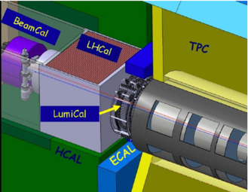
FCAL detector purposes at ILC
LumiCal :
  Precise integrated luminosity measurements (Bhabha events)
  Extend calorimetric coverage to small polar angles. Important for physics analysis
LHCal :
  Extend the hadronic calorimeter coverage
BeamCal :
  Measure instant luminosity. feedback for beamtuning
  tagging of high energy electrons to suppress backgrounds to potential BSM process
  shielding of the accelerator components from the beam-induced background
  providing supplementary beam diagnostics information extracted from the pattern of incoherent-pair energy depositions

Slide 5
Purposes
FCAL detectors : simulation
FCAL detectors : hardware
Electronics
conclusion

Slide 6
FCAL detector designs
LumiCal :
  Electromagnetic sampling calorimeter
  30 layers of 3.5 mm thick tungsten plates with 1 mm gap for silicon sensors
  Cover the angles between 41 mrad to 67 mrad
LHCal :
  Sampling Calorimeter (silicon)
  29 layers of 16mm thickness. Absorber : tungsten or iron
BeamCal:
  Sampling calorimeter based on tungsten plates (30 layers)
  Cover the angles between 6 mrad to 43 mrad
  Due to large dose, rad hard sensors (GaAs, Diamond, Sapphire)

Slide 7
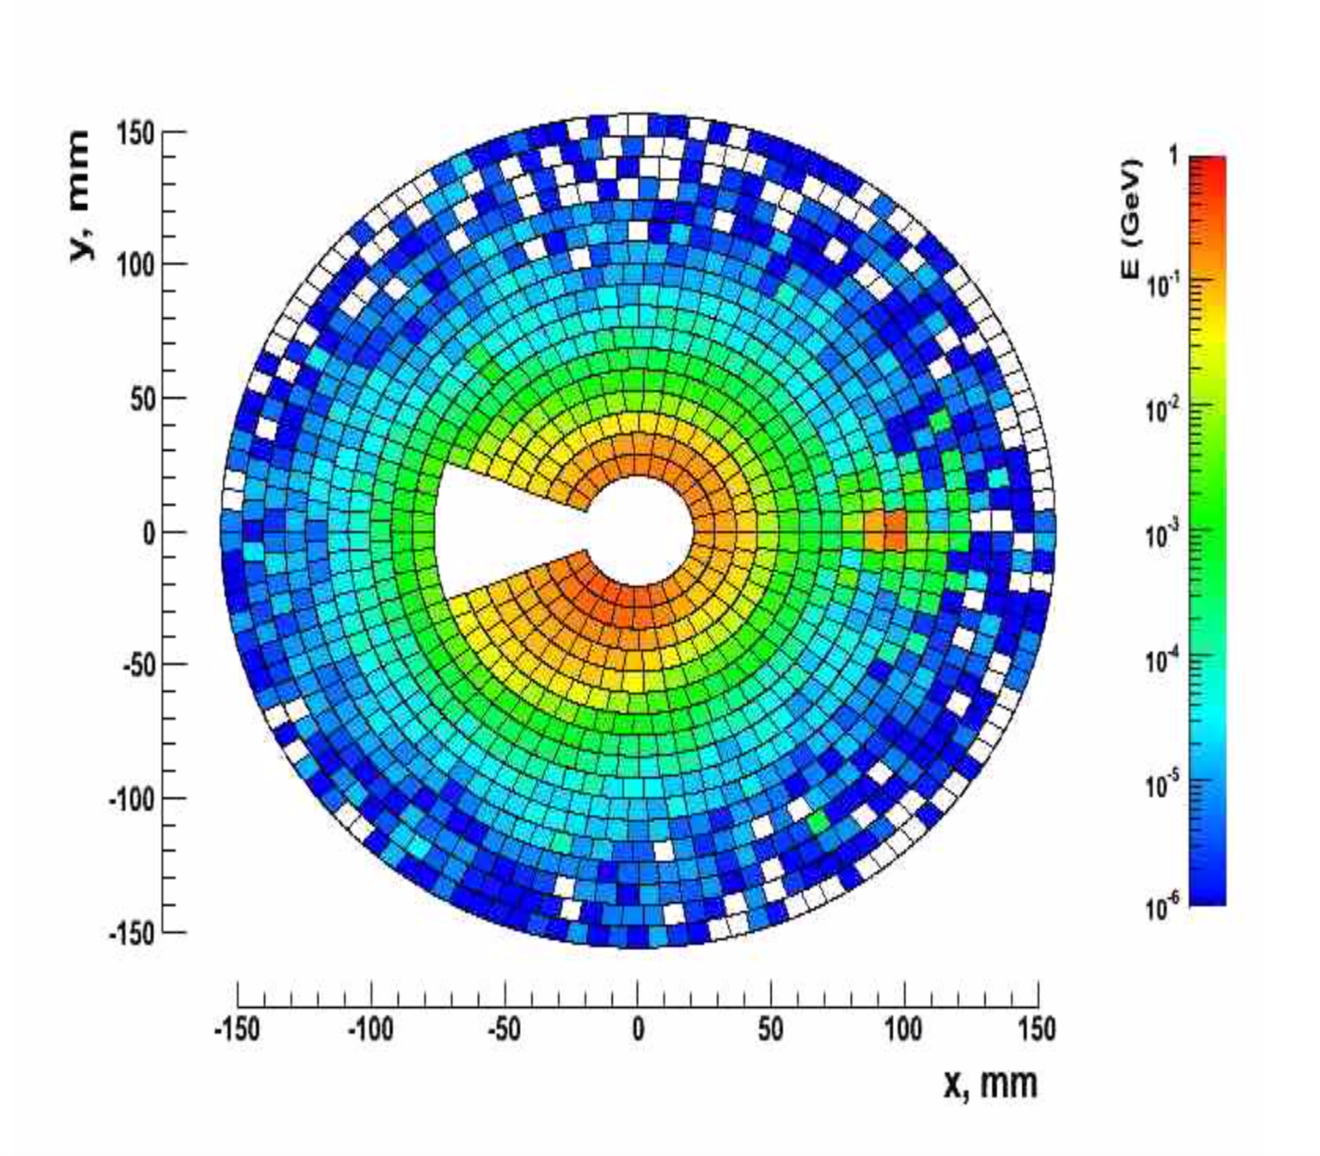
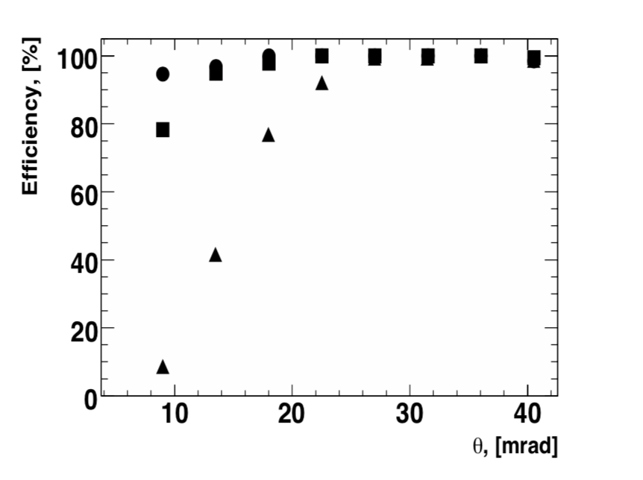
BeamCal simulation
Simulations within DD4hep environment and validation started
Reconstruction software for LumiCal and BeamCal present (FcalClusterer Marlin module) adopted for DD4HEP
Different methods of background generated and different reconstruction algorithms compared
Results : for example, efficiency and angle resolution with 40 bunch crossing overlaid to the signal

Slide 8
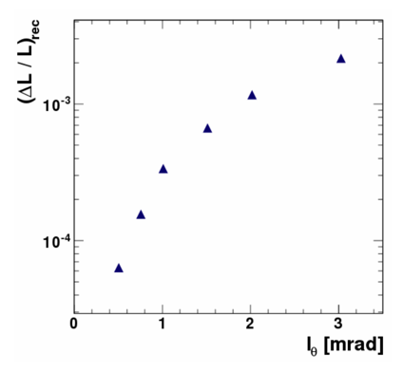
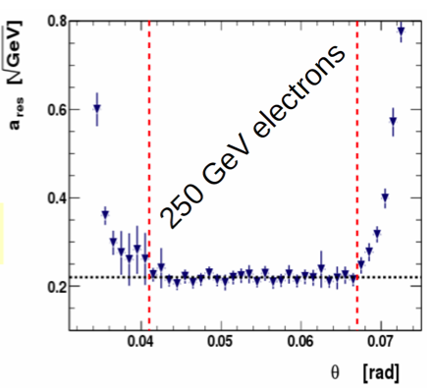

LumiCal simulation
Polar angular pad size calculated to obtain the given precision of luminosity measurement
Simulation of the
energy resolution
Small Moliere radius
for compactness study
ILC
Polar angle pad size
For I_{θ} =0.8 mrad, ΔL/L = 1.6 10⁻⁴
H Abramowicz et al 2010 JINST 5 P12002

Slide 9
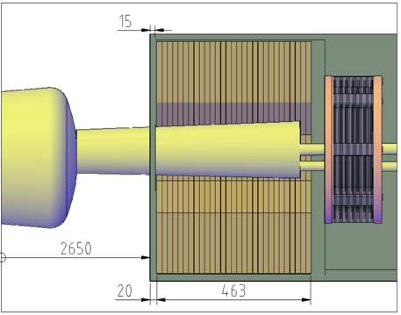
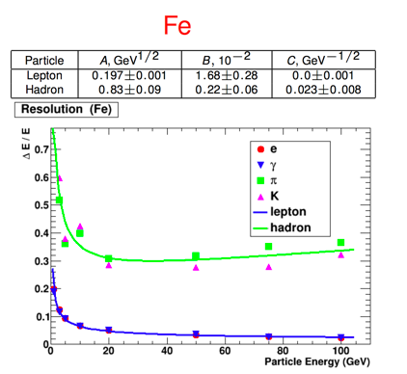
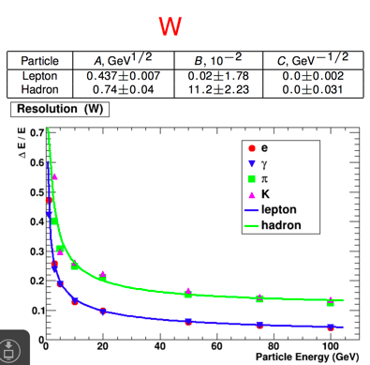

LHCal simulation
Located between the LumiCal and BeamCal
Total thickness : 463 mm
Simulation of tungsten-Si and iron-Si with different incident particles
Tungsten looks to be the best candidate

Slide 10
The collaboration
FCAL detectors : simulation
FCAL detectors : hardware
Electronics
conclusion

Slide 11
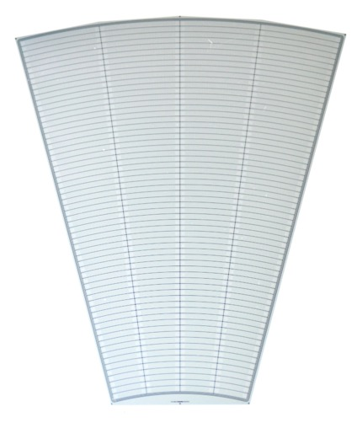
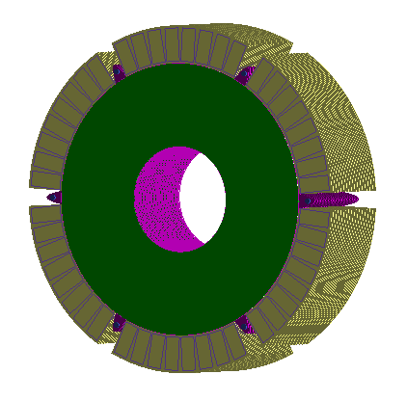
LumiCal sensor
4 sectors:
L1
R1
L2
R2
Silicon senor, 320 μm thickness
64 radial pads, pitch 1.8 mm
4 azimuthal sectors in one tile, each 7.5 degrees
12 tiles make full azimuthal coverage
p+ implants in n-type bulk
DC coupled with read-out electronics
40 modules were produced by Hamamatsu
Outer active radius R = 195.2 mm
channels: 1 - 64
3 x 100 μm guard rings
Inner active radius R = 80.0 mm

Slide 12
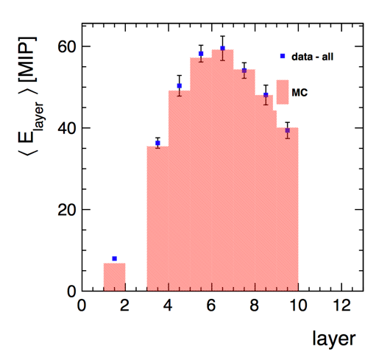
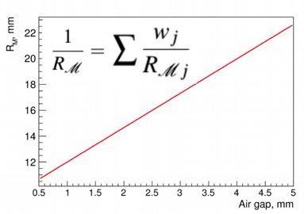
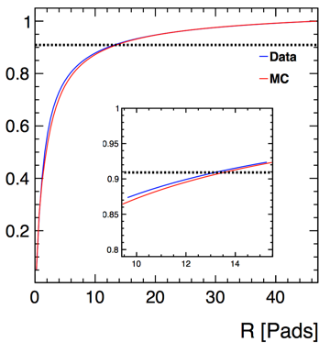
LumiCal test at CERN in 2014
4 LumiCal modules equipped with dedicated electronics (32 channels) glued on a 2.5 mm PCB
4.5 mm between tungsten plates
Tested in test beam at PS with 5 GeV e-/μ
Energy fraction
Effective Moliere radius :
24.0 ± 0.6 (stat.) ± 1.5 (syst.) mm
Nucl. Instrum. Meth. A908 (2018) 198-205

Slide 13
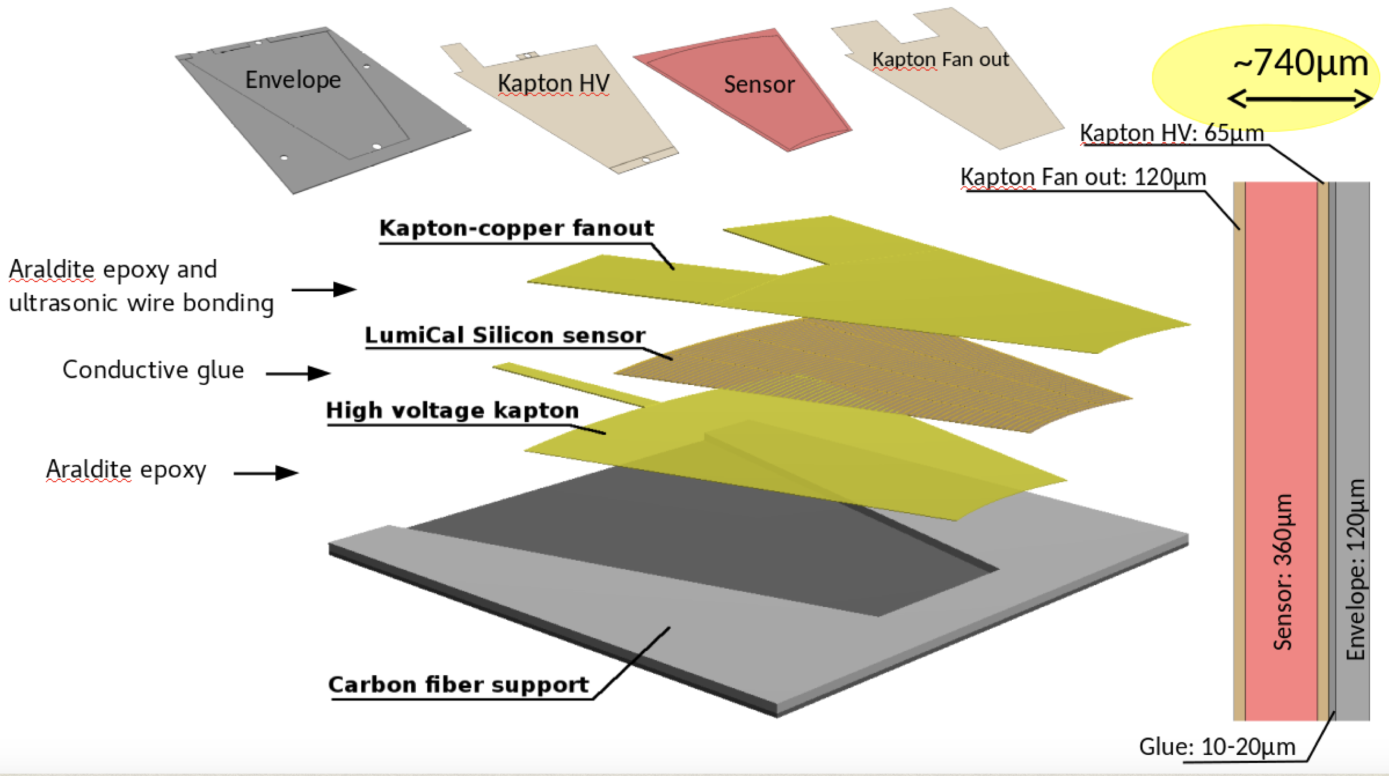
Thin detector assembly

Slide 14
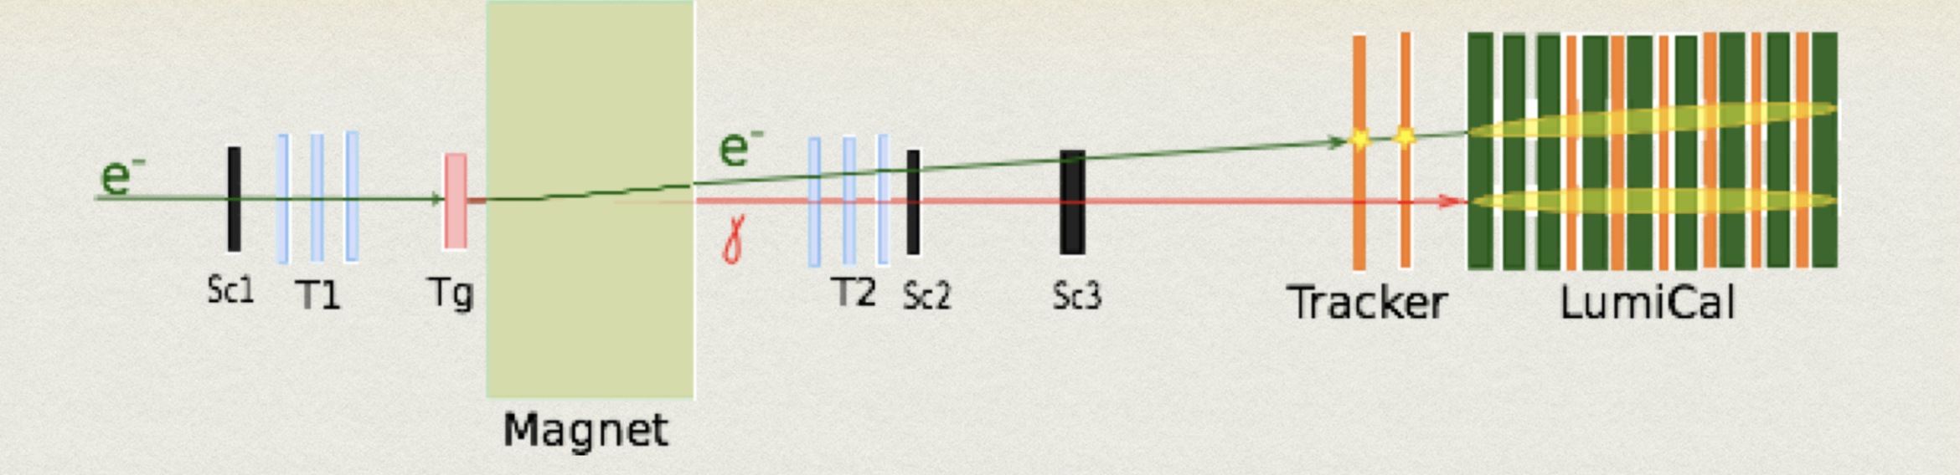
LumiCal test at DESY in 2016
New LumiCal module design : 750 μm thickness. 1mm between tungsten planes
Eight modules fully equipped with generic read out (256 channels)
Two modules were installed without tungsten planes : test of a tracker in front of LumiCal for electron/photon identification
Six modules formed the LumiCal
Test at DESY with 1 to 6 GeV electrons
Creation of a e⁻γ beam
14

Slide 15
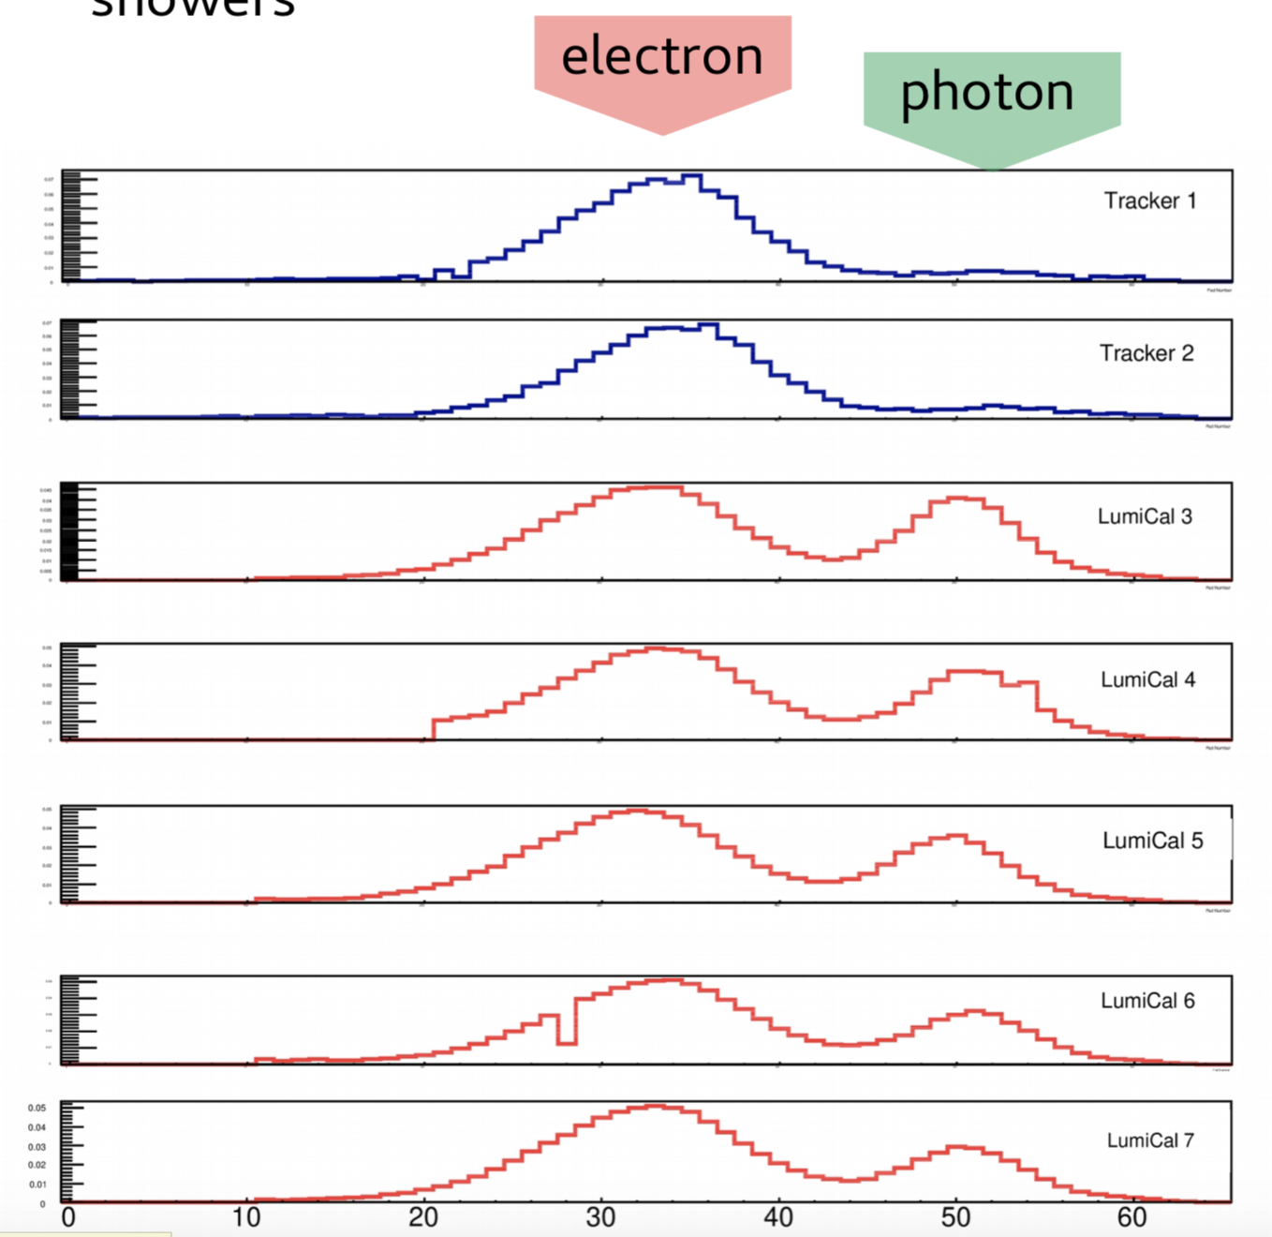
Lumical test at DESY in 2016
e/γ identification around 90%
Pad number

Slide 16
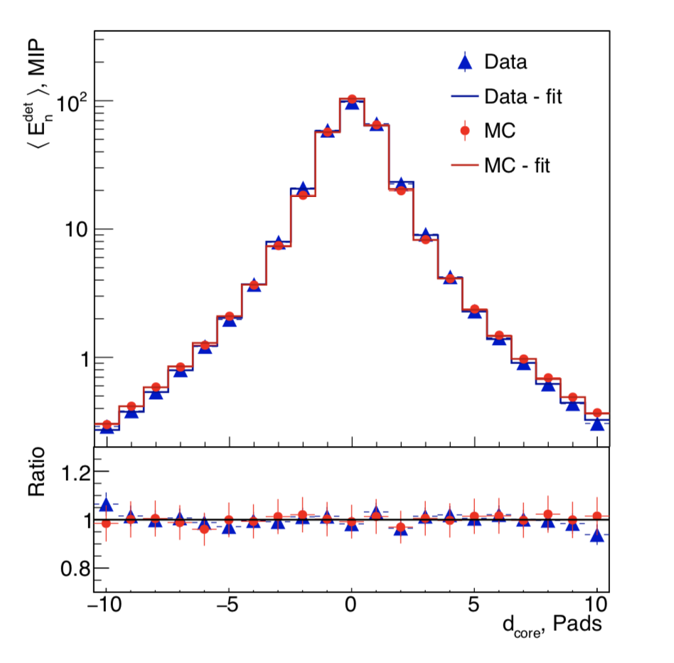
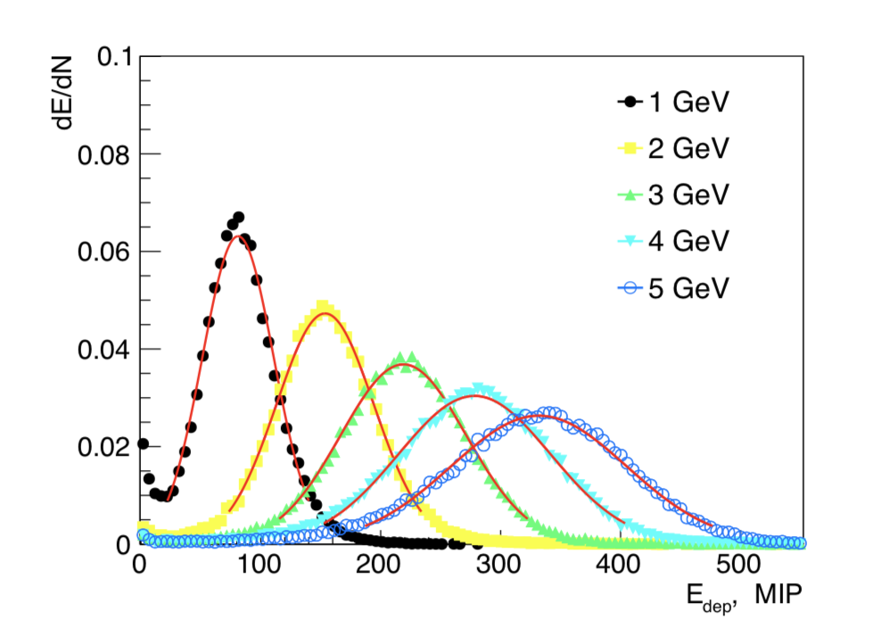
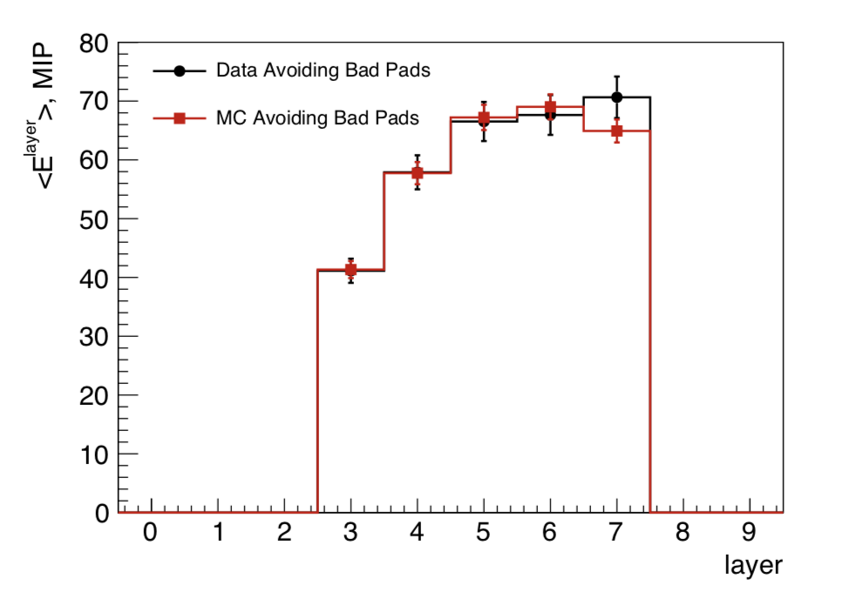
lumical test at DESY in 2016
Energy response, longitudinal profile and effective moliere radius
Effective Moliere radius :
8.1 ± 0.1 (stat) ± 0.3 (syst) mm
arXiv:1812.11426

Slide 17
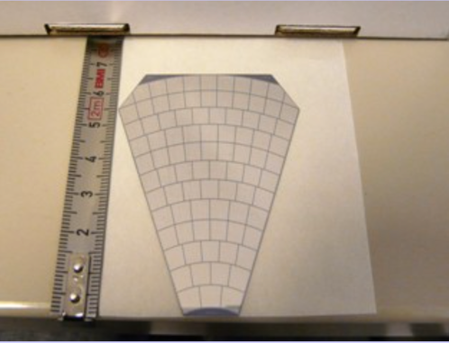
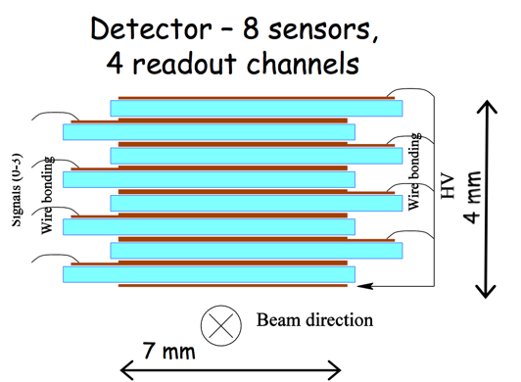
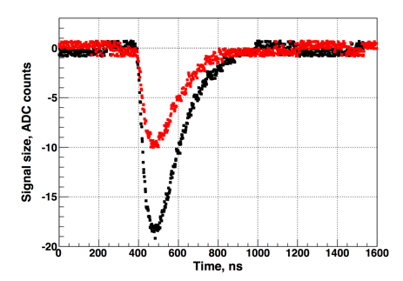
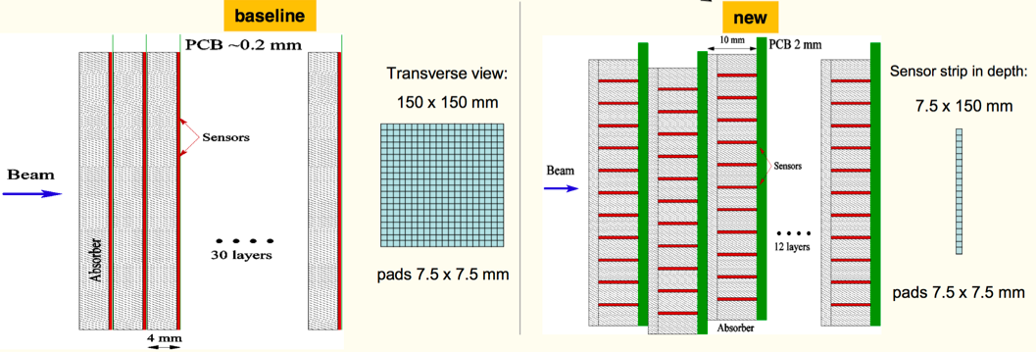
BeamCal test beam
DESY 2010 :
  GaAs plate with Al metallization: 500 μm thick
  45 deg tiles, segmented into 12 rings, 5x5mm² pads
  S/N ratio and CCE are good: CCE ~33% at 60V, S/N ~19 for all channels.
  4 independent pad areas show identical charge collection
DESY 2013 :
  Idea to test sapphire sensors parallel to the beam line
  Perfect electrical properties, excellent radiation hardness, but presently low charge collection efficiency
2017 :
  New design of the detector
  Aiming to build and test this new model in 2019
Red : 550V
Black 950V

Slide 18
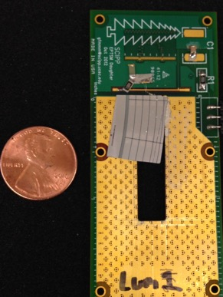
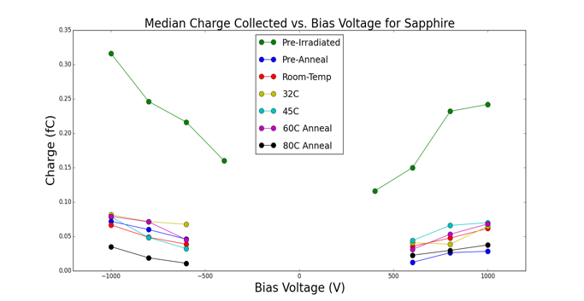
Radiation damage in electromagnetic shower
BeamCal maximum dose ~100 MRad/yr
Study is performed at California University of Santa Cruz
Exposition of Si, GaAs, Sapphire, Silicone carbide
Dark current remain low for Sapphire
300 Mrad Exposure
500 μm thick Al₂O₃
300 Mrad Exposure

Slide 19
Purposes
FCAL detectors : simulation
FCAL detectors : hardware
Electronics
conclusion

Slide 20
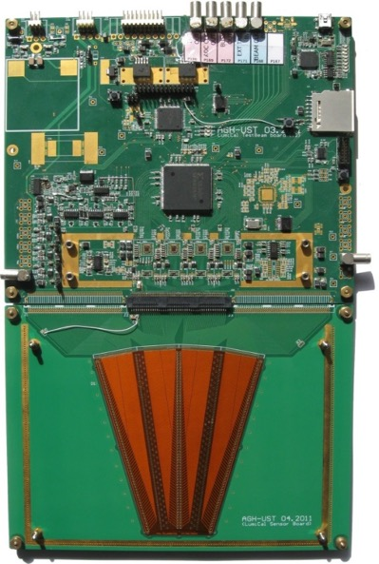
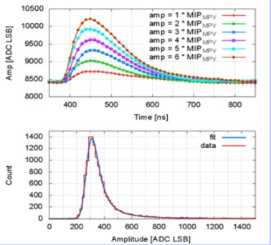
LumiCal readout in 2014
Development of an ASIC for the 2014 test beam
Charge amplifier shaper with different gain (MIP/electron)
8 front end channels
Development of an 8 channel 10 bit ADC
Signal to noise ratio ~19
Cross Talk < 1%

Slide 21
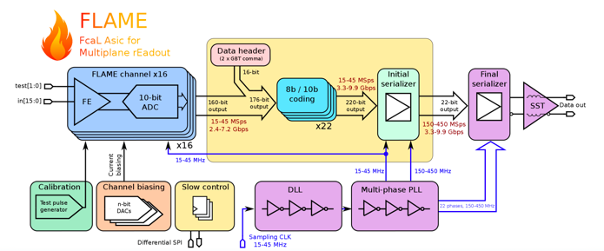
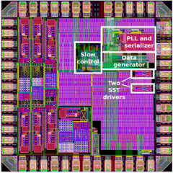
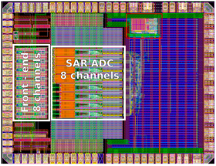
New readout : FLAME
JINST 10 (2015) P11012
JINST 10 (2015) P12015
FLAME: project of 16-channel readout ASIC in CMOS 130nm, front-end&ADC in each channel, fast serialization and data transmission, all functionalities in a single ASIC
FLAME prototype :
  Prototype 8-channel FE+ADC ASIC
  Prototype serializer ASIC
First tests are encouraging : FE ok, ADC ok, basic functionality of serializer are ok

Slide 22

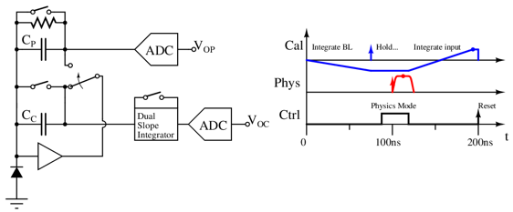
BeamCal readout
Firstly, BeamCal is hit by beam halo (muons)
  MIP deposition, low noise electronics
  Clean environment
  Good for calibration
~25ns later, BeamCal is hit by collision scattering
  Large deposit energy
  Physics readout
Dual slope integrator for calibration signal
  Integrate baseline (negative gain)
  Calibration halo signal is deposited and held
  Switch to physics mode, process and digitize Vop
  Then integrate calibration signal and digitize Voc

Slide 23
Conclusions
The precise and complete geometry of the FCAL detectors has been simulated and showed that :
  above 10 mrad, the BeamCal high energy electron reconstruction efficiency is close to 100%
  Very good energy resolution and luminosity measurements with the LumiCal (stochastic term ~0.2)
  Tungsten seems to be the best candidate for the LHCal
A ultra compact LumiCal, including a tracker allowing electron/photon identification has been tested and the results are good and allow a good angle/position reconstruction
GaAs BeamCal gave relatively good charge collection efficiency and a new sapphire based prototype in under study
LumiCal prototypes of key blocks readout fabricated and first promising results obtained. BeamCal readout chip is under intensive study
2019
LumiCal test beam with :
  Between 18 to 20 thin layers
  Close to final front end electronics + readout and DAQ

Slide 24
thanks

Slide 25
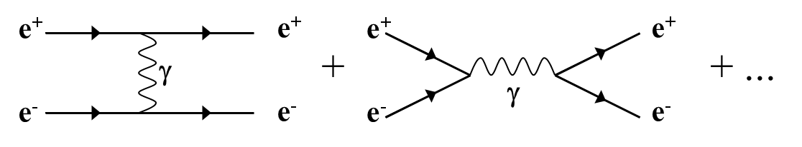
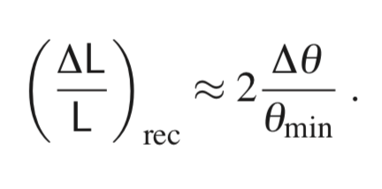
Luminosity at e⁺e⁻ collider
Bhabha scattering at low polar angles is used
e⁺e⁻ e⁺e⁻ (γ)
L = N / σ
Count Bhabha events
From theory
ECFA, Linear Collider Workshop 2016
25
31/05/16

Slide 26
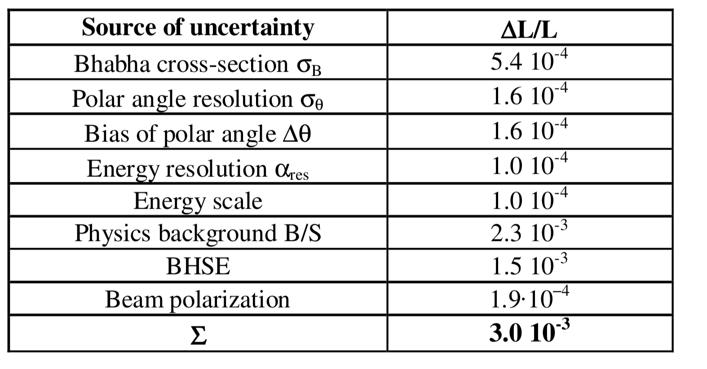
Luminosity precision details

