Slide 1
ILD IDR
ILD meeting, 27.2.2019

Slide 2
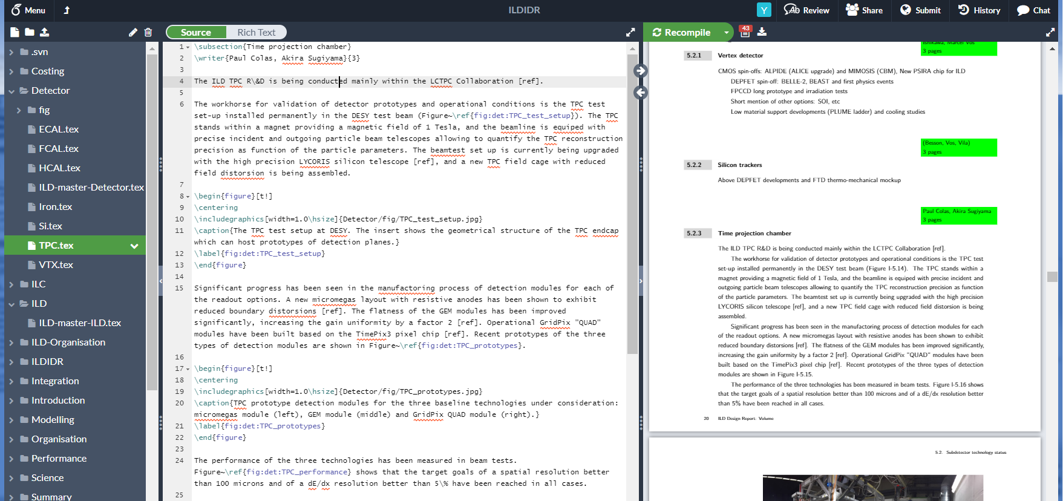
IDR editing
The IDR is maintained on overleaf, a WEB-based interface to latex:

Slide 3
Places
ILD IDR:
Edit https://www.overleaf.com/project/5b30eafb30cd6f754b3f3fc5
Read: https://www.overleaf.com/read/jrxfxbssqfgs
Overleaf is a front end to git, all changes you do are synchronised automatically
to a git repository.
To work offline, it is recommended that you pull the document from this git:
git clone https://git.overleaf.com/5b30eafb30cd6f754b3f3fc5
Frank prepared a nice document explaining how to work with git:
https://confluence.desy.de/display/ILD/The+ILD+Design+Report%2C+IDR?preview=/97009435/120369840/overleaf_git_howto.pdf

Slide 4
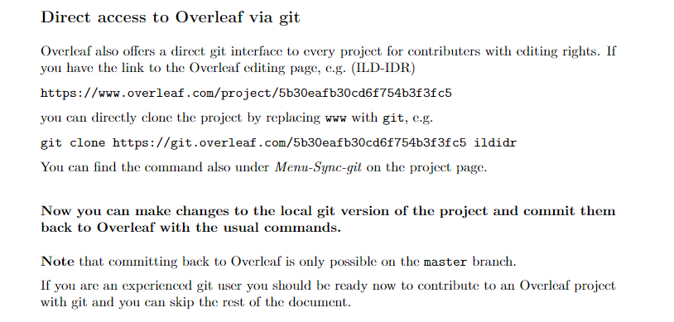
Working with Overleaf and git
Note: access to the svn repository for the ILD IDR is discontinued and not
supported any more!

Slide 5
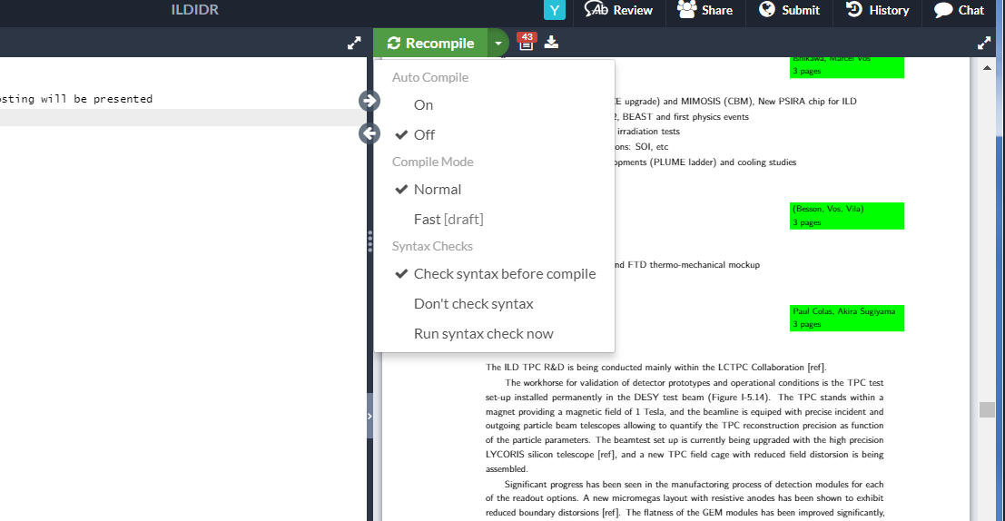
Working with overleaf
Switch off the automatic re-compilation:

Slide 6
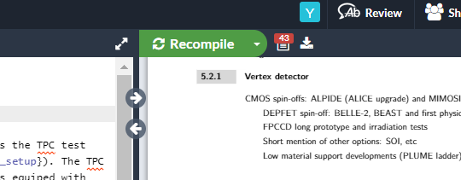
Some hints for using overleaf
The overleaf compiler is rather forgiving: check for latex errors to ensure that
major errors are caught.

Slide 7
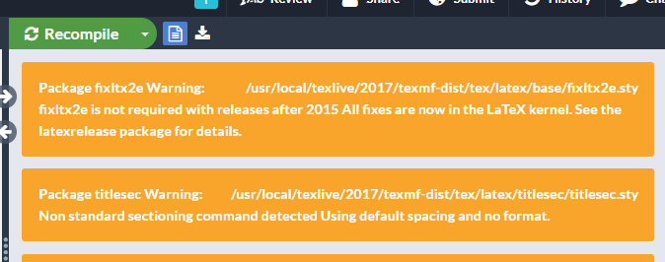
Some hints for using overleaf
The overleaf compiler is rather forgiving: check for latex errors to ensure that
major errors are caught.

Slide 8
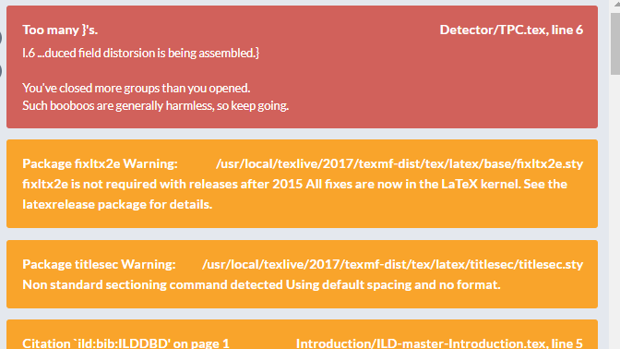
Some hints for using overleaf
The overleaf compiler is rather forgiving: check for latex errors to ensure that
major errors are caught.

Slide 9
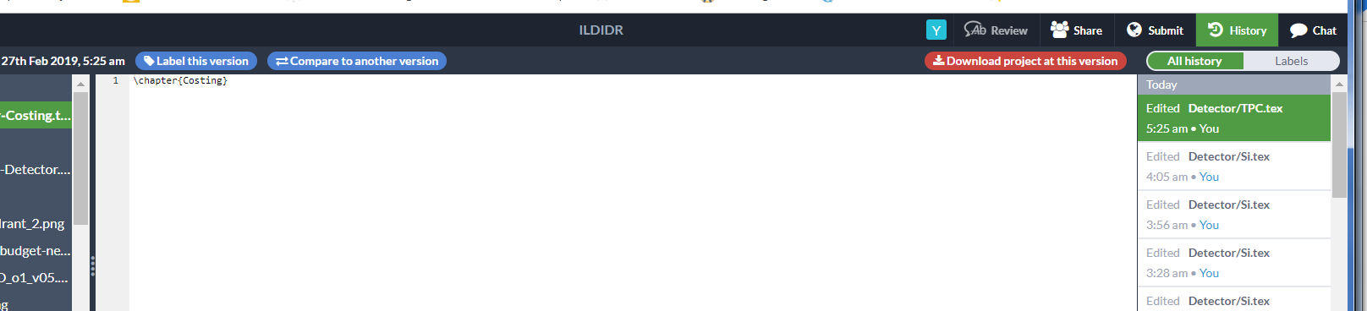
History of changes:

Slide 10
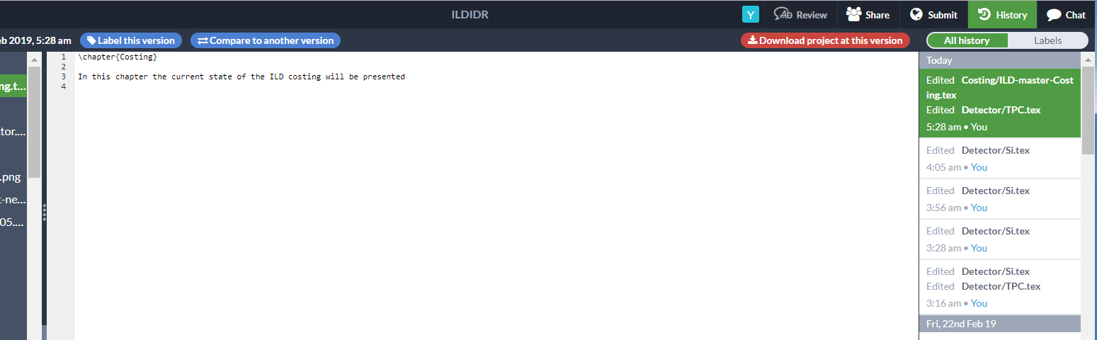
History of changes:

Slide 11
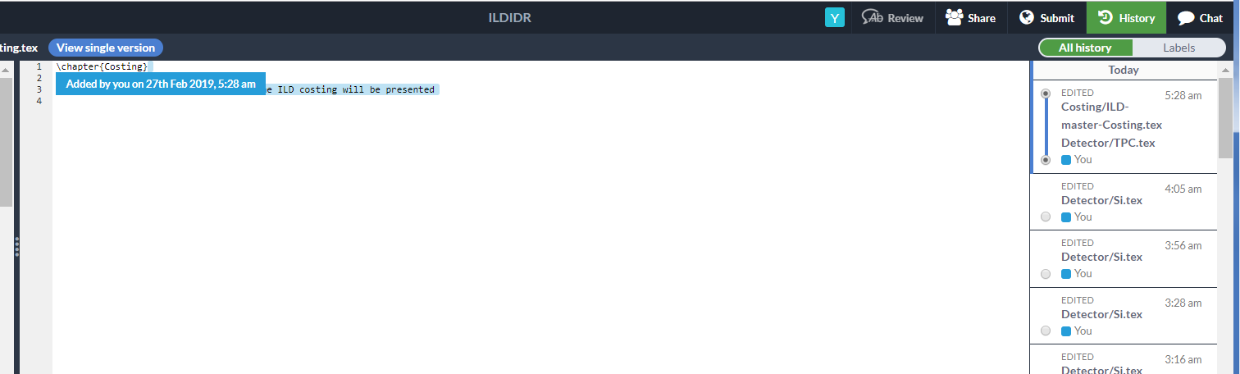
History of changes:

