Slide 1
Detector Utility
2019/2/12
Yasuhiro Sugimoto
@ILD Integration Meeting

Slide 2
CFS Schedule
By N.Terunuma

Slide 3
CFS Schedule
If a positive statement by Japanese government is made, ILC basic design linked to CFS has to be fixed by 2019 summer
CFS Engineering Documents will be made in ~1 year based on this basic design
Based on the CFS Engineering Documents, CFS detailed design will be made by civil engineering companies in ~3 years
So, detector groups should clarify the requirements for the experimental hall and the utilities by 2019 summer

Slide 4
Necessary utilities for detectors
Electricity
Heating, ventilation, air conditioning (HVAC)
Cooling water
Cryogenics for s.c. magnets
Chamber gas
(Network for data transfer)
Sub-detector assembly building
etc.

Slide 5
Utility Survey
Requirements for utilities for sub-detectors were surveyed in 2018
  Electric power
  Cooling water
  Space
Two rounds of the survey were made, but only 5 sub-detector groups responded
  Vertex detector
  TPC
  ECAL
  SDHCAL
  AHCAL
Requirements for other sub-detectors will be supplemented by Y.S. to estimate total necessary electric power and cooling water
  Power consumption by sub-detectors is relatively small compared to magnet power
  So, rough estimate on the sub-detector power consumption is OK

Slide 6
Utility Survey
6 items for electricity/cooling water
Extracted by cooling water
Cooled by FCU
Heat loss to air
Type of
cooling
water
Electric Power
P_{FE} : Power consumption of sub-detector Front-end Electronics
Q_{D} : Heat loss in sub-det. (= P_{FE} )
Q_{PC} : Heat loss in power cables
P_{LV} : AC power input to LV PS
ε : Efficiency of LV PS (P_{LV}*ε= P_{FE} +Q_{PC})
Q_{LV} : Heat loss in the LV PS (=(1-ε)*P_{LV})
P_{BE} : AC power input to back-end elec./HV power supply
Q_{BE} : Heat loss in the BE/HV PS (=P_{BE})
P_{CS} : Electric power to drive the cooling system
Q_{CS} : Heat to be extracted from cooling system (= Q_{D} +P_{CS})

Slide 7
electricity

Slide 8
Basic concept
On surface: 275(154)kV → (66kV) → 6.6kV
6.6kV AC is sent to underground USC through Utility Shaft
In USC: 6.6kV → 400(3φ) / 200(3φ,1φ) / 100V(1φ)
Power dissipation is eventually extracted by cooling water (→ cooling tower on surface)

Slide 9
Tentative estimation for ILD
Item |  | Power (kW)
QD0/QF1/Crab cavity | Power supply | 150
 | Cold box | 150
 | He Compressor | 300 | (Surface)
Detector Solenoid | Power supply | 250
 | Cold box | 50
 | He Compressor | 500 | (Surface)
Sub-detector | Total | 161 | FEE | BEE | Cooling
 | Muon | 12 | 5 | 5 | 2
 | HCAL | 45.5 | 27.5 | 8 | 10
 | ECAL | 40 | 20 | 12 | 8
 | VFC | 9 | 2 | 5 | 2
 | SET | 9 | 2 | 5 | 2
 | TPC | 16.2 | 15 | NA | 1.2
 | SIT | 8 | 1 | 5 | 2
 | FTD | 8 | 1 | 5 | 2
 | VTX | 13.5 | 2 | 1.5 | 10
Computer farm |  | 1000 | (Surface)
Water pump |  | 25 | (11kWx2+3.7kW)
HVAC |  | 600 | (Surface, CMS)
Lighting |  | 25
Air compressor |  | 50 | (Surface)
Platform mover |  | 100
Crane for ILD | 5t x 3 | 21
 | 40t | 50
Total |  | 3432
Underground |  | 1282
Sub-detectors:
Y.S.’s guess (based on TDR description, if exists) except for HCAL, ECAL, TPC, and VTX
Not listed:
Infrastructure in assembly halls
Computers for rec/ana/sim.
Office building
Cooling tower and chiller on surface

Slide 10
Comparison with other study
 | CMS | CLIC | SiD | ILD
Detector Solenoid | 900 | 900 | 294 | 800
QD0/QF1/CC | NA | NA | NA | 600
FEE | 600 | <10 | 12 | 75
BEE | 650 | <10 | 70 | 47
PC farm | 800 | 1000 | NA | 1000
DH utility | NA | NA | 105 | 246
Cooling | 850 | 750 | NA | 65
HVAC | 600 | 600 | NA | 600
Sum | 4400 | 3250 | 481 | 3432
He compressor is not included in SiD Detector Solenoid
Cranes and lighting are not included in SiD DH utility
CMS and CLIC data is taken from LCD-Note-2013-011

Slide 11
Cooling water

Slide 12
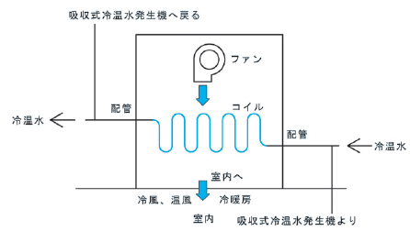
Basic concept
Two types of water are supplied from surface
  Normal temp. water: T~30 ℃, ΔT~10 ℃
  Chilled water: T~10 ℃, ΔT~5 ℃ (TBD)
  High pressure due to Δh~100m can be isolated by heat exchangers in USC
Sub-detectors are cooled by sub-detector cooling systems
  Coolant could be CO2, water, air, or something else
  Sub-detector cooling systems are cooled by cooling water
Electronics racks are cooled by fan-coil units
  Cool air flow generated by chilled water removes heat, and returns to room temperature

Slide 13
Schematic
Surface
~15℃
~10℃
~40℃
~30℃
Underground
Chilled water
Fan-coil units (electronics racks)
Sub-det. Cooling systems
Normal temp. water
Sub-det. Cooling systems
Low-conductivity water
ρ>1MΩcm
Magnet power supply

Slide 14
Requirement
Cooling water for underground facilities
 |  | Chilled Water |  |  | Low-conductive Water |  |  | Normal Water
Item |  | Heat (kW) | dT | Flow (L/min) | Heat (kW) | dT | Flow (L/m) | Heat (kW) | dT | Flow (L/m)
QD0/QF1/CC | Power supply |  |  |  | 150 | 10 | 214
 | Cold box |  |  |  | 150 | 10 | 214
Detector Solenoid | Power supply |  |  |  | 250 | 10 | 357
 | Cold box |  |  |  | 50 | 10 | 71
Sub-detector | Muon | 12 | 5 | 34
 | HCAL | 45.5 | 5 | 130
 | ECAL | 40 | 5 | 114
 | VFC | 9 | 5 | 26
 | SET | 9 | 5 | 26
 | TPC | 3 | 5 | 9 |  |  |  | 13 | 5 | 38 | NW for precision chiller
 | SIT | 8 | 5 | 23
 | FTD | 8 | 5 | 23
 | VTX | 13.5 | 5 | 39
Pump |  | 11 | 5 | 31 | 11 | 10 | 16 | 3.7 | 5 | 11
Cubicle (AC transformer) |  | 64 | 5 | 183 |  |  |  |  |  |  | 95% efficiency, FCU
Total |  | 223 |  | 637 | 611 |  | 873 | 17 |  | 48
Primary Loop |  | Chilled Water |  |  | Normal Temperature Water
 |  | 637 |  |  | 921

Slide 15
hvac

Slide 16
HVAC
Air handling units on surface (next to assembly hall)
Air ducts through main shaft
Necessary capacity has not been studied yet

Slide 17
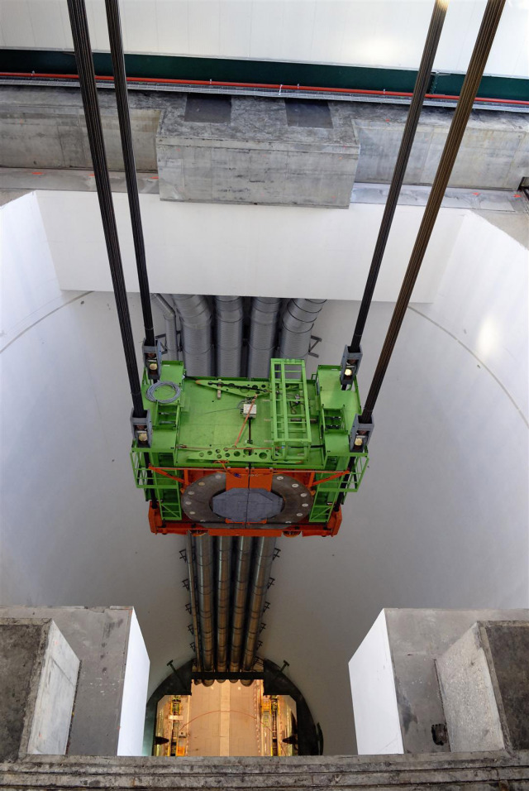
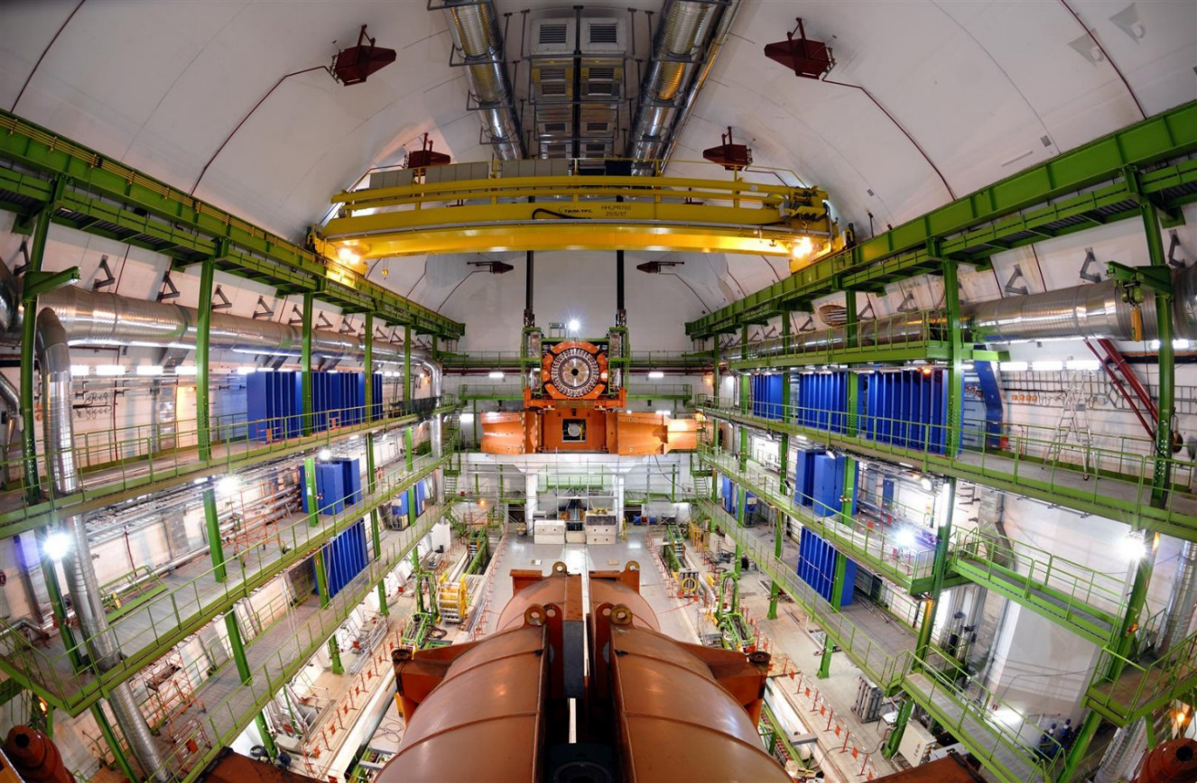
HVAC - CMS

Slide 18
HVAC – Assembly Hall
Garage for air handling units

Slide 19
Other services

Slide 20
Chamber gas
Chamber gas is necessary for TPC and SDHCAL
Gas storage on surface: 8x4m² for each
Gas system underground
  TPC: Some space on the platform
  SDHCAL: 4x4m² space in USC and small space on service gallery and platform
CMS RPC gas system

Slide 21
LASER system
Laser system will be used for tracker alignment
Laser light source requires isolated space for safety reason

Slide 22
space

Slide 23
Location of Utility/Service
Surface
He/Air compressors
HVAC
Gas storage
PC farm (?)
Cooling tower/chiller
Utility/Service Cavern
AC transformer
Heat exchangers/pumps for cooling water
Sub-det. Cooling systems
LASER/Gas system
QF1 cryogenics
Workshop
WC
Service gallery
Electronics racks
Magnet power supply
He, Chamber gas,
Optical fibers, Air ducts
Main Shaft
Platform
Low-voltage power supply
Cryogenics for magnet
Etc.
Utility Shaft
Electricity, cooling water, elevator

Slide 24
Utility/service cavern
Utility Shaft
Detector Hall
Main Shaft
Tentative design

Slide 25
Detector Platform
: Space for electronics racks

Slide 26
Service Gallery
2F is just a path to platform
3F-5F are used for electronics racks
6F is for magnet power supply

Slide 27
Service Gallery
2F

Slide 28
Service Gallery
3-5F

Slide 29
Service Gallery
6F

Slide 30
Space requirements
People tends to like electronics rack space on the platform, where
  few 100 G leakage field could exists
  access may not be allowed during experiment
Because space on the platform is limited, there could be severe competition between sub-detectors

Slide 31
Pre-assembly hall
In addition to the main assembly hall on surface, we need pre-assembly hall for sub-detector assembly
Requirements from sub-detector groups were collected/estimated since 2015
Sub-detector | Area (m²) | Building
Iron yoke blocks | 900 (=20x45) | Yoke assembly building attached to Main AH
SDHCAL/AHCAL | 1400/330 | Independent Pre-Assembly Hall at IR Total 3000/1930 m² FCAL should use HCAL space after HCAL installation
ECAL | 830
Muon detector | 400
TPC | 100
Si detectors | 100
Utility | 170

Slide 32
Summary
ILD requirements for utilities have been surveyed to some extent
For the moment, it seems power consumption of sub-detectors are relatively small compared to magnet power
Because the estimation for each sub-detector still has large uncertainty, total power consumption of sub-detectors should be describe in IDR
Service gallery and Utility/Service cavern which we propose seem to have enough space for ILD
Detail of space requirements is still too premature to be described in IDR
There are still many items of requirements for detector utilities to be clarified to fix the CFS design in interaction region

