Slide 1
The current status of the ILC project in Japan
Yasuhiro Okada (KEK)
January 2019

Slide 2
Outline of this talk
Background
The report of the Science Council of Japan (SCJ)
Ongoing efforts

Slide 3
Background of the ILC project in Japan
The Japanese HEP community (JAHEP) proposed to host the ILC in Japan in Oct. 2012.
In May 2013, MEXT asked the Science Council of Japan (SCJ) for advice on the ILC project.
In September 2013, the SCJ sent a report on the ILC project to MEXT.
MEXT set up the ILC Advisory Panel in May 2014.
The JAHEP proposed 250 GeV ILC as a Higgs factory in July 2017.
LCB/ICFA released a report/statement and endorsed the plan of 250 GeV ILC in November 2017.
The ILC250 plan was introduced to the ILC Advisory Panel of MEXT.

Slide 4
Developments in 2018
The ILC Advisory Panel released a report on the revised plan of the ILC in July 2018. MEXT asked the SCJ for advice on the revised plan.
Intensive discussions started in the Committee formed in the SCJ in August 2018. 11 meetings were held in August-November. There have been many presentations and many submissions of documents from researchers and various sectors. More than 30 letters from abroad were sent to the Committee.
The final report was approved at the Executive Board of the SCJ and handed to the MEXT on December 19, 2018.

Slide 5
The SCJ report
The full report is available at
http://www.scj.go.jp/ja/info/kohyo/pdf/kohyo-24-k273.pdf
KEK released a message to clarify our stand point on December 19, 2018.
https://www.kek.jp/ja/newsroom/2018/12/19/1700/
Also statements was released from the Tohoku area and Diet members.
KEK sent out an English translation of the executive summary of the report, the KEK statement, and the Diet member’s statement .
https://www2.kek.jp/ilc/file/SCJ_report_clarification_181221.pdf
This was also covered by LC Newsline.
http://newsline.linearcollider.org/

Slide 6
The SCJ report : Executive summary
The SCJ recognizes the importance of the Higgs physics “In the high-energy particle physics community, a consensus has been reached that research on the precise measurement of Higgs couplings is extremely important”
“Judging from the information so far presented regarding the current state of the project and its preparation, the Science Council of Japan cannot reach a consensus to support hosting the 250 GeV ILC project in Japan”
Their main concerns are “the major part of the huge project cost that Japan is expected to bear”, “still some concerns regarding the project’s implementation (for technical issues)”, and “the prospects for appropriate international sharing of the huge investment”

Slide 7
KEK statement (December 19, 2018)
……..
The SCJ appreciated the scientific significance of the ILC project, the “pursuit of new physics beyond the standard model,” but also pointed out issues concerning the hosting of the ILC project in Japan, in particular the cost-sharing as an international project and the international project organization and management. To address these issues, we ask the Japanese government to promptly convey a forward-looking position regarding the implementation of international discussions toward the realization of the ILC.
………
The scientific significance of the ILC project is widely accepted, but the significance and consequences of Japan taking on a major part of the ILC project should be discussed not only from the academic but also societal points of view. Investigations of the project by researchers have now reached the stage at which further progress requires international discussions by the government. If, in the course of these discussions, it becomes clear that international and domestic conditions are not satisfied, the project will be canceled. We will advance the ILC project, establishing worldwide consensus, including on its budget, while gaining support from both academic circles and society at large.
As for the identified technical issues, the global community will cooperate, combining resources to resolve them. Based on our experience and achievements at LHC, KEKB, European XFEL, and other research facilities, we are convinced that we can solve them.

Slide 8
Diet member’s statement (December 19, 2018)
We wish to express our sincere gratitude for the intensive discussions conducted at the Science Council of Japan. It is extremely important that the scientific merits of the ILC and the significance of Japan contributing to international collaborative research have been recognized.
The ILC has a far-reaching impact on a wide range of national policies, such as science and technology innovation, diplomacy and national security, industrial development and growth, and regional revitalization and post-disaster reconstruction. We believe that it is our political mission to push forward the ILC project as a national priority.
Japan has been and will remain a science and technology-oriented nation. We will continue to seek public understanding of the ILC project and will work to address the issues raised by the Science Council of Japan.
The Federation of Diet Members for the ILC and the Liaison Committee for Realizing the ILC will be working at full strength to ensure that the Japanese government reaches a positive decision to realize the ILC project in Japan.
Takeo KAWAMURA
Chairperson, Federation of Diet Members for the ILC
Chairperson, Liaison Committee for Realizing the ILC, Liberal Democratic Party

Slide 9
Q&A at MEXT Minister’s press conference (Dec. 21, 2018)
Journalist
Recently, the Science Council of Japan delivered a report on the International Linear Collider (ILC) to the Ministry of Education, Culture, Sports, Science, and Technology (MEXT). The report states “the Science Council of Japan cannot reach a consensus to support hosting the ILC.” How will MEXT respond to this report and what are its next steps?
Mext Minister
We asked the Science Council of Japan (SCJ) to consider the International Linear Collider following the issue of a report in July by MEXT’s ILC Advisory Panel. On December 19th, we received the SCJ’s response to our request. The project was thoroughly discussed in the SCJ by researchers from diverse academic fields. I am grateful to those researchers for their work. Now MEXT will consider government’s response, taking into account the SCJ’s report. The SCJ’s summary acknowledges the scientific significance of the ILC in the field of elementary particle physics, but also expresses concerns. The main concerns are the prospects for international cost sharing and the availability of human resources. We would like next for the government to proceed with careful consideration of the ILC, while paying attention to these concerns. Regarding the schedule, the key international research organization acknowledged on December 5th that it is unrealistic to expect the Japanese government's expression of its position on the ILC in 2018. They requested a statement from the Japanese government by the beginning of March, 2019. While carefully monitoring such international developments, we will consider how the government should respond, after carefully reviewing the contents of the SCJ’s report.
Journalist
Today, the governors of the Miyagi Prefecture and the Iwate Prefecture said the government should consider societal significance as it makes a decision on the ILC. What do you think of this?
MEXT Minister
I think a comprehensive examination taking account such viewpoints is necessary. We will consider more factors now, including intra-government coordination.

Slide 10
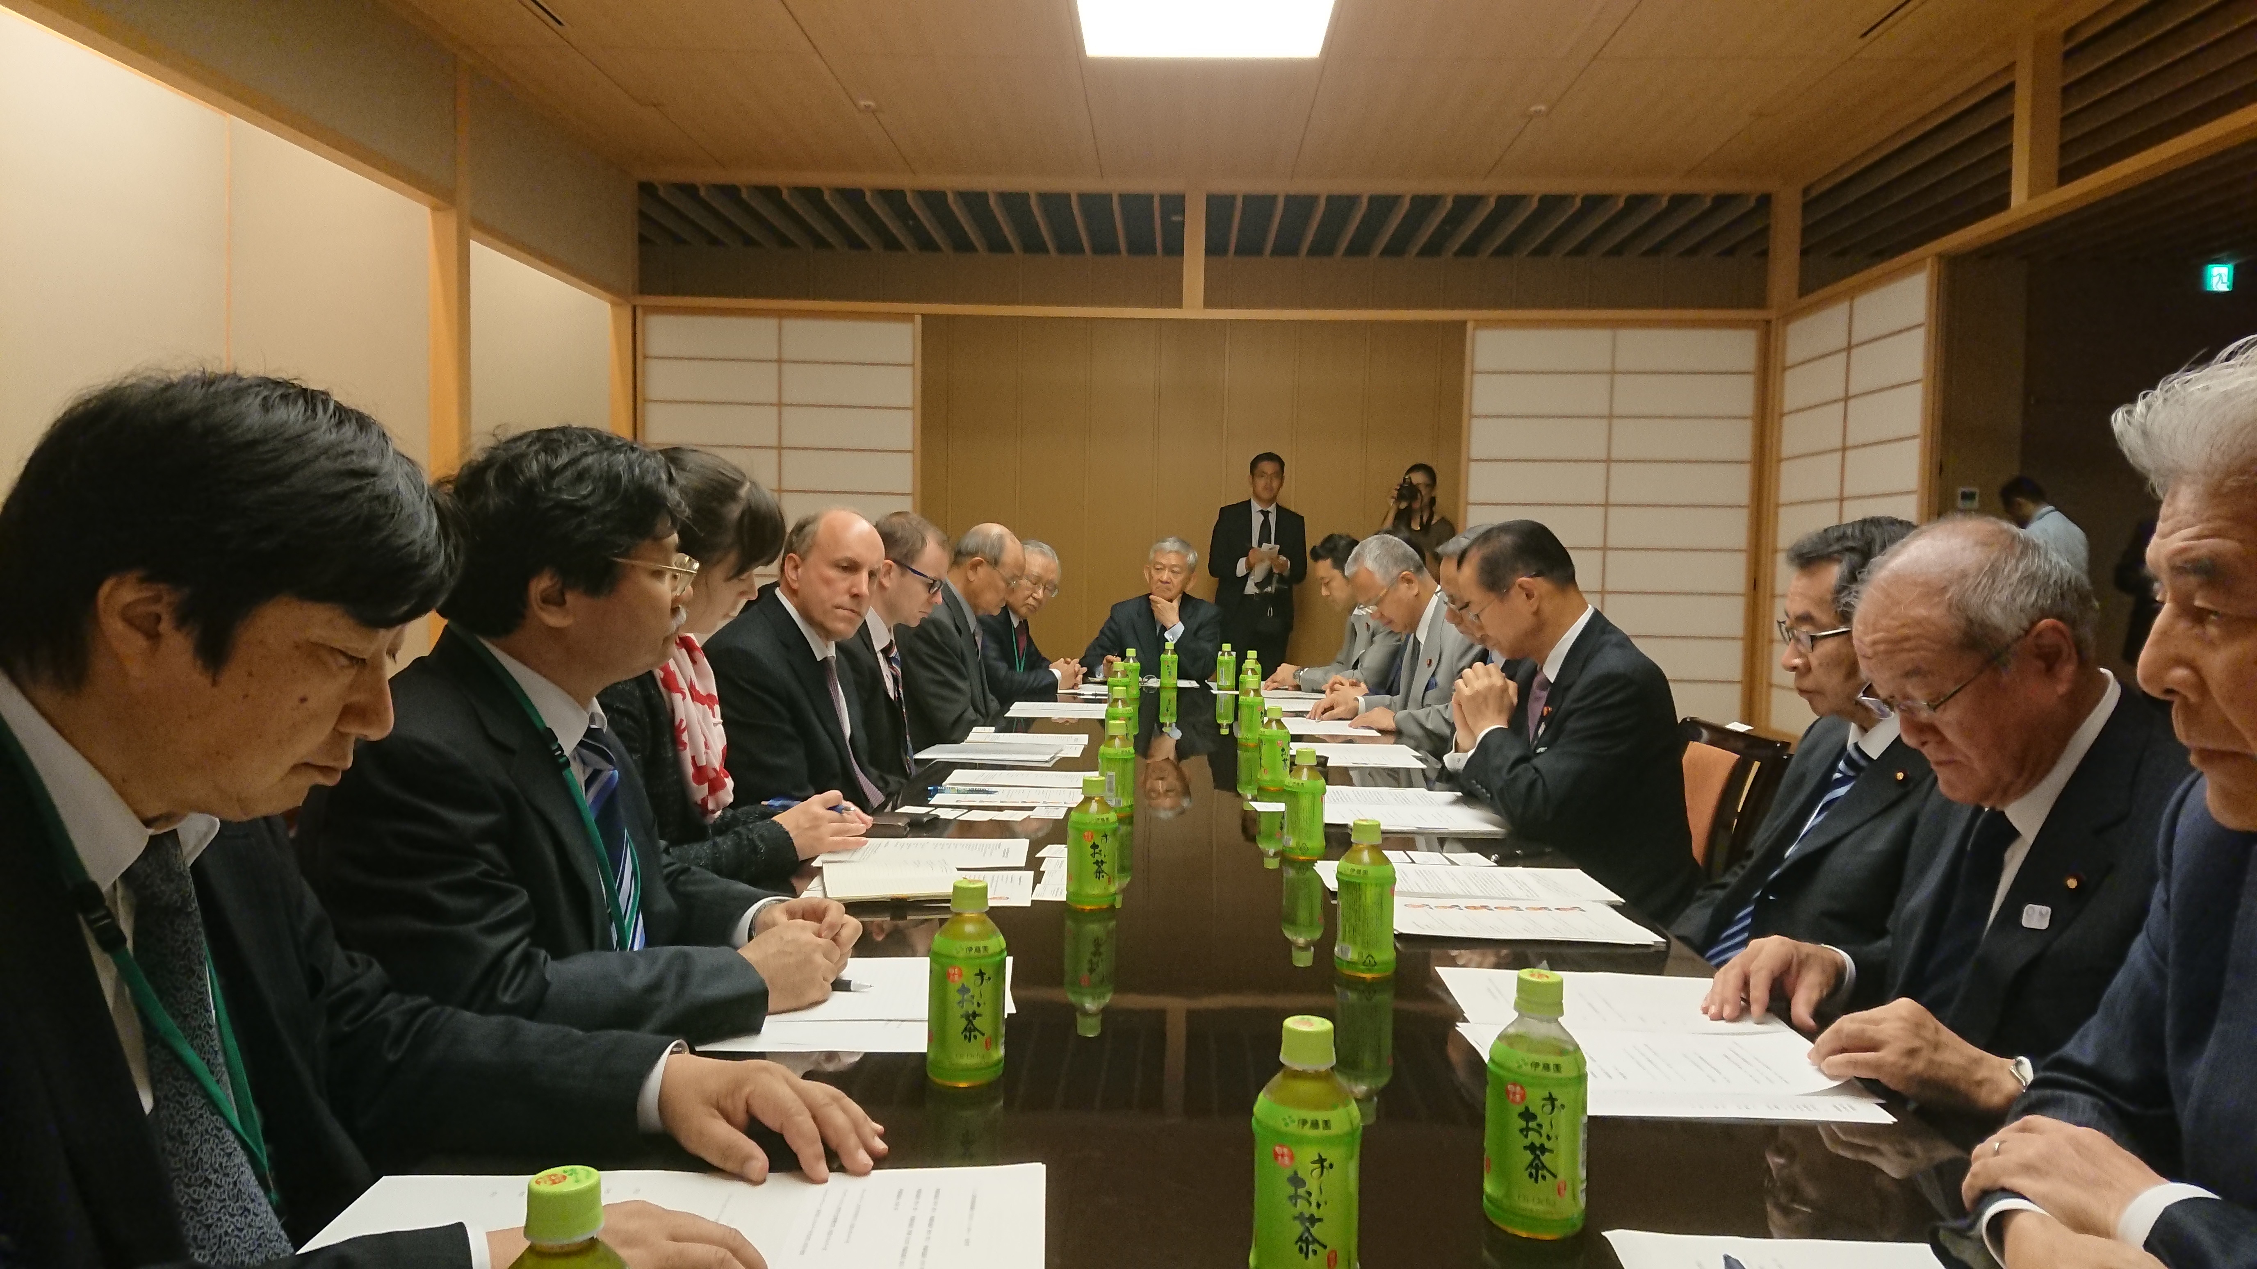
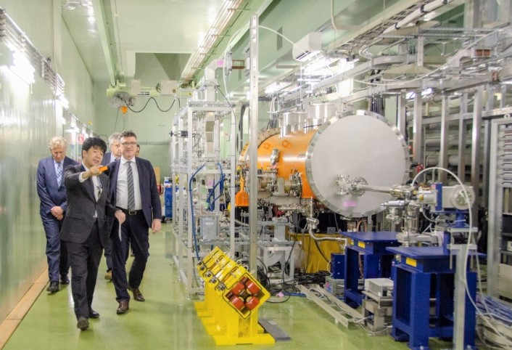
Promotion in political/governmental sectors
Non-patrician Federation of Diet members for the ILC was formed in 2008. Advanced Accelerator Association Promoting Science and Technology (AAA) was also established in 2008 as an industry and academia collaboration.
These organizations have vigorously promoted the ILC project last ten years. Many visits were made to Europe and US.
The MEXT-DOE discussion group on the ILC was formed in 2016 and decided to start collaboration on ILC cost reduction R&D.
Diet members together with governmental officials, industrial representatives and researchers visited Europe in January, 2018 and identified counterparts of Japanese representatives in France and Germany at each level.
Recent visits of the DOE Undersecretary (Dr. Paul Dabber), a German parliament member (Dr. Stefan Kaufmann) and French National Assembly members to Diet members produced encouraging results.
Dr. P. Dabbar at a Diet member meeting
Dr. S. Kaufmann at KEK-STF

Slide 11
Recent progress in political efforts
Address by Hon. Shintaro Ito, Member of the House of Representatives of Japan, at LCWS2018 on October 26, 2018.
http://www.uta.edu/physics/lcws18/pages/info_files/Address%20by%20Hon%20Shintaro%20Ito%20LCWS2018.pdf
Establishment of a new organization in the Liberal Democratic Party, “Liaison Committee for Realizing the ILC”. This brings together various strategic groups involved in making important policies, such as science technology and innovation, regional revitalization, reconstruction from natural disasters, and national resilience.
Significant progress already made with Europe and the United States concerning international discussions.
Expression of Interest to host the ILC by the Japanese government, originally by the end of 2018. Now an expected date is by the beginning of March after discussions at LCB on December 5, 2018.

Slide 12
KEK’s efforts
KEK and the HEP community in Japan, together with other sectors promoting the ILC (political, industrial, and local), will make every effort to help the Japanese government announce the EoI to host the ILC by the beginning of March 2019.
KEK and the HEP community in Japan will work together with worldwide HEP researchers, especially with European colleagues, in order to place the ILC in a high priority position as an international project in the update of the European Strategy for Particle Physics.
Beyond the EoI, KEK and the HEP community in Japan will facilitate international discussions between governments with colleagues of foreign partners.
KEK and the HEP community in Japan together with other sectors will continue to promote the ILC in order that the project will receive the final approval after international negotiations.

