Slide 1
CLIC Workshop 2019
CERN
Tuesday 22nd January 2019
FONT
Phil BURROWS, Colin PERRY, Douglas BETT, Rebecca RAMJIAWAN
University of Oxford

Slide 2
Contents
Introduction to Interaction Point (IP) feedback
FONT IP system and cavity BPM signal processing
  Recent beam stabilisation results
    1-BPM feedback
    2-BPM feedback
FONT upstream position and angle system
  Recent beam stabilisation results
Prototype stripline BPM processor for CLIC

Slide 3
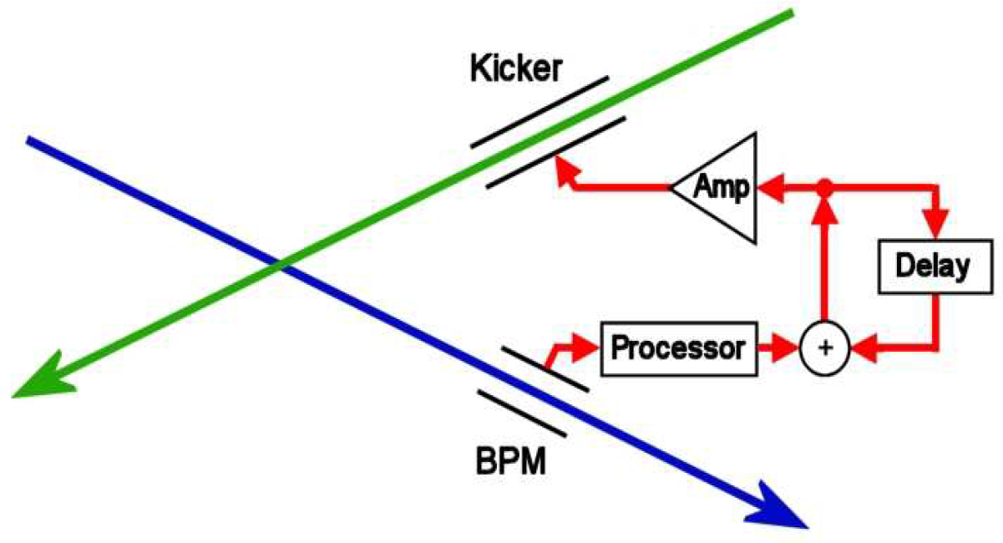
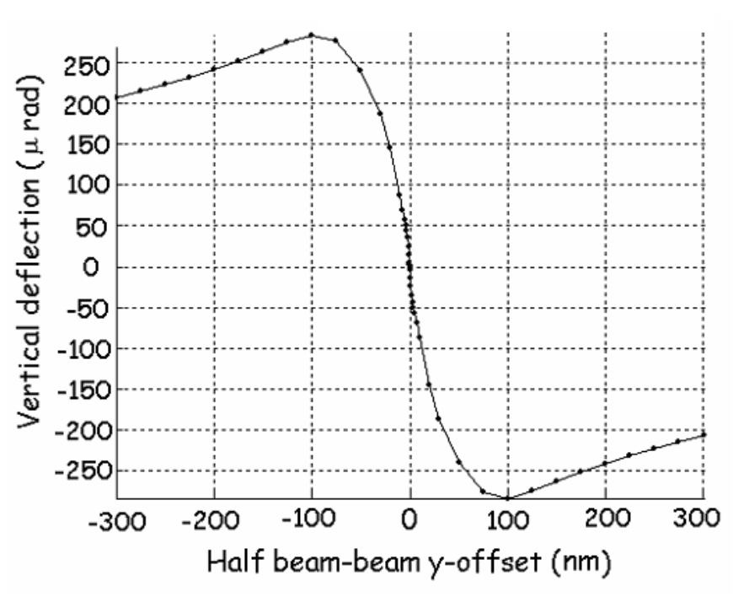
Interaction Point feedback
Offset of bunches at IP inferred from position of first bunch measured at downstream BPM
Second bunch kicked upstream of IP in other beamline to compensate for this misalignment
Delay loop preserves correction for subsequent bunches
Beam-beam deflection curve

Slide 4
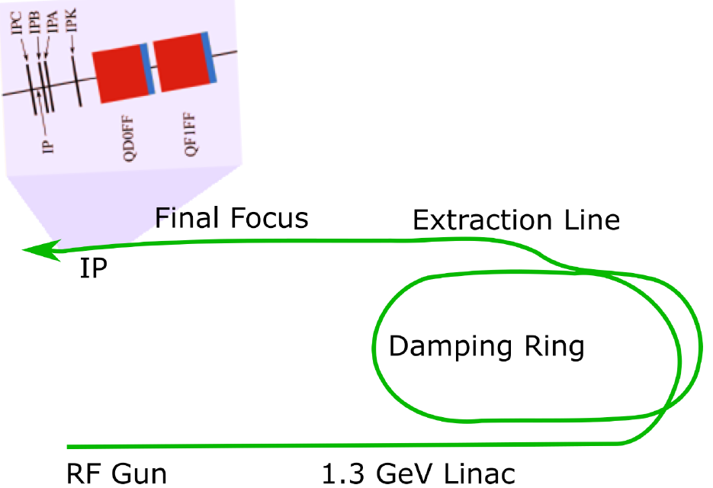
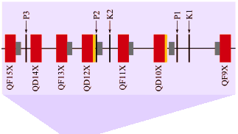
Beam stabilisation at ATF2
ATF2 = test accelerator at KEK in Japan with 1.3 GeV electron beam
ATF2 collaboration has two goals for beam:
  37 nm beam size
  nm level beam stability
FONT5A digital board processes BPM waveforms to determine correction, generates kicker drive signal
Ultra-fast amplifier used with stripline kicker to apply beam deflection
Uses bunch trains of two bunches with bunch spacing of ~280 ns
IP region
3 cavity BPMs around IP.
Stripline kicker IPK.
Upstream region
Stripline BPMs P2 and P3.
Stripline kickers K1 and K2.
Extraction Line

Slide 5
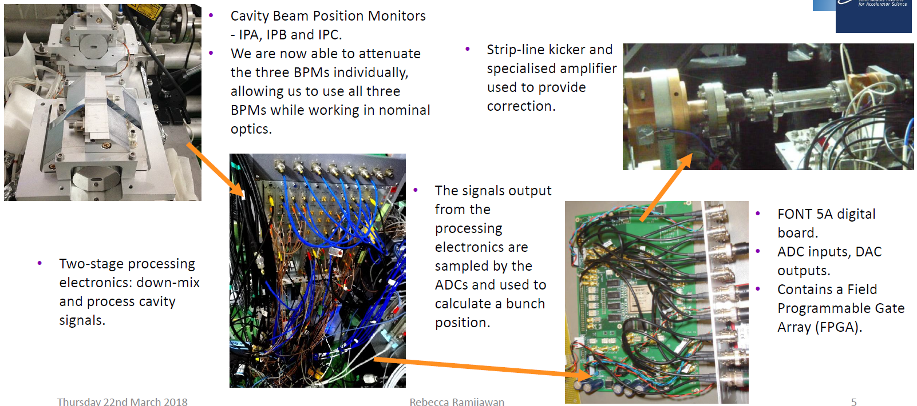
FONT IP feedback system
Slide by R. Ramjiawan

Slide 6
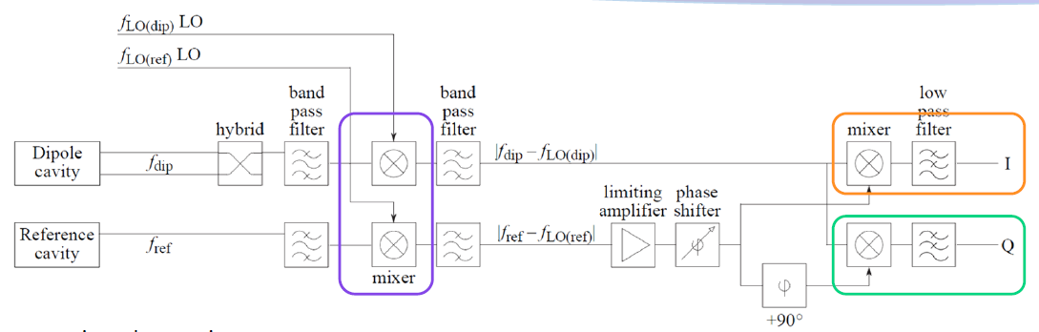
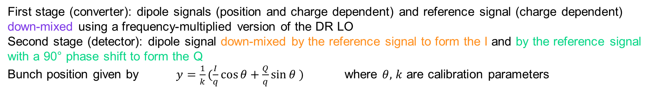
Cavity BPM signal processing
LO
First stage (converter): dipole signals (position and charge dependent) and reference signal (charge dependent) down-mixed using a frequency-multiplied version of the DR LO
Second stage (detector): dipole signal down-mixed by the reference signal to form the I and by the reference signal with a 90° phase shift to form the Q
Bunch position given by $y=\frac{1}{k}(\frac{I}{q}\cos{θ}+\frac{Q}{q}\sin{θ} )$ where $θ,$ $k$ are calibration parameters
Slide by R. Ramjiawan

Slide 7
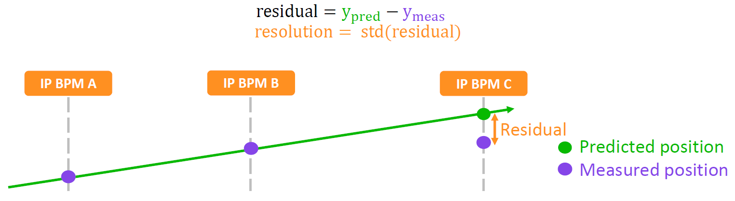
Highest resolution achieved
Recent focus has been on improving the usable resolution of the system that applies to real-time position measurements used for feedback.
Higher resolution can be achieved in off-line analysis by fitting bunch position as a function of additional parameters.
Resolution | IPA (nm) | IPB (nm) | IPC (nm) | Justification
Geometric | 20.6 ± 1.0 | 20.6 ± 1.0 | 20.6 ± 1.0 | -
Fit to position (fit for k) | 20.4 ± 1.0 | 20.5 ± 0.8 | 20.3 ± 0.8 | Fit out error in k
Fit to position and charge | 19.9 ± 0.9 | 19.9 ± 0.8 | 19.7 ± 0.9 | Fit out error in k and position-charge correlation
Fit for k and theta (fit to I and Q) | 20.3 ± 1.0 | 20.3 ± 0.8 | 20.2 ± 0.9 | Fit out error in k and theta.
Fit for k and theta and to charge | 19.6 ± 0.9 | 19.6 ± 0.8 | 19.6 ± 0.8 | Fit out error in k and theta, and position-charge correlation.
Fit for k, theta, charge and self Q’ | 19.5 ± 0.9 | 19.6 ± 0.8 | 19.2 ± 0.8 | Fit out all of the above and residual position information in Q’ / Q’ coupling in through phase jitter.
Slide by R. Ramjiawan

Slide 8
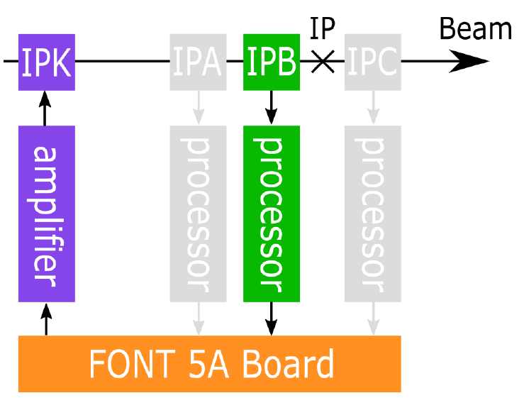
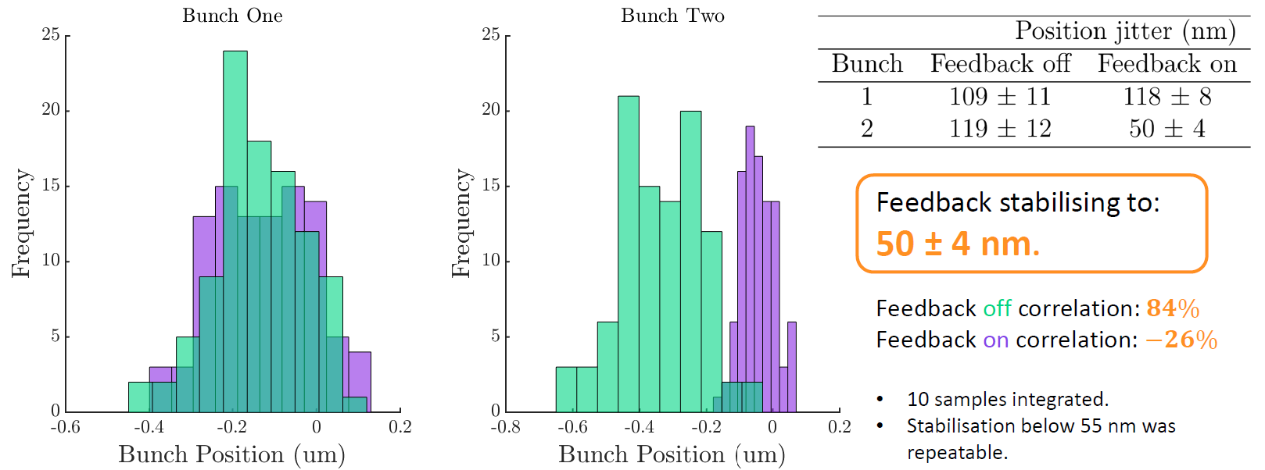
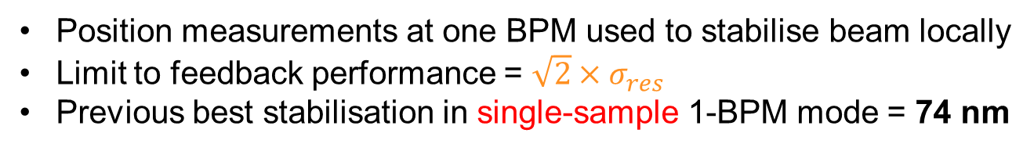
IP feedback: 1-BPM mode
Position measurements at one BPM used to stabilise beam locally
Limit to feedback performance = $\sqrt{2}×σ_{res}$
Previous best stabilisation in single-sample 1-BPM mode = 74 nm
Latest results using waveform integration
Slide by R. Ramjiawan

Slide 9
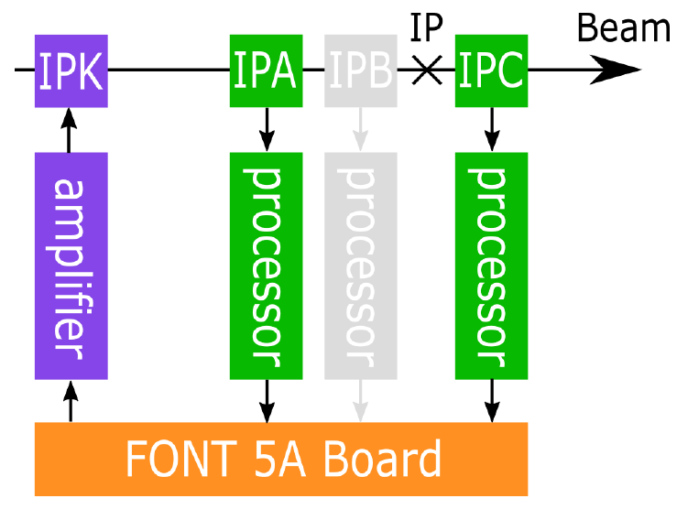
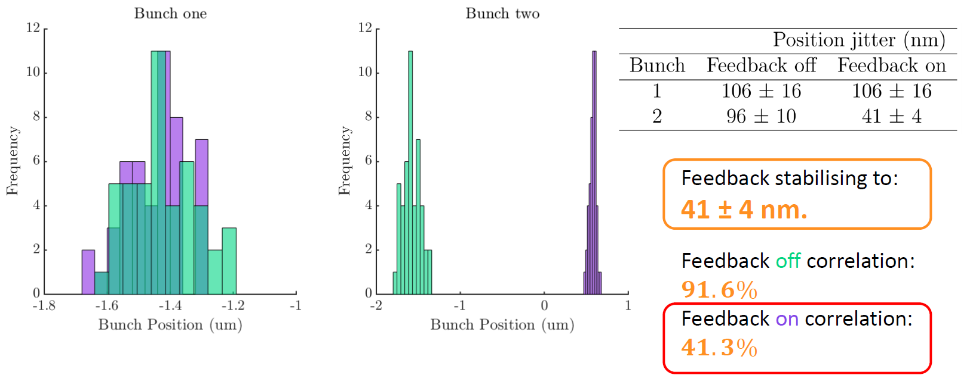
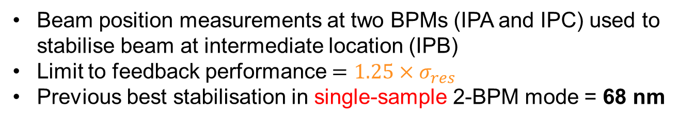
IP feedback: 2-BPM mode
Beam position measurements at two BPMs (IPA and IPC) used to stabilise beam at intermediate location (IPB)
Limit to feedback performance $=1.25×σ_{res}$
Previous best stabilisation in single-sample 2-BPM mode = 68 nm
Latest results using waveform integration
Slide by R. Ramjiawan

Slide 10
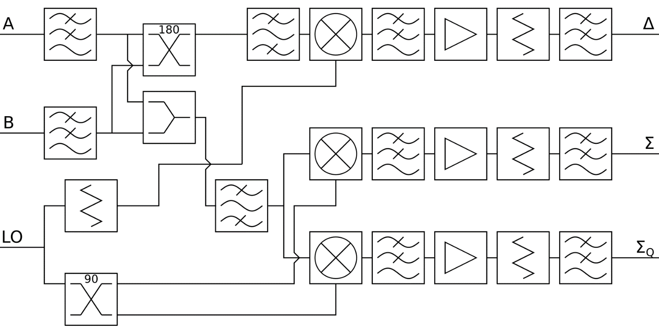
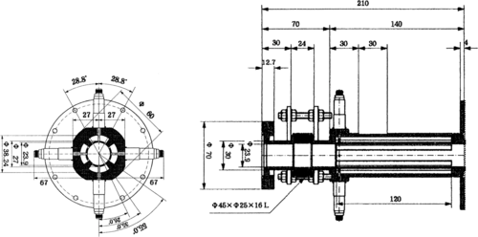
Upstream system: 2-BPM, 2-kicker
Beam
LPF
180° hybrid
BPF
mixer
K1
K2
P2
P3
processor
coupler
amplifier
processor
amplifier
FONT 5A Board
supplemental stage
FONT stripline BPM processors
FONT stripline BPMs

Slide 11
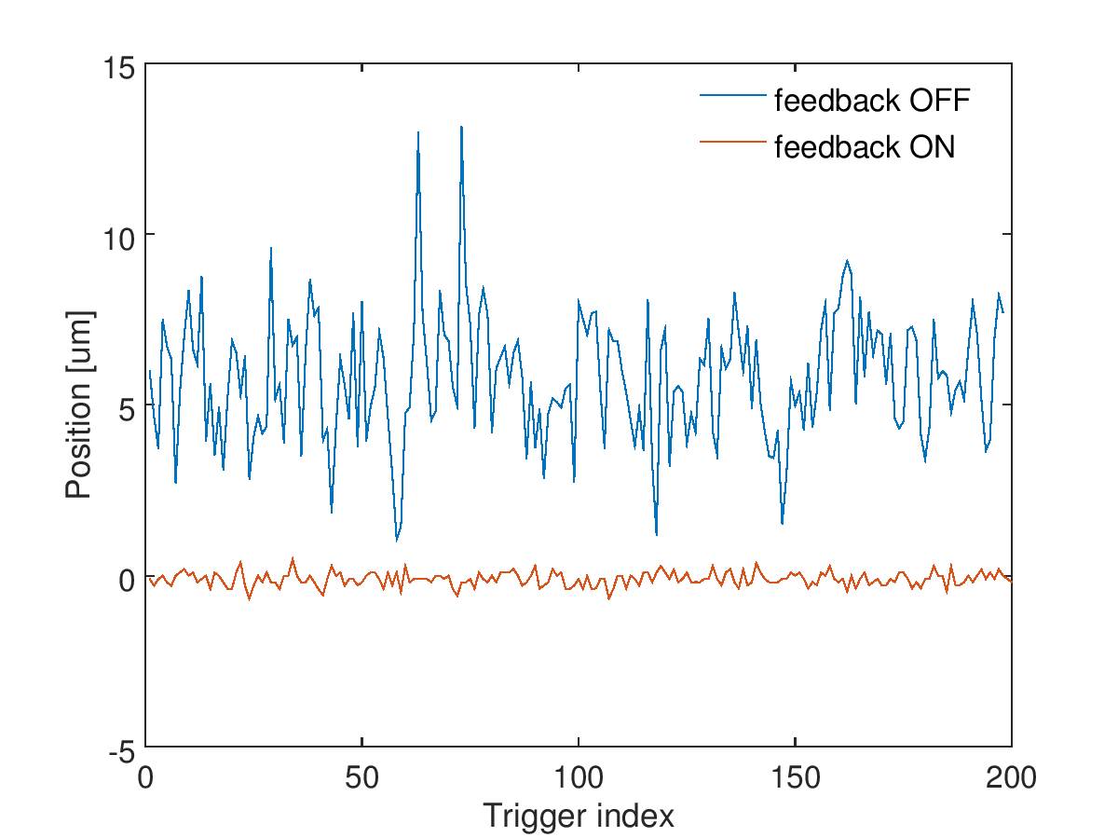
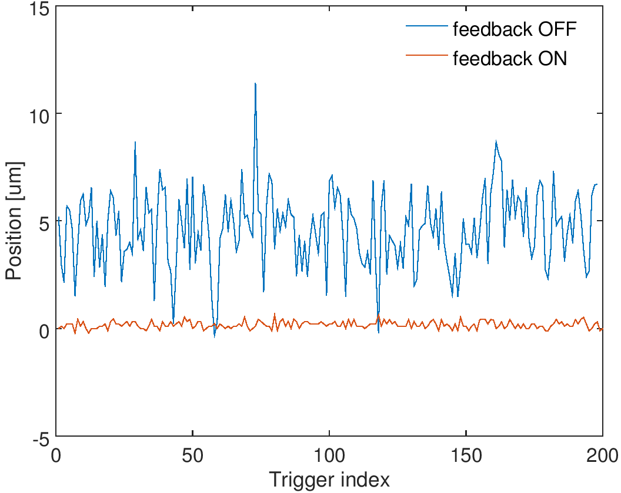
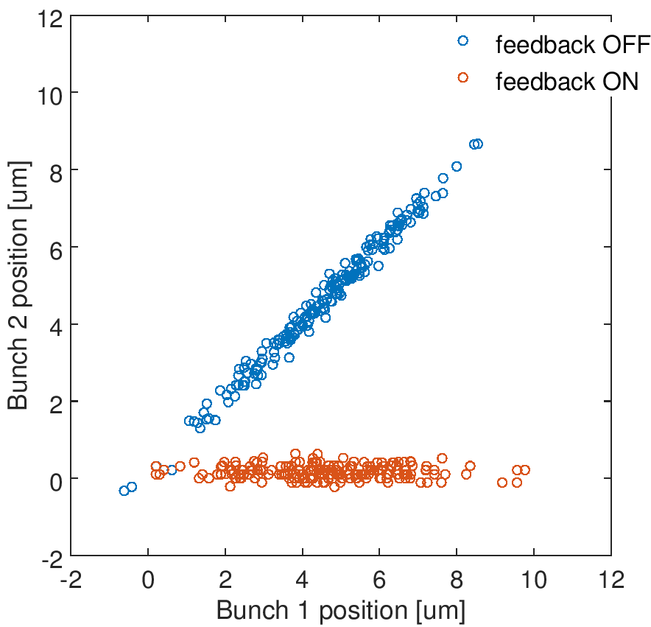
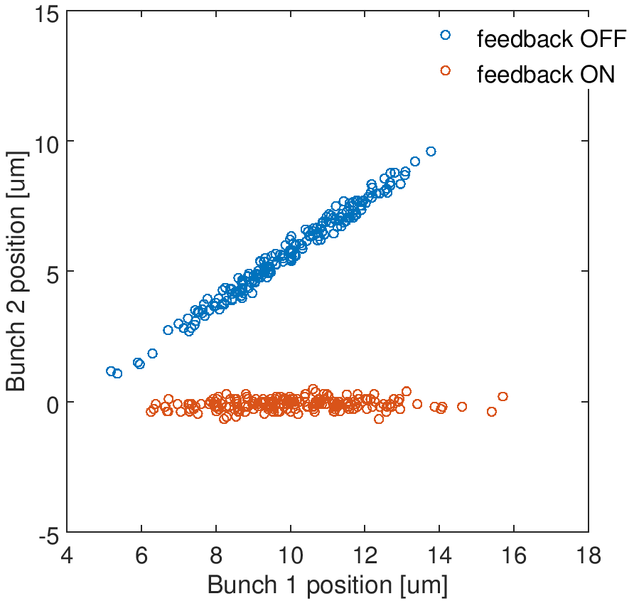
Upstream feedback results
Position jitter of bunch 2
1.78 μm (feedback off)
0.17 μm (feedback on)
Position jitter of bunch 2
1.85 μm (feedback off)
0.20 μm (feedback on)
P2
P3
Bunch-bunch correlation
0.994 (feedback off)
-0.035 (feedback on)
Reduction factor = 10.5
Bunch-bunch correlation
0.992 (feedback off)
0.163 (feedback on)
Reduction factor = 9.1

Slide 12
Diode processor
Motivation
The Compact Linear Collider (CLIC) will require a beam position feedback system at the interaction point (IP)
This will require a beam position monitor (BPM) with the following characteristics:
  Low latency, simple, reliable, rad-hard, tolerant of high magnetic field (no ferrites!)
These requirements are met by a stripline BPM used with the simplest possible processor:
a diode detector on each strip
Design
A prototype was constructed for testing at the KEK Accelerator Test Facility (ATF)
Processor designed to scale up in frequency
At CLIC processor outputs would be input to differential amplifiers
  FONT5 digitizer at ATF unable to handle pulses this narrow due to 357 MHz ADCs,
  so supplement diode processor with an additional stage to condition signals

Slide 13
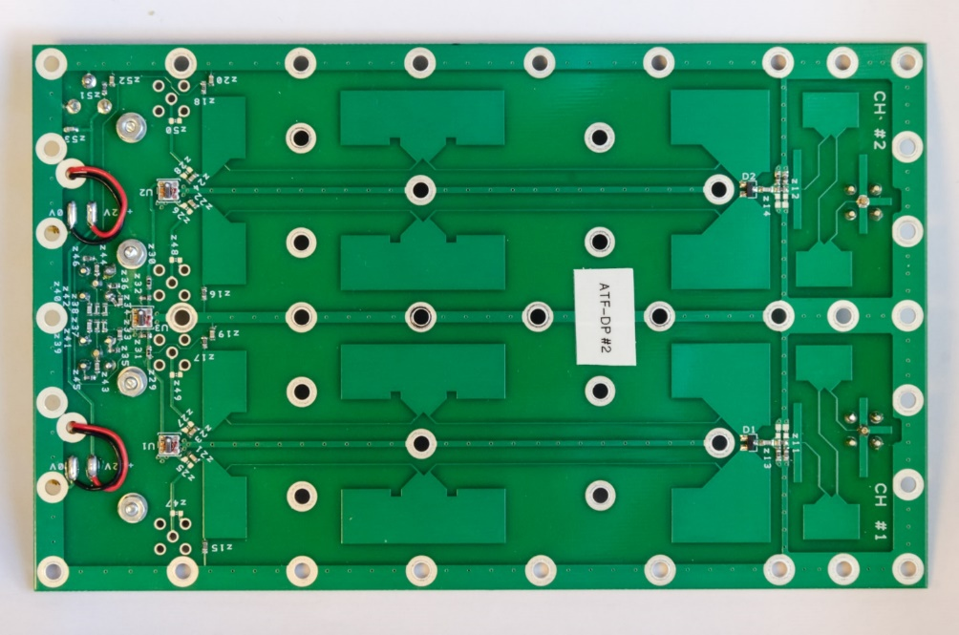
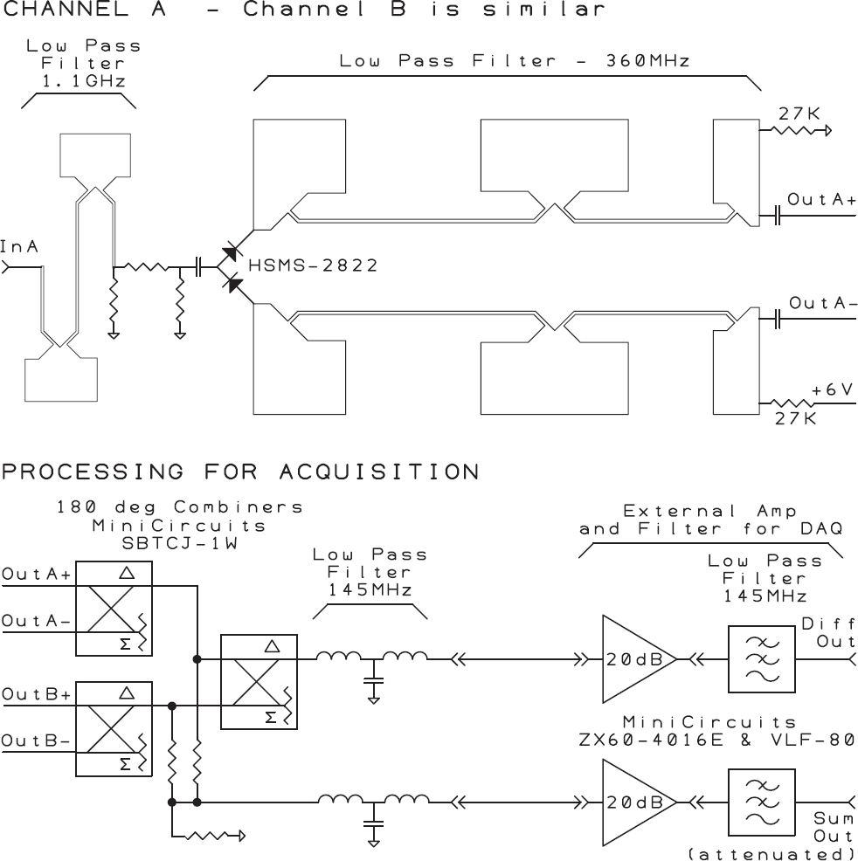
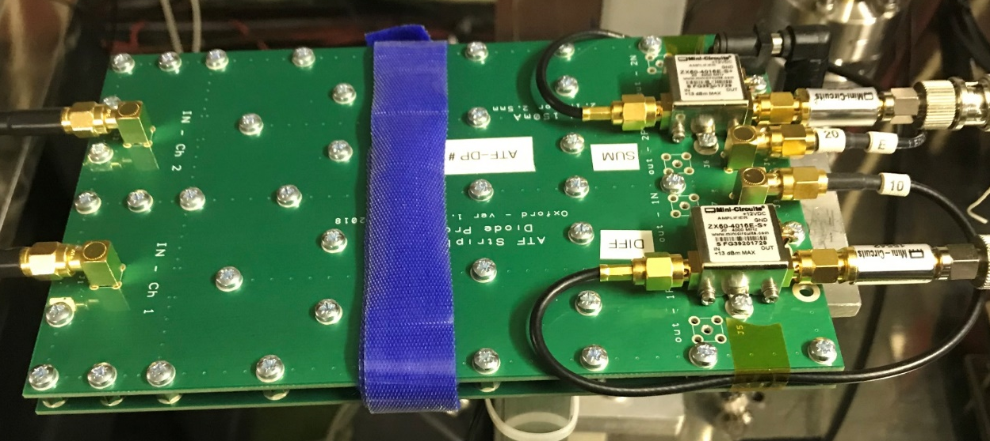
Diode processor schematic
diode detectors
(supplemental stage)

Slide 14
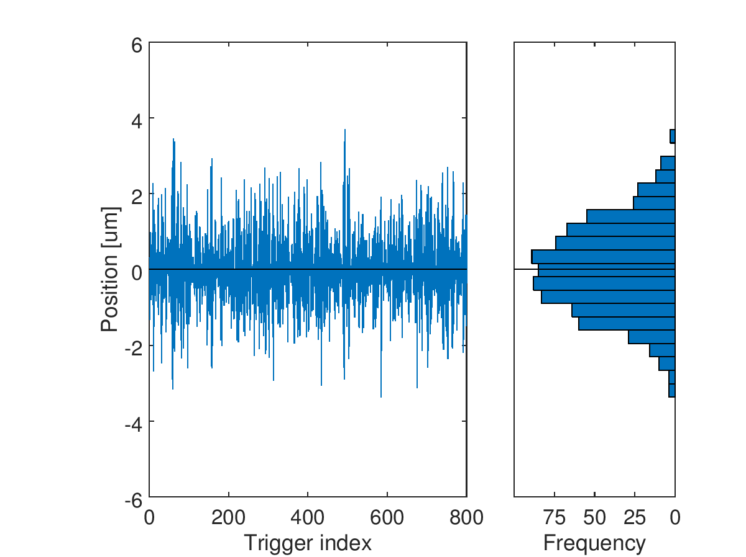
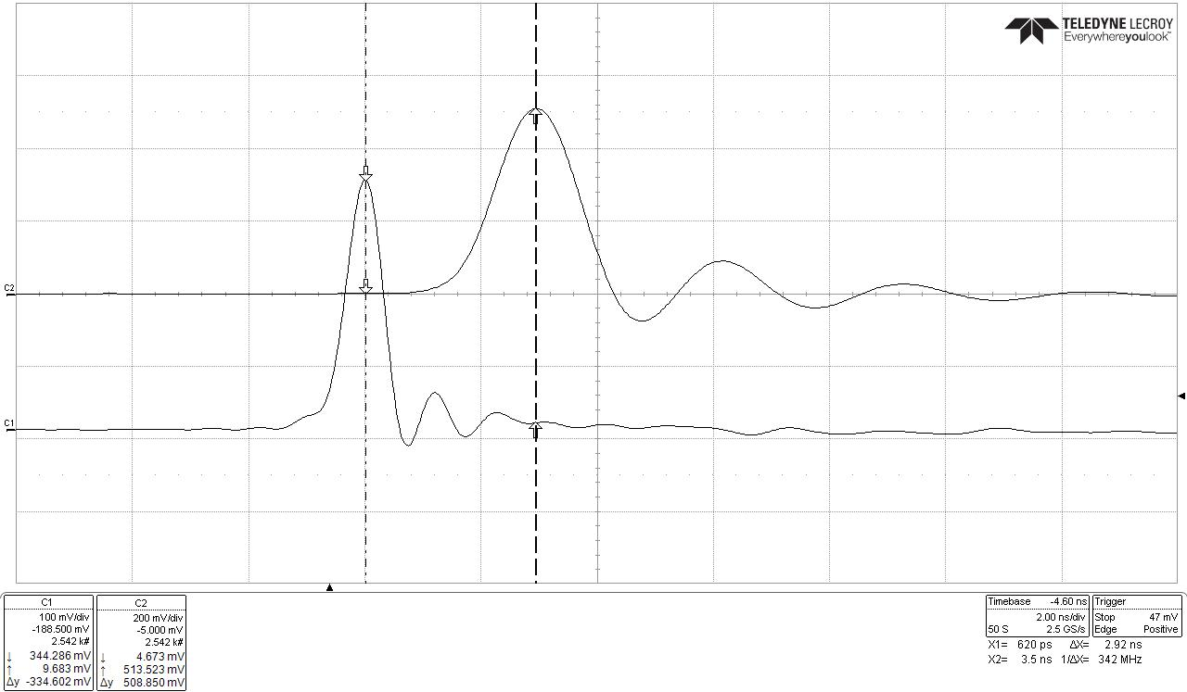
Diode processor performance
2 ns
Latency measured in lab:
Diode processor only: 2.9 ns
+ supplemental stage: 10.4 ns
Diode processor with supplemental stage instrumented on P1; conventional processors (resolution = 200 nm) on P2 and P3
Diode resolution estimate ~325 nm
2.9 ns would scale to ~1.0 ns for CLIC-optimized design

Slide 15
Summary
Best IPBPM resolution ever measured: ~20 nm
Best IP feedback performance:
  1-BPM mode
    Smallest jitter of corrected bunch (single-sample) = 74 nm
    Reduced to 50 nm by integrating 10 samples
  2-BPM mode
    Smallest jitter of corrected bunch (single-sample) = 68 nm
    Reduced to 41 nm by integrating 5 samples
Best upstream feedback performance: P2, P3 jitter of ~200 nm
Diode processor achieves ~ns latency and <1 μm resolution

