Slide 1
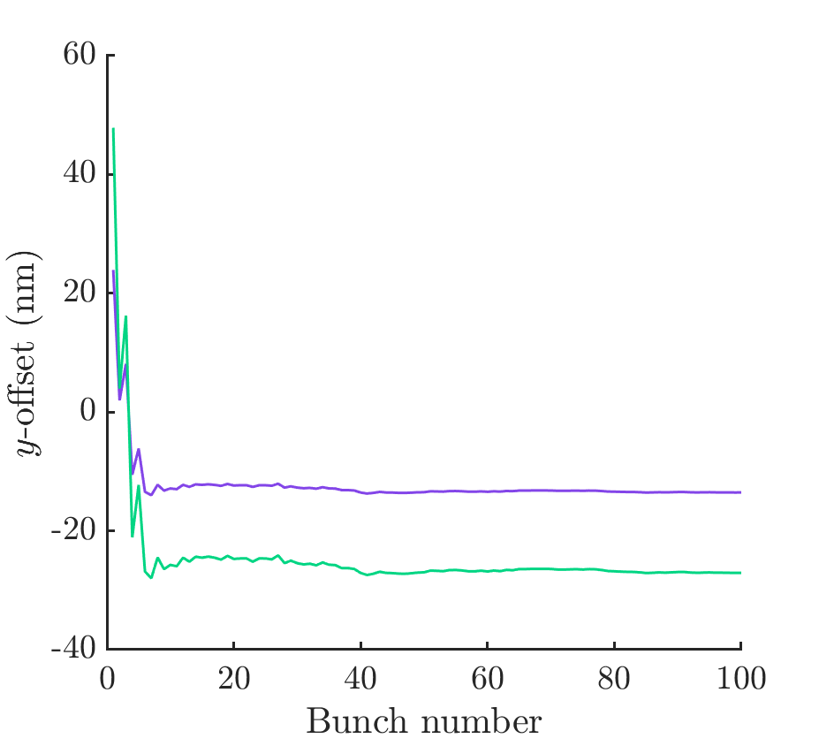
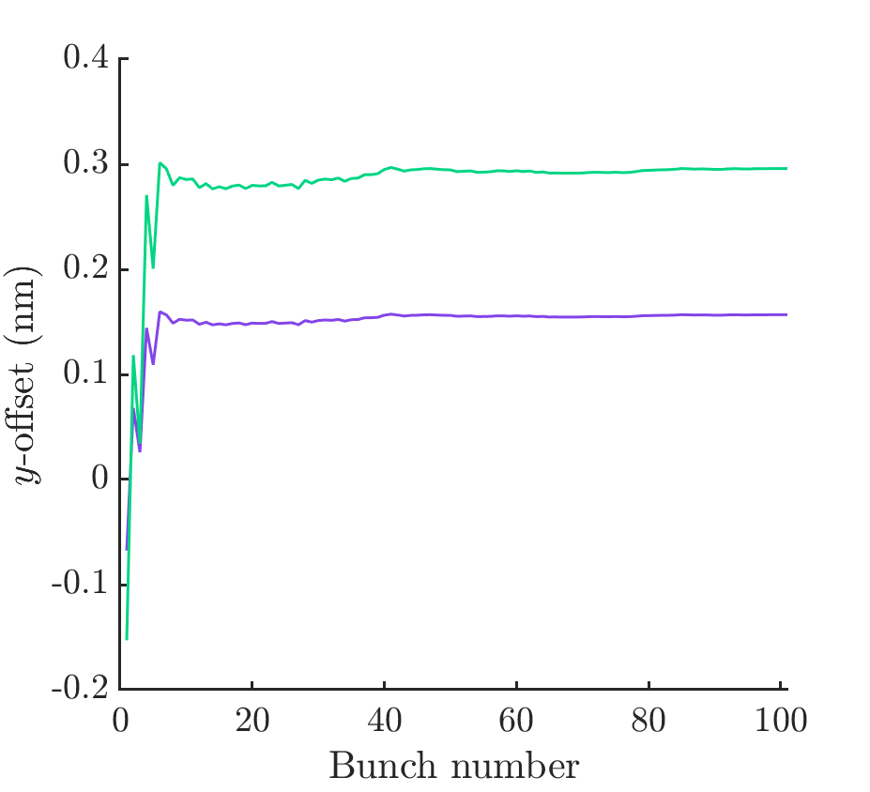
At the end of the ML
Green : 1um offset at start of ML
Purple: 2um offset at start of ML
At IP
Green : 1um offset at start of ML
Purple: 2um offset at start of ML

Slide 2
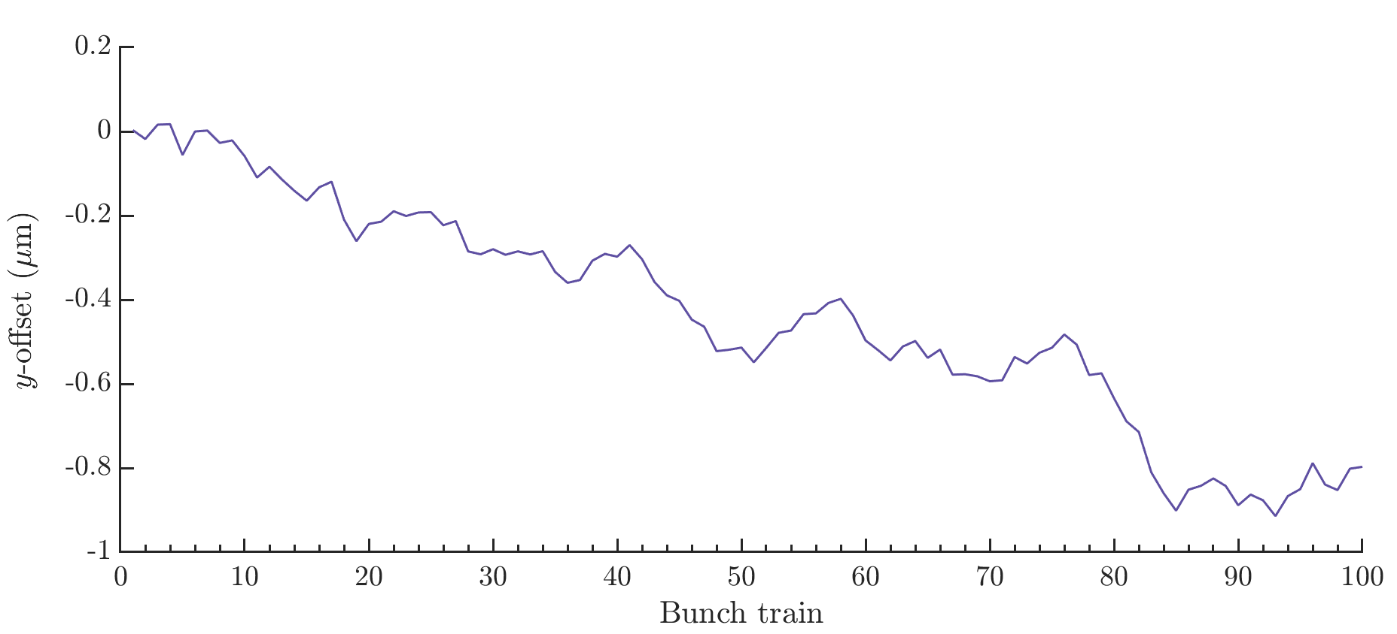
100 consecutive applications of ground motion model K (0.2s)

Slide 3
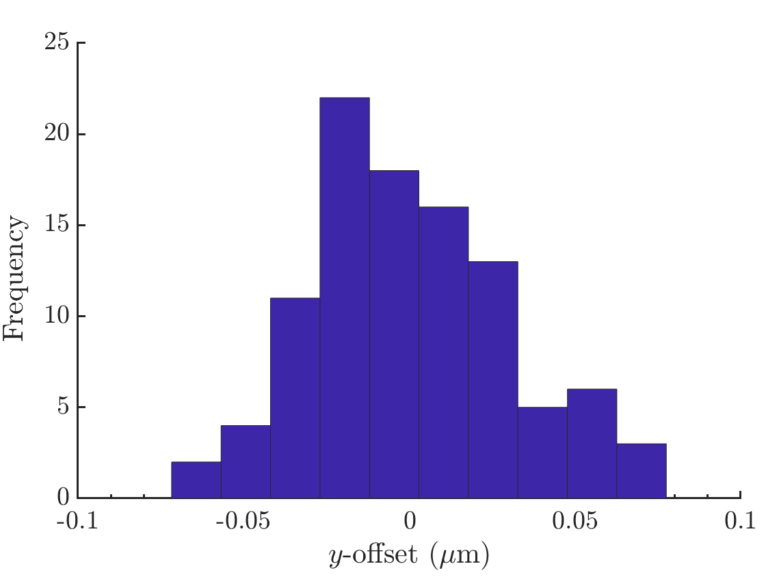
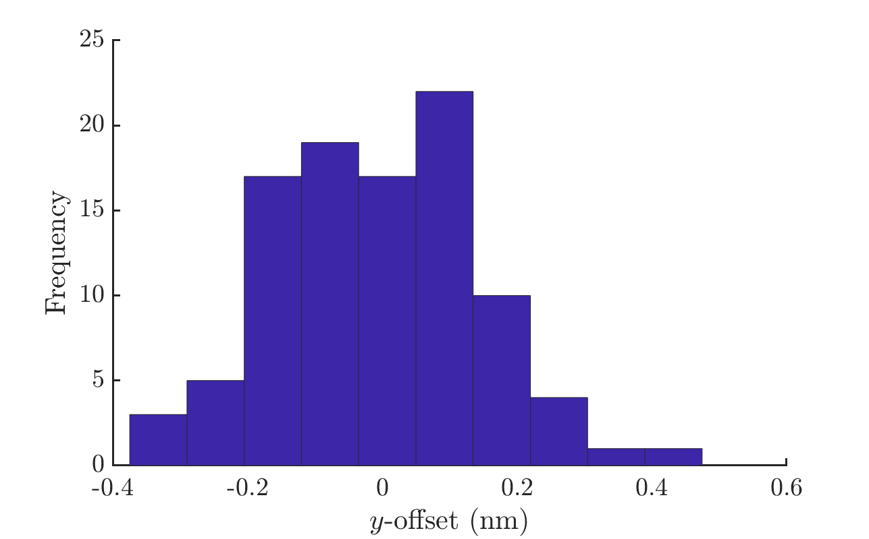
0.2 s of GM (K) measured at IP
0.2 s of GM (A) measured at IP
33 nm std of bunch positions
Reduces luminosity to 27% of nominal
Tried modelling one GM filter (gain 2) and this brings the lumi to 32% - requires optimisation.
0.15 nm std of bunch positions
Reduces luminosity to 99% of nominal

Slide 4
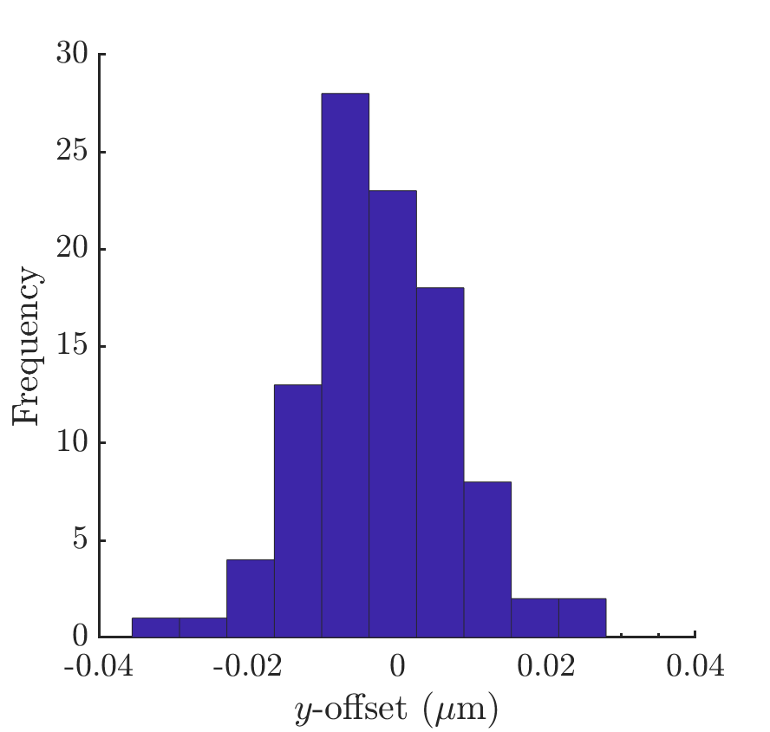
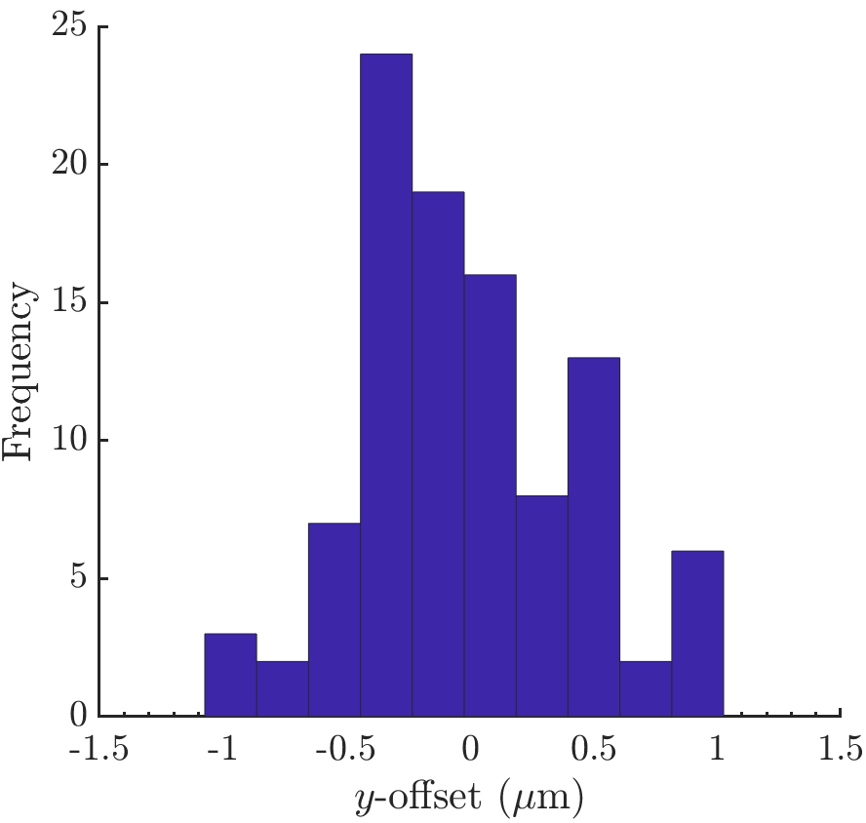
30 minutes GM (K) at end of ML
30 minutes GM (K) at IP

