Slide 1



The result of low energy beam data in
semi-digital hadron calorimeter
Bing Liu, Imad Laktineh, Haijun Yang
Oct 2, 2019

Slide 2
Outline
Introduction to low energy beam data
Event selection
    Muon rejection
    Electron background check & rejection
resolution
Conclusion

Slide 3
Low energy beam data analysis
Data samples were taken at PS, May 2015
Energy : 3, 4, 5, 6, 7, 8, 9, 10, 11
Contamination : muons , electrons(since using electron eliminator in test beam period, the electron contamination is negligible except 3-5GeV samples)
Simulation: FTF_BIC , geant4.9.6

Slide 4
Muon background rejection

Slide 5
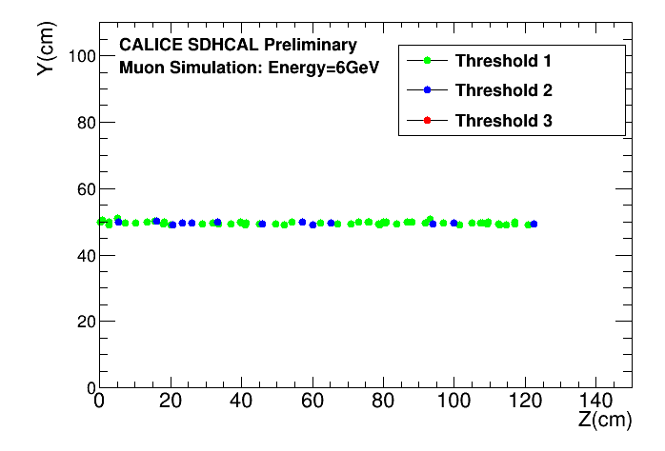
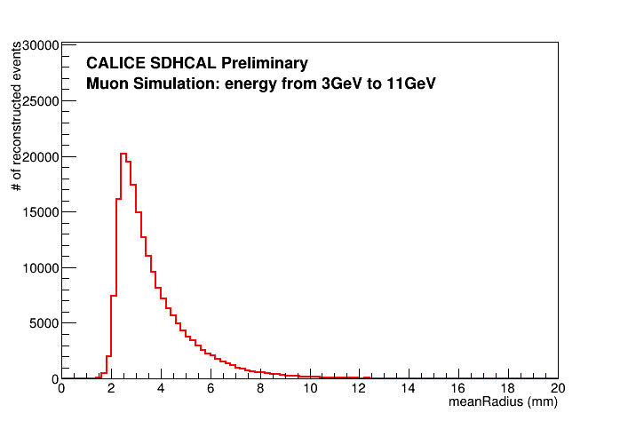
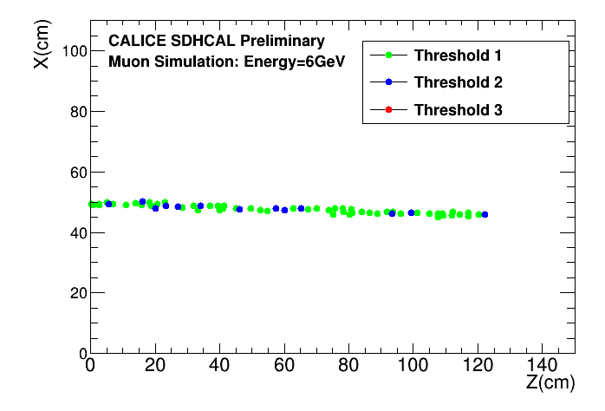
MeanRadius of muon track
The shower radius is very small < 15mm(≈1.5pad size)

Slide 6
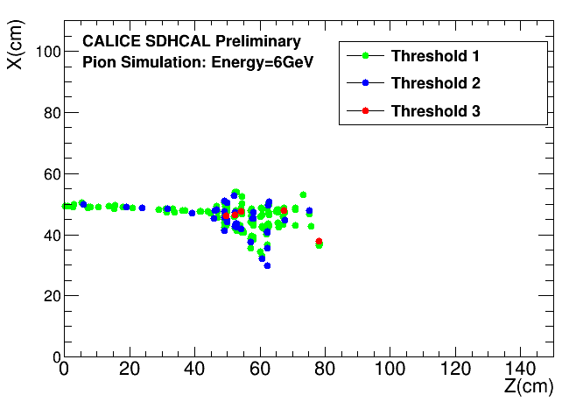
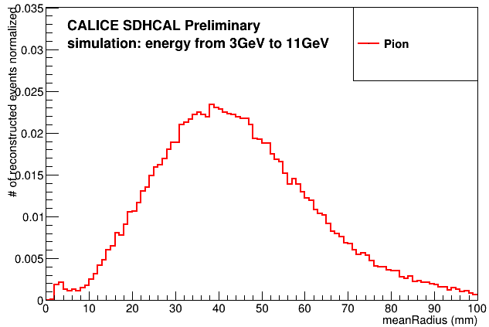
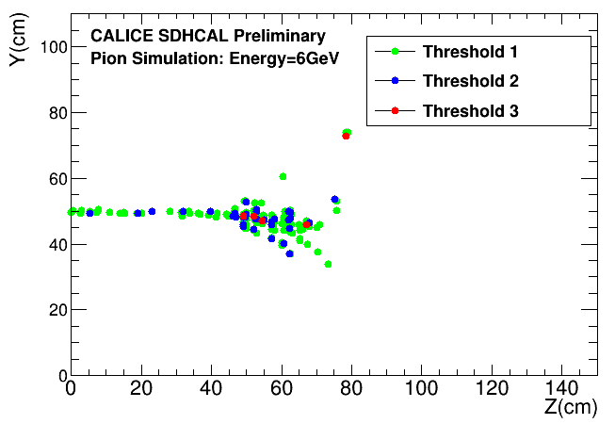
MeanRadius of pion shower
Larger shower radius than muon

Slide 7
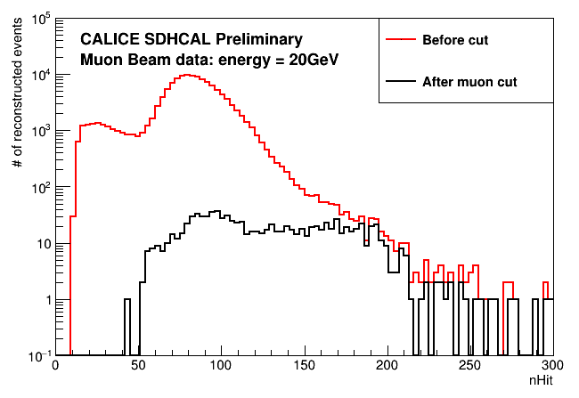
Event selection:muon rejection
MeanRadius > 15mm
Muon beam data validation
99% background rejection rate achieved

Slide 8
Electron background
Method: BDT
Training set:
  Electron 1-12GeV, 10000 events per GeV
  Pion 1-12GeV, 10000 events per GeV
Test set: the same size
Input variables:nTrack, nCluster, radius, nHit/nLayer, density,
nHit3/nLayer, nShower layer/nLayer, nHough/nHit

Slide 9
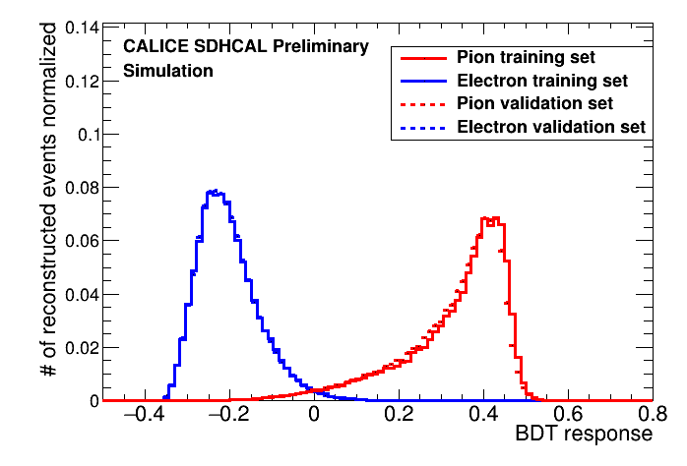
Model Performance
The model is reliable

Slide 10
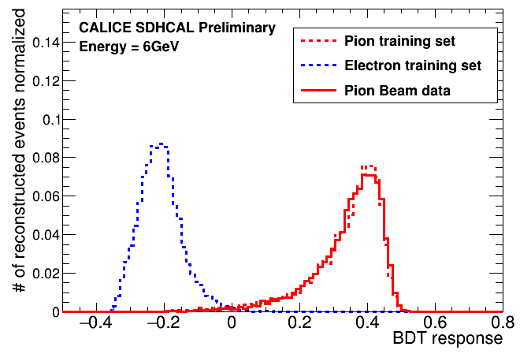
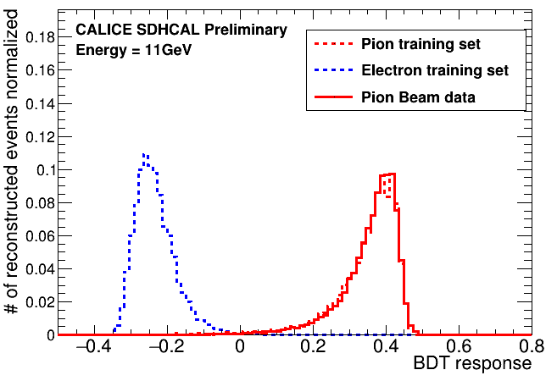
Pion beam validation for 6-11GeV
We know there is no electron for 6-11GeV pion beam. These two results confirm it.
The model reliable.

Slide 11
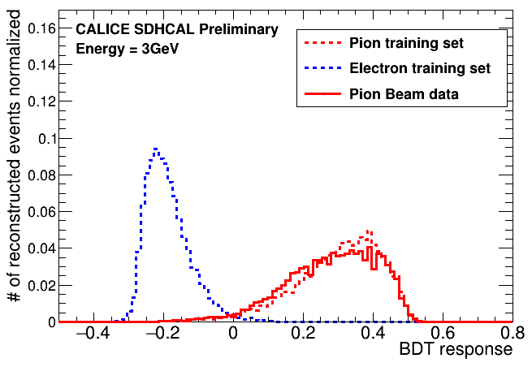
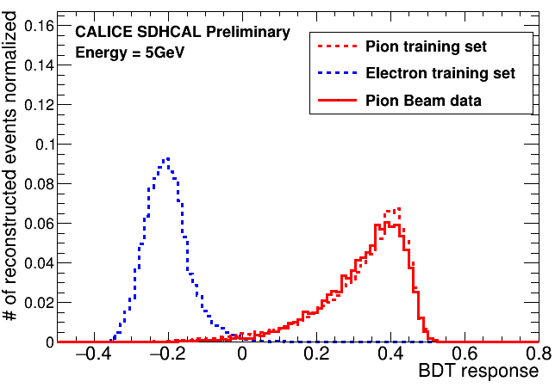
Electron check for pion beam 3-5GeV
The electron contamination is negligible. Applying BDT value cut > 0.0 is enough to reject electron-like events

Slide 12
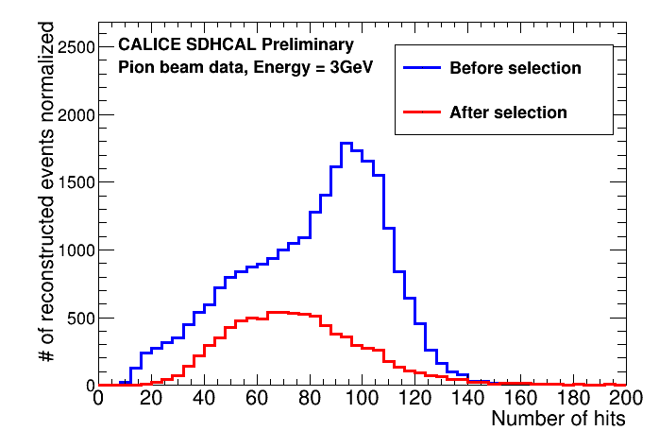
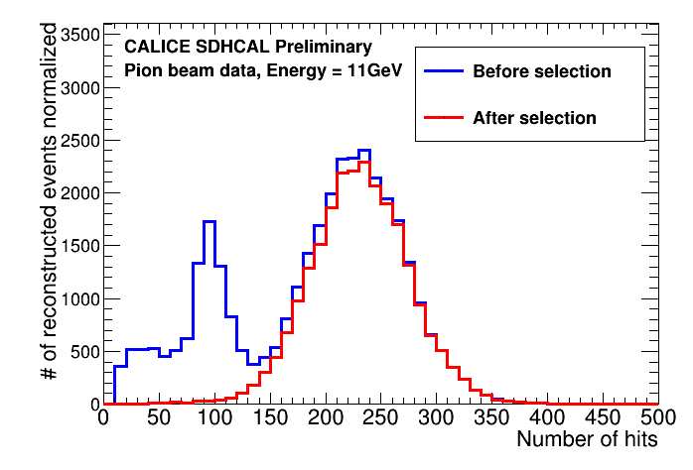
Apply the muon rejection and electron rejection
The number of hits before and after selection

Slide 13
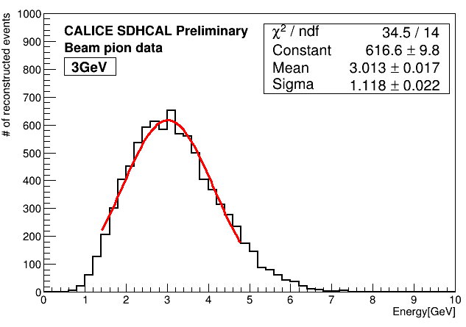
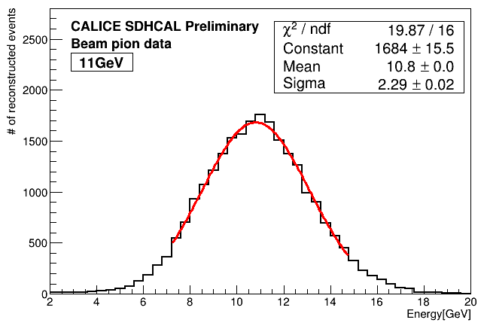
Energy reconstruction
Fitting range 1.65σ
Fitting range 1.65σ

Slide 14
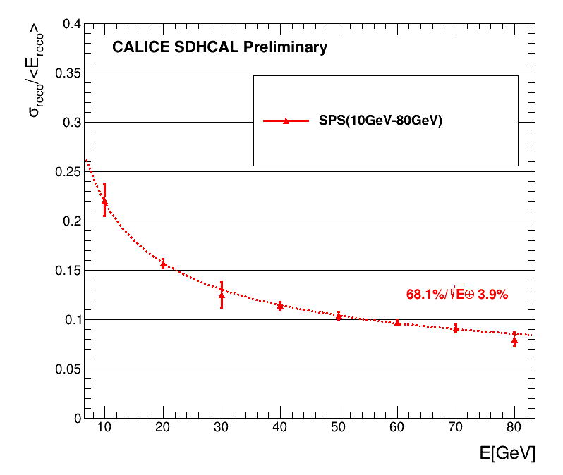
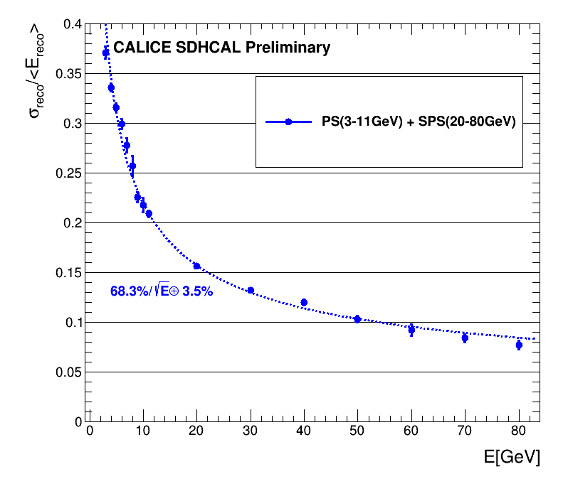
resolution
Good agreement with SPS data taken at 2015 October

Slide 15
Conclusions & Next
The cut based on MeanRadius can easily remove the muon background
The BDT model is robust and it can separate electron and pion of low energy beam data
The resolution of low energy beam data has a good agreement with SPS data.
Continue to write the analysis note

