Slide 1
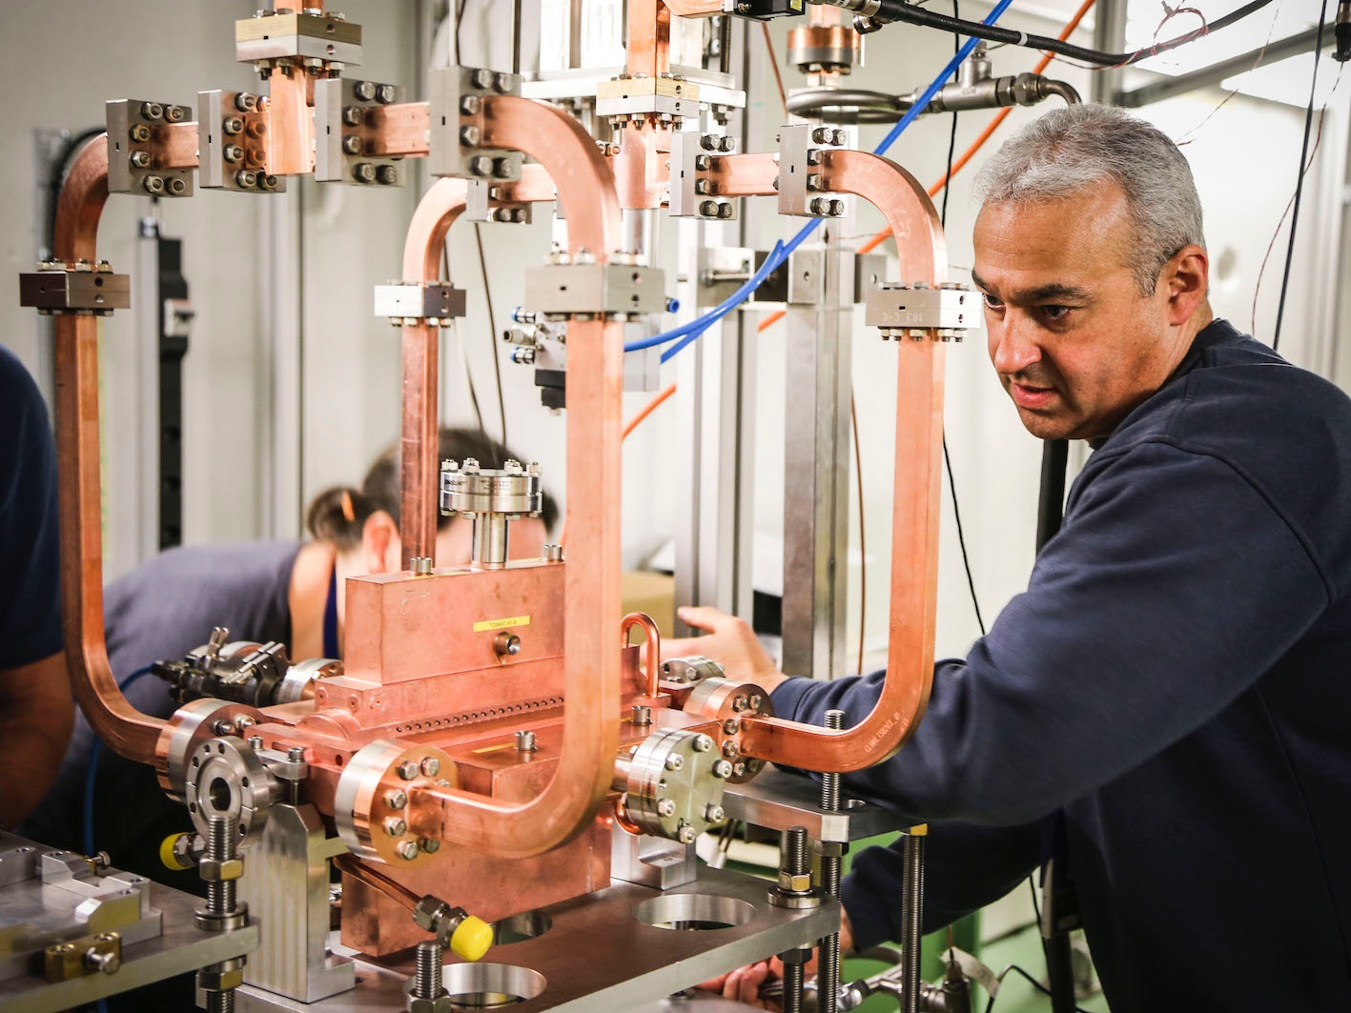
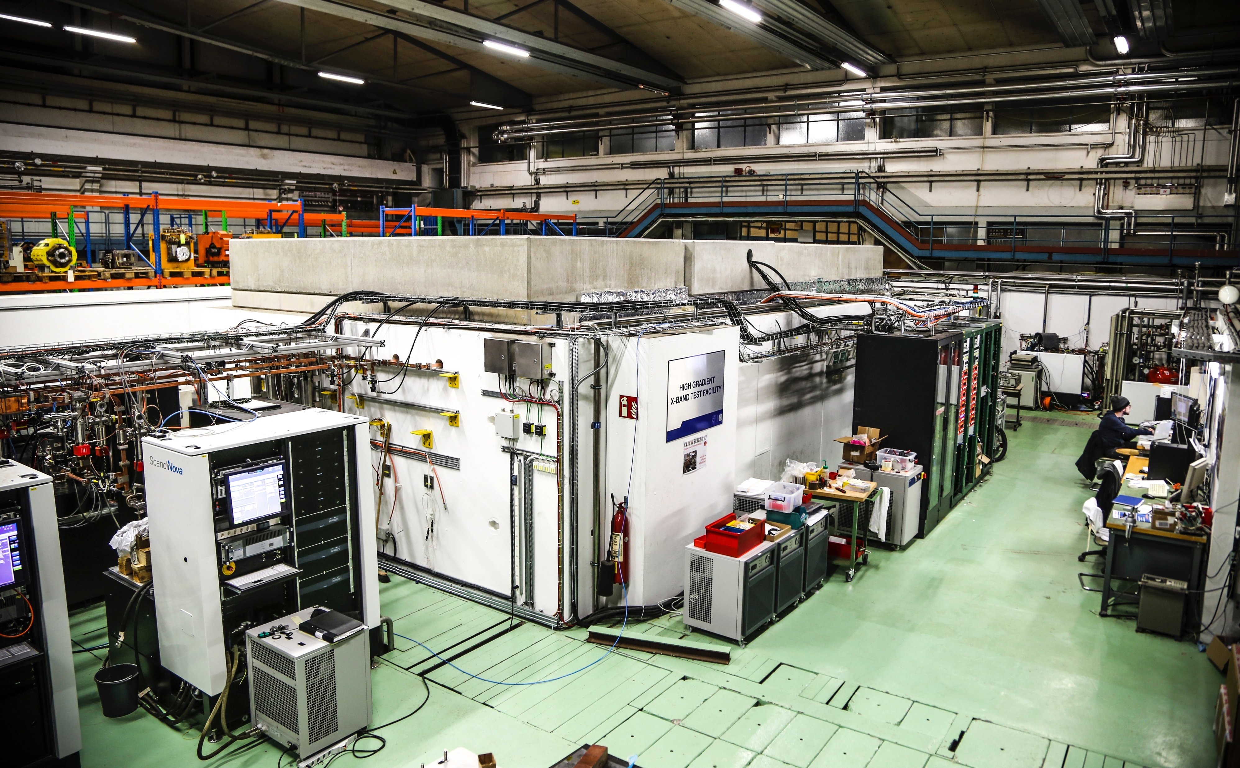
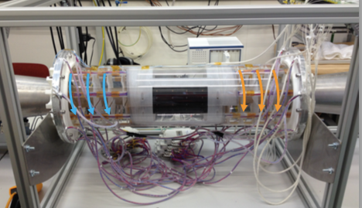
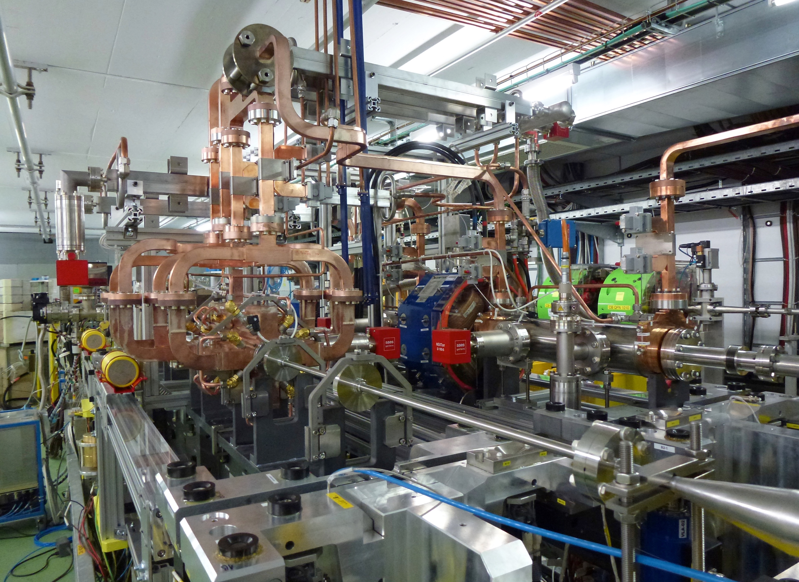
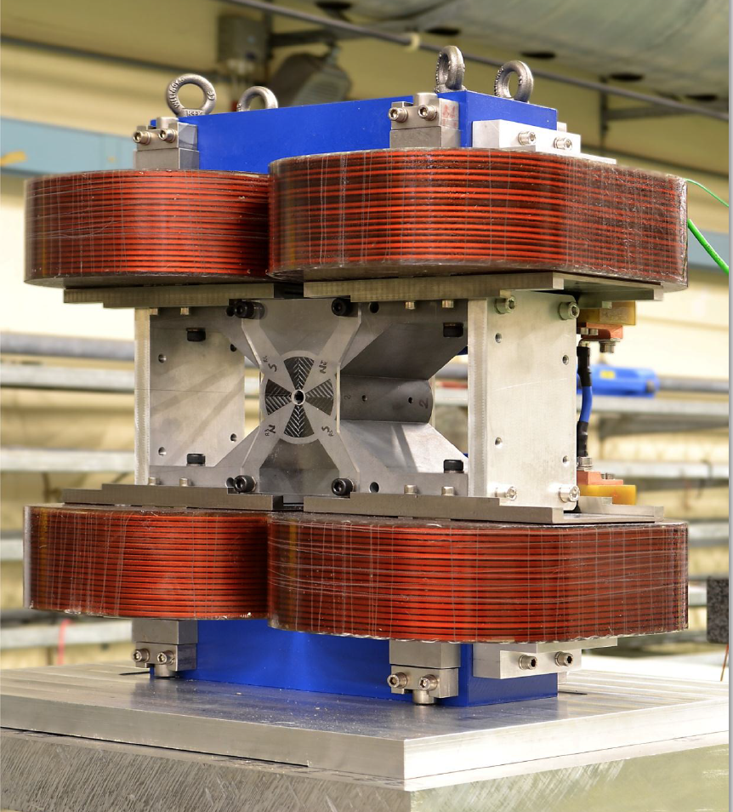
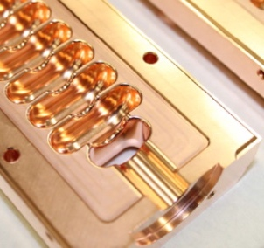
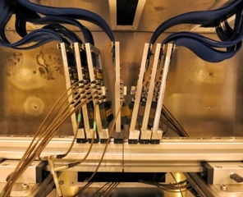
CLIC – next steps
Steinar Stapnes, CERN
Outline:
The input to the European Strategy process
Additional studies responding to questions raised in this process
Next phase and an overall strategy for a LC

Slide 2
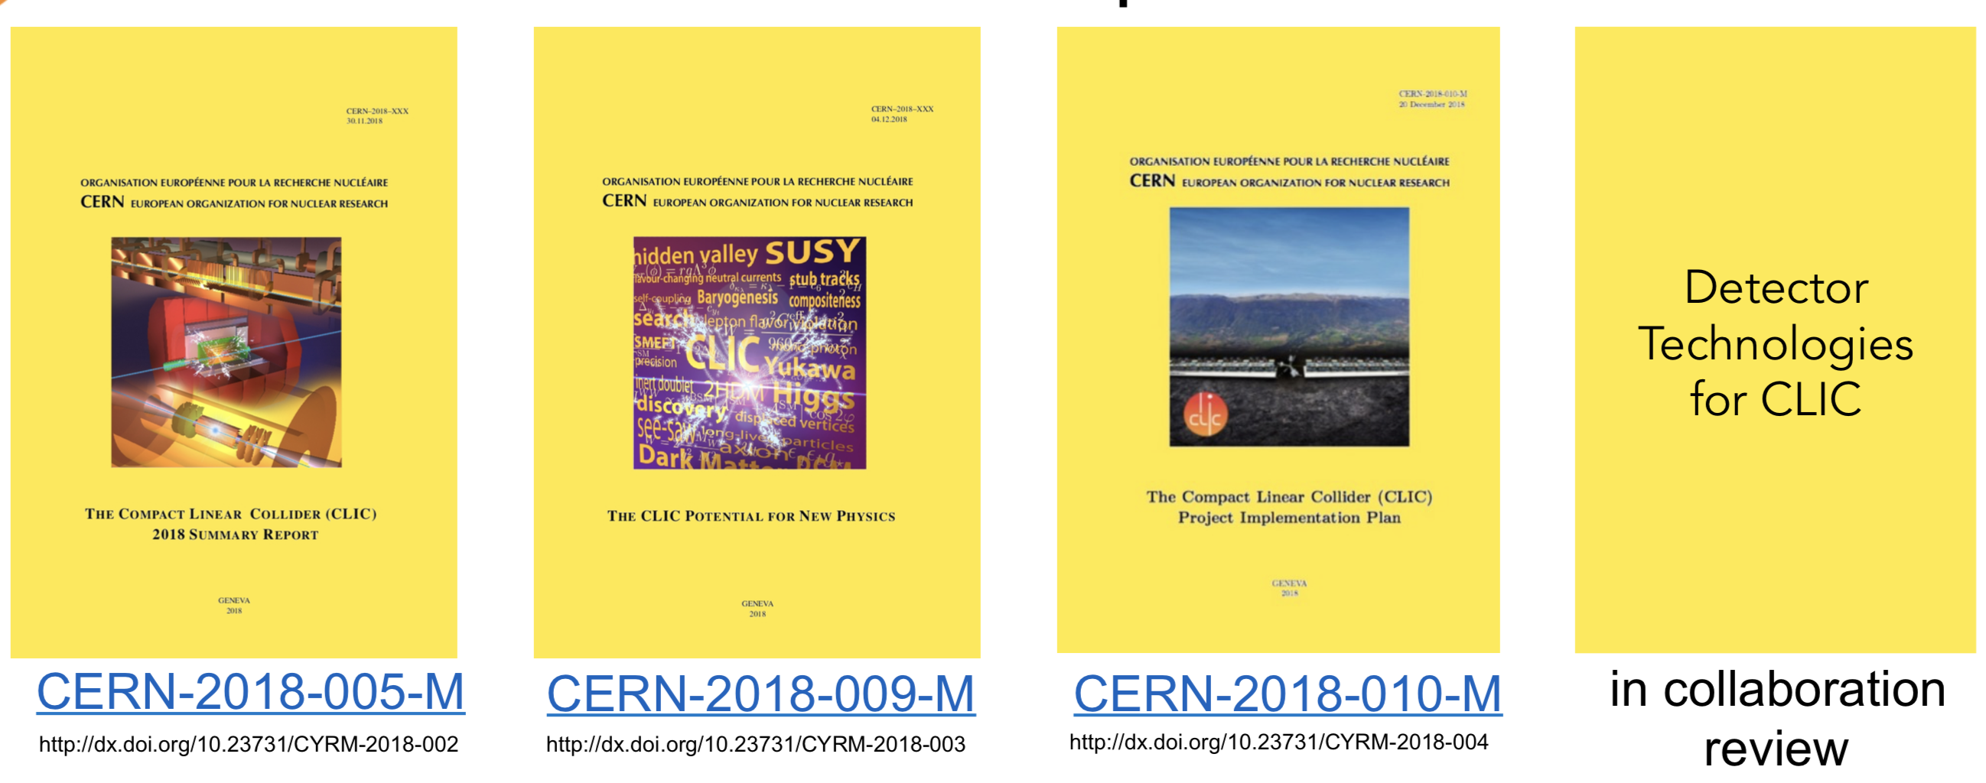
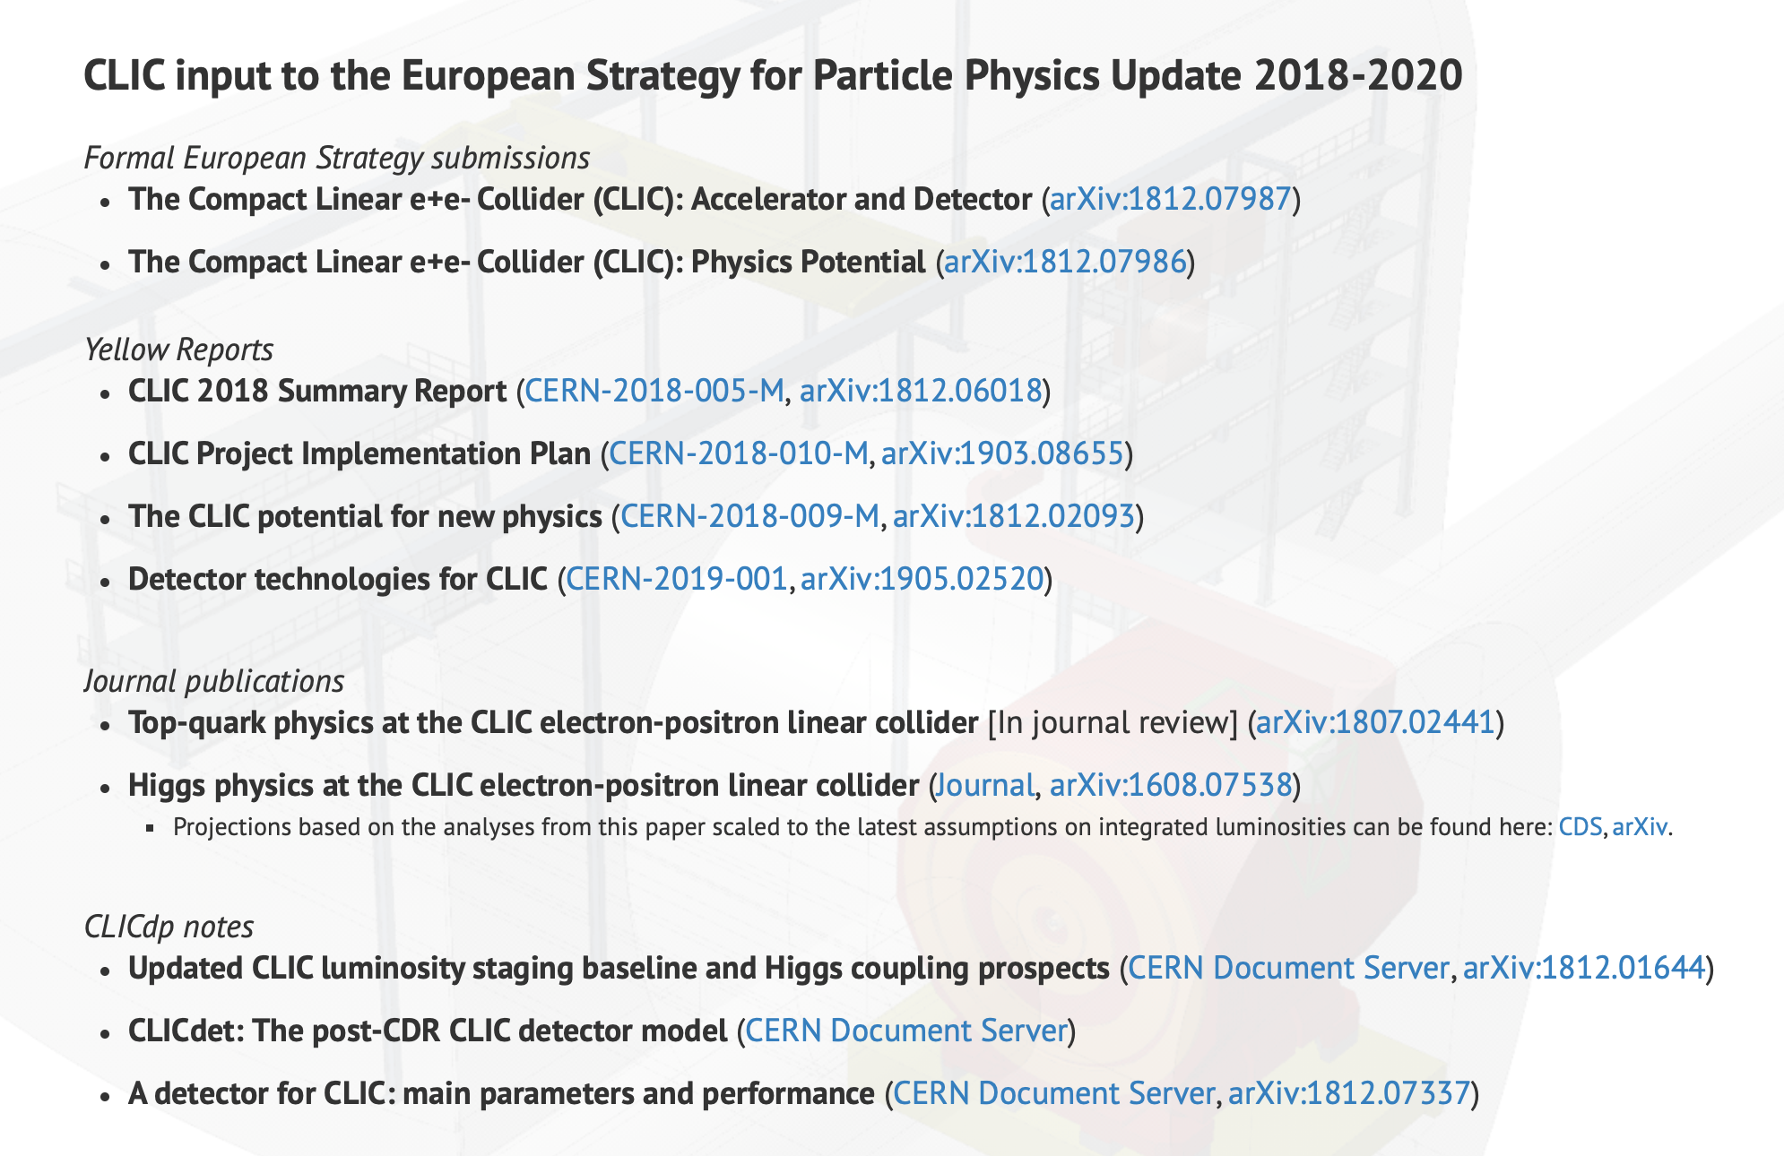
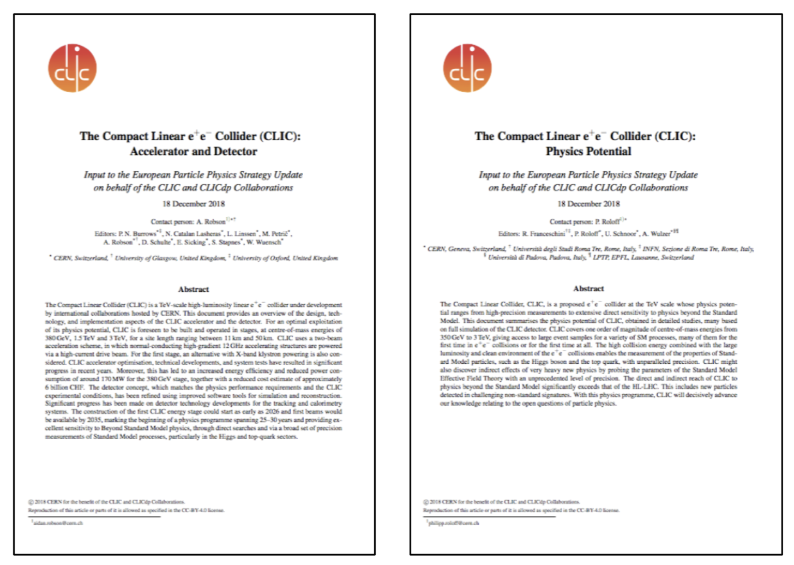
CLIC European Strategy Input
CERN-2019-001
http://dx.doi.org/10.23731/CYRM-2019-001
Link: http://clic.cern/european-strategy

Slide 3
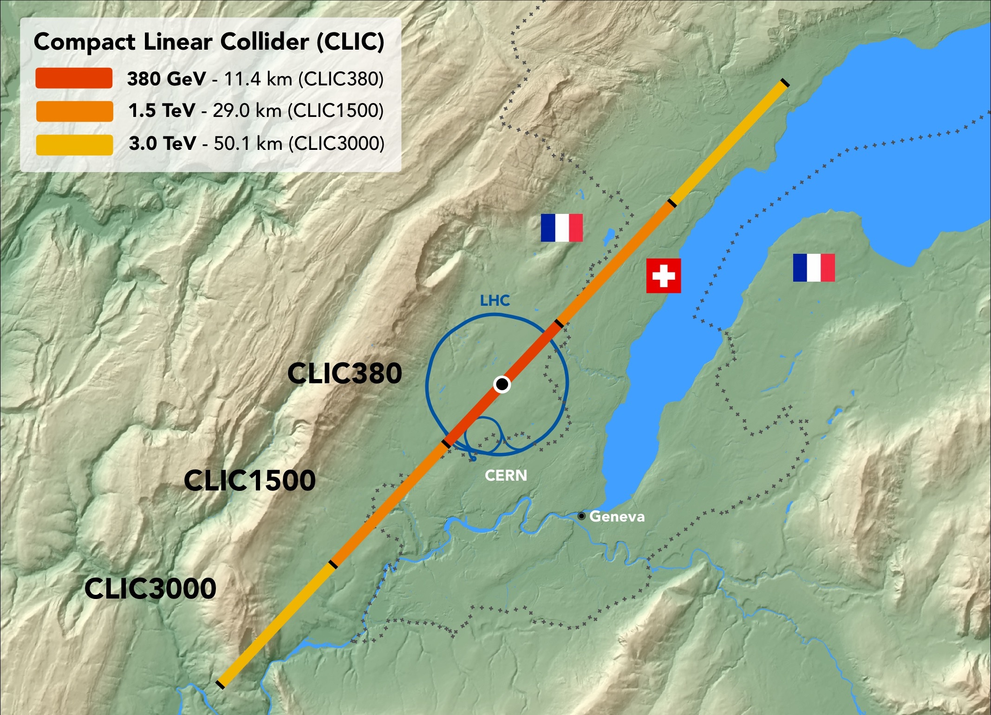
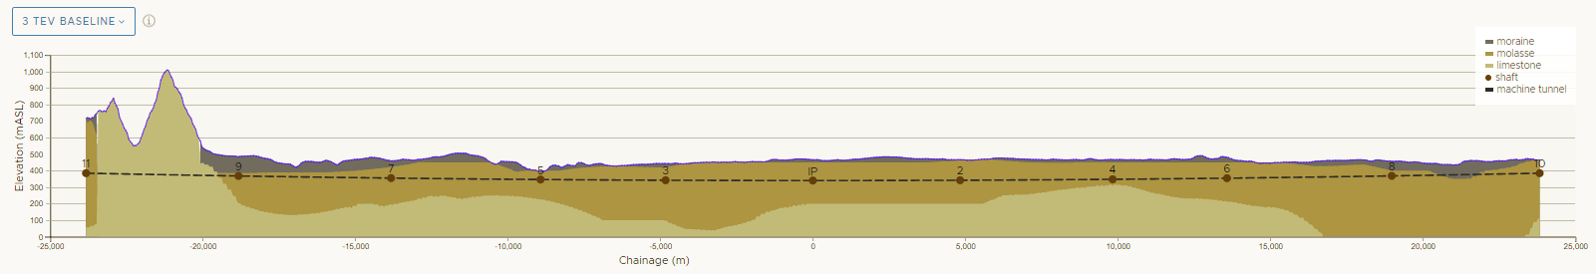
CLIC

Slide 4
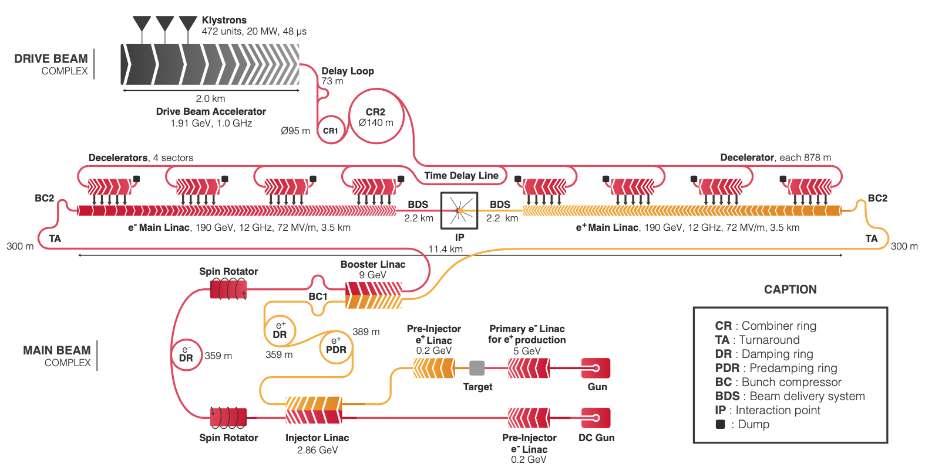
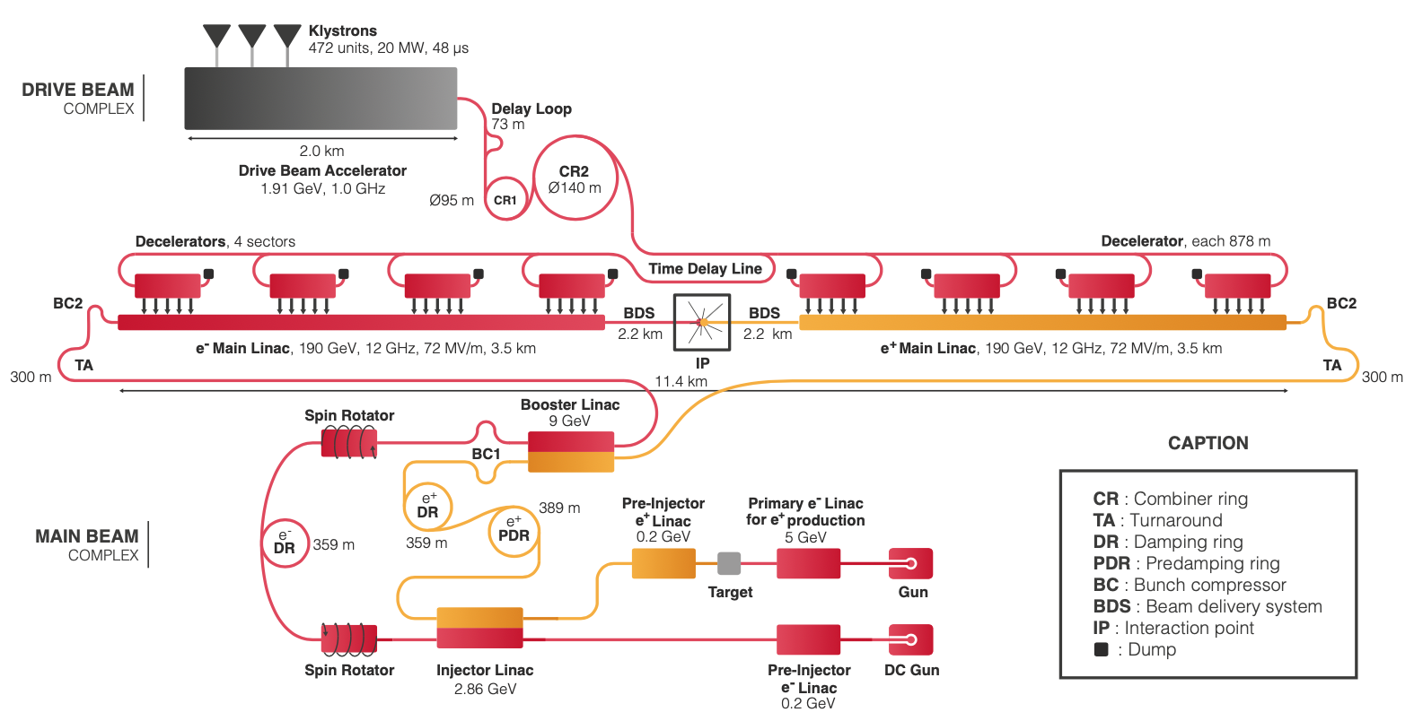
CLIC 380 GeV layout and power generation
Baseline electron polarisation ±80%

Slide 5
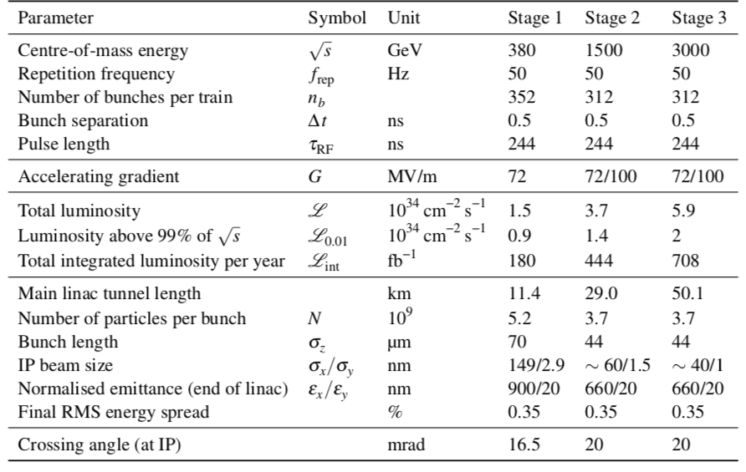
CLIC parameters

Slide 6
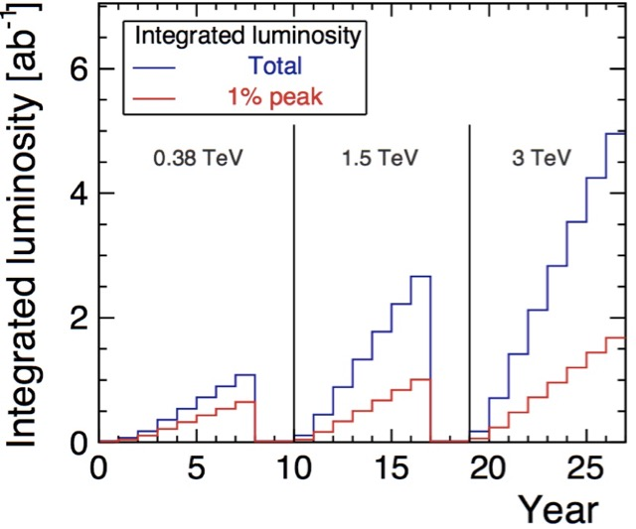
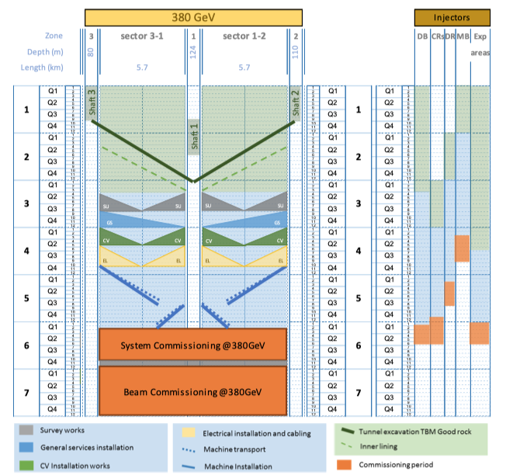
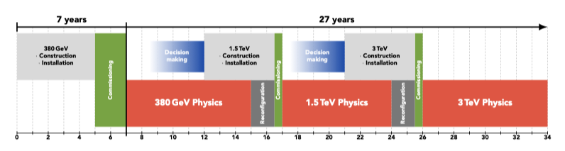
Schedule
Updated schedule:
Construction + commissioning for 380 GeV: 7 yr
Full physics programme 27 yr

Slide 7
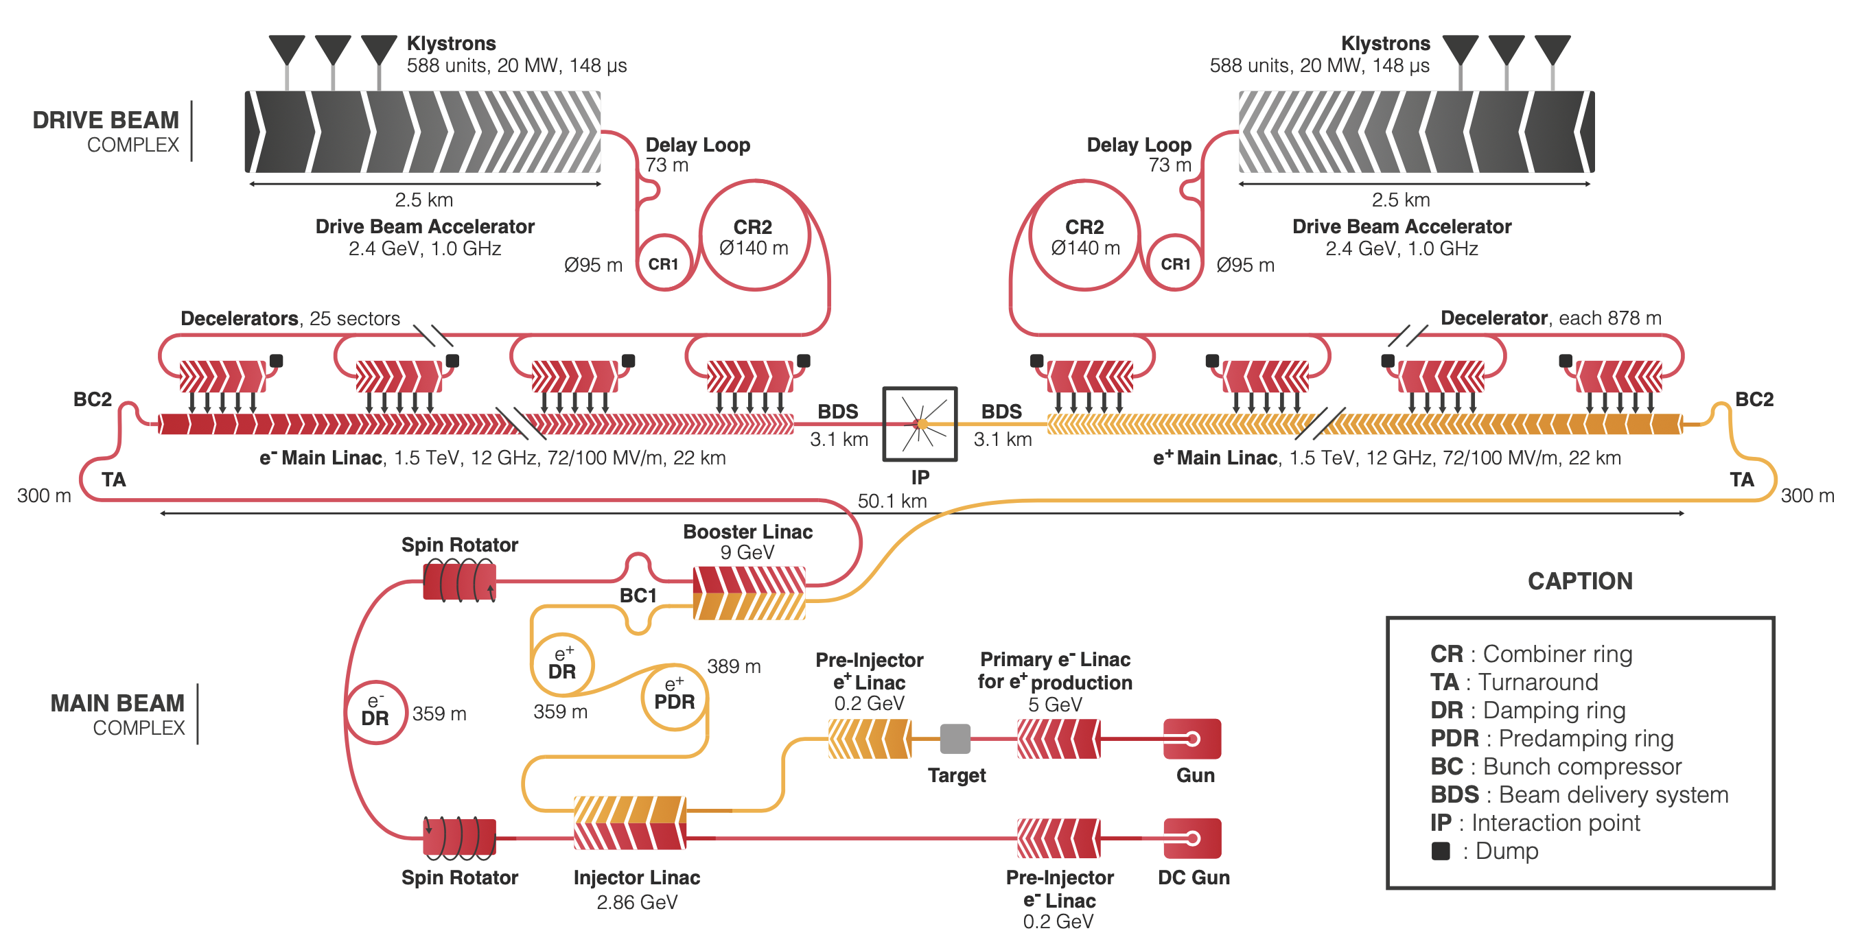
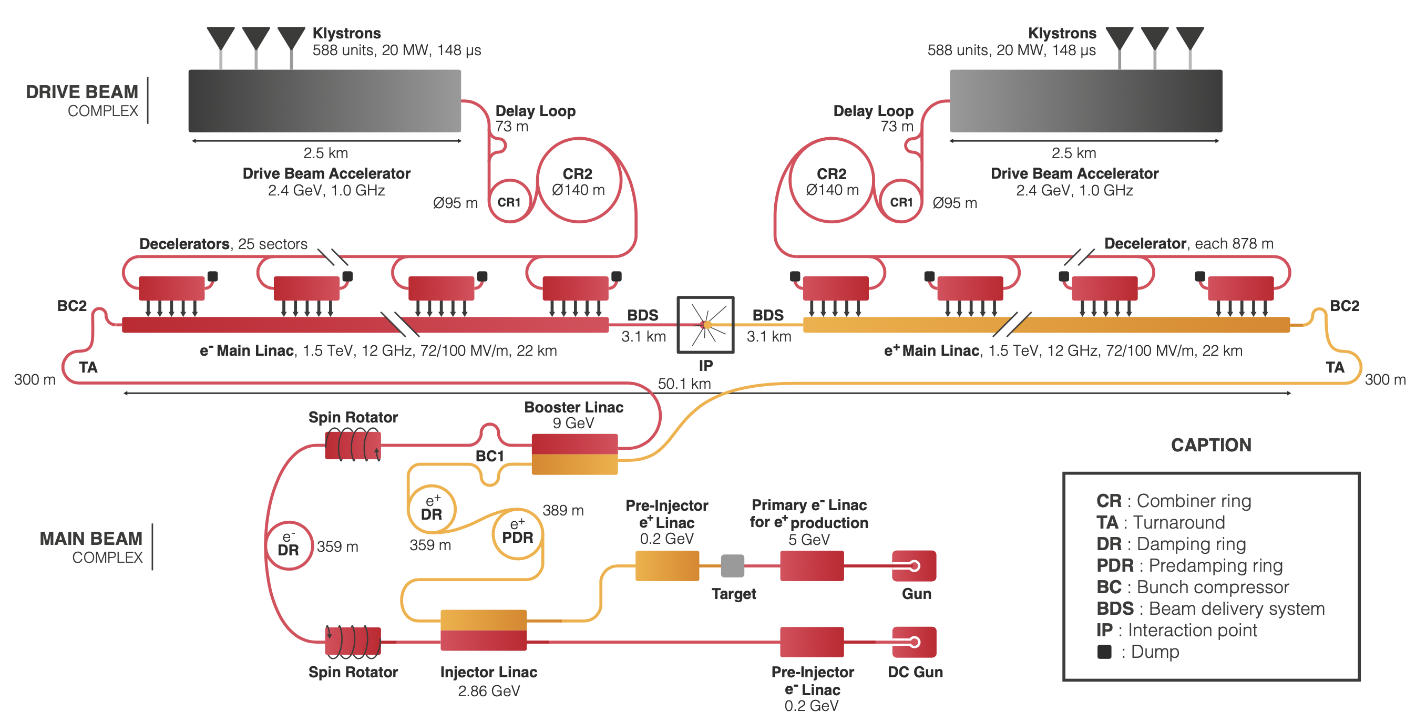
CLIC layout – 3TeV
Baseline electron polarisation ±80%

Slide 8
Looking forward
Much more about the accelerator in Roberto Corsini’s talk this afternoon (link)
Additional questions about Z-pole performance, luminosity margin at 380 GeV – can it be increased, a the gamma-gamma spectrum addressed since Granada meeting, see next slide and talk of Andrea Latina tomorrow - link
Then moving on the future plans (brief)

Slide 9
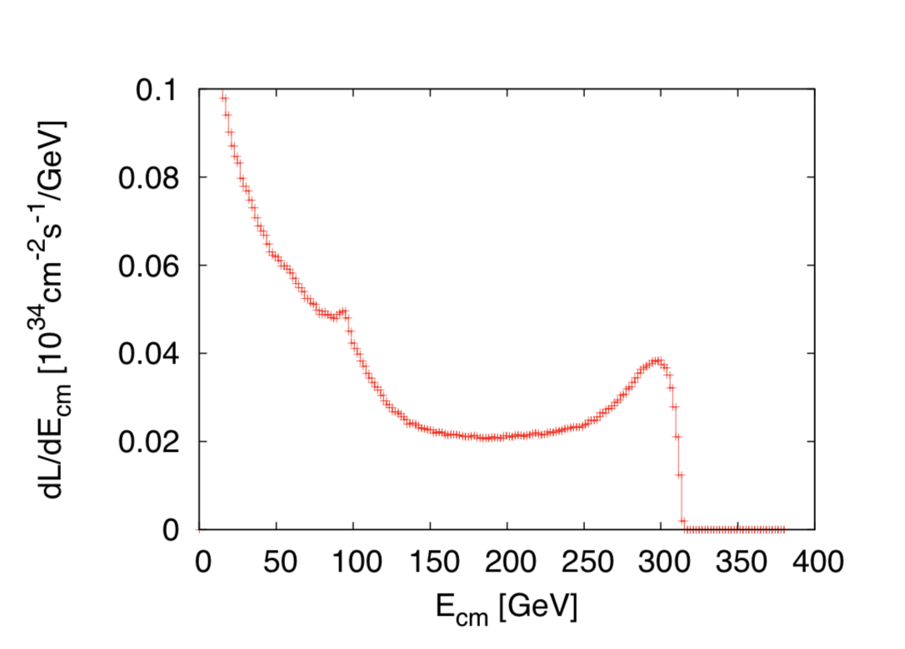
After Granada
Three questions:
Z pole performance, 2.3x10³² – 0.4x10³⁴ cm⁻² s⁻¹
  The latter number when accelerator configured for Z running (either early or end of first stage)
Gamma – Gamma spectrum (example)
Luminosity margins and increases
  Baseline includes estimates static and dynamic degradations from damping ring to IP: 1.5 x 10³⁴ cm⁻² s⁻¹, a “perfect” machine will give : 4.3 x 10³⁴ cm⁻² s⁻¹, so significant possibilities for doing better
  In addition: doubling the frequency (50 Hz to 100 Hz) would double the luminosity, at a cost of +50 MW and ~5% cost increase
Note at: http://cds.cern.ch/record/2687090
See talk tomorrow by Andrea Latina (link)

Slide 10
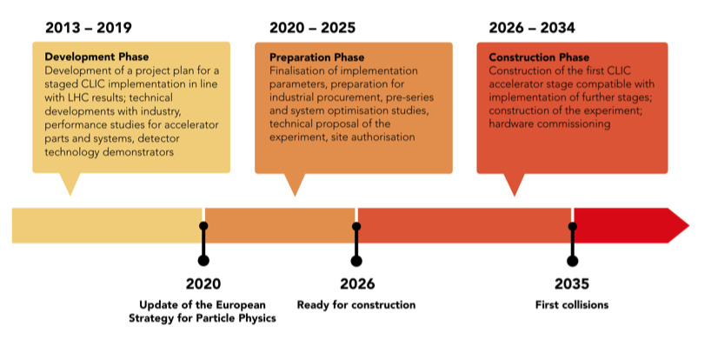
Next phase for CLIC

Slide 11
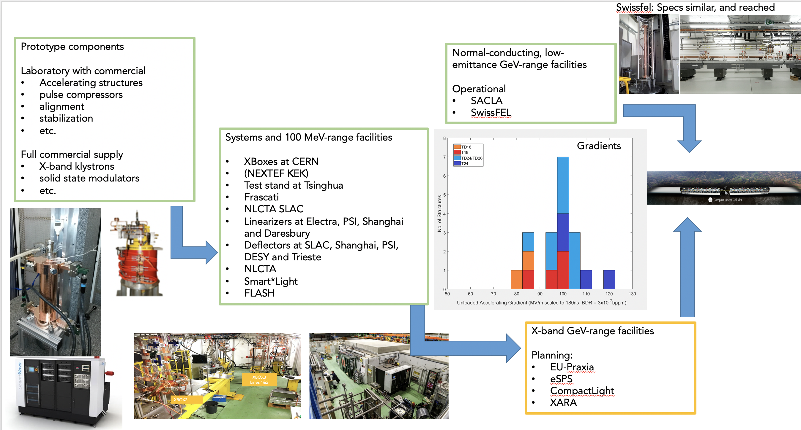
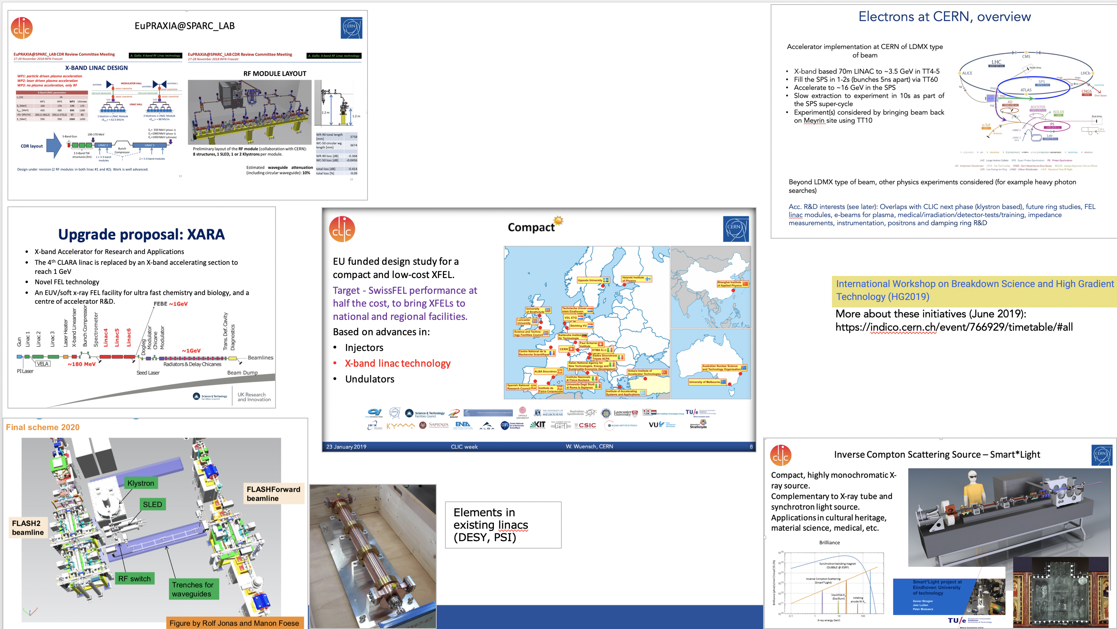
X-band technology and its use
(see talk of Walter Wuensch tomorrow (link)

Slide 12
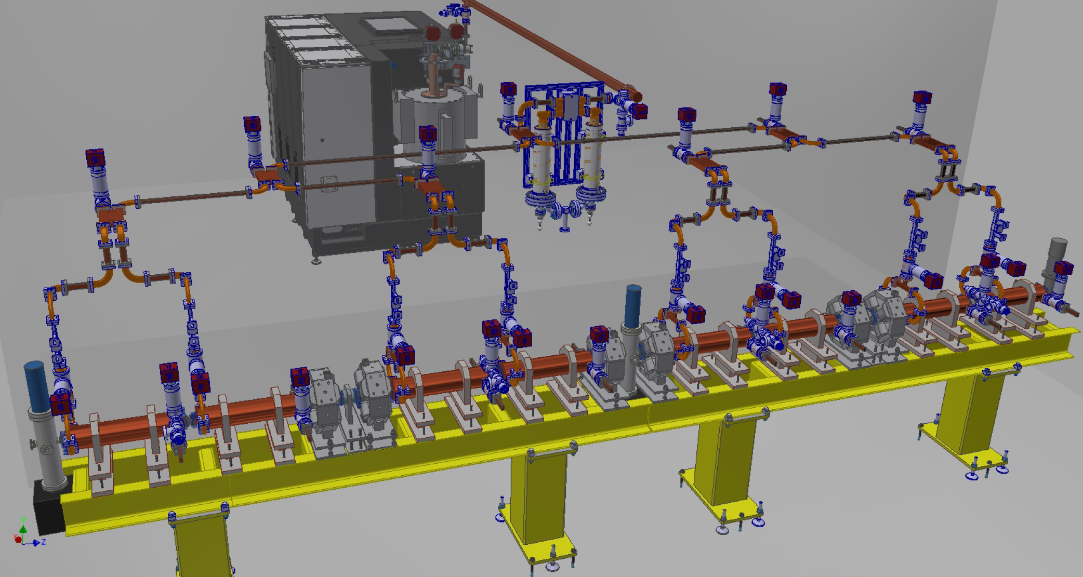
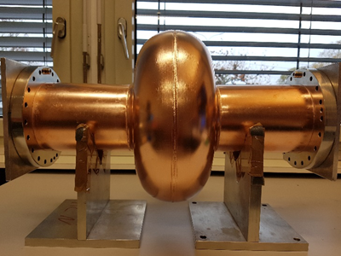
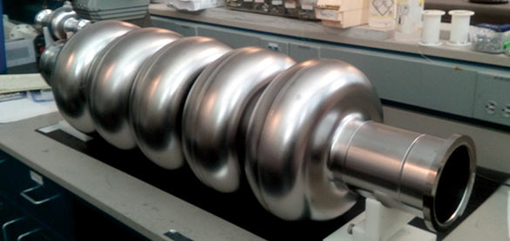
Electrons at CERN, overview
Accelerator implementation at CERN of electron beam for light dark matter searches (LDMX type) - part of Beyond Collider Physics programme
X-band based 70m LINAC to ~3.5 GeV in TT4-5
Fill the SPS in 1-2s (bunches 5ns apart) via TT60
Accelerate to ~16 GeV in the SPS
Slow extraction to experiment in 10s as part of the SPS super-cycle
Experiment(s) considered by bringing beam back on Meyrin site using TT10
X-band linac and SC RF with FCC-ee relevance (800 MHz)
Beyond LDMX type of beam, other physics experiments considered (for example heavy photon searches)
Acc. R&D interests: Overlaps with CLIC next phase (klystron based), future ring studies, FEL linac modules, e-beams for plasma, medical/irradiation/detector-tests/training, impedance measurements, instrumentation, positrons and damping ring R&D
Primary electron beam facility at CERN
3

Slide 13
LC and beyond

Slide 14
Looong term future for a LC – NAT
Working group for use of Novel Acceleration Technologies (NAT) – plasma with various drivers, dielectrics, etc (short chapter in Project Implementation Plan document)
  Physics and accelerator parameters (luminosity in particular)
  Consider status of various studies
  Key challenges beam-quality, positrons, energy efficiency for suitable luminosities
Possible re-use of tunnel/infrastructure/drive-beams/injectors etc interesting for a LC infrastructure
The fact the actual effective ML might remain short (and hence possibly “cheap” and inter-changeable in a limited time) makes this long term perspective worth considering
Have not found any “constrains/guidance” from these very long term “hopes” that would impact the design of CLIC stages 1-3
  CLIC is laser-straight and with a “reasonable” crossing angle likely to compatible with higher beam energies and the bunch separations needed for these technologies

Slide 15
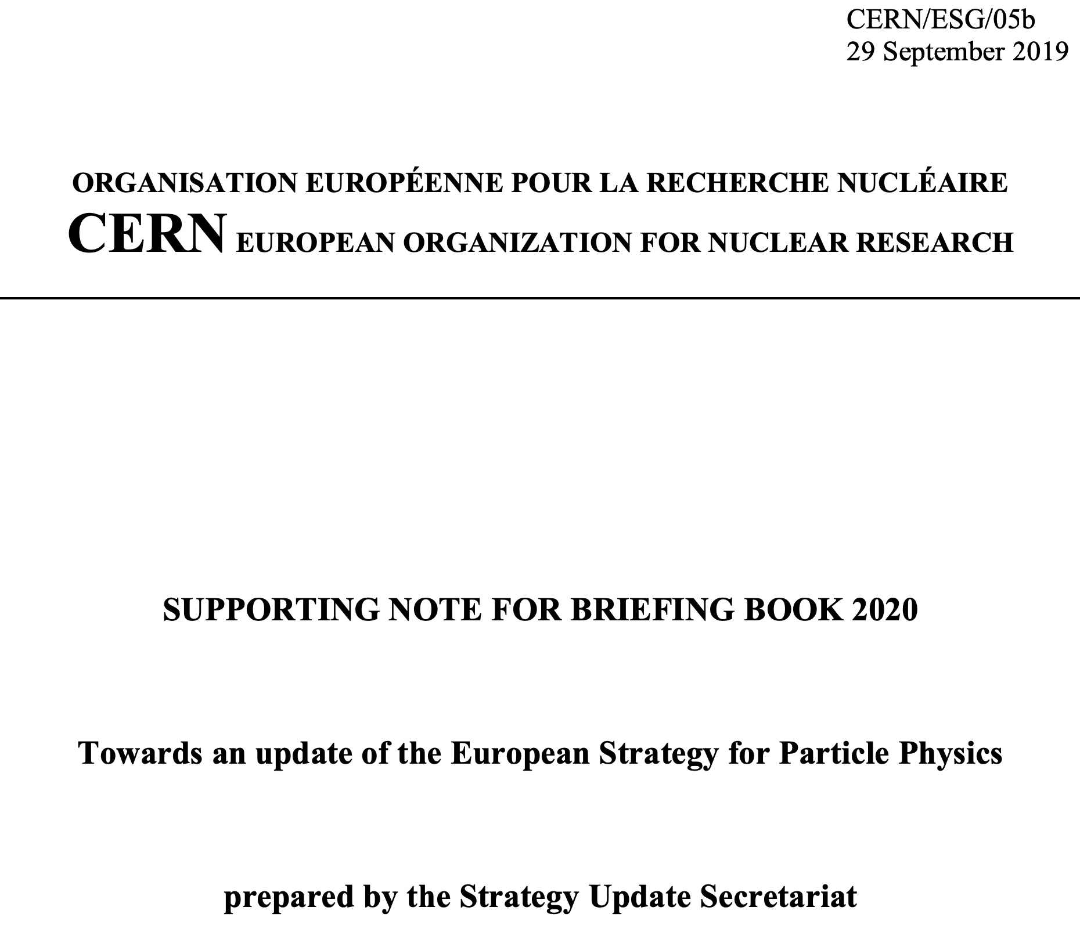
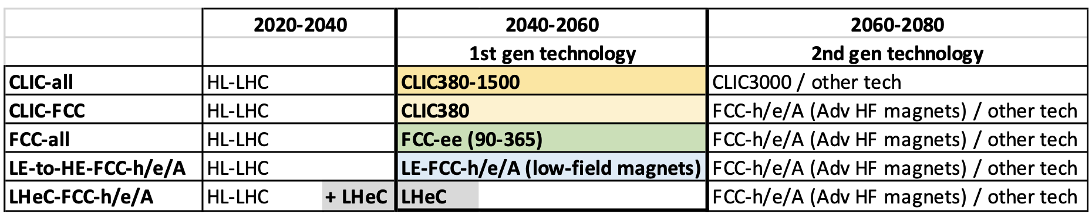
Scenarios in the European Strategy
With a view to update the European Strategy for Particle Physics, the Briefing Book compiled by the Physics Preparatory Group (PPG), based on the submitted inputs and the discussions during the Open Symposium in Granada, provides a summary of the present landscape in the field.
It summarises the scientific aspirations, opportunities, as well as technical challenges. Revolving around future major colliders in Europe, at this stage, five scenarios are defined to initiate the discussions within the European Strategy Group (ESG).

Slide 16
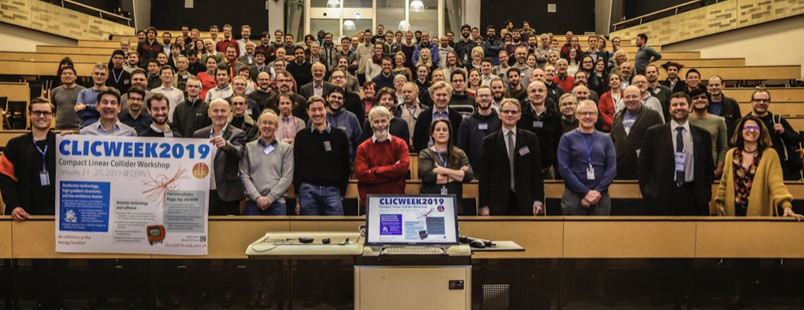
Summary
CLIC is now a mature project, ready to move towards next phase preparing for a 380 GeV stage
There is an consistent way forward with initial LC at “SM energies”, keeping the options open for future upgrades and/or circular accelerators further on
The cost and implementation time for CLIC 380 are similar to LHC
The physics case is broad and profound, and being further developed
The detector concept and detector technologies R&D are advanced
The full project status has been presented in a series of Yellow Reports and other publications: http://clic.cern/european-strategy
Picture from the CLIC week 2019,
Next year it will take place March 9-13 2020

Slide 18
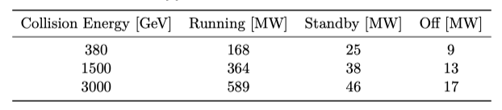
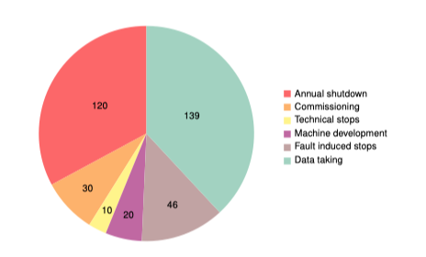
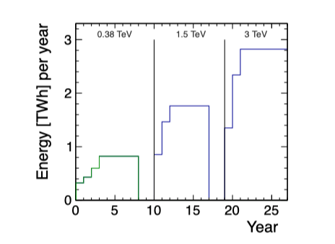
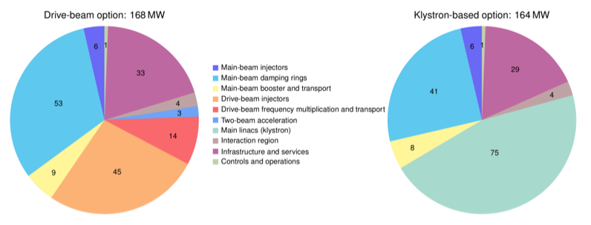
Implementing CLIC
Power estimate bottom up (concentrating on 380 GeV systems)
Very large reductions since CDR, better estimates of nominal settings, much more optimised drivebeam complex and more efficient klystrons, injectors more optimisation, etc
Further savings possible, main target damping ring RF
Will look also more closely at 1.5 and 3 TeV numbers next
From running model and power estimates at various states – the energy consumption can be estimated
CERN is currently consuming ~1.2 TWh yearly (~90% in accelerators)

Slide 19
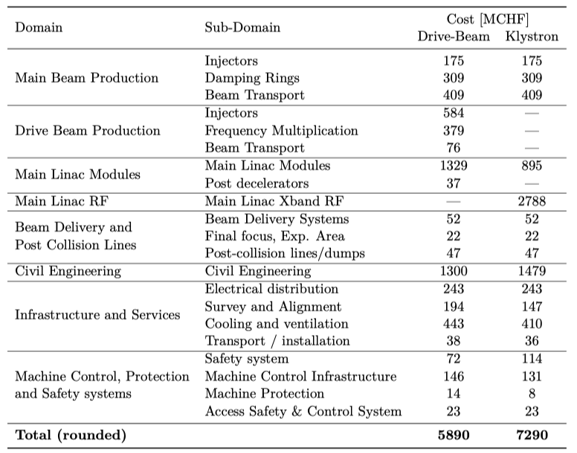
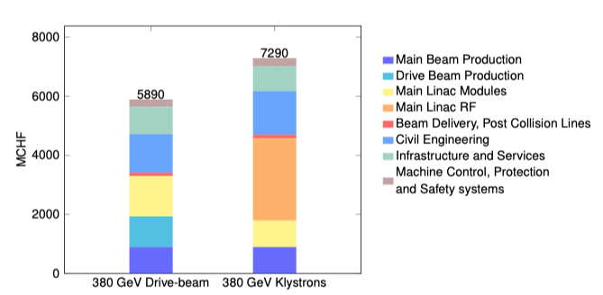
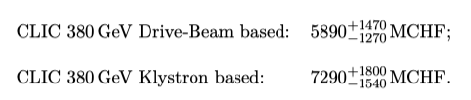
Cost - I
Machine has been re-costed bottom-up in 2017-18
Methods and costings validated at review on 7 November – similar to LHC, ILC, CLIC CDR
Technical uncertainty and commercial uncertainty estimated

Slide 20
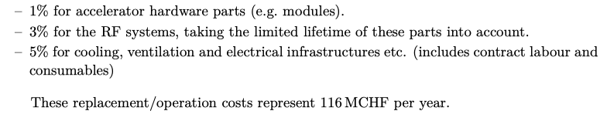
Cost - II
Other cost estimates:
Construction:
From 380 GeV to 1.5 TeV, add 5.1 BCHF (drive-beam RF upgrade and lengthening of ML)
From 1.5 TeV to 3 TeV, add 7.3 BCHF (second drive-beam complex and lengthening of ML)
Labour estimate: ~11500 FTE for the 380 GeV construction
Operation:
116 MCHF (see assumptions in box below)
Energy costs

Slide 21
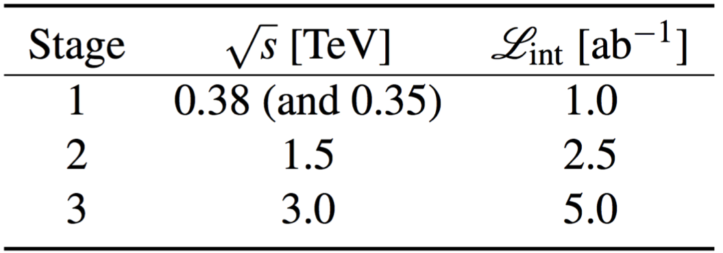
Luminosity staging baseline
increased
from
0.5+0.1ab^{–1}
1.5ab^{–1}
3ab^{–1}
Sensitivities updated for new luminosity staging baseline
Baseline polarisation scenario adopted:
electron beam (–80%, +80%) polarised in ratio
(50:50) at √s=380GeV ; (80:20) at √s=1.5 and 3TeV
Staging and live-time assumptions following guidelines consistent with other future projects:
Machine Parameters and Projected Luminosity Performance of Proposed Future Colliders at CERN
arXiv:1810.13022, Bordry et al.

Slide 22
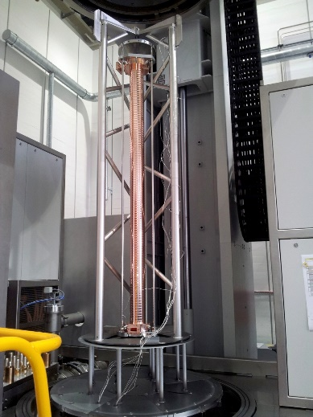
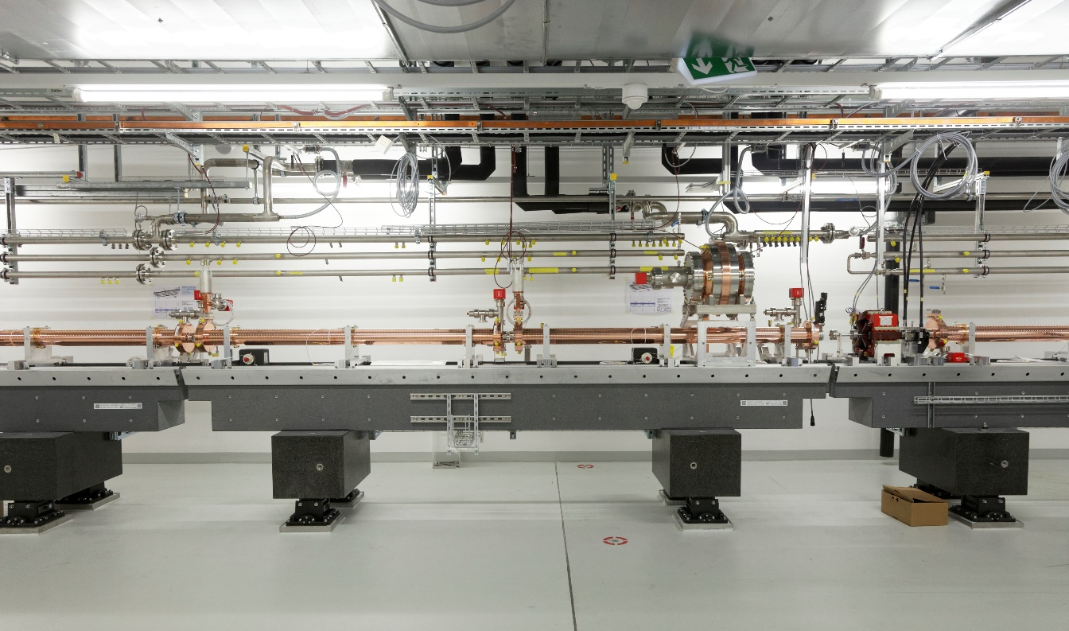
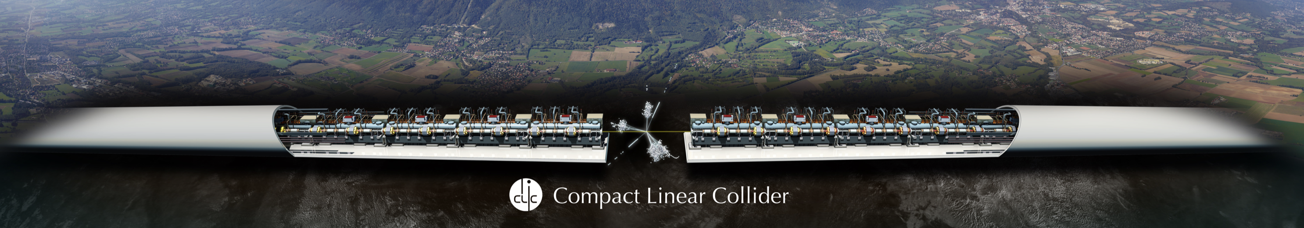
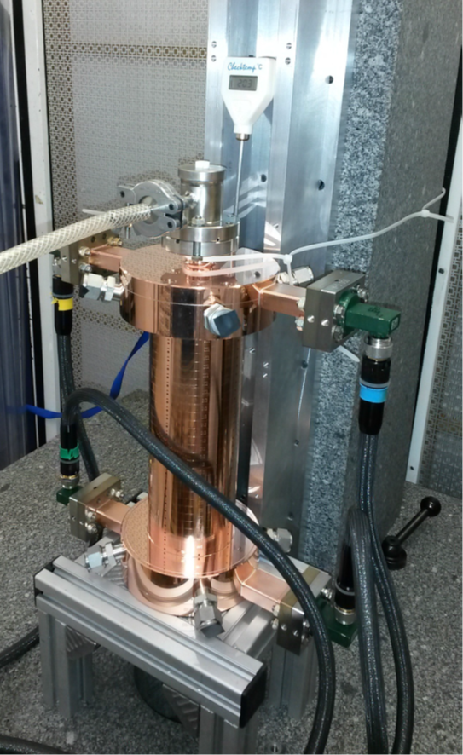

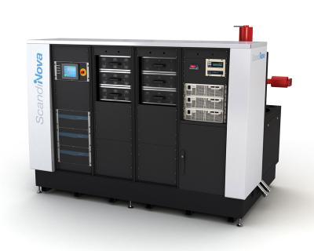
Swissfel: Specs similar, and reached
Prototype components
Laboratory with commercial
Accelerating structures
pulse compressors
alignment
stabilization
etc.
Full commercial supply
X-band klystrons
solid state modulators
etc.
Normal-conducting, low- emittance GeV-range facilities
Operational
SACLA
SwissFEL
Systems and 100 MeV-range facilities
XBoxes at CERN
(NEXTEF KEK)
Test stand at Tsinghua
Frascati
NLCTA SLAC
Linearizers at Electra, PSI, Shanghai and Daresbury
Deflectors at SLAC, Shanghai, PSI, DESY and Trieste
NLCTA
Smart*Light
FLASH
Gradients
X-band GeV-range facilities
Planning:
EU-Praxia
eSPS
CompactLight
XARA

Slide 23
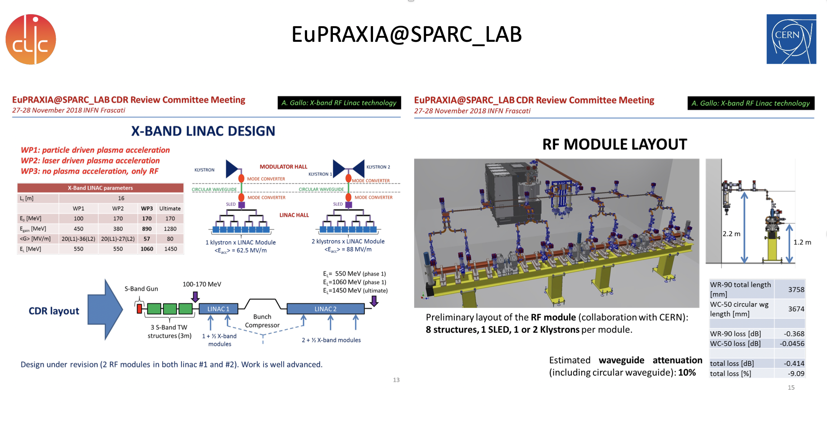
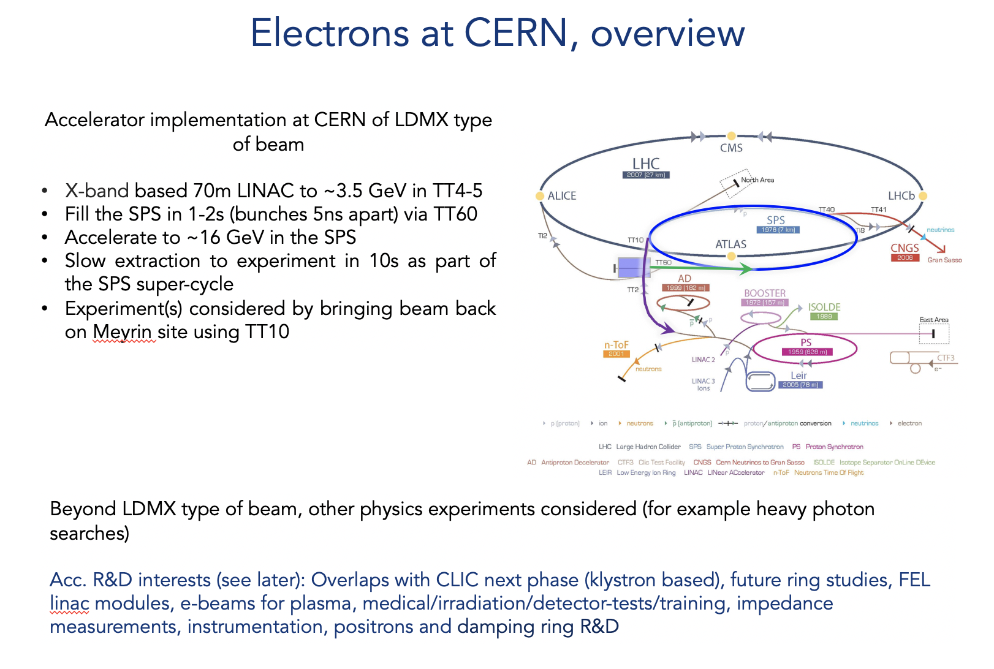

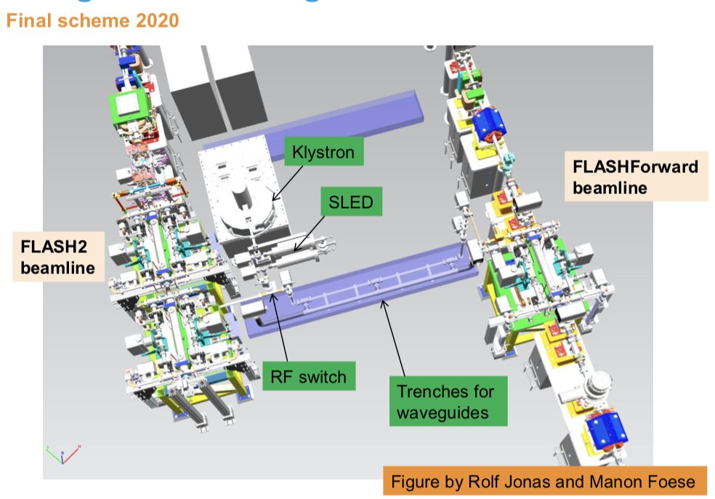
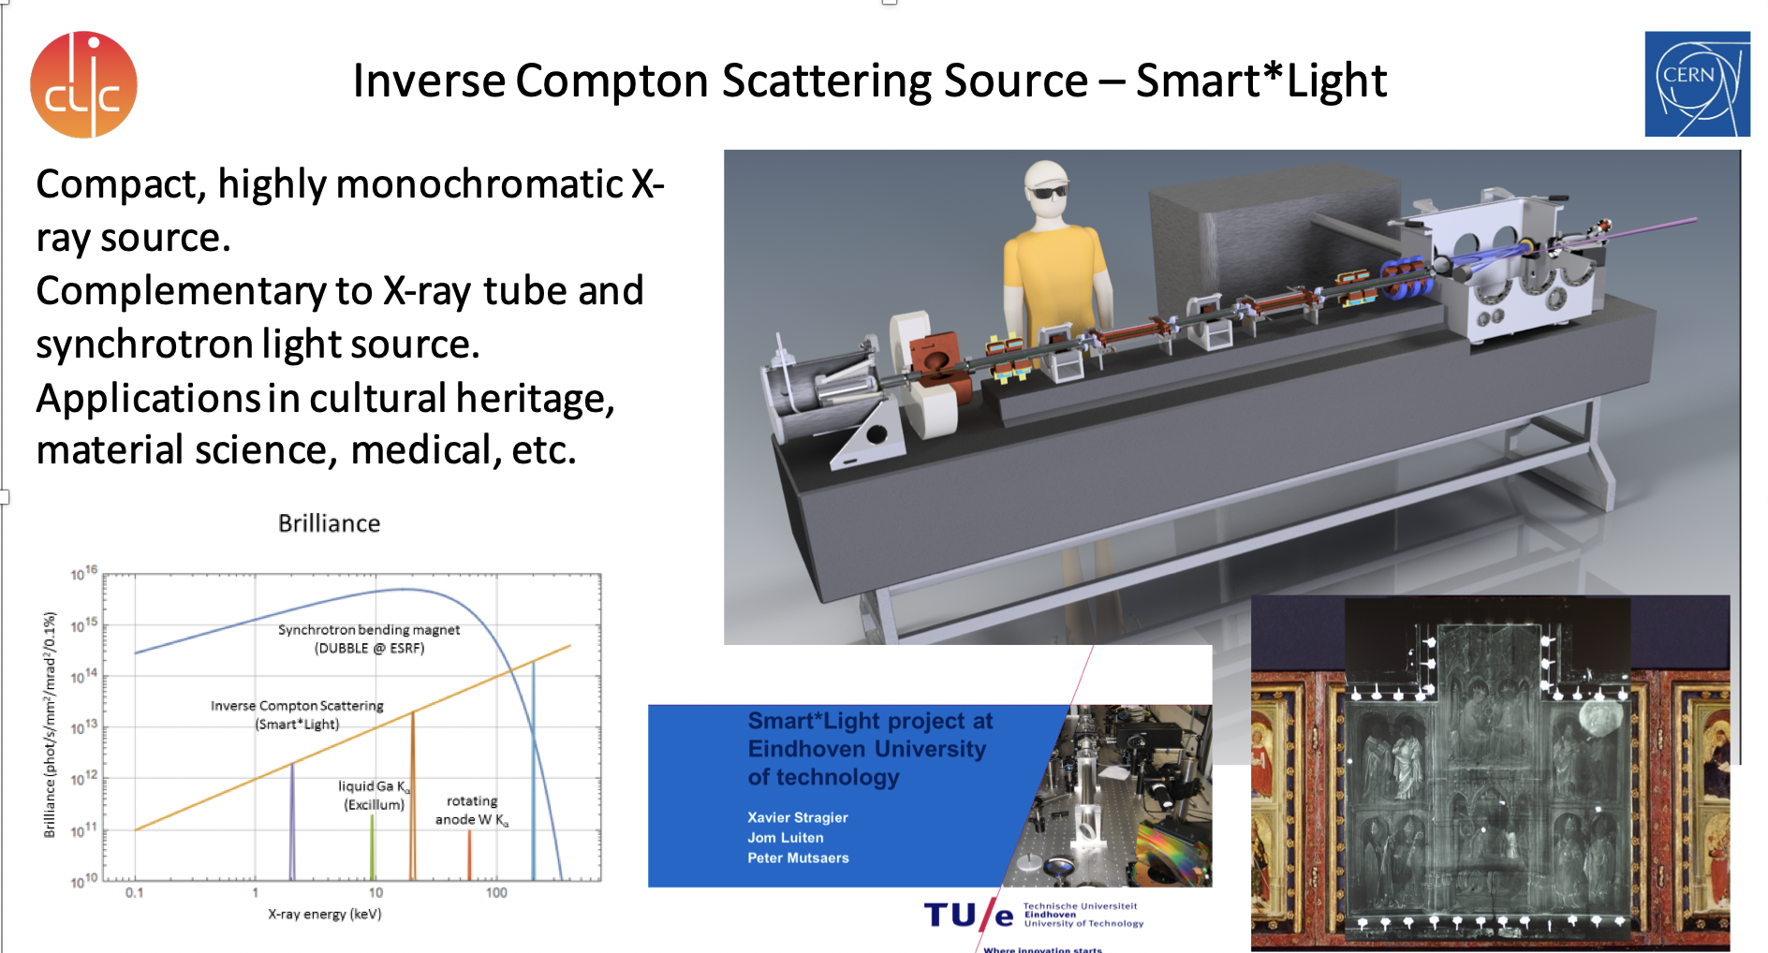
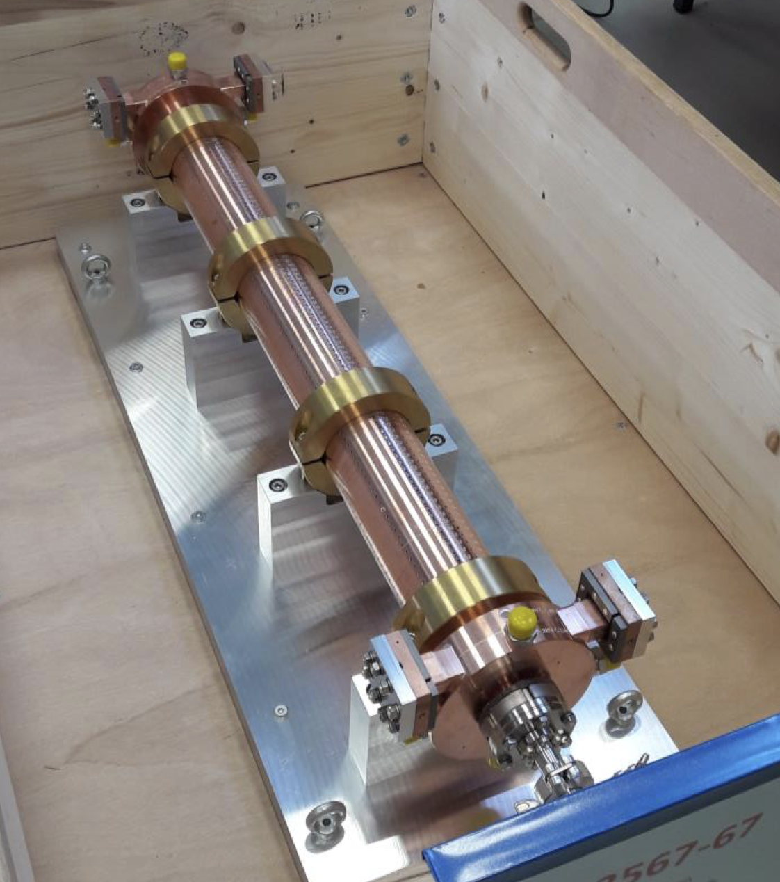
More about these initiatives (June 2019): https://indico.cern.ch/event/766929/timetable/#all
Elements in existing linacs (DESY, PSI)
Notes:
Add refs

