Slide 1


Summary R&D Detector
Peter Kluit
LCWS2019 – Sendai (Japan)

Slide 2


R&D Detector selected topics
  Calorimetry
    Si-W ECAL
    Scintillator ECAL
    HCal, Muon shielding
  TPC tracking
  Silicon pixel detectors

Slide 3
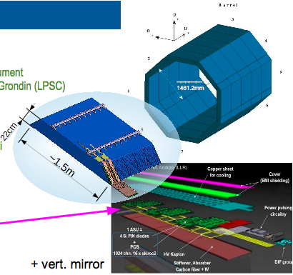
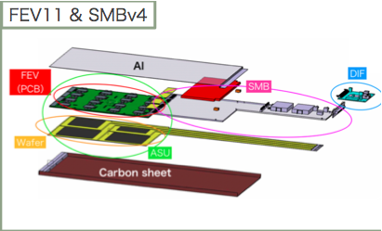
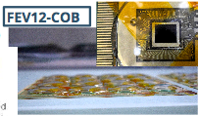
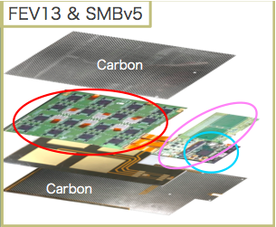
R&D for Si-W ECAL
Three ASUs tested:
ECAL
geometry
SLAB
ASUs (green)
Active Signal Unit

Slide 4
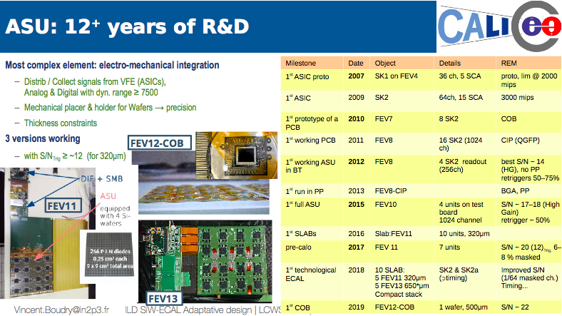
Next steps:
Study of 8’’ 725 μm wafers
  Thicker: will give better S/N
ASICs with zero suppression
Passive/Active cooling (see back up slide) in particular relevant for high luminosity phase
Continuing high level integration
ASUs (green)

Slide 5
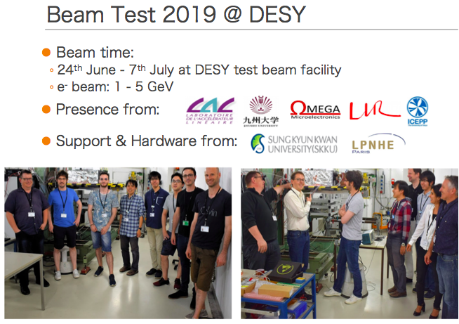
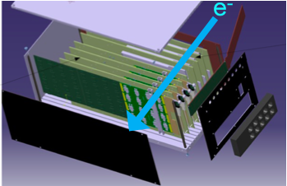

Slide 6
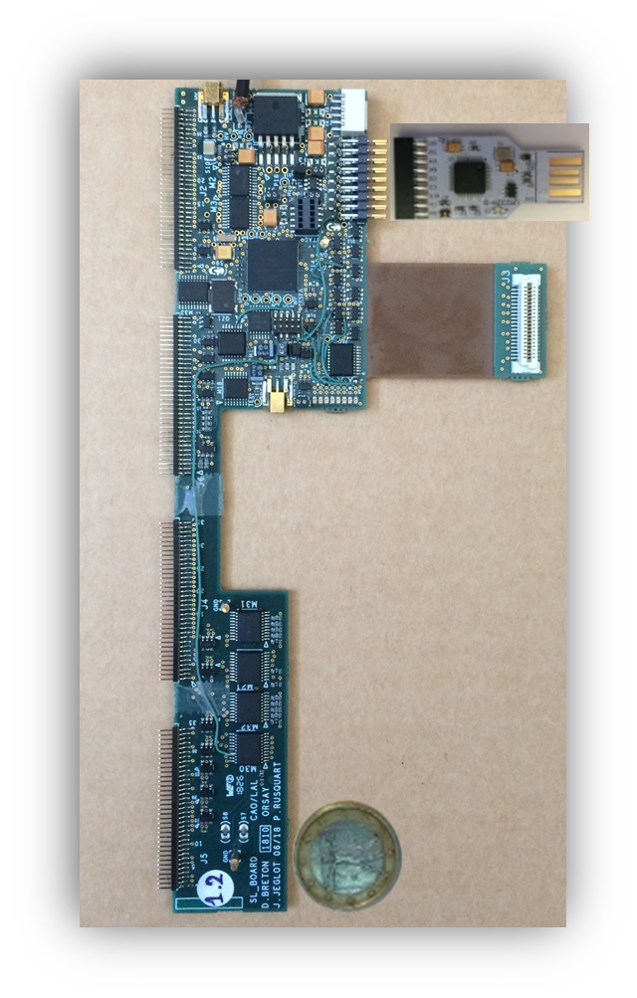
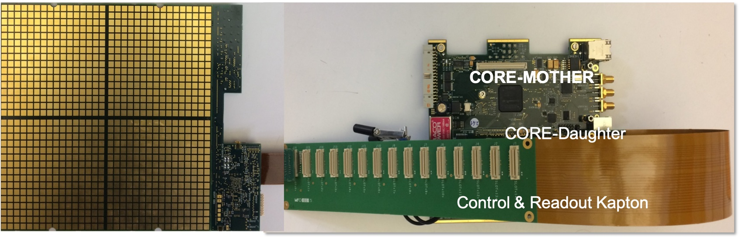

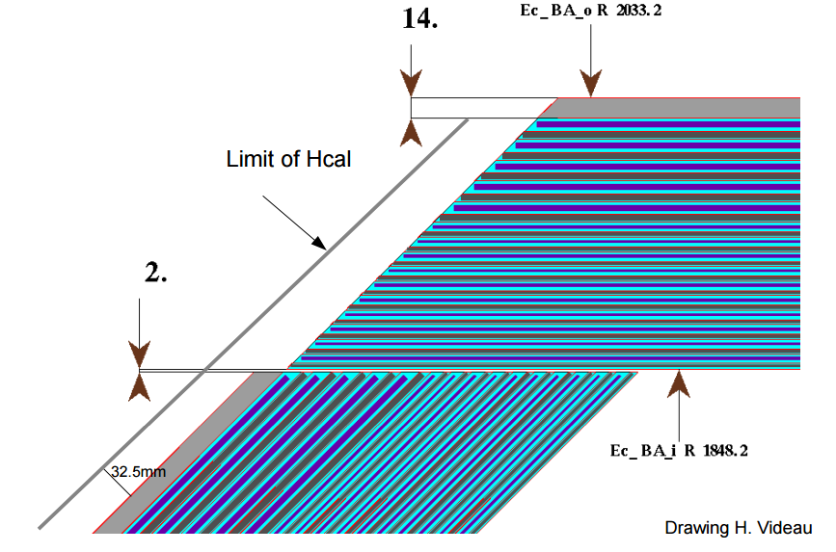

Towards a system for a final detector
NEW: SL board
Service for
up to 15 layers
HDMI from CCC
Guiding/receiving signals to/from slabs
Approximately 6 cm between Ecal and Hcal

Slide 7
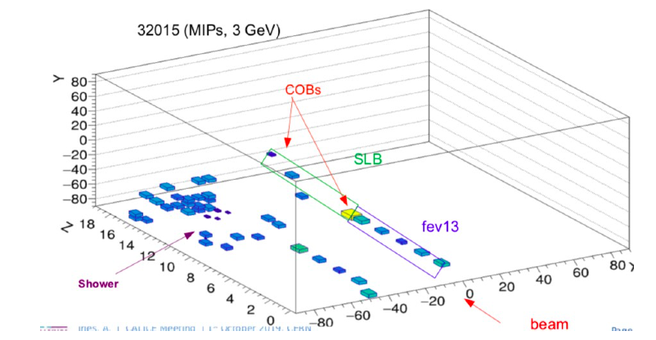
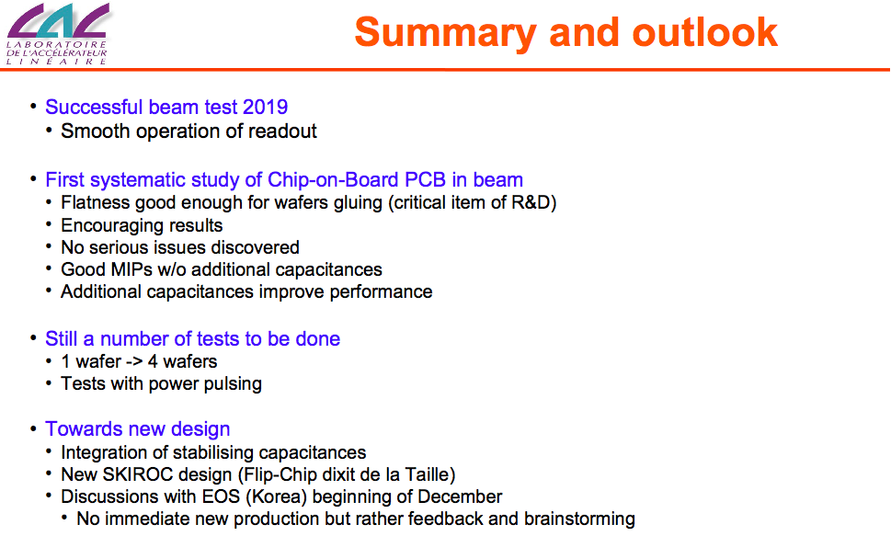
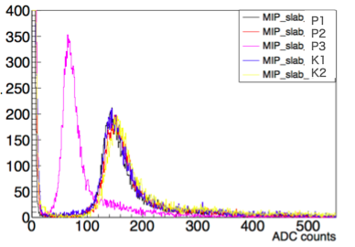
Testbeam results for Si-W ECAL
event display
M.i.p. signals

Slide 8
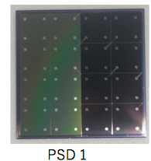
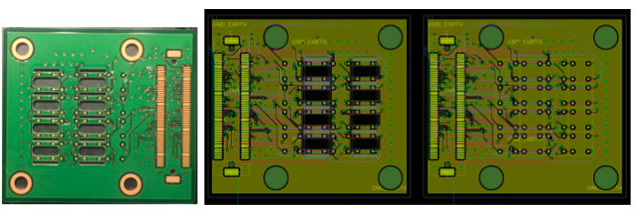
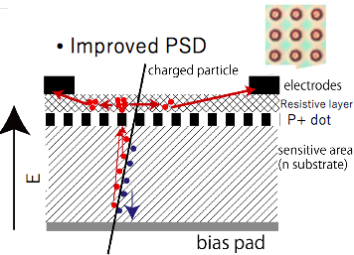
Position sensitive silicon detector
Part of the Si-W calorimeter
Reconstruct the position & direction of the photon
• PSD1 cell size : 5.5×5.5 mm²; sensor thickness : 650 μm
New boards
Preparations for test beam
Different versions of PSDs

Slide 9
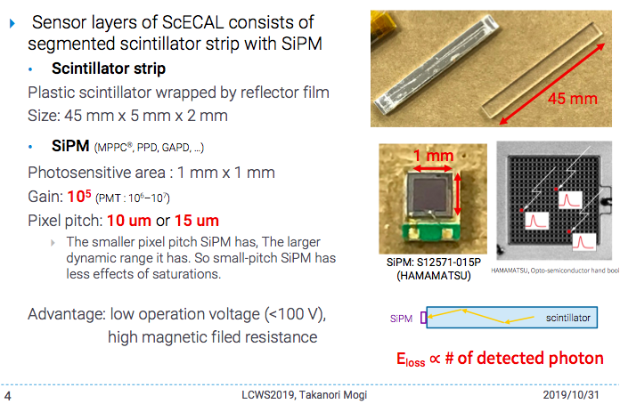
Scintillator ECAL

Slide 10
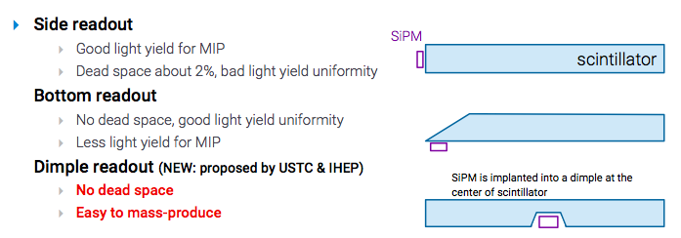
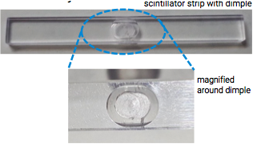
Scintillator ECAL
The dimple readout scintillator has good light yield and good uniformity

Slide 11
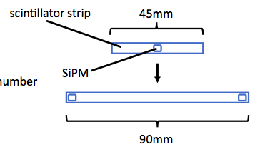
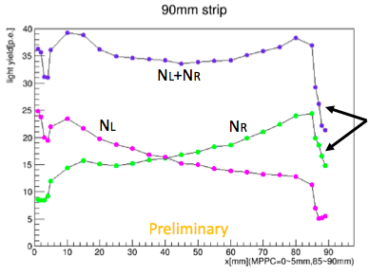
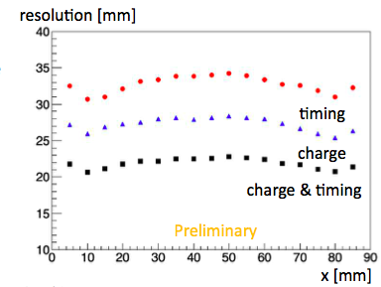
Sc ECAL with double SiPM readout
Some possible advantages:
Eliminating noise by coincidence
Higher light yield by summing two SiPMreadouts
Even lower light yield for each SiPM(less saturation)
Operational even if one of SiPMs is dead
Position by charge or timing differences
Large N p.e. 35
Single readout N p.e. 20
Edge effect not yet understood
Position resolution ~20 mm

Slide 12
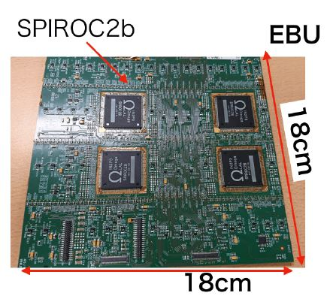
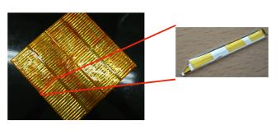
DAQ for the Sc ECAL: EBU
Bottom readout scintillator
MPPC position
Scintillator surface
EBU (ECAL Basic Unit) is fabricated by DESY.
EBU consists of SPIROC surface and scintillator surface.
One EBU is a PC board with 144 MPPCs and 144 scintillators.
One EBU is equipped with four ASICs called SPIROC2b developed by OMEGA group.
One SPIROC2b can control 36ch of MPPCs and adjust each applied voltage for a channel.
Notes:
・Next, talk about EBU for readout.
・EBU is fabricated by DESY.
・EBU consists of SPIROC surface and scintillator surface.
・One EBU is a PC board with 144 MPPCs and 144 scintillators.
・And EBU is equipped with four ASICs called SPIROC2b which is developed by OMEGA group.
・One SPIROC2b can control 36ch of MPPCs and can adjust each applied voltage for a channel.

Slide 13
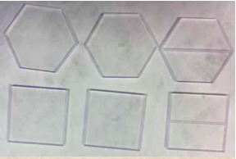
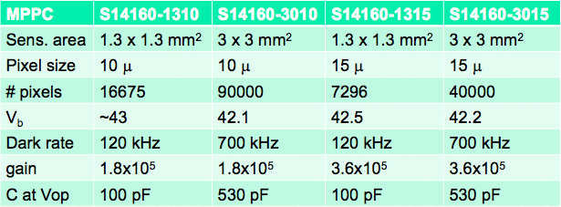
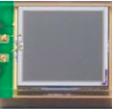
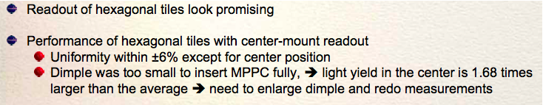
Scintillator Tiles MPPCs
Both hexagonal and squared tiles
Using 4th generation MultiPixelPhotonCounter

Slide 14
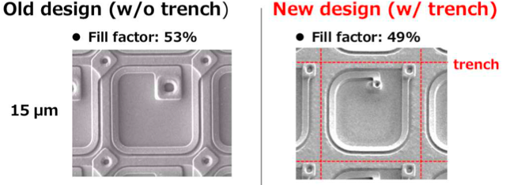
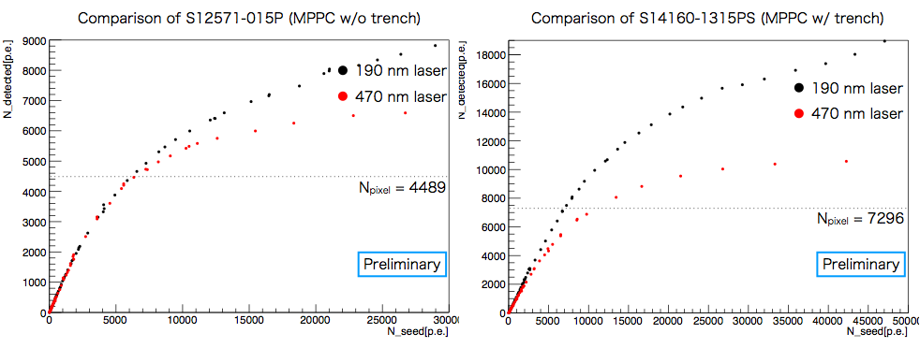
Saturation of SiPM
SiPM saturation can be an issue for Sc-ECAL
Studied for two MPPCs w(w/o) trench

Slide 15
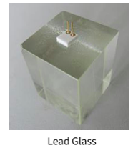
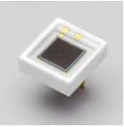
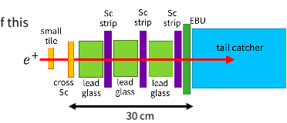
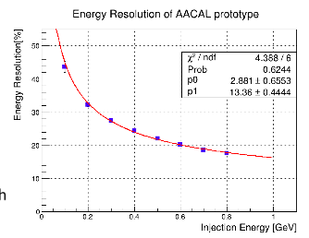

Sampling Calorimeter AACAL
Lead glass segmented 3x3x4 cm³
MPPC size 3x3 mm²
Active Absorber CAL (AACAL)
MPPC

Slide 16
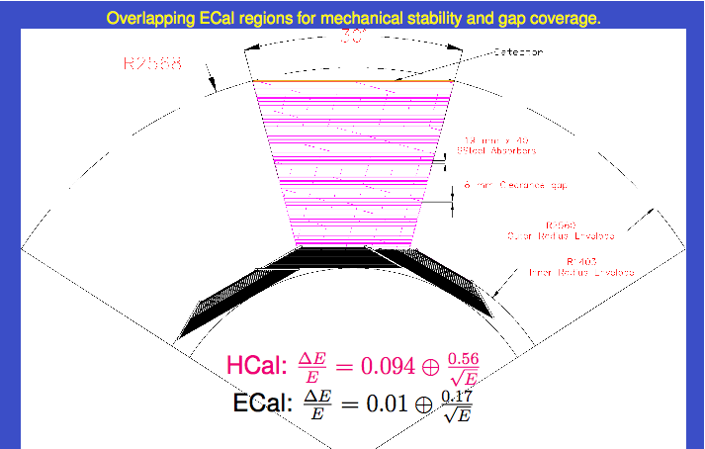
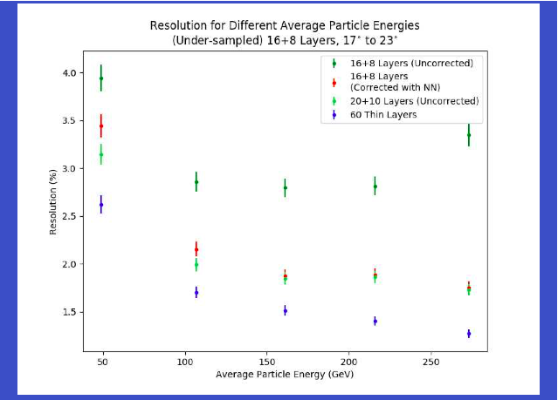
Leakage correction for SiD
Problem bad e.m. E resolution
not whole e.m. shower measured
Geometry of Calorimeters
Note special overlap zone
After correction (NN) improved

Slide 17
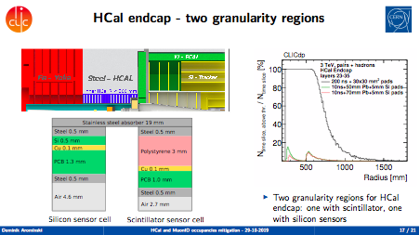
HCal shielding for CLIC

Slide 18
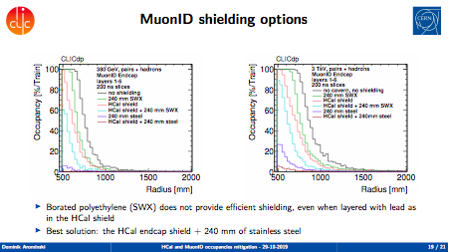

Muon shielding for CLIC

Slide 19
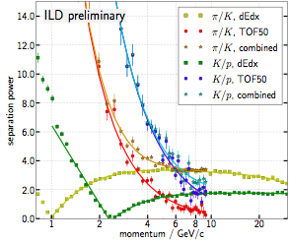
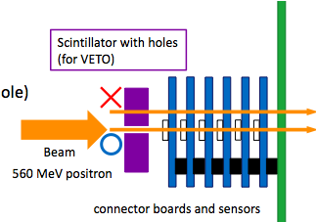
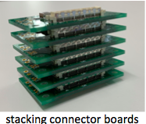
Precise timing with silicon sensors
Low Gain avalanche photo diode (LGAD)
Allows particle ID using Time of Flight
LGADs are part of LHC upgrades σ~30 ps
Several (8) avalanche photo diodes tested
Preparations for a test beam

Slide 20
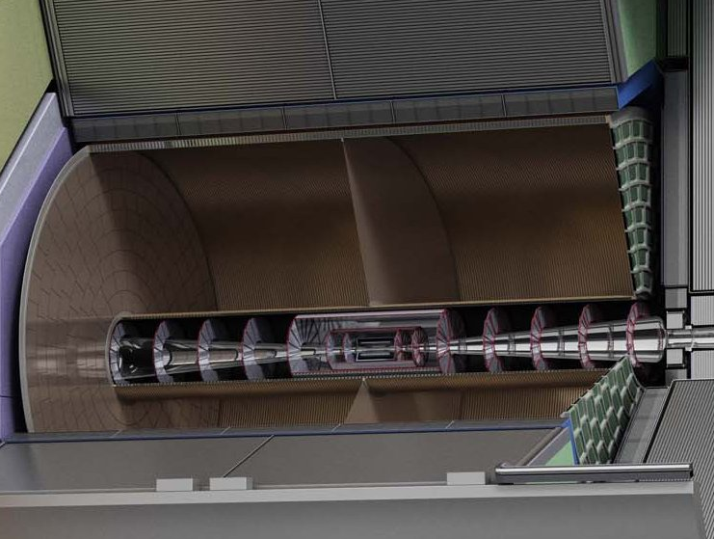

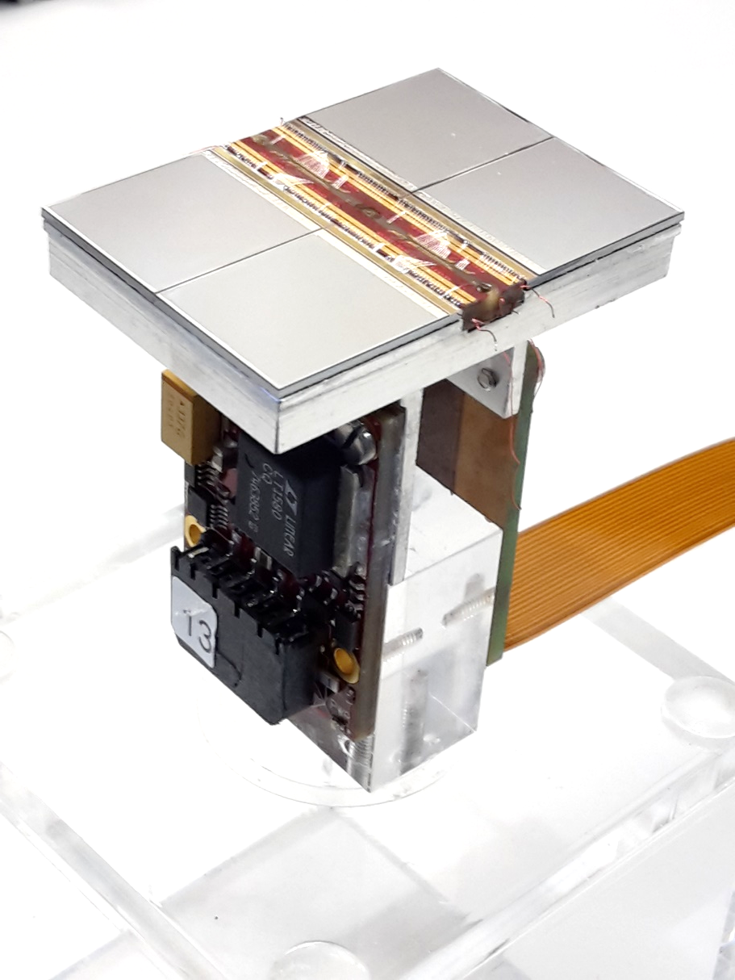
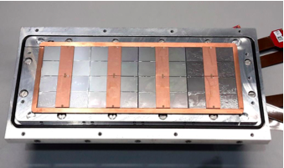
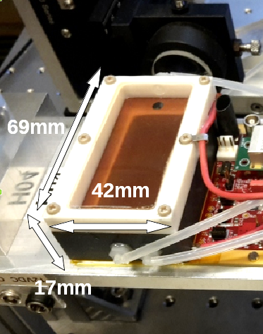
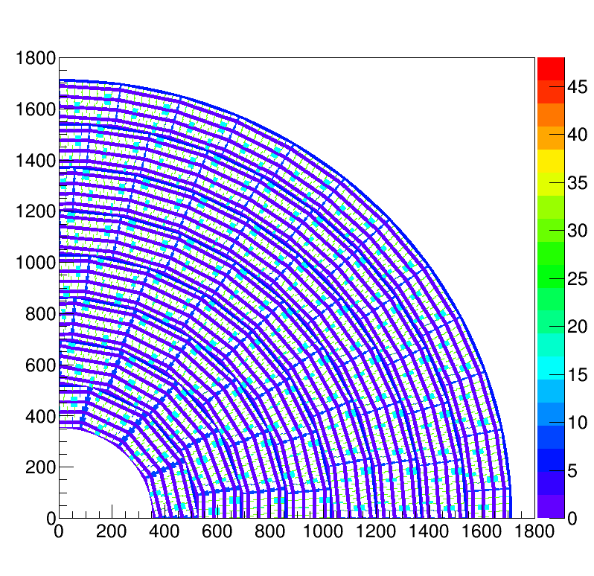
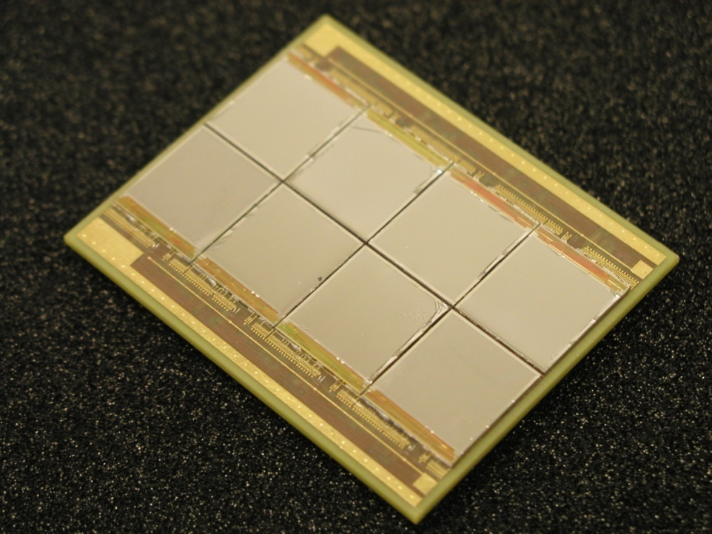
Pixel TPC
(Octopuce)
(TimePix1) TPX3 chip Quad Module TPC plane
(2007-14) 2017 2018 2019

Slide 21
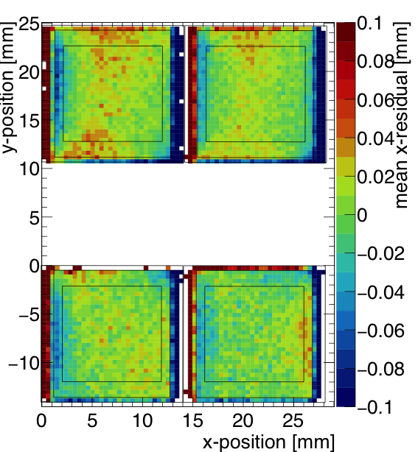
Quad and 8-Quad module
One quad in
8-Quad module
  A Quad detector was designed and the results from the 2018 test beam presented
  Small edge deformations between two chips are observed
    added guard wires to the module to obtain a homogeneous field
    After correcting the deformations in are less than 15 µm
An 8-Quad module has been designed with guard wires
  Deformations (no corrections) are shown to be < 15 µm
  Test beams are being planned at DESY and Bonn
A pixel pixel TPC has become a realistic viable option for experiments
  High precision tracking in the transverse and longitudinal planes, dE/dx by electron and cluster counting, excellent two track resolution, digital readout that can deal with high rates
Preliminary

Slide 22
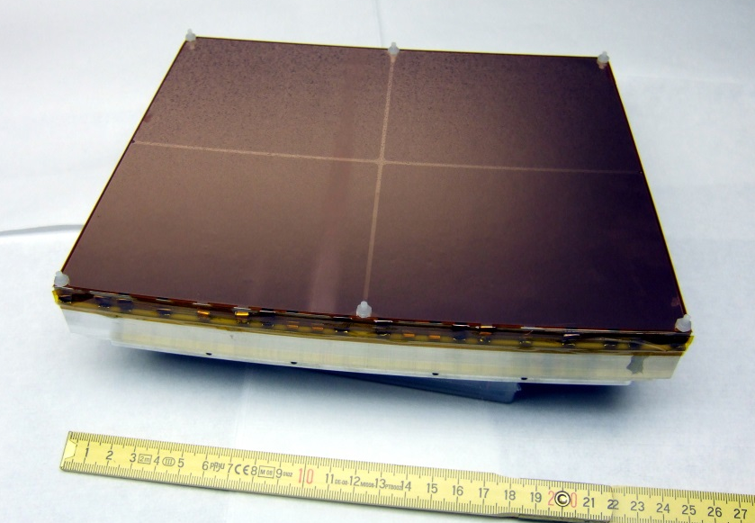
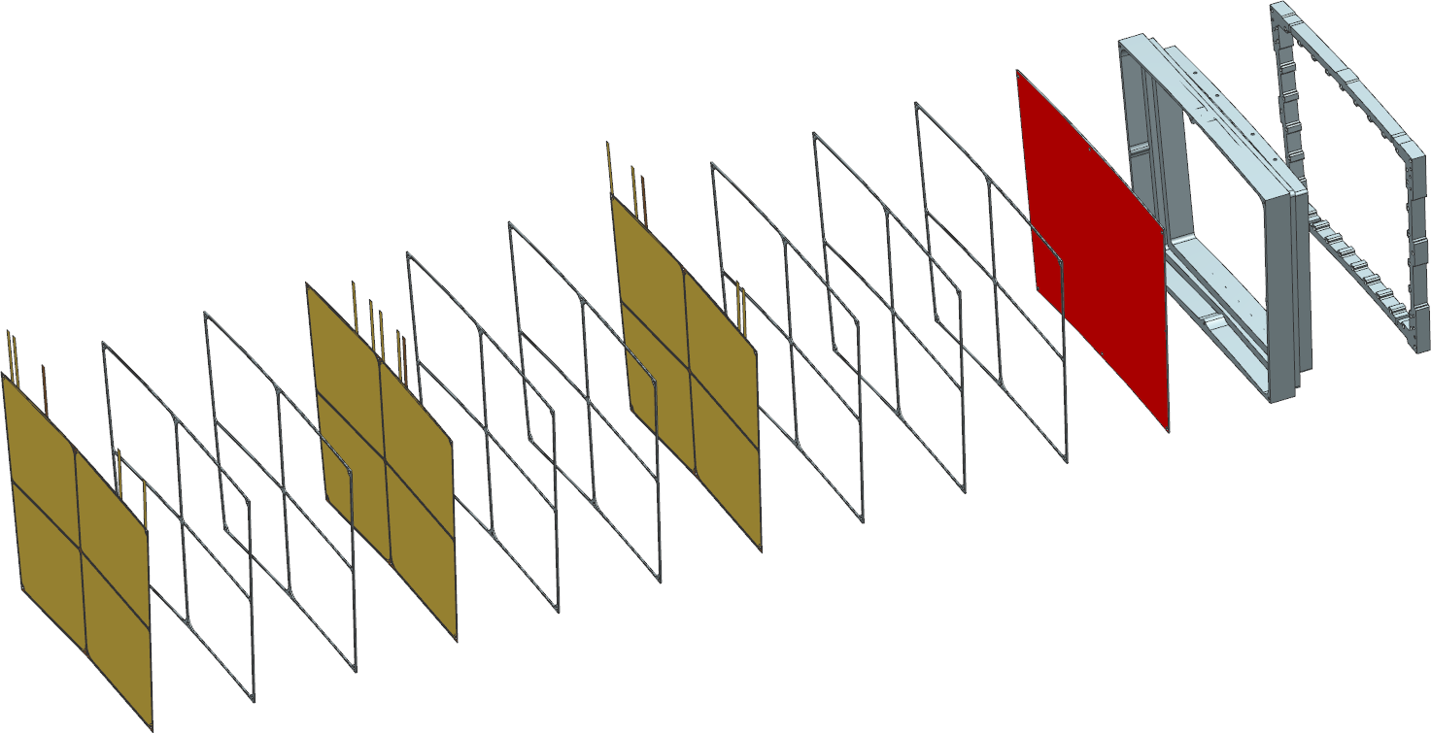


DESY GEM module
ceramic
grids
aluminium
strongback
anode
pad plane
GEM
dE/dx 4.4% in ILD
  A better dEdx resolution?
    smaller pad size

Slide 23




DESY Large Prototype TPC
New version field cage
Silicon Beam telescope PCMAG

Slide 24




GEM Gating device
Ion Feed back problem
Gating device
^{Electron transmission}
^{Measured} ^{to be ~86 % with gating GEM.}

Slide 25


TPC for CEPC
CEPC running at the Z
Deformations due to Ion back flow
Laser calibration of a TPC
IHEP

Slide 26


Silicon: SOI based pixel detector
Monolithic sensor using silicon-on-insulator (SOI) technology:
Lapis 0.20 mm FD-SOI Pixel nodes (in handle Si) are electrically connected
to readout circuit (SOI layer) through small vias fabricated in a conventional
LSI process. Pixel size v4 20 μm x 20 μm
 | Ver. 1 | Ver. 2 | Ver. 3 | Ver. 4
Produced /Tested* | 2016/2017 | 2017/2018 | 2018/2019 | 2018/2020
Wafer | SOI | DSOI | DSOI | DSOI
Pixel size (μm²) (μm) | 20x20 | 25x25 | 30x30 | 20x20
Chip size (mm²) (μm) | 3x3 500 | 4.5x4.5 75 | 6x6 300 | 4.5x4.5 300
Charged Particle
Yearly test beam activities FNAL

Slide 27


Silicon: SOFIST-4 3-D stacking
Electronics circuits in two chips are fused using cylindrical micro-bumps to extend the circuit functionality in limited space.
upper
lower
Comp
Comp
AGnd
AVdd
AGnd
AVdd
micro-bumps
4 mm
Signal
Signal

Slide 28


Silicon: CMOS pixel detector
Monolithic (Signal created in low doped thin epitaxial layer ~10-30 μm)
Thermal diffusion of e- (Limited depleted region)
Charge collection: N-Well diodes (Charge sharing resolution)
Continuous charge collection (No dead time)

Slide 29


Silicon: CMOS pixel detector
Keep excellent spatial resolution and push towards better time resolution
Strong synergy between Higgs factories and Heavy ion experiments

Slide 30

MIMOSIS towards ILC vertex detector

Slide 31
Conclusions R&D Detector
  Rich field of activities in detector R&D
    Calorimetry
      Si-W ECAL
      Scintillator ECAL
      HCal, Muon shielding
    TPC tracking
    Silicon pixel detectors
  Large synergies with other (non LC) experiments

Slide 32

Si-W ECAL
ASUs (green)

