Slide 1
Summary of the
Accelerator Sessions
International Workshop on Future Linear Collider 2019
2019/11/01
Mathieu Omet (KEK)

Slide 2
Disclaimer
The summary is (by nature) incomplete and is a personal view
  Several excellent and interesting results, which were presented during the sessions are not mentioned
I invite everyone to take a look at the contributions uploaded

Slide 3
Accelerator Session Overview
Session name | Session count | Talk count | Discussion count
CFS | 3 | 9 | 2
Green Accelerator | 1 | 5 | -
Sources | 3 | 14 | -
Warm RF | 2 | 9 | 2
SCRF | 4 | 20 | -
ATF/DR/BDS | 2 | 8 | -
Total | 15 | 65 | 4

Slide 4
Accelerator Session Conveners
CFS
  John Osborne (CERN), Nobuhiro Terunuma (KEK)
Green Accelerator
  Takayuki Saeki (KEK), Steinar Stapnes (CERN)
Sources
  Steffen Doebert (CERN), Joe Grames (JLab), Masao Kuriki (U. Hiroshima)
Warm RF
  Toshi Higo (KEK), Emilio Nanni (SLAC), Walter Wuensch (CERN)
SCRF
  Matthia Checchin (FNAL), Marc Wenskat (DESY), Yasuchika Yamamoto (KEK)
ATF/DR/BDS
  Philip Burrows (Oxford), Toshiyuki Okugi (KEK), Rogelio Tomas (CERN), Renjun Yang (CERN)

Slide 5
Accelerator Session Conveners
CFS
  John Osborne (CERN), Nobuhiro Terunuma (KEK)
Green Accelerator
  Takayuki Saeki (KEK), Steinar Stapnes (CERN)
Sources
  Steffen Doebert (CERN), Joe Grames (JLab), Masao Kuriki (U. Hiroshima)
Warm RF
  Toshi Higo (KEK), Emilio Nanni (SLAC), Walter Wuensch (CERN)
SCRF
  Matthia Checchin (FNAL), Marc Wenskat (DESY), Yasuchika Yamamoto (KEK)
ATF/DR/BDS
  Philip Burrows (Oxford), Toshiyuki Okugi (KEK), Rogelio Tomas (CERN), Renjun Yang (CERN)
A big thank you to all accelerator session conveners!

Slide 6
CFS
Notes:
Conventional Facility and Siting

Slide 7

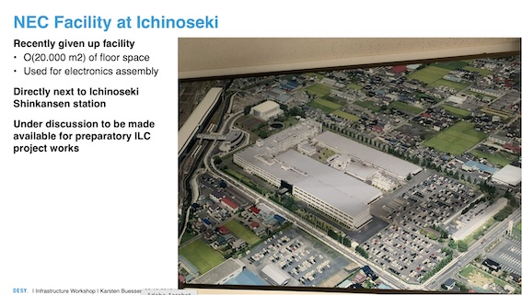
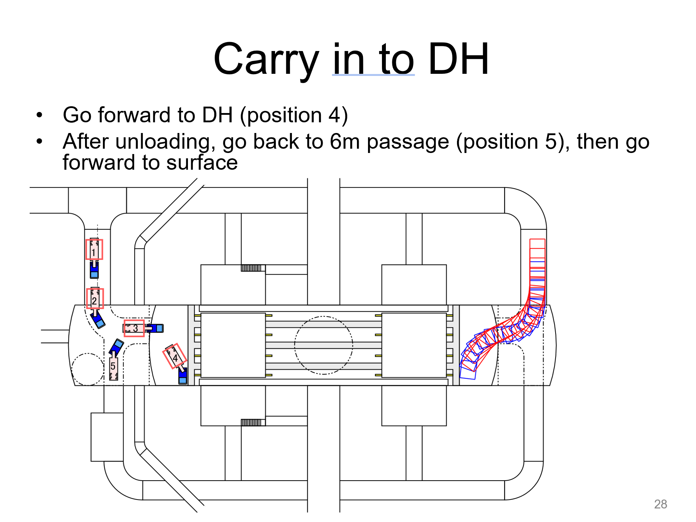
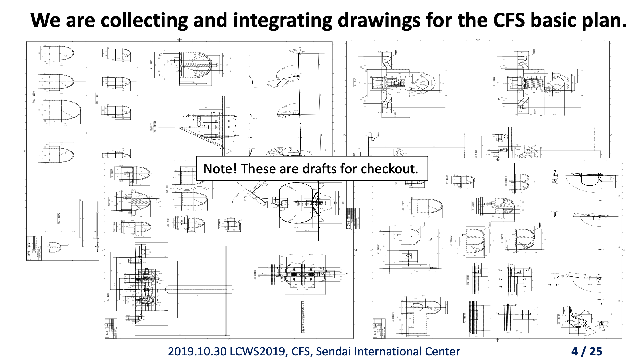
Siting and facility layout considertaions
2 campus model
Collection of CFS basic plan
Volume optimization
Layout considerations
Themes

Slide 8
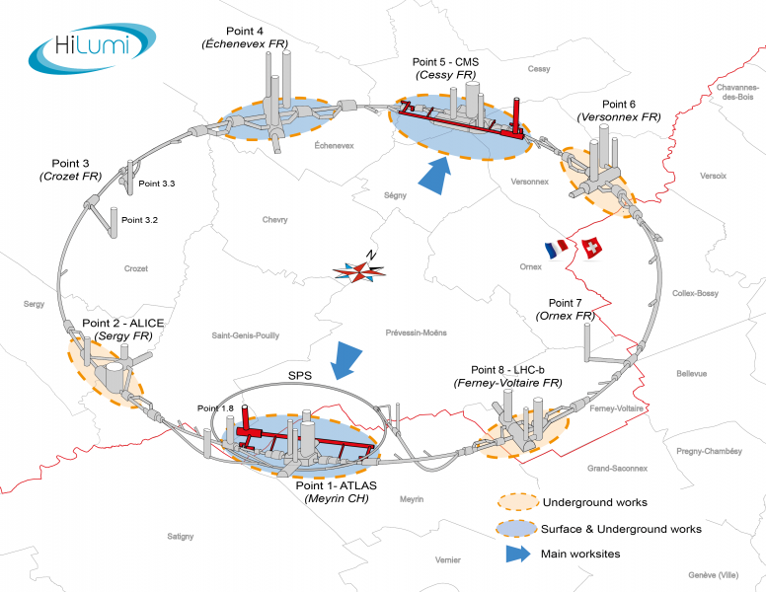
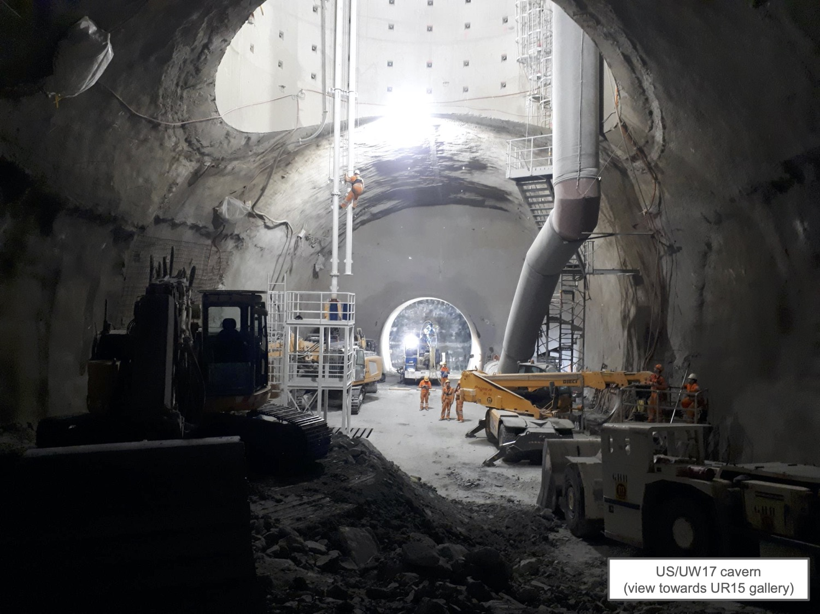
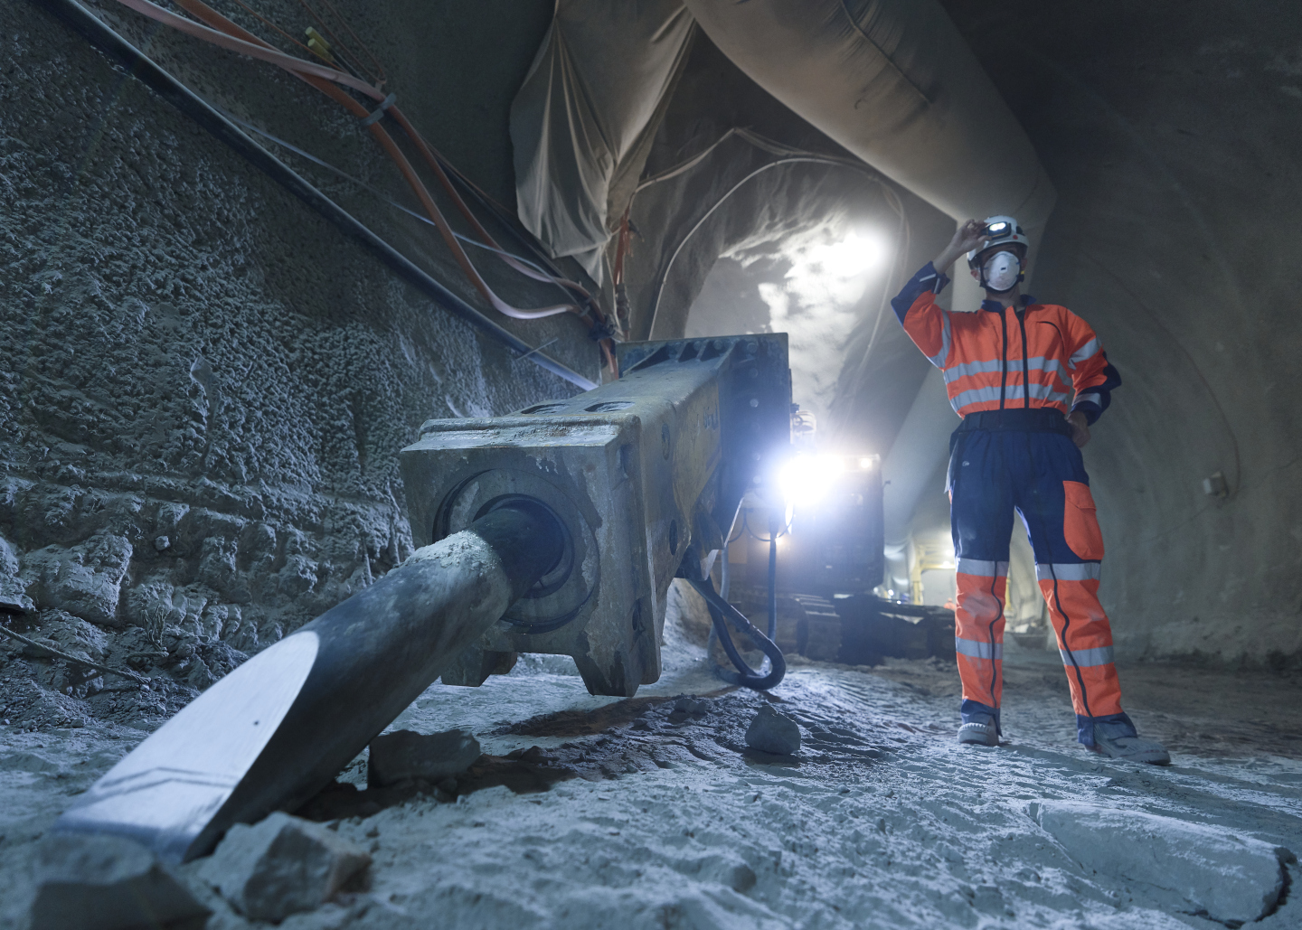
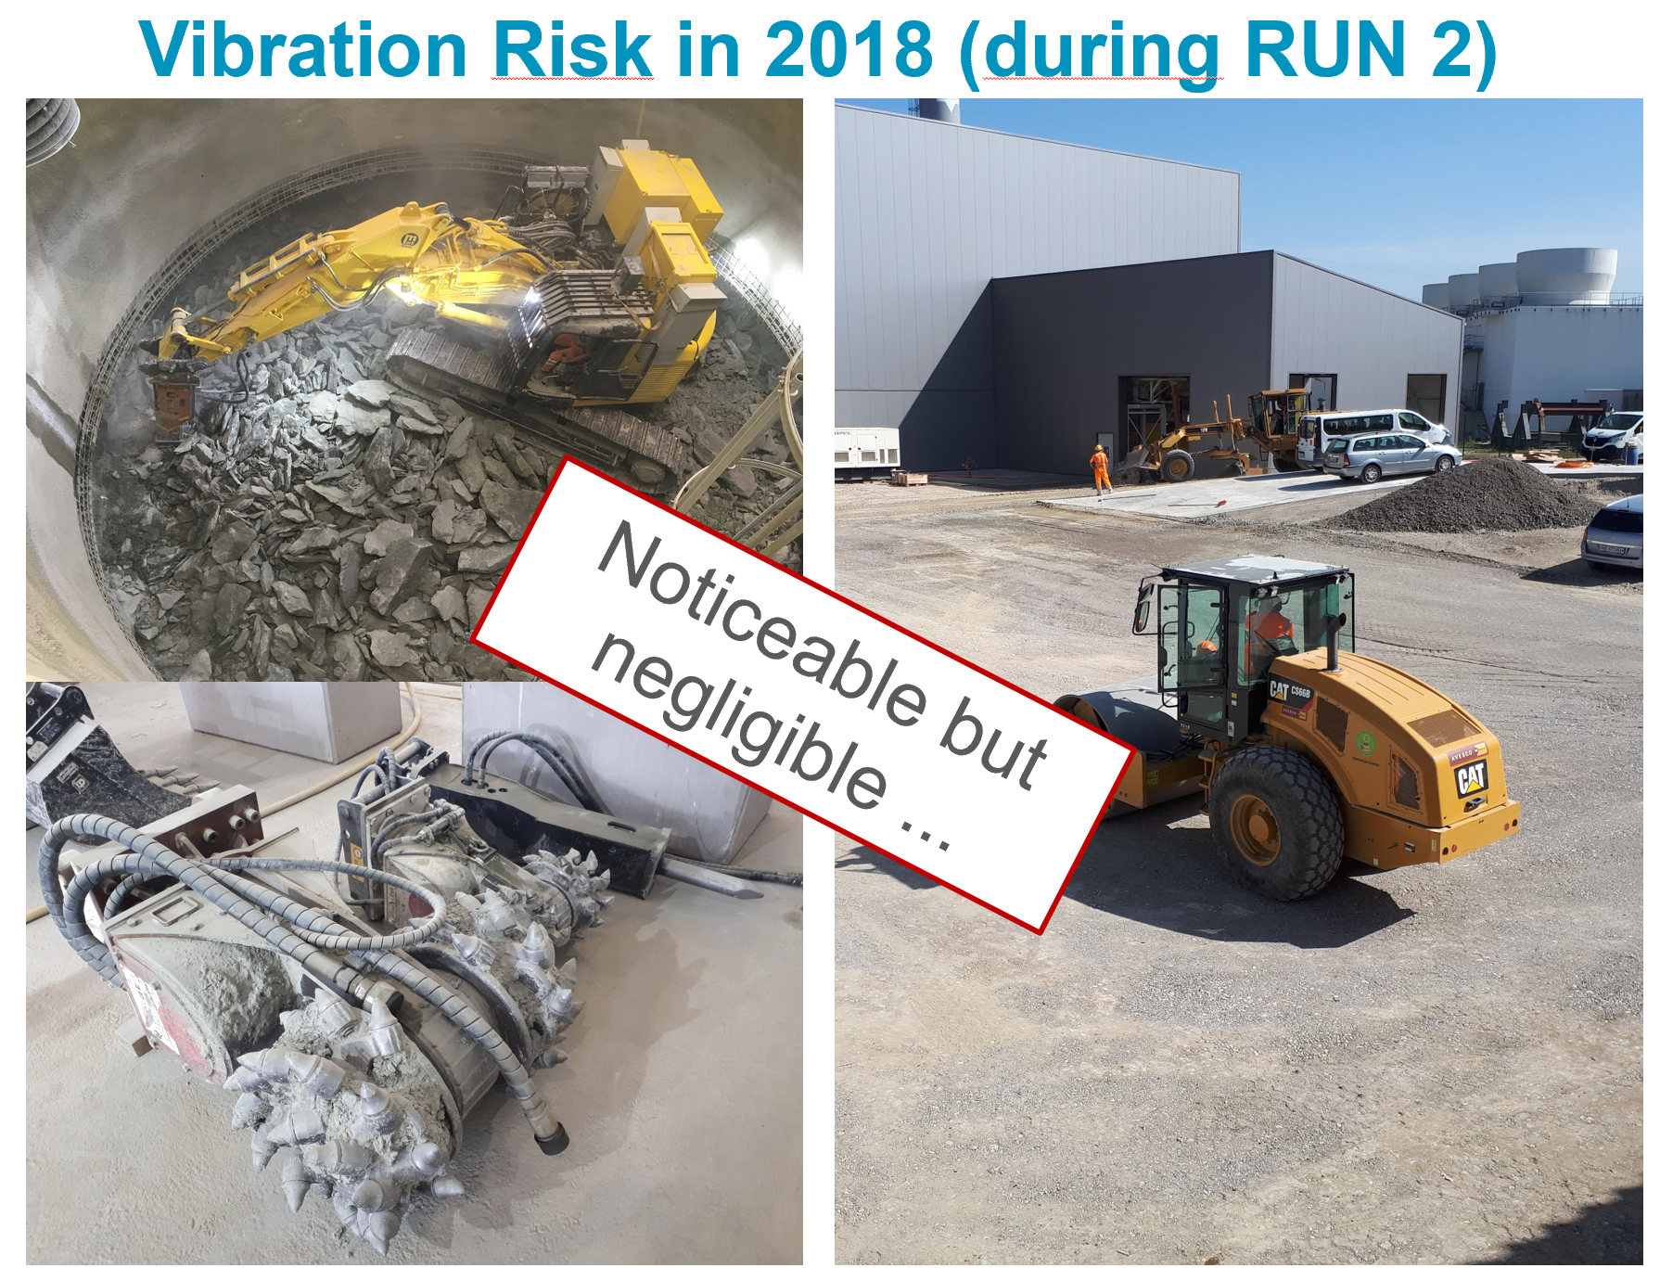
HL-LHC civil works & ILC upgrade studies
Themes
Diesel powered hydraulic hammer
… the LHC’s worst vibration nightmare …

Slide 9
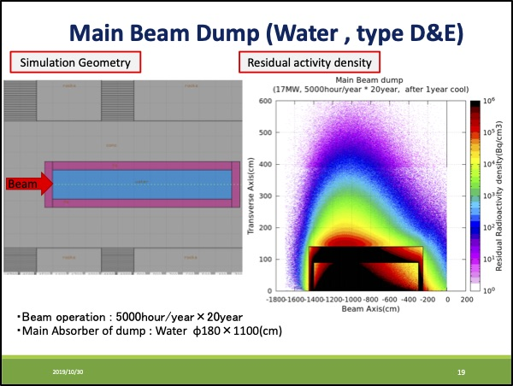
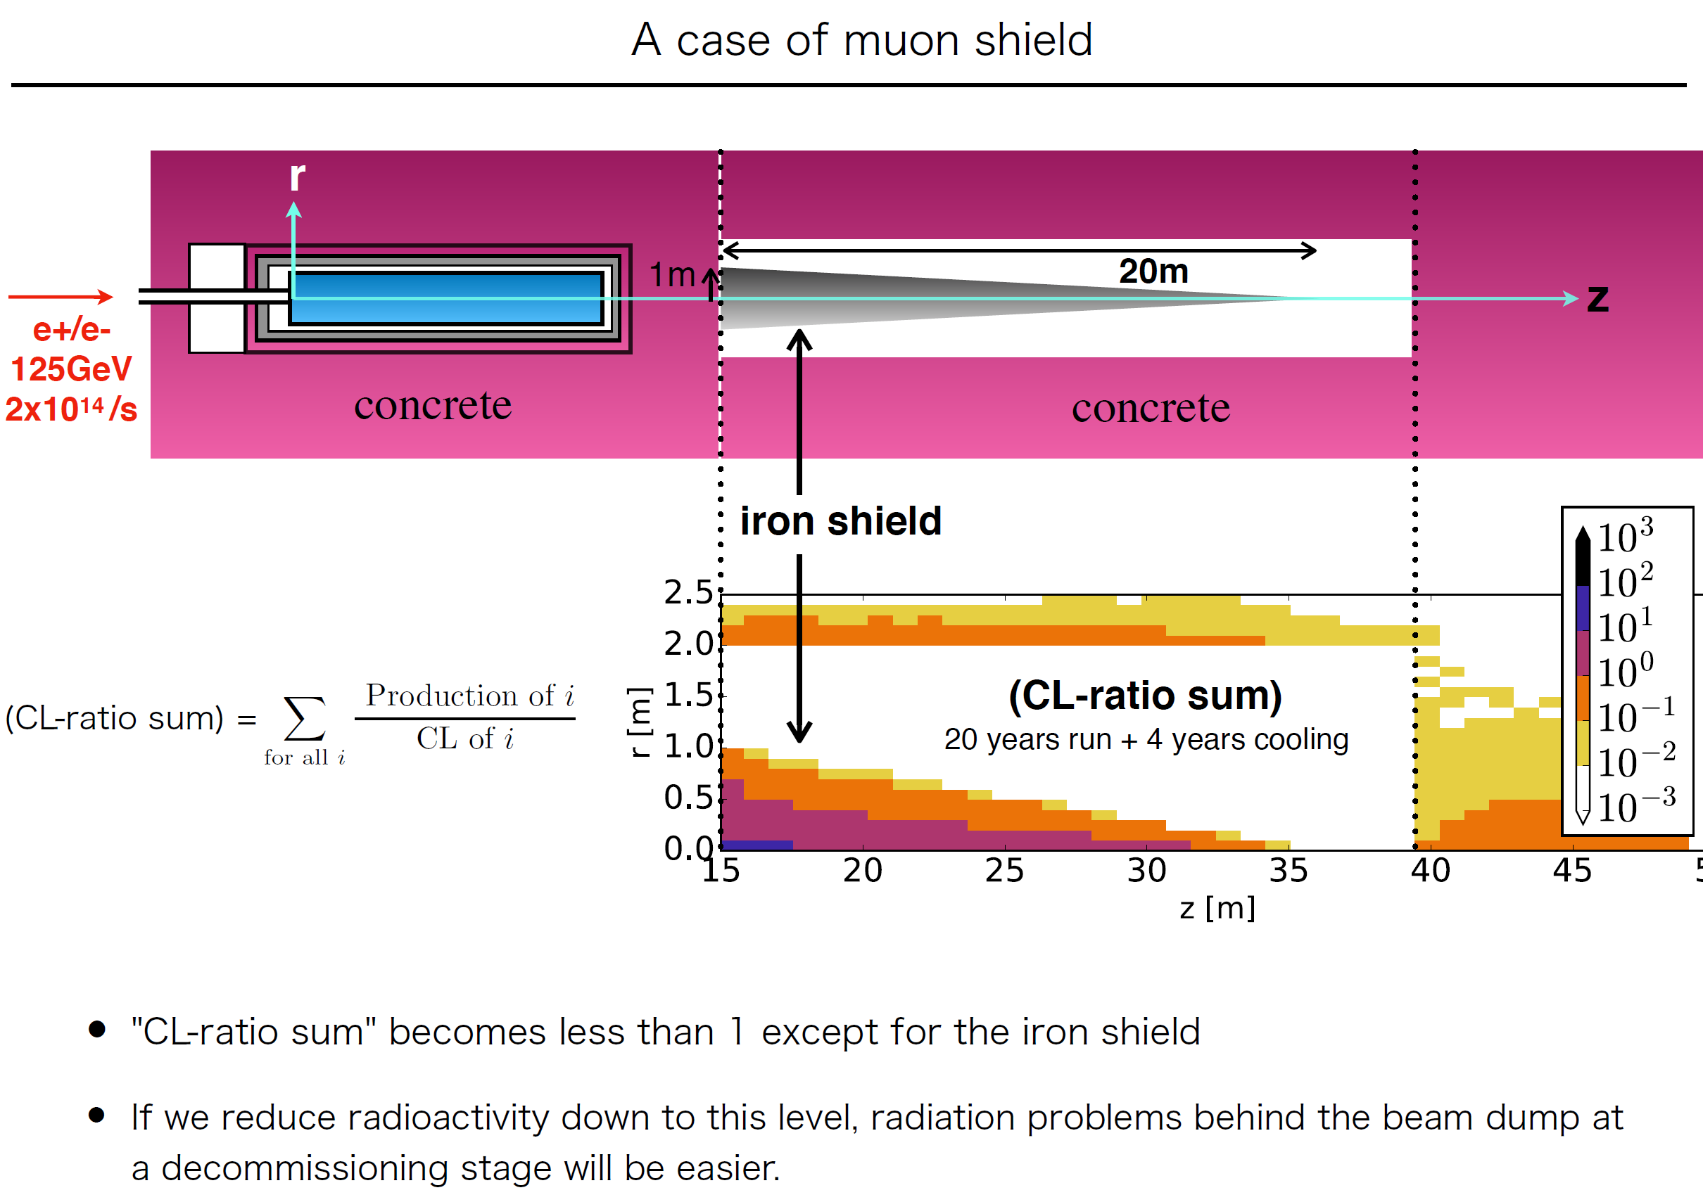
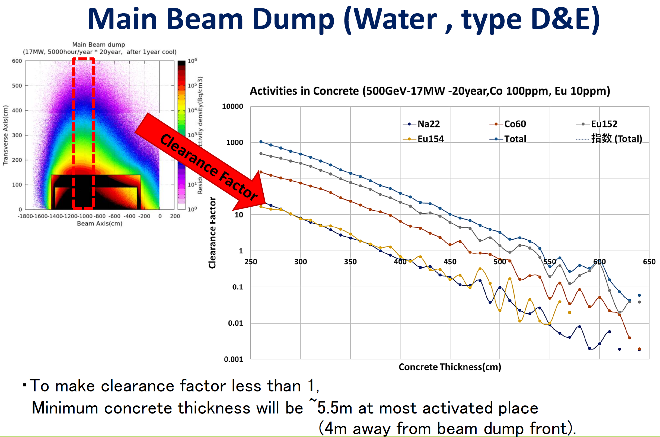
Dump shielding & Muon radiation
Themes

Slide 10
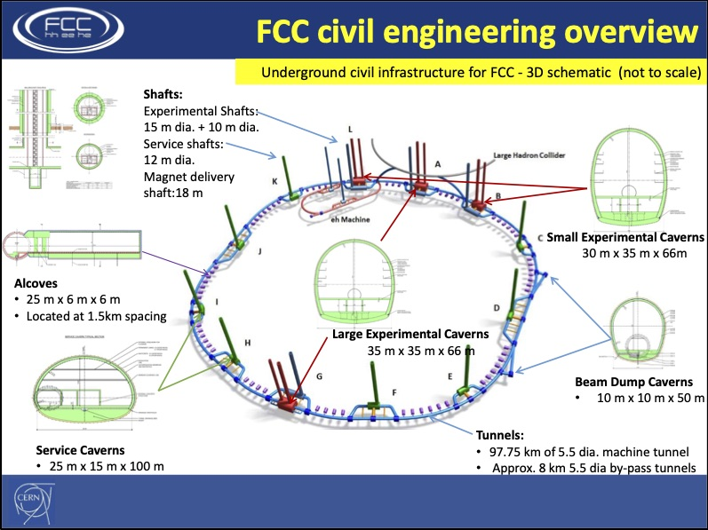

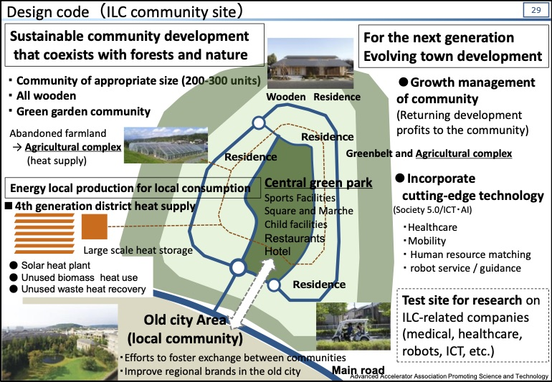
Infrastructure planning for FCC and CLIC /
Planning of green ILC community
Themes

Slide 11
Green Accelerator

Slide 12
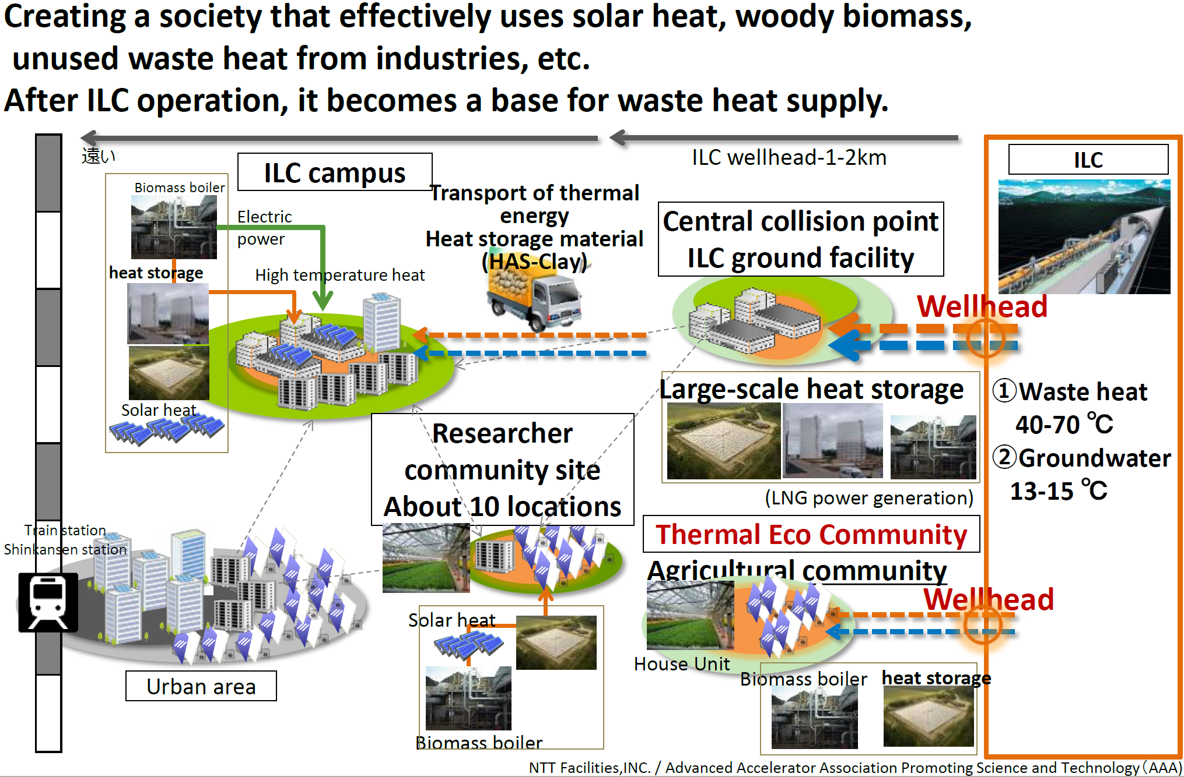
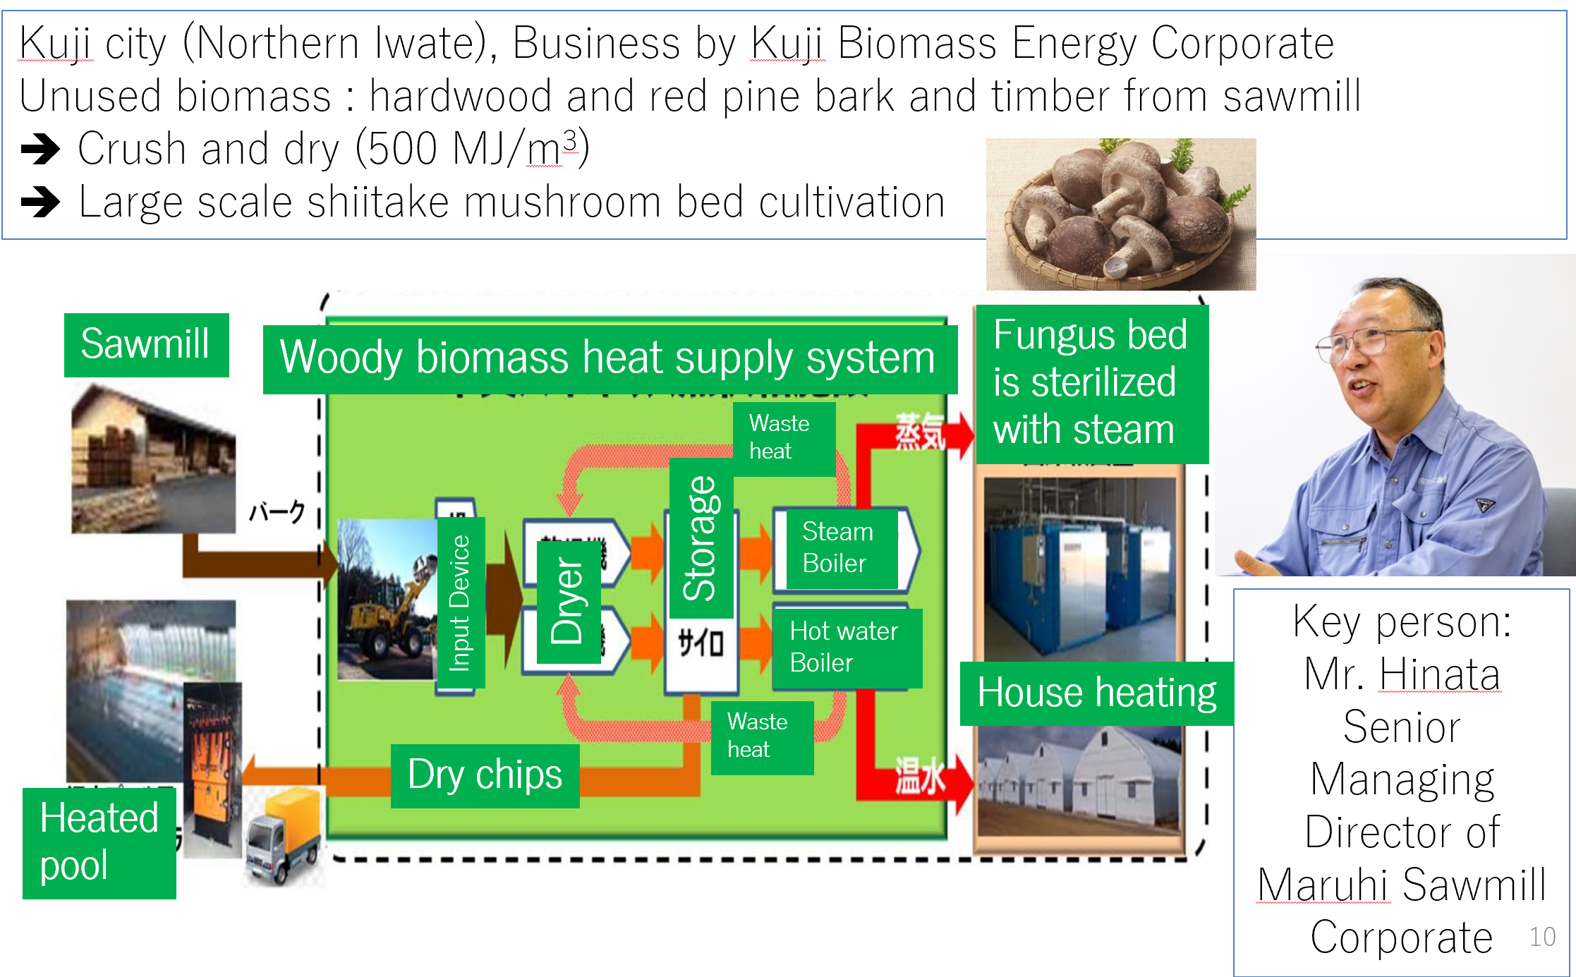
Renewable energy and waste heat usage
Solar heat utilization project in Iwate Prefectural University based on existing technology in Denmark
Waste heat recovery and offline transport is part of the concept (HAS-Clay)
Unused biomass will be used in surrounding industry (e.g. wood and wood chip drying, etc.)

Slide 13
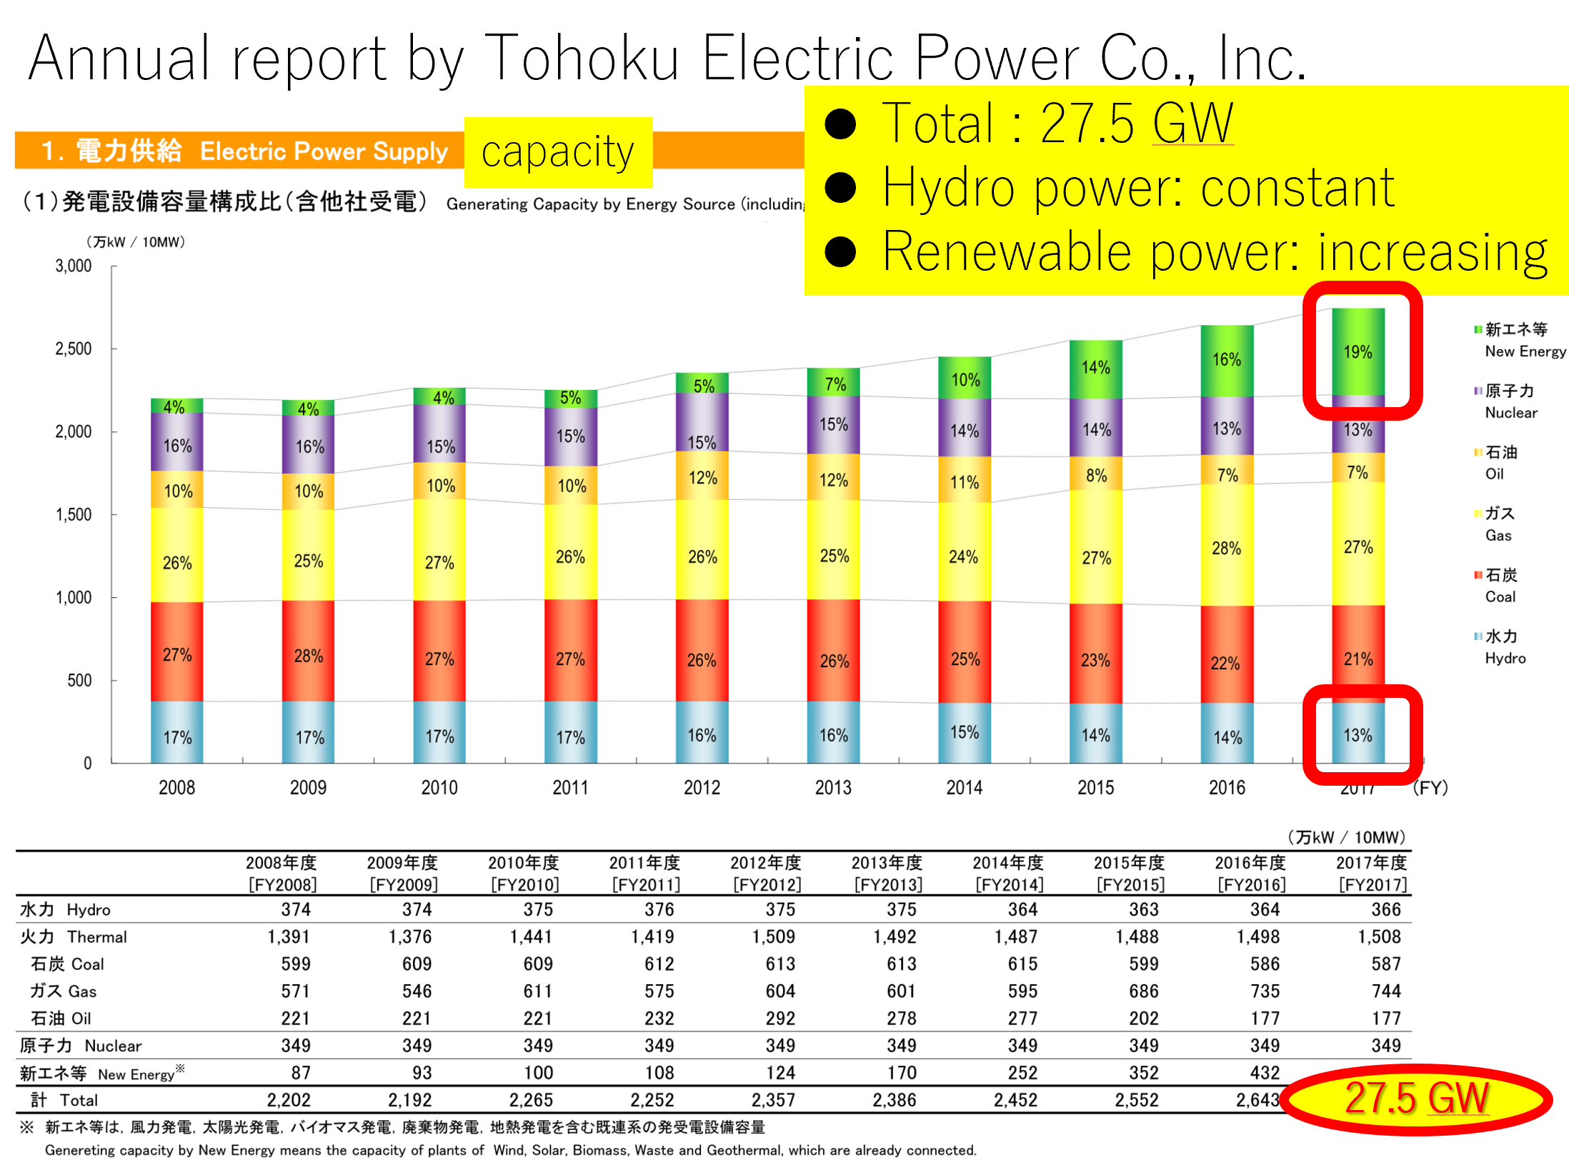
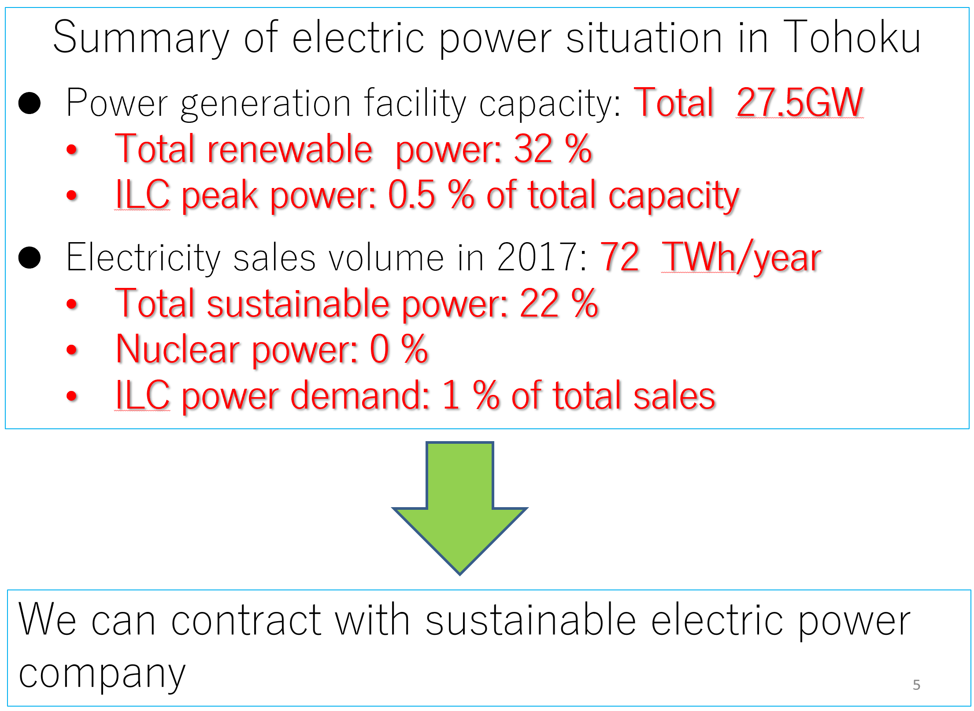
Electrical power situation in Tohoku

Slide 14
Further possibilities of energy saving
Proposal of solid-state amplifier for ILC in terms of Green Accelerator by R&K Company Limited
  Cost per watt constantly decreasing, performance constantly increasing
  Maybe worth to reevaluate SSAs for ILC
Would have impact on e.g. waveguide design, LLRF systems, tunnel layout, etc.

Slide 15
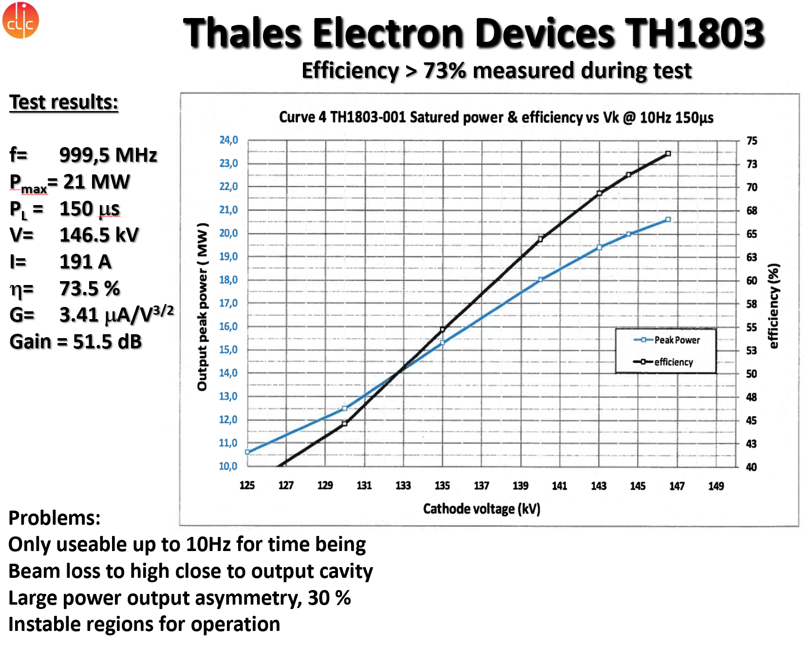
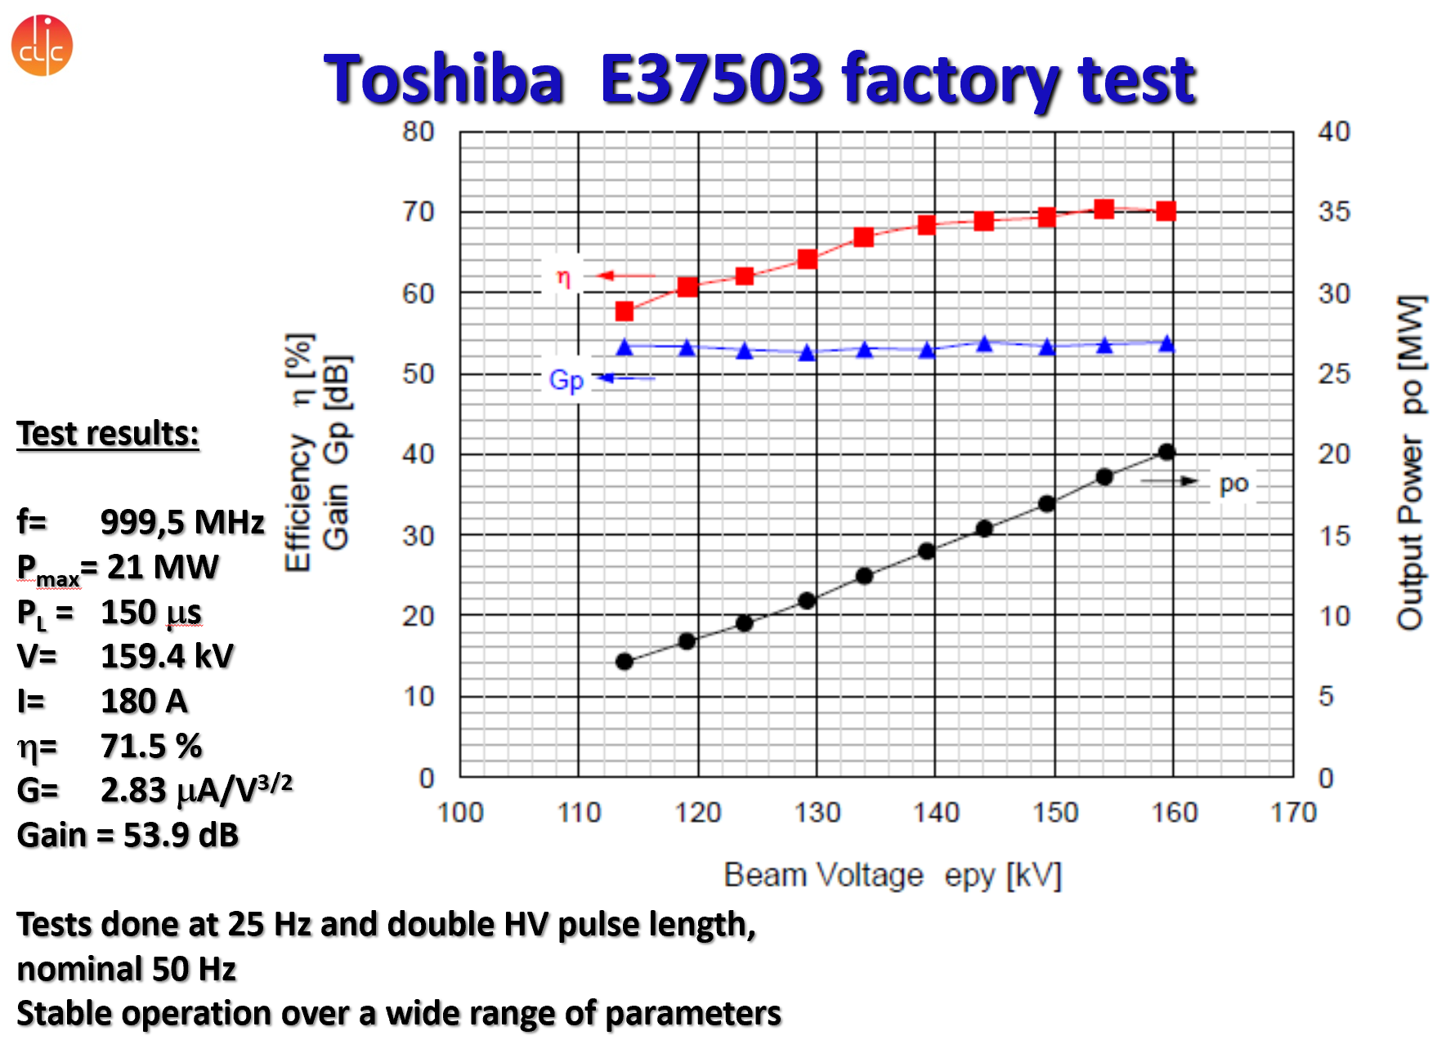
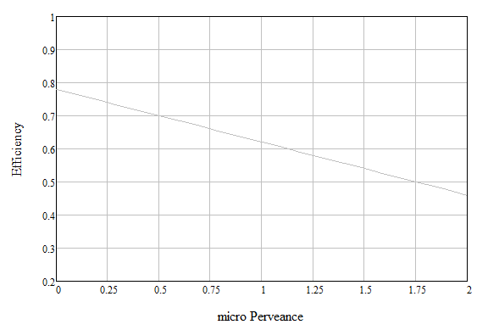
Increase klystron and modulator efficiency
Efforts at CERN in scope of CLIC
Klystron prototypes tested together with Thales and Toshiba (Canon)
L-MBK CLIC, 20 MW
L-SNS, 0.55 MW
L-MBK ILC,10 MW
L-ESS,1.5 MW
UHF-LHC
0.3 MW
UHF-B-factory
1.25 MW
industrial empirical limit
X-KEK
PPM, 50 MW
X-CERN
6 MW
S-SLAC
65 MW
X-CERN
50 MW
S-band
Industry
ITT 2960
33 MW
Klystrons for science
(µA/V^{1.5})

Slide 16
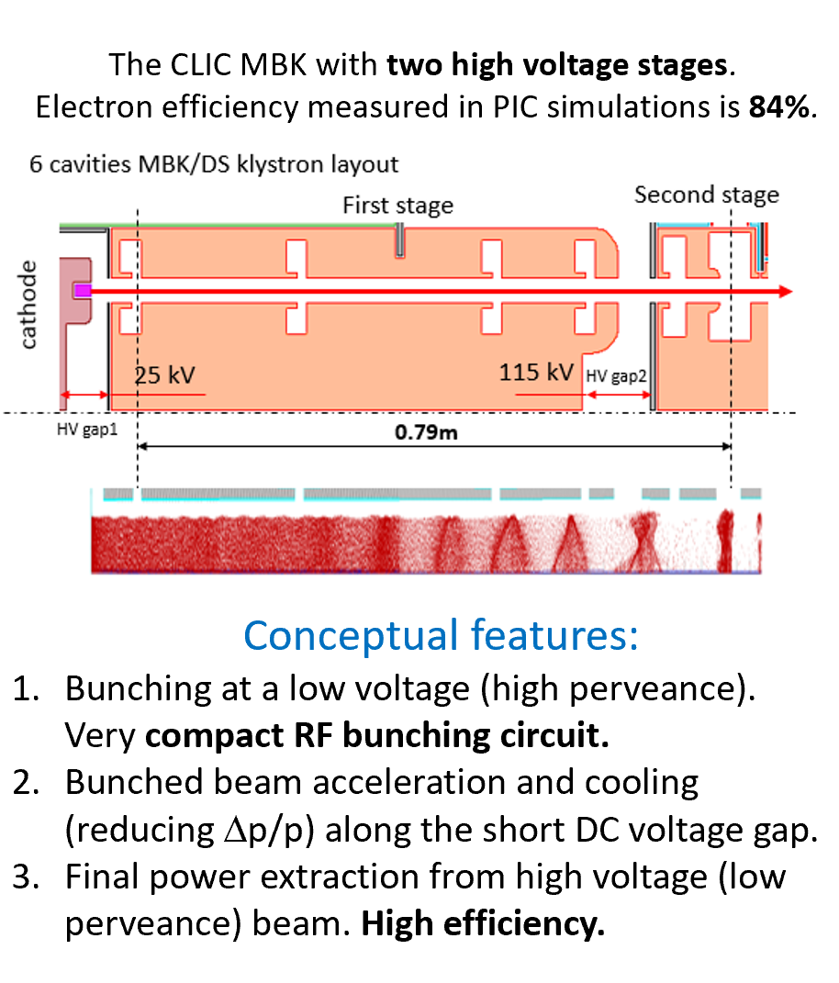
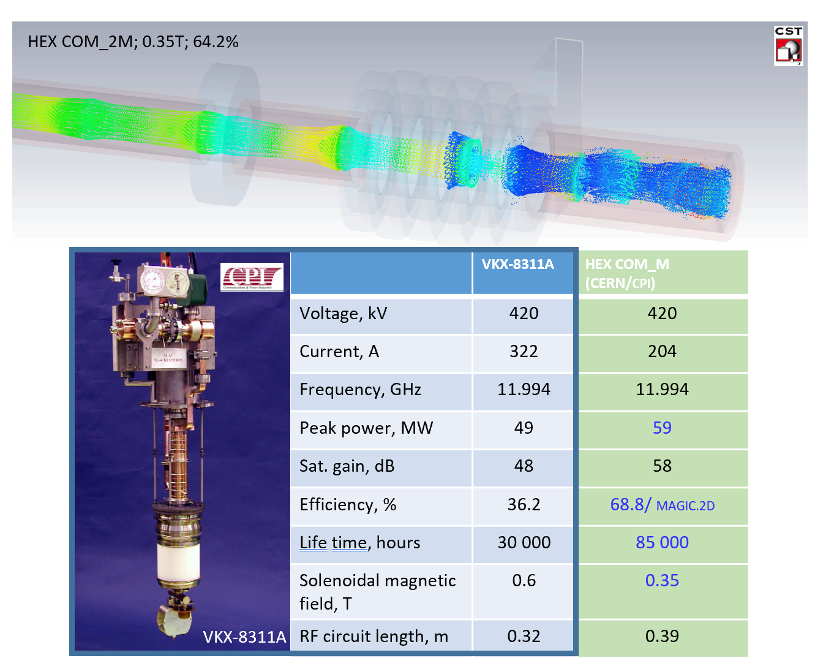
Development of new klystrons at CERN
New bunching methods and simulation tools
L-MBK/2S
CLIC, 24 MW
L-FCC, 1.5 MW
L-MBK ILC, 10 MW
UHF-LHC
0.35 MW
L-MBK CLIC, 20 MW
L-SNS, 0.55 MW
X-CERN,50 MW
L-ESS,1.5 MW
X-CERN, 8 MW
S-Canon
7.5 MW
X-BVERI
50 MW
UHF-LHC
0.3 MW
UHF-B-factory
1.25 MW
X-Toshiba
PPM, 50 MW
X-Canon
6 MW
S-SLAC
65 MW
X-CPI
50 MW
S-band
Industry
S-SLAC
150 MW
Klystrons for science
ITT 2960
33 MW
HE design, CERN (PIC simulations)
HE industrial prototype ; off shelf
(µA/V^{1.5})

Slide 17
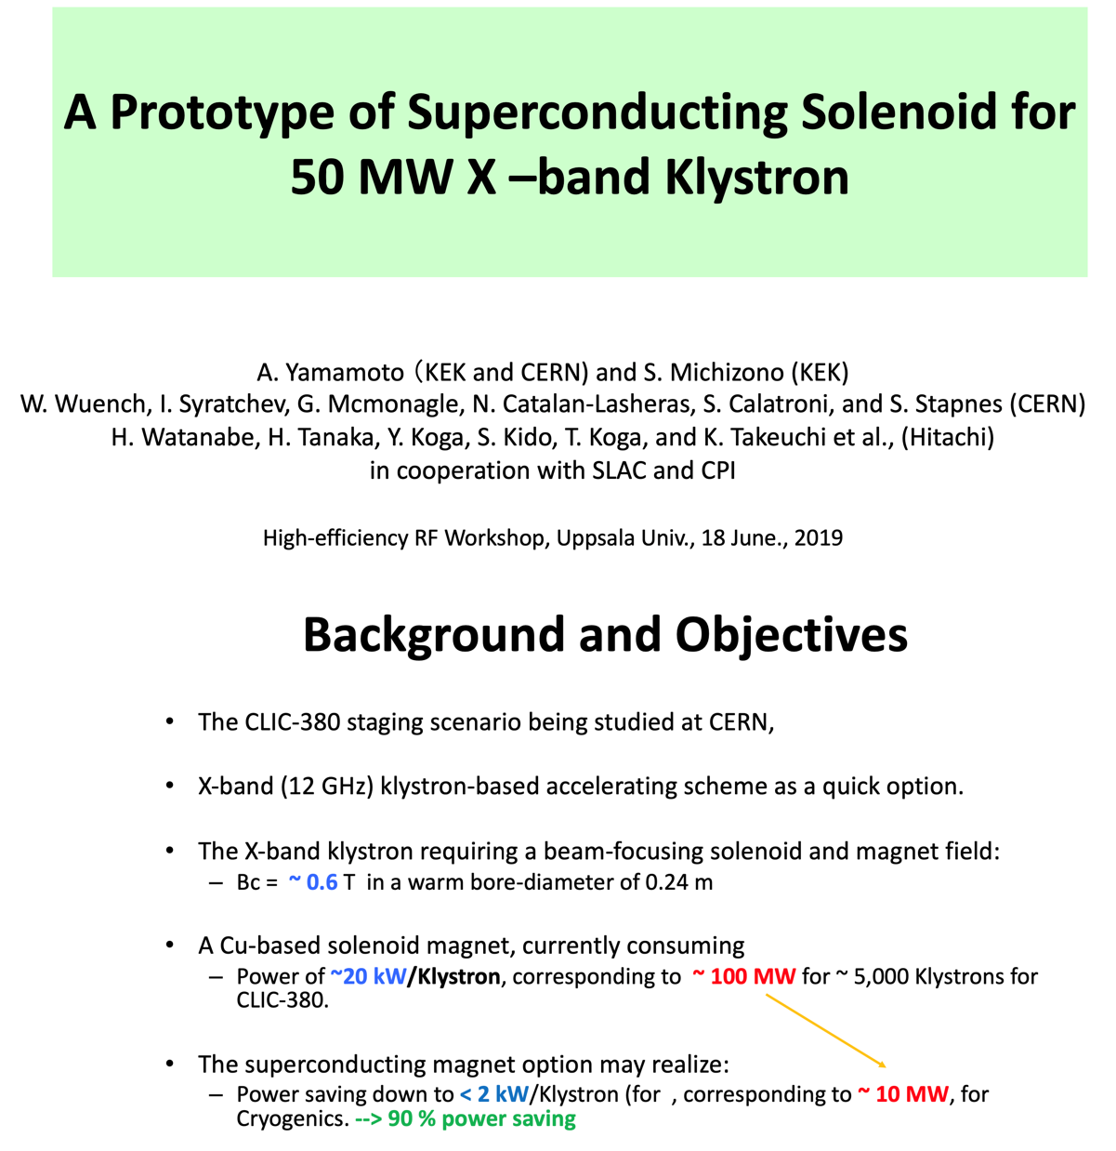
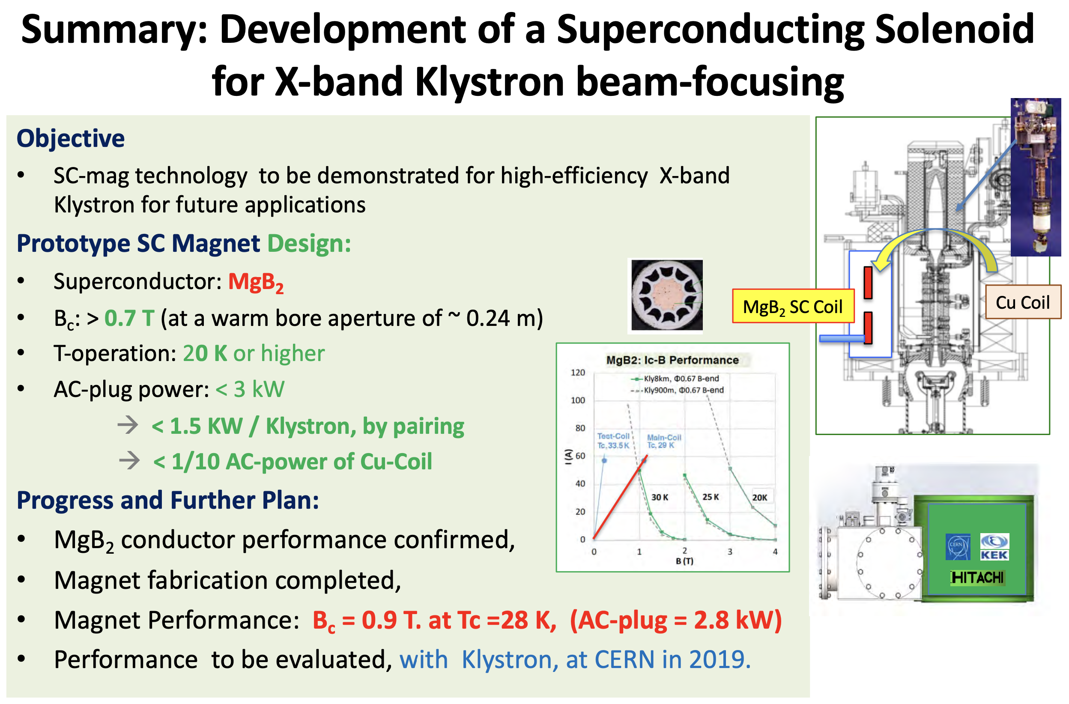
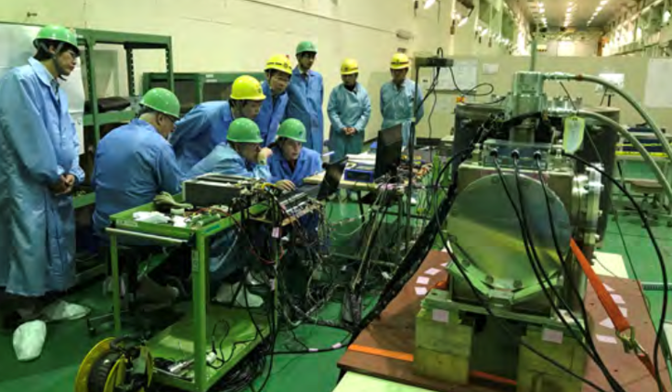
Increase klystron efficiency
Common themes

Slide 18
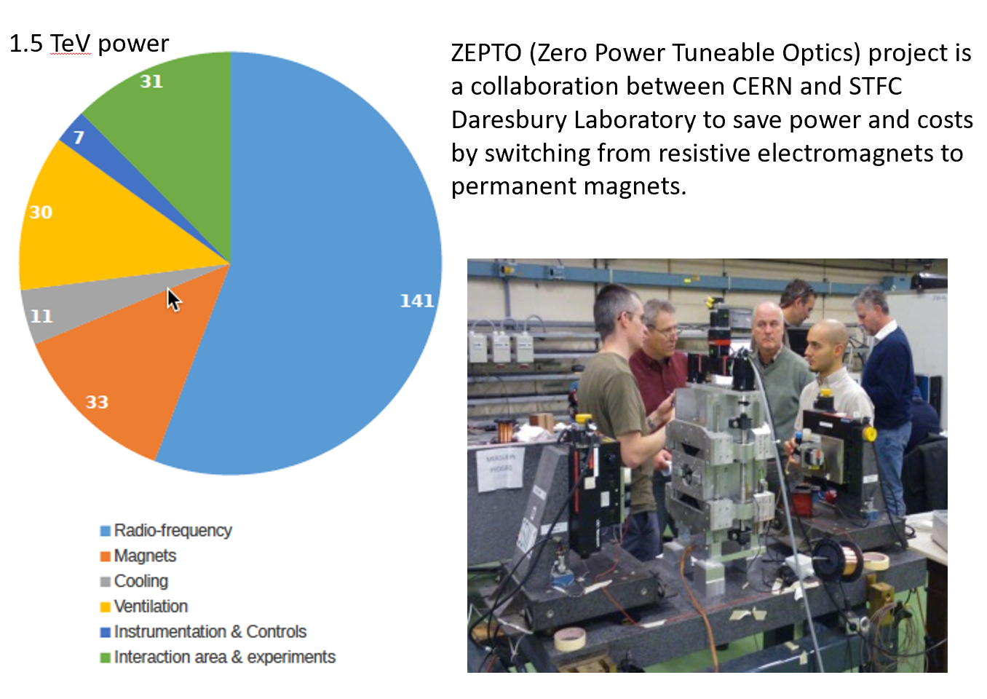
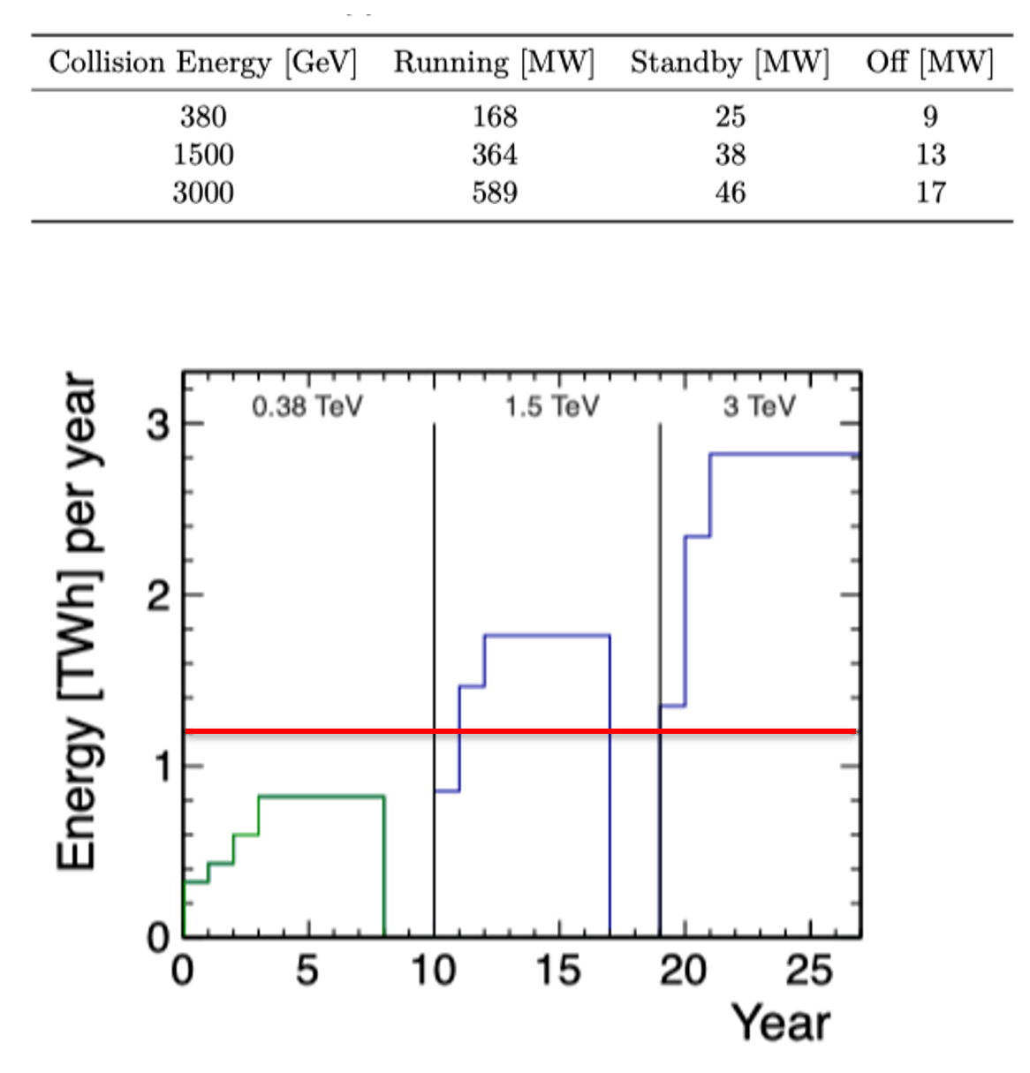
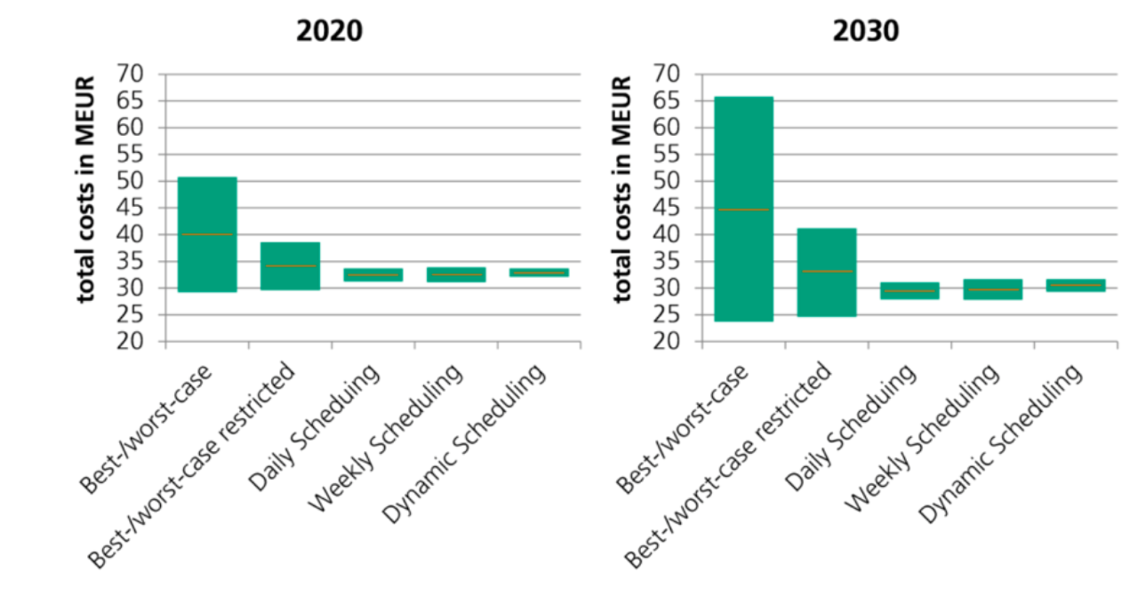
Reduction of operation cost studies for CLIC
Usage of permanent magnets (also being considered for ILC)
Operations schedule following energy prices
Study by Fraunhofer

Slide 19
Sources

Slide 20
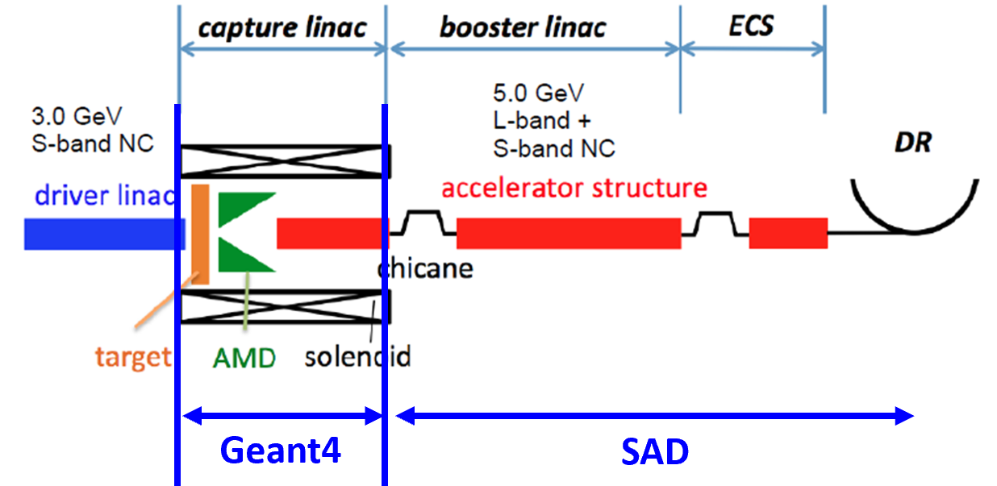
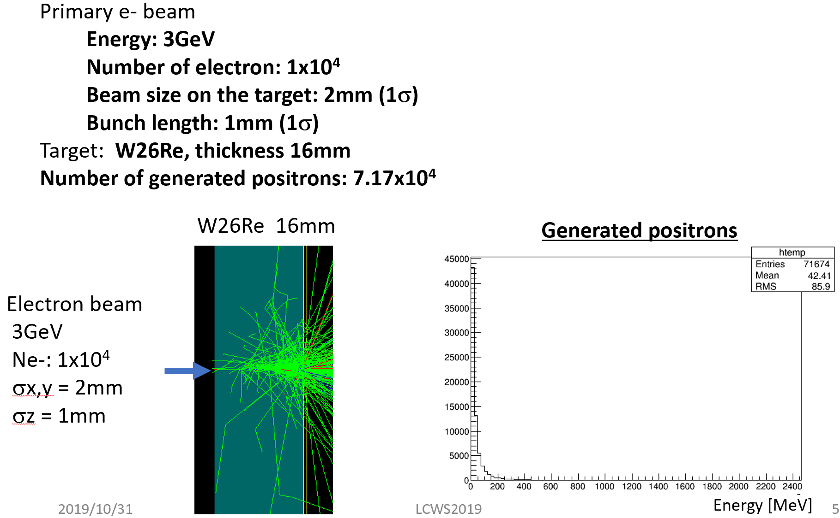
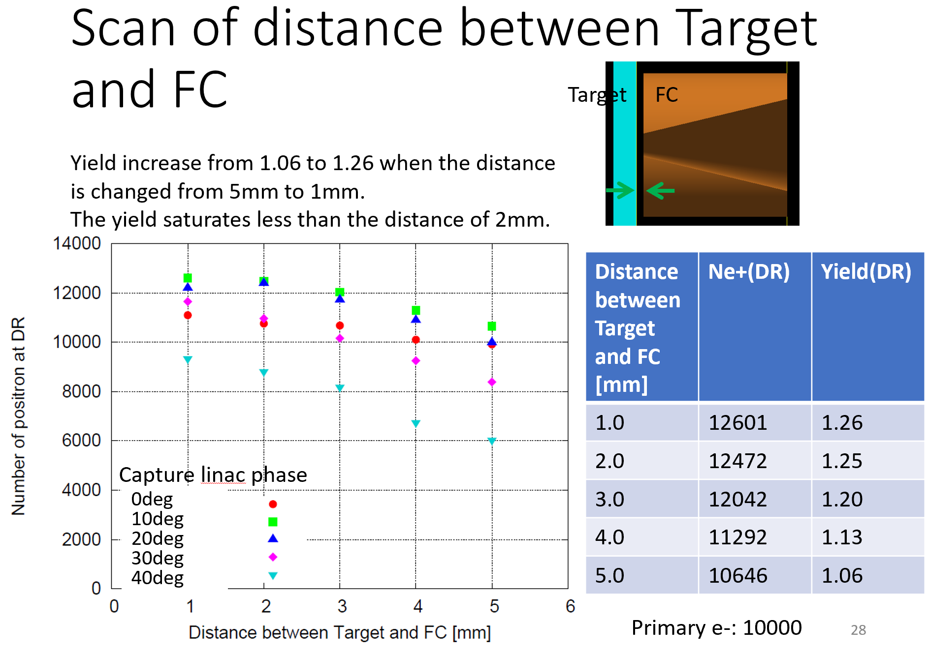
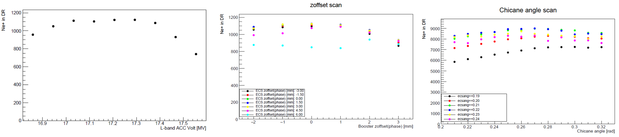
Simulation of e- driven scheme
Results from previous simulations confirmed
Parameter scan (L-band Vacc, z offset, chicane angle, etc.)
Notes:
flux concentrator

Slide 21
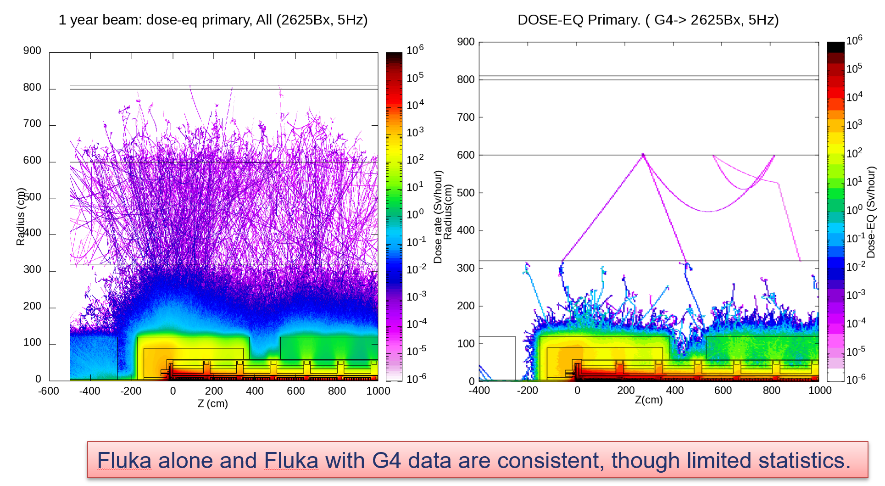
Simulation of radiation environment of e- driven positron source
Realistic geometries, but not actual ones yet
  Gives an idea for following engineering design
Developed tools can be used for final design

Slide 22
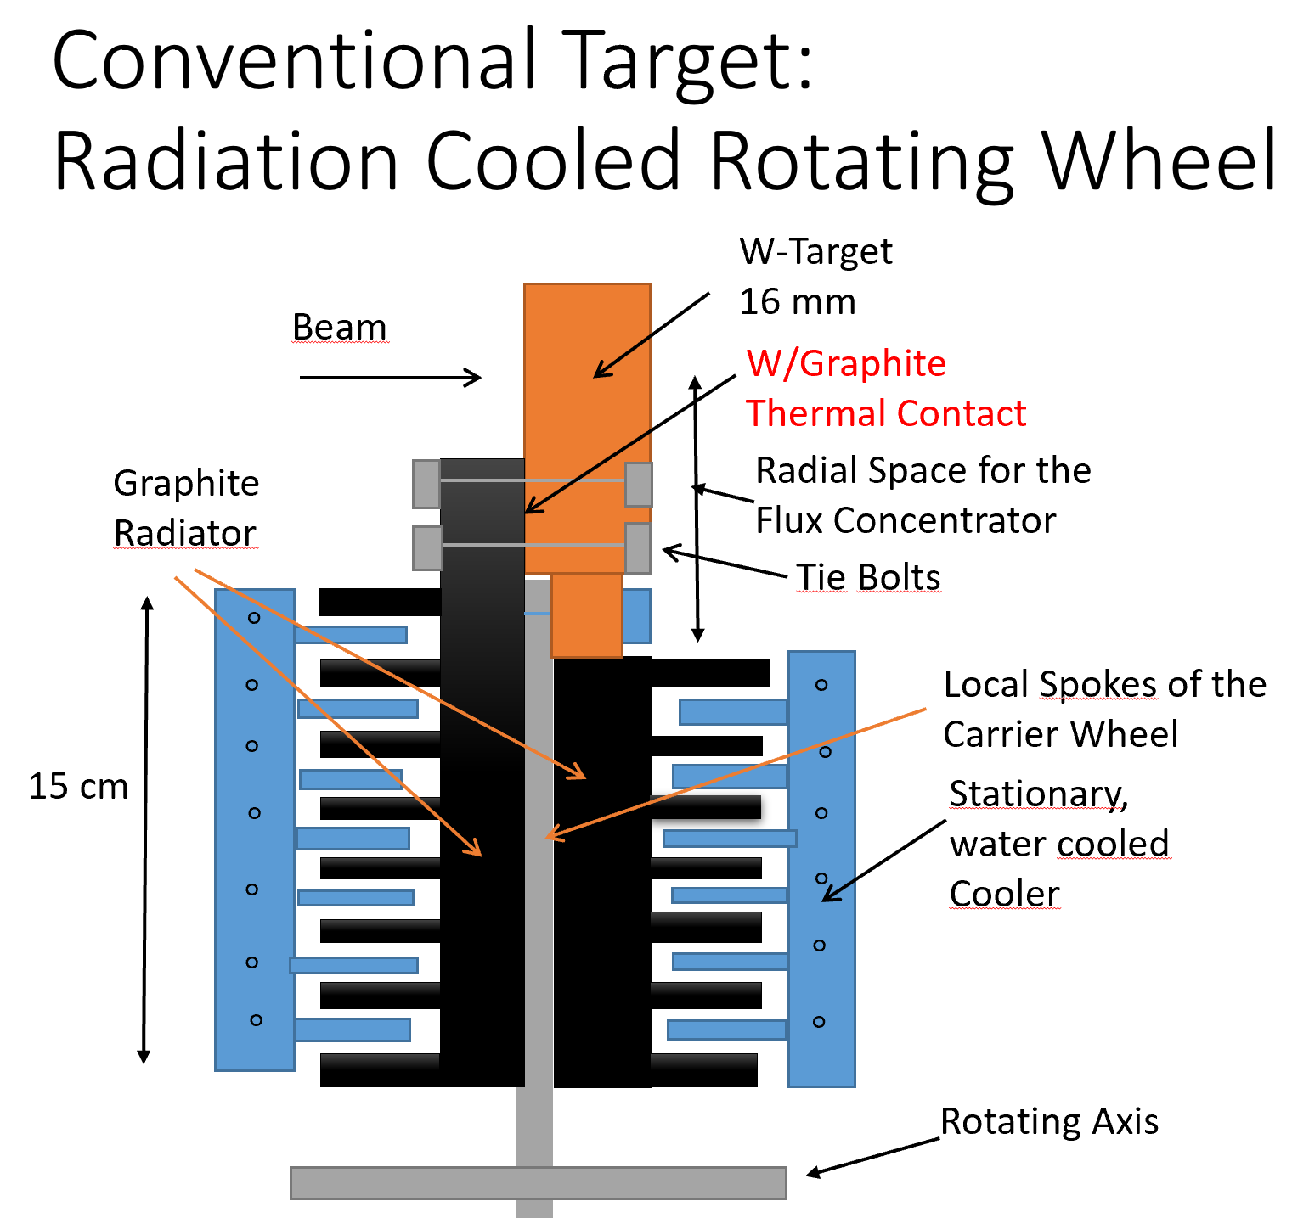
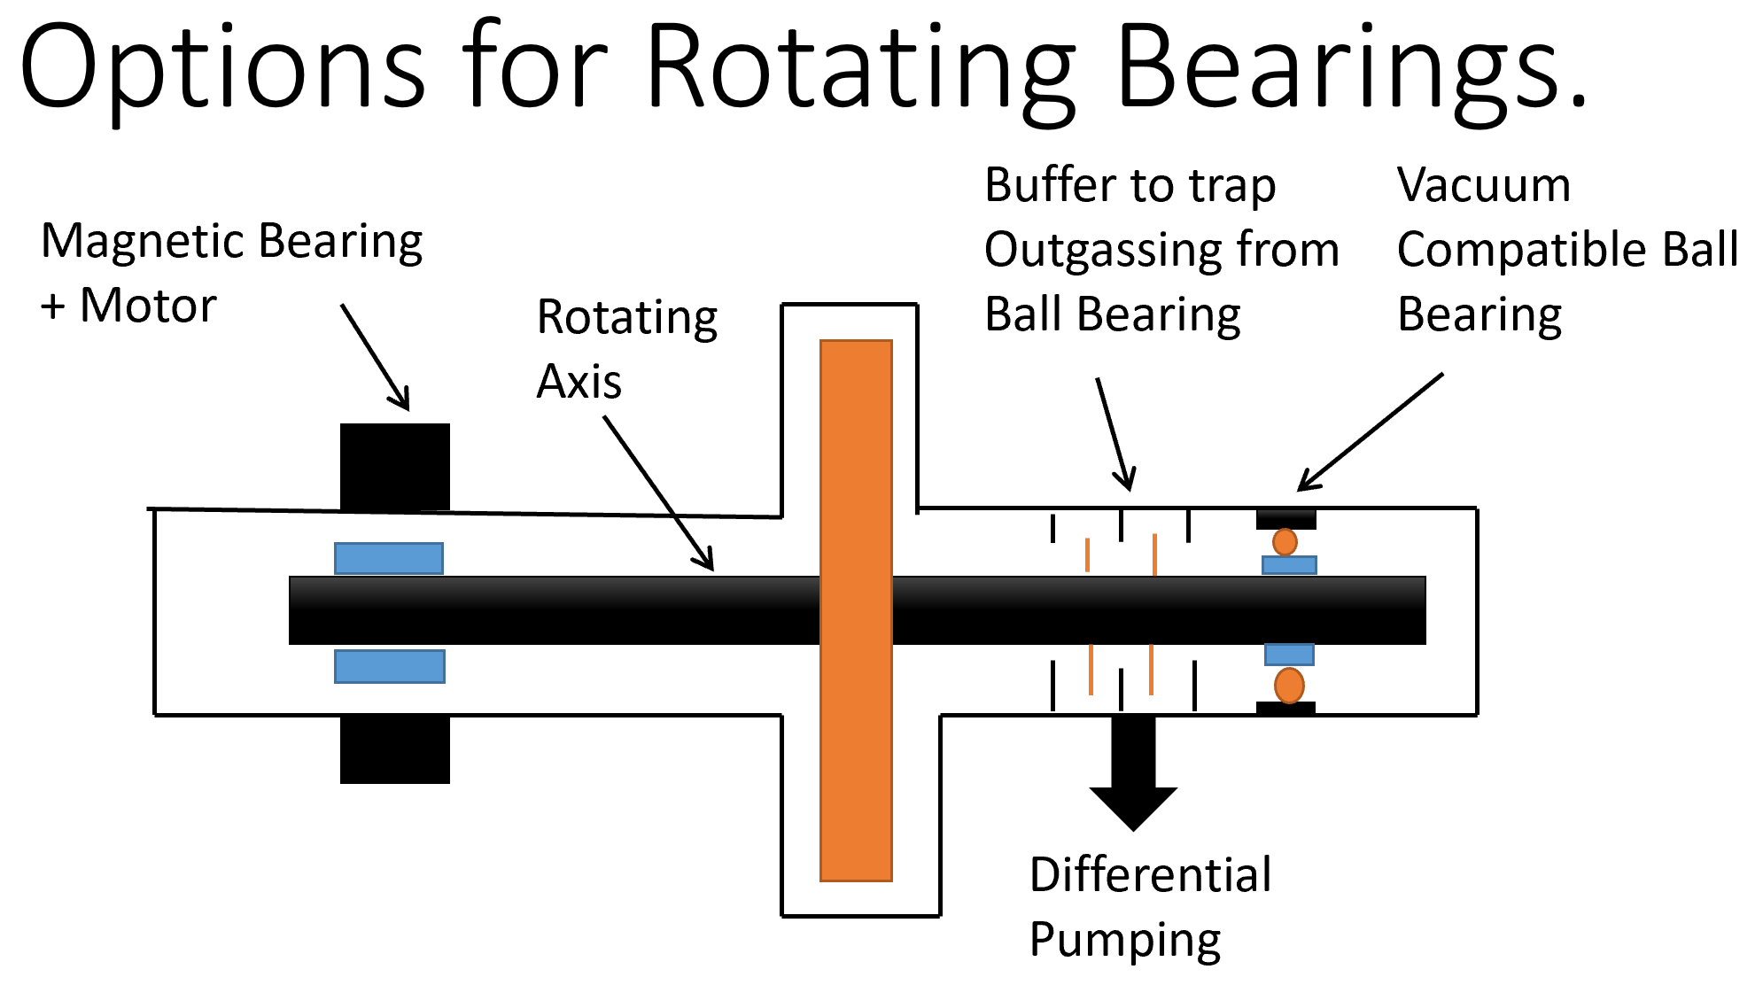
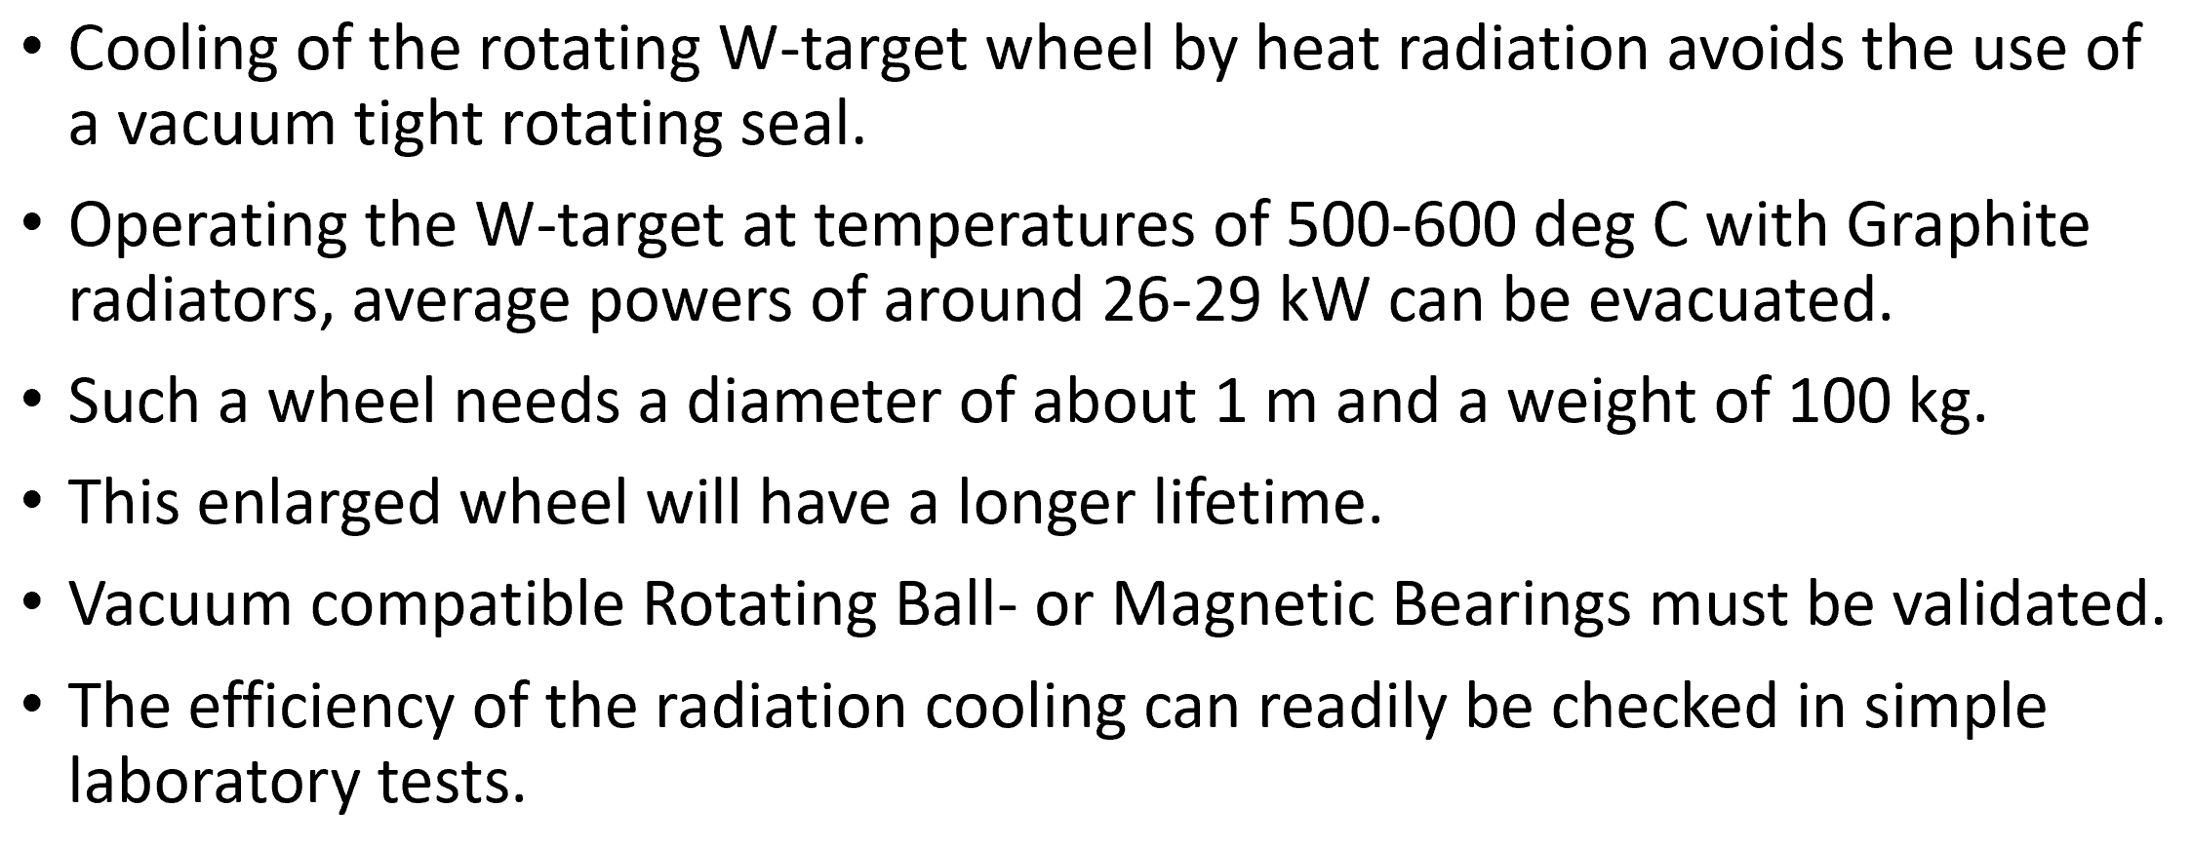
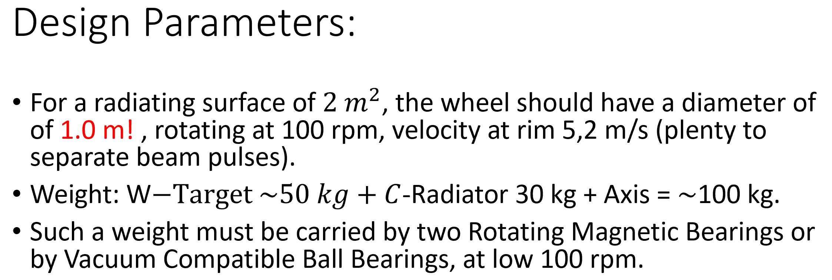
Thermal radiation cooled conventional target
Themes

Slide 23
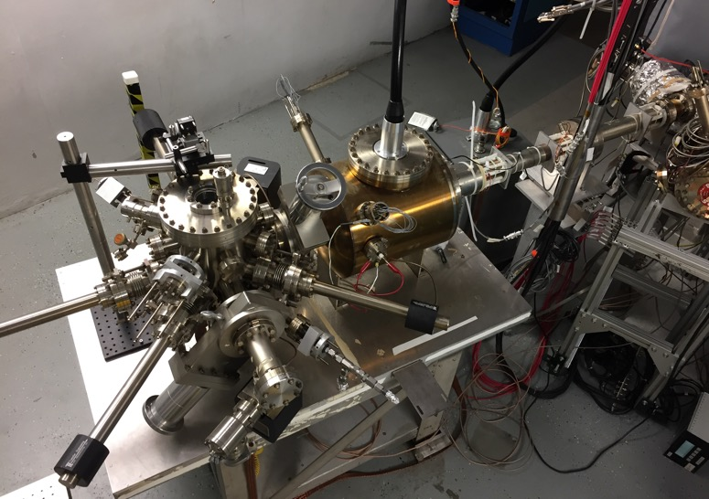
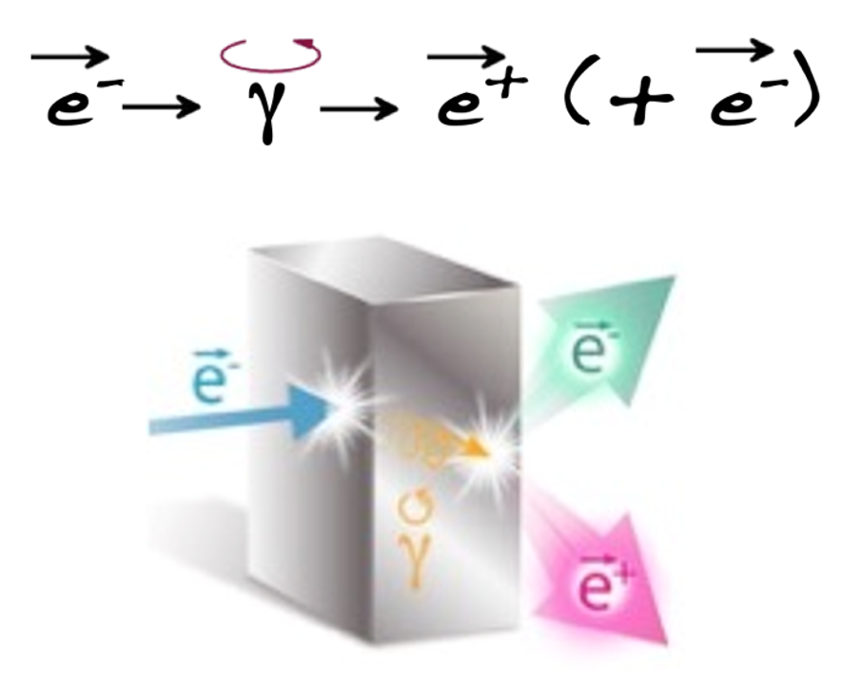
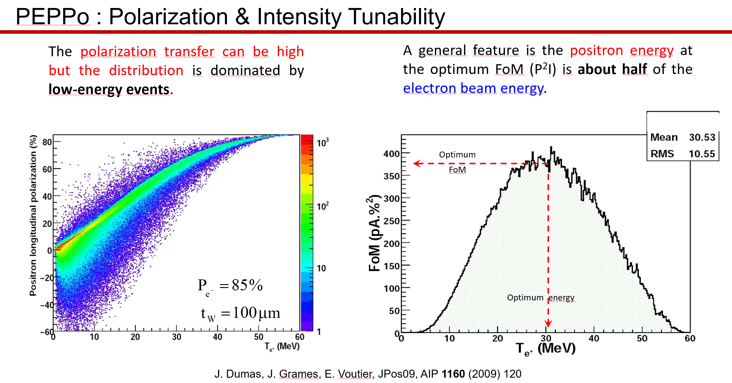
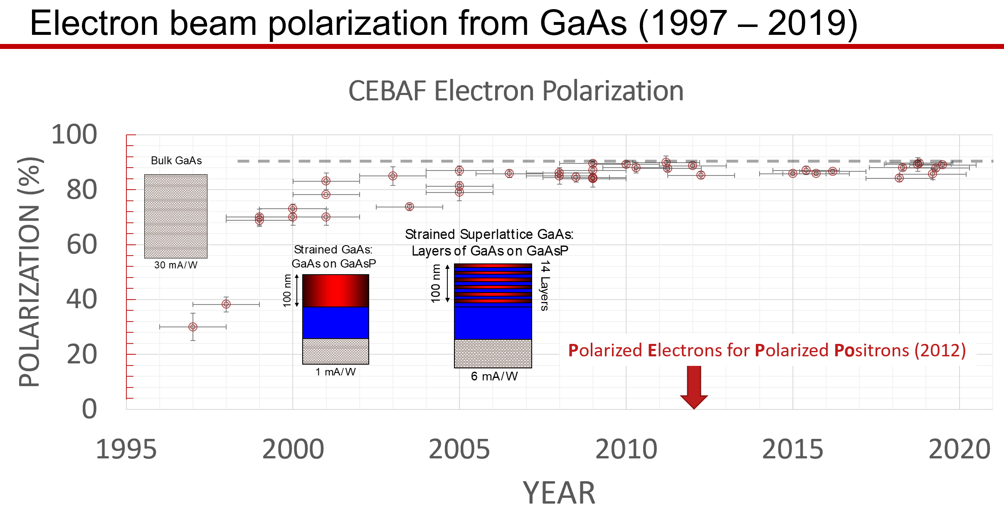
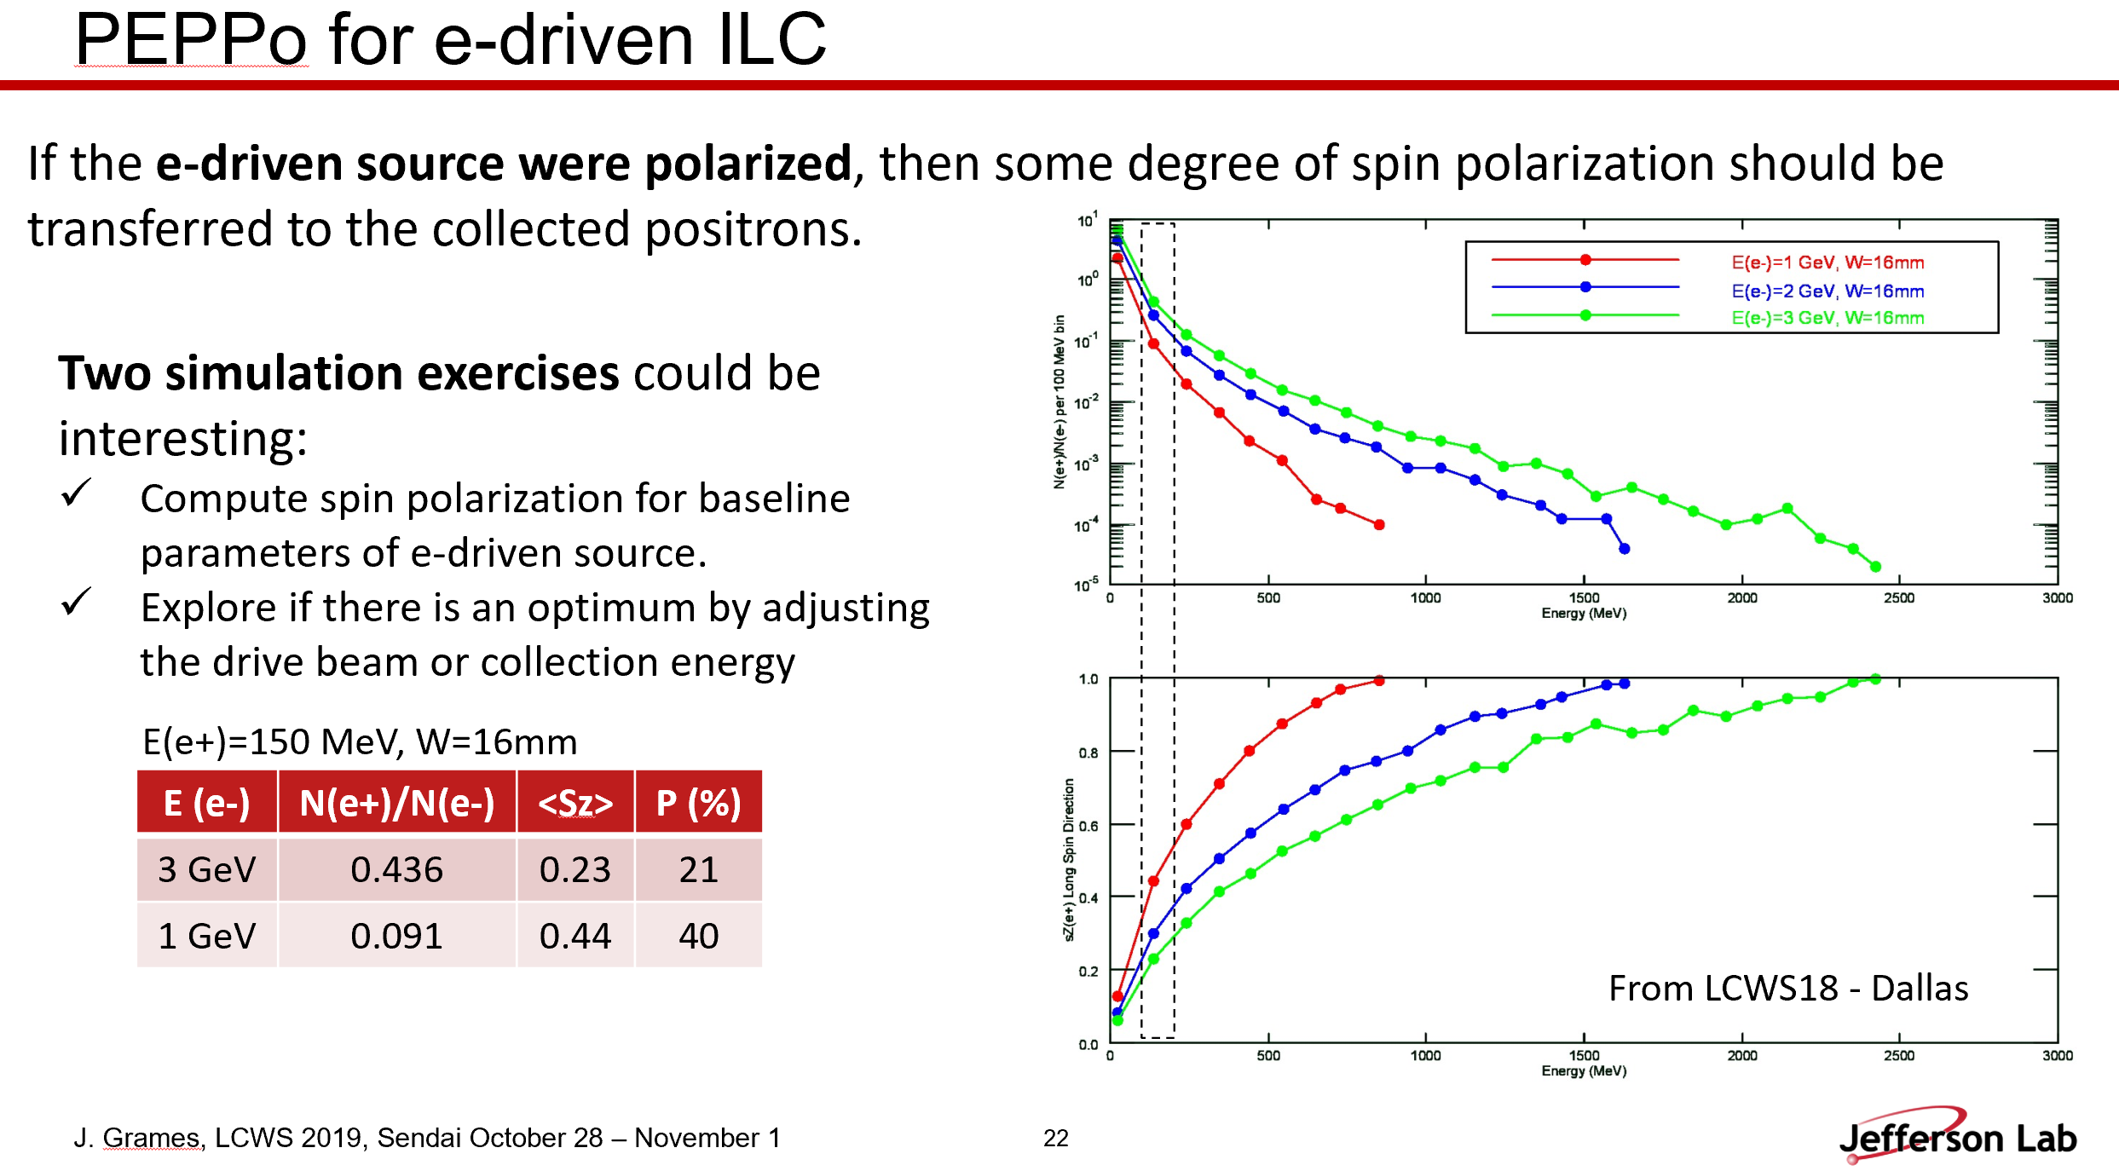
Polarized Electron Source R&D at JLab
Themes

Slide 24
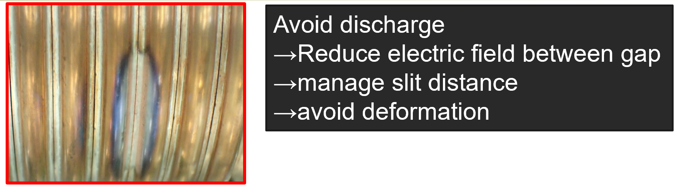
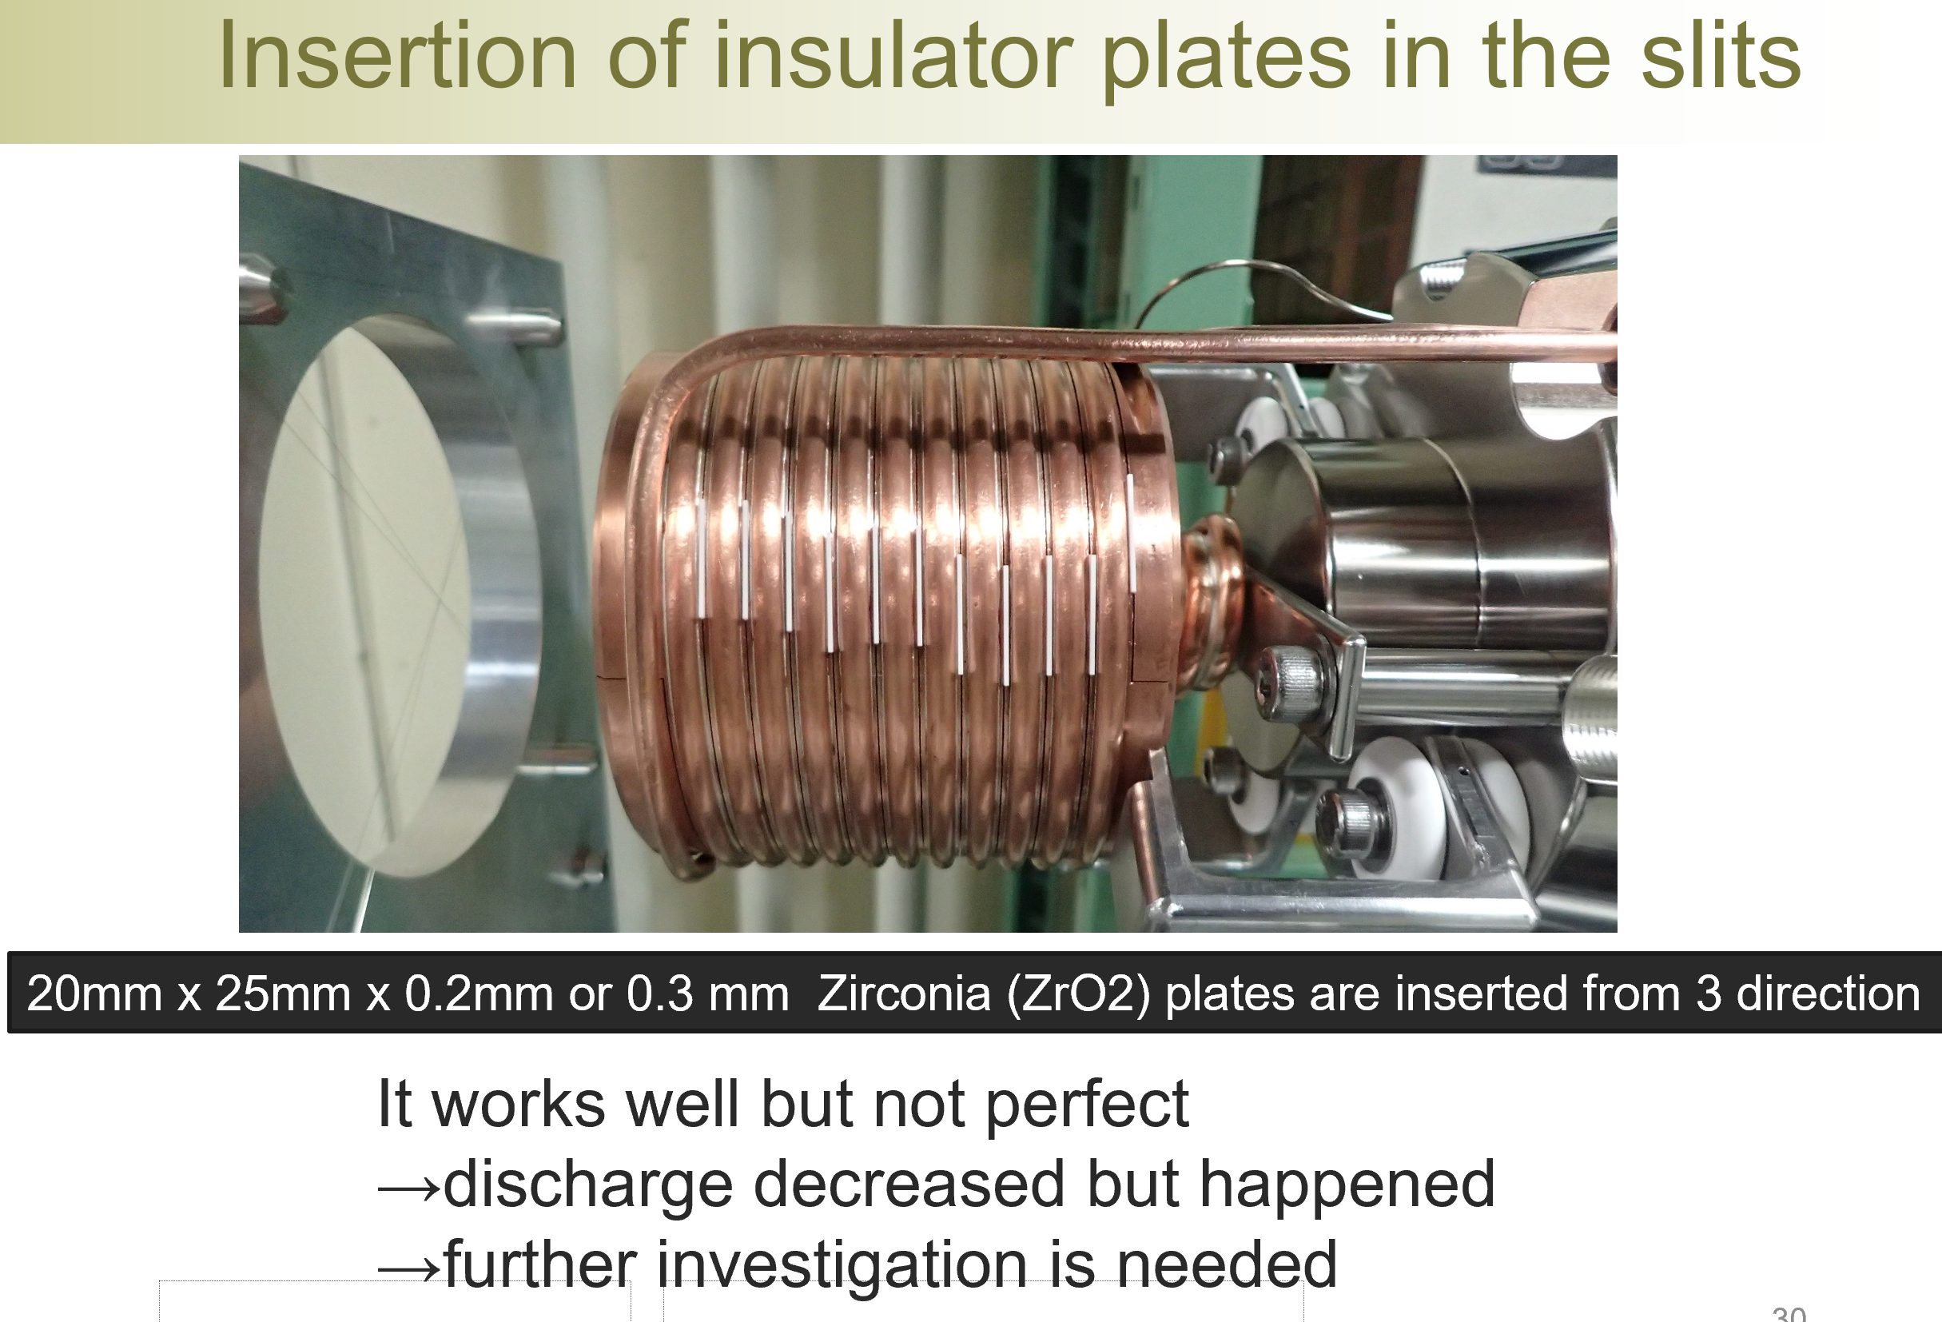
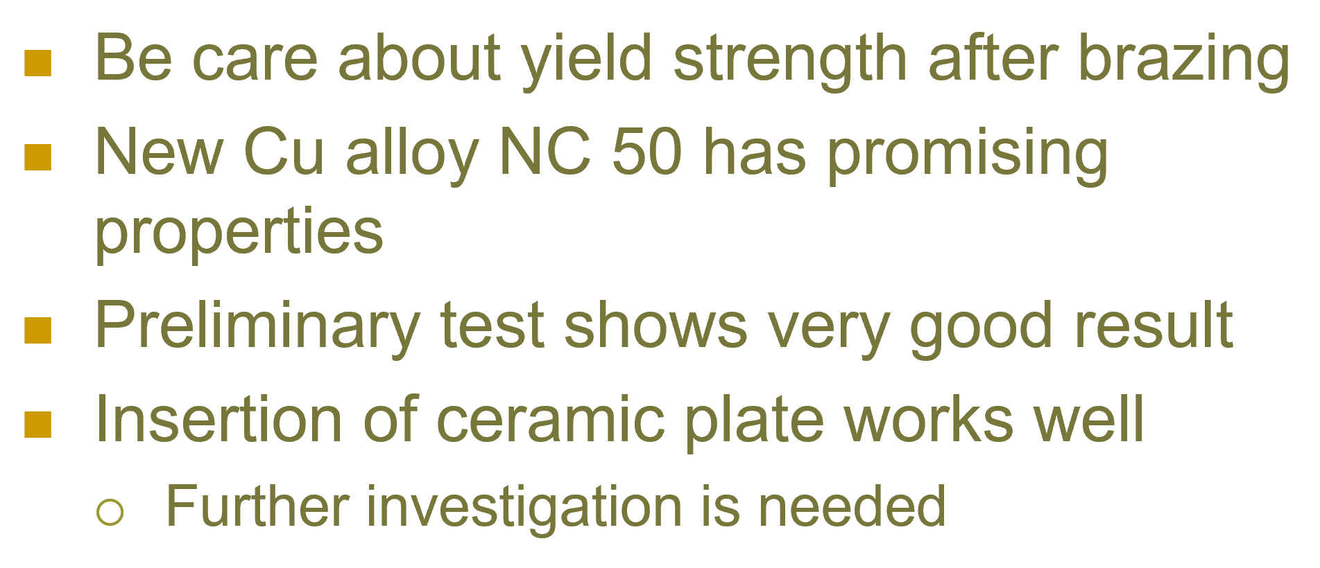
SuperKEKB positron source
Old material
New material for FC (flux concentrator) head

Slide 25
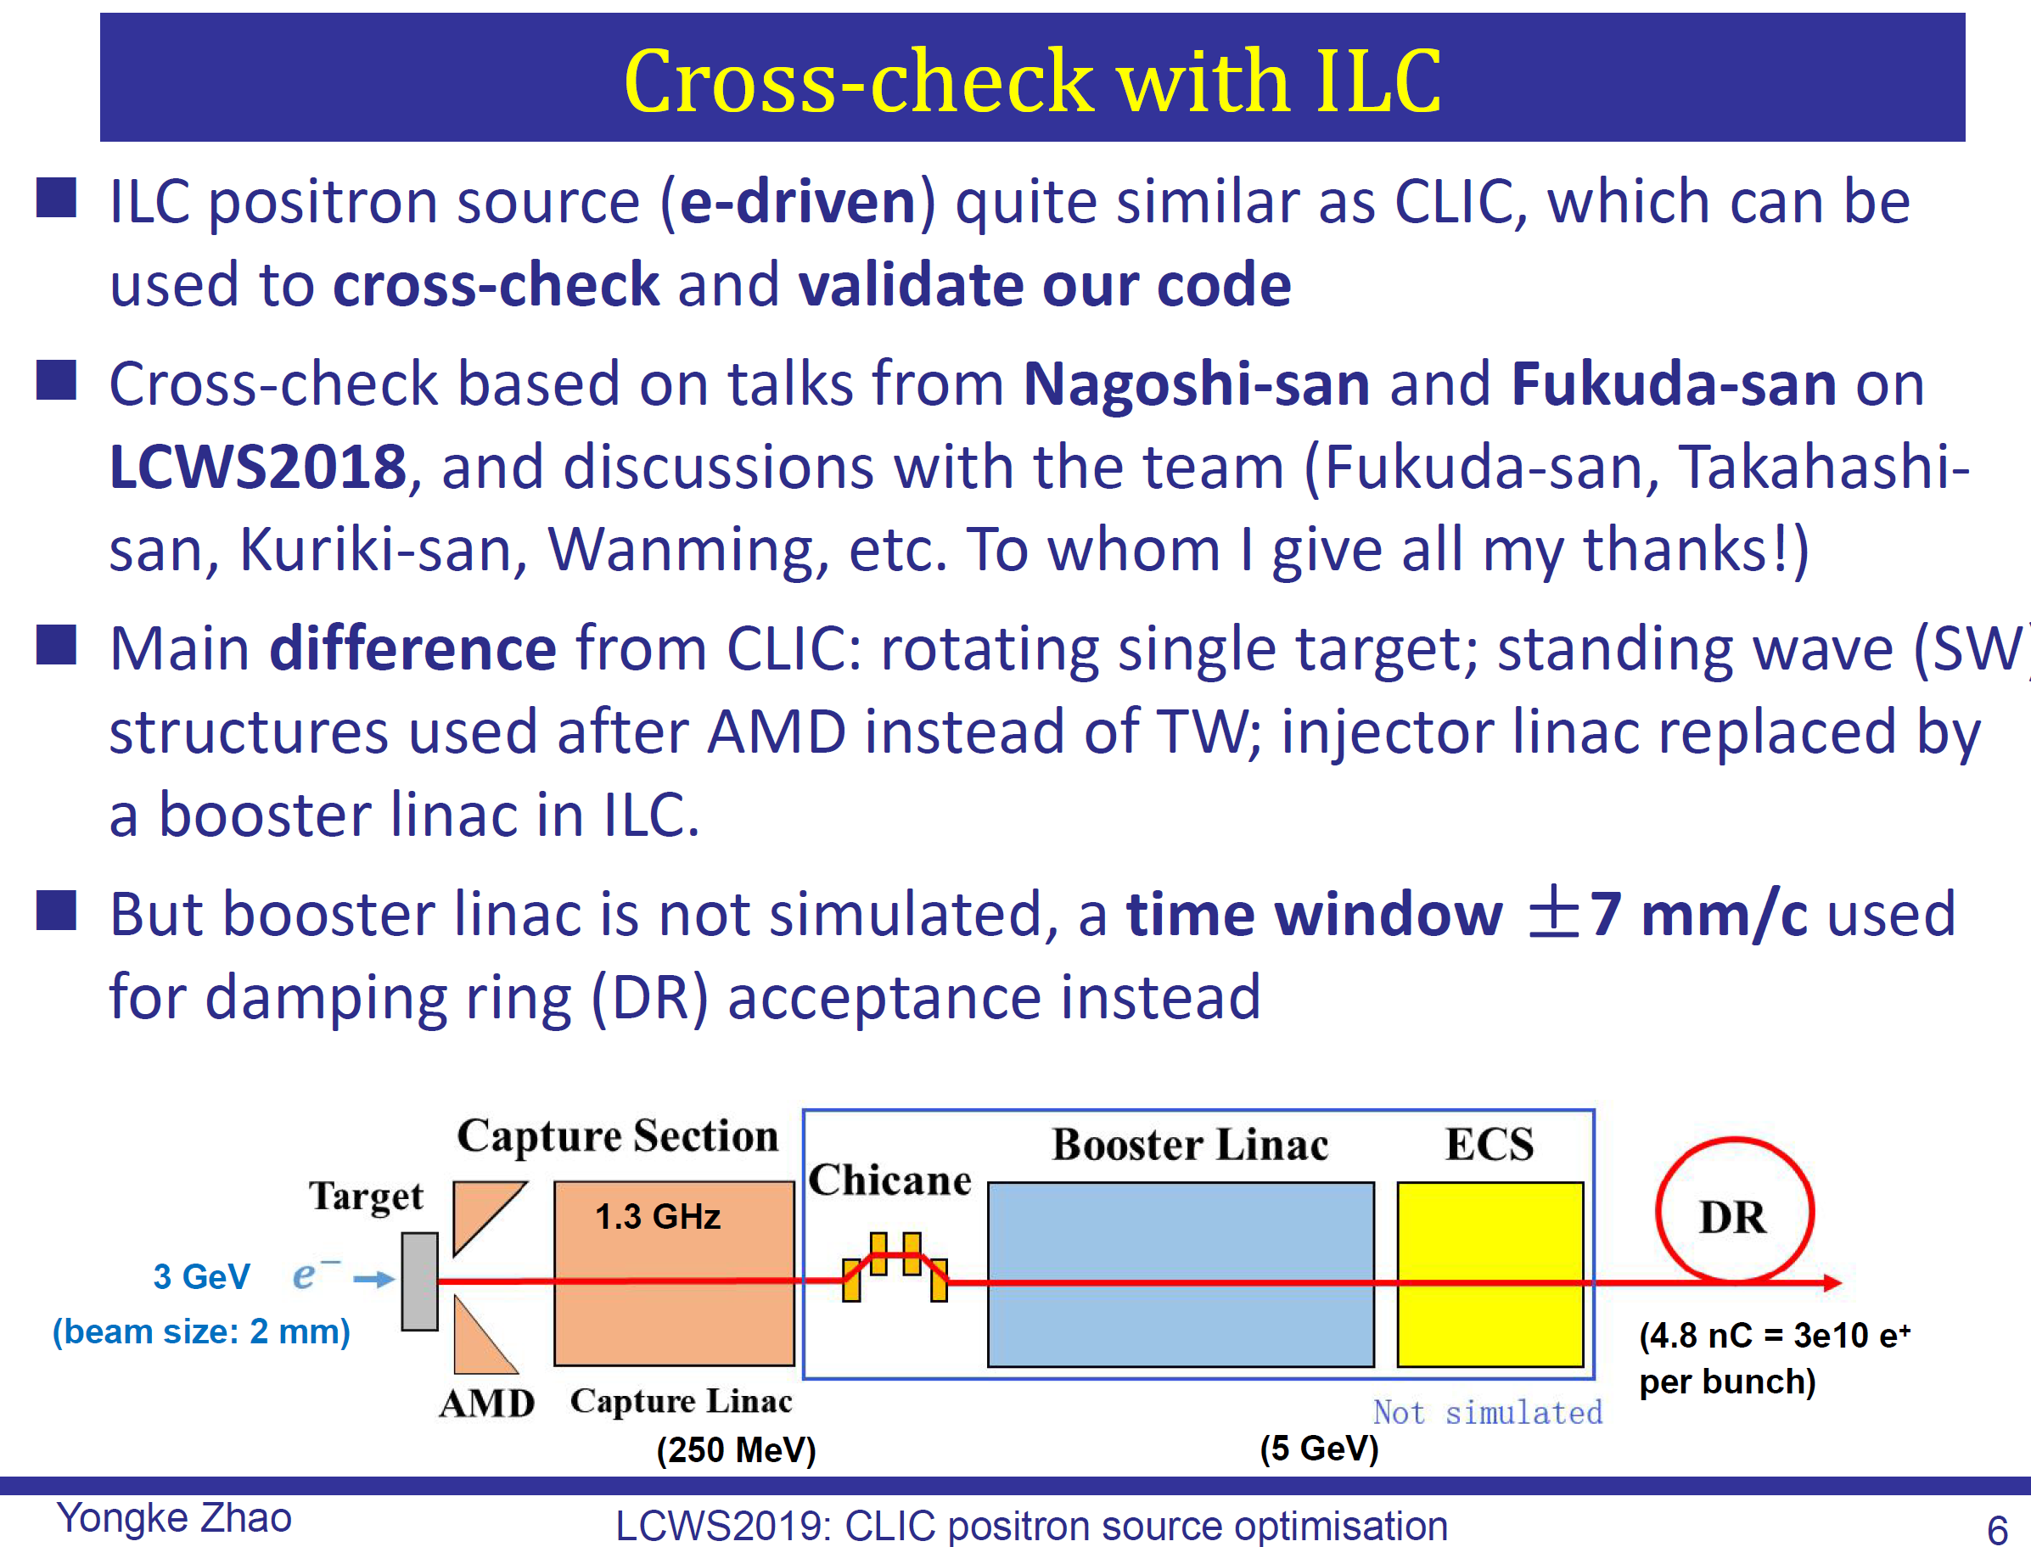
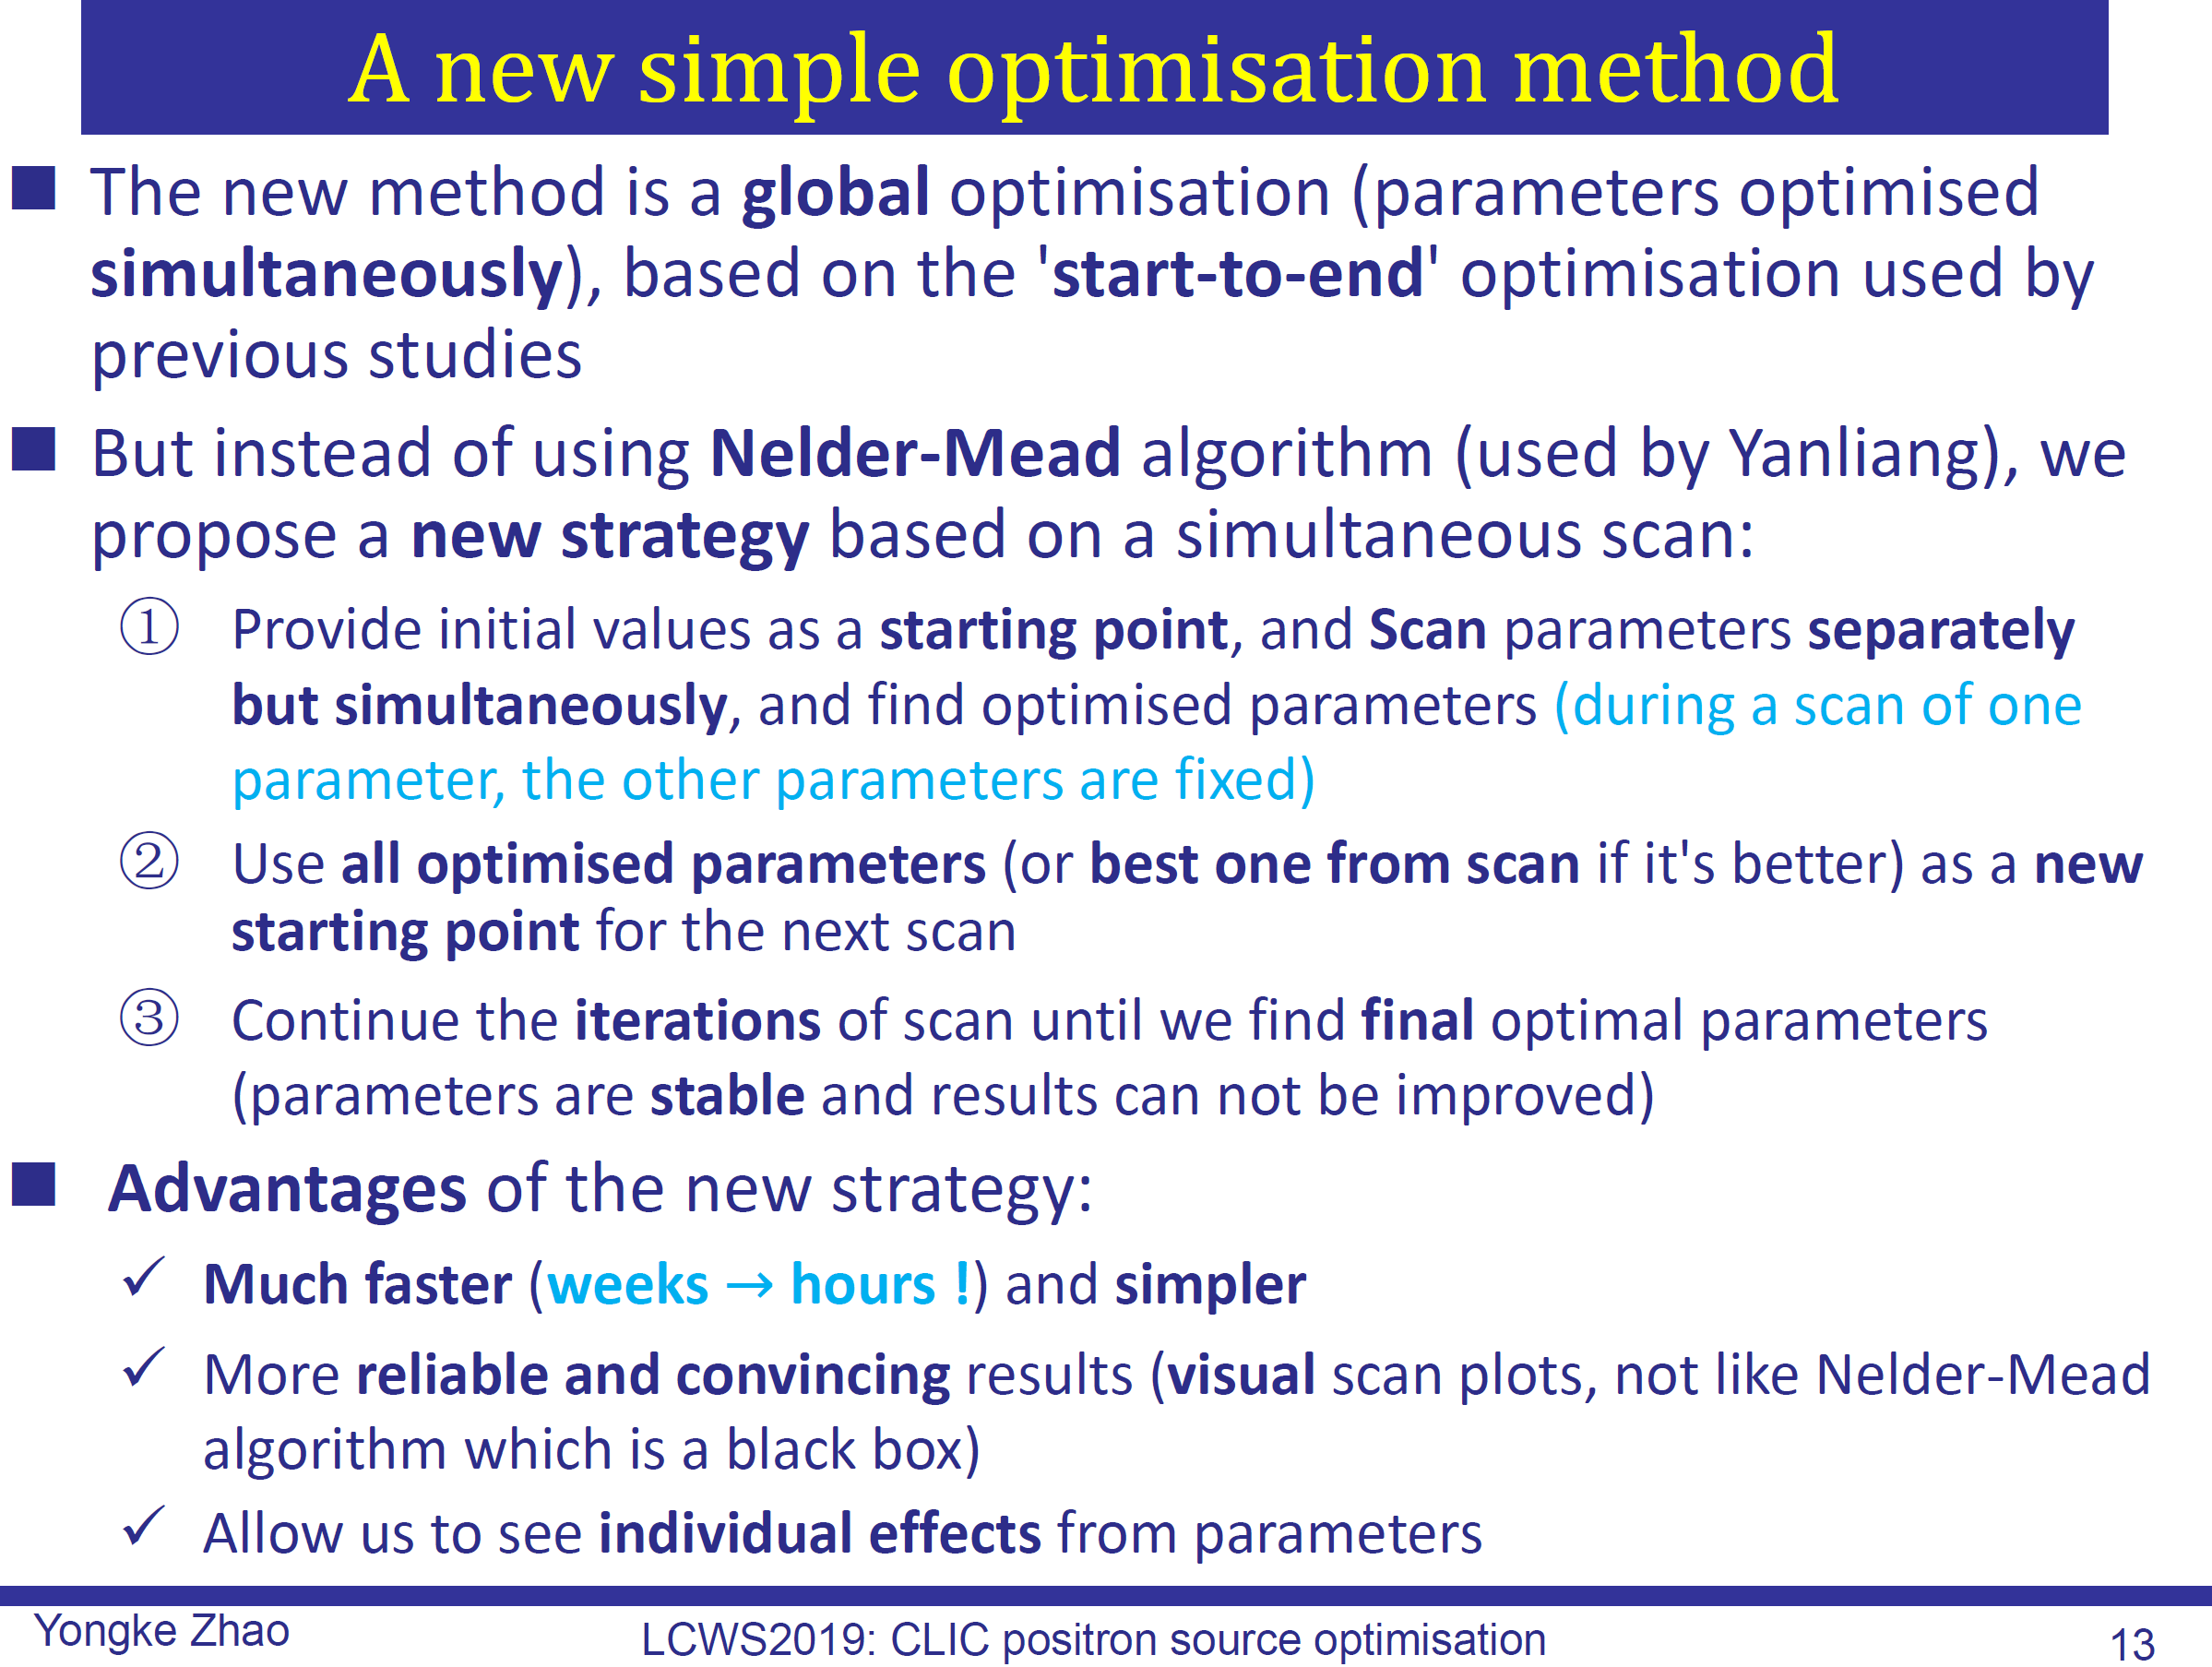
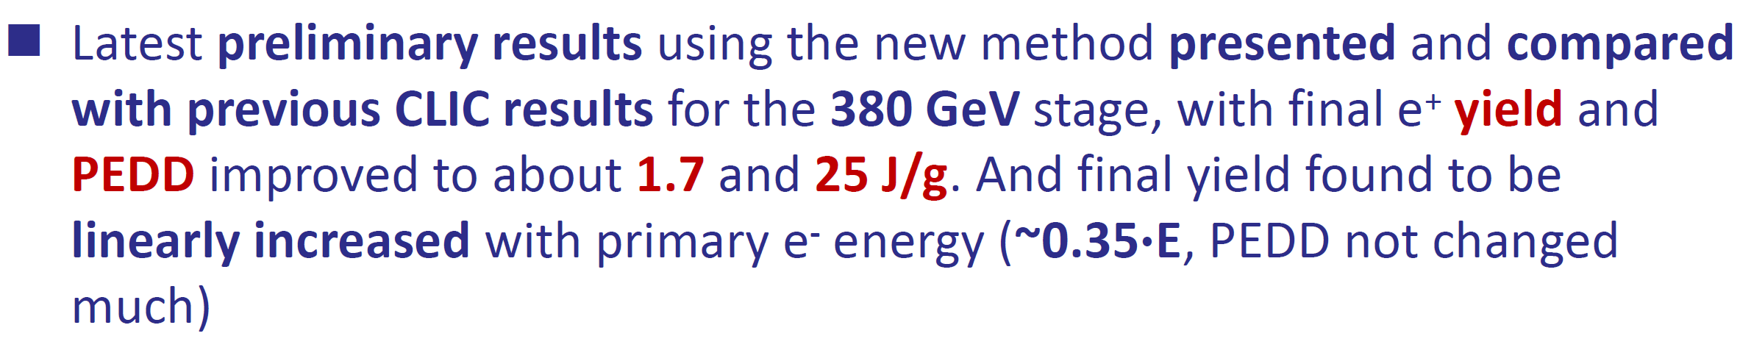
Positron source optimization studies at CERN and Shandong University

Slide 26
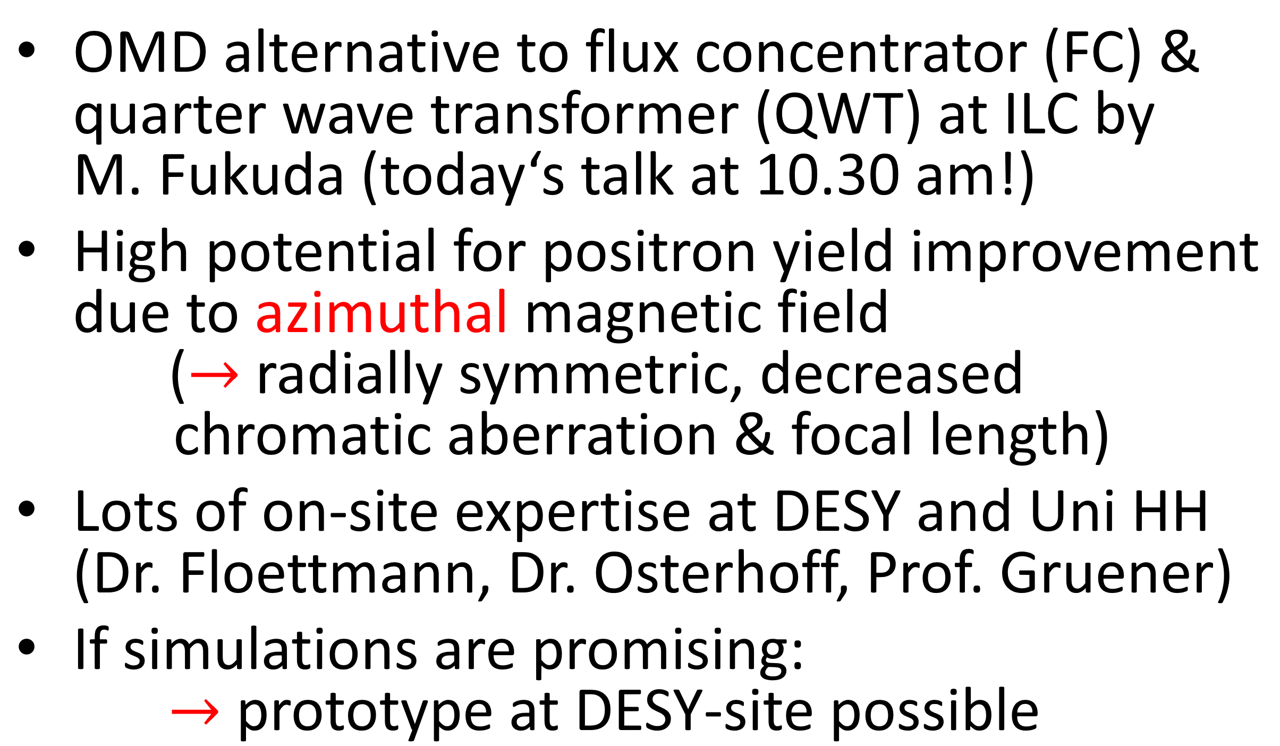
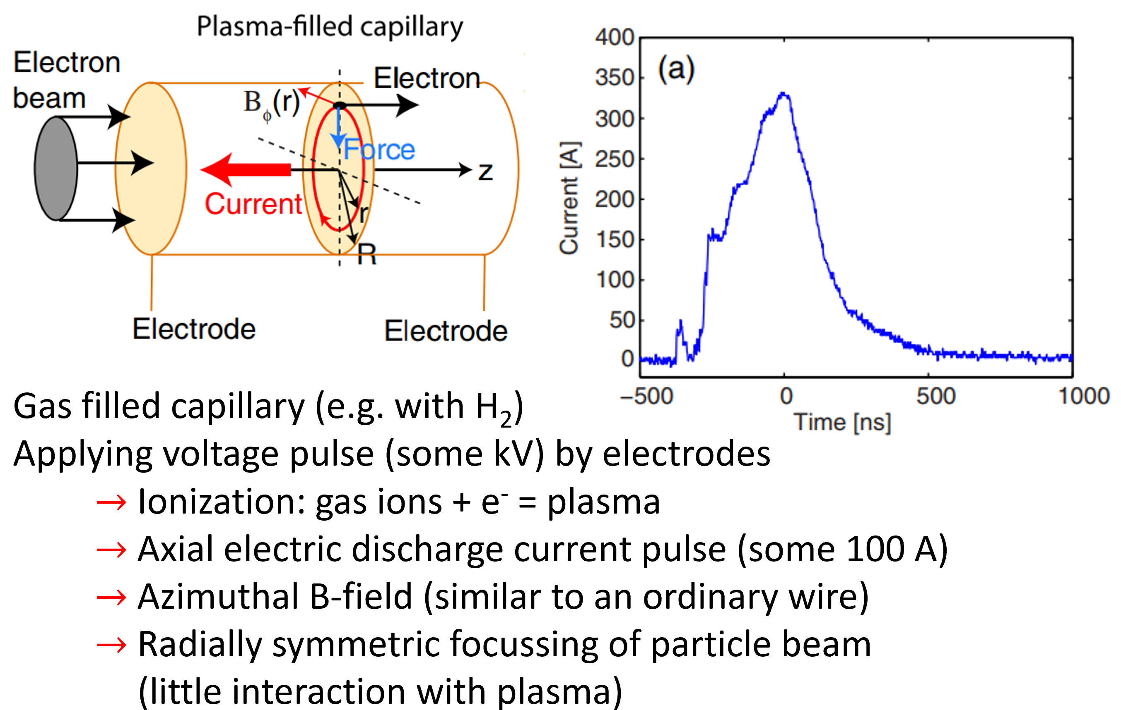
Plasma Lens as possible alternative
Optical Matching Device (OMD)

Slide 27
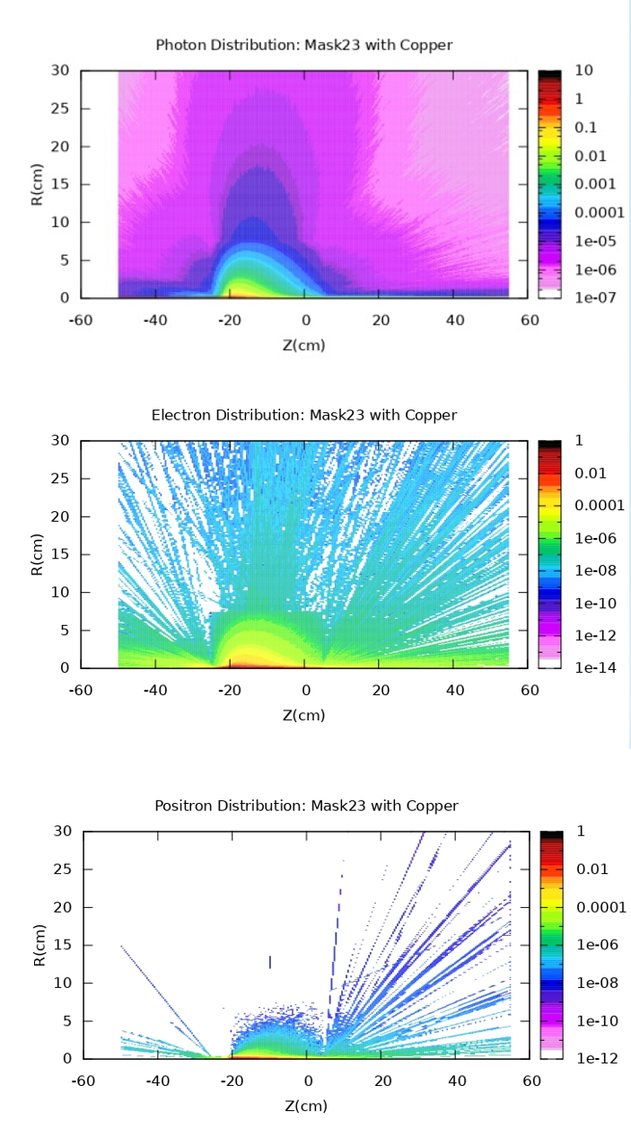


Energy and temperature simulations in photon masks at ILC undulators

Slide 28



Flux Concentrator Opera Model
Themes

Slide 29
Warm RF

Slide 30






Different production approaches
  Round disk*
  Square disk
  Half structure
  Quarter structure**
  * Mature, but still
  ** has to be studied
  more

Slide 31

Fabrication
Always trade off
between these two

Slide 32




High precision manufacturing
Excellent performance even before tuning

Slide 33


R&D for large frequency range at SLAC
S-band C-band X-band
108 GHz 300 GHz

Slide 34



Assembly R&D at SLAC

Slide 35


State of the art milling
Further discussions
  Milling technique
    Time consumption has to be reduced (quarter CLIC multicell structure at KEK took one week to be manufactured)
  Turning vs milling

Slide 36




High power RF tests at CERN
Themes

Slide 37


Simulations at Los Alamos
Atomistic modeling of surface evolution under strong electric fields
Simulations to understand breakdown mechanisms on atomic scale on clean flat Cu surface

Slide 38
SCRF

Slide 39




ILC cost reduction
Average accelerating gradient of main SRF LINAC is the largest cost driver
Higher gradients = fewer cryomodules ➔ less $$
Higher Q₀ = lower cryogenic costs

Slide 40

Large grain

Slide 41



SRF cavities with Nb3Sn film
Efforts at Cornell, Fermilab and KEK
Nb3Sn more efficient at 4 K instead of pure Nb at 2 K
  Lower dynamic load, lower static load, simpler cryo system
  2.6 GHz cavities smaller, thus cheaper
Technology maybe ready for ILC upgrade

Slide 42






Nitrogen infusion
First N infusion at IPN Orsay, France on single cell cavity
They think they suffer from N contamination from the N vessel to the injector valve
Production and development of N infused cavities has started in at IHEP China

Slide 43


Nitrogen infusion

Slide 44




Nitrogen doping for LCLS-II HE cavities

Slide 45

Trapped-flux Surface Resistance at High Gradients
Themes

Slide 46





Plasma processing R&D
Themes

Slide 47




Alternative Cavity Shapes for High Gradient
Low-Surface-Field (LSF) Shape Cavity R&D
Jlab, KEK & SLAC

Slide 48





ILC Prototypes (actual & planned)
Themes

Slide 49
ATF/DR/BDS

Slide 50



Beam instrumentation studies for future LCs
Goal: non-invasive way to measure beam size
Tests ongoing at ATF, CLEAR and Diamond light source
ODR: Sensitivity to 4 μm achieved at 250 nm @ATF2
ChDR: measured 63±2 μm, 30 μm not verified yet
  If requirements are all met, it would be a nicely simple and this easy scalable beam instrumentation tool for linear colliders

Slide 51



Status of ultra-low βy* optics tuning at ATF /
Nonlinear optimization of the Ultra-low (25β∗x×0.25β∗Y) optics
50 nm IP beam size achieved with ultra-low betay* optics @ATF2
Swapping octupoles for further beam size reduction at ATF2

Slide 52


Completion of two-beam lumi tuning for CLIC
Simulation with realistic signal for CLIC BDS

Slide 53


Wakefield effects in the CLIC BDS
Copper coated pipe is favorable for CLIC BDS
44% increase of aperture can mitigate the wakefield impact

Slide 54


Intensity-dependent effects in ATF2 and ILC
ILC BDS long-range wakefields induce mainly IP position
3.6% luminosity loss at 2x10¹⁰ e- with an incoming position offset of 1 σy

Slide 55



FONT beam stabilization results at ATF
Feedback On Nanosecond Timescale (FONT)
Study for ILC and CLIC at the ATF extraction line and the IP
BPM resolution improvement by integration -> better FB performance
  Jitter reduction from 96 nm to 41 nm with 2-BPM IP FONT feedback

Slide 56
A big thank you to all the speakers for the excellent talks!

Slide 57
Takeaways

Slide 58
Takeaways
We have an excellent and strong world-wide accelerator community
We keep optimizing and advancing already mature technologies
We are well prepared and ready for all upcoming large-scale LC projects

Slide 59
Takeaways
We have an excellent and strong world-wide accelerator community
We keep optimizing and advancing already mature technologies
We are well prepared and ready for all upcoming large-scale LC projects
Thank you very much for your attention!

