Slide 2
Beam instrumentation studies for future linear colliders
International Workshop on Future Linear Colliders
Sendai, 28 October – 1 November 2019
S. Mazzoni, CERN

Slide 3






Outline
Transverse profile measurement for LCs: studies at KEK & CERN
Recent development with (C)ChDR
Several people & labs involved:
D. Alves, M. Bergamaschi, A. Curcio, R.O. Jones, R. Kieffer, K Lasocha*, T. Lefèvre S. Mazzoni, N. Mounet, E. Senes, A. Schloegelhofer, R. Yang, CERN, Geneva, Switzerland
K. Fedorov, P. Karataev, D. Harryman, K. Lekomtsev JAI, Royal Holloway University of London, Egham, UK
V.V. Bleko, S.Y. Gogolev, A.S. Konkov, J.S. Markova, A.P. Potylitsyn, D.A. Shkitov Tomsk Polytechnic University, Tomsk, Russia
M. Apollonio, L. Bobb, Diamond Light Source, Oxfordshire, UK
A. Aryshev, N. Terunuma, KEK, Tsukuba, Japan
J. Gardelle, CEA, Le Barp, France
* also Jagiellonian University, Krakow, Poland

Slide 4
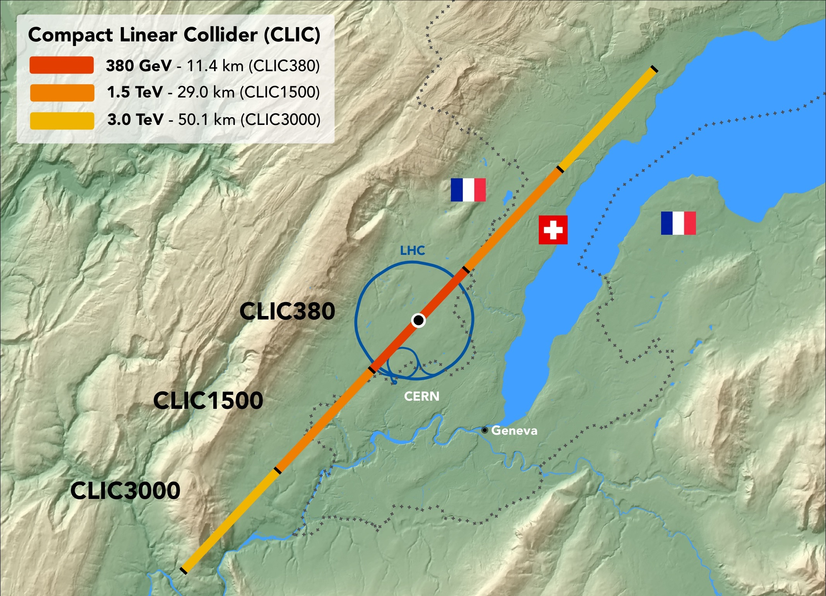
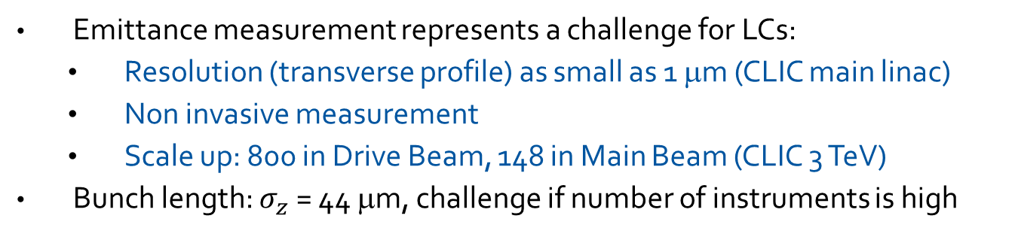
Beam instrumentation challenges in LCs
Emittance measurement represents a challenge for LCs:
  Resolution (transverse profile) as small as 1 μm (CLIC main linac)
  Non invasive measurement
  Scale up: 800 in Drive Beam, 148 in Main Beam (CLIC 3 TeV)
Bunch length: $σ_{z}$ = 44 μm, challenge if number of instruments is high

Slide 5
Measuring emittance in LC
Ultimate goal of emittance monitoring in a LC:
  A high –resolution (sub μm) technique (can be invasive) for commissioning / beam setup with pilot bunches.
    Optical Transition Radiation
  A non-invasive technique (lower resolution tolerated) for full intensity beam
    Optical Diffraction Radiation
    Cherenkov Diffraction Radiation
Many years of challenges…
2016
2017
2018
2019
2015
2013
2014
Previous OTR ODR R&D @ CESR, KEK
OTR/ODR at ATF2
ChDR at ATF2
Preliminary ChDR @ CESR
ChDR at DIAMOND
(C)ChDR at CLEAR
CChDR at CLARA

Slide 6
Measuring emittance in LC
Ultimate goal of emittance monitoring in a LC:
  A high –resolution (sub μm) technique (can be invasive) for commissioning / beam setup with pilot bunches.
    Optical Transition Radiation
  A non-invasive technique (lower resolution tolerated) for full intensity beam
    Optical Diffraction Radiation
    Cherenkov Diffraction Radiation
Many years of challenges and achievements!
ChDR: 60 μm
2016
2017
2018
2019
2015
2013
2014
OTR: 500 nm
ODR: 3 μm
Previous OTR ODR R&D @ CESR, KEK
OTR/ODR at ATF2
ChDR at ATF2
Preliminary ChDR @ CESR
ChDR at DIAMOND
(C)ChDR at CLEAR
First beam size measurement with ChDR
Also bunch length, beam position
CChDR at CLARA

Slide 7
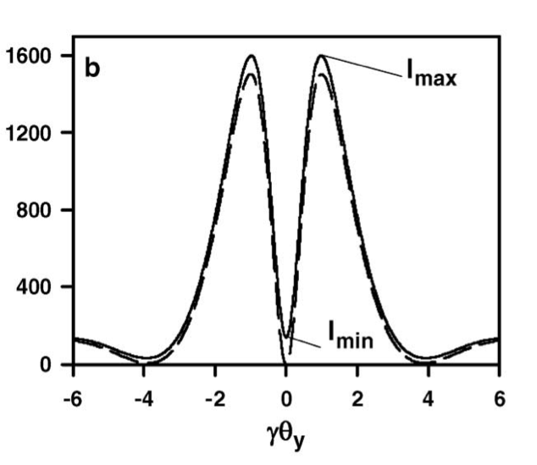
Optical Diffraction Radiation
ODR source
Aperture
d
f
Polarizer
Filter
Lens
CCD camera
On focal plane
Beam goes through a narrow horizontal slit (for vertical beam size). EM field interacts with edges, broadband radiation is produced
The beam size is extracted from the visibility I_{min}/I_{max} of the projected vertical component of the DR angular distribution
Challenges: alignment, suppression of SR and optical noise

Slide 8
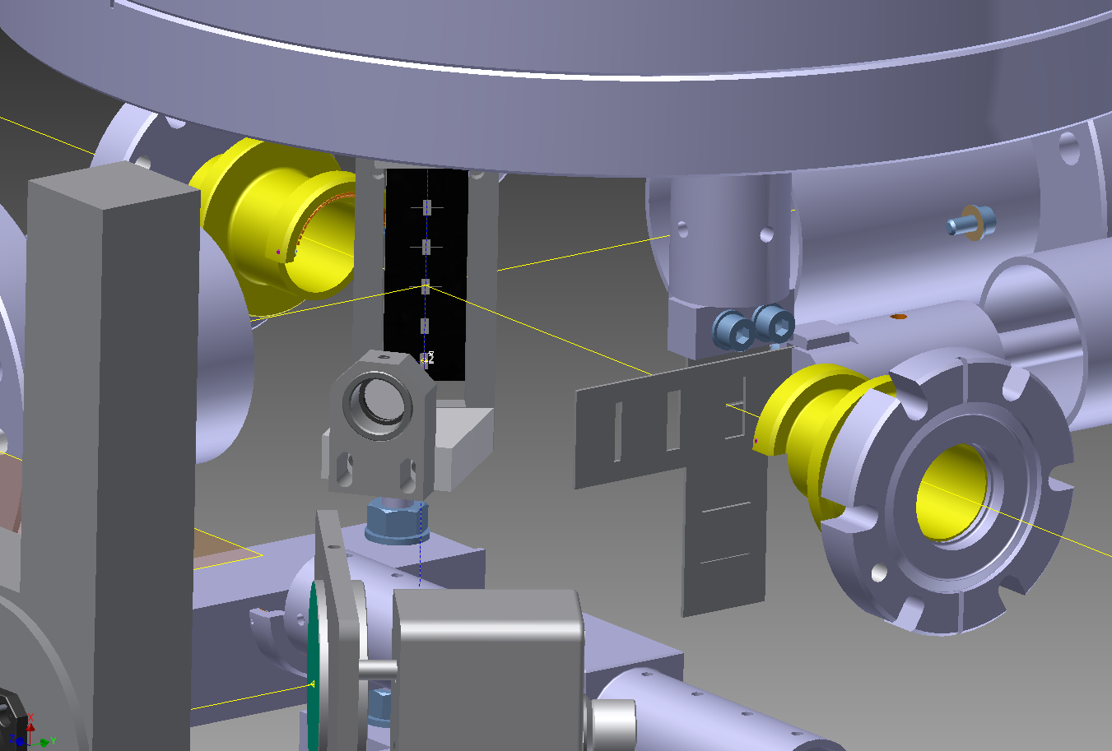
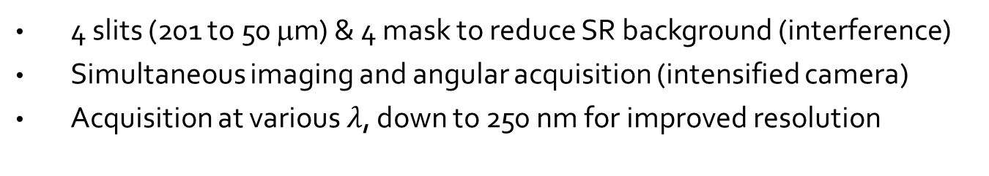
ODR setup at KEK
TARGET
ODR
Masks
e- Beam
4 slits (201 to 50 μm) & 4 mask to reduce SR background (interference)
Simultaneous imaging and angular acquisition (intensified camera)
Acquisition at various $λ$, down to 250 nm for improved resolution

Slide 9
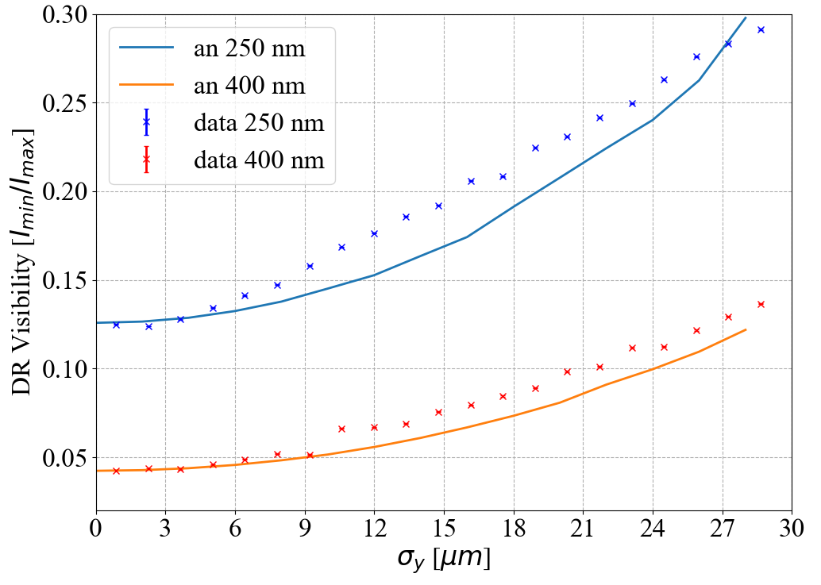
ODR@KEK results
Better sensitivity in the UV (250 nm ) than visible (400 nm)
Sensitivity to 4 μm achieved at 250 nm
Relatively simple and inexpensive setup > scale up OK
Ease of use in real operational scenario to be improved / studied.

Slide 10
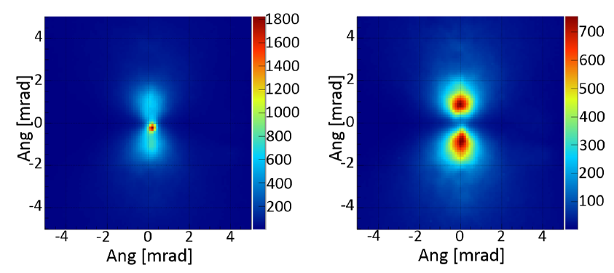
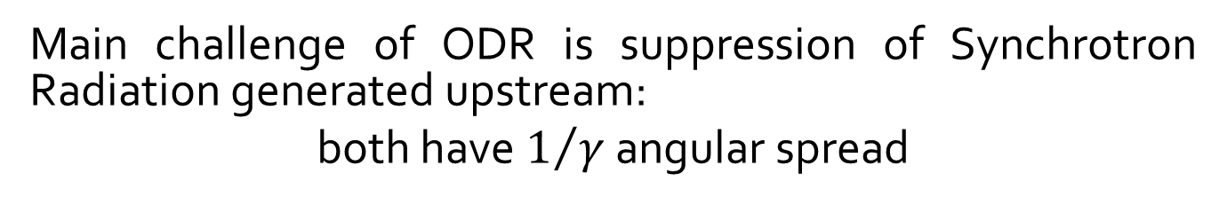
From ODR to ChDR
Main challenge of ODR is suppression of Synchrotron Radiation generated upstream:
both have $1/γ$ angular spread

Slide 11
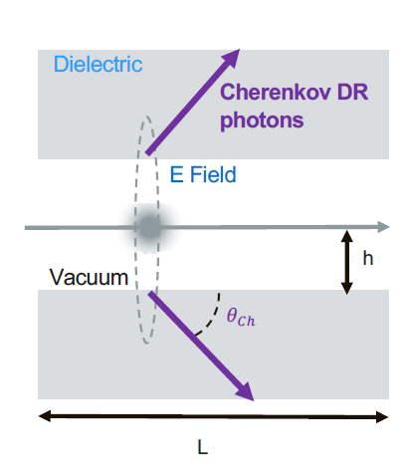
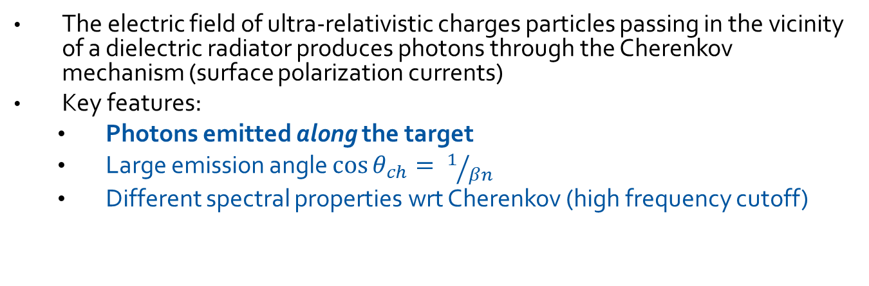
Cherenkov Diffraction Radiation (ChDR)
The electric field of ultra-relativistic charges particles passing in the vicinity of a dielectric radiator produces photons through the Cherenkov mechanism (surface polarization currents)
Key features:
  Photons emitted along the target
  Large emission angle $\cos{θ_{ch}}= 1/{βn}$
  Different spectral properties wrt Cherenkov (high frequency cutoff)

Slide 12
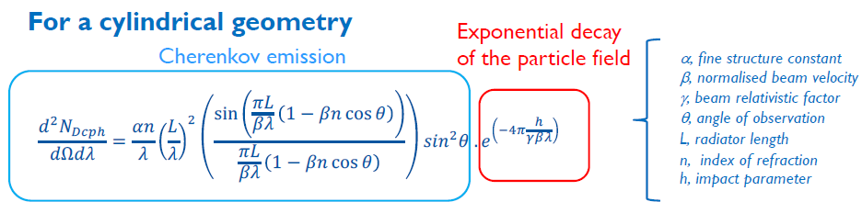
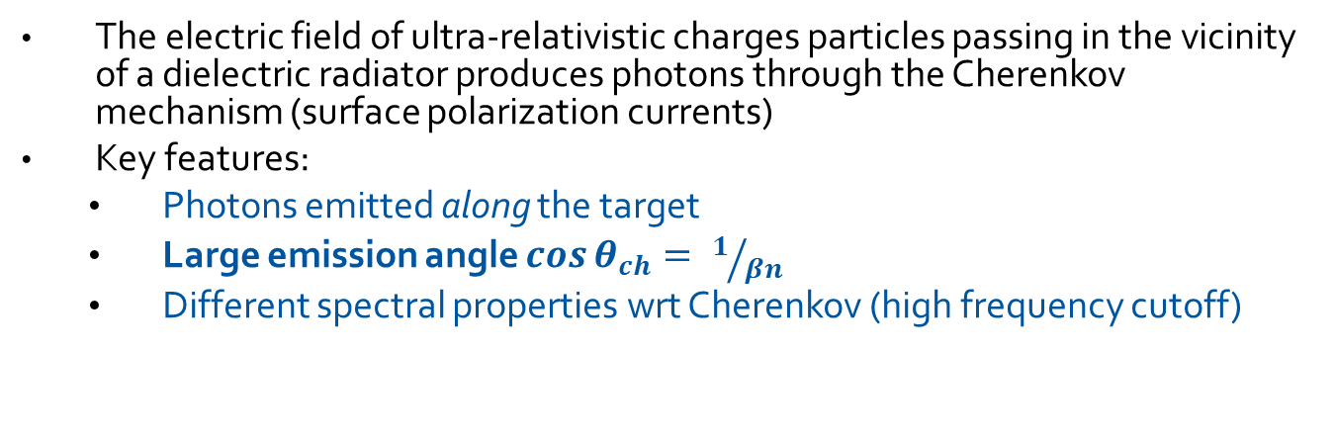
Cherenkov Diffraction Radiation (ChDR)
The electric field of ultra-relativistic charges particles passing in the vicinity of a dielectric radiator produces photons through the Cherenkov mechanism (surface polarization currents)
Key features:
  Photons emitted along the target
  Large emission angle $\cos{θ_{ch}}= 1/{βn}$
  Different spectral properties wrt Cherenkov (high frequency cutoff)

Slide 13
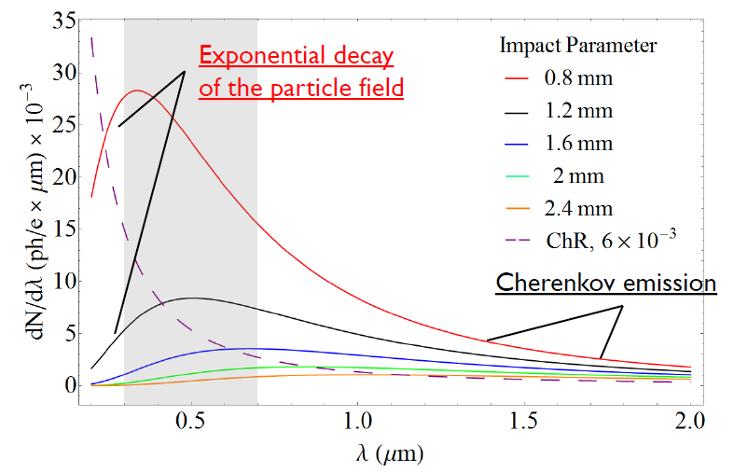
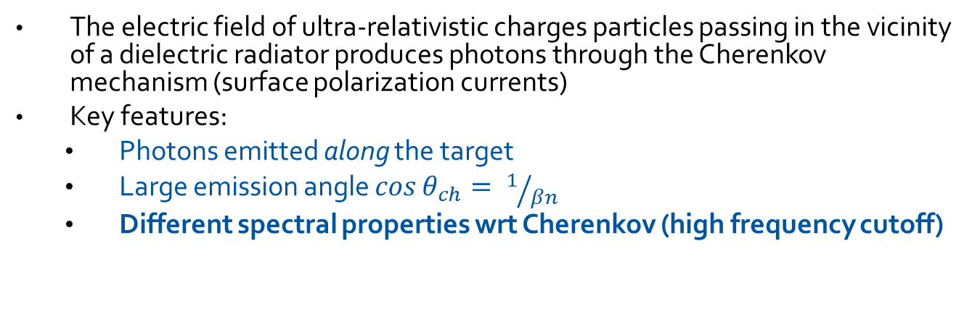
Cherenkov Diffraction Radiation (ChDR)
The electric field of ultra-relativistic charges particles passing in the vicinity of a dielectric radiator produces photons through the Cherenkov mechanism (surface polarization currents)
Key features:
  Photons emitted along the target
  Large emission angle $\cos{θ_{ch}}= 1/{βn}$
  Different spectral properties wrt Cherenkov (high frequency cutoff)

Slide 14
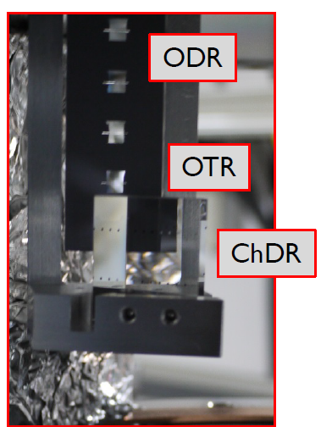
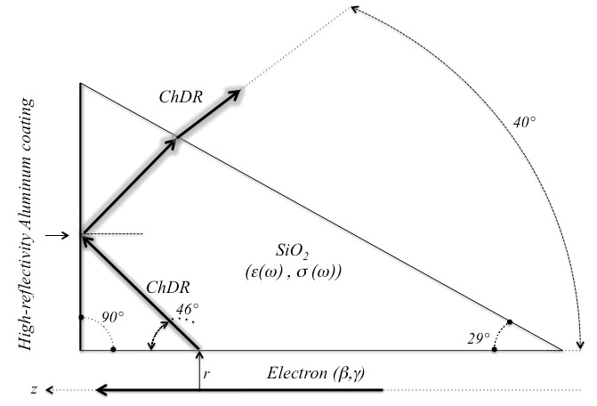
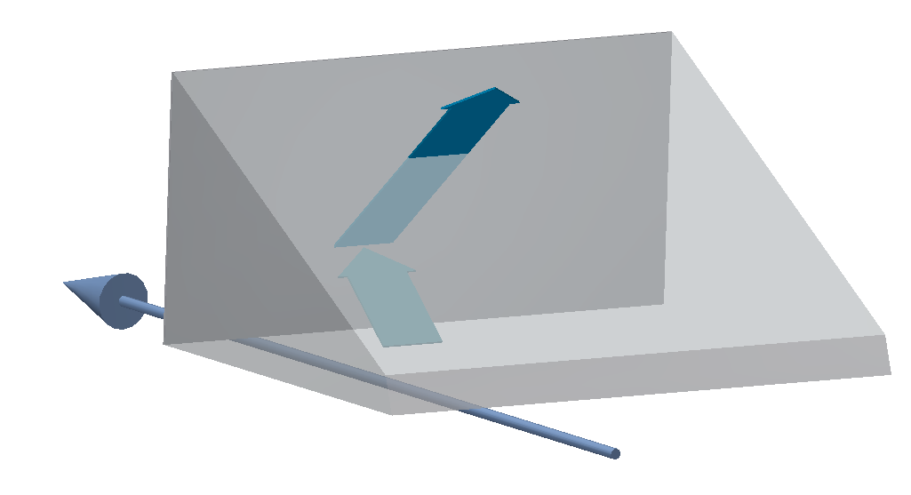
ChDR studies at KEK
In 2018 we modified the ODR setup and mounted a ChDR prismatic target
IR-VIS-UV setup to
  study spatial resolution of ChDR (small beams)
  Angular distribution (test of theoretical models)
OTR used for cross-calibration

Slide 15
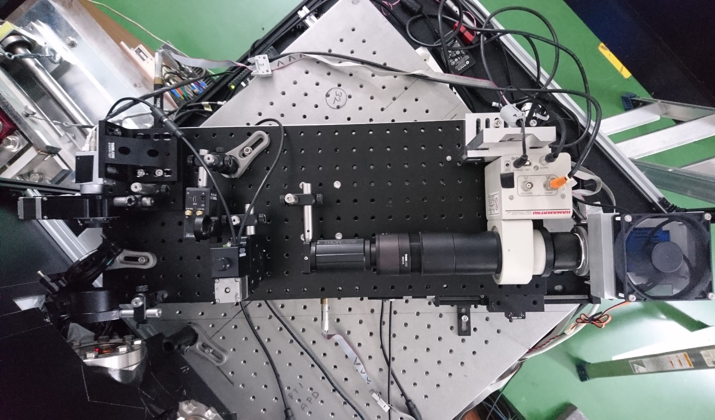
ChDR target
ATF2 e- beam
two 300 mm achromatic doublets
BW filters, polariser
Angular line
5x , 10x, 20x microscope w intensified camera

Slide 16
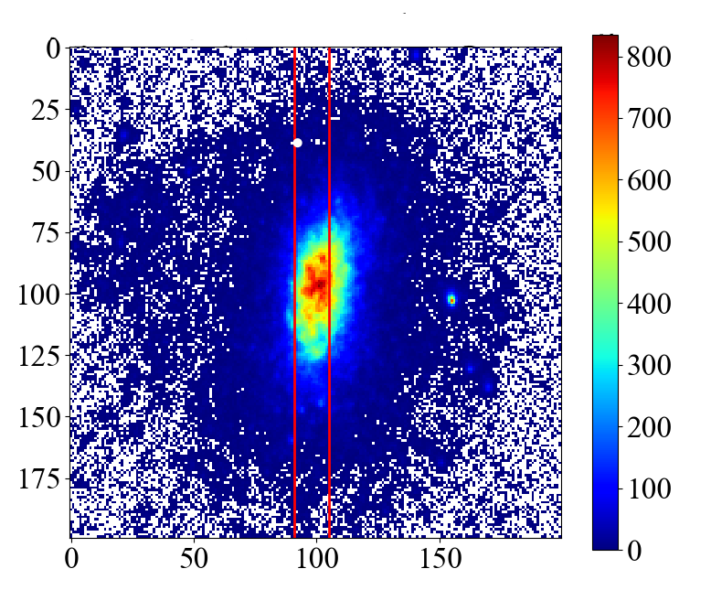
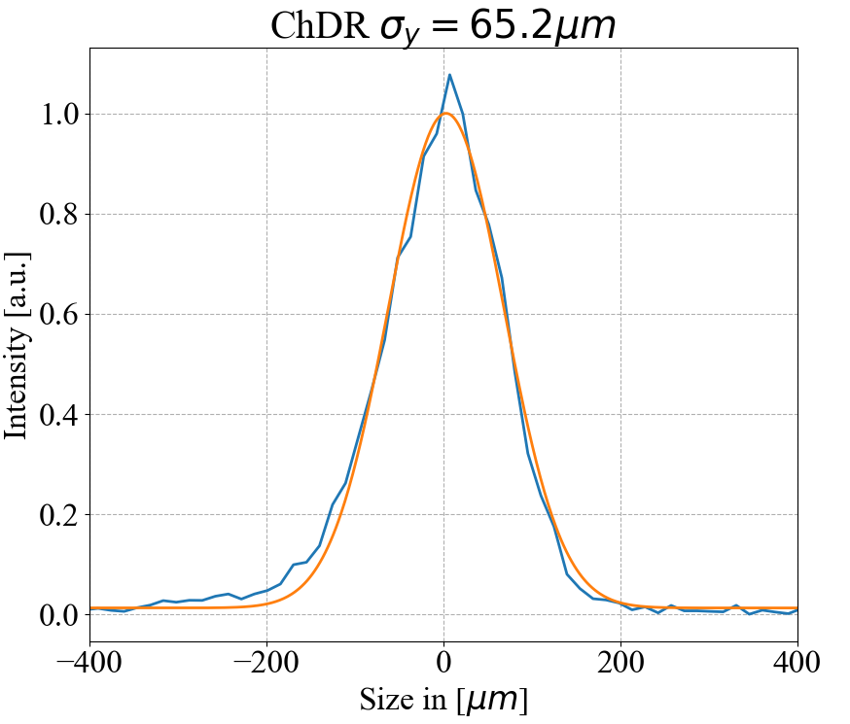
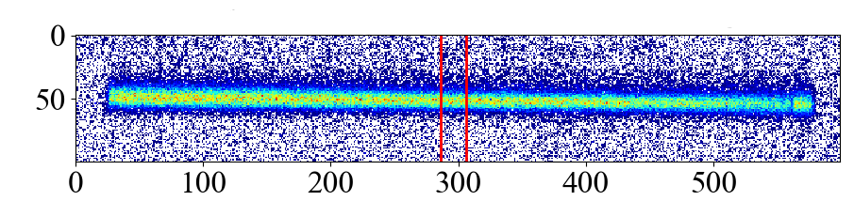
ChDR @ KEK: results…so far
H rms: 30 ± 2 µm
OTR, H pol
OTR V rms
67 ± 2 µm
ChDR V rms 65±2 µm
ChDR, H pol
Experiments ongoing: June 18, Nov 18, March 19, Nov 19,…
60 um beam correctly measured at 700 nm (40 nm BW).
Smaller beams down to 30 um also observed. LSF still to be assessed
Ongoing tests also at Diamond light source (UK)

Slide 17
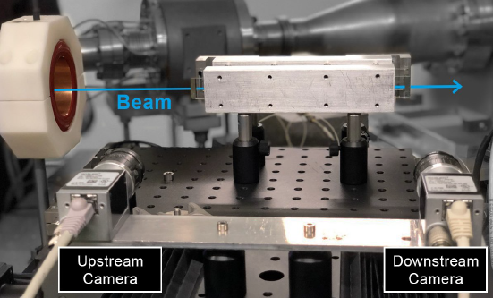
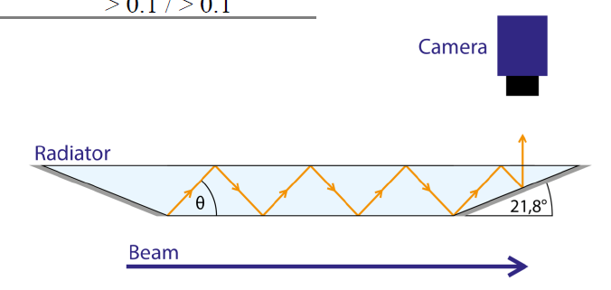
ChDR at CLEAR
CLEAR: 200 MeV electron test facility at CERN
Test of ChDR in longer dielectrics to increase sensitivity
Signal produced in 20 cm long fused silica strips in air

Slide 18
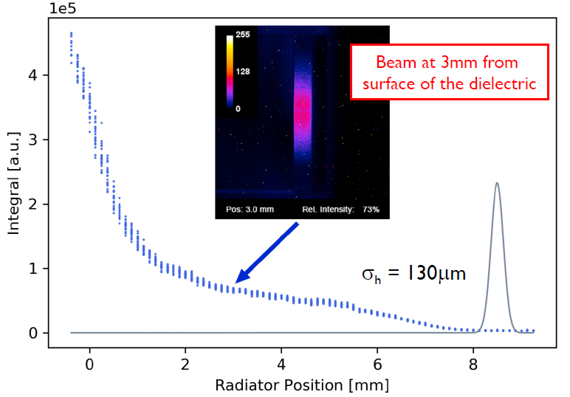
ChDR @ CLEAR
Impact parameter scan with 200 MeV, 500 pC bunch
Measuring at 600 +/- 10 nm: signal present at h> 7 mm
Work in progress…

Slide 19
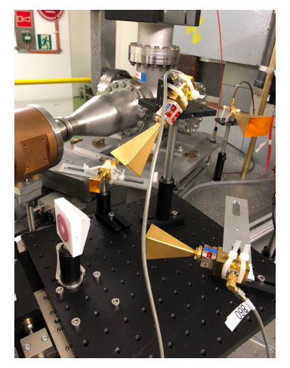
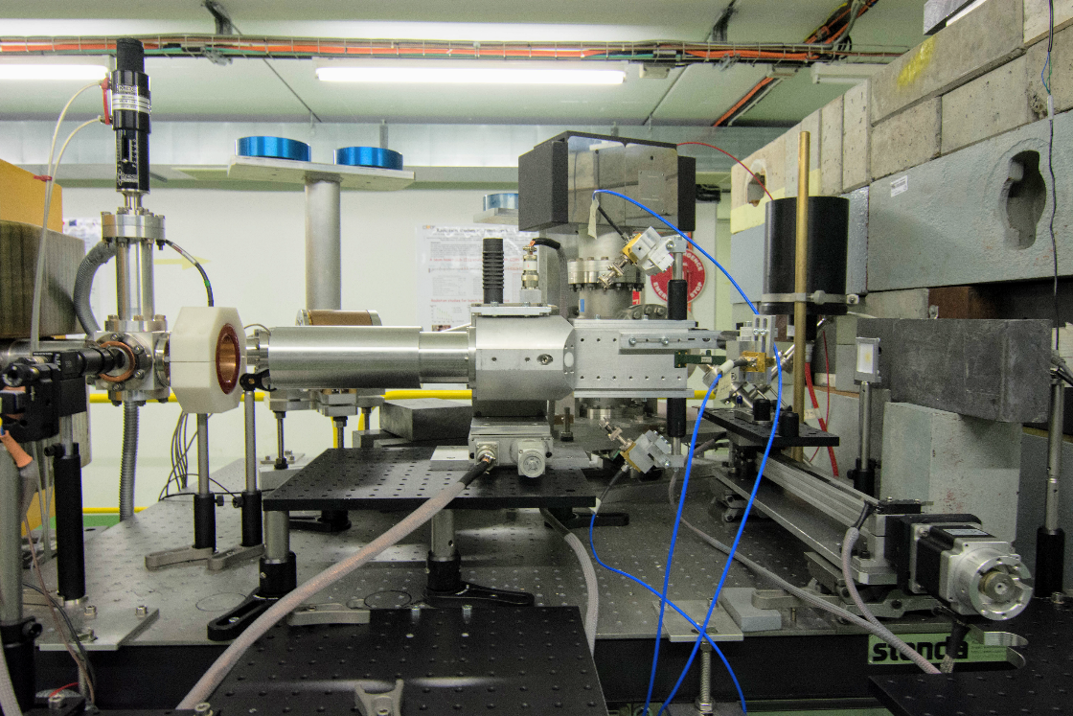
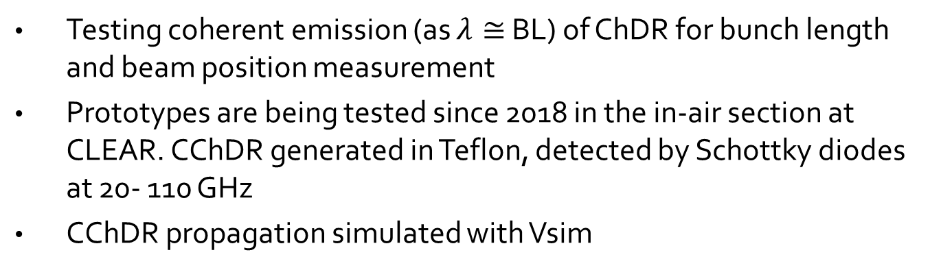
Coherent ChDR
Testing coherent emission (as $λ≅$ BL) of ChDR for bunch length and beam position measurement
Prototypes are being tested since 2018 in the in-air section at CLEAR. CChDR generated in Teflon, detected by Schottky diodes at 20- 110 GHz
CChDR propagation simulated with Vsim

Slide 20
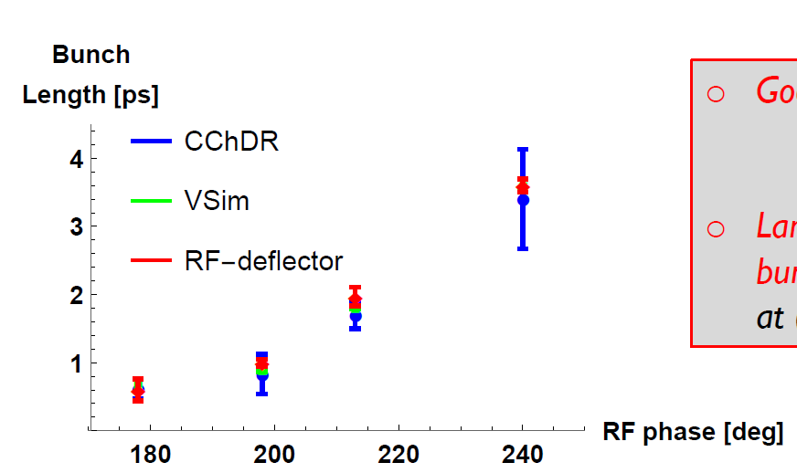
Coherent ChDR
Good agreement with benchmark (RF deflector) for Teflon pyramid geometry.
Very recently: promising results on beam position (data analysis in progress).
Studies ongoing also at CLARA (UK)

Slide 21
Conclusions
Well articulated R&D programme on beam instrumentation for Linear colliders involving international partners
More established studies reached targets:
  500 nm resolution for OTR
  4 μm resolution non invasive (ODR)
  and the know-how on how to build and operate these instruments
Since 2016 we started R&D on ChDR:
  60 μm (sigma) beam measured, possibly smaller, resolution limit not yet determined, presently under investigation. Angular, LSF in progress
  Demonstrated sub-ps bunch length measurement with Coherent ChDR, beam position in progress

Slide 22
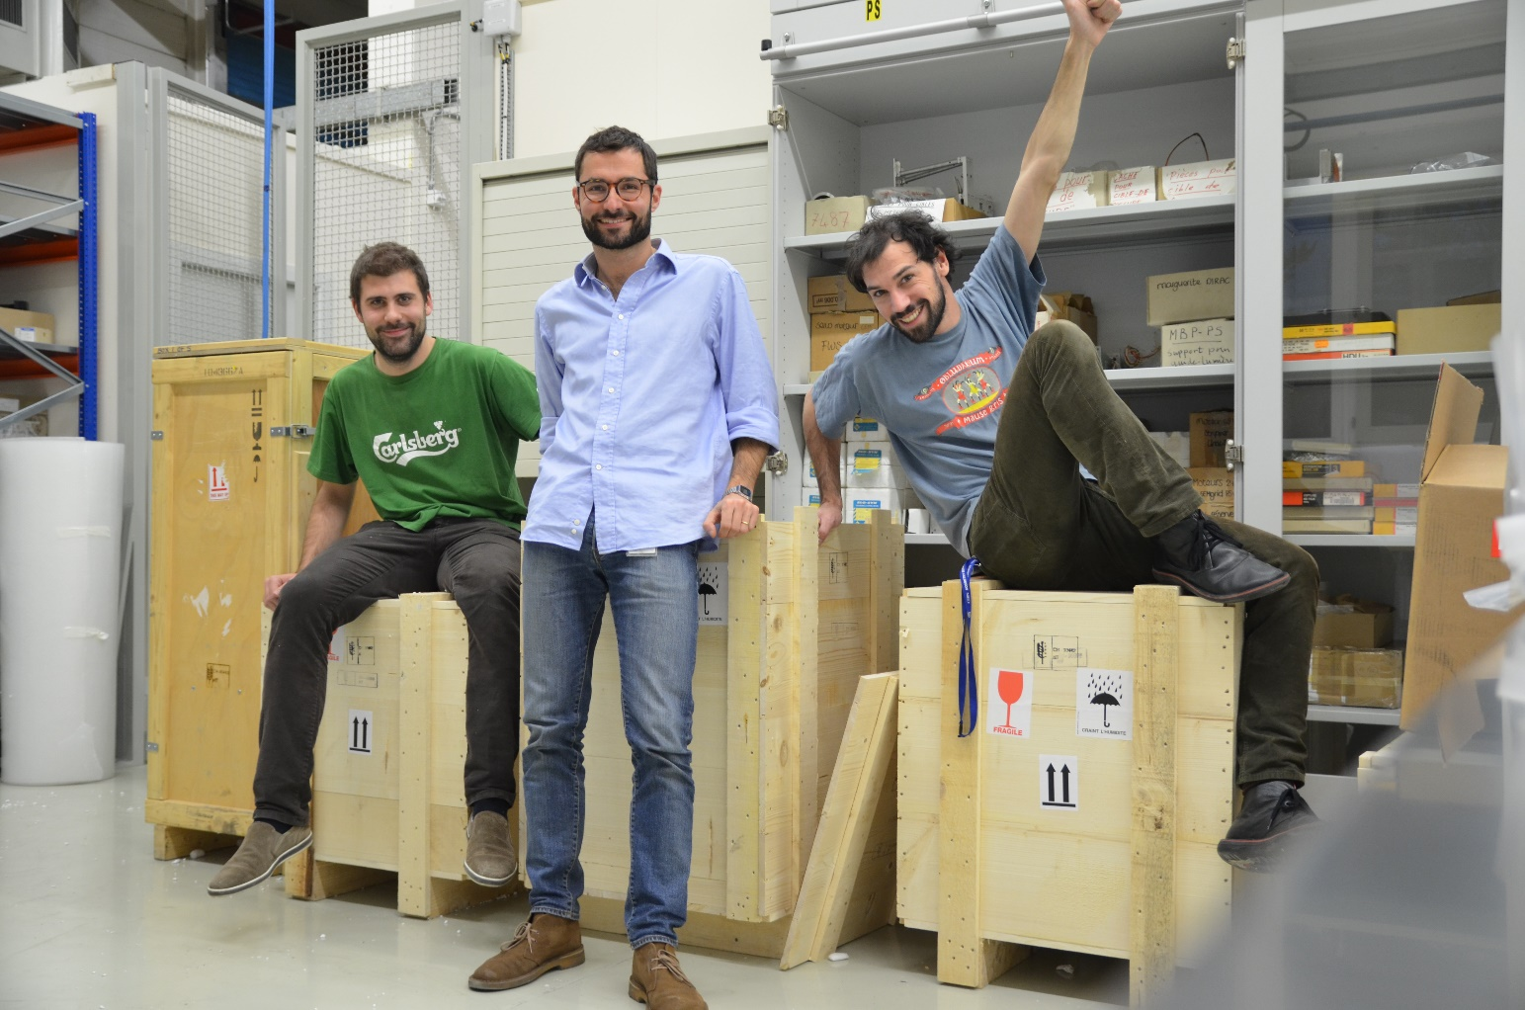
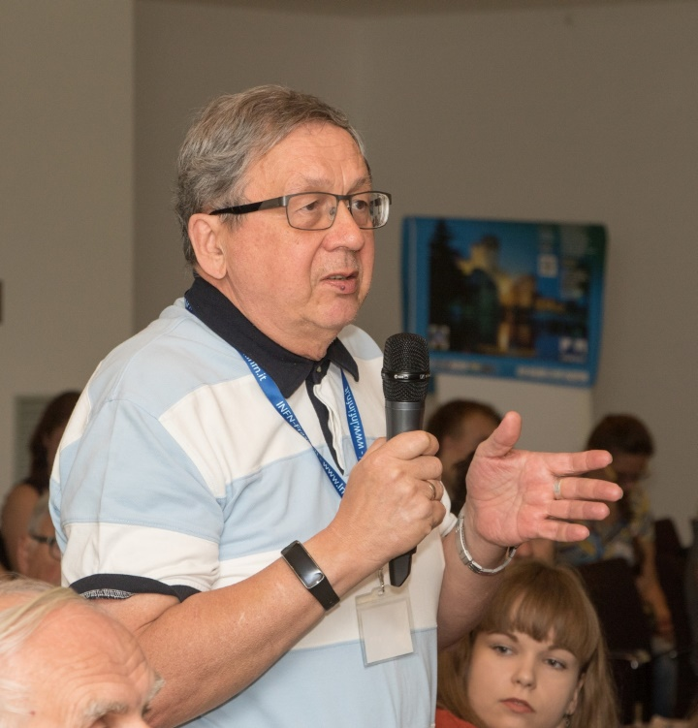
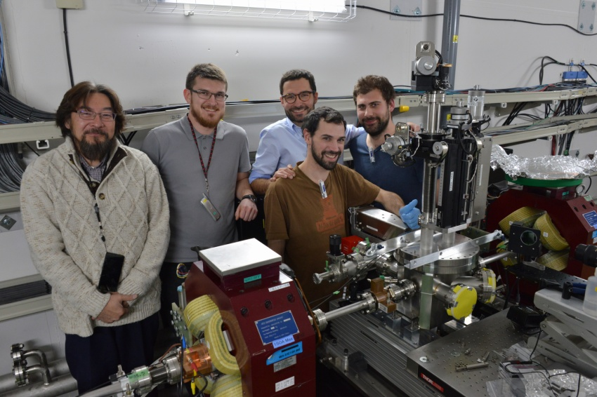
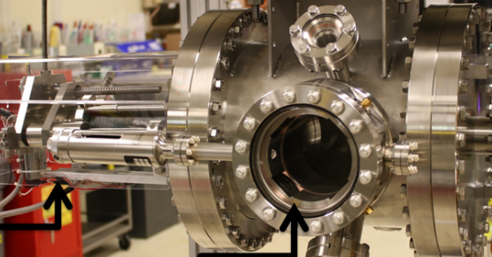
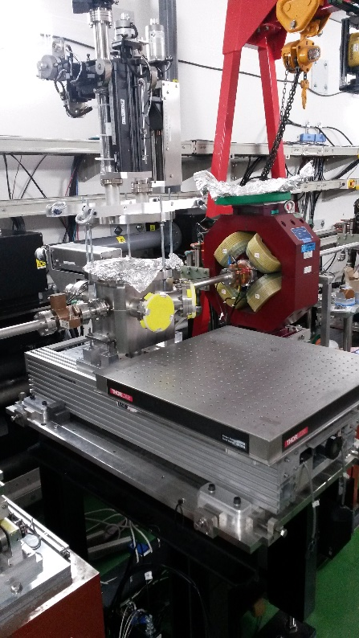
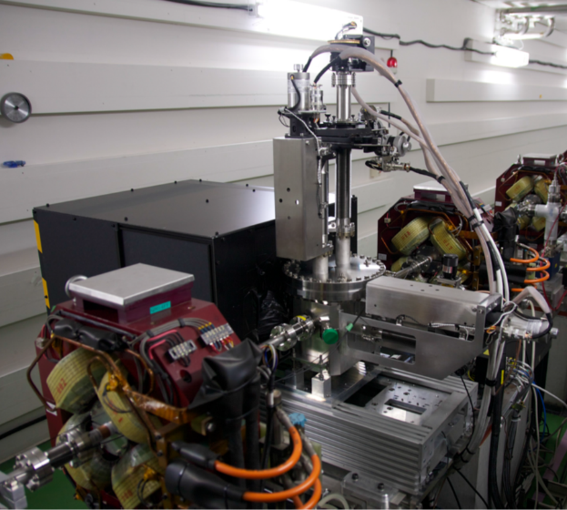
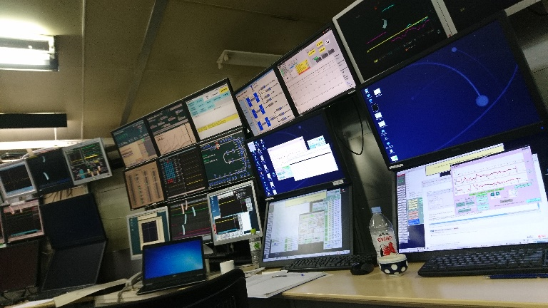
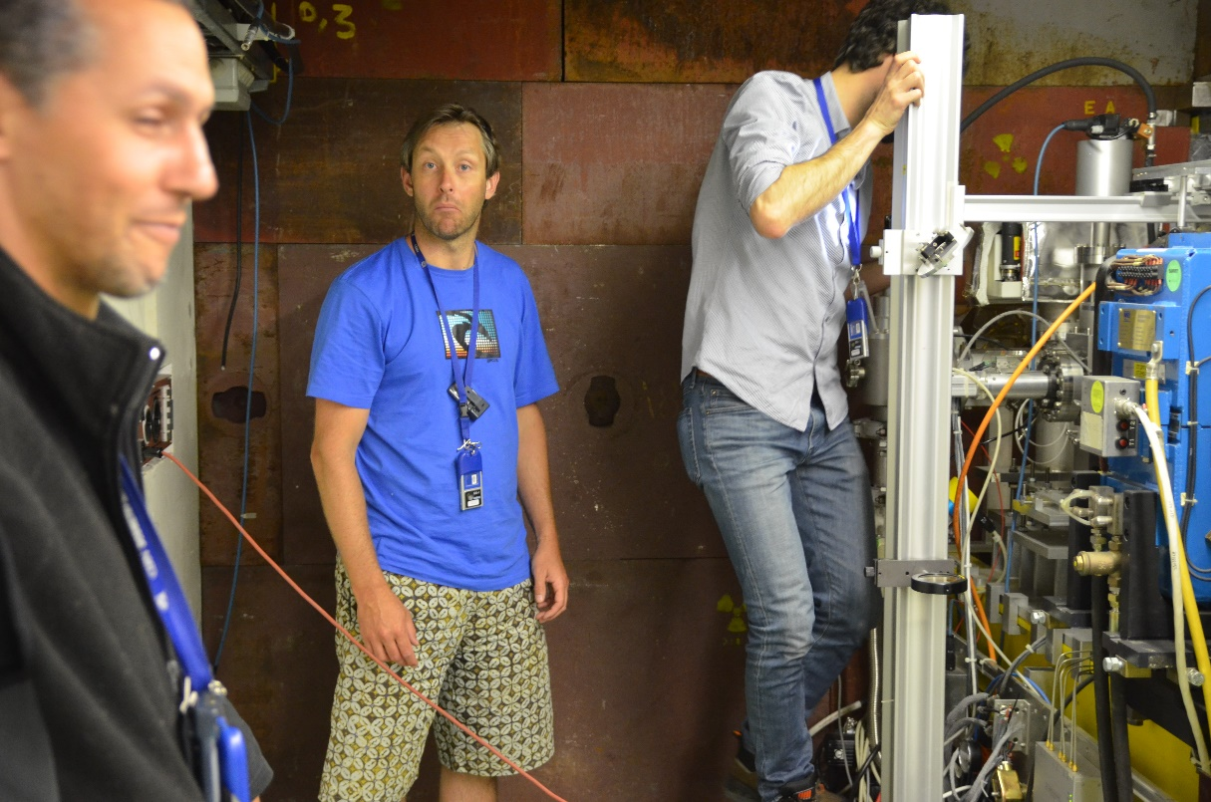
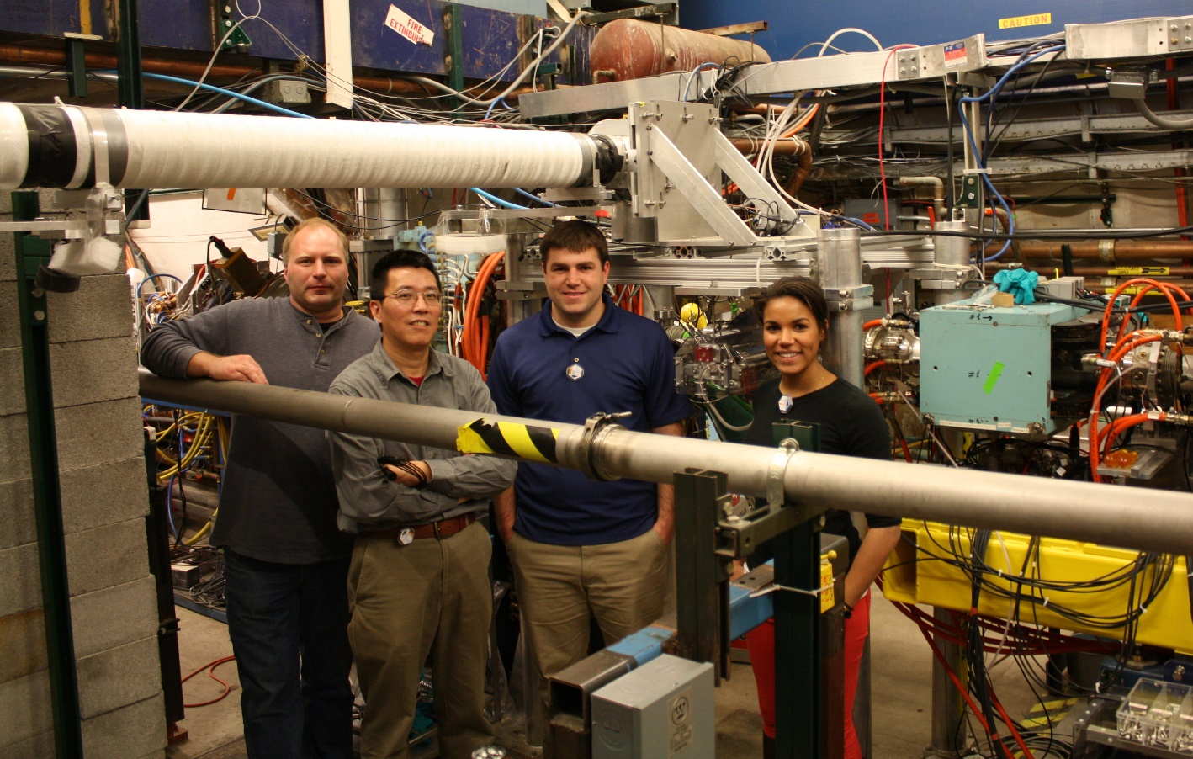
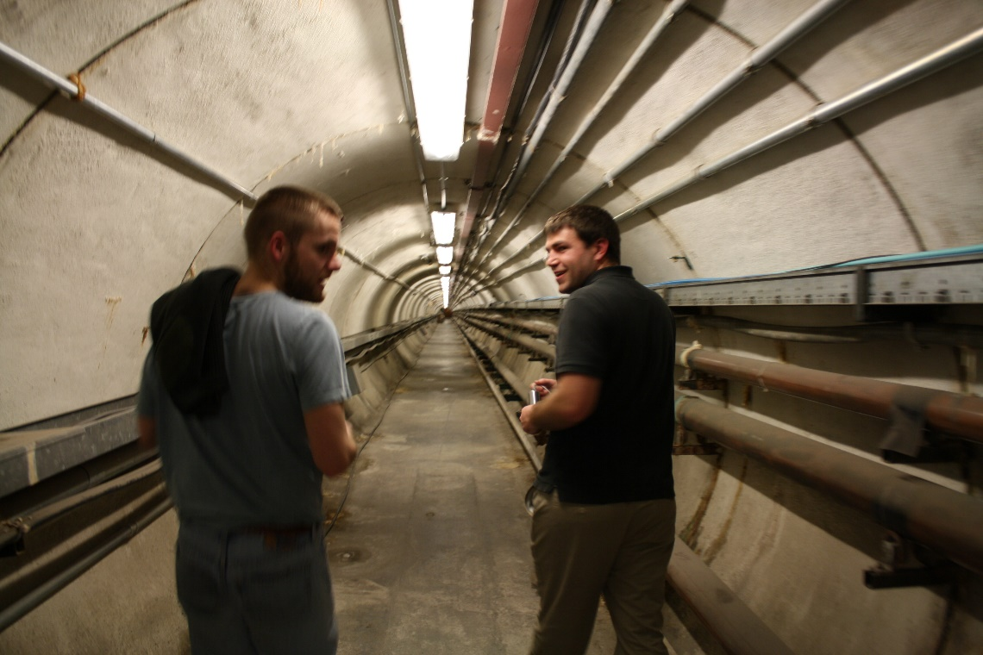
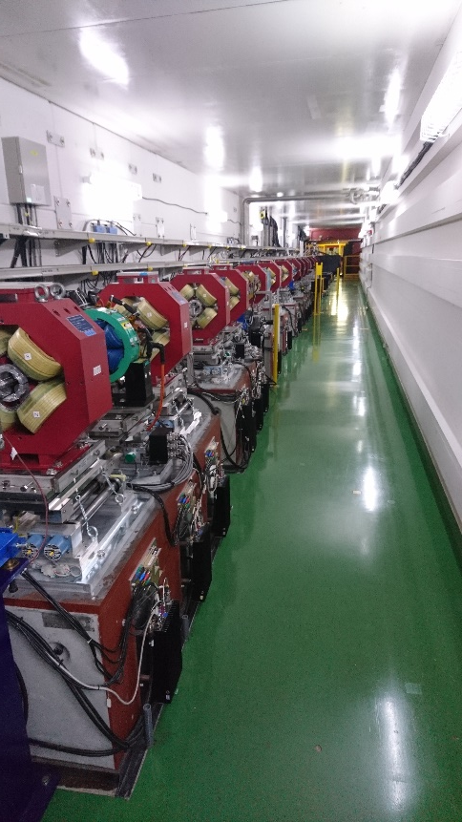

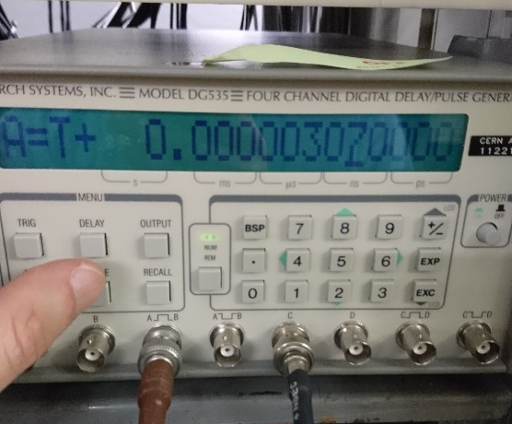
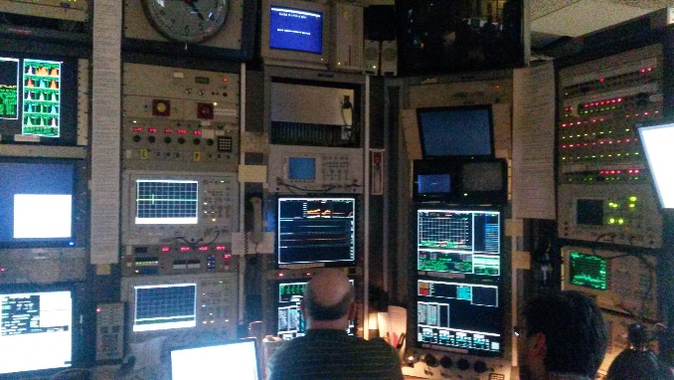
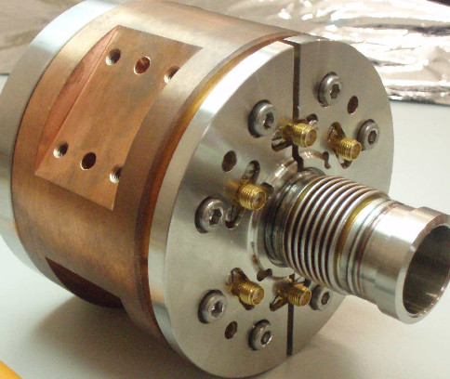
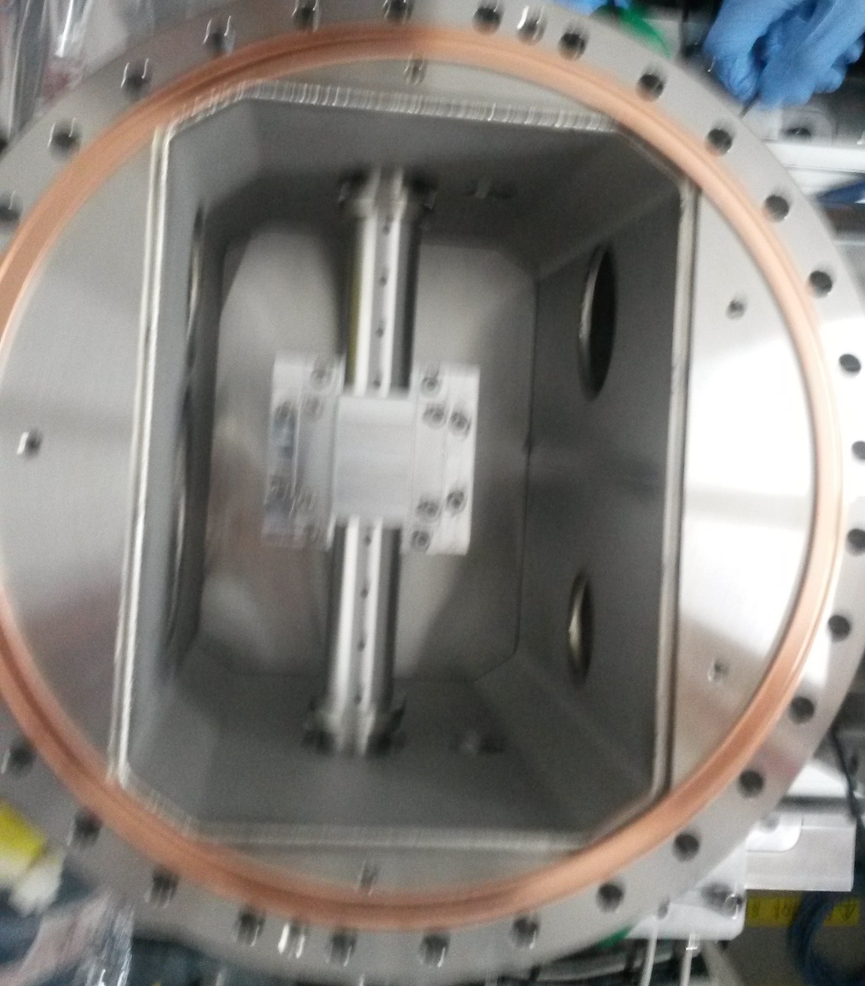
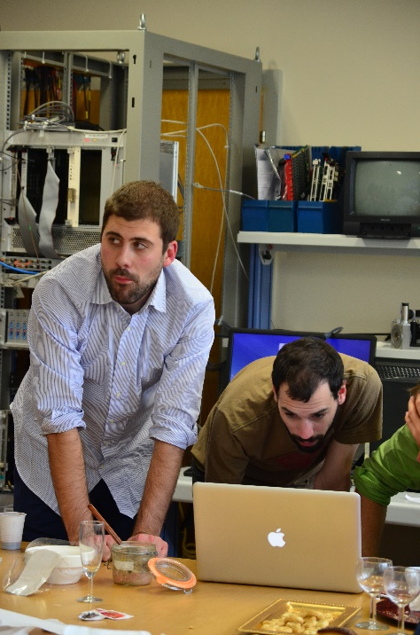
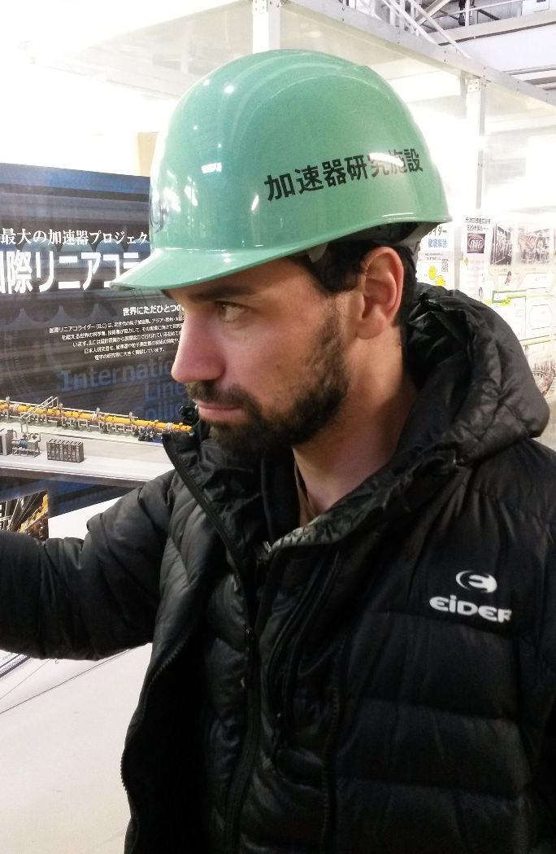
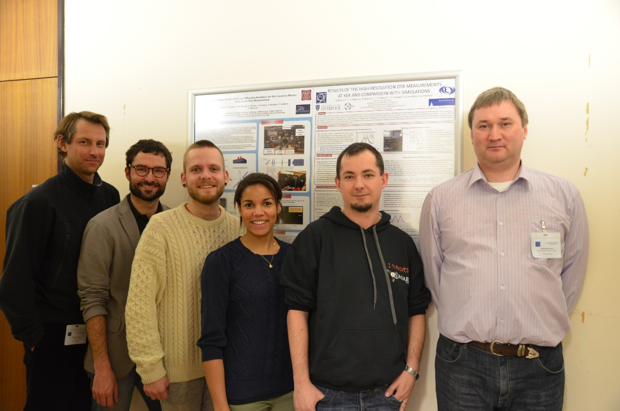
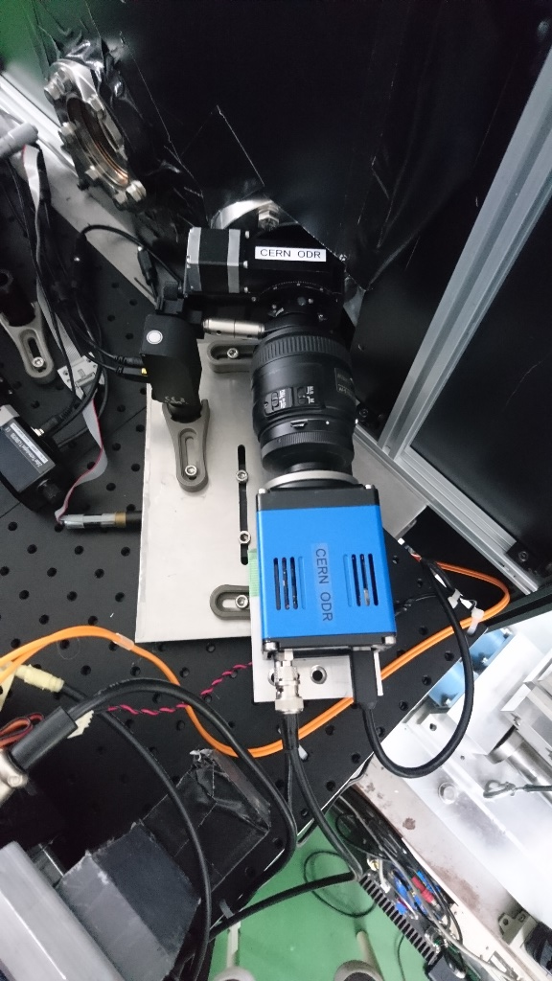
Getting ready for the next big (linear) thing!

