Slide 1
Muon Pair Production
Koichiro Shimomura (KEK IMSS)*
^{T. Yamazaki (KEK IMSS)}
^{N. Kawamura (KEK IMSS)}
^{D. Nomua (KEK IPNS)}
^{Y. Kawashima (RCNP)}
^{* Koichiro.shimomura@kek.jp}

Slide 2
Possible way from ILC to muon collider
Need efficient muon pair production
45GeV positron beam on fix target
Use Laser Compton gamma

Slide 3
Possible way from ILC to muon collider
Need efficient muon pair production
45GeV positron beam on fix target
Although emittance is good O(10⁻⁴)
Intensity is not so large 2×10⁷/s
Use Laser Compton gamma

Slide 5
Muon pair production
Target
e⁻
Laser
μ±
γ線
Study Items
Electron beam energy from ILC 5GeV and 125GeV
Laser choice
Muon pair production target

Slide 6
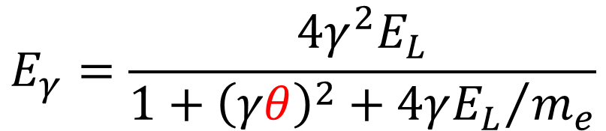
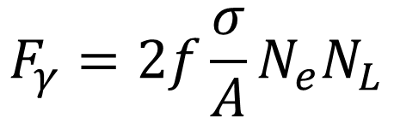

Laser Compton
E_{γ} [eV] γ energey F_{γ} [/s] Flux
$$E_{γ}=\frac{4γ^{2}E_{L}}{1+{\left(γθ\right)}^{2}+{4γE_{L}}/{m_{e}}}$$
γ：electron γ factor
E_{L} [eV]：Laser photon energy
θ [rad]：scattering angle（～1/γ）
m_{e} [eV]：electron mas
f [/s]：collision frequency
σ [m²]：Thomas sc. Cross section
A [m²]：Area size of larger beam
※ normally laser size
N_{e}：number of electron per pulse
N_{L}：number of photon per pulse
$$F_{γ}=2f\frac{σ}{A}N_{e}N_{L}$$
Assume pulsed laser simultaneously excited ILCに同期したパP [W], Laser power λ [m], laser wave length
$$F_{γ}∝{fN_{L}}/A∝{Pλ}/A∝P/λ$$
→ High power, Shor wave length

Slide 7
About Laser Exmaple
ILC 1 pluse structure 1312 bunch of 0.3mm length, 554ns interval
Repetition rate5Hz
Laser developed by AMPHOS Co.
  1μm wavelength
  200W power
  20J macro pulse（ width 1ms）with10Hz
  20mJ micro pulse ~1MHz in macro pulse
  Pulse width ~500ps
  compression with grating
  →1ps=0.3mm (94% efficiency)
  M²<1.25（focusing factor
  focusing size ~1.25 times of wavelength）
  Assume every laser pulse interacts with
  electron beam.
1ms

Slide 8
Beam Dump Specification
From Yokoya

Slide 9
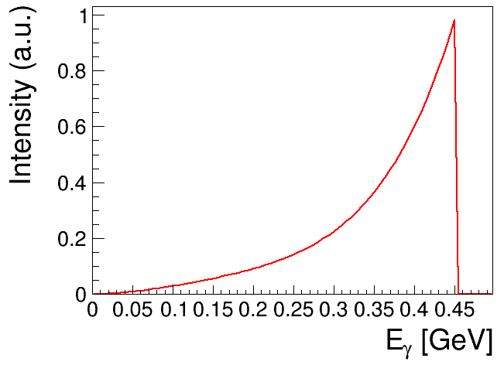
Case1 5GeV Dump（E-1）
Beam Power at Dump max=100kW
Dump W=60kW
→ Assume 50kW（10μA）→1.25×10¹³ e⁻/pulse（10¹⁰ e⁻/bunch）
M²<1.25 hoever we assume w₀=10μm.
  Because electron beam bunch length 0.3mm
  λ=1μm
  w₀=10μm Layleigh length z_{R}=πw₀²/λ=0.3mm
Use P. 3 formula
  E_{γ} = 450MeV (max)
  F = 8.4×10¹² photons/s
  Divergence 0.1mrad

Slide 10
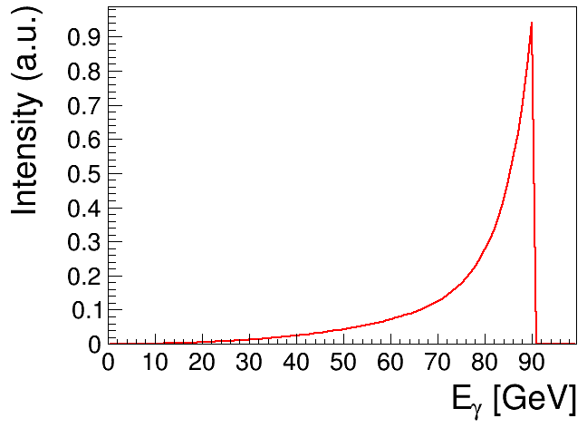
Case2 125GeV Dump（E-5)
Beam Power at Dump max= PB max=2500kW
Dump W=17000kW
Asuume 2500kW（20μA）2.5×10¹³ e⁻/pulse（2×10¹⁰ e⁻/bunch）
w₀=10μm
Use P. 3 formula、
  E_{γ} = 90GeV (Max)
  F = 1.7×10¹³ photons/s
  Divegence 4μrad
γ→∞でE_{γ}→E_{e}
→、Better than 5GeV dump

Slide 11
muon pair production via. γA→μ⁺μ⁻A
γA→μ⁺μ⁻A Total cosssection
Dotted line is appoximate
c.f. Phys. Rev. ST Accel. Beams 12, 111301 (2009)
r₀^{μ}：classical muon adisu
μ：muon mass
Au (Z=79, ρ=19g/cc) thickness 1cm
  5GeV dump、E_{γ} = 450MeV
  σ ~ 30μb
  125GeV dump、E_{γ} = 90GeV σ ~ 1300μb

Slide 12
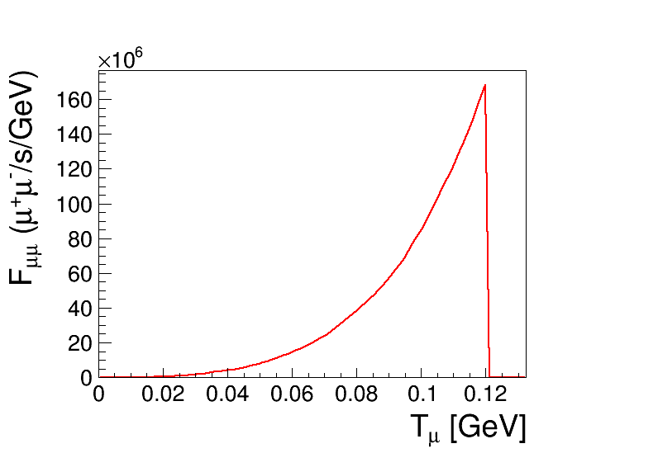
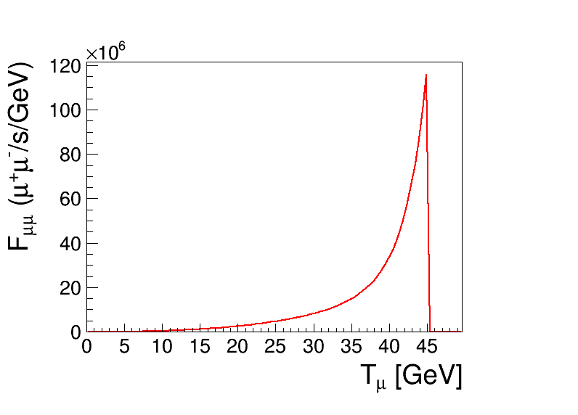
Muon Beam Intensity
Au（Z=79, A=197, ρ=19.3g/cm³）
5GeV dump
125GeV dump
4.4×10⁶ μ⁺μ⁻/s
5.7×10⁸ μ⁺μ⁻/s
125GeV dump θ~2m_{μ}/E_{γ}=O(1) mrad
Beam size
5GeV dump 1mm
125GeV dump 40μm

Slide 13
Comparison
Production method | ~1GeV p | 45GeV e⁺ | 5GeV e⁻ | 125GeV e⁻
K.E (GeV) | 10⁻³～10⁻² | 22 | 0.1 | 45
Energy width (%) | 10 | 20 | 20 | 10
emittance (mm*mrad) | O(10³) | O(10⁻⁴) | O(10³) | O(0.1)
Instensity (/s) | O(10⁸) | 2×10⁷ | 4×10⁷ | 6×10⁸
 |  | μ⁺μ⁻ | μ⁺μ | μ⁺μ⁻
Suitable for muon collider !

Slide 14
Improvement
How about 500GeV, 1TeV case ?
Oher particle pair production（π, K, B, τ etc.）
Any other photon source ?
Cavity enhancement ?（c.f. H. Shimizu, et al., NIMA 745 (2014) 63-72）

