Slide 1

Applications of LC beams
Y. Iwashita, Kyoto University

Slide 2
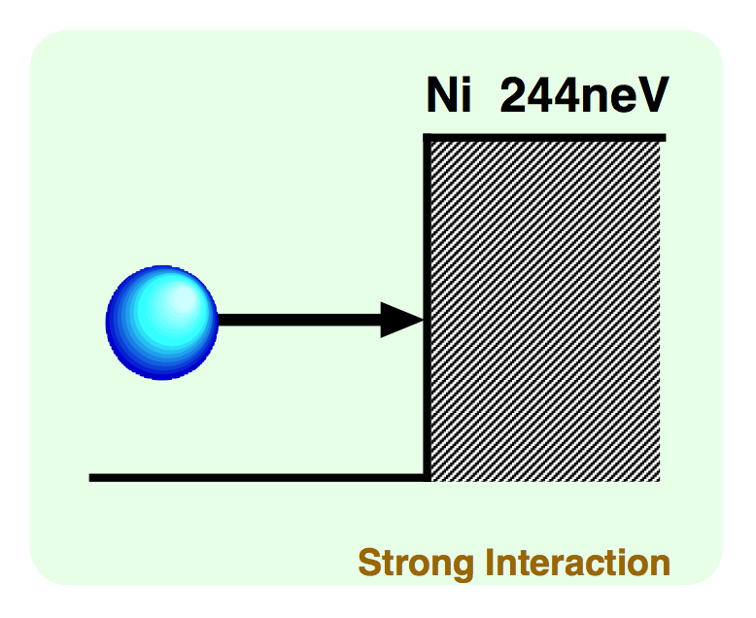

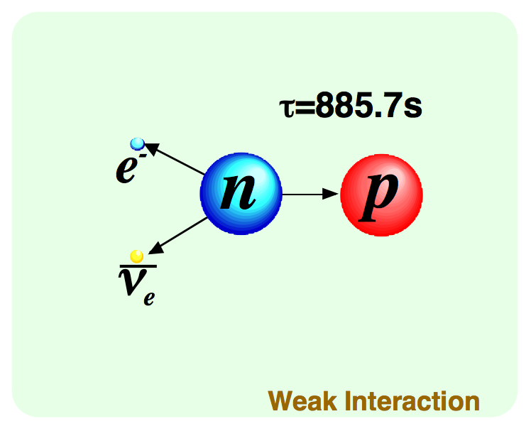
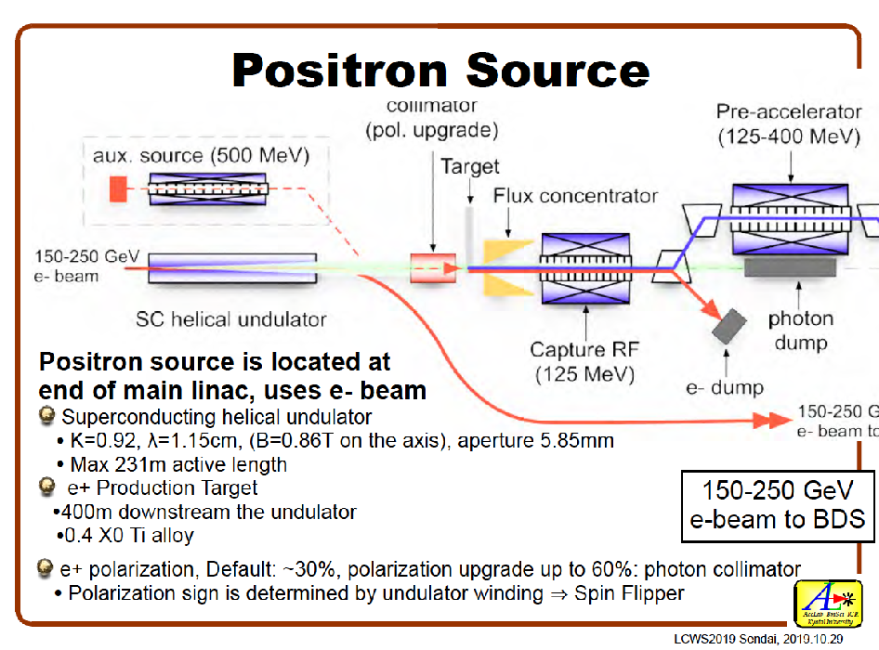




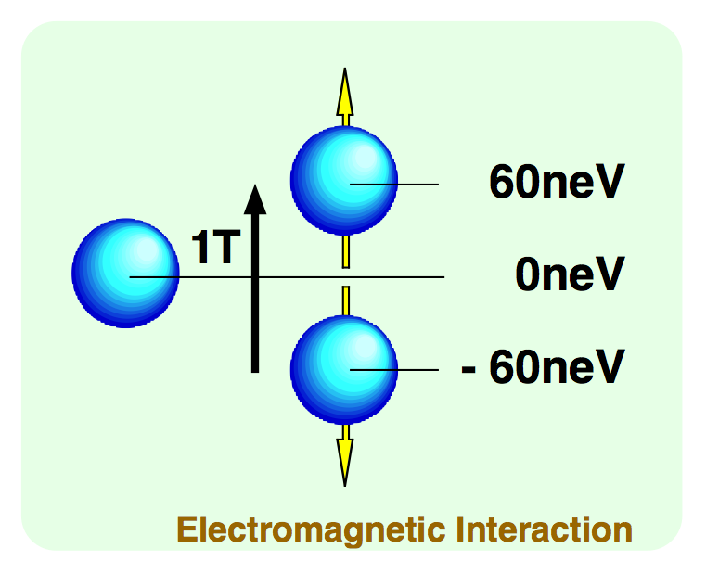
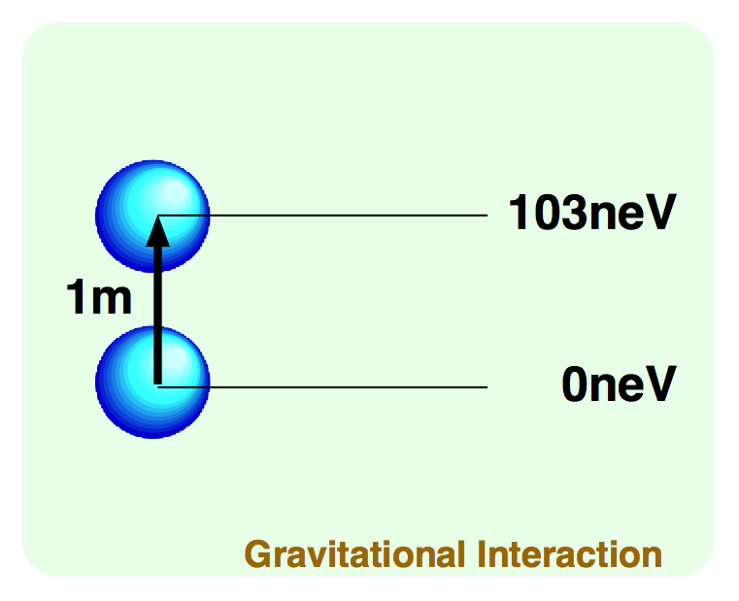



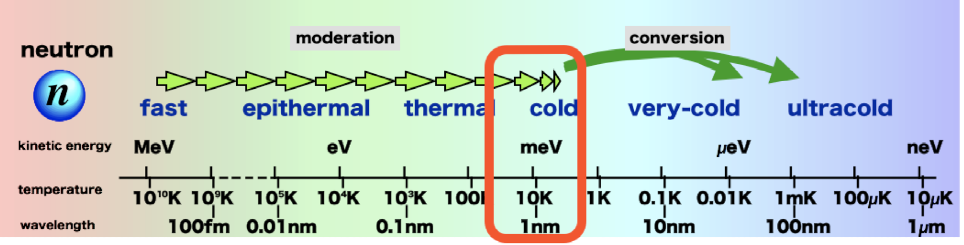
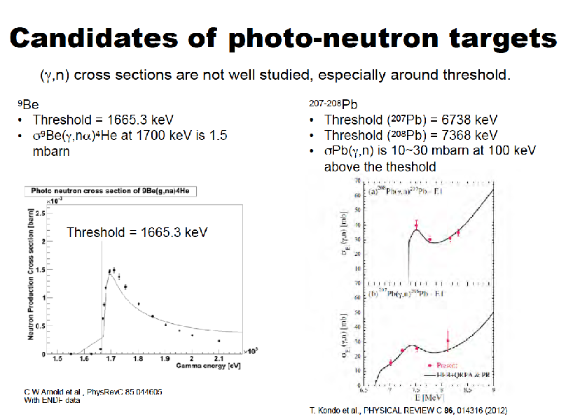
Introduction
In order to seek new schemes for direct generation of usable energy neutron, intense MeV gamma source at positron source was picked up.
Then, spread to other hidden users to share this unique facility.
The precious facility could Contribution to widely spread science fields. Diversity of the usage enhances efficiencies to share knowledge and merits.
Tunnels or extra spaces have to be incorporated from the beginning. Raise the attention of researchers who are not interested, and dig up discussions to sublimate attractively.

Slide 3
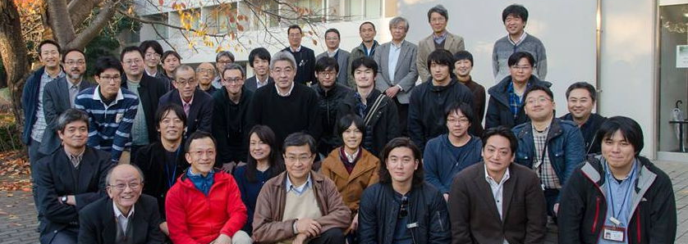
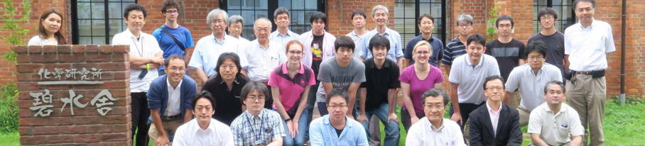
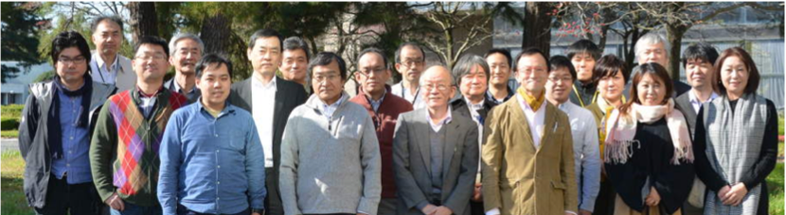
WG6: divILC activities so far
In order to explore possibilities of this unique facility, events were held to discuss diversified applications on ILC and/or its facilities and
to gather as many personnel who have not been interested in ILC so far.
  1) First kick off meeting: 2017/11/29-30
  @ KEK 2Bldg.1F— Report in Japanese
2) IPAC’18 @Vancouver:
http://accelconf.web.cern.ch/AccelConf/
ipac2018/papers/mopml047.pdf
3) 2nd meeting: 2018/7/5-6
@ Uji Campus, Kyoto University
https://conference-indico.kek.jp/indico/event/52
4) 3rd workshop of Concepts of neutron sources (CoNS-Ⅲ)
2018/8/21@KEK Tokai 1-gokan Rm324
http://www2.kek.jp/imss/kens/topics/2018/07/191648.html
5) 3rd meeting: 2018/11/13-14
@ KEK 3Bldg.1F — Report in Japanese
6) JAPAN-SPAIN WORKSHOP ON OPPORTUNITIES ON ACCELERATORS: 2018/12/10 Madrid
7) Symposium at JPS meeting: 2019/3/15 15pF303

Slide 4
Possible Beam Conditions in ILC
Overview of ILC Accelerator
  (May be omitted if the audience is familiar with ILC → then, jump to page 16)
Diversified application of ILC beam to other purpose
Kaoru Yokoya, KEK
2019.10.29 LCWS2019 Sendai
2019/10/29 LCWS19 Yokoya

Slide 5
Diversified Use of the ILC Beam
ILC beam
  Very high energy
  Low emittance
  High intensity (beam thrown away)
Once ILC is built, people will certainly think of the possibility of using the beam for other purposes
Expect a long life of ILC system
  Luminosity-energy upgrade in the future desirable
First consider parasitic usage under high-energy experiment of ILC250
  Center-of-mass energy 250GeV
  Beam energy maximum 125GeV
2019/10/29 LCWS19 Yokoya

Slide 6
Parasitic Use of the Beam
Destructive use of a part of the beam (extraction)
  Take out the head (or tail) of the 1312 bunches
    Fast kicker needed (rise/fall time < 0.5μs)
  Take out a part of (rise/fall time < 200ms)
  Might be possible to use the beam for a few hours/days (shutdown, summer time)
Non-destructive use of the whole (or part) of the beam
  For example, insert an undulator in the main beamline
  In such a case a chicane is needed to separate the electrons and photons
  Must not degrade the main beam emittance
Other possibilities not affecting the collision experiment
  Use of the beam after collision
  Use of photons for producing the positron
  Operate the electron injector (5GeV) at 10Hz, 5Hz for high energy experiment and 5Hz for parasitic use
2019/10/29 LCWS19 Yokoya

Slide 7
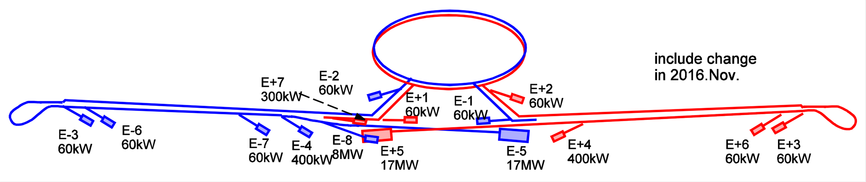
Distribution of the Beam Dumps
Extraction use will be most practical at the location of beam dumps
Show below the schematic layout of the beam dumps
Blue: electron, red : positron,. Yellow arrow : bunch compressor (bunch length 6mm at its upstream, 0.3mm downstream)
The power number is the design upper limit of each dump (including 20% margin)
  For commissioning or for emergency, except E-5, E+5, E+7, E-8
  Therefore, the power of the full beam passing nearby exceeds the dump design (see next page)
  Only E-5, E+5, E+7 can dump the full beam. (The design upper limit exceeds the full beam intensity because future upgrade is taken into account)
It is not decided yet whether E-8 is to be constructed in ILC250GeV (Z-pole !!)
Bunch Compression
Bunch Compression
2019/10/29 LCWS19 Yokoya

Slide 8
Summary
There are a few places when the beam line may be used as light sources.
  5GeV electron injector
  Right after 15GeV bunch compressor
  Others
The best parasitic mode parallel to Higgs experiment is the 5Hz+5Hz operation
In any case possible changes of the machine design must carefully be examined
Caution:
  Safety in intercepting the beam
  Tunnel access during beam operation
  Construction at a later time
2019/10/29 LCWS19 Yokoya

Slide 9

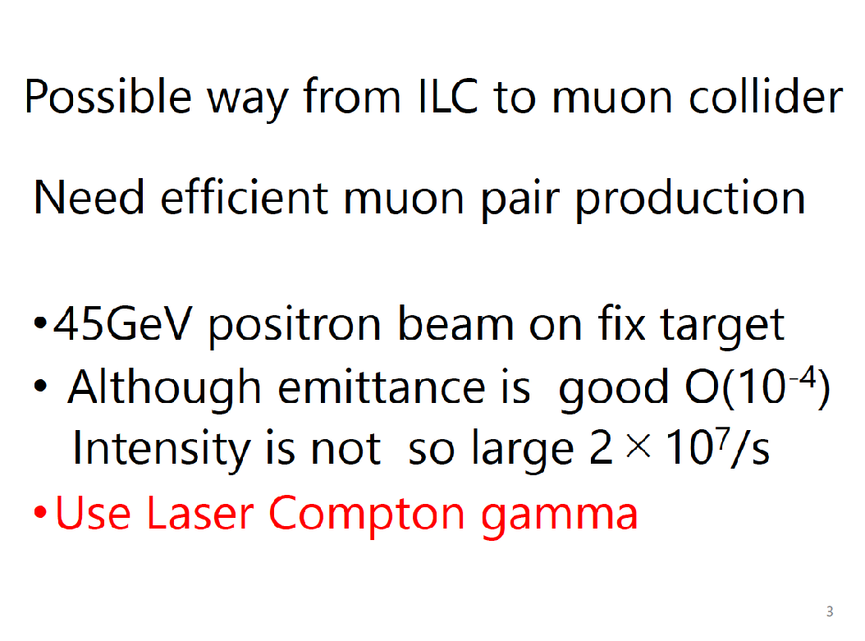
Muon Pair Production
Koichiro Shimomura (KEK IMSS)*
T. Yamazaki (KEK IMSS)
N. Kawamura (KEK IMSS)
D. Nomura (KEK IPNS)
Y. Kawashima (RCNP)
* Koichiro.shimomura@kek.jp

Slide 10
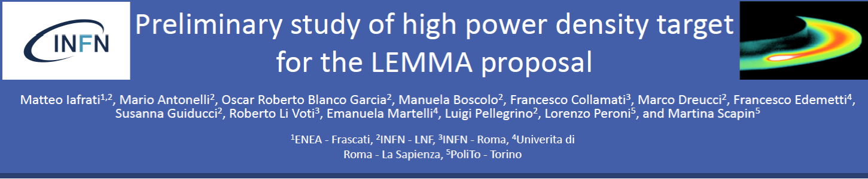
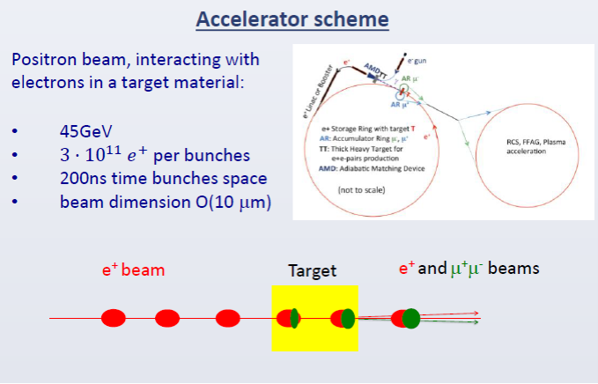
Notes:
Introduced

Slide 11

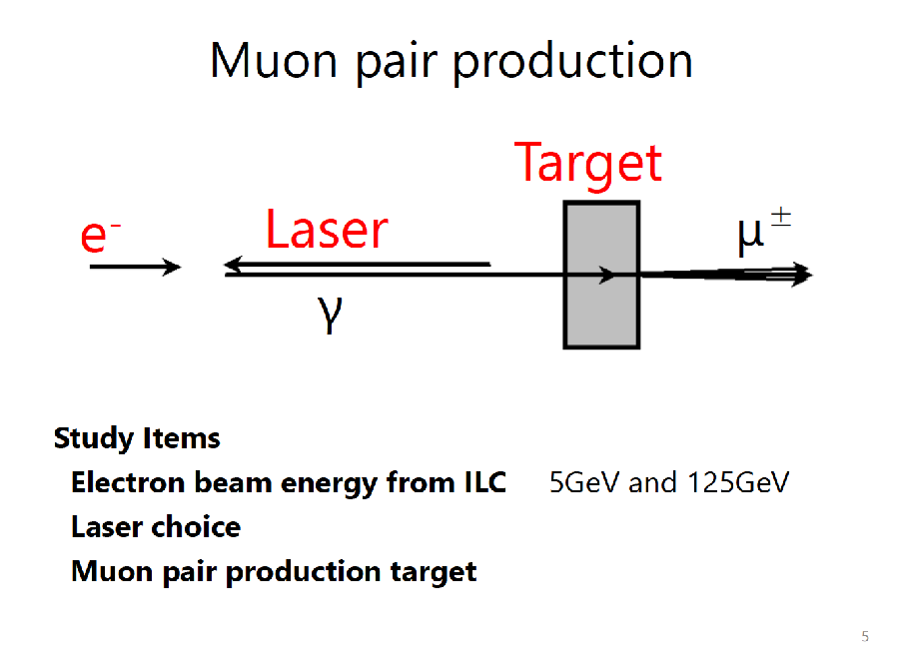
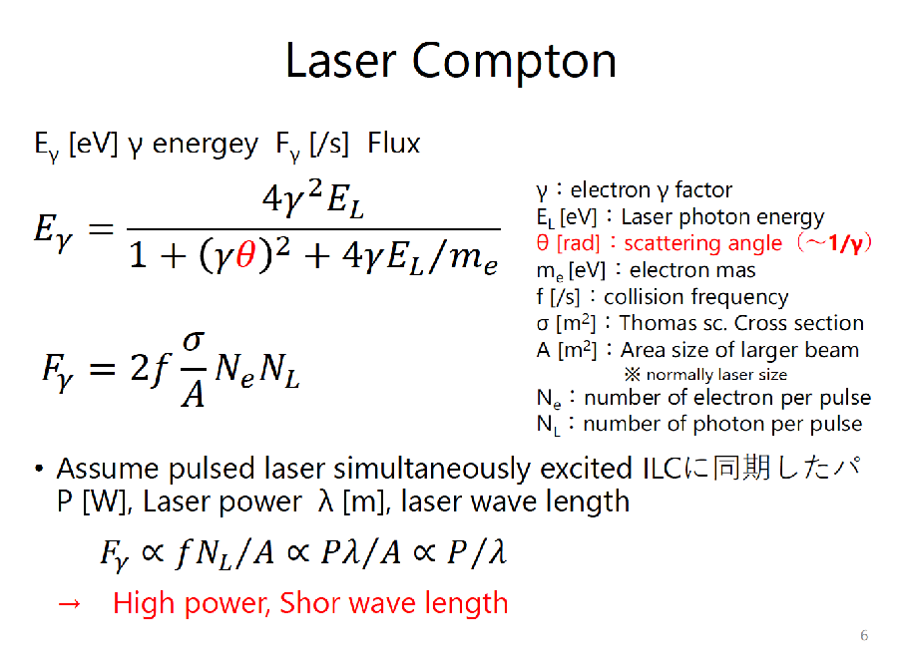


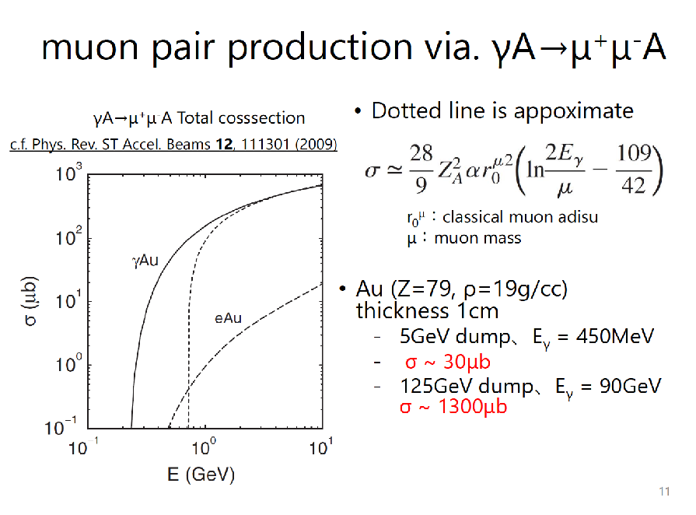
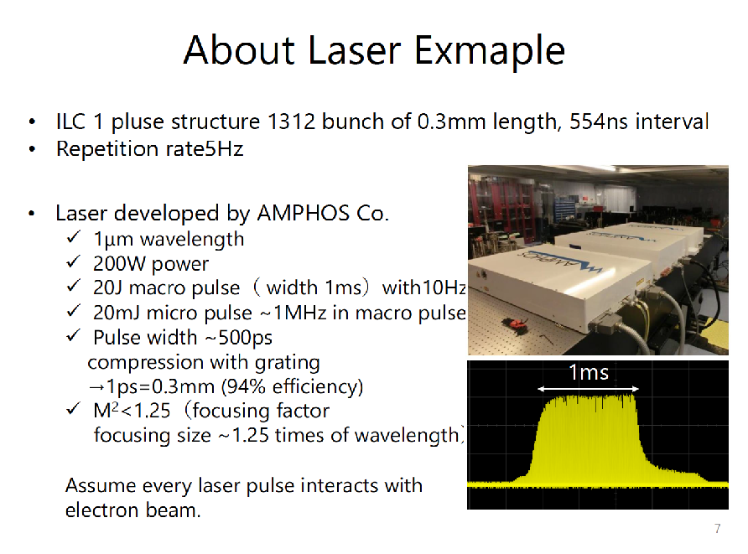
Muon Pair Production

Slide 12

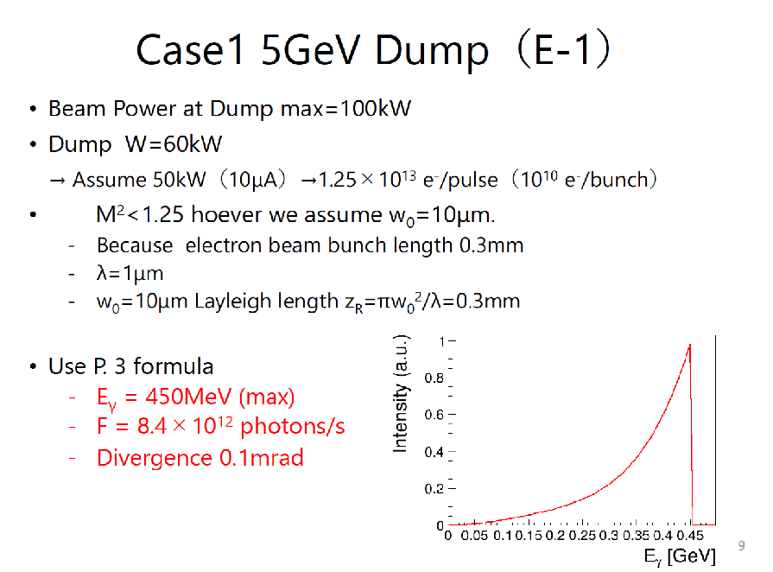
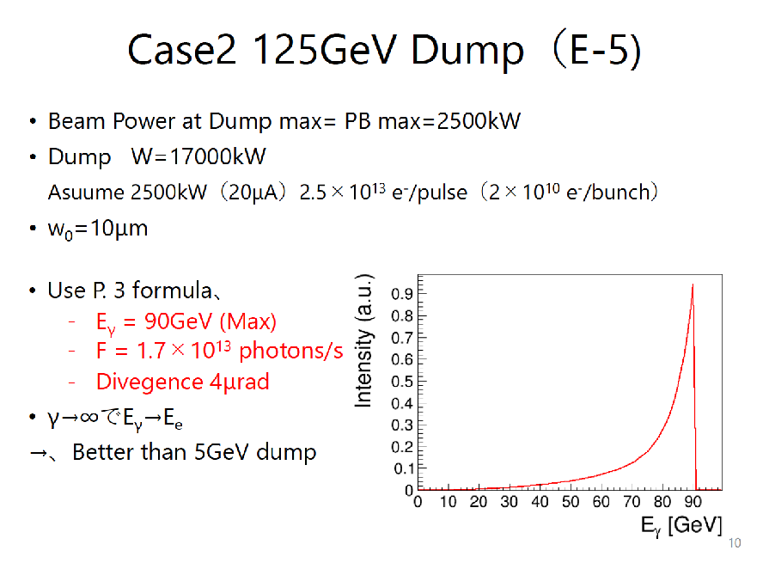
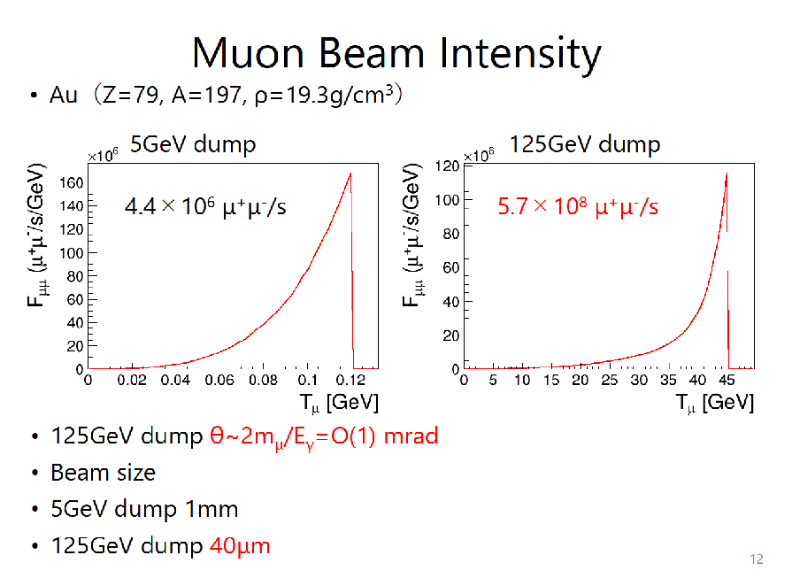
Muon Pair Production

Slide 13
Comparison
Production method | ~1GeV p | 45GeV e⁺ | 5GeV e⁻ | 125GeV e⁻
K.E (GeV) | 10⁻³～10⁻² | 22 | 0.1 | 45
Energy width (%) | 10 | 20 | 20 | 10
emittance (mm*mrad) | O(10³) | O(10⁻⁴) | O(10³) | O(0.1)
Instensity (/s) | O(10⁸) | 2×10⁷ | 4×10⁷ | 6×10⁸
 |  | μ⁺μ⁻ | μ⁺μ | μ⁺μ⁻
Suitable for muon collider !
Improvement:
How about 500GeV, 1TeV case ?
Other particle pair production（π, K, B, τ etc.）
Any other photon source ?
Cavity enhancement ?（c.f. H. Shimizu, et al., NIMA 745 (2014) 63-72）

Slide 15
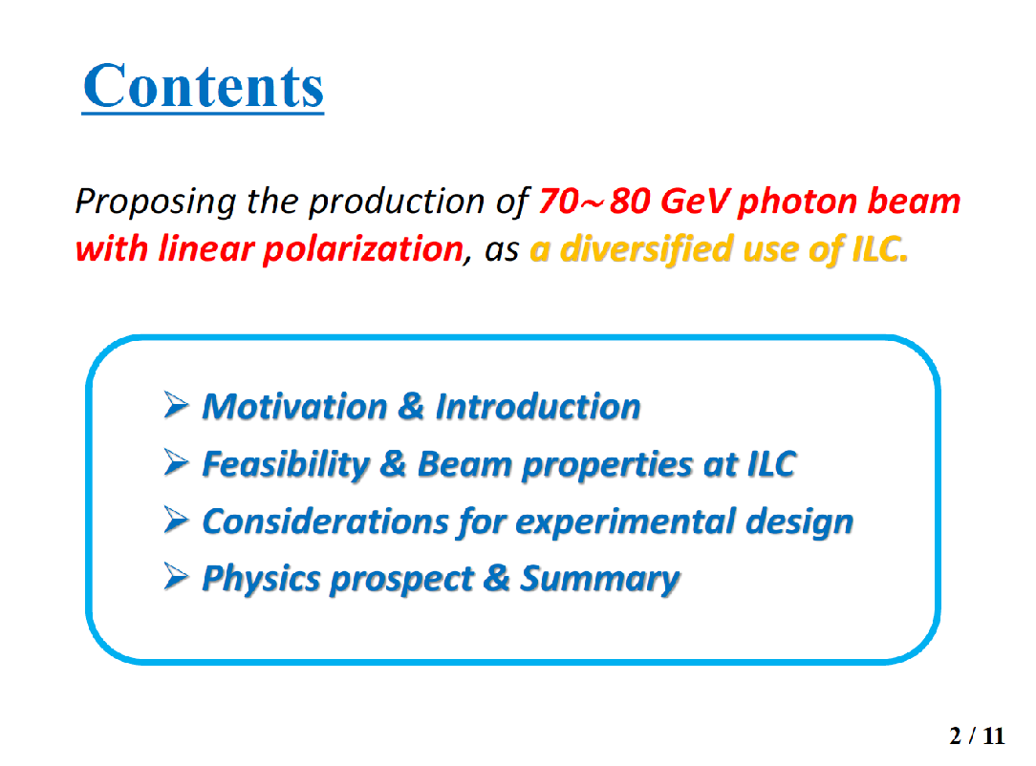
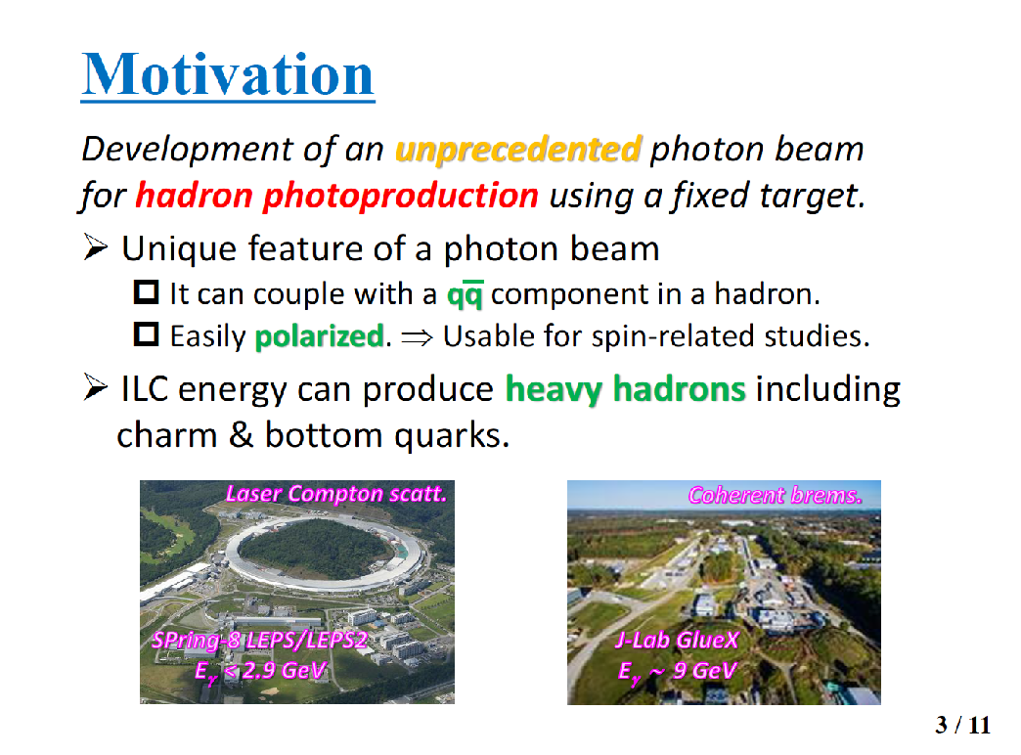
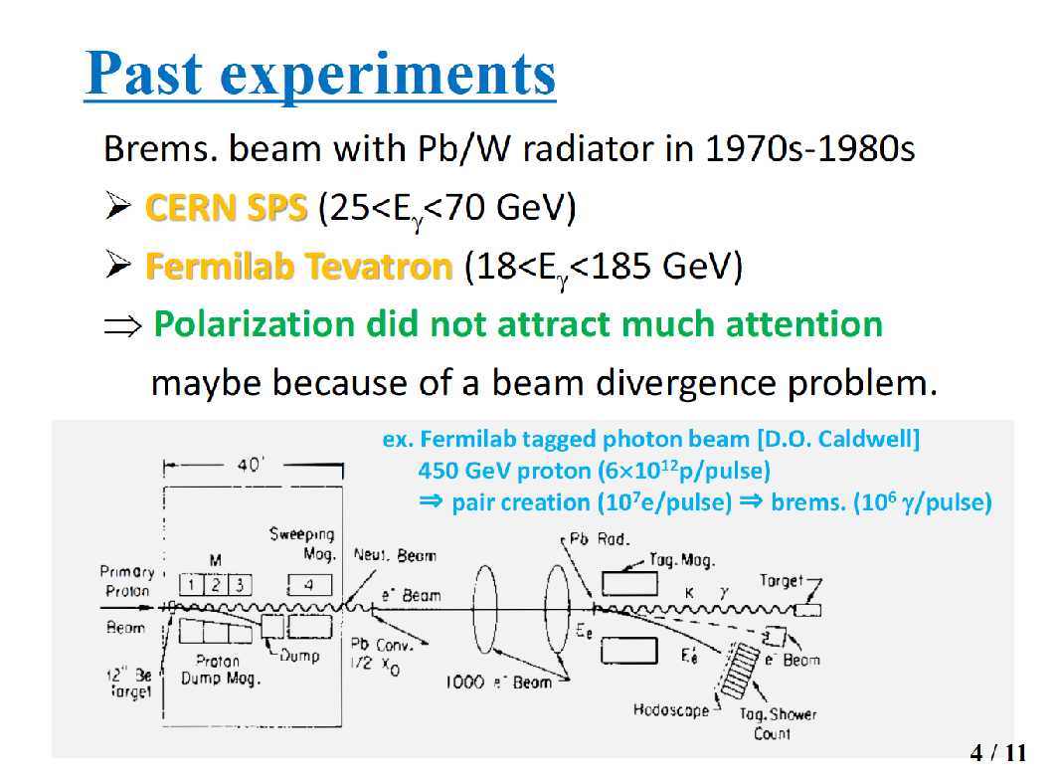
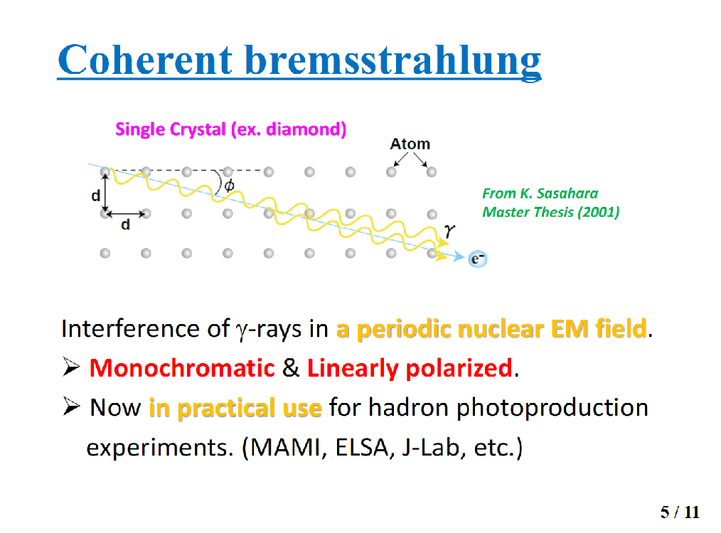

Slide 16

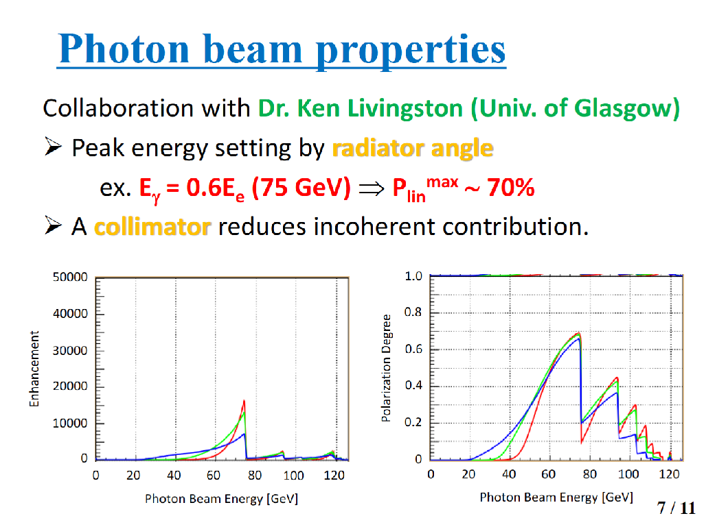
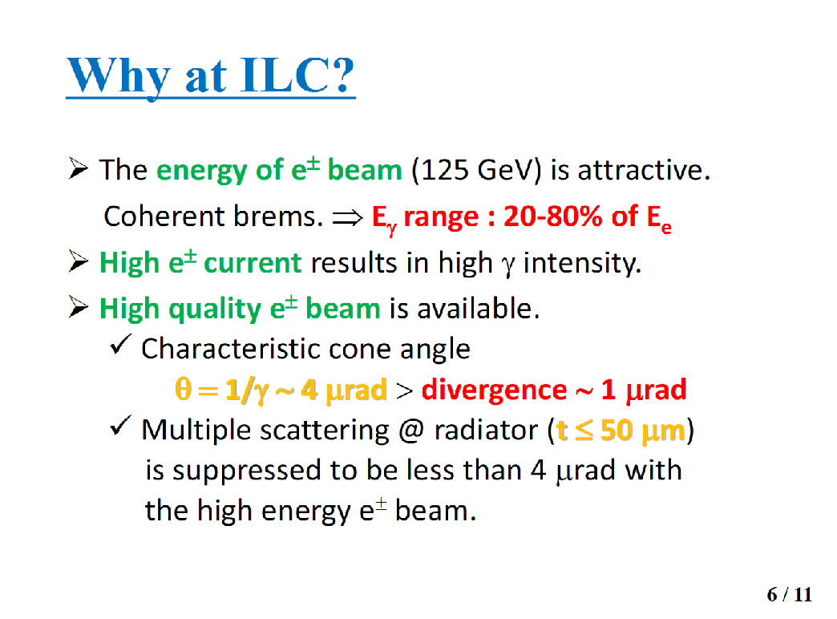

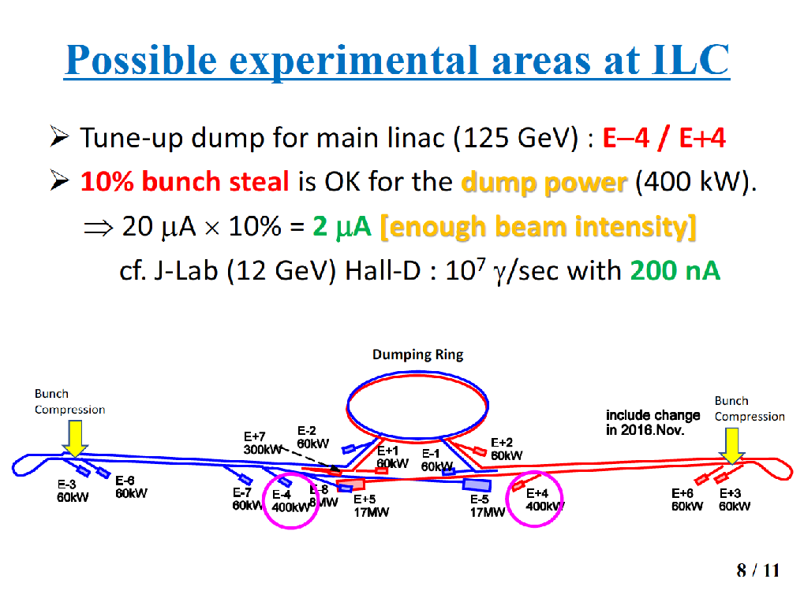

Slide 17


Slide 20
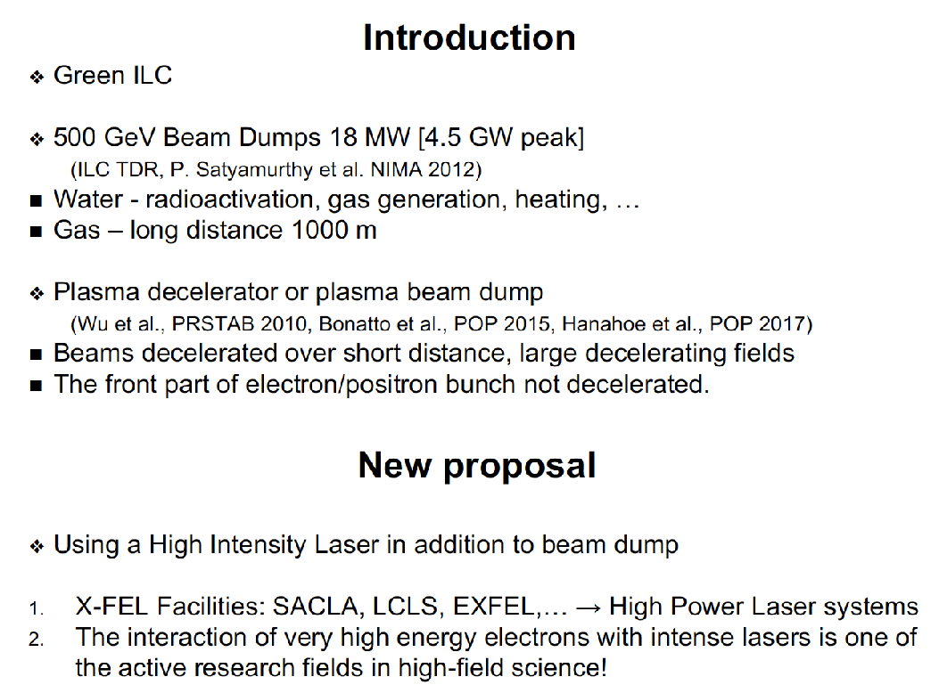
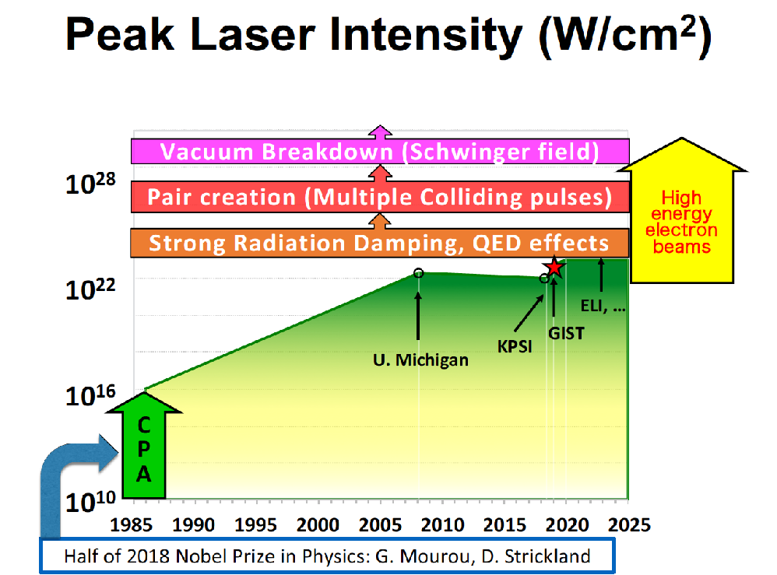
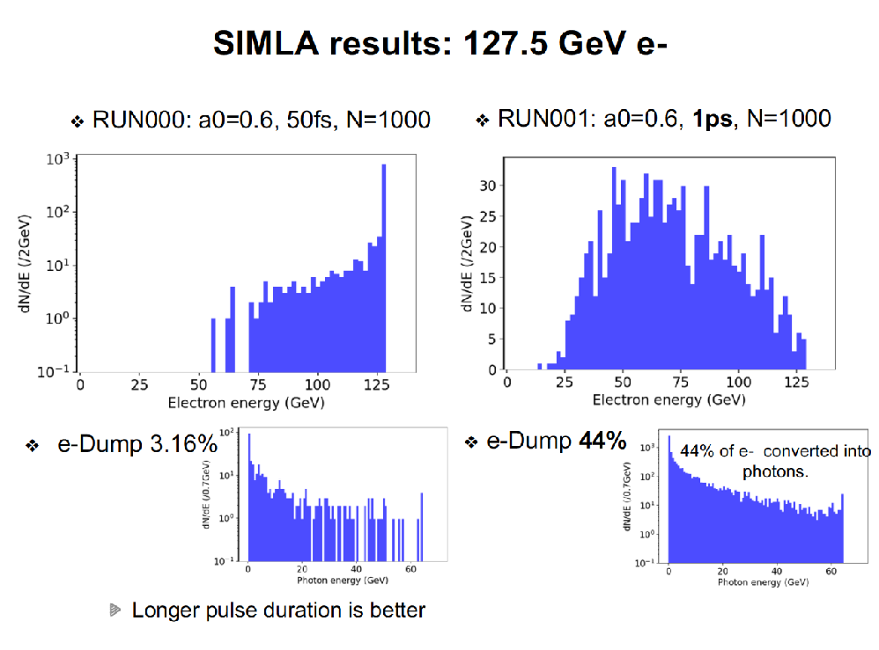
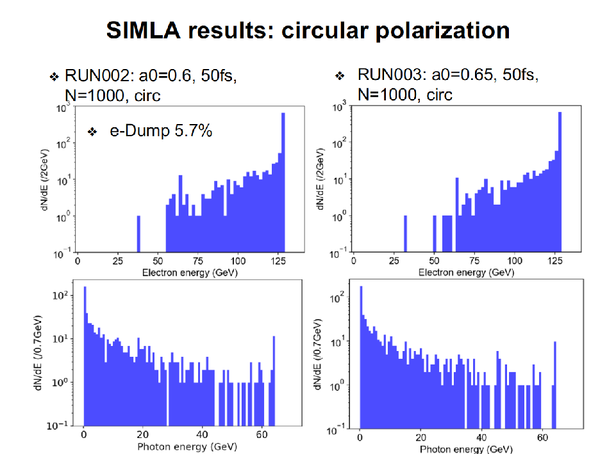

Slide 21


Slide 26
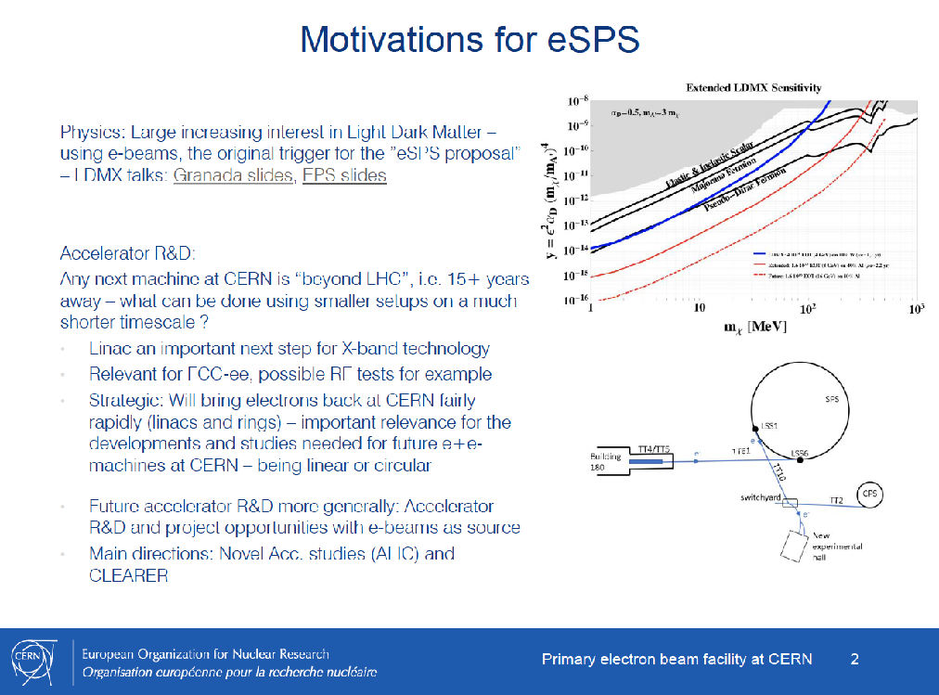
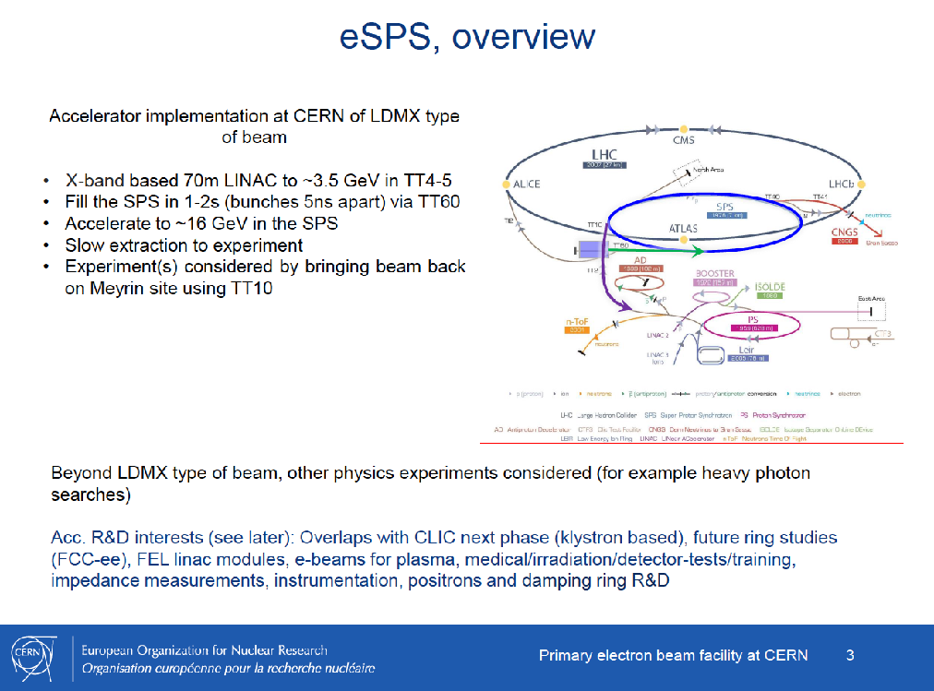
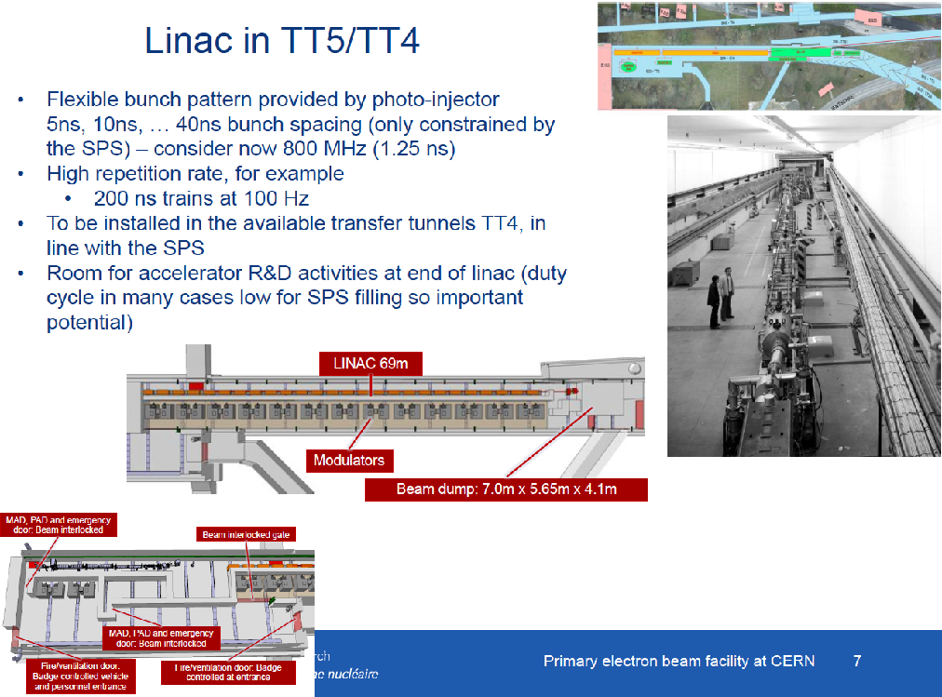
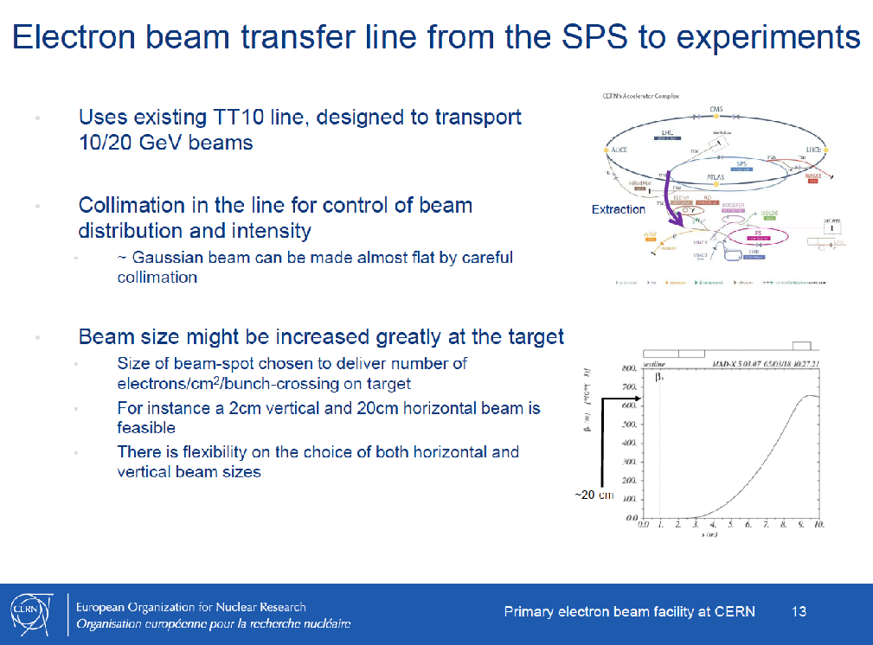

Slide 27
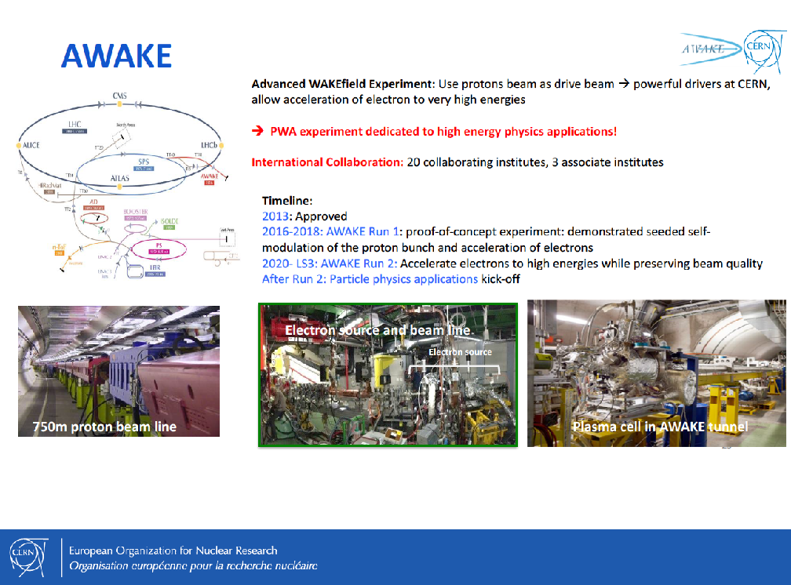
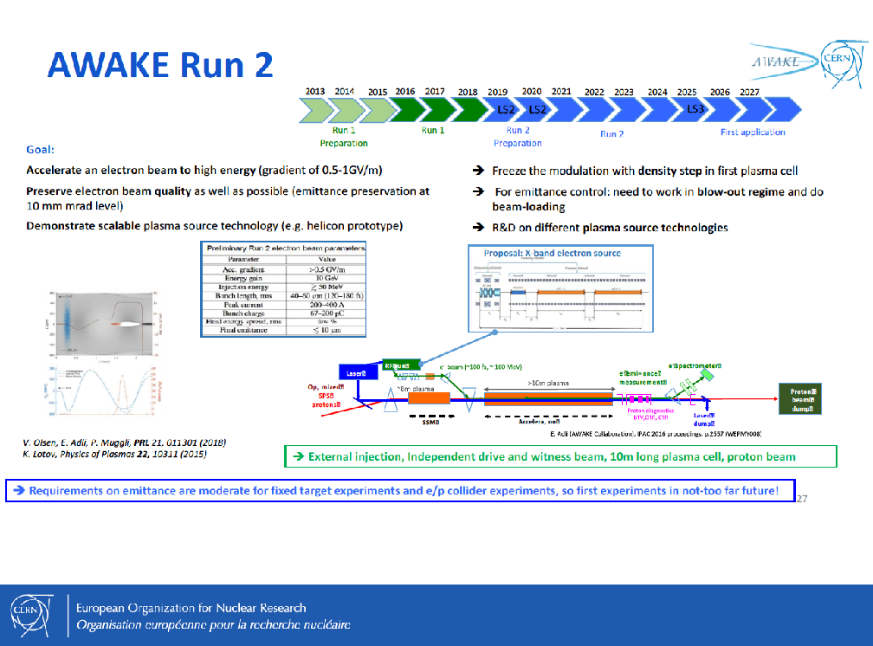
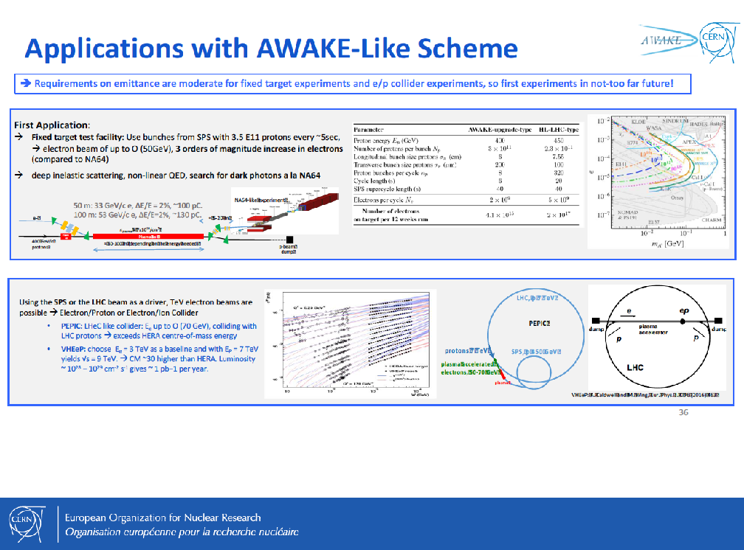
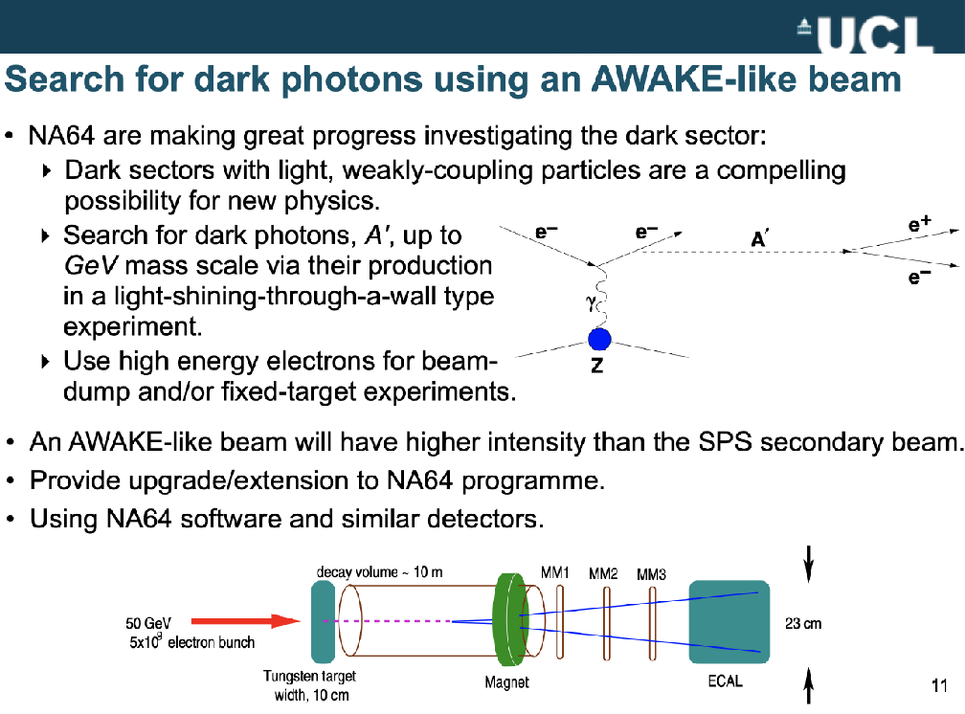

Slide 30
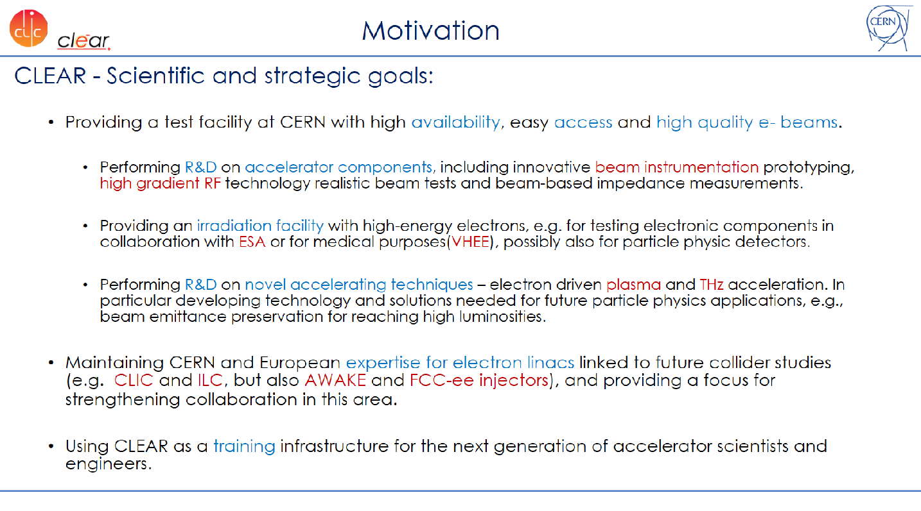
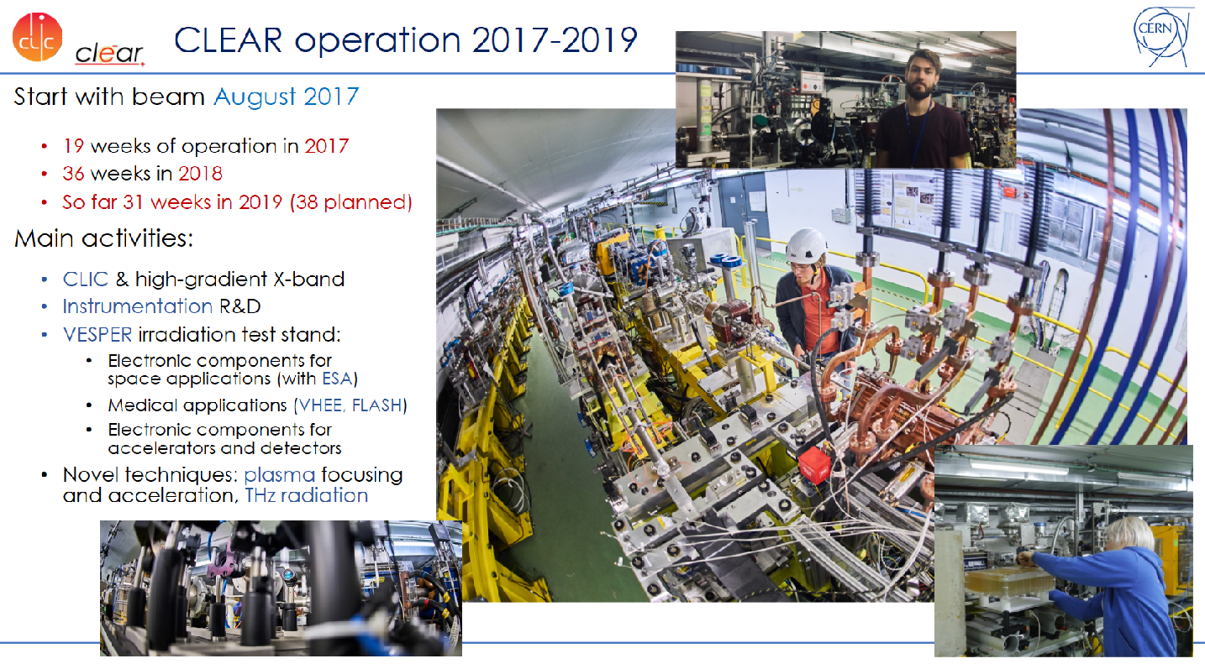
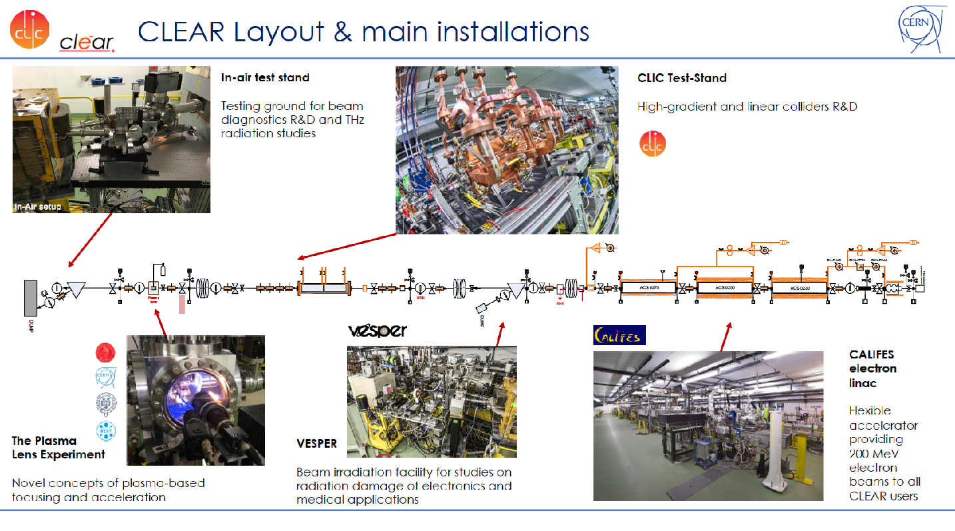
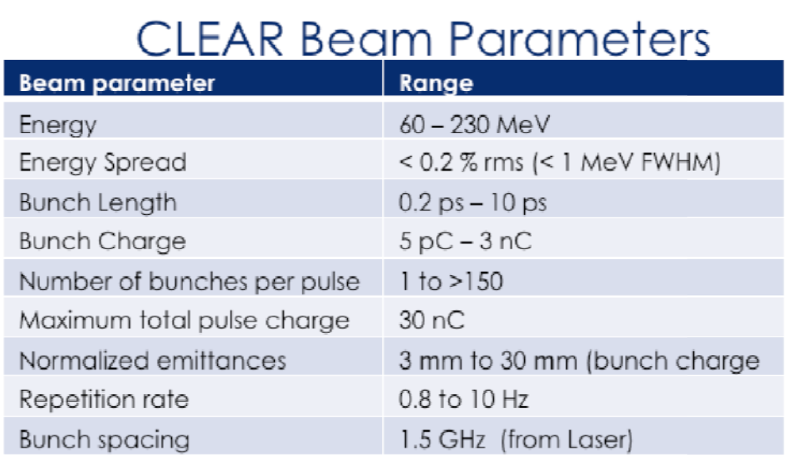

Slide 31
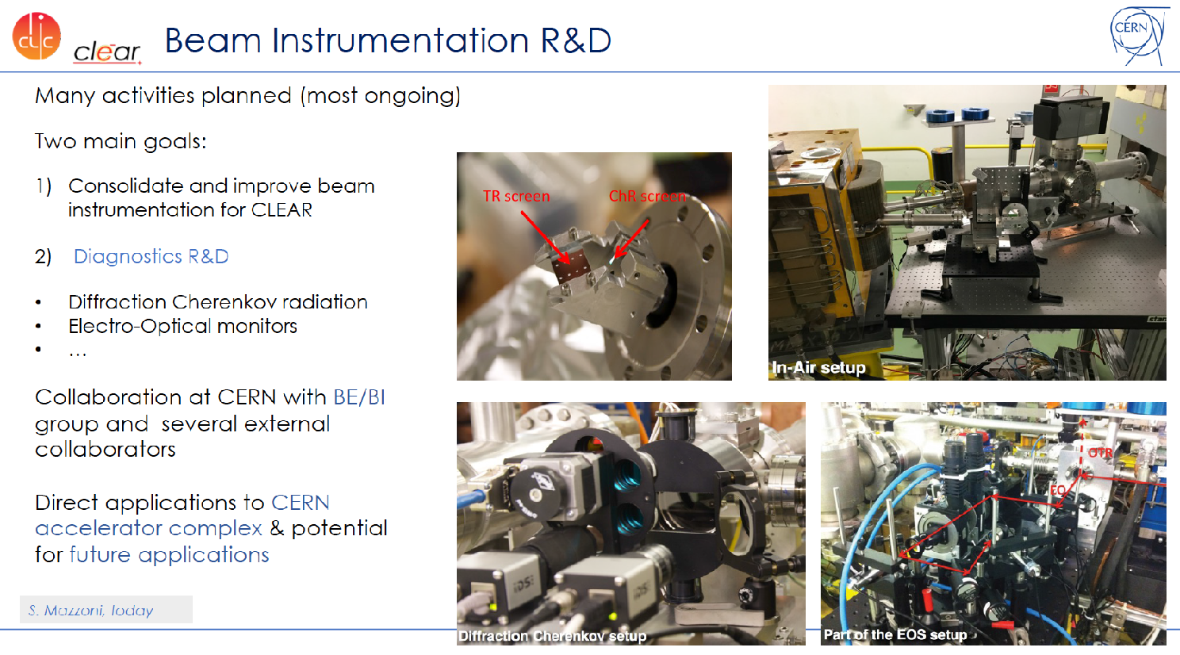
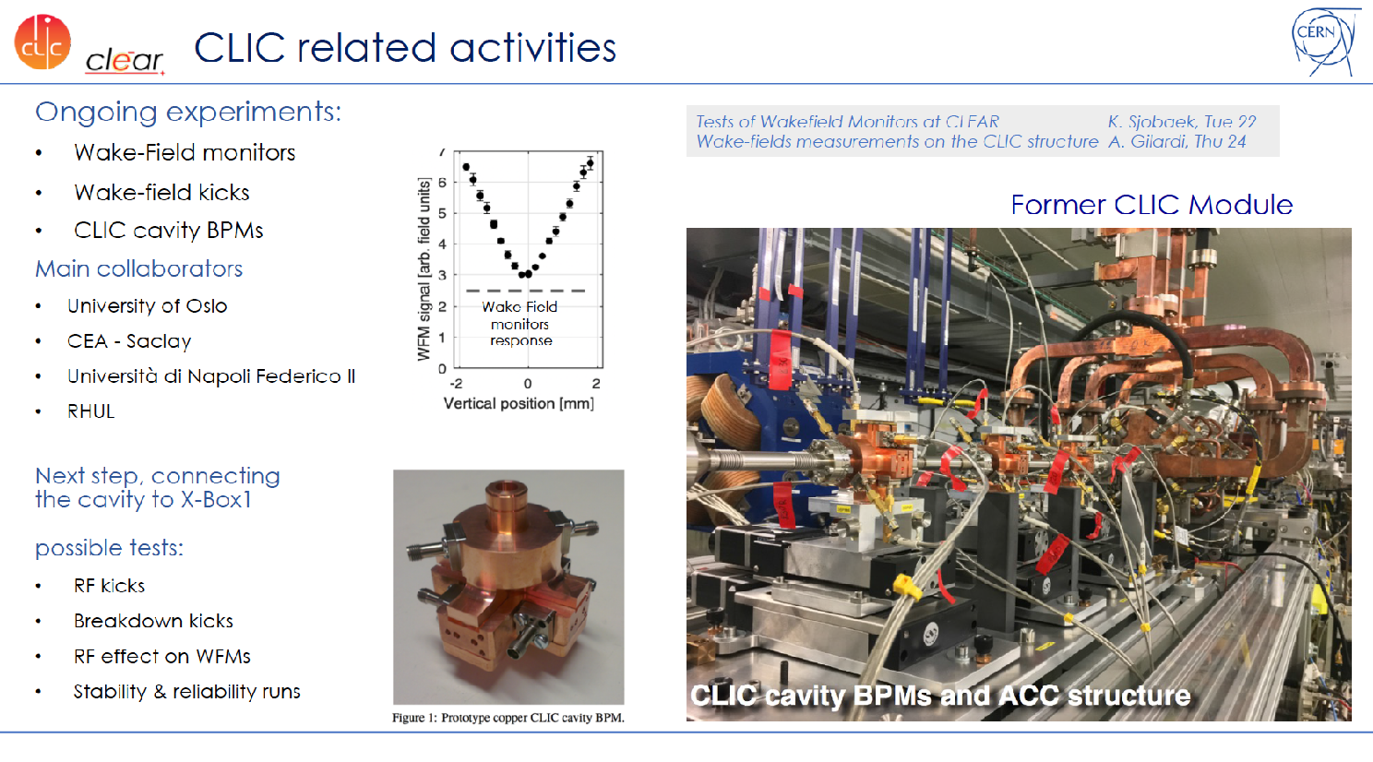
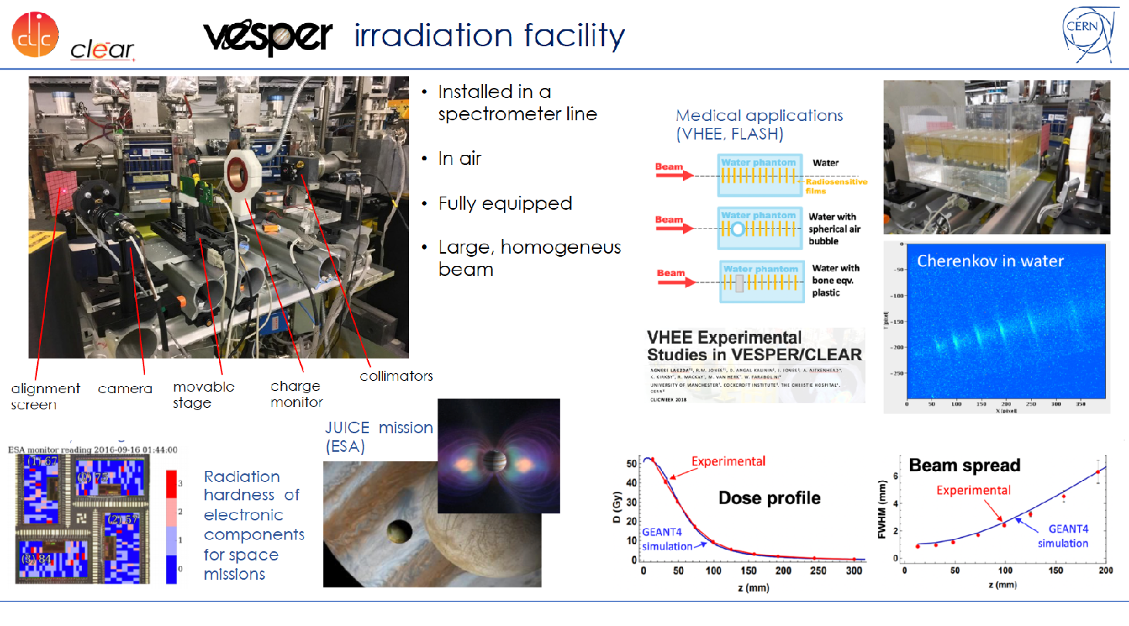
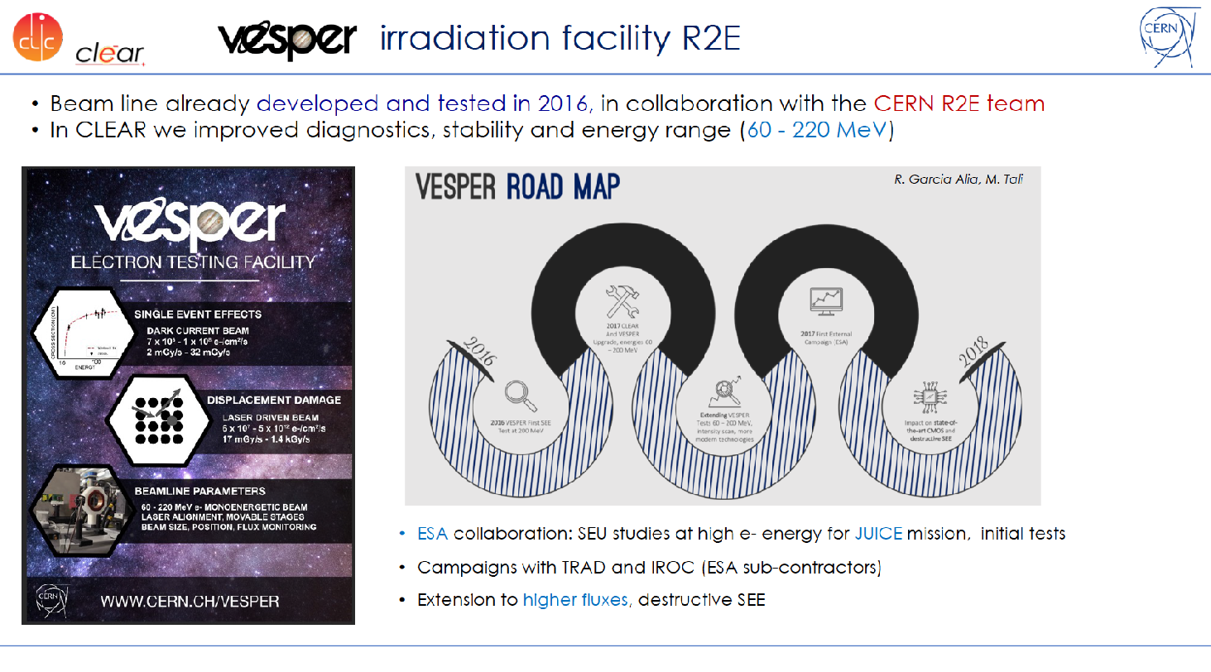
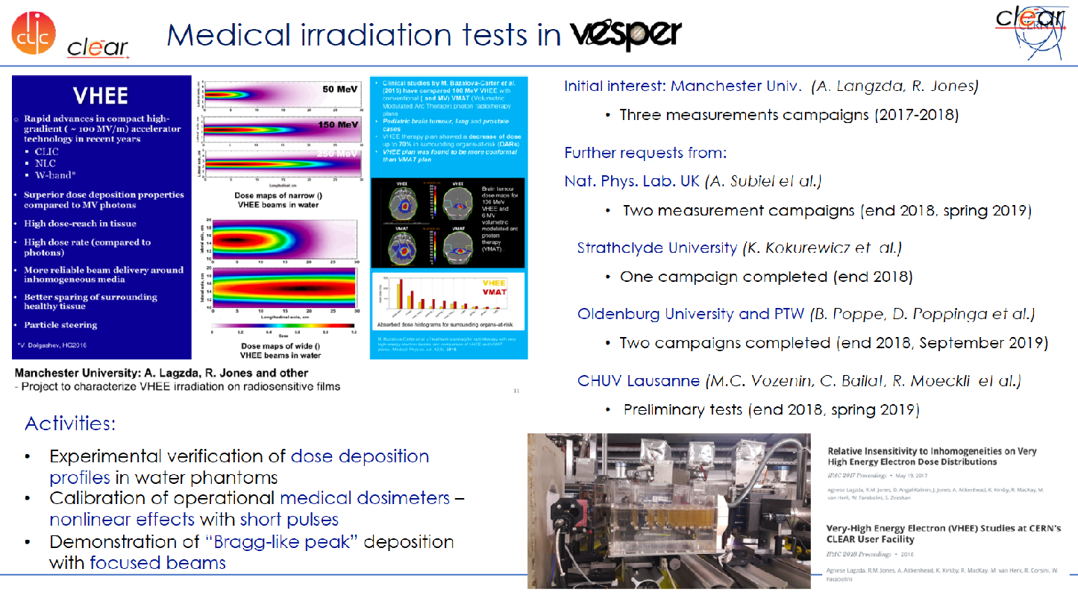

Slide 32
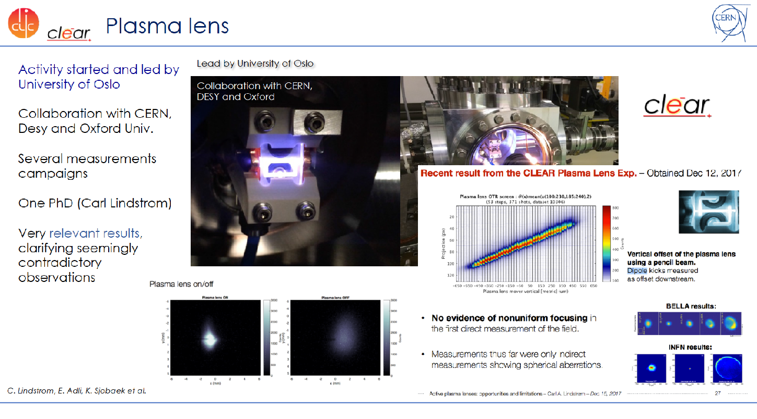


Slide 33



Slide 34




