Slide 1
Atomistic modeling of surface evolution under strong electric fields
Danny Perez, Andrew Garmon, Timothy Germann, Gaoxue Wang, Frank Krawczyk

Slide 2
Motivating challenges
Compact, low-cost, accelerators would benefit from high gradients
These however lead to increase in RF breakdown
Incidence of breakdown is well characterized, but microscopic causes are complex:
  Occurs at fields that are well below what needed of a clean flat Cu surface (~10 GV/m)
  Implies the formation of precursors that locally enhance the field before breakdown can occur

Slide 3
Key questions
What are these precursors and how they form?
What controls their formation rate?
Dolgashev, Tantawi, Higashi, Spataro, 2010

Slide 4
Key questions
How does precursor formation couple with microstructure and composition?
Simakov, Dolgashev, Tantawi, 2018

Slide 5
Goals
Short-term goals:
  Demonstrate that the response of metal surfaces to external E can be captured by a classical approach calibrated by quantum calculations
Long(er)-term goals:
  Include combined H,E effects
  Understand how the breakdown propensity couples to the microstructure and composition of the material
  Inform the design of optimized material solutions
The goal is not to reach engineering scales, but to understand fundamental breakdown mechanisms and inform materials design

Slide 6
Levels of theory
Quantum description:
  Density functional theory (DFT)
  Explicit description of the electron gas
Strengths:
  Very accurate (~100 meV/atom)
  First principles (few parameters, transferable)
Weakness:
  Very expensive (scales as N_{electrons}³)
    Small systems (~few 100 atoms): cannot capture microstructure effects
    Static or short dynamic simulations (~ps): cannot explicitly simulate surface evolution

Slide 7
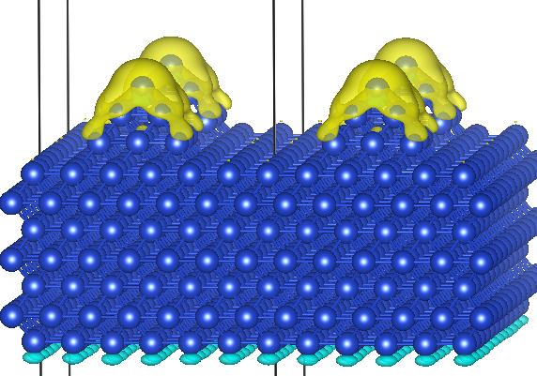
Example of DFT results
Coupling with structure: concentration, shielding
E=-0.4 GV/m
Induced charges
Polarization

Slide 8
Example of DFT results
Energetics
Electronics

Slide 9
Levels of theory
Classical description:
  Molecular dynamics (integration of classical EOM)
Strengths:
  Reasonably accurate empirical description of Cu
  Relatively fast
    “Large” systems (>10⁶ atoms): can capture microstructural effects
    “Long” simulations (milliseconds): can capture surface evolution
Weakness:
  Scales are very limited compared to engineering scales
  How to include field effects?

Slide 10
Classical MD
In conventional MD, charges are typically implicit or fixed. In order to capture field effects, we need a charge equilibration model.
Procedure:
  Choose an empirical Hamiltonian for the electronic energy
  Parameterize the Hamiltonian by fitting to quantum data
  Assign charges so as to minimize the electronic Hamiltonian at the instantaneous position of the atoms

Slide 11
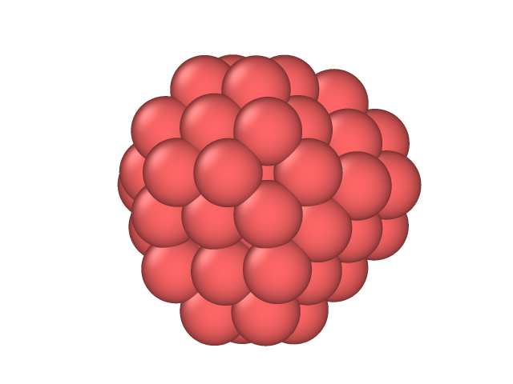
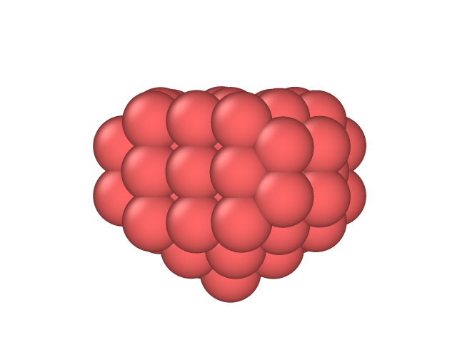
Training set
Bulk atoms are non-informative of fields response. Want as much surface atoms as possible for quantum calculations
Characterized 6 Cu small nanoclusters (30-68 atoms) for fields varying between -3 and 3 GV/m using DFT
Fitted model on energies at highest fields (42 data points), the rest (174 data points) is used as validation

Slide 12
Electronic Hamiltonian
3 ingredients are essential:
  Hardness: onsite charge repulsion
  Polarizability: excess charges induced in vacuum, not on atoms
  Intrinsic dipole: breaks the E,-E symmetry.

Slide 13
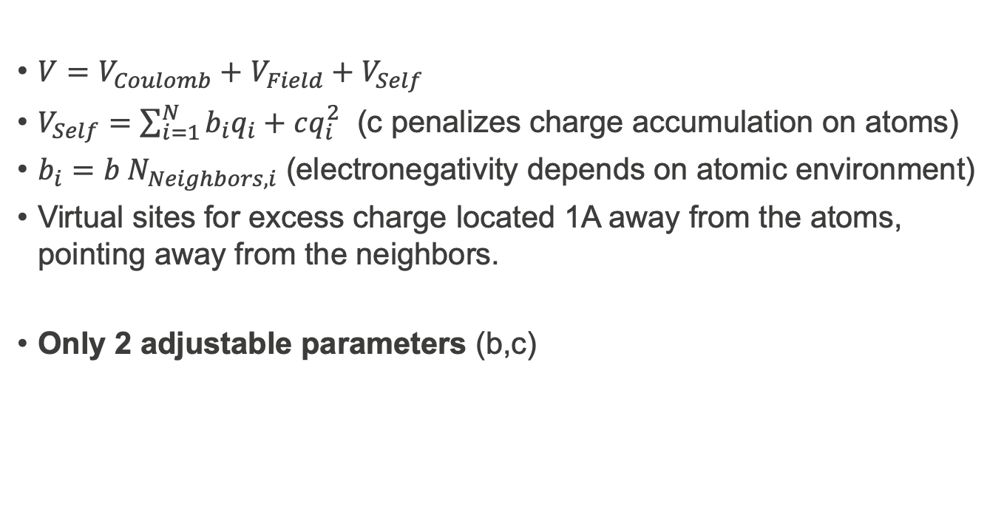
Electronic Hamiltonian
$V=V_{Coulomb}+$ $V_{Field}+V_{Self}$
$V_{Self}=\sum_{i=1}^{N}{b_{i}q_{i}+cq_{i}^{2}}$ (c penalizes charge accumulation on atoms)
$b_{i}=b N_{Neighbors,i}$ (electronegativity depends on atomic environment)
Virtual sites for excess charge located 1A away from the atoms, pointing away from the neighbors.
Only 2 adjustable parameters (b,c)

Slide 14
Validation: hardness

Slide 15
Validation: hardness, polarizability

Slide 16
Validation: hardness, polarizability, intrinsic dipoles

Slide 17
Intrinsic dipole

Slide 18
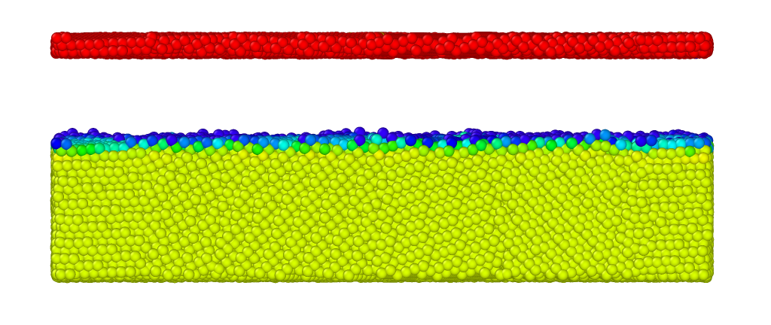
Large-scale MD

Slide 19
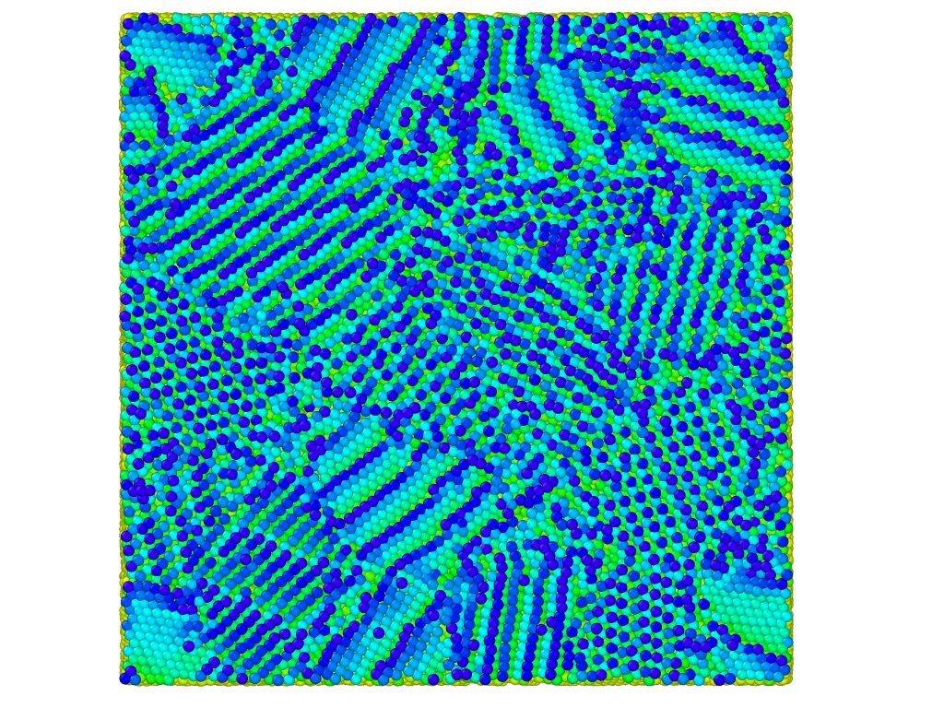
Large-scale MD

Slide 20
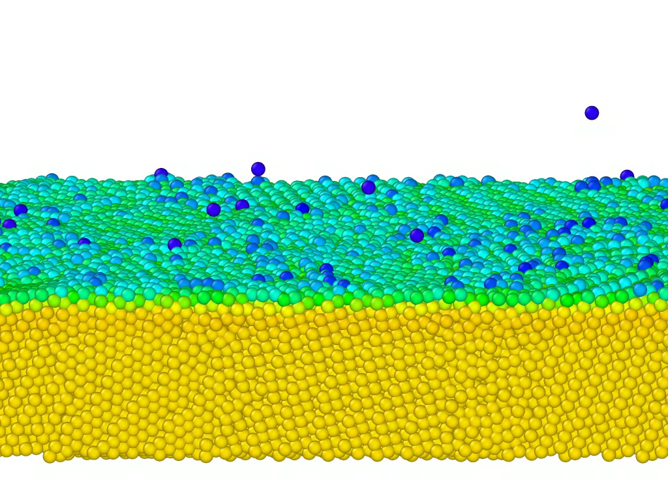
Large-scale MD

Slide 21
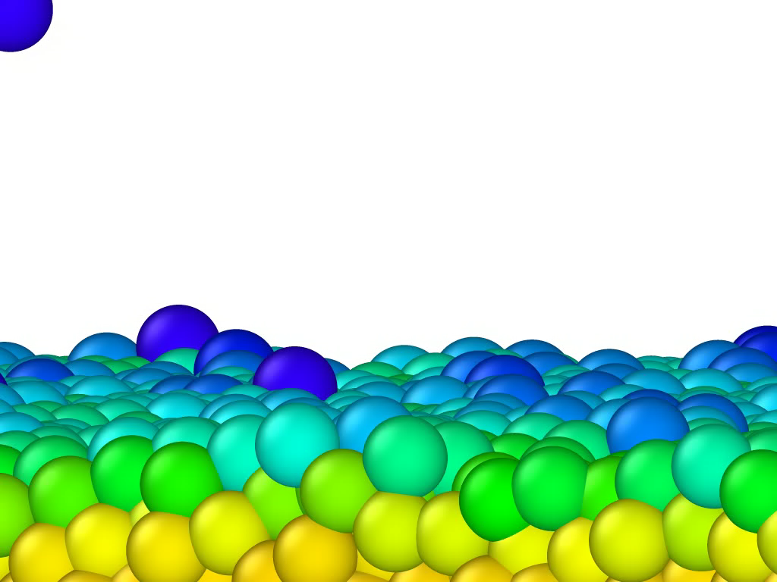
Large-scale MD
We expect a good description of the formation of precursors, but not of the breakdown process itself

Slide 22
Large-scale MD
At very high fields (~10 GV/m), nano-pyramids spontaneously form, leading to local field enhancement and evaporation/field emission
Can this mechanism spontaneously create breakdown precursors? DC models suggest that growth should occur on >h timescales at ~100 MV/m. >1000h in pulsed conditions.
Might play a role, but not the whole story, as breakdown affected by bulk mechanical properties
This mechanism can amplify short wavelength structures formed by some other mechanism

Slide 23
Future work: nature of the precursors
Clear indications that magnetic fields are crucial
Pulse heating is known to be a factor
Will explore microstructural changes induced by thermal fatigue and their coupling with E and with the microstructure
Dolgashev, Tantawi, Higashi, Spataro, 2010

Slide 24
Conclusion
Classical models parameterized from quantum calculations can describe the energetics of metals under high fields
In critical conditions, we see the spontaneous formation of nano-pyramids and the emission of atoms (i.e., “breakdown”)
Still have to simulate the growth of the precursors
Atomistic simulations face a challenge of scales, but can provide unique insights
Suggestions are welcome!

