Slide 1



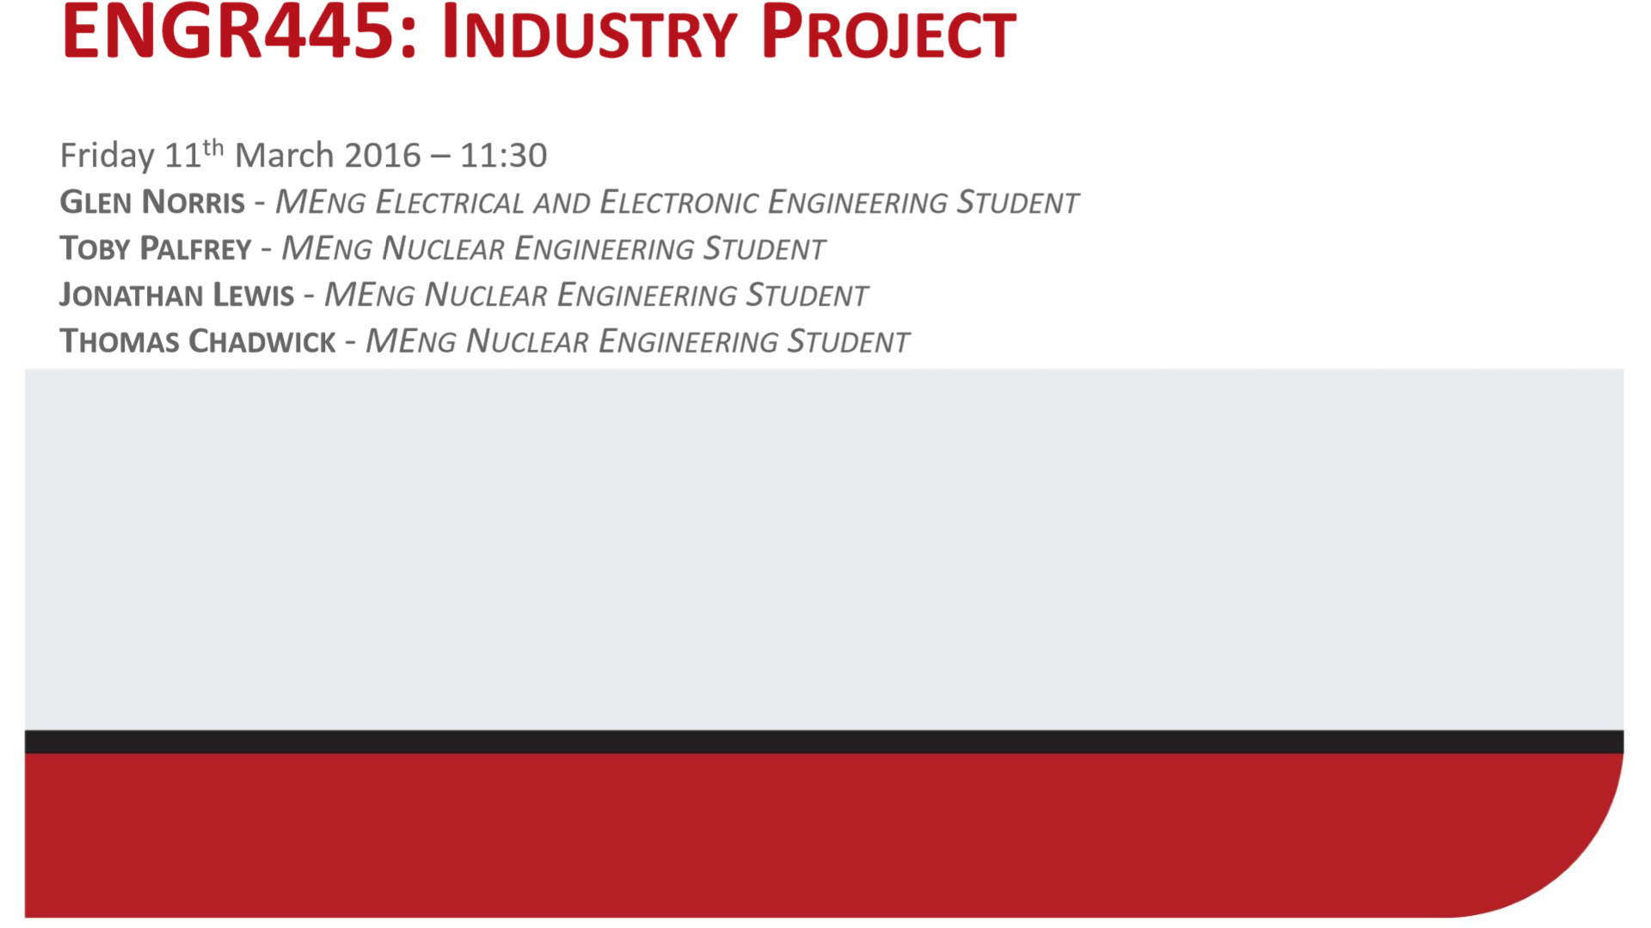
CLIC Fabrication
Joel Sauza Bedolla^{1,2}
On behalf of the X-Band Production Team
¹Lancaster University Engineering Department: Graeme Burt
²CERN, BE-RF Section: Nuria Catalan Lasheras
International Workshop on Future Linear Colliders (LCWS19), Sendai, Japan
30/10/2019

Slide 2

Summary
CLIC fabrication in a nutshell
Discs
  TD26 Prototype
  TD31 Prototype
  Diffusion bonding issues
Other technical solutions
  Halves
  Rectangular discs
Conclusions

Slide 3
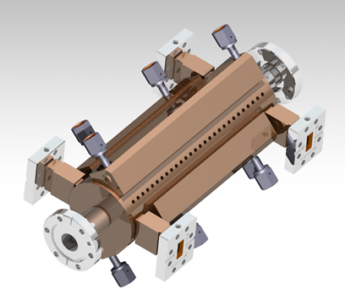
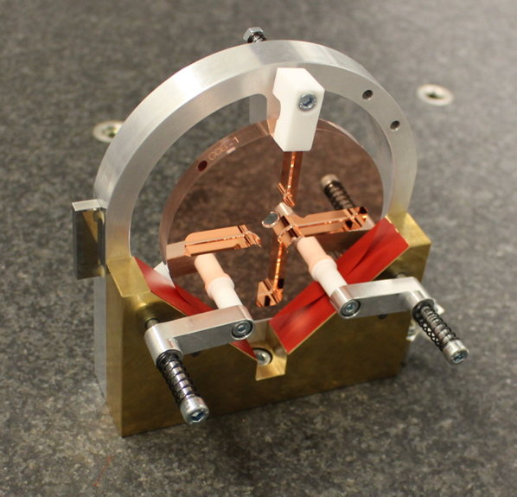
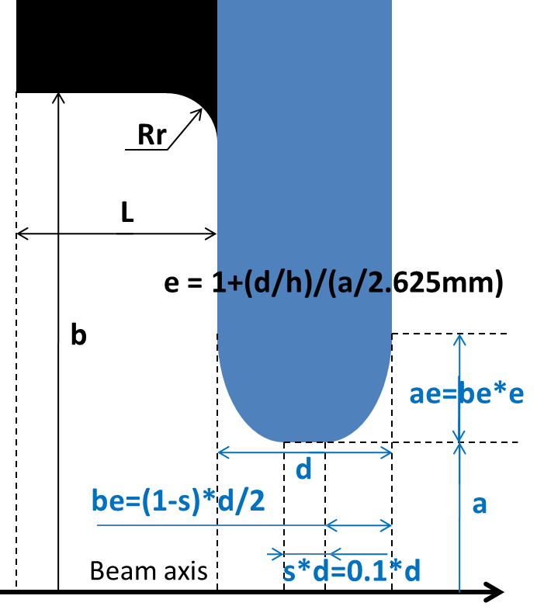
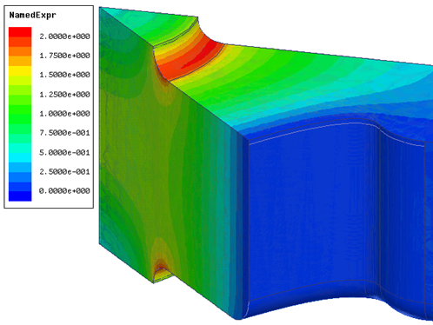
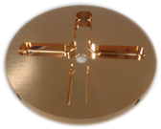
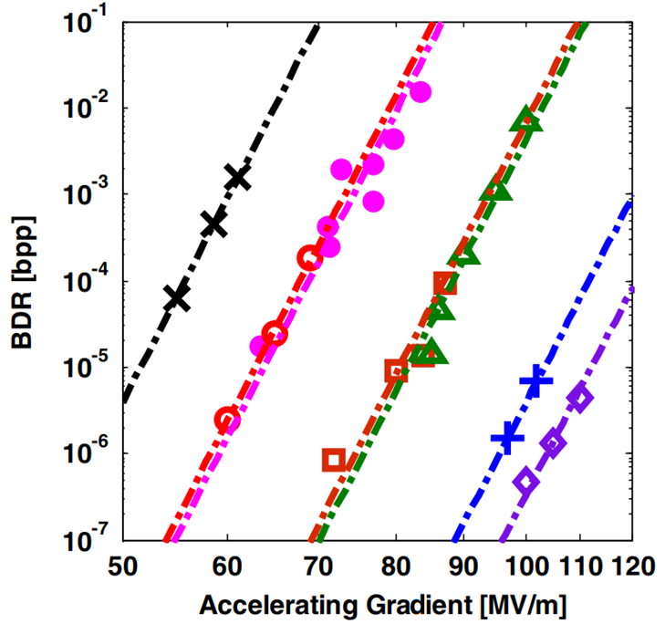
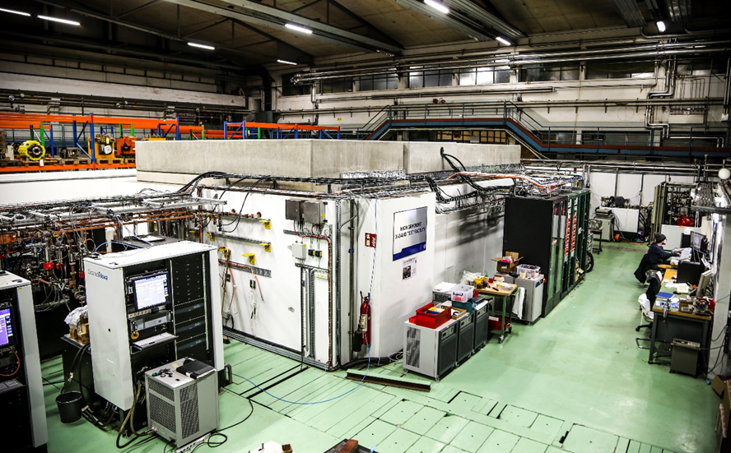
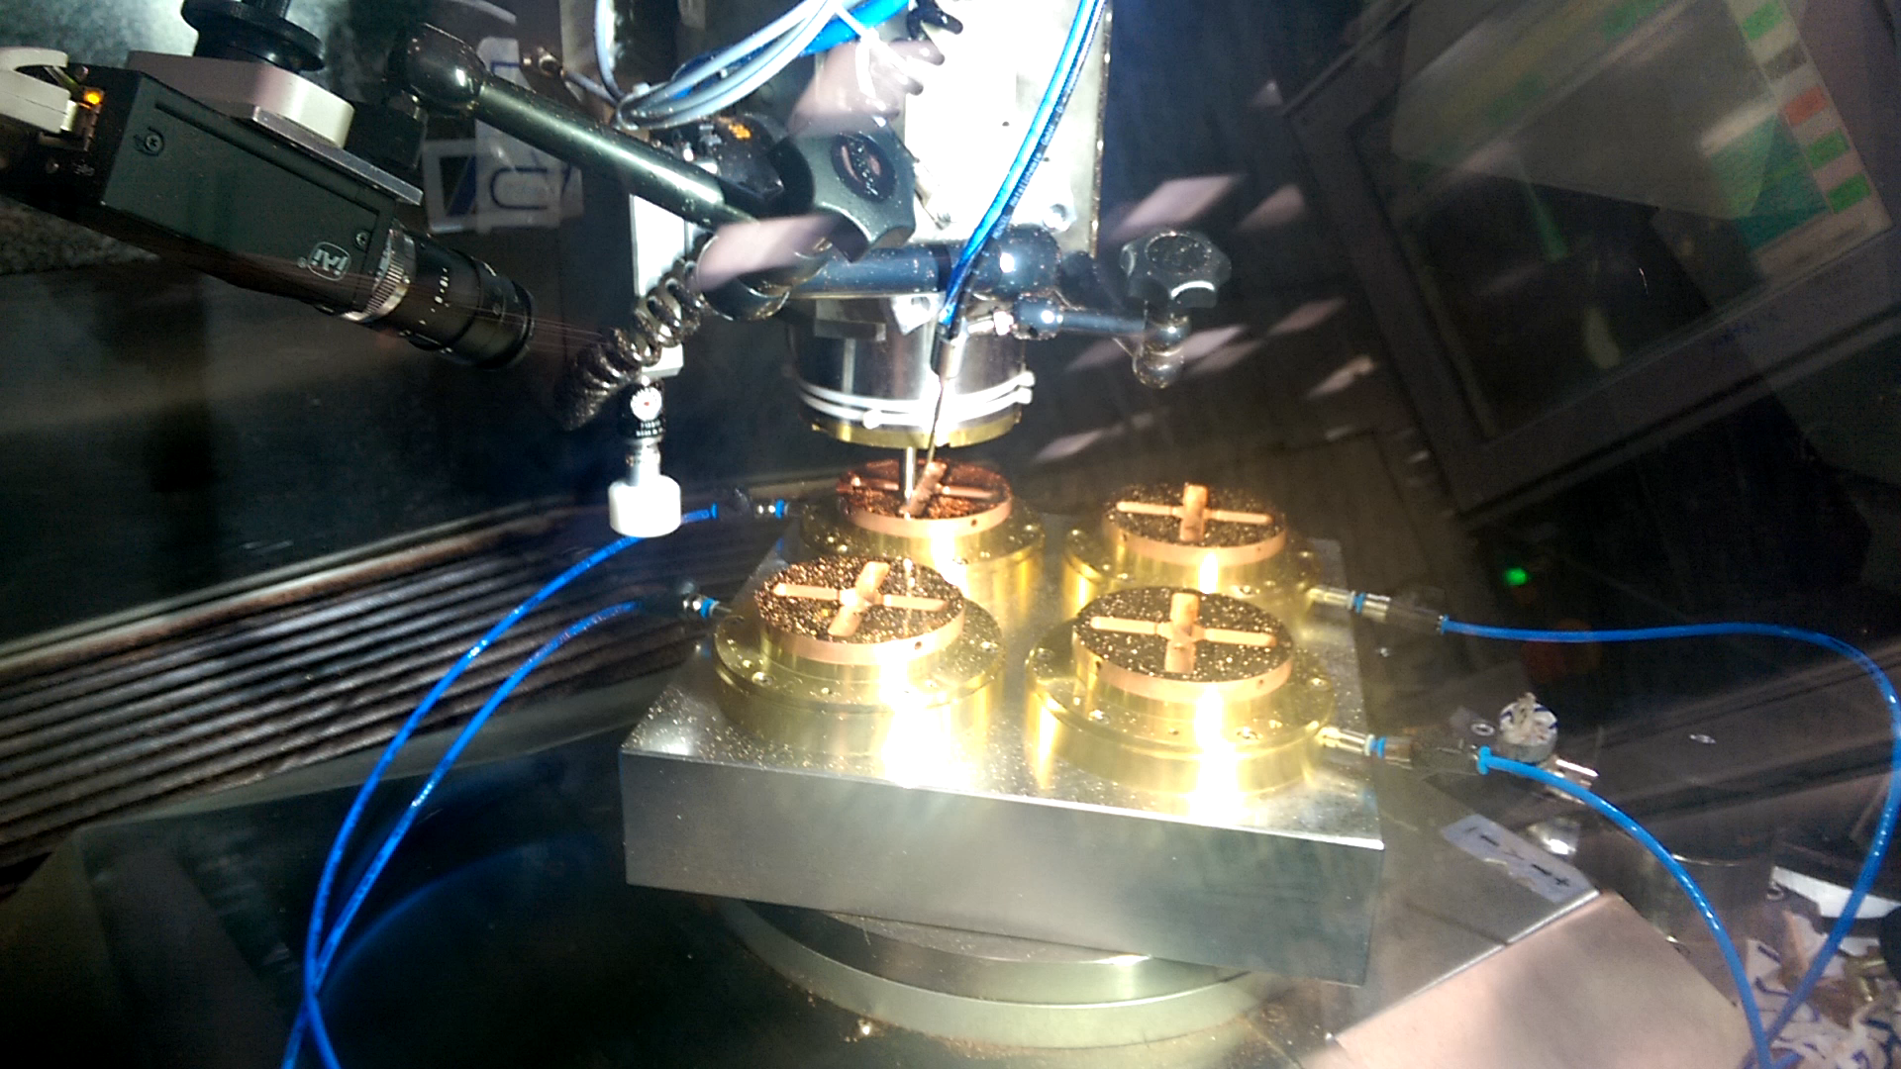
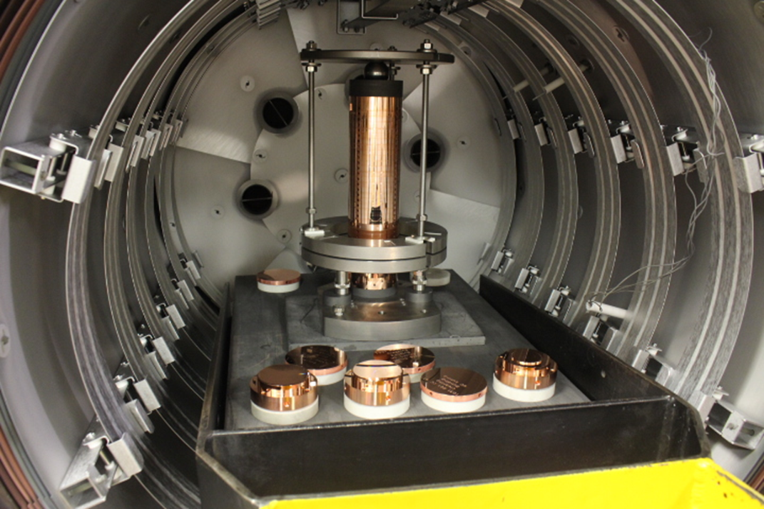
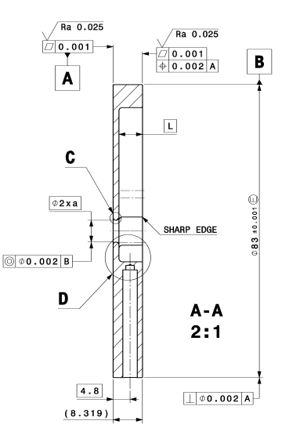
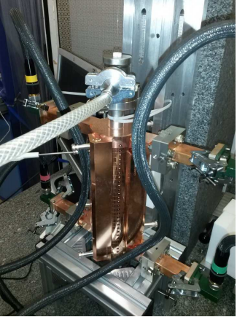
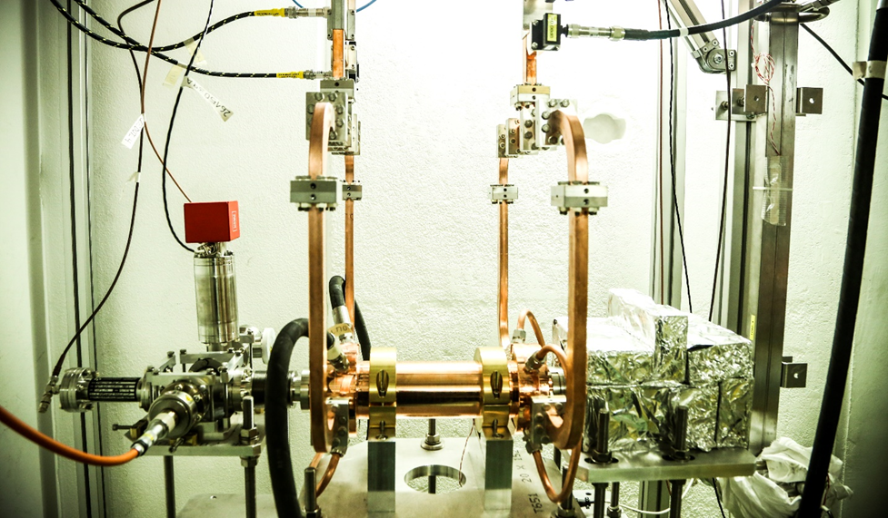
CLIC Fabrication in a nutshell
Physics
RF design
High Power Test
Xboxes
HFSS
3D Models
Mechanical design
Assembly
Diffusion bonding
Detailed design
Brazing
Ultra Precise
Milling and Turning
Manufacturing
Quality
Metrology
Bead-Pull

Slide 4
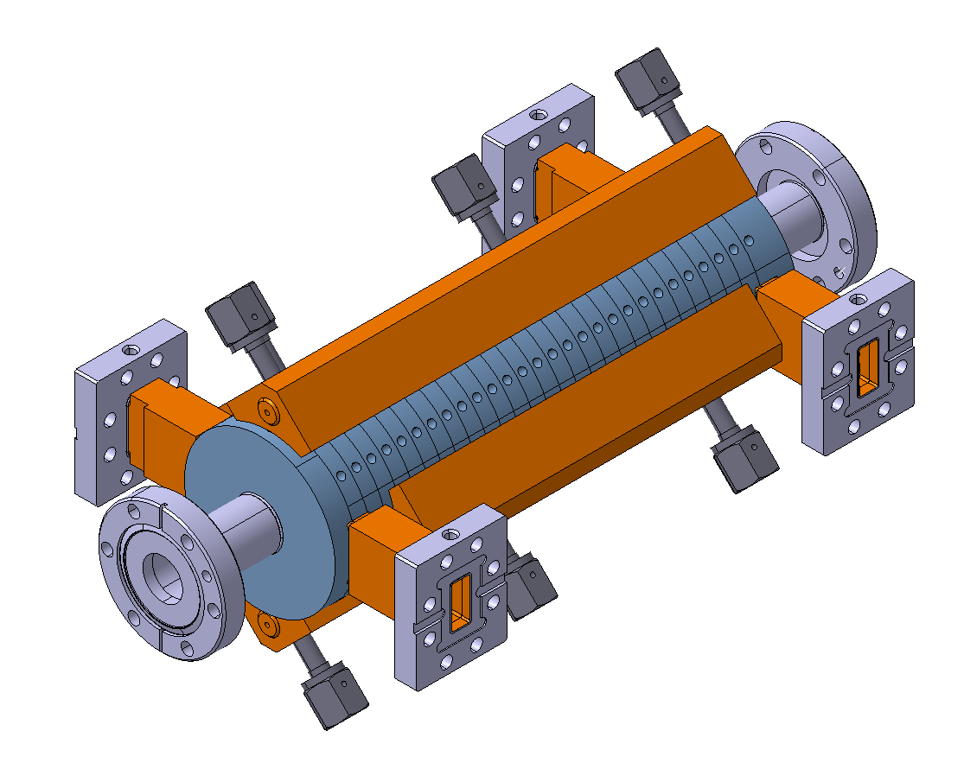



TD26
N1
N2
N3
N4
Post-Mortem
Waiting High Power test
Waiting High power test
Assembly on-going
More details on bonding issues section
Tuned
Baked
Tuned
Unbaked
More details next slide

Slide 5
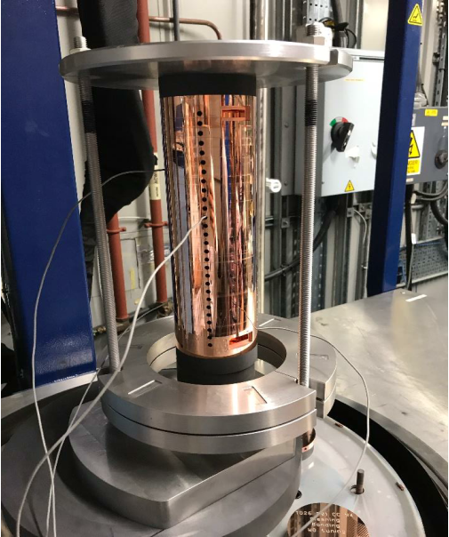
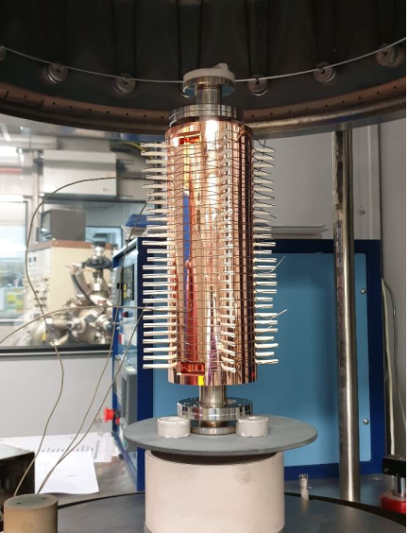
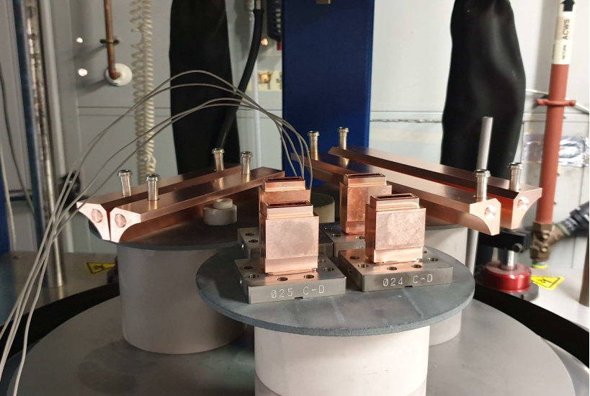
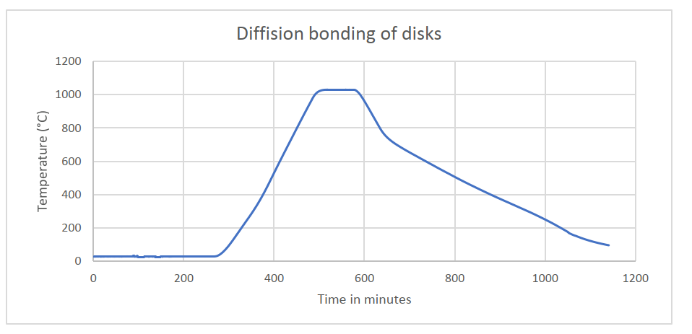
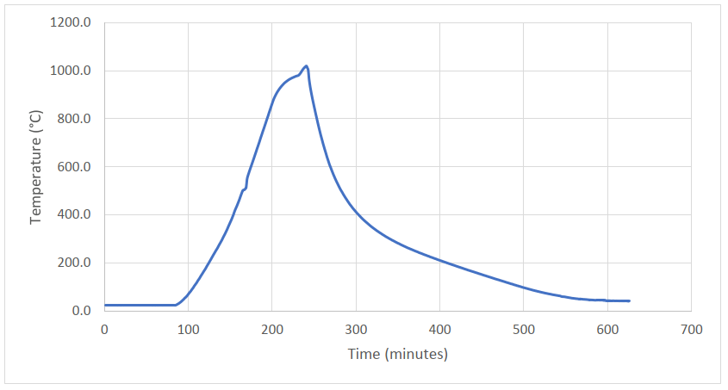
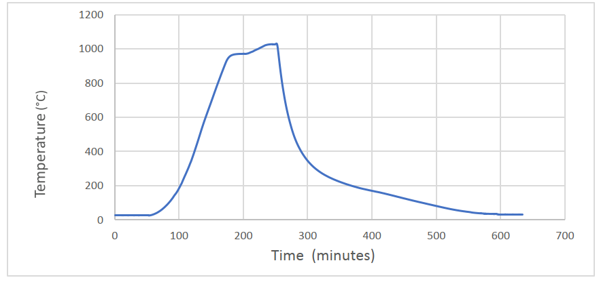
TD26-N4
Brazing of cooling blocks and waveguides
Brazing of tuning pins
Diffusion bonding executed at TMD technologies (UK)
  1040 °C x 1h 30 min x 0.06MPa x H₂

Slide 6
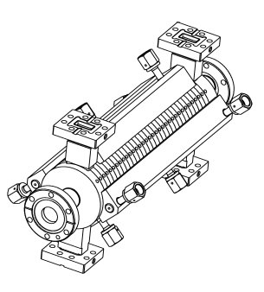


TD31
N1
N2
N3
N4
Assembly on-going
Assembly on-going
Manufacturing completed
Manufacturing completed
Bonding completed
Brazing on-going
Bonding completed Brazing on-going
New tooling tested
New tooling tested
Baseline for CLIC-380GeV

Slide 7
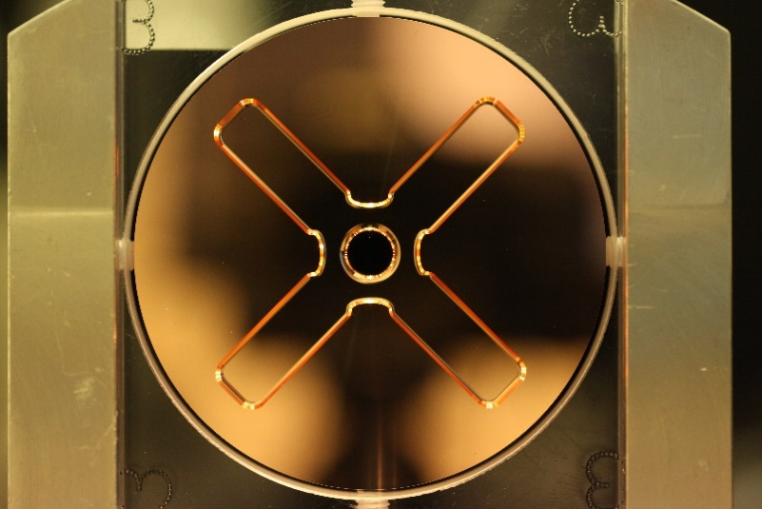
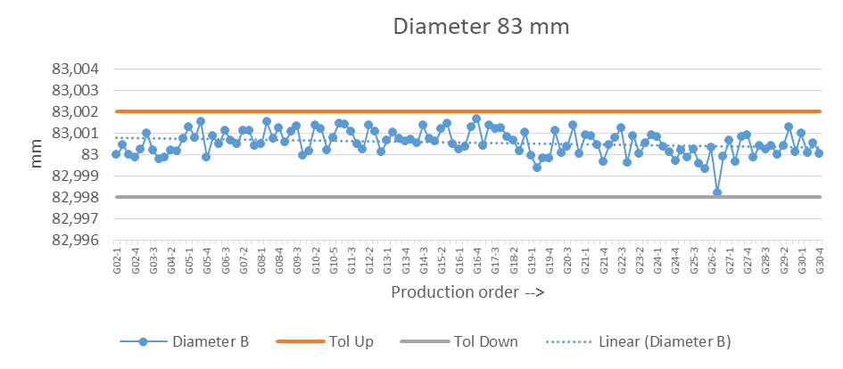

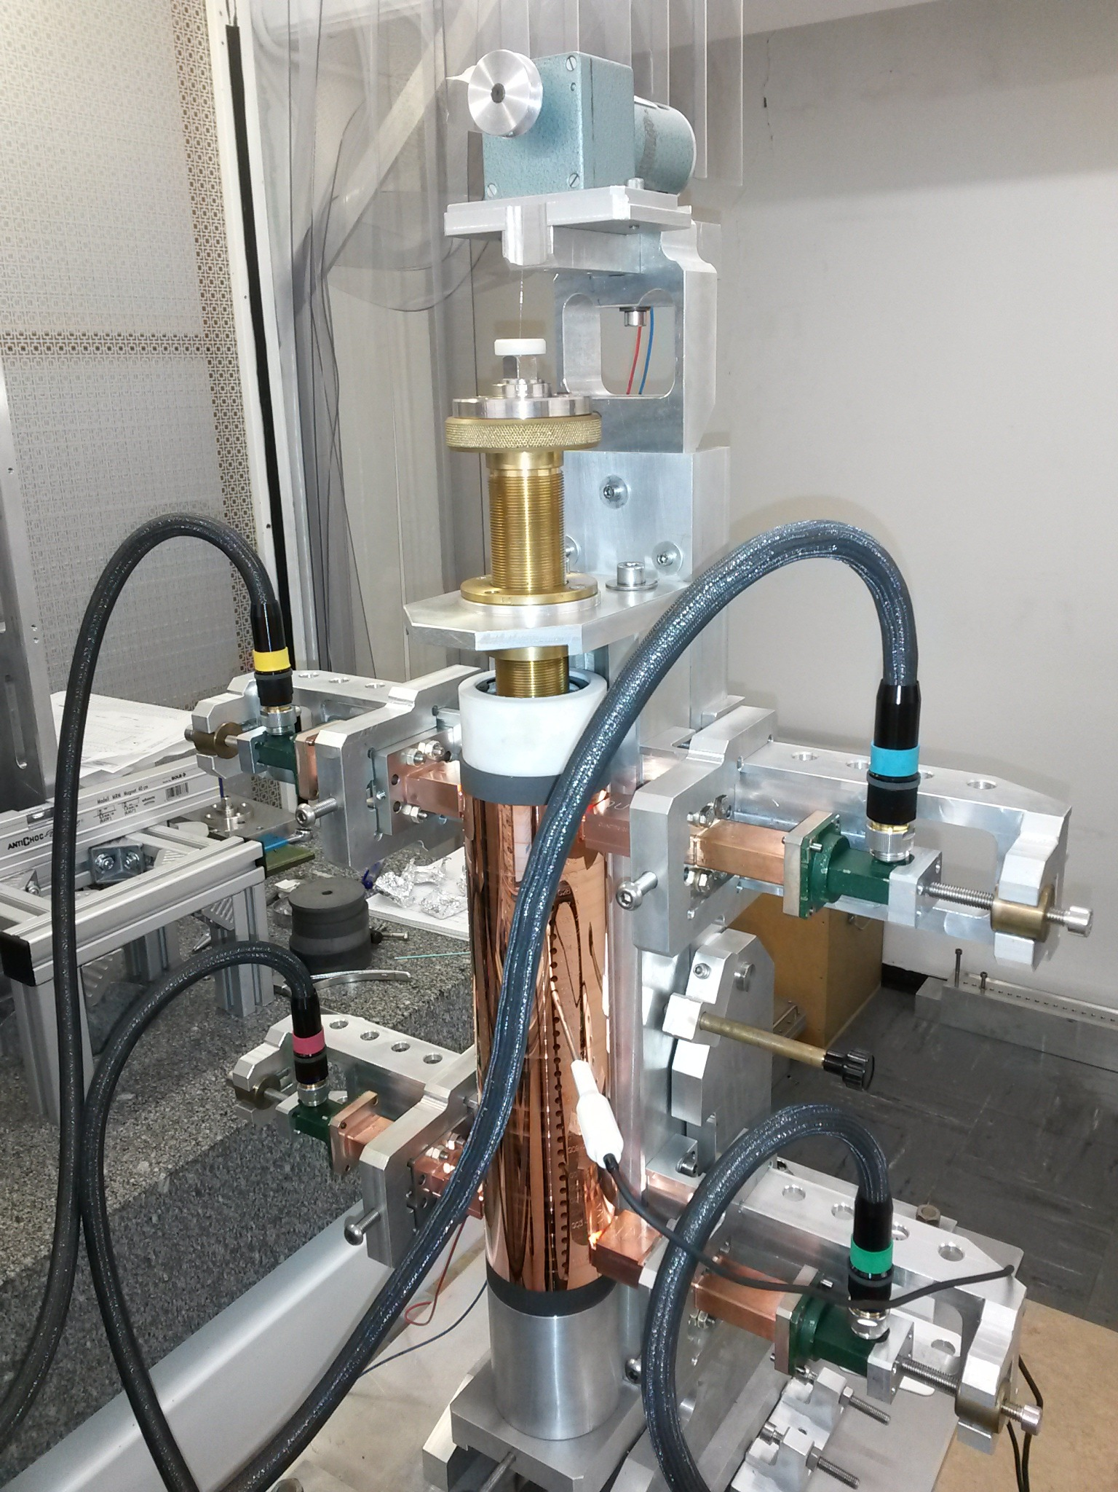
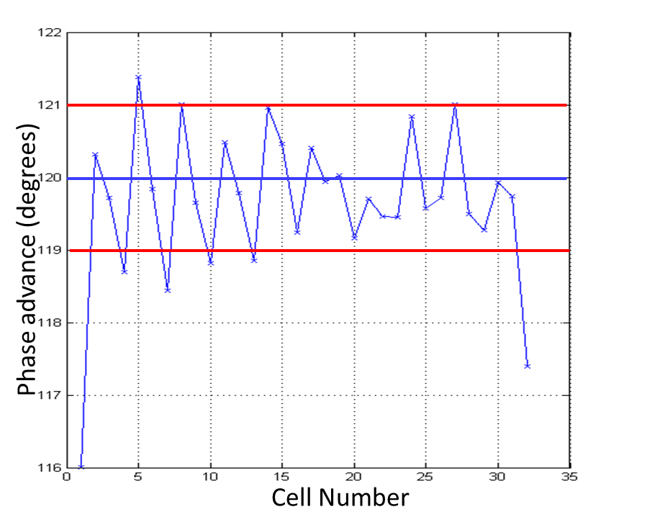
TD31
140 discs produced. 0 defects
Bead Pull measurements before bonding are better than we usually see. Phase advance (N1) nearly fulfils the requirements after tuning.
Due to extremely good quality
Also due to the good alignment and RF contact of the tooling.

Slide 8
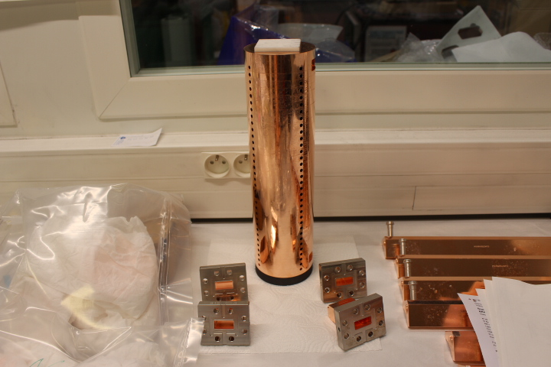

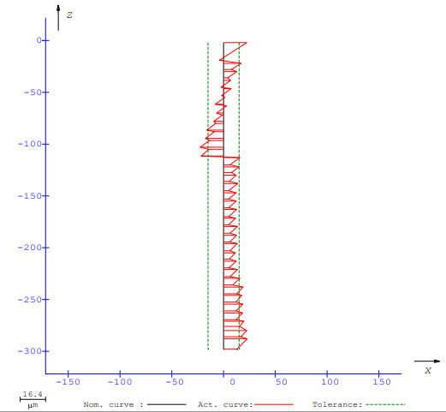
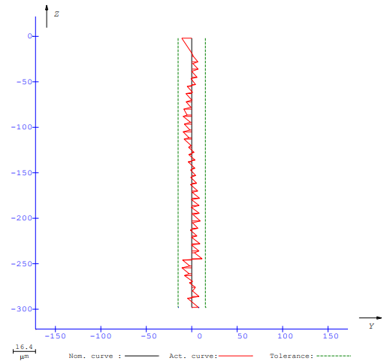

TD31 – N1 and N2
Diffusion bonding executed at Bodycote (FR)
  1040 °C x 1h 30 min x 0.06MPa x H2
N1
N2
No banana effect
Reduced disc to disc alignment
No banana effect
Reduced disc to disc alignment
Straightness: 15 µm
Straightness: 46 µm
A bump during transport

Slide 9





Diffusion bonding issues
The process is stable and it works
  The structures are leak-tight!
  We have some issues with straightness but the main cause is the transport from the assembly table to the furnace.
Two years ago, it was decided to assess the contribution of diffusion bonding
  Careful attention to metrology
  Cross-check with Bead-Pull Measurements
  Post-mortem analysis
1040 °C
1h 30 min
0.06 MPa
H₂
Optimization

Slide 10
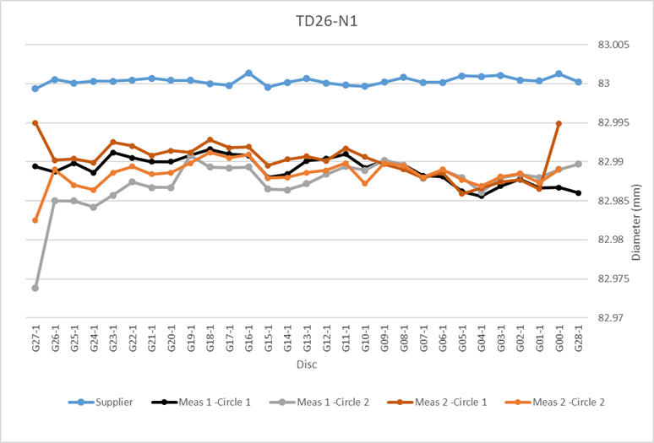


Diffusion bonding issues
Identical bonding cycles on different days (same supplier) for TD26 N1, N2 and N3.
N4 different supplier (diameter after bonding was not measured)
External diameter reduction in average 12 µm
Observed in structures N1, N2 and N3. Double checked on structure N1.
The total length of the structure is smaller 25 µm
Copper sublimation
Internal Volume change
RF Change
10 µm external diameter
Is the iris bigger?
Have the noses change?
Is there a frequency change?

Slide 11
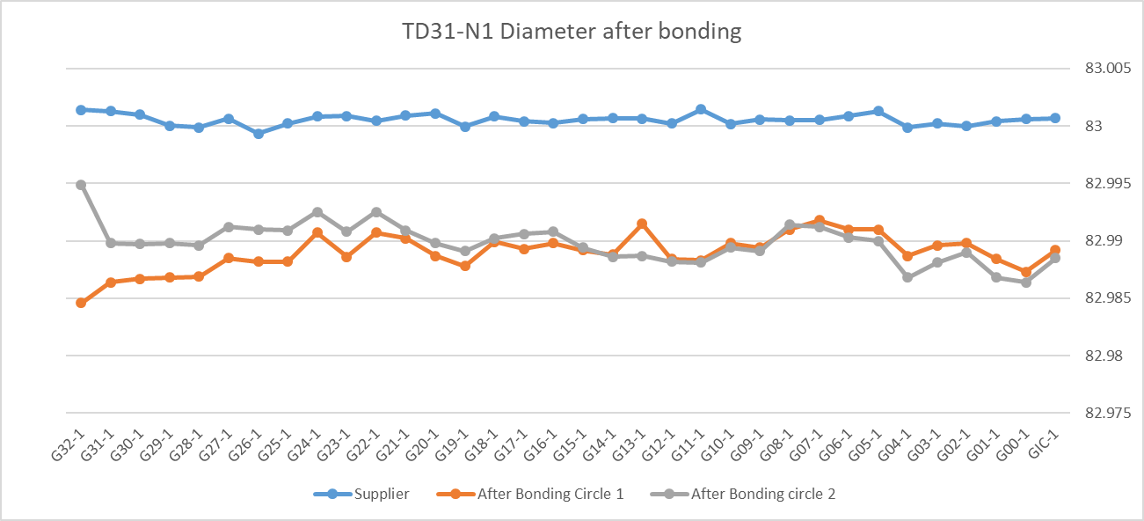
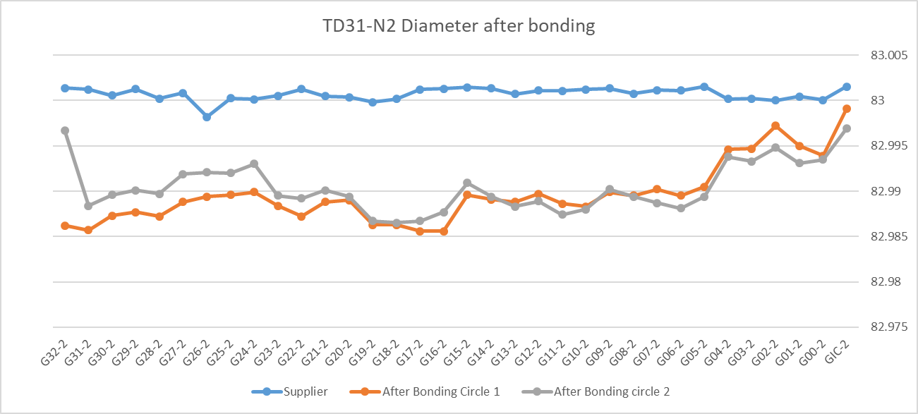
Diffusion bonding issues
Bonding of TD31 N1 and N2 performed by the same supplier (TD26-N1-N2-N3).
However, the oven has been completely refurbished in-between.
Same trend than TD26: diameter reduction in average 11 µm

Slide 12
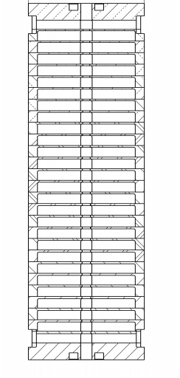
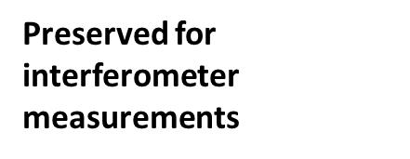
TD26-1
Post-Mortem analysis
Cutting plan (EDM):
  Same reference for all the discs
  Shape of the nose (horizontal)
  Shape of the nose (vertical)
  Irises
  Flatness of the waveguide
G16
G15
Contamination from cutting
G14
G03
G02
Already performed
G01
G00

Slide 13
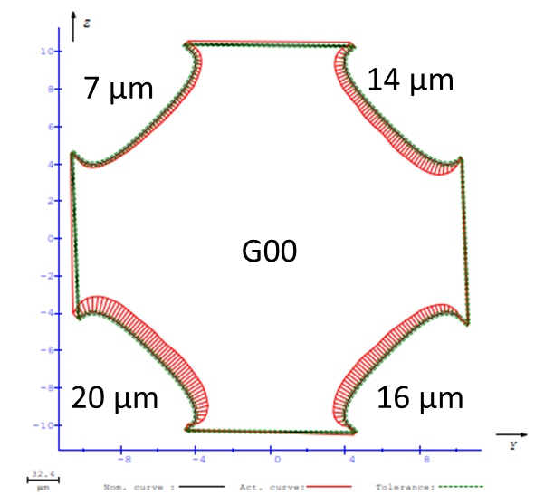
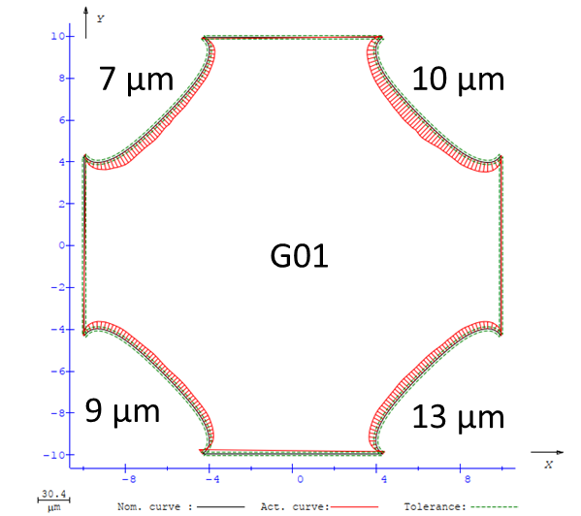
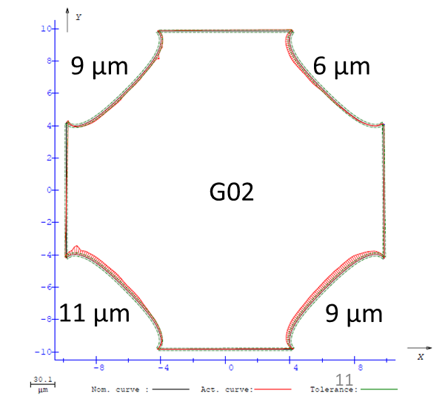
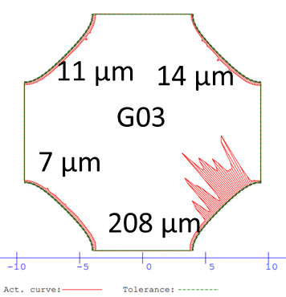
TD26-1: Shape of the nose (horizontal)
Datum references have changed with respect to original measurements.
Shape seemed to improve according to disc position. G00 is worst than G02
First traces of EDM cutting residuals observed on G03

Slide 14
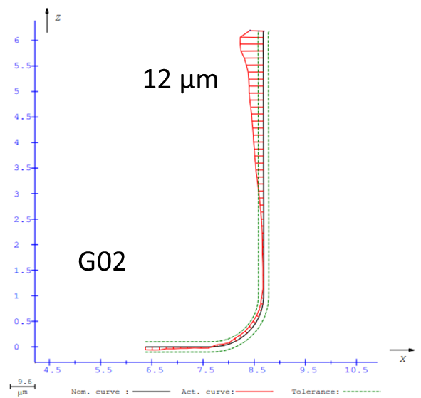
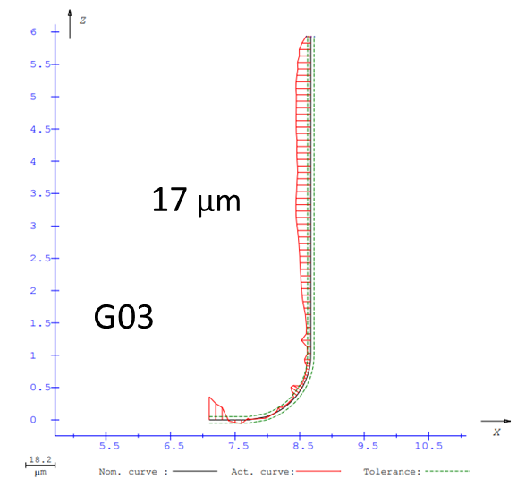
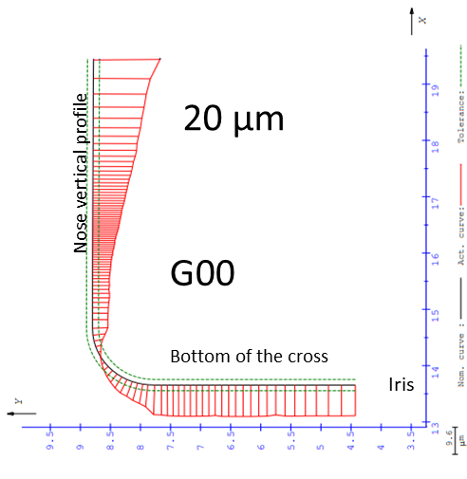
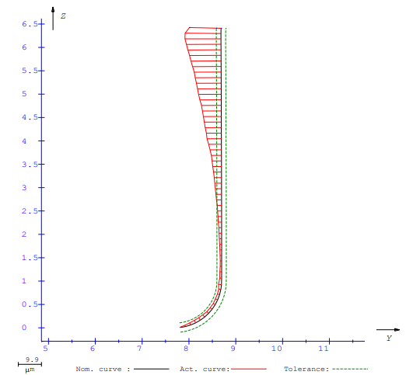
TD26-1: Shape of the nose (vertical)
15 µm
G01
A cone shape is observed
The error was diminishing up to G03
Contamination of EDM cutting on G14

Slide 15
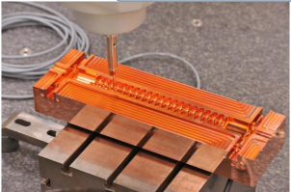
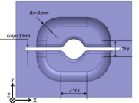
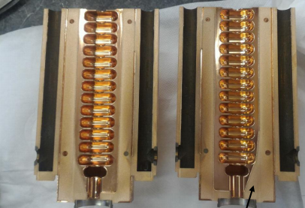
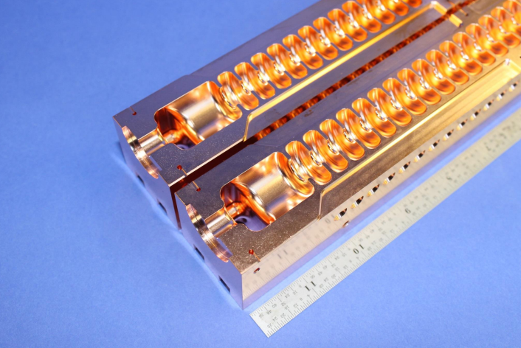
Halves
Long development process:
  First trial (bonding - CERN): Good RF before bonding. After boding, a gap between the halves (10-200 µm) and a shift between the irises of 70 µm (systematic error)
  Second trial (brazed – SLAC): A gap between irises was introduced to minimize field of filling material leaking to the structure. Alignment with pins. RF conditioning ok. Breakdown activity near the brazing region.
  A third trial (brazed through irises – SLAC): not yet tested but there is a visual misalignment between the irises.

Slide 16
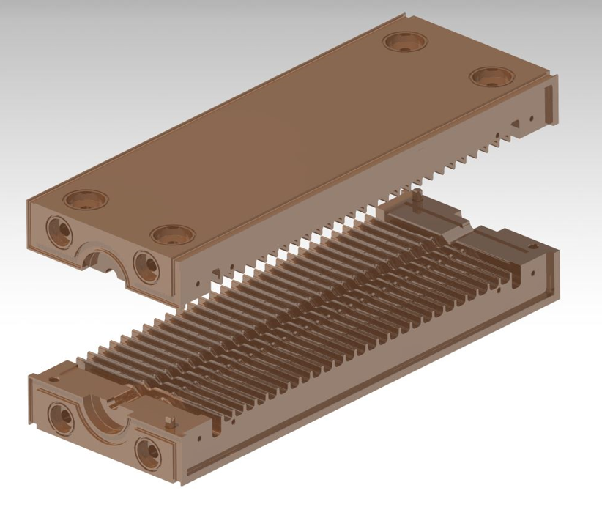
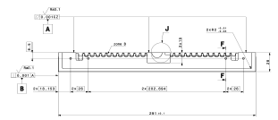
Halves
Last development TD26:
  Two identical halves: 285 mm x 146 mm x 14 mm, damped (no SiC), gap.
Form tolerance: 4 µm on Zone A (zone near the iris of the whole length)
Electron beam welding design:
  Hard copper (no heat treatments above 245 °C) showed shorter RF conditioning
  Welding lips
Less components to assembly but bigger risks for manufacturing companies
  Challenging but feasible

Slide 17
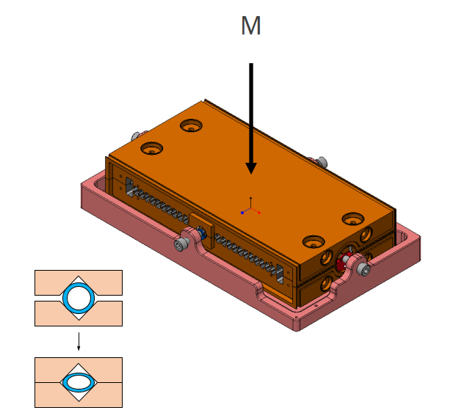
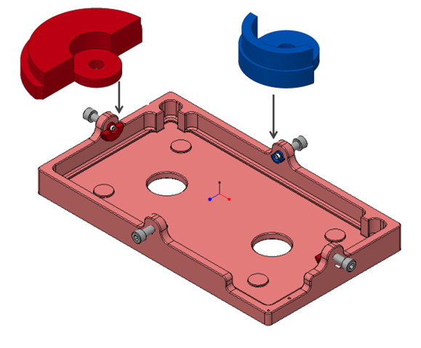
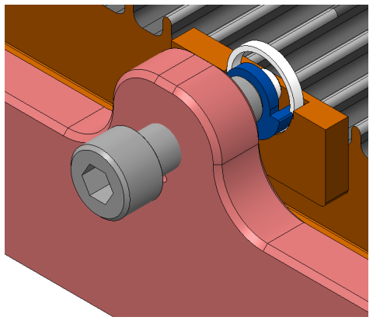


Halves
We do care about the alignment. Special tooling: Herzian deformation of high precision rings.
Ready to be produced!

Slide 18





Rectangular discs
First trial successful at 95% (it was leaking)
  Caused by the SiC geometry
  Not related to the bonding problem: the SiC was copper coated.
Second trial successful at 99% (it was not leaking)

Slide 19







Rectangular discs
Lancaster University PROton Boosting Extension (PROBE) structure
High gradient (54 MV/m), side coupled, standing wave, S-Band for Proton Computed Tomography (pCT) scan
Bonding done. Leak test after brazing of components.
Straightness of 25 µm

Slide 20
Conclusions
TD26:
  N1: Post-mortem finished
  N4: Brazing operations on-going
TD31
  N1 and N2: Brazing operation on-going
Bonding issues:
  The diameter reduction (copper sublimation) of 10 µm is confirmed: 6 structures
  The shape of the nose is changing on both horizontal (collapsing) and vertical shapes (cone shape)
  The cells are deforming due to bonding
    Weight is excessive? Already reduced from 0.1 MPa to 0.06 MPa
    Temperature is too high?
    Time is too long?
Halves: Ready for production
Rectangular discs: Bonding performed on the PROBE structure. Leak test in following weeks.

Slide 21

Thank you
Questions?

