Slide 1


Update on Progress of
Vertical EP at Marui and KEK
International Workshop on Future Linear Colliders
(LCWS2019)
31st October 2019
Vijay Chouhan
Marui Galvanizing Co. Ltd/KEK
Y. Ida, K. Nii, T. Yamaguchi (Marui)
H. Hayano, S. Kato, M. Monjushiro, T. Saeki, M. Sawabe (KEK)
H. Ito (Sokendai)
H. Oikawa (Utsunomiya University)

Slide 2
Contents
Introduction of Horizontal and Vertical Electropolishing (EP)
VEP Results of Single-Cell Cavity
Parametric Study with 9-Cell Cavity
VEP Results of 9-Cell Cavity
Summary & Future Work

Slide 3
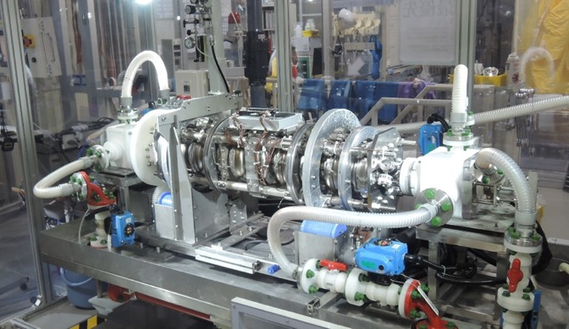
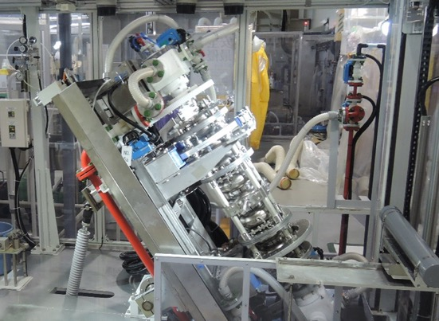
Horizontal & Vertical Electropolishing
Horizontal EP (HEP): Cavity in horizontal position during the EP process
Vertical EP (VEP): Cavity in vertical position during the EP process
Massive Horizontal EP Setup with Rotating Cavity
Vertical EP at Marui
Turning of EP bed
VEP is performed with a simple setup.

Slide 4
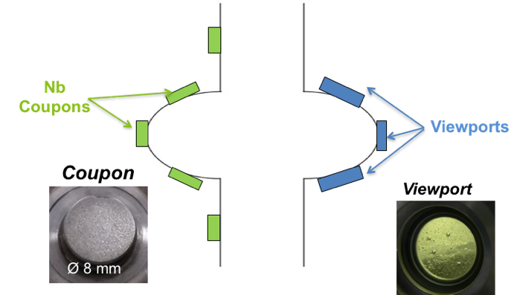
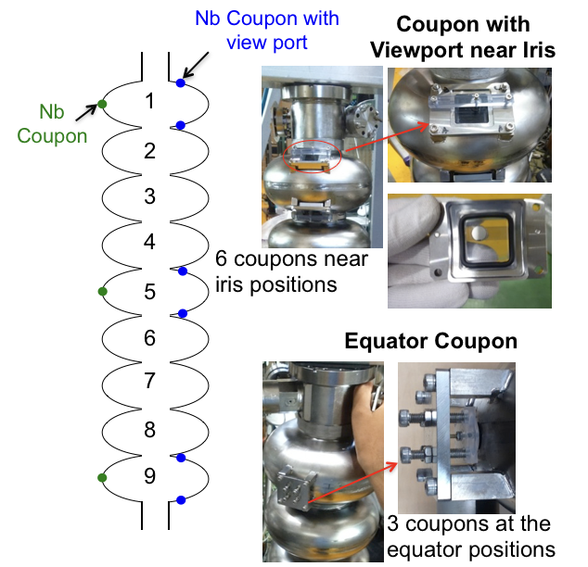
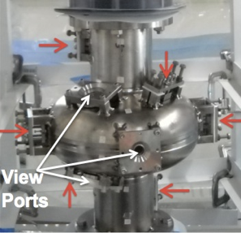
1.3 GHz Single and Nine-Cell Coupon Cavities
Single-Cell Coupon Cavity
Nine-Cell Coupon Cavity
Measurable coupon current, in-situ observation, post VEP surface analysis

Slide 5
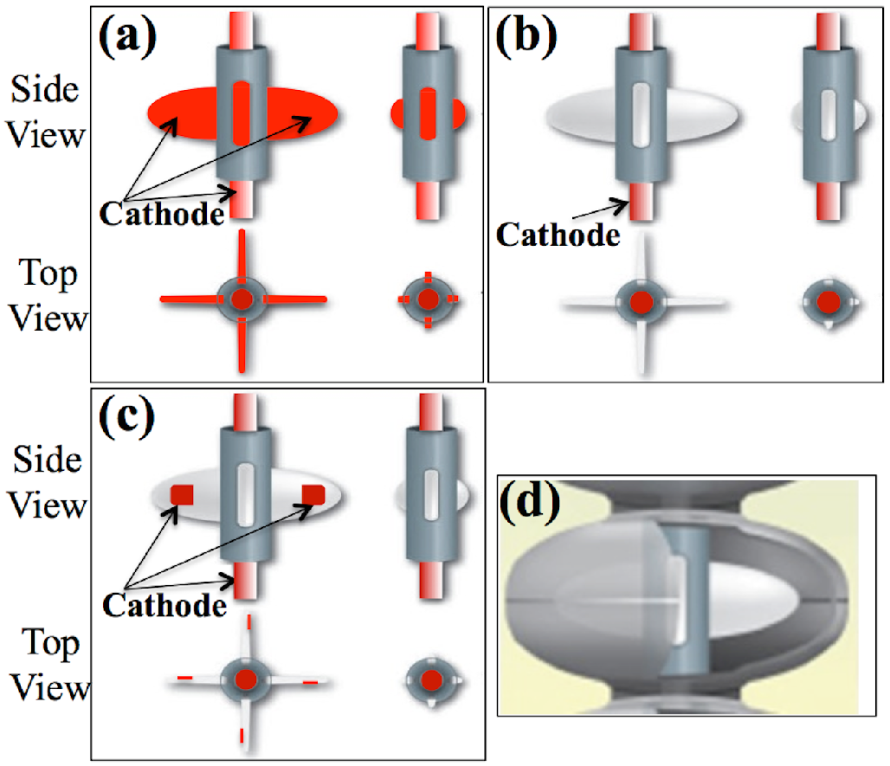
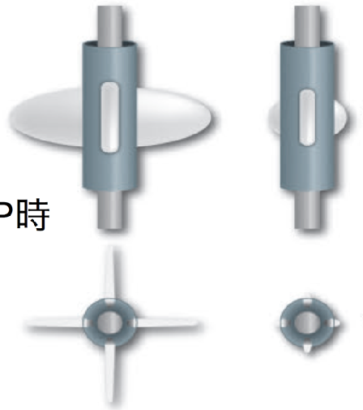
Optimized Design of Unique Ninja Cathode
We have applied several models of Ninja cathodes to find an optimized structure and VEP parameters.
Insulating Wings (Ver-2)
Partial Metal Wings (Ver-3)
Metal Wings (Ver-1)
Insulating Wings + Large Cathode Surface Area + Meshed Cover (Ver-5)
Ninja cathode v5: Enhanced cathode surface area, cathode housing covered with meshed sheet, insulating wings
The cathode is rotated during the VEP process.
Ninja cathode is inserted in the cavity and then its blades are expanded.

Slide 6
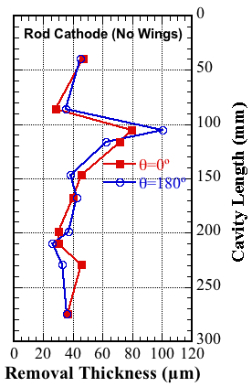
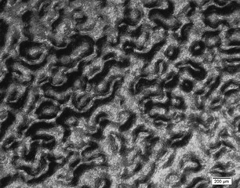
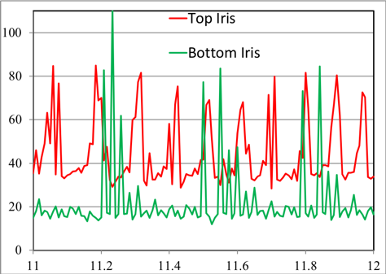
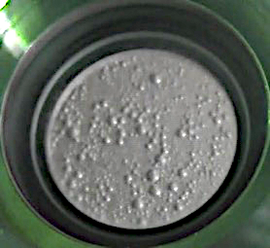
VEP with Conventional Rod Cathode
Acid flow rate ~ 5L/min
Voltage ~9 V
Removal Trend
Bubble Footprints at Upper Iris
Coupon Currents
Top Iris
Current Density (mA/cm²)
500 µm
Top Iris Viewport
Bottom Iris
Elapsed Time (min)
Major Issues in VEP:
Non-uniform removal
Rough surface/Bubble traces
Higher EP current at the upper half cell
The higher removal at the top iris is due to accumulation of H₂ gas bubble on the surface.
It was confirmed with lab EP experiments.
V. Chouhan et al., Phys. Rev. Accel. Beams 20, (2017) 083502

Slide 7
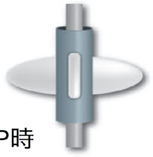
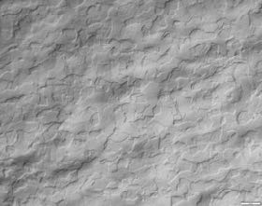

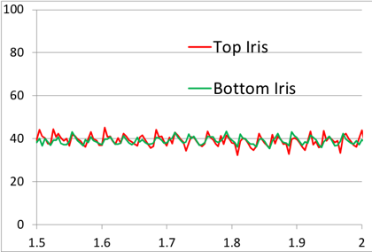
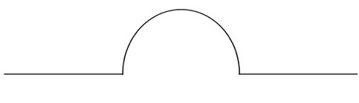
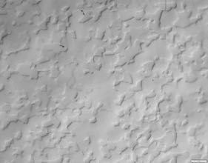
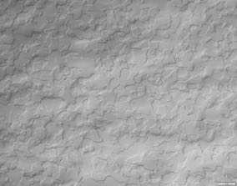
  VEP with Ninja Cathode
Optical Images
At 20 rpm
Top Iris
Removal Thickness
Coupon Currents
Equator
Current Density (mA/cm²)
Bottom Iris
Elapsed Time (min)
Meshed housing guides hydrogen bubbles along the cathode and reduces bubble accumulation in the cavity cell
Cathode rotation might make uniform flow on the surface
Larger cathode surface reduces cathode screening by bubbles
200 µm
Voltage: ~13 V, Acid flow rate: ~5 L/min, Cathode rotation: 20 rpm, Temperature < 20 ºC, Cavity cooling by water spray
The cathode and optimized parameters yield smooth surface and symmetric removal.
Hence, the cathode was opted for further VEP and RF tests.

Slide 8
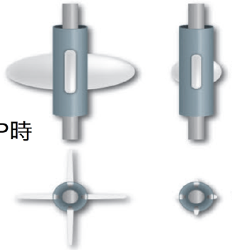
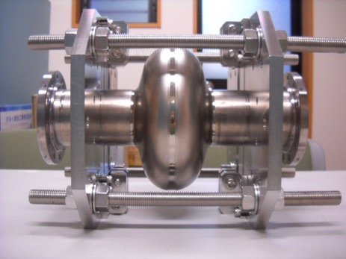
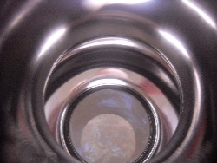
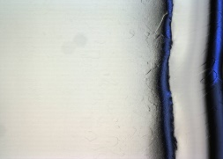

VEP for RF Test Comparison
Ninja Cathode-v5
Single-Cell Cavity with Support-jig
VEP Current Profile
Side View
Top
View
Voltage: 16-17 V
Cathode rotation: 20 rpm
Acid flow rate ~ 5 L/min
Temperature ~ 20 ºC
Ninja-5
TB1-TSB02 Cavity
Removal Thickness Profile
Cavity Surface after VEP
Equator
Avg. removal: 36 µm
`
𝛳=0˚
Top View
12 mm x 9 mm
𝛳=180˚
Uniform removal in the cell
Smooth and glossy surface
Removal rate: 0.22 µm/min

Slide 9
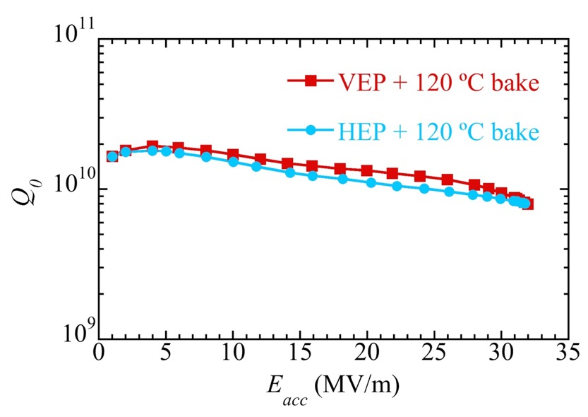
SRF Performance (Single-Cell Cavity)
VEP Process
Cavity Performance after HEP and VEP
VEP1（36µm）
↓
HPR &
120ºC baking
↓
Annealing (750ºC)
↓
VEP2（10µm）
↓
HPR &
120ºC baking
↓
Vertical test
at 2K
E_{acc}=32 MV/m; Q₀=8×10⁹
TB1-TSB02 Cavity
Field gradient of 32 MV/m (Q₀=8×10⁹) was achieved after VEP.
The accelerating gradient after VEP was as good as achieved after HEP.

Slide 10
VEP of 9-Cell Cavity
VEP test was conducted with similar parameters as optimized with the single-cell cavity.
Condition | Value
Cathode Type | Ninja v-5
Cathode Rotation | 20 rpm
Cavity Temperature | 15–22 °C
Voltage | 15 V
Acid flow rate | ~5 L/min

Slide 11
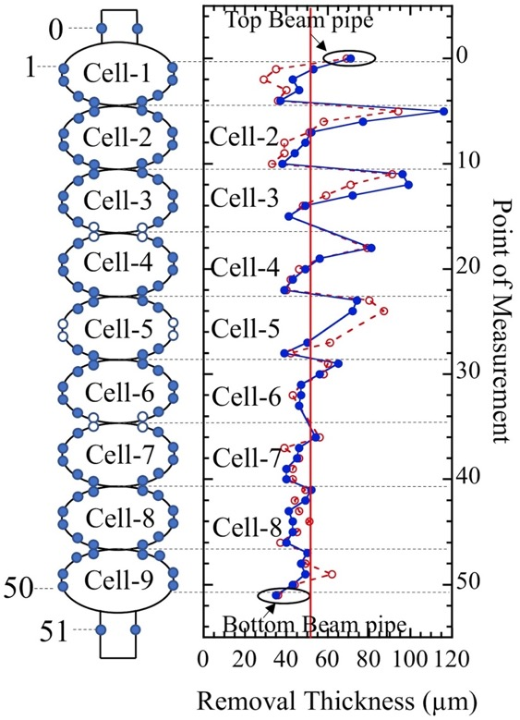
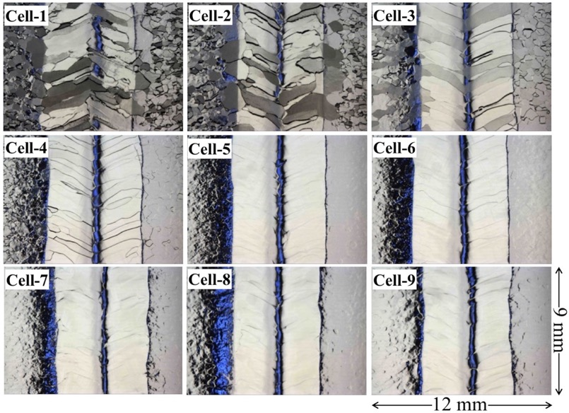
Results of VEP
Removal Trend
Equator Surface after VEP
VEP yields rough equator surface and asymmetric removal in the upper cells.
The optimized parameters for the single cell cavity are adequate for a 4-cell-scale cavity.
But these parameters are not adequate to apply to the 9-cell cavity.
Avg. removal: 50 µm

Slide 12
Parametric Study with 9-Cell Coupon Cavity
V Chouhan et al., Phys. Rev. Accel. Beams 22, (2019) 103101

Slide 13
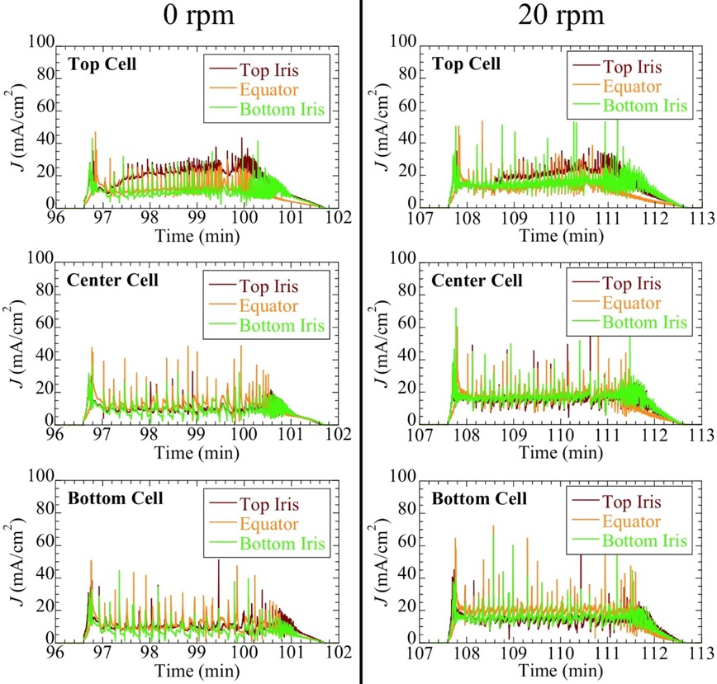
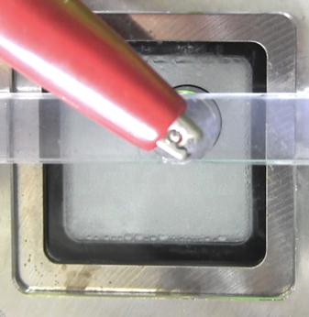
Effect of Cathode Rotation
Top Cell Filled with bubbles
Cathode Housing
Cathode rotation of 20 rpm reduces the difference in the coupon currents in the top cell.
Acid Flow Rate = 5 L/min

Slide 14

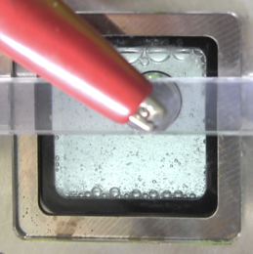
Novel Acid Flow Method (Dual Flow)
Acid was flowed separately in the cavity and cathode housing.
5 L/min in the cavity, and different flow rates in the cathode housing
5 L/min
10 L/min
Cathode Housing
20 L/min
Adequate flow rates:
Cavity: 5 L/min
Cathode housing: 10 L/min
No intentional flow in cathode housing
10 L/min in cathode housing

Slide 15
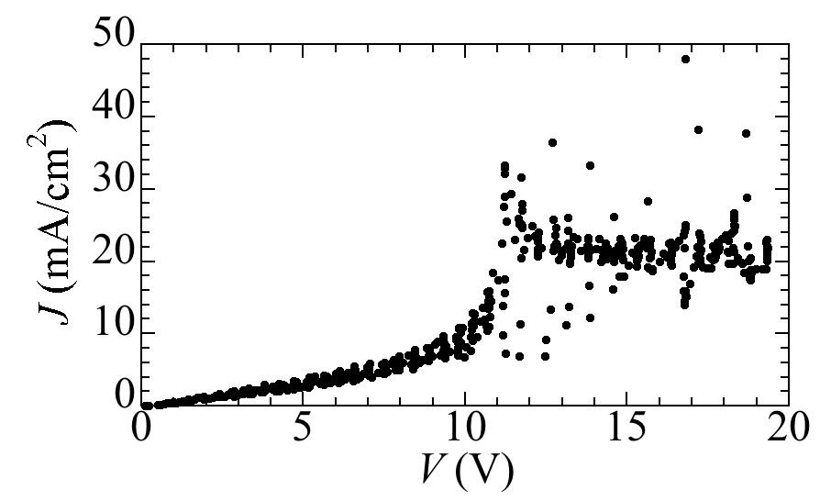
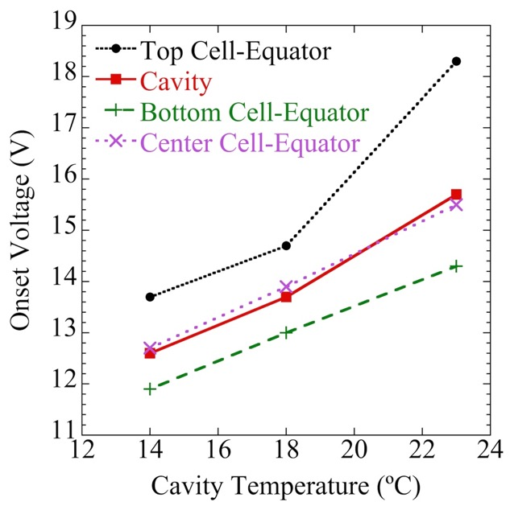
Effect of Temperature
Polarization (J-V) curves were obtained at different temperatures of the cavity.
Strong cathode screening
Higher Temperature
Higher EP Current
Higher Bubble Quantity
Lower Electric Field
Higher Onset Voltage
Oscillation
Etching
Polishing
Bubble Quantity/Cathode screening
Onset Voltage
The optimized voltage can be chosen for a set cavity temperature.

Slide 16
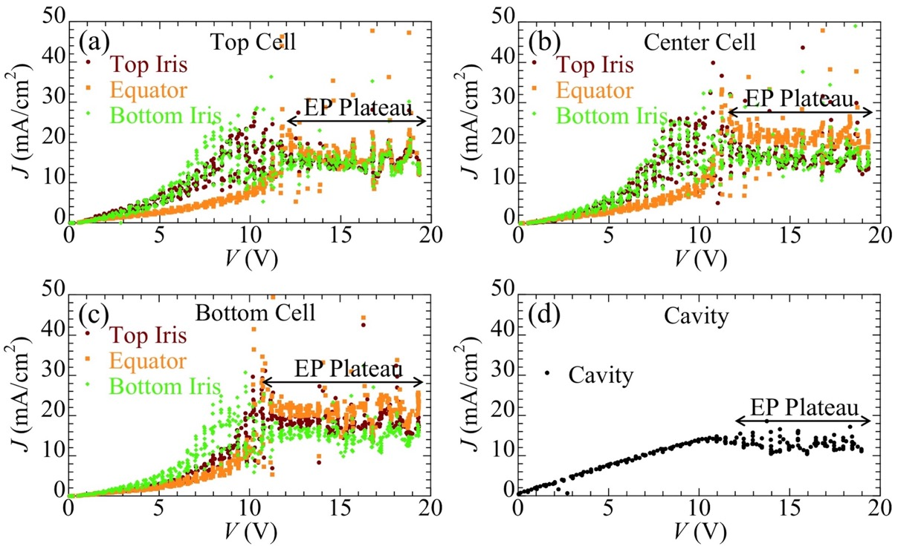
J-V Curves under Optimized Conditions
Polarization curves at ~15 ºC.
The EP plateaus are apparent for all the coupons and cavity.

Slide 17
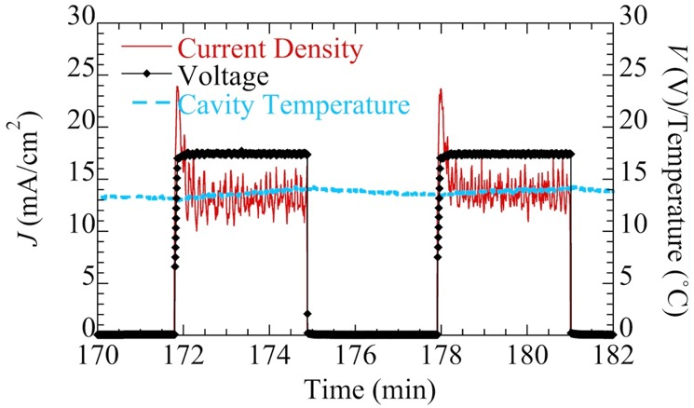
VEP Conditions (Dual Flow)
Condition | Value
Acid flow type | Dual flow
Flow rate in cathode housing | 10 L/min
Flow rate in cavity | 5 L/min
Cathode Type | Ninja v-5
Cathode Rotation | 20 rpm
Cavity Temperature | < 15 ºC
Voltage | 17.5 V
Voltage-on/off period | 3/3 min
3 min
3 min
On/Off voltage cycles were applied to reduce returning bubbles from the acid tank to the cavity.

Slide 18
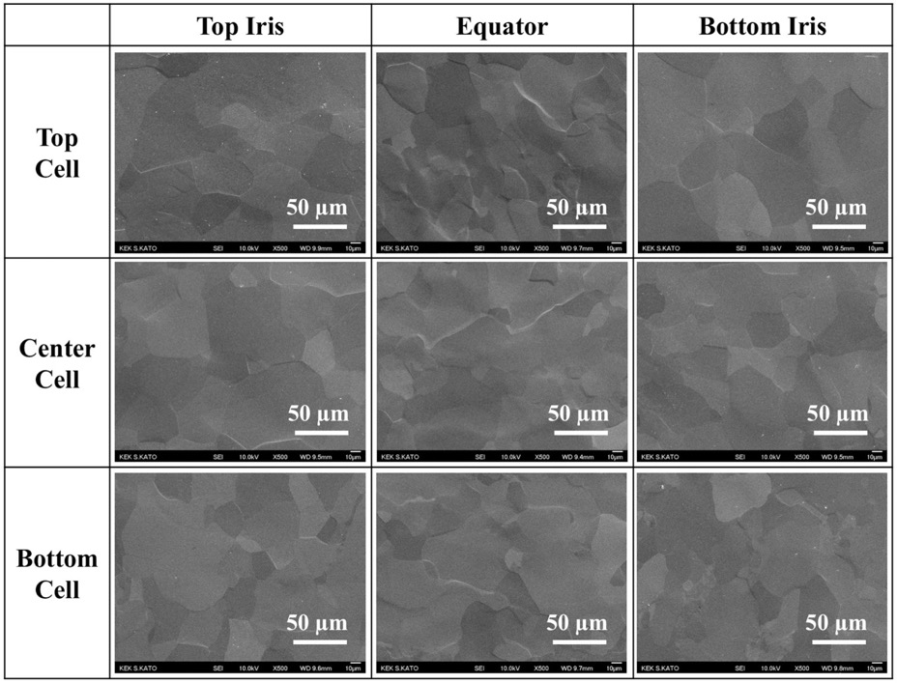
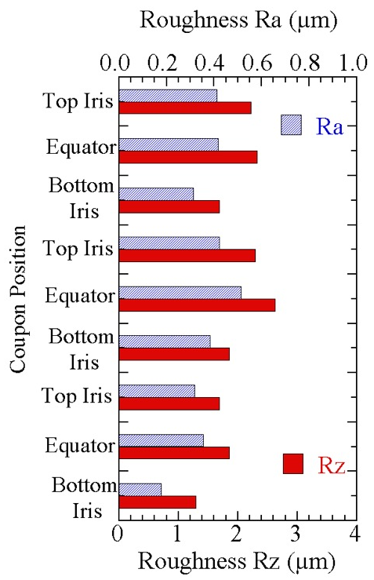
Surface Morphologies
VEP was conducted for an average removal thickness of 25 µm.
SEM Images
Top Cell
Center Cell
Bottom Cell
The coupon surfaces were smooth after VEP with the optimized conditions.

Slide 19
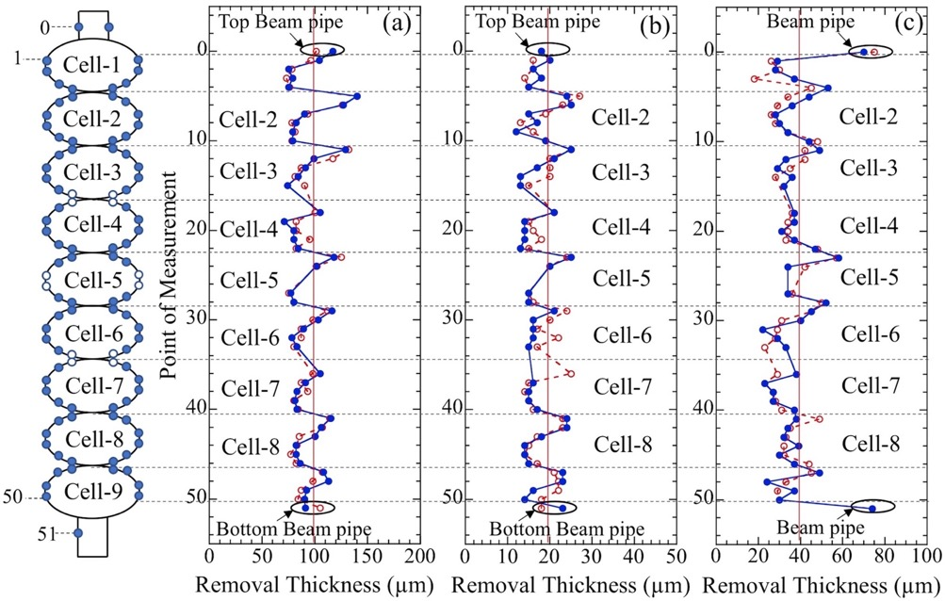
Bulk and Light Removal (Removal Trend)
Flow rate: Cathode housing-10L/min, Cavity-5L/min
VEP with Unoptimized Conditions
VEP with Optimized Conditions
VEP for 100 µm
VEP for 20 µm
HEP for 40 µm
Top Beam pipe
Cell-2
Cell-3
Cell-4
Cell-5
Cell-6
Cell-7
Cell-8
Bottom Beam pipe
Removal asymmetry significantly reduced.

Slide 20
Surface after Bulk Removal
Flow rate: Cathode housing-10L/min, Cavity-5L/min
Surface was smooth in all the cells.
A pristine cavity can be processed with VEP.
12 mm x 9 mm

Slide 21
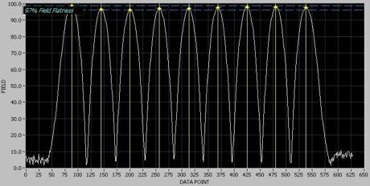
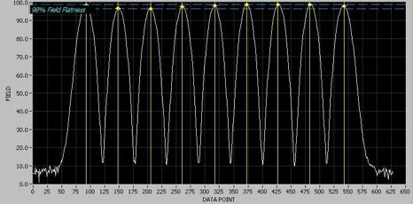
Field Flatness
Field Flatness before and after VEP
Field Flatness before VEP (20 µm)
VEP condition | Removal thickness (µm) | Field Flatness before VEP (%) | Field Flatness after VEP (%)
Unoptimized | 51 | 91 | 67
Optimized | 100 | 95 | 91
Optimized | 20 | 97 | 98
Optimized | 10 | 99 | 99
Field Flatness after VEP (20 µm)
Degradation in the field flatness after bulk removal is similar as observed after HEP.
No degradation in the field flatness after 10 and 20 µm removal.

Slide 22
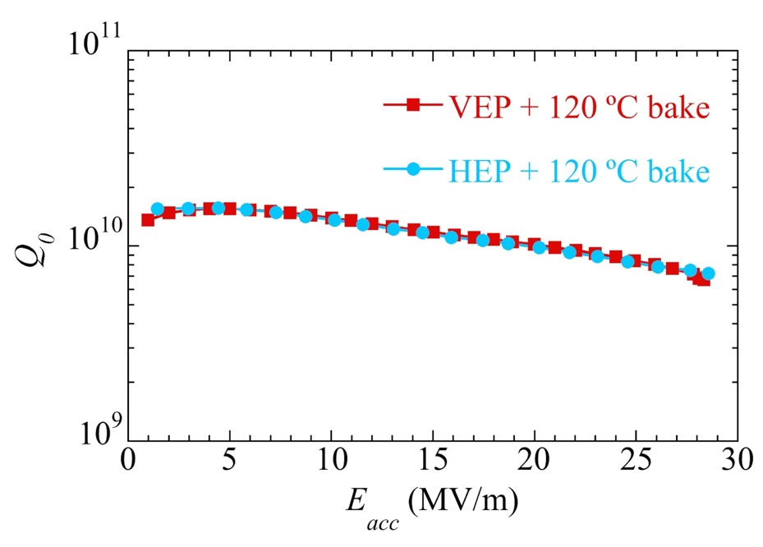
SRF Performance (Nine-Cell Cavity)
Horizontal EP (baseline RF test)
VEP for 100 µm
750ºC bake
VEP for 20 µm
750ºC bake
Field Flatness Tuning (99%)
VEP for 10 µm and 120ºC
RF Test
Field Flatness: 99%
At 2 K
Eacc=28.3 MV/m; Q₀=6.7e9
Limited by quench
The SRF performance after the HEP and VEP was the same.

Slide 23
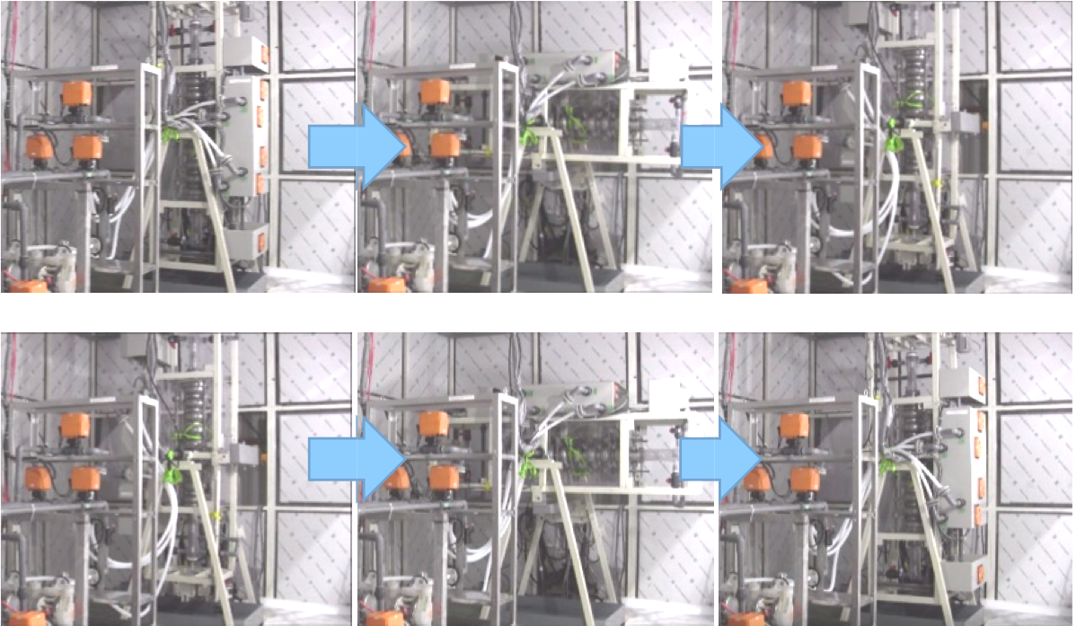
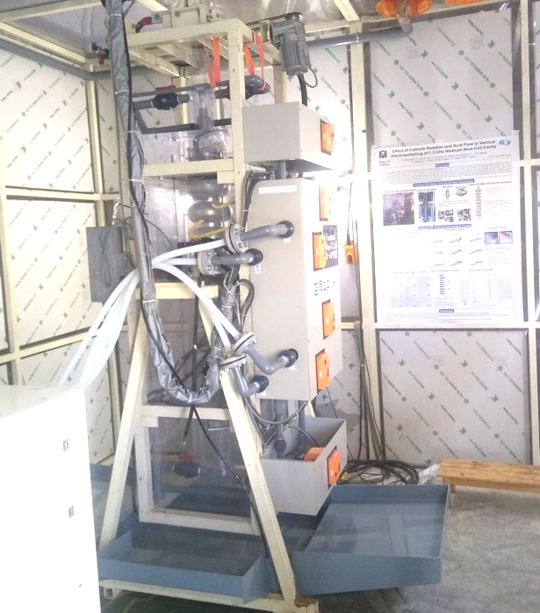
Flipping System for VEP
We are also working on another method to improve the removal uniformity.
The cavity is flipped upside down periodically.

Slide 24
Preliminary Result of VEP with Flipping System
Condition | Value
Voltage | 14 V
Acid flow rate | 5–10 L/min
Cathode | Ninja Cathode (metal wings)
Cathode Rotation | 20 rpm
Cavity Temperature | 20–30 ºC
Flipping frequency | Flipped every 20 min of EP
Removal Trend
Coupon surface
Top Iris
Equator
Bottom Iris
Top Cell
Unoptimized conditions w/o flipping
Center Cell
Unoptimized conditions w/ flipping
Bottom Cell
Uniformity is significantly better.
Surface is rough. Parameter optimization is necessary.

Slide 25
Summary and Future Work
The VEP process was successfully optimized with the single-cell coupon cavity. The optimized parameters and cathode yield desired surface and removal uniformity.
A single-cell cavity showed good and the same SRF performance after HEP and VEP. The field gradient reached 32 MV/m at Q₀=8e9.
A parametric study was conducted with the 9-cell coupon cavity. A novel dual flow method was developed and VEP parameters were optimized. The asymmetry was significantly reduced and smooth surface was attained for the 9-cell cavity as well.
The 9-cell cavity after bulk removal with VEP showed a good SRF performance (E=28.3 MV/m; Q₀= 6.7e9). The performance is the same as the baseline performance.
The VEP parameters for 9-cell cavity will be further tuned to improve removal uniformity.
VEP is planned with a bigger acid tank that could avoid circulation of bubbles from the tank to the cavity. Parameters will be optimized for the VEP with flipping method.

Slide 26
Thank You
Acknowledgement
WING Co. Ltd., Japan
&
Higashinihon Kidenkaihatsu Co. Ltd., Japan

Slide 27
Backup Slides

Slide 28
Effect of Dual-Flow Method
Coupon currents for the top cell with no cathode rotation
No Intentional Flow in Cathode Housing
Optimized Dual Flow
Total Flow Rate: 15 L/min
Total Flow Rate: 15 L/min (Cavity-5L/min ; Cathode Housing-10 L/min)
The difference in the current was higher when no intentional flow was applied in the cathode housing.

