Slide 1
Material R&D at the Technical University of Darmstadt on N-doped Nb and Nb₃Sn for SRF cavities
Márton Major, Ruben Grewe and Nils Schäfer
Technische Universität Darmstadt, Darmstadt, Germany

Slide 2
Possible superconducting materials for RF cavities
Material | Critical Temp. T_{c} [K] | Normal-state resistivity ρ_{n} [μΩcm] | Critical Field H_{c}(0) [T] | Lower Critical field H_{c1}(0) [T] | Upper Critical field H_{c2}(0) [T] | Penetration depth λ(0) [nm] | Δ [meV] | Type
Nb | 9.23 | 2 | 0.2 | 0.18 | 0.28 | 40 | 1.5 | II
Pb | 7.2 |  | 0.08 | N/A | N/A | 48 |  | I
NbN | 16.2 | 70 | 0.23 | 0.02 | 15 | 200-350 | 2.6 | II, B1 comp.
NbTiN | 17.3 | 35 |  | 0.03 |  | 150-200 |  | II, B1 comp.
Nb₃Sn | 18 | 20 | 0.54 | 0.05 | 30 | 80-100 | 3.1 | II, A15
V₃Si | 17 |  |  |  | 24.5 | 179 |  | II, A15
Mo₃Re | 15 |  | 0.43 | 0.03 | 3.5 | 140 |  | II, A15
MgB₂ | 40 | 0.1-10 | 0.43 | 0.03 | 3.5-60 | 140 | 2.3/7.2 | II- 2 gaps
YBCO | 93 |  | 1.4 | 0.01 | 100 | 150 | 20 | d-wave
Pnictides | 30-55 |  | 0.5-0.9 | 30 | >100 | 200 | 10-20
Whistler 2015, SRF Tutorial - Pushing Nb Performance - A.-M. Valente-Feliciano

Slide 3
Possible superconducting materials for RF cavities
Material | Critical Temp. T_{c} [K] | Normal-state resistivity ρ_{n} [μΩcm] | Critical Field H_{c}(0) [T] | Lower Critical field H_{c1}(0) [T] | Upper Critical field H_{c2}(0) [T] | Penetration depth λ(0) [nm] | Δ [meV] | Type
Nb | 9.23 | 2 | 0.2 | 0.18 | 0.28 | 40 | 1.5 | II
Pb | 7.2 |  | 0.08 | N/A | N/A | 48 |  | I
NbN | 16.2 | 70 | 0.23 | 0.02 | 15 | 200-350 | 2.6 | II, B1 comp.
NbTiN | 17.3 | 35 |  | 0.03 |  | 150-200 |  | II, B1 comp.
Nb₃Sn | 18 | 20 | 0.54 | 0.05 | 30 | 80-100 | 3.1 | II, A15
V₃Si | 17 |  |  |  | 24.5 | 179 |  | II, A15
Mo₃Re | 15 |  | 0.43 | 0.03 | 3.5 | 140 |  | II, A15
MgB₂ | 40 | 0.1-10 | 0.43 | 0.03 | 3.5-60 | 140 | 2.3/7.2 | II- 2 gaps
YBCO | 93 |  | 1.4 | 0.01 | 100 | 150 | 20 | d-wave
Pnictides | 30-55 |  | 0.5-0.9 | 30 | >100 | 200 | 10-20
Whistler 2015, SRF Tutorial - Pushing Nb Performance - A.-M. Valente-Feliciano

Slide 4
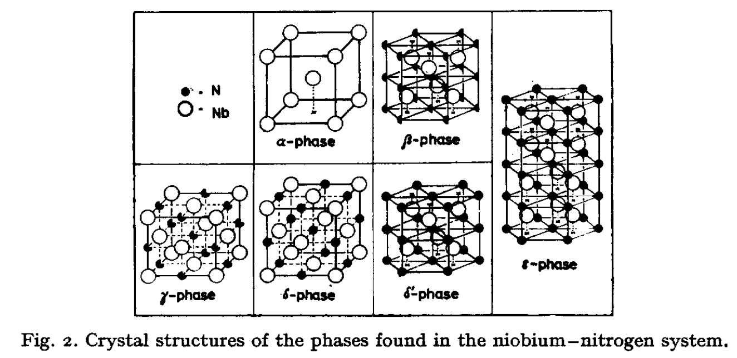
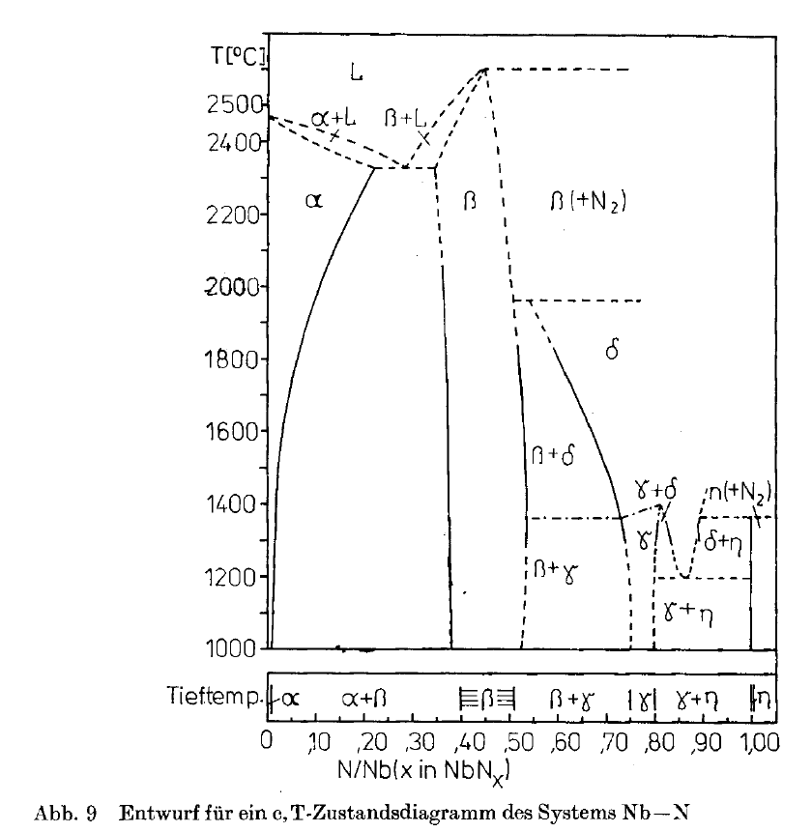
Nb–N phase diagram
Temperature (°C)
Brauer, J. Less-Common Met. 2 (1960) 131
Phase
T_{c}
α:Nb-N solid solution, bcc 9.2 K
β: Nb₂N, hexagonal 9.5 K
γ: Nb₄N₃, tetragonal 12.2 K
δ: NbN, cubic NaCl type 16.5 K
ε: NbN, hexagonal < 1.2 K (11.6 K*)
Layout of the Nb-N phase diagram (η → ε)
Springer Handbook of Condensed Matter and Materials Data (W. Martienssen, H. Warlimont, Eds., 2005)
Brauer and Kern, Z. anorg. Allg. Chem. 507 (1983) 127
*Zou et al., Sci. Rep. 6 (2016) 22330
Musenich et al., J. Alloys Compd. 209 (1994) 319

Slide 5
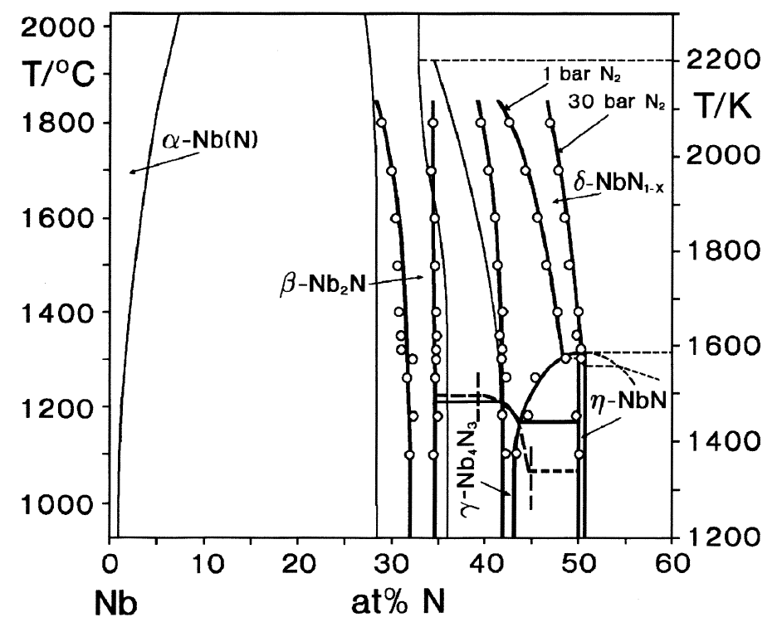
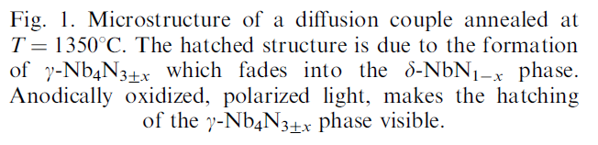
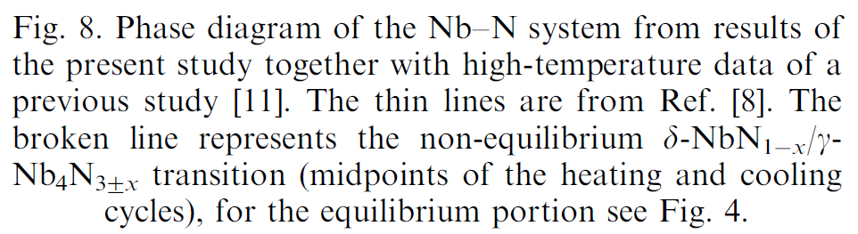
Nb–N phase diagram
Lengauer et al., Acta mater. 48 (2000) 2633

Slide 6
Nitrogen doping of SRF cavities
Record after nitrogen doping – up to 4 times higher Q!
Standard state-of-the art preparation
This was the highest Q possible up to 2012
1.3 GHz
Grassellino et al., Supercond. Sci. Technol. 26 (2013) 102001
Whistler 2015, SRF Tutorial - Pushing Nb Performance - Alexander Romanenko

Slide 7
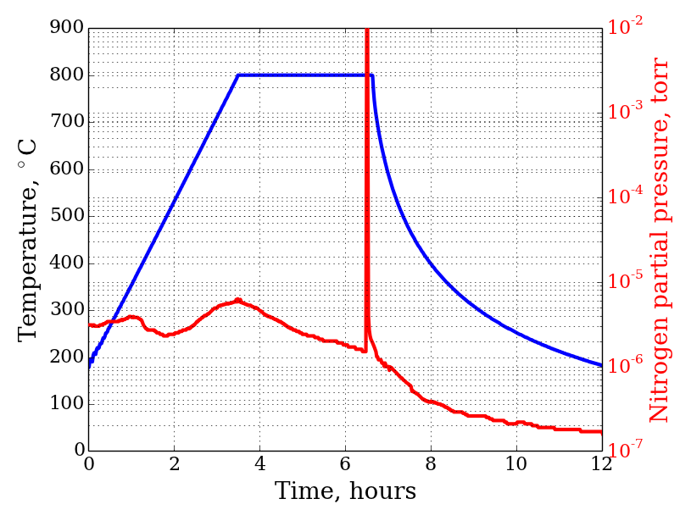
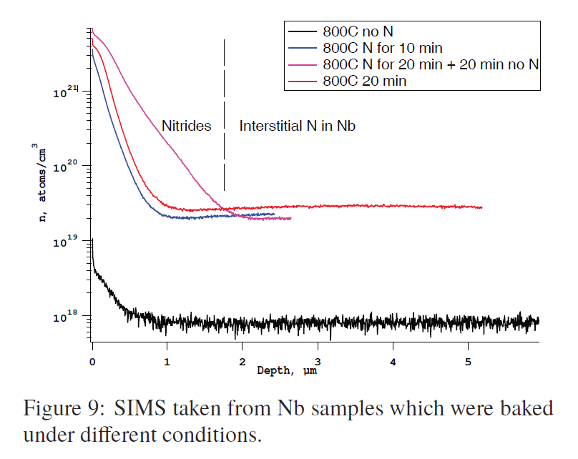
Nitrogen doping of SRF cavities
Injection of small nitrogen partial pressure at the end of 800C degassing-> drastic increase in Q.
Nitride (Nb₂N phase) layer electro polished (EP) down (5μm was removed by EP).
Trenikhina et al., MOPB055, SRF2015
Whistler, SRF Tutorial - Pushing Nb Performance - Alexander Romanenko

Slide 8
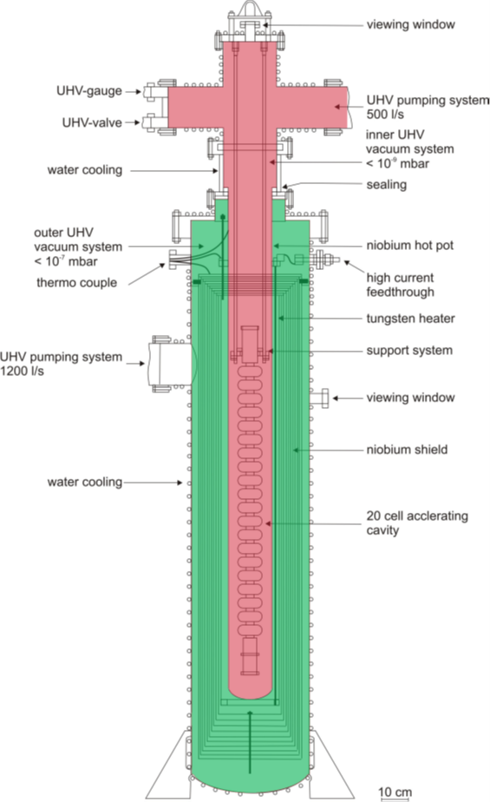
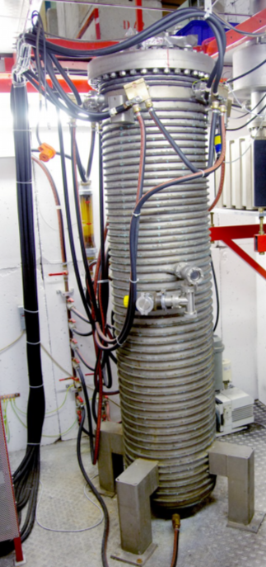
High temperature UHV furnace
Built in 1983 in Wuppertal by G. Müller
Now located at S-DALINAC
Two vacuum systems
  Insulating vacuum (green)
  Hot-pot vacuum (red)
< 10⁻⁴ mbar at 1750 ˚C
Hot pot and heat shield made of niobium
Heaters made of tungsten
40 kW power supply
Water cooled

Slide 9
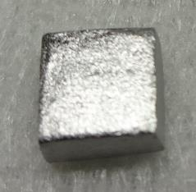
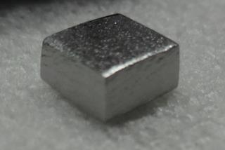
Niobium samples
5x5x2.7 mm³

Slide 10
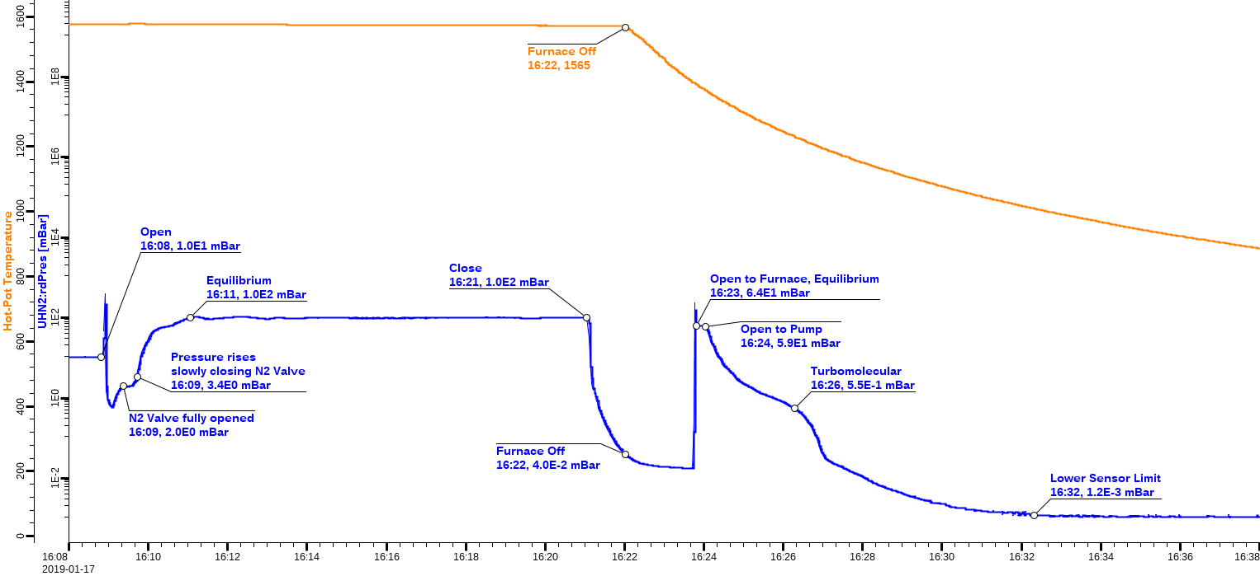
Nb sample N-doping (IKP) new procedure

Slide 11
SIMS of N-doping (IKP) new procedure
14N
Int. (c/s)
Sputter time (s)

Slide 12
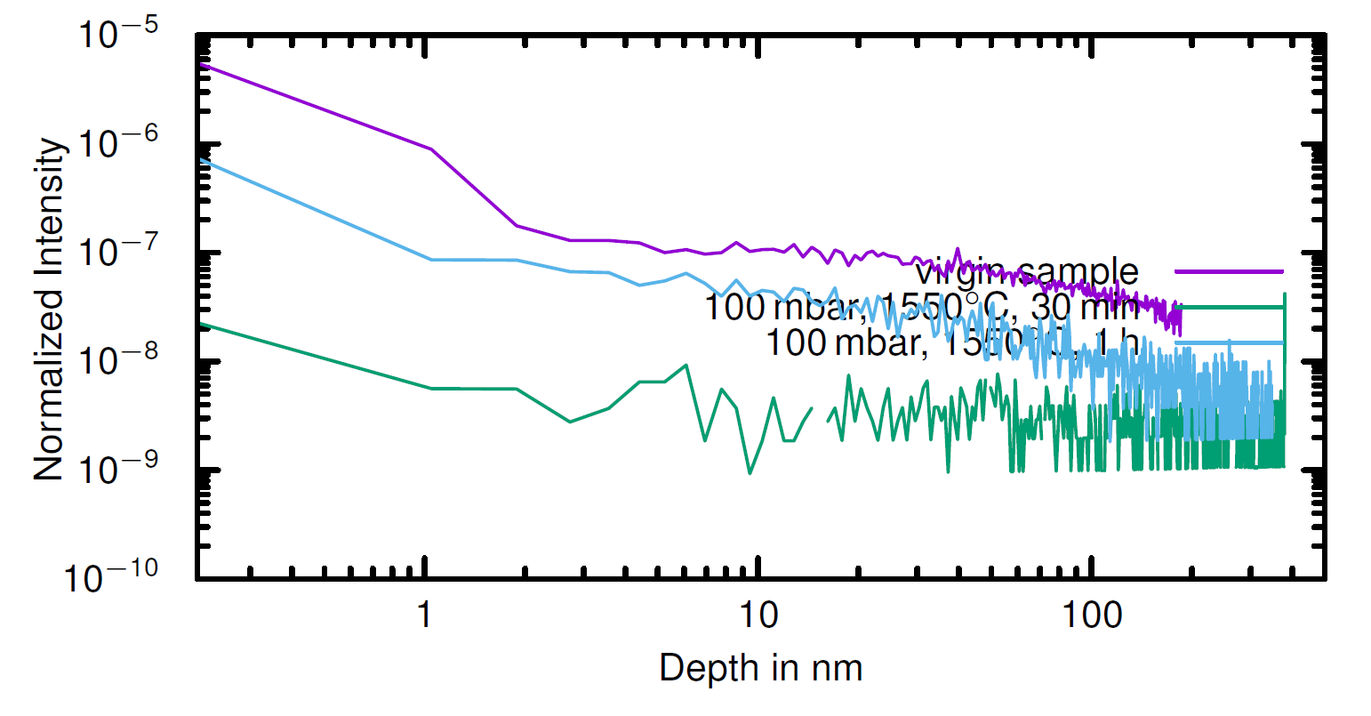
SIMS of N-doping (IKP) new procedure
16O

Slide 13
XRD of N-doped Nb samples (IKP, new procedure)
β-Nb₂N
α-Nb
Int. (a.u.)
δ-NbN
Int. (a.u.)
2θ (deg)

Slide 14
2N180005-2: 1h 100 mbar N₂, 1550 °C
Int. (a.u.)
2θ (deg)

Slide 15
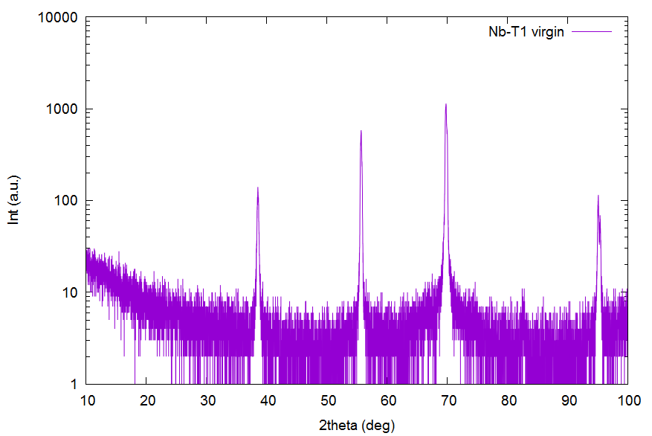
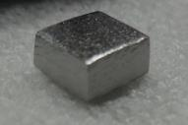
X-ray diffraction: phases and texture
Nb 211
Nb 200
Nb 110
Nb 310
Nb 220

Slide 16
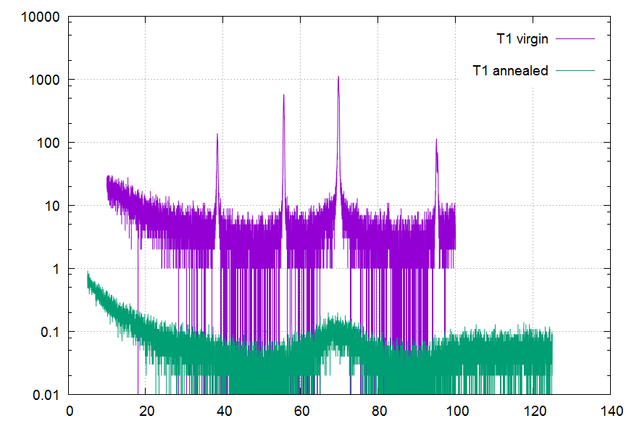
T2: Annealed Nb sample
Nb 211
Nb 200
Nb 110
Nb 220
Annealed in UHV at approx. 1200 ºC (nominal) for approx. 1 h
Int (a.u.)
2θ (deg)

Slide 17
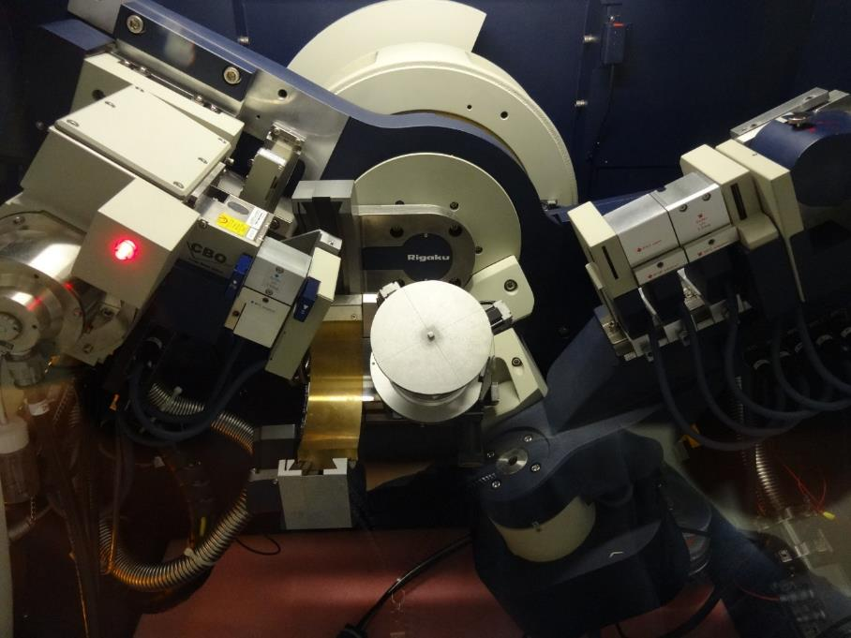
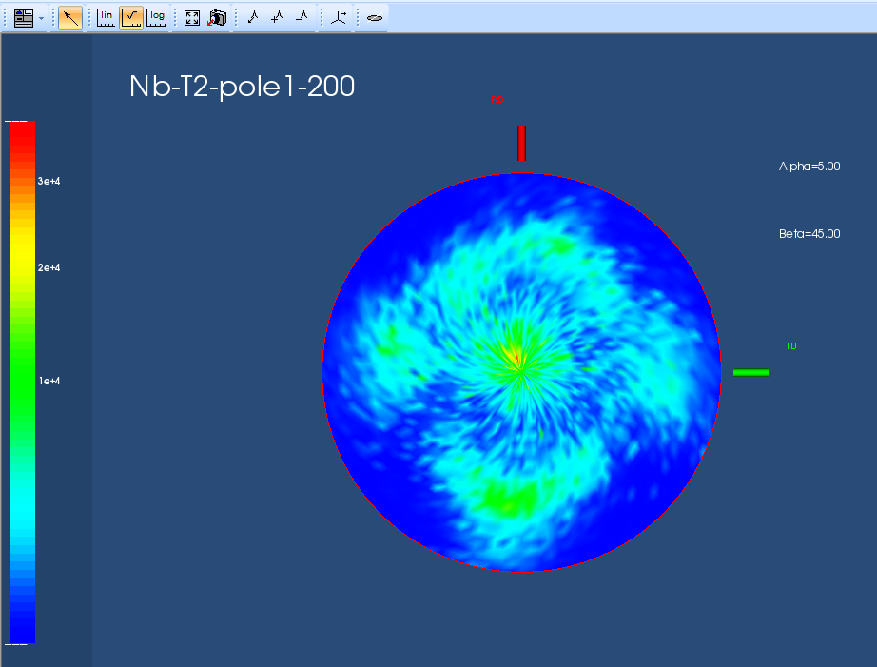
Pole figures

Slide 18
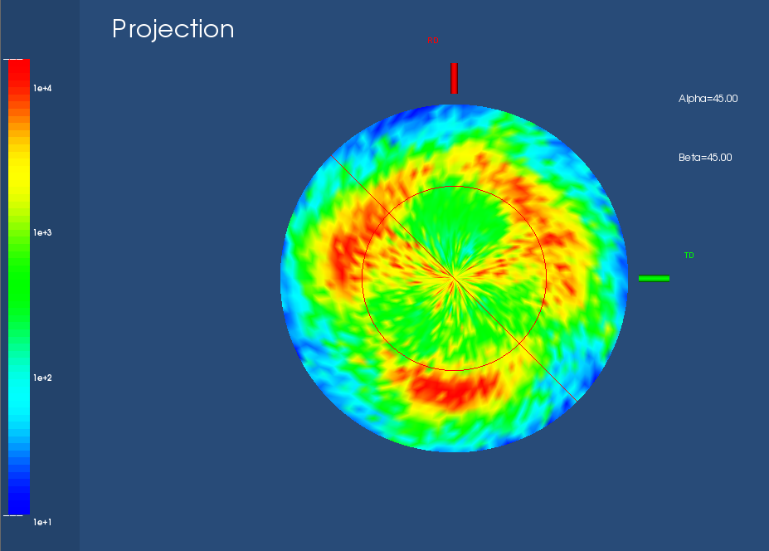
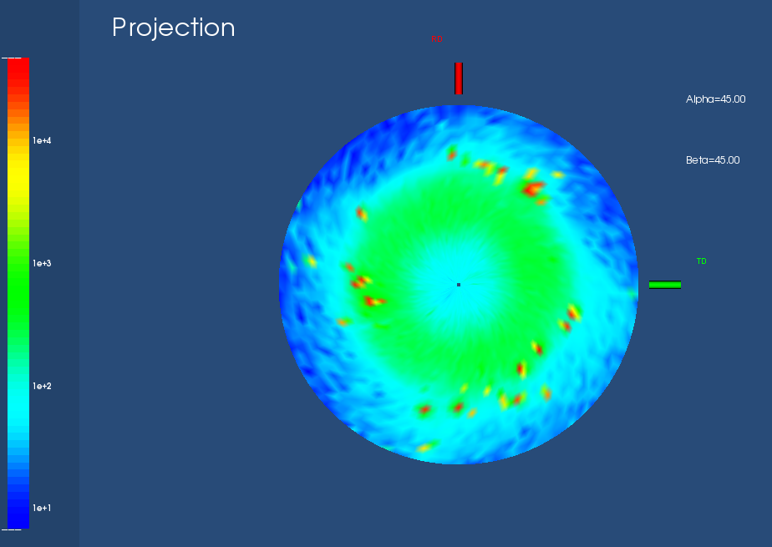
T1 (Not polished Nb): Pole figures of 200 Bragg-peak
Virgin
After annealing (1200 °C 1h)
Log colour scale

Slide 19


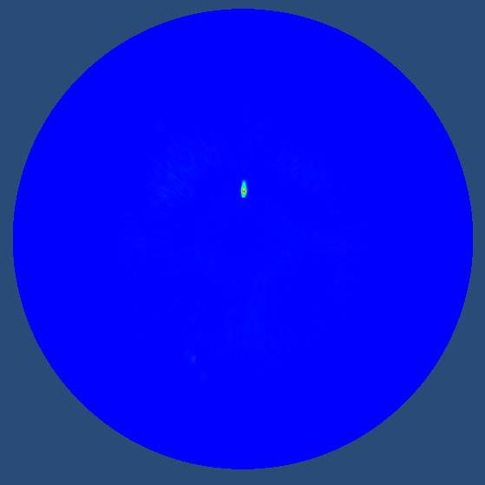
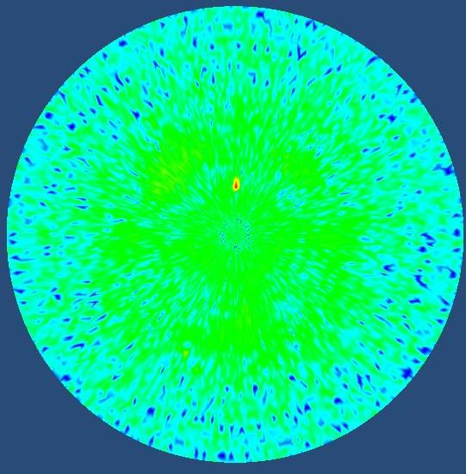
2N180005-2: 1h 100 mbar N₂, 1550 °C
Nb 200 reflection (2θ = 55.7°)

Slide 20

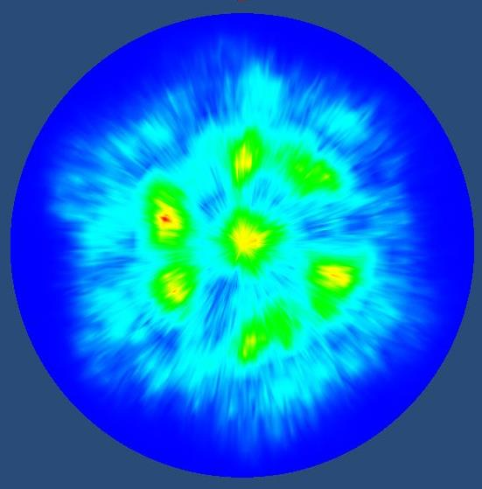
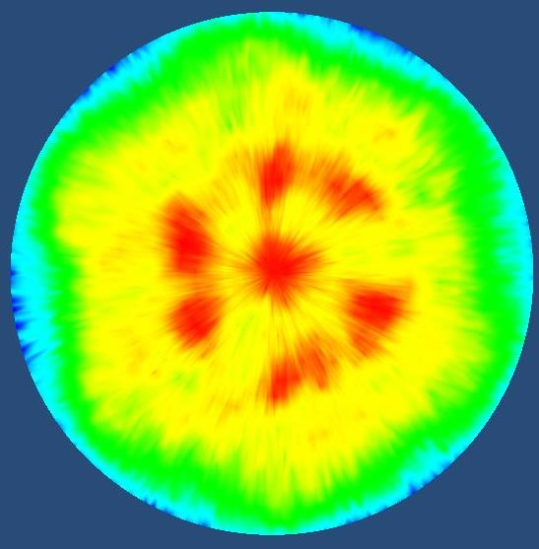
2N180005-2: 1h 100 mbar N₂, 1550 °C
NbN-111 reflection (2θ = 35.67°)

Slide 21
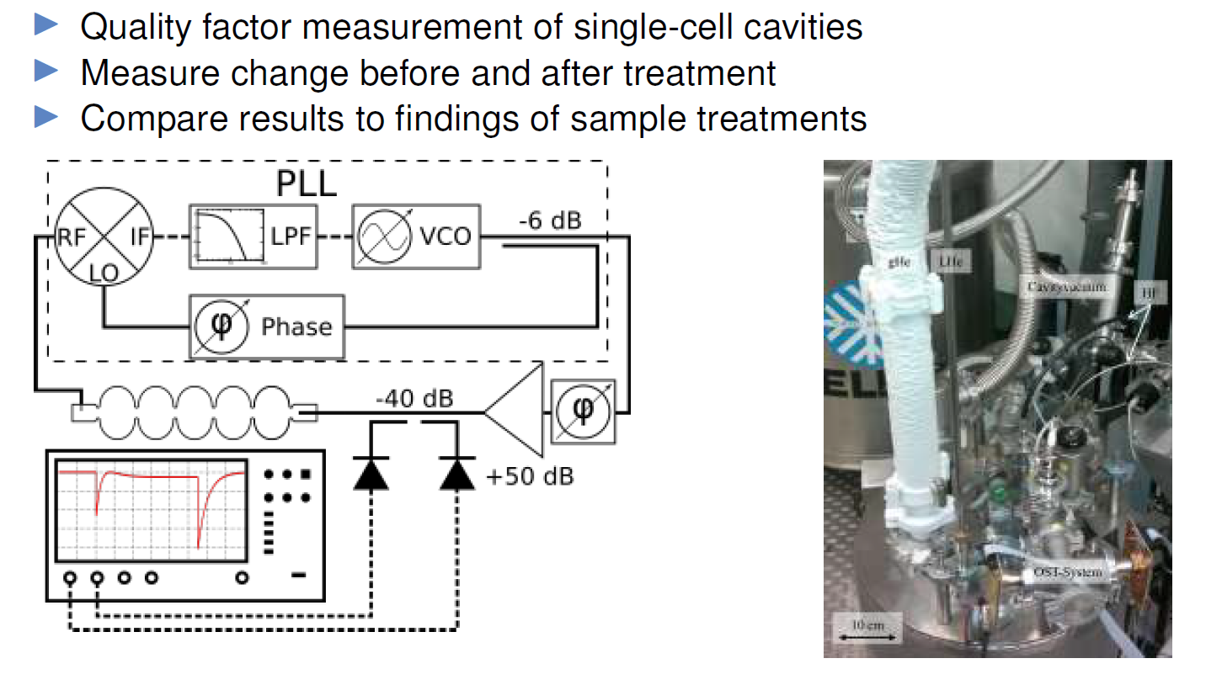
Quality factor measurement

Slide 22
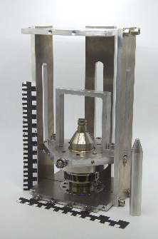
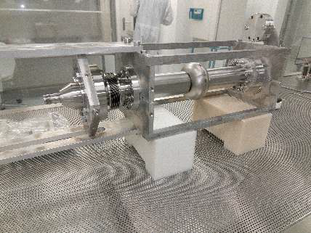
Quality factor measurement
Variable input coupler

Slide 23
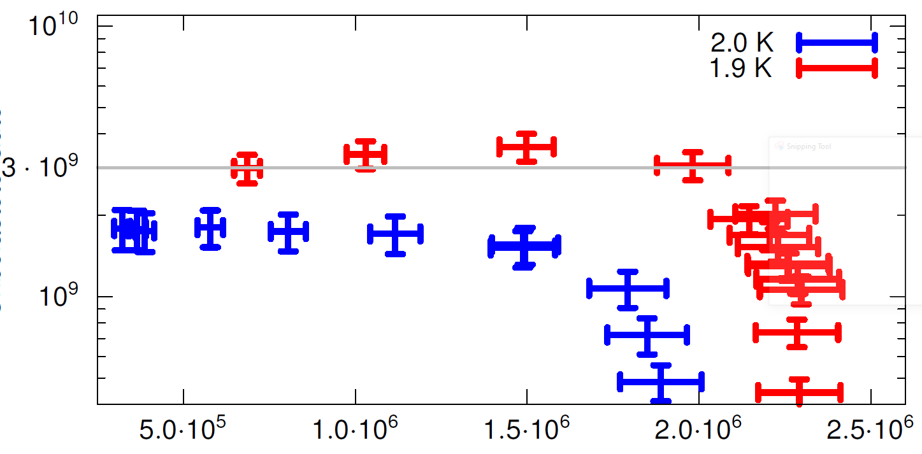
Quality factor measurement
Q₀
E_{acc} (V/m)

Slide 24
Possible superconducting materials for RF cavities
Material | Critical Temp. T_{c} [K] | Normal-state resistivity ρ_{n} [μΩcm] | Critical Field H_{c}(0) [T] | Lower Critical field H_{c1}(0) [T] | Upper Critical field H_{c2}(0) [T] | Penetration depth λ(0) [nm] | Δ [meV] | Type
Nb | 9.23 | 2 | 0.2 | 0.18 | 0.28 | 40 | 1.5 | II
Pb | 7.2 |  | 0.08 | N/A | N/A | 48 |  | I
NbN | 16.2 | 70 | 0.23 | 0.02 | 15 | 200-350 | 2.6 | II, B1 comp.
NbTiN | 17.3 | 35 |  | 0.03 |  | 150-200 |  | II, B1 comp.
Nb₃Sn | 18 | 20 | 0.54 | 0.05 | 30 | 80-100 | 3.1 | II, A15
V₃Si | 17 |  |  |  | 24.5 | 179 |  | II, A15
Mo₃Re | 15 |  | 0.43 | 0.03 | 3.5 | 140 |  | II, A15
MgB₂ | 40 | 0.1-10 | 0.43 | 0.03 | 3.5-60 | 140 | 2.3/7.2 | II- 2 gaps
YBCO | 93 |  | 1.4 | 0.01 | 100 | 150 | 20 | d-wave
Pnictides | 30-55 |  | 0.5-0.9 | 30 | >100 | 200 | 10-20
Whistler 2015, SRF Tutorial - Pushing Nb Performance - A.-M. Valente-Feliciano

Slide 25
Possible superconducting materials for RF cavities
Material | Critical Temp. T_{c} [K] | Normal-state resistivity ρ_{n} [μΩcm] | Critical Field H_{c}(0) [T] | Lower Critical field H_{c1}(0) [T] | Upper Critical field H_{c2}(0) [T] | Penetration depth λ(0) [nm] | Δ [meV] | Type
Nb | 9.23 | 2 | 0.2 | 0.18 | 0.28 | 40 | 1.5 | II
Pb | 7.2 |  | 0.08 | N/A | N/A | 48 |  | I
NbN | 16.2 | 70 | 0.23 | 0.02 | 15 | 200-350 | 2.6 | II, B1 comp.
NbTiN | 17.3 | 35 |  | 0.03 |  | 150-200 |  | II, B1 comp.
Nb₃Sn | 18 | 20 | 0.54 | 0.05 | 30 | 80-100 | 3.1 | II, A15
V₃Si | 17 |  |  |  | 24.5 | 179 |  | II, A15
Mo₃Re | 15 |  | 0.43 | 0.03 | 3.5 | 140 |  | II, A15
MgB₂ | 40 | 0.1-10 | 0.43 | 0.03 | 3.5-60 | 140 | 2.3/7.2 | II- 2 gaps
YBCO | 93 |  | 1.4 | 0.01 | 100 | 150 | 20 | d-wave
Pnictides | 30-55 |  | 0.5-0.9 | 30 | >100 | 200 | 10-20
Whistler 2015, SRF Tutorial - Pushing Nb Performance - A.-M. Valente-Feliciano

Slide 26
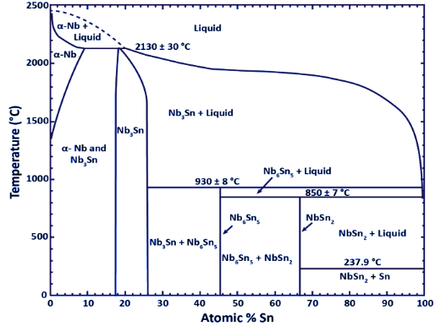
Nb-Sn phase diagram
Charlesworth JP, Macphail I, Madsen PE. Experimental work on the niobium-tin constitution diagram and related studies. Journal of Materials Science. 1970 Jul 1;5(7):580-603.

Slide 27
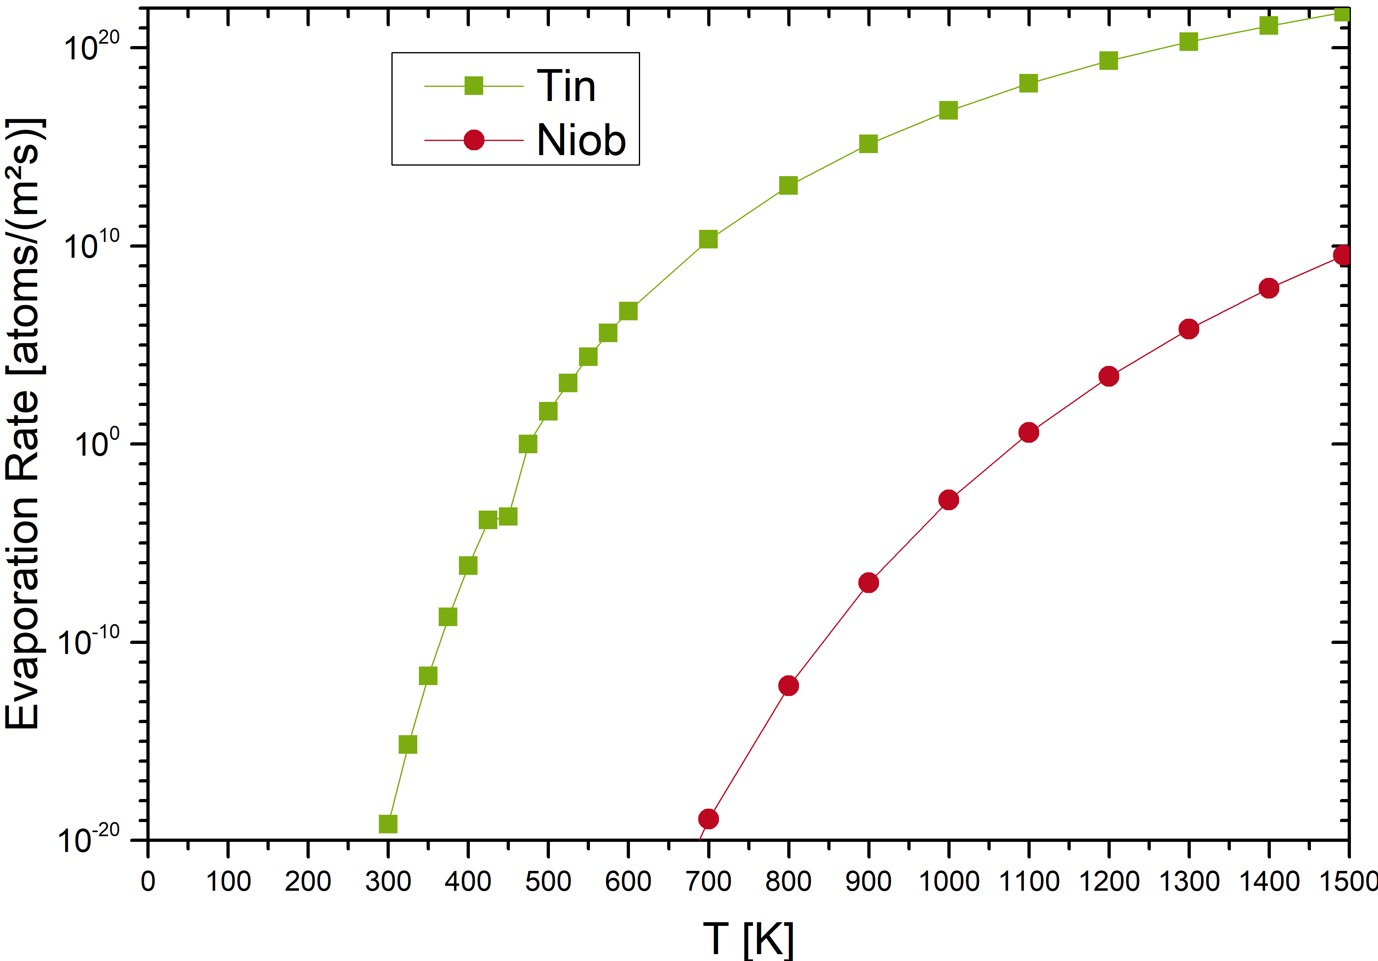
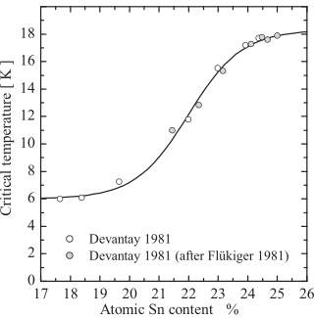
Challenge: Vapor-pressure of Sn

Slide 28
Challenge: Vapor-pressure of Sn
Nb₃Sn
Nb
+ 3 – 24 h
800 – 1200 °C
Sn
Nb₃Sn
Nb
Nb
Nb
Sn
Nb
Sn
Nb

Slide 29
Nb₃Sn co-sputtering
Heater
Substrate
Nb₃Sn
Nb
MFC
Argon
Butterfly valve
Exhaust
Nb Target
Sn Target

Slide 30
Nb₃Sn morphology
50 – 100nm grain size

Slide 31
Stoichiometry

Slide 32
Stoichiometry 20W Sn / 105W Nb

Slide 33
XRD: Temperature Study

Slide 34
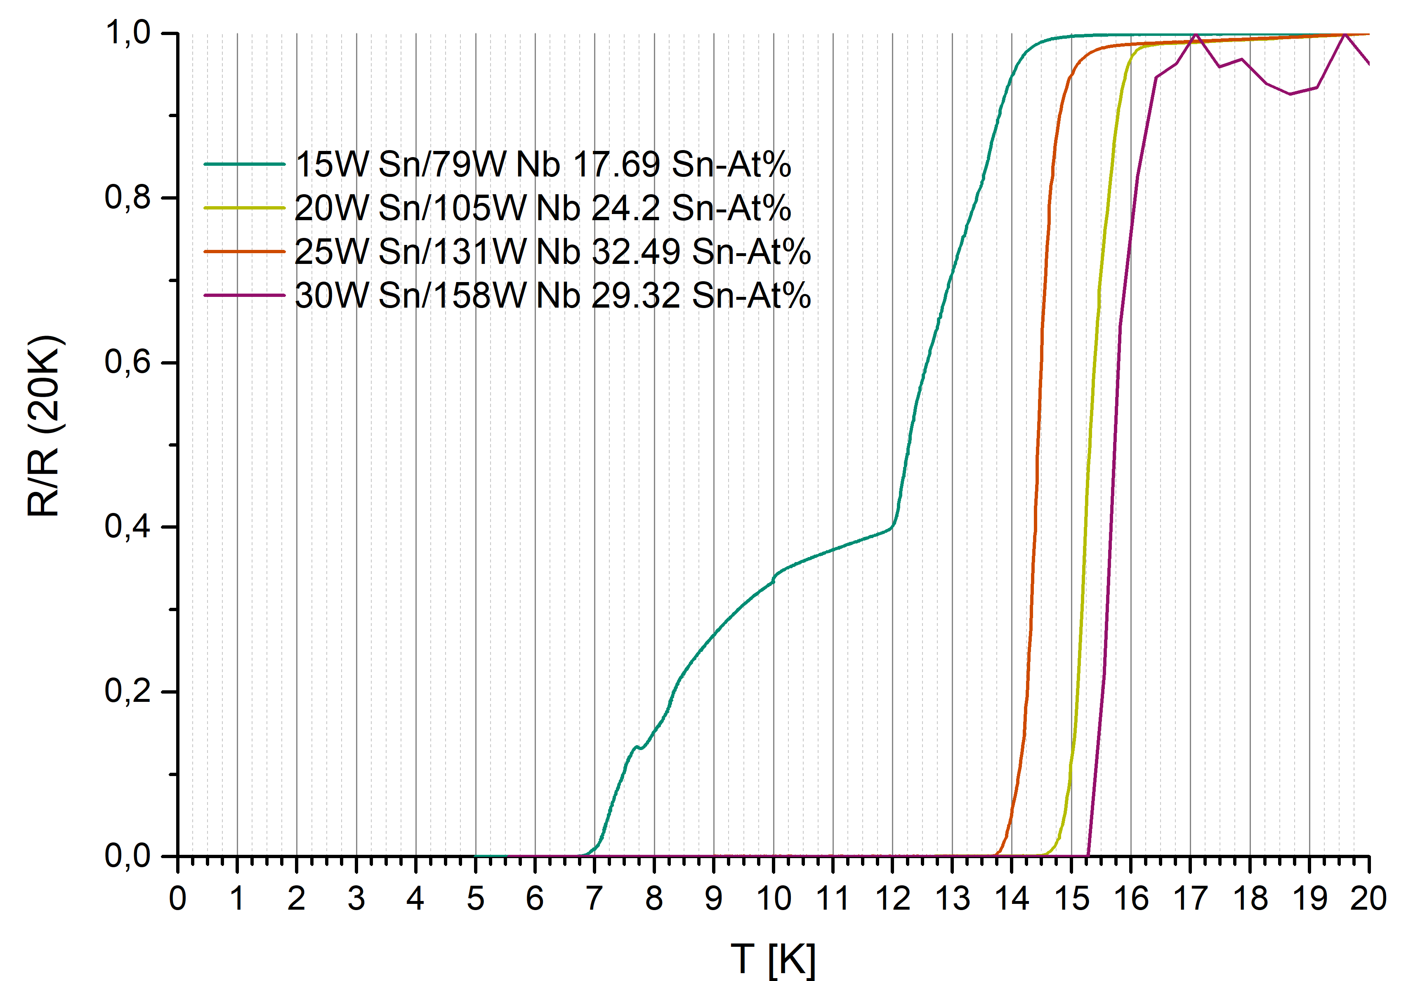
R-T measurements: Power Study

Slide 35





Acknowledgement
Lambert Alff
Matthias Mahr
Norbert Pietralla
Jens Conrad
Michaela Arnold
Florian Hug
Thank you for your attention!
Stefan Flege
Funded by BMBF Projects 05H15RDRBA and 05H18RDRB2

Slide 36
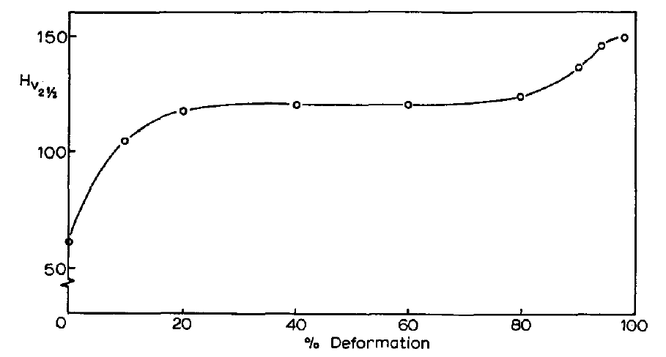
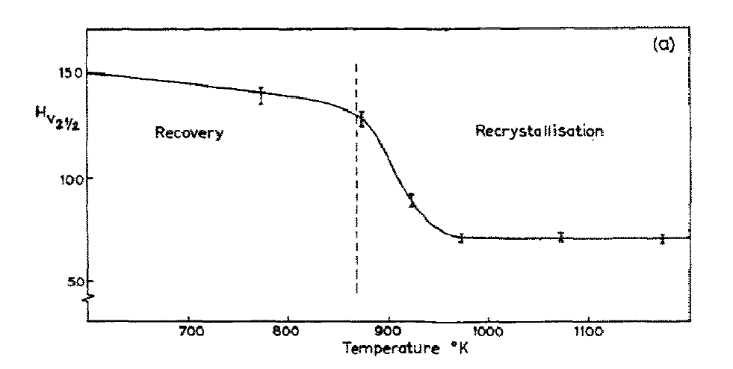
Recrystallization of Nb
Fig. 1. Plot of Vickers Hardness Number HV, against percentage reduction in thickness for cold-rolled niobium.
Fig. 2a. Plot of hardness against annealing temperature for niobium deformed by 94% and
annealed for five hours.
T_{M} = 2477 °C
Recrystallization starts ~ 590 °C, maximum ~ 630 °C (0.32 T_{M})
Thompson and Flewitt, J. Less-Common Metals, 21 (1970) 456

Slide 37
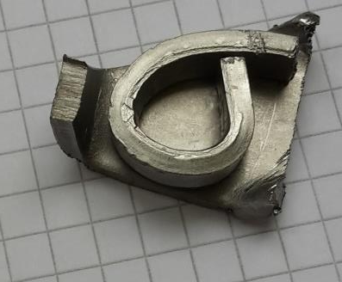
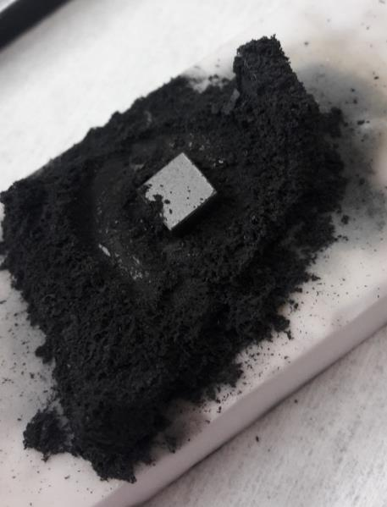
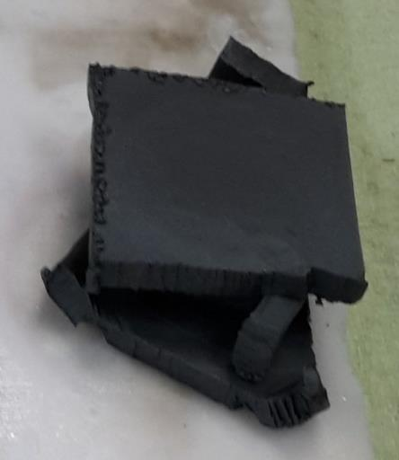
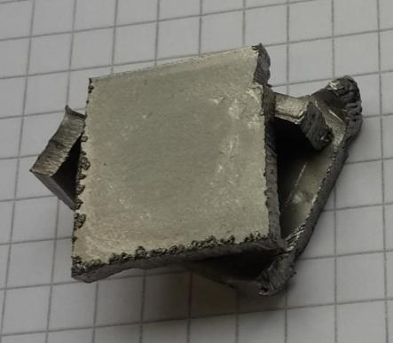
Sample holder
Sample
Pulverised after 10th N-cycle
After some cycles
Virgin

Slide 38
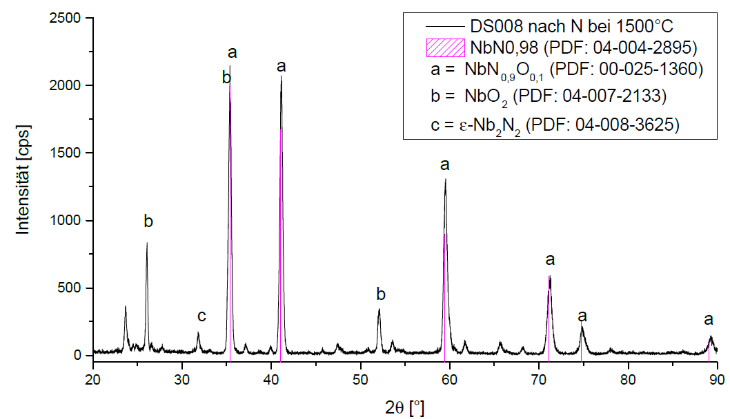
Nitridation: 1500°C, 1 bar N₂, 1 h
M. Mahr, bachelor thesis

Slide 39
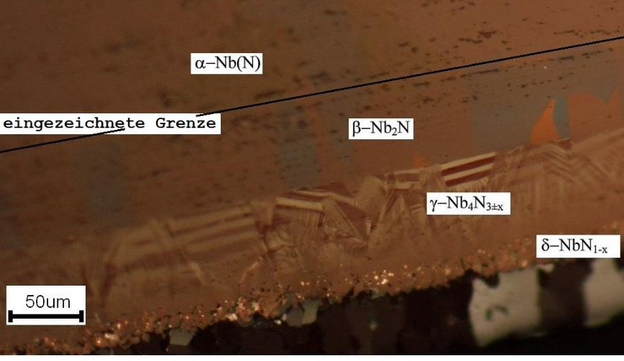
Optical metallography on cutout of sampleholder
M. Mahr, Bachelor thesis (2017)
Lengauer et al., Acta mater. 48 (2000) 2633

Slide 40
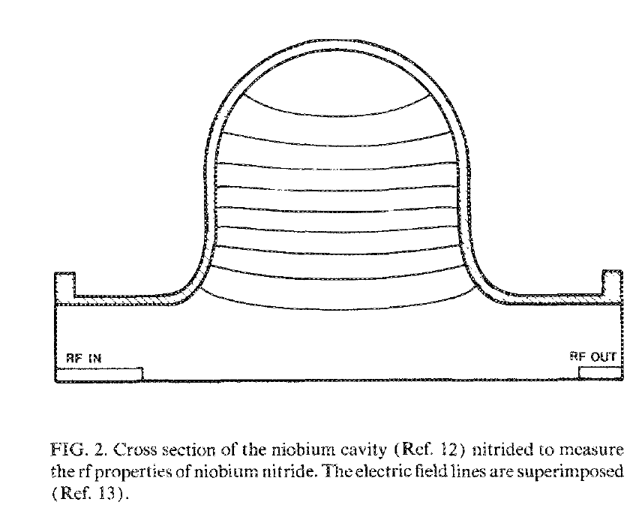
NbN coating of SRF cavities
Sample | T (˚C) | P (mbar) | t (h) | T_{c} (K)
1 | 1427 | 40 | 3.5 | 13.1
2 | 1427 | 130 | 3 | 14.6
3 | 1427 | 200 | 1.5 | 14.3
4 | 1427 | 200 | 3 | 14.9
5 | 1727 | 130 | 3 | 15.6
Table. Reaction conditions for the niobium nitride samples. The cavity was nitrided together with the sample No. 2.
No δ-NbN was found only γ, and phases with lower N content (α, β). High residual resistance. Possible cause: columnar growth of nitrides with amorphous material between the grains. Seen previously for sputtered NbN films on stainless steel [Wagner et al., J. Appl. Phys. 45 (1974) 465]
Test samples 0.1 mm thick, cavity wall 1 mm thick. Furnace: T up to 2000 ˚C, pressure: UHV (10⁻⁸ mbar) – atmosphere. Cleaning: 2h UHV @ 1427 ˚C, then nitridation (Table). The resulting nitrides have a light gold colour and are very hard and brittle.
Fabbricatore et al., J. Appl. Phys., 66 (1989) 5944

