Slide 1
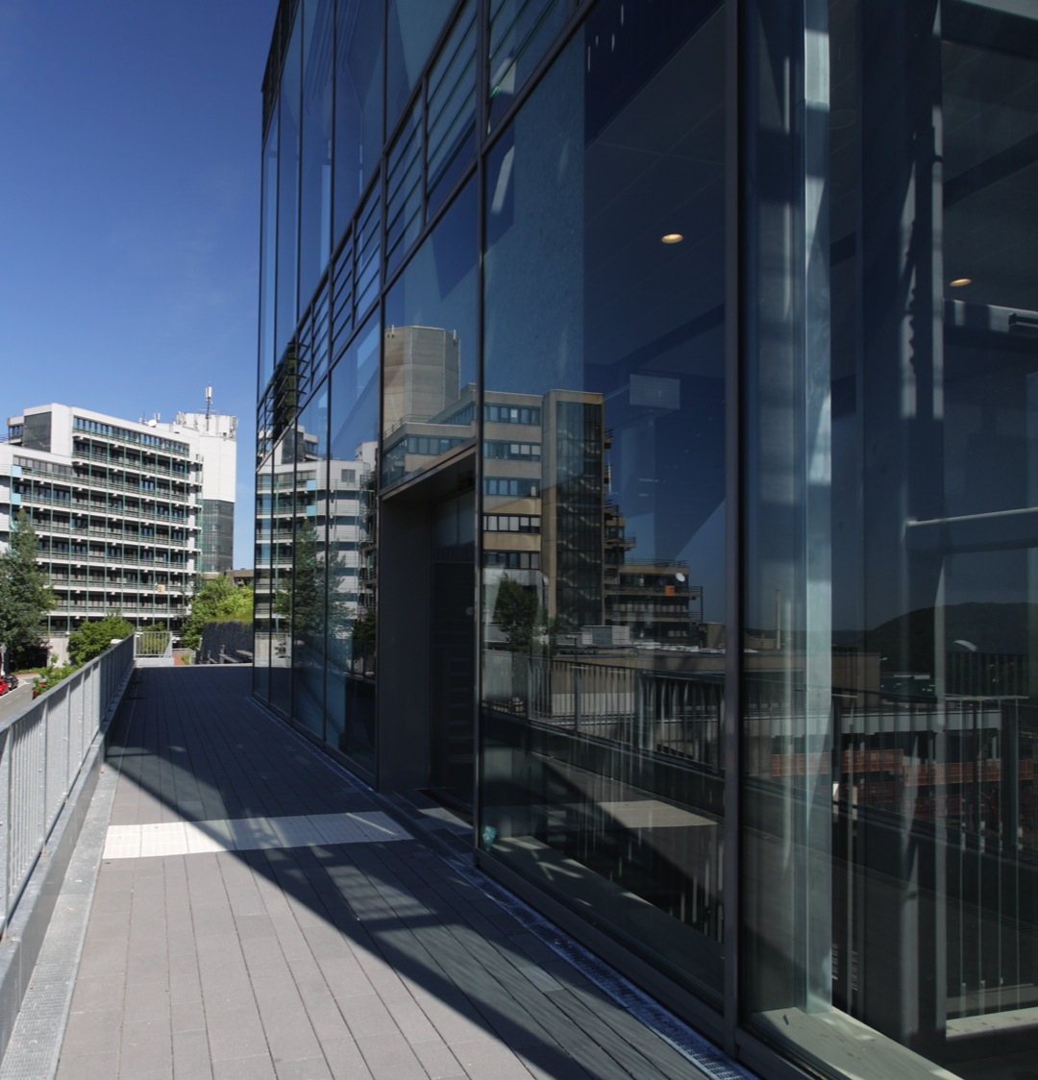

University of Wuppertal
In-Situ EXAFS Investigation of N₂ Treatment of Nb
P. Rothweiler*, J. Kläs, R. Wagner,
D. Lützenkirchen-Hecht**
* patrick.rothweiler@uni-wuppertal.de
** dirklh@uni-wuppertal.de

Slide 2
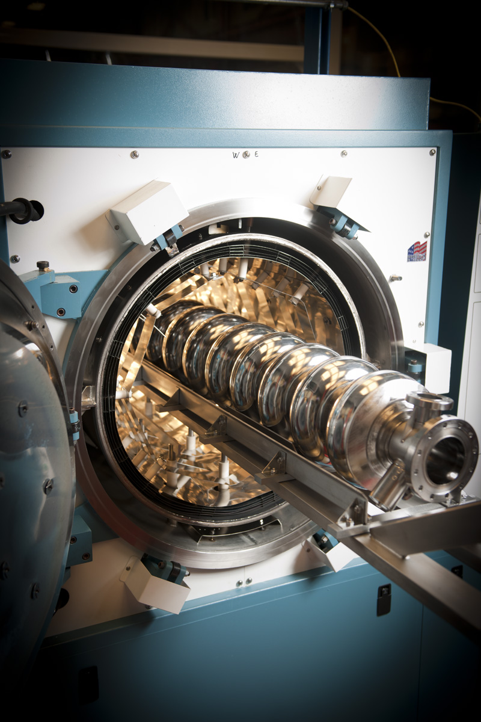
Motivation
Nowadays most Nb-cavities are treated with N₂ to improve Q-factor
  “nitrogen-doping”
Effects still not well understood: especially position of “doped” nitrogen in the Nb-lattice unclear
Very low doses of N₂
  Too low for e.g. XRD
  ⇒ in-situ measurements during doping procedure
*Fermilab today

Slide 3
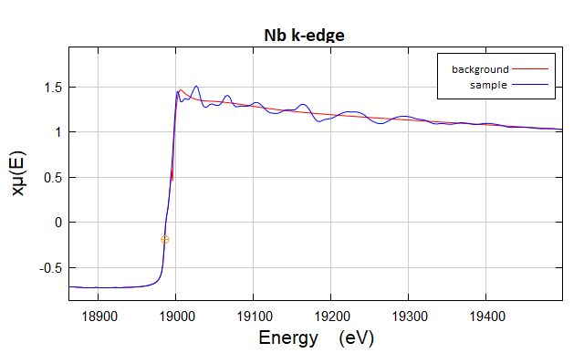
X-Ray Absorption Spectroscopy
Element Specific: Absorption edges are element-specific
XANES
EXAFS
Valence Probe: XANES gives chemical state and formal valence of selected element.
Local Structure Probe: EXAFS gives atomic species, distance, and number of near-neighbor atoms around a selected element..
Low Concentration: concentrations down to 10 ppm for XANES, 100 ppm for EXAFS detectable!
Various Samples: samples can be solids, solutions, amorphous solids, soils, surfaces, etc.
In-situ measurements: Suited for real in-situ studies with time resolution!
XANES = X-ray Absorption Near-Edge Spectroscopy
EXAFS = Extended X-ray Absorption Fine-Structure

Slide 4
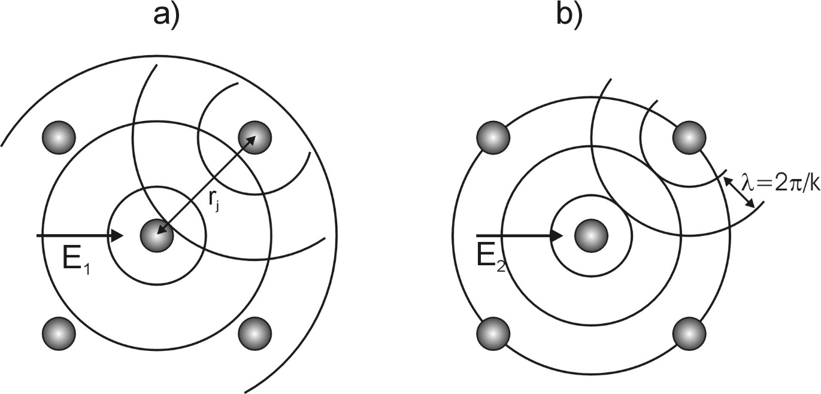
X-Ray Absorption Spectroscopy
Constructive
Destructive Interference
Measure energy-dependence of X-ray absorption coefficient µ(E) of a core-level of selected element (i.e. Nb)
Good example of wave-particle dualism: Photoelectron acts like a wave!
Interference effects on absorption coefficient
Fourier-Transform of the oscillations gives bond length in R-space
Main Idea: Inserted N-atoms will slightly modify interference pattern of Nb

Slide 5
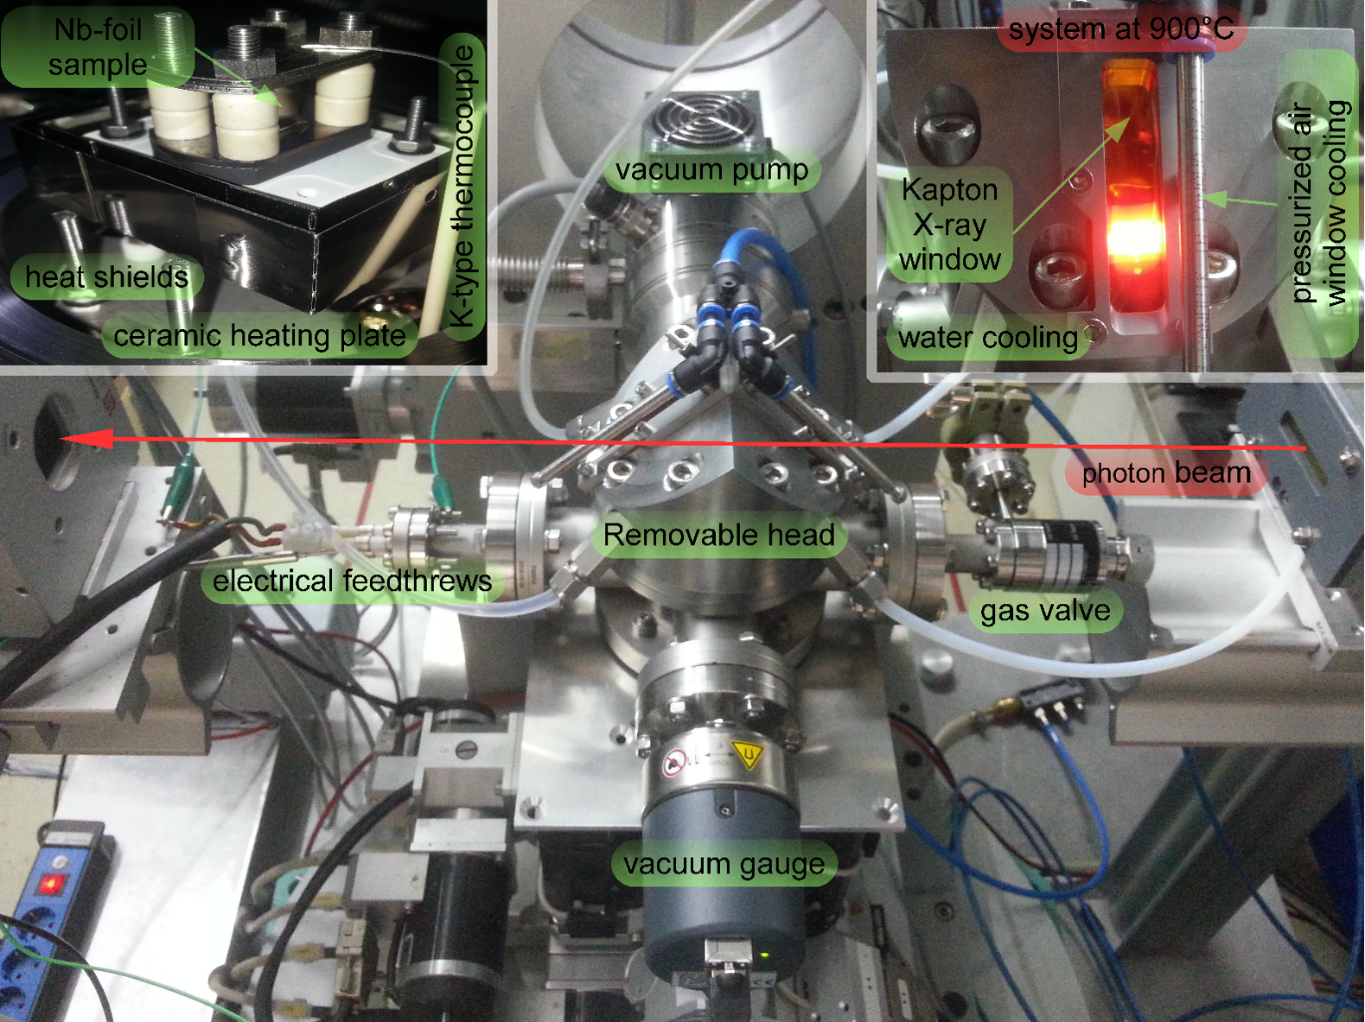
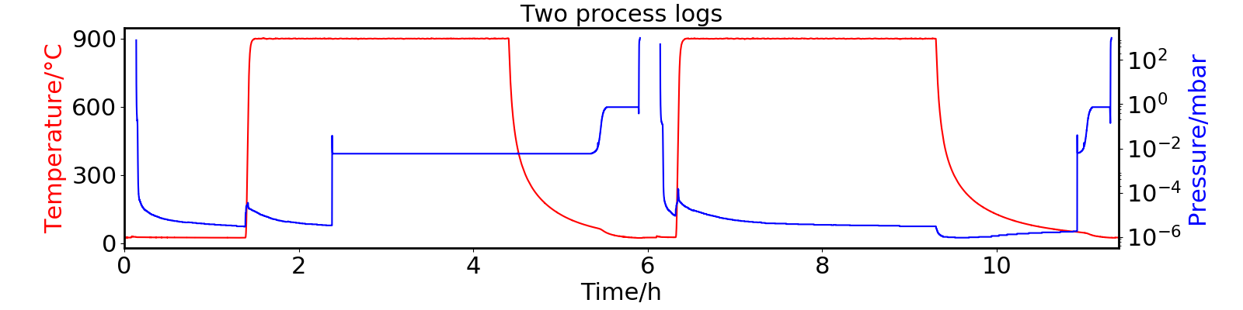
Experimental setup
In-situ heating chamber, fully remote controlled
Kapton windows for X-ray measurements
RT < T < 1200°C
p < 10⁻⁶ mbar
(at 900°C ca. 2x10⁻⁶ mbar)
Nb foils of 6 – 25 µm thickness
Measured in transmission
Treatment up to 30 mbar N₂ (Kr, Ar,…) for minutes … to … several hours
Slightly higher pressure and time (= exposure) because of very small effects

Slide 6
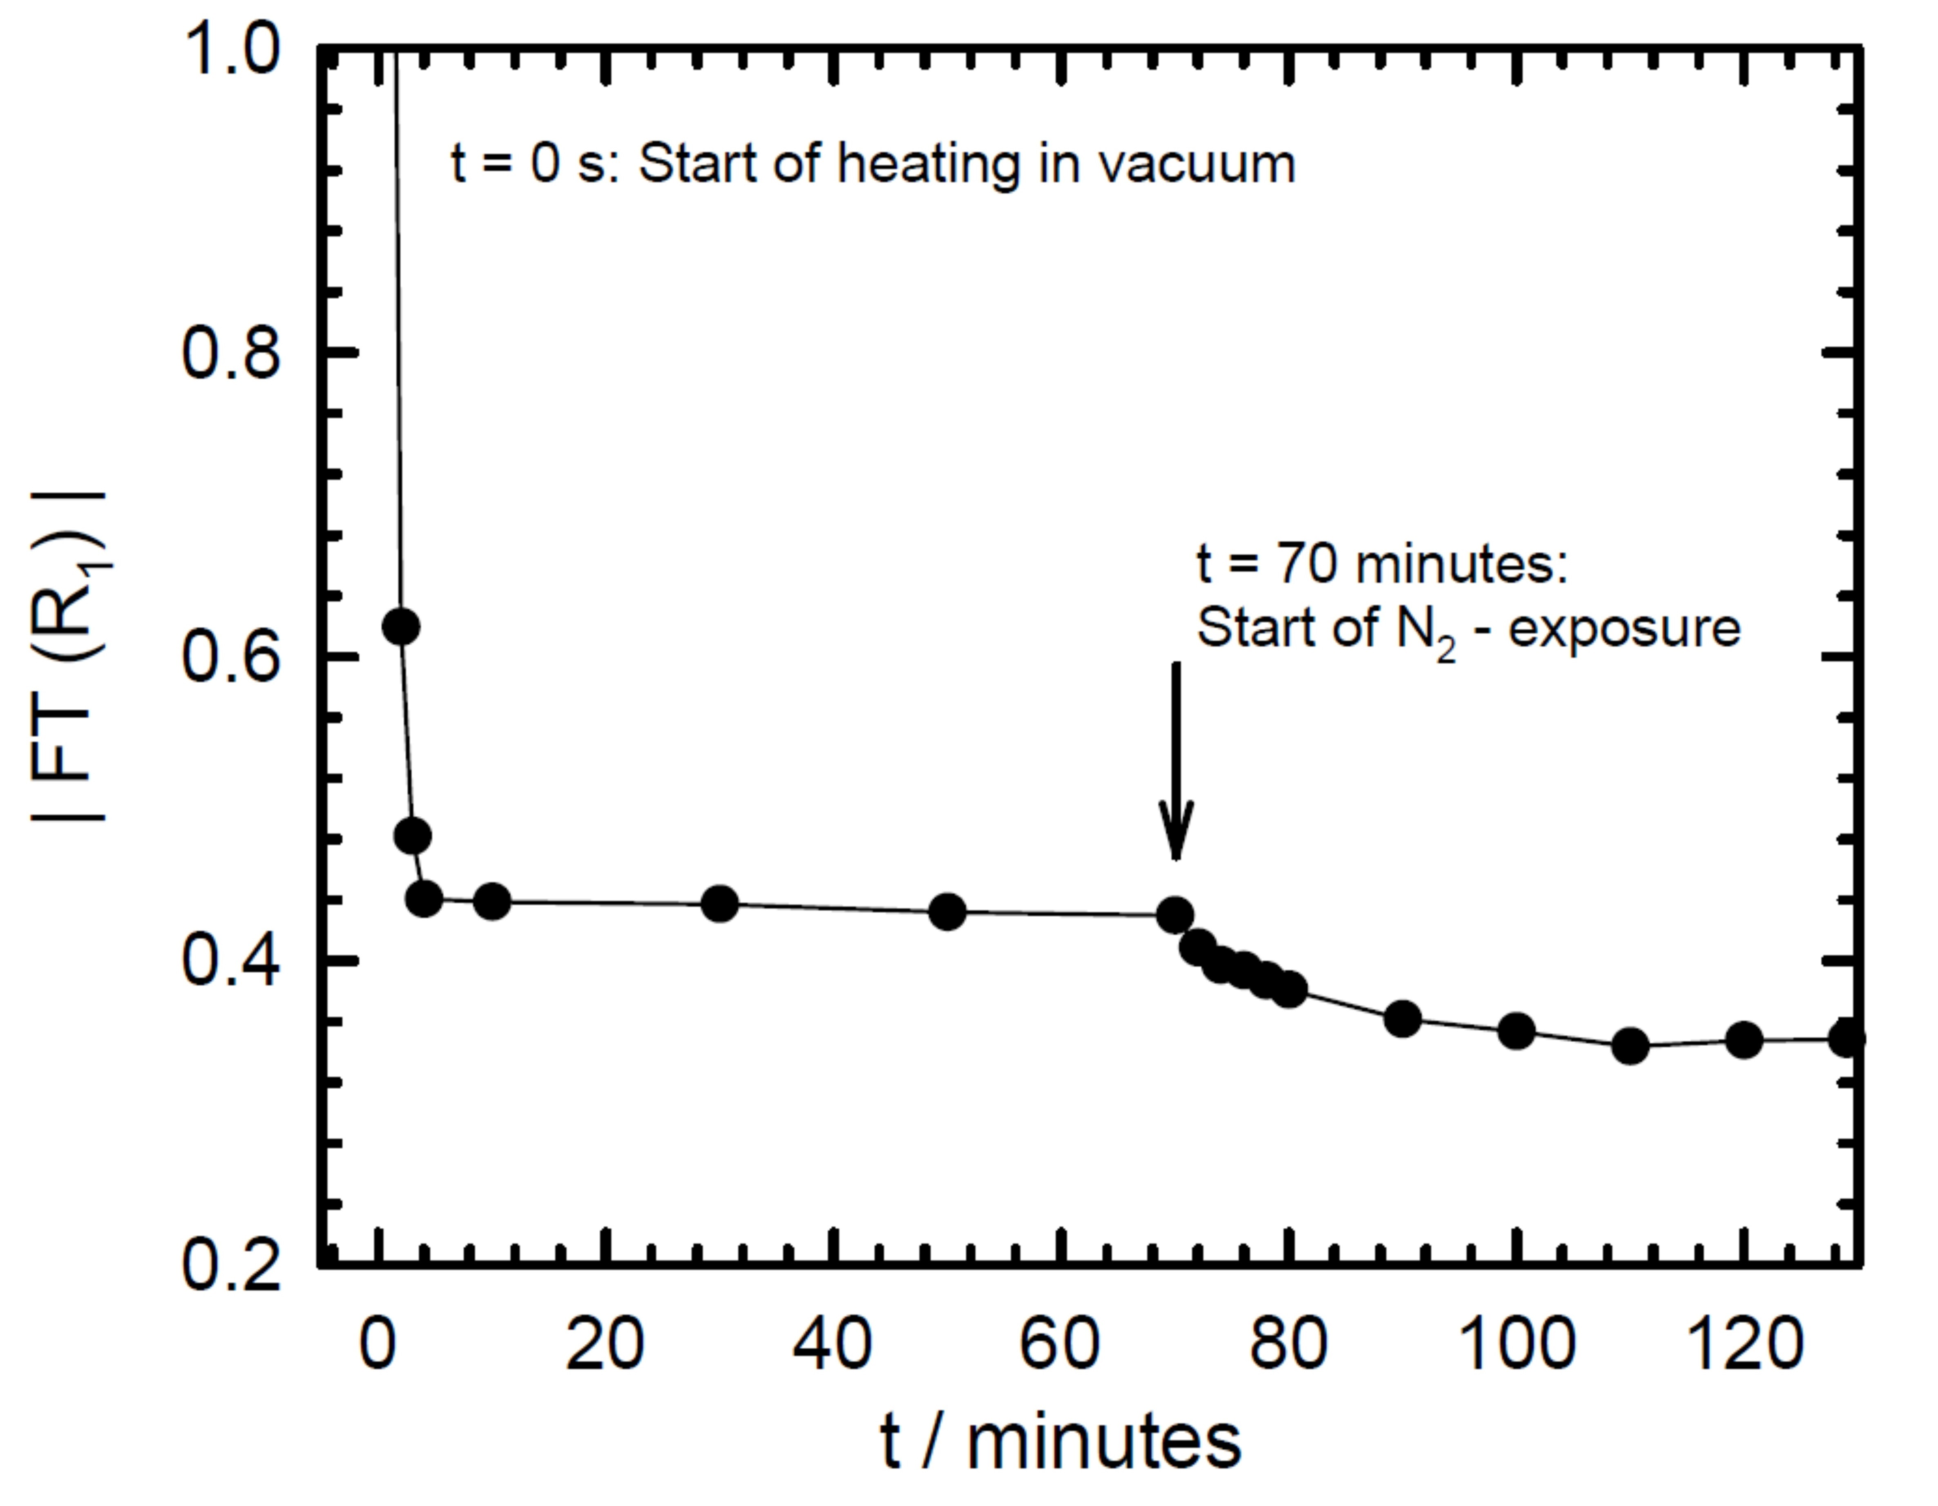
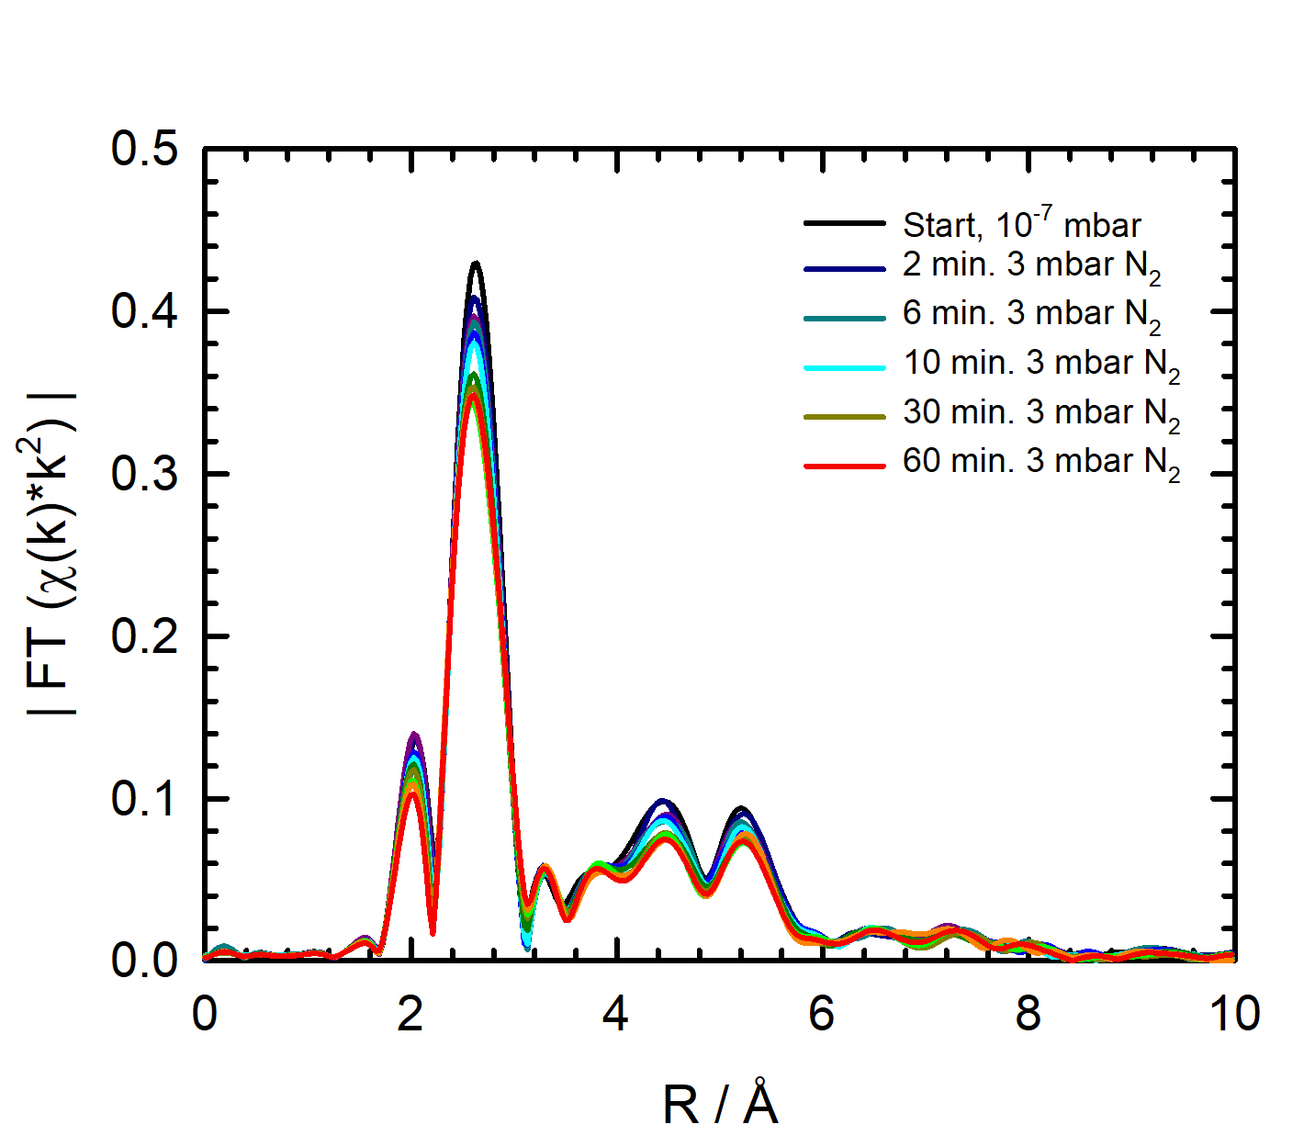
In-situ Measurements: Time dependence
Phase 1: Heating in vacuum
Plot Fourier-Trafo in R-Space
Reduction in NN-amplitude
⇒ caused by lattice vibrations
Constant after first minutes of baking
⇒ no effects of e.g. poor vacuumconditions etc.
Phase 2: N₂ - exposure
Further reduction in NN-amplitude caused by N-gas exposure
⇒ Effect of N₂ visible
Uptake causes blurring

Slide 7
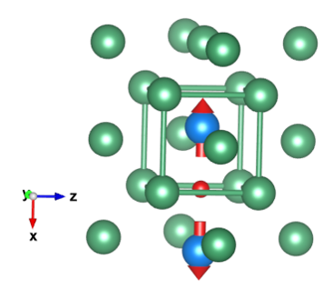
Used model and EXAFS data fitting with two phases
Model of hard spheres
Linear Fit of unit cells with and without N₂
Up to 2% of unit cells with N₂
  Bcc (2 Nb-Atoms/unit- cell): 1 atom%
Octahedral site competitive with ionic N-size of 70 pm
Nb: bcc-crystal
N₂-uptake at octahedral interstitial site
Neighboring atoms are (slightly) displaced

Slide 8
Ex-situ measurements at Room-Temperature: Exposure dependence
Verification of in-situ measurements
Fit of the first two
coordination shells
Investigation on effect of different exposure intensities on Nb-Nb bond distances (R₁, R₂) and mean squared displacement (σ₁², σ₂²)
Increases agree qualitatively with model
But: large uncertainties

Slide 9
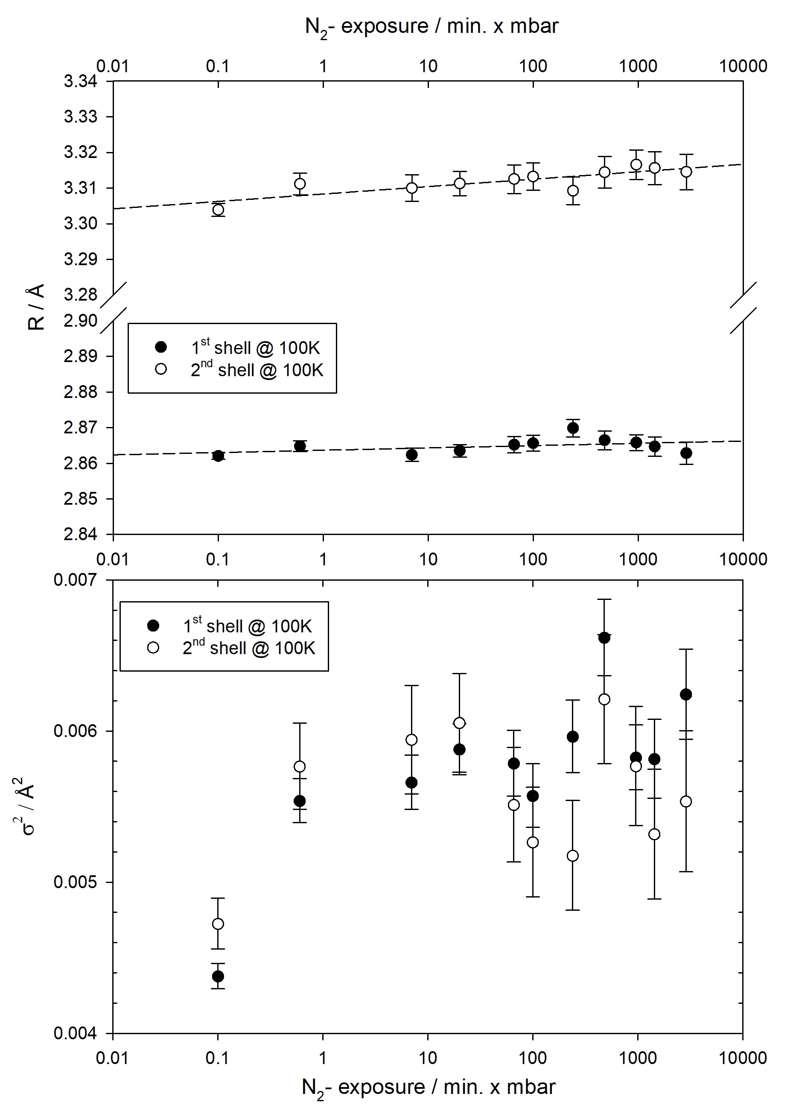
High precision (ex-situ) EXAFS measurements at 100 K
High precision
  Reduction of lattice vibrations
  Smaller uncertainties in R
  Smaller σ² (linear shift)
Main result:
Trends from RT measurements are fostered

Slide 10
Summary and Outlook
N₂ -uptake on interstitial octahedral sites
Investigations of time- and pressure-dependence
In- and ex-situ measurements agree with each
other
100 K measurements show same trends
Kr- and Ar-uptake: do not show any detectable effects
Next steps:
Improvement of fit model
  More shells / paths
Measurements with samples from real cavities using surface sensitive EXAFS
⇒ samples from the community are welcome!

Slide 11


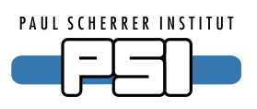


Acknowledgements
Department in Wuppertal: R. Frahm, B. Bornmann,
P. Pagel, R. Wabnitz, …
DELTA (TU Dortmund, Germany)
PSI – Villingen, Swiss Light Source
DESY photon science Hamburg
BMBF: financial support (05H15PXRB1, 05H18PXRB1, 05K16PX1)
MWF NRW: financial support
MWF NRW

Slide 12
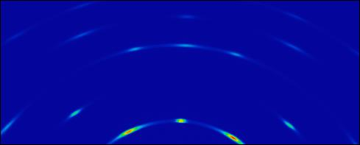
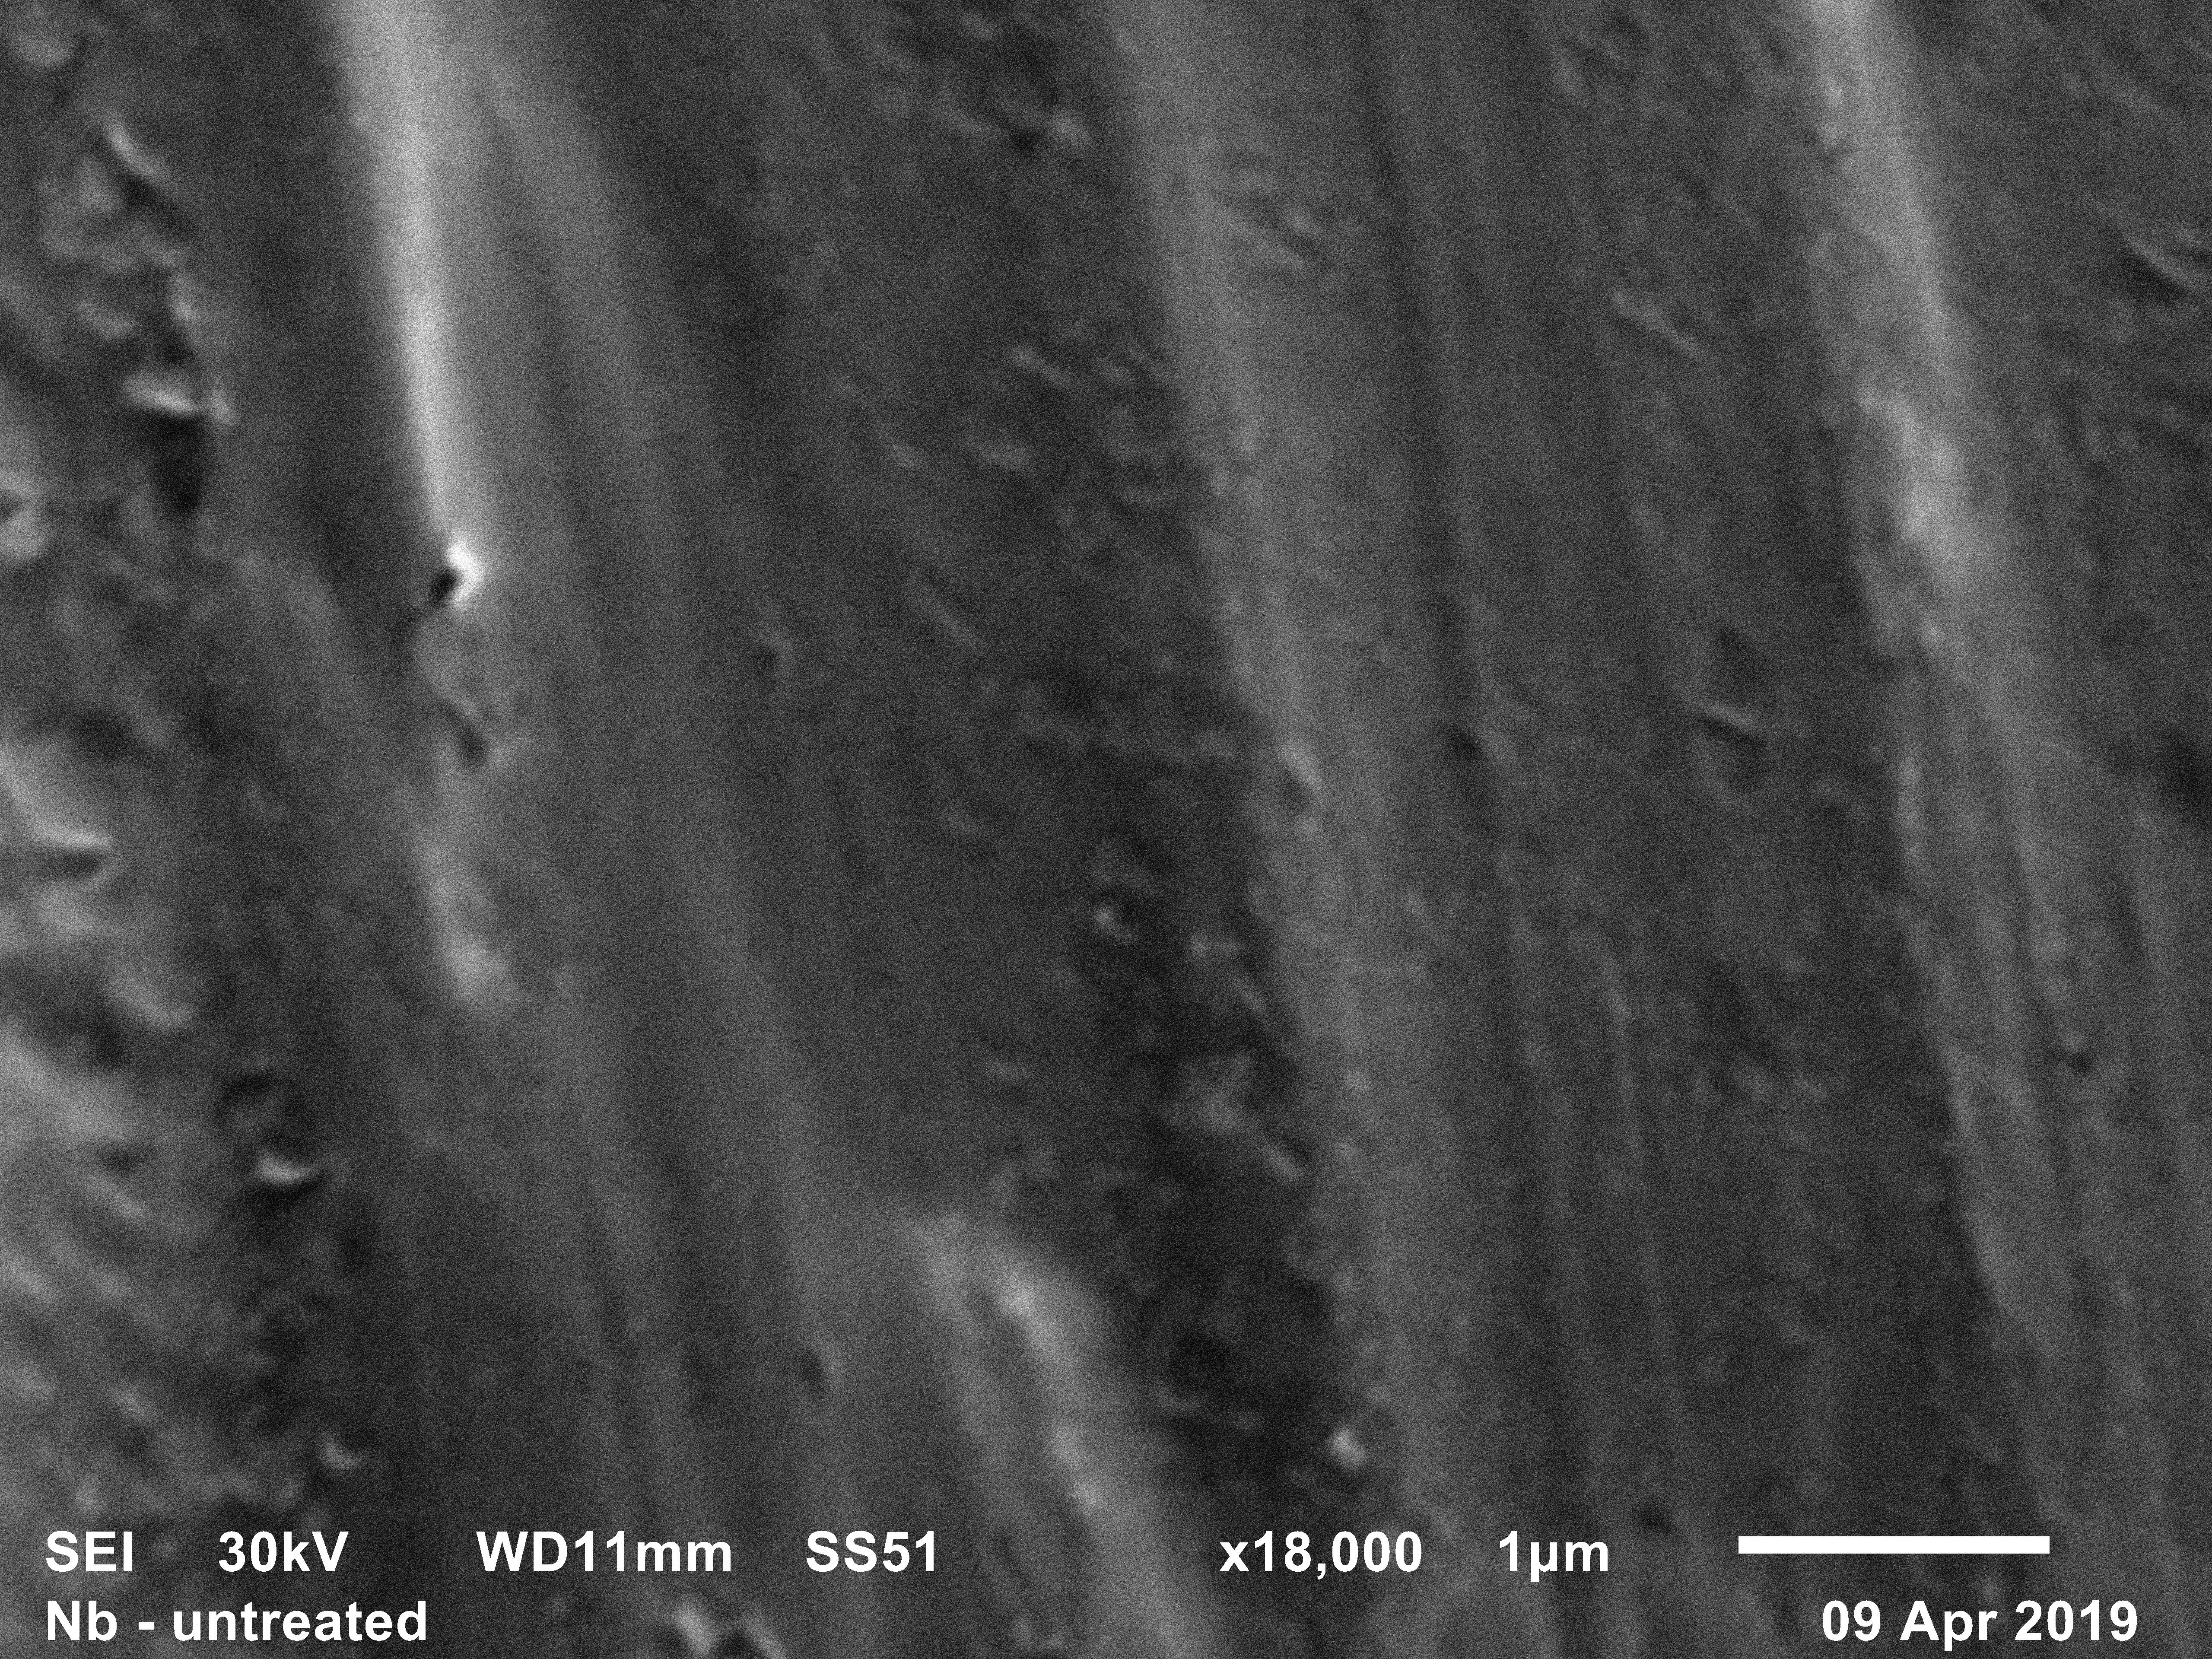
Addional material: Nb - foils
X-ray diffraction, E = 16 keV:
Polycrystalline, textured foils
SEM:
Smooth, wavy surfaces

