Slide 1
SuperKEKB e+ source
Yoshinori Enomoto
KEK electron positron injector LINAC group

Slide 2
Today’s topic
3 major findings since ALCW2018 (May 2018)
  New material for FC head
  Magnetic field correction in solenoid section
  Improvement of pulsed power supply and circuit
General lesson from specific topics in SupreKEKB

Slide 3
OUTLINE
Introduction of SuperKEKB positron source
lesson 1 : avoid deformation of FC head
  Solution 1 : new material for FC head
lesson 2 : compensate deformation of magnetic field
  Solution 2 : BPM and steering coils inside solenoid
lesson 3 : decrease voltage on FC head
  Solution 3 : LCR measurement and control
upgrade plan

Slide 4
OUTLINE
Introduction of SuperKEKB positron source
lesson 1 : avoid deformation of FC head
  Solution 1 : new material for FC head
lesson 2 : compensate deformation of magnetic field
  Solution 2 : BPM and steering coils inside solenoid
lesson 3 : decrease voltage on FC head
  Solution 3 : LCR measurement and control
upgrade plan

Slide 5
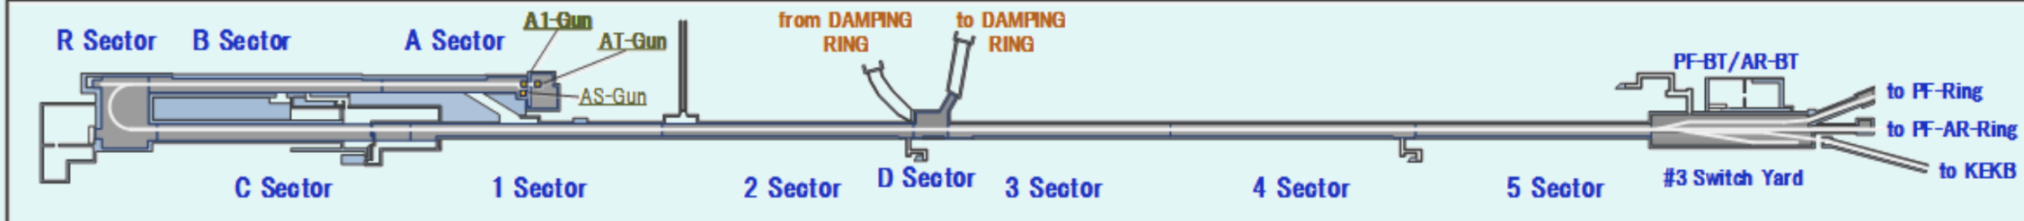
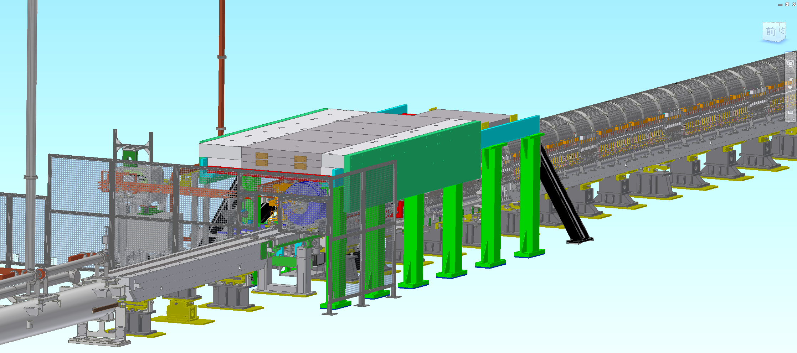
Positron source setup 1
Positron target and capture section

Slide 6
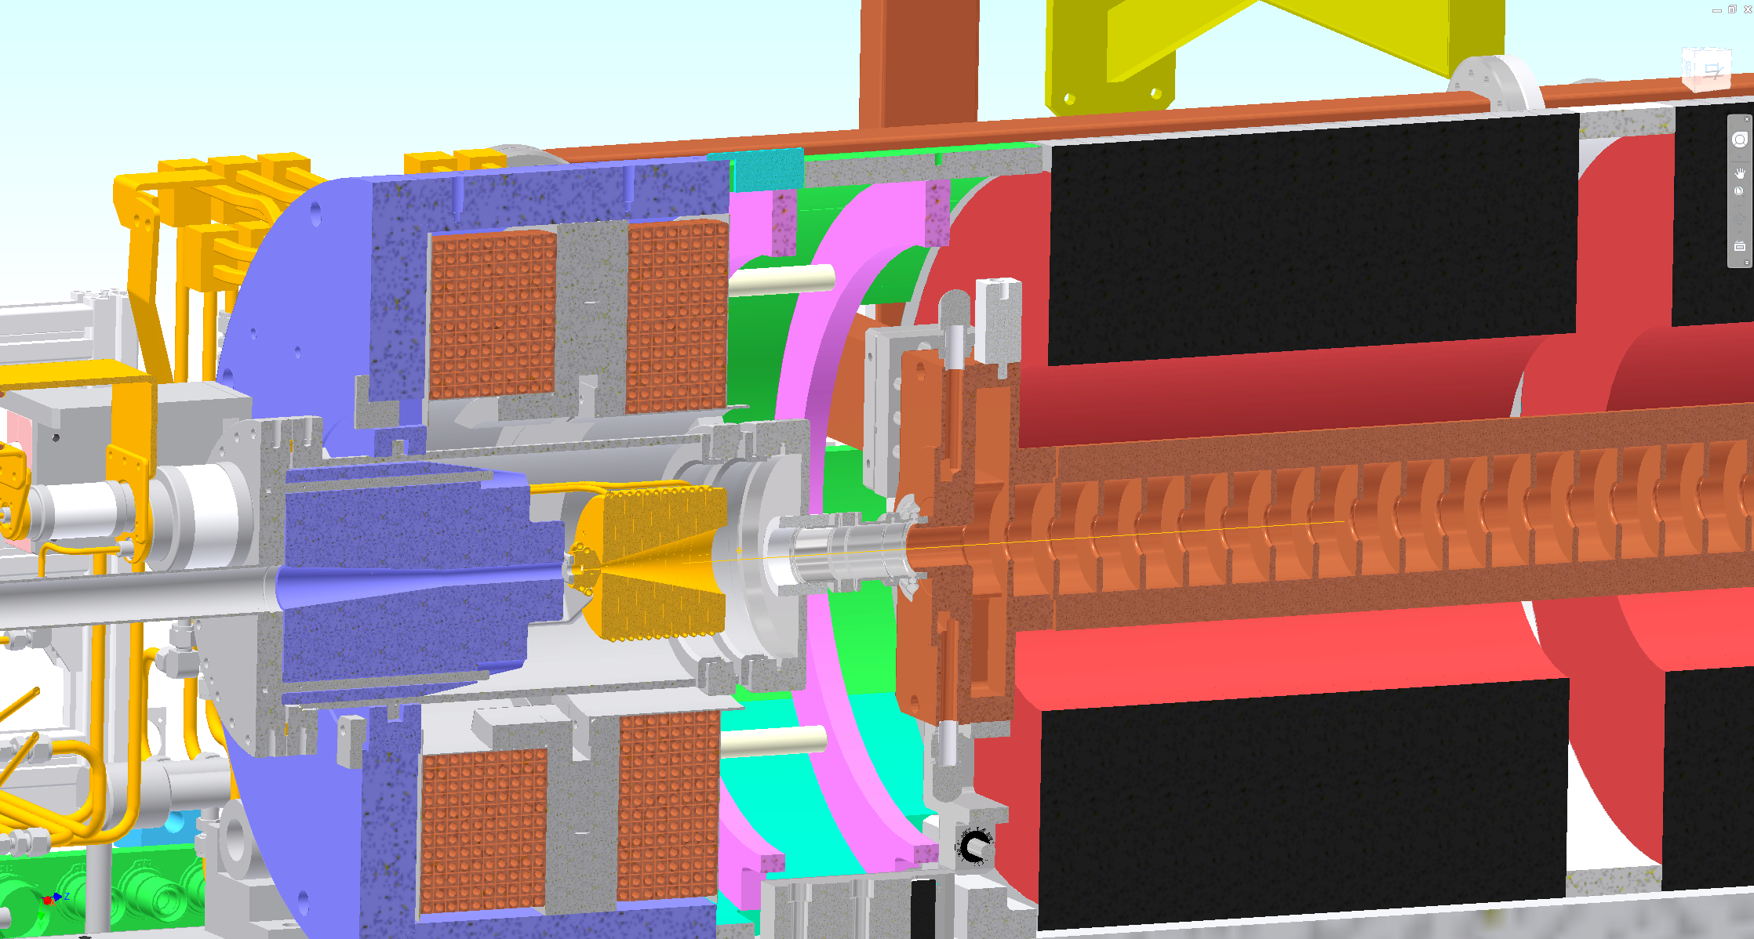
Positron source setup 2
FC head + BC + target = FC assembly
BC (bridge coil)
LAS (large aperture S-band)
target
FC(flux concentrator) head
solenoid

Slide 7
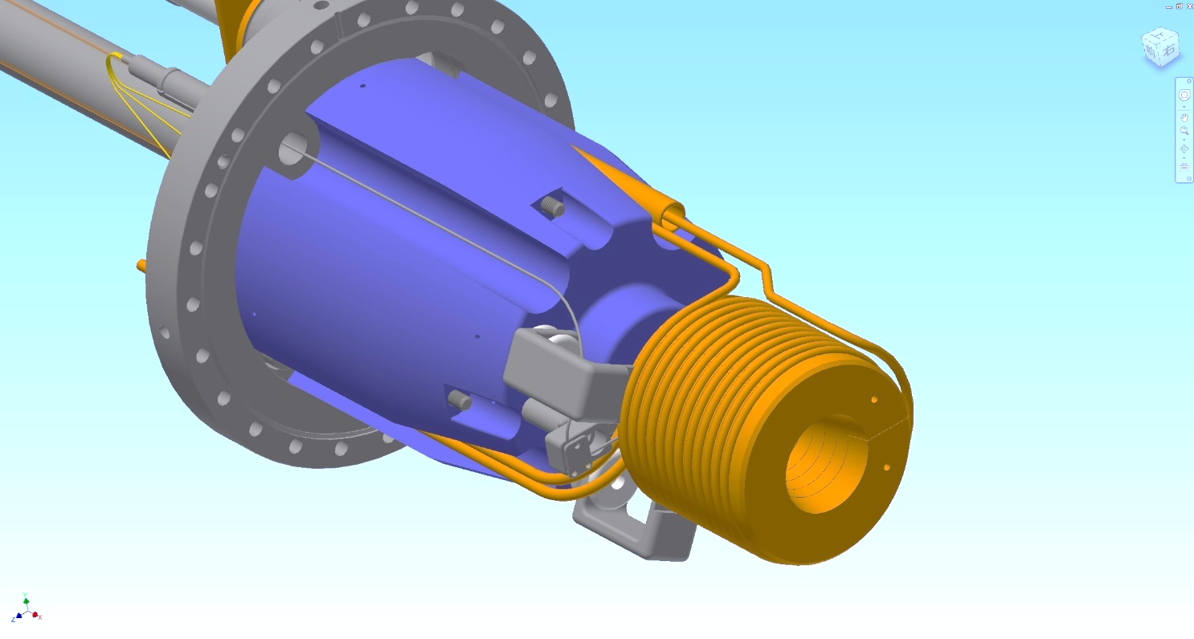
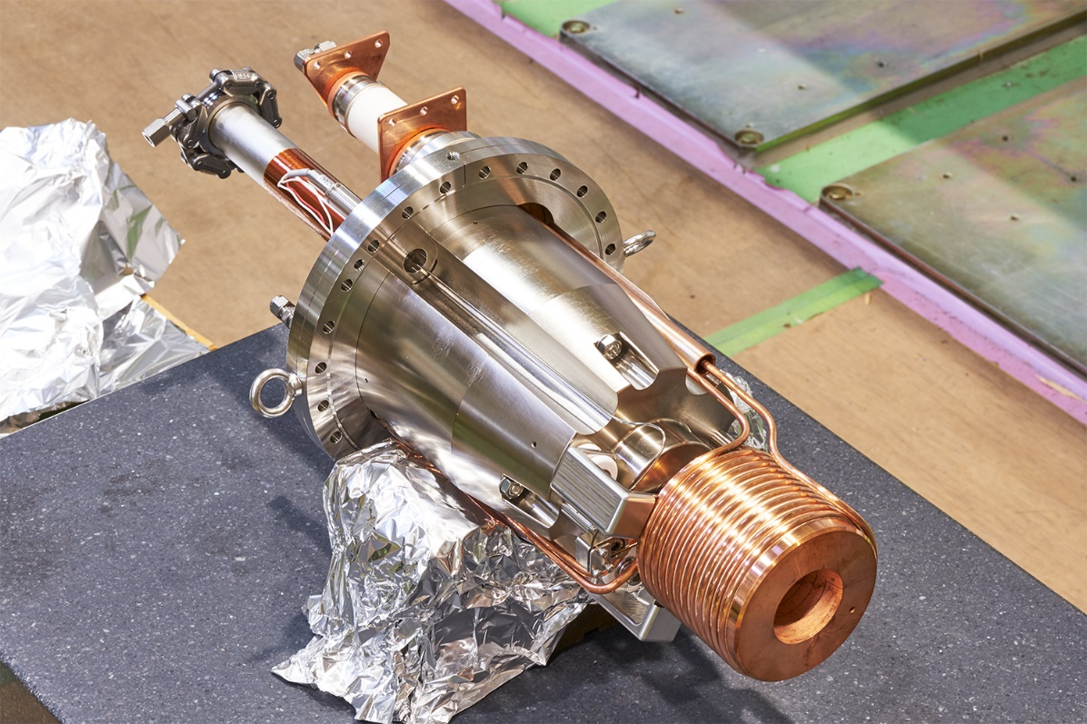
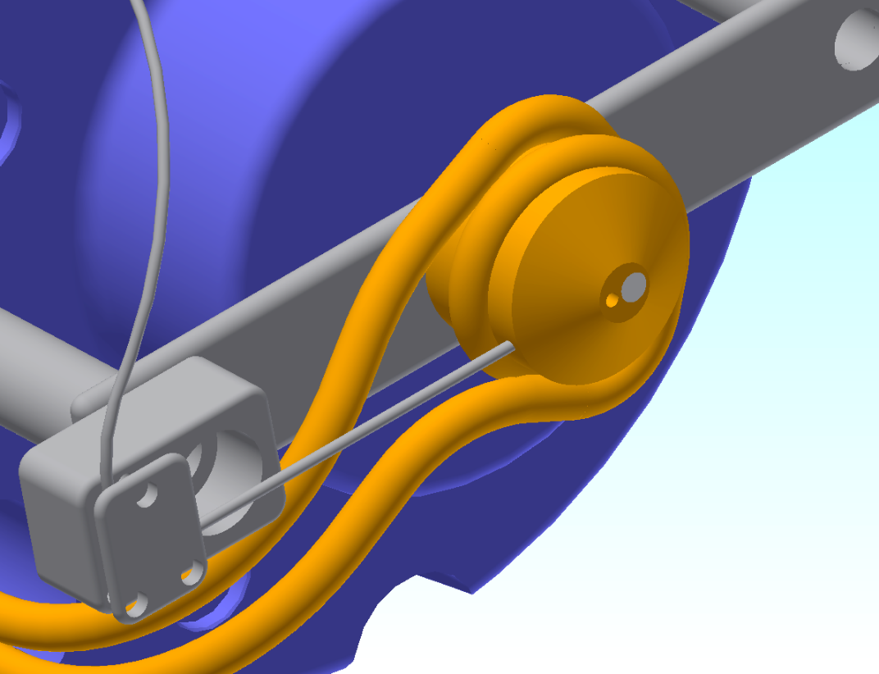
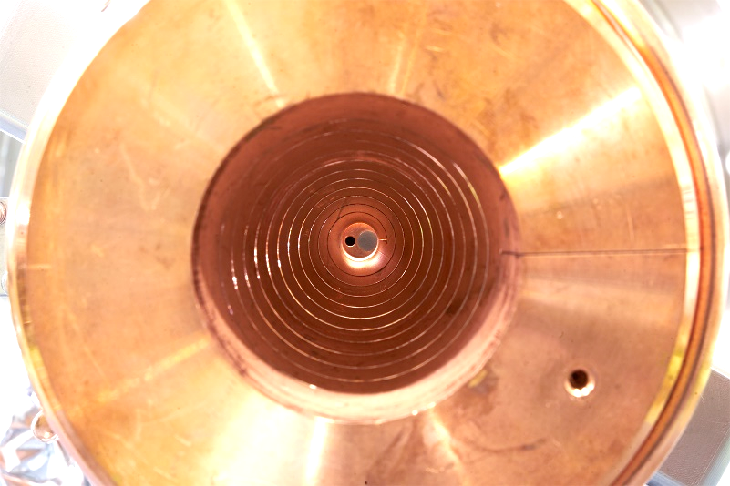
Positron source setup 3
beam
W target
Φ2 mm hole for electron
Temp sensor
Cooling water pipe

Slide 8
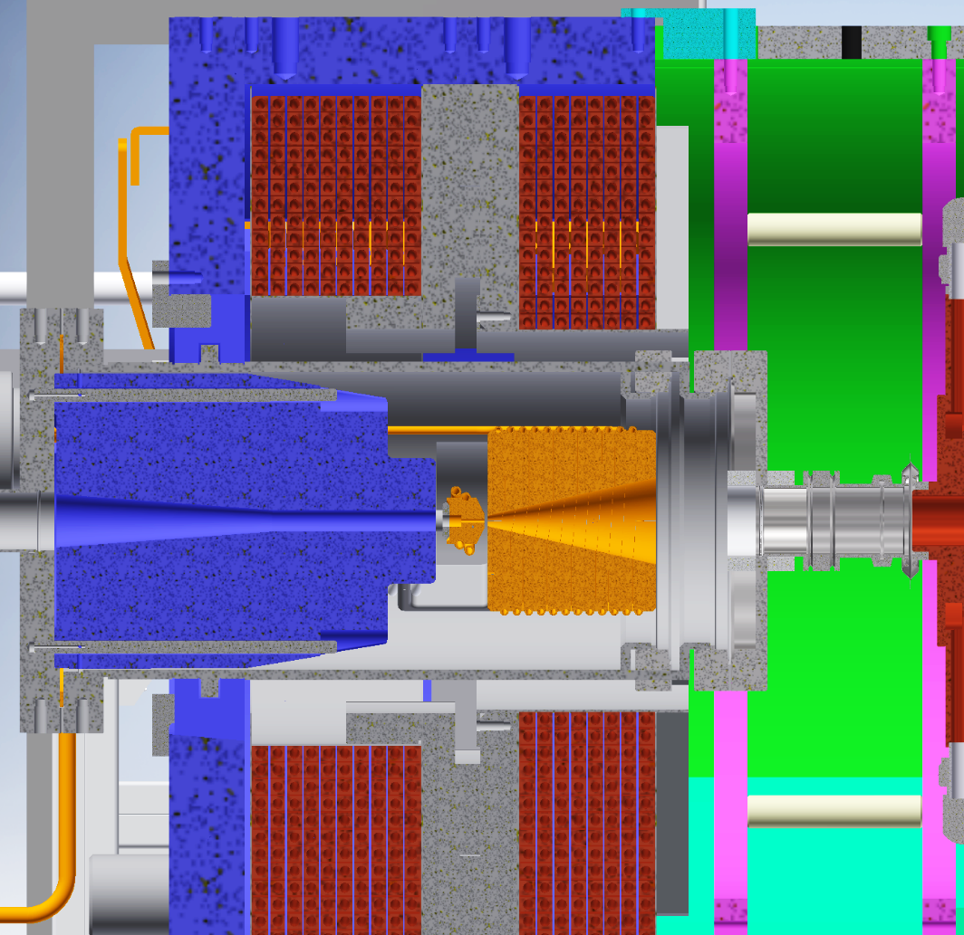
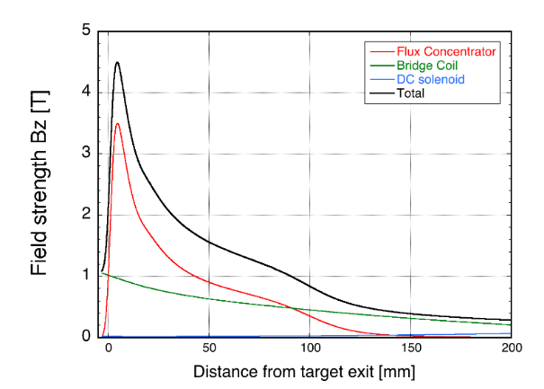
Positron source setup for SuperKEKB 4
Bridge coil
DC magnet
I = 600～750 A
Flux Concentrator
pulsed magnet
I = 6000～12000A
Calculated by T. Kamitani
Ratio B @ target / B @ entrance of the LAS is important
stronger field is preferred in the following solenoid section
much stronger field is required @ target

Slide 9
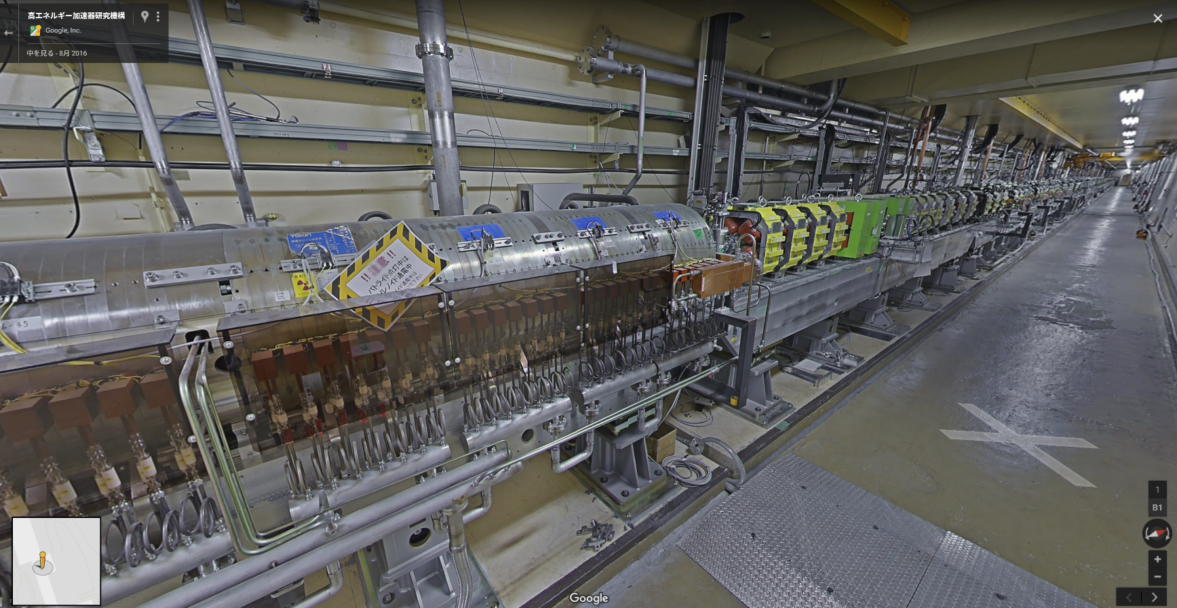
Capture section after the target 1
FC
+
target
solenoid
LAS
AC_15_1
AC_15_2
AC_16_1
AC_16_2
AC_16_3
AC_16_4
Normal
solenoid
Q
AC_17_1
AC_17_2
AC_17_3
AC_17_4
AC_18_1
AC_18_2
AC_18_3
AC_18_4
Quad section (115 m)
Solenoid section (15 m)
 | LAS | Normal S band
Acc. Gradient (MV/m) | 14/10 | 20
Aperture (mm) | 30 | 20
Electron / positron separator

Slide 10
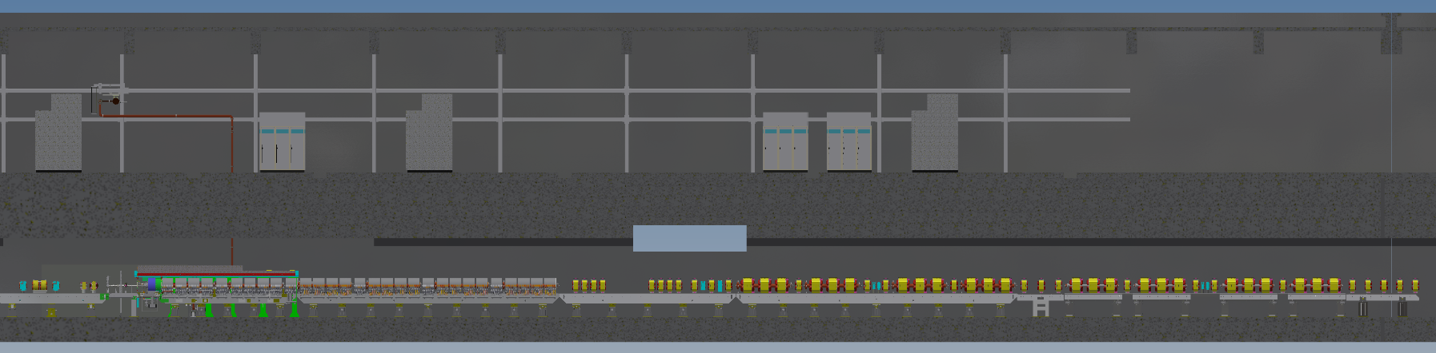
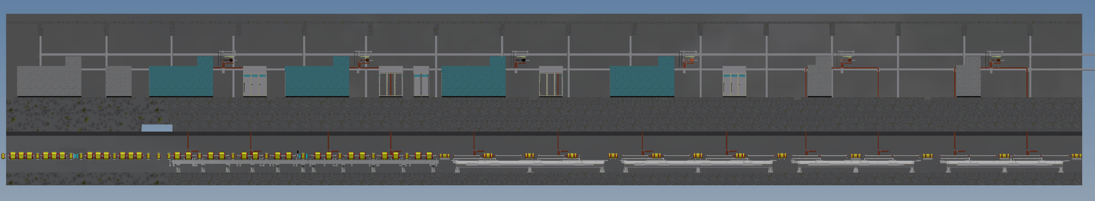
Capture section after the target 2
Target & FC
15m long solenoid
About 100 Quad magnet
1.1 GeV @ DR
LAS x 10
Normal x 32
1-5
1-6
1-7
1-8
To dumping ring
2-1
2-2
2-3
2-4
2-6
2-7
2-8
10m

Slide 11
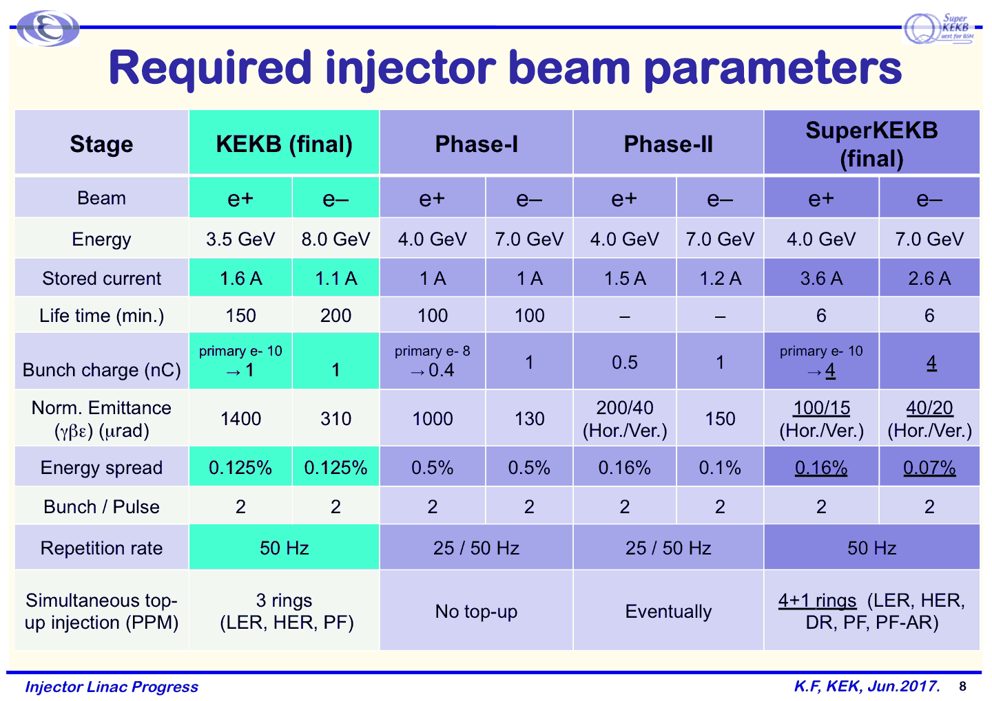
x2.25
1/25

Slide 12
Injection requirement
Present working assumption (final)
Life | 360 s
Current | 3.6 A
Injection bunch charge | 4 nC
Injection rate | 25* Hz x 2 bunch
Injection efficiency | 50 %
Circulation frequency | 10⁵
$$\frac{dI}{dt}=\frac{3.6 [A]}{360 [s]}=10 [mA/s]$$
$$4 \left[nC\right]×25 \left[Hz\right]×2 \left[bunch\right]×50\left[\%\right]×{10}^{5}\left[Hz\right]$$
$$=10 [mA/s]$$

Slide 13
Injection requirement
Present working assumption (final)
Life | 360 s
Current | 3.6 A
Injection bunch charge | 4 nC
Injection rate | 25* Hz x 2 bunch
Injection efficiency | 50 %
Circulation frequency | 10⁵
$$\frac{dI}{dt}=\frac{3.6 [A]}{360 [s]}=10 [mA/s]$$
$$4 \left[nC\right]×25 \left[Hz\right]×2 \left[bunch\right]×50\left[\%\right]×{10}^{5}\left[Hz\right]$$
$$=10 [mA/s]$$
Typical Phase 3 operation
Life | 2500 s
Current | 0.5 A
Injection bunch charge | 0.6 nC
Injection rate | 6.2 Hz x 1 bunch
Injection efficiency | 50 %
Circulation frequency | 10⁵
$$\frac{dI}{dt}=\frac{0.5 [A]}{2500 [s]}=0.2 [mA/s]$$
$$0.6 \left[nC\right]×6.25 \left[Hz\right]×1 \left[bunch\right]×50\left[\%\right]×{10}^{5}\left[Hz\right]$$
$$=0.2 [mA/s]$$
Due to limitation by Belle2 detector and SuperKEKB ring
Required injection amount is still low.
*total rep. rate is 50 Hz
The other 25 Hz will be used electron injection

Slide 14
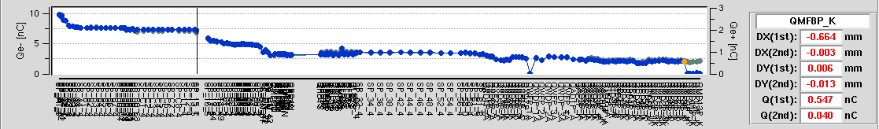
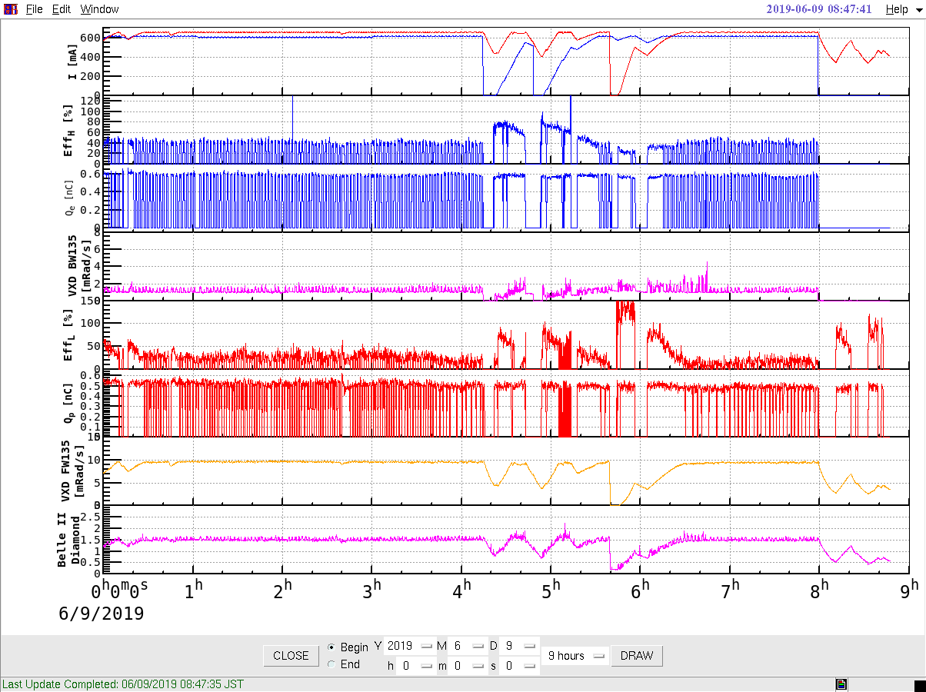
Positron charge and injection efficiency
Primary e- 7 nC@target
Primary e- 10 nC@e-gun
Positron 1 nC@DR
Positron 0.55 nC@BT end dump
Positron 1.5 nC@first BPM
Positron current in the ring (LER)
Injection efficiency
9 hours

Slide 15
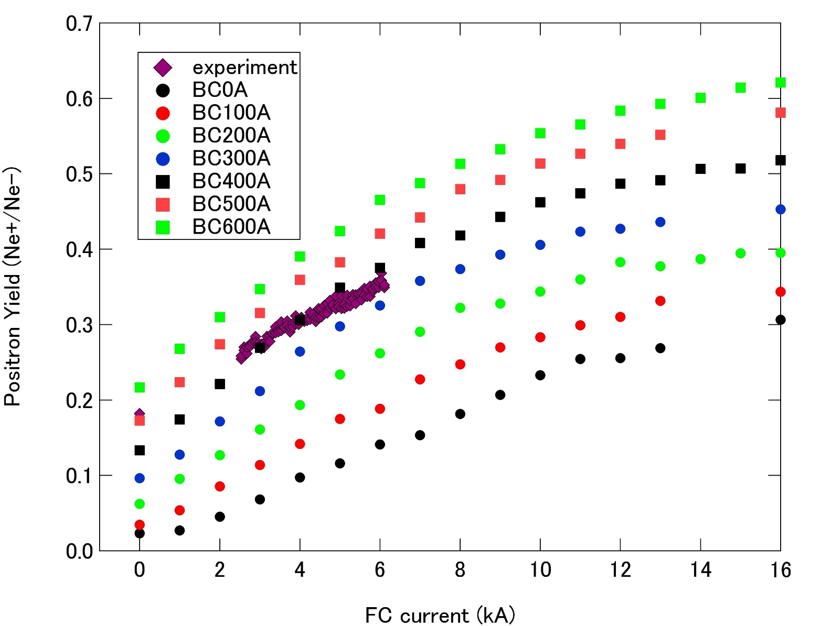
Simulation and experiment
Increase efficiency
lesson 2
Increase FC current
lesson 1 and 3

Slide 16
OUTLINE
Introduction of SuperKEKB positron source
lesson 1 : avoid deformation of FC head
  Solution 1 : new material for FC head
lesson 2 : compensate deformation of magnetic field
  Solution 2 : BPM and steering coils inside solenoid
lesson 3 : decrease voltage on FC head
  Solution 3 : LCR measurement and control
upgrade plan

Slide 17
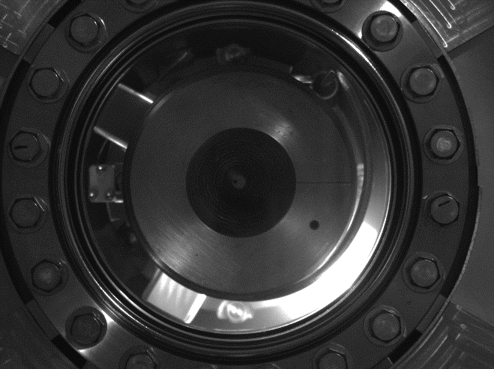

Slide 18
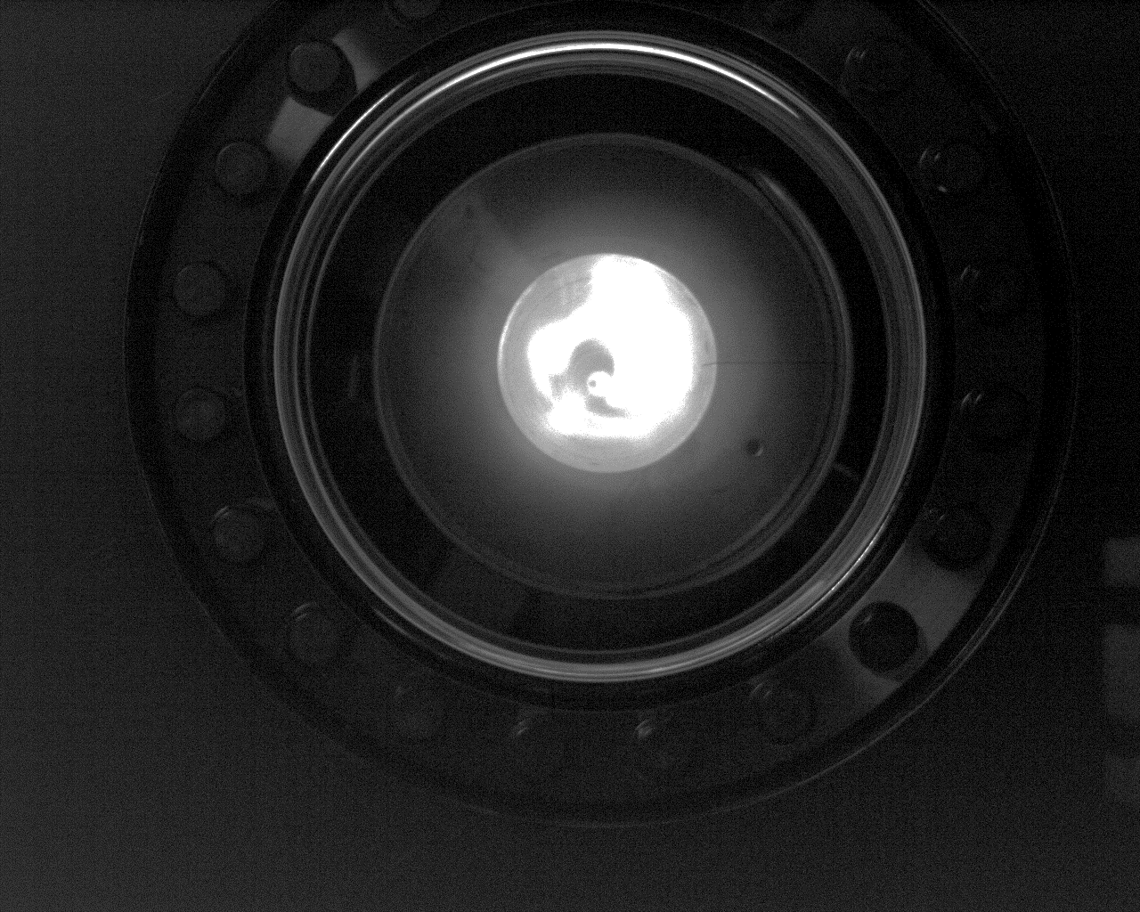

Slide 19
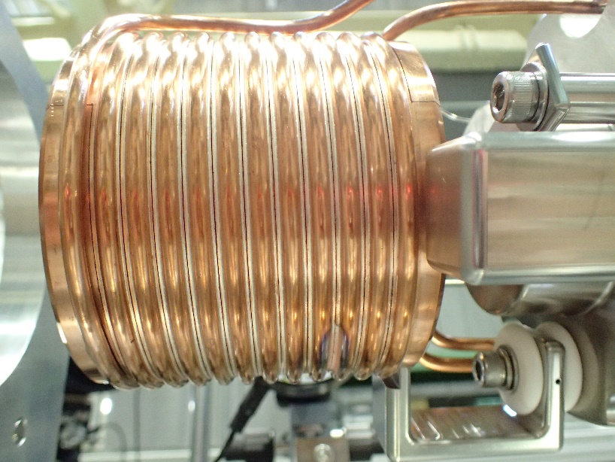
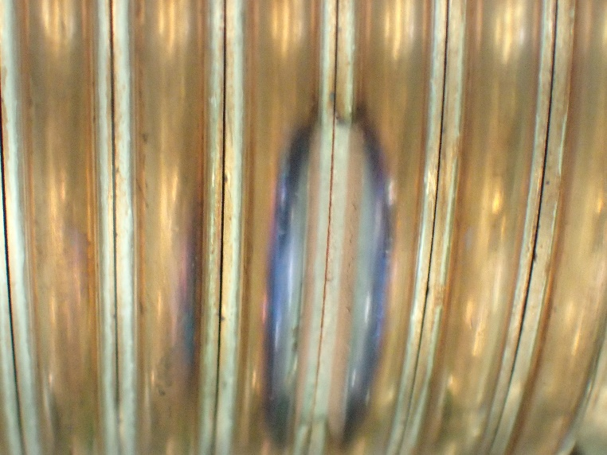
After large discharge…
Slit gap got narrow.
Not possible to apply high voltage unless the gap will be expanded.

Slide 20

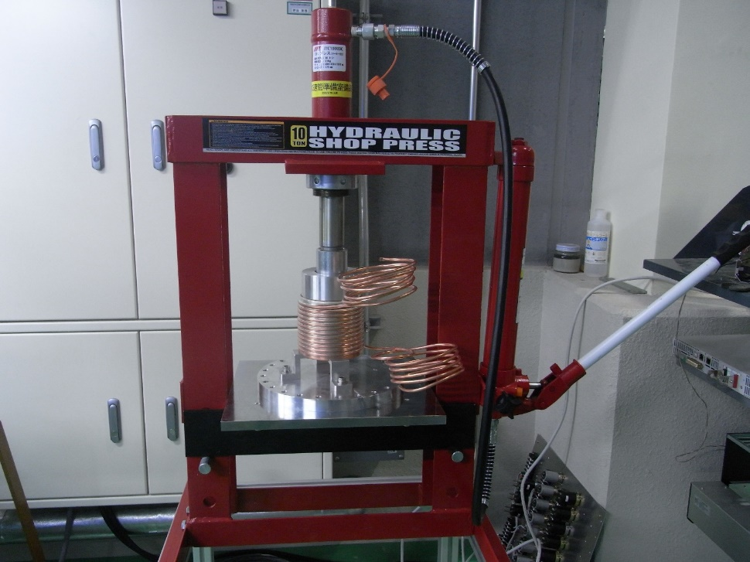
New material for FC head
Avoid discharge
→Reduce electric field between gap
→manage slit distance
→avoid deformation
$$E\sim \frac{dV}{dx}$$
Increase yield strength of the material
Work hardening process was tested
  Result was not clear
Another approach using Cu-alloy
Requirements for material of the FC head are
Good brazing characteristic
High yield strength even after brazing
High electric and thermal conductivity

Slide 21
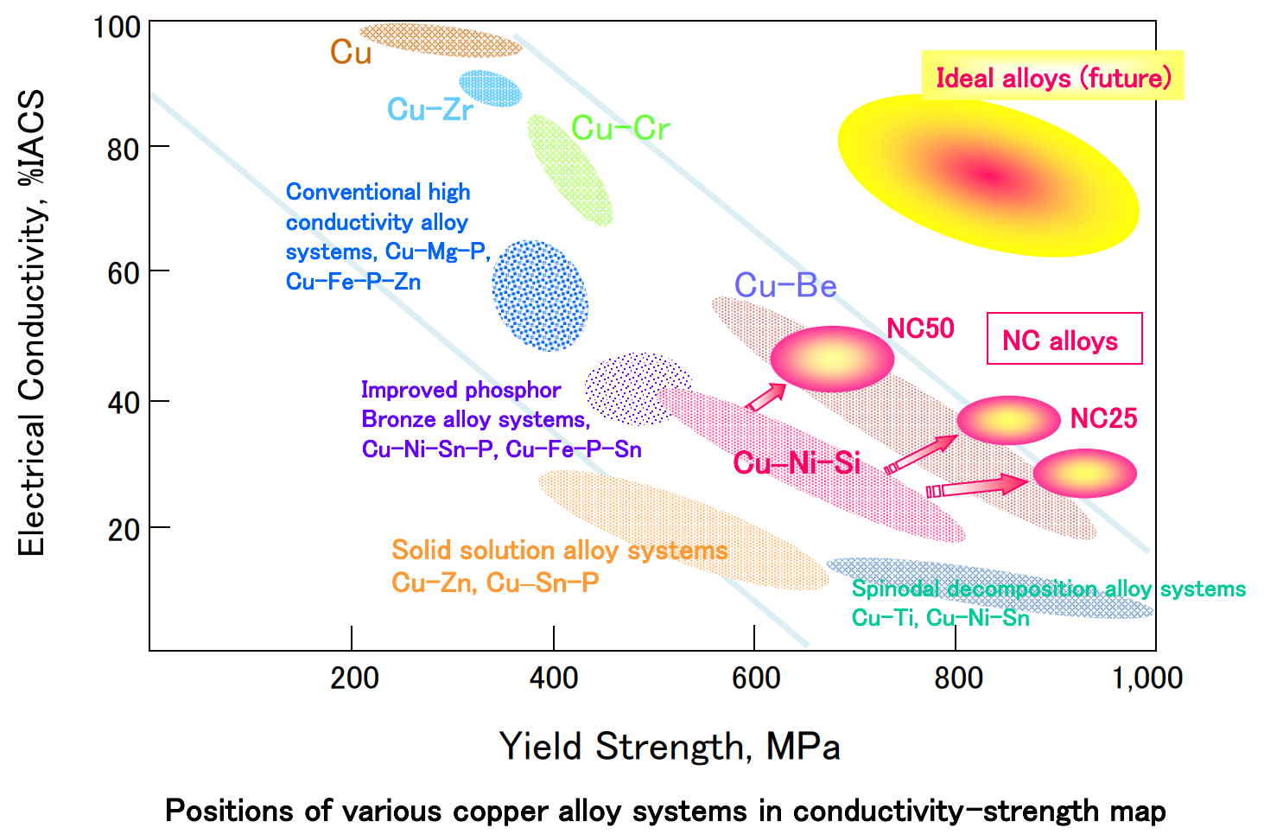
Cu alloys
Cu
Cu-Zr
Cu-Cr
Cu-Ni-Si
were tested

Slide 22
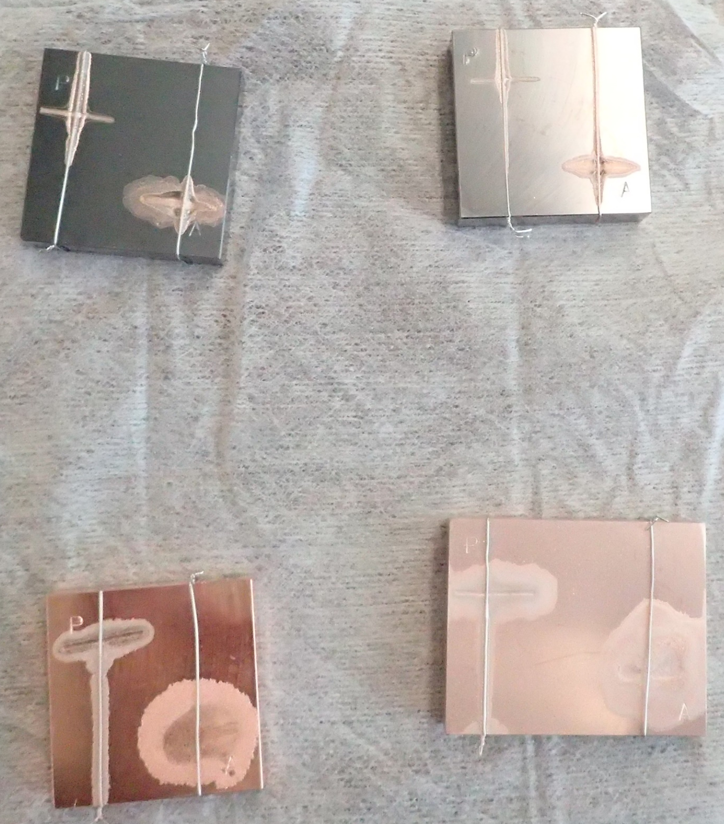
Evaluation of brazing characteristic
Cu-Zr(SH-2)
Cu-Cr(SH-1)
P:Palladium
C1020
Cu-Ni-Si(NC50)
A:Silver

Slide 23
Measured properties of materials
Material | Cu (C1020) |  | Cu-Cr (SH-1) |  | Cu-Zr (SH-2) |  | Cu-Si-Ni (NC50)
Thermal cycle |  | After brazing |  | After blazing |  | After blazing |  | After blazing | After aging
conductivity %IACS | 102.2 | 102.1 | 90.8 | 76.0 | 81.1 | 68.5 | 50.3 | 25.1 | 48.8
Hardness | 87.4 | 30.4 | 71.6 | 60.0 | 45.9 | 55.8 | 95.3 | 61.2 | 95.4
Tensile strength Mpa | 327.4 | 232.1 | 402.6 | 237.2 | 443.1 | 238.3 | 648.7 | 323.7 | 658.8
Elongation % | 21.6 | 54.4 | 36.8 | 56.8 | 32.6 | 51.4 | 14.8 | 46.6 | 10.6
Yield strength Mpa | 322.3 | 12.9 | 293.6 | 57.9 | 348.2 | 40.8 | 551.8 | 109.7 | 513.1

Slide 24
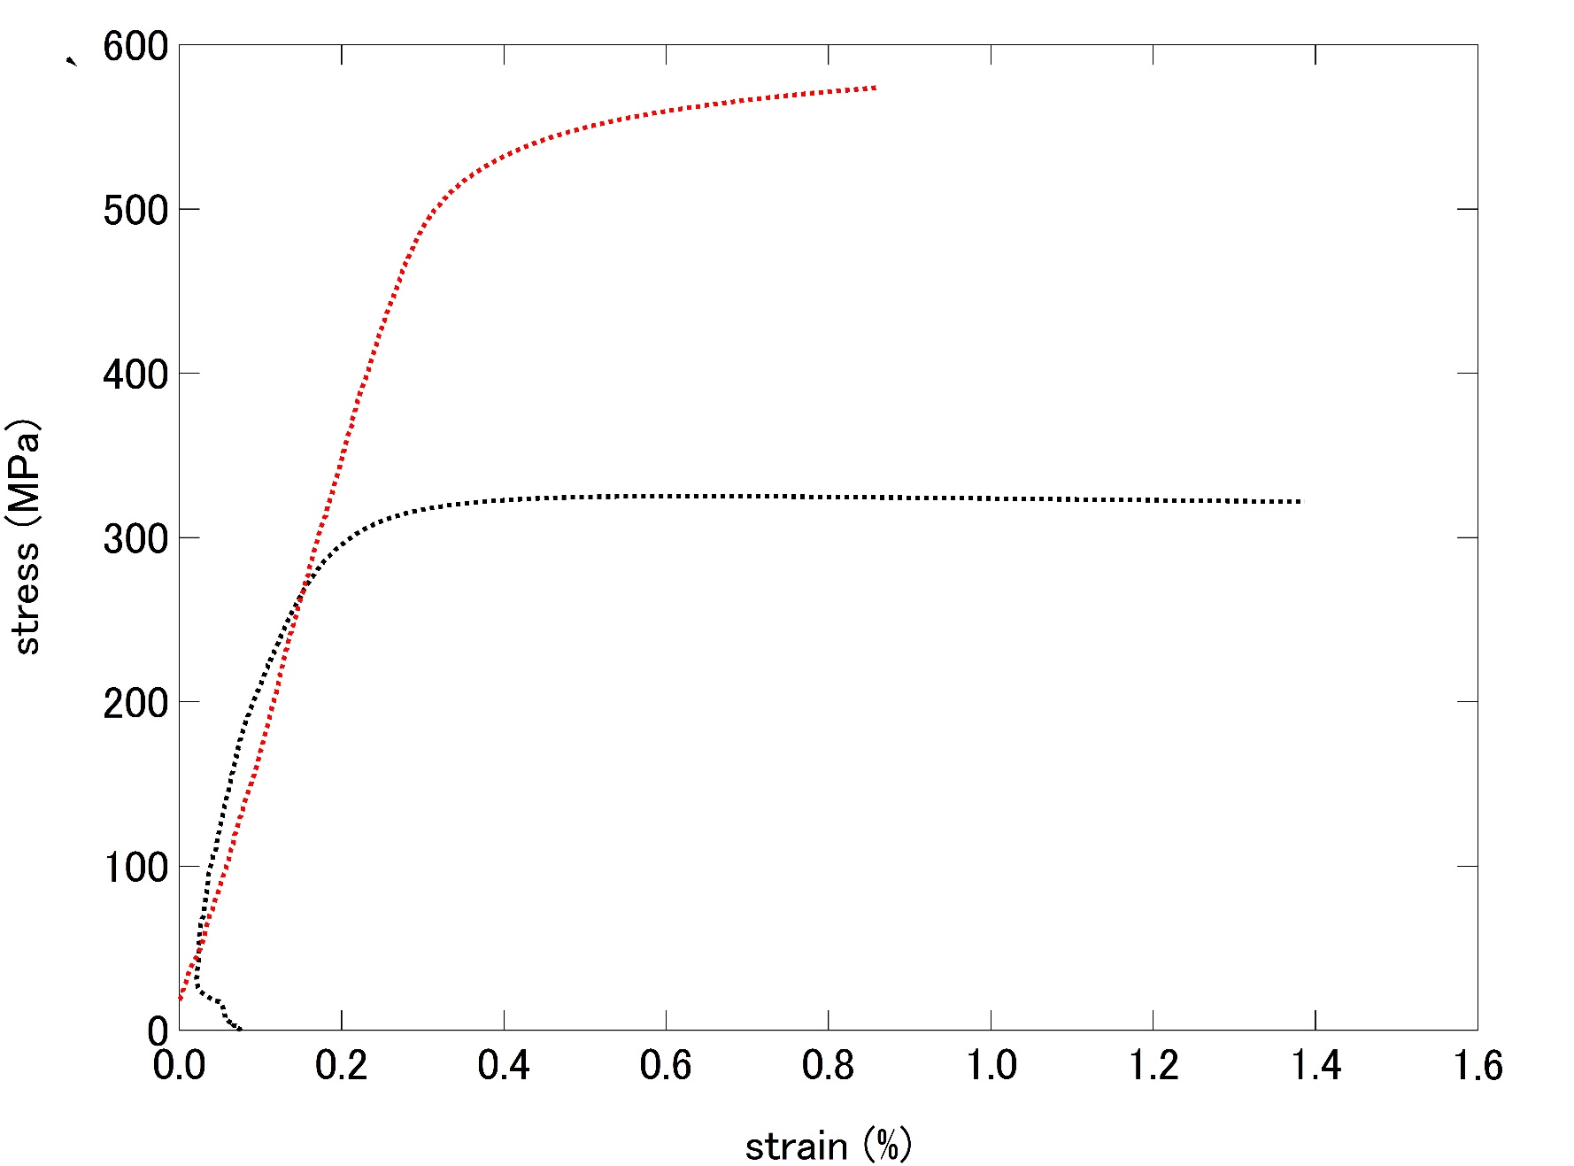
Strain-stress curve for C1020 and NC50
NC50
C1020

Slide 25
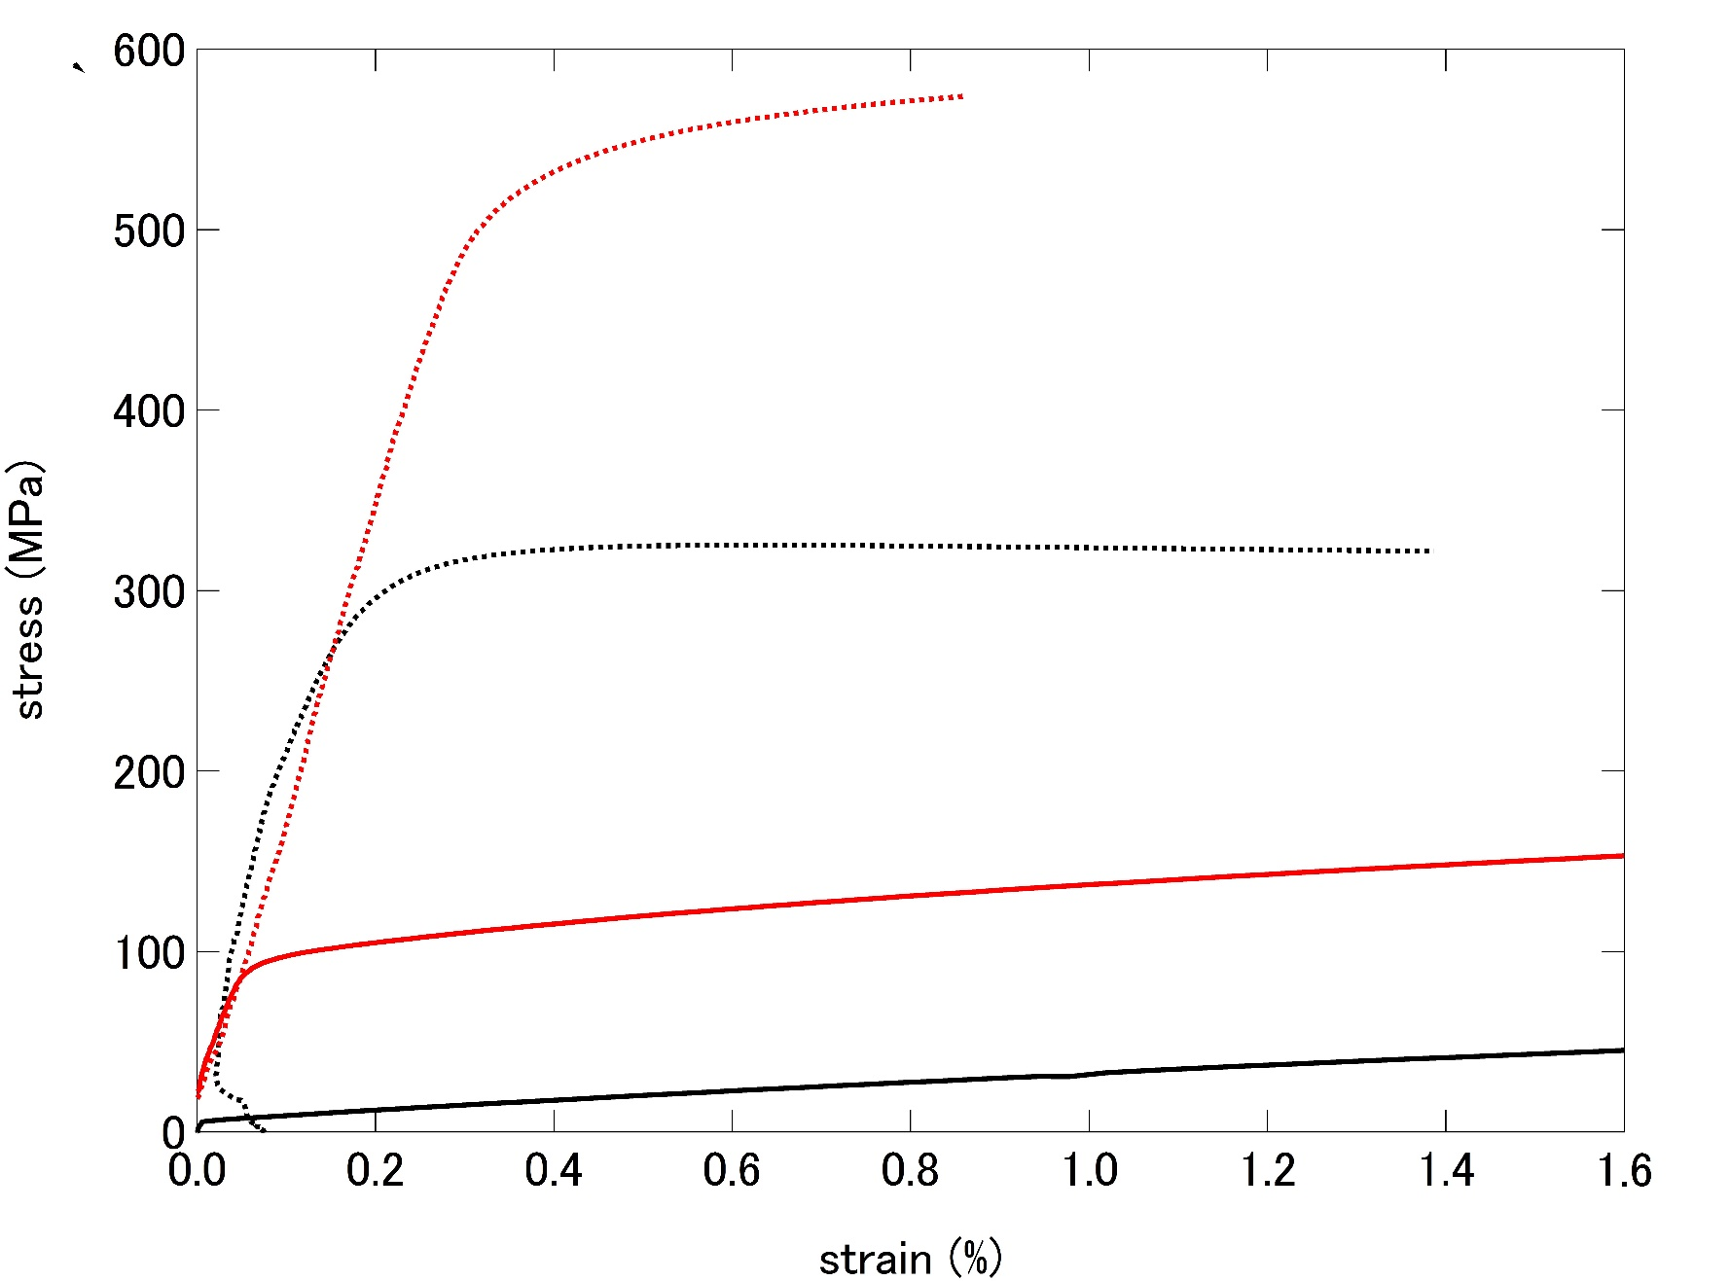
Strain-stress curve for C1020 and NC50
NC50 after brazing
C1020 after brazing

Slide 26
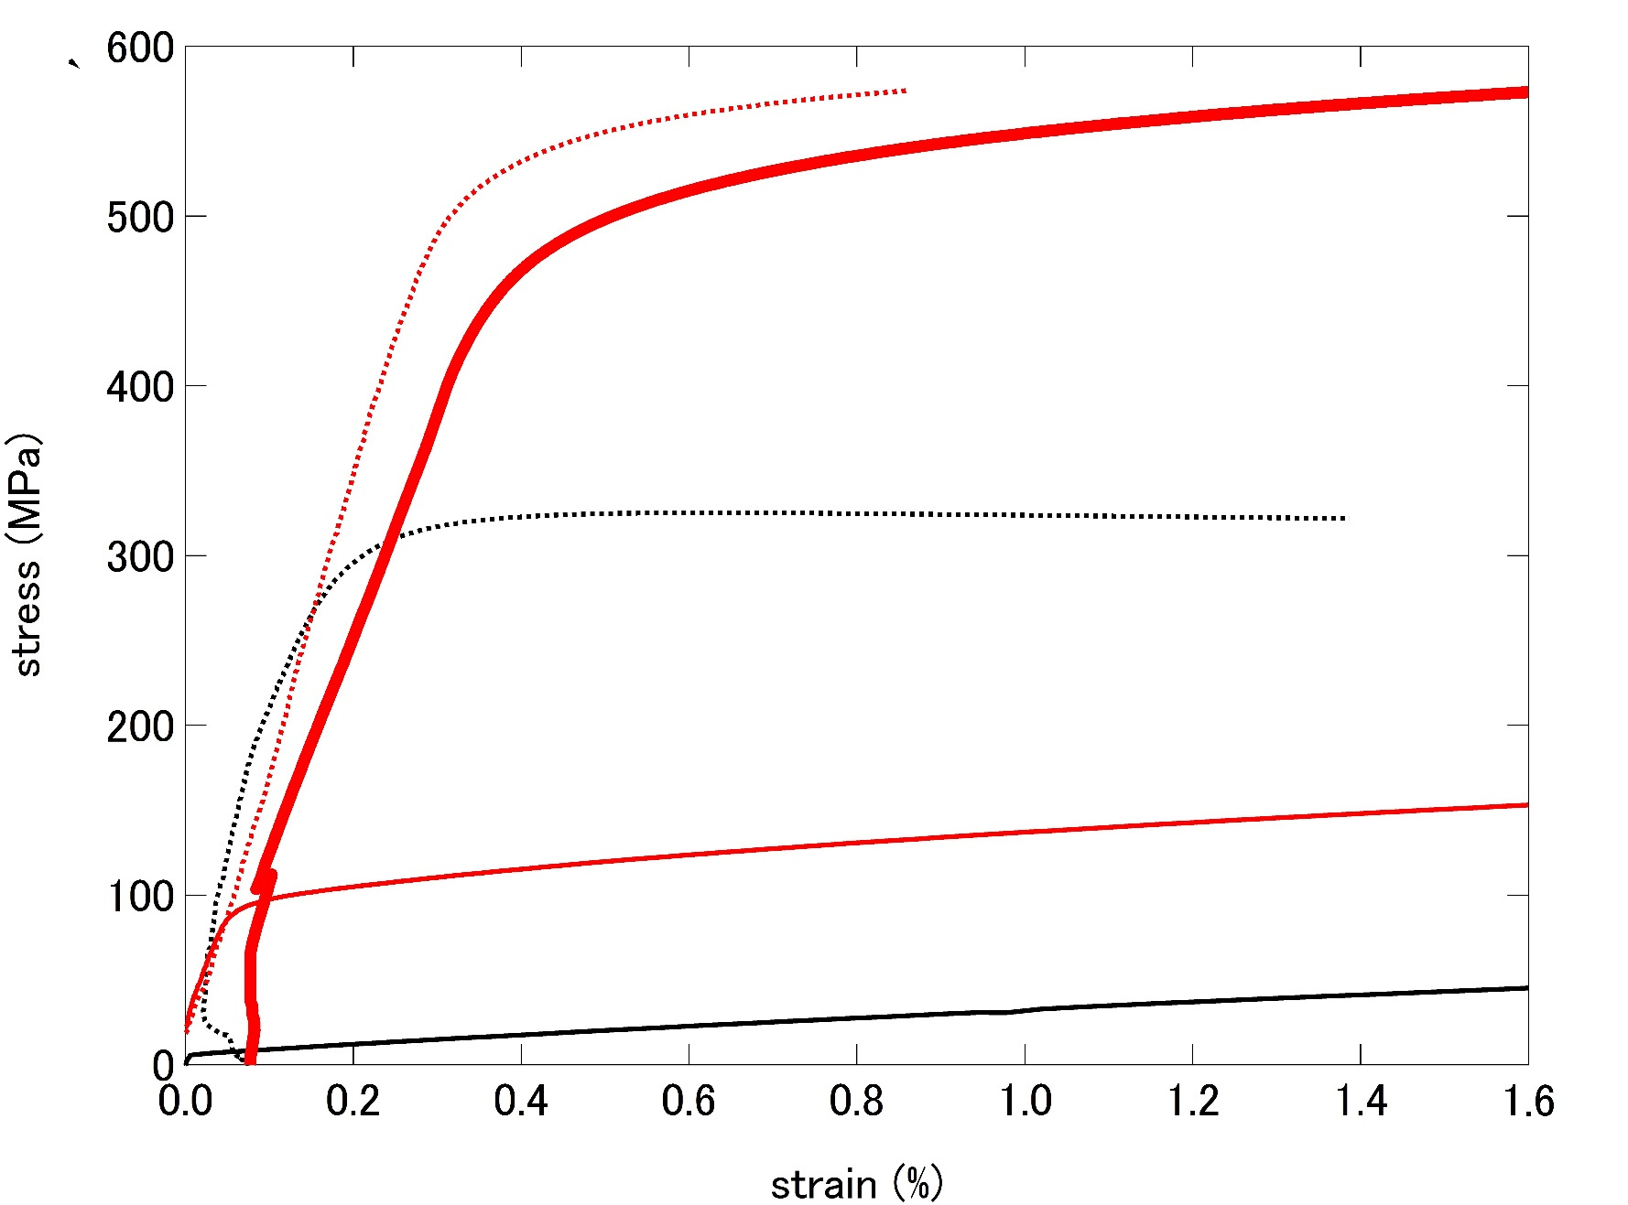
Strain-stress curve for C1020 and NC50
NC50 after aging
(precipitation hardening)

Slide 27
Strain-stress curve for C1020 and NC50
NC50
NC50 after aging
(precipitation hardening)
C1020
NC50 after brazing
C1020 after brazing

Slide 28
Yield strength
x40

Slide 29
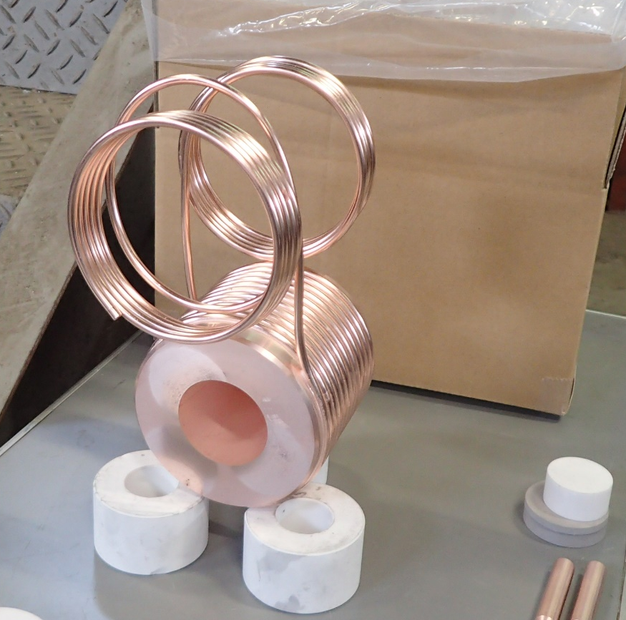
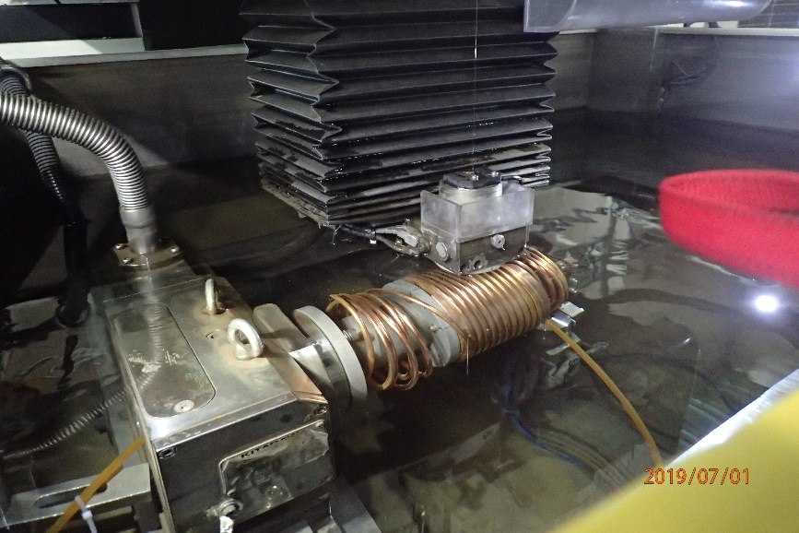
Production and simulation
After 6 months of manufacturing, new FC head using NC 50 was delivered on 18th Oct.
Evaluation at our test bench has started.
  Shows very good result now.
  Already reached 12.5 kA without discharge.
To evaluate mechanical stress, combined electromagnetic and mechanical simulation by ANSYS-Maxwell is in progress by Y. Morikawa.

Slide 30
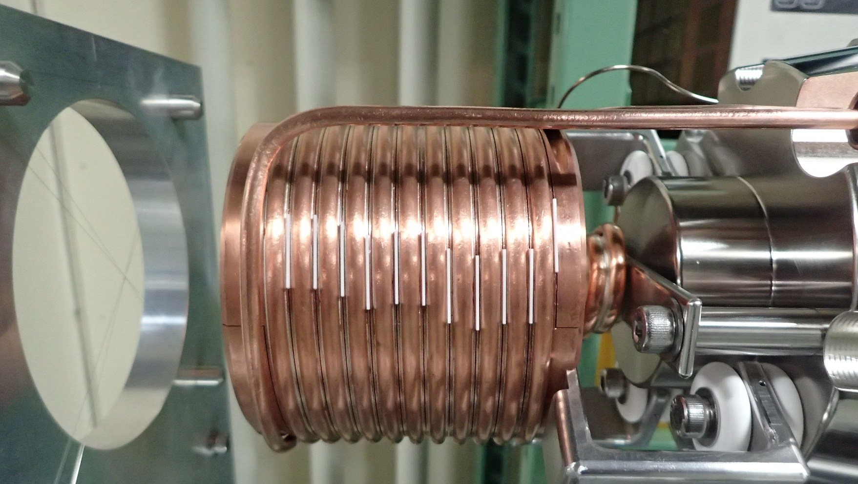
Insertion of insulator plates in the slits
20mm x 25mm x 0.2mm or 0.3 mm Zirconia (ZrO2) plates are inserted from 3 direction
It works well but not perfect
→discharge decreased but happened
→further investigation is needed

Slide 31
Short summary 1
Be care about yield strength after brazing
New Cu alloy NC 50 has promising properties
Preliminary test shows very good result
Insertion of ceramic plate works well
  Further investigation is needed

Slide 32
OUTLINE
Introduction of SuperKEKB positron source
lesson 1 : avoid deformation of FC head
  Solution 1 : new material for FC head
lesson 2 : compensate deformation of magnetic field
  Solution 2 : BPM and steering coils inside solenoid
lesson 3 : decrease voltage on FC head
  Solution 3 : LCR measurement and control
upgrade plan

Slide 33
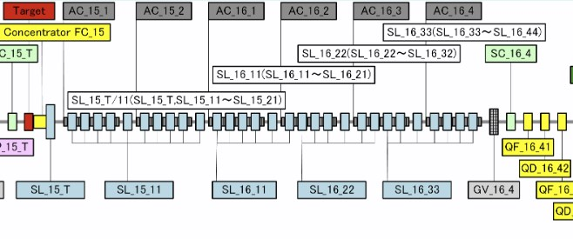
Solenoid field issue
Design
present
600 A
600 A
650 A
600 A
650 A
400 A
650 A
400 A
650 A
650 A
Solenoid section consists of 30 solenoid coils.
They are connected in 5 groups.
Each group is energized by independent power supply.
Design value and present value tuned to maximize positron yield is different

Slide 34
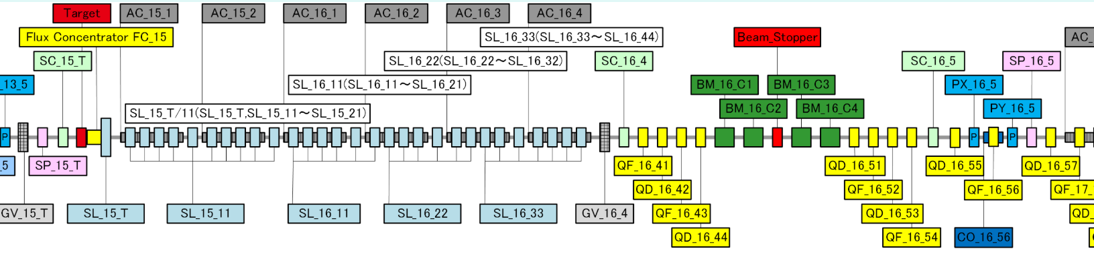
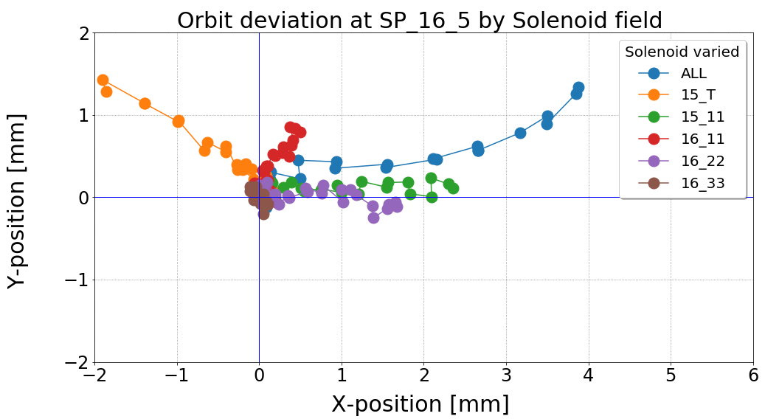
Solenoid field issue
Measured by T. Kamitani
Measurement of deflection amount of 3 GeV electron beam
by asymmetric field in solenoid section
1,Prepare ballistic beam between SP_15_T and SP_16_5
2,Energize a part of solenoid by
1/10* max. value step.
3, Monitor beam position at SP_16_5

Slide 35
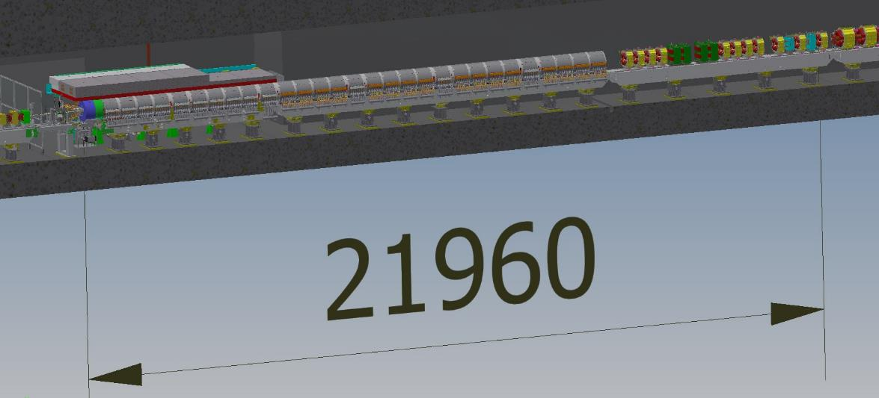
Present layout
target
BPM and 1st steering

Slide 36
BPM and steering coils inside solenoid
Steering coils
BPM
Install steering coils and BPM in solenoid section.
Detailed simulation of magnetic field by CST is also in progress
Inner diameter of solenoid changes
Steel radiation shield end
●It is not possible to use BPM for positron beam before separation.
●Use electron beam as a probe for magnetic field
●Development of a Fast BPM which can dissolve λ/2 @ S-band is under cosideration
Bx
By

Slide 37
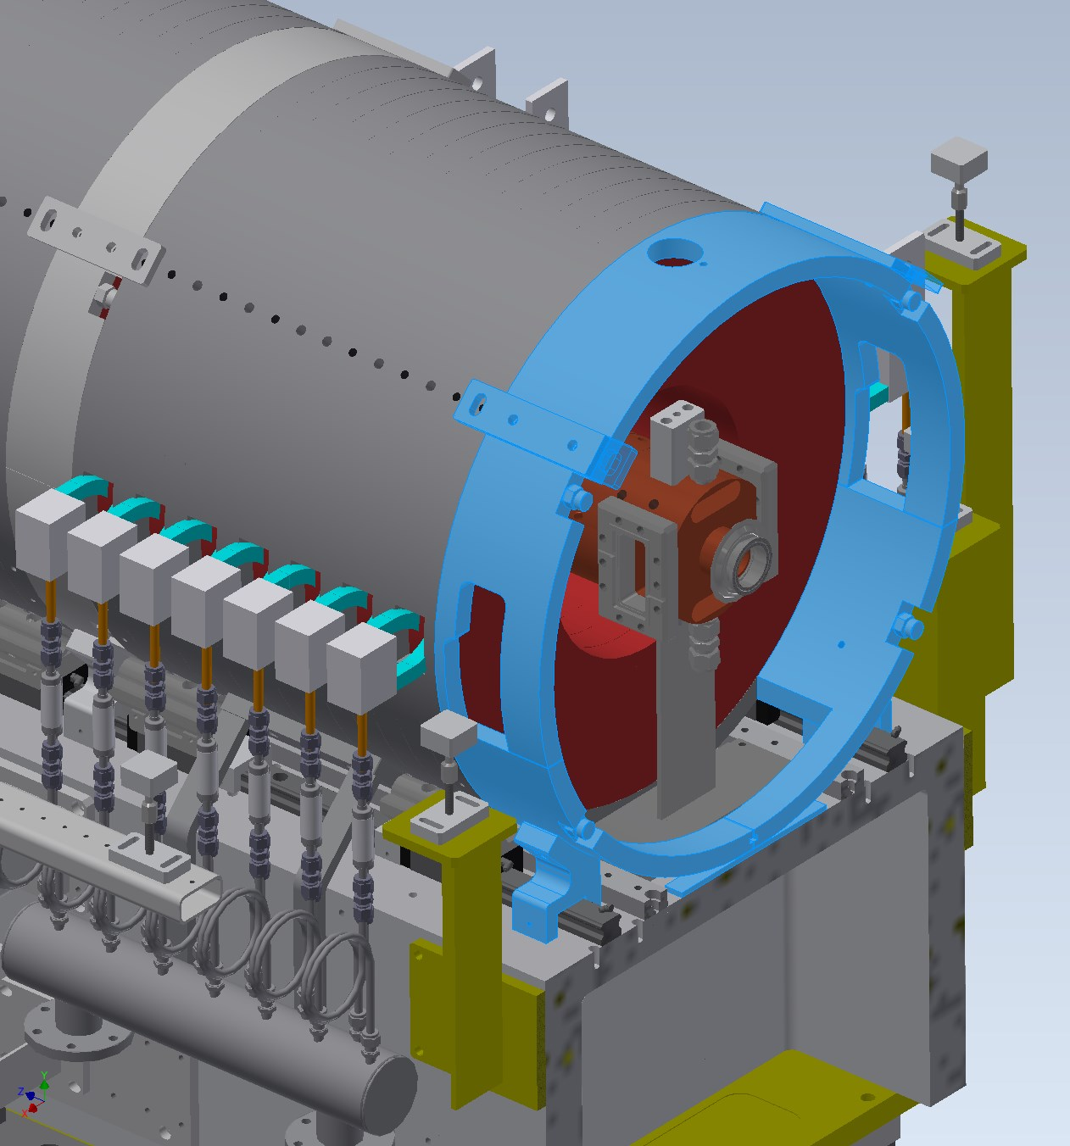
Asymmetry of magnetic connection
Iron yoke to connect flux of solenoid
need space for waveguide and support

Slide 38
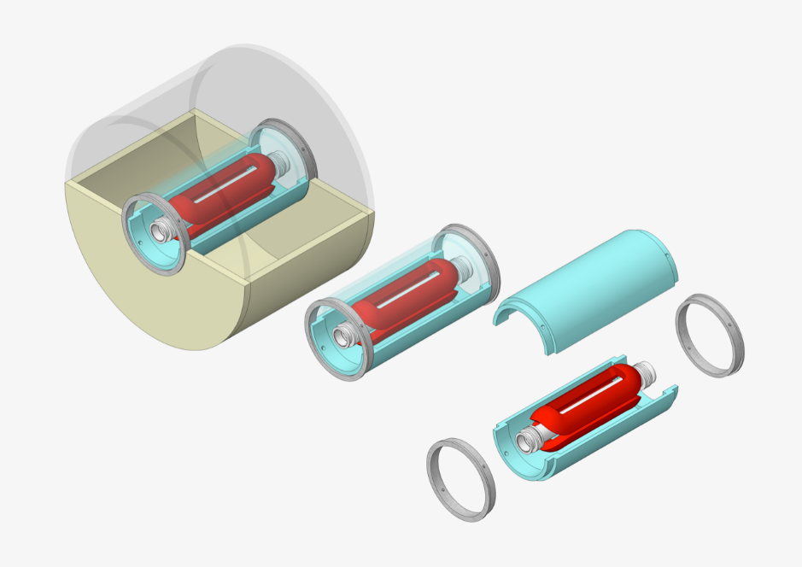
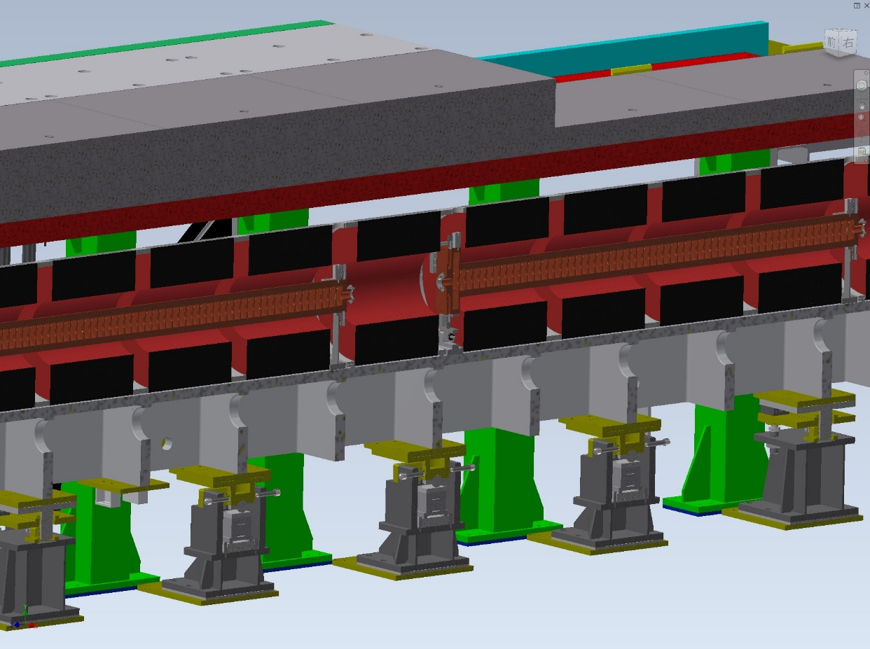
BPM and steering coils inside solenoid
Steering coil
support
BPM
K. Yokoyama
Very limited space
Design is in progress
In max. plan, between Acc. structures
Install 3 horizontal, 2 vertical steering coils
Install 5 BPM

Slide 39
Short summary 2
Asymmetry of iron yoke might affect magnetic field.
3 GeV electron beam is deflected in solenoid section.
No direct measurement for positron but expected to be deflected.
Correction and monitor in the solenoid section is important
Fast BPM to measure positron directly is under consideration
  Such monitor will be useful for future positron source

Slide 40
OUTLINE
Introduction of SuperKEKB positron source
lesson 1 : avoid deformation of FC head
  Solution 1 : new material for FC head
lesson 2 : compensate deformation of magnetic field
  Solution 2 : BPM and steering coils inside solenoid
lesson 3 : decrease voltage on FC head
  Solution 3 : LCR measurement and control
upgrade plan

Slide 41
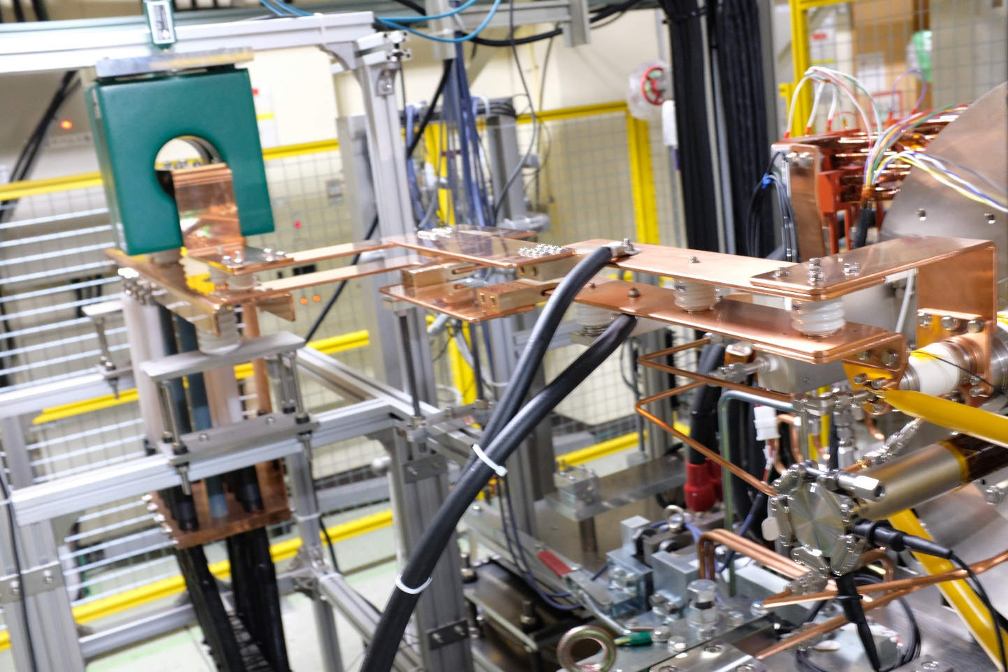
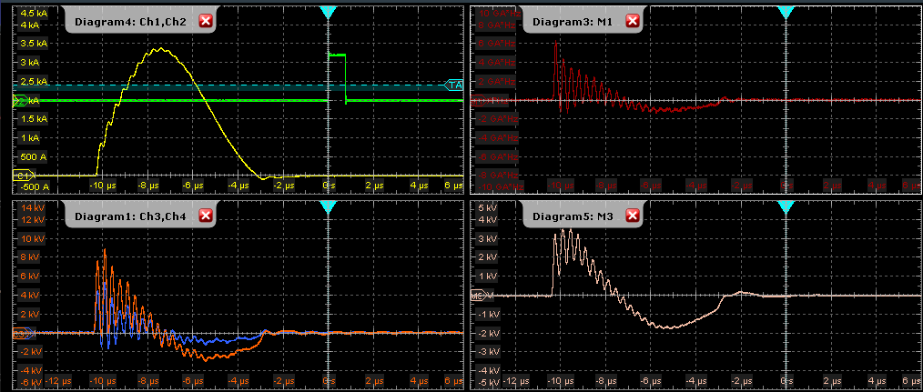
CT
$$V\sim L\frac{dI}{dt}$$
High voltage probe
～3MHz
Due to resonance by capacitance of the cable and inductance of the load
$$A=πr^{2}$$
High voltage probe
I[kA]
dI/dt]
Vsupply[kV]
Vreturn[kV]
Vsupply-Vreturn[kV]

Slide 42
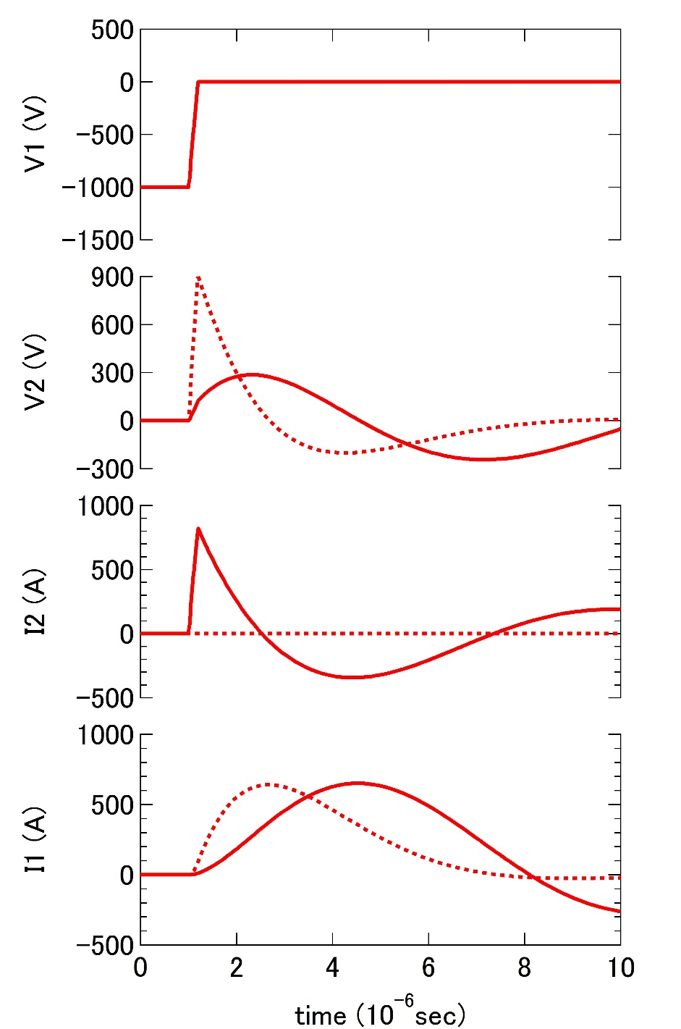
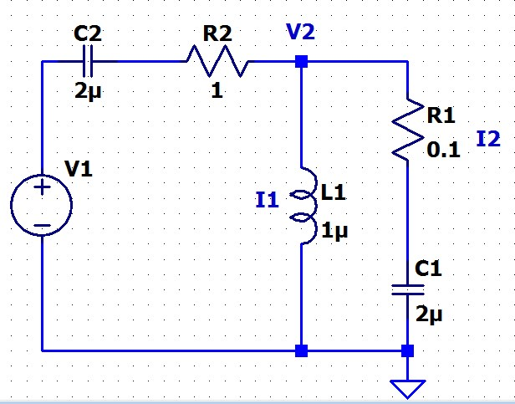
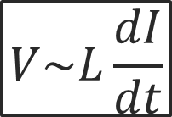
Snubber circuit
Avoid discharge
→Reduce electric field between gap
→Reduce voltage keeping current
→suppress rapid current change
$$V\sim L\frac{dI}{dt}$$
solid : C1 = 2 uF
dashed : C1 = 1 fF
Pulsed power supply
Load(FC)
snubber

Slide 43
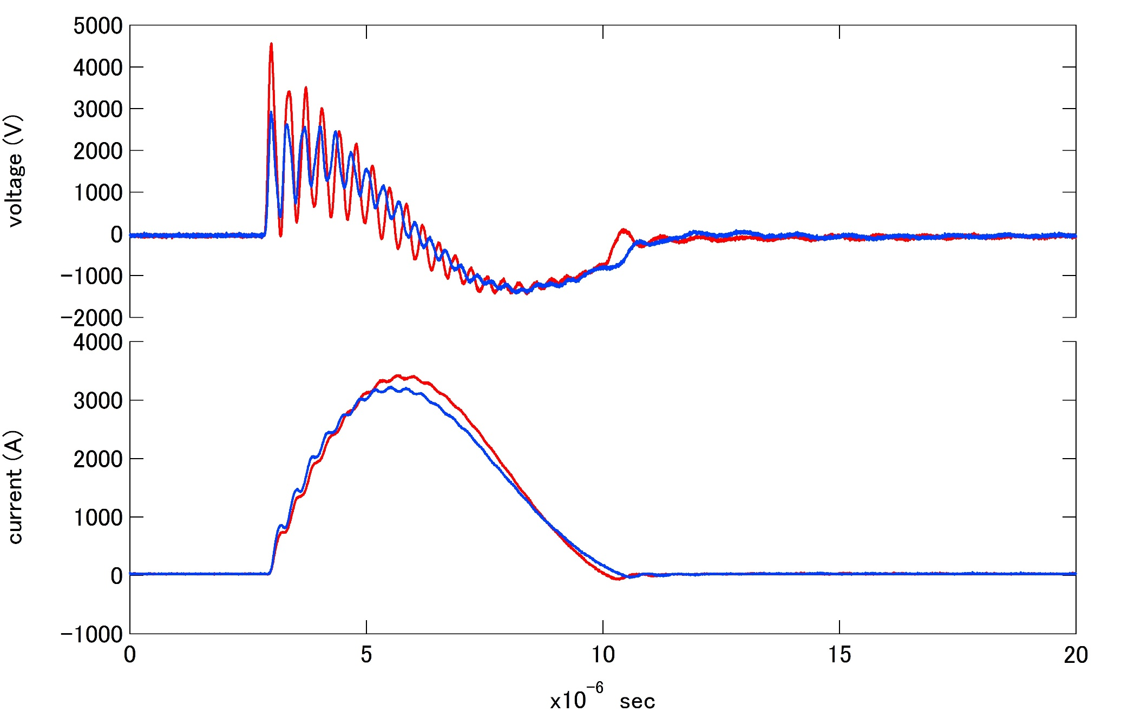
Current and voltage waveform w or w/o snubber circuit
w/o snubber circuit
w snubber circuit

Slide 44
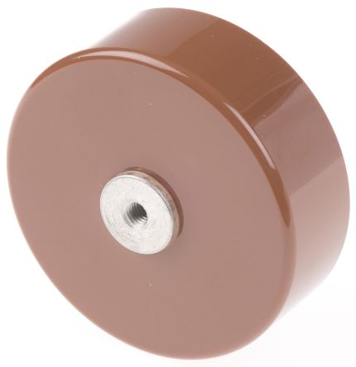
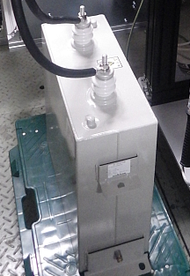
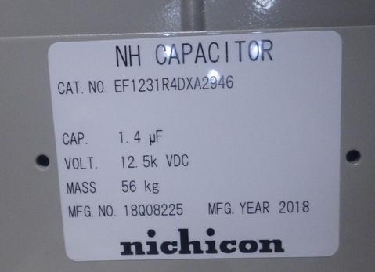
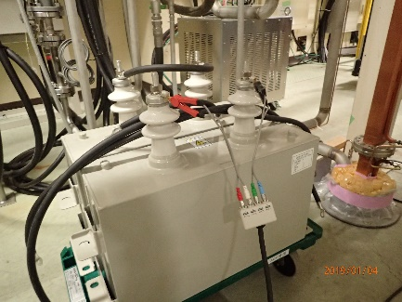
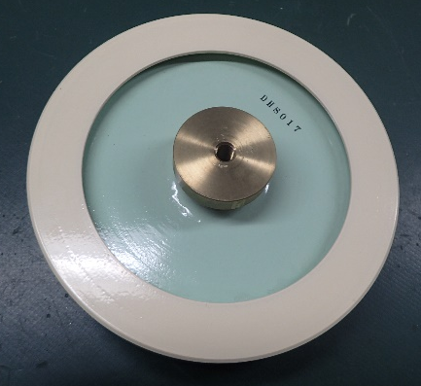
Frequency response of capacitors
previous
new

Slide 45
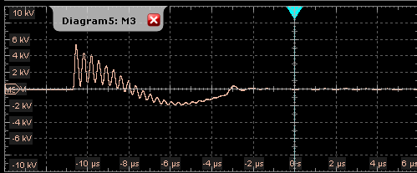
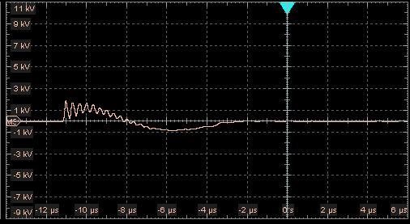
Optimization of the snubber circuit
Es = 5 kV
IFC = 3.5 kA

Slide 46
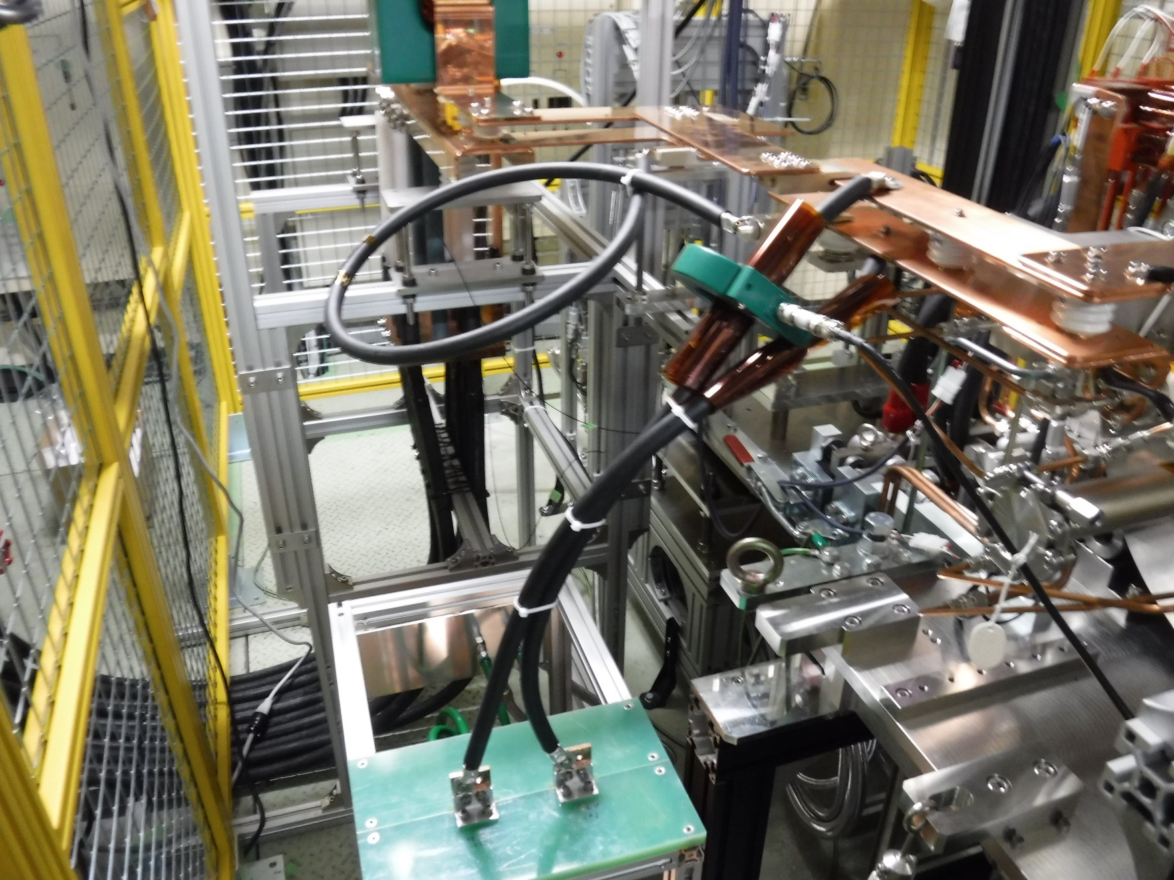
Insertion of series inductance
Inductance of FC is about 1 uH
Inserted inductance has similar value

Slide 47





Insertion position of inductance
L=H : insert L in return side
L=0 : without L
L=L : insert L in supply side

Slide 48


Insertion position of inductance
FC voltage | FC current | Snubber current | I/V (FC) | V/Es
1148 | 2245 | 356 | 1.96 | 0.230
1217 | 2800 | 375 | 1.41 | 0.398
2083 | 2631 | 394 | 2.47 | 0.213
2561 | 2792 | / | 1.090 | 0.512
L=H : insert L in return side
L=0 : without L
L=L : insert L in supply side
Without L and C

Slide 49

Optimization of the snubber circuit
Simulation by T. Natsui
Circuit simulation

Slide 50

Optimization of the snubber circuit
LCR measurement

Slide 51
Short summary 3
Load (FC) and power supply, transmission line, external circuit (snubber) should be designed as a system.
Circuit simulation, LCR measurement and voltage current monitor is important to reduce voltage across the FC.

Slide 52
OUTLINE
Introduction of SuperKEKB positron source
lesson 1 : avoid deformation of FC head
  Solution 1 : new material for FC head
lesson 2 : compensate deformation of magnetic field
  Solution 2 : BPM and steering coils inside solenoid
lesson 3 : decrease voltage on FC head
  Solution 3 : LCR measurement and control
upgrade plan

Slide 53
Upgrade plan
 | 2019 |  |  |  |  |  |  |  |  |  |  |  | 2020
 | 1 | 2 | 3 | 4 | 5 | 6 | 7 | 8 | 9 | 10 | 11 | 12 | 1 | 2 | 3 | 4 | 5 | 6 | 7 | 8 | 9 | 10 | 11 | 12
FC (present)
FC (new material)
FC (optimized design)
Snubber circuit
Longer pulse operation
Steering coils
BPM
Magnetic field measurement
Operation
Design
Test
Biding
Manufacturing
Installation
We are planning big upgrade of positron source in 2020 summer shutdown.
budget is one of the concern…..

Slide 54
Other topics
Deformation of magnetic field by return yoke before target
  Material consideration
  Simulation and beam measurement
Vibration measurement and resonance frequency
Temperature distribution simulation and measurement of the FC head

