Slide 1
Undulator Positron Source Capture Simulation
KEK M. Fukuda

Slide 2
Simulation of a positron source for undulator method
I am developing start-to-end simulation programs for ILC positron source.
The tracking of positrons up to the exit of Capture section (125MeV) can be simulated now.
ILC - Technical Design Report(TDR)
CAIN
Geant4
SAD (not implemented)
Gamma-ray generation: calculated by K. Yokoya
Positron generation at a target --- Capture section (125MeV): calculated by M. Fukuda
Tracking of positrons after Capture section: T. Okugi
A. Ushakov-san has continued the simulation of Undulator ILC positron source
all the time.

Slide 3
Analyzed by T. Okugi
LCWS2018: M. Fukuda

Slide 4
Difference between Fukuda’s simulation and Ushakov-san’s simulation
The positron yield between Ushakov-san’s simulation and my simulation is different in undulator scheme.
The difference is caused by the difference of the model of the QWT magnetic field and the accelerating tubes.
Fukuda’s simulation
  QWT and the solenoid field designed by Wanming Liu.
  Capture linac: two SW and three TW accelerating tubes.
Ushakov-san’s simulation
  QWT and solenoid field: Simple shape like trapezoid.
  Capture linac: one long SW accelerating tube.
I could reproduce the Ushakov-san’s result by using Ushakov-san’s model of QWT and an accelerating tube.

Slide 5
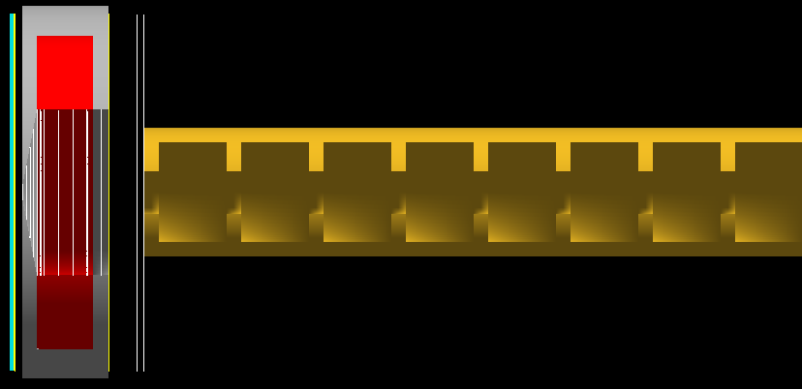
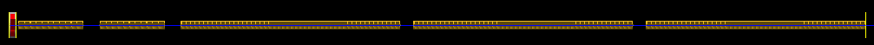
Placement of the QWT and an accelerator (Fukuda)
I input this geometry in my simulation.
This placement is different as that of Ushakov-san’ simulation.
Positrons are accelerated by two SW accelerating tubes and three TW accelerating tubes.
Target – QWT: 11.5mm
QWT – ACC: 50mm
Standing wave tube
Target
QWT

Slide 6
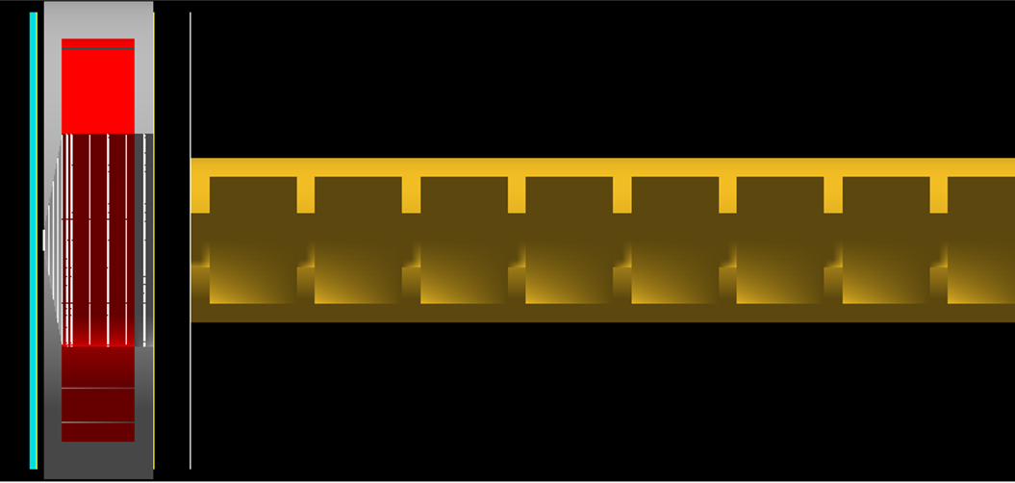
Placement of the QWT and an accelerator (Ushakov)
To reproduce the Ushakov-san’ result, I changed the geometry in my simulation.
This placement is same as that of Ushakov-san’ simulation.
Positrons are accelerated by one SW accelerating tube with the length of ~16.8m.
Target – QWT: 7.6mm
QWT – ACC: 40mm
Standing wave tube
Target
QWT

Slide 7
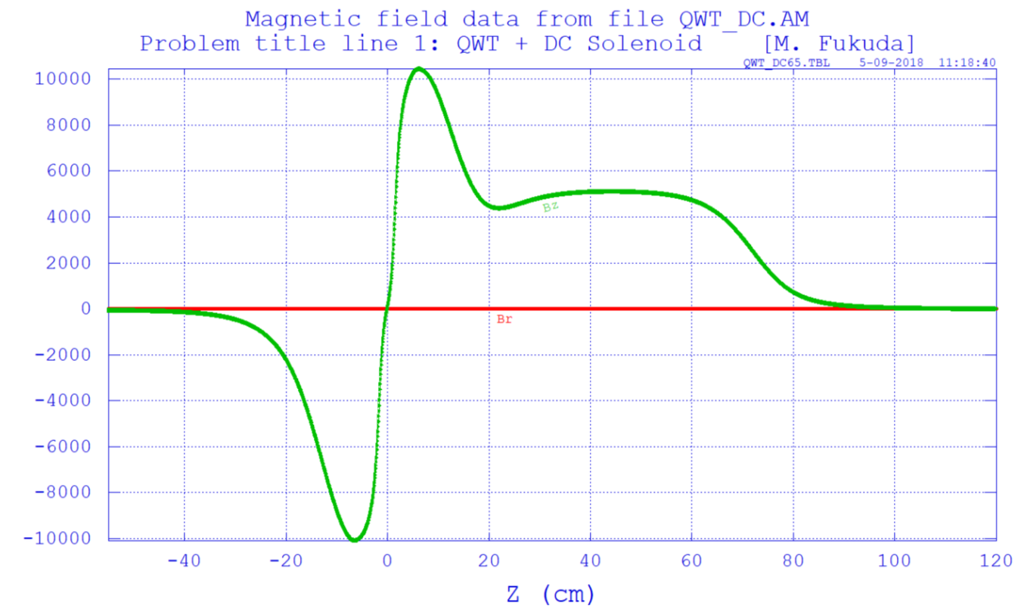
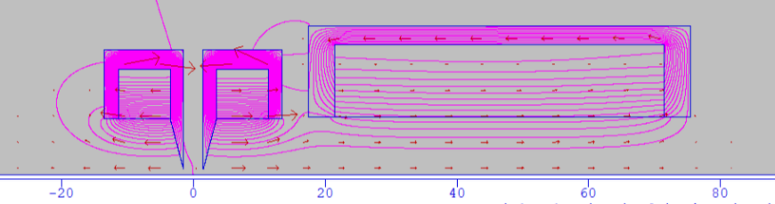
Magnetic field of QWT and Solenoid (Fukuda)
The magnetic field data was calculated by POISSON.
This 2D map data of magnetic field is used in my simulation.
QWT (Peak 1.04T) + 0.5T (capture section)
After z = 444.5mm, Bz = const. (~0.51T), Br =0
Bz = const. Br=0
Designed by Wanming Liu
Recalculated by Fukuda

Slide 8
Magnetic field of QWT and Solenoid (Ushakov)
The magnetic field model is different between Ushakov-san’ simulation and mine.
Bz profile is like trapezoid in Ushakov-san’s simulation.
QWT (Peak 1.04T) + 0.5T (capture section)
From Ushakov-san

Slide 9
Magnetic field of QWT and Solenoid (Simple shape)
I input the magnetic filed of simple shape like trapezoid.
  Bz=0 at the target rear surface(z=0)
  Bz linearly increases up to 1.04T at QWT front (z=7.6mm)
  Bz is 1.04T until QWT end (z=7.6+120 mm)
  Bz linearly decreases up to 0.5T at ACC front (z=7.6+120+40 mm )
  Bz is 0.5T after ACC front.
Input magnetic field (r=0, on z-axis)
Input magnetic field (r=5mm, off-axis)
QWT
ACC

Slide 10
Parameters of the simulation
To reproduce the Ushakov-san’ result, I simulated with below condition.
Input ：Gamma-rays from Undulators calculated by CAIN (Yokoya’s calculation)
Number of Gamma-rays is 4,025,930 which are generated from 10000
electrons with 125GeV.
Target：Ti6Al4V, 7mm
OMD: QWT (Peak 1.04T) + 0.5T (capture section)
The magnetic filed was calculated by equations (Simple model)
Accelerating tube : SWx1 (~16.8m)
Ez = E0*2*sin(omegaspace*(z-zfrontRF)*cos(omegatime*t+Ephase)
omegaspace = k = 2π/λ
omegatime = ω = 2πf = 2πc/λ
λ=230.60958mm (L-band)
2*E0: 16.08MV/m

Slide 11
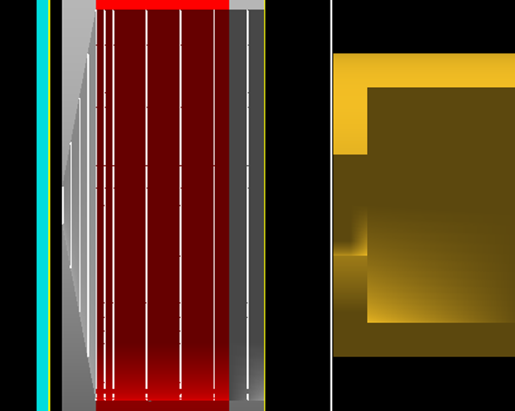
Detector position at Before RF1
I compare the positron distribution
at before RF1.
Z=0
Target rear surface
BeforeRF1 Z= 167.6mm

Slide 12
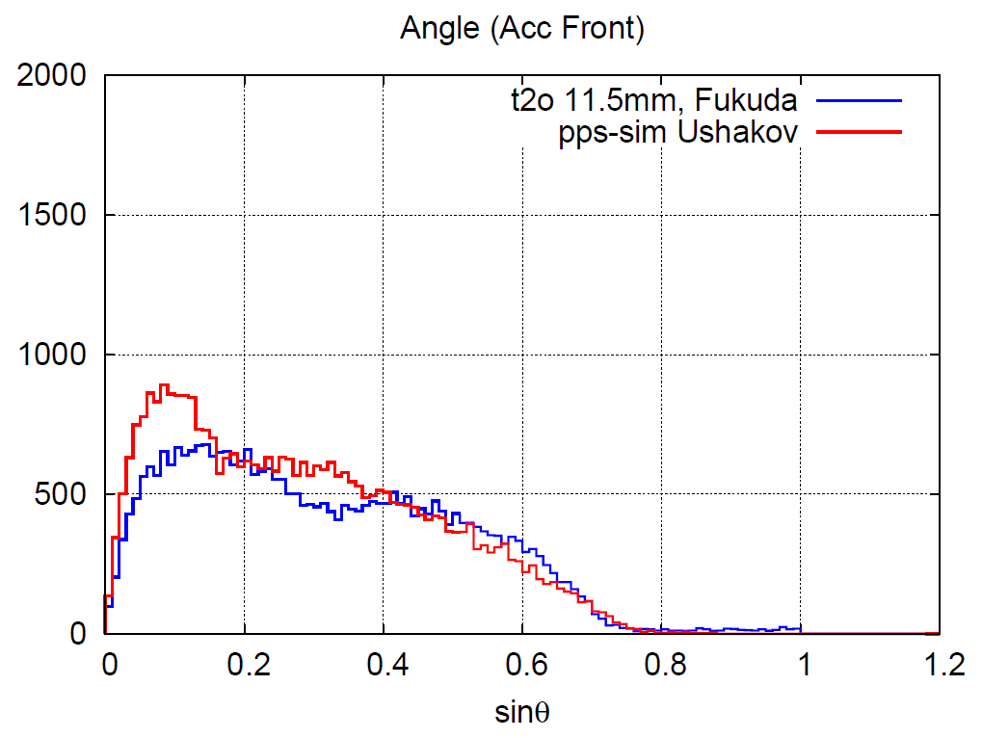
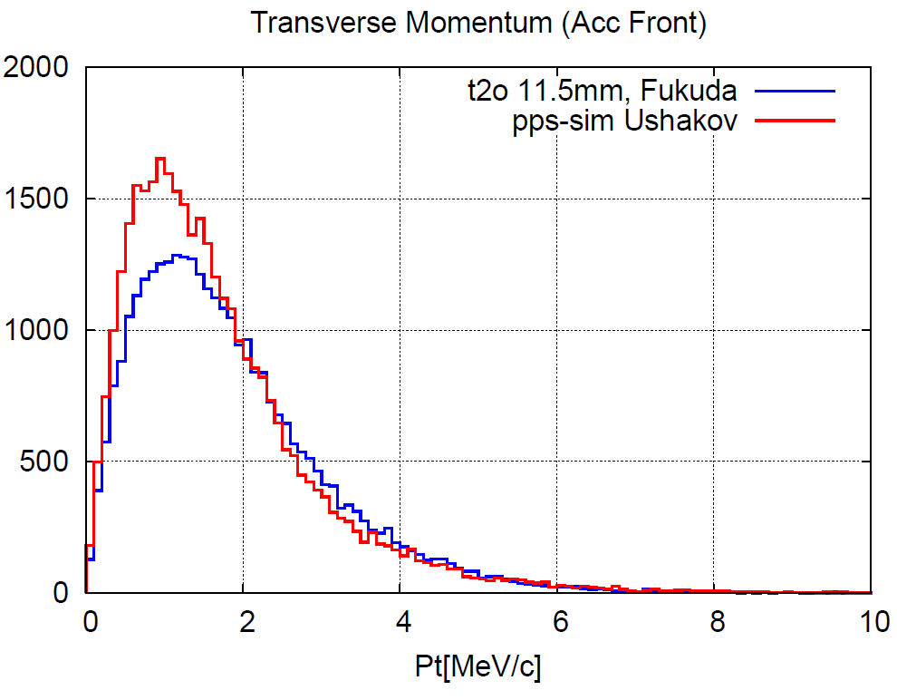
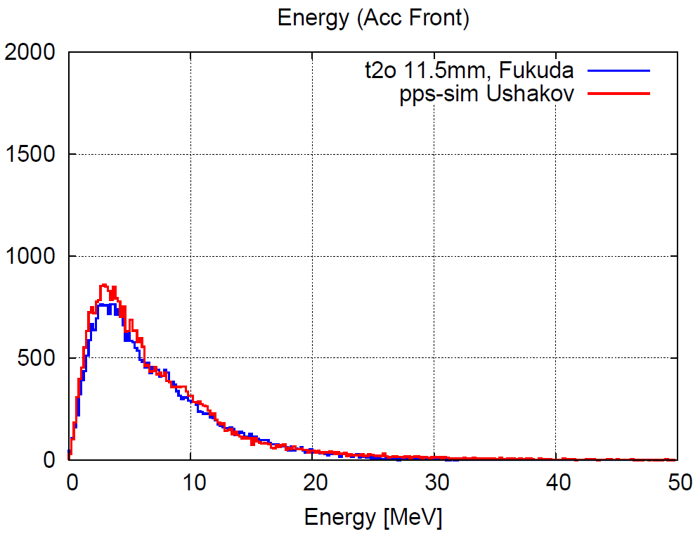
ACC Front
Magnetic field: 2D map data (POISSON)
Z=167.6mm (BeforeRF1)
Ne+: 31877(Fukuda), 34970(Ushakov)
difference: 10%
The e+ distributions are different.

Slide 13
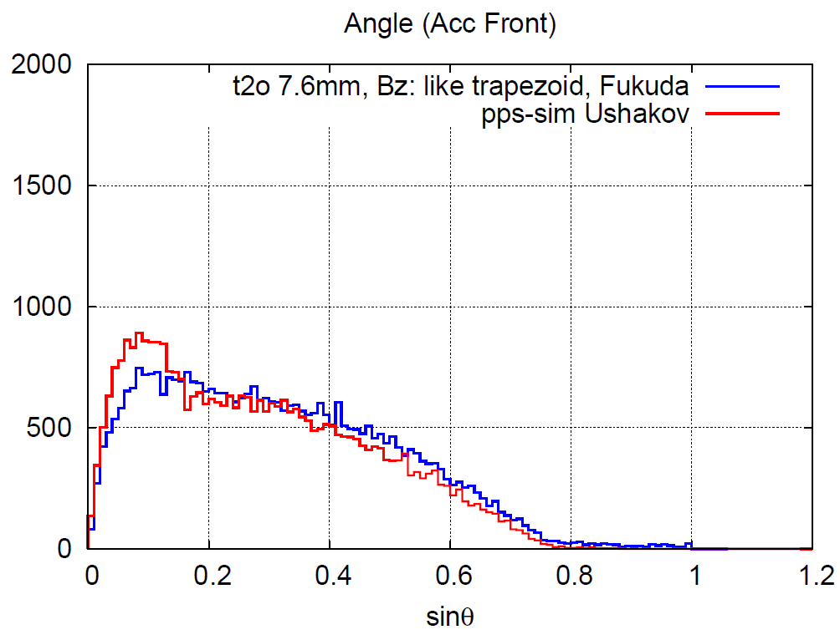
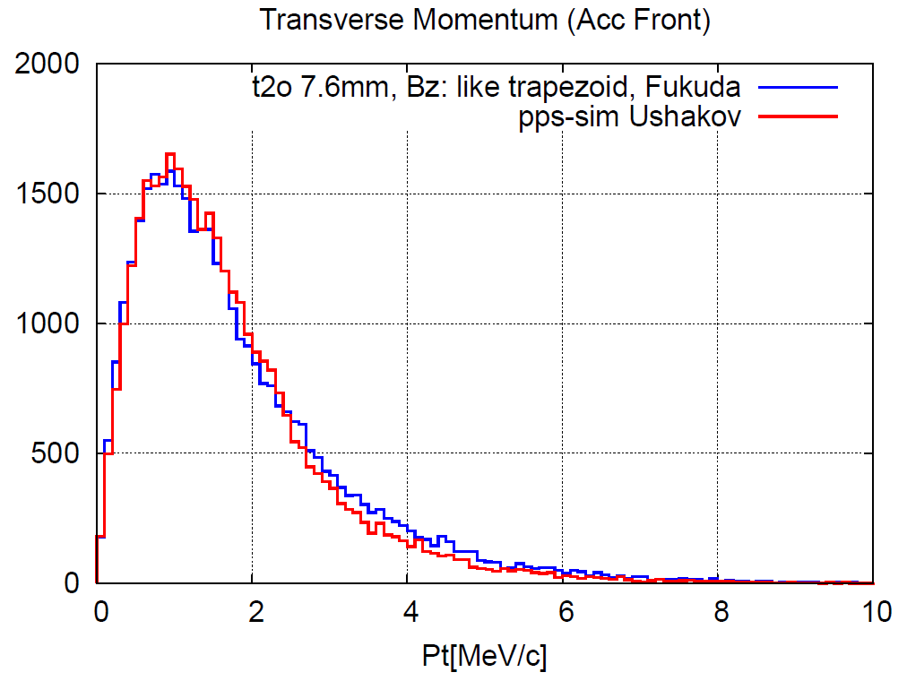
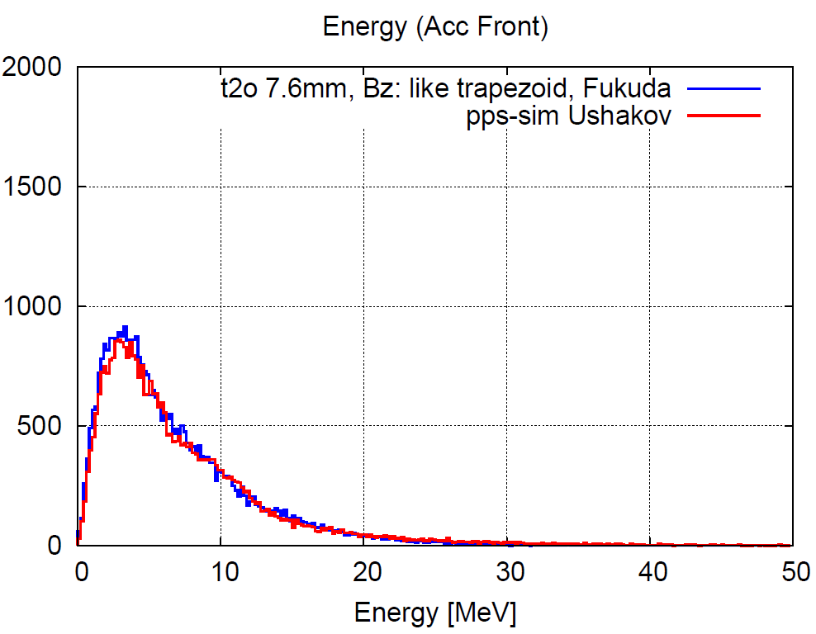
ACC Front
Magnetic field: (Simple shape)
Z=167.6mm (BeforeRF1)
Ne+: 35865 (Fukuda), 34970(Ushakov)
difference: 3%
The e+ distributions become same shape.
In angle distribution, there is difference
in low angle part.

Slide 14
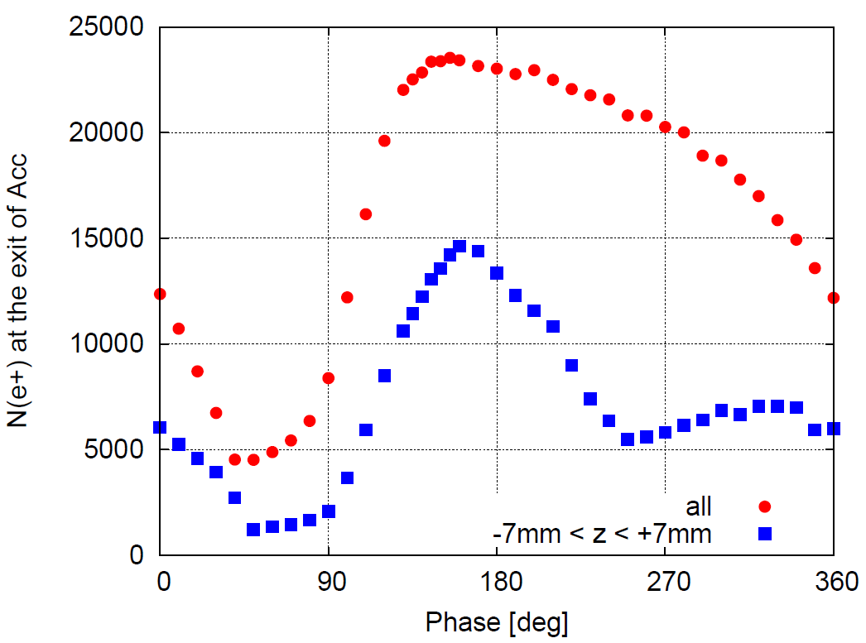
Phase scan result
I scanned the accelerating phase to find the best phase.
Number of positrons becomes maximum at 160deg.

Slide 15
Phase scan of accelerators
The phase of the accelerator was optimized so that the number of positrons within +/- 7 mm in the longitudinal position distribution was maximized.
Positrons within +/-7mm from the peak of longitudinal position distribution are captured in DR.
The phases of all the accelerating tubes were simultaneously moved.
Analyzed by T. Okugi

Slide 16
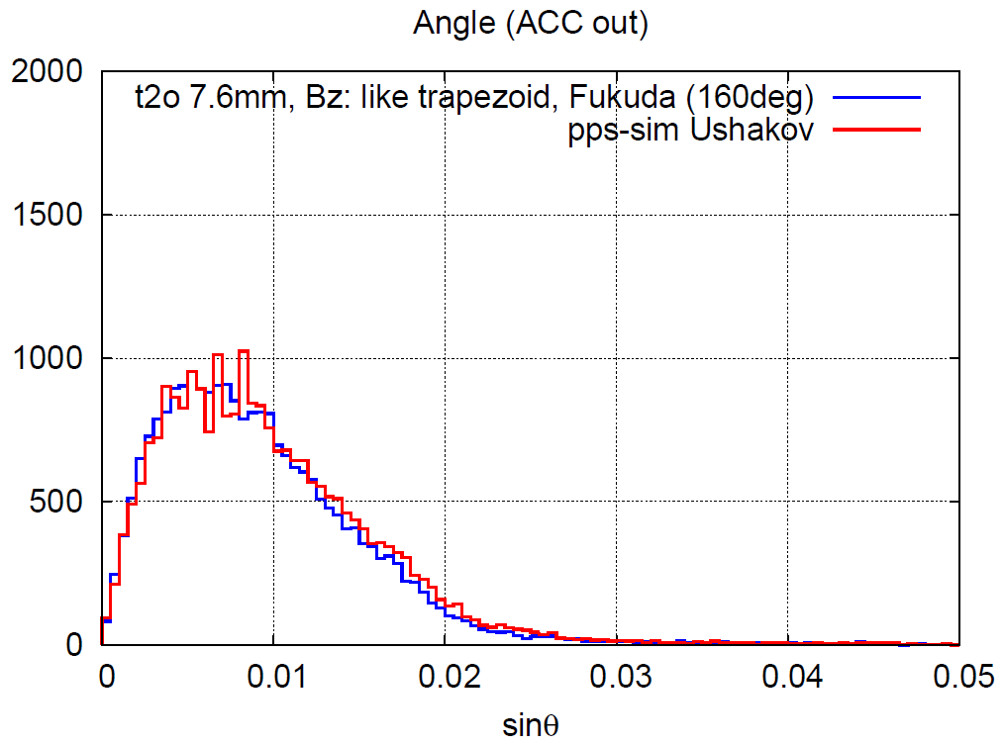
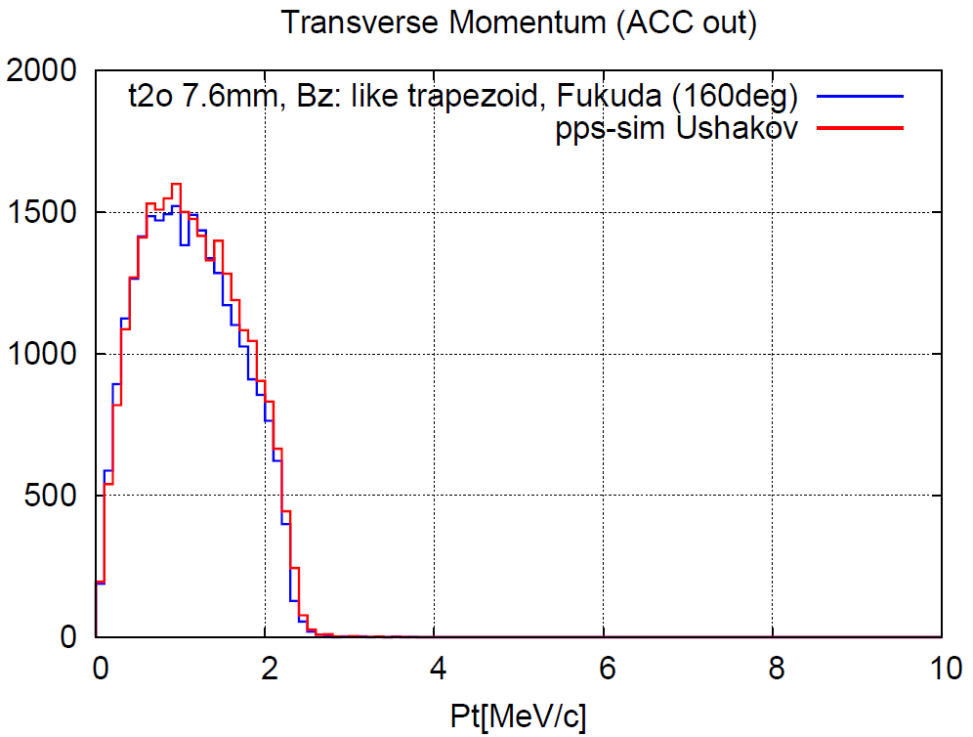
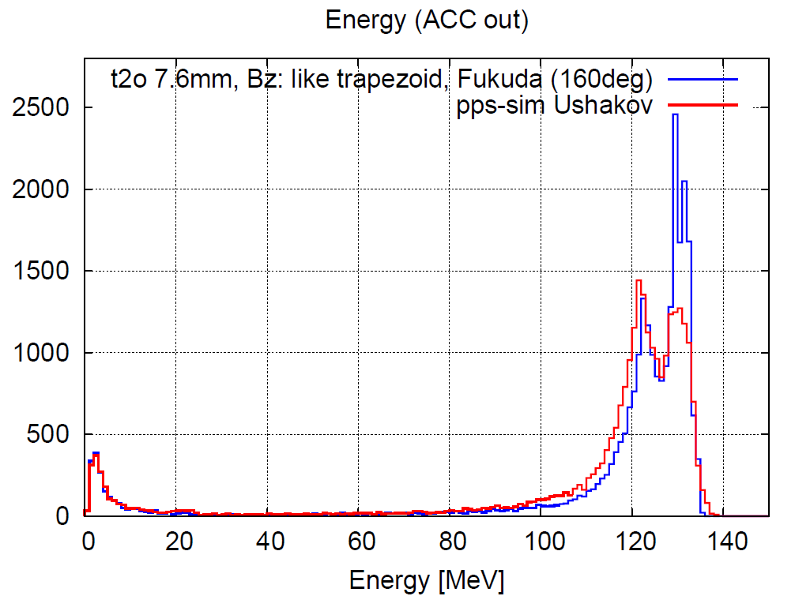
ACC Exit
Phase: 160deg
The Pt and angle distributions become similar.
The energy distribution is slightly different.
Ne+: 25460 (Fukuda), 26462 (Ushakov)
difference: 4%

Slide 17
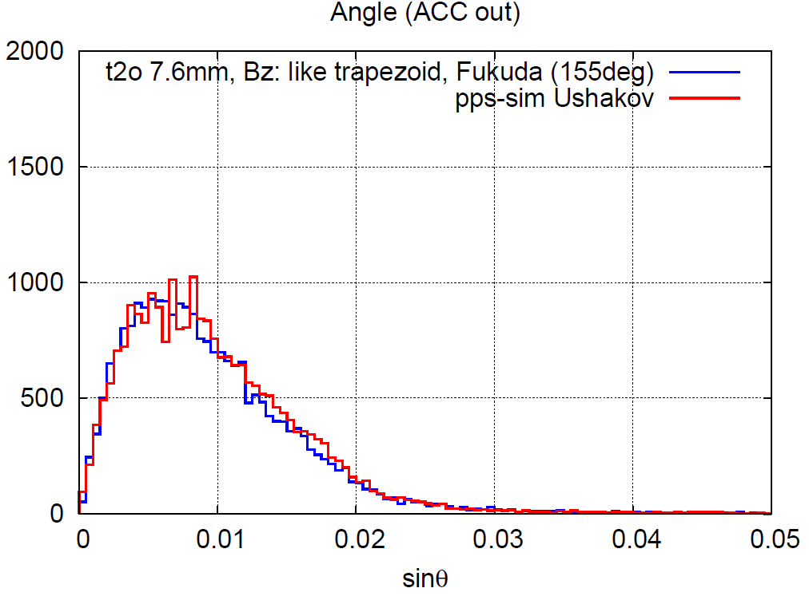
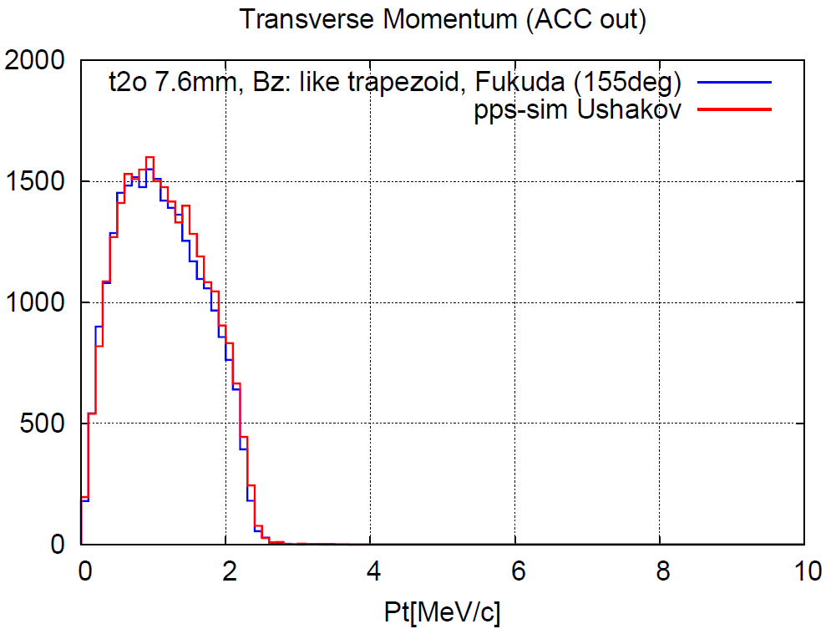
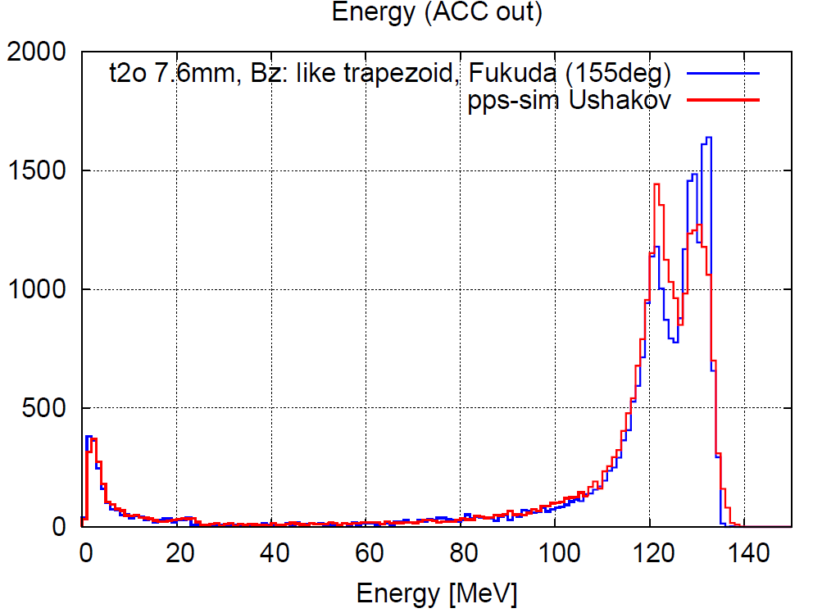
ACC Exit
I adjusted the phase.
Phase: 155deg
The distributions are more similar.
Ne+: 25639(Fukuda), 26462 (Ushakov)
difference: 3%

Slide 18
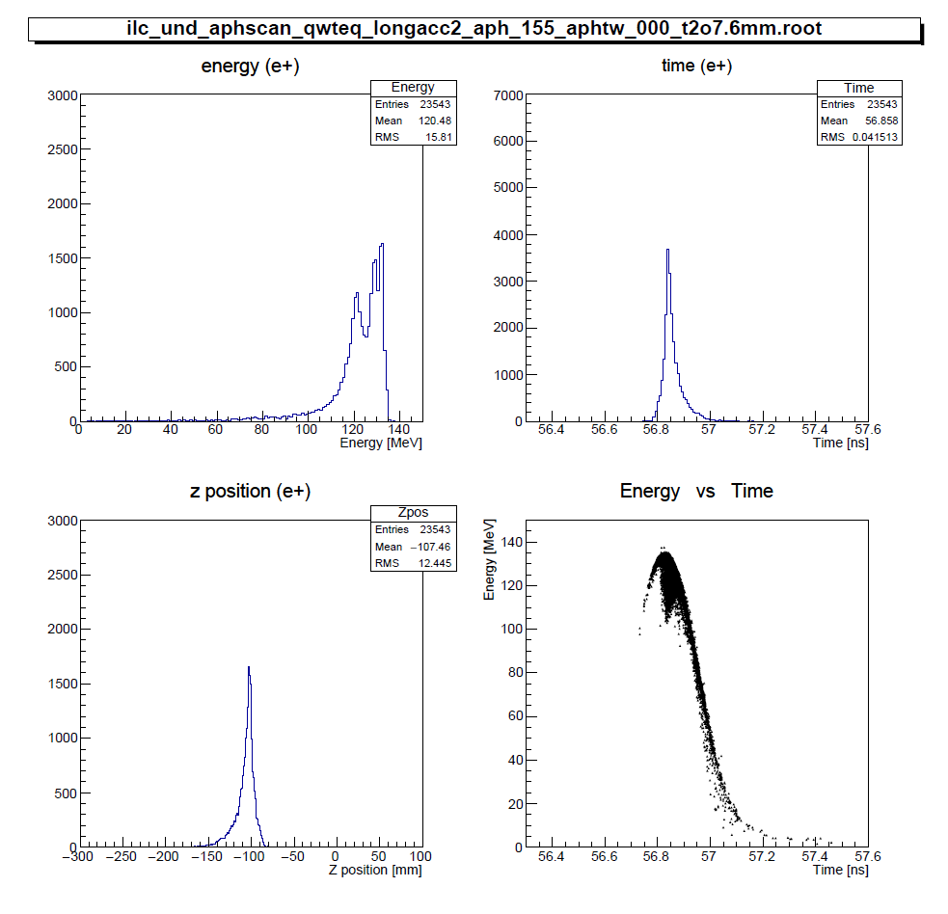
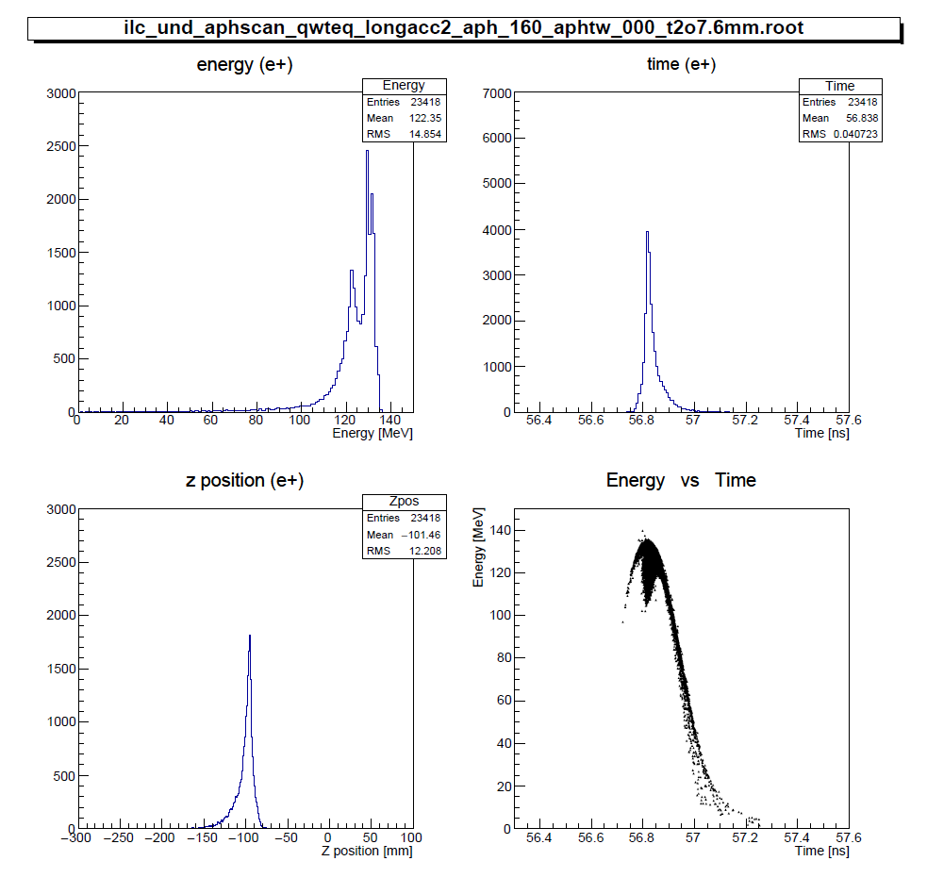
Positron profile
Energy vs time is similar to that of
Ushakov-san’s simulation.
155deg
160deg

Slide 19
Summary
I could reproduce the Ushakov-san' result by using the simple Bz profile like trapezoid.
Hence the positron yield at DR decrease from 1.3 to 0.8 when the magnetic field of the QWT designed by W. Liu-san is used.
This is not the final result. The optimization of the QWT and solenoid field and so on is not enough.
I thank Ushakov-san for providing me with useful information and simulation data.

