Slide 1
Design Options for the Undulator Driven, Radiation Cooled Positron Target for the ILC.
P. Sievers-CERN-Ret. , S. Riemann-DESY

Slide 2
1.Introduction and Design Options.
In the initial proposal (see POSIPOL 2013), Cu was considered for the radiator: good Th. Conductivity and reasonable Emissivity. But heavy and temperature limited to about 300 oC.
Following the reduction of the number of bunches and the thickness of the Ti-target, a monolithic Ti-Target-Radiator Wheel was studied ( S. Riemann et al.).
Starting from this, in the following possible design and engineering options are discussed.
Finally, the use of a Pulsed Solenoid as an AMD is considered.

Slide 3
Principal Layout: Ti-Wheel with a Diameter of 1.0 m, rotating at 100 m/s, 2000 rpm.
Rotating Ti-Target+
Radiator
Photon + e+ Beam
Photon Beam
AMD
Motor + Magnetic Bearing
Rotating Target Wheel
Vacuum Tank
Stationary Water Cooler

Slide 4
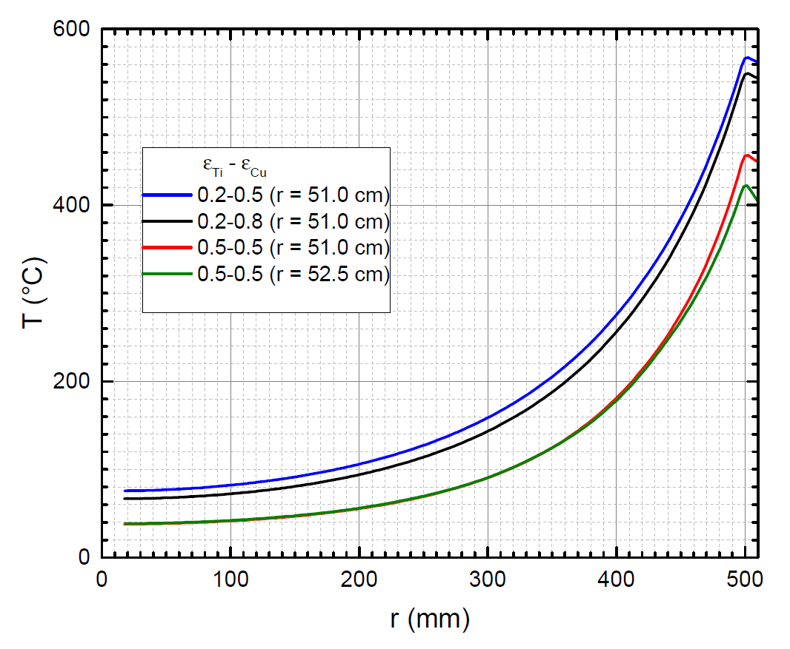
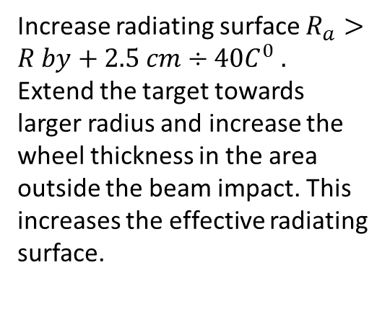
There is room for improvement.
Increase radiating surface $R_{a}>R by+2.5 cm÷40C^{0} .$
Extend the target towards larger radius and increase the wheel thickness in the area outside the beam impact. This increases the effective radiating surface.
4%
96% of Power
Increasing the effective radiating surface by a factor 2-3 could reduce the average temperature from 400 to 280-240 oC.
S. Riemann
Most of the power radiated between r=300-500 mm. Can reduce weight.

Slide 5







Ti-Target Sector Modules, mounted onto a «Carrier Wheel»
7 mm
Ti-Target/Radiator.
Ti-sectors mounted «stress free», free to expand thermally .
Synchronise rotation with beam pulses by fine tuning the rotation velocity.
Centrifugal stresses in the Ti –target are well below 10 MPa.
Beam
$$°$$
$$°$$
$$°$$
$$°$$
$$°$$
$$°$$
$$°$$
15 mm
200 mm
Stressfree fixation
Increasing the effective radiating surface by a factor 2-3 could reduce the average temperatures from 400 oC to 280-240 oC.
Carrier Wheel
Not to scale!
Rotation Axis

Slide 6
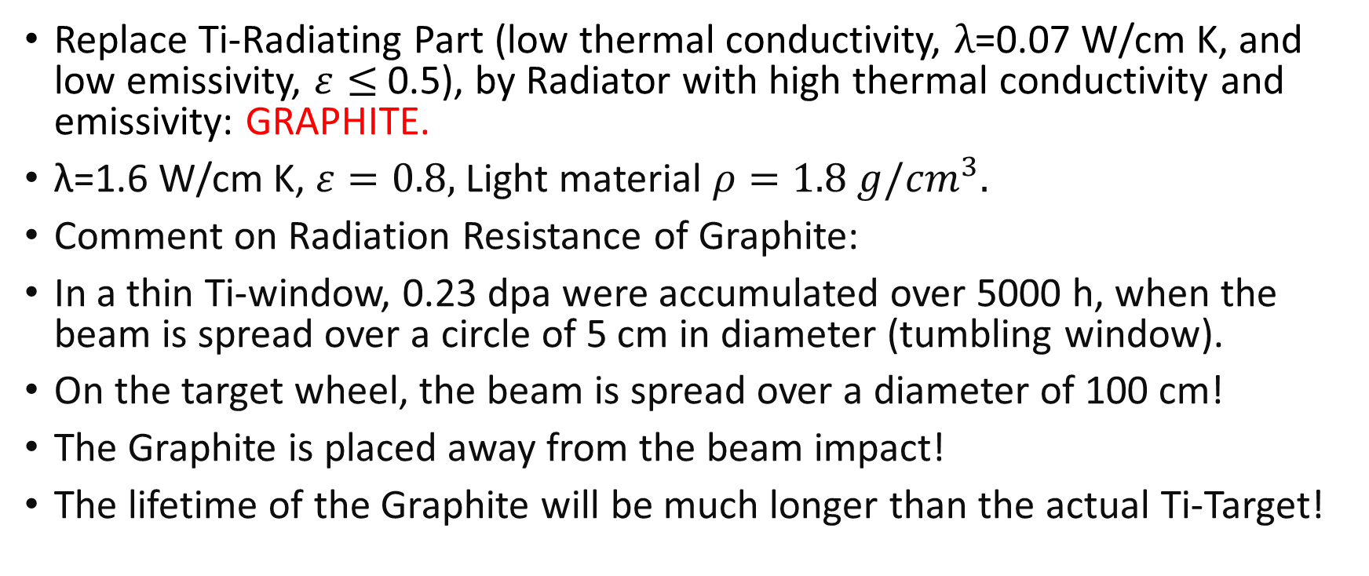
Further Improvements.
Replace Ti-Radiating Part (low thermal conductivity, $λ$=0.07 W/cm K, and low emissivity, $ε≤$ 0.5), by Radiator with high thermal conductivity and emissivity: GRAPHITE.
λ=1.6 W/cm K, $ε=0.8,$ Light material $ρ=1.8 g/{cm}^{3}.$
Comment on Radiation Resistance of Graphite:
In a thin Ti-window, 0.23 dpa were accumulated over 5000 h, when the beam is spread over a circle of 5 cm in diameter (tumbling window).
On the target wheel, the beam is spread over a diameter of 100 cm!
The Graphite is placed away from the beam impact!
The lifetime of the Graphite will be much longer than the actual Ti-Target!

Slide 7
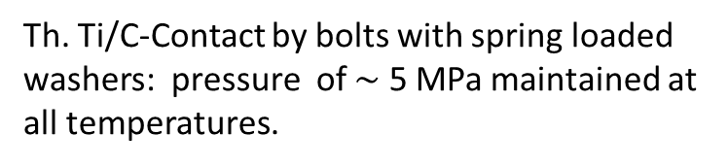
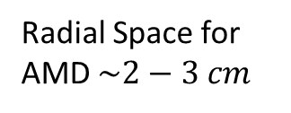
Replace Ti-Radiator by a Graphite Radiator: High Emissivity and Th. Conductivity.
7 mm
Beam
Tie Bolts
Radial Space for AMD $\sim 2−3 cm$
Thermal Ti/Graphite Contact
15 mm
Graphite Radiator
Stationary Water Cooler
Stationary Water Cooler
Th. Ti/C-Contact by bolts with spring loaded washers: pressure of $\sim$ 5 MPa maintained at all temperatures.
Tie Bolt
Local Spokes of the Carrier Wheel
10 cm
Spring Washers
Th. Ti/C-Contact
Rotating Axis

Slide 8











Undulator Wheel with Graphite Radiator, Downstream Side.
Graphite Radiator
Ti-Target Sectors
$$°$$
$$°$$
$$°$$
$$°$$
$$°$$
$$°$$
$$°$$
$$°$$
$$°$$
Spoked Carrier Wheel
$$°$$
$$°$$

Slide 9
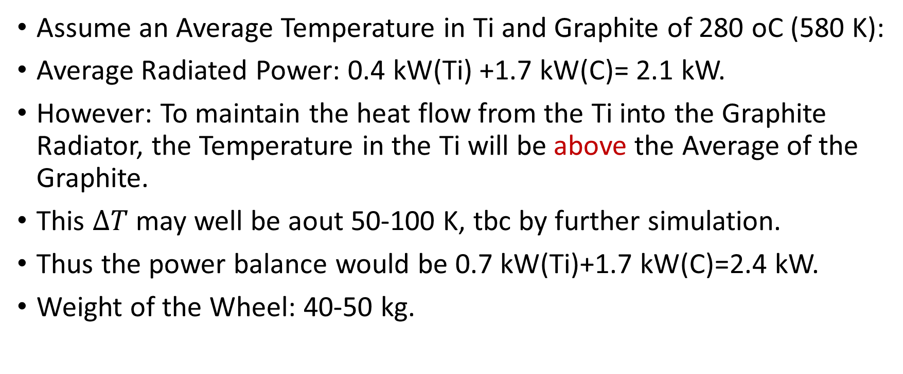
Assume an Average Temperature in Ti and Graphite of 280 oC (580 K):
Average Radiated Power: 0.4 kW(Ti) +1.7 kW(C)= 2.1 kW.
However: To maintain the heat flow from the Ti into the Graphite Radiator, the Temperature in the Ti will be above the Average of the Graphite.
This $∆T$ may well be aout 50-100 K, tbc by further simulation.
Thus the power balance would be 0.7 kW(Ti)+1.7 kW(C)=2.4 kW.
Weight of the Wheel: 40-50 kg.

Slide 10
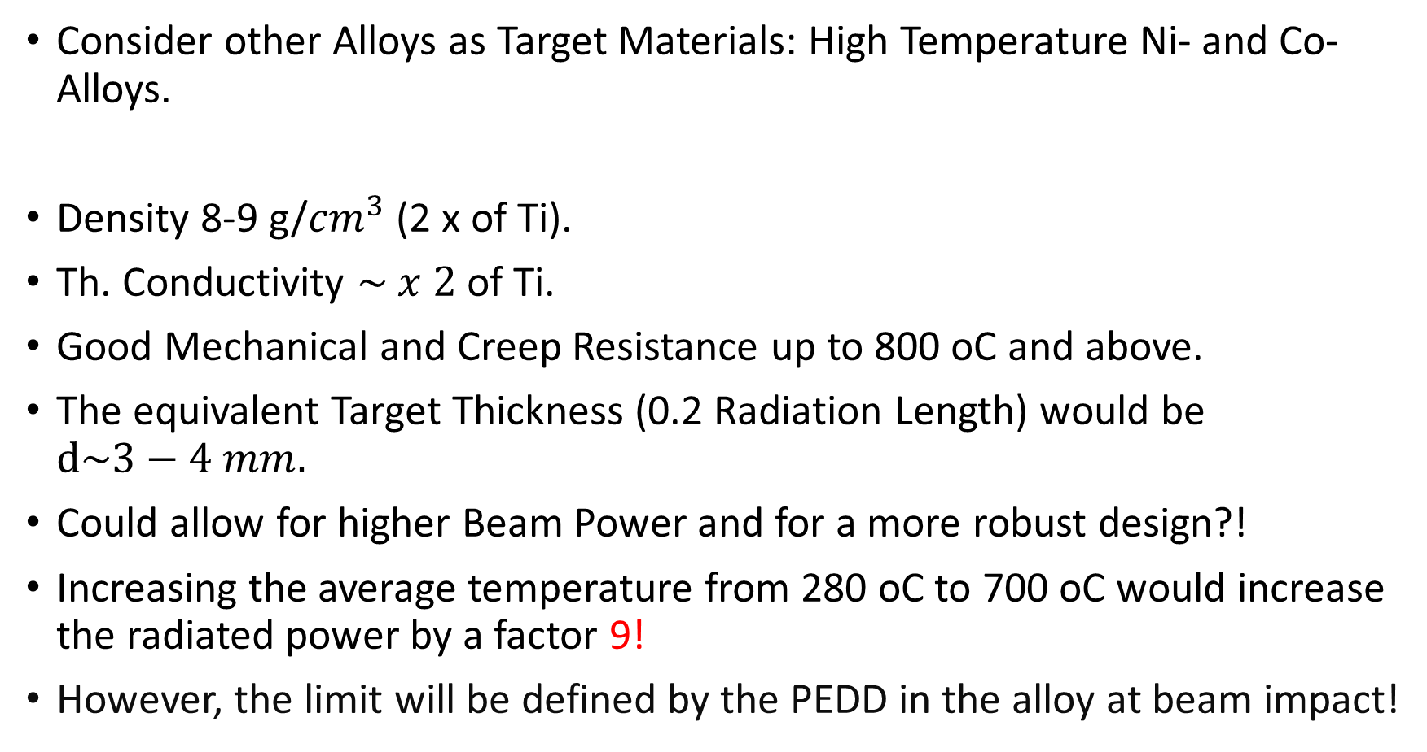
Consider other Alloys as Target Materials: High Temperature Ni- and Co-Alloys.
Density 8-9 g/${cm}^{3}$ (2 x of Ti).
Th. Conductivity $\sim x 2$of Ti.
Good Mechanical and Creep Resistance up to 800 oC and above.
The equivalent Target Thickness (0.2 Radiation Length) would be $d\sim 3−4 mm.$
Could allow for higher Beam Power and for a more robust design?!
Increasing the average temperature from 280 oC to 700 oC would increase the radiated power by a factor 9!
However, the limit will be defined by the PEDD in the alloy at beam impact!

Slide 11




Laboratory Set Up for Test of Radiation Cooling of a Target Sector with different Radiators: Ti, C or Alloys.
Vacuum Tank
Side View
Multy Layer Super Insulation
Ti-Heat Conductor
$$°$$
1 kW Electrical Heater, simulating the average beam power.
$$°$$
«Ti-Target»
$$°$$
Thermo-Couples
«Radiator» in Ti, C or Alloy
$$°$$
Water Cooled Cooler

Slide 12
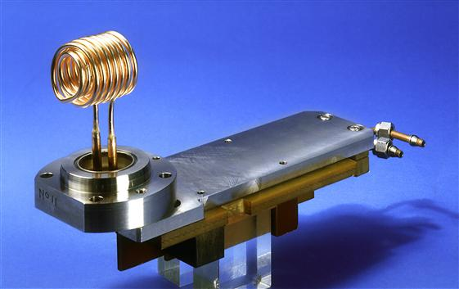
The LEP-Pulsed Solenoid- L. Rinolfi.
I=2.5 kA, Bo=0.83 T, 100 Hz with 20 µs.
2. Collection of Positrons by a Solenoid as an Adiabatic Matching Device AMD.

Slide 13
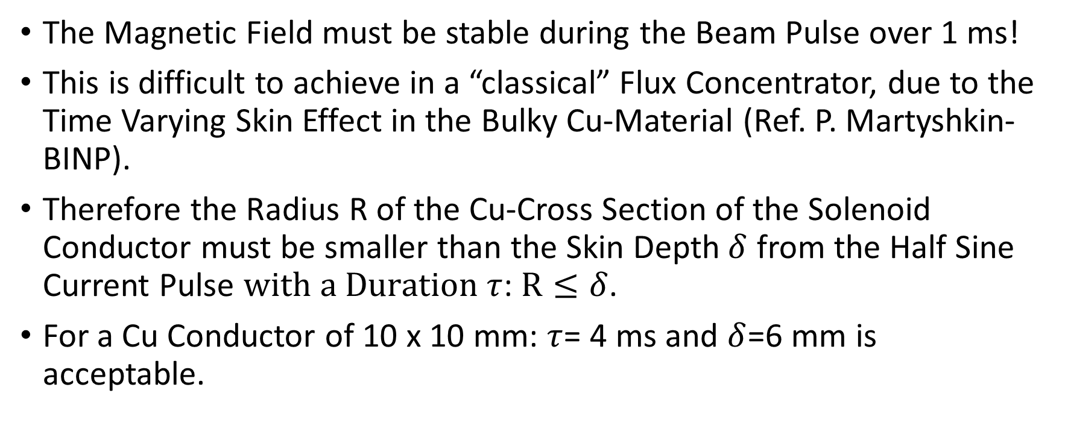
A Pulsed Solenoid for the ILC-Undulator Target.
The Magnetic Field must be stable during the Beam Pulse over 1 ms!
This is difficult to achieve in a “classical” Flux Concentrator, due to the Time Varying Skin Effect in the Bulky Cu-Material (Ref. P. Martyshkin-BINP).
Therefore the Radius R of the Cu-Cross Section of the Solenoid Conductor must be smaller than the Skin Depth$δ$ from the Half Sine Current Pulse $with a Duration τ$: $R≤δ$.
For a Cu Conductor of 10 x 10 mm: $τ$= 4 ms and $δ$=6 mm is acceptable.

Slide 14
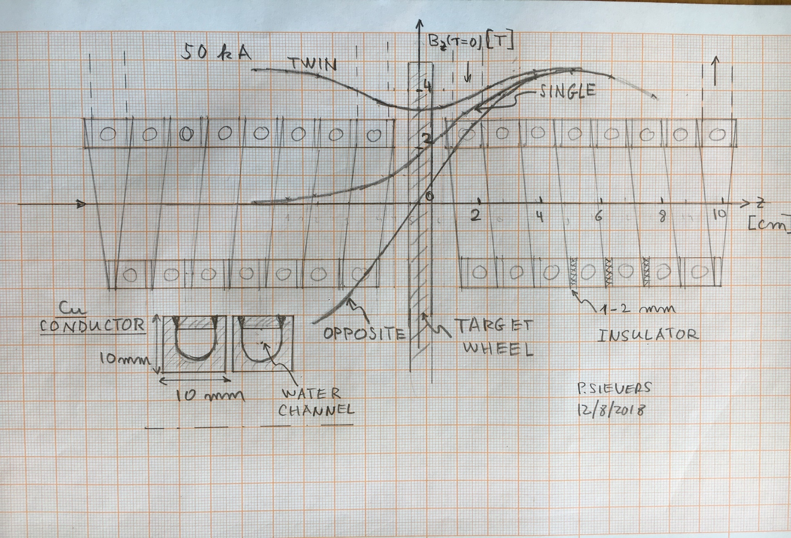
Aperture 4 cm, 50 kA, 7 Turns.

Slide 15
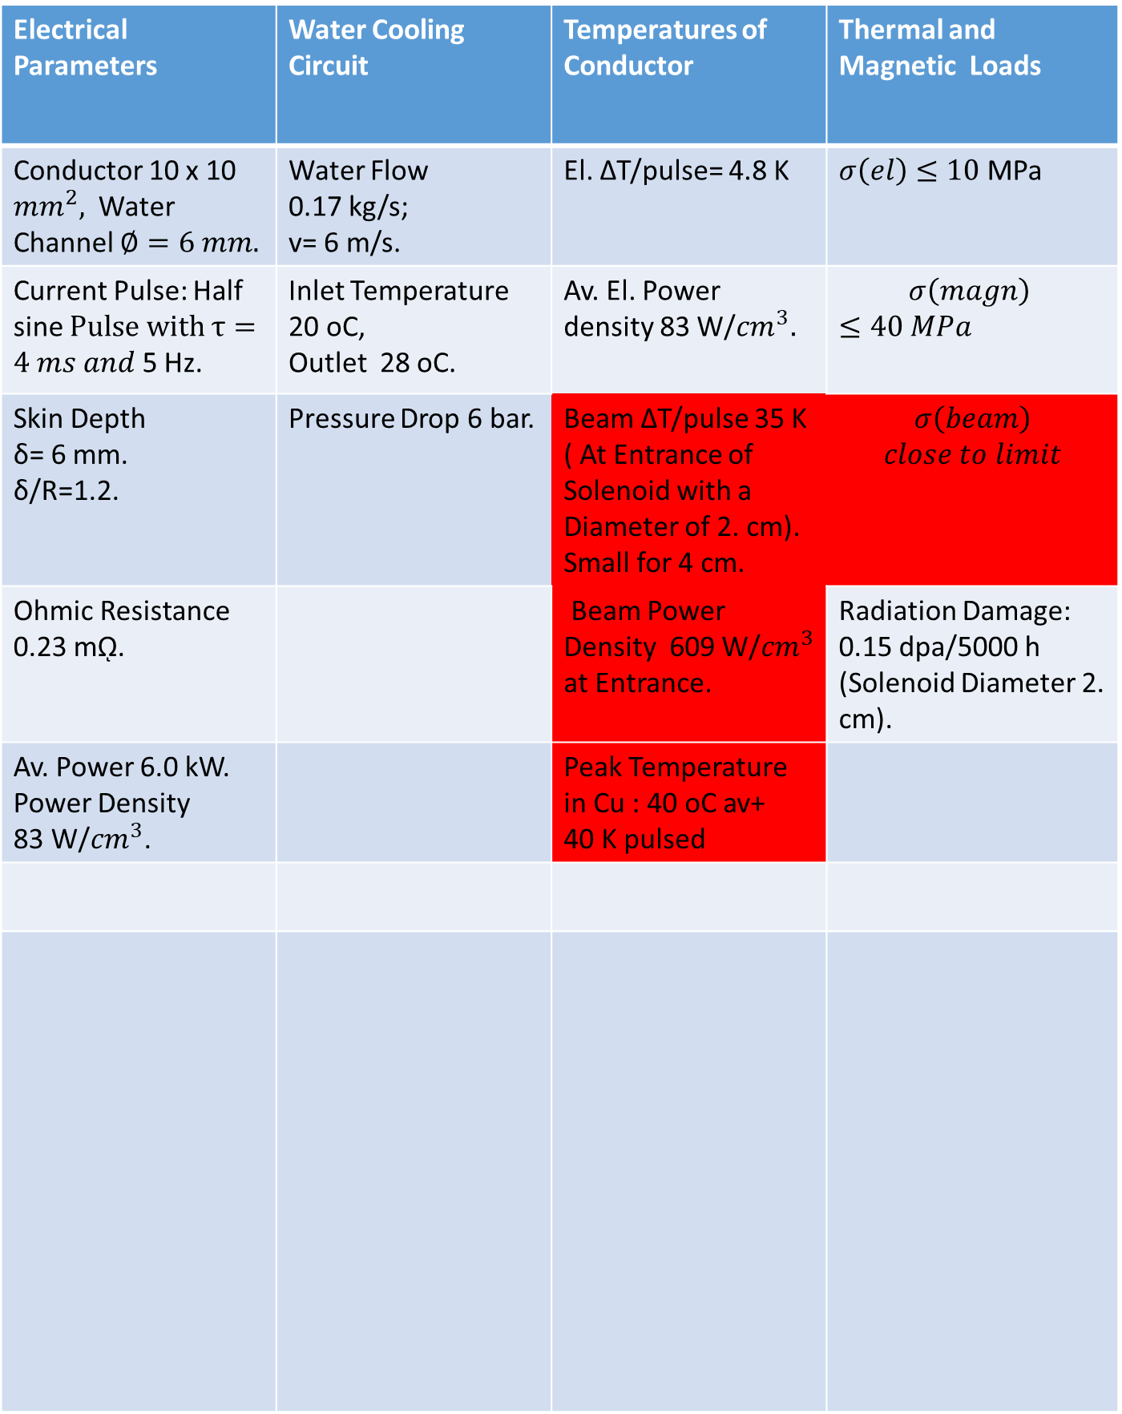
Electrical Parameters | Water Cooling Circuit | Temperatures of Conductor | Thermal and Magnetic Loads
Conductor 10 x 10 ${mm}^{2},$ Water Channel $∅=6 mm.$ | Water Flow 0.17 kg/s; v= 6 m/s. | El. ΔT/pulse= 4.8 K | $σ\left(el\right)≤10$ MPa
Current Pulse: Half sine $Pulse with τ=4 ms and$ 5 Hz. | Inlet Temperature 20 oC, Outlet 28 oC. | Av. El. Power density 83 W/${cm}^{3}.$ | $$σ\left(magn\right)$$ $$≤40 MPa$$
Skin Depth δ= 6 mm. δ/R=1.2. | Pressure Drop 6 bar. | Beam ΔT/pulse 35 K ( At Entrance of Solenoid with a Diameter of 2. cm). Small for 4 cm. | $$σ\left(beam\right)$$ $$close to limit$$
Ohmic Resistance 0.23 mῼ. |  | Beam Power Density 609 W/${cm}^{3}$ at Entrance. | Radiation Damage: 0.15 dpa/5000 h (Solenoid Diameter 2. cm).
Av. Power 6.0 kW. Power Density 83 W/${cm}^{3}$. |  | Peak Temperature in Cu : 40 oC av+ 40 K pulsed
Power Supply has still to be considered!

Slide 16

Conical Pulsed Solenoid
Ceramic Spacers and Brackets
Current Inlet
Target
Solenoid Coils must be well constrained by a ceramic insulating Strucure, to resist to pulsed Magnetic Forces.
Beam
$$≥20 mm$$
Cu-Conductor Spiral
Water Cooling Channel
Current Outlet

Slide 17
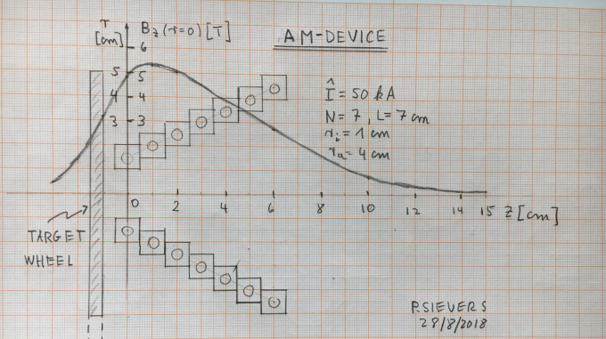
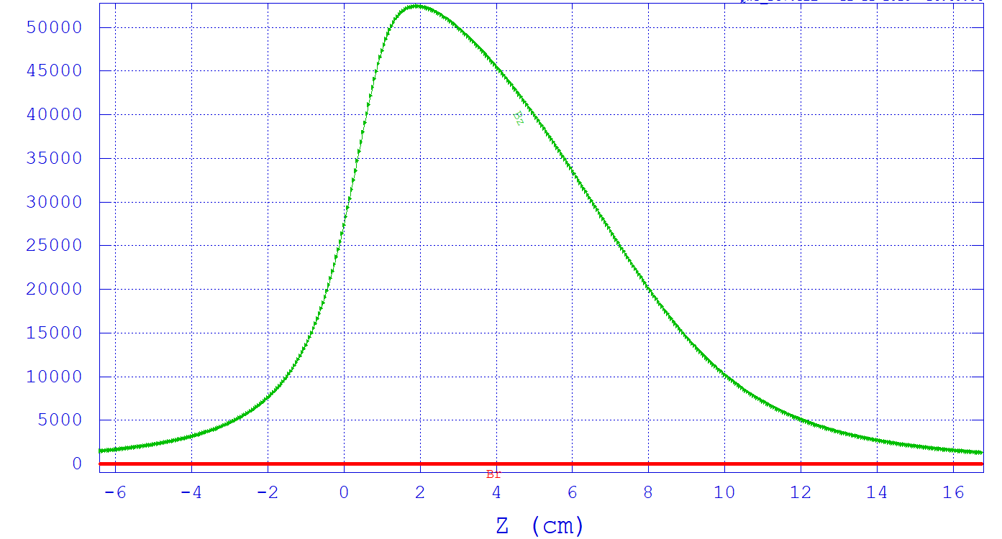
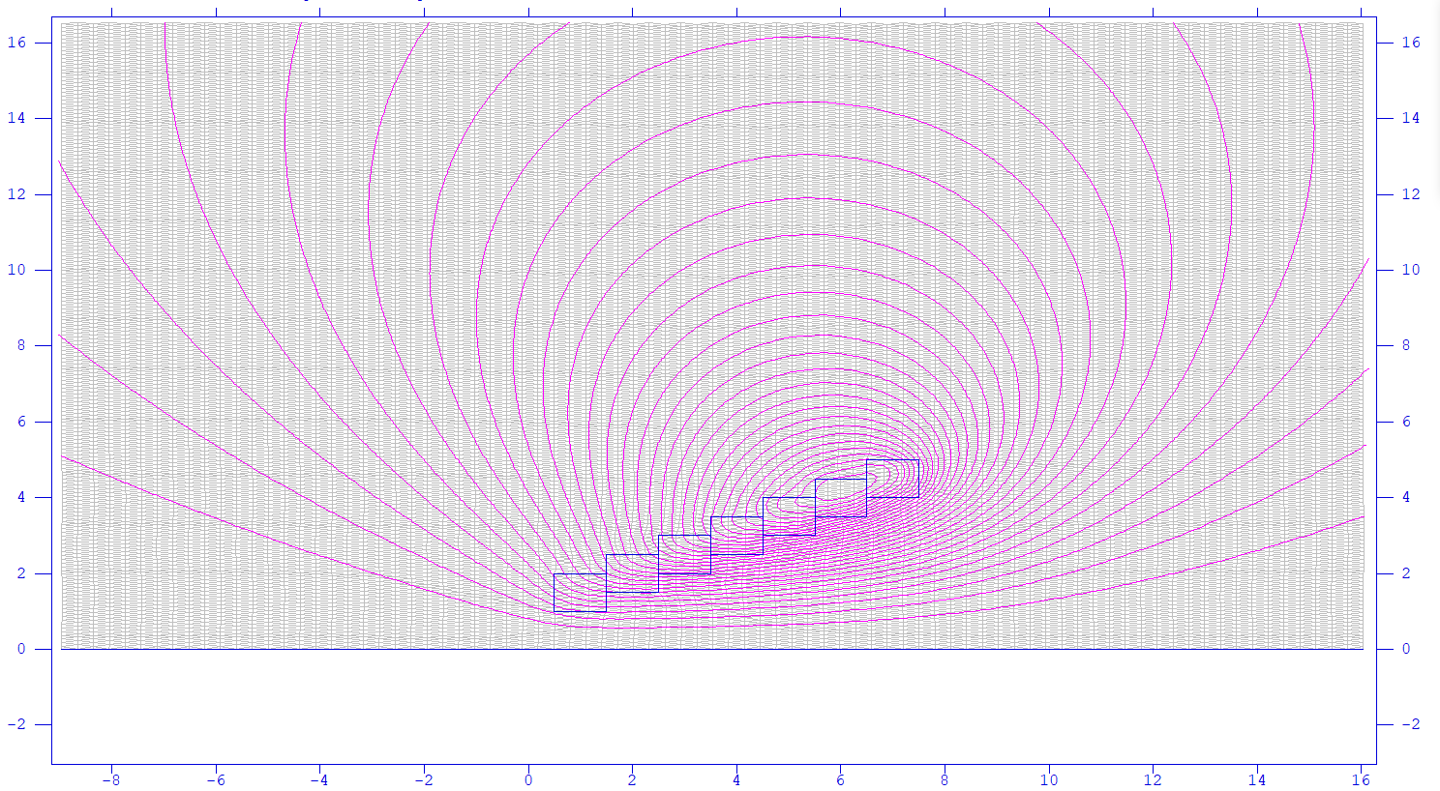
Magnetic field calculated by POISSON, Ref. Fukuda-san.
The magnetic field of the pulse solenoid was calculated by POISSON.
The coil current is 50kA.
The cross section of the coil is 10mm x 10mm square.
Field at the rear of the target 2.-2.5 T.
With an additional upstream solenoid could go up to 4 T.
Flux Return to be considered!
Bz on the Z-axis
Field of the FC is Dragged by the rotating Wheel. To be studied!
70mm
Z=0: Target rear surface

Slide 18
Number of positrons after acceleration (125MeV)
I scanned the phase of accelerating field to find the maximum point of
number of positrons. The best phase is 280deg.
Number of positron has increased 1.5 times when the pulse solenoid is used.
Pulse solenoid (5.3T)
QWT (1.04T)

Slide 19
Power and Forces, induced in the Rotating Wheel by the Quasi Static Magnetic Field of the Pulsed Solenoid.
An axial field in rotational symmetry is assumed, similar to the field at the upstream side of a solenoid.
Due to the very low electrical conductivity of the Ti-alloy, for a pulse of 4 ms the skin depth is about 6 cm. The Ti-target becomes transparent to this pulsed magnetic field. No skin effect, only slowly varying field.

Slide 20
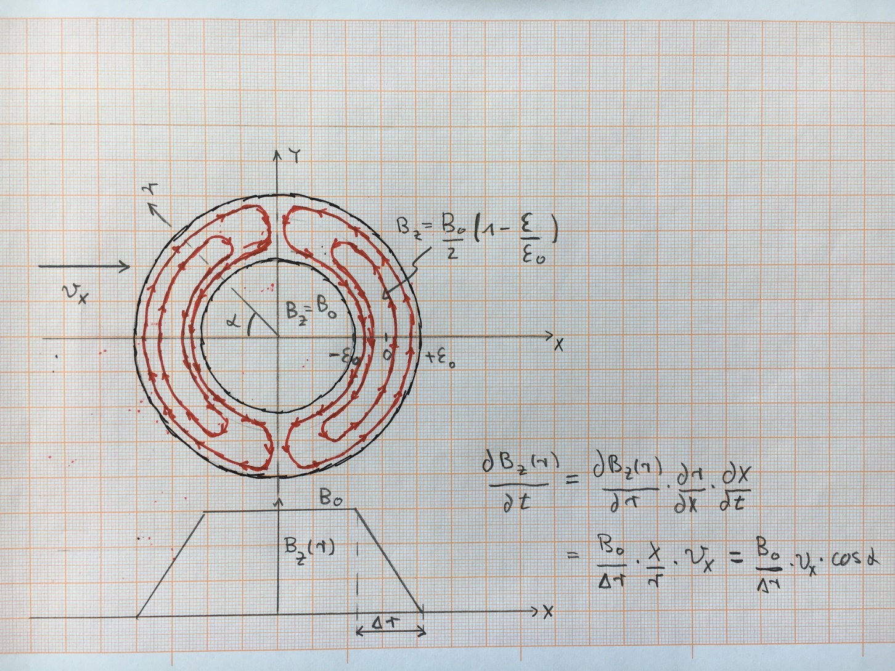
Principal Geometry and Magnetic Field
Induced currents, in red, only where $∂B_{r}/∂r≠0$

Slide 21
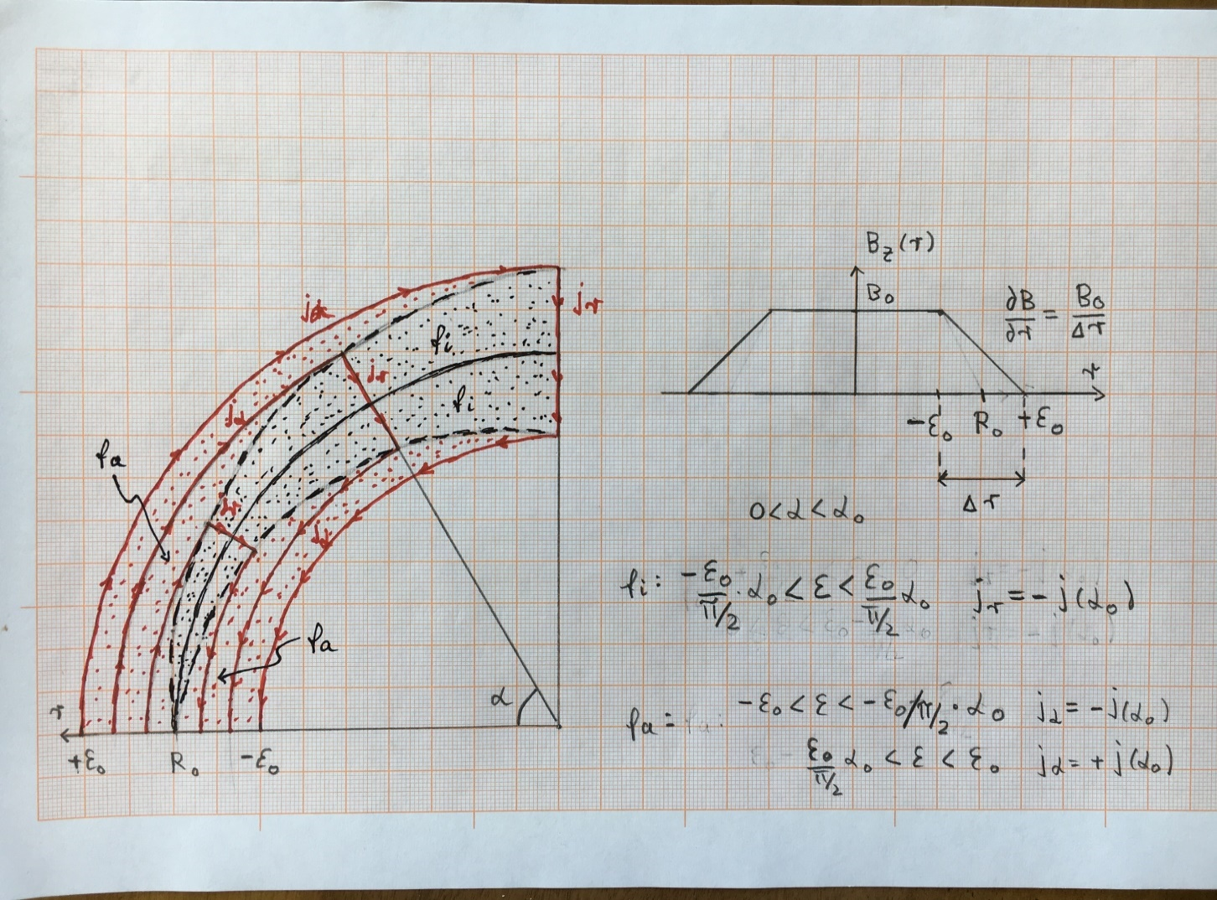

${Azimuthal j}_{α}$ inside red zone $f_{a}$, radial $j_{r}$ inside black zone $f_{i}$.
Boundary between $f_{i} and f_{a }dashed line in black.$

Slide 22
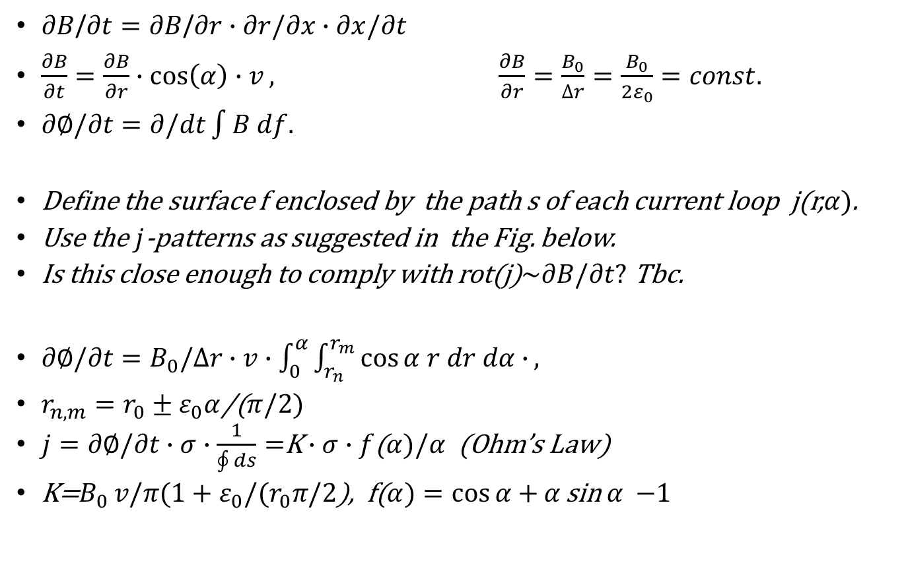
Consider Cylindrical Symmetry.
$∂B$/$∂t=∂B$/$∂r∙∂r/∂x∙∂x/∂t$
$\frac{∂B}{∂t}=\frac{∂B}{∂r}∙\cos\left(α\right)∙v, \frac{∂B}{∂r}=\frac{B_{0}}{∆r}=\frac{B_{0}}{2ε_{0}}=const.$
$∂∅/∂t=∂/dt\int{B df.}$
Define the surface f enclosed by the path s of each current loop j(r,$α)$.
Use the $j$-patterns as suggested in the Fig. below.
Is this close enough to comply with rot(j)$\sim ∂B/∂t?$ Tbc.
$∂∅/∂t=B_{0}/∆r∙v∙\int_{0}^{α}{\int_{r_{n}}^{r_{m}}{\cos{α r dr dα}}∙},$
$r_{n,m}=r_{0}±ε_{0}α$/($π/2)$
$j=∂∅/∂t∙σ∙\frac{1}{\oint{ds}}=$K$∙$ $σ∙f$($α)/α$ (Ohm’s Law)
K=$B_{0 }v/π(1+ε_{0}/(r_{0}π/2$), f($α)=\cos{α+}α$ sin $α$ $−1$

Slide 23
${Azimuthal j}_{α}$ inside red zone $f_{a}$, radial $j_{r}$ inside black zone $f_{i}$.
Boundary between $f_{i} and f_{a }dashed line in black.$

Slide 24
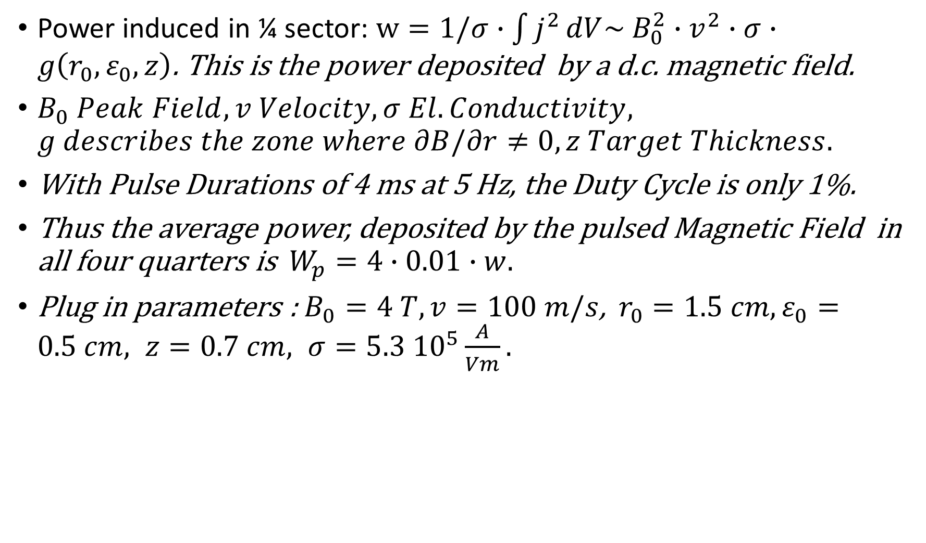
Power induced in ¼ sector: $w=1/σ∙\int{j^{2}}dV\sim B_{0}^{2}∙v^{2}∙σ∙g\left(r_{0},ε_{0},z\right)$. This is the power deposited by a d.c. magnetic field.
$B_{0} Peak Field, v Velocity, σ El. Conductivity, g describes the zone where ∂B/∂r≠0,z Target Thickness.$
With Pulse Durations of 4 ms at 5 Hz, the Duty Cycle is only 1%.
Thus the average power, deposited by the pulsed Magnetic Field in all four quarters is $W_{p}=4∙0.01∙w.$
Plug in parameters : $B_{0}=4 T, v=100 m/s$, $r_{0}=1.5 cm, ε_{0}=0.5 cm, z=0.7 cm, σ=5.3 {10}^{5}\frac{A}{Vm}.$

Slide 25
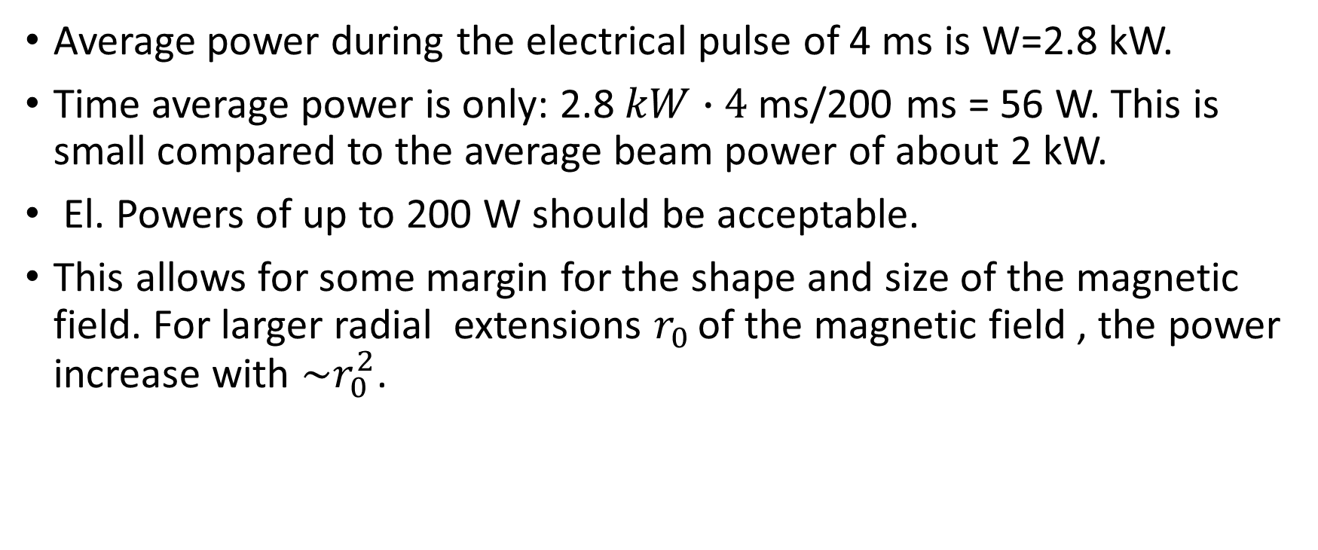
Average power during the electrical pulse of 4 ms is W=2.8 kW.
Time average power is only: 2.8$kW∙4$ms/200 ms = 56 W. This is small compared to the average beam power of about 2 kW.
El. Powers of up to 200 W should be acceptable.
This allows for some margin for the shape and size of the magnetic field. For larger radial extensions $r_{0 }$of the magnetic field , the power increase with $\sim r_{0}^{2}$.

Slide 26
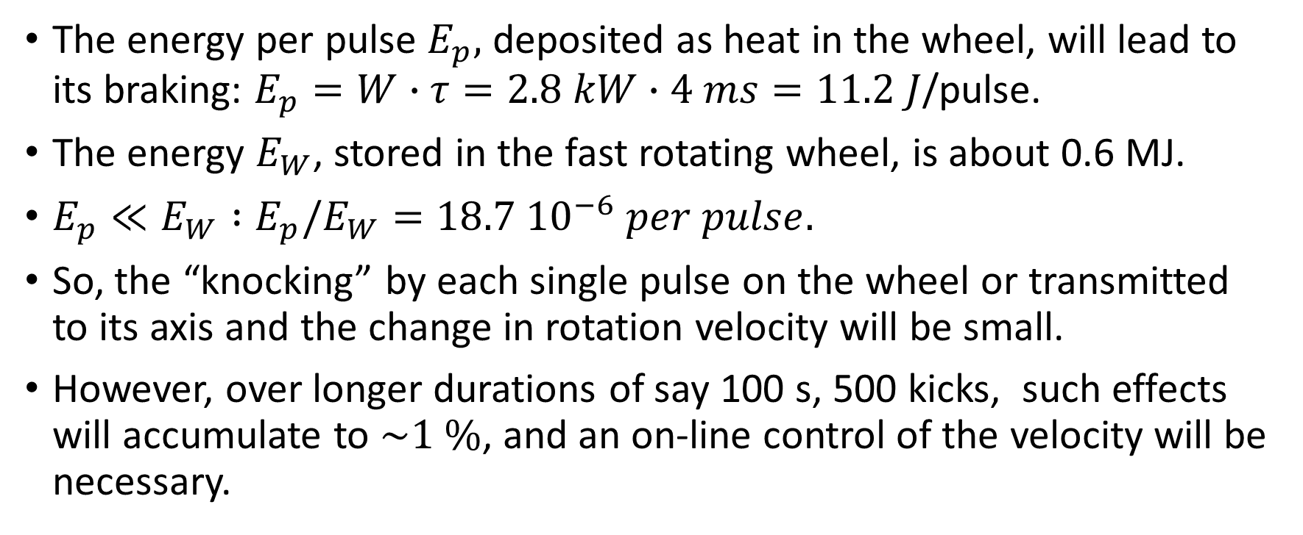
Mechanical Response of the Wheel to the Pulsed Magnetic Braking.
The energy per pulse $E_{p},$ deposited as heat in the wheel, will lead to its braking: $E_{p}=W∙τ=2.8 kW∙4 ms=11.2 J$/pulse.
The energy $E_{W}$, stored in the fast rotating wheel, is about 0.6 MJ.
$E_{p}≪E_{W} :E_{p}/E_{W}=18.7 {10}^{−6} per pulse.$
So, the “knocking” by each single pulse on the wheel or transmitted to its axis and the change in rotation velocity will be small.
However, over longer durations of say 100 s, 500 kicks, such effects will accumulate to $\sim 1 \%$, and an on-line control of the velocity will be necessary.

Slide 27
3. Conclusion.
Based on the initial studies of the temperatures and cooling by radiation of the Ti-target wheel (Ref. S.Riemann et al.), some design aspects have been revisited:
Reduction of the weight of the target.
Proposals to improve the cooling by more efficient radiators:
Increase the diameter and thickness of the Ti-wheel outside the position of the beam impact.
Use Graphite or high temperature alloys.
These considerations must still be verified by simulations and validated by experimental laboratory tests.

Slide 28
For the Adiabatic Matching Device, AMD, a solenoid, pulsed at 5 Hz is proposed.
With a 4 ms current pulse, a sufficiently stable magnetic field can be achieved at its peak over the duration of the beam pulse of 1 ms.
With 50 kA pulses, magnetic fields close to the target of about 4 T can be reached.
The engineering and cooling of this solenoid looks possible.
The power and forces, induced by the pulsed solenoid in the fast rotating Ti-wheel, are tolerable.
The pulsed network has still to be designed.
The field quality and its imperfections have to be studied in detail.
These are very important issues for the positron yield.

Slide 29
Thank You for Your Attention.

Slide 30
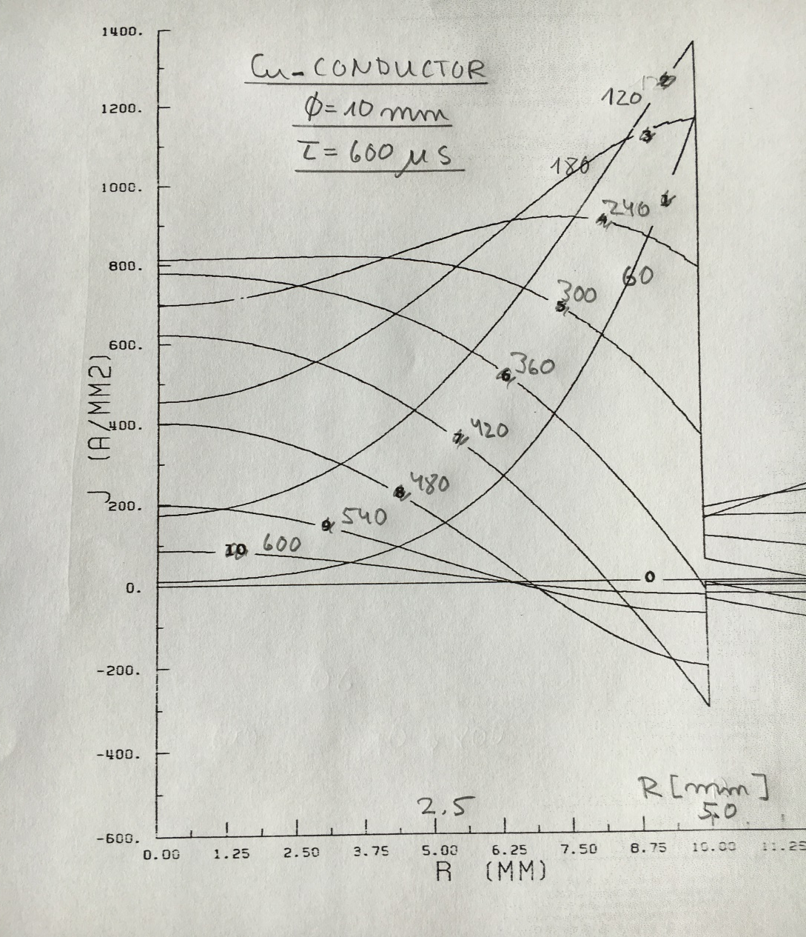
Backups

Slide 31
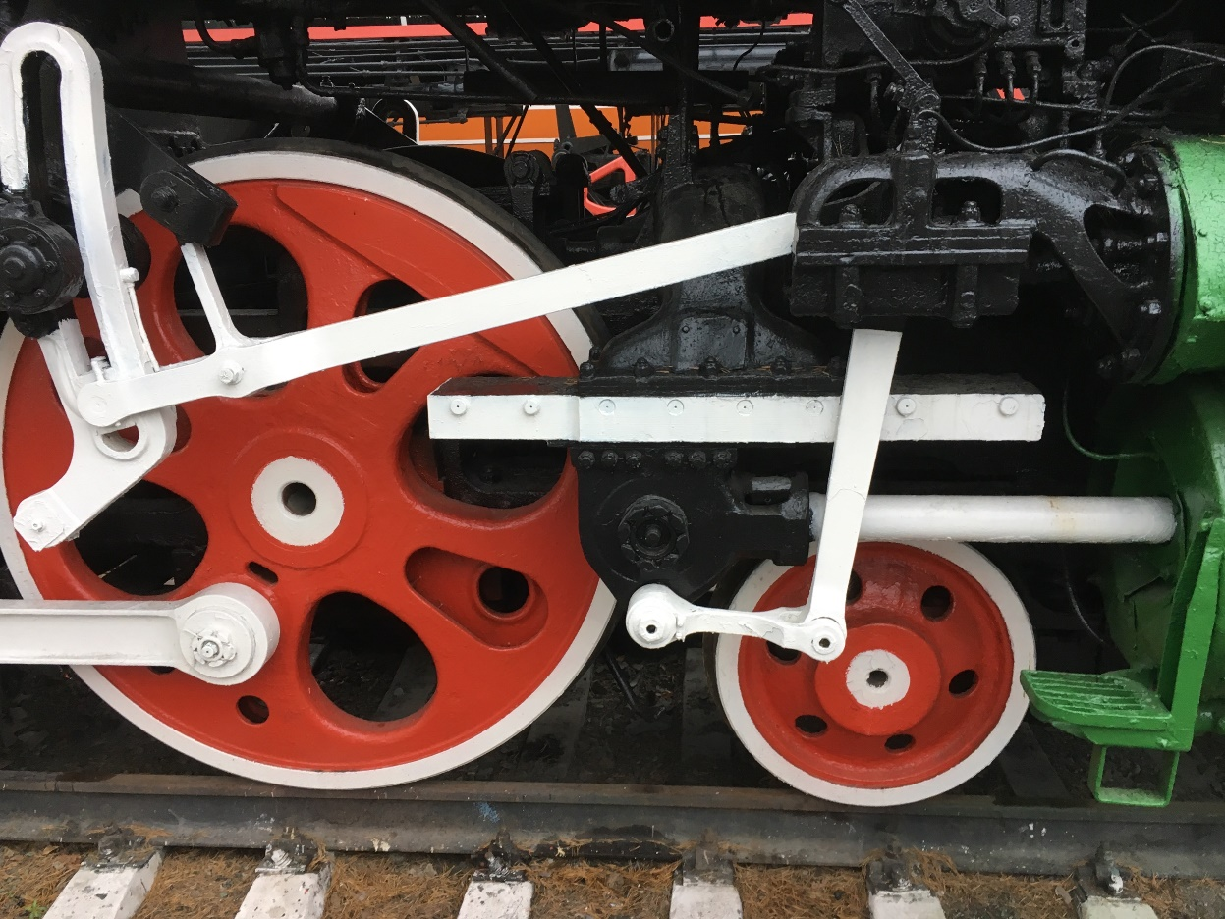
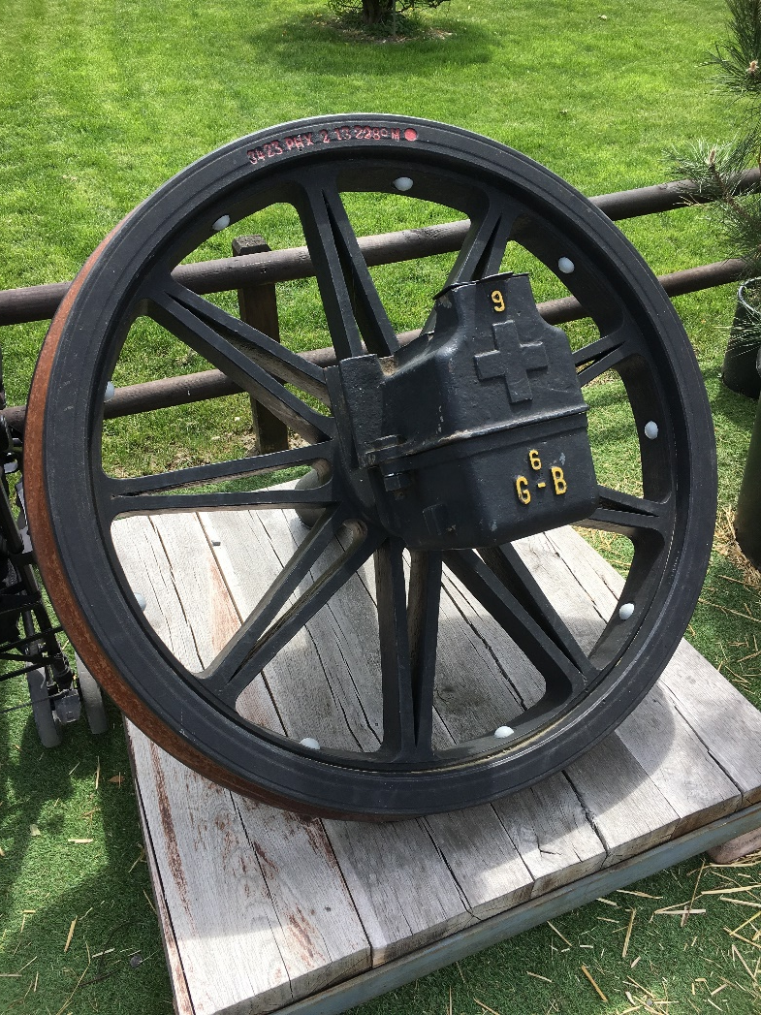
Some Old Style Wheels.

