Slide 1
Progress in the Accelerator Design
Operation at Z-pole
Status of Positron Source Development
Kaoru Yokoya
2019.10.29 LCWS2019, Sendai

Slide 2
Z-pole Operation of ILC@250
This report presents study results about the Z-pole (E_{CM} =91.2GeV) operation of ILC@250, assuming the undulator scheme for positron production.
The possibility of Z-pole operation was first discussed by N. Walker
  “ILC possibilities at Z and W”,
  http://ilcdoc.linearcollider.org/record/63004?ln=ja
and by KY at the LCWS2016 at Morioka in Dec.2016 .
  LCWS2016-ZpoleOperation-Yokoya.pptx in
    https://agenda.linearcollider.org/event/7371/contributions/38173/
These reports only gave a speculation by a scaling law and some comments on the issues to be studied
The situation has changed since then
  ILC energy is now 250GeV rather than 500GeV with shorter linacs
  The baseline luminosity at 250GeV has been improved from 0.82E34 to 1.35E34 since AWLC at SLAC in Jun.2017, by adopting a reduced (halved) horizontal emittance with a new lattice of the damping ring.

Slide 3
Issues to Be Considered
Repetition rate
Damping Ring
  Dynamic aperture under increased wiggler strength
Main Linac
  Alternating operation 125GeV ←→ 45.6GeV
  Emittance growth due to the low gradient
BDS
  Collimation depth
  Momentum bandwidth
  Wakefield
Beam-Beam
More technical details for DR, ML and BDS will be presented by K.Kubo and T.Okugi in the Beam Dynamics parallel session (Wednesday 8:30).

Slide 4
Parameter Set
This is the result of the study by K.Kubo, T.Okugi, and KY
Uploaded in
http://arxiv.org/abs/1908.08212
See parallel sessions for more detail

Slide 5
Repetition Rate
Obviously, the electron beam with energy E=91.2/2=45.6 GeV is not sufficient to produce the positron beam
TDR adopted 5+5Hz operation at E_{CM} =250GeV, assuming the power system for 500GeV
  5Hz to produce positron, 5Hz for colliding beam
  Assumed positron production at E_{e}=150GeV
  No power problem
    The required power for 150GeV (5Hz) + 45.6GeV (5Hz) is lower than that for 250GeV (5Hz)
However, the power system of ILC@250 is not sufficient for 5+5Hz operation
Here, we assume 3.7+3.7 Hz operation is possible
  This value was estimated by T. Matsumoto
  Klystron output power can be changed at 5Hz but the loaded Q (5.46x10⁶) cannot be changed
  Assume same bunch interval (554ns) for 125 and 45.6GeV
  Parameters: (obtained by T.Matsumoto, KEK)
    Gradient 31.5 ←→ 8.76 = 31.5x (45.6-15)/(125-15) MV/m
    Peak power per cavity 189 ←→ 77.2 kW
    Klystron peak power 9.82 ←→ 4.15 MW
    Klystron efficiency 67% ←→ 53%
    Modulator output 14.66 ←→ 7.83 MW
    Fill time 0.927 ←→ 0.328 ms
    Beam pulse length 0.727 ←→ 0.727 ms
    RF pulse length 1.65 ←→ 1.06 ms
    Rep rate 3.7 ←→ 3.7 Hz
135ms
135ms
45.6GeV for Z
125GeV for e+

Slide 6
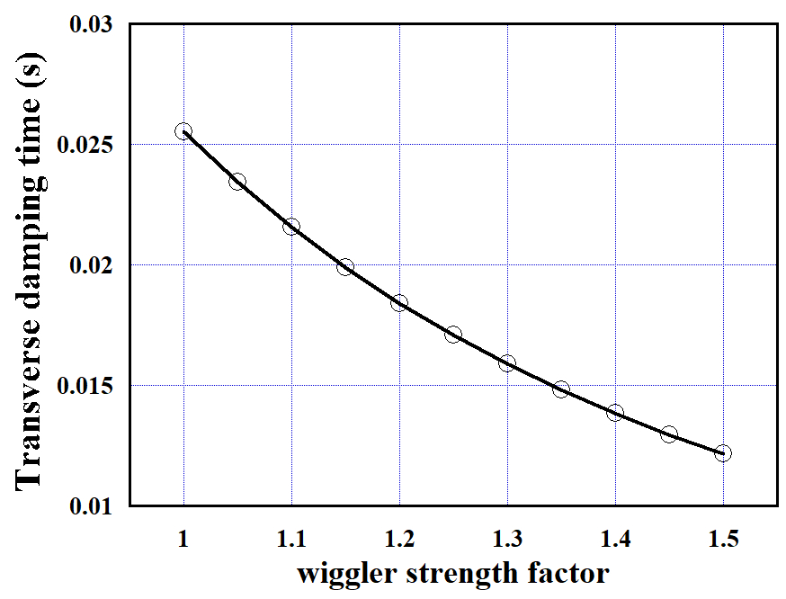
Damping Ring
Horizontal emittance improved 6μm → 4μm
(AWLC2017@SLAC)
Reinforce the wigglers for the shorter time for damping
  5Hz: 200ms → 3.7+3.7Hz : 270ms/2=135ms
  Wigglers are ready (TDR)
K. Kubo
Dynamic aperture of the new lattice with stronger wigglers must be confirmed
Damping time vs. wiggler strength factor →
Factor 1.0 corresponds to 1.29T (ρ⁻¹=0.07745m⁻¹)

Slide 7
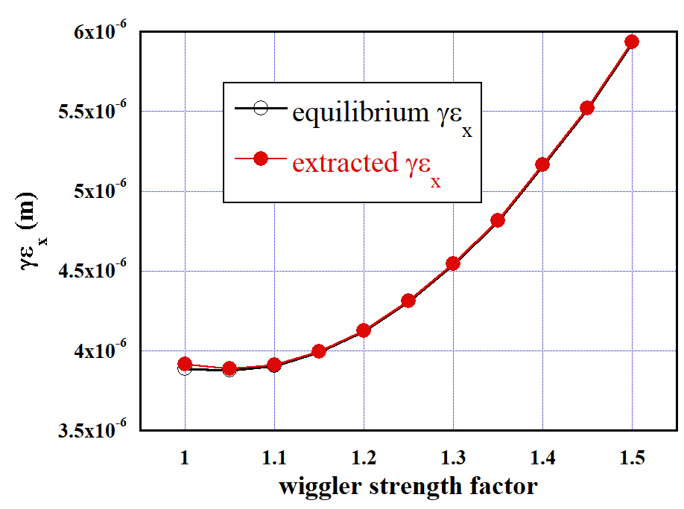
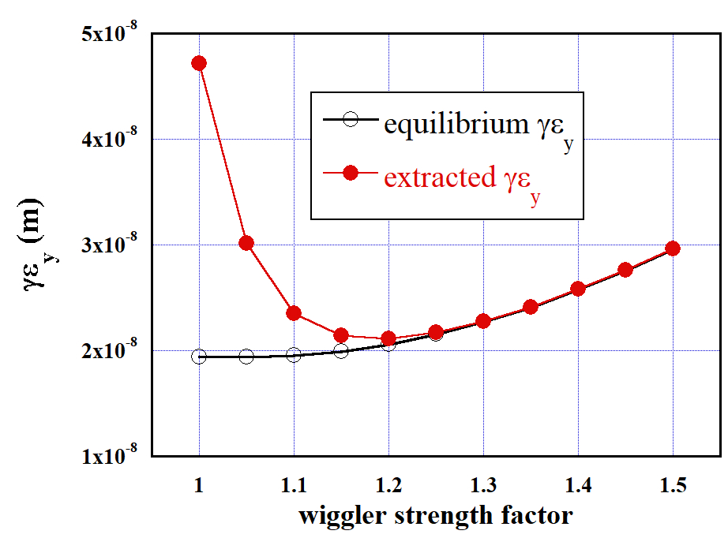
Extracted Emittance
The plots below show the equilibrium and extracted emittances as functions of the wiggler strength
Wiggler strength factor
  <1.15 gives large vertical exracted-emittance
  >1.2 gives large horizontal emittance
Factor ~1.15 (1.48T) gives the extracted emittance γε_{x} ~ 4μm, γε_{y} ~ 21nm
(extracted at 135ms)
Emittance vs. wiggler strength. Assume V-H coupling 0.005
K.Kubo

Slide 8
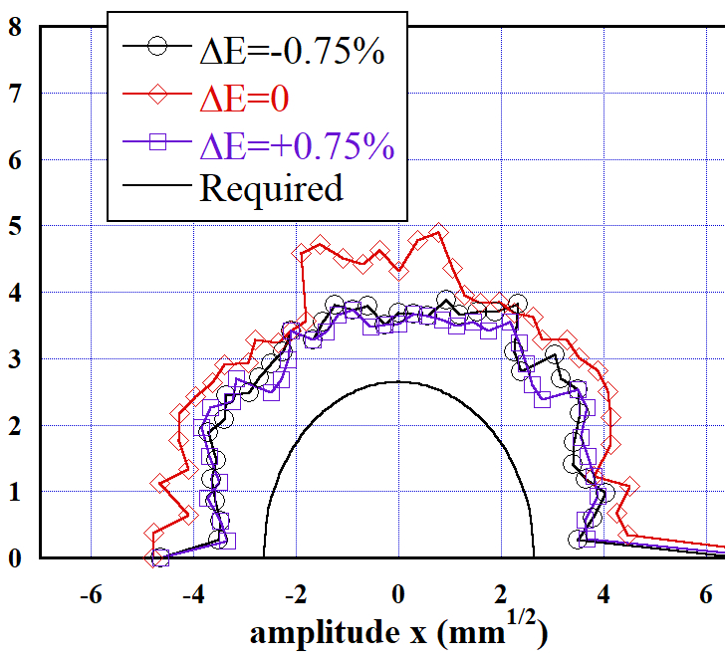
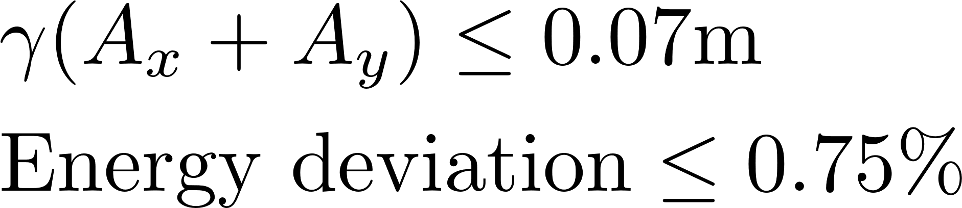
Dynamic Aperture
The plot shows the dynamic aperture for the wiggler strength factor 1.15
(The sextupole component of the wiggler field is included)
The hemi-circle around the origin shows the TDR design value
The dynamic aperture is sufficient
K.Kubo

Slide 9
Main Linac
Issues
  Orbit difference between 125 and 45.6GeV beams (due to the vertical curvature of the earth) must be corrected by pulsed magnets at the end of electron main linac
  Emittance degradation due to the low gradient for 45.6GeV
  Emittance degradation of 125GeV beam (Orbit correction to be done only for the colliding beam)
    From the previous studies we believe this is not serious

Slide 10
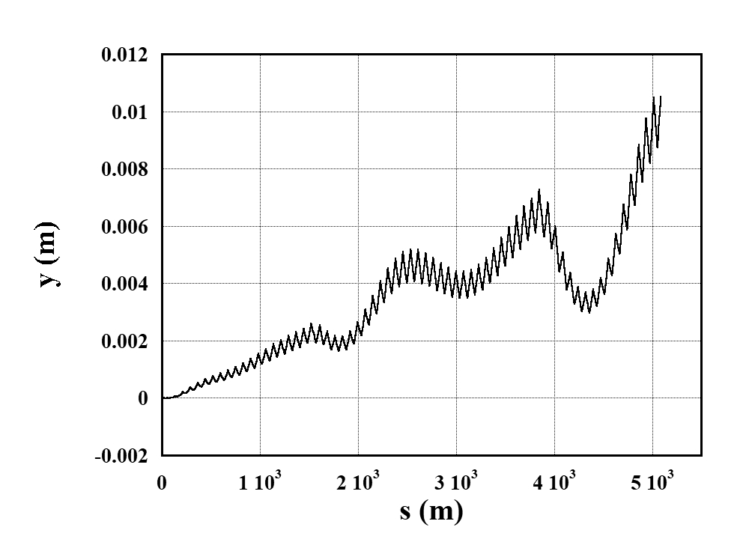
ML: Beam Dynamics : Positron production beam
2 different energy beams in electron main linac
Orbit is tuned for the colliding beam (E_{CM}/2)
The positron production beam (125GeV) will shift vertically due to earth-following curvature)
250GeV Linac !!
K.Kubo
The orbit difference is ~10mm) for E_{CM}/2=45.6 GeV,
Orbit difference itself can be corrected by pulsed magnets (3.7Hz) at ML exit

Slide 11
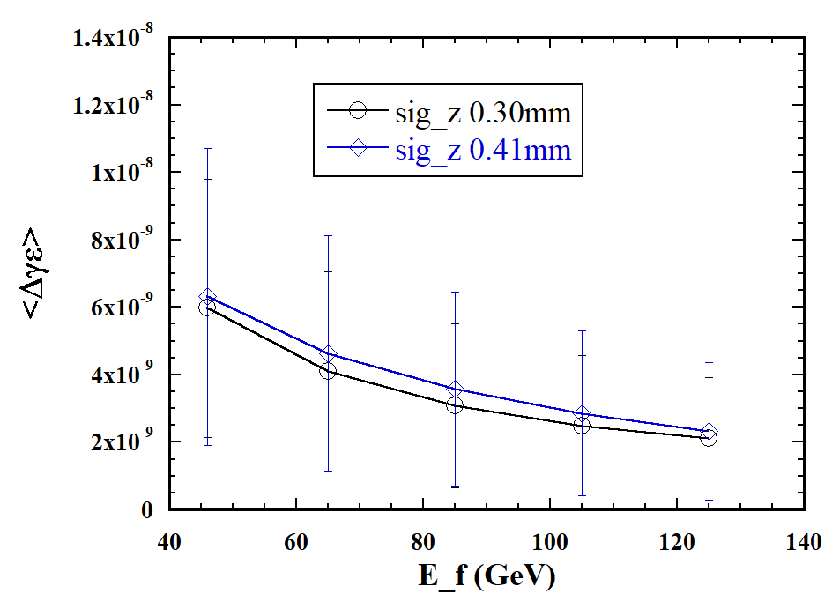
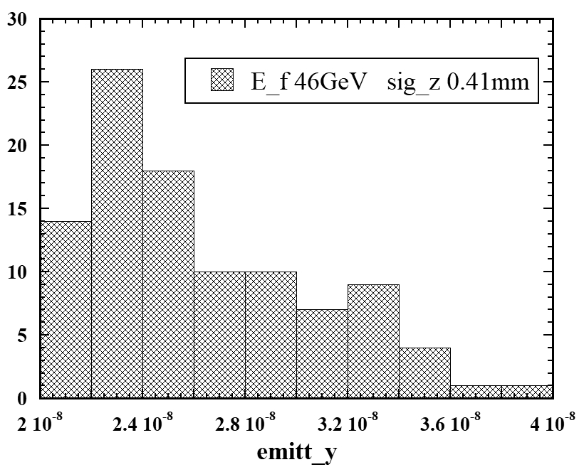
ML : Vertical Emittance Increase
Simulation of the orbit correction for 45.6GeV beam
  Q magnet offset 0.36mm, cavity 0.67mm, tilt 0.3mrad, BPM offset 1μm
  Vertical only (initial emittance γε_{y} = 20nm)
  ΔE = 20% for Dispersion Free Steering
Two cases of the bunch length σ_{z} = 0.3 and 0.41mm (see BDS)
Δγε_{y} slightly large for σ_{z} = 0.41mm
Final emittance γε_{y} = 33nm : acceptable
  we adopted 35nm in the parameter table

Slide 12
Dynamics in the Undulator Section
In the present design the colliding beam (45.6GeV) also goes through the undulator (active length 231m)
The resistive wall wake has been studied long ago. Must be revisited for the very low energy electron, but presumably OK.
Photons opening angle (~1/γ) is large. Large angle photons are mostly eliminated by the masks, but a significant fraction may hit and heat the undulator
If these turn out to be serious, we need a beamline to bypass the undulator section (~700m, not expensive at all) and additional pulsed magnets
We need to study these issues in the future
~ 1/γ

Slide 13
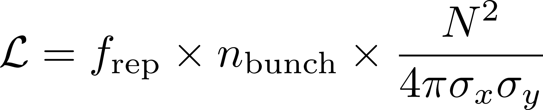
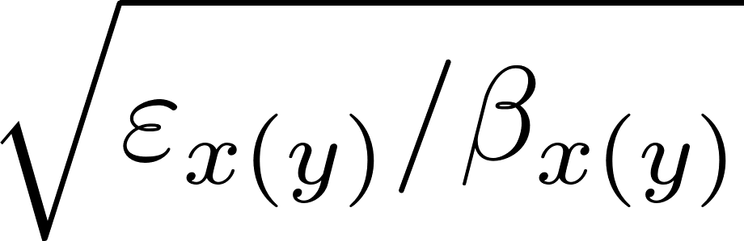
Luminosity with a Simple Scaling
Naive scaling: σ_{x}σ_{y} is proportional to sqrt(ε_{x}ε_{y}) ~ 1/E_{CM} → L ~ E_{CM}
However, the larger beam divergence near IP due to the larger emittance at low energies would cause background.
  The synchrotron radiation from halo particles from upstream hit the final quadrupole magnets
  IP beam angle is proportional to
  These halo particles must be collimated out in the collimator section
  E_{beam}=125GeV with TDR parameters (ε_{x}=10μm/γ, ε_{y}=35nm/γ, β_{x}*=13mm, β_{y}*=0.41mm) are already at the limit of horizontal collimation depth ~6σ_{x} (vertical still has big room: >40σ_{y}). (see next page)

Slide 14
Luminosity with a Simple Scaling (2)
Now, owing to the new DR design, the horizontal emittance has been improved : γε_{x}*=10→5μm
Hence, to keep the collimation depth ~6σ_{x}, the horizontal beta must be

Slide 15
Issues in the BDS
Collimation depth
  Mentioned in the previous page
  Adopt β_{y}* = 18mm
Momentum band width
Wakefield effects due to the low energy

Slide 16
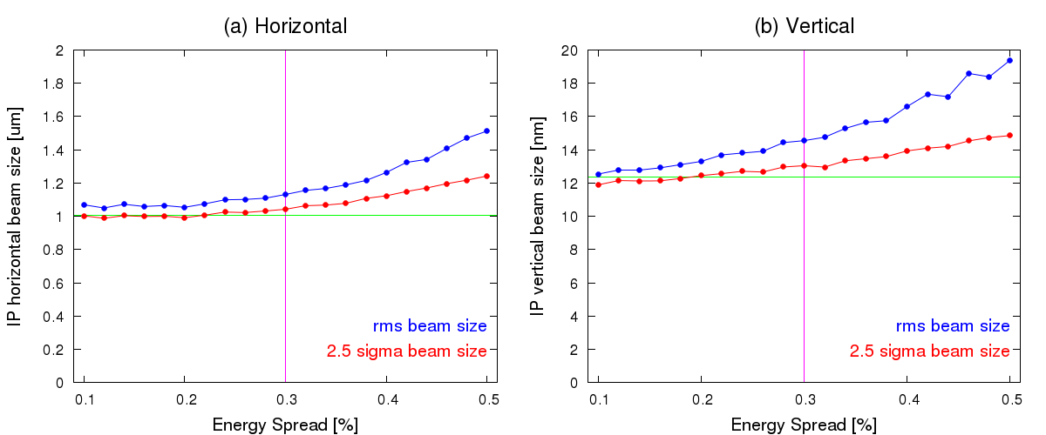
BDS : Momentum Band Width (1)
Momentum band width in FFS is a bottle neck
  TDR parameters gives the energy spread σ_{E}/E=0.41% at 45.6GeV
  (proportional to 1/E, 0.15% for 125GeV)
T.Okugi, No errors included
  The emittance increase the energy spread σ_{E}/E=0.41% is too large

Slide 17
BDS : Momentum Band Width (2)
The energy spread can be reduced by adopting a longer bunch in the bunch compressor
  σ_{E}/E) proportional to 1/ σ_{z}
  Let’s adopt
  (σ_{z}, σ_{E}/E) = (0.3mm, 0.41%) → (0.41mm, 0.30%)
  The emittance increase due to the band width is still sizable, but let us be satisfied with this.
  Side effect: increased transverse wake in the main linac and BDS
    Main linac: already examined. Accelptable
It may be possible to adopt new final quads with larger apertures dedicated to Z-pole operation (to relax the collimation depth)
  Required fields are low for 45.6GeV
  To be studied next time

Slide 18
BDS : Tuning Simulation (1)
Tuning simulation done with the error parameters in the table
  For Q-BPM and sext-BPM alignment, here adopted 5μm, tighter than 10μm in BDS simulations, expecting several year operation experience
Bend | rotation | 100 | μrad
 | field strength | 1x10⁻⁴
 | alignment to BPM | 100 | μm
Quad | alignment (x,y) | 100 | μm
 | rotation | 100 | μrad
 | field strength | 1x10⁻⁴
 | sext. component B₂/B₁ at r=1cm | 1x10⁻⁴
 | alignment to BPM | 5 | μm
Sext. | alignment (x,y) | 100 | μm
 | rotation | 100 | μrad
 | field strength | 1x10⁻⁴
 | alignment to BPM | 5 | μm
For wakefield simulation the dislocation of 0.3mm is assumed for the wake sources (~100 BPMs)

Slide 19
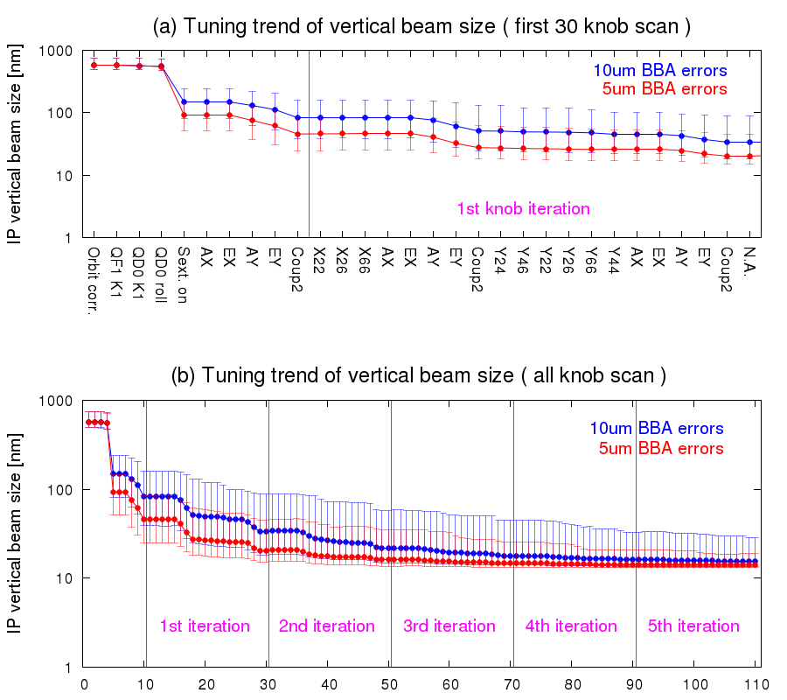
BDS : Tuning Simulation (2)
Example of tuning simulation process
σ_{y}* (nm)
T. Okugi
σ_{y}* (nm)

Slide 20
BDS : Tuning Simulation (3)
Simulation Results
 | σ_{x}*(μm) | σ_{ψ}*(nm)
No errors | 1.04 | 12.7
Magnet errors + correction | 1.12 | 14.0
Magnet errors + static wake + correction |  | 14.3
Magnet errors + static&dynamic wake + correction |  | 14.6
T. Okugi
The effective emittance increase as
γε_{x}* = 5μm → 6.2 μm
γε_{ψ}* = 35nm → 48.5nm
These values are used for the beam-beam simulation

Slide 21
Beam-Beam Interaction
The effets of beamstrahlung is small
  L at top 1% is ~99.0%
The disruption parameter ~32 is not larger than 250GeV value ~35
So, we did not check the luminosity sensitivity to offset

Slide 22
Z-Pole Summary
The previous reports (N.Walker, KY at LCWS2016@Morioka) suggested the expectation L=(1-1.5)x10³³ /cm²/s at Z-pole in 5+5Hz operation of ILC500
ILC250 (shorter linac) is
  Worse in total available power → up to 3.7+3.7Hz operation
  But better in beam dynamics (emittance growth at low gradient)
The previous luminosity improvement for ILC250 by smaller horizontal emittance (AWLC2017@SLAC) brings about significant effects for Z-pole operation
Expected luminosity is now L ~ 2.1 x 10³³ /cm²/s
No particular problem is expected in doubling the luminosity by doubling the number of bunches
If you want even higher luminosity, the bottle neck is the momentum band width of BDS under the large energy spread of the low energy beam

Slide 23
Positron Status
Undulator (many slides from Sabine Riemann)
e-Driven
Positron Working Group Report written in May last year, available at
http://edmsdirect.desy.de/item/D00000001165115
Since this report there has been no essential progress in the undulator scheme due to lack of resources

Slide 24
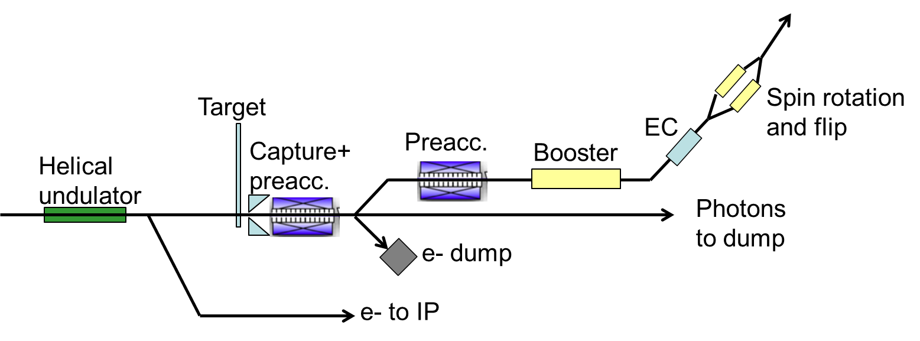
Undulator System
Superconducting helical undulator
  passed by e- beam → circularly polarized photon beam for e+ production in thin target
Target
  Ti6Al4V target wheel spinning with 2000rpm in vacuum to distribute heat load
Positron capture
  Pulsed flux concentrator offers higher capture efficiency but so far no reliable design
  Alternative: QWT
positron beam is polarized
Goal: positron yield at damping ring Y = 1.5e+/e-
S.Riemann

Slide 25
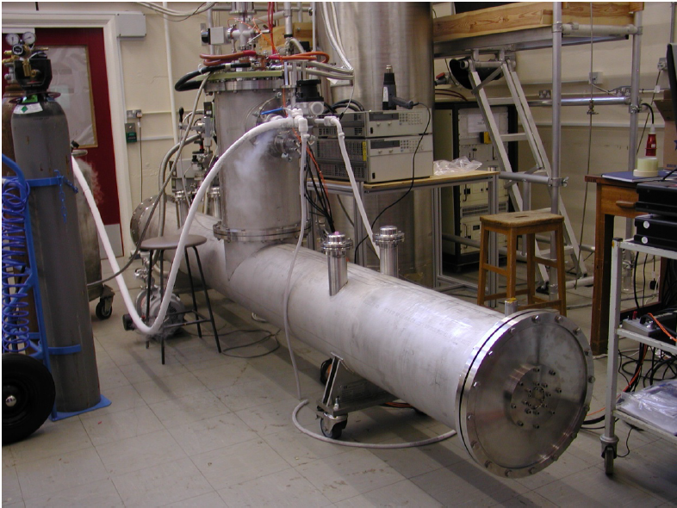
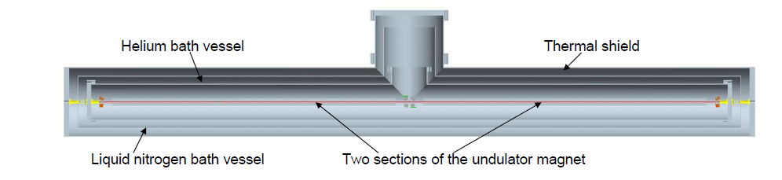
Superconducting Helical Undulator
D.Scott et al.,
Phys. Rev. Lett. 107, 174803
Prototype developed at RAL
  2 unduator modules of 1.75m in 4m cryomodule
Parameters
  Undulator period, λ_{U} =11.5mm
  Undulator strength K ≤ 0.92 (B_{max} ≤ 0.86T)
  Beam aperture (diam.) 5.85mm
  Max 231m active undulator length available (132 undulator modules ⬄ 66 cryomodules]
  Quadrupoles every 3 modules → total length of undulator system is 320m
S.Riemann

Slide 26
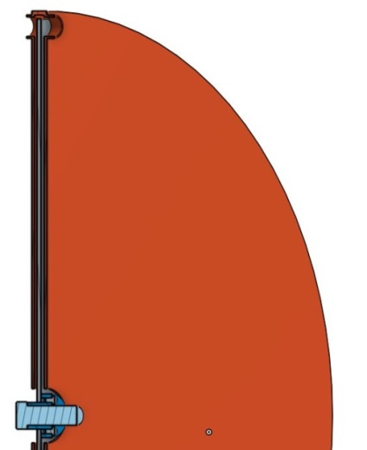
Target for the Undulator-based e+ Source
Ti alloy wheel, Ø 1m, spinning in vacuum with 2000rpm (100m/s tang speed)
ILC250, GigaZ: E(e-) = 125GeV
  Photon energy is O(7.5 MeV);
  target thickness of 7mm to optimize power deposition and e+ yield
Target cooling
  T⁴ radiation from spinning wheel to stationary water cooled cooler
    Peak temp in wheel ~550˚C for ILC250, 1312b/p
    Peak temp in wheel ~500˚C for GigaZ, 1312b/p
    for wheel designed as full Ti alloy disk
Test of target material resistivity against high temperature and cyclic load using an intense pulsed e- beam at the Microtron in Mainz (MAMI)
  No substantial damage obtained although material was loaded below and above the phase transition limit
Magnetic bearing for spinning wheel
  Vacuum-tight, oil free, maintenance free even for very high speed
  Technology and experience exists (e.g. neutron chopper; companies: Juelich, SKF)
Photon beam
Target wheel
Water-cooled cooler
S.Riemann

Slide 27
Undulator Positron Source Parameters
S.Riemann

Slide 28

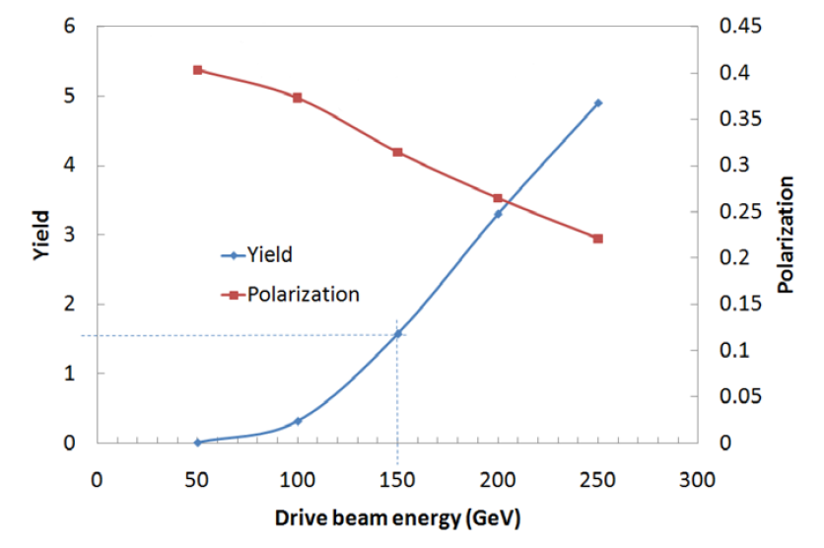
Undulator : Positron yield
Electron energy 125GeV (126.5GeV to compensate loss in undulator)
Photon energy is O(7.5 MeV)
Expected yield from this figureis ~1e+/e-
for E(e-) = 125GeV
The simulation described in the positron WG report gave ~1.3e+/e-
More recent simulation gives a smaller value
Need to optimize/improve the e+ capture
TDR

Slide 29
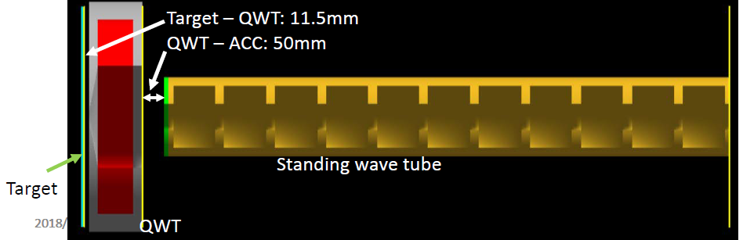
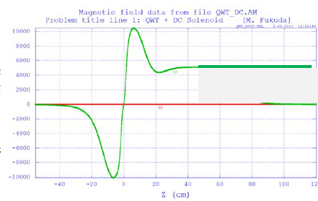
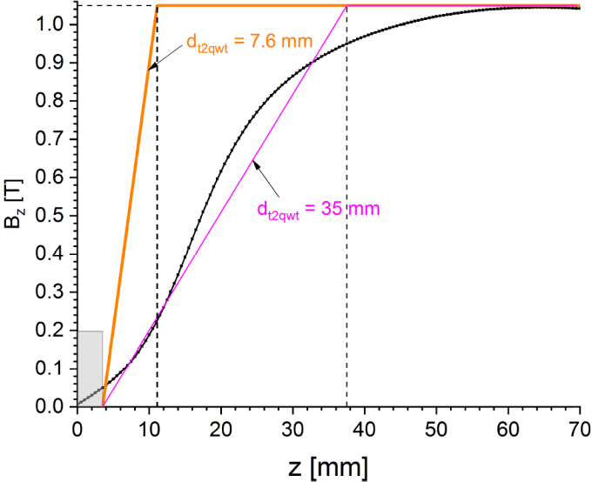
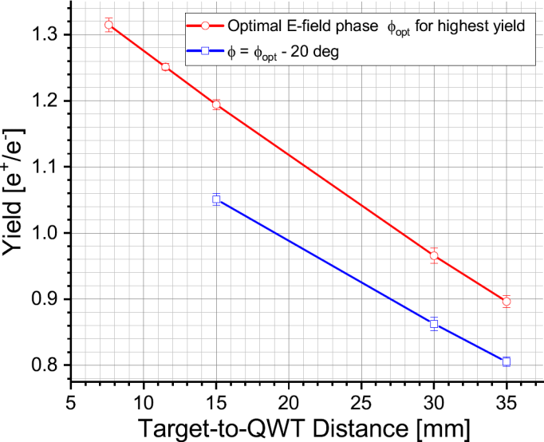
QWT
Flux concentrator (TDR) does not seem feasible due to the long pulse
To be replaced by QWT (Quarter Wave Transformer)
M. Fukuda, LCWS18
  Y < 1e+/e
B
B field is decisive for positron yield
  Steeper field rise close to target needed for yield > 1e+/e-
  Immersed target could help but eddy current increase heat load for non-pulsed operation
  Optimization is under study
A. Ushakov
S.Riemann

Slide 30
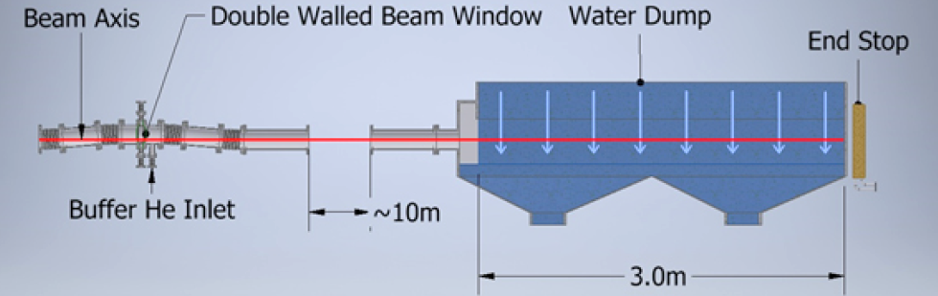
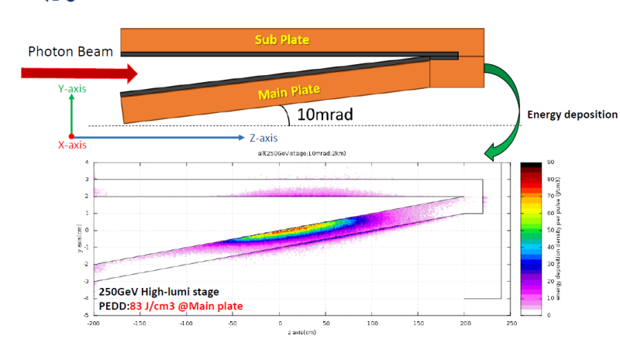
Undulator : Photon dump
Narrow 60-120kW photon beam deposits only few percent in target
Problem: high energy density of photon beam even at distance of O(km) from target
Options under study
  Water dump
    Tumbling Ti window, He cooled → acceptable stress and heat load
    Free falling water curtain to absorb the photon beam and to scatter particles at safe distance to Ti window
  graphite dump
    Shallow angle (~10mrad) to beam
    No need for exit window
    But: high peak load and graphite
    degradation
P. Sievers
Y. Morikawa
S.Riemann

Slide 31
Undulator Summary
No showstopper seen for undulator-based source
Detailed engineering specifications for target wheel and experimental tests still to be done
  Test cooling efficiencies by thermal radiation for a target piece
  Develop full-size mock-up for the target to test the target rotation in vacuum
  Photon dump design
resources….(only for information)
    DESY e+ source group decreased:
      Andriy and Felix left, Sabine retired; no successors
      Khaled (PhD student) studies realistic undulator (see his talk)
S.Riemann

Slide 32
e-Driven System
Intensive design/simulation studies on-going
New powers
  H. Ego, Y. Enomoto : KEKB linac experts
  A. Miyamoto : physics, radiation environment

Slide 33
e-Driven System Latest Parameters
Based on a paper being prepared for a journal
There are various simulation results giving slightly different yields
The data here is the one being used for a consistent parameter set
The yield n(e⁺)/n(e⁻) ~ 1.2-1.3 confirmed
This defines the required bunch charge in the electron driver, and all the power deposition (next page) in the entire system

Slide 34
e-Driven : Heat and Power Parameters

Slide 35
e-Driven : Yield Simulation
Simulation works by Nagoshi (Hiroshima) was succeeded by Fukuda (KEK)
Detailed consistency checks done
  In good agreement between Nagoshi and Fukuda to a few percent level
Added more reality and details
  Solenoid field : divided into pieces, interval, gap,
  FC field calculated by Pavel
  Target-FC distance
  QWT field (undulator)
  Tracking by SAD to DR
  Chicane after capture section (not finalized yet)
  ECS chicane parameters
  Booster acceleration gradient
  …………
Cannot go into detail → Fukuda’s talks in the positron session on Thursday

Slide 36
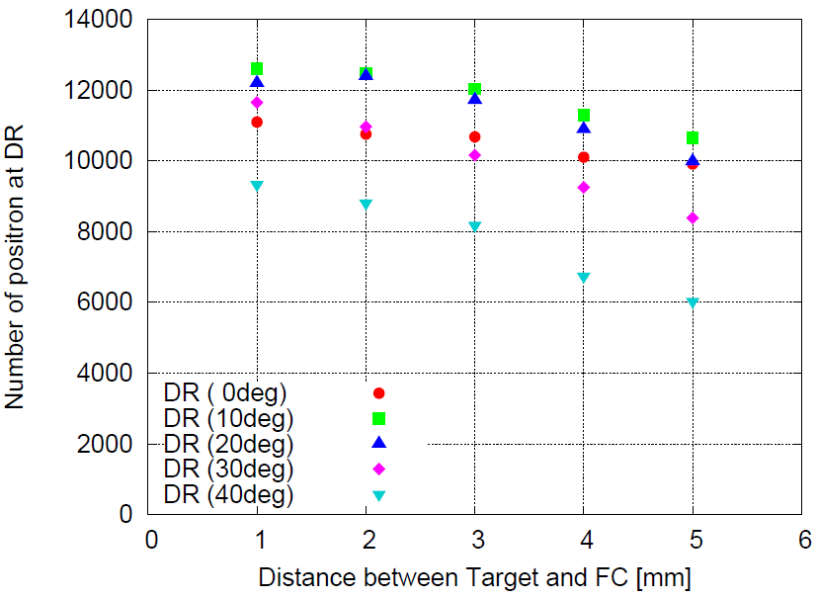
An example: Target-FC Distance
Yield increases 1.06→1.26 (15%) as 5mm → 1mm
No essential difference between 1mm and 2mm
But there is a significant difference in the eddy current heating due to the rapid (10’s of μs) change of the field of FC
(Initial positron 10000)
D(mm) | yield
1 | 1.26
2 | 1.25
3 | 1.20
4 | 1.13
5 | 1.06
M. Fukuda

Slide 37
e-Driven : Target
Design
  Tungsten 16mm thick, diameter 50cm, rotating at 5m/s (225 rpm)
  Copper disk brazed to tungsten (or might be bolted)
  Water-cooled
  Vacuum seal by ferro-fluid
R&D
  Heat & stress simulation
  Prototype fabricated
  Vacuum test with ferro-fluid seal and rotation (but no load)
  Irradiation (Co60) test of ferro-fluid at QST Takasaki
  These have been reported in previous LC workshops already
2019
  Irradiation test continued
  Analysis of gas generated at the irradiation to study the surface physics (Feb.2019)
  Need a test against neutron irradiation
Design of the next prototype being discussed
  Should the ferro-fluid seal be replaceable?
  I do not know the final conclusion
  Listen to the talk by Omori in the positron session

Slide 38
Capture Cavities
L-band Standing Wave same as in TDR (undulator scheme) has been used in the simulation works
  Designed and studied at SLAC for the undulator system
But, for e-driven system, several problems associated with the standing wave nature(zero group velocity) pointed out
  Multiple cell, high β,
  High beam-loading for e-driven
    Up to 0.5-1A (~6mA in undulator scheme)
New design being considered including APS (Alternating Periodic Structure) but it will take time

Slide 39
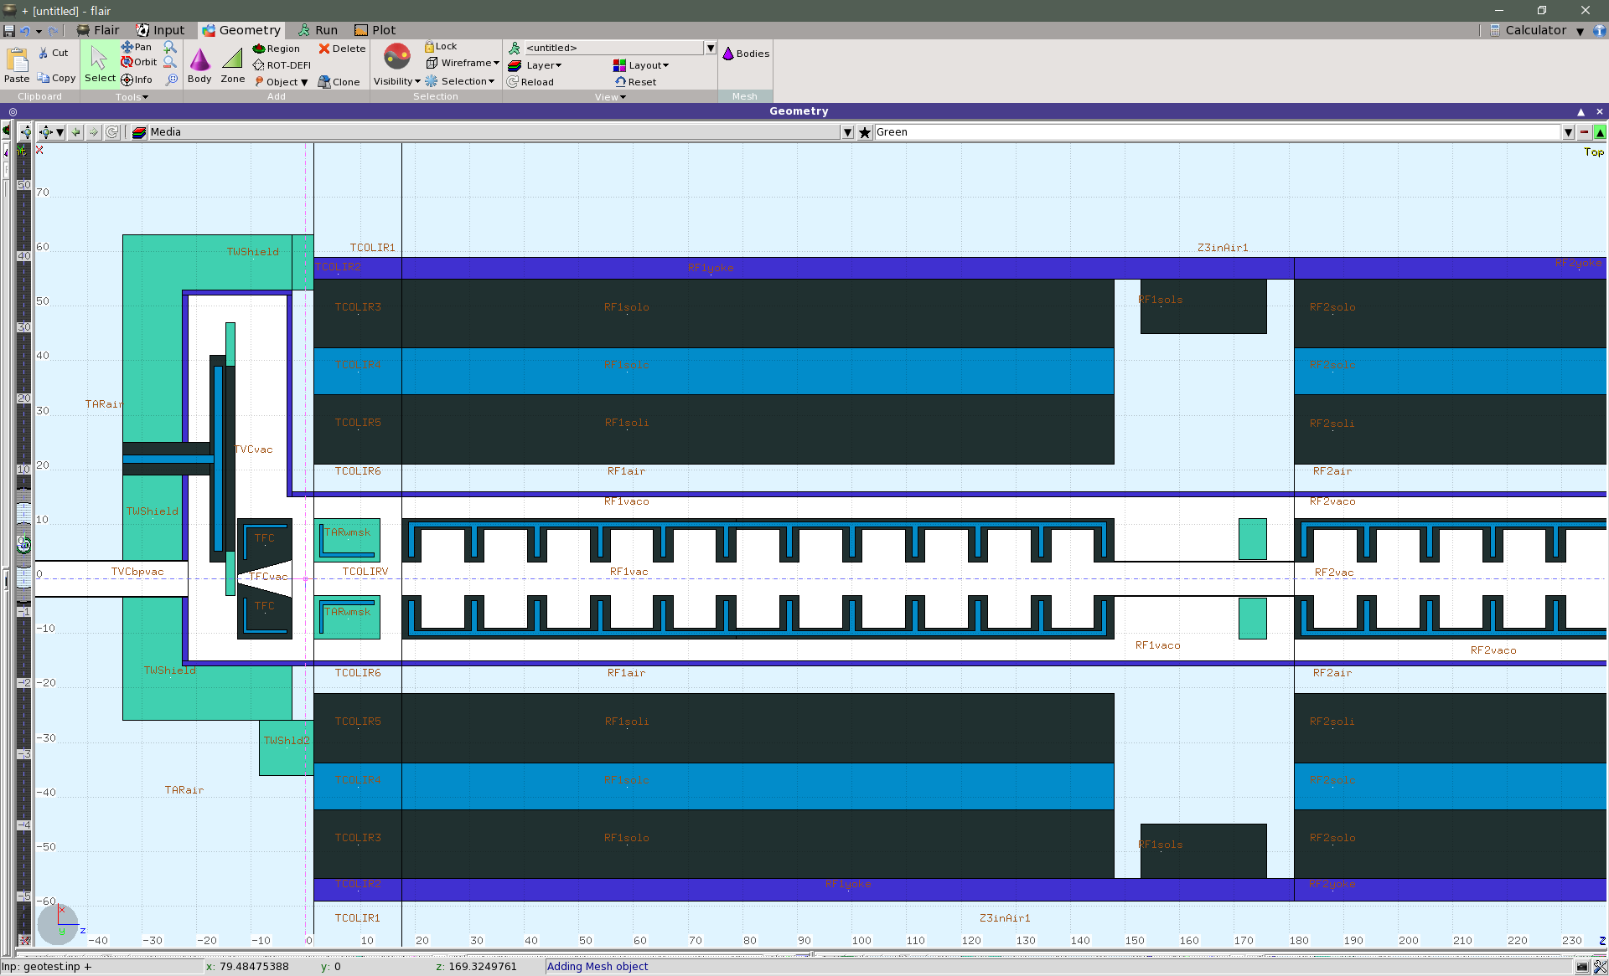
Radiation Environment (1)
Target/capture region
Accurate modeling
r_{disk}=25
163.4
129.83
unit: cm
1.5^{φ}
r_{out}=55
8.6^{φ}
r_{in}=21
0.7^{φ}
1.0^{φ}
W
Copper
0.5cm gap
(W-FC)
H₂O
Stainless
A. Miyamoto

Slide 40
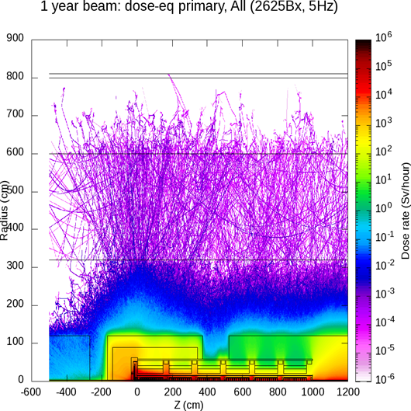
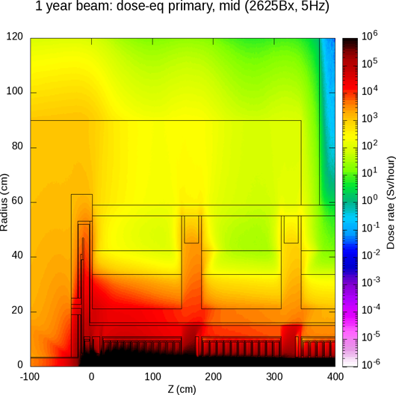
Primary dose
(not depend on run year)
A. Miyamoto
Giving the basic data in designing the shield sytem around the target

Slide 41
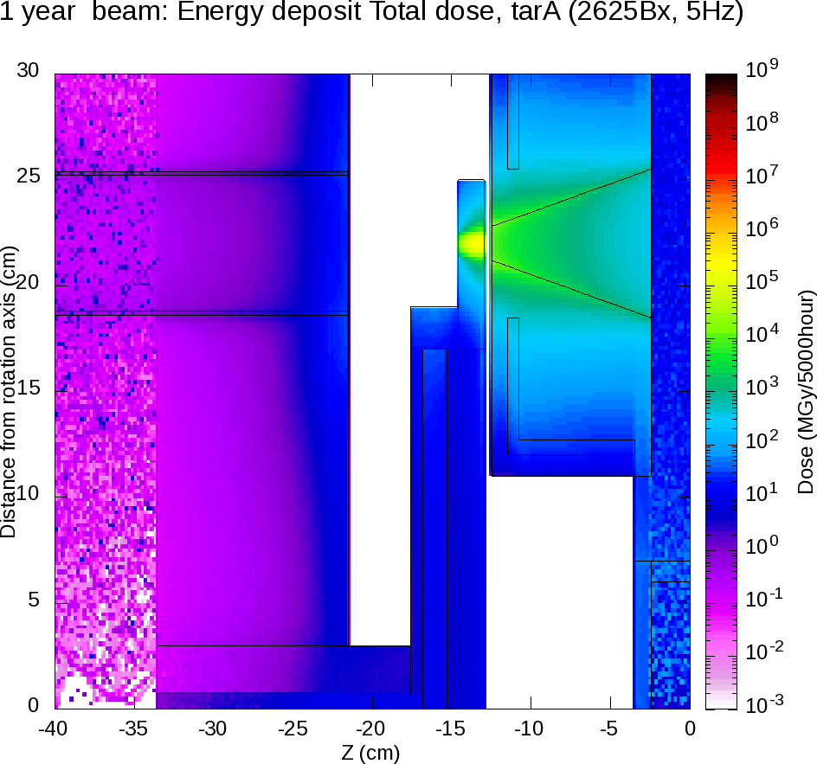
Radiation Environment (2)
Detailed simulation of the Radiation near the rotating target
Radiation on the ferro-fluid seal
  Check neutron flux
10MGy/year
Need more shield for < 1MGy/year
Miyamoto

Slide 42
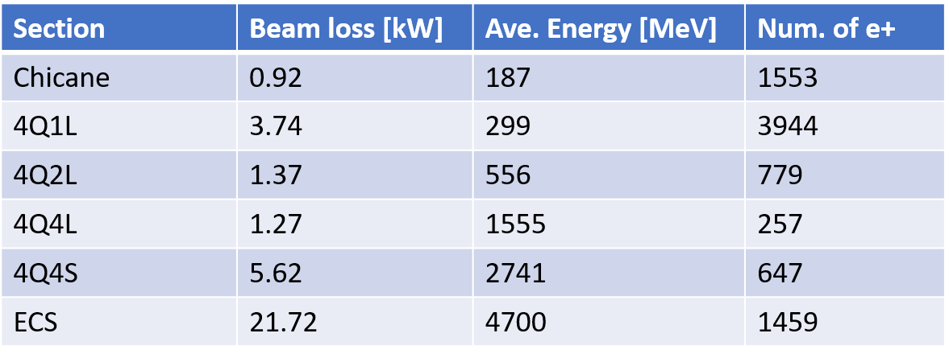
Radiation Enviroment (3)
All along the beamline from the chicane to DR
Turned out the loss at ECS very large (comparable to the target)
Fukuda

Slide 43
Remaining Issues of e-Driven System
Target
  Prototype test for more realistic model
  Endurance against neutron
Flux concentrator
  Cooling
Capture cavity (standing wave)
  New design (multiple cell, high β)
  Transient beam loading
  Cooling system
Beamline
  Chicane (after capture)
Replacement system of target-capture area
Radiation shield
  Target-capture region
  Entire beamline
Layout
  Possible transition from e-driven to undulator

Slide 44
Positron Summary
Intense studies of e-driven scheme on-going
  Overall design
  Yield calculation
  Target
  Radiation calculation for the design of the shielding of the entire positron system
Still more detail necessary for the above topics, plus
  Shield and tunnel design
  Capture cavity design and loading calculations
  Target exchange system
  Entire layout
Need resources for the undulator scheme

