Slide 1
Recent CFS activity in Japan
Nobuhiro Terunuma, KEK

Slide 2
Background of Civil Engineering Design
Design of accelerator tunnels and detector hall has been conducted by the international working groups under GDE and LCC.
Site specific design, especially for facilities on ground and its connection to the accelerator, has been conducted by the working group under the Tohoku ILC planning office.
Comprehensive civil engineering integration is underway by the CFS team from KEK and Tohoku ILC planning office. The draft will be discussed with the international ILC-CFS working group.

Slide 3
Recent Activity on CFS in Japan (1)
The design group has been enhanced to create a basic planning document that serves as input for basic and detailed designs during the preparation phase.
  It consists of members from the KEK ILC Group, KEK Facility Department, and Tohoku ILC Research Group.
AAA (Advanced Accelerator Association)
  Working group has been established to support CFS design, particularly for groundwater treatment, beam dump civil design, and earthquake resistance.

Slide 4
Recent Activity on CFS in Japan (2)
ILC Facility Evaluation Subcommittee of the Rock Mechanics Committee, the Japan Society of Civil Engineers
  Evaluate the validity of ILC civil engineering design at the Kitakami candidate site from the viewpoint of rock dynamics.
  Closed committee because it includes the site specific confidentials.
  Expect a report will come by March 2020.
  Note: 2012, Guidelines for the civil engineering work of International Linear Collider (ILC) facilities; Rock Mechanics Committee in Japan Society of Civil Engineers. It was the subcommittee for the establishment of standard specifications for the civil engineering work of Internal Linear Collider

Slide 5
We are collecting and integrating drawings for the CFS basic plan.
Note! These are drafts for checkout.

Slide 6
for Discussions

Slide 7
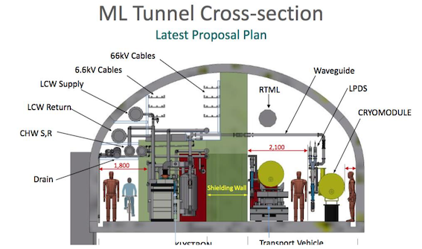
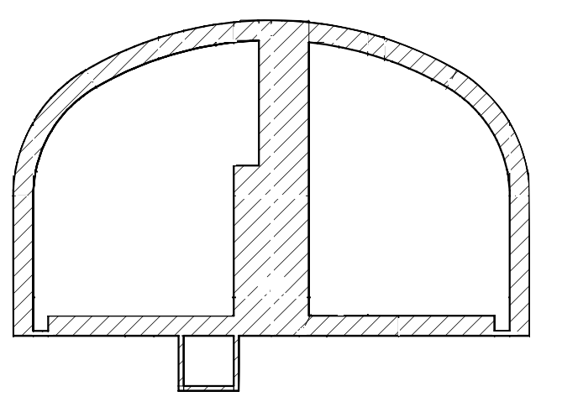
Main Linac (ML) tunnel
ML section is about 70% of the ILC-250 (end to end).
Follow the geoid
Central radiation shield will be put after finishing the tunnel.
?
1 m
5.5 m
Beamline
1.1m from
floor
1.5 m
9.5 m
RF power station
Notes:
左下のブロックを消す

Slide 8
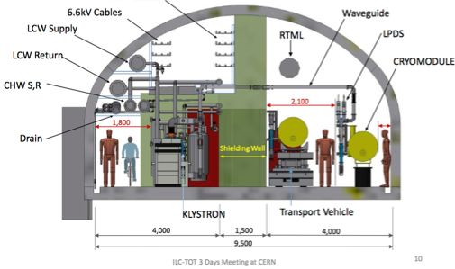
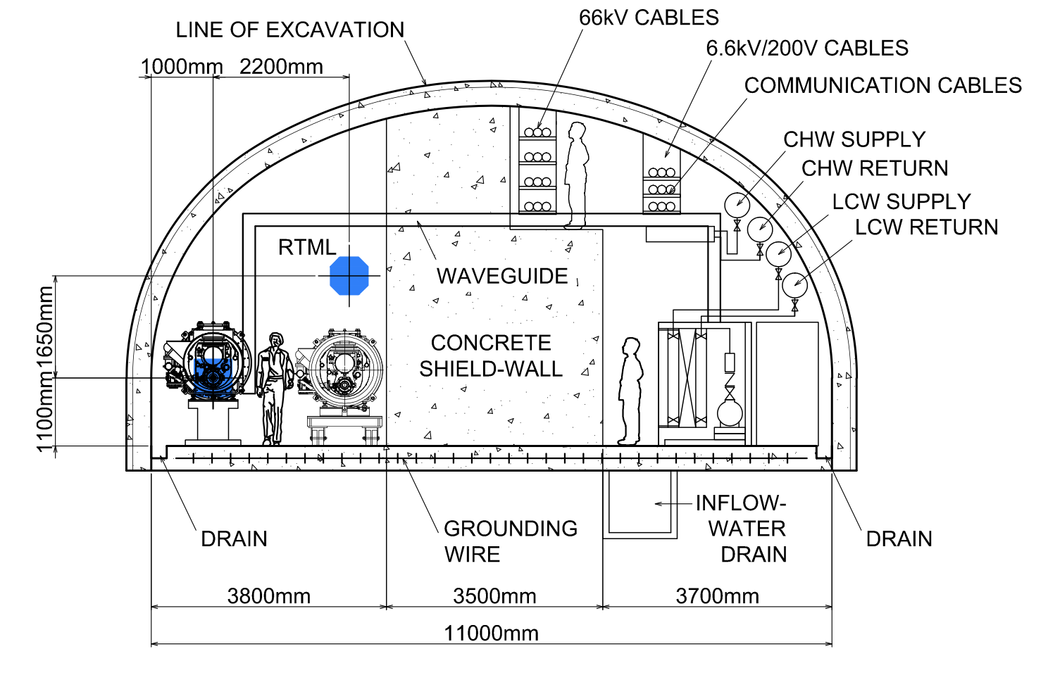
Where does RTML pass through the ML tunnel?
The upper left figure is often used after the change request of central wall reduction.
It was prepared only for discussion of equipment layout and its layout has not been determined.
In particular, RTML is above the waveguide and is higher than that of TDR.
    It is misleading and brings many considerations on beam dynamics, installation and alignment.
RTML position in the current optics design has never changed from TDR.
This figure should be modified.
TDR Vol3,
p167
Notes:
左下のブロックを消す

Slide 9
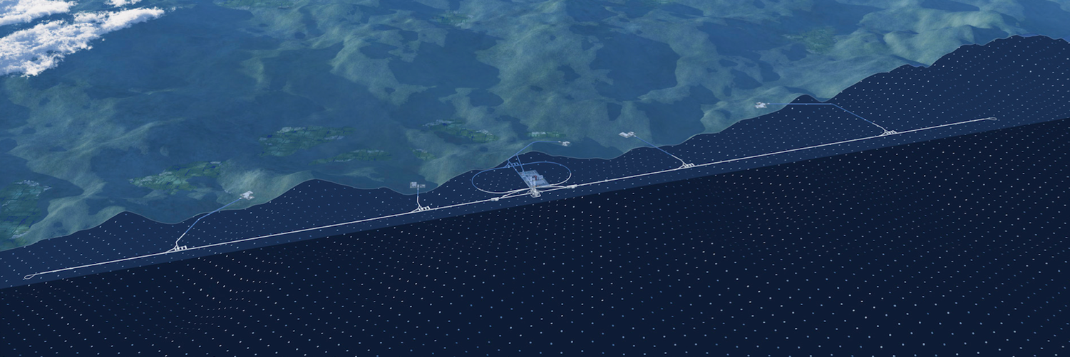
Handling of groundwater outside the tunnel
Inflow water assumption
・1.0 tons/min/km (max)
・5.0 tons/min/Access Point (max)
About 30,000 tons/day
Pump-up to the surface;
Supplemental water for cooling tower
Draw water into the access hall tank
  Natural flow scheme
  Pump relay scheme
To access hall
Rey.Hori / KEK

Slide 10
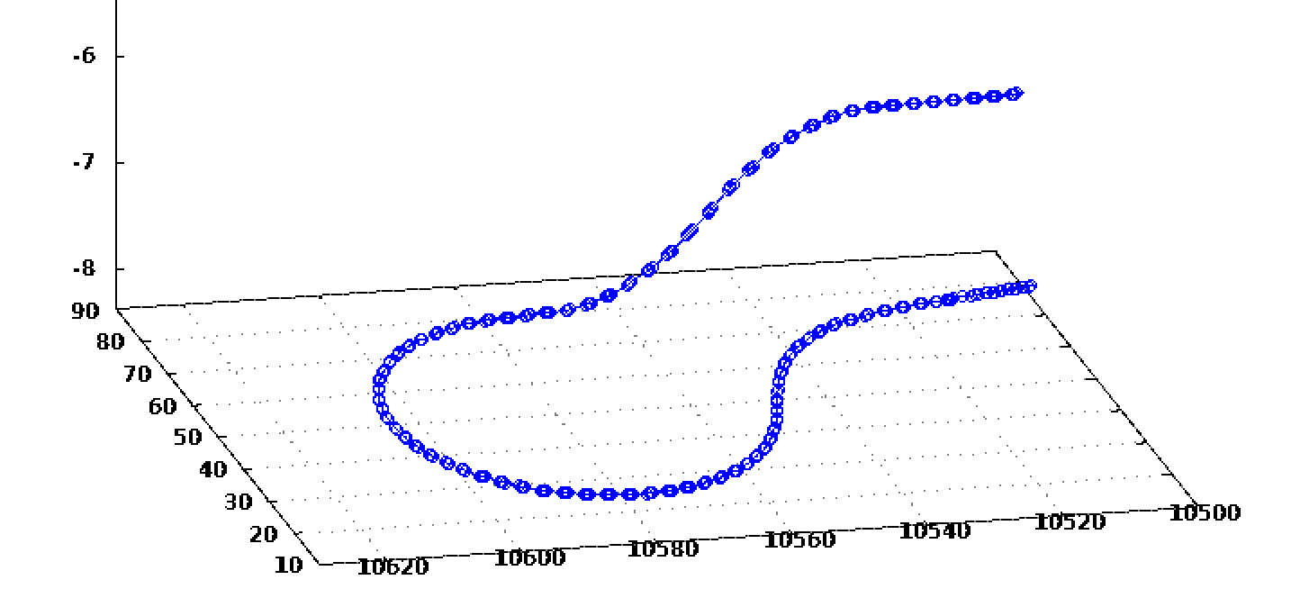
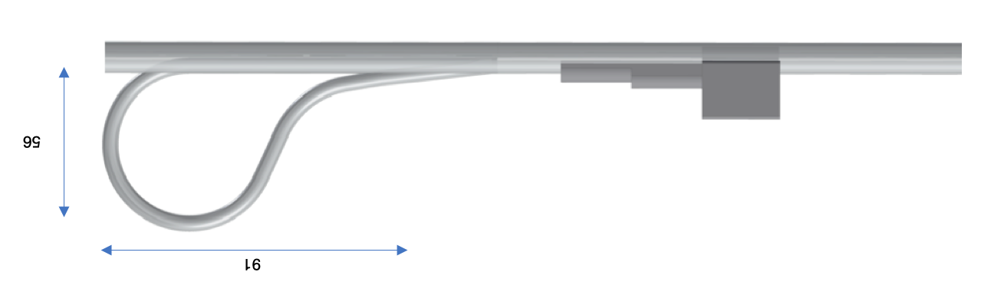
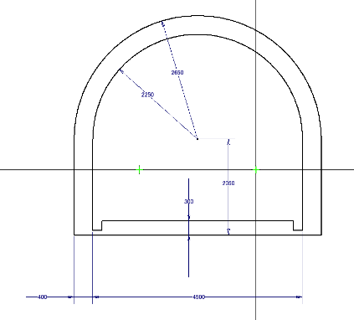
Turn-around
ML tunnel Will be extended beyond the turn-around;
Make a future extension of ML easily.
Enhance the safe evacuation of turn-around.
1.65 m
RTML
5.5 m
ML
9.5 m
ML tunnel
56 m
Tune-up beam dump
4.0 m
4.5 m
91 m

Slide 11
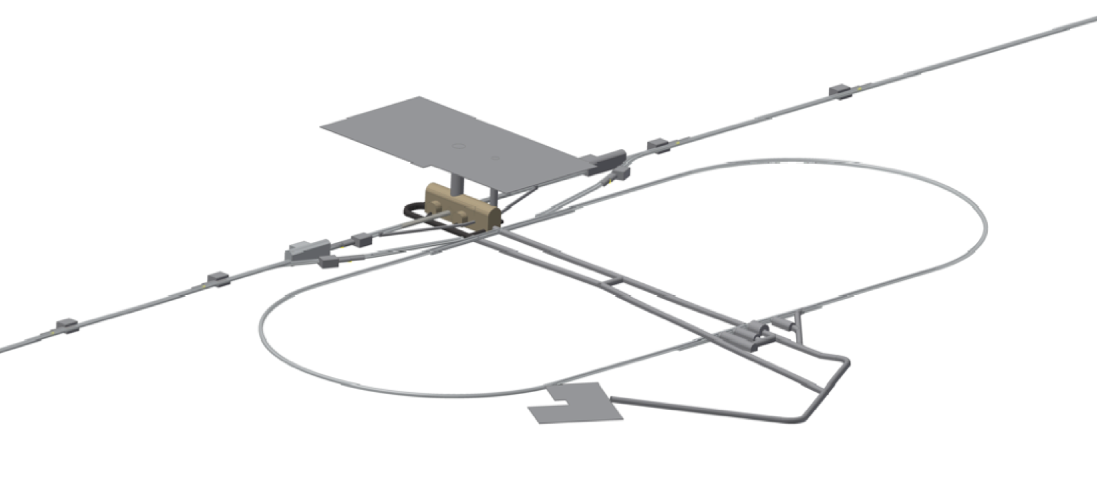
Layout of Central Region
Tune-up Dump
IP
Detector Hall
Surface facility for IP
100 m
Main Beam Dump
0.5 km
Damping Ring
Main Beam Dump
Tune-up Dump
1.3 km
Surface facility for DR

Slide 12
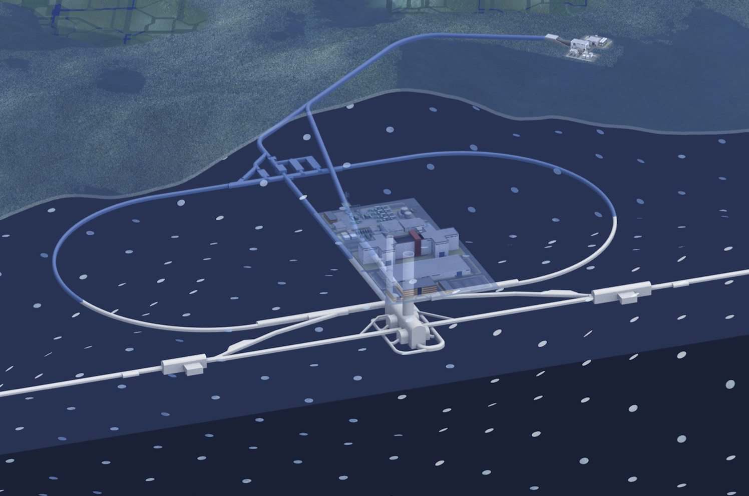
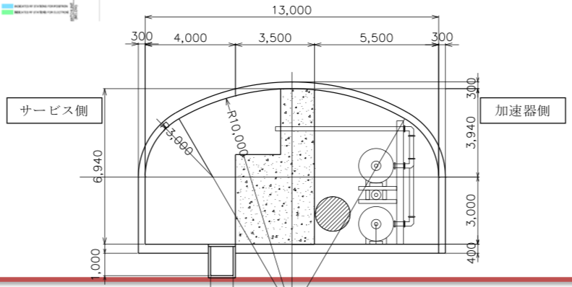
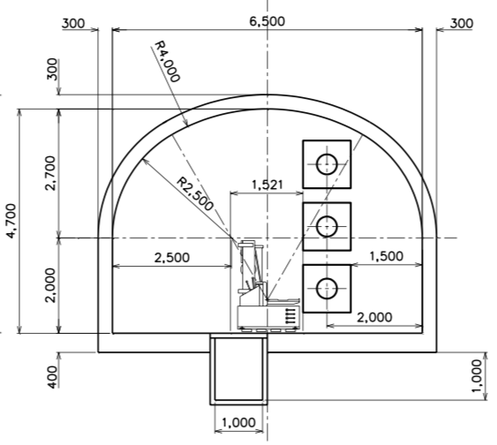
Damping Ring
Circumference: 3.2km
Start with two rings
The arc section of the ring is a single tunnel without a central shield.
Straight section is Kamaboko with a 3.5m central shield. (TDR)
Rey.Hori / KEK
13 m
Arc Section
Straight Section
6.5 m
4.7 m
Positron
6.9 m
electron
Positron

Slide 13
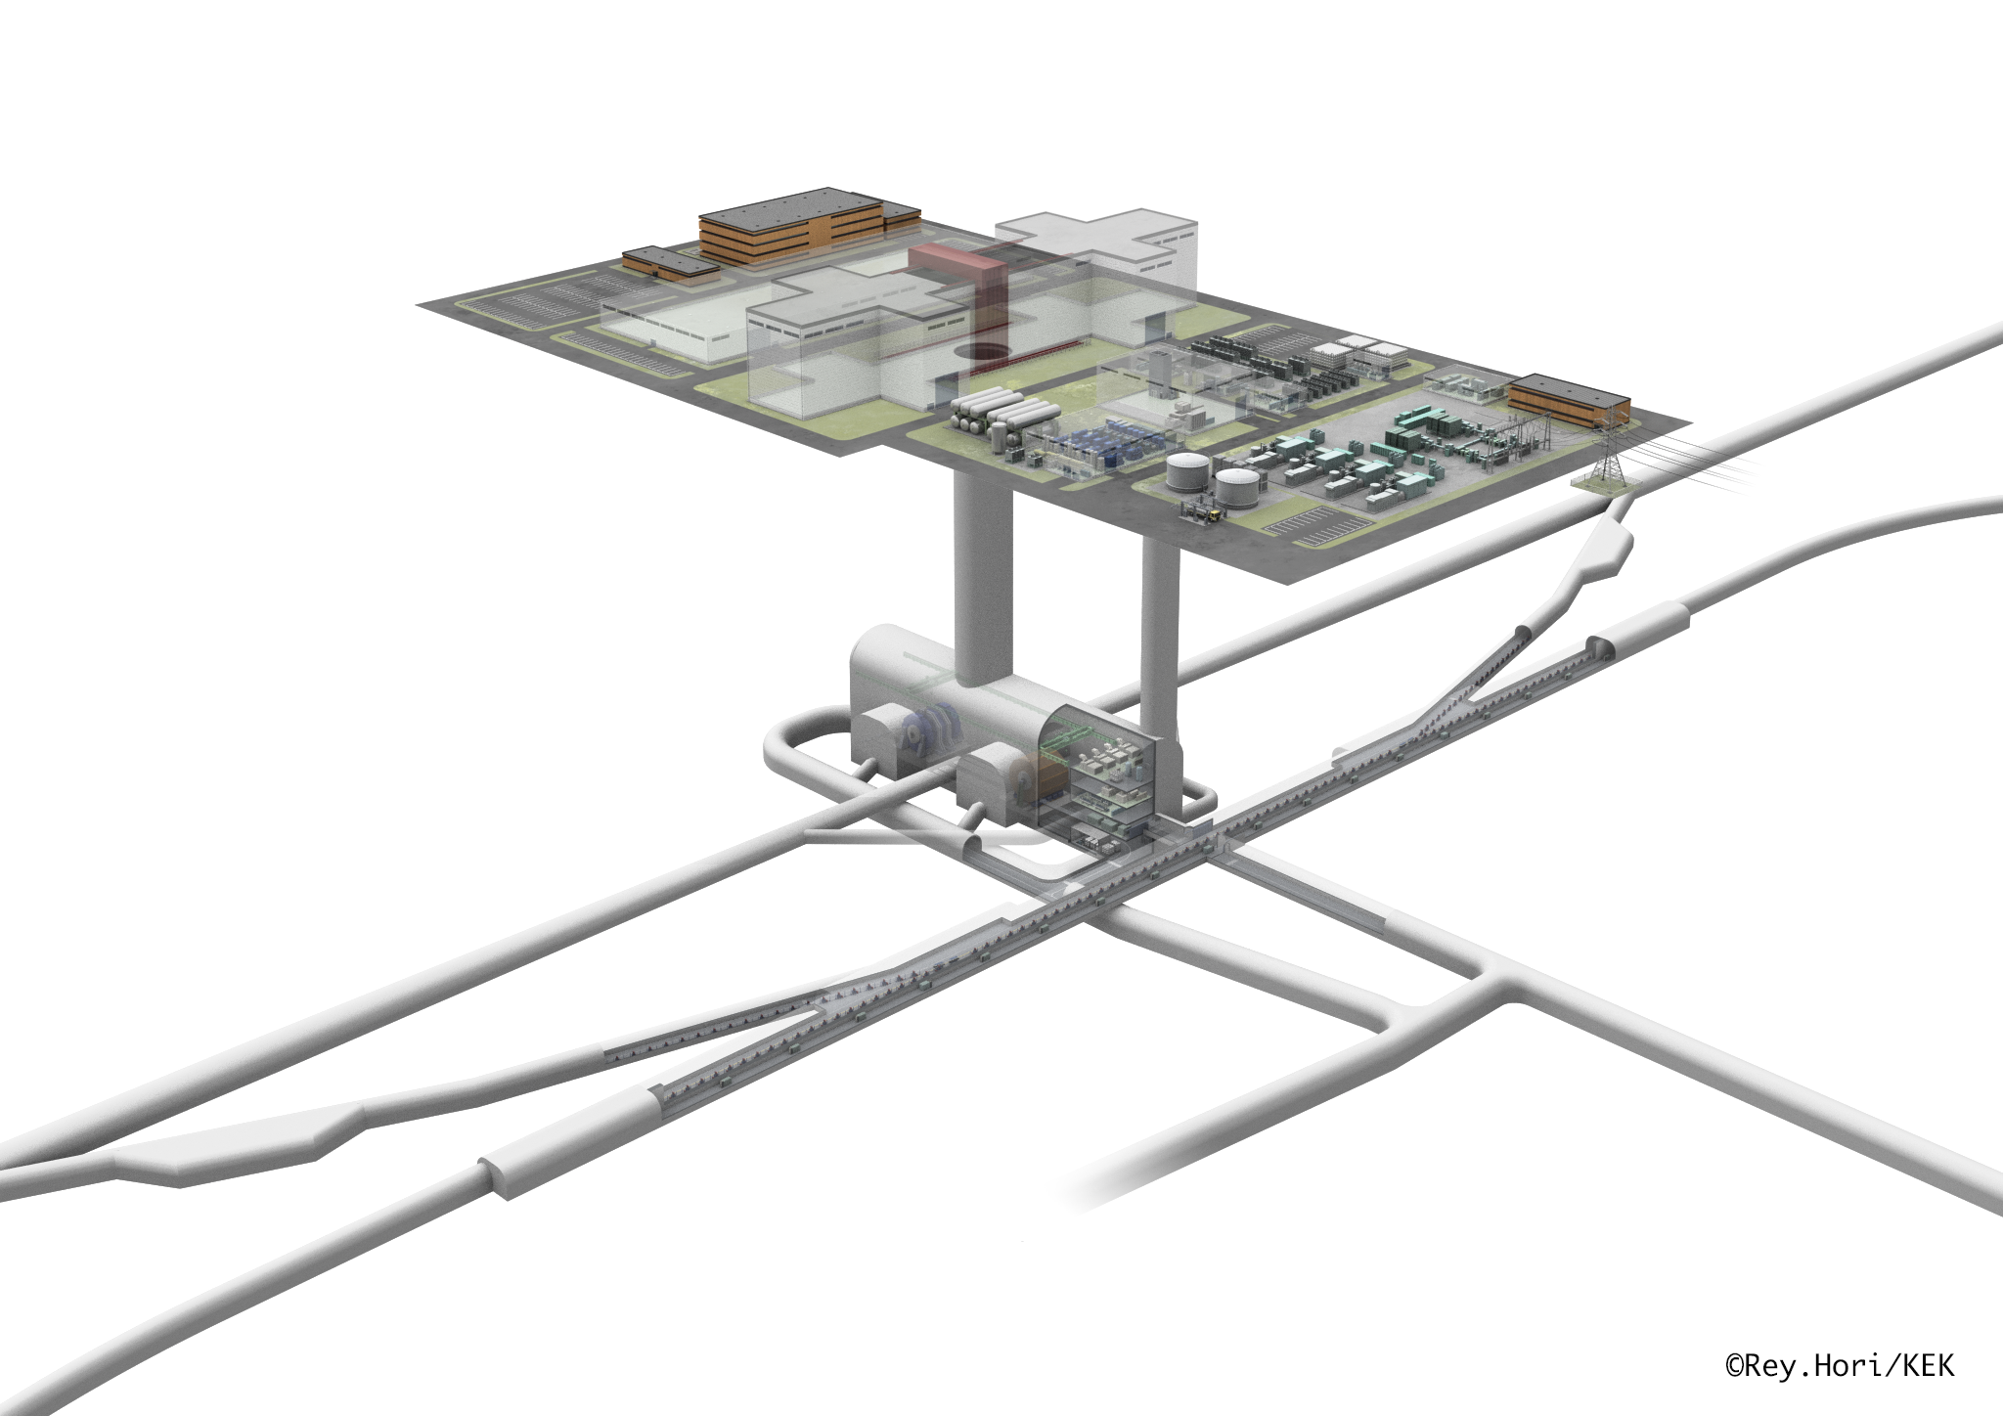
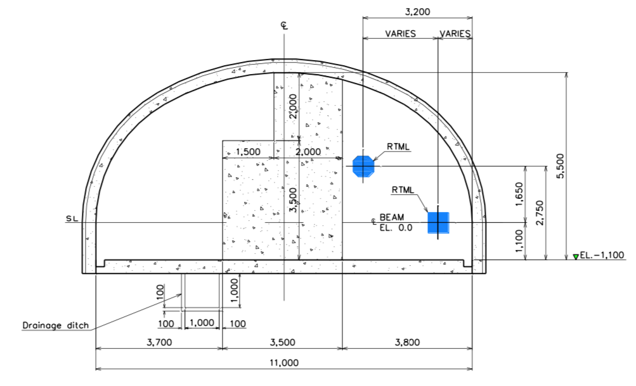
LTR/RTL
Between DR and BDS tunnel
Beamlines
  Injection to DR
  Extraction from DR with tune-up dump
  Spin rotator
TDR design:
  Kamaboko with 3.5m central shield
  Do we need it?
Check the requirements and optimize the design
BDS
300 m
BDS
300 m
Damping Ring
5.5 m
Rey.Hori / KEK
11 m

Slide 14
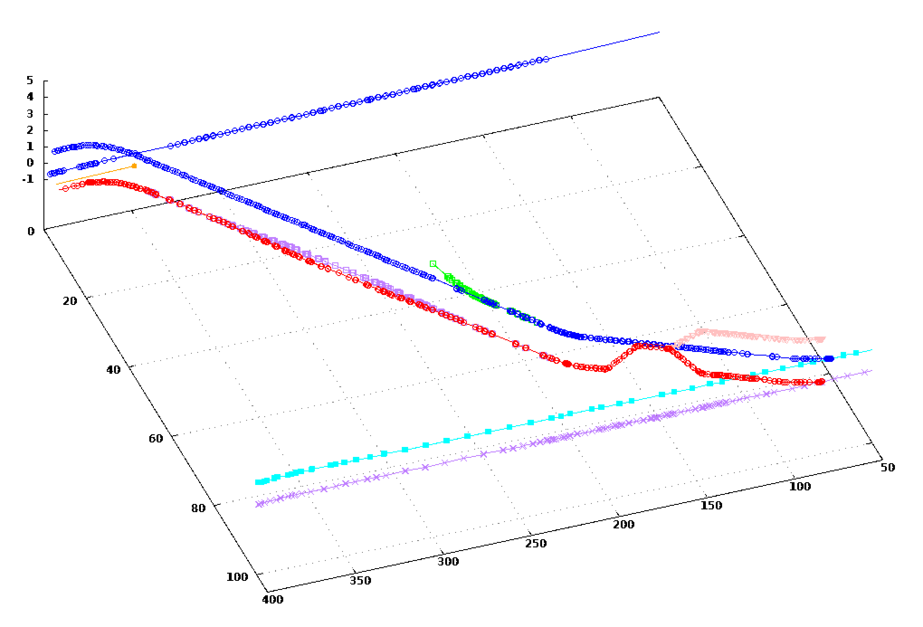
IP
BDS (electron)
Example:
Electron ML side
RTML
electron
DR beam dump
(electron)
Positron
spin rotation
(electron)
(positron)
Damping Ring

Slide 15
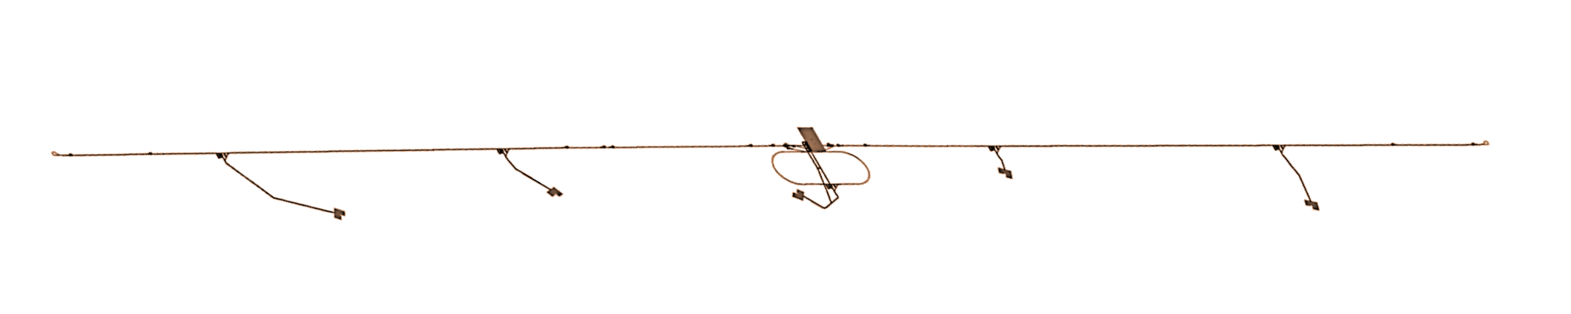
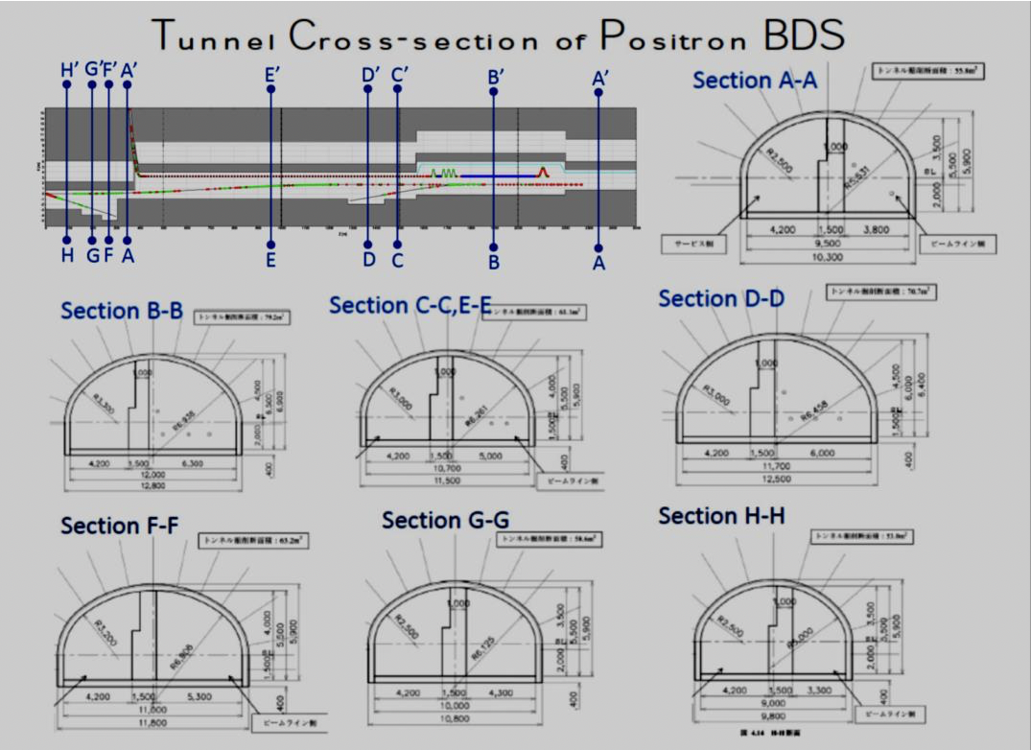
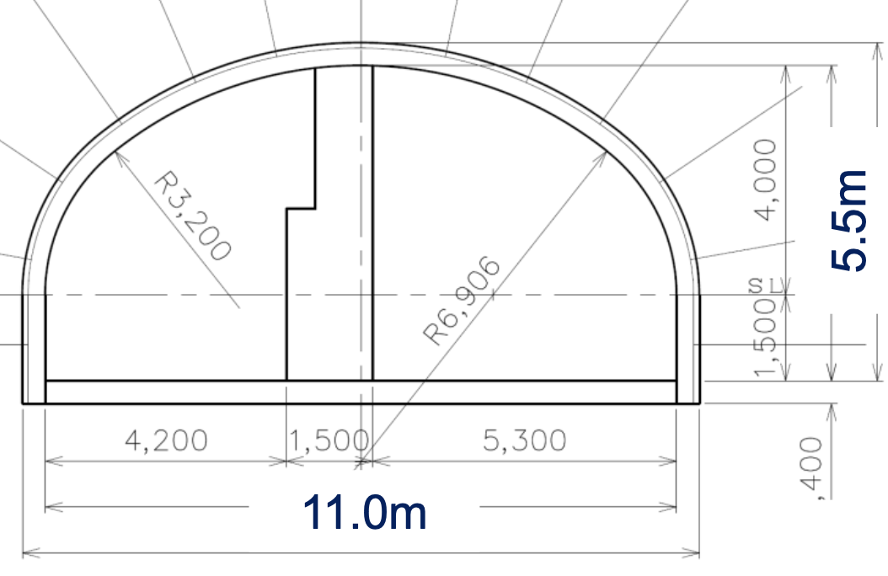
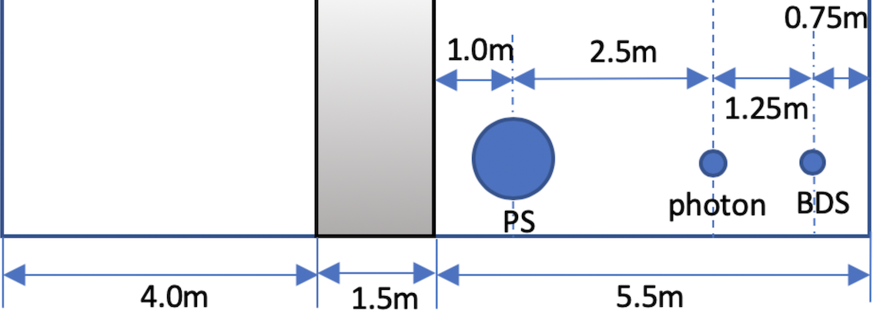
BDS tunnel (PM-8 to PM+8)
ChangeRequest-015: Single tunnel for e+ BDS (TDR was two tunnel scheme.)
From the construction point of view, it is desirable to simplify the design.
  Discussion has been started by the CFS group in Japan.
  The 11m-wide kamaboko tunnel along the BDS beamline is a candidate.
PM-8
PM+8
Example: electron BDS; downstream of undulator
CR-015: Fig.5 tunnel cross-section model for cost estimation

Slide 16
Positron Source
For undulator scheme, draft CFS design exists as that for BDS.
For e-driven schemes, CFS design will be conducted by following the current discussions, for example, the separate dedicated tunnel for flexible construction/commissioning strategy .
Scheme selection will be done by the end of the first year of preparation phase.
Prepare the CFS design for all possible schemes.
Tunnel options for e-driven: T.Omori, LCWS2018

Slide 17
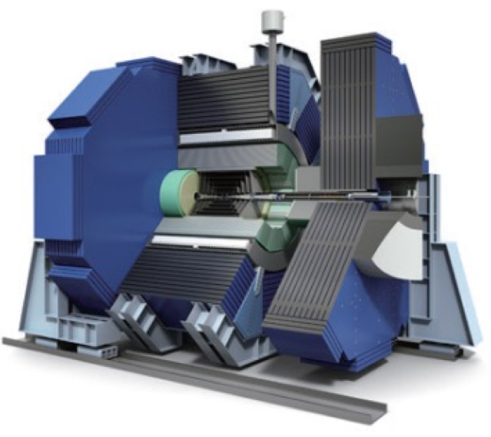
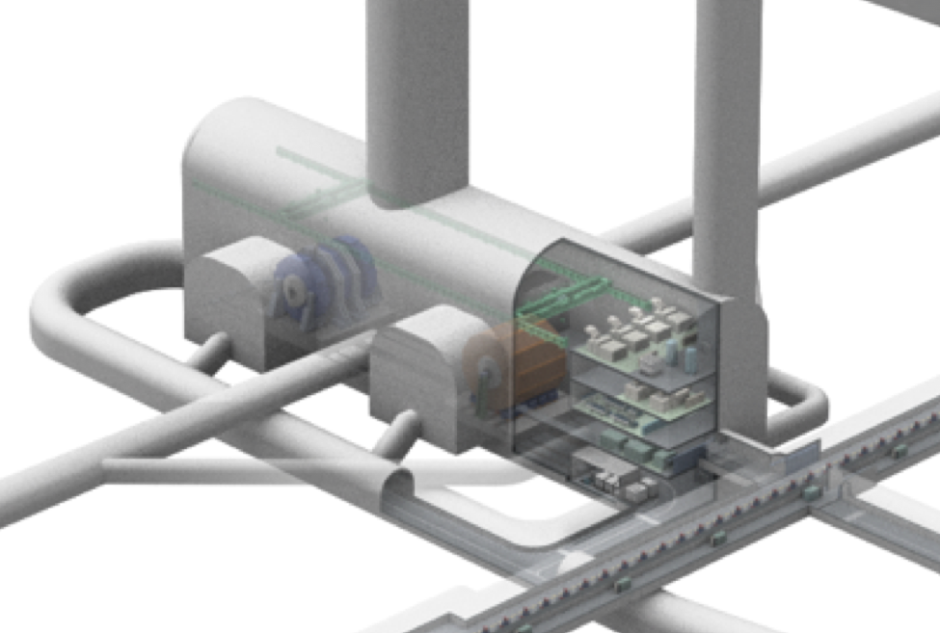
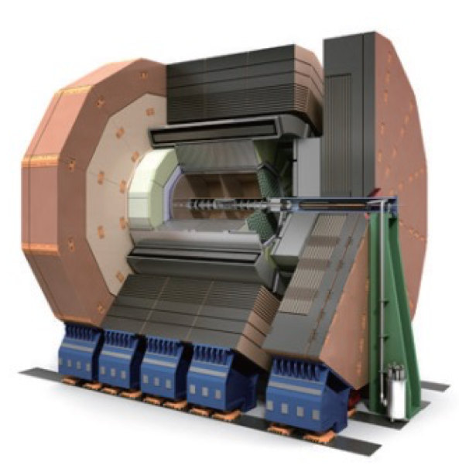
Detector Hall
12 m
25 m
Vertical Shaft for Detector (diam. 18m )
4000t Crane
Utility Shaft
（diam. 10m）
11 m
BDS (positron)
SiD検出器, 重量 8,000t
133 m
IP
Damping Ring
16 m
40 m
Utility
floors
BDS (electron)
13 m
Layout of the detector hall and around is under discussion with MDI
ILD検出器, 重量 15,000t
Rey.Hori / KEK

Slide 18
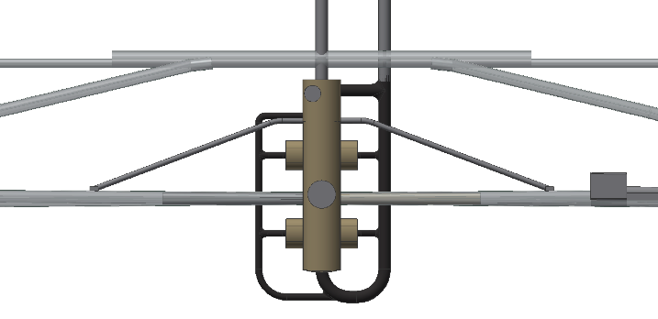
Plan view of the Detector Hall
Access tunnel
11m
Damping Ring
Straight section
300m
PLTR/ERTL
Positron injection
Electron extraction
ELTR/PRTL
Electron injection
Positron extraction
100m
Distribution of 66kV
Distribution of 66kV
BDS (positron)
BDS (electron)
160m
4m
96m

Slide 19
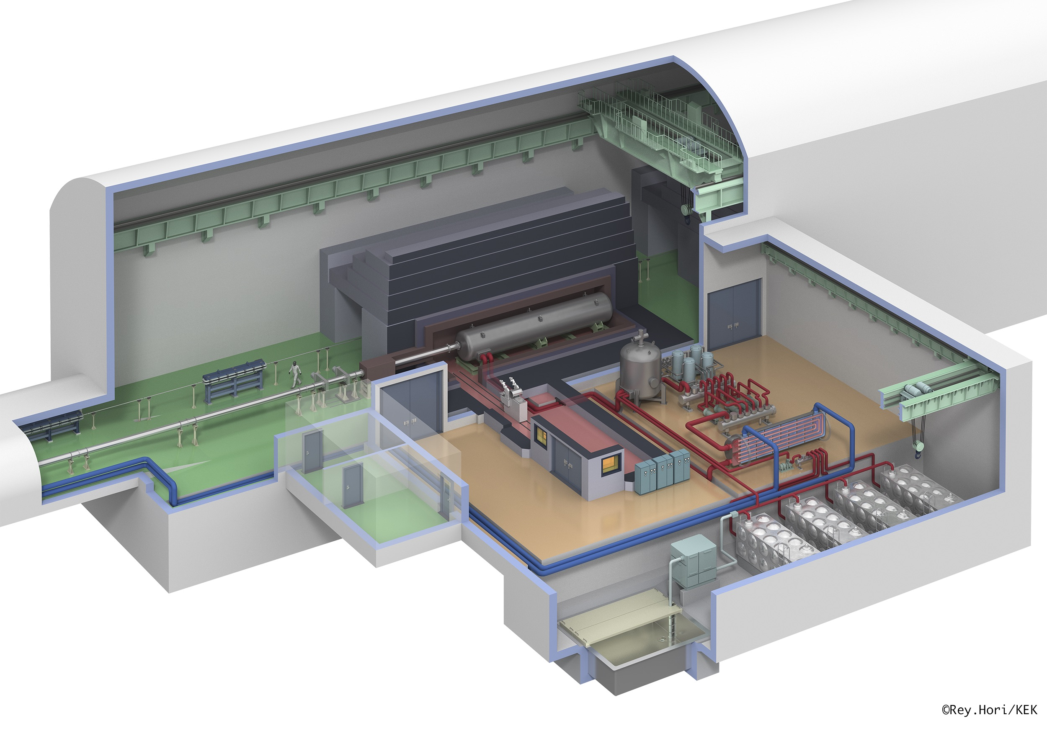
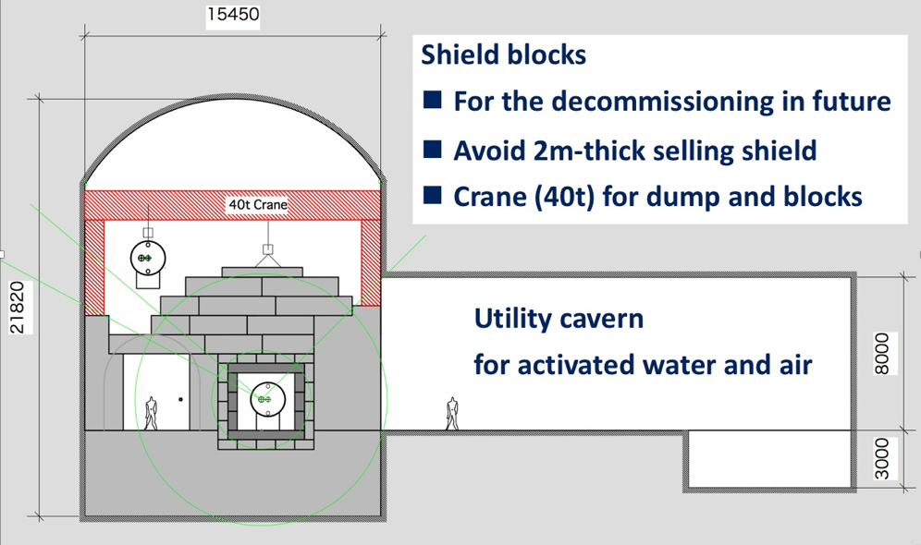
Main beam dump
Big cavern to install the 5m-thick shields.
Water dump capable for 18MW beam power (1TeV).
Enable the future de-commissioning
70 m
16 m
Radiation Shield
Beam dump
22 m
Cooling system
25 m
25 m

Slide 20
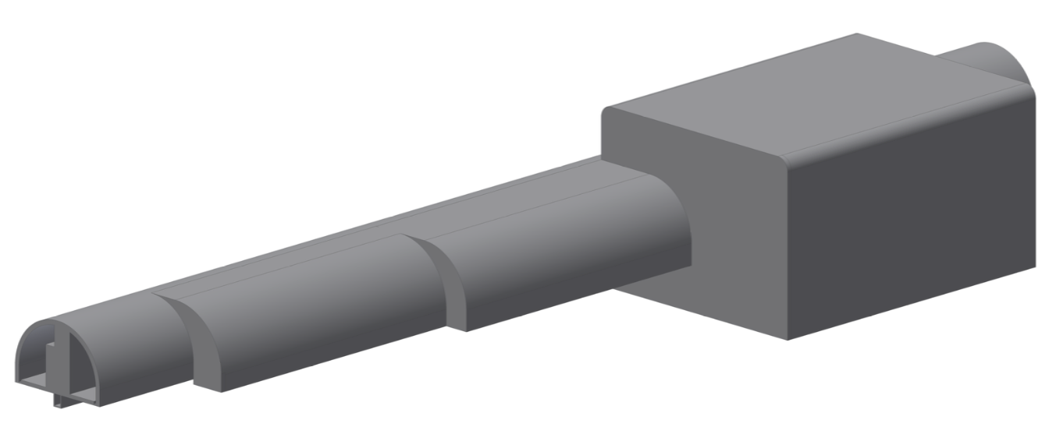
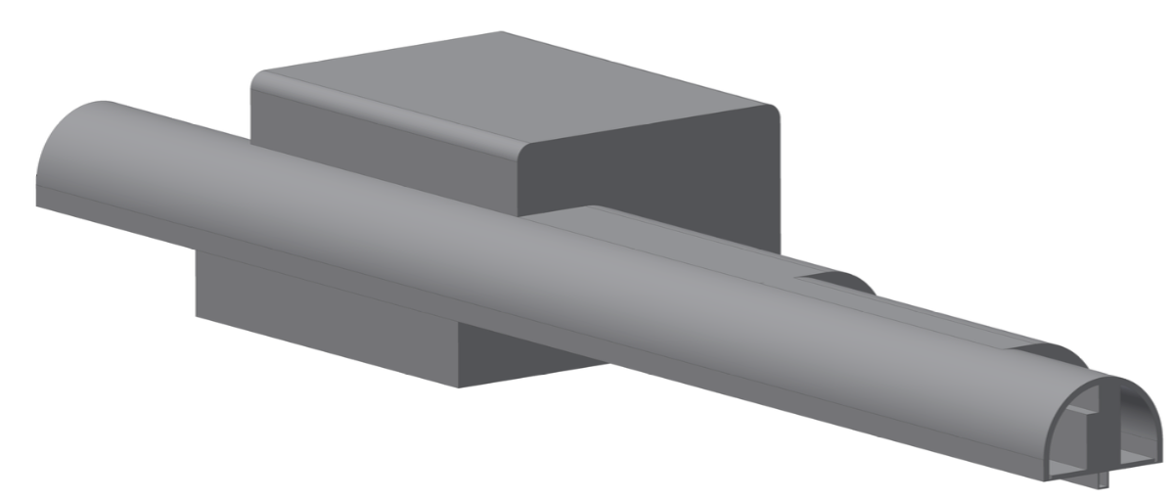
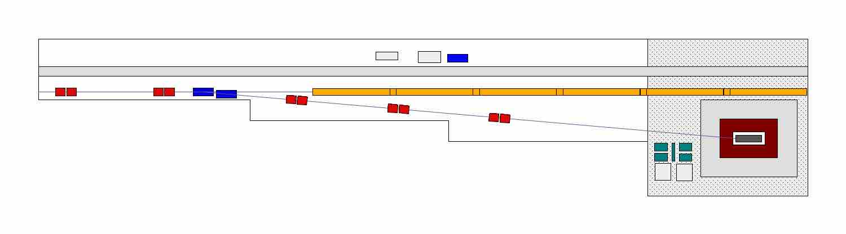
Tune-up beam dumps
60kW (9 points) and 400kW (2 points)
20 m
14 m
50 m
Dump room
with 4m thick concrete bed
ML tunnel
25 m
Tunnel cross section will be simplified.

Slide 21
Rey.Hori / KEK
H. Hayano, LCWS2017, Strasburg

Slide 22
H. Hayano, LCWS2017, Strasburg

Slide 23
H. Hayano, LCWS2017, Strasburg

Slide 24
TDR
Tohoku study
  Smaller volume
  Separate cavern by function
H. Hayano, LCWS2017, Strasburg

Slide 25
H. Hayano, LCWS2017, Strasburg

Slide 26
An example of access tunnel arrangement:
It shows how large space is required for pipes and cables.
The actual layout must be determined by considering various backgrounds.
Transport
Cold Box (diam. 4m)
Into access hall
In installation, repair(?) and addition for future extension of ILC
H. Hayano, LCWS2017, Strasburg

