Slide 1


Plan for ATF2 June Trip
R. Ramjiawan, D.R. Bett
Friday, 3rd May 2019

Slide 2
Setup
To pack: FONT5A board, amplifier for splitting fast clock
Friday 7th June:
  Arrive in JPN, collect badges, attend radiation training
Saturday/Sunday 8-9th June: Setup
  Split and amplify fast clock for upstream X board
  Check attenuators/movers/FONT boards/serial servers are working
  Re-install FONT laptop after hard drive replacement
  Install X processors (processors without 6 dB modification)
  Check power levels of LOs
  Supply trigger and fast clock to X board
  Connect X board to serial device server
  Setup 1dB step variable attenuator driver on dipole signal?

Slide 3
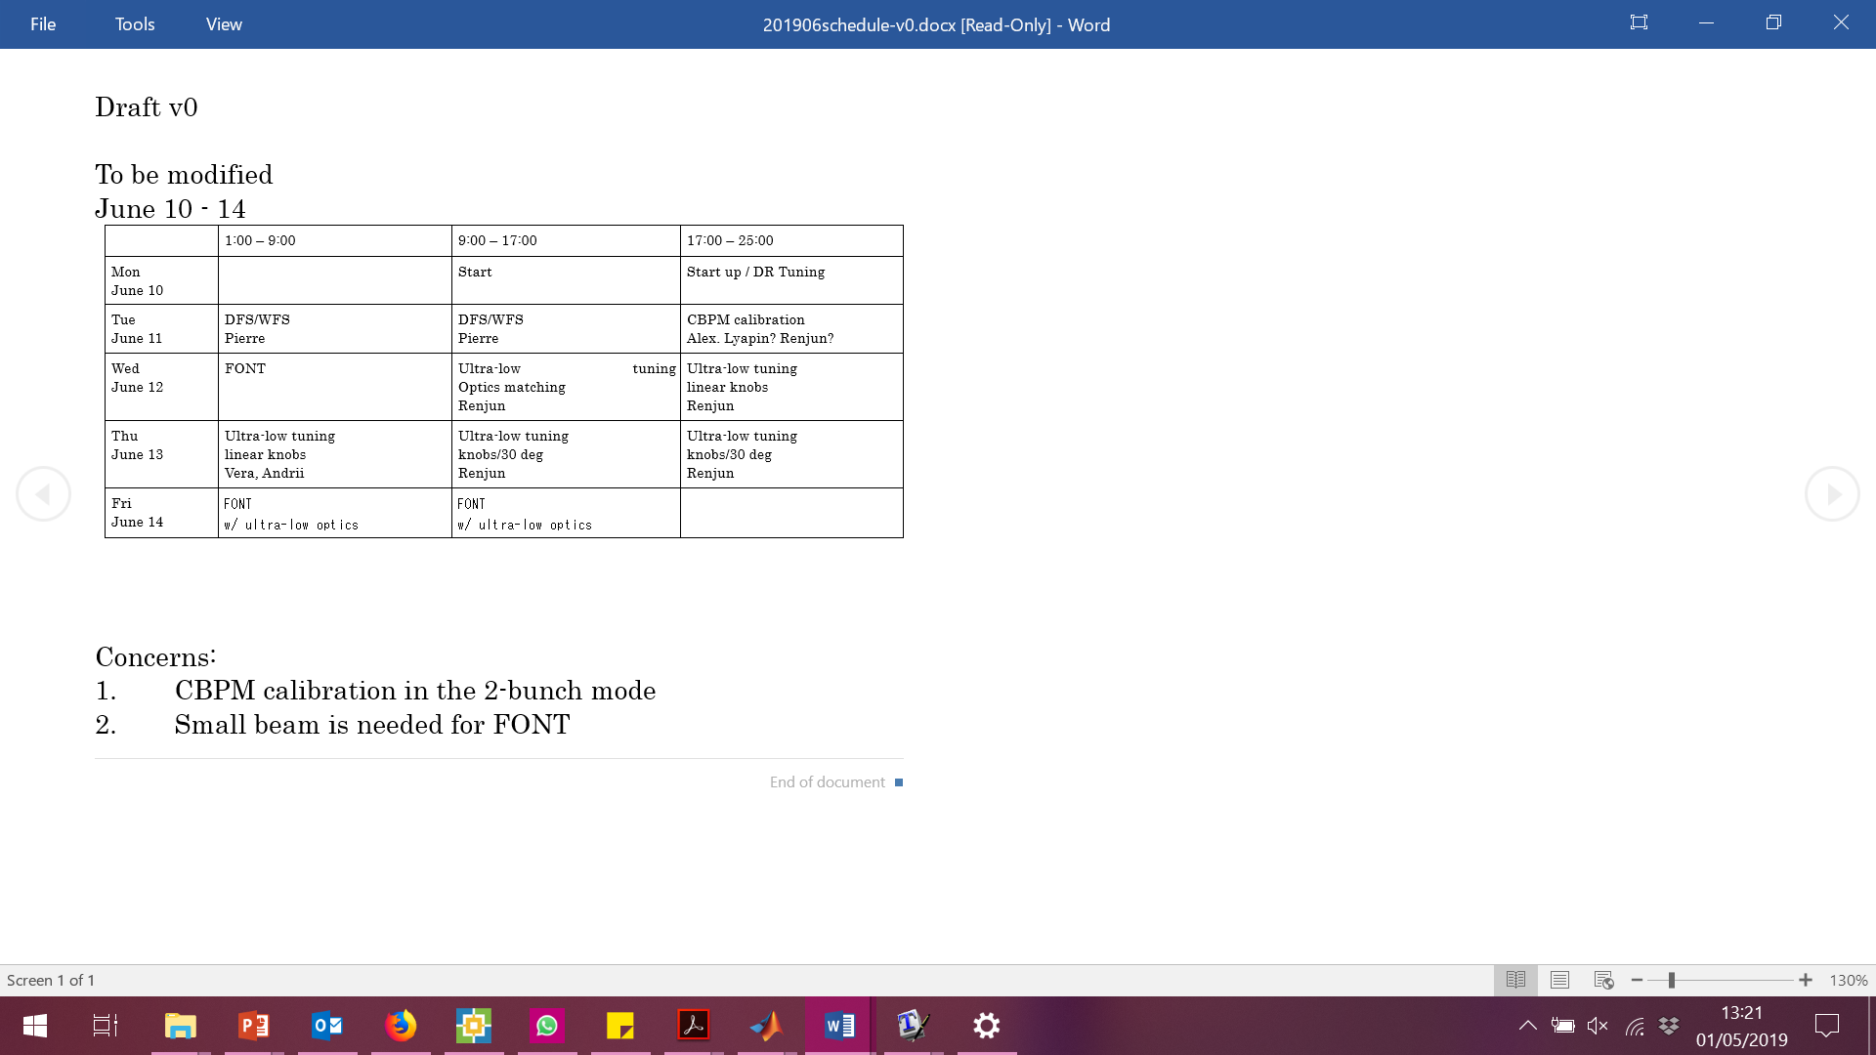
Beam schedule
Wednesday 12th: Owl shift –
nominal optics
Interleaved feedback with MFB1FF and IPB/C as witnesses
Friday 14th: Owl & day shift –
ultra low β optics
Interleaved feedback with MFB1FF and IPB/C as witnesses
Studies using the IP BSM while running upstream FB

Slide 4
Shift plan
Wednesday 12th: Owl shift – nominal optics
Interleaved feedback with MFB1FF and IPB/C witnesses
  Apply constant kick with upstream system to align bunch-1 and bunch-2
  Put beam waist between IPB and IPC
  Align beam in X at IP, repeat in Y.
  Upstream setup and calibration
  Calibrate MFB1FF using ZV1FF
  Calibrate IP (X and Y)
  Kicker scans and measure correlation
  Run dual loop FB then switch gains to zero one-by-one
Friday 14th: Owl & day shift – ultra low β optics
Continue FB studies & perform studies with the IP BSM while running upstream FB
  Repeat feedback study with pi/2 phase advance between P2 and P3
  Upstream jitter source scan – measure beam size with upstream FB
  Charge scan – measure beam size with upstream FB

Slide 5
Potential Issues
Bunch spacing (required for MFB1FF) might be too short for ATF cavity BPMs.
Poor correlation in two bunch mode – little ATF tuning for 2 bunch operation.
Possibly unable to swap to π/2 phase advance between P2 and P3 with ultra-low beta optics (Doug emailed Okugi-san about this –awaiting reply)
Might be unable to align IP BSM and IP BPMs – looks like ~200 um separation
Nominal optics for first shift and ultra-low beta optics for double shift – not ideal for paper data to have such large change in angular jitter between data sets
We only have two working phase shifters and we will struggle if one of these breaks
Would need help or instruction to run IP BSM – most likely will be during Friday day shift
Would require high charge for our studies for best performance

