Slide 1
FONT Meeting
Friday 3rd May 2019
Update on dual-phase feedback paper
&
Effect of feedback on location of beam waist
Douglas BETT

Slide 2
Update on paper
Switched to REVTeX template used by APS journals
Incorporated suggested changes:
  Layout of figures (histograms)
  Content of tables

Slide 3
Update on paper
What’s wrong with the data?
  Not the best feedback performance (IPAC19 paper)
  Not the best survival of the correction (IPAC17 paper)
  Imperfect agreement between data and model (correlations)
  Correction factor differs from IPA to IPB despite ballistic beam
  No reduction in jitter at waist interpolated from IPA/IPB data

Slide 4
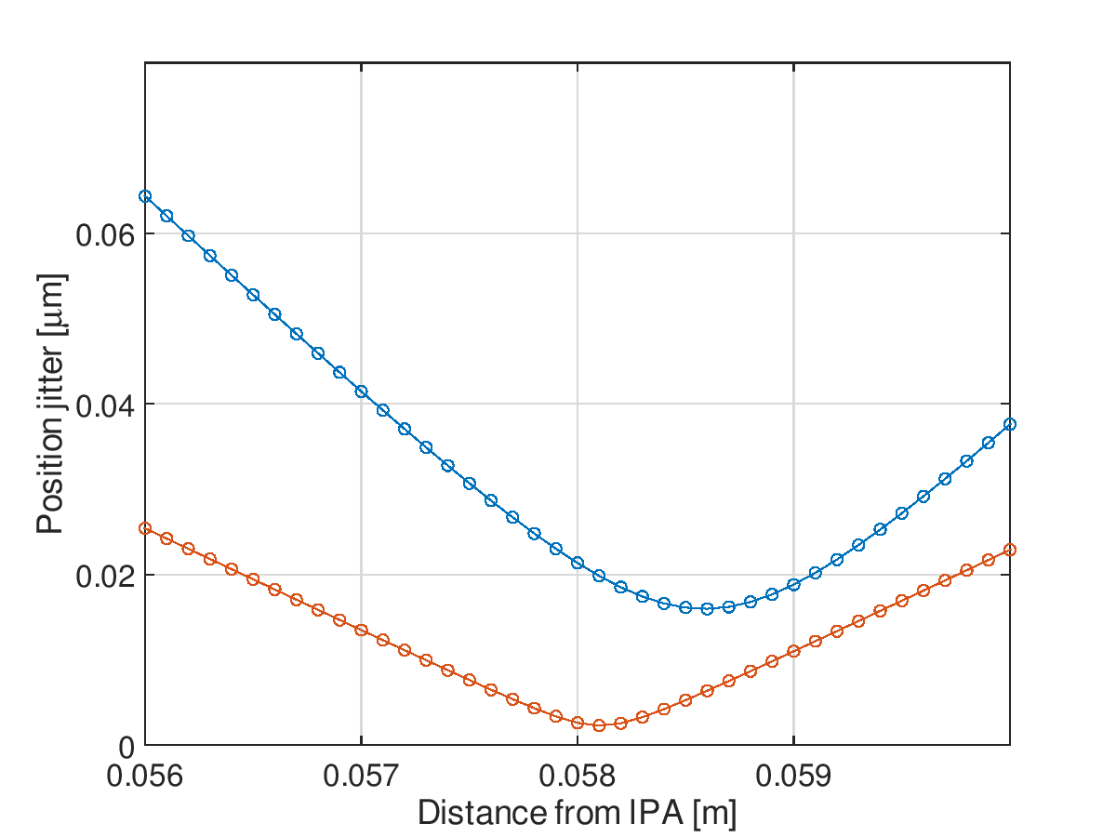
Jitter at IP
Angle at P2 inferred from measurements of bunch 2 at P2 and P3 and MAD8 transfer matrix
Resulting position-angle distribution at P2 tracked to IP for both jitRun2 (off), fbRun14 (on)
Results suggest the feedback has shifted the waist from 0.0586 m downstream of IPA to 0.0581 m: closer to IPA by 0.50 mm
waist
shift
Calculated P2 position-angle correlation coefficient
 | jitRun2 | fbRun14
Bunch 1 | 0.979 | 0.977
Bunch 2 | 0.981 | 0.621

Slide 5
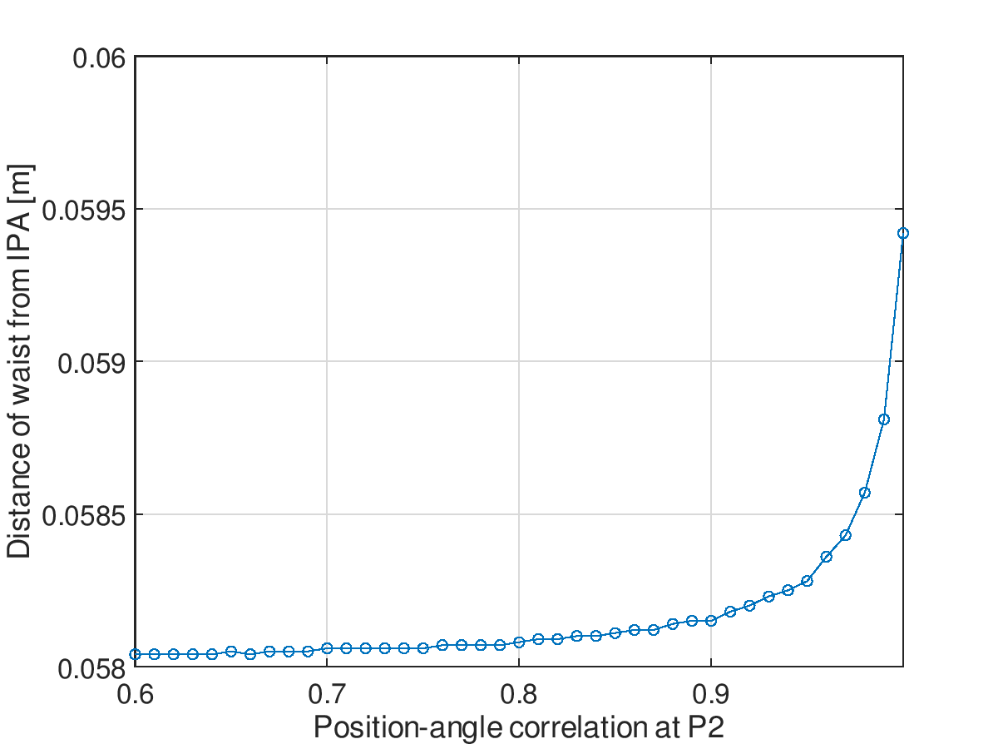
Location of waist
Draw two random vectors from a given multivariate Gaussian distribution
i.e. generate a pair of vectors with a specified correlation coefficient to represent the position and angle at P2
Propagate this simulated data to the IP region using the MAD8 transfer matrix
Location of waist is seen to change as a function of position-angle correlation at P2
Measured effect of feedback is to reduce position-angle correlation at P2 from
~0.98 down to ~0.62 [previous slide]
Model predicts this should shift waist from 0.05857 m downstream of IPA to 0.05804 m: 0.53 mm closer to IPA
waist
shift

Slide 6
Conclusion
Effect of feedback on waist location should be considered in paper – particularly if results from Shintake are included

