Slide 1
Operation at Z-pole for ILC@250
Kaoru Yokoya, Kiyoshi Kubo, Toshiyuki Okugi
2019-0604 TCMB

Slide 2
Z-pole Operation of ILC@250
This report presents preliminary study results about the Z-pole (E_{CM} =91.2GeV) operation of ILC@250, assuming the undulator scheme for positron production.
The possibility of Z-pole operation was discussed at the LCWS2016 at Morioka in Dec.2016 .
  LCWS2016-ZpoleOperation-Yokoya.pptx in
    https://agenda.linearcollider.org/event/7371/contributions/38173/
  It only gave a speculation by a scaling law and some comments on the issues to be studied
The situation has changed since then
  ILC energy is now 250GeV rather than 500GeV with a shorter linac
  The baseline luminosity at 250GeV has been improved from 0.82E34 to 1.35E34 since AWLC at SLAC in Jun.2017, by adopting a reduced (halved) horizontal emittance with a new lattice of the damping ring.

Slide 3
Issues to Be Considered
Repetition rate
Damping Ring
  Dynamic aperture
Main Linac
  Alternating operation 125GeV ←→ 45.6GeV
  Emittance growth due to the low gradient
BDS
  Momentum bandwidth
  Collimation depth
  Final quads
Beam-Beam

Slide 4
Repetition Rate
Obviously, the electron beam with energy E=91.2/2=45.6 GeV is not sufficient to produce the positron beam
TDR adopted 5+5Hz operation at E_{CM} =250GeV, assuming the power system for 500GeV
  5Hz to produce positron, 5Hz for colliding beam
  Assumed positron production at E_{e}=150GeV
  No power problem
    The required power for 150GeV (5Hz) + 45.6GeV (5Hz) is lower than that for 250GeV (5Hz)
However, the power system of ILC@250 is not sufficient for 5+5Hz operation
Here, we assume 3.7+3.7 Hz operation is possible
  This value was estimated by T. Matsumoto
  Klystron output power can be changed at 5Hz but the loaded Q (5.46x10⁶) cannot be changed
  Assume same bunch interval (554ns) for 125 and 45.6GeV
  Parameters:
    Gradient 31.5 ←→ 8.76 = 31.5x (45.6-15)/(125-15) MV/m
    Peak power per cavity 189 ←→ 77.2 kW
    Klystron peak power 9.82 ←→ 4.15 MW
    Klystron efficiency 67% ←→ 53%
    Modulator output 14.66 ←→ 7.83 MW
    Fill time 0.927 ←→ 0.328 ms
    RF pulse length 1.65 ←→ 1.06 ms
    Rep rate 5 ←→ 3.73 Hz

Slide 5
Damping Ring
Horizontal emittance improved 6μm → 4μm
(AWLC2017@SLAC)
Reinforce the wigglers for the shorter time for damping
  5Hz: 200ms → 3.7+3.7Hz : 270ms/2=135ms
  Wigglers are ready (TDR)
Dynamic aperture of the new lattice with stronger wigglers must be confirmed
  It may be possible to split 270ms into, e.g., 150ms+120ms such that more time is assigned for the beam for collision
  Here, we assume OK.

Slide 6
Main Linac (1)
Orbit difference between 125 and 45.6GeV beams (due to the vertical curvature of the earth)
  Kubo’s estimation in LCWS2016 was ~10mm for ILC@500 (45GeV ←→ 150GeV in 10km linac) (see next page)
  Must be smaller for 45←→125GeV in 5km linac
  Can be corrected by pulsed magnets at the end of electron main linac
Emittance degradation in the undulator (not a linac issue)
  Resistive wall wake
  Presumably OK
  But, if not, we need a beamline to bypass the undulator section (~700m, not expensive at all) and pulsed magnets

Slide 7
Beam Dynamics : Positron production beam
2 different energy beams in electron main linac
Orbit is tuned for the colliding beam (E_{CM}/2)
The positron production beam (125GeV or 150GeV) will shift vertically due to earth-following curvature)
250GeV Linac !!
The orbit difference is O(1mm) for E_{CM}/2=100GeV,
but >10mm for E_{CM}/2=45
Orbit difference itself can be corrected by pulsed magnets at ML exit
K.Kubo LCWS2016 @Morioka
K.Kubo EDMS D*01133735

Slide 8
Main Linac (2)
Emittance growth of the beam for collision in the main linac (the beam for positron production is not an issue)
  ε_{yDR} = 20nm, growth budget 10nm in ML
  Full gradient operation followed by detuned cavities is ideal from beam dynamics and from klystron efficiency point of view
  But 5Hz detuning by piezo is difficult (too large detuning). Must adopt uniform acceleration with reduced gradient.
  Kubo’s simulation showed Δε_{y}/ε_{yDR} = 0.8 when 250GeV 10km linac is operated for 45GeV (see next page)
  The growth consists of mainly two terms:
    Proportional to (energy spread)²
    Proportional to (wake)²
  Both are smaller than in the case of 45GeV in 250GeV linac
    is proportional to the linac length (for given energy spread)
    is proportional to 1/gradient²
  Should be OK for 45.6GeV operation of 125GeV 5km linac
    Must be confirmed
  Later, a longer bunch will be discussed in this report (BDS)
    Energy spread is smaller : (a) becomes smaller
    But wake is stronger : (b) becomes larger
    Simulations needed

Slide 9
Emittance growth vs. final energy
Average of 40 random seeds. Error bar: standard deviation.
K.Kubo LCWS2016
ε₀ = 20nm
Linac length for 250GeV
Uniform gradient over whole linac
Random alignment errors
DFS correction
20161201 K.Kubo, preliminary

Slide 10
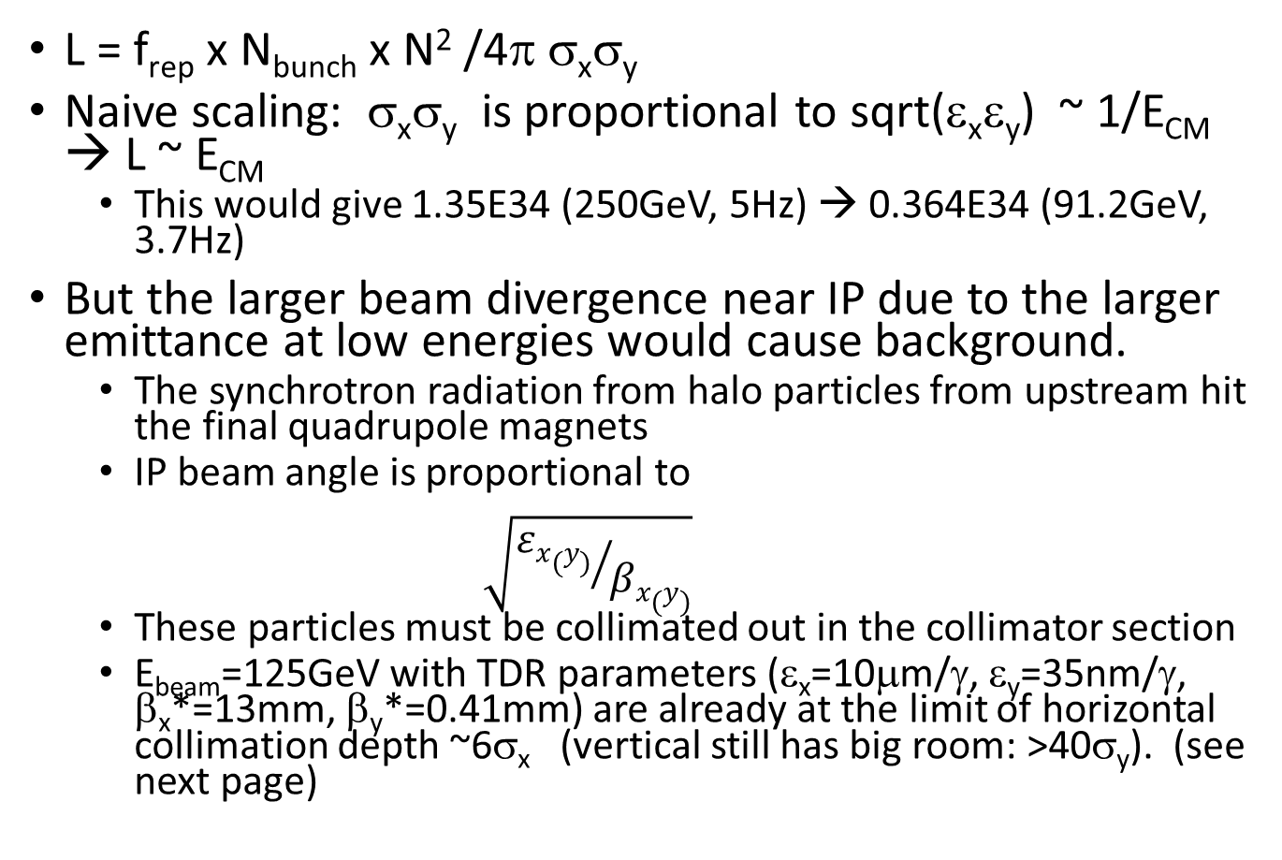
Luminosity with a Simple Scaling
L = f_{rep} x N_{bunch} x N² /4π σ_{x}σ_{y}
Naive scaling: σ_{x}σ_{y} is proportional to sqrt(ε_{x}ε_{y}) ~ 1/E_{CM} → L ~ E_{CM}
  This would give 1.35E34 (250GeV, 5Hz) → 0.364E34 (91.2GeV, 3.7Hz)
But the larger beam divergence near IP due to the larger emittance at low energies would cause background.
  The synchrotron radiation from halo particles from upstream hit the final quadrupole magnets
  IP beam angle is proportional to
  $\sqrt{{εx(y)}/{βx(y)}}$
  These particles must be collimated out in the collimator section
  E_{beam}=125GeV with TDR parameters (ε_{x}=10μm/γ, ε_{y}=35nm/γ, β_{x}*=13mm, β_{y}*=0.41mm) are already at the limit of horizontal collimation depth ~6σ_{x} (vertical still has big room: >40σ_{y}). (see next page)

Slide 11
Collimation Depth with TDR Params
250GeV 1m QD0
250GeV 2m QD0
The circles shows the betas in TDR
T. Okugi, AWLC2017@SLAC

Slide 12
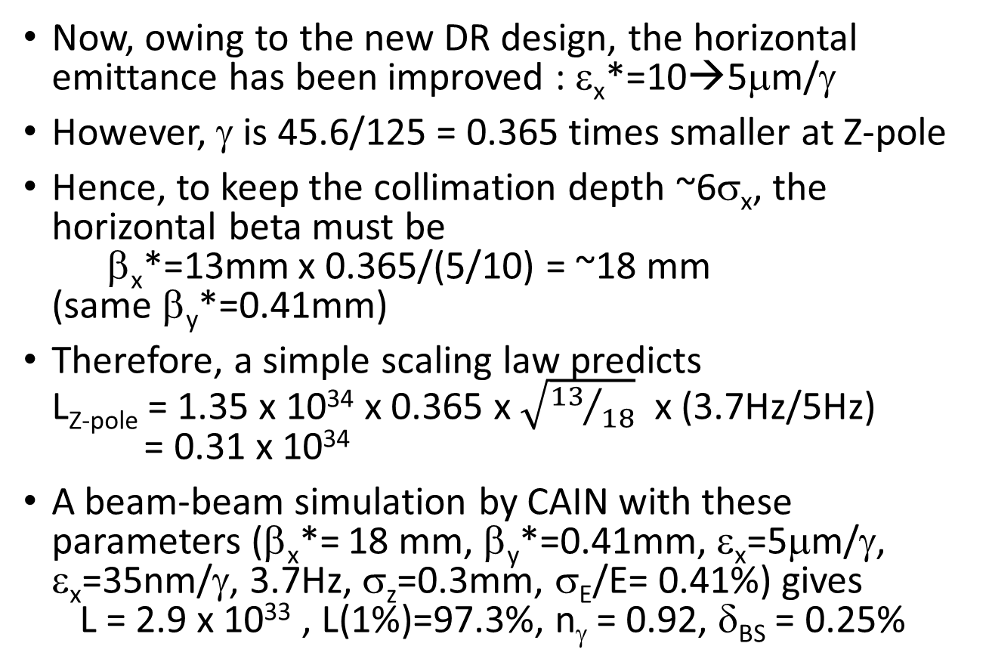
Luminosity with a Simple Scaling (2)
Now, owing to the new DR design, the horizontal emittance has been improved : ε_{x}*=10→5μm/γ
However, γ is 45.6/125 = 0.365 times smaller at Z-pole
Hence, to keep the collimation depth ~6σ_{x}, the horizontal beta must be
β_{x}*=13mm x 0.365/(5/10) = ~18 mm
(same β_{y}*=0.41mm)
Therefore, a simple scaling law predicts
L_{Z-pole} = 1.35 x 10³⁴ x 0.365 x $\sqrt{{13}/{18}}$ x (3.7Hz/5Hz)
= 0.31 x 10³⁴
A beam-beam simulation by CAIN with these parameters (β_{x}*= 18 mm, β_{y}*=0.41mm, ε_{x}=5μm/γ, ε_{x}=35nm/γ, 3.7Hz, σ_{z}=0.3mm, σ_{E}/E= 0.41%) gives
L = 2.9 x 10³³ , L(1%)=97.3%, n_{γ} = 0.92, δ_{BS} = 0.25%

Slide 13
BDS
However, Momentum band width in FFS is a bottle neck
  Beam energy spread σ_{E}/E=0.41% (proportional to 1/E, 0.15% for 125GeV)
    Energy spread increase in ML and undulator is negligible
  Horizontal emittance increases in FFS (β_{x}*=18mm, β_{y}*=0.41mm) from 5nm to more than 8nm
  Better to use a smaller energy spread by adopting a longer bunch, e.g.,
  (σ_{z}, σ_{E}/E) = (0.3mm, 0.41%) → (0.41mm, 0.30%)
  This combination makes the horizontal emittance at IP ~6.2nm (T. Okugi). The increase from 5nm is still sizable, but let us be satisfied with this.
It may be possible to adopt new final quads with larger apertures dedicated to Z-pole operation (to relax the collimation depth)
  Required fields are low for 45.6GeV
  To be studied next time

Slide 14
Increase of horizontal emittance in BDS due to the momentum band width
Final emittance vs. β_{y}*
2 curves: r.m.s. emittave and 2.5σ emittance
β_{x}*=18mm
σ_{E}/E = 0.41%
T. Okugi
σ_{E}/E = 0.3%

Slide 15
Preliminary Parameters
We assume the parameters listed here →
45.6←→125GeV
3.7+3.7Hz operation
(ε_{nx}*, ε_{ny}*) = (6.2nm, 35μm)
(β_{x}*, β_{y}*) = (18mm, 0.39mm)
L = 2.46 x 10³³ /cm²/s
Center-of-mass energy spectrum : next pages (log and linear scale)
Beamstrahlung is very small
  But not easy to make use of this

Slide 17
The blue curve is the initial distribution with the same peak value

Slide 18
Brief Explanation of Luminosity Increase since LCWS2016
The range 1-1.5 x 10³³ given in LCWS2016 came from L~ either E² or E^{3/2}
Upper limit comes from the beam angle in x, the lower limit in both x & y. The former is the reality.
If apply the luminosity improvement in AWLC2017 by factor 1.35/0.82=1.65, L=2.47 x 10³³
The lower ε_{nx}* could give some more increase (~3 x 10³³⁾ but it is cancelled by 5→3.7Hz
Another complication is the momentum band width under large energy spread. This is (partly) cured by the longer bunch. The side effects (larger wake) must be checked.

Slide 19
Next Steps
First step: confirm the present results
  Damping ring dynamic aperture
  Linac simulation for 45.6GeV beam in 125GeV linac with increased bunch length
  BDS momentum band width and collimation depth
    Note ε_{nx}* = 6.2nm with β_{x}* = 18mm will cause collimation depth < 6σ_{x}
  Also, 2625 bunches. Any problem (except positron production)?
Second: possible drastic improvements, if needed
  Better design of DR
    smaller ε_{nx} , smaller longitudinal emittance (shorter bunch)
    Tighter focusing (as is being considered in circular colliders)
  Better design of BDS
    Final quads with larger aperture (not vert much drastic)
    Larger momentum band width with a drastic change of the lattice ????
Third: ILC@500
  Nick’s idea

Slide 20
Summary
The previous report (LCWS2016@Morioka) suggested the expectation L=(1-1.5)x10³³ /cm²/s at Z-pole in 5+5Hz operation of ILC500
ILC250 (shorter linac) is
  worse in power : up to 3.7+3.7Hz operation
  but better in the beam dynamics
The previous luminosity improvement for ILC250 by smaller horizontal emittance (AWLC2017@SLAC) brings about significant effects for Z-pole operation
Expected luminosity is now L ~ 2.46 x 10³³ /cm²/s, though preliminary
This must be confirmed by more detailed simulations
If you want higher luminosity, the bottle neck is the momentum band width of BDS under the large energy spread of the low energy beam

