Slide 1
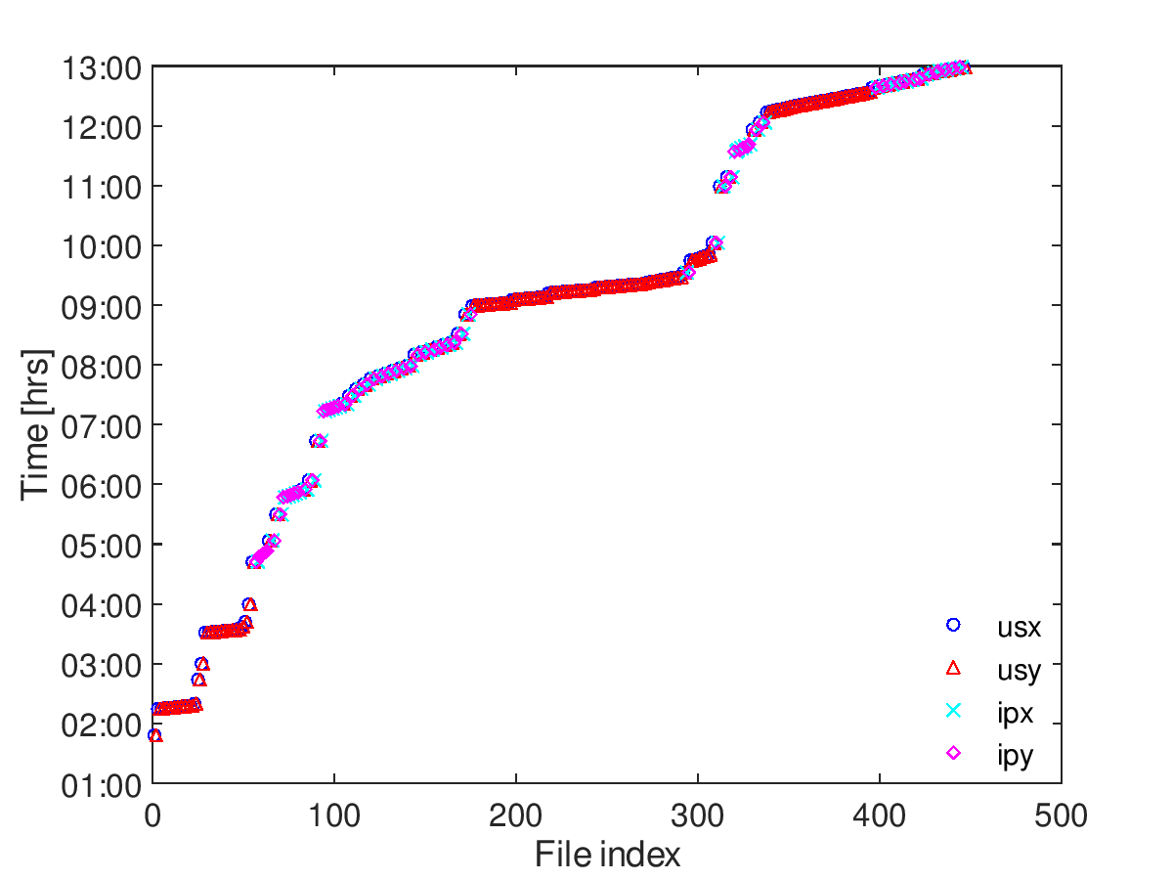
yMovCal1
xMovCal1
loPhaseCal1
yPhaseLo1
xPhaseLo1
K1/K2Cal3
ZV1FFScan3
K1/K2Scan1
IPXCal1
fbRun29-30
fbRun28
jitRun7
jitRun6
ZV1FFCal2
fbRun13-24
ext. kick timing
fbRun27
fbRun25-26
jitRun5
fbRun10-12
AQD0FFyScan3
fbRun9
jitRun4
fbRun8
AQD0FFyScan2
jitRun2-3
AQD0FFyScan1
π/2 optics
low-β optics
fbRun4-7
K1/K2Cal2
fbRun1-3
K1/K2Cal1
jitRun1

