Slide 1


ATF2 June 2019 Trip
(IP data)
R. Ramjiawan
FONT meeting
Friday, 21th June 2019

Slide 2
Overview (13/06/2019)
Calibrations
Feedback performance 20 dB (non-interleaved)
Feedback performance 30 dB (interleaved)
Study of the charge lost in the beamline for the pi/2 optics

Slide 3
Beamline configuration
Operating in nominal optics with the beam waist between IPB and IPC
IPB and IPC instrumented in Y with 20/30 dB attenuation, and in X with 20 dB attenuation.
For this shift, we opted to switch to a new set of optics constructed by Okugi-san to have a pi/2 phase advance between P2 and P3.

Slide 4
20 dB IPB Calibrations
IPB, 20 dB (AQD0FFyScan2)
35:45 dipole sample, 43 reference sample
IPB/IPC Calibration constants: -0.057,-0.025
IPB

Slide 5
30 dB IPB Calibrations
IPB, 30 dB (AQD0FFyScan3)
35:45 dipole sample, 43 reference sample
IPB/IPC Calibration constants: [0,-0.016,-0.0085]
IPB

Slide 6
fbRun8 / AQD0FFyScan2
13/06/2019
20 dB
Non-interleaved – feedback on

Slide 7
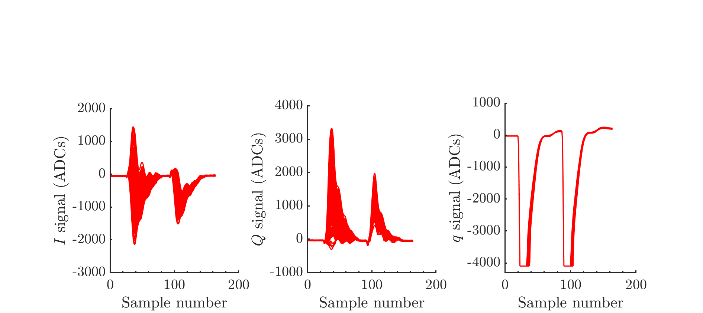
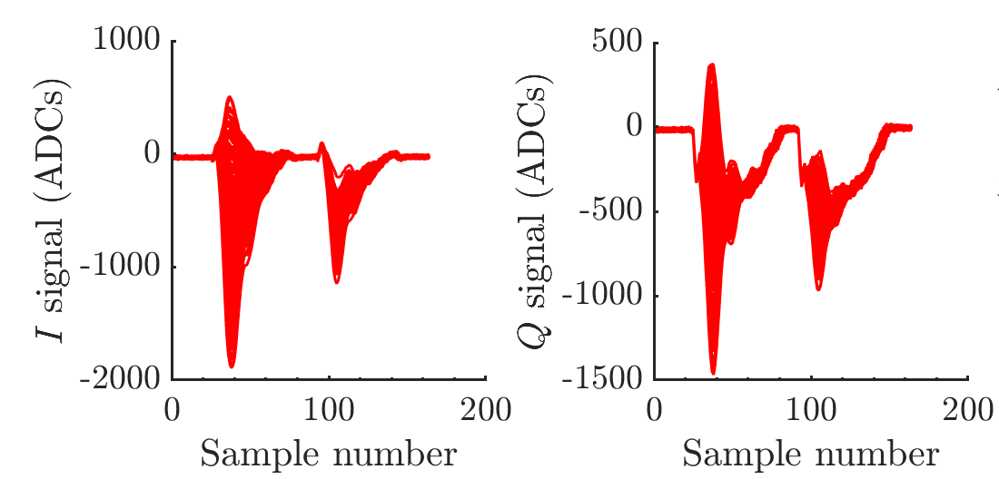
Waveforms
IPB
IPC

Slide 8
Feedback on - correlation
IPB
Bunch-1 jitter: 9.16 um
Bunch-2 jitter: 3.95 um
Scale factor: 2.3
Bunch-to-bunch correlation: 6%
Feedback off correlation: 98.1%
IPC
Bunch-1 jitter: 12.66 um
Bunch-2 jitter: 3.18 um
Scale factor: 3.98
Bunch-to-bunch correlation: 9%
Feedback off correlation: 98.3%

Slide 9
FBRun8
Jitter on waist
FB off: 235 um
FB on: 220 um
Longitudinal position 0 corresponds to IPB and 1 to IPC

Slide 10
Jitter on waist as a function of sample number
Plots enlarged on next slide.
fbRun8
20 dB
fbRun7
30 dB
No. samples integrated
1
2
3
4
5

Slide 11
Jitter on waist as a function of sample number
fbRun8
20 dB
fbRun7
30 dB
No. samples integrated
1
2
3
4
5

Slide 12
fbRun14 / AQD0FFyScan1
13/06/2019
30 dB
Interleaved feedback

Slide 13
fbRun14
IPB
IPC
IP: 228 to 278 nm
IPB: 9 um to 2.54 um
IPC: 9.1 um to 2.66 um

Slide 14
Interpolated jitter
Longitudinal position 0 corresponds to IPB and 1 to IPC
Feedback off
Feedback on
IP: 228 to 278 nm
IPB: 9 um to 2.54 um
IPC: 9.1 um to 2.66 um

Slide 15
Charge loss in the beamline
13/06/2019
30 dB
K2 Kicker scan

Slide 16
Pi/2 optics
For this shift, we opted to switch to a new set of optics constructed by Okugi-san to have a pi/2 phase advance between P2 and P3.
As we were not able to do any tuning with these optics without help the beam trajectory was not optimal and depending on the position offset we lost beam charge throughout the beamline.

Slide 17
Charge as a function of position
K2Scan1; exercising K2 in constant DAC mode
The charge lost in the beamline varies as a function of the kick given at K2.
Reference sample: 105

Slide 18
Sample jumps
13/06/2019
fbRun18

Slide 19
Sample jumps
Could repeatably get sample jumps with certain settings of the extraction kicker timing.
Extraction kicker setting 3.927 us.

Slide 20
Conclusions
Calibrations weren’t ideal, with larger jitter at each setting than calibration step size.
Factor of 3 reduction in beam jitter seen at IPB and IPC, not seen at beam waist.
Beam waist measurements to ~220 nm, possibly resolution limited at this point.
Charge loss somewhere in the beamline may affect the model propagations
Sample jumps were reproducibly achievable by varying the extraction kicker timing.

Slide 21
Back up slides
jitRun4 / AQD0FFyScan2
13/06/2019
20 dB
Non-interleaved – feedback off

Slide 22
IPB
Bunch-1 jitter: 9.07 um
Bunch-2 jitter: 8.93 um
Scale factor: 1.01
Bunch-to-bunch correlation: 98.1%
IPC
Bunch-1 jitter: 12.43 um
Bunch-2 jitter: 12.09 um
Scale factor: 1.03
Bunch-to-bunch correlation: 98.3%

