Slide 1

ILD Status and future
1.11.2019

Slide 2
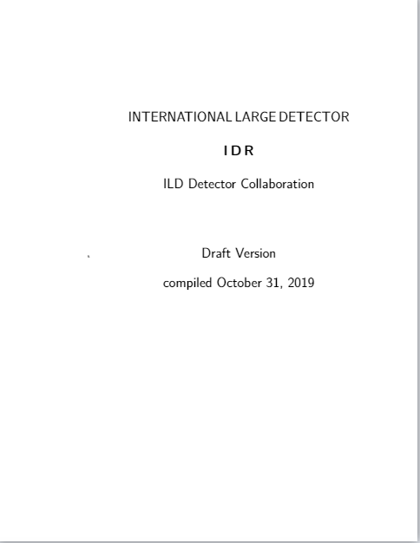
The IDR
International Large Detector
Design Report

Slide 3
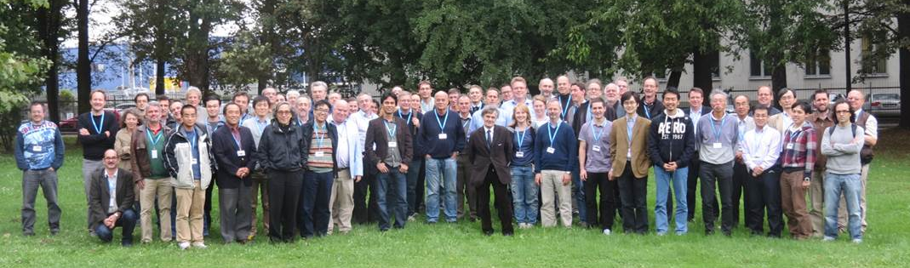
Crawkow, 2013
Where it all started:
Kickoff the optimization of ILD after having finished the DBD document
Start the organisation of ILD as a “collaboration”

Slide 4
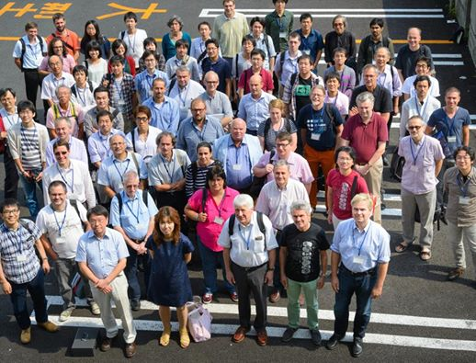
Oshu City, Japan, 2014
Decision to complete re-invent our simulation framework
Define a set of benchmark reactions and an optimization strategy
New ILD organisation kicked off

Slide 5
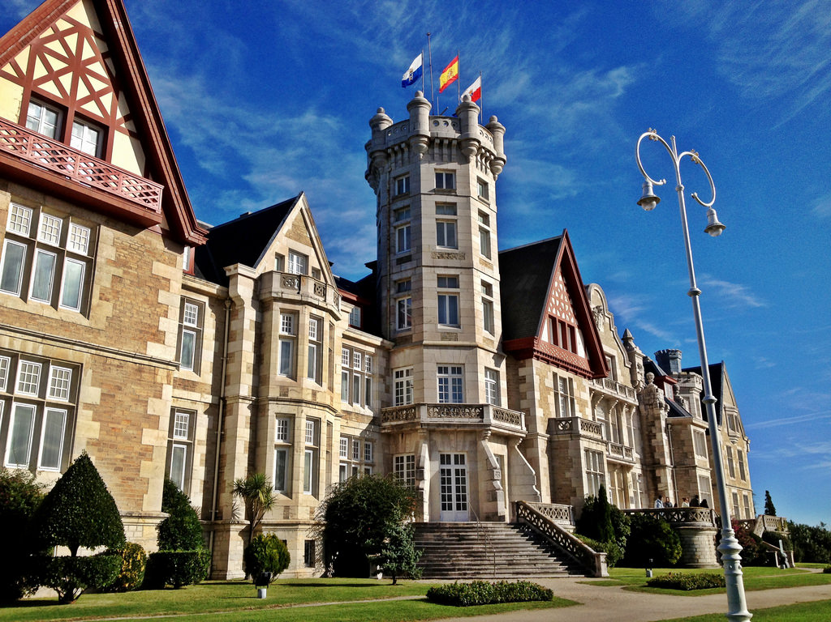
Santander, Spain, 2016
Santander, Spain, 2016:
Define the two ILD models
Define a strategy to study
ILD in performance/ cost space

Slide 6
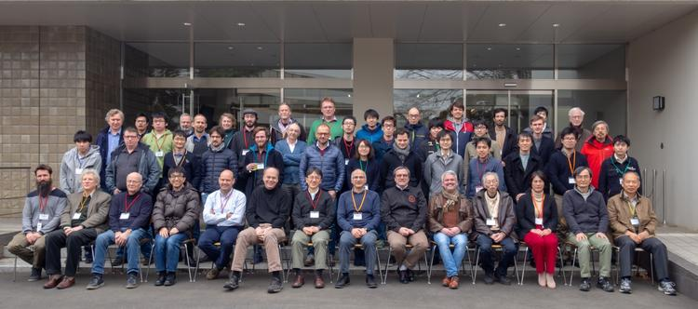
KEK 2019
Bringing things together, consolidating analyses
Start serious writing of the IDR

Slide 7
Today: The IDR
International Large Detector
Design Report

