Slide 1
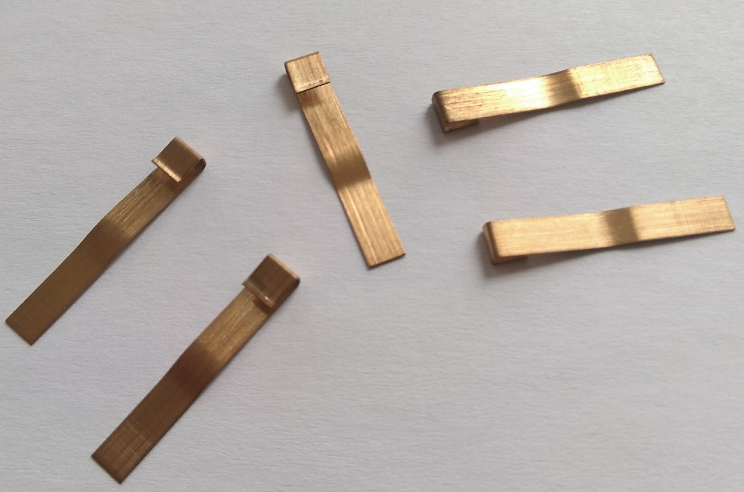
“the devil is in the details”
need: 2 x 20
have: 34
keep searching…
(+ additional production)
not successful
DELAYED

