Slide 1


Analysis of SiW-ECAL technological prototype beam test with electron beam
Y. Kato^{B}, K. Goto^{A}, T. Suehara^{A}
and ILD SiW-ECAL group
Kyushu University^{A}
The University of Tokyo^{B}
LCWS2019 @ Sendai, Japan
29th Oct. 2019
katou@icepp.s.u-tokyo.ac.jp
Notes:
Hello everyone, this is Yu Kato, from the University of tokyo, and I will be talking about BSM Search using Higgs to Invisible Decay at the ILC.

Slide 2
Table of Contents
Introduction
R&D of SiW-ECAL technological prototype
  FEV13-Jp Status
Beam Test 2019
Procedure for Energy Measurement
Analysis
  Trigger Adjustment
  Pedestal
  MIP
  TDC
  Shower
  Remain Issues

Slide 3

International Large Detector
One of the detector concepts at the ILC
Optimized for Particle Flow Algorithm
  Reconstruct & identify all the particles
Components
  Vertex detector
  Trackers
  Calorimeters
    ECAL
      ScW-ECAL
      SiW-ECAL
    HCAL
  Muon Yoke
  etc.

Slide 4
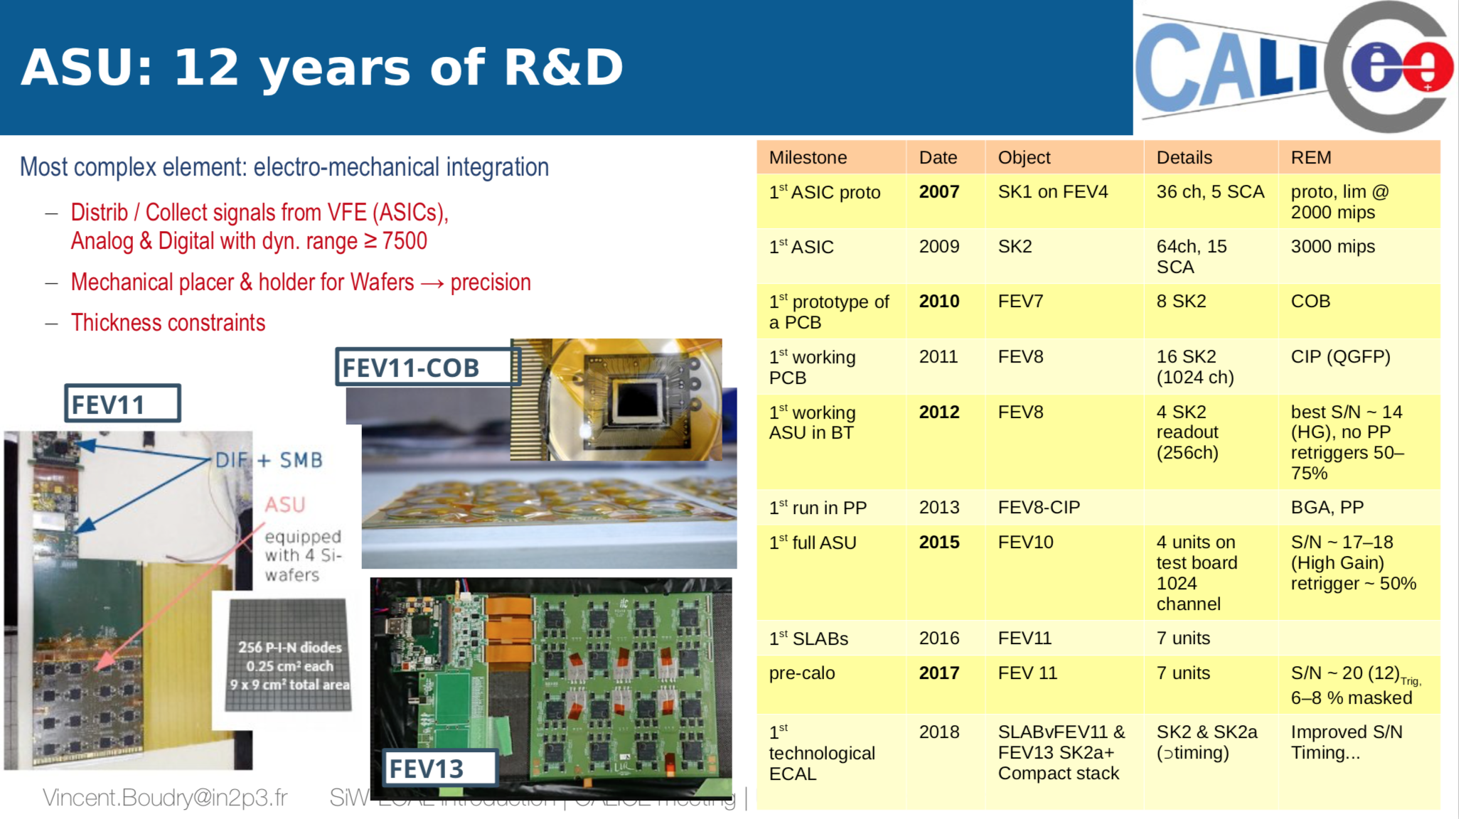
R&D of SiW-ECAL technological prototypes
TBD

Slide 5
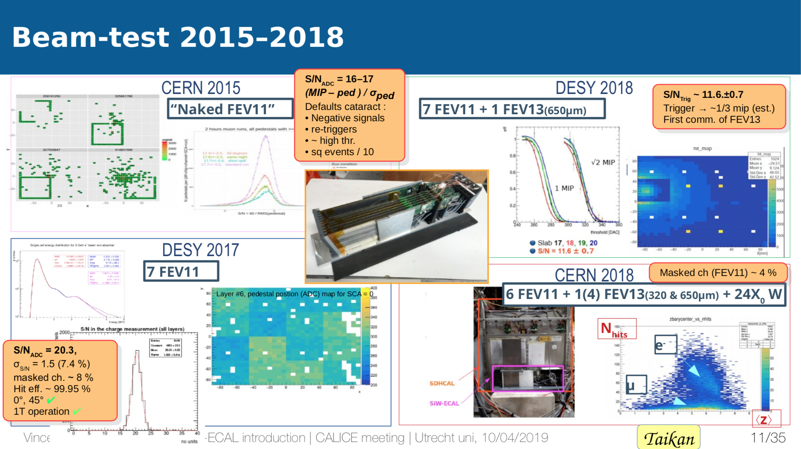
R&D of SiW-ECAL technological prototypes
TBD

Slide 6
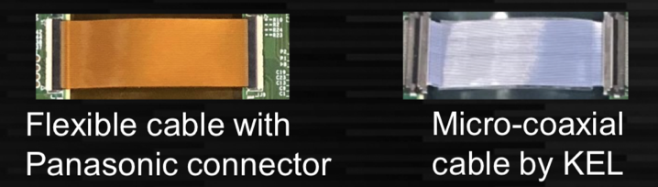
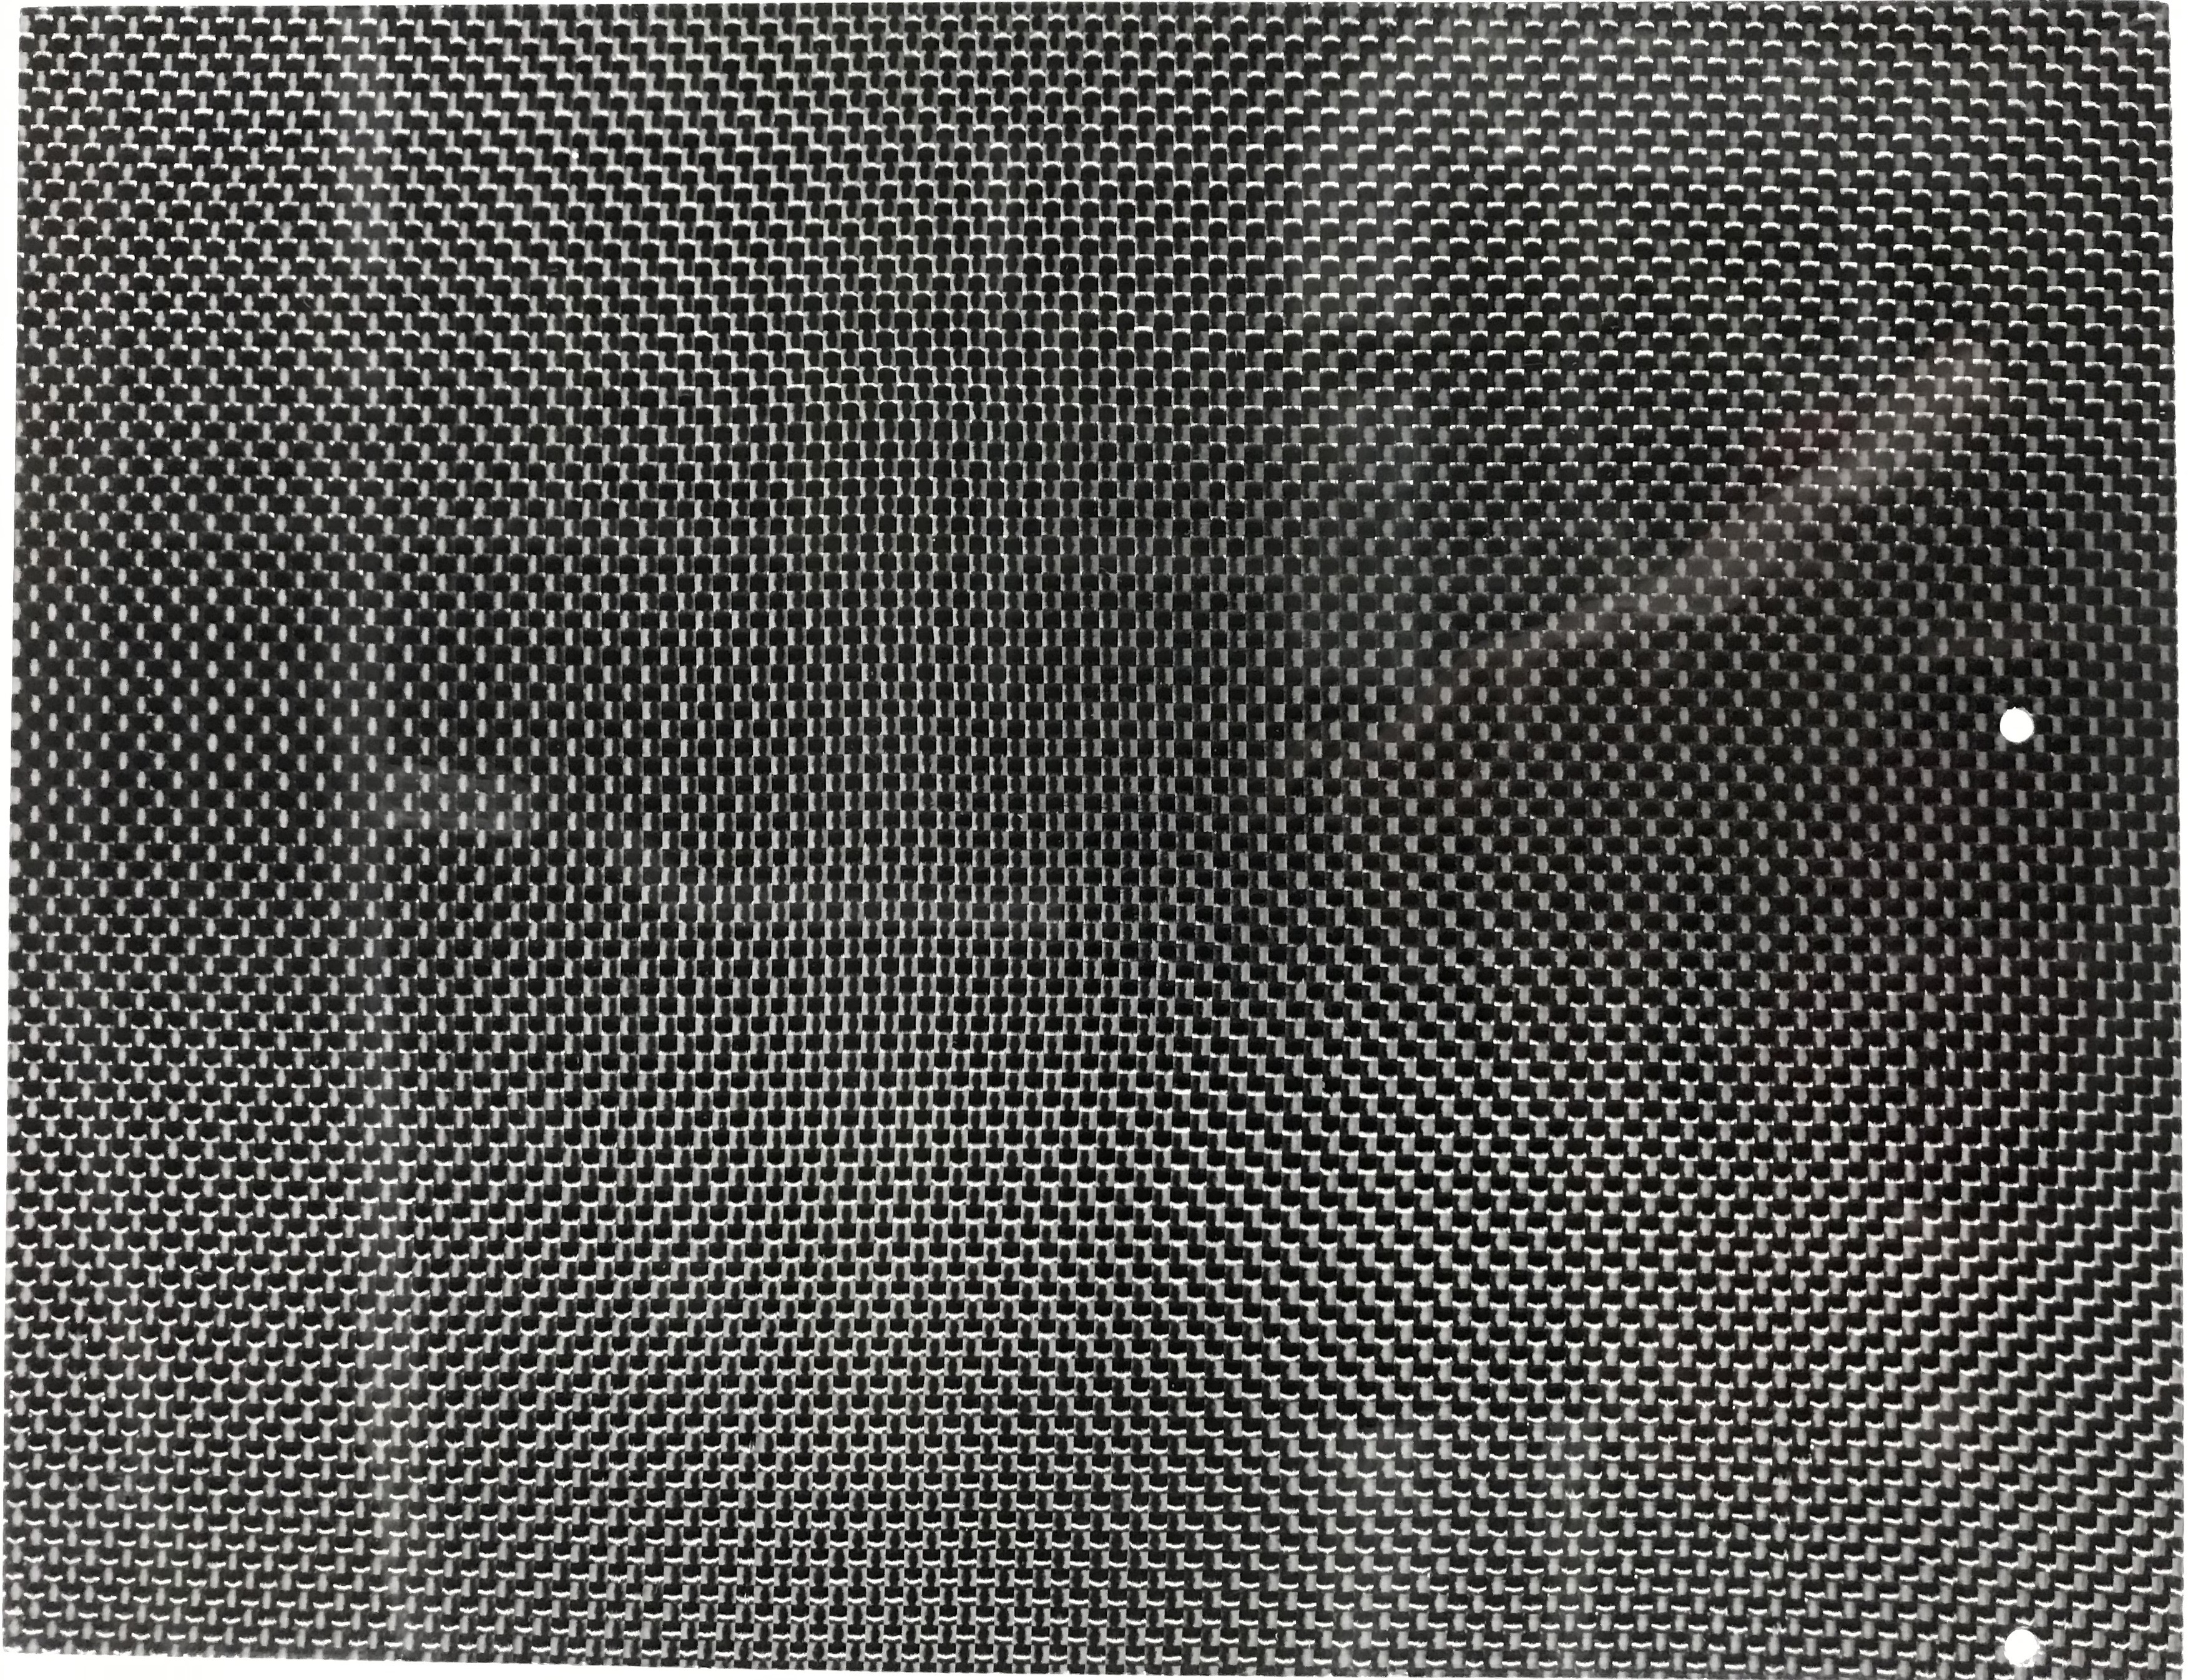
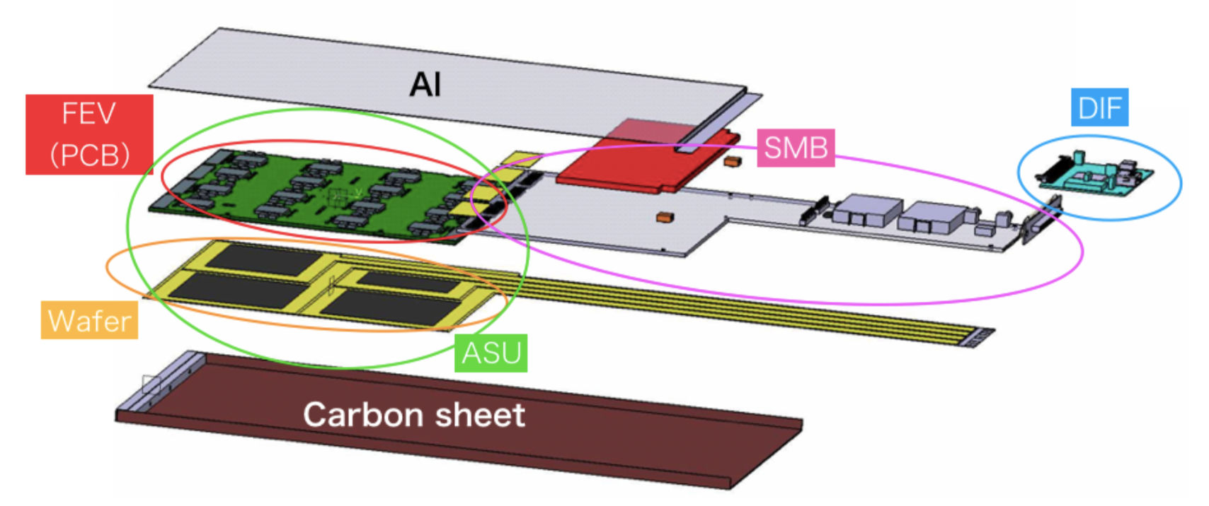
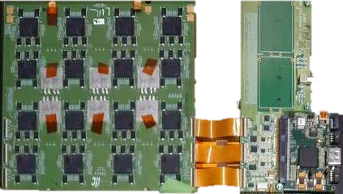
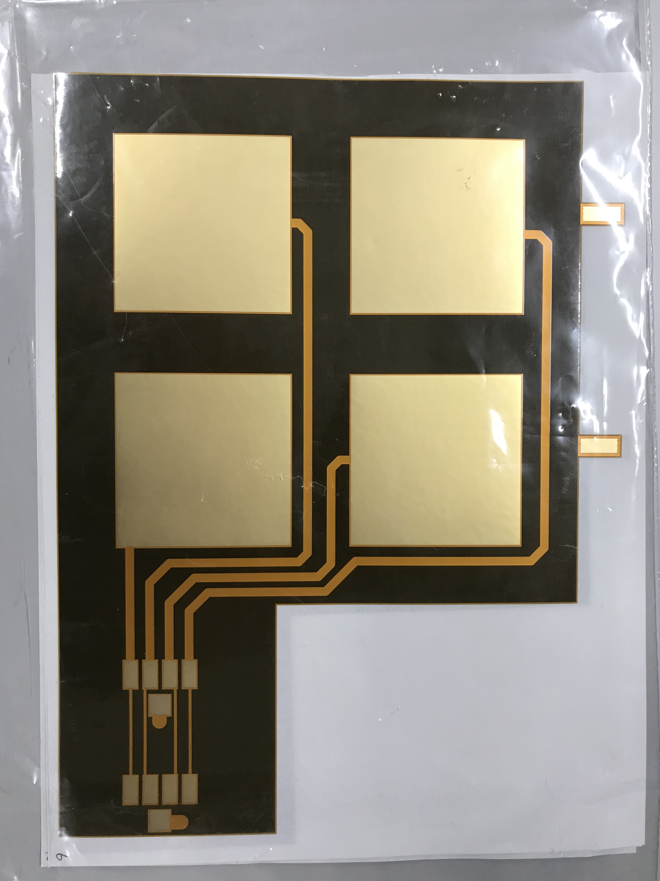
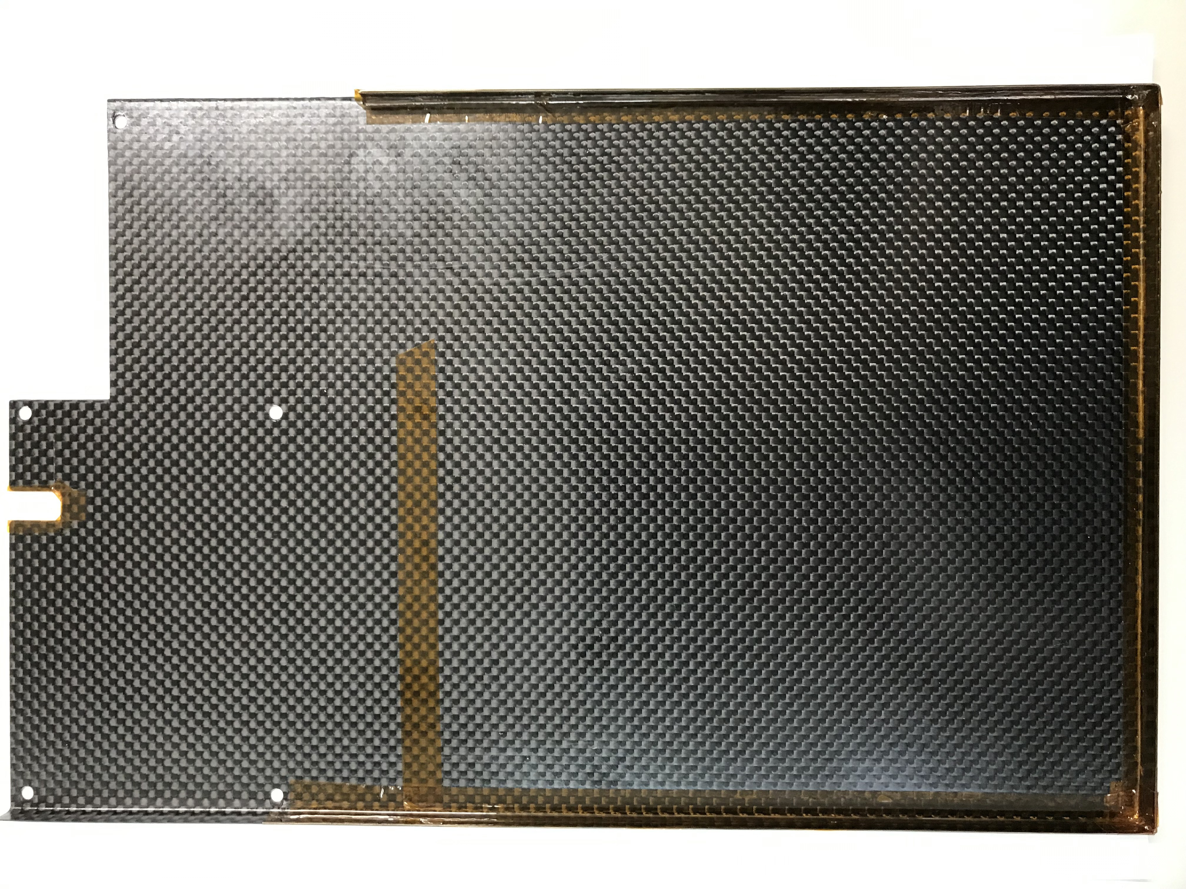
R&D of SiW-ECAL technological prototypes
Major changes in FEV11 → 13 and SMBv4 → v5
ASIC: SKIROC2 → 2A
  – Individual threshold control
  – Improvements on TDC
Smaller SMB footprint
Connection by 0.4mm-pitch flex cables
  – Two candidates, footprint compatible
FEV11 & SMBv4
FEV13 & SMBv5
Carbon
Carbon

Slide 7

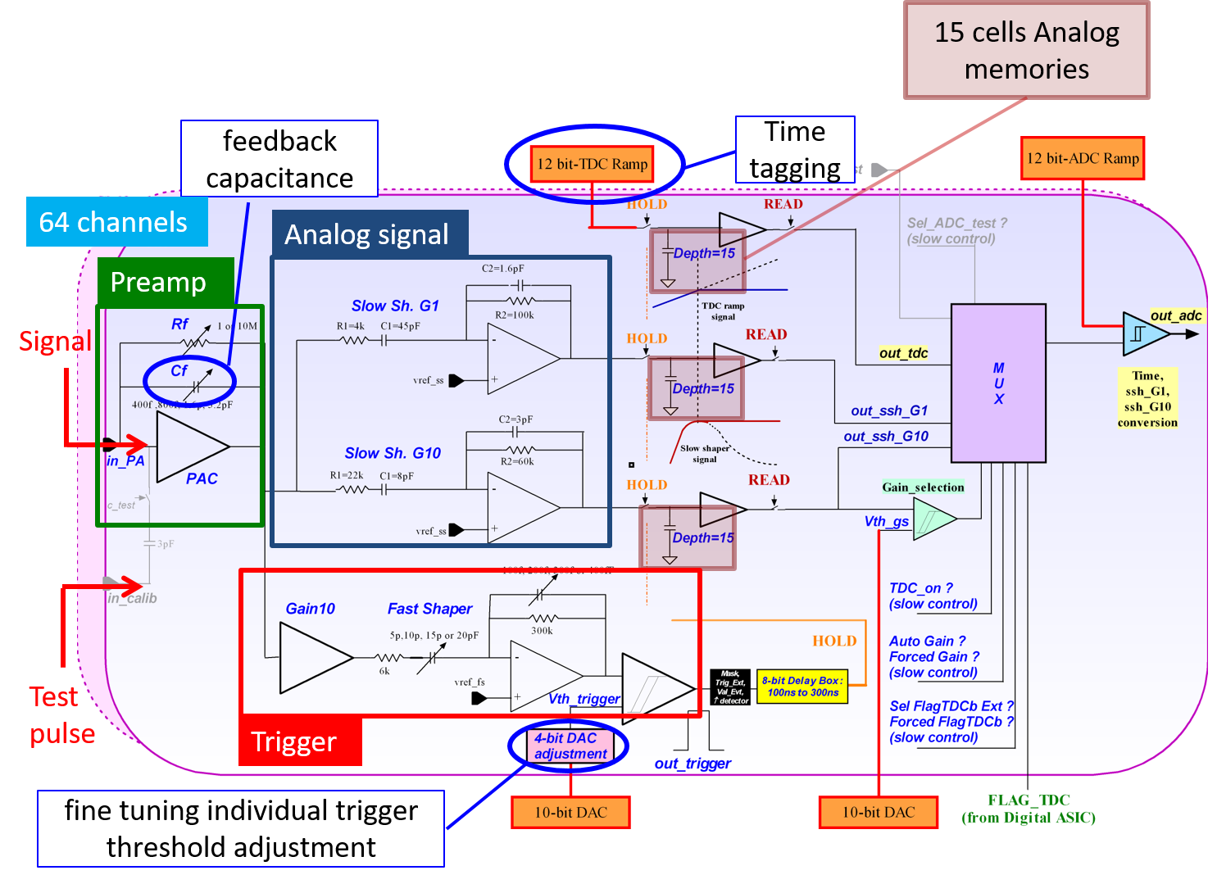
Analogue core: SKIROC2A
Outputs: Gain (High/Low), TDC
arXiv:1801.02024

Slide 8
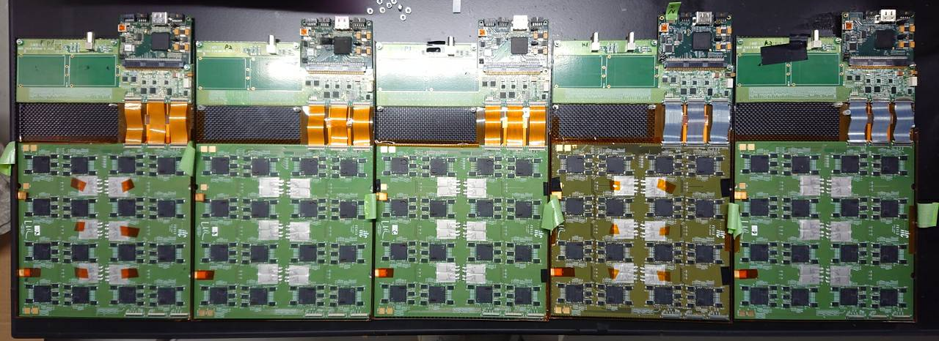
FEV13-Jp Status
ASIC: SKIROC2A
Si thickness: 320µm & 650µm New!
  256 ch/sensor × 4 sensor/slab
FEV-SMB Connection: Flexible cable or Micro-coaxial cable
EM shielding: w/ Carbon frame and cover
Power Pulsing
See previous talk
for details
Total 5 slabs
in Kyushu U., Japan
slab ID | P1 | P2 | P3 | K1 | K2
Si thickness | 650 µm | 650 µm | 320 µm | 650 µm | 650 µm
Assembly | in Kyushu U. | in Kyushu U. | in Kyushu U. | in LLR | in Kyushu U.

Slide 9
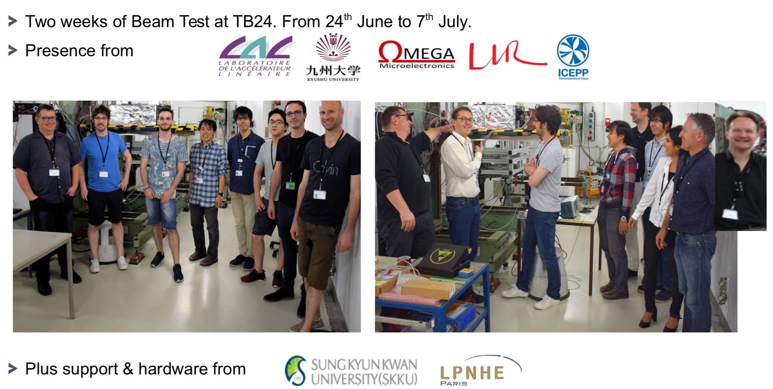
Beam Test 2019 @ DESY
Beam time:
  24th June - 7th July at DESY test beam facility
  e⁻ beam: 1 - 5 GeV
Presence from:
Support & Hardware from:

Slide 10
Beam Test 2019 @ DESY
Beam time:
  24th June - 7th July at DESY test beam facility
  e⁻ beam: 1 - 5 GeV
Objectives:
  Comparison of ASU based on BGA and based on Chip-On-Board (COB)
  Test of new SL-Boards
  Validation of FEV13-Jp ← Target of this talk
Programs:
MIP program (w/o Tungsten)
  Position scan for MIP calibration
  TDC test
  Angled beam: 25 deg.
  Retriggering / double pedestal
Shower program (w/ Tungsten)
  Energy measurement
  Response from large signal
  TDC / auto gain
  Edge effect

Slide 11
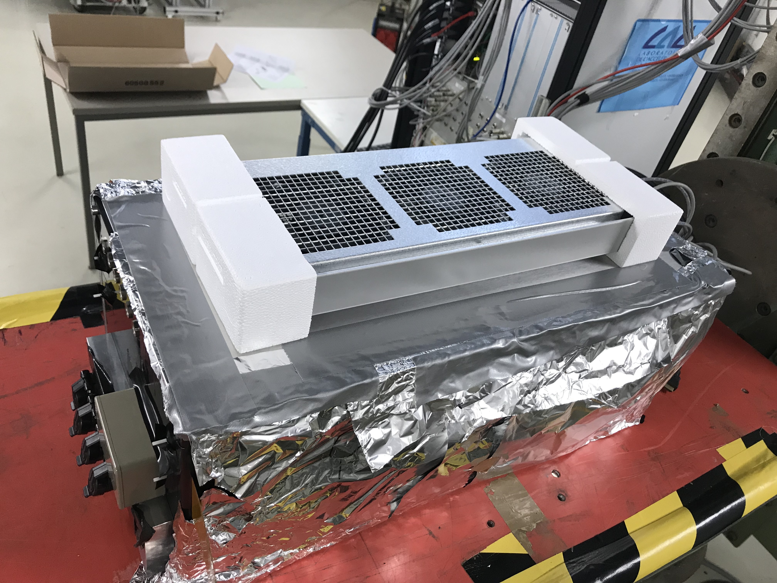
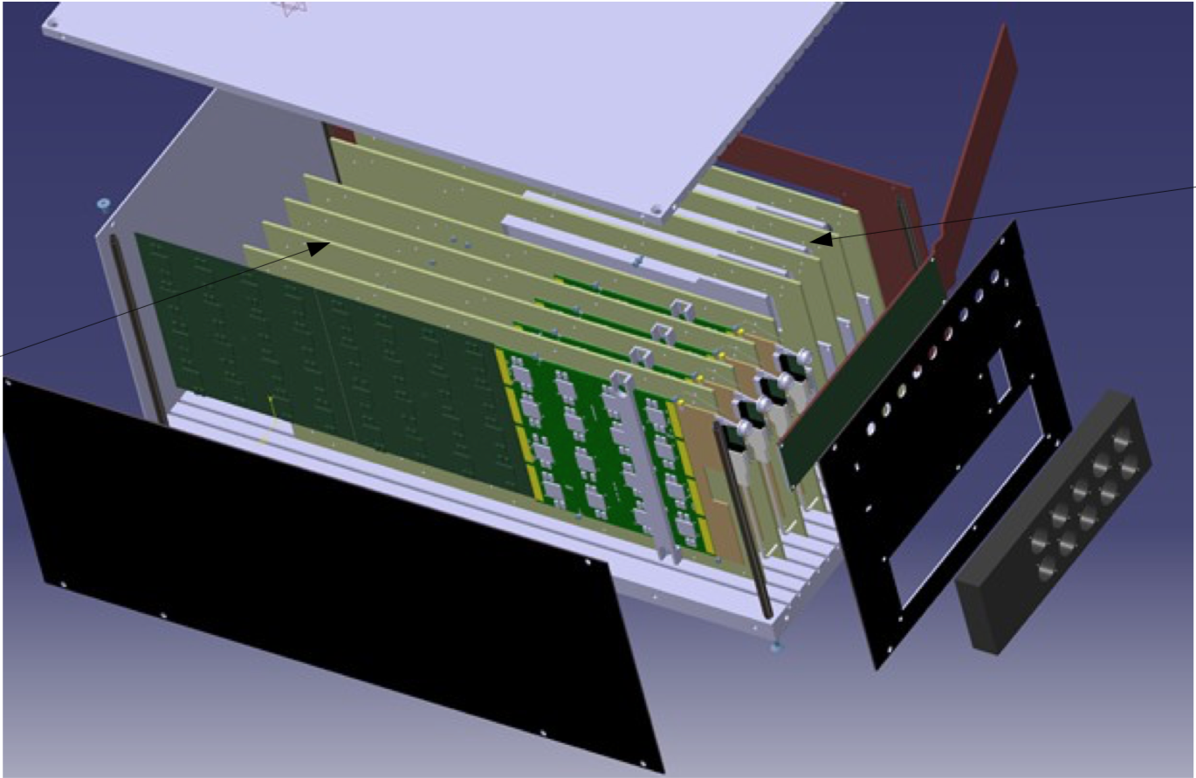
Setup for Beam Test
Devices: 2 types of readouts
  DIF based slabs: FEV13-Jp × 5
  SLB based slabs:
    COB × 2
    FEV12 × 2
Absorber: Tungsten
  X₀ = 3.5 mm, R_{M} = 9 mm, λ₀ = 96 mm
e⁻
e⁻
SLB slabs
DIF slabs
Tungsten (2.1 mm / 4.2 mm)

Slide 12
Procedure for Energy Measurement
Single Slab Analysis
  Trigger adjustment & Masking of noisy channels
  Pedestal calibration
    16 chips × 64 channels × 15 memories
  Gain calibration using MIP
    16 chips × 64 channels
  (TDC calibration using test pulse)
    time walk correction
Multi Slab Analysis
  Timing coincidence
    using bunch crossing ID (BCID) Δt = 0.2 µs
  Event Building

Slide 13
Trigger Adjustment
Threshold scan is performed for evaluation of S/N_{Trig} and trigger adjustment.
Test pulse of {4.2, 8.4, 16.8} fC is injected.
  320 µm: 1 MIP ~ 4.2 fC
  650 µm: 1 MIP ~ 8.4 fC
S-curve is fitted by Err-function.
Preliminary
Injection [fC] | 4.2 | 8.4 |  | 16.8
mean [DAC] | 263.5 | 335.1 |  | 457.5
sigma [DAC] | 11.9 | 10.3 |  | 4.3
S/N_{Trig} | 6.0 |  | 11.9
Trigger is set as 0.5 MIP of 320 µm slab:
~ 230 DAC.

Slide 14
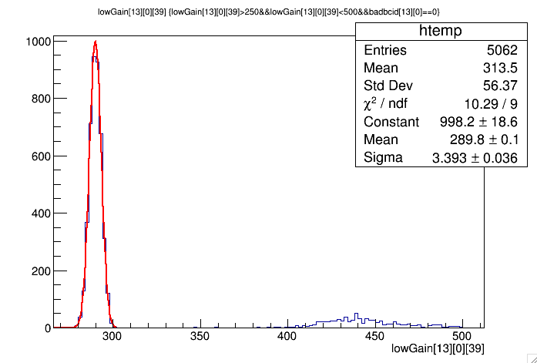
Pedestal Analysis
Non-triggered ADC output (around ~300 [ADC])
Fitted by Gaussian
pedestal peak
(non-triggered)
MIP events
(triggered)

Slide 15
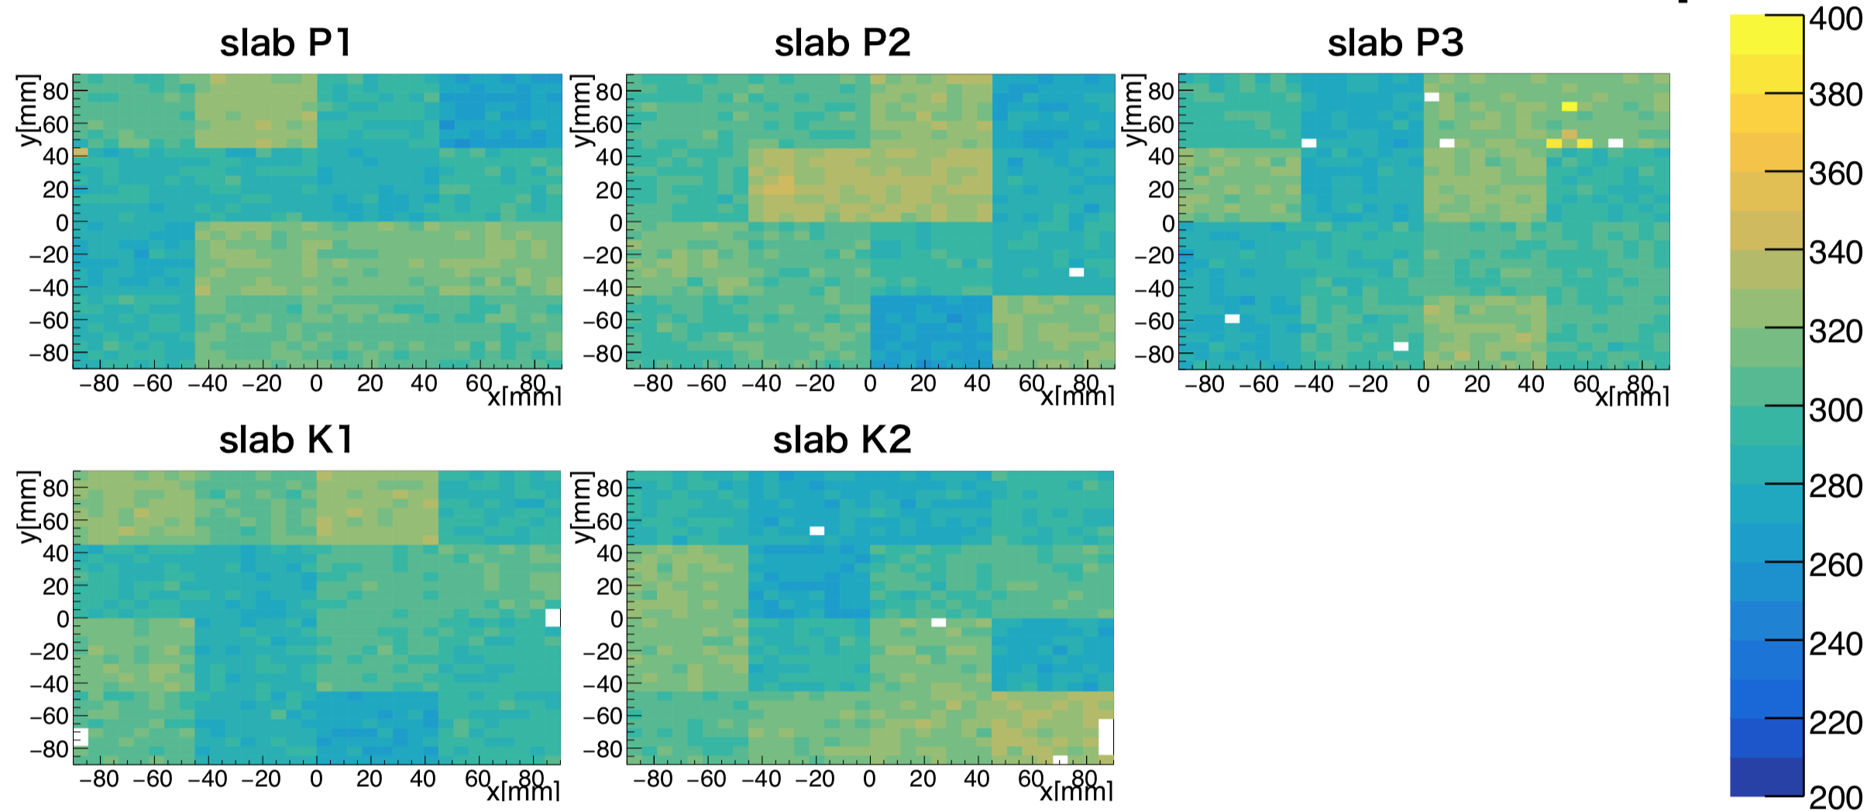
Pedestal Homogeneity: Mean
Mean of Gaussian
SCA = 0 (Memory-cell dependence is referred later.)
Although there are differences between chips,
mean of pedestals looks generally uniform within the same chip.

Slide 16
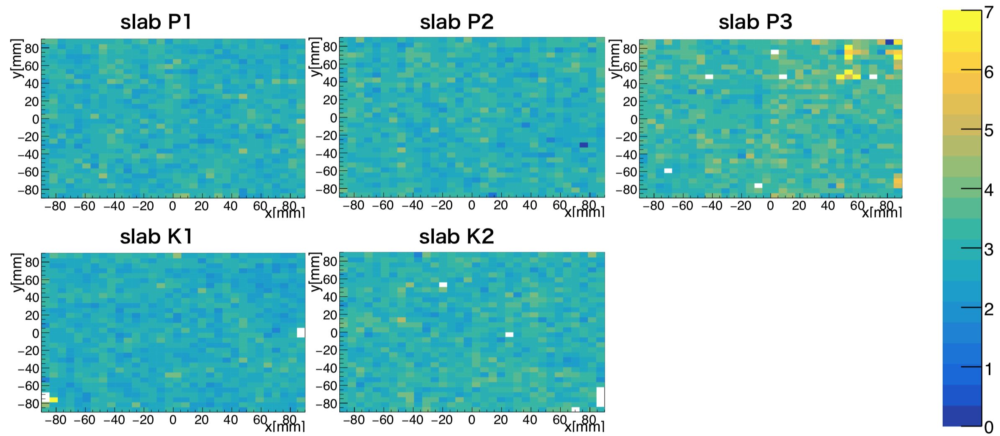
Pedestal Homogeneity: Width
Sigma of Gaussian
SCA = 0 (Memory-cell dependence is referred later.)
P3-chip0 looks strange.
Width of pedestal is almost uniform (3~4) throughout.

Slide 17
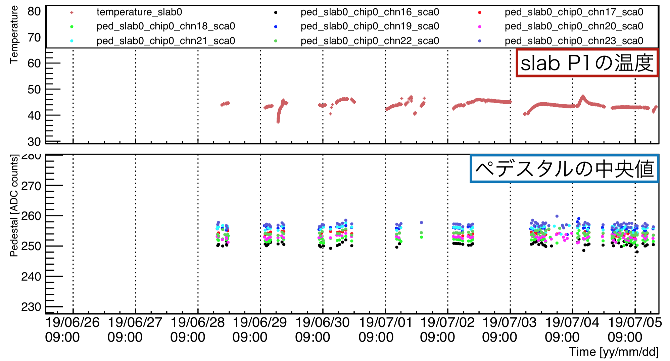
Pedestal Stability
Pedestal stability is confirmed in this beam time.
Temperature: P1
Pedestal mean: P1 chip0

Slide 18
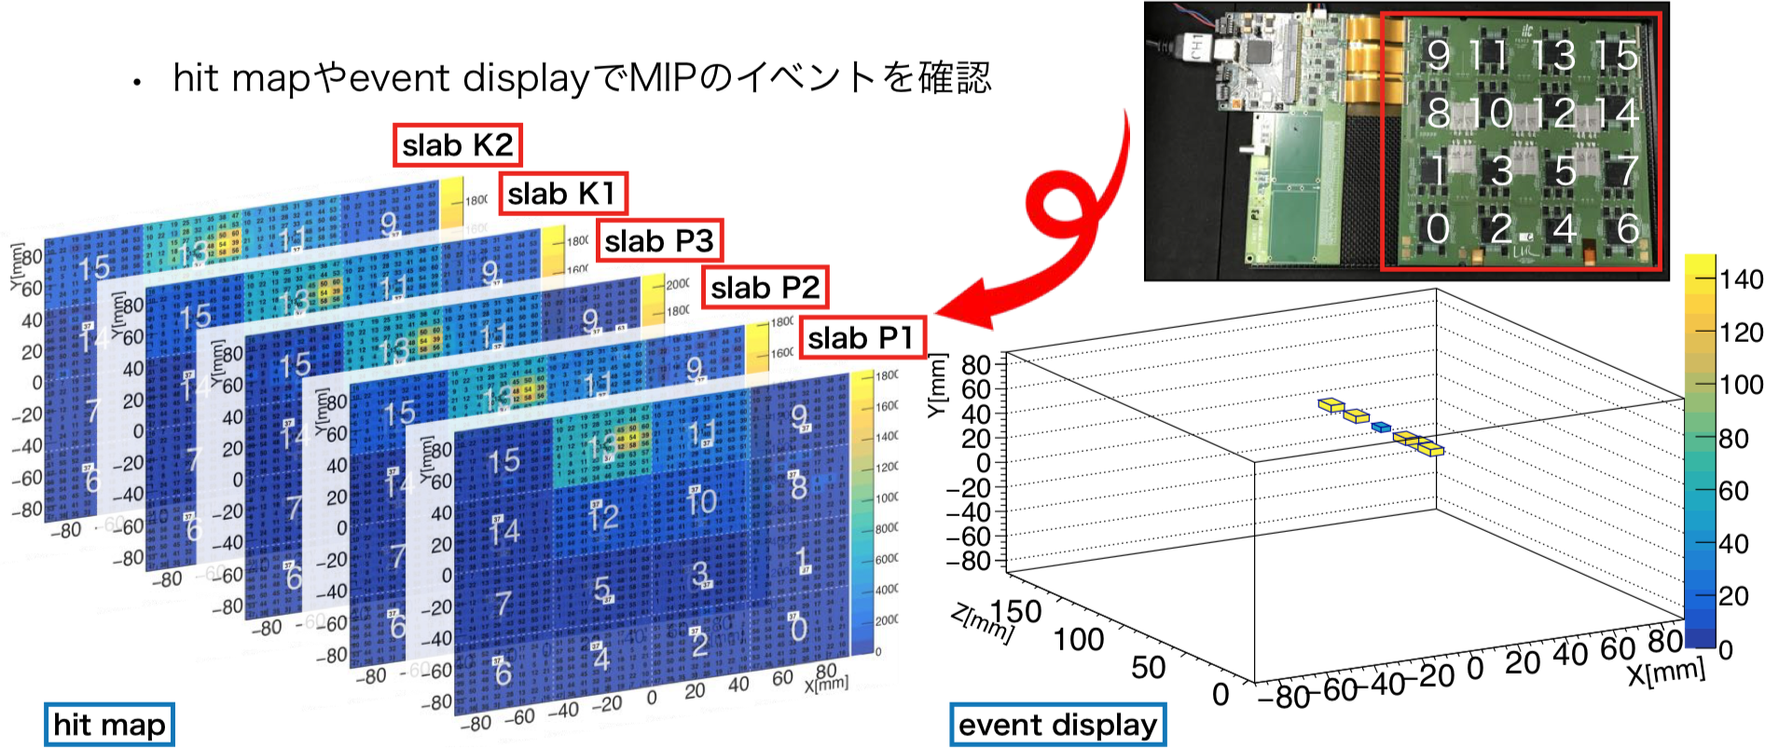
MIP event
MIP program is performed for mainly energy calibration of all the pixels.
Hit map: Sum of the triggered events
Event display: ADC output of single event
Electron energy: 3 GeV
ADC
P3
(320 µm)

Slide 19
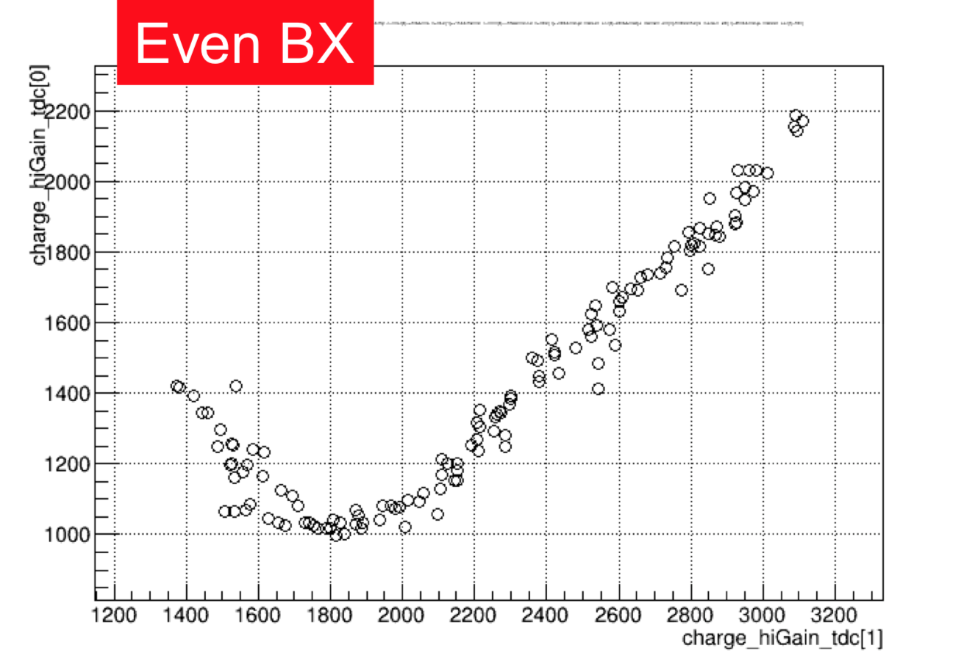
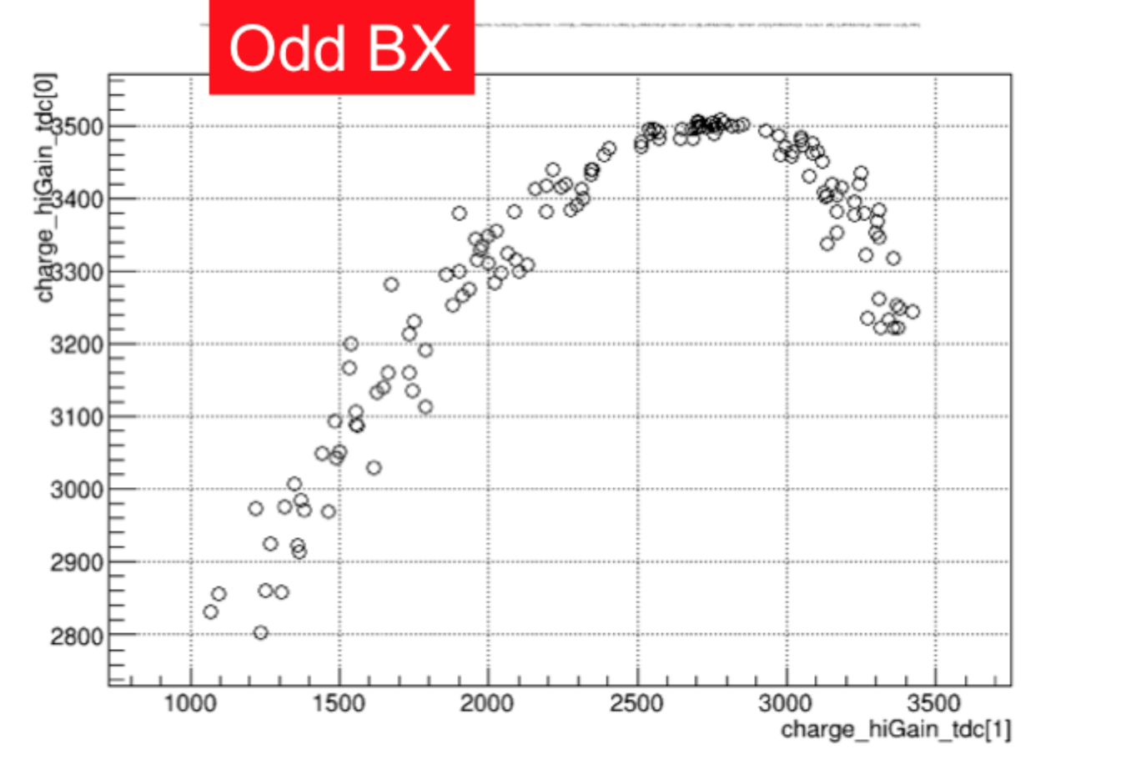
TDC with MIP
Preliminary
Correlation of TDC between slab 1 and 2
Select 1 ch (at the center of the beam), 450 < ADC < 500 (to avoid timewalk)
~10 / 1 ns at the normal slope: timing resolution ~ a few ns?
TDC calibration in progress.

Slide 20
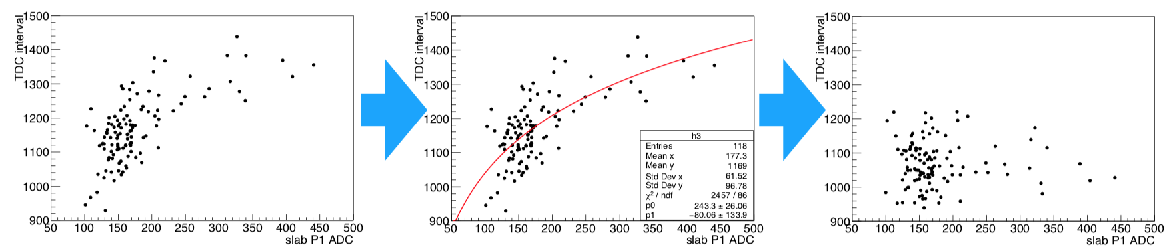
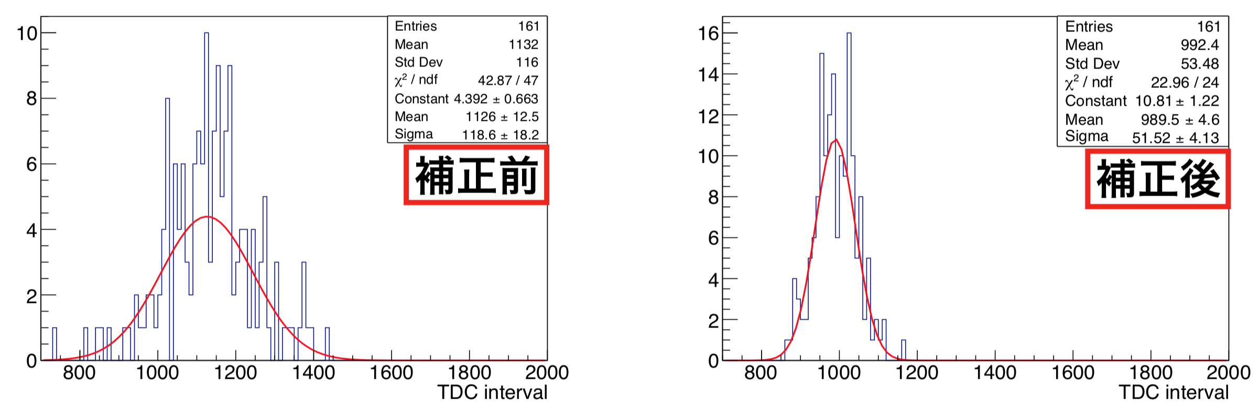
Correction of Time Walk
Preliminary
Time Walk: TDC depends on ADC.
TDC interval
ADC
before
after
timing resolution: 3.2 ns

Slide 21
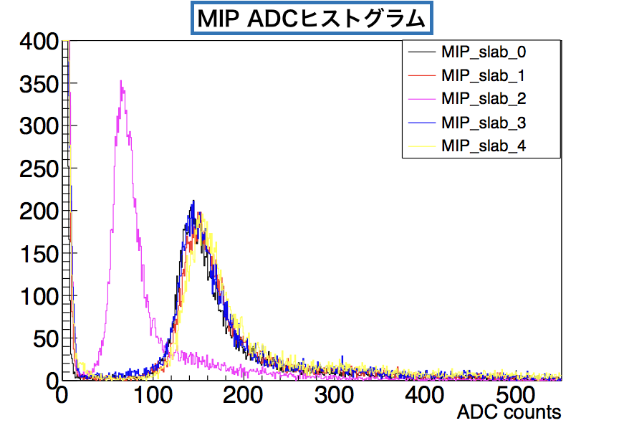
MIP spectrum
MIP spectrums of each slabs are shown.
Pedestal is subtracted.
Fitted by Lan-Gaus function.
  Convolution of Landau × Gaussian
MPV: Most Probable Value
Definition of S/N_{ADC}:
P1
P2
P3
K1
K2
slab | P1 | P2 | P3 | K1 | K2
thickness | 650µm | 650µm | 320µm | 650µm | 650µm
MPV | 146.5 | 144.9 | 71.3 | 141.4 | 146.1
Ped_width | 3.0 | 3.0 | 3.3 | 2.8 | 3.1
S/N | 49.0 | 48.9 | 21.7 | 50.2 | 47.5

Slide 22
MIP calibration: Summary
MPV maps:
P1
P2
P3
Problems
K1
K2
Higher statistics

Slide 23
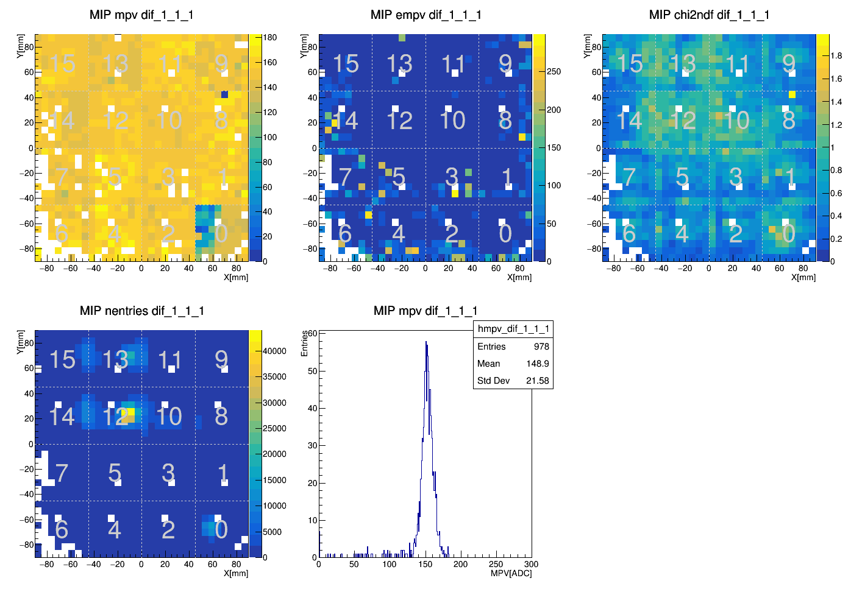
MIP calibration
slab: P1
Error of MPV
MPV
χ²/ndf
Chip0 is broken?
entries
MPV
Preliminary

Slide 24
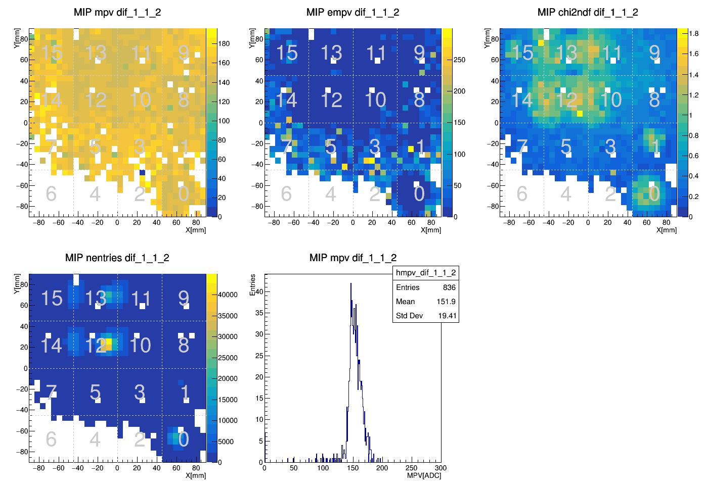
MIP calibration
slab: P2
Error of MPV
MPV
χ²/ndf
entries
MPV
Preliminary
Low-statistics because
DIF was broken in position scan

Slide 25
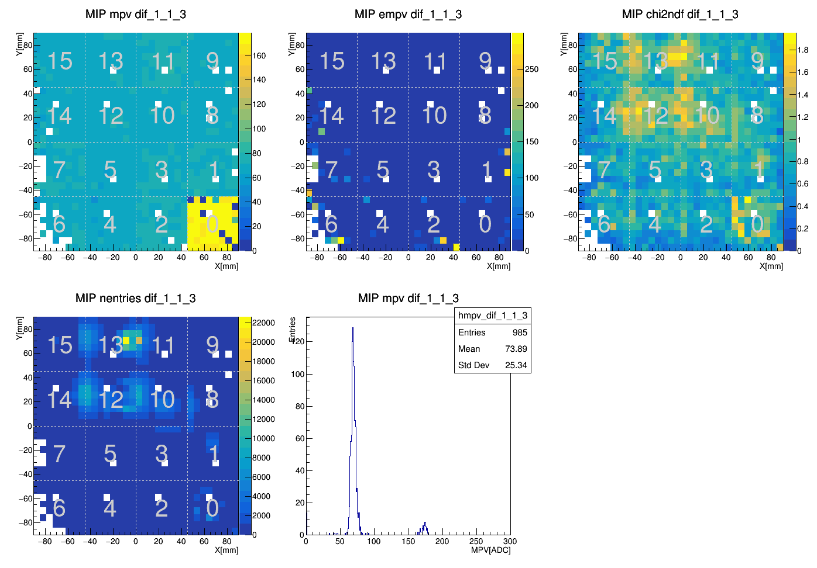
MIP calibration
slab: P3
Error of MPV
MPV
χ²/ndf
Chip0 is broken?
entries
MPV
Preliminary

Slide 26
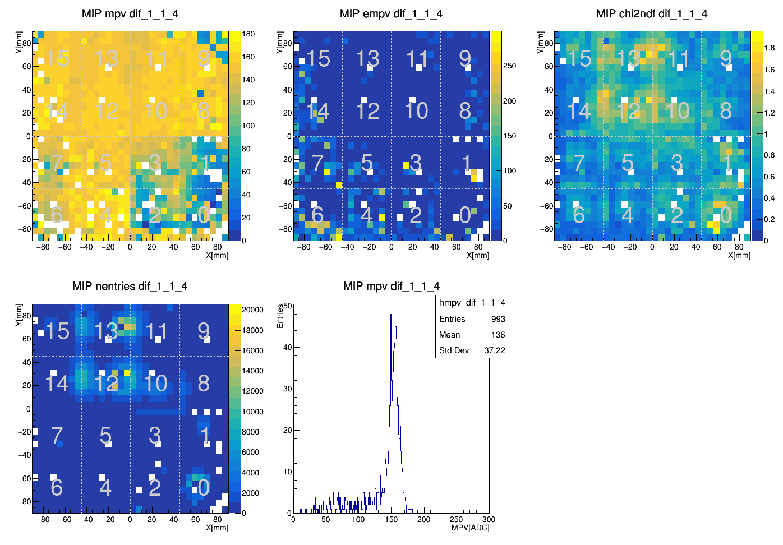
MIP calibration
slab: K1
Error of MPV
MPV
χ²/ndf
HV connection is bad?
entries
MPV
Preliminary

Slide 27
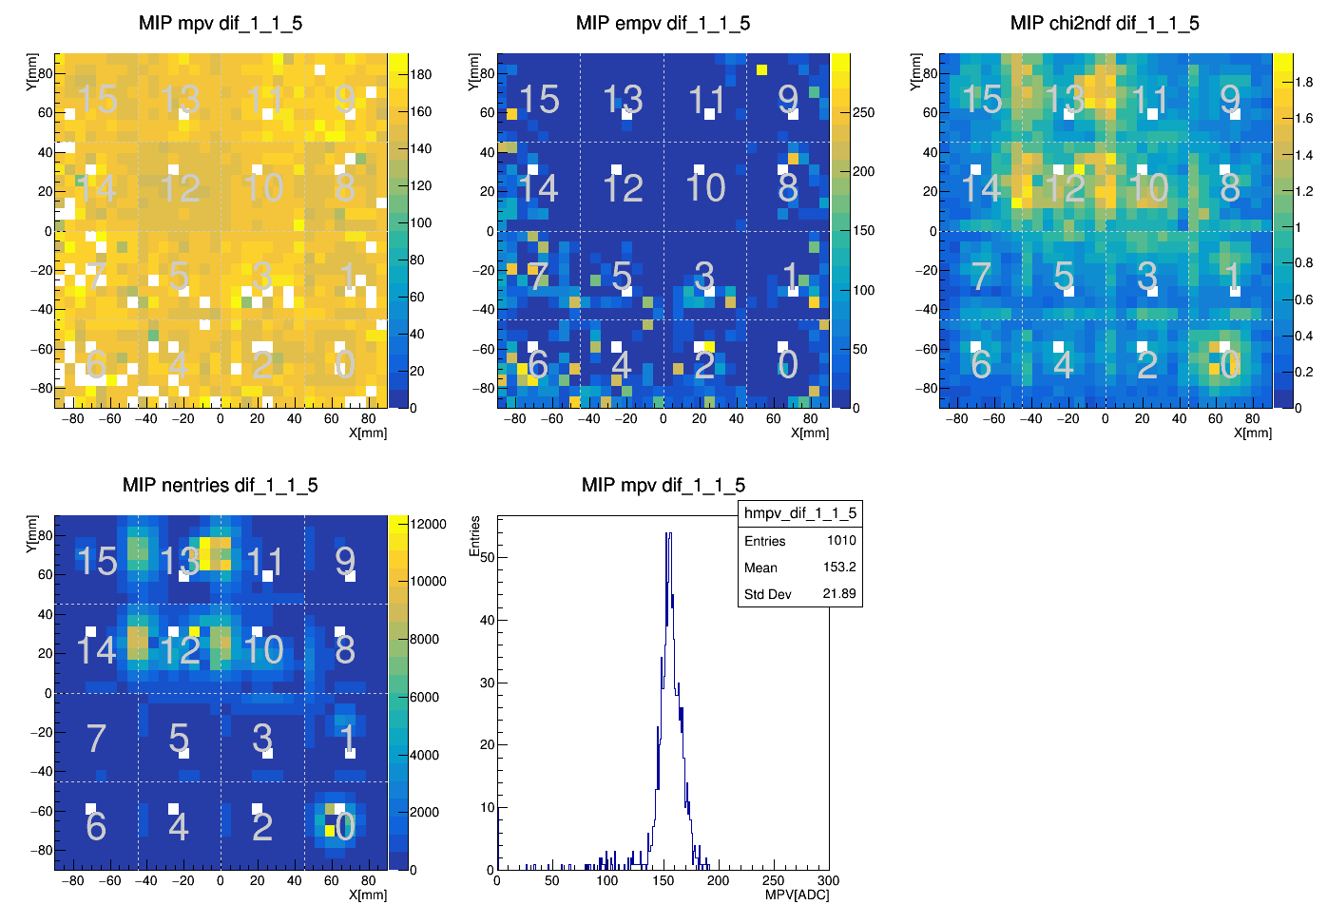
MIP calibration
slab: K2
Error of MPV
MPV
χ²/ndf
entries
Good!
MPV
Preliminary

Slide 28
MIP calibration: Summary
MPV maps:
P1
P2
P3
Problems
K1
K2
Higher statistics

Slide 29
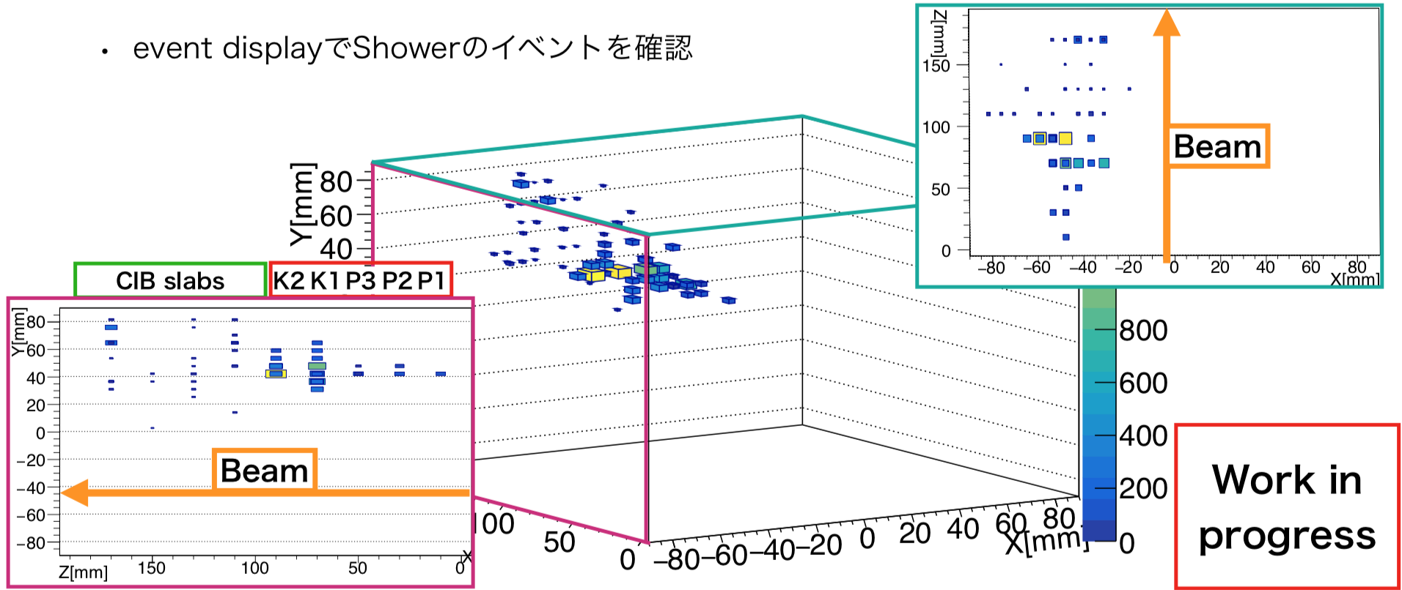
Shower event
Preliminary
TBD
Event display of shower event

Slide 30
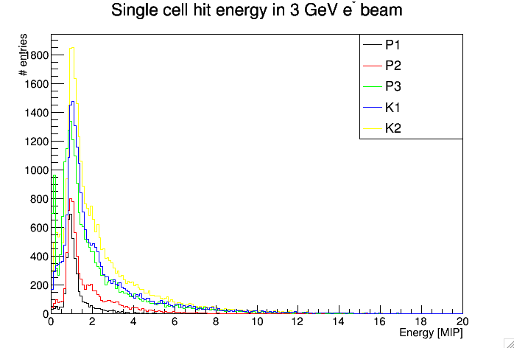
Hit Energy
Preliminary
Hit energy after MIP calibration

Slide 31
Simulation with DDSim in iLCSoft
Preliminary
  We performed detector simulation for this beam test.
  FEV13:
    CF: 0.6mm
    Electronics(Air)
    PCB: K1: 1.6mm, others: 1.8mm
    Glue(Air): 0.08mm
    Si: 0.32mm or 0.65mm
    Glue(Air): 0.08mm
    Kapton(Cu): 0.06mm
    CF: 0.6mm
    Plastic(polyethylene): 5mm

Slide 32
Remaining Issues

Slide 33
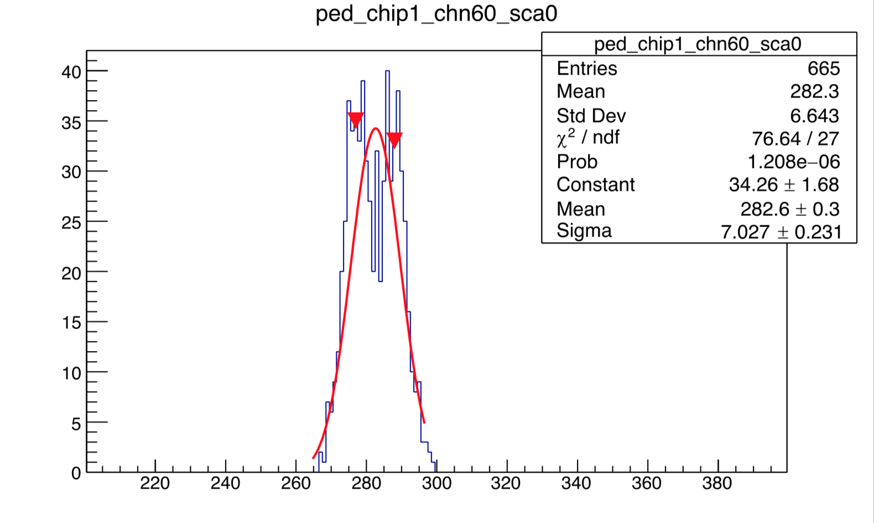
Double pedestal / Retrigger
run 32015, slab P1
All
Good
Retrigger
Retrigger event:
BCID is consecutive.
(badbcid≠0)
Mean
Width
Double pedestal
by retrigger
Hip map
Mean difference
entry ratio

Slide 34
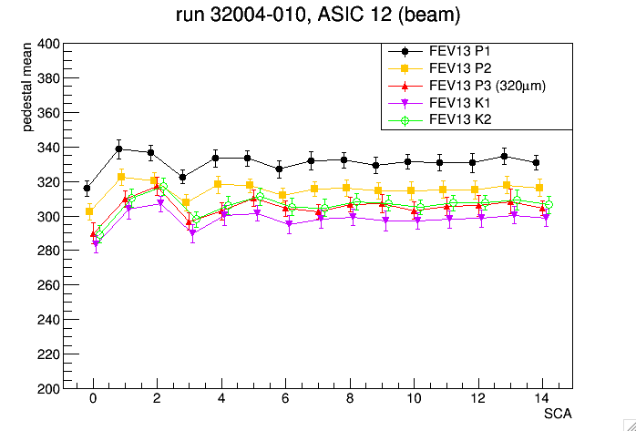
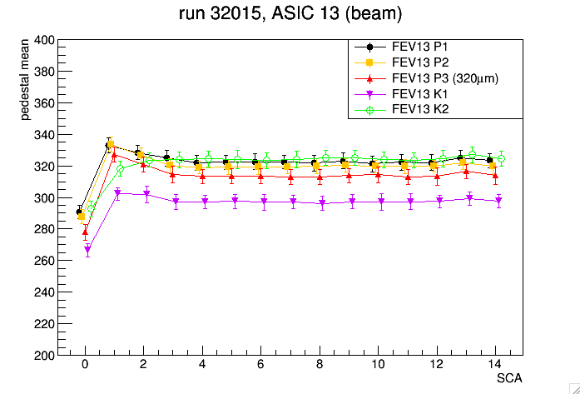
Pedestal difference between ADC/TDC mode
We found the difference of pedestals between ADC/TDC mode.
Memory-cell dependence is not same.
In the first memory cell, the difference of typical Ped_mean is ~15.
Mean of pedestal
with ADC mode
Mean of pedestal
with TDC mode

Slide 35
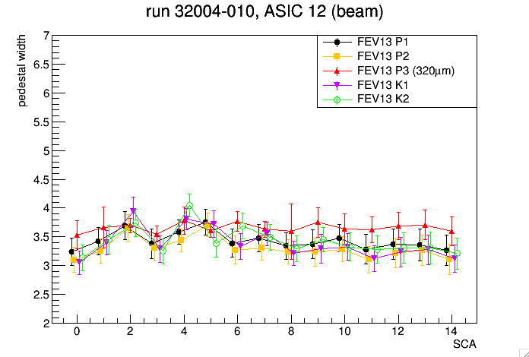
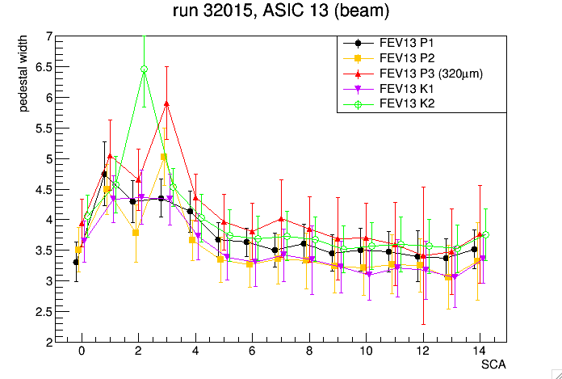
Pedestal difference between ADC/TDC mode
We found the difference of pedestals between ADC/TDC mode.
Memory-cell dependence is not same.
In TDC mode, SCA~2 is worse.
Width of pedestal
with ADC mode
Width of pedestal
with TDC mode

Slide 36
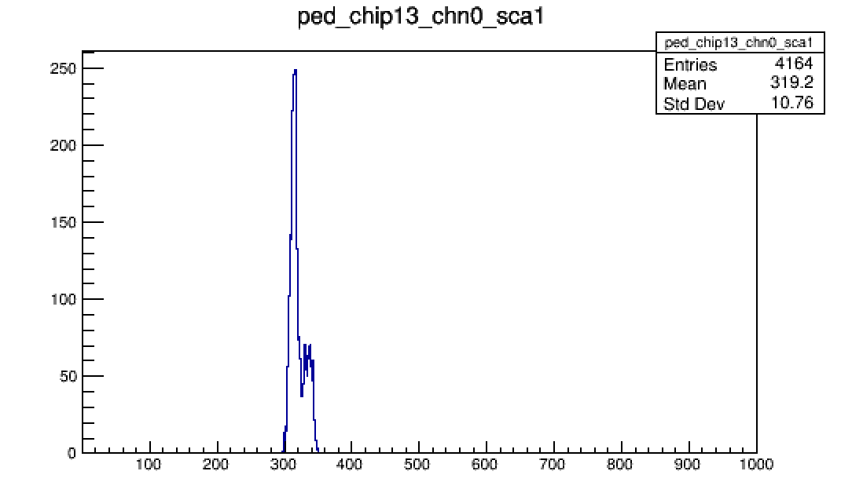
Pedestal difference between ADC/TDC mode
We found the difference of pedestals between ADC/TDC mode.
Memory-cell dependence is not same.
In TDC mode, SCA~2 is worse.
Width of pedestal
with TDC mode
There are double pedestal even after bcid selection in TDC mode.
Work in progress...

Slide 37
Summary
FEV13: P1, P2, P3, K1, K2 in Kyushu
BT 2019 DESY: 5 slabs fully working finally
Pedestal study
  Homogeneity and Stability is verified.
  In TDC mode, pedestals become worse probably because of retriggers.
MIP study
  MIP calibration is almost completed.
  S/N is obtained for 5 slabs
TDC study
  Time walk is corrected.
  Timing resolution is obtained, however we need more detail study using injection.
Shower study
  Simulation setup is in progress.
  Event building is done and shower event is confirmed.
Preliminary
slab | P1 | P2 | P3 | K1 | K2
thickness | 650µm | 650µm | 320µm | 650µm | 650µm
S/N | 49.0 | 48.9 | 21.7 | 50.2 | 47.5

Slide 38
backup

Slide 39
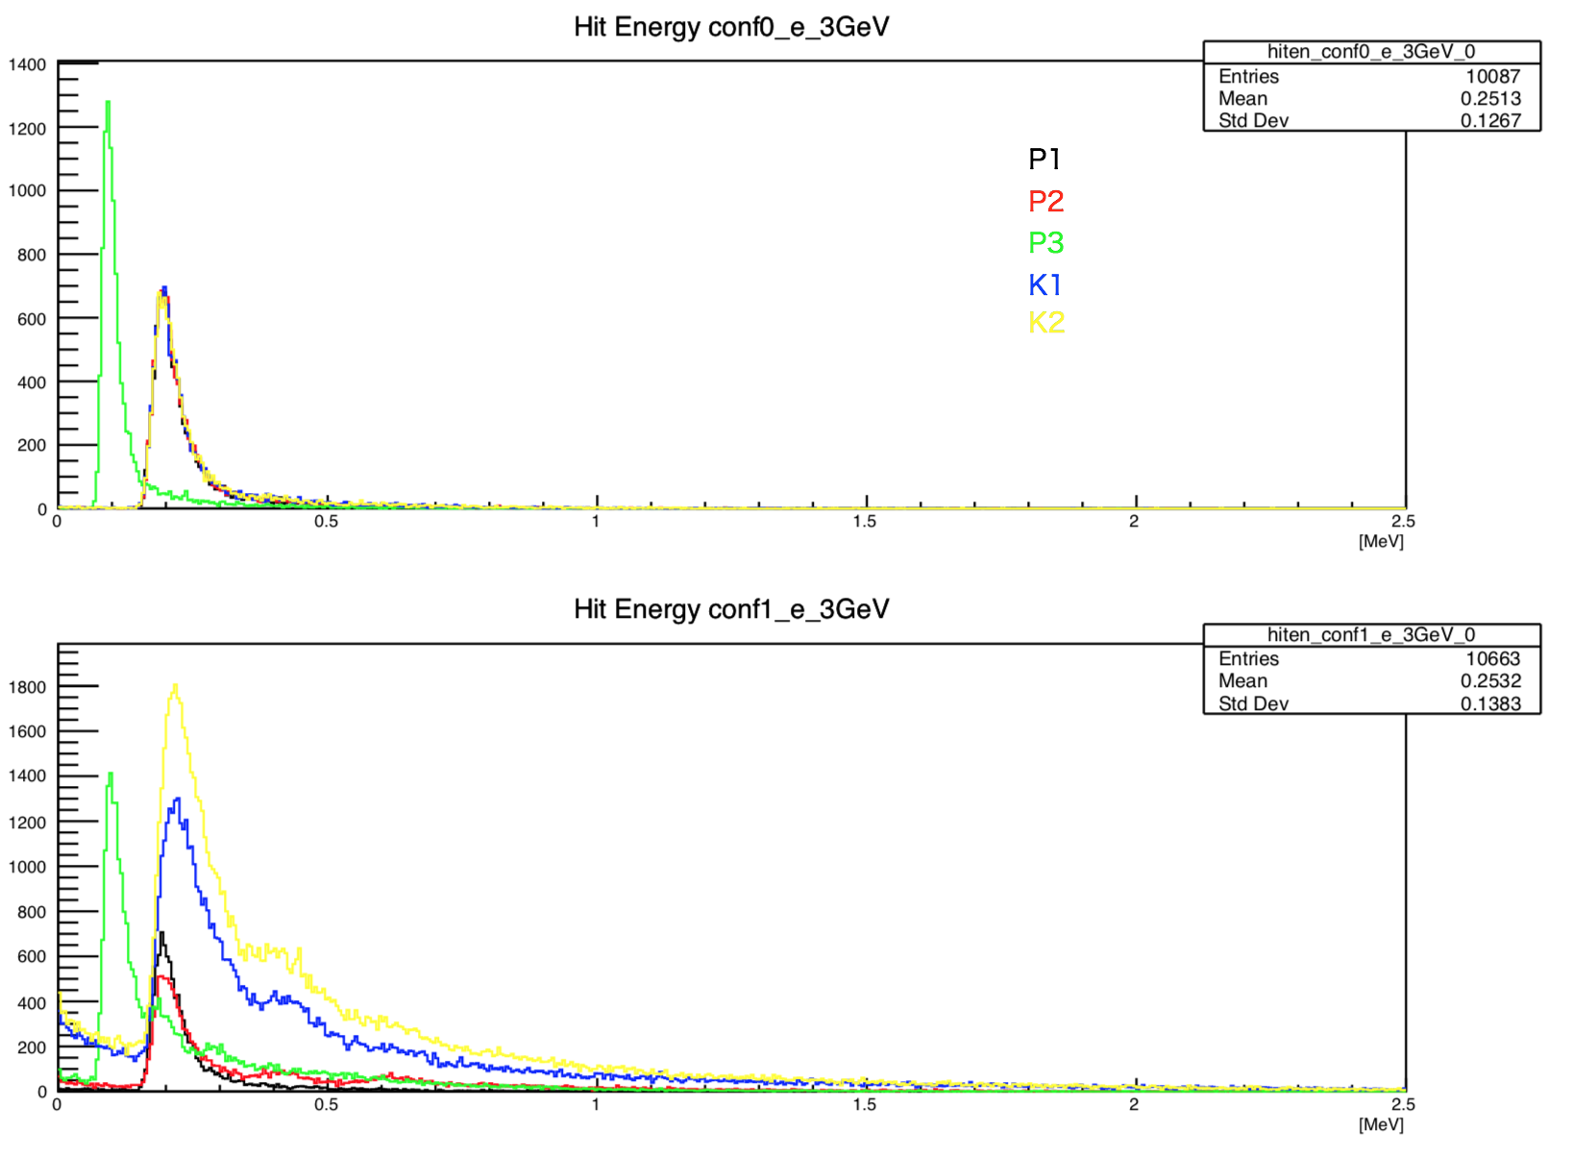
Simulation outputs
Preliminary
Hit energy distribution in each slabs
w/o Tungsten
(320µm)
w/ Tungsten

Slide 40
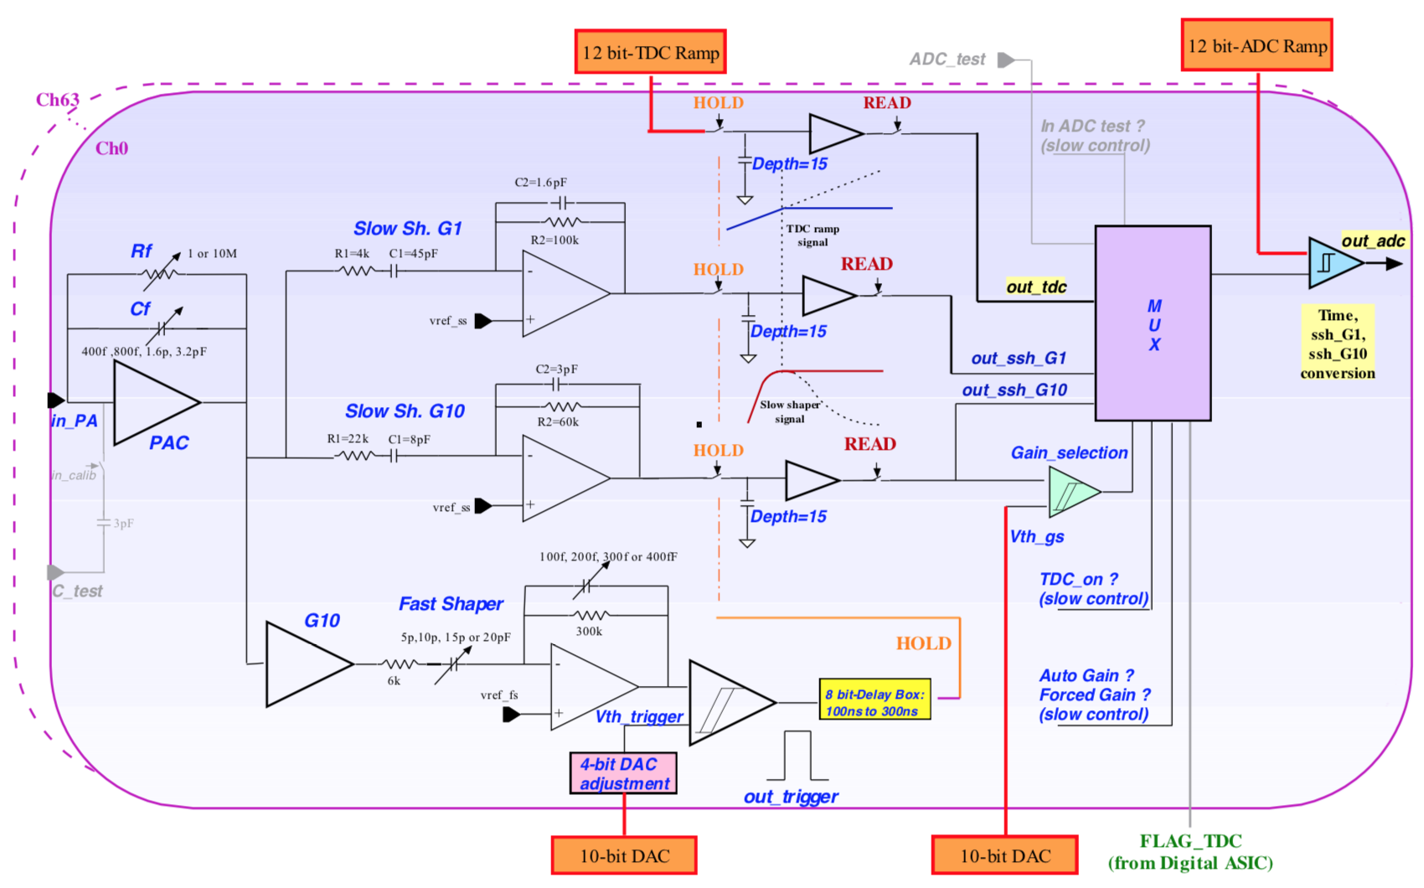
SKIROC2A
64ch / chip × 16 chip / slab
Self trigger: Individual threshold control is available.
3 types of output: ADC with high/low gain & TDC
3 types of DAQ mode:
  1. ADC high & ADC low 2. TDC & ADC [high or low] 3. TDC & Auto Gain
TDC
Slow Shaper
Preamp
Low Gain
High Gain
Fast Shaper

Slide 41
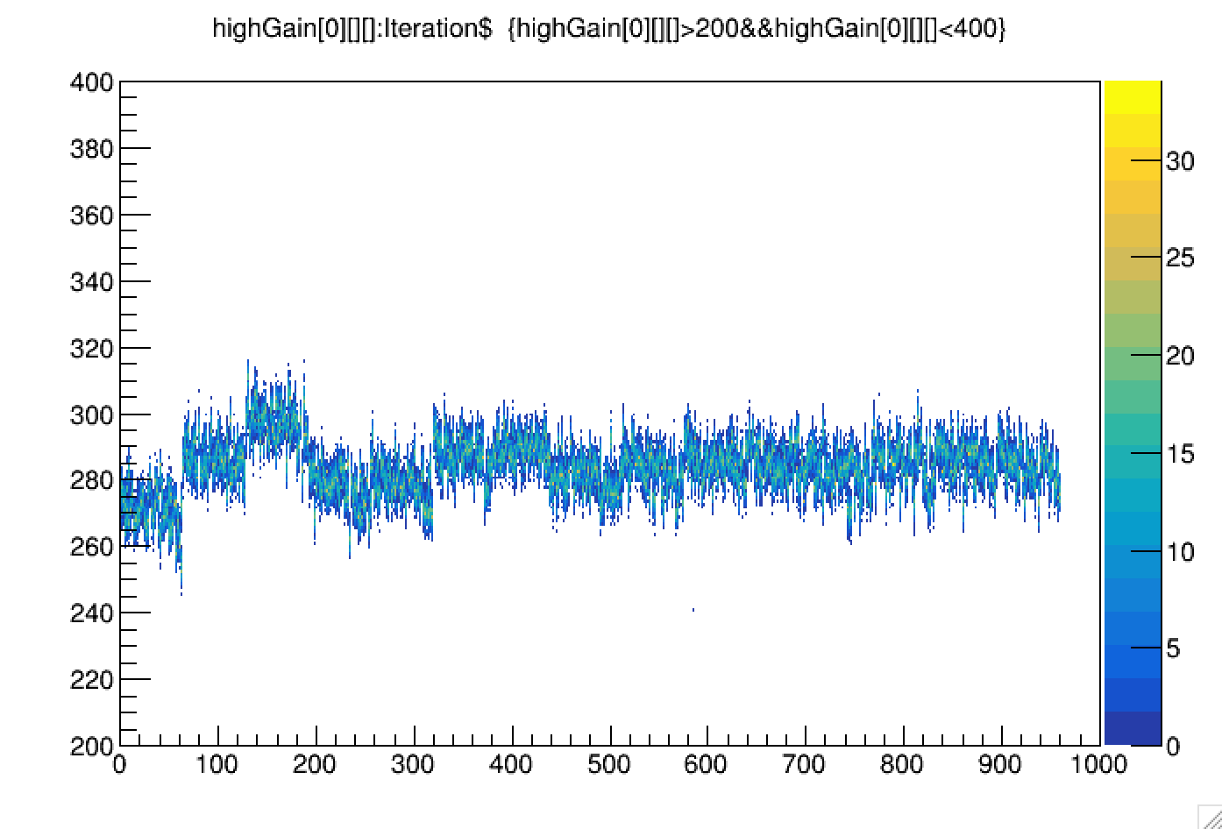
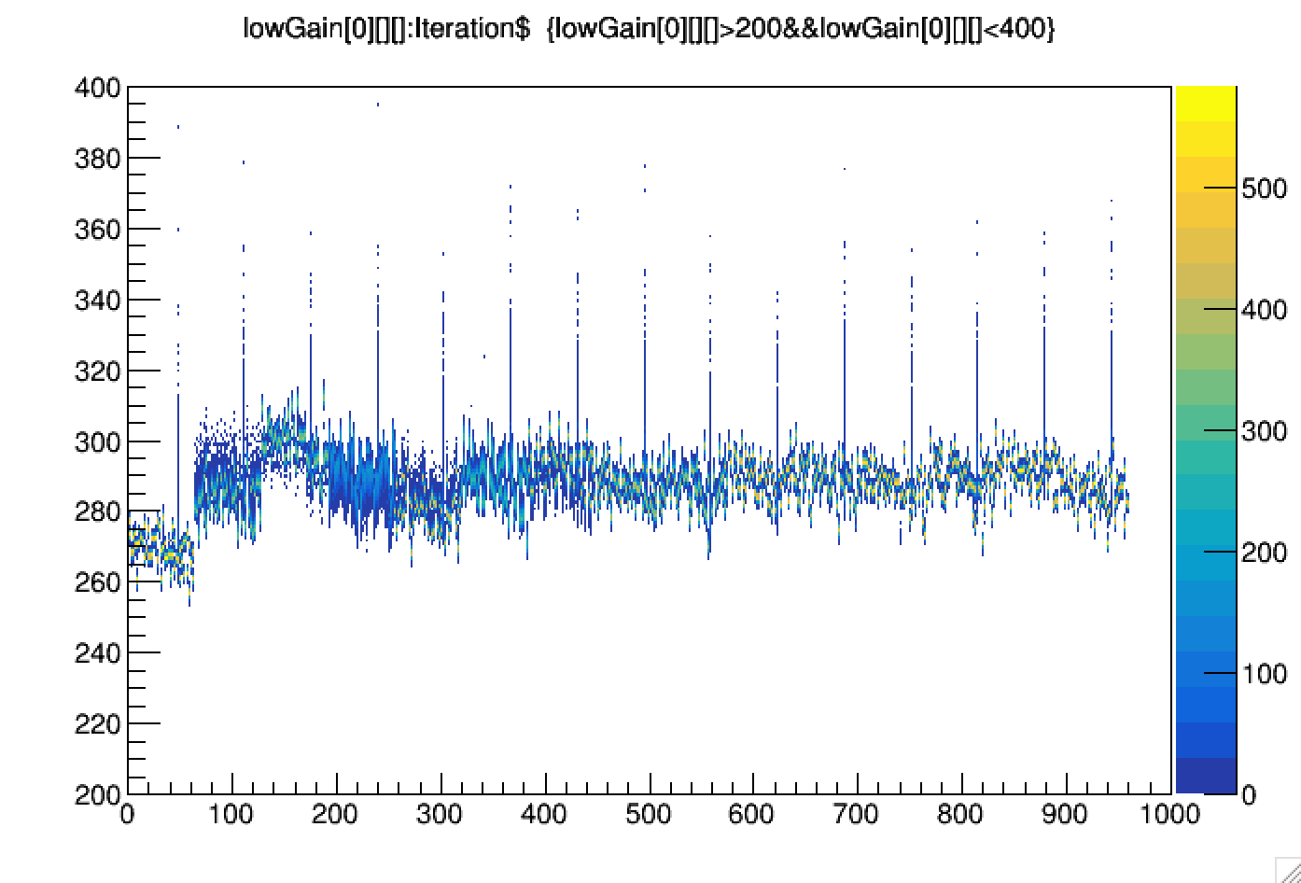
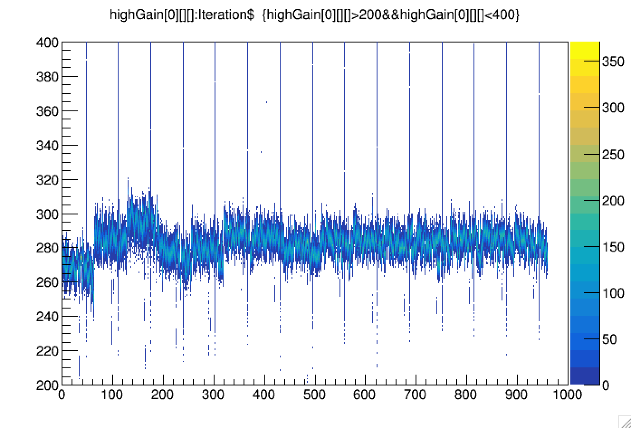
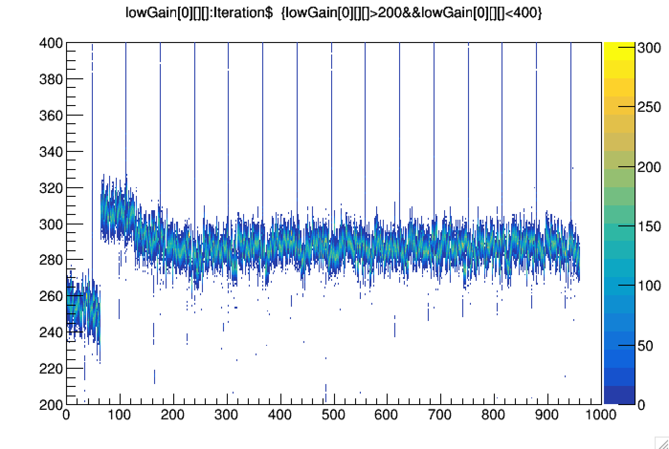
Pedestal difference between ADC/TDC mode
Reme

Slide 42
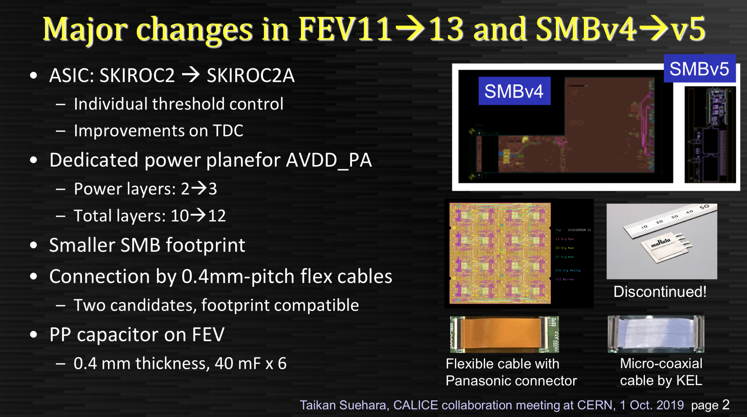
FEV13: SiW-ECAL technological prototype

Slide 43
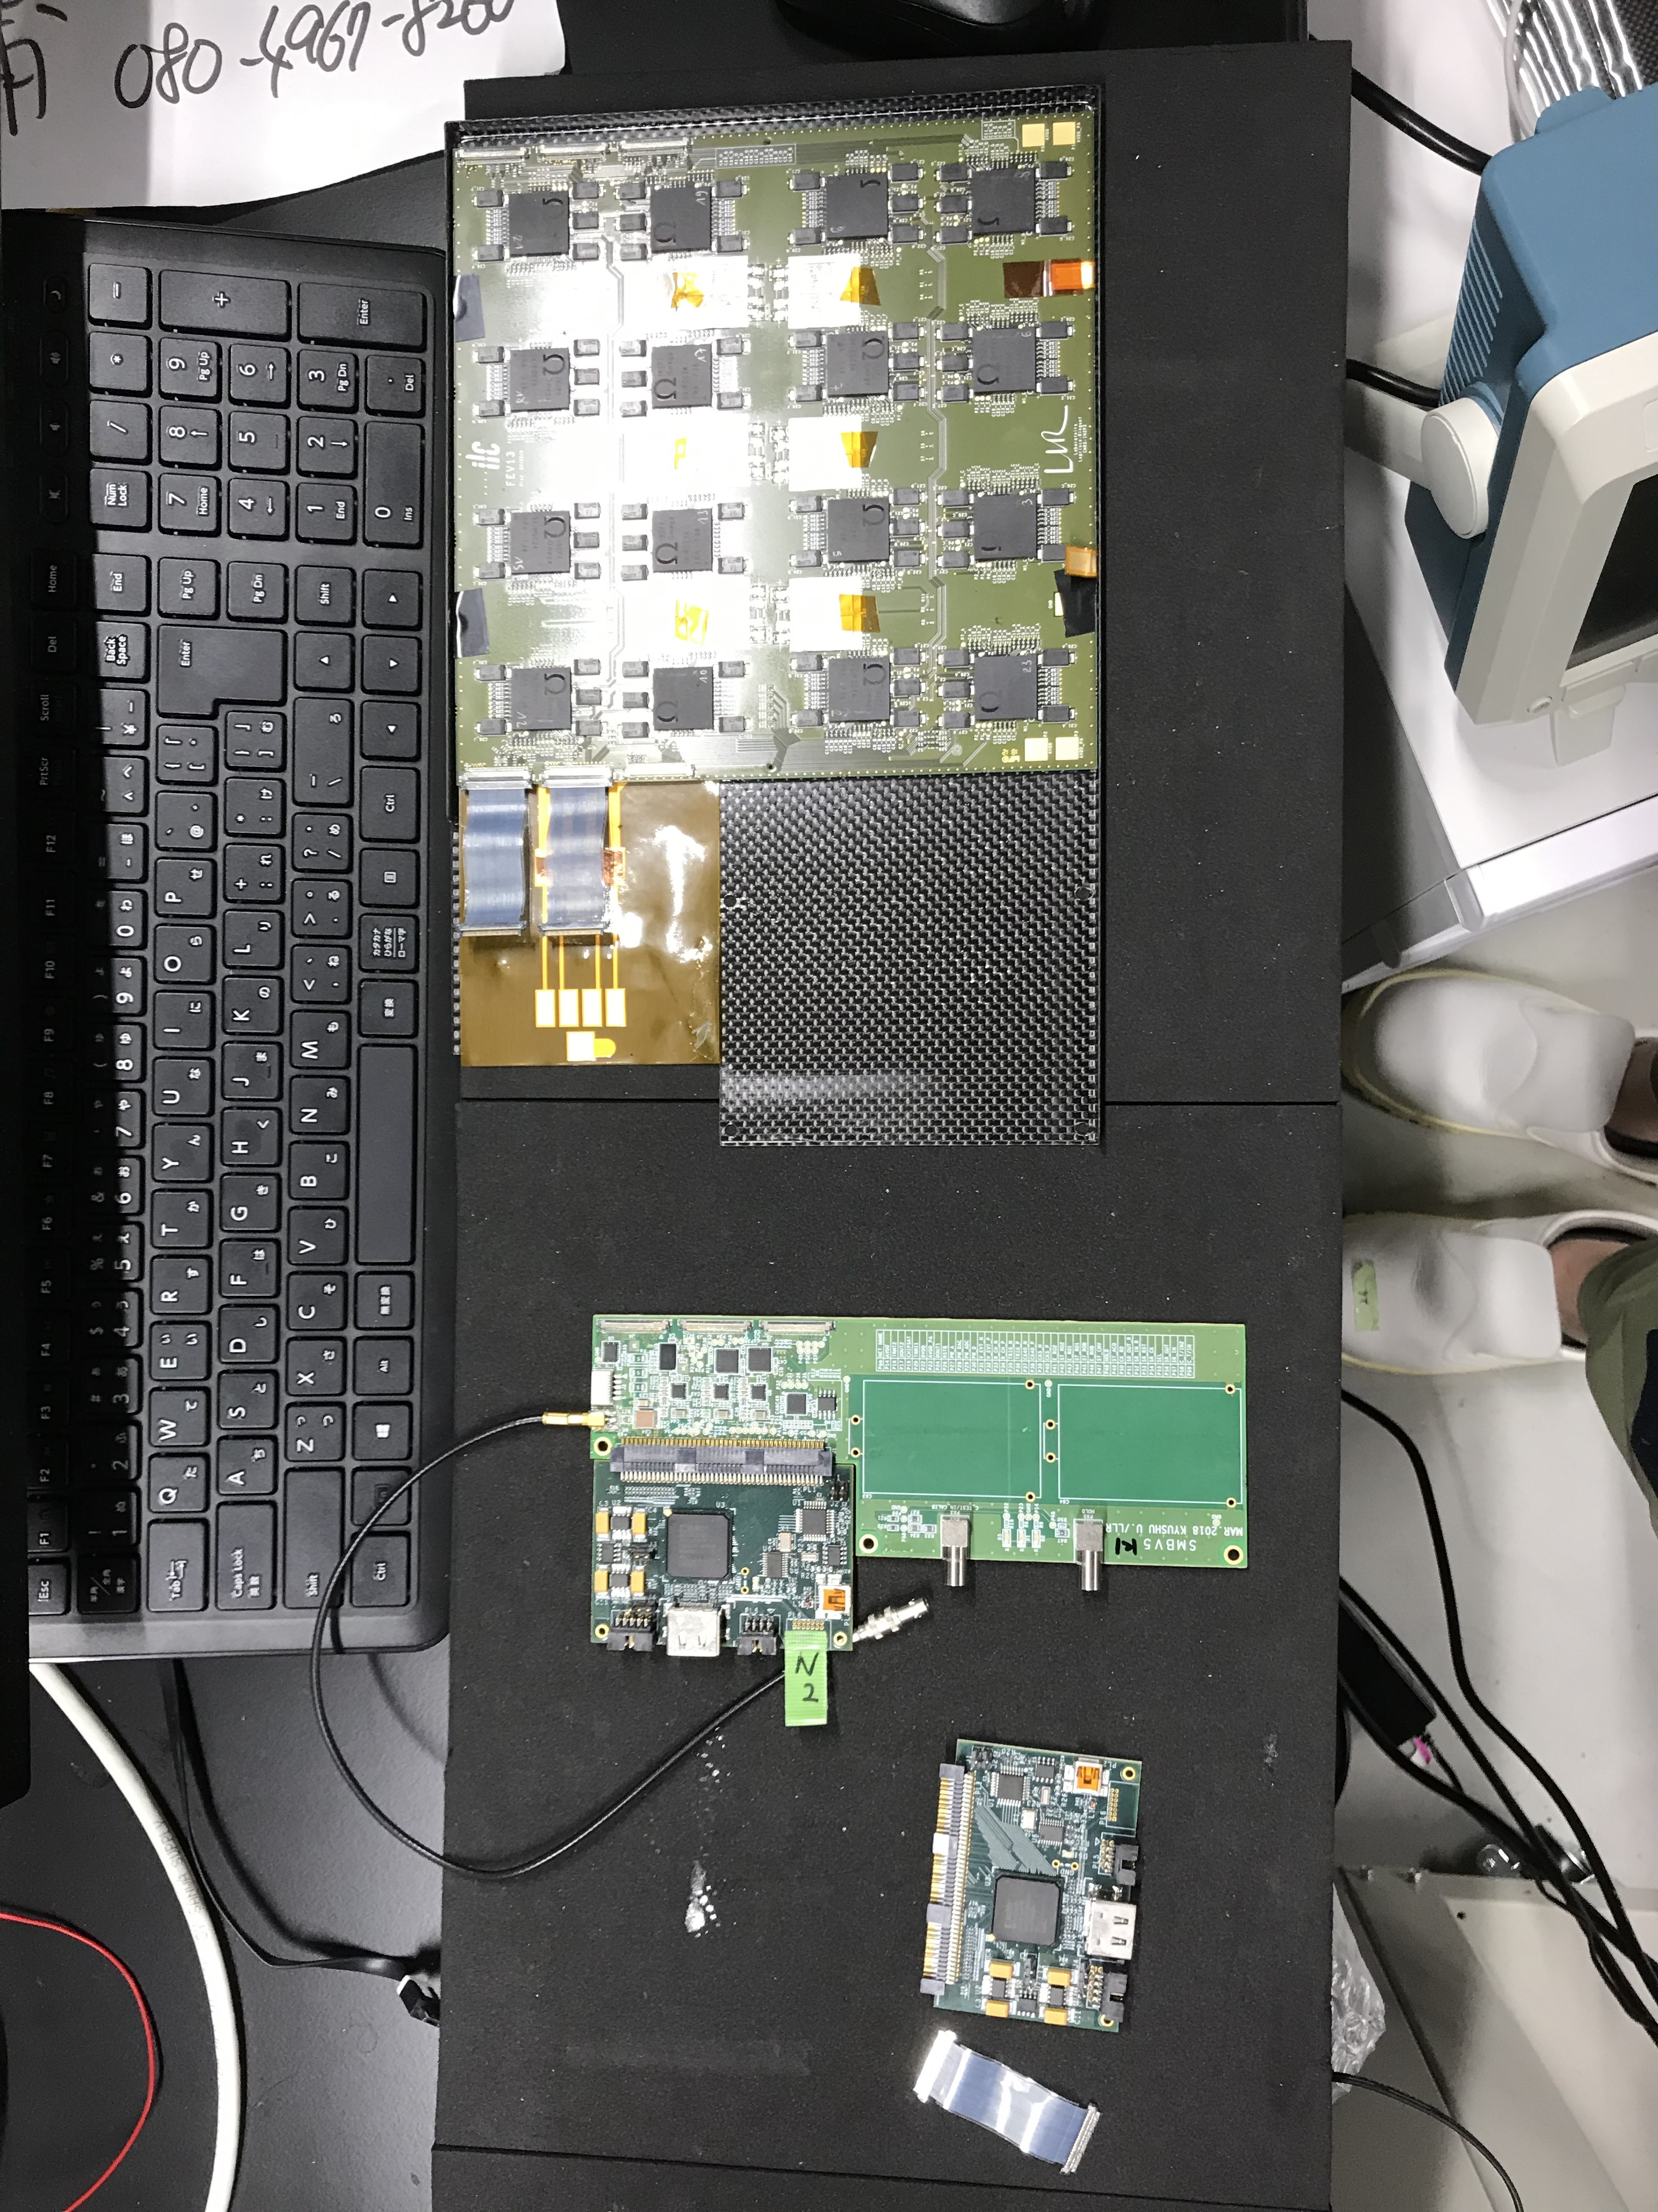
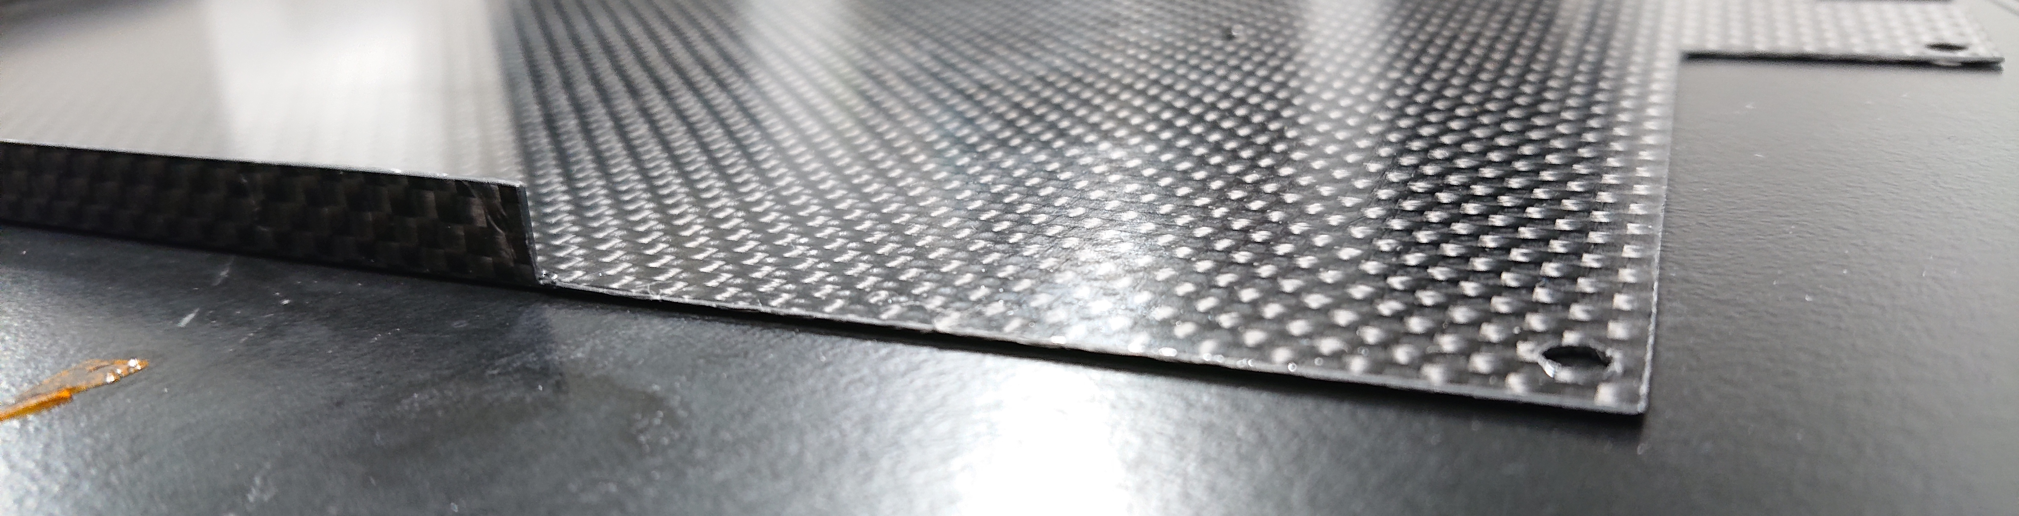
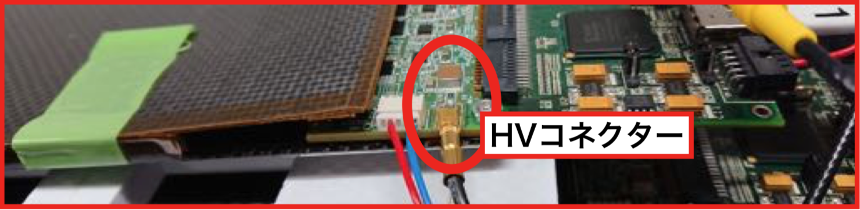
Hardware update
Previous problems
  Carbon frame was not optimized for FEV13.
  HV connection between SMB and flex was fragile.
Update: New carbon frame
SMB
FEV13
DIF
Cut
HV socket

Slide 44
Hardware update
Previous problems
  Carbon frame was not optimized for FEV13.
  HV connection between SMB and flex was fragile.
Update: Conductive adhesion

Slide 45
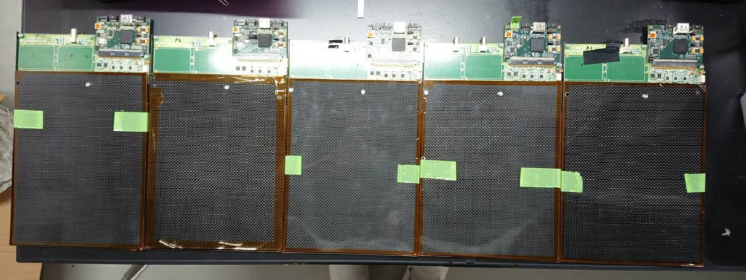
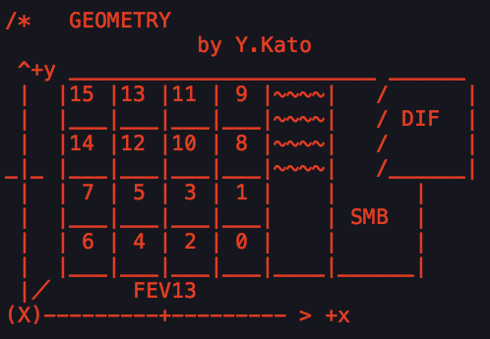
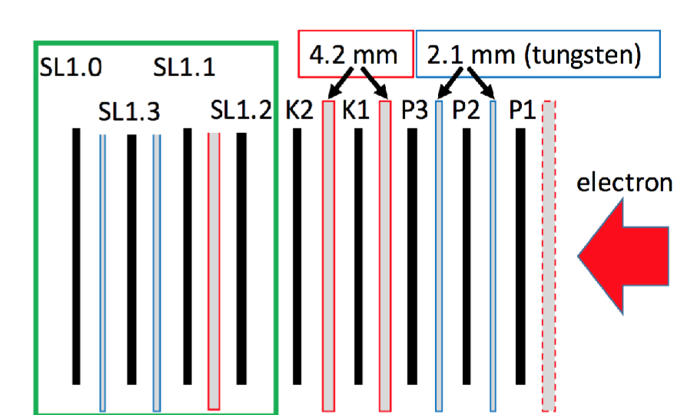
FEV13
↑ beam direction is
from front to back
P1 | P2 | P3 | K1 | K2
dif_1_1_1 | dif_1_1_2 | dif_1_1_3 | dif_1_1_4 | dif_1_1_5
650 µm | 650 µm | 320 µm | 650 µm | 650 µm
We used 5 FEV13 slabs.
There are 2 types of Silicon thickness.
Slab position against e- beam: →

Slide 46
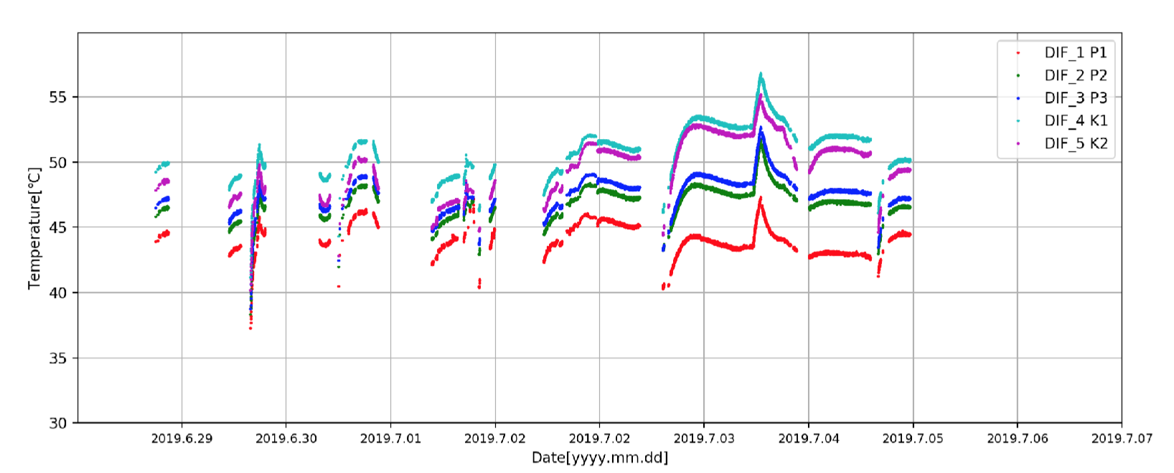
Data Summary
All the run information is summarized on
  https://drive.google.com/file/d/1uQojIu9KlS9badhVrBf1LRFNt-kz62vV/view?usp=sharing .
  not perfect, could be improved.
June 27: DIF on P2 had broken down → June 28: replaced DIF and recovered
June 28: made script to record temperature & start measurement
July 1: Data transition from P1 was sometimes lost because of bad connection of HDMI

Slide 47
Pedestal Analysis
We generated pedestal maps for all runs.
run_30003-006
_dif_1_1_1 (P1)

