Slide 1
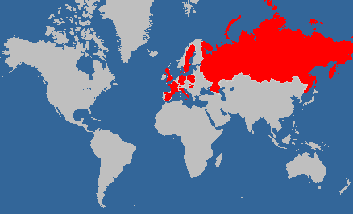

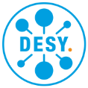



Hard X-Ray FELs & The European XFEL
European XFEL
International project realised in Hamburg area, Germany
12 participating countries:

Slide 2
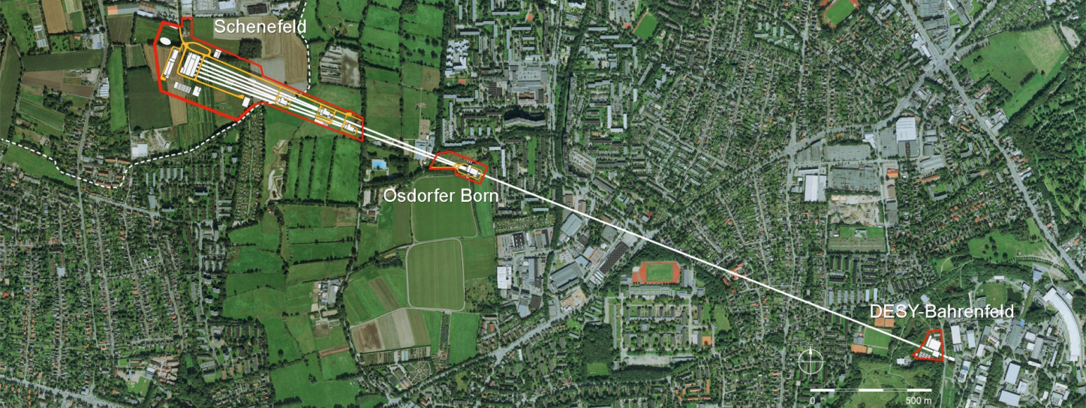


European XFEL at a Glance
International project realised in Hamburg area, Germany
Accelerator and large parts of infrastructure built by international consortium under the coordination of DESY
Accelerator operation and development by DESY
Experimental Hall
Photon Beam Lines
Beam Dumps
Undulators
3.3 km
Electron Beam Distribution
Collimation
Linear Accelerator
Bunch
Compressors
Injector

Slide 3
European XFEL at a Glance
Superconducting accelerator in 10 Hz pulsed mode with 97 modules / 776 cavities
Up to 17.5 GeV and 27000 bunches/s
Three variable gap undulators for hard and soft X-rays (250 eV to 25 keV)
Initially 6 equipped experiments
All accelerator and beamlines in tunnels 6 -25 m below surface
Experimental Hall
Photon Beam Lines
Beam Dumps
Undulators
3.3 km
Electron Beam Distribution
Collimation
Linear Accelerator
Bunch
Compressors
Injector

Slide 4
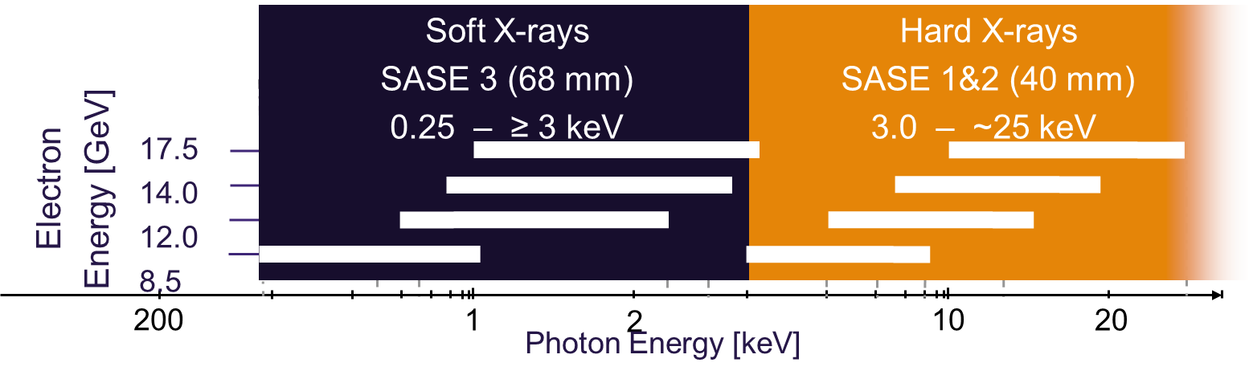
Covers photon energies from 0.25 keV to 25 keV

Slide 5


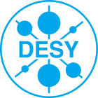














Project History
1993: Start of TESLA technology development
2000: First lasing at 109 nm at the TESLA Test Facility (TTF), now FLASH
2001: TESLA Linear Collider TDR with XFEL appendix
2006: European XFEL TDR
2009: Foundation of the European XFEL GmbH
Start of underground construction
2010: Formation of the Accelerator Consortium:
16 accelerator institutes under the coordination of DESY
2012: End of tunnel construction, start of underground installation
2016: Finish of accelerator installation, start of commissioning
2017: First lasing SASE1, start of early user program
2018: First lasing SASE3 & SASE2, parallel operation of all 3 FELs
2019: User operation with all 3 FELs and 6 experiments
16 Years Preparation
7 Years Construction
3 Years Operation

Slide 6
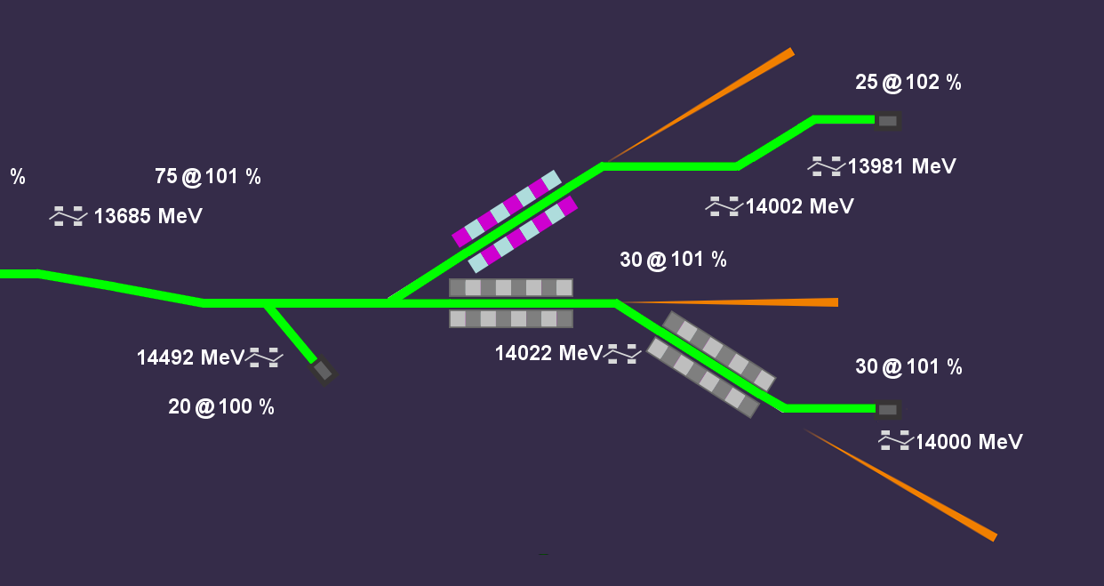
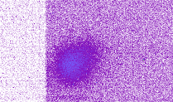
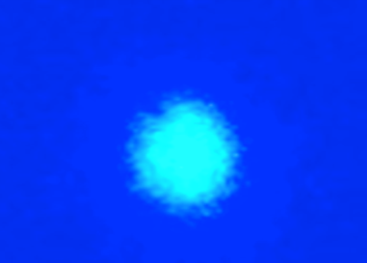
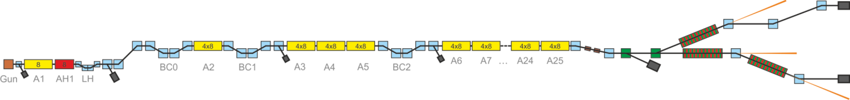
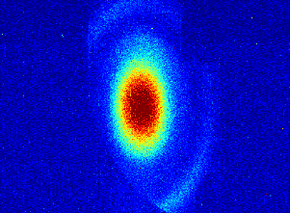
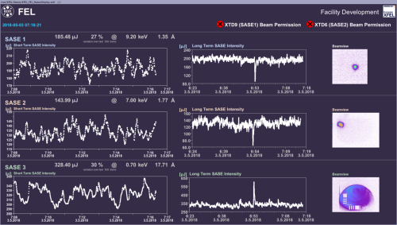
Commissioning Milestones 2016-2018
Flexible Beam Distribution
First lasing SASE2
@ 1.8 Å
March 13, 2018
First lasing SASE1
@ 9 Å
May - October, 2018
May 1, 2018
May 2-3, 2017
April 27, 2017
First lasing SASE3 @ 1.3 nm
Dec 12, 2015: 130 MeV
Mar 19 ,2016: 2700 bunches/RF pulse
Feb 2, 2017: 600 MeV
Feb 22, 2017: 2.5 GeV
Feb 25, 2017: 2.5 GeV
Apr 8, 2017: 12 GeV
Oct 23, 2017: 14.9 GeV
February 8, 2018
Jan 15, 2017: 130 MeV
Jan 19, 2017: 600 MeV
Lasing in all 3 FELs in parallel
July 12, 2018: 17.6 GeV
Nov 2, 2018: 2699 bunches/RF pulse
May 2, 2018

Slide 7
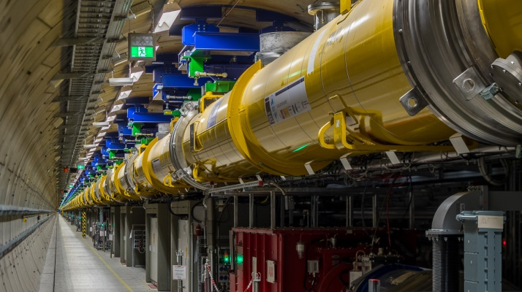
Superconducting linear accelerator demonstrates design performance:
Reached design energy of 17.5 GeV
Accelerated full bunch train of 27000 bunches/second

Slide 8
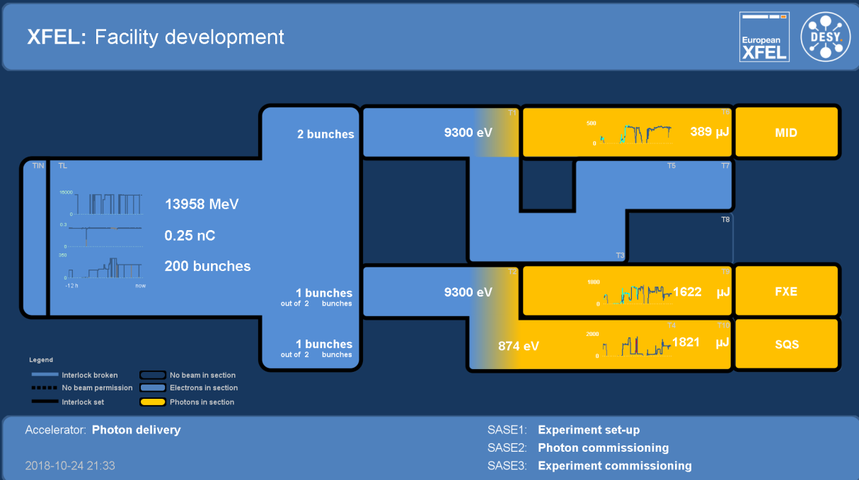
FEL Status
All 3 FELs in routine operation
All 6 photon beam lines commissioned
All 6 experiments in operation
http://tesla.desy.de/status_PNGs/XFEL_StatusPublic.png

Slide 9
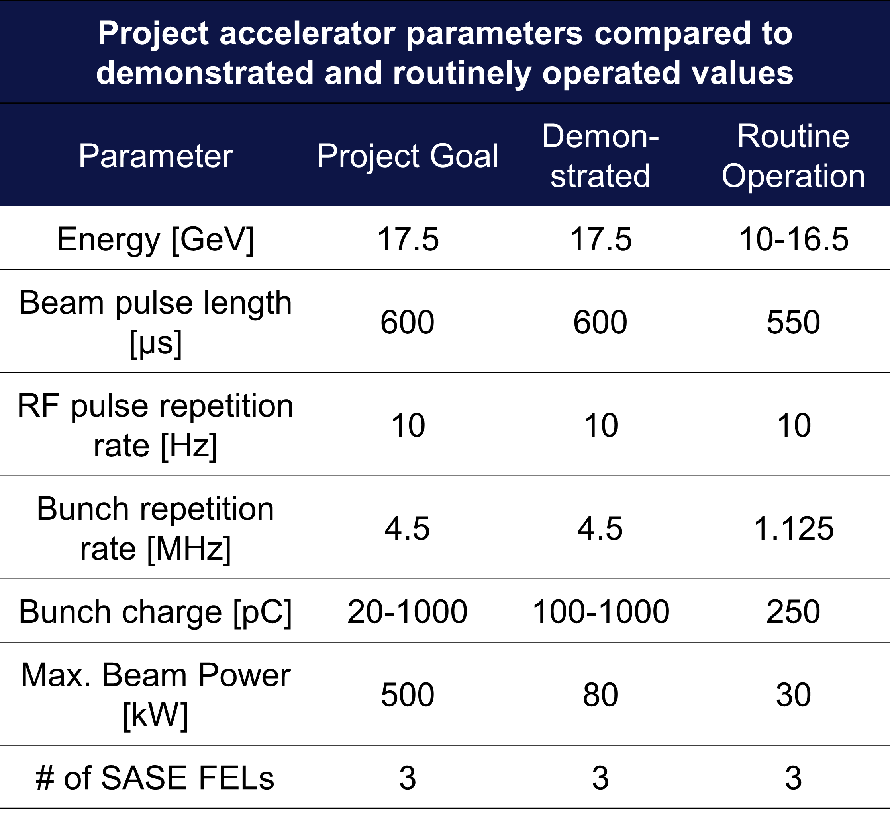
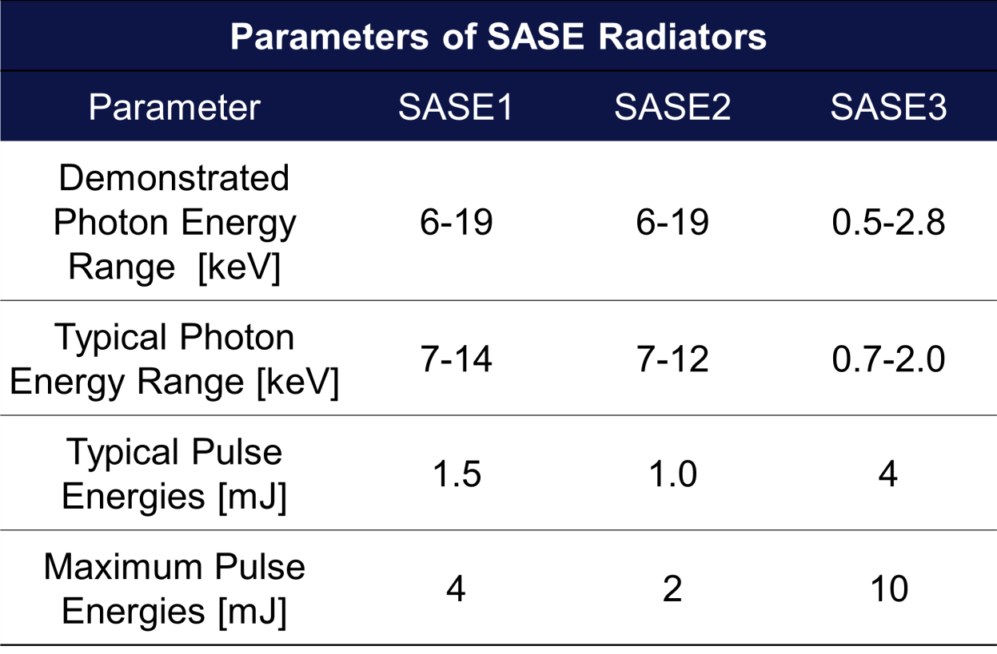
Achieved Accelerator and SASE Parameters

Slide 10
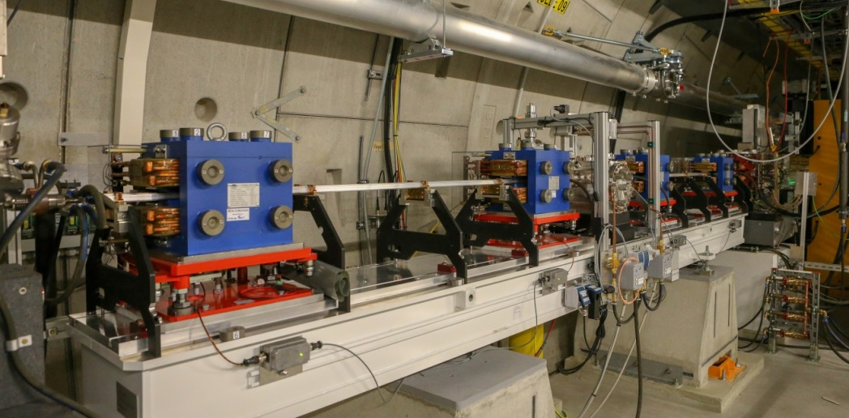
Upgrades
Self Seeding in the hard X-ray regime:
  SASE2 chicanes installed and operational
  Commissioning with beam started in SASE2
  SASE1 chicanes available
SASE3 Helical Afterburner and Two Color Scheme
  Hardware installation starts in Winter shutdown 2019/2020
  Hardware complete and first photons in 2021
Still two empty tunnels suitable for FELs; Let’s call them SASE4 and SASE5
  Ideas to extend photon energy range in hard and soft x-ray regime are developed
  Technical and scientific cases are explored
  Proof of principle tests, e.g. Harmonic Lasing Self-Seeding (HLSS) have already been demonstrated at SASE3 reaching 4.5 keV
  R&D towards CW operation and a second fan

