Slide 1
The decays to c c̅̅, b b̅, b s̅ in the light of the MSSM with quark flavor violation
K. Hidaka
Tokyo Gakugei University
Collaboration with
H. Eberl, E. Ginina
References:
Phys. Rev. D 91 (2015) 015007 [arXiv:1411.2840 [hep-ph] ]
JHEP 1606 (2016) 143 [arXiv:1604.02366 [hep-ph]]]
The 64th General Meeting of the ILC physics working group,
6 Dec. 2019, KEK

Slide 2
Contents
1. Introduction
2. MSSM with QFV
3. Constraints on the MSSM
4. Parameter scan in the MSSM
5. h⁰ → c c̅ & b b̅ & b s̅ in the MSSM
6. Conclusion

Slide 3

1. Introduction
What is the SM-like Higgs boson discovered at LHC?
It can be the SM Higgs boson.
It can be a Higgs boson of New Physics.
This is one of the most important issues in the present particle physics field!
Here we study a possibility that it is the lightest Higgs boson of the
Minimal Supersymmetric Standard Model (MSSM), focusing on the decays h⁰(125) $→c\overline{c}, b\overline{b}, bs̅$.

Slide 4
2. MSSM with QFV
The basic parameters of the MSSM with QFV:
{tanβ, m_{A} , M₁ , M₂ , M₃ , μ , M²_{Q,αβ} , M²_{U,αβ} , M²_{D,αβ} , T_{Uαβ} , T_{Dαβ} }
(at Q = 1 TeV scale ) (α,β = 1,2,3 = u, c, t or d, s, b)
tanβ : ratio of VEV of the two Higgs doublets <H⁰ ₂>/<H⁰₁>
mA : CP odd Higgs boson mass (pole mass)
M_{1,} M₂ ,M₃ : U(1), SU(2),SU(3) gaugino masses
μ : higgsino mass parameter
M²_{Q,αβ} : left squark soft mass matrix
M²_{Uαβ} : right up-type squark soft mass matrix
M²_{Dαβ} : right down-type squark soft mass matrix
T_{Uαβ} : trilinear coupling matrix of up-type squark and Higgs boson
T_{Dαβ} : trilinear coupling matrix of down-type squark and Higgs boson

Slide 5
Key parameters in this study are:
QFV parameters: δ^{LL}₂₃ , δ^{uRR}₂₃ , δ^{uRL}₂₃ , δ^{uLR}₂₃
QFC parameter: δ^{uRL}₃₃

Slide 6
3. Constraints on the MSSM
We respect the following experimental and theoretical constraints:
(1) The recent LHC limits on the masses of squarks, sleptons, gluino, charginos and neutralinos.
(2) The constraint on (m_{A / H+ ,} tanβ ) from recent MSSM Higgs boson search at LHC.
The constraints on the QFV parameters from the B meson data.
etc.
(4) The constraints from the observed Higgs boson mass at LHC
(allowing for theoretical uncertainty): 121.6 GeV < m_h⁰ < 128.6 GeV.
(5) Theoretical constraints from the vacuum stability conditions for the
trilinear couplings T_{Uab} and T_{Dab} .
(6) The experimental limit on SUSY contributions to the electroweak ρ parameter
Δρ(SUSY) < 0.0012.
Notes:
Experimental constraint from B(b -> s l+ l-) ;
The low-s region (1 GeV^2 < s < 6 GeV^2) is dominated by the Wilson
coefficients C_9 and C_10, has sizable integrated branching ratio and is very
sensitive to the C_7 - C_9 interference. In the following, we utilize the latter
to put constraints on the Wilson coefficients C_7,8,9,10.
We calculate the integrated branching ratio in the low-s region following Ref. [52]:

Slide 7

4. Parameter scan in the MSSM
We compute the decay widths Γ (h⁰ $→$ c c̅), Γ (h⁰ $→$ b b̅),
and Γ (h⁰ $→$ b s̅) at full 1-loop level in the MSSM with QFV.
- Parameter points are generated by using random numbers
in the following ranges (in units of GeV or GeV^2):
10 < tanβ < 60
2500 < M_3 < 5000
100 < M_2 < 2500
100 < M_1 < 2500
(without assuming the GUT relation for M_1, M_2, M_3)
100 < mu < 2500
800 < m_A(pole) < 6000;
1 TeV < M_{SUSY} < 5 TeV

Slide 8
MQ2_11 = 4500^2 (fixed)
2500^2 < MQ2_22 < 4000^2
2500^2 < MQ2_33 < 4000^2
|MQ2_23| < 1000.^2 <=== QFV param.
MU2_11 = 4500^2 (fixed)
1000.^2 < MU2_22 < 4000.^2
600.^2 < MU2_33 < 3000.^2
|MU2_23| < 1500.^2 <=== QFV param.
MD2_11 = 4500^2 (fixed)
2500.^2 < MD2_22 < 4000.^2
1000.^2 < MD2_33 < 3000.^2
|MD2_23| < 2000.^2
ML2_11 = 1500^2 (fixed)
ML2_22 = 1500^2 (fixed)
ML2_33 = 1500^2 (fixed)
ML2_23 = 0. (fixed)

Slide 9
ME2_11 = 1500^2 (fixed)
ME2_22 = 1500^2 (fixed)
ME2_33 = 1500^2 (fixed)
ME2_23 = 0. (fixed)
|TU_23| < 4000 <=== QFV param
|TU_32| < 4000 <=== QFV param
|TU_33| < 5000 <=== QFC param
|TD_23| < 2000 <=== QFV param
|TD_32| < 2000 <=== QFV param
|TD_33| < 3000 <=== QFC param
TE_23 = 0. (fixed)
TE_32 = 0. (fixed)
|TE_33| < 500
In the parameter scan, all of the relevant experimental and
theoretical constraints are imposed.
- 101000 parameter points are generated and 2993 points survive
the constraints.

Slide 10

5. h⁰ → c c̅ & b b̅ & b s̅ in the MSSM
We compute the decay widths Γ (h⁰ $→$ c c̅), Γ (h⁰ $→$ b b̅),
and Γ (h⁰ $→$ b s̅) at full 1-loop level in the DRbar renormalization scheme
in the MSSM with QFV.
Main 1-loop correction to h⁰ → c c̅ :
gluino - su loops [ su = (t̃ - c̃ mixture)]
Main 1-loop corrections to h⁰ → b b̅ & b s̅ :
gluino – sd loops [ sd = (̂b̃ - s̃ mixture)]
chargino - su loops [ su = (t̃ - c̃ mixture)]
- The width Γ (h⁰ $→$ c c̅) can be measured very precisely at ILC,
but it is very difficult to measure it at LHC.

Slide 11
In this large & mixing scenario;
In our scenario “trilinear couplings“ ( , ,
couplings) = (T_{U23} T_{U32} , T_{U33} ) are large!
couplings are large!
Gluino loop contributions can be large!

Slide 12
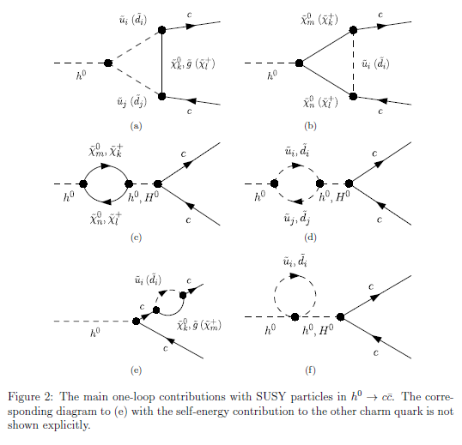
Main one-loop contributions with SUSY particles

Slide 13
b
d̃
d̃ ̴ s̃ + b̃
h⁰
d̃
b̅ / s̅
b
ũ
ũ ̴ c̃ + t̃
h⁰
χ̃±
ũ
b̅ / s̅

Slide 14
5.1 Deviation of the width from the SM prediction
- The deviation of the width from the SM prediction:
_ _ _
DEV(h⁰ -> X X) = Γ(h⁰ -> X X)_{MSSM} / Γ (h⁰ -> X X)_{SM} - 1
X = c, b

Slide 15
Scatter plot in DEV(h⁰ -> c c̅) - DEV(h⁰ -> b b̅) plane
DEV(h⁰ -> b b̅)
DEV(h⁰ -> c c̅)
DEV(h⁰ -> c c̅) and DEV(h⁰ -> b b̅) can be very large simultaneously!
ILC can observe such large deviations from SM at high significance!(arXiv:1908.11299):
Δ DEV(h⁰ -> c c̅) = (3.60%, 2.40%, 1.58%) at (ILC250, ILC500, ILC1000)
Δ DEV(h⁰ -> b b̅) = (1.98%, 1.16%, 0.94%) at (ILC250, ILC500, ILC1000)
Recent LHC data:
DEV(h⁰ -> b b̅) = 0.12 +0.92/-0.62 = [-0.50, 1.04] (ATLA S) (ATLAS-CONF-2019-005)
DEV(h⁰ -> b b̅) = 0.37 +1.52/-1.06 = [-0.69, 1.89] (CMS) (arXiv:1809.10733)
Both SM and MSSM are consistent with the recent ATLAS/CMS data!
The errors of the recent ATLAS/CMS data are too large!

Slide 16
5.2 Deviation of width ratio from the SM prediction
- The deviation of the width ratio from the SM prediction:
DEV(b/c) = [Γ (b) / Γ (c)]_{MSSM} / [Γ (b) / Γ (c)]_{SM} - 1
_
Γ (X) = Γ (h⁰-> X X)

Slide 17
Scatter plot in T_U32 – DEV(b/c) plane
DEV(b/c)
T_U32 (GeV)
c̃_{L} – t̃_{R} mixing parameter
There is a strong correlation between T_U32 – DEV(b/c)!
DEV(b/c) can be as large as 200%!

Slide 18
Scatter plot in T_U23 – DEV(b/c) plane
DEV(b/c)
T_U23 (GeV)
c̃_{R} – t̃_{L} mixing parameter
There is almost no correlation between T_U23 – DEV(b/c)!
DEV(b/c) can be as large as 200%!

Slide 19
Scatter plot in T_U33 – DEV(b/c) plane
DEV(b/c)
T_U33 (GeV)
t̃_{R} – t̃_{L} mixing parameter
There is almost no correlation between T_U33 – DEV(b/c)!
DEV(b/c) can be as large as 200%!

Slide 20

5.3 BR(h⁰ -> b s̅ / s b̅)
BR(h⁰ -> b s̅ / s b̅) $≅$ 0 (SM)
BR(h⁰ -> b s̅ / s b̅) can be as large as 0.13% (MSSM with QFV)!

Slide 21
Scatter plot in T_D23 - BR(h⁰ -> b s̅ / s b̅) plane
BR(h⁰ -> b s̅ / s b̅)
T_D23 (GeV)
s̃_{R} – b̃_{L} mixing parameter
There is a strong correlation between T_D23 - BR(h⁰ -> b s̅ / s b̅)!
BR(h⁰ -> b s̅ / s b̅) can be as large as 0.13%!
ILC(250 + 500 + 1000) sensitivity could be 0.1%!
(private communication with J. Tian)
- LHC &HL-LHC sensitivity should not be so good due to huge QCD BG!

Slide 22
Scatter plot in T_D32 - BR(h⁰ -> b s̅ / s b̅) plane
BR(h⁰ -> b s̅ / s b̅)
s̃_{L} – b̃_{R} mixing parameter
T_D32 (GeV)
There is a strong correlation between T_D32 - BR(h⁰ -> b s̅ / s b̅)!
BR(h⁰ -> b s̅ / s b̅) can be as large as 0.13%!

Slide 23
6. Conclusion
We have studied the decays
h⁰ (125GeV) → c c̅ & b b̅ & b s̅ at full one-loop level in the MSSM with QFV.
- Performing a parameter scan, we have found the followings:
* DEV(h⁰ -> c c̅) and DEV(h⁰ -> b b̅) can be very large simultaneously! :
DEV(h⁰ -> c c̅) can be as large as ~ ± 40%,
DEV(h⁰ -> b b̅) can be as large as ~ ± 20%.
* The deviation of the width ratio Γ (h⁰ -> b b̅) / Γ (h⁰ -> c c̅)
from the SM value can be as large as ~ +200%!
* ILC can observe such large deviations from SM at high significance!
* BR(h⁰ -> b s̅ / s b̅) can be as large as ~ 0.13%!
ILC(250 + 500 + 1000) sensitivity could be ~ 0.1%!

Slide 24
All of these large deviations in h⁰ (125GeV) → c c̅ & b b̅ & b s̅ are due to
large scharm-stop mixing & large stop/scharm involved trilinear couplings
T_{U32}, T_{U23}, T_{U33} and
large s̃ - b̃ mixing & large s̃ / b̃ involved trilinear couplings
T_{D32}, T_{D23}, T_{D33}!
- In case the deviation pattern shown here is really observed at ILC, then it would
strongly suggest the discovery of QFV SUSY (MSSM with QFV)!
- See next slide also.

Slide 25
Our analysis suggests the following:
PETRA/TRISTAN e- e+ collider discovered virtual Z⁰ effect for the first time.
Later, CERN p pbar collider discovered the Z⁰ boson.
Similarly, ILC could discover virtual Sparticle effects for the first time in h⁰(125GeV) decays!
Later, HE-LHC/VLHC p p collider could discover the Sparticles!

Slide 26
END
Thank you!

Slide 27

Backup Slides

Slide 30
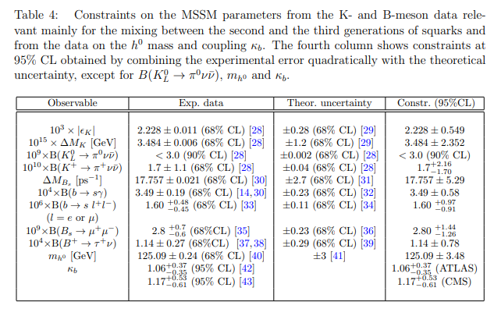
Constraints on the MSSM parameters from K & B meson and h⁰ data:

