Slide 1
  Updates to the Power Estimate (ILC-CR-0018)
  Benno List, DESY
  TCMB Meeting
  3.12.2019

Slide 2
TDR Tables

Slide 3
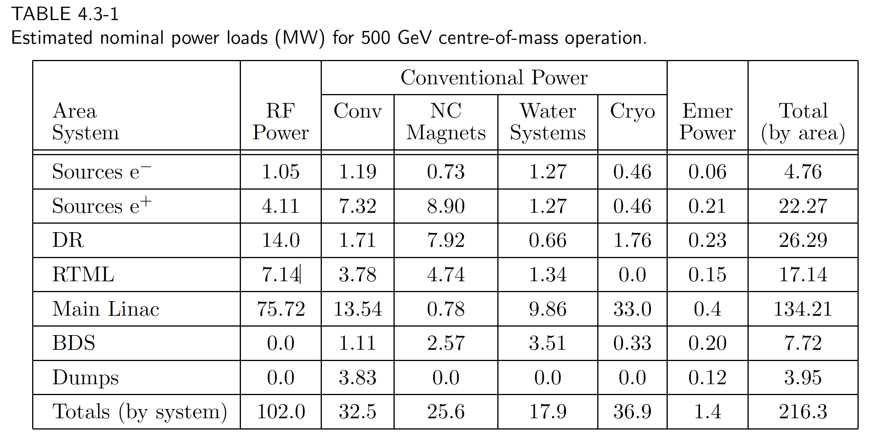
For Comparison: RDR Table
Note: This is for 2625 bunches!

Slide 4
Damping Ring
Japanese (DKS) and American (KCS) designs have different numbers for power of conventioanl facilities
For Damping Rings, the difference is 0.07MW for „normal“ CFS power and 0.56MW for „emergency“ power
Resulting overall power numbers for different configurations
 | KCS | DKS
2 Rings, 10Hz (TDR), 1312b | 15.1MW | 15.7MW
2 Rings, 5 Hz, 1312b | 13.6 | 14.2
2 Rings, 5 Hz, 2625b | 21.5 | 22.2
3 Rings, 10Hz, 2625b | 30.3 | 31.0

Slide 5
RTML
TDR has 8.40MW for DKS and 6.59MW for KCS
On top: 2MW from cryogenics (reassigned from Main Linac)
Included: 4.76MW RF power
  Surprise: Bunch compressor total voltage is 0.465+11 = 11.465GV per arm
  => corresponds to 0.5MW total RF to beam => 2.5MW RF power
  => TDR number almost certainly an overestimate
Calculation by N.W. spreadsheet nevertheless scales RF power up
(+60% for 2625 bunches, +100% for 10Hz)
-> consistent with RDR numbers!
Reduction for smaller length of transport line <1MW, not considered
Power RTML | KCS | DKS
5+5Hz, (TDR), 1312b | 8.6 MW | 10.4 MW
5 Hz, 1312b |  | 10.4
5 Hz, 2625b |  | 13.3
10Hz, 2625b |  | 16.1

Slide 6
Sources
Sources: include 1.3/1.4 MW RF power
This seems to be already the number for full power (2625 bunches) operation:
With I_beam=1.5*5.8mA and <g>=24.1MV/m for 176 cavities in SC booster,
one gets 0.15MW RF to beam in 5GeV booster
-> approx 0.7MW RF power
Calculation by N.W. spreadsheet nevertheless scales RF power up
(+60% for 2625 bunches, +100% for 10Hz)
Power e-/e+ source | KCS | DKS
5+5Hz, (TDR), 1312b | 4.09 / 9.56 MW | 4.87 / 9.32 MW
5 Hz, 1312b |  | 4.9 / 9.3
5 Hz, 2625b |  | 5.6 / 10.2
10Hz, 2625b |  | 6.4 / 11.0

Slide 7
The Result
 | 500 TDR | 250-A | 250-A’ w/R&D | 250-A Lx2 | 500@250 | 500 Lx2
Rep-Rate / Hz | 5 | 5 | 5 | 5 | 10 | 5
Bunches / Pulse | 1312 | 1312 | 1312 | 2625 | 2625 | 2625
Lumi / 10³⁴ | 1.8 | 1.35 | 1.35 | 2.7 | 5.4 | 3.6
Gradient / MV/m | 31.5 | 31.5 | 35 | 31.5 | 14.7 | 31.5
Q₀/1E10 | 1.0 | 1.0 | 1.6 | 1.0 | 1.0 | 1.0
ML E-gain / GeV | 470 | 220 | 220 | 220 | 220 | 470
ML Power / MW | 107.1 | 50.1 | 49.3 | 53.5 | 104.3 | 135.7
e- Src / MW | 4.9 | 4.9 | 4.9 | 5.6 | 6.4 | 5.6
e+ Src / MW | 9.3 | 9.3 | 9.3 | 10.2 | 11.0 | 10.2
DR / MW | 14.2 | 14.2 | 14.2 | 22.2 | 31.0 | 22.2
RTML / MW | 10.4 | 10.4 | 10.4 | 13.3 | 16.1 | 13.3
BDS / MW | 12.4 | 9.3 | 9.3 | 9.3 | 9.3 | 12.4
Dumps / MW | 1.2 | 1.2 | 1.2 | 1.2 | 1.2 | 1.2
IR / MW | 5.8 | 5.8 | 5.8 | 5.8 | 5.8 | 5.8
Campus / MW | 2.7 | 2.7 | 2.7 | 2.7 | 2.7 | 2.7
Gen. Margin/MW | 5.1 | 3.3 | 3.2 | 4.0 | 5.6 | 6.3
Total | 173 | 111 | 110 | 138 | 191 | 215

Slide 8
Summary
Further checks have confirmed the numbers presented last time and checked by the CRP
I propose to approve the Change Request

