Slide 1
The decays to c c̅̅, b b̅, b s̅ , γ γ, g g in the light of the MSSM with quark flavor violation
K. Hidaka
Tokyo Gakugei University
Collaboration with
H. Eberl, E. Ginina
References:
Phys. Rev. D 91 (2015) 015007 [arXiv:1411.2840 [hep-ph] ]
JHEP 1606 (2016) 143 [arXiv:1604.02366 [hep-ph]]]
IJMP A34 (2019) 1950120 [arXiv:1812.08010 [hep-ph]]
ILC-JP end-of-year physics and detector meeting,
13 Mar. 2020, KEK

Slide 2
Contents
1. Introduction
2. MSSM with QFV
3. Constraints on the MSSM
4. Parameter scan for h⁰ → c c̅ , b b̅ , b s̅ in the MSSM
5. h⁰ → c c̅ , b b̅ , b s̅ in the MSSM
6. h⁰ → γ γ, g g in the MSSM
7. Conclusion

Slide 3

1. Introduction
What is the SM-like Higgs boson discovered at LHC?
It can be the SM Higgs boson.
It can be a Higgs boson of New Physics.
This is one of the most important issues in the present particle physics field!
Here we study a possibility that it is the lightest Higgs boson of the
Minimal Supersymmetric Standard Model (MSSM), focusing on the decays h⁰(125) $→$c c̅ , b b̅ , b s̅ , γ γ, g g.

Slide 4
2. MSSM with QFV
The basic parameters of the MSSM with QFV:
{tanβ, m_{A} , M₁ , M₂ , M₃ , μ , M²_{Q,αβ} , M²_{U,αβ} , M²_{D,αβ} , T_{Uαβ} , T_{Dαβ} }
(at Q = 1 TeV scale ) (α,β = 1,2,3 = u, c, t or d, s, b)
tanβ : ratio of VEV of the two Higgs doublets <H⁰ ₂>/<H⁰₁>
mA : CP odd Higgs boson mass (pole mass)
M_{1,} M₂ ,M₃ : U(1), SU(2),SU(3) gaugino masses
μ : higgsino mass parameter
M²_{Q,αβ} : left squark soft mass matrix
M²_{Uαβ} : right up-type squark soft mass matrix
M²_{Dαβ} : right down-type squark soft mass matrix
T_{Uαβ} : trilinear coupling matrix of up-type squark and Higgs boson
T_{Dαβ} : trilinear coupling matrix of down-type squark and Higgs boson

Slide 5
Key parameters in this study are:
* QFV parameters: Μ ²_{Q23} , Μ ²_{U23} , Μ ²_{D23} , Τ_{U23} , Τ_{U32} , Τ_{D23} , Τ_{D32}
* QFC parameter: Τ_{U33,} Τ_{D33}
Μ ²_{Q23} = (c̃_{L} – t̃_{L} mixing parameter)
Μ ²_{U23} = (c̃_{R} – t̃_{R} mixing parameter)
Μ ²_{D23} = (s̃_{R} – b̃_{R} mixing parameter)
Τ_{U23} = (c̃_{R} – t̃_{L} mixing parameter)
Τ_{U32} = (c̃_{L} – t̃_{R} mixing parameter)
Τ_{U33} = (t̃_{L} – t̃_{R} mixing parameter)
Τ_{D23} = (s̃_{R} – b̃_{L} mixing parameter)
Τ_{D32} = (s̃_{L} – b̃_{R} mixing parameter)
Τ_{D33} = (b̃_{L} – b̃_{R} mixing parameter)

Slide 6
3. Constraints on the MSSM
We respect the following experimental and theoretical constraints:
(1) The recent LHC limits on the masses of squarks, sleptons, gluino, charginos and neutralinos.
(2) The constraint on (m_{A / H+ ,} tanβ ) from recent MSSM Higgs boson search at LHC.
The constraints on the QFV parameters from the B meson data.
etc.
(4) The constraints from the observed Higgs boson mass at LHC
(allowing for theoretical uncertainty): 121.6 GeV < m_h⁰ < 128.6 GeV.
(5) Theoretical constraints from the vacuum stability conditions for the
trilinear couplings T_{Uab} and T_{Dab} .
(6) The experimental limit on SUSY contributions to the electroweak ρ parameter
Δρ(SUSY) < 0.0012.
Notes:
Experimental constraint from B(b -> s l+ l-) ;
The low-s region (1 GeV^2 < s < 6 GeV^2) is dominated by the Wilson
coefficients C_9 and C_10, has sizable integrated branching ratio and is very
sensitive to the C_7 - C_9 interference. In the following, we utilize the latter
to put constraints on the Wilson coefficients C_7,8,9,10.
We calculate the integrated branching ratio in the low-s region following Ref. [52]:

Slide 7

4. Parameter scan for h⁰ → c c̅ , b b̅ , b s̅ in the MSSM
We compute the decay widths Γ (h⁰ $→$ c c̅), Γ (h⁰ $→$ b b̅),
and Γ (h⁰ $→$ b s̅) at full 1-loop level in the MSSM with QFV.
- Parameter points are generated by using random numbers
in the following ranges (in units of GeV or GeV^2):
10 < tanβ < 60
2500 < M_3 < 5000
100 < M_2 < 2500
100 < M_1 < 2500
(without assuming the GUT relation for M_1, M_2, M_3)
100 < mu < 2500
800 < m_A(pole) < 6000;
1 TeV < M_{SUSY} < 5 TeV

Slide 8
MQ2_11 = 4500^2 (fixed)
2500^2 < MQ2_22 < 4000^2
2500^2 < MQ2_33 < 4000^2
|MQ2_23| < 1000.^2 <=== QFV param.
MU2_11 = 4500^2 (fixed)
1000.^2 < MU2_22 < 4000.^2
600.^2 < MU2_33 < 3000.^2
|MU2_23| < 1500.^2 <=== QFV param.
MD2_11 = 4500^2 (fixed)
2500.^2 < MD2_22 < 4000.^2
1000.^2 < MD2_33 < 3000.^2
|MD2_23| < 2000.^2
ML2_11 = 1500^2 (fixed)
ML2_22 = 1500^2 (fixed)
ML2_33 = 1500^2 (fixed)
ML2_23 = 0. (fixed)

Slide 9
ME2_11 = 1500^2 (fixed)
ME2_22 = 1500^2 (fixed)
ME2_33 = 1500^2 (fixed)
ME2_23 = 0. (fixed)
|TU_23| < 4000 <=== QFV param
|TU_32| < 4000 <=== QFV param
|TU_33| < 5000 <=== QFC param
|TD_23| < 2000 <=== QFV param
|TD_32| < 2000 <=== QFV param
|TD_33| < 3000 <=== QFC param
TE_23 = 0. (fixed)
TE_32 = 0. (fixed)
|TE_33| < 500
In the parameter scan, all of the relevant experimental and
theoretical constraints are imposed.
- 101000 parameter points are generated and 2993 points survive
the constraints.

Slide 10

5. h⁰ → c c̅ , b b̅ , b s̅ in the MSSM
We compute the decay widths Γ (h⁰ $→$ c c̅), Γ (h⁰ $→$ b b̅),
and Γ (h⁰ $→$ b s̅) at full 1-loop level in the DRbar renormalization
scheme in the MSSM with QFV.
Main 1-loop correction to h⁰ → c c̅ :
gluino - su loops [ su = (t̃ - c̃ mixture)]
Main 1-loop corrections to h⁰ → b b̅ & b s̅ :
gluino – sd loops [ sd = (̂b̃ - s̃ mixture)]
chargino - su loops [ su = (t̃ - c̃ mixture)]
- The width Γ (h⁰ $→$ c c̅) can be measured very precisely at ILC,
but it is very difficult to measure it at LHC.

Slide 11
In large & mixing scenario;
h⁰ ̴ H₂⁰
g̃
In our scenario, “trilinear couplings“ ( , ,
couplings) = (T_{U23} T_{U32} , T_{U33} ) are large!
couplings are large!
Gluino loop contributions can be large!
Deviation of Γ (h⁰ → c c̅) from SM width can be large!

Slide 12
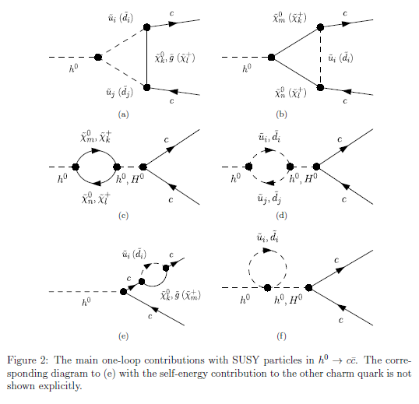
Main one-loop contributions with SUSY particles

Slide 13
In large s̃_{R/L} - b̃_{R/L} & b̃_{L} - b̃_{R} mixing scenario;
b
h⁰ ̴ - sα H₁⁰ + cα H₂⁰
d̃_{1,2}
d̃_{1,2} ̴ s̃_{R/L} + b̃_{R/L}
h⁰
g̃
d̃_{1,2}
b̅ / s̅
In our scenario, “trilinear couplings“(T_{D23} T_{D32} , T_{D33} ) =
(s̃_{R} - b̃_{L} - H₁⁰ , s̃_{L} - b̃_{R} - H₁⁰ , b̃_{L} - b̃_{R} - H₁⁰ couplings) are large!
d̃_{1,2} - d̃_{1,2} - h⁰ couplings are large!
Gluino loop contributions can be large!
Deviation of Γ (h⁰ → b b̅/s̅ ) from SM width can be large!

Slide 14
In large c̃_{R/L} - t̃_{R/L} & t̃_{L} - t̃_{R} mixing scenario;
b
h⁰ ̴ H₂⁰
ũ_{1,2}
ũ_{1,2} ̴ c̃_{R/L} + t̃_{R/L}
h⁰
χ̃±
χ̃± ~ W̃± + H̃±
ũ_{1,2}
b̅ / s̅
In our scenario, “trilinear couplings“ ( , ,
couplings) = (T_{U23} T_{U32} , T_{U33} ) are large!
couplings are large!
Chargino loop contributions can be large!
Deviation of Γ (h⁰ → b b̅/s̅ ) from SM width can be large!

Slide 15
5.1 Deviation of the width from the SM prediction
- The deviation of the width from the SM prediction:
_ _ _
DEV(h⁰ -> X X) = Γ(h⁰ -> X X)_{MSSM} / Γ (h⁰ -> X X)_{SM} - 1
X = c, b

Slide 16
Scatter plot in DEV(h⁰ -> c c̅) - DEV(h⁰ -> b b̅) plane
DEV(h⁰ -> b b̅)
DEV(h⁰ -> c c̅)
DEV(h⁰ -> c c̅) and DEV(h⁰ -> b b̅) can be very large simultaneously!:
DEV(h⁰ -> c c̅) can be as large as ~ ± 60%.
DEV(h⁰ -> b b̅) can be as large as ~ ± 20%.
ILC can observe such large deviations from SM at high significance (arXiv:1908.11299)!:
Δ DEV(h⁰ -> c c̅) = (3.60%, 2.40%, 1.58%) at (ILC250, ILC500, ILC1000)
Δ DEV(h⁰ -> b b̅) = (1.98%, 1.16%, 0.94%) at (ILC250, ILC500, ILC1000)

Slide 17
Scatter plot in DEV(h⁰ -> c c̅) - DEV(h⁰ -> b b̅) plane
DEV(h⁰ -> b b̅)
DEV(h⁰ -> c c̅)
Recent LHC data:
DEV(h⁰ -> b b̅) = 0.12 +0.92/-0.62 = [-0.50, 1.04] (ATLA S) (ATLAS-CONF-2019-005)
DEV(h⁰ -> b b̅) = 0.37 +1.52/-1.06 = [-0.69, 1.89] (CMS) (arXiv:1809.10733)
Both SM and MSSM are consistent with the recent ATLAS/CMS data!
The errors of the recent ATLAS/CMS data are too large!

Slide 18
5.2 Deviation of width ratio from the SM prediction
- The deviation of the width ratio from the SM prediction:
DEV(b/c) = [Γ (b) / Γ (c)]_{MSSM} / [Γ (b) / Γ (c)]_{SM} - 1
_
Γ (X) = Γ (h⁰-> X X)

Slide 19
Scatter plot in T_{U32} – DEV(b/c) plane
DEV(b/c)
SM
T_U32 (GeV)
c̃_{L} – t̃_{R} mixing parameter
There is a strong correlation between T_{U32} – DEV(b/c)!
DEV(b/c) can be as large as ~ +200% for large T_{U32} !

Slide 20

5.3 BR(h⁰ → b s̅ / s b̅)
BR(h⁰ -> b s̅ / s b̅) $≅$ 0 (SM)
BR(h⁰ -> b s̅ / s b̅) can be as large as ~ 0.17% (MSSM with QFV)!
ILC(250+500+1000) sensitivity could be ~ 0.1% (at 4 σ significance)!
(See also Heinemeyer et al., PR D93 (2016) 095021 [arXiv:1511.04342]. )

Slide 21
Scatter plot in T_{D23} - BR(h⁰ -> b s̅ / s b̅) plane
ILC(250+500+1000) sensitivity at 4 σ significance
← 0.1%
BR(h⁰ -> b s̅ / s b̅)
T_D23 (GeV)
s̃_{R} – b̃_{L} mixing parameter
There is a strong correlation between T_{D23} - BR(h⁰ -> b s̅ / s b̅)!
BR(h⁰ -> b s̅ / s b̅) can be as large as 0.17% for large T_{D23} !
ILC(250 + 500 + 1000) sensitivity could be ~ 0.1% at 4 sigma significance!
(private communication with J. Tian)
- LHC &HL-LHC sensitivity should not be so good due to huge QCD BG!

Slide 22
Scatter plot in T_{D32} - BR(h⁰ -> b s̅ / s b̅) plane
ILC(250+500+1000) sensitivity at 4 σ significance
← 0.1%
BR(h⁰ -> b s̅ / s b̅)
s̃_{L} – b̃_{R} mixing parameter
T_D32 (GeV)
There is also a strong correlation between T_{D32} - BR(h⁰ -> b s̅ / s b̅)!
BR(h⁰ -> b s̅ / s b̅) can be as large as 0.17% for large T_{D32} !

Slide 23
Scatter plot in BR(h⁰ → b s̅ / s b̅) - DEV(h⁰ → b b̅ ) plane
ILC(250+500+1000) sensitivity at 4 σ significance
← 0.1%
BR(h⁰ → b s̅ / s b̅)
SM
x
DEV(h⁰ → b b̅ )
- There is a strong correlation between DEV(h⁰ → b b̅ ) & BR(h⁰ → b s̅ / s b̅)!
- This is due to the fact that DEV(h⁰ → b b̅) & BR(h⁰ → b s̅ / s b̅) have
a common origin of enhancement effect, i.e. large trilinear couplings
T_{D23,32,33} & T_{U23,32,33}.

Slide 24
Scatter plot in BR(h⁰ → b s̅ / s b̅) - tanβ plane
ILC(250+500+1000) sensitivity at 4 σ significance
← 0.1%
BR(h⁰ → b s̅ / s b̅)
tanβ
- There is a strong correlation between BR(h⁰ → b s̅ / s b̅) & tanβ !
- BR(h⁰ -> b s̅ / s b̅) can be as large as 0.17% for tanβ ∼ 20 !

Slide 25
6. h⁰ → γ γ, g g in the MSSM
For the h decays to photon photon and gluon gluon we compute the
widths at NLO QCD level. We perform a MSSM parameter scan
respecting theoretical and experimental constraints.
From the parameter scan, we find the followings:
(1) DEV(h⁰ → γ γ ) and DEV(h⁰ → g g) can be sizable simultaneously:
DEV(h⁰ → γ γ ) can be as large as ~ + 4%,
DEV(h⁰ → g g) can be as large as ~ -15%.
(2) There is a very strong correlation between DEV(h⁰ → γ γ )
and DEV(h⁰ → g g). This correlation is due to the fact that the
stop-loop (stop-scharm mixture loop) contributions dominate the
two DEV's.
(3) The deviation of the width ratio Γ (h⁰ → γ γ ) / Γ (h⁰ → g g ) in the
MSSM from the SM value can be as large as ~ +20%.

Slide 26
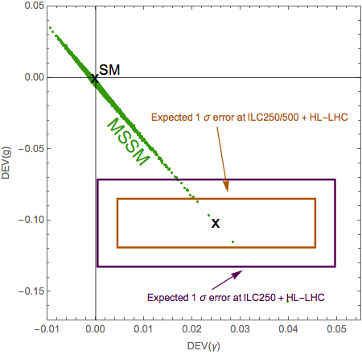
Scatter plot in DEV(h⁰ → γ γ ) - DEV(h⁰ → g g) plane
DEV(h⁰ → g g)
DEV(h⁰ → γ γ )
DEV(h⁰ → γ γ ) and DEV(h⁰ → g g) can be sizable simultaneously!
There is a strong correlation between DEV(h⁰ → γ γ ) and DEV(h⁰ → g g)!
This correlation is due to the fact that the stop-loop (stop-scharm mixture loop)
contributions dominate the two DEV’s .

Slide 27
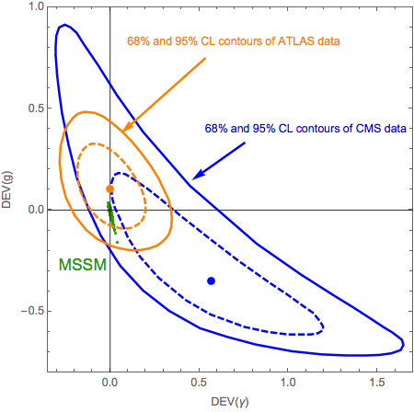
Scatter plot in DEV(h⁰ → γ γ ) - DEV(h⁰ → g g) plane
DEV(h⁰ → g g)
SM
DEV(h⁰ → γ γ )
- Both SM and MSSM are consistent with the recent ATLAS/CMS data!:
ATLAS: ATLAS-CONF-2018-031 (ICHEP2018)
CMS: arXiv:1804.02716 (Submitted to JHEP)
- The errors of the recent ATLAS/CMS data are too large!

Slide 28
7. Conclusion
- We have studied the decays
h⁰ (125GeV) → c c̅ , b b̅ , b s̅ , γ γ, g g in the MSSM with QFV.
- Performing a parameter scan respecting theoretical and experimental constraints ,
we have found the followings:
* DEV(h⁰ -> c c̅) and DEV(h⁰ -> b b̅) can be very large simultaneously! :
DEV(h⁰ -> c c̅) can be as large as ~ ± 60%,
DEV(h⁰ -> b b̅) can be as large as ~ ± 20%.
* The deviation of the width ratio Γ (h⁰ -> b b̅) / Γ (h⁰ -> c c̅)
from the SM value can be as large as ~ +200%.
* BR(h⁰ -> b s̅ / s b̅) can be as large as ~ 0.17%!
ILC(250 + 500 + 1000) sensitivity could be ~ 0.1% at 4 sigma signal significance!

Slide 29
* DEV(h⁰ -> γ γ ) and DEV(h⁰ -> g g) can be sizable simultaneously! :
DEV(h⁰ -> γ γ ) can be as large as ~ +4%,
DEV(h⁰ -> g g) can be as large as ~ -15%.
* The deviation of the width ratio Γ (h⁰ -> γ γ )/ Γ (h⁰ -> g g) from the SM value
can be as large as ~ +20%.
* There is a very strong correlation between DEV(h⁰ -> γ γ )
and DEV(h⁰ -> g g). This correlation is due to the fact that the stop-loop
(stop-scharm mixture loop) contributions dominate the two DEV's.
- All of these large deviations in the h⁰ (125GeV) decays are due to
large c̃ - t̃ mixing & large c̃ / t̃ involved trilinear couplings T_{U32}, T_{U23}, T_{U33} and
large s̃ - b̃ mixing & large s̃ / b̃ involved trilinear couplings T_{D32}, T_{D23}, T_{D33}.
ILC can observe such large deviations from SM at high significance!
In case the deviation pattern shown here is really observed at ILC, then it would strongly suggest the discovery of QFV SUSY (MSSM with QFV)!
- See next slide also.

Slide 30
Our analysis suggests the following:
PETRA/TRISTAN e- e+ collider discovered virtual Z⁰ effect for the first time.
Later, CERN p p̄ collider discovered the Z⁰ boson.
Similarly, ILC could discover virtual Sparticle effects for the first time in h⁰(125GeV) decays!
Later, HE-LHC/VLHC p p colliders could discover the Sparticles!

Slide 31
END
Thank you!

Slide 32

Backup Slides

Slide 33
Scatter plot in T_{U23} – DEV(b/c) plane
DEV(b/c)
SM
T_U23 (GeV)
c̃_{R} – t̃_{L} mixing parameter
There is almost no correlation between T_{U23} – DEV(b/c)!
DEV(b/c) can be as large as 200%!

Slide 34
Scatter plot in T_{U33} – DEV(b/c) plane
DEV(b/c)
SM
T_U33 (GeV)
t̃_{R} – t̃_{L} mixing parameter
There is almost no correlation between T_{U33} – DEV(b/c)!
DEV(b/c) can be as large as 200%!

Slide 37
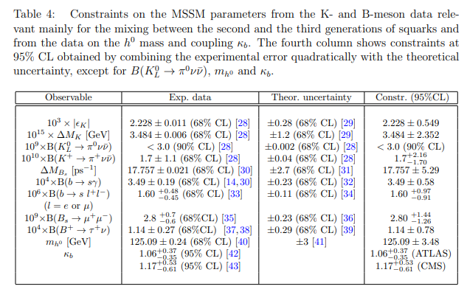
Constraints on the MSSM parameters from K & B meson and h⁰ data:

