Slide 1
Accelerator Design –
Current Change Requests.
Changes to the accelerator design, under review or recently approved
Benno List
ILC@DESY General Project Meeting
21.2.2020

Slide 2
ILC-CR-0020: Helium Storage
Provide gaseous storage for complete helium inventory
Concern: Long-term (days to weeks) of power failure after storm or earth quake
Requirement: He inventory must be preserved, limited backup (diesel generator) power available
-> no cryo plant operation
Without operational cryo plant: Helium evaporates within 3 days; max pressure in cryo modules: 2 bar
CR is now under review

Slide 3
Change of storage concept
Original concept:
  use 50% gaseous storage at 20 bar, 50% liquid storage
  Requires liquifier at each cryo plant
  Liquifier must run contunously
New concept:
  Provide gaseous storage fo 100% of inventory
  Only one liquifier at central location
  -> requires (gas) He transfer line in tunnel
  20 bar gaseous storage: requires compressor (2 bar -> 20 bar) for 3 days
  After that: He storage requires no power

Slide 4
New Layout

Slide 5
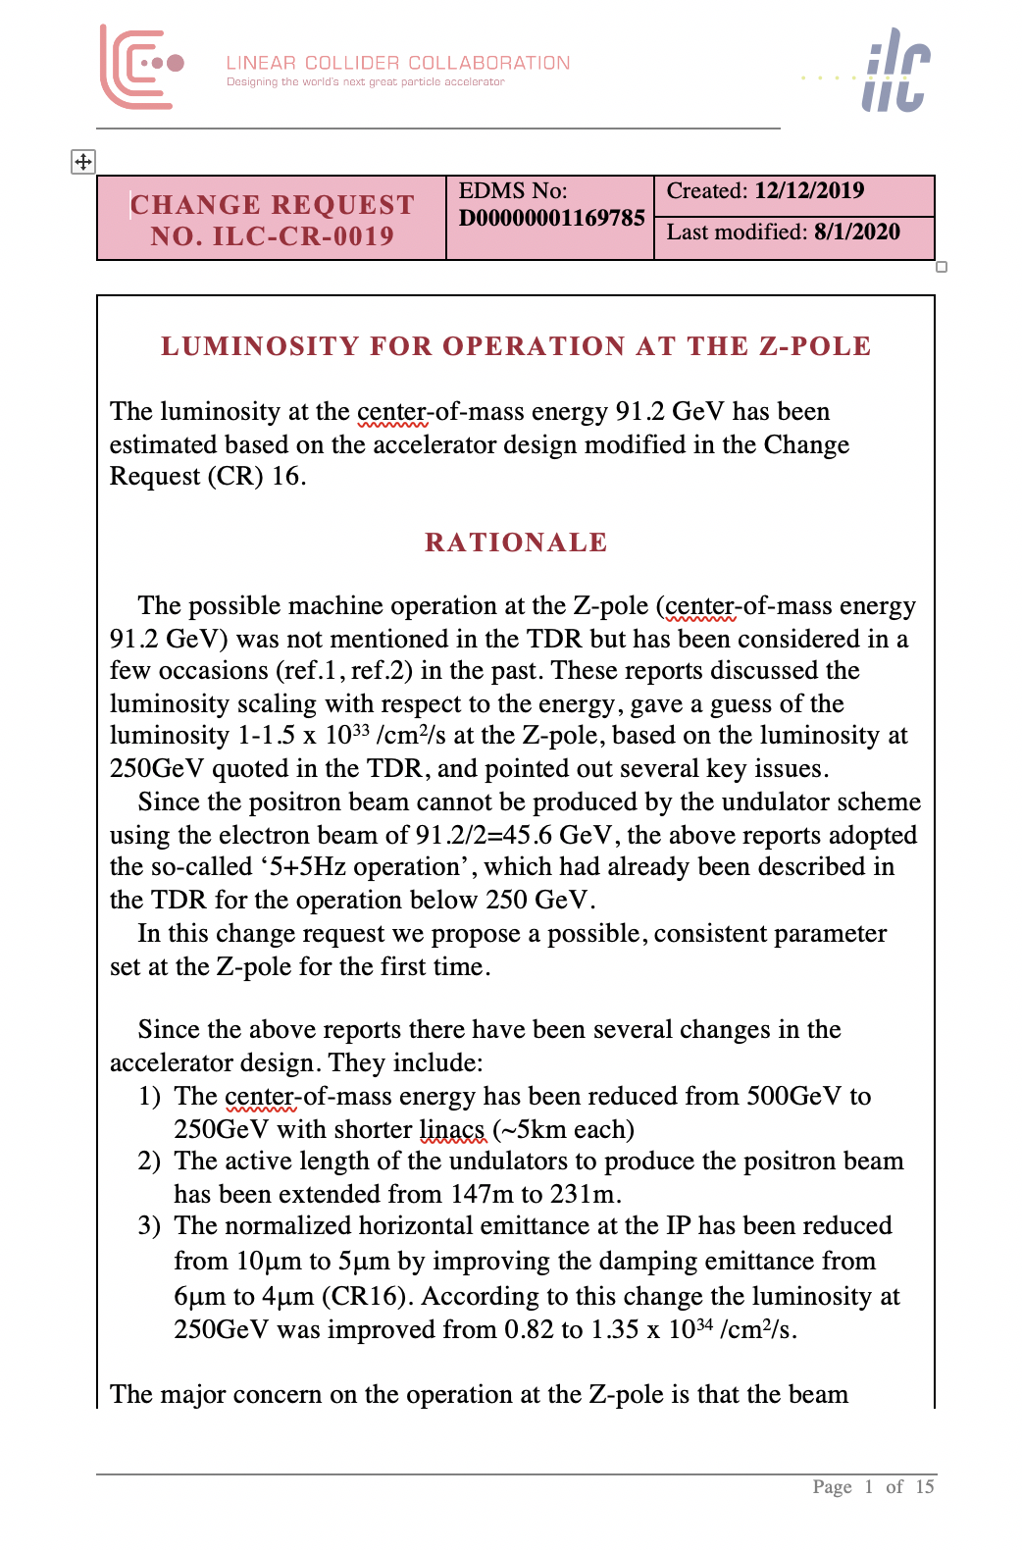
ILC-CR-0019 Z-Pole luminosity
Performance of the ILC at the Z pole
Based on arXiv:1908.08212
Gives performance estimate for running on the Z pole

Slide 6
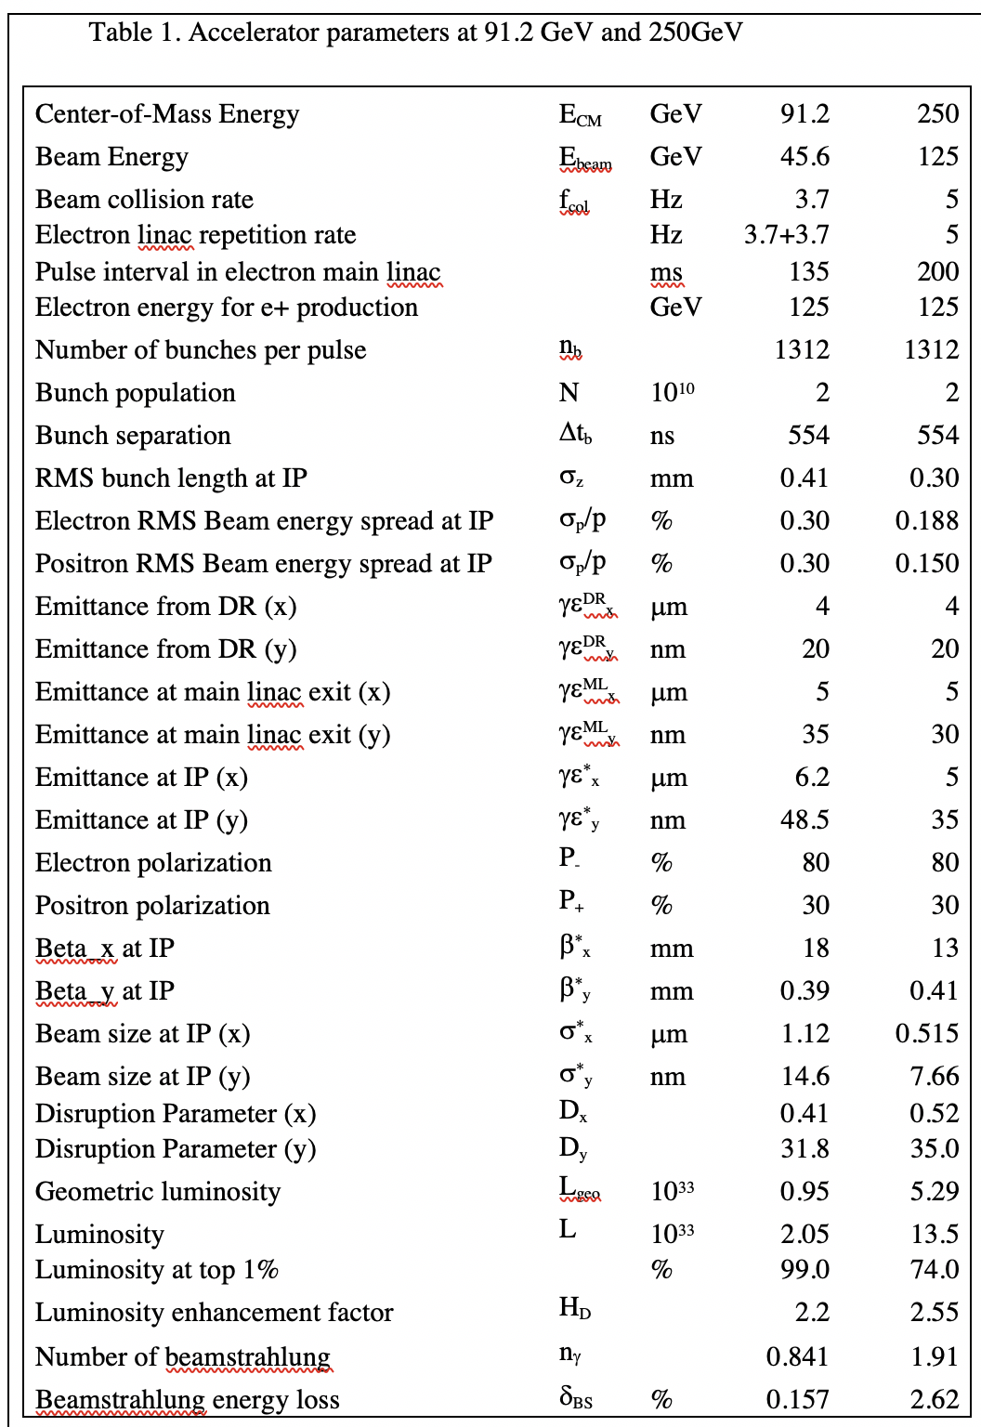
Accelerator Parameters
New baseline numbers for performance at the Z pole
Change Request has been accepted
Z pole running is now baseline (for the first time!)
But: requires additional infrastructure (special line to dump) for helical undulator source
-> may not be available from day1 on
-> this is not the performance promised / to be expected for calibration runs

Slide 7
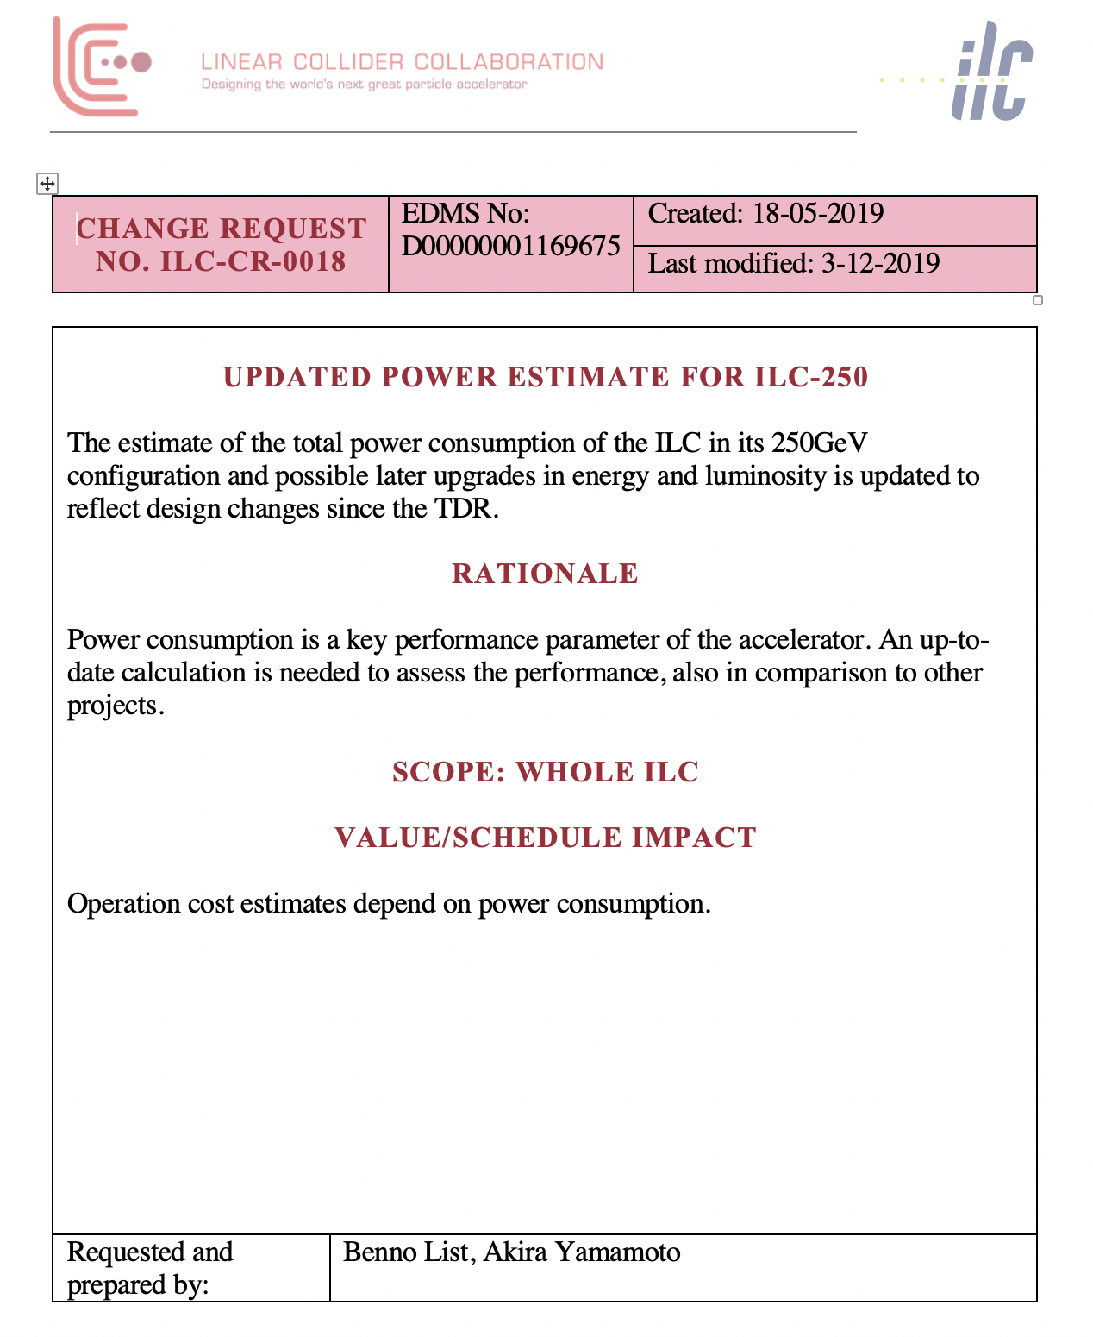
ILC-CR-0018 Power Estimate
Power estimate was updated end of 2019
Small error in spreadsheet was discovered in calculation of RF power for 10Hz operation
-> power for sourecs and RTML went up a bit
Final result is now approved

Slide 8
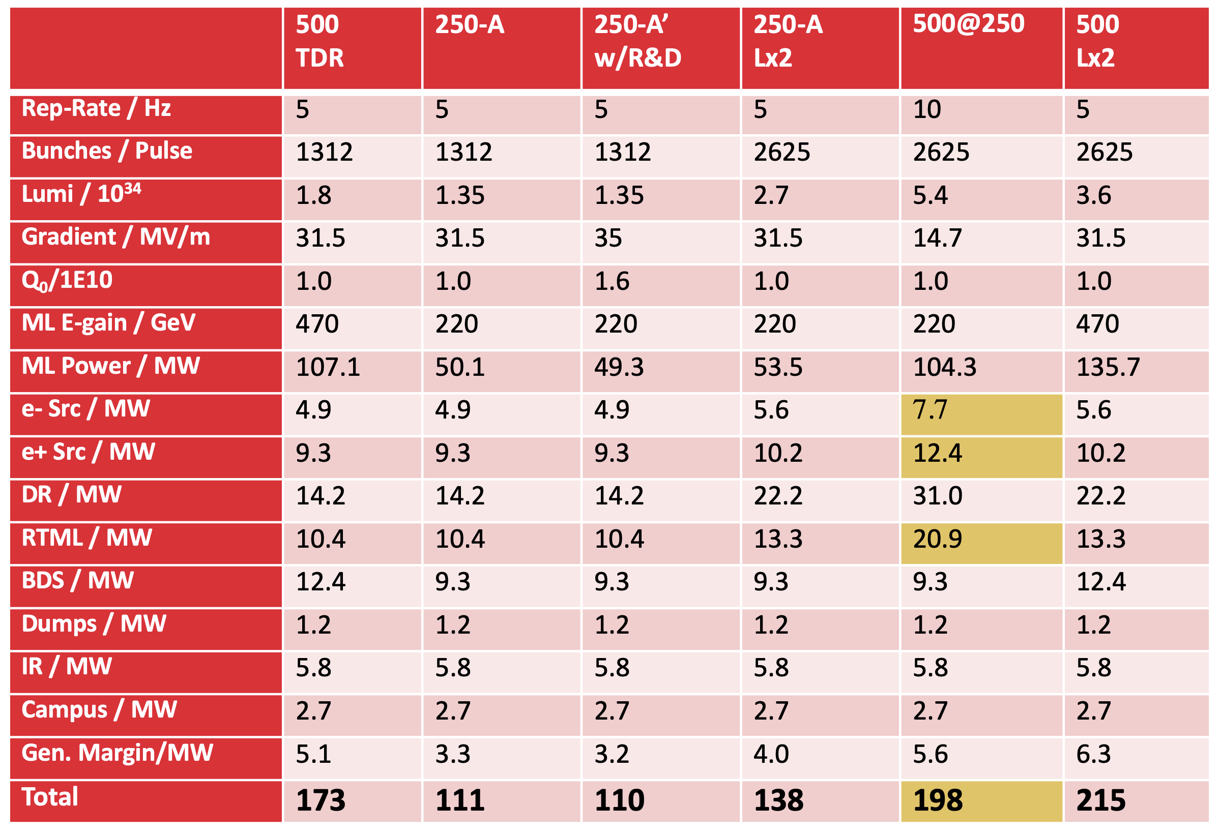
The final result
Updated power estimate for the ILC in different configurations

