Slide 1


Starting simulation for
Fcal testbeam 2020
A. T. Neagu

Slide 2
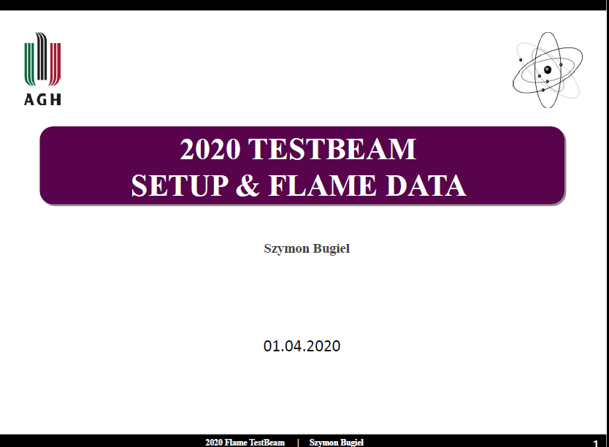
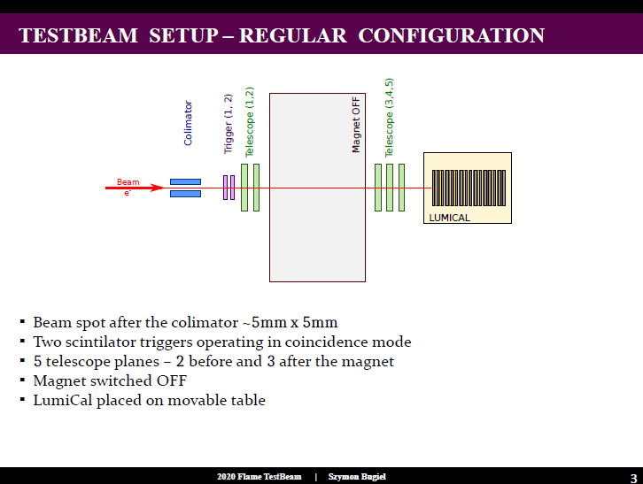

Slide 3
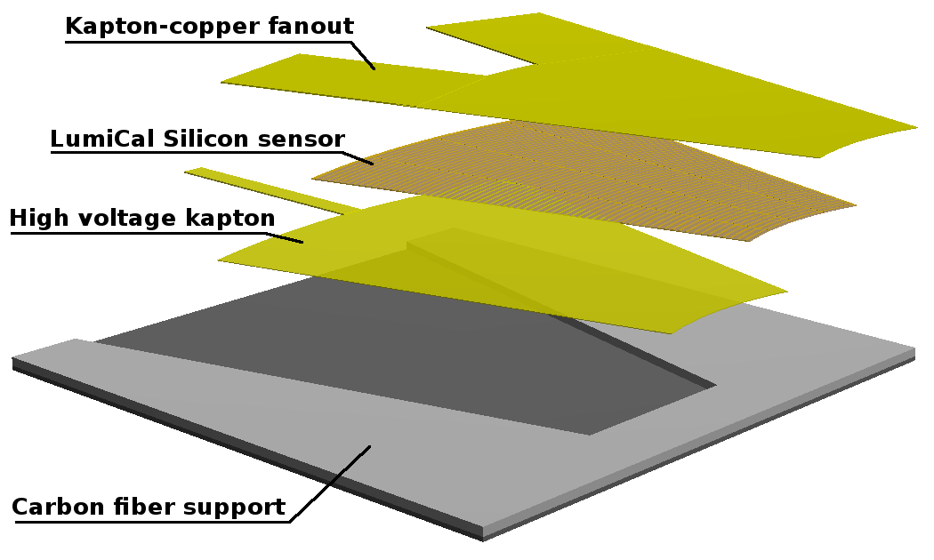
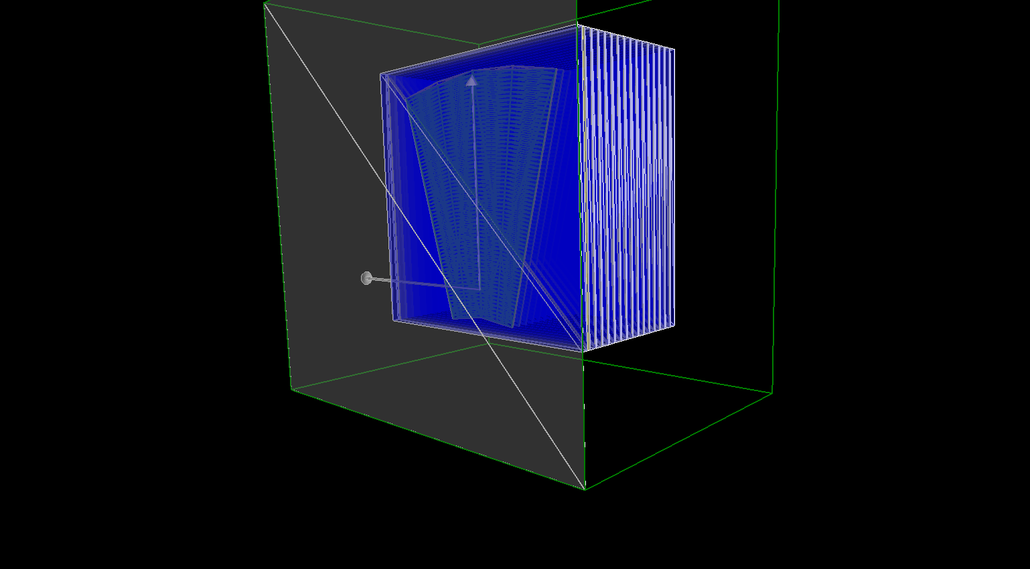
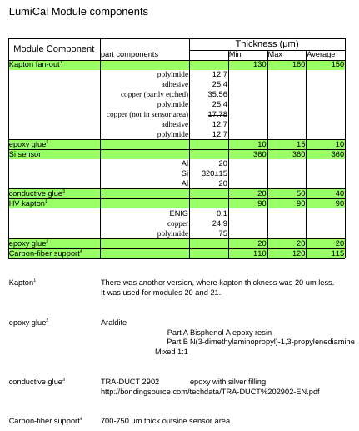
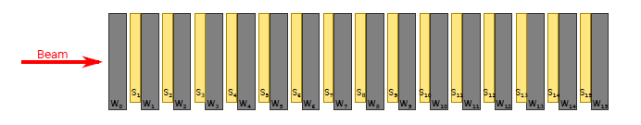
2020 Fcal TB geometry and materials in Geant4
Lumical sensors
Geant4 – Lumical sensors- TB 2020

Slide 4
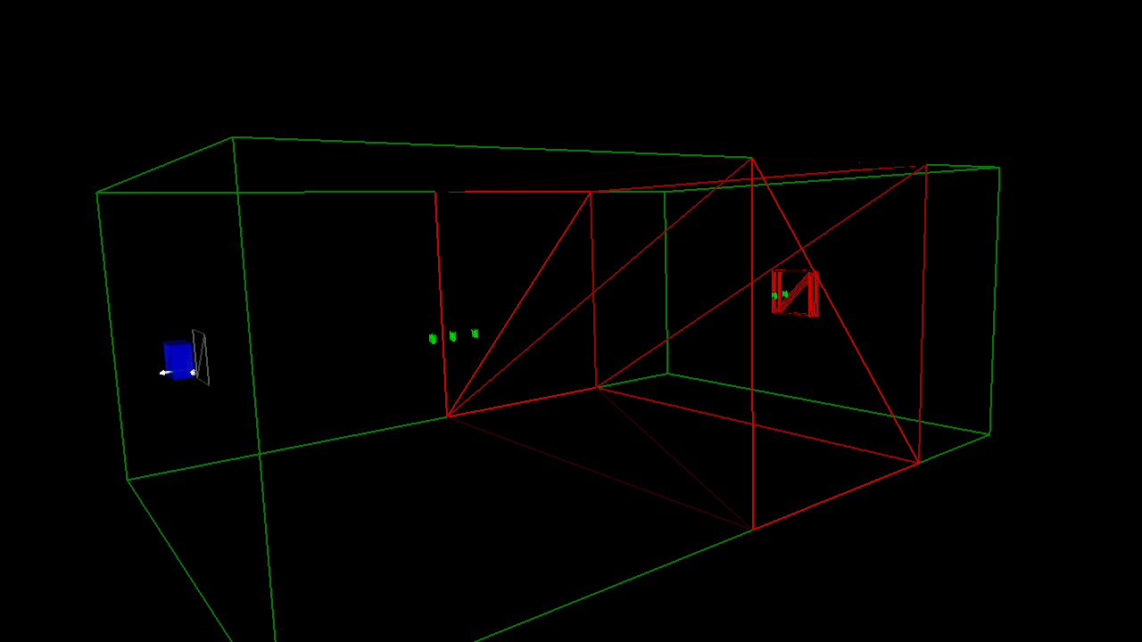
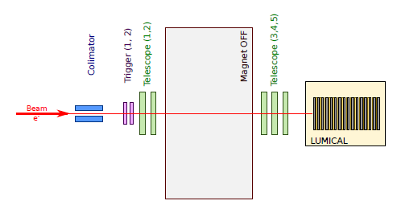
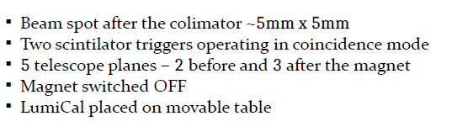
2020 test-beam set-up in Geant4
W plate - composition and dimension
distances from sensor to collimator
?
130 cm

Slide 5
Geant 4 simulation conditions
Physics list
-PAI for the e+, e-, gamma interaction with silicon sensors and standard EM model for the interaction with tungsten plates and other materials
Beam
- e-, 5GeV, uniform distribution inside a square: of 5 x 5mm^2
TO DO
the geometry of 2020 TB implemented in Geant4 (right dimension)
simulated the energy deposition on every sensor pad
determine the energy deposition on sensors
determine the longitudinal shower development
?
?

