Slide 1


TB2020 – SRS noise analysis
Veta Ghenescu*
^{*Institute of Space Science}
29.04.2020

Slide 2
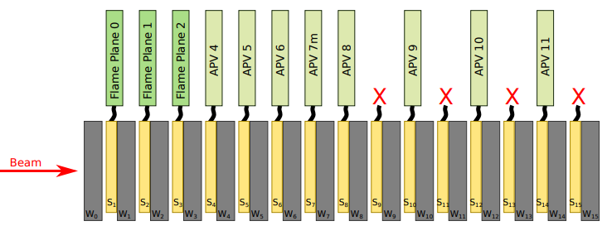
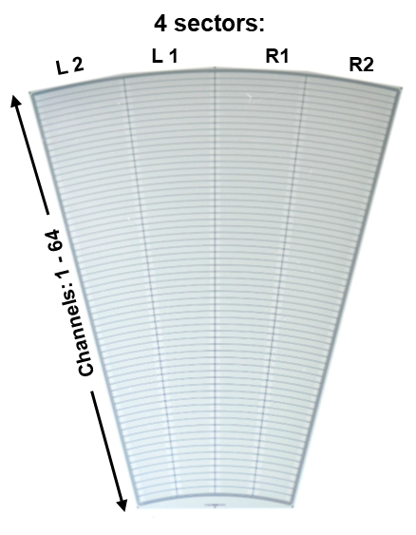
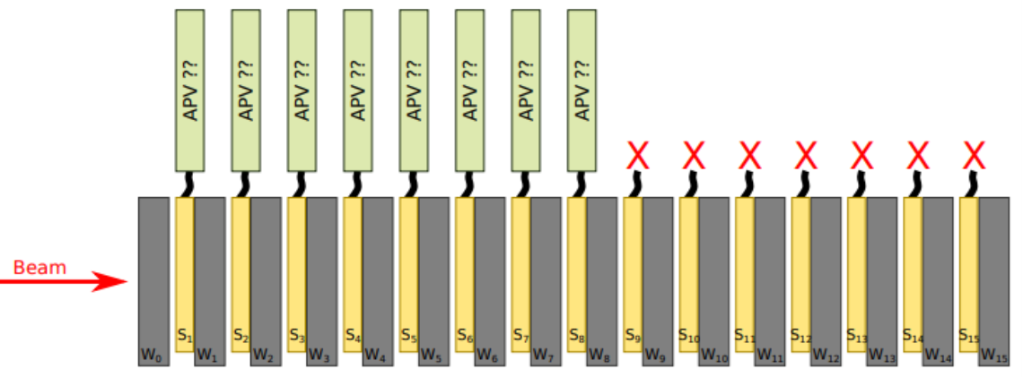

Experimental set-up
Test beam at DESY with 1 – 6 GeV electron beam
ALPIDE telescope – 2 arms, 1st arm consists of 2 layers and 2nd arm consists of 3 layers;
Lumical calorimeter consists of 15 Si sensors with one absorber layer placed in front of each active sensor layer;
Experimental set-up
127
126
.
.
.
65
64
0
1
.
.
.
62
63
Available for 1st and 2nd energy scan, calorimeter edge and LUXE experiment?!
Beam direction
Available for tilted LumiCal calorimeter?!
Sensor | 1 | 2 | 3 | 4 | 5 | 6 | 7 | 8 | 9 | 10 | 11 | 12 | 13 | 14 | 15 | 16
Configuration A | B0 | B1 | B2
Configuration B |  |  |  | B0 | B1 | B2
Configuration C |  |  |  |  |  |  | B0 | B1 | B2
Configuration D |  |  |  |  |  |  |  |  |  | B0 | B1 | B2
Configuration E |  |  |  |  |  |  |  |  |  |  |  |  | B0 | B1 | B2
Configuration F |  |  |  |  |  |  |  | B0

Slide 3
Experimental set-up
Energy scan - 1 to 5 GeV
Run no. | Energy (GeV)
18 | 4
24 | 3
35 | 2
45 | 1

Slide 4
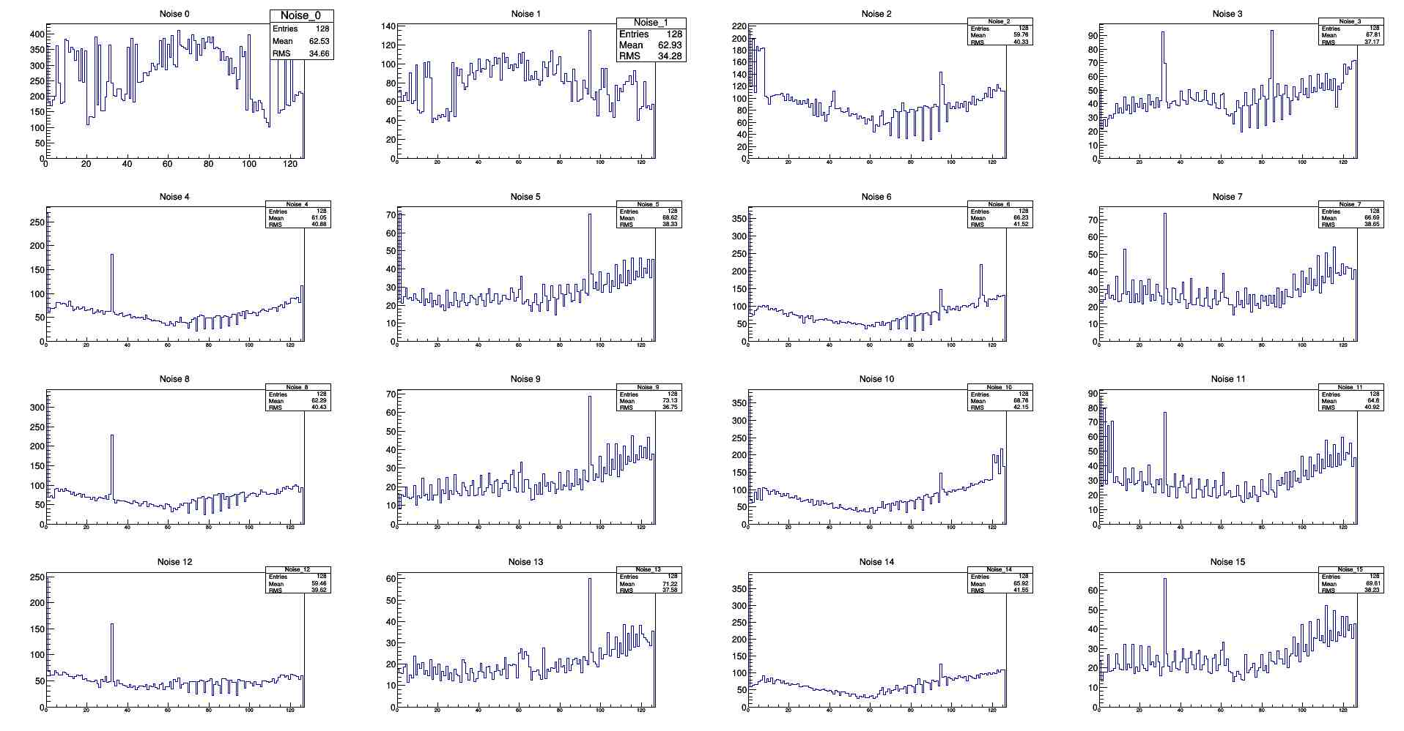
Data analysis
APVs noise – run 18 – energy scan, 4 GeV

Slide 5
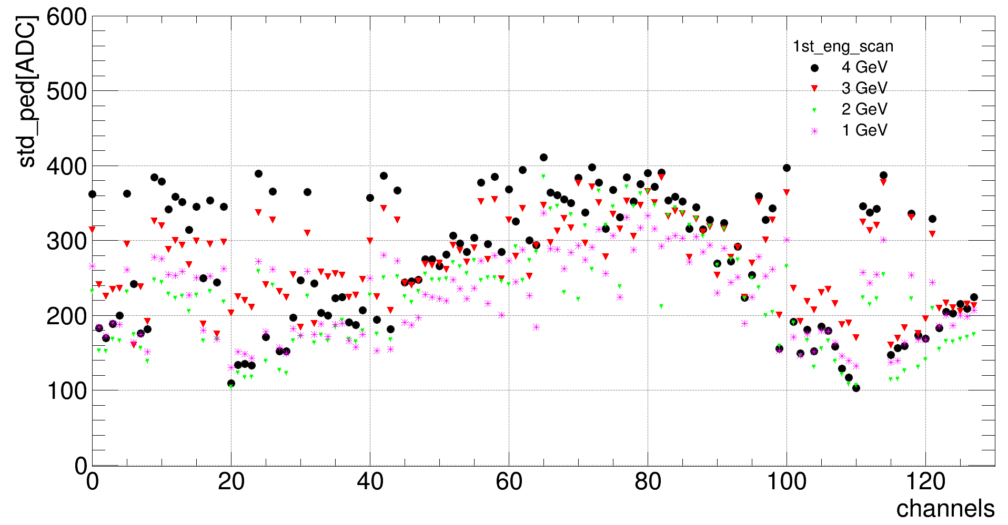
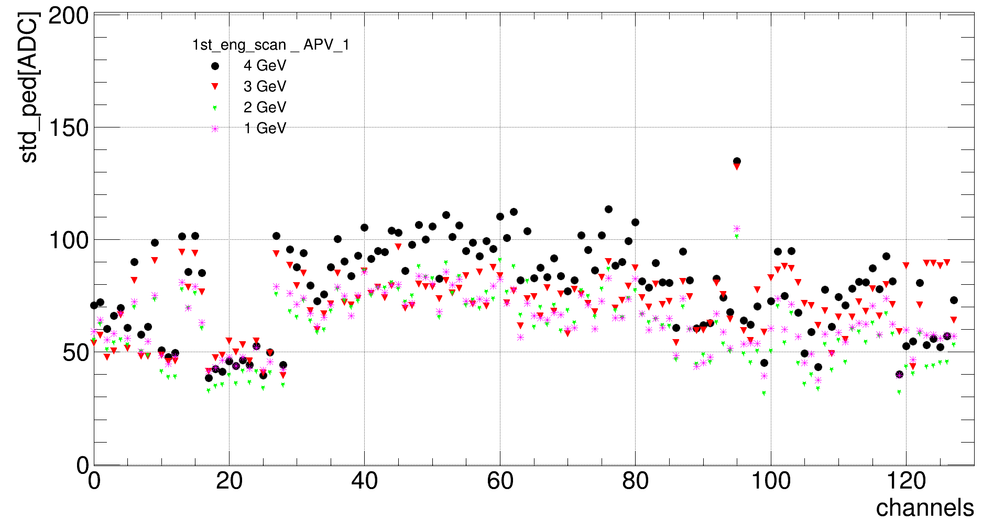
Noise distribution for all channels
_APV_0
Run 18, 24, 35, 45 – energy scan

Slide 6
Experimental set-up
LumiCal tilted by 2, 4, 6 degrees – 5 GeV
Run no. | Tilt (degree)
87 | 2
88 | 2
94 | 4
103 | 6

Slide 7
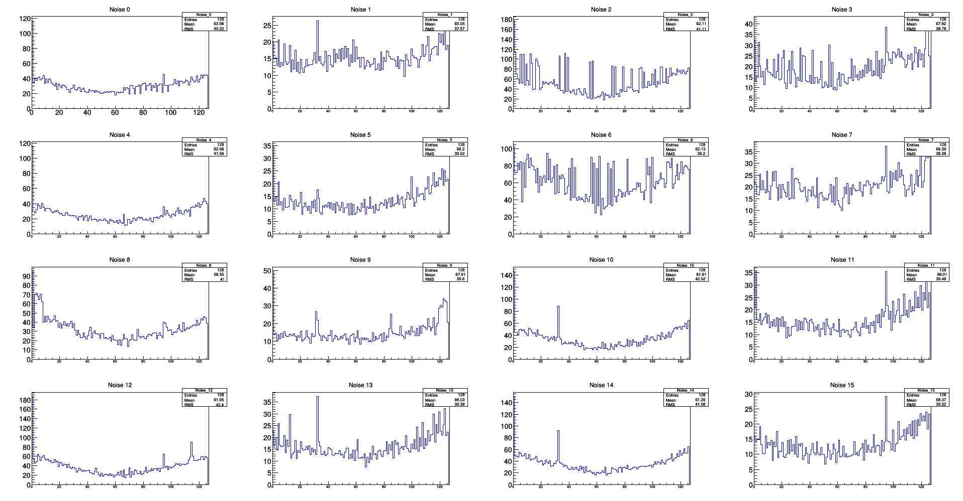
Noise distribution for all channels
APVs noise – run 87 – FCAL tilted - 2 degree

Slide 8
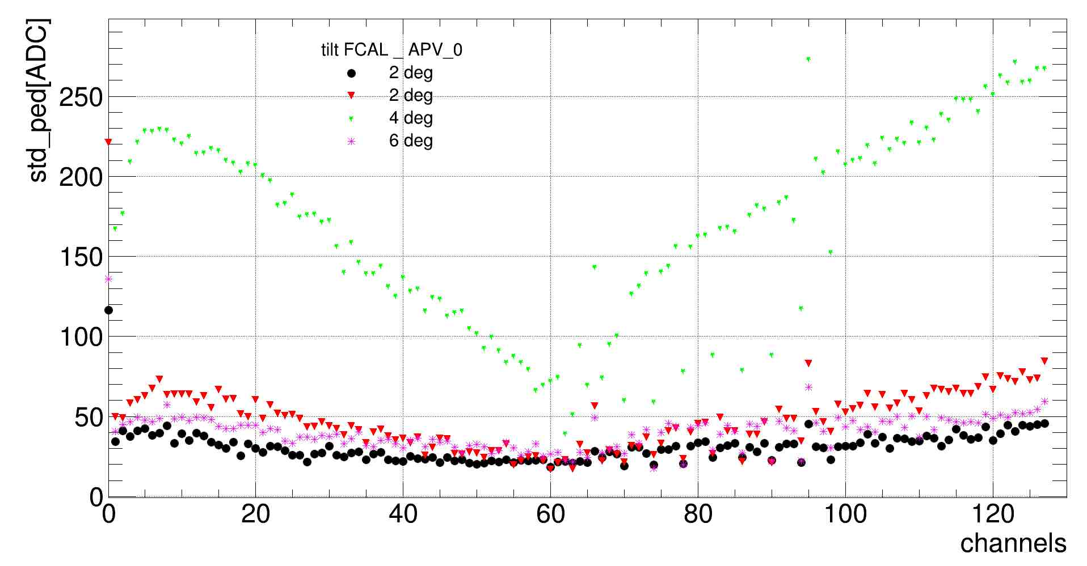
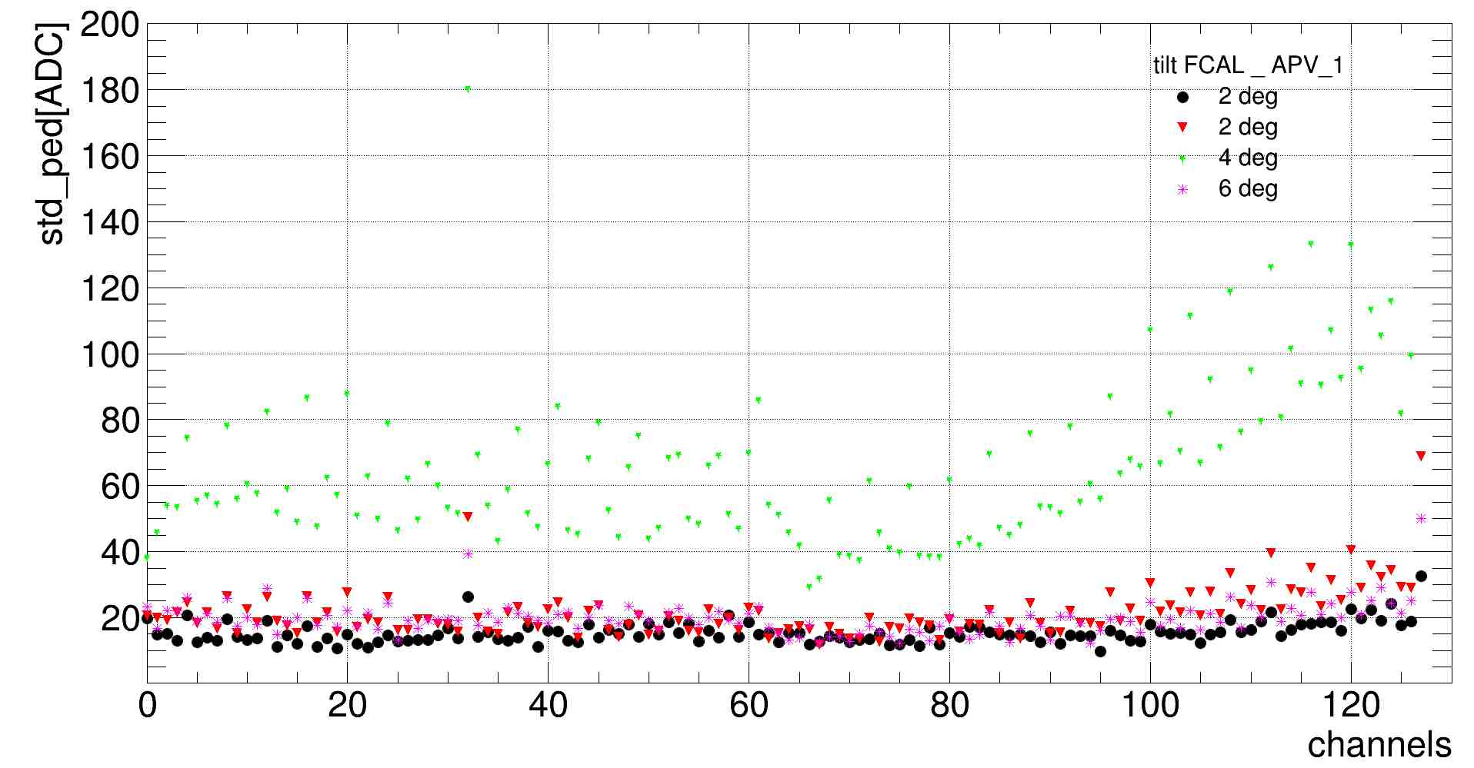
Noise distribution for all channels
Run no.:
87, 88, 94, 103 – FCAL tilted

Slide 9
Next steps
More runs will be check, like runs used for energy scan: 174, 188, 193, 198, 203
Runs took during the LUXE experiment like: 228, 234, 237, 238

