Slide 1


Preliminary MC results on the 2020 test beam
Alina Tania Neagu

Slide 2
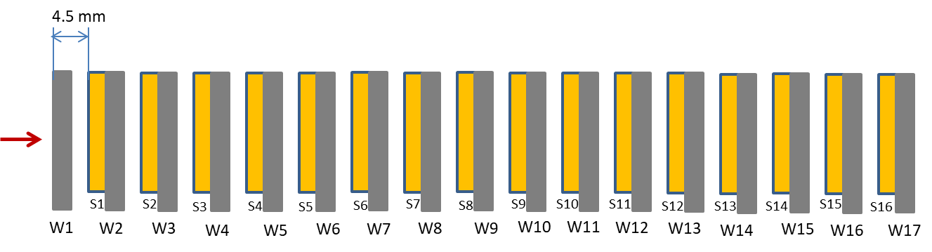
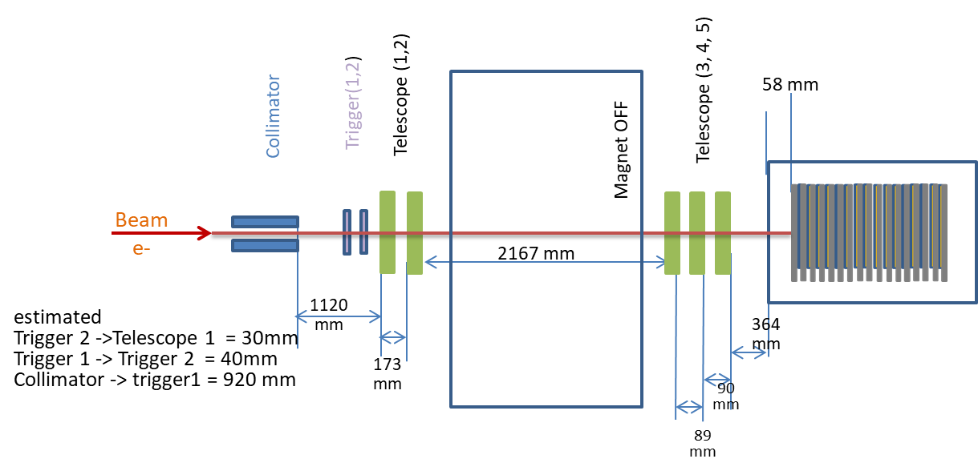
FCAL 2020 test-beam – set up
e- beam 5 mm x 5 mm

Slide 3
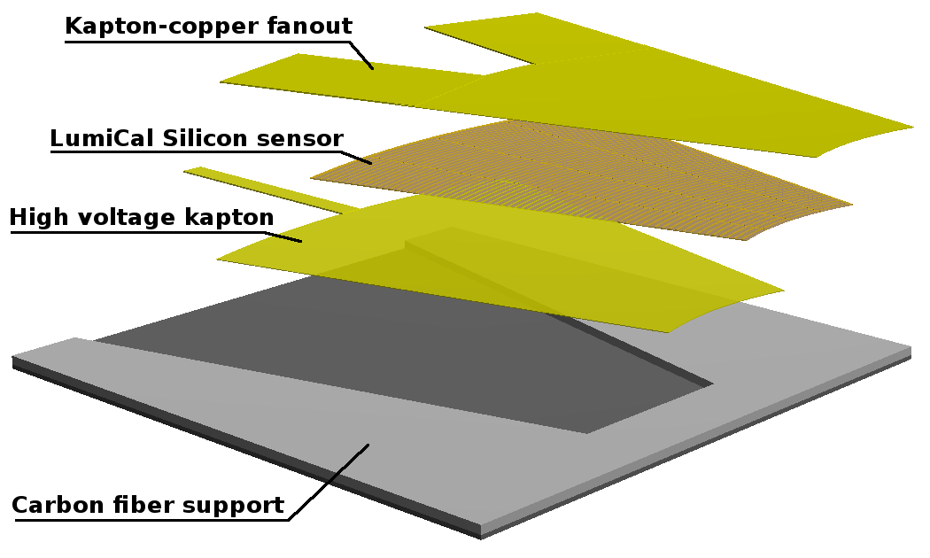
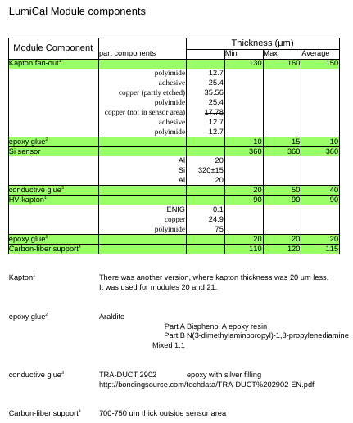
FCAL 2020 test-beam – set up
layer | sensor | plate | Thickness [mm]
1 | - | Plansse 2 | 3.520
2 | 52 | Plansse 3 | 3.470
3 | 51 | MGS3 | 3.542
4 | 29 | Plansse 1 | 3.505
5 | 59 | Plansse 5 | 3.490
6 | 10 | MGS1 | 3.584
7 | 57 | MGS2 | 3.521
8 | Free | MGS5 | 3.645
9 | 53 | MGS6 | 3.470
10 | 60 | A2 | 3.55
11 | 64 | A8 | 3.588
12 | 42S | B24 | 3.543
13 | Old T2 | B23 | 3.543
14 | Old C3 | B12 | 3.55
15 | 61 | B17 | 3.55
16 | Old C4 | A5 | 3.538
17 | 58 | Plansse 4 | 3.474
Brand | Density | Chemical composition
 |  | W | Ni | Cu
Plansee | 18 | 95% | 3.5% (estimated) | 1.5% (estimated)
MGS | 17.7 | 93% | 5.25% | 1.75%
JINR | 18 | 95% | 3.5% (estimated) | 1.5% (estimated)

Slide 4
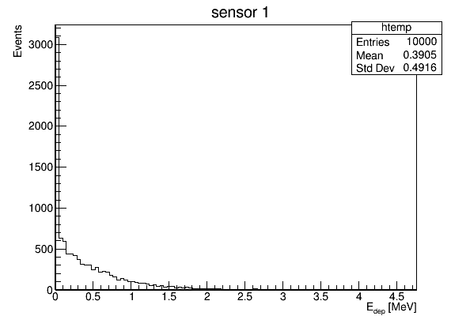
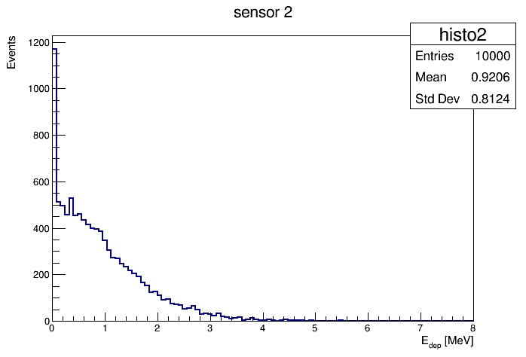
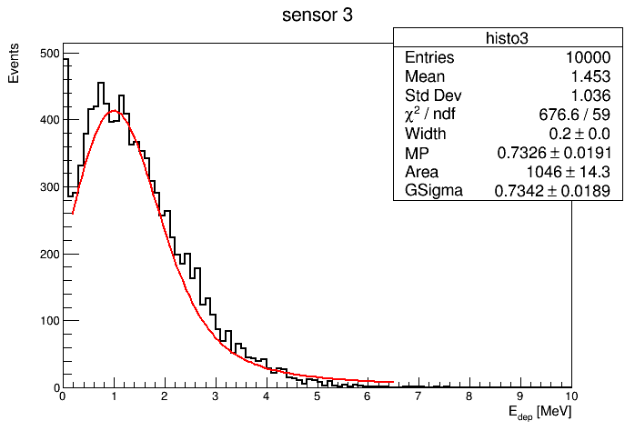
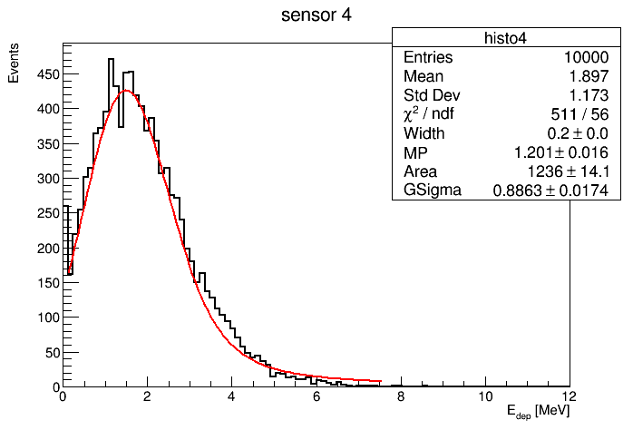
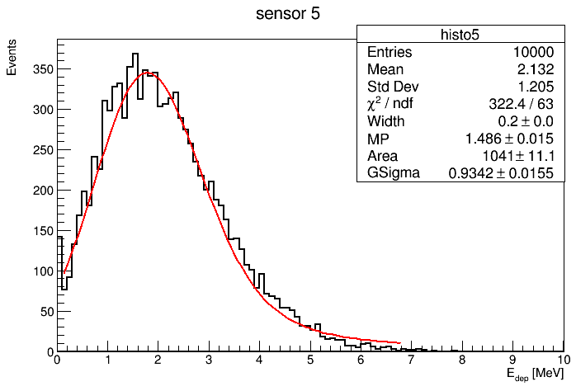
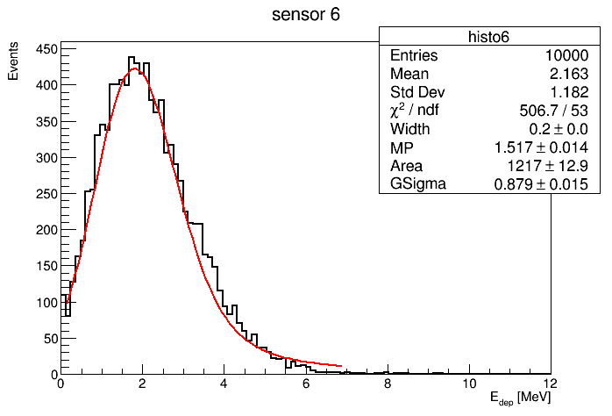
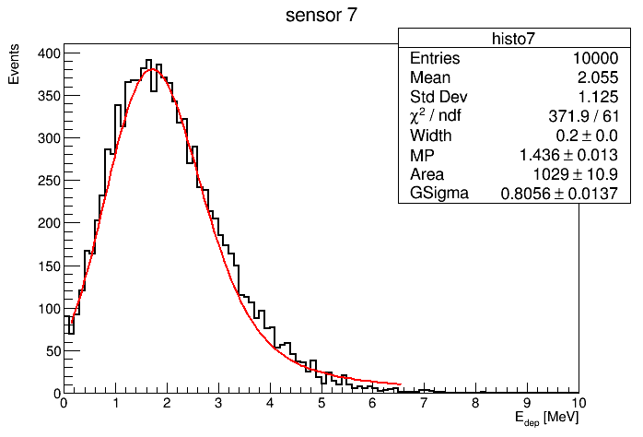
energy deposited in sensors
Geant 4 simulation conditions
Beam:
energy 5 GeV
Shape: uniform distributed inside a square: of 5 x 5mm^2
Position :
y axis in the middle of sensor
X between sector R1 and R2
without noise
- Landau Gauss convolution fit

Slide 5
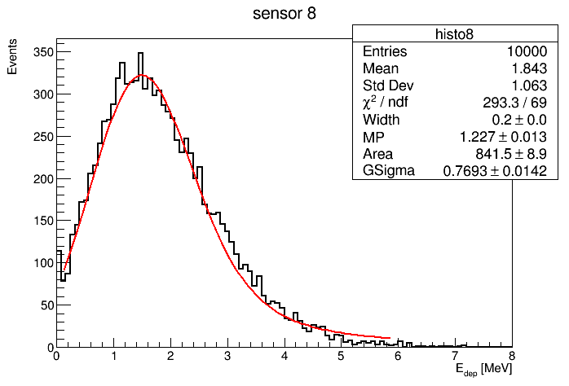
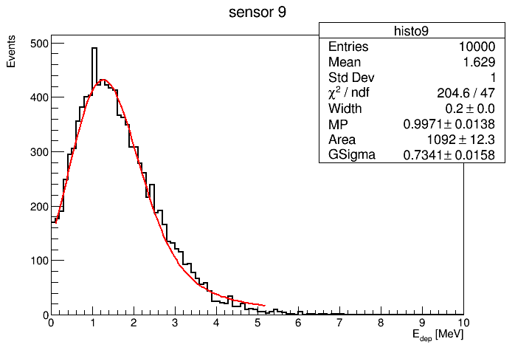
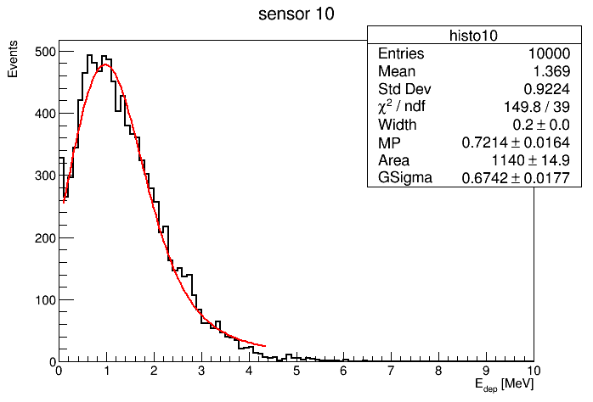
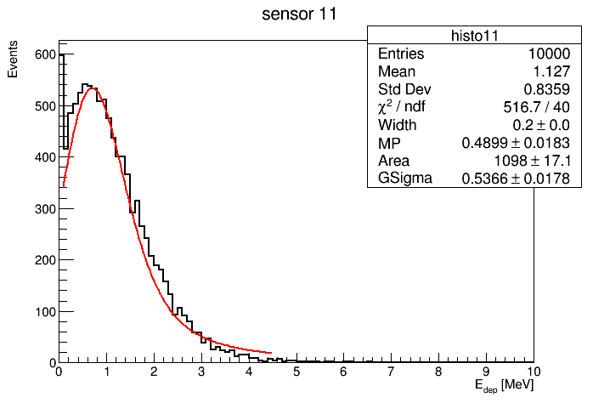
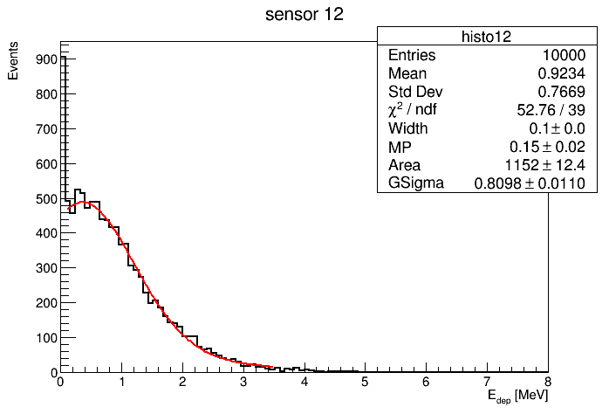
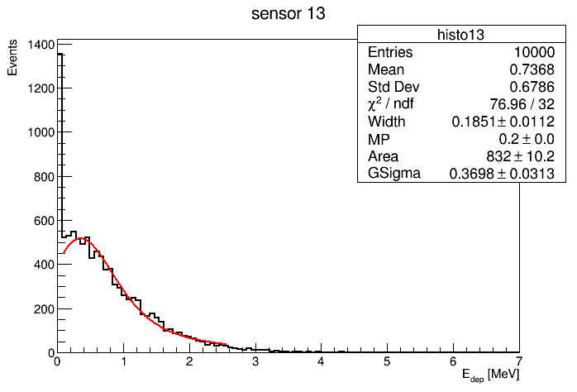
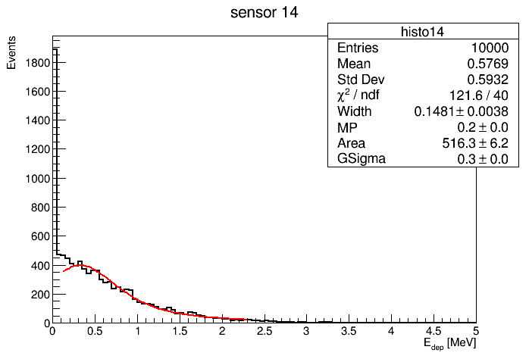
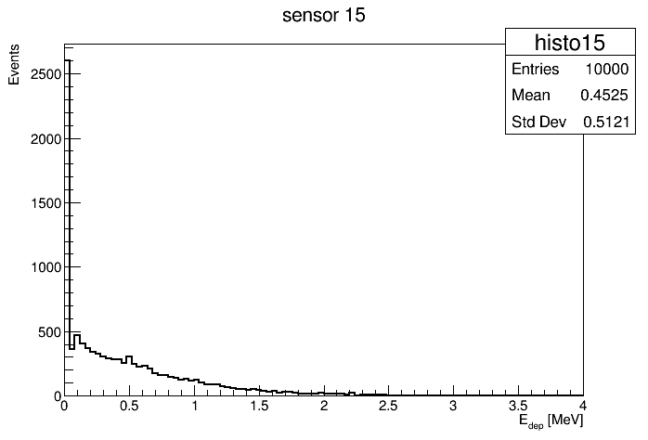
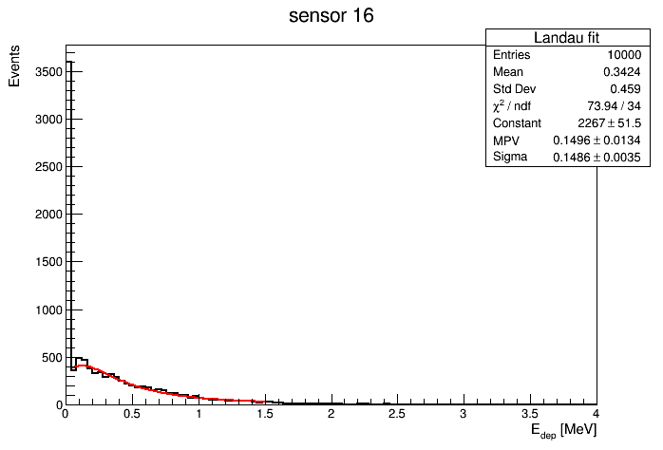
energy deposited on silicon sensors

Slide 6
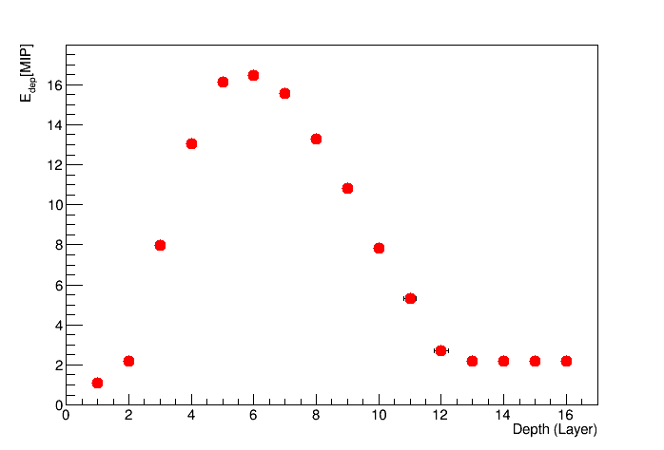
Longitudinal shower development
e- 5 GeV

Slide 7
Work in progress
Investigate why strange behavior of convoluted function fit
spectra from different energies: 1, 2, 3 and 4 GeV;
energy deposited for each pad;

