Slide 1
BDS Design Issues with
Short-Bunch LC Configurations
Glen White, SLAC

Slide 2
Overview
Recent interest in collider options with short-bunch configurations -> long-term vision of ILC…
  Conventional and advanced (e.g. PWFA) acceleration technology
  arXiv:2010.00680 (3 TeV γγ collider with σ_{z}=5μm)
  Snowmass LOI’s
    SNOWMASS21-EF0_EF0-CF7_CF0-TF6_TF0-AF6_AF0-CompF2_CompF0-037(2).pdf
    Particle Colliders with Ultra-Short Bunches LoI to Energy Frontier
    SNOWMASS21-AF1-008.pdf
    Beam Physics of Extreme Bunch Compression
    SNOWMASS21-EF1-AF1-015.pdf
    Short-Bunch Paradigm Laserless γγ Collider
    SNOWMASS21-CF1-001.pdf
    Probing QED Cascades and Pair Plasmas in Laboratory Experiments
    SNOWMASS21-TF1-001.pdf
    Understanding the Fully Non-Perturbative Strong-Field Regime of QED
Implications for BDS design to maintain beam quality and provide clean environment to detectors
  Large energy spread, CSR, space-charge, backgrounds
Recently proposed short-bunch collider parameters raise challenges for BDS design

Slide 3
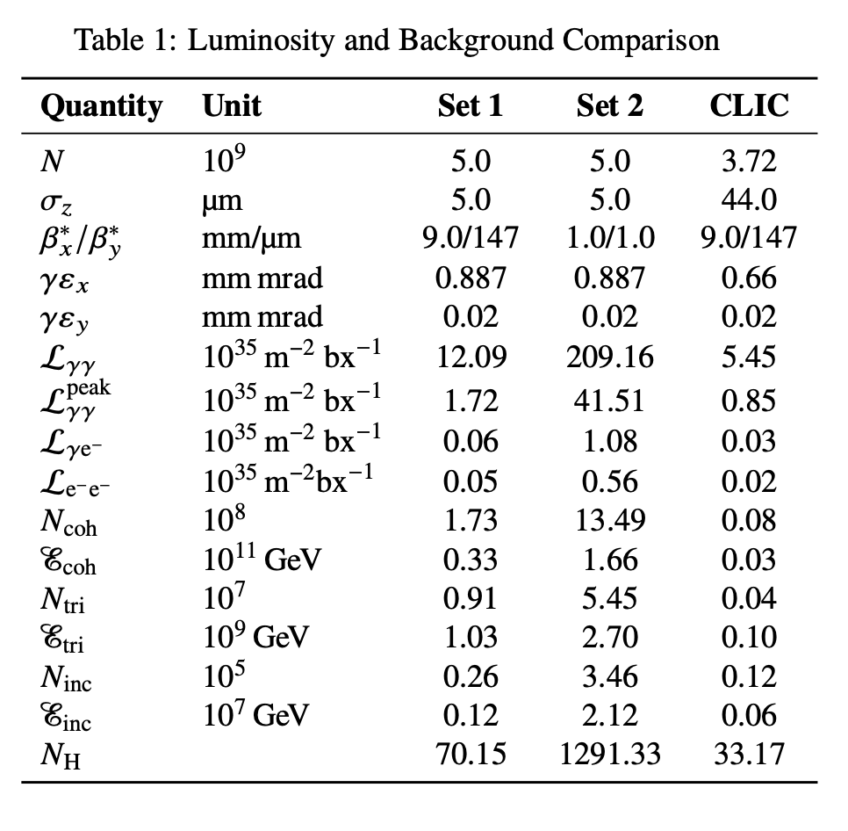
3 TeV PWFA LC γγ beam parameter study
arXiv:2010.00680: J.Chen, D.Schulte, E.Adli
19.1 kA
PWFA requires large energy spread ~>1%
  Increased chromaticity of FFS
  Complicated high-order aberration control & tight tolerances
γγ options, large (100%) energy distribution of beam post-collision
  MDI design for detector backgrounds
Coherent SR in BDS bends
  e.g. emittance degradataion at LCLS for I_{pk} ~> 1 kA

Slide 4
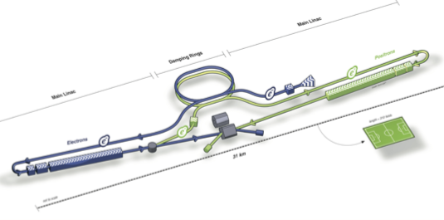
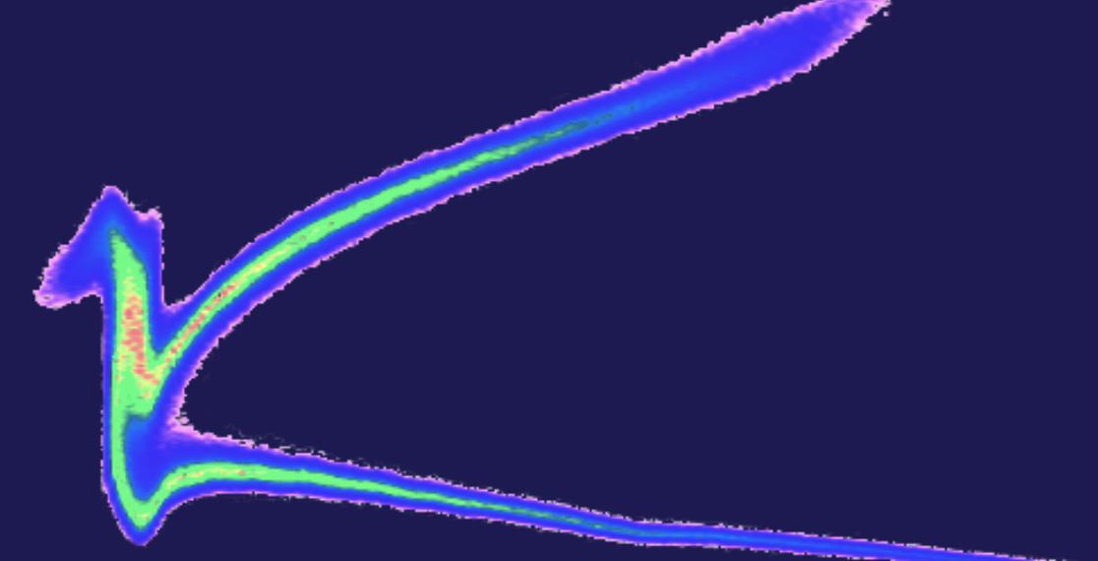
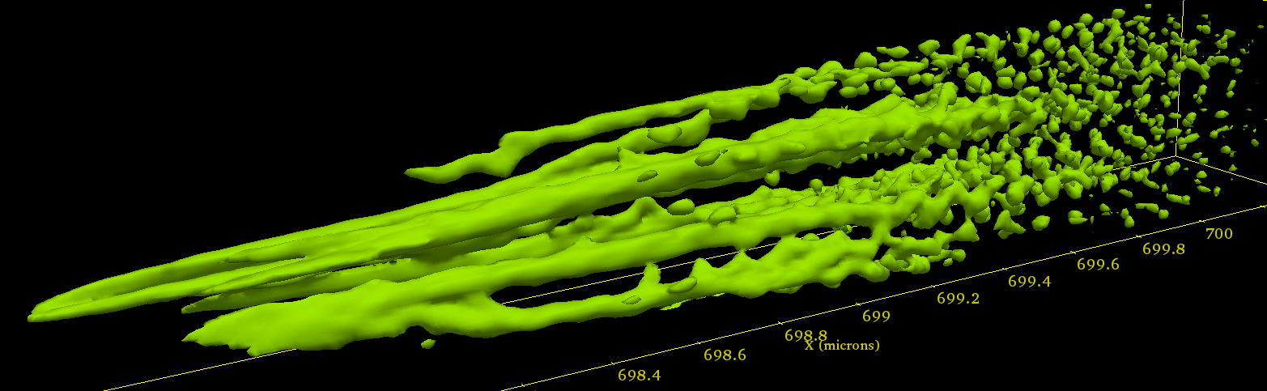
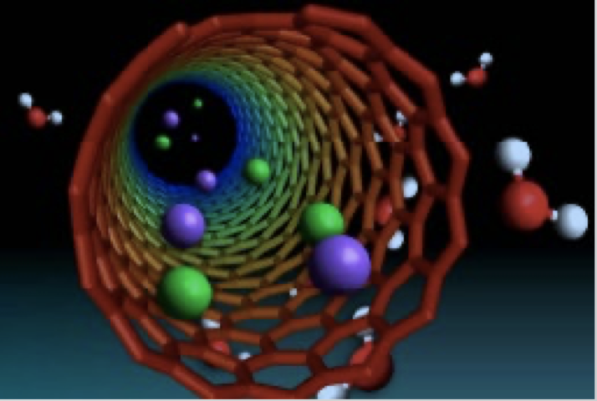





The primary goal of FACET-II is to develop new technologies for next-generation research facilities
Future HEP collider
Single spike FEL
High intensity γ rays
Counter-streaming beam and plasma electrons result in instability and form self-generated beam filaments and strong EM fields.
Convert joule-level electron-beam energy into gamma-rays via plasma instabilities
Alternative beamstrahlung mitigation strategy based on short, round beams:
100x reduction in beam power and thus costs
X-ray pulse has single spike when radiation emitted by the electrons in beam tail, travels to beam head in time shorter than few gain times
$$σ_{z}∼1μm@1TeV$$
$$σ_{z}∼0.1μm@10GeV$$
$$σ_{z}∼0.5μm@10GeV$$
R. Blankenbecler, S. Drell, PRD 36, 277 (1987)
R. Bonifacio et al. PRL 73, 70 (1994)
A. Benedetti et al. Nature Photon. 12, 319 (2018)
Fully non-perturbative QED regime
Beam Physics Advancement
TV/m in Crystals and Nanostructures
Disruptive progress in accelerator technology is required in order to advance high energy physics
Ultra-short, high-intensity beams promise to facilitate seminal research opportunities far beyond HEP
The benefit of these opportunities outweigh the greater uncertainties associated with handling beams with such extreme parameters
Beam-beam collisions of short bunches can create the largest EM fields in the universe
Access the regime where dynamical mass generation becomes dominant over the Higgs mechanism
Acceleration in plasmas created from crystals and nanostructures facilitate extreme gradients, continuous focusing – the properties needed for producing high-quality, high-energy beams
$$σ_{z}∼0.1μm@100GeV$$
$$σ_{z}∼0.3μm@10GeV$$
  V. Yakimenko, et.al. PRL 122, 190404 (2019)
  T. Tajima, et.al. PRL 59,1440 (1987)
Ultra-Short Bunches to Enable Qualitatively New Physics

Slide 5
FACET-II : 3-stage bunch compressor S10 – S20
6D Particle tracking to IP with 2D CSR
FACET-II will use LCLS-style photo-injector
  designed for @ 2nC with ε_{x,y} < 3 μm-rad
Three-stage compression with reverse-sign chirp in BC20
Existing “W-chicane” compressor limited to I_{pk} ~ 70 kA,
with Δε_{x} = 40 μm-rad due to CSR effects
FACET-II can operate with significantly higher compression than FACET-I
In this mode, significant emittance degradation due to CSR is expected

Slide 6
New BC20 configuration
6D Particle tracking to IP with 2D CSR
δ_{E}/E = 0.4%
δ_{E}/E = 0.9%
Proposed upgrade : “double-dogleg” style BC20 compressor
Reduced integrated bending & optimized optics mitigates CSR degradation
  I_{pk} ~200 kA with Δε_{x} = 23 μm-rad (low espread)
  I_{pk} ~300 kA with Δε_{x} = 40 μm-rad (high espread)
Proposed upgrades to BC20 partially mitigates CSR emittance growth and generates high peak current electron beams

Slide 7
Benchmarking simulation tools against FACET-II experiments important
Updated 2D CSR Model implemented in Lucretia
  Y. Cai, Phys. Rev. Accel. Beams 23, 014402
Discrepancy with 1d model seen for I_{pk} > 10 kA
Important to benchmark in experiment @ FACET-II
ML surrogate-modeling opportunity for improved simulation speed
  addressed in recent grant approval, work ongoing
Adjust Bunch Length with Laser Heater (Upgrade)
Going beyond 1-d CSR models important when compressing beyond 10 kA
R&D on efficient 2D CSR code implementations in tracking models ongoing

Slide 8
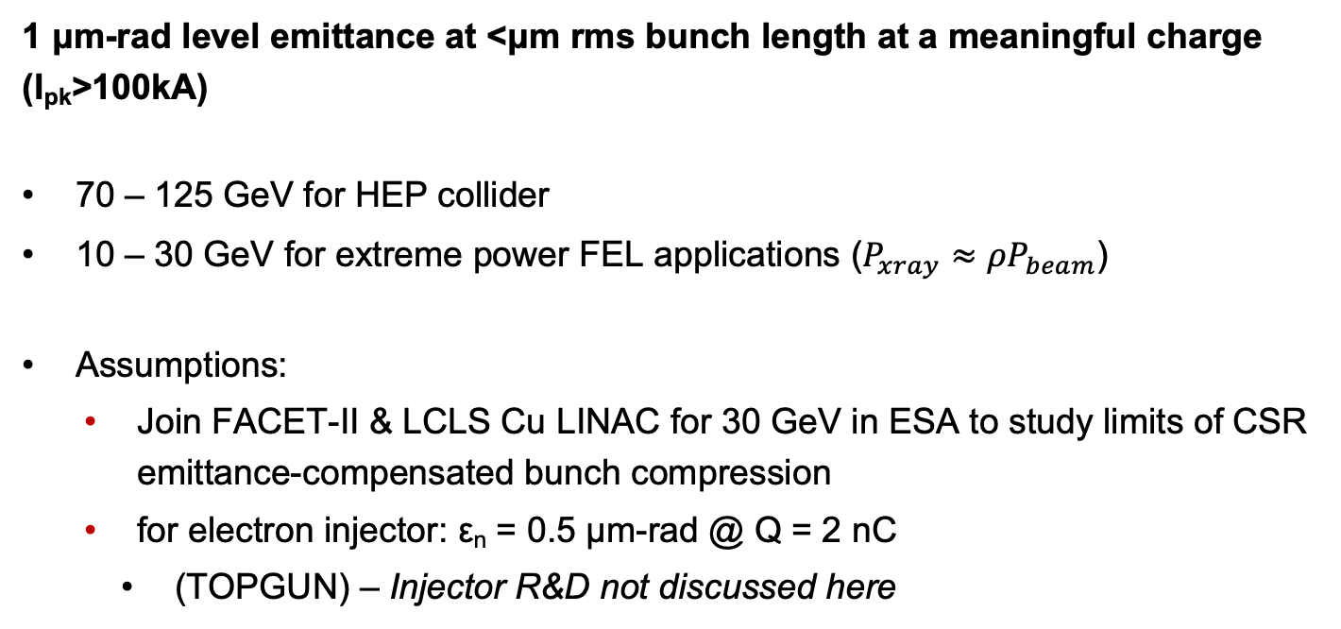
Definition of design targets for emittance compensated CSR bunch compressor: FACET-III in ESA @ 30 GeV
1 μm-rad level emittance at <μm rms bunch length at a meaningful charge (I_{pk}>100kA)
70 – 125 GeV for HEP collider
10 – 30 GeV for extreme power FEL applications ($P_{xray}≈{ρP}_{beam}$)
Assumptions:
  Join FACET-II & LCLS Cu LINAC for 30 GeV in ESA to study limits of CSR emittance-compensated bunch compression
  for electron injector: ε_{n} = 0.5 μm-rad @ Q = 2 nC
    (TOPGUN) – Injector R&D not discussed here
Conduct feasibility study for CSR emittance-compensated bunch compressor

Slide 9
Emittance degradation by CSR
δP_{z,CSR} momentum kicks as CSR “Wake” catches up to beam in bends
  Correlated with longitudinal position along bunch
Projected emittance degraded due to misalignment of longitudinal slices along z axis in bending plane
  Can be analytically estimated for Gaussian profiles
Slice emittance also affected by CSR if sufficient mixing in z
  “phase mixing” ⇒ incoherent “sum” of C-S invariants.
  Particle tracking simulation required
At FACET-II
  Δε_{x} ~ 40 μm @ max compression
  Effect severe enough to also limit max compression for W-chicane optics: I_{pk} <70 kA for “W”, 300 kA for upgraded optics
Dipole
P P+δP
x
z
Interaction of Coherent SR wake with bunch through and beyond bend magnets leads to degradation of emittances

Slide 10
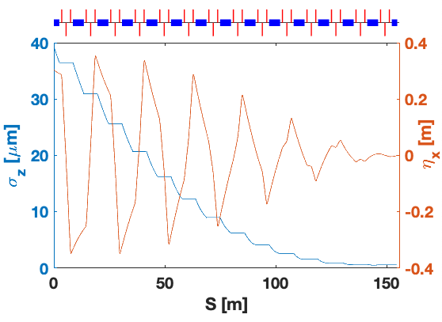
30 GeV wiggler compressor with distributed CSR compensation using linear-kick interpretation for CSR
L_{bend} = 2.5m, ρ = 667 m, B₀ = 0.15 T, δ_{E}/E=0.25%, R56= 18mm
14X dogleg cells, triplet focusing lattice
ISR emittance growth <10%
Sextuple correction fully compensates for CSR kicks using simplified linear-kick model
Notes:
\

Slide 11
Wiggler simulation: optical non-linearities + CSR
Does emittance compensation idea still work in fully 6D coupled case?
CSR compensation using sextupoles & quadrupole families
  Quads adjust dispersion between cells modified by CSR wakes & tailor compression profile for optimal CSR cancelation
ε_{n} = 0.5 μm-rad : σ_{x,y}* = 1 μm
  Pushed goal is to further increase focused bunch density
    Further challenges chromatic aberration control of magnetic optics
6D start-to-end tracking model built to test compressor design

Slide 12
Optimization of 3D bunch density @ 2 nC
No CSR
Sextupoles Optimized to cancel
T566 & T166
Add 1D CSR Simulation
CSR with Sext + Quad corrections
ε_{n,x} = 0.55 μm-rad
σ_{x,y,x} = 0.9 x 0.9 x 0.5 μm
I_{pk} = 431 kA
ε_{n,x} = 24.5 μm-rad
σ_{x,y,x} = 6.7 x 1.0 x 0.5 μm
I_{pk} = 394 kA
ε_{n,x} = 2.4 μm-rad
σ_{x,y,x} = 1.9 x 0.9 x 0.9 μm
I_{pk} = 258 kA
Results from 6D tracking simulation in Lucretia with 1D CSR model + corrections
Emittance = 0.5 -> 2.4 μm-rad with σ_{z} < 1 μm
Optimization with full 6D tracking look promising

Slide 13
Arc compressor option
Flexibility: relax compression (initial chirp):
  No re-optimization performed
  ε_{x,n} < 1μm-rad @ I_{pk} > 100 kA (Q=2nC)
  dE/E ~ 0.4% without removing chirp
Triplet bending lattice (9 cells)
  θ_{total} = 67 mrad @ 30 GeV
Second-order achromatic (without CSR)
Similar CSR-canceling performance as wiggler so far:
  ε = 2.5 μm-rad @ σ_{z} = 1 μm, Q=2 nC (I_{pk} = 250 kA)
Relaxed chirp: <μm slice emittance @ I_{pk}>100 kA
Design with net-bending (as part of ESA bend system) with similar performance

Slide 14
Status summary & compressor design next steps
FACET-II expectations (E=10 GeV, L ~50m):
  Existing W-chicane
    I_{pk} < 100 kA, Δε_{n,x} ~ 40 μm-rad
  Upgraded “double-dogleg” chicane (CSR minimized, not compensated)
    I_{pk} 200 - 300 kA, Δε_{n,x} ~ 20 - 40 μm-rad
FACET-III expectations (E=30 GeV, L ~150m):
  Multi-cell wiggler or bending triplet lattice compressor (CSR compensated)
  I_{pk} ~ 250 kA with Δε_{n,x} < 2 μm-rad, or
  I_{pk} ~ 100 kA with Δε_{n,x} < 0.5 μm-rad
FACET-II(a) (E=10 GeV, L ~50m, 40-60 magnets) ? :
  Experimentally verify CSR compensation in multi-cell wiggler or bending triplet lattice compressor
Experimental confirmation of CSR models required to improve confidence in CSR compensation design

Slide 15
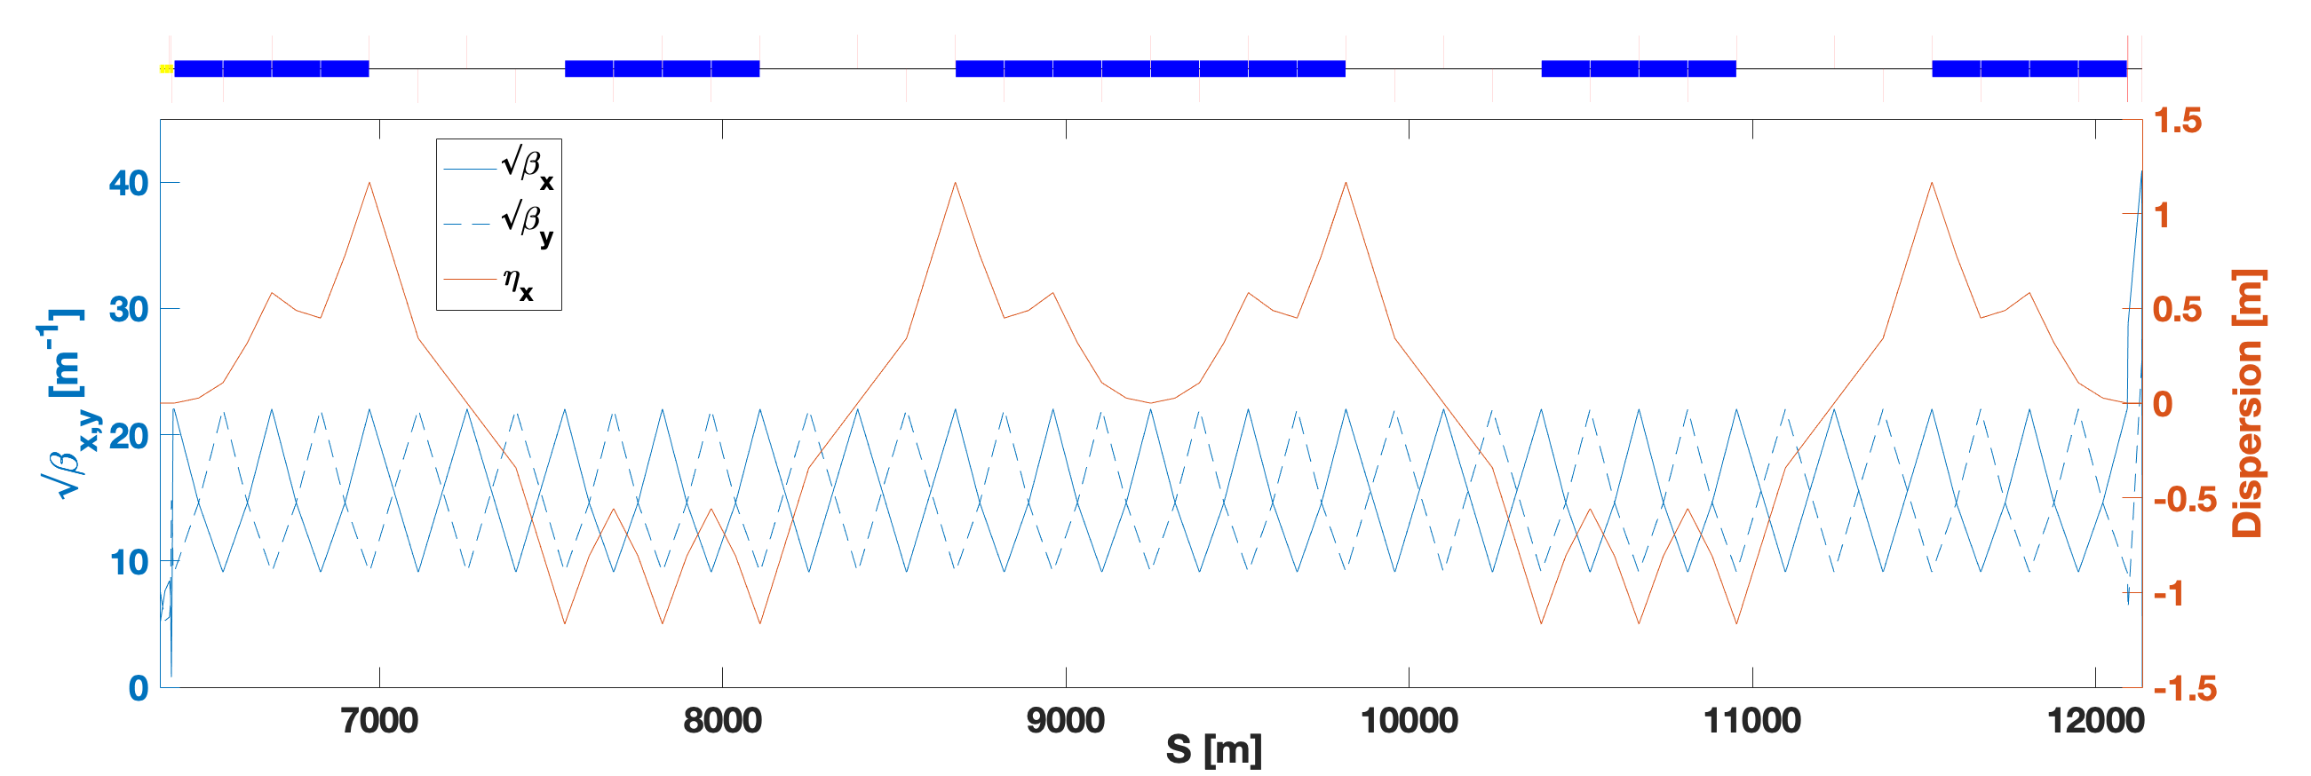
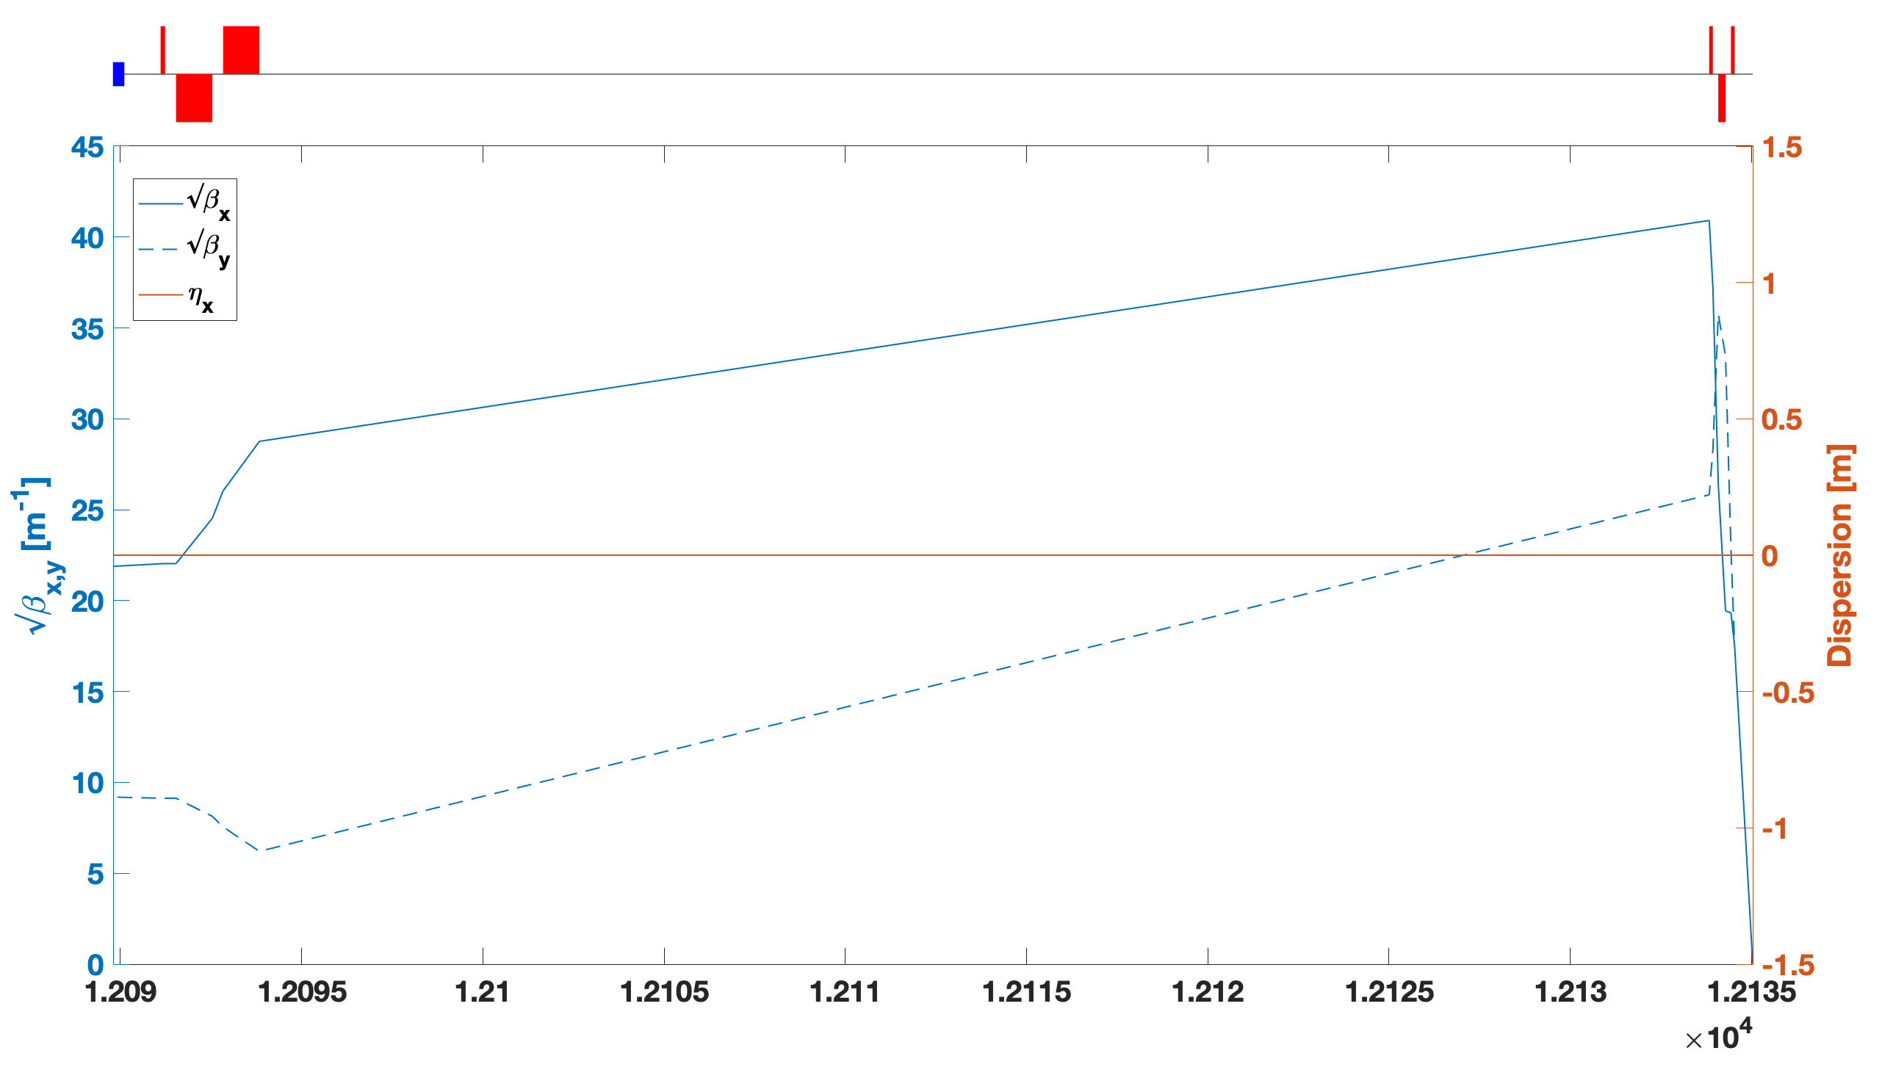
FBCFS – 6 km Compressor
Final Bunch Compressor and Focus System
BC : R56 = 30mm
  10 x 90⁰ FODO cells x 2
  2nd order achromatic
  large T566 & U5666
    16 sextupoles & octupoles
FFS: doublet + triplet (β* = 0.8 mm)
  V. compact: L*=0.5m, L_{B}=10cm

Slide 16

BC FODO Cell & CSR Shielding Possibility
μ = π/2, N_{c}=10, N_{BC}=2
L_{bend} = 140m
θ_{bend} = 3 mrad
ρ = 46.2 km
B₀ = 9 mT
Large bend radius provides possibility to shield CSR radiation
Transverse formation size: ~
  Shielding plates from
  3.5 cm -> 0.8 mm required (tapered along BC for
  σ_{z} = 30 -> 0.1 μm)
$$l_{⊥}={\left(ρσ_{z}^{2}\right)}^{1/3}$$

Slide 17
Next steps: Collective effects modeling R&D
1D CSR model implemented within Lucretia tracking code
(similar to Elegant simulation)
  Extending to deal with changing geometries & shielding (a la BMAD)
2D/3D CSR solutions being studied, benchmark at FACET-II & apply to these designs
  e.g. currently deployed 2D model omits transient effects: developing theory to address this
    expected to be small perturbations in results
Improve tracking speed to allow more sophisticated optimization algorithms
  GPU algorithm implemented
  R&D ongoing in conjunction with ML group on surrogate modeling
Compression work (longitudinal space charge) effects expected to be important
  adding to tracking simulations.
CSR modeling based on existing 1D models
R&D ongoing to improve 2/3D, optimize execution speed & benchmark

Slide 18
Next steps: Employ Machine Learning to speed up simulations
Machine Leaning based surrogate modeling (SM) is becoming a common tool in the accelerator community to speed up tracking operations with time-intensive collective physics effects
Application of ML tools are well suited for CSR tracking
simulations
  CSR generates highly non-linear correlations in
  longitudinal and bend-plane dimensions
  SM can be trained to replicate these correlations
  SM is faster than physics simulation & parallelizable
Further development needed
  Understand which & how many beam parameters
  are required for accurate bunch compressor design
  & optimization
  Close collaboration with AD/ML group to explore alternative ML algorithms
Particle tracking through bend
physics-based model vs. SM
Initial feasibility tests for fast, neural network-based surrogate modeling of CSR
has demonstrated > 2 x N x (CPU/GPU) cores speedup

Slide 19
Backup Slides

Slide 20
Survey Coordinates of FBCFS

Slide 21
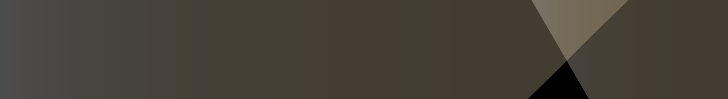
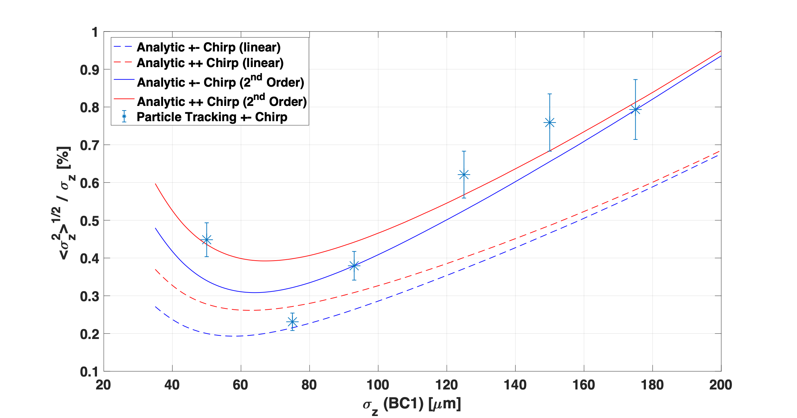
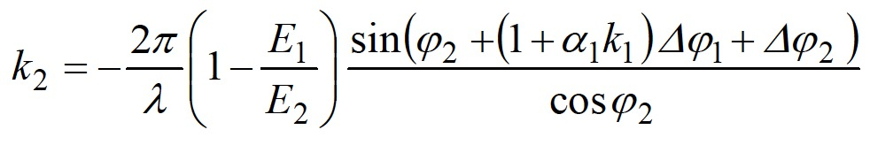




RF Phase Jitter
$$C_{2}=\frac{E_{2}}{C_{1}^{2}E_{1}}$$
Linear Contribution from 2-stage rf compression (LCLS CDR Ch.7):
2nd order from non-linear rf & T566 (Acc. Handbook 4.5):
$$σ_{z_{f}}^{2}=\frac{E_{i}^{2}}{E_{f}^{2}}R_{56}^{2}σ_{i}^{2}+(1+hR_{56})^{2}σ_{z_{i}}^{2}+R_{56}^{2}(h_{2}+rh^{2})^{2}ζ$$
$$r=T_{566}/R_{56}$$
$$h_{2}=−\frac{2π^{2}eV_{0}}{λ^{2}E_{f}}cosφ_{rf}$$
For Gaussian:
$$ζ=2σ^{4}$$
Monte Carlo Simulation
Fix final bunch length at 29μm
Vary C1/C2 ratio by adjusting φ^{L1} & φ^{L2}
Optimum at BC1 σz~75μm
  Δσz/σz ~ 0.2% (Δz/σz ~ 1.7%)
Apply random jitter to each cavity
  Δφ +/- 0.1º
Track 10⁵ MP * 100 random seeds
rms Bunch length jitter: Δσz
rms Bunch arrival jitter: Δz

Slide 22
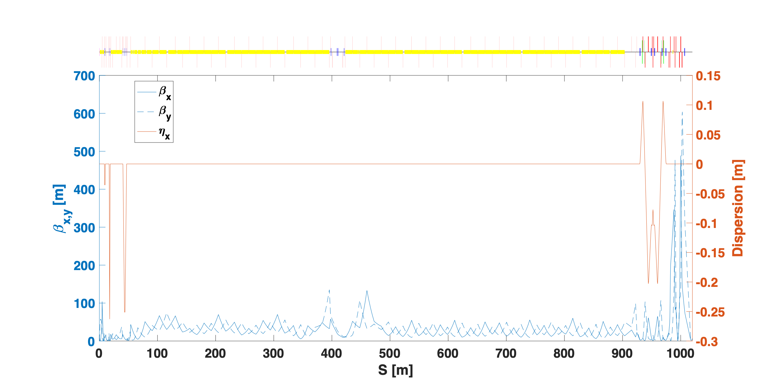

FACET-II 2-Stage Compression Configuration
σz=300μm
σz=46μm
$$C_{2}=\frac{E_{2}}{C_{1}^{2}E_{1}}$$
: C1=6.5 C2=1.6
σz=28μm
Q=10pC
BC11 E=135 MeV
L2 - φ=54º
BC14 OFF
L3 - φ=54º
BC20 E=8.2 GeV
L1 - φ=-90º
R56 = 5mm
R56 = -46mm

Slide 23
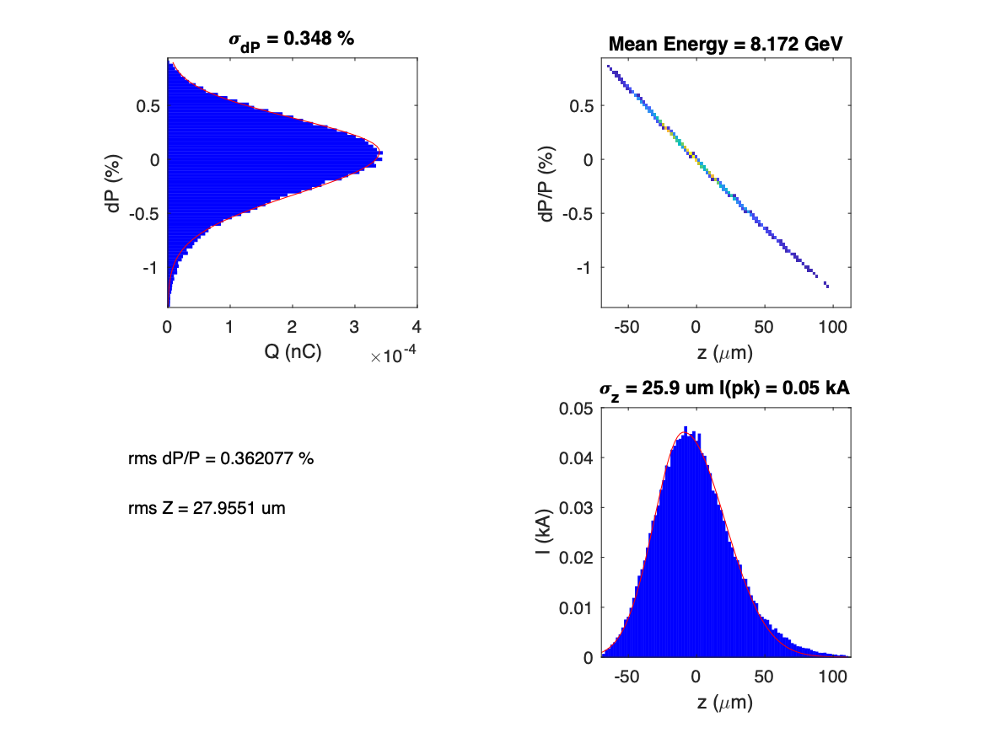
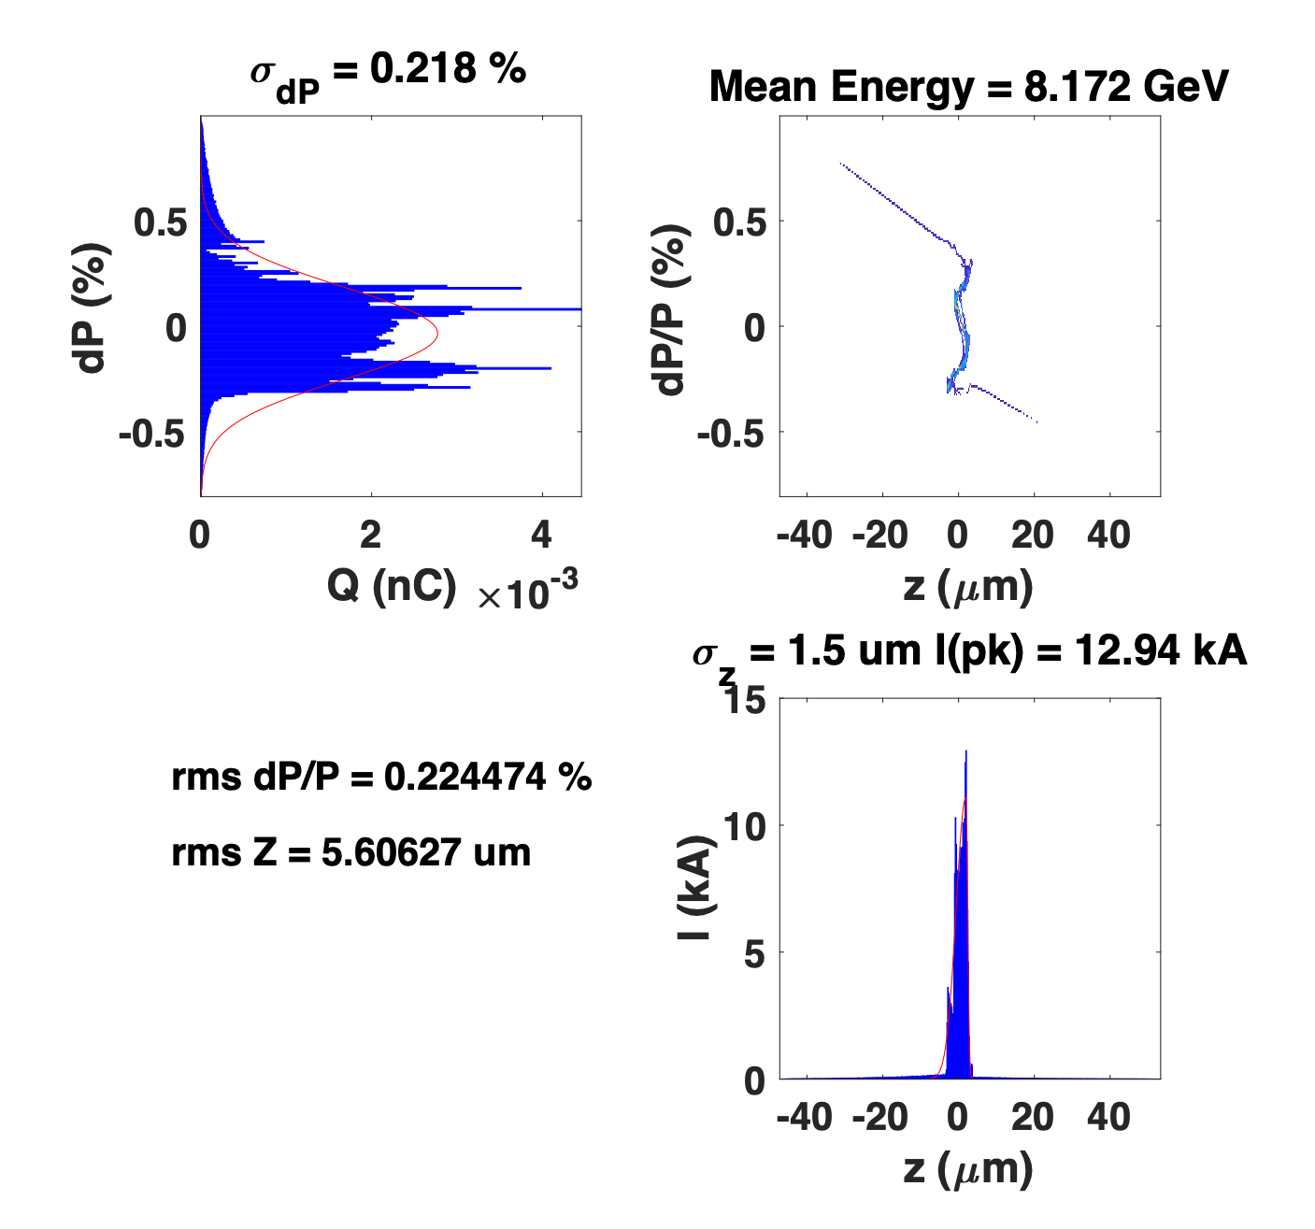
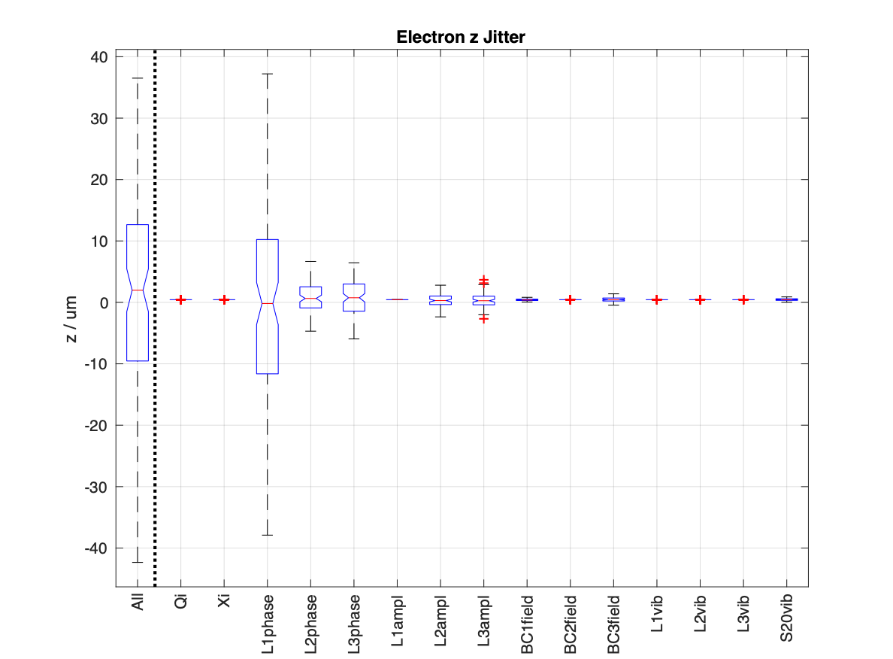
FACET-II Particle Tracking & Monte Carlo Simulation
Start-to-end Tracking + ISR, CSR, Wakes & LSC
Q=10pC
Q=150pC
γεx=0.3μm
γεx=2.6μm
100-seed MC Sim
RMS Jitter | Q=10pC | Q=150pC | Q=2nC (3-stage Compression)
Δσz/σz (%) | 2.9 | 3.3 | 48.4
Δz (μm) | 16.1 | 10.1 | 30.0

Slide 24
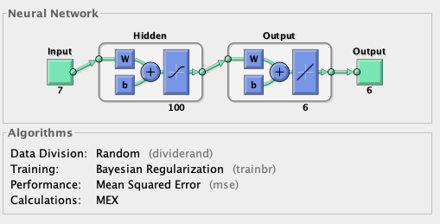
ML Surrogate Model Development
2-d CSR (or 1-d model with >>10k macro particles) model slow for use with optimization engine
ML surrogate model helps if general enough
First test: feed-forward NN model using
Matlab Deep Learning Toolbox to generate surrogate element model in Lucretia:
  Train on any element (or group of elements)
  Training parameters are input 6D coordinates & bulk properties of beam
  Example here trained on 20k data set
  with example bend+drift, 1-d CSR,
  consider 20% σ_{z} variability
Need to investigate how many bulk parameters can be included & input ranges
Liaising with ML group
Tracking time for 1M macro particles:
CPU = 5.8 s
ML = 2.4 s (per core), can be sped up many times via multi-core or GPU
Initial feasibility tests for fast, NN-based surrogate modeling of CSR look promising
Collaborate with ML group to develop further

Slide 25
Linear Collider Luminosity @ Low Power
Parameter | Symbol [Unit] | ILC (TDR) | Collider with short bunches
Center mass Energy | ECM [GeV] | 250 GeV
Beam Energy | E [GeV] | 125
Bunch Charge | Q [nC] | 3.2 | 1.4
Peak Current | Ipk [kA] | 0.4 | 1700
rms Bunch Length | σz [μm] | 300 | 0.1
rms Bunch Size | σ*x,y [μm] | 0.73, 0.008 | 0.01, 0.01
Pulse rate x # Bunches/pulse | frep [Hz] x Nbunch | 5 x 1312 | 700
Beamstrahlung Parameter | χ av , χ max | 0.06, 0.15 | 969, 1721
Beam Power | P [MW] | 2.6 | 0.12
Geometric Luminosity | L [cm⁻²s⁻¹] | 3E+33
HEP LC with round bunches: 20 times reduction of required beam power for equivalent geometric luminosity

Slide 26
BC + FFS Performance (CSR OFF)
Δγε_{x} = 30% from ISR
Sextupoles & octupoles tuned to reduce T566 & U5666 terms, cancel FF chromaticity @ resultant geometric & chromo-geometric errors introduced by correction
Momentum bandwidth ~0.1%
4th+ order vertical aberrations dominate after correction
  Need to investigate adding decupoles to mix of correction magnets
σ_{z} (min) ~ 100nm (limit from ISR energy spread)
σ_{x,y} (min) ~ 14 nm (core) (limit from residual aberrations)
Wakefields from shielding plates not simulated

Slide 27
Start-to-End Tracking
All physics effects enabled – 1d CSR model
18 x 15 x 108 nm @ Q=10pC
Higher charges degrade longitudinal emittance due to Linac wake fields & CSR in BC1 & BC2

Slide 28
Effect of Linac Wakes and CSR (1-d unshielded CSR model)
In each case, adjust L1 and L2 phases to maintain σ_{z}= 30 μm @ BC1 and minimize bunch length at IP
Longitudinal emittance grows vs. Q initially due to non-linear wake shape in L2, then additionally due to CSR in BC1
  Limits final bunch length for Q > 0.05 nC
CSR Horizontal emittance growth in BC1 > 0.1 nC and in BC2 >0.01 nC
  Emittance growth in BC2 exacerbated by non-linear magnets, without sextupoles and octupoles & for mono-energetic beam: Δε_{x} ~ 10 μm-rad

Slide 29
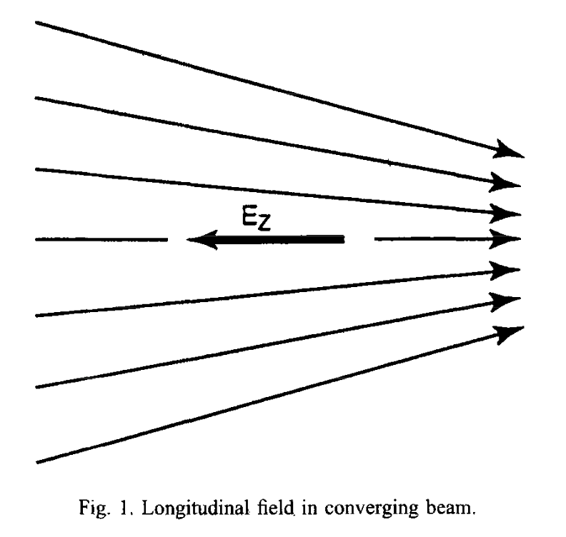
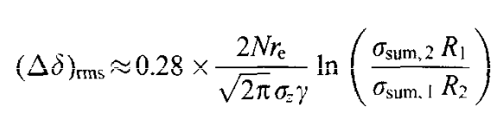
FFS Longitudinal Space-Charge
FFS longitudinal space-charge in converging beam (Tor, Frank NLC paper)
NIM 390 (3), 11 May 1997, Pages 279-285 https://doi.org/10.1016/S0168-9002(97)00406-3
LC FFS sensitive to ppm energy deviations due to high chromaticity
Longitudinal space force due to converging beam (not 1/γ² dependent)
From energy conservation: p.e. of bunch increases as focus -> comes from k.e. of beam and induces additional energy
spread not compensated by sextupoles
NLC: OK for N<10¹¹
  Scales as N/σ_{z}
  Small-z collider 1000X shorter bunches
  Imposes N or focusing limit?
MC simulation required to check

Slide 30
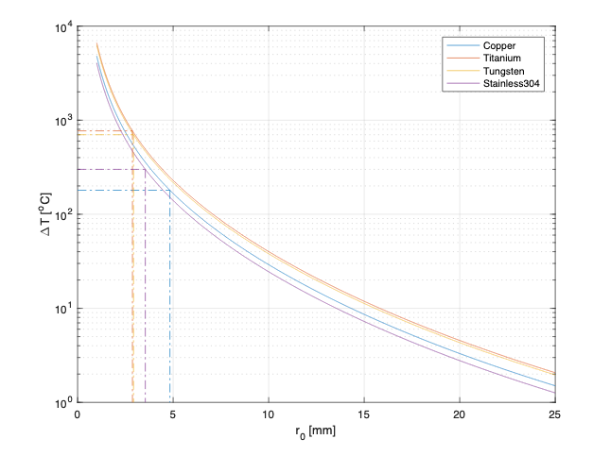


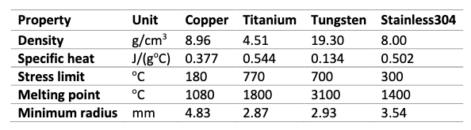
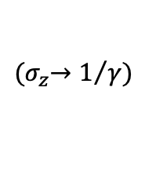
Material Effects Considerations: Image Current Heating
For FACET-II at max compression: Single bunch T>melting for single pulse for apertures R<2-3 mm
For short-bunch collider, R exceeds desirable magnet apertures
Effects?
  Ablate um-thickness of metal from vacuum chamber surface each bunch?
Mitigation?
  Non-conductive vacuum chambers
  “Consumable” vacuum chambers
$${(σ}_{z}→1/γ)$$
FACET-II Sector 20 @ E=10 GeV

