Slide 1
PIP-II SRF Cryomodules
Genfa Wu
Americas Workshop on Linear Colliders 2020
October 20, 2020

Slide 2
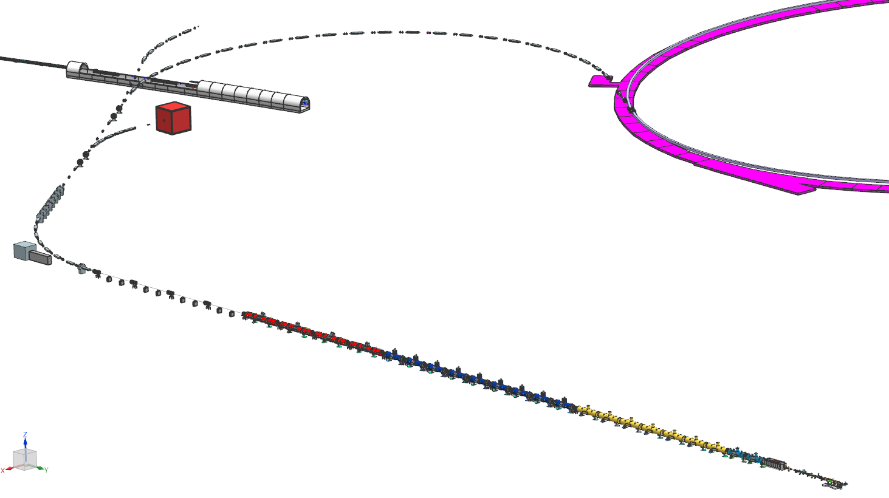
Outline
Introduction
Design Overview
Recent progress
Summary

Slide 3
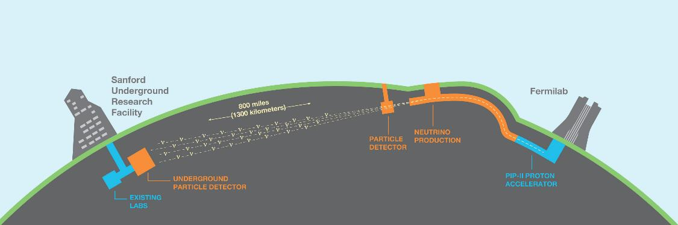




Currently: 1,214 collaborators from 202 institutions in 33 countries (including CERN)
  Origin of matter. Investigate leptonic CP violation. Are neutrinos the reason the universe is made of matter?
  Neutron star and black hole formation. Ability to observe neutrinos from supernovae events and perhaps watch formation of black holes in real time.
  Unification of forces. Investigate nucleon decay.

Slide 4
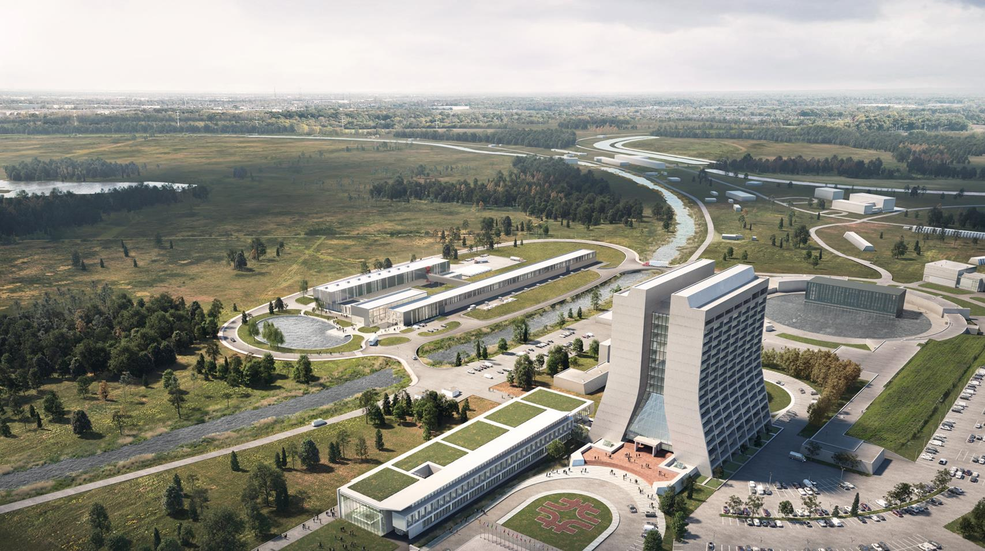







Proton Improvement Plan – II
(PIP-II)
Main Injector
Transfer Line
PIP-II
SRF Linac
Booster
Slide by L. Merminga

Slide 5

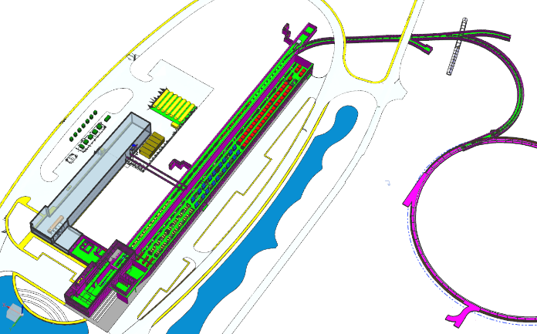
PIP-II Mission
PIP-II will enable the world’s most intense beam of neutrinos to the international LBNF/DUNE project, and a broad physics research program, powering new discoveries for decades to come.
PIP-II Linac capabilities
Beam Power
1.2 MW proton beam
Upgradeable to multi-MW
Flexibility and multi-user capability
Compatible w/ CW-operations
Customized beams
Multi-user delivery
Reliability
PIP-II Scope
800 MeV H− linac
  Warm Front End & SRF section
Linac-to-Booster transfer line
  3-way beam split
Upgraded Booster
  20 Hz, 800 MeV injection
  New injection area
Upgraded Recycler, Main Injector
  RF in both rings
Conventional facilities, incl.
  Site preparation
  Cryoplant Building
  Linac Complex
  Booster Connection
The PIP-II scope enables the accelerator complex to reach 1.2 MW proton beam on LBNF target.
Slide by L. Merminga

Slide 6
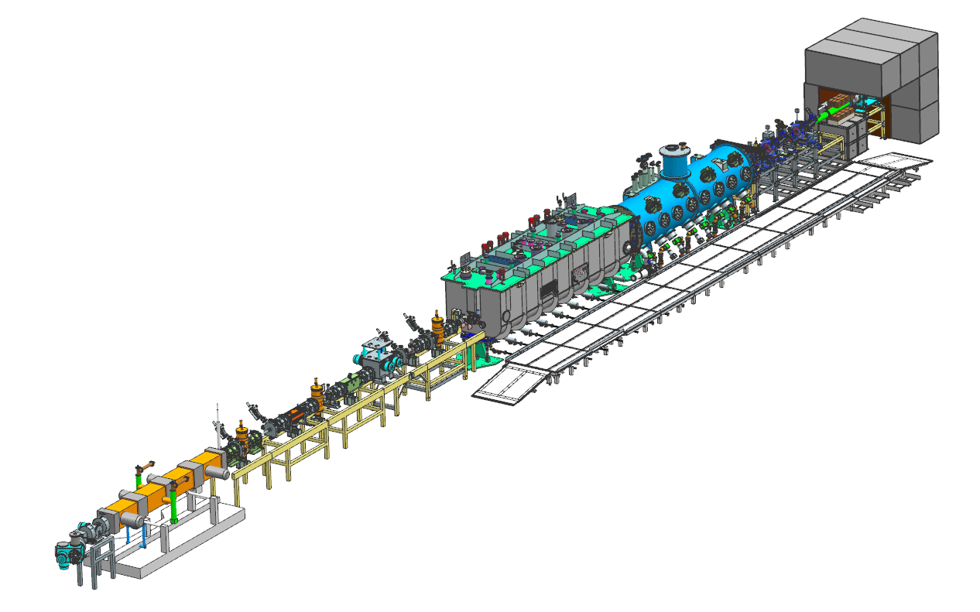
PIP-II Front-End and Injector Test Facility

Slide 7
Outline
Introduction
Design Overview
Recent progress
Summary

Slide 8



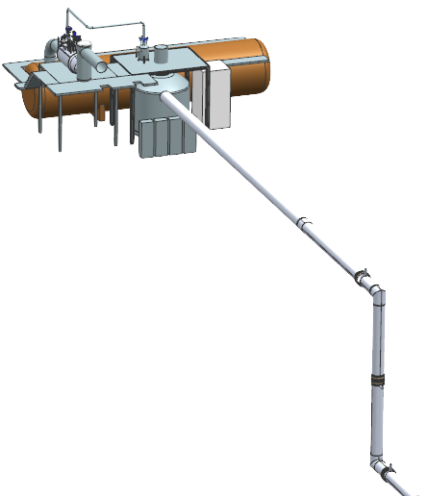





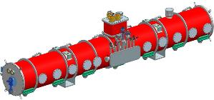
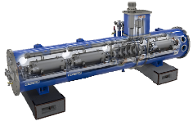

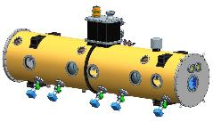
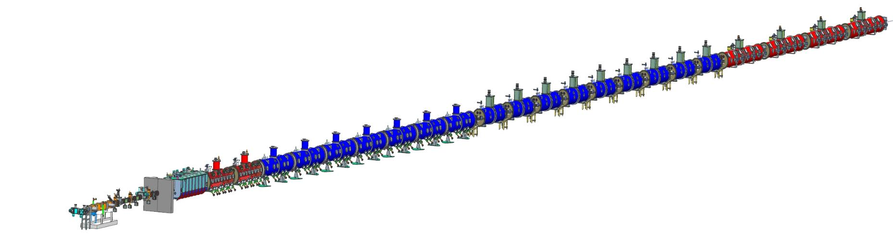
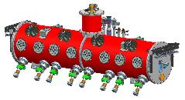

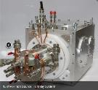
PIP-II Linac
Elliptical
HB650 X 4
24 Cavities
650 MHz
Cryoplant
Elliptical
LB650 X 9
36 Cavities
650 MHz
Single Spoke
SSR2 X 7
35 Cavities
325 MHz
Single Spoke
SSR1 X 2
16 Cavities
325 MHz
HWR
8 Cavities
162.5 MHz
CDS
833 MeV
H- Ion source
516 MeV
177 MeV
Superconducting
RFQ
PIP-II Linac is technically complex, state of the art superconducting RF accelerator
32 MeV
10 MeV
2.1 MeV
PIP-II is the World’s highest energy and power CW proton linac, and the first U.S. accelerator project to be built with major international contributions
Room Temperature

Slide 9
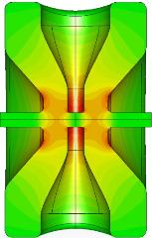
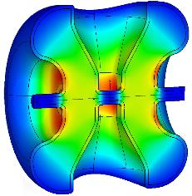
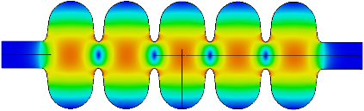

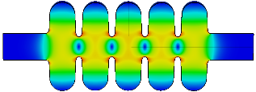

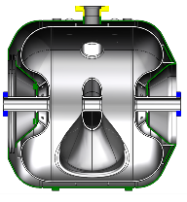
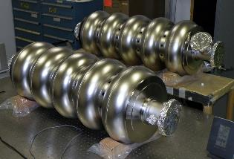
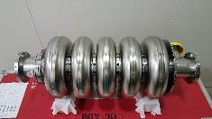
PIP-II Cavities
Cavity | β | Frequency [MHz] | Aperture [mm] | Effective Length [cm] | Accelerating Gradient* [MV/m] | E_{peak} [MV/m] | B_{peak} [mT] | R/Q [Ω] | G [Ω]
HWR | 0.11 | 162.5 | 33 | 20.7 | 9.7 | 44.9 | 48.3 | 272 | 48
SSR1 | 0.22 | 325 | 30 | 20.5 | 10.0 | 38.4 | 58.1 | 242 | 84
SSR2 | 0.47 | 325 | 40 | 43.6 | 11.5 | 40.3 | 77.4 | 305 | 115
LB650 | 0.61 | 650 | 88 | 70.4 | 16.8 | 40.2 | 75.0 | 340 | 193
HB650 | 0.92 | 650 | 118 | 106.1 | 18.7 | 38.8 | 72.8 | 610 | 260
*Highest gradient in a cryomodule

Slide 10




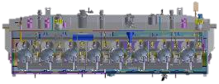
PIP-II SRF Cryomodules
HWR
SSR1
SSR2
LB650
HB650
Cryomodule | CM # | Cavity # | String Assy. | CM Length [m] | Q₀ @ 2K | R_{s} [Ω] | Q_{L} [x10⁶]
HWR | 1 | 8 | 8 x (SC) | 5.93 | 8.5E9 | 5.6 | 2.3
SSR1 | 2 | 8 | 4 x (CSC) | 5.3 | 8.2E9 | 10.2 | 3.0
SSR2 | 7 | 5 | SCCSCCSC | 6.5 | 8.2E9 | 14.0 | 5.1
LB650 | 9 | 4 | CCCC | 5.52 | 2.4E10 | 8.0 | 10.4
HB650 | 4 | 6 | CCCCCC | 9.92 | 3.3E10 | 7.9 | 9.9
C = Cavity, S = Solenoid
23 Cryomodules + 4 Prototypes, 14 Cryomodules will be transported between Europe and US
Total Linac 2K nominal heat load is 1.7 kW

Slide 11
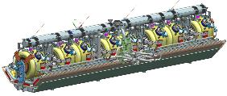
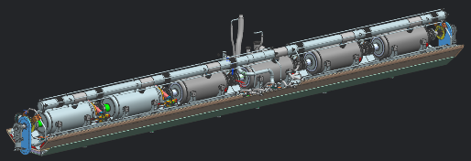
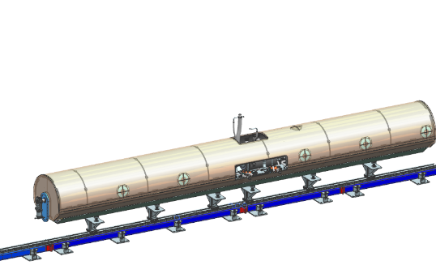
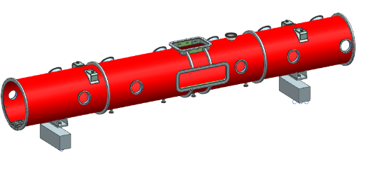
Cryomodules Standardization
Except HWR
All cryomodules have cavities supported by room temperature strong back.
Same size of thermal shield, support post and vacuum vessel.
Same tooling and assembly procedure.
SSR1/SSR2 common design and components
LB650/HB650 common design and components
Strongback cryomodule design
Ease of assembly and tooling
Less assembly footprint
Predictable alignment
Favorable vibration isolation

Slide 12
Outline
Introduction
Design Overview
Recent progress
Summary

Slide 13
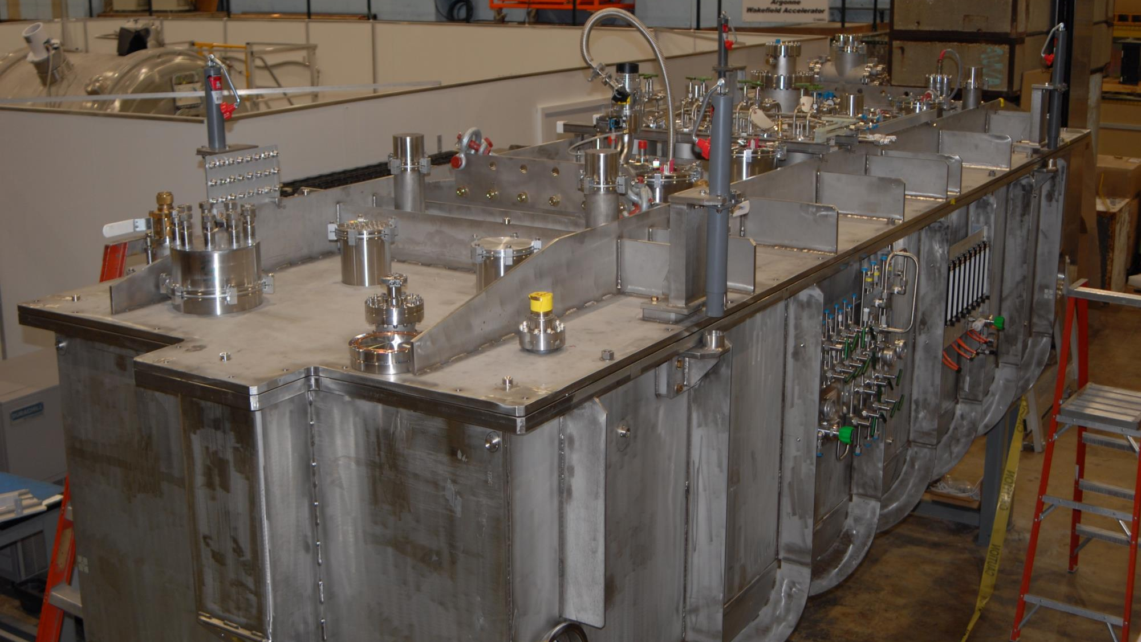


Half-Wave Resonator (HWR) Fabrication by
HWR cryomodule at 2K, RF tests completed, beam accelerated.

Slide 14

HWR Cryomodule Tests
Operated all cavities to the full nominal field and at least 10% above the nominal maximum gradient for extended time.
Average Quality Factors exceeded specification of 8.5e9 (measured as an ensemble).
Solenoids all met specification, exceed operational requirements
All tuner ranges exceed requirements.
All cavities (except 3, untested) operated in GDR mode (LLRF control demonstrated)
Five cavities were used to accelerate beams to >6 MeV
Cavity Position | Cavity Serial # | Nominal gradient required (MV/m) | Maximum gradient (MV/m) | Cavity Q₀ | Note
CAV1 | #P1 | 1.6 | 10.6 | >1.4e10 | No FE, no MP
CAV2 | #P2 | 2.5 | 10.9 | >1.4e10 | No FE, no MP
CAV3 | #2 | 3.5 | 6.5 |  | Need to replace warm window
CAV4 | #3 | 4.8 | 11.2 | >1.4e10 | No FE, no MP
CAV5 | #4 | 6.5 | 10.5 | >1.4e10 | No FE, no MP
CAV6 | #5 | 8.7 | 11.0 |  | No FE, no MP
CAV7 | #7 | 9.4 | 10.7 | >1.4e10 | No FE, no MP
CAV8 | #1 | 9.7 | 10.8 | >1.4e10 | No FE, no MP

Slide 15
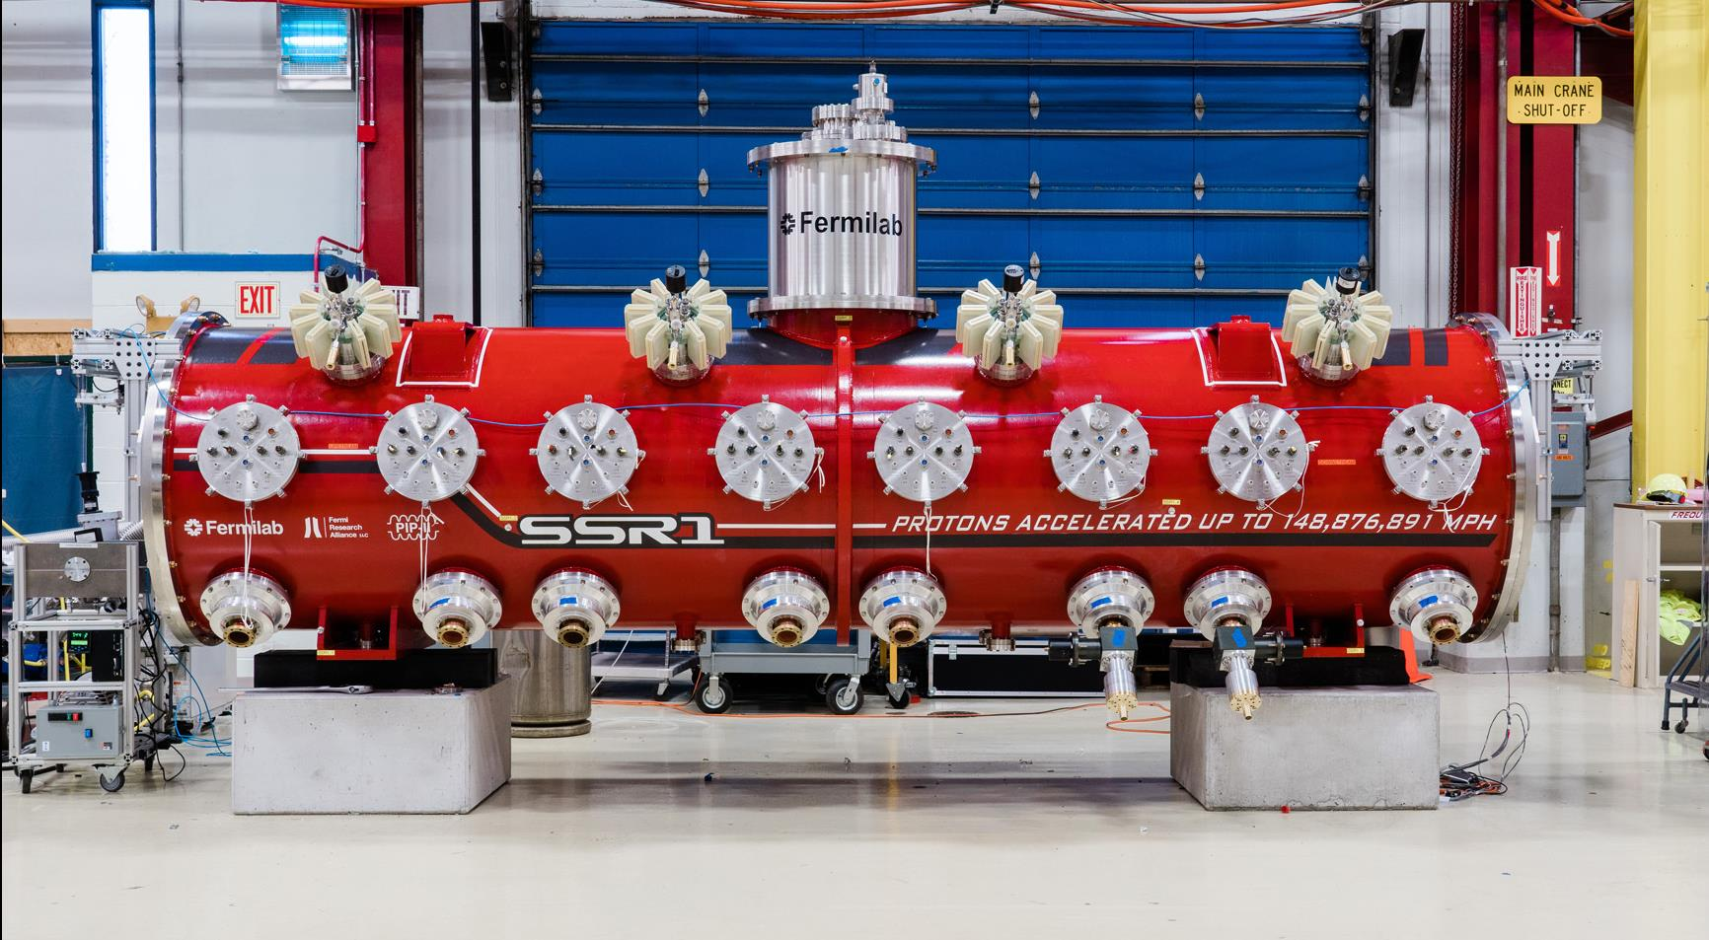


Single Spoke prototype cryomodule fabricated by Fermilab; installed at PIP2IT; 2K RF tests in progress

Slide 16
SSR1 Cryomodule Tests
  Two cavities exceed gradient specification required for PIP2IT beam test
  Both cavities have microphonics detuning ~15 Hz (< 20 Hz specification)
  RF amplifier used to power SSR1 cavities is a DAE deliverable; five more units are being installed.
  All solenoids tested and meet specification. Heat load tests are in progress.
  Strong back design validated preliminarily.
Cavity Position | Cavity Serial # | Nominal gradient required (MV/m) | Maximum gradient (MV/m) | Note
CAV1 | S1H-NR-106 | 10.00 | 11.5* | No MP after conditioning FE onset 10.5 MV/m
CAV2 | S1H-NR-110 | 8.78
CAV3 | S1H-NR-112 | 8.05
CAV4 | S1H-NR-109 | 10.00
CAV5 | S1H-NR-114 | 9.76
CAV6 | S1F-IU-104 | 10.00
CAV7 | S1H-NR-113 | 8.54
CAV8 | S1H-NR-111 | 10.00 | 11.0* | No MP after conditioning FE onset 10.5 MV/m
*Admin. limited

Slide 17



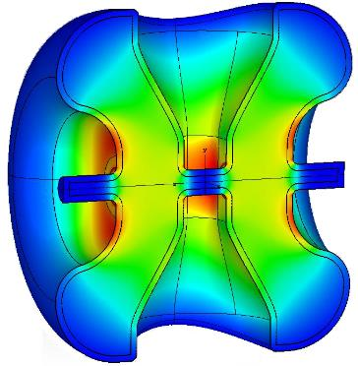
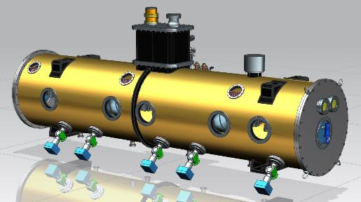
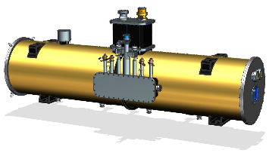
SSR2 Cryomodule
Cavity
Integrated design team: Fermilab, IN2P3 and DAE
RF design optimized
  Multipacting is dramatically minimized
Niobium production at vendor completed
Prototype jacketed cavity procurement in progress
SSR1 Coupler power capability demonstrated at >20 kW;
  procurement is in progress
Cryomodule
Design in progress by Fermilab, DAE
Parameters | SSR2 v 3.1
Optimal beta β_{opt} | 0.472
Aperture [mm] | 40
Frequency [MHz] | 325
Effective length 2β_{opt}λ/2 [m] | 0.436
E_{peak}/E_{acc} | 3.51
B_{peak}/E_{acc} [mT/(MV/m)] | 6.75
G [Ohm] | 115
R/Q [Ohm] | 305.2
E_{peak} [MV/m] @ 5 MeV | 40.2
B_{peak} [mT] @ 5 MeV | 77.4
Max energy gain [MeV] | 5.0
Max gradient [MV/m] | 11.47

Slide 18



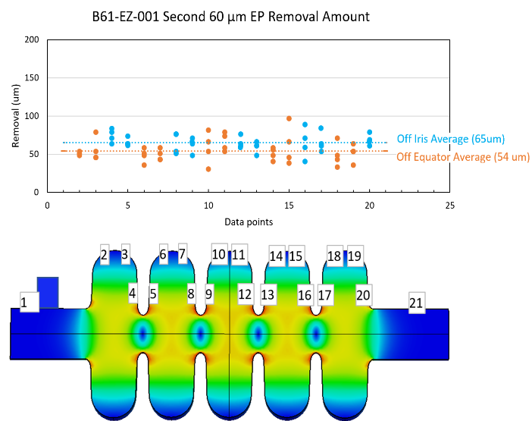
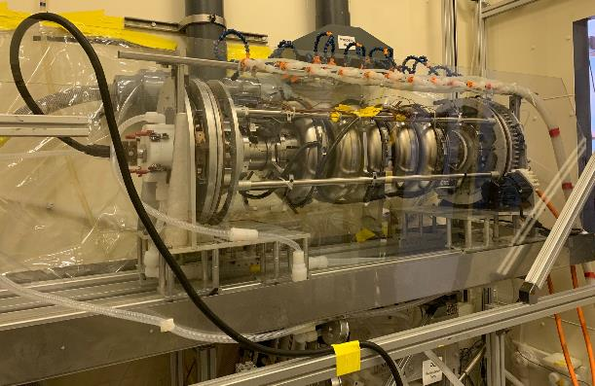
LB650 Cryomodule
Cavity RF design completed
  INFN led design of bare cavities
  First prototype bare cavity INFN contribution arrived in May 2020
Q₀, Gradient → 2.4 x10¹⁰ and 16.8 MV/m unprecedented for β <1
Uniformity of electropolishing (EP) material removal is a prerequisite for N-doping
  Low beta shape multi-cell cavity EP demonstrated promising uniformity
  Testing in progress
B61-EZ-001 EP uniformity
B61-EZ-001 on ANL EP stand

Slide 19


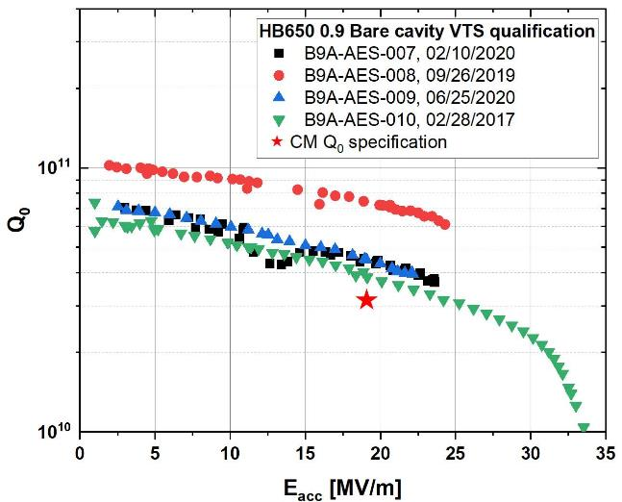
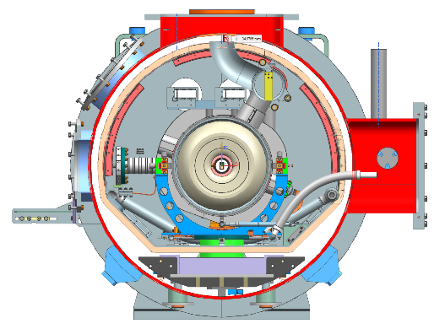
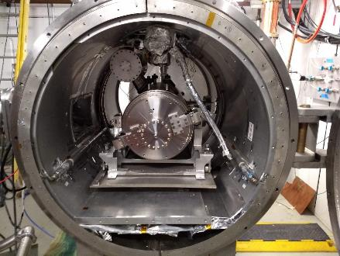
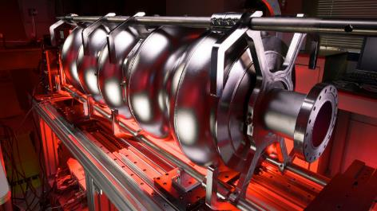
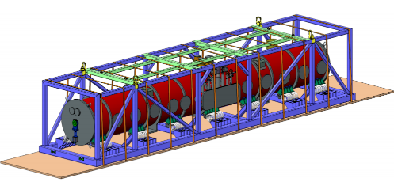
HB650 Cryomodule
Cavity
Q₀, Gradient → 3.3 x10¹⁰ and 18.7 MV/m unprecedented for β <1
  N-doping optimization is required
All four HB650 Fermilab cavities exceeded cryomodule Q₀ spec
RRCAT cavity testing in progress
Cavity, coupler procurement in progress
Cryomodule
FDR was completed successfully on 7/29-31
Successful HB650 Transportation FDR on 9/22/2020 led by UKRI
Bare HB650 Cavity
Jacketed HB650 Cavity in STC
HB650 proto cryomodule
HB650 Transportation Tooling

Slide 20
Summary
PIP-II SRF development is pushing the state of art to meet the needs of intensity frontier program at Fermilab.
  PIP-II is the highest energy CW SRF Proton Linac in the world.
  PIP-II has attracted interest from Partner labs for in-kind contributions.
Significant progress has been made on all fronts.
  HWR cryomodule demonstrated the beam acceleration.
  SSR1 cold test is in progress.
    Two cavities met specification.
    Strongback design validated.
  SSR2 and LB650 prototyping are in progress.
  HB650 cryomodule design and cavity prototyping completed.
We thank all the partner labs for their contributions !

