Slide 1
High-Q/High-G R&D of SRF cavities by applying 2-step baking at KEK
Ryo Katayama
KEK CASA

Slide 2
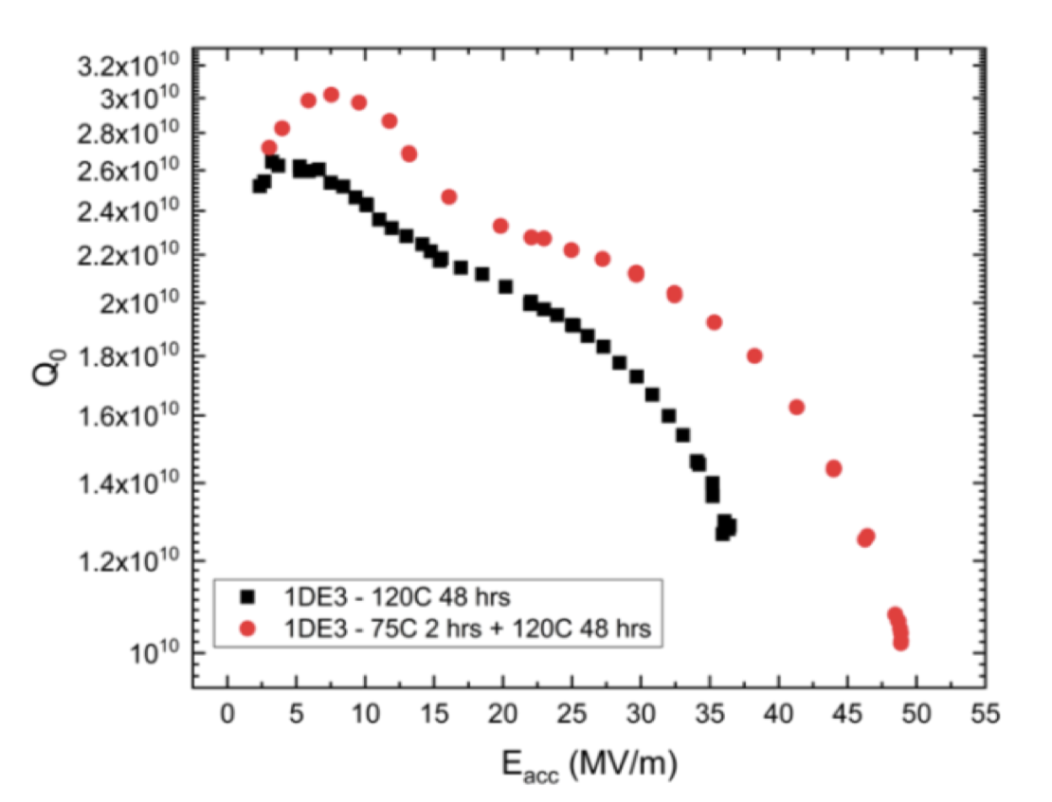
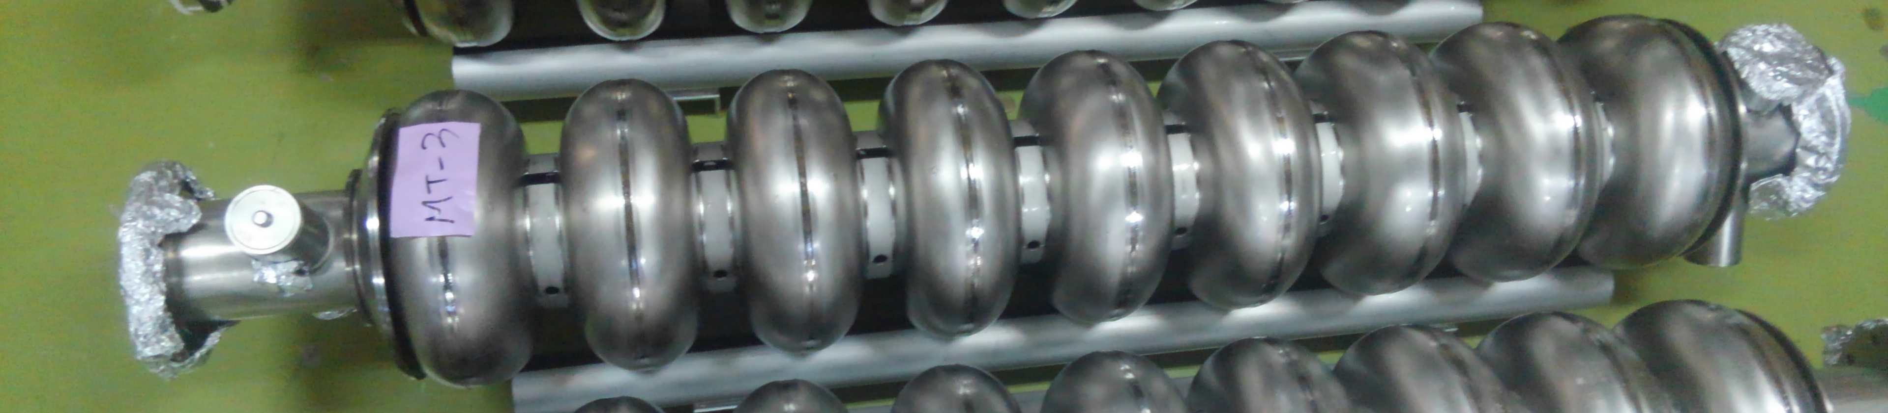
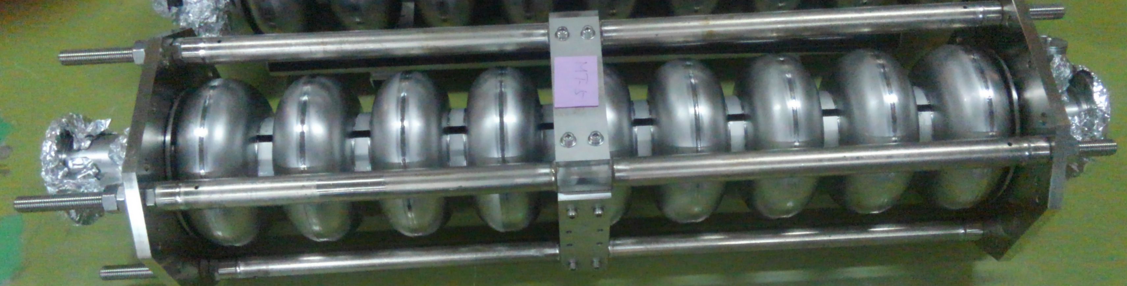
Introduction
For TESLA-shape superconducting RF (SRF) niobium cavities, the maximum quench field are typically 30-40 MV/m.
Recently, it has been reported that the additional surface treatment of the low temperature bake process at 75 ℃ for few hours before the ordinal bake process at 120 ℃ 48 hours increases the quench field (2-step baking) .
At KEK, we first try to enhance the cavity performance of two 9-cell TESLA-shape SRF niobium cavities (MT-3 and MT-5) with the surfaces treatment of 2-step baking of 75 ℃ 4 h + 120 ℃ 48 h.
We will present on the current status of this study.
75 ℃ 2h + 120 deg 48 h
120 ℃ 48 h
Comparison of Q-E curves between the case for 120 ℃ 48 h and that for 75 ℃ 2 h + 120 ℃ 48 h.
The above figure are cited from “Accelerating fields up to 49 MV/m in TESLA-shape superconducting RF niobium cavities via 75C vacuum bake” , arxiv 1806.09824.
MT3
MT5

Slide 3
Mitsubishi Tesla SRF cavities
KEK has four 9-cell SRF Nb cavities named Mitsubishi Tesla No.3 to 6 (named MT-3, MT-4, MT-5, and MT-6) for the purpose of the cost down R&D of ILC.
We used MT-3 and MT-5 for this study which of the profiles are summarized in the following table.
 | MT-3 | MT-5
Company | Mitsubishi Heavy Industry | Mitsubishi Heavy Industry
RRR | >300 (Tokyo Denkai) | >300 (Tokyo Denkai)
Grain Size | Fine | Fine
Heat Treatment | 750 ℃ 3 h | 900 ℃ 3h

Slide 4
Surface treatment and assembly

Slide 5
MT5 and MT3 history (until reference meas.)
For MT3 reference measurement
For MT5 reference measurement
Pre-EP (5 um) and EP1 (100 um)
Pre-EP (5 um) and EP1 (100 um)
Heat Treatment (750 ℃ , 3 h)
Heat Treatment (900 ℃, 3 h)
Several EP2 and Vertical Tests
(not good results)
EP2 (standard, 20 um)
EP2 (standard, 20 um)
Wet Assembly
Wet Assembly
120 ℃ 48 h baking
120 ℃ 48 h baking
MT5 1st Vertical Test
MT3 4th Vertical Test

Slide 6
MT5 and MT3 history
(until Vertical Test after 2-step bake)
For MT5 2-step baking.
For MT3 2-step baking.
Cold EP (20 um)
Cold EP (10 um)
Dry Assembly
Dry Assembly
75 ℃ 4h and 120 ℃ 48 h baking
75 ℃ 4h and 120 ℃ 48 h baking
(Trouble: one heater was out of order)
MT5 Vertical Test 2nd
MT3 Vertical Test 5th

Slide 7
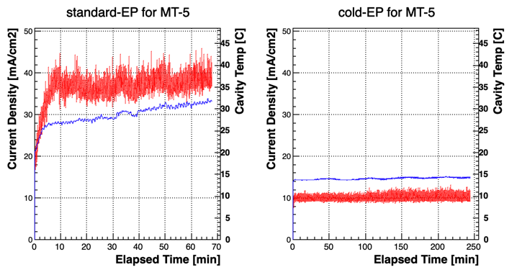
EP process used in this study for MT-5
Time evolution of current density and cavity temperature during EP process are shown below.
Current Density
Cavity Temperature
 | Standard EP | Cold EP
Cav Temp | 26-32 ℃ | 14 ℃
Current Dens | 38 mA/cm2 | 10 mA/cm2
Applied voltage | 16-20 V | 6-8 V
Removal Speed | 0.3 um/min | 0.085 um/min
NOTE: In the current status of the KEK EP facility water cooling cannot be applied during the cold EP process.

Slide 8
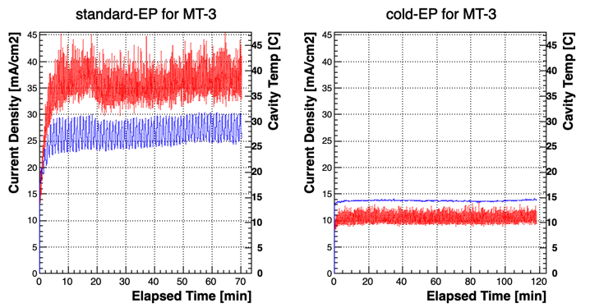
EP process used in this study for MT-3
Time evolution of current density and cavity temperature during EP process are shown below.
Current Density
Cavity Temperature
 | Standard EP | Cold EP
Cav Temp | 23-32 ℃ | 14 ℃
Current Dens | 35 mA/cm2 | 11 mA/cm2
Applied voltage | 21-23 V | 7 V
Removal Speed | 0.3 um/min | 0.085 um/min
NOTE: In the current status of the KEK EP facility water cooling cannot be applied during the cold EP process.

Slide 9
2step baking used in this study for MT-5
Time evolution of Cavity Temperature and Vacuum Level during 2-step bake are shown below.
120 ℃
Heater cloth I
 | 75 ℃ | 120 ℃
cell1 | 4 h | 48 h
cell3 | 4 h | 48 h
cell7 | 4 h | 48 h
cell9 | 4 h | 47 h
Heater Jacket
Temp sensors
75 ℃
It seems to be almost perfect process.
Heater cloth II

Slide 10
2step baking used in this study for MT-3
Time evolution of Cavity Temperature and Vacuum Level during 2-step bake are shown below.
Heater cloth I
120 ℃
 | 75 C | 120 C
cell1 | 2 h | 47 h
cell3 | 4 h | 50 h
cell7 | 4 h | 50 h
cell9 | 4 h | 46 h
Heater Jacket
Temp sensors
75 ℃
Temp rising rate at all channels are not same.
Heater cloth II
Although there was a trouble, it seems to be almost perfect process
for cell3 to cell9.
Temp rising at cell 1 was fault.
The heater cloth at cell 1 was out of order, and it was restored after 2 h.

Slide 11
Vertical Test Result

Slide 12
Vertical Test results
（evaluated by π-mode measurement)
The measurement result of Q-E curve for π mode (final) were shown below
(Blue) The case for the standard recipe (Red) The case for the 2-step bake
MT5 before-after 2-step baking (only π mode)
MT3 before-after 2-step baking (only π mode)
ILC Target
ILC Target
Eacc,max = 36.3 → 35.3 MV/m
Eacc,max = 36.9 → 36.6 MV/m
No improvement was observed because the difference of Eacc,max and Q₀ are in the range of error bars

Slide 13
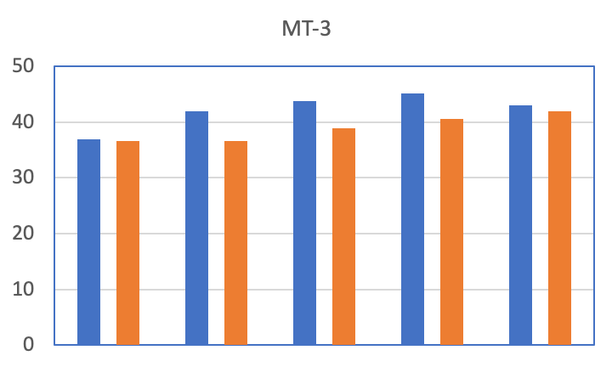
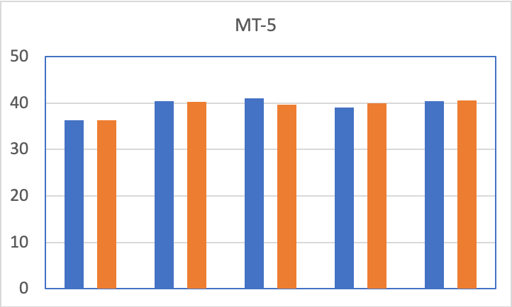
Vertical Test Result
（evaluated by all passband measurements)
Eacc,max per cells obtained from all passband mode measurements before and after 2-step bake are summarized in the following histograms.
Standard recipe
2-step bake
>42.0
43.8
45.1
43.0
>41.9
>40.4
>39.6
>38.9
>40.5
40.2
41.0
39.0
40.0
40.4
40.6
36.9
36.6
36.6
36.3
36.3
Eacc,max [MV/m]
deteriorated
Eacc,max [MV/m]
Within error bar
Not improved at least
Cannot conclude
anything
Within error bar
Within error bar
Cannot conclude anything
#1 & #9
#2 & #8
#3 & #7
#4 & #6
#5
#1 & #9
#2 & #8
#3 & #7
#4 & #6
#5
Cell Number
Cell Number
Although the passband measurements are considered,
no improvement was observed (Eacc,max per cells are in the range of error bars).

Slide 14
Summary
Cold EP (14 ℃) + 2-step bake (75℃ 4h + 120℃ 48h) was first applied to two 9-cell SRF cavities at KEK.
For MT-5, Eacc,max was 35.3 MV/m (It was 36.3 MV/m for the reference meas. ).
For MT-3, Eacc,max was 36.6 MV/m (It was 36.9 MV/m for the reference meas. ).
Comparing results from passband measurements, no improvement was observed.

Slide 15
Thank you for your attention

Slide 16
Backup

Slide 17
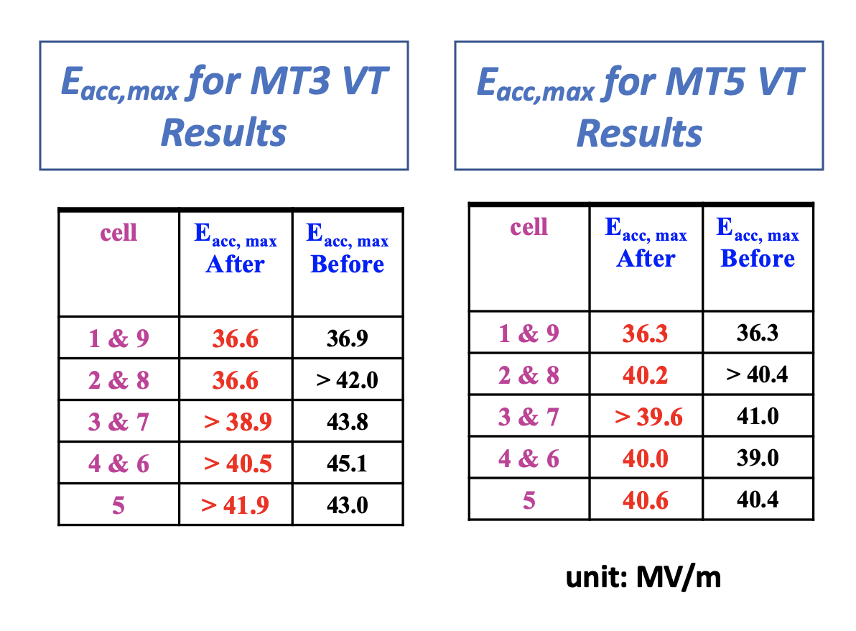
Analysis Results of Eacc,max
from passband mode measurement

Slide 18
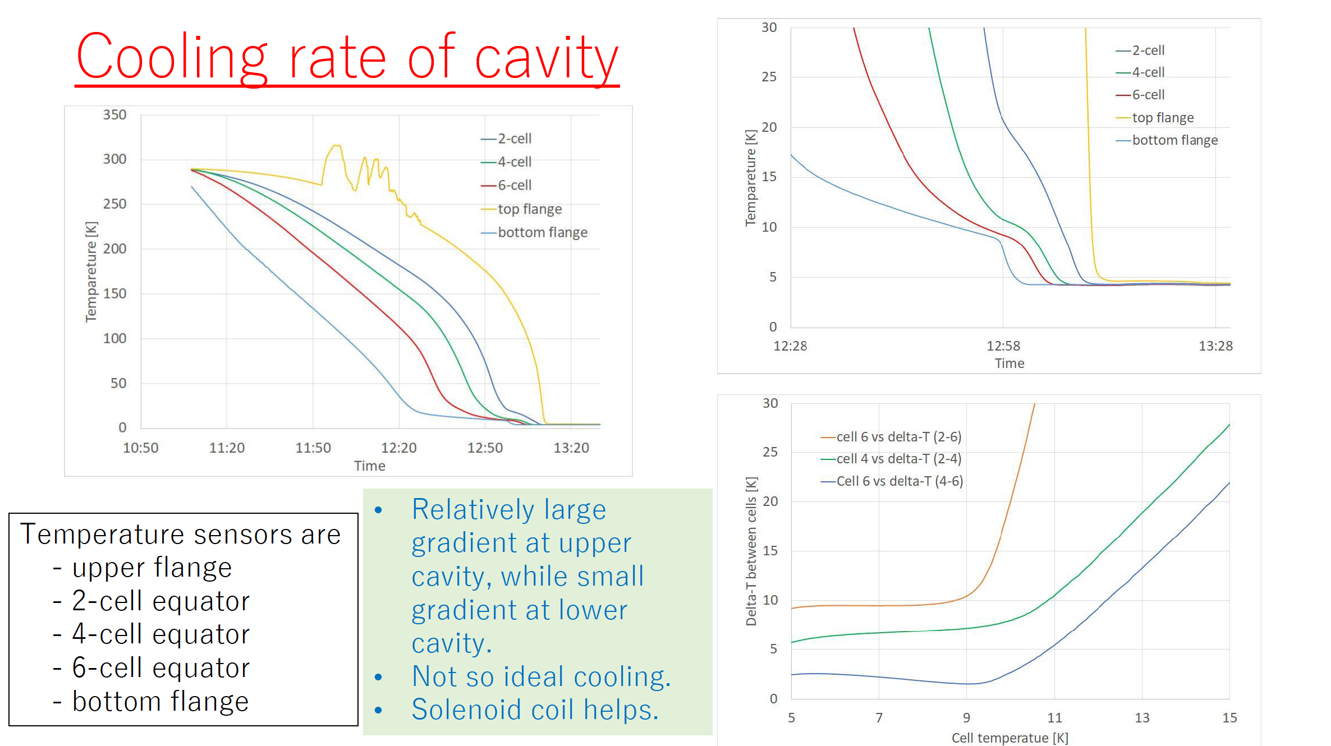

Slide 19
Plan for near future
MT-3
  After 5th VT, MT-3 cavity was sent to FNAL for cross check of the cavity performance.
MT-5
  After 2nd VT, N-doping was applied to MT-5.
  We will try 2-step baking process again to enhance the quench field of MT-5.
  Thus, additional EP will be applied to MT-5 cavity for refreshing the surface.

Slide 20
Q-E curve for π-mode meas at MT-3 5th VT
Quench did not occur at 2 K during π-mode meas when SSA supply the full power.
So, after cooling to 1.8 K, Q-E curve was measured again → Eacc,max = 36.6 MV/m.

