Slide 1
Tunnel Consideration Update with Accelerator Arrangement
CFS-WG AWLC2020 SLAC Oct222020
H. Hayano KEK

Slide 2
CFS design flow
Revise the lattice for ILC250 and create geometry file
Optics Deck (as of Feb. 2020) -> Geometry file ( CSV format)
Create 3D arrangement of accelerator components
Geometry file -> 3D accelerator components ( by STEP format )
This presentation
Create 3D tunnel arrangement
Check any interference and check tunnel shape,
then feedback to the tunnel design

Slide 3
ILC Lattice Design Update
Major revision and updates of the optics deck (the lattice) in 2018 - 2019
Vertically curved Main Linac, Laser straight in BDS, DR
Put 583m extra-space at both Main Linac upstream for collision timing adjustment
Make Positron undulator longer and put extra-space for future upgrade
Positron undulator dogleg position was optimized to avoid beamline interfarence
Undulator photon-dump line was added
Electron source Linac position was moved to upstream
Radius at turn-around were increased to widen bend-to-bend distance
All dump lines were added
…

Slide 4
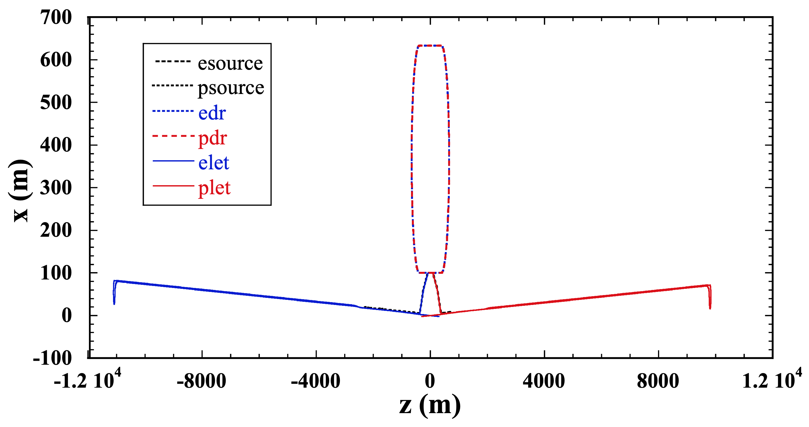
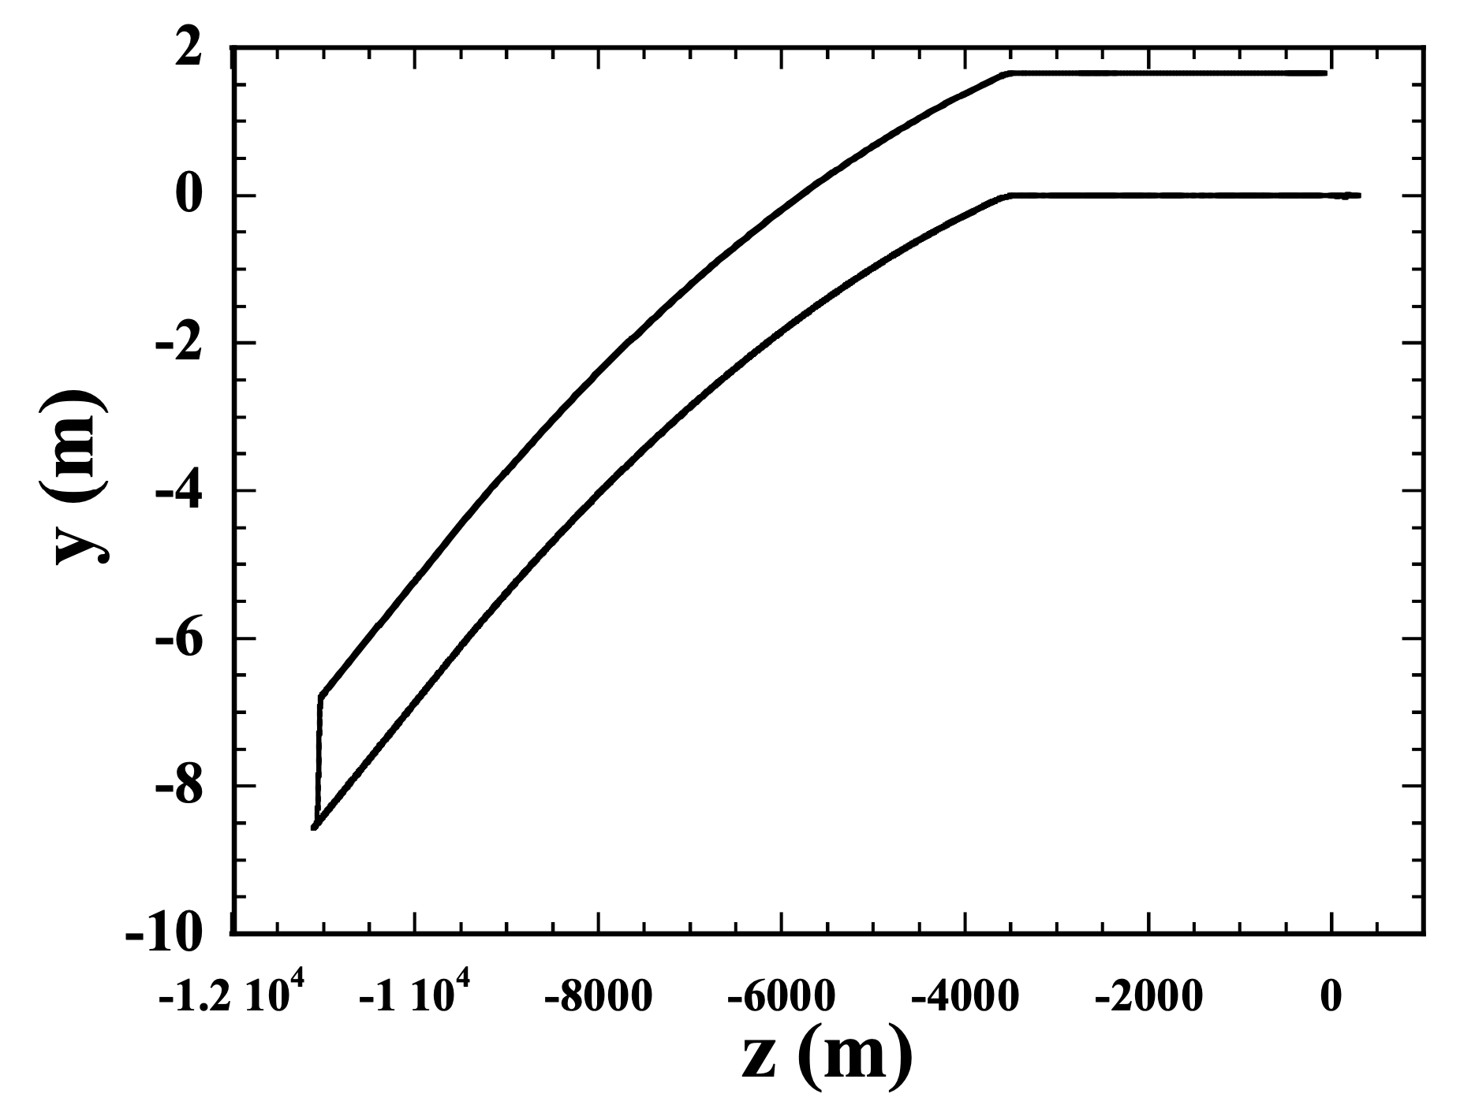
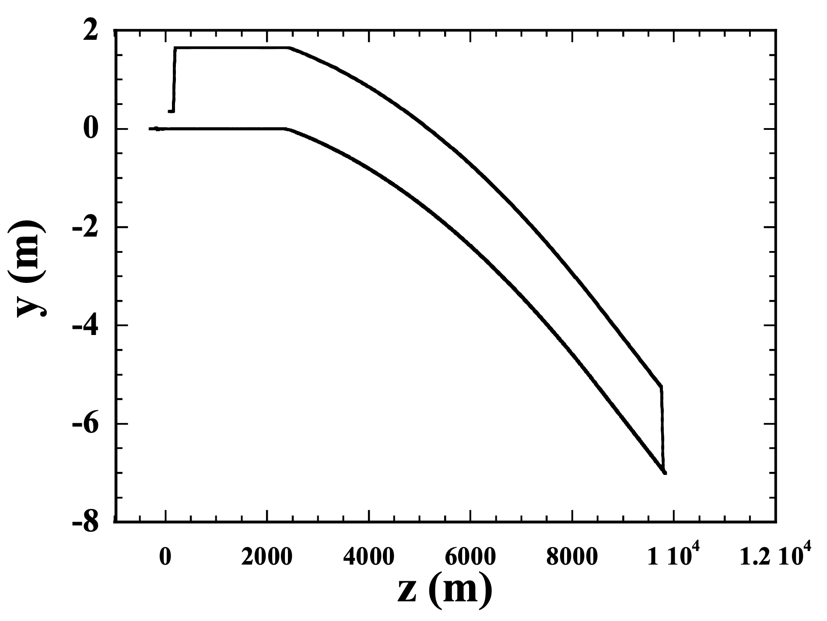
Overall plot of geometry file output
Vertically
Curved Linacs
X-Z plane
* This plots show
before left-right turn-over.
Not a final.
In order to fit accelerator
into Kitakami candidate site,
left-right turn-over was done.
Laser straight BDS
Vertically curved Linac
along geoid
Vertically curved Linac
along geoid
Y-Z plane
Y-Z plane
K. Kubo

Slide 5
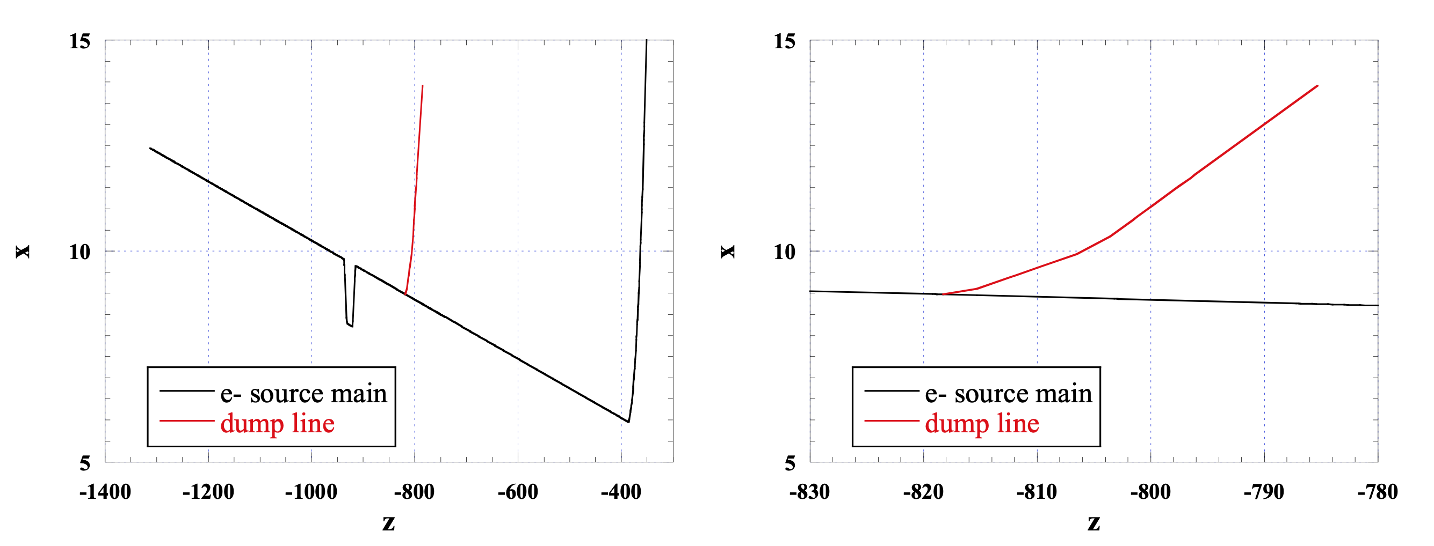
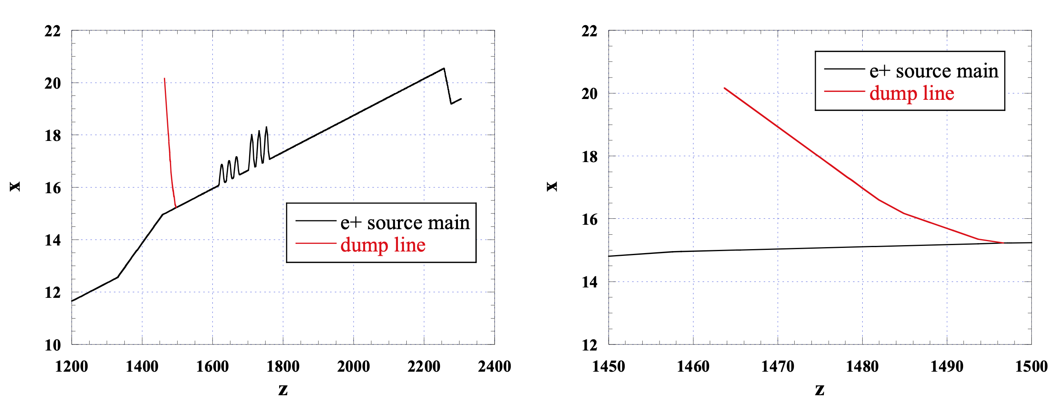
e- source dump line
e- source dump line (expanded view)
Adding dump lines
examples
K. Kubo
e+ source dump line
e+ source dump line
(expanded view)
K. Kubo

Slide 6
Generation of Accelerator Components Arrangement
Optics Deck
-> Geometry file
-> 3D accelerator components ( by STEP format )
Make accelerator component symbol, like below;
Bend : Blue rectanguar 0.5m x 0.5m x L
Quadrupole : Red cylinder 0.5m x 0.5m x L
Sextupole : Yellow cylinder 0.5m x 0.5m x L
Cavity : silver cylinder d=0.2 x L
Cryomodule : Yellow cylinder d=1.0 x L
Drift space : Black line

Slide 7
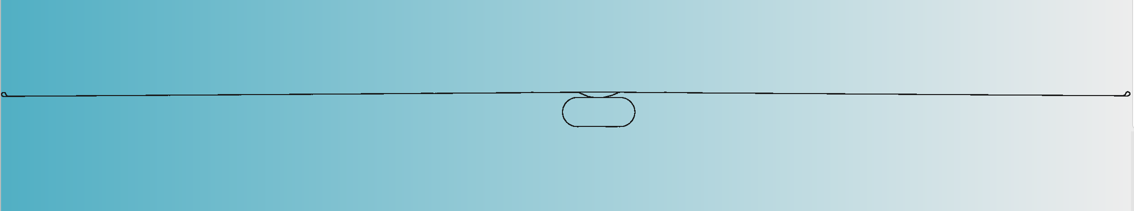
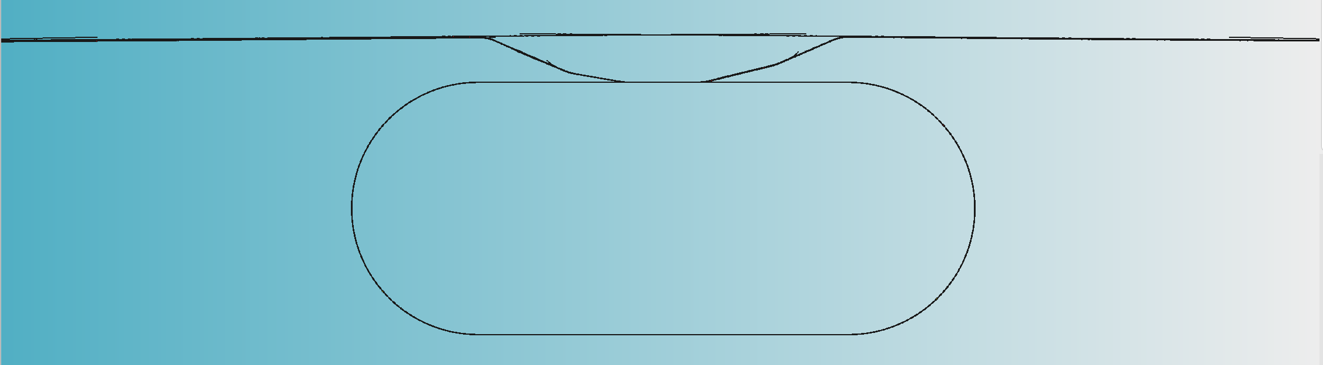
3D accelerator components arrangement
ILC overall
Electron Main Linac
Positron Main Linac
DR
Z
Y (upside +)
ILC central region
X

Slide 8
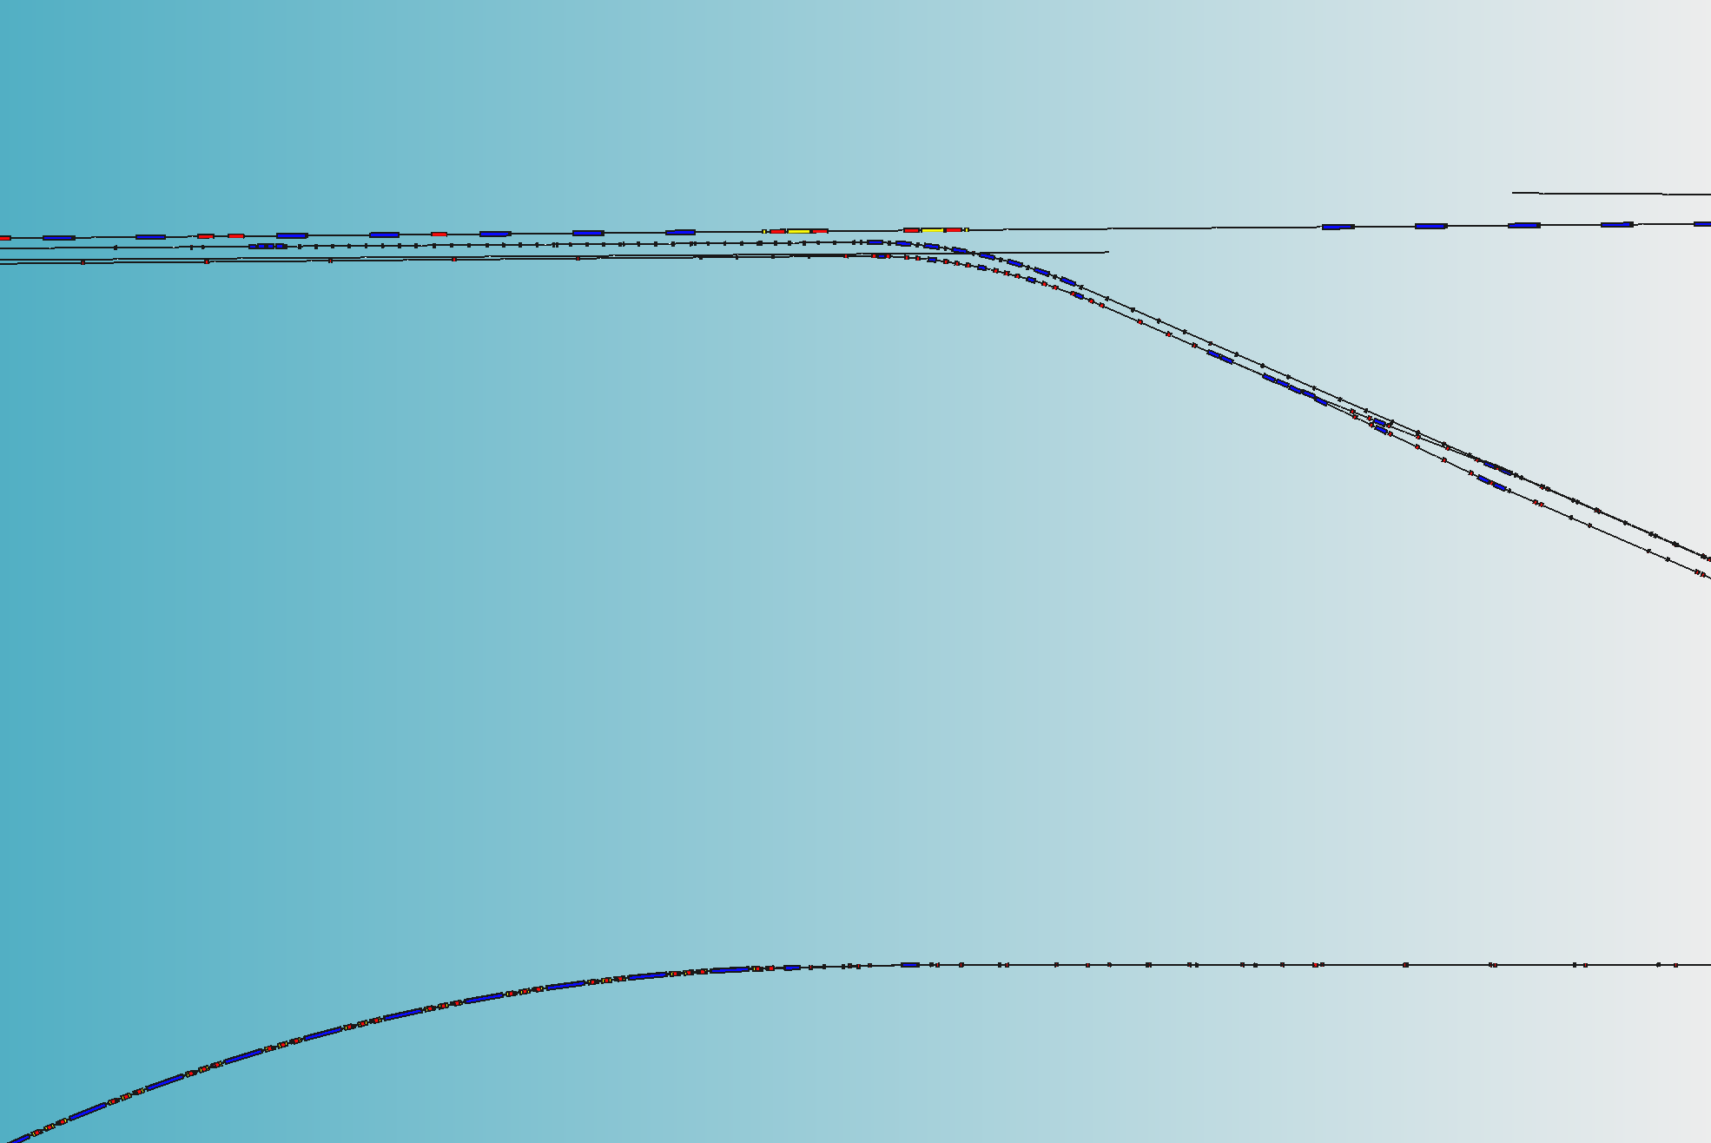
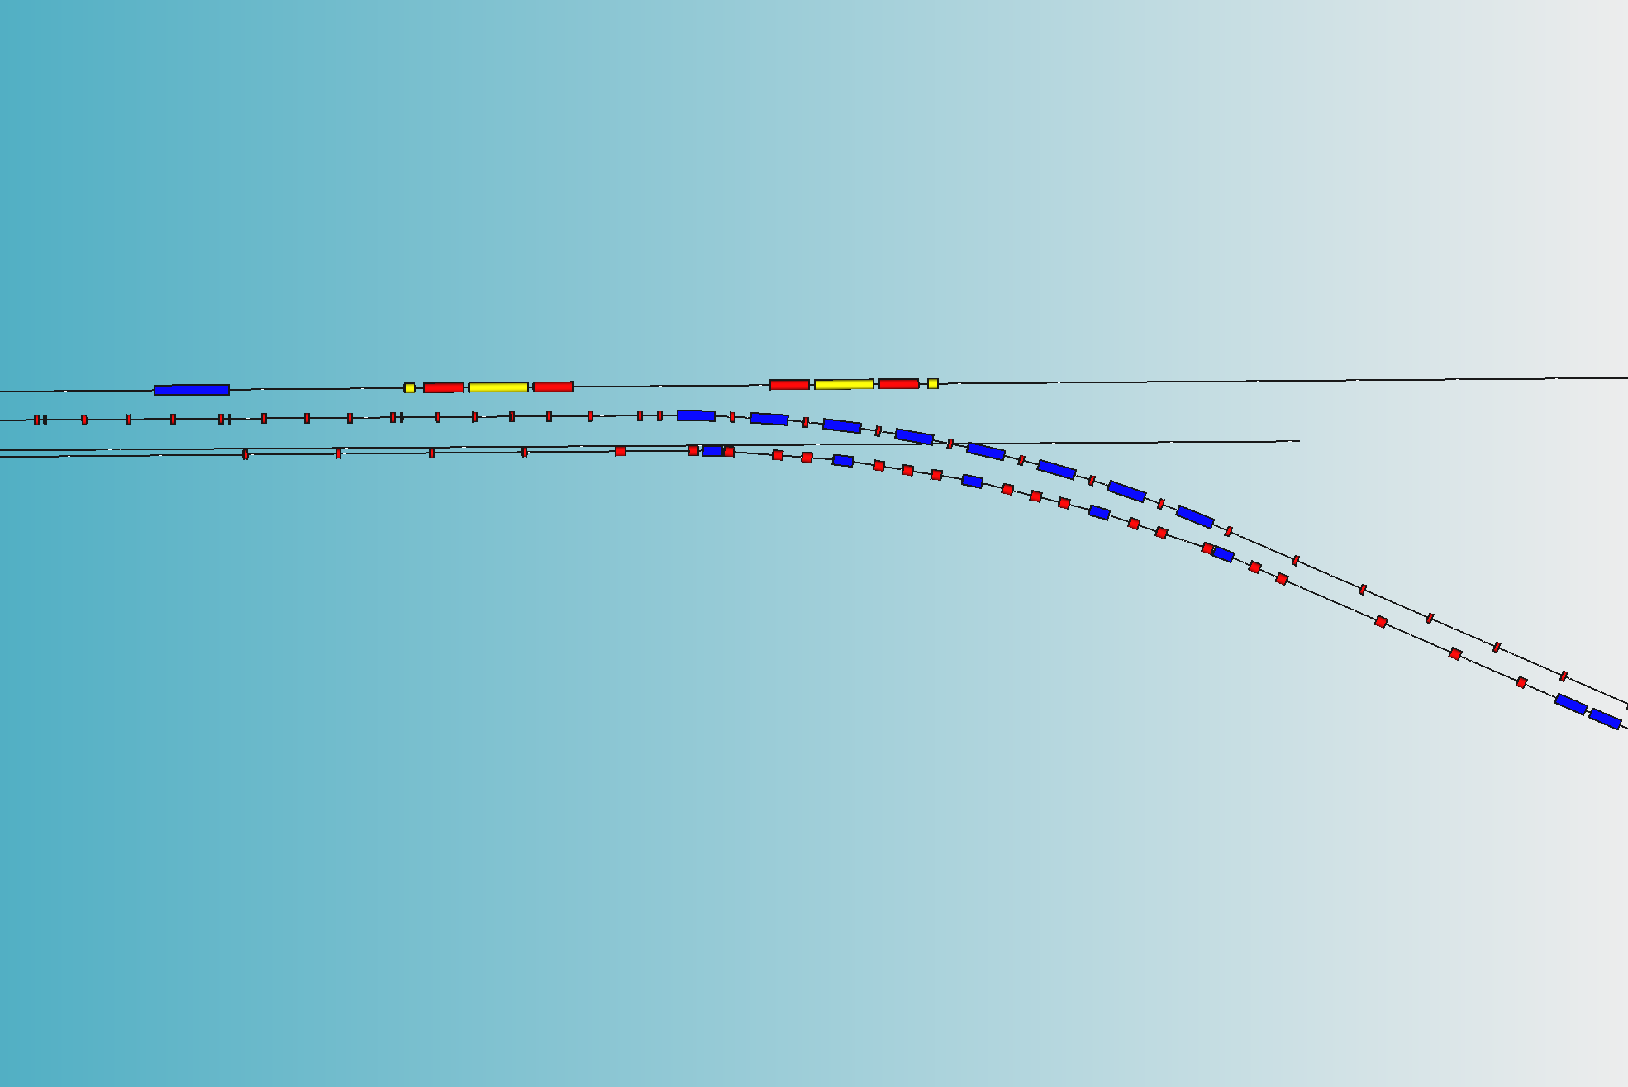
Electron-side BDS, RTML
Electron-side BDS, RTML
Photon Dump Area
Photon Dump
to be this point
(~2km from undulator end point)

Slide 9
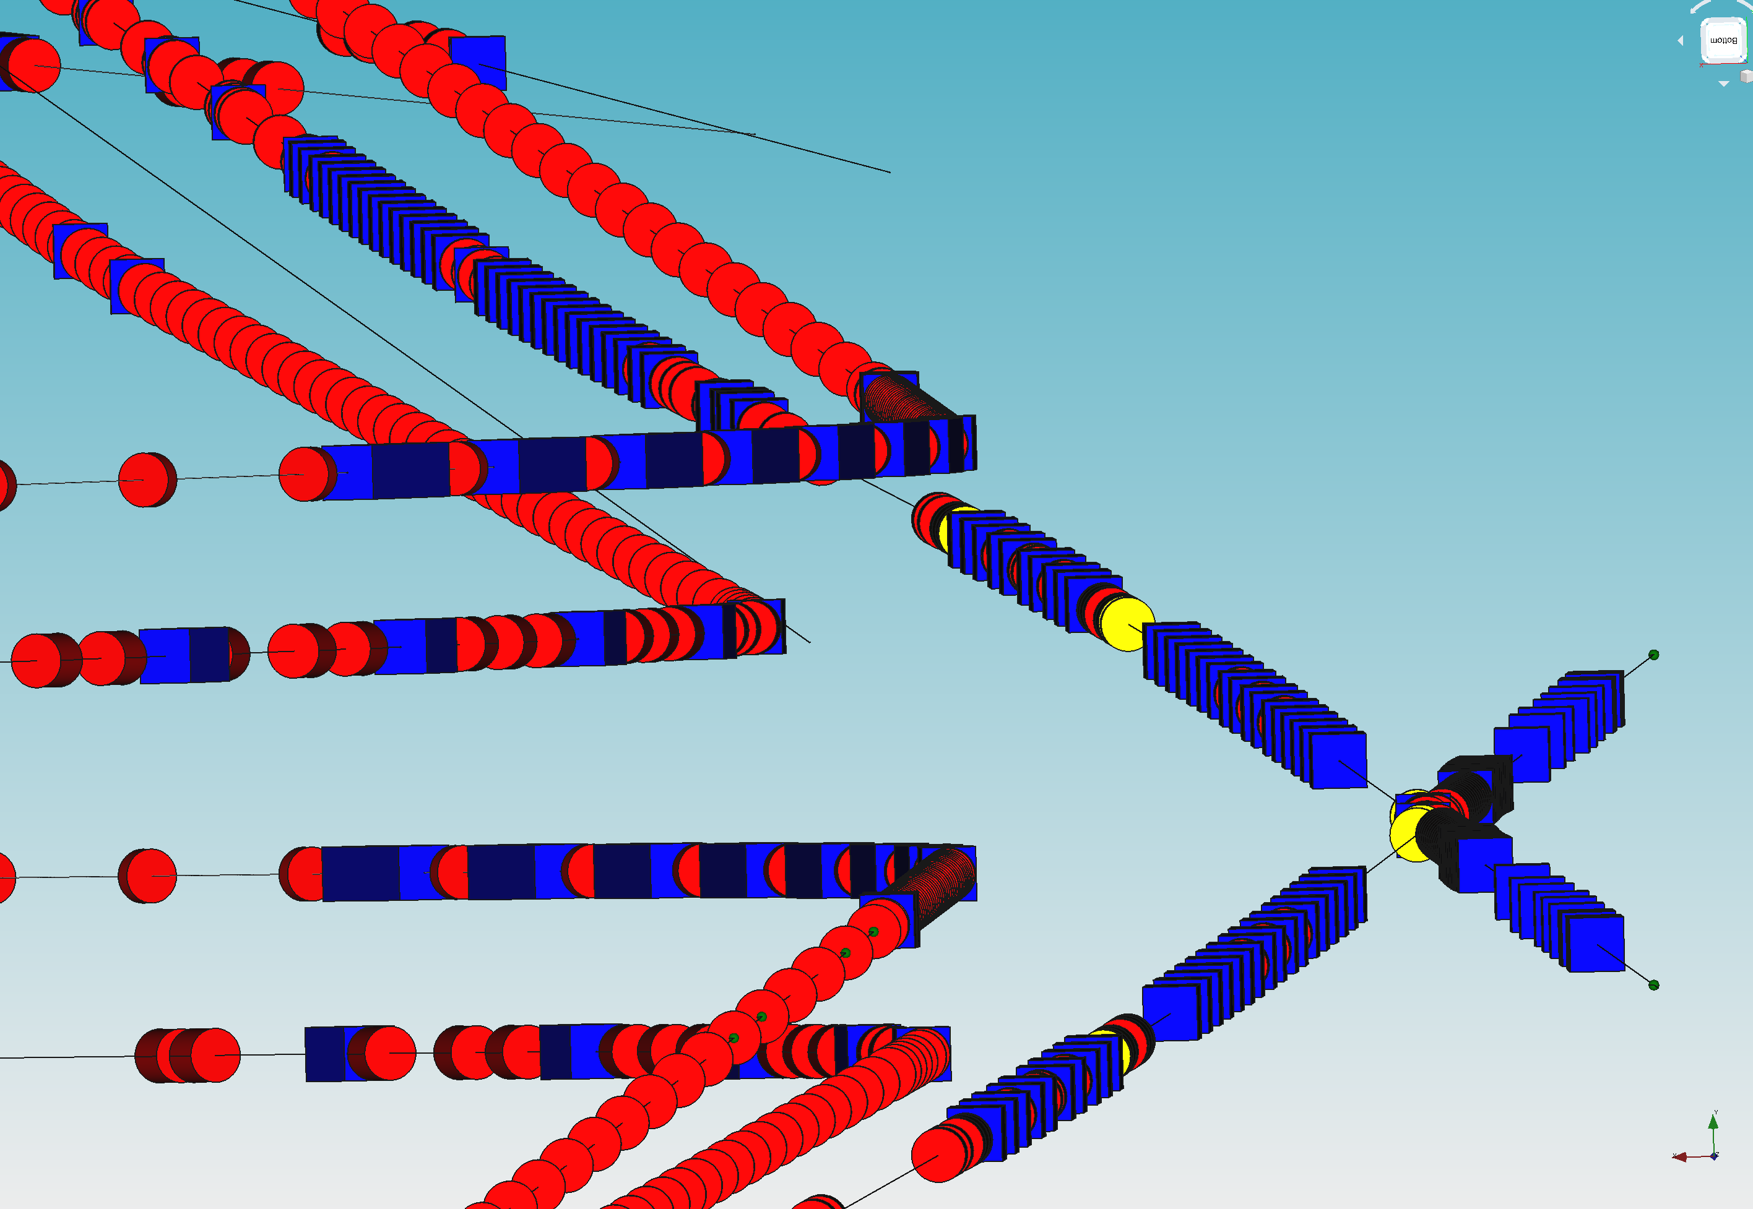
3D View of components arrangement, looking to IP region
Electron-side RTML
Ring to ML
Electron-side BDS
Electron-side RTML
Source to Ring
Positron-side
Main Dump
Positron-side RTML
Ring to ML
IP
Positron-side RTML
Source to Ring
Electron-side
Main Dump
Positron-side BDS

Slide 10
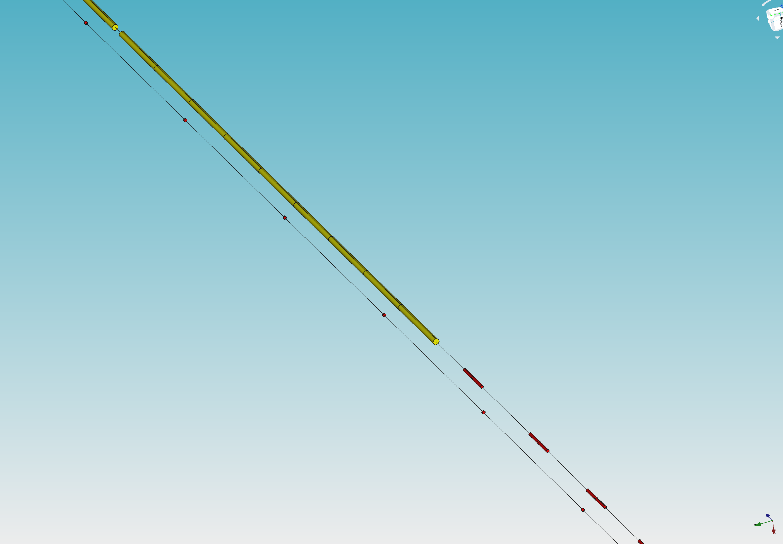
3D View of components arrangement, looking to Cryomodule region
Electron-side Main Linac end
Cryomodules
Electron Beam Direction
Electron-side RTML
Ring to ML
Electron Beam
to undulator section

Slide 11
Creation of 3D tunnel Arrangement
Create 3D Tunnel Wall to house accelerator components
Purpose as follows;
To check any interference between accelerator, beam dumps and tunnel wall
To ensure space for installation, maintenance, emergency walk through
To get feedback from accelerator expert, civil expert, and safty expert

Slide 12
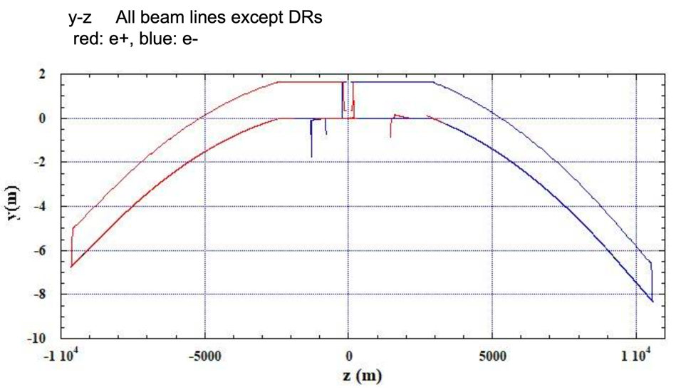
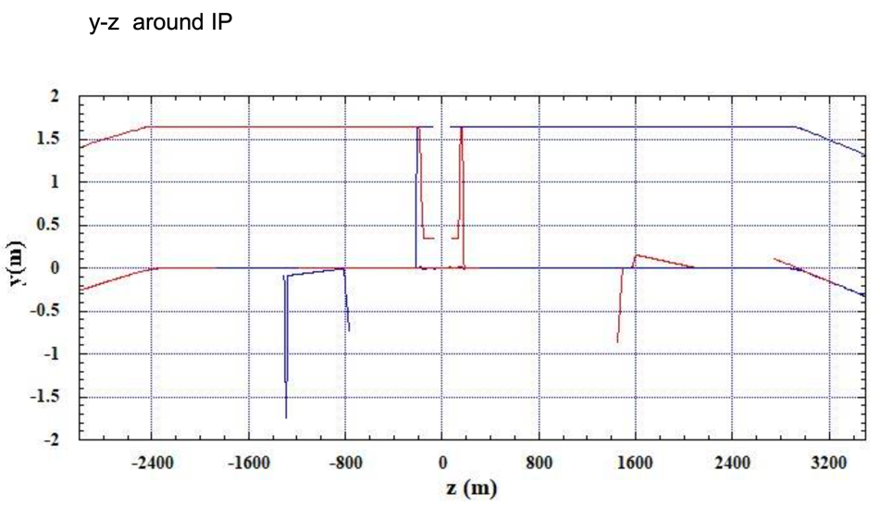
Accerelator Positioning in tunnel Arrangement
accelerator components layout, as of Feb. 2020
connecting to Damping Ring
e+ RTML
e- RTML
e+ RTML
e- RTML
e+ Main Linac
e+ BDS
e- BDS
e- Main Linac
e- Injector
IP
e+ booster
Y-Z plane projection of whole ILC, except DR
Expanded View or IP region (Y-Z plane projection)

Slide 13
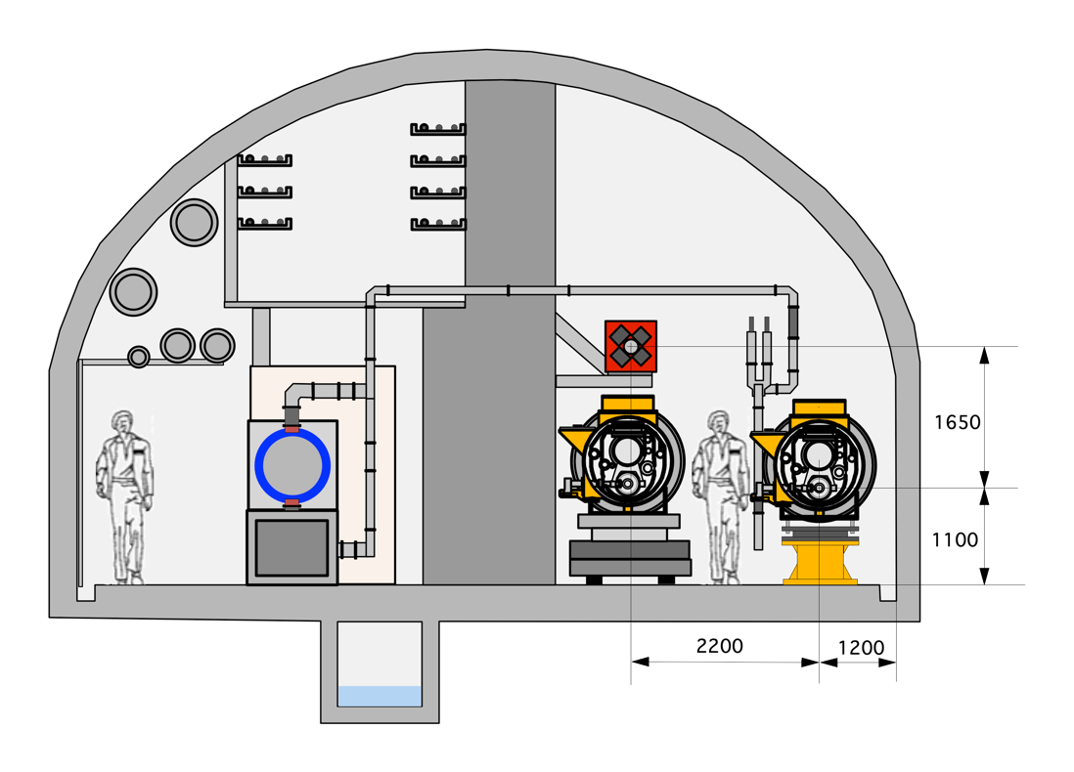
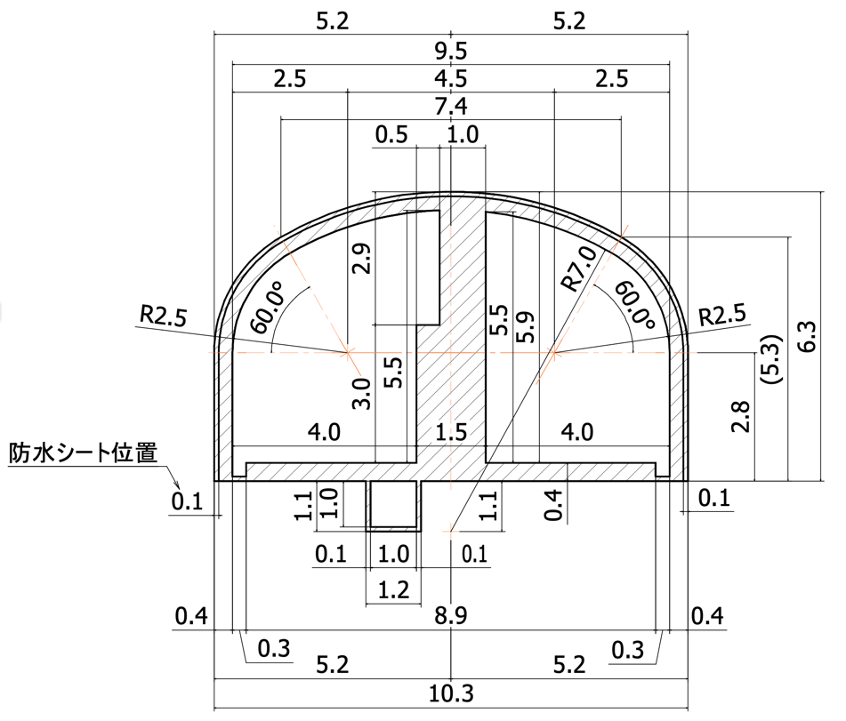
Accerelator Positioning in tunnel Arrangement
Main Linac
RTML Beam Center
Main Linac Beam center

Slide 14
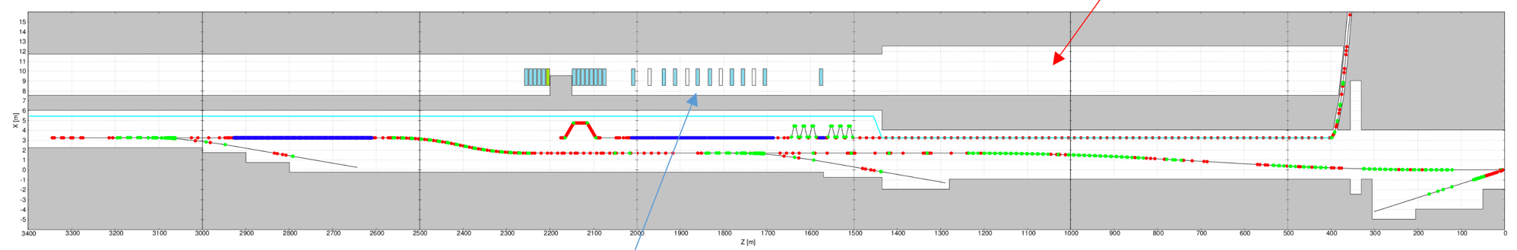
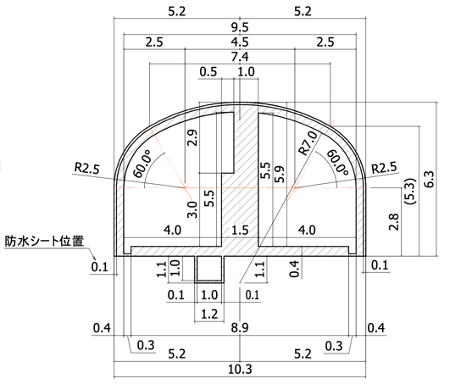
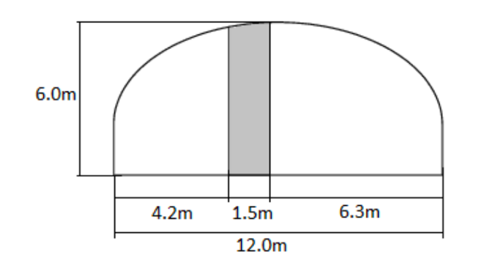
Accerelator Positioning in tunnel Arrangement
C
Electron-side BDS
Photon Dump Room
B
A
IP
Main Dump Room
Magnets
Power Supply gallery
Dump room
C
B
Dump room
A
Electron side Main Linac
Beam Line hight from floor is 1100mm
AA cross-section
BB cross-section
CC cross-section
same as main linac
not include dump-room expansion

Slide 15
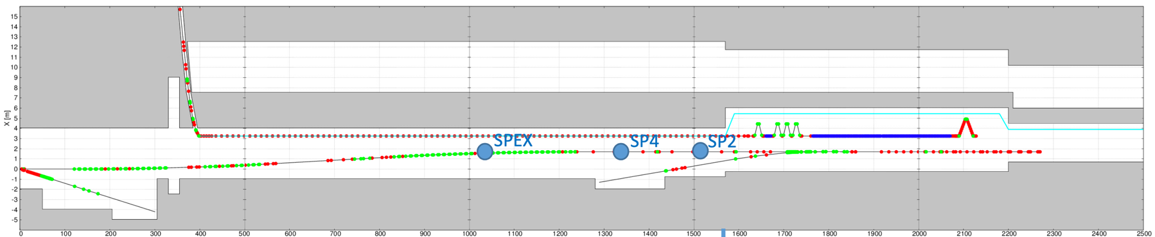
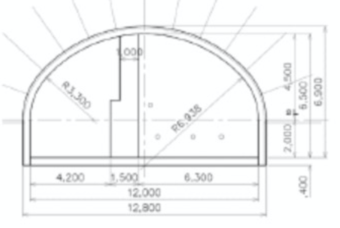
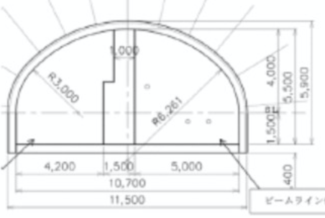
Accerelator Positioning in tunnel Arrangement
Positron-side BDS
A
B
C
IP
A
Dump room
B
C
Main beam
dump
Beam Line hight from floor is 1100mm
positron-side
Main Linac
CC cross-section
same as main Linac
AA cross-section
BB cross-section

Slide 16
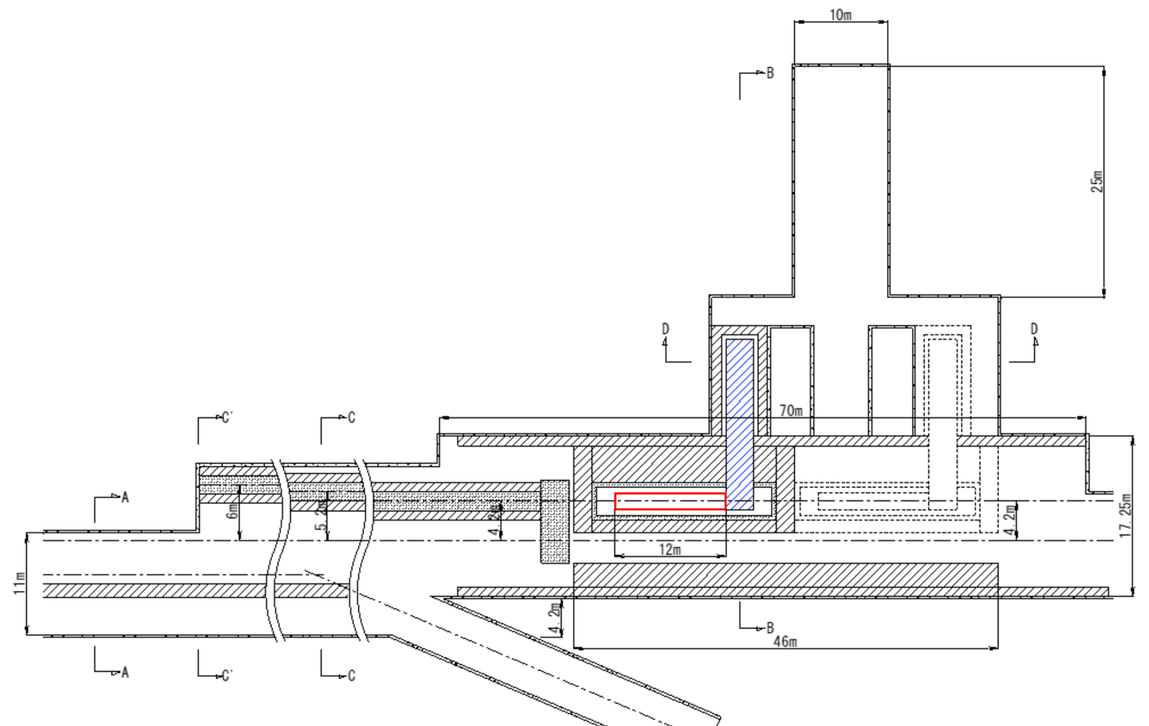
Accerelator Positioning in tunnel Arrangement
Main Beam Dump Room
Proposal from Civil Engineering Society, Evaluation Panel
Dump window exchange device
Beam Line hight from floor is 1100mm
Main Beam Dump
Muon dump after main beam dump
130m
Beam after collision
BDS beam to IP
BDS beam to IP
RTMLbeam
Reserved are for 2-nd main beam dump

Slide 17
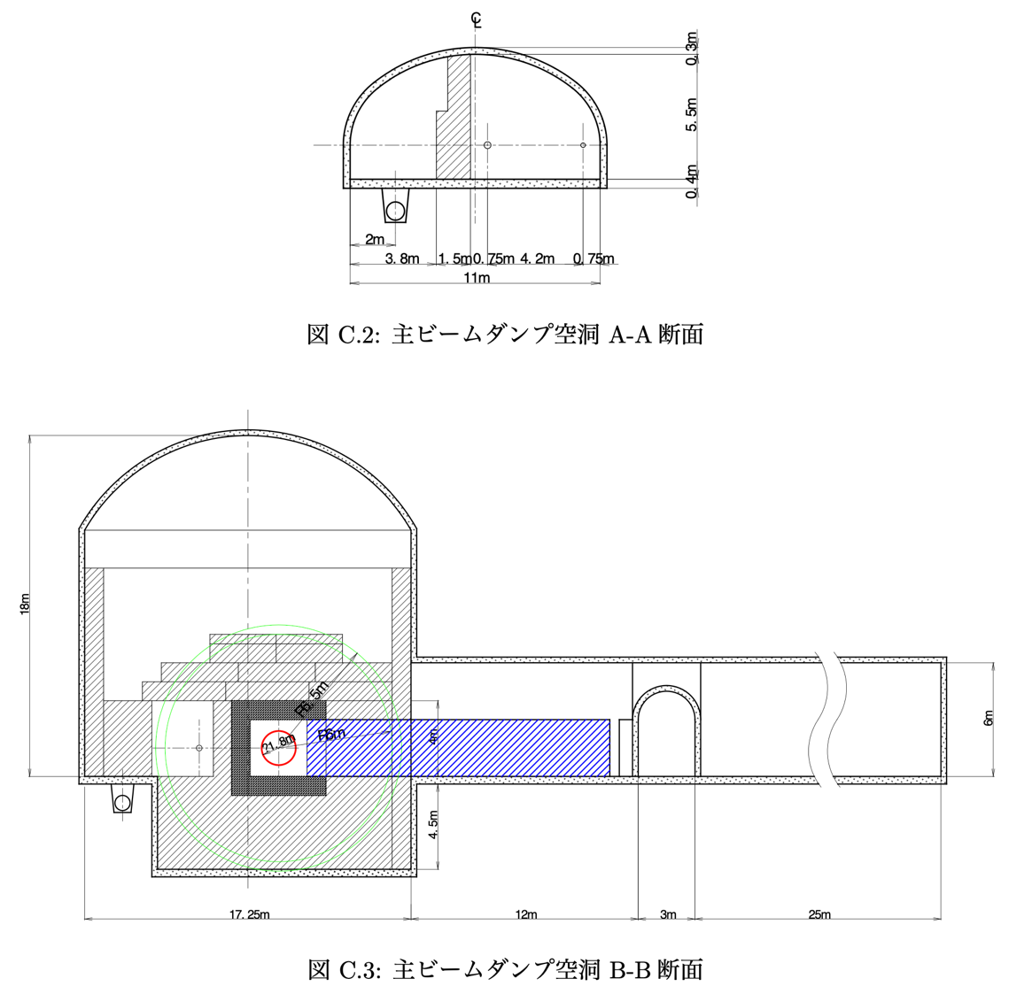
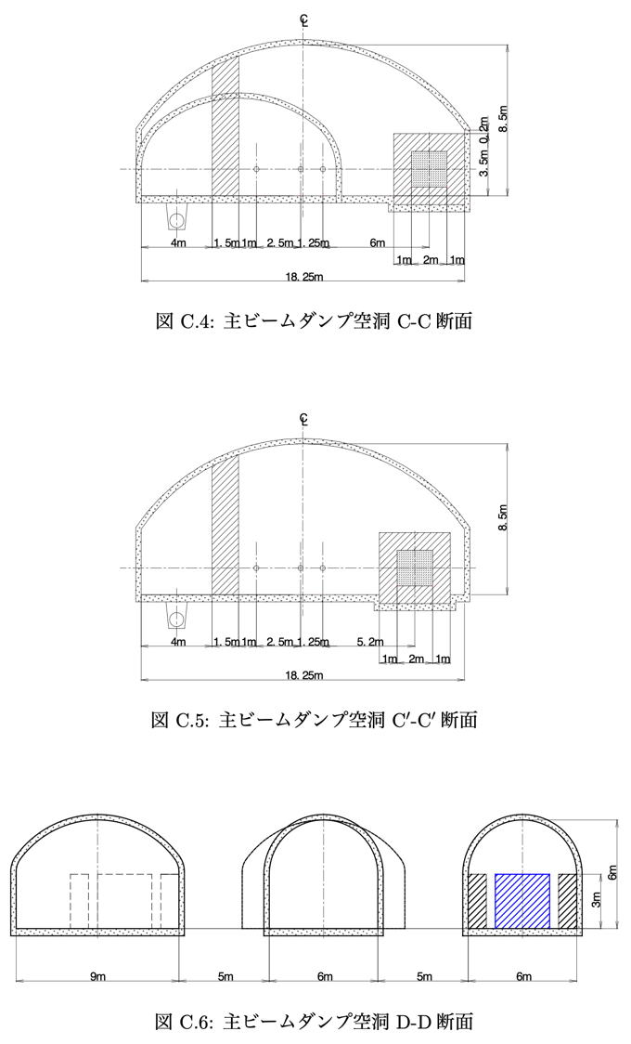
Accerelator Positioning in tunnel Arrangement
Main Beam Dump Room
Proposal from Civil Engineering Society

Slide 18
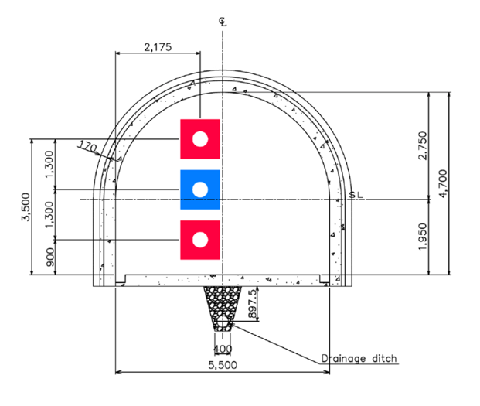
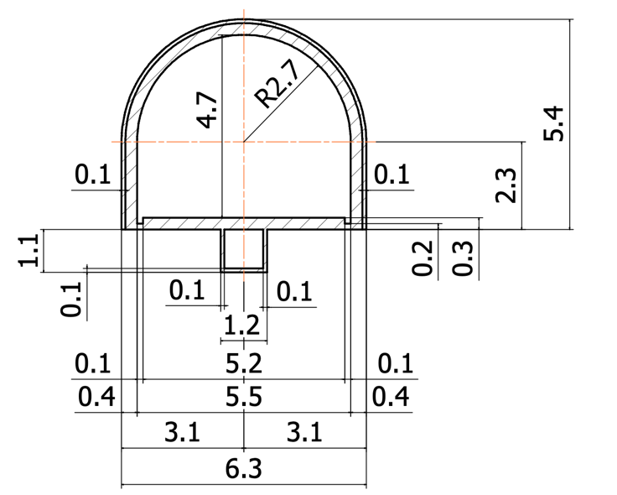
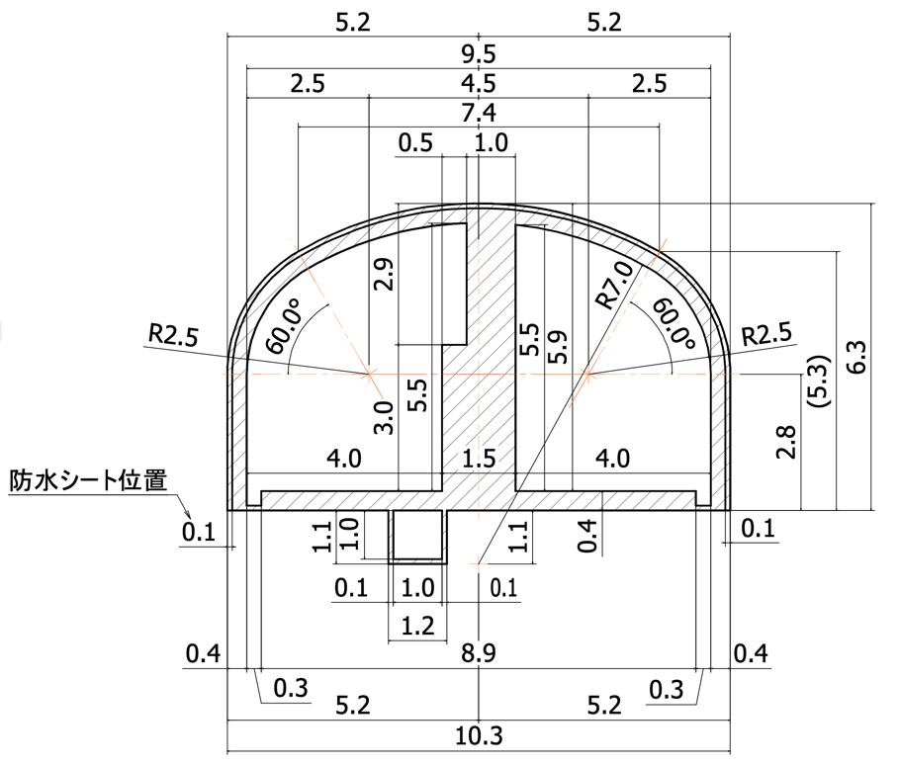
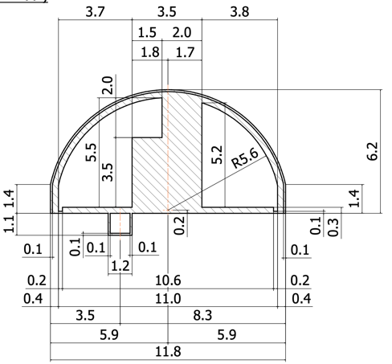
Accerelator Positioning in tunnel Arrangement
3-rd Ring is future installation
Damping Ring
Straight Section
Wide area
6.7
arc outside
Arc inside
11
6
8.9
Arc section and
Straight section narrow area
(TDR)
5.5
2.175
Change 3.5m -> 1.5m shield
10.4
11.8

Slide 19
Creation of 3D tunnel Arrangement
Tunnel Wall 3D-CAD input was finished, September 2020.
This will be the start of feedback.
Detector Hall will be discussed with MDI group.
Access Tunnels and Vertical Shafts are temporary one.
To be studied in preparation phase.

Slide 20
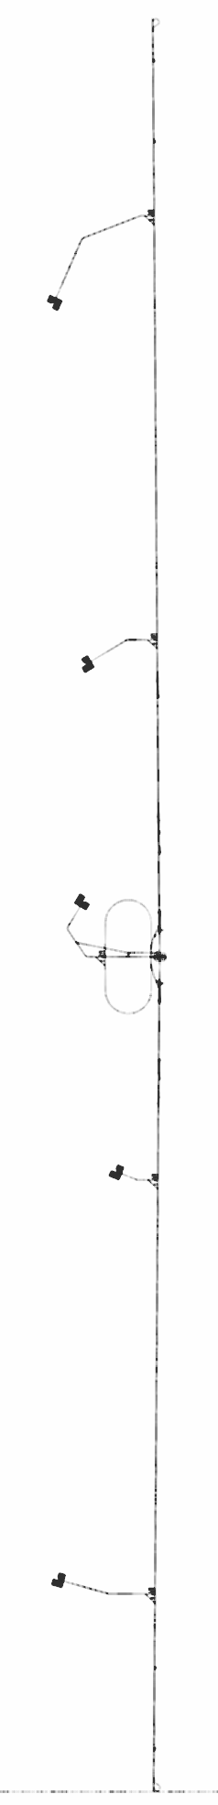
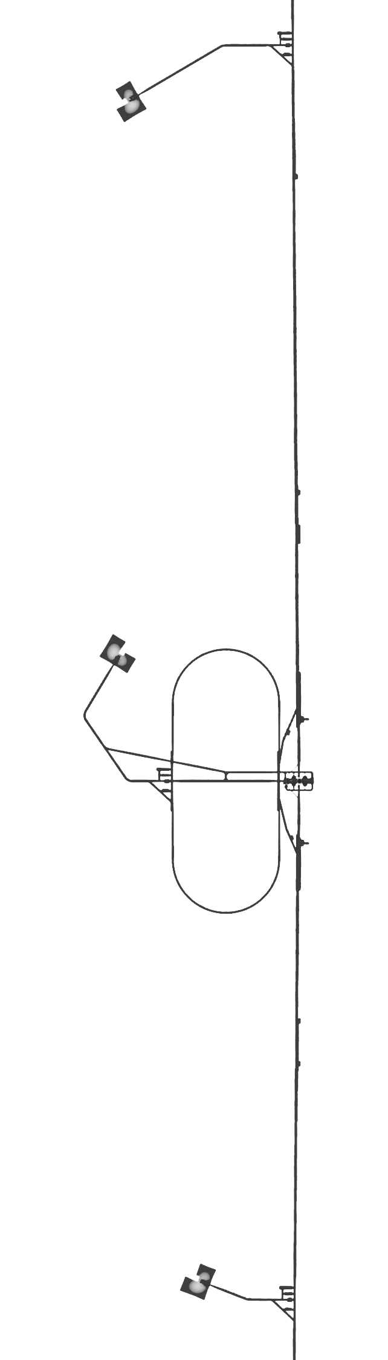
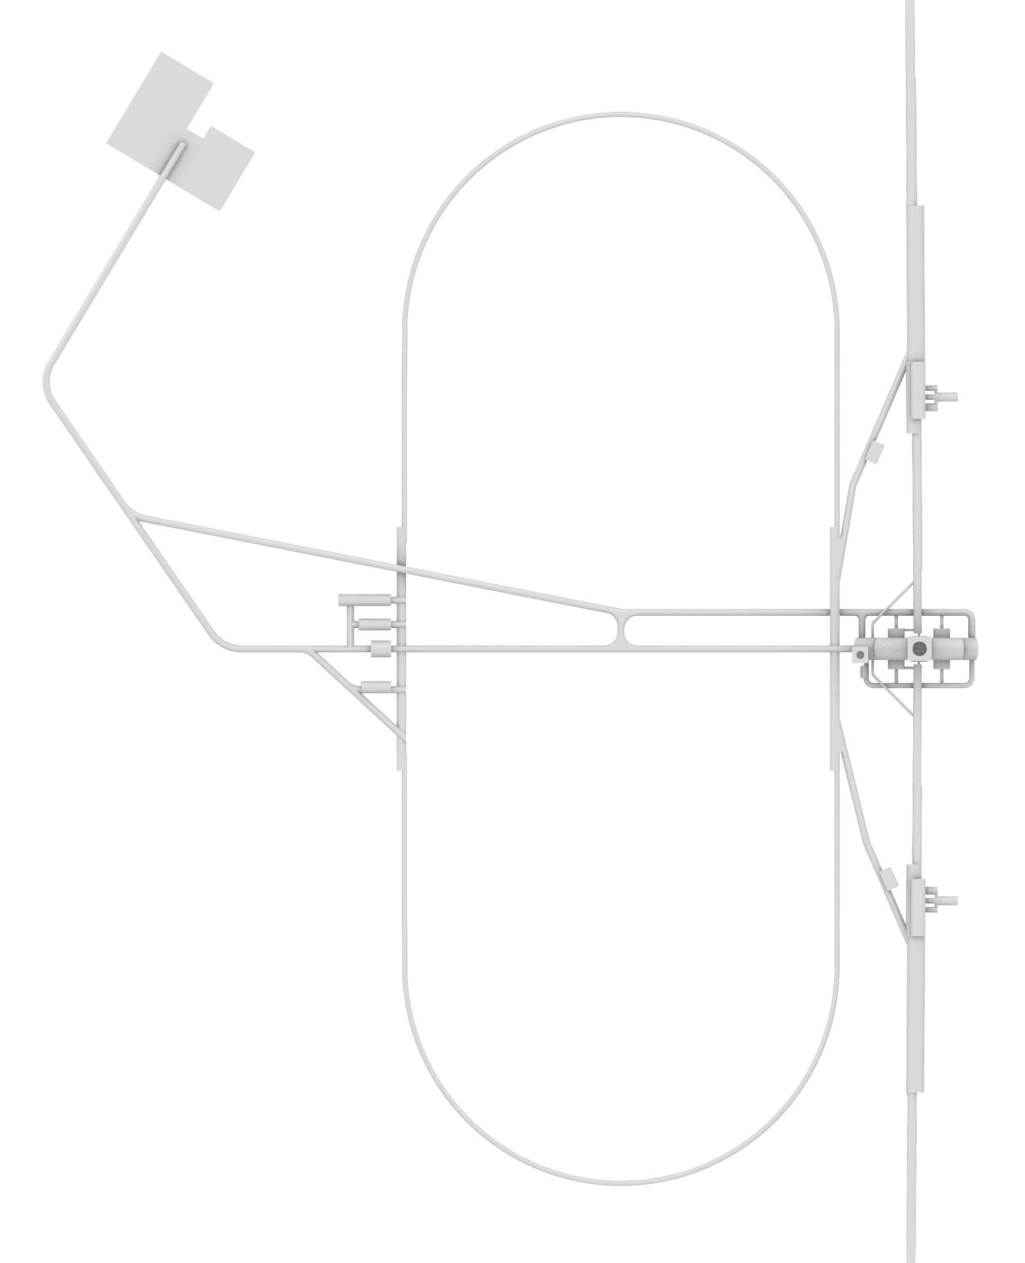
Whole ILC tunnel
From PM-8 to PM+8
20.5km
Expanded View of
Central Area

Slide 21
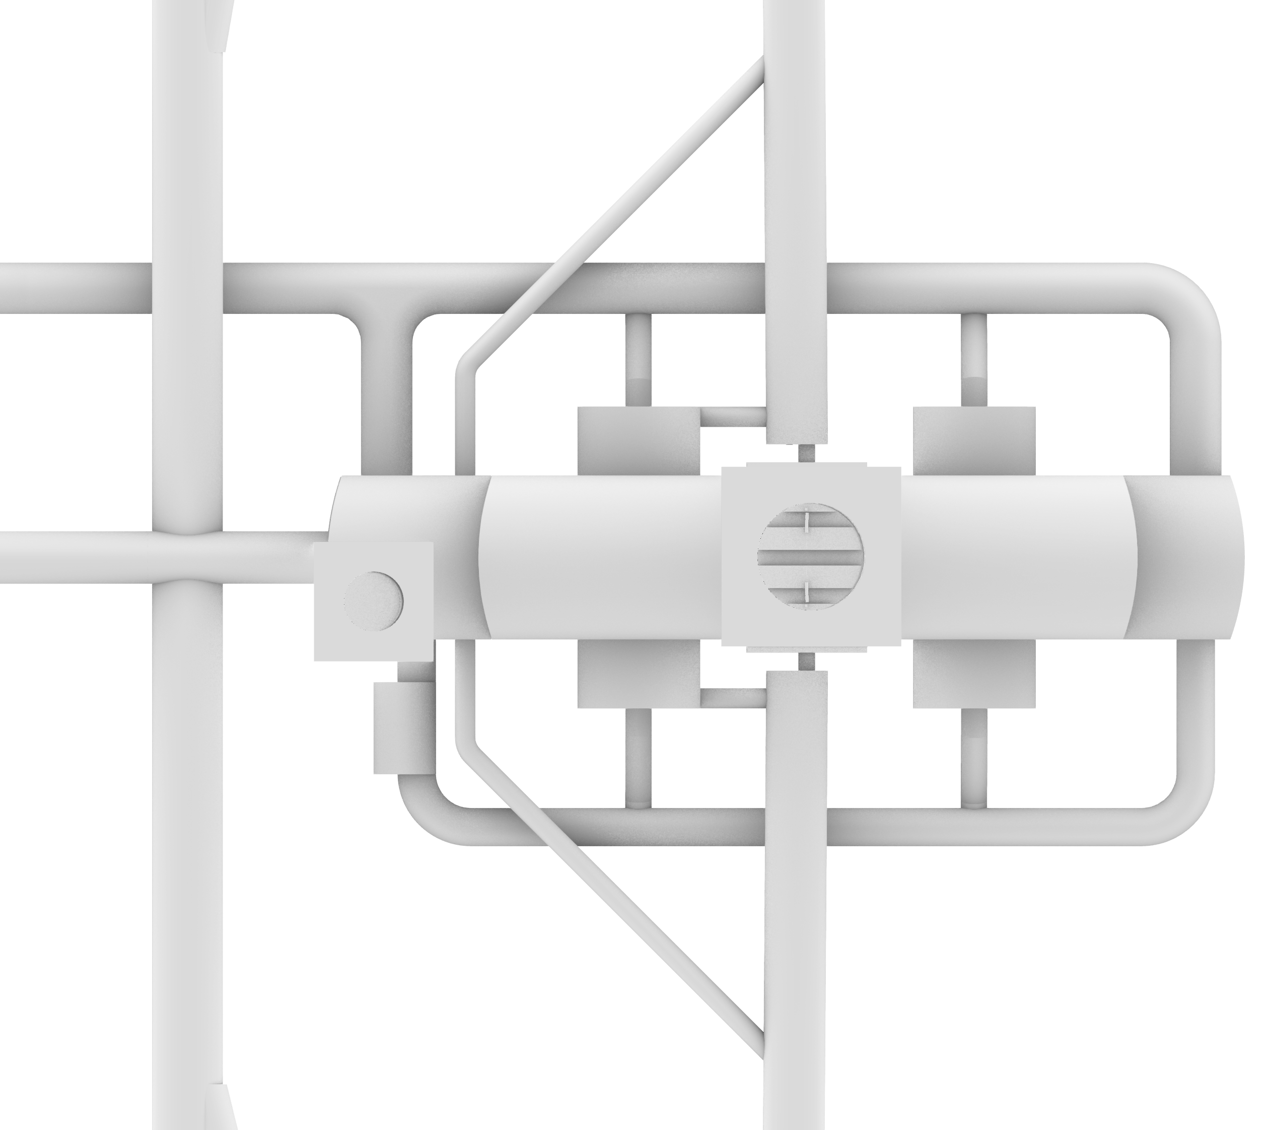
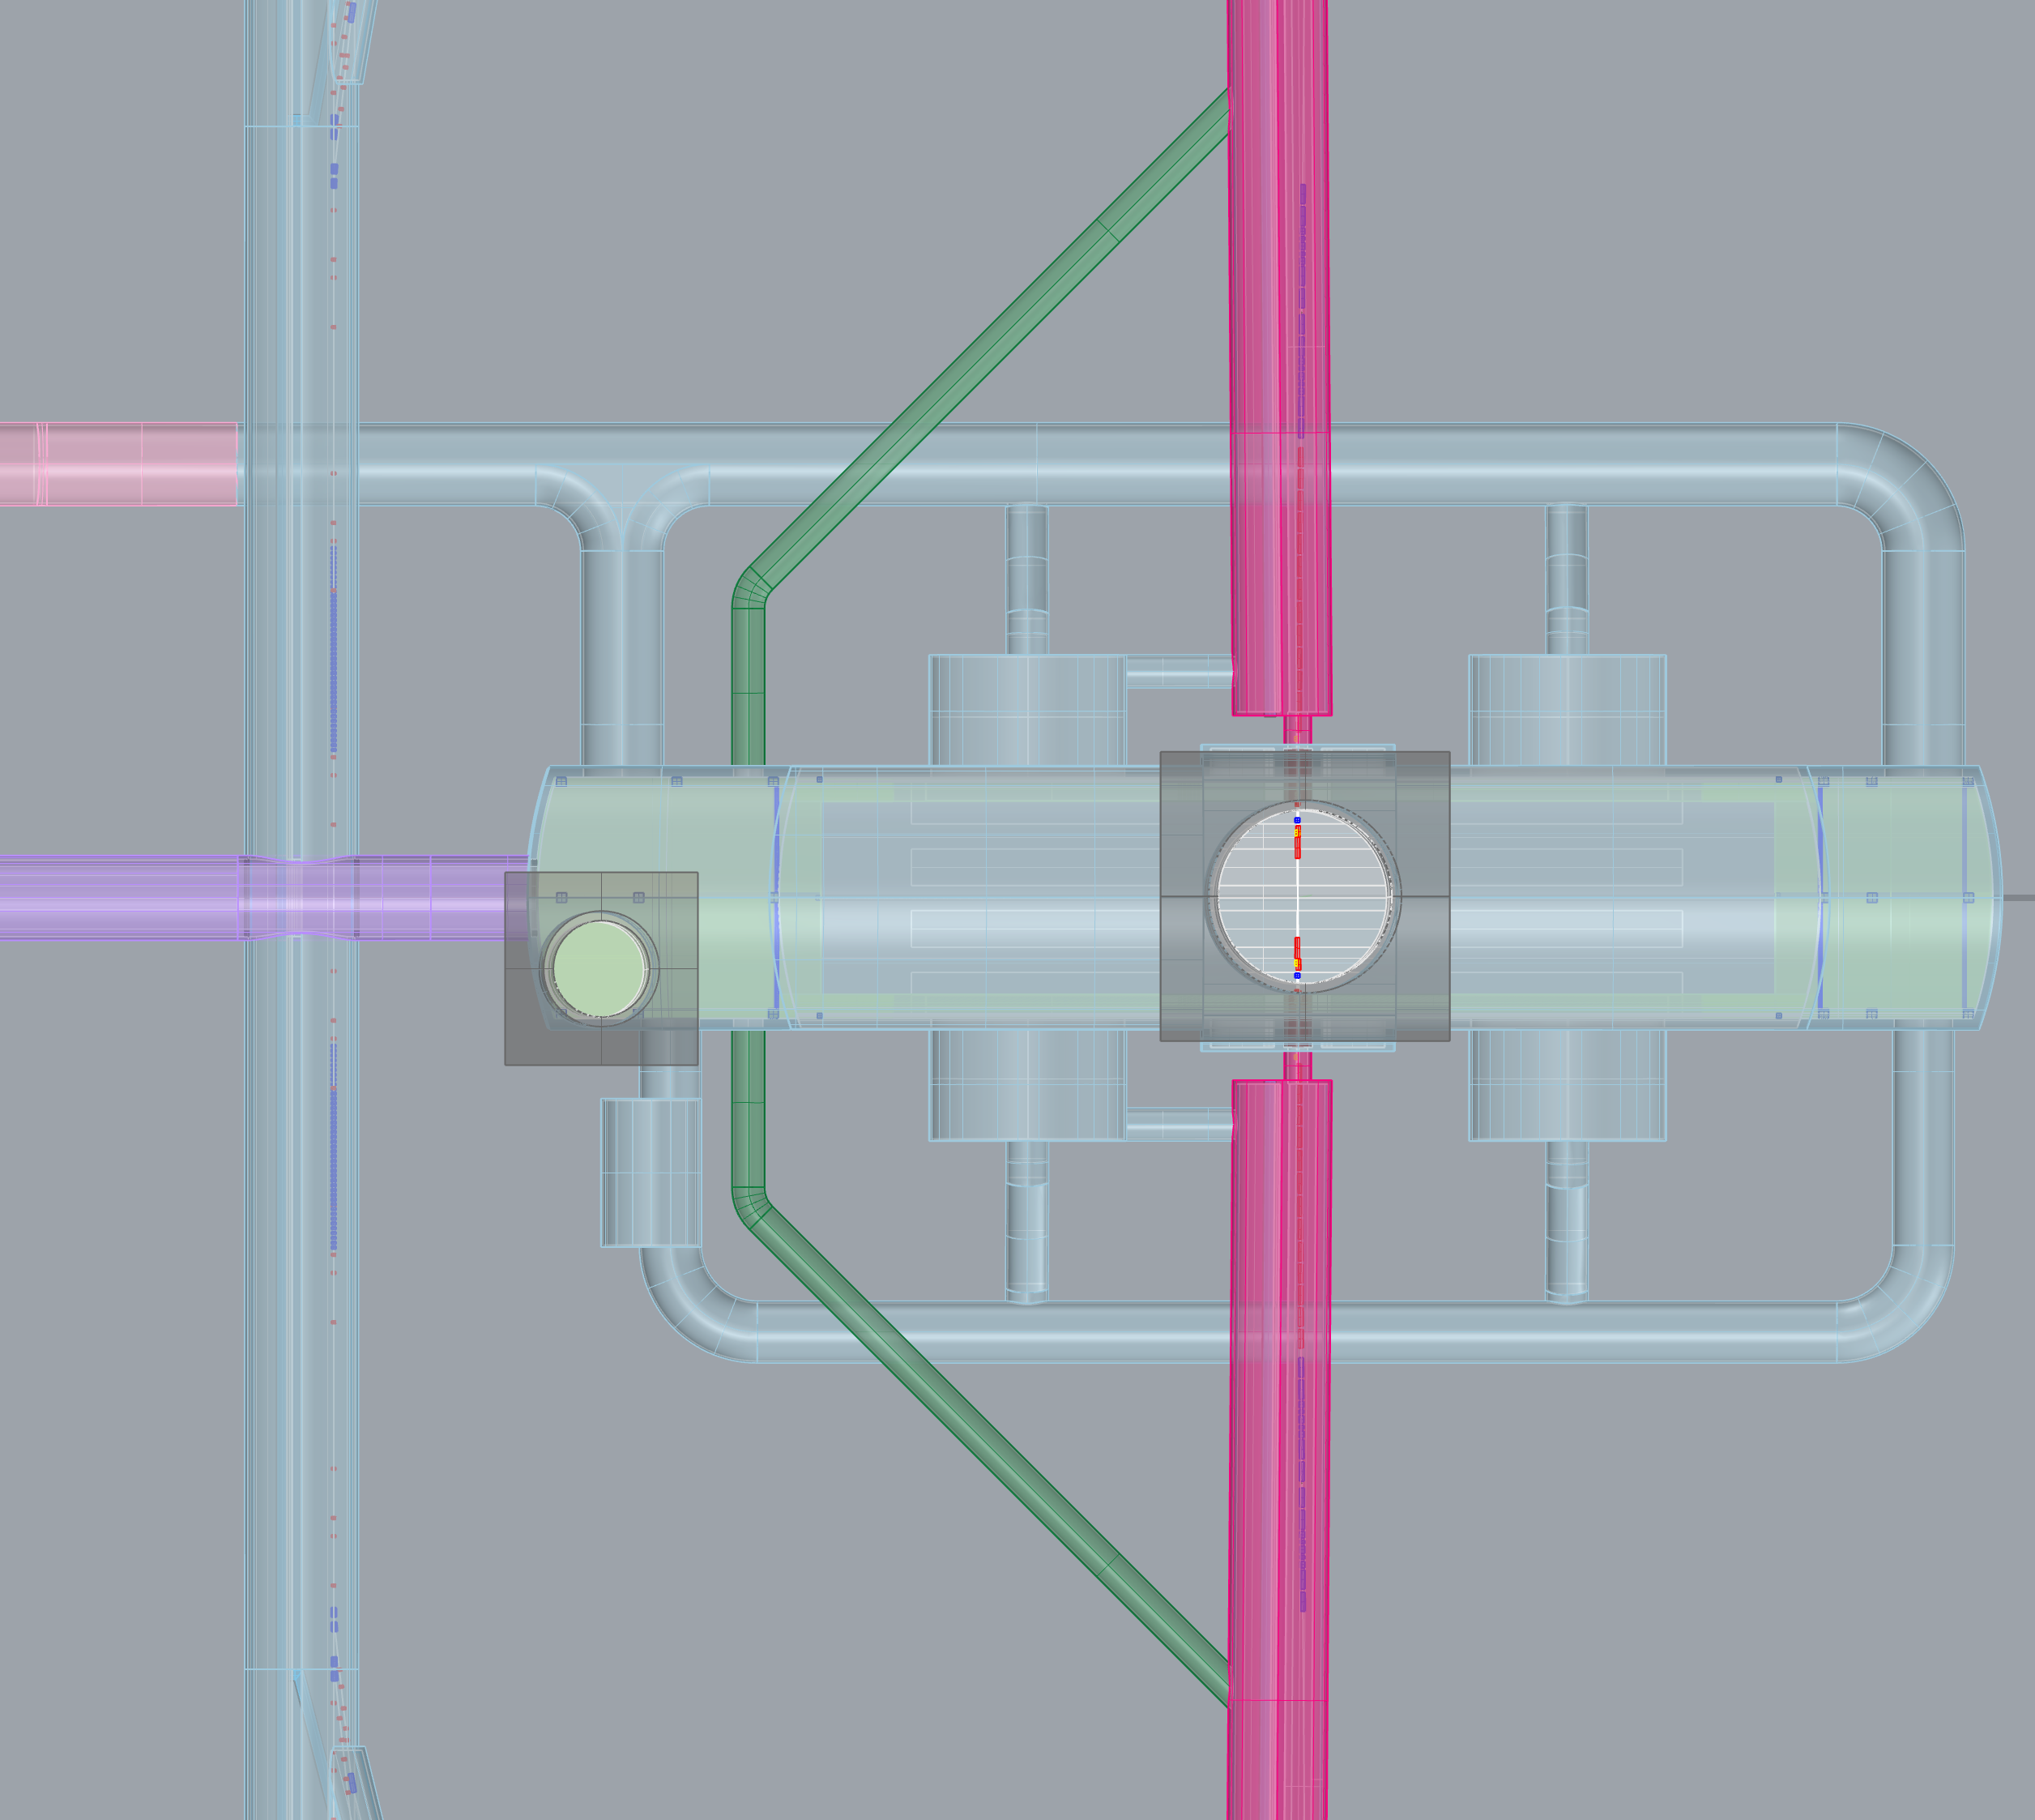
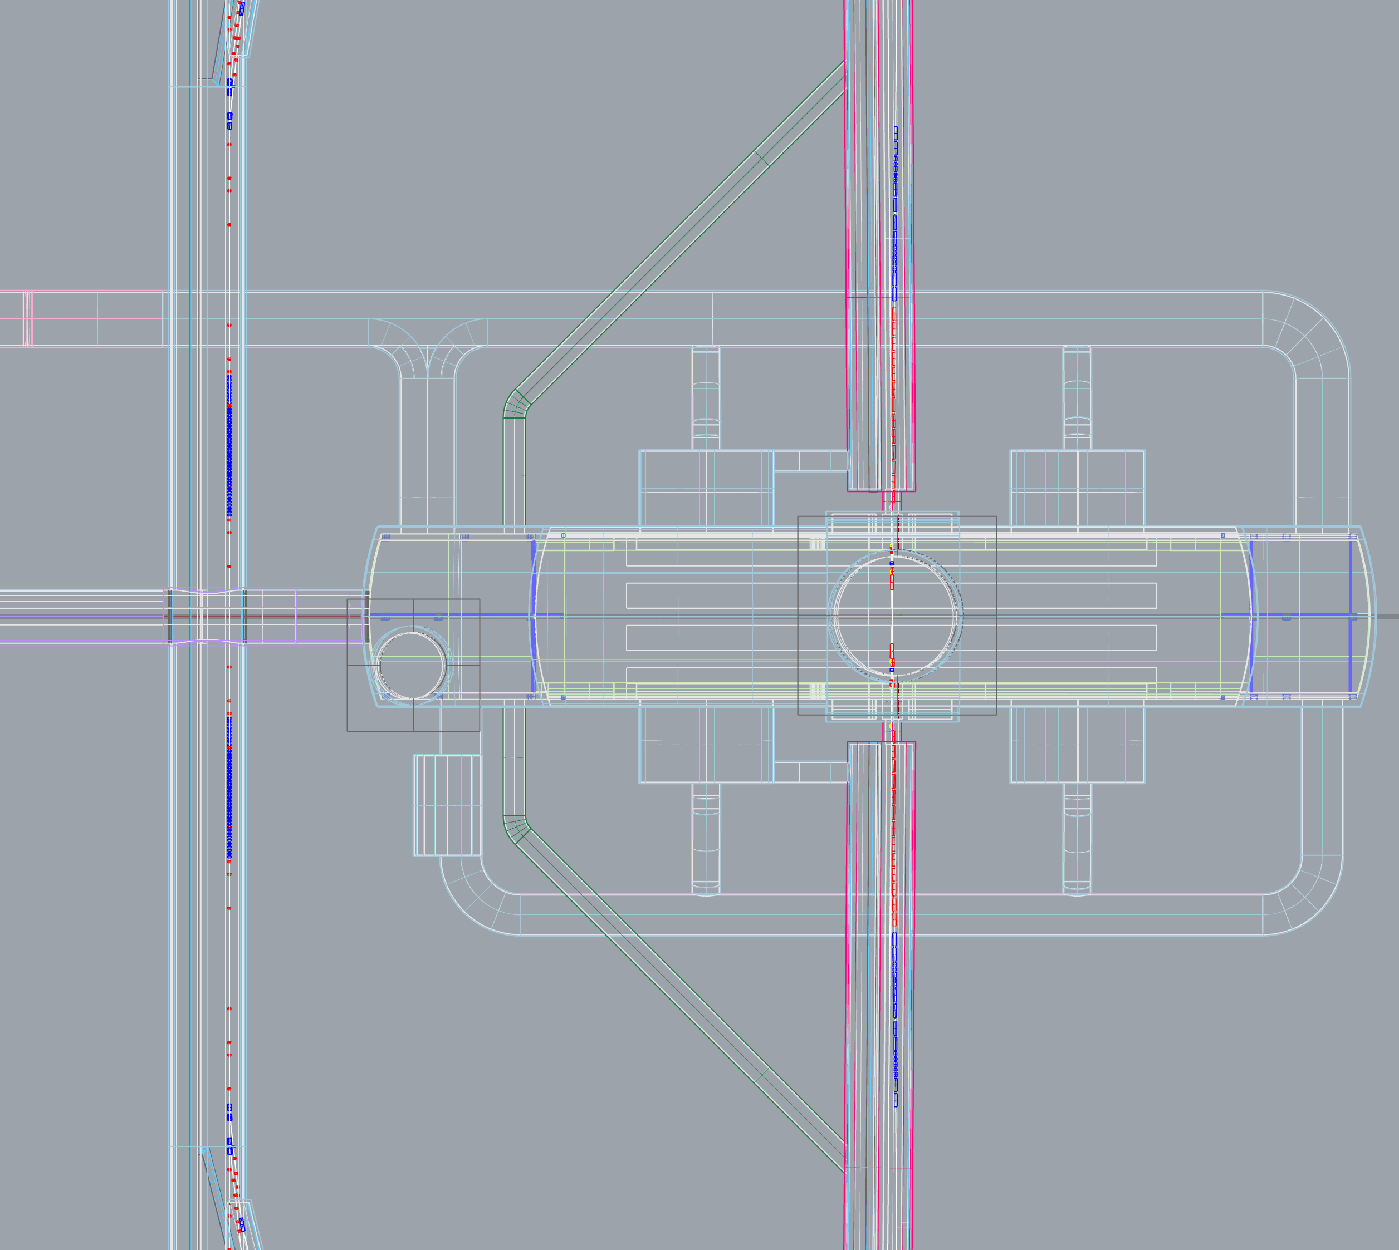
Detector Hall View

Slide 22
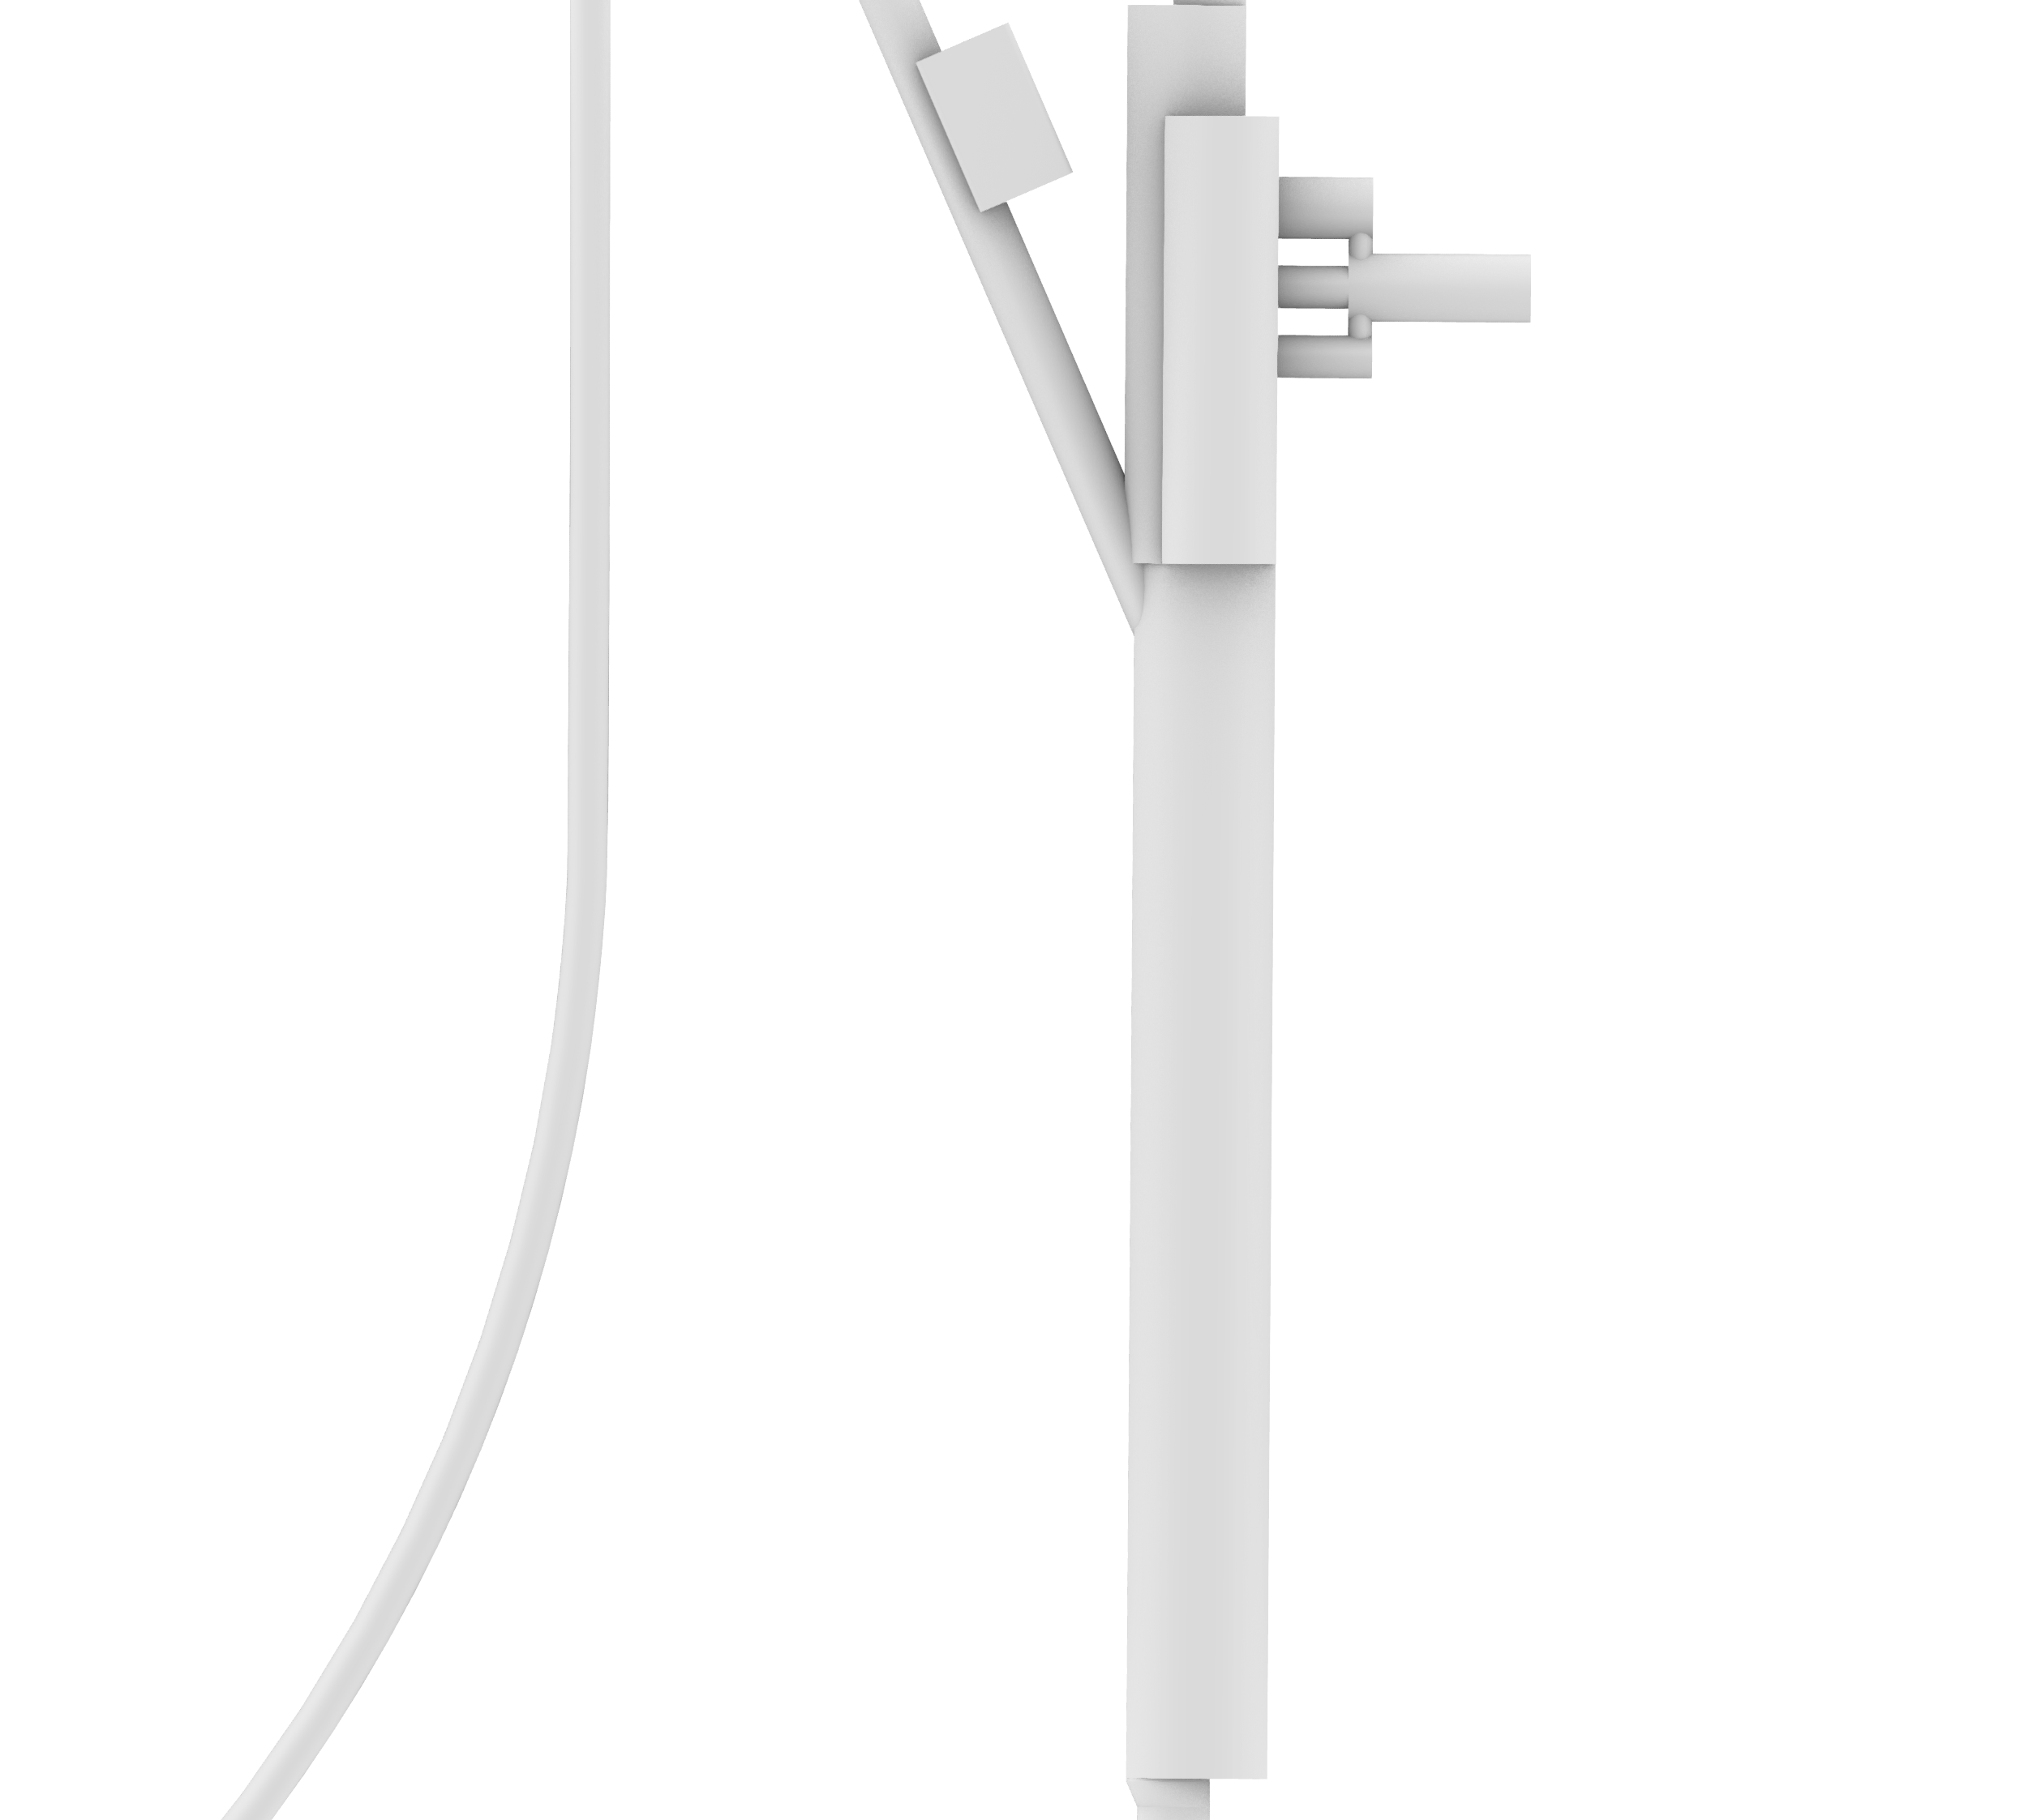
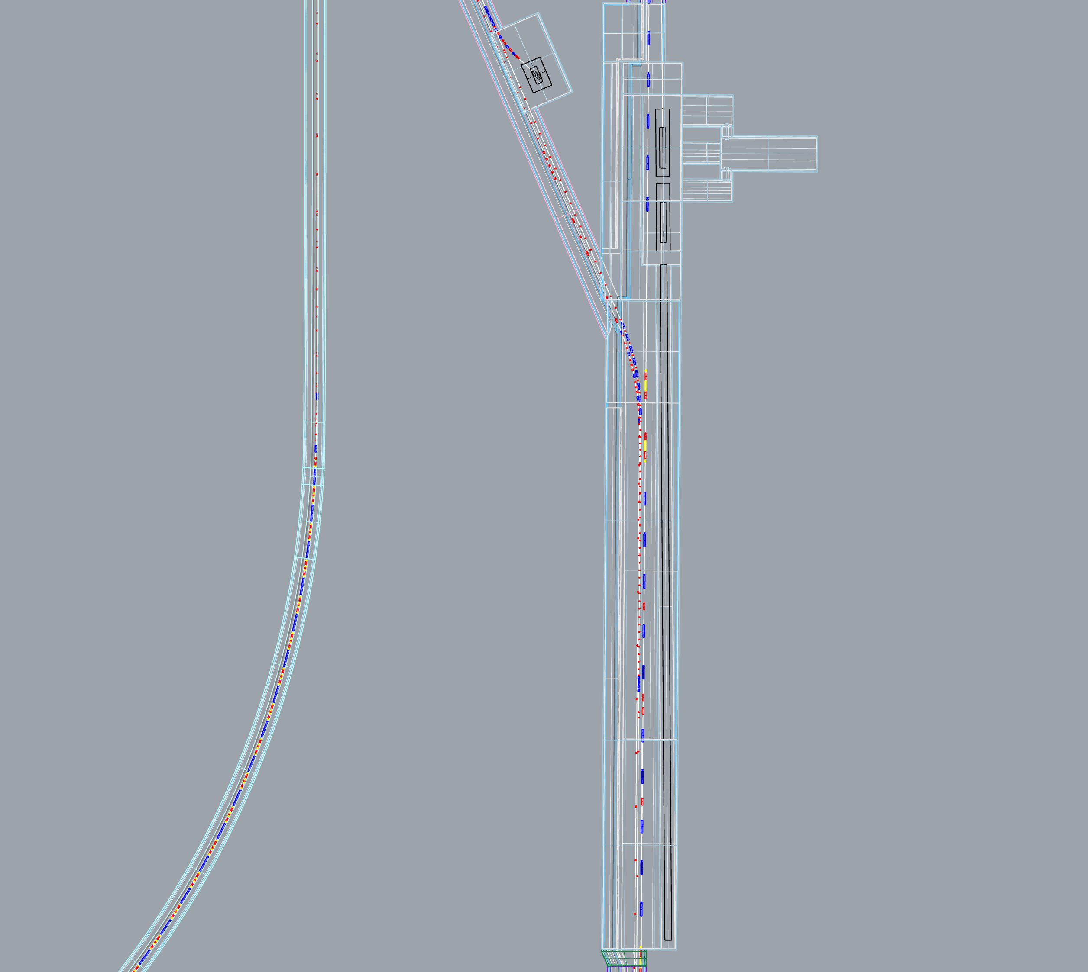
Electron-side
Main Beam Dump
Area

Slide 23
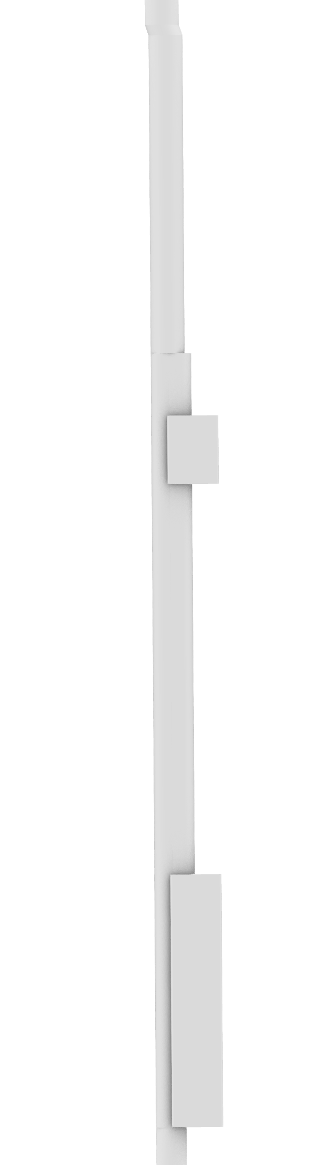
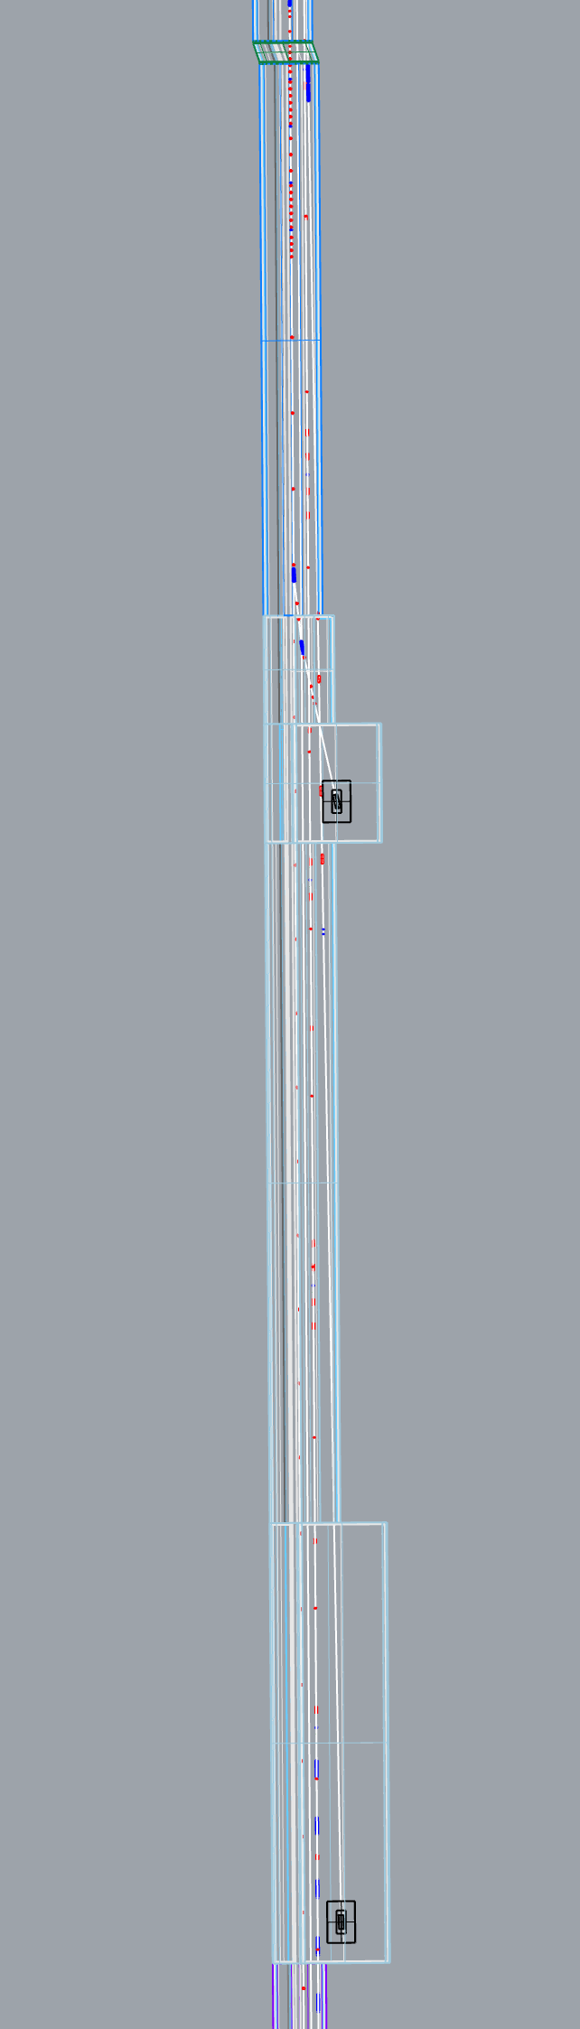
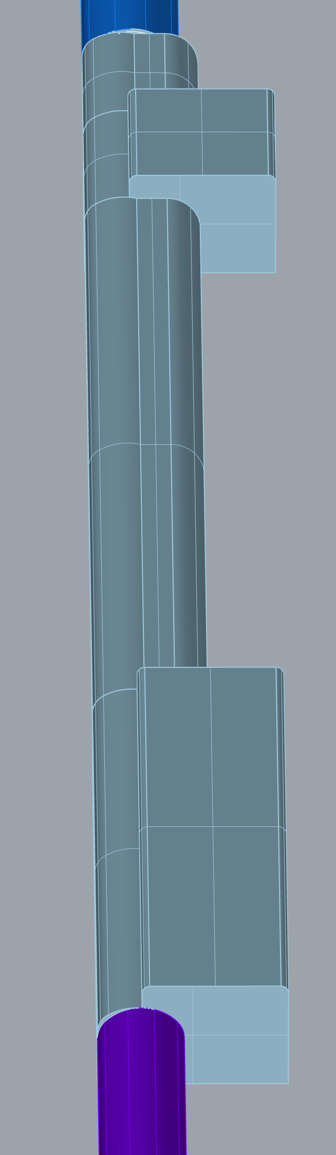
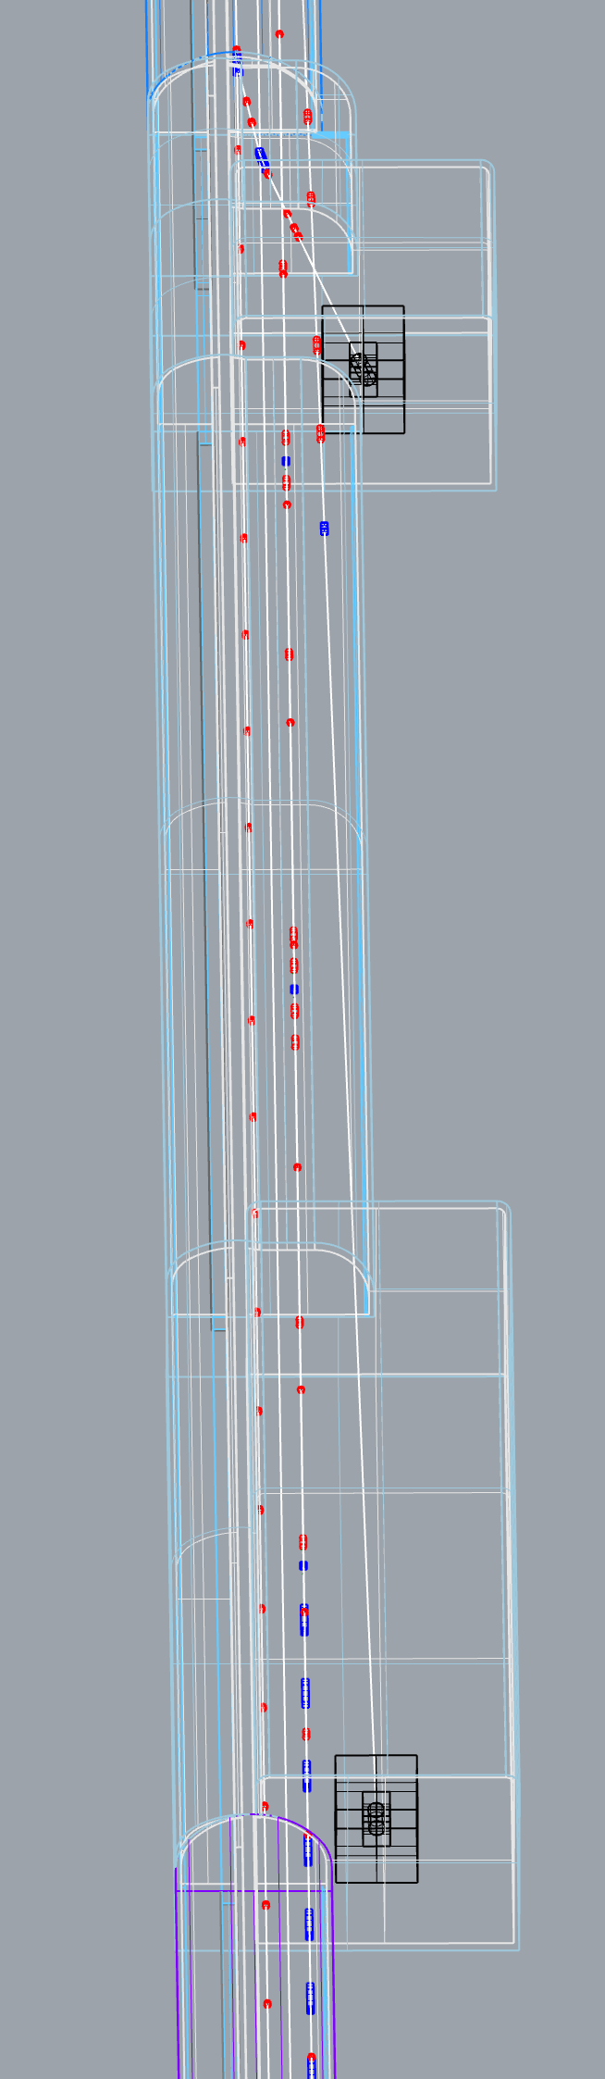
Positron-side
BDS tune-up dump
and
Electron source
tune-up dump
(Plain View)
Positron-side
BDS tune-up dump
and
Electron source
tune-up dump
(3D View)

Slide 24
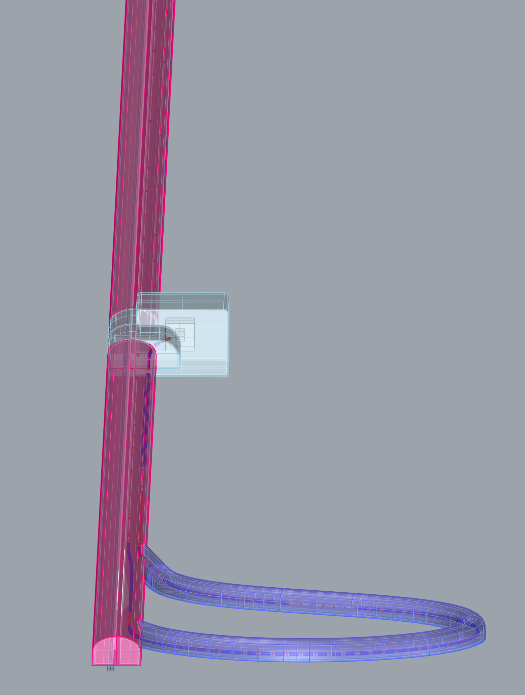
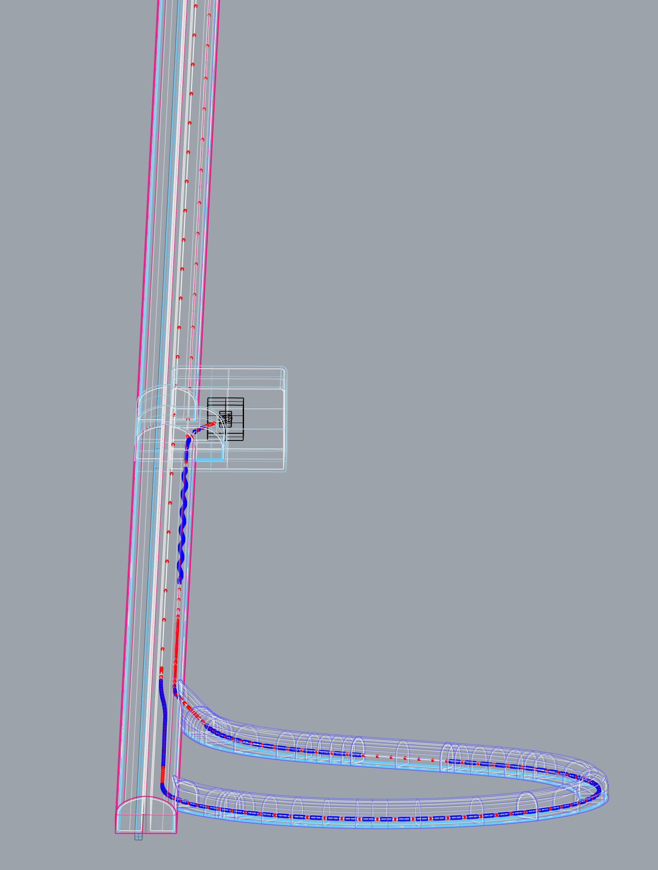
Positron-side
Turn-around
and
Bunch Compressor
tune-up dump 1
(3D View)

Slide 25
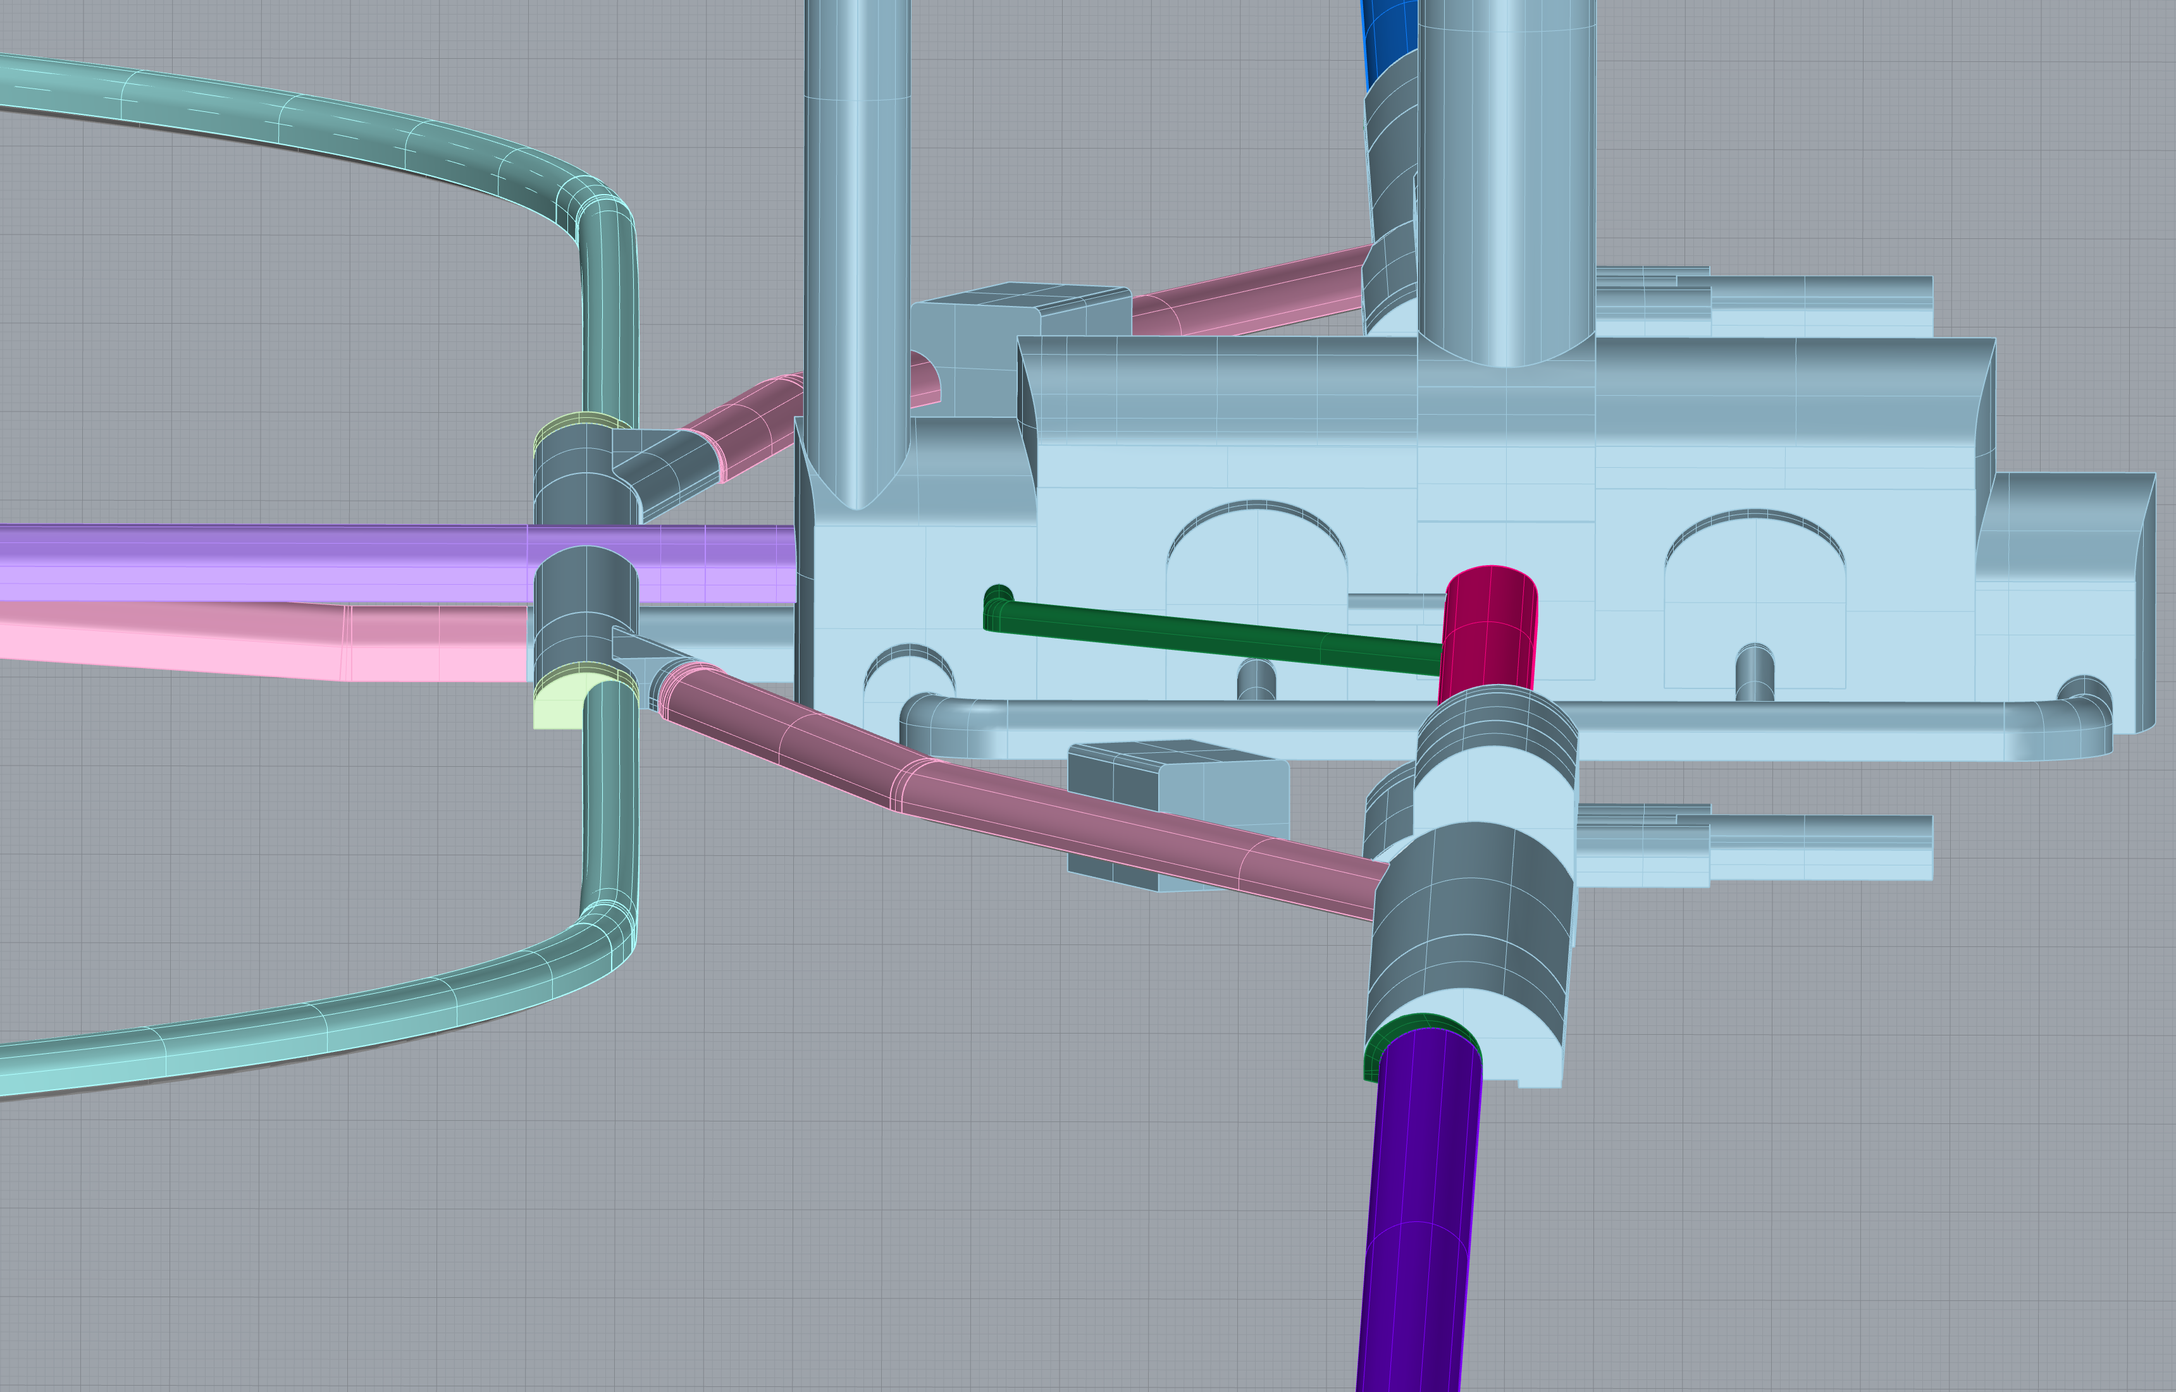
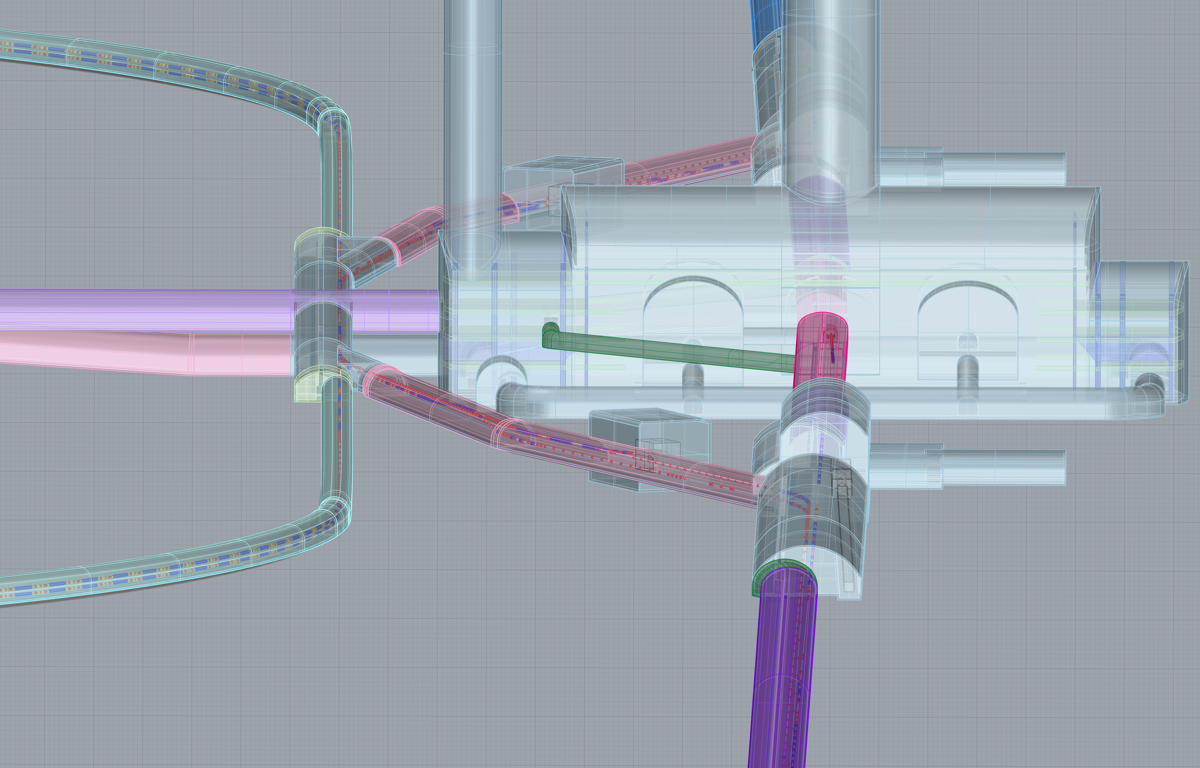
Central Region
(3D View)

Slide 26
Creation of 2D tunnel Plain view and Cross-section view
To check any interference
and To get feedback from accelerator expert, MDI expert, civil expert, and safty expert,
2D drawings with precise dimensions are good for those people,
They are under preparation.
Example of 2D drawings

Slide 27
Summary
1. Based on the Optics Deck as of end of 2019,
the arrangement of accelerator components were made.
2. To house the accelerator, 3D tunnel design was made,
based on the most recent discussion, as a tentative design.
Check any interference, get feedback from expert
will be done using 2D drawings with precise dimensions.
(*) 2D drawings will be generated from 3D tunnel design.
and it is on a way.

Slide 28
End of slide

