Slide 1
Tasks of IDT and Pre-Lab
Kaoru Yokoya (KEK)
2020.10.20

Slide 2
ILC Timeline
Hypothetical Timeline
now
2022
2026
2036
IDT
Pre-Lab
Construction
Operation
commissioning
IDT: Organize Pre-Lab
Pre-Lab: start at Apr.2022, 4 yrs
  IDT plan is based one this date
Construction: 10 yrs
  Last 1 yr : Commissioning
Operation

Slide 3
IDT (International Development Team)
On August 2, 2020, ICFA approved the formation of the ILC-IDT
  mandate to make preparations for the ILC Pre-Lab in Japan
Structure and function of the ILC-IDT
  IDT is hosted by KEK,
  consists of the Executive Board (EB) and three Working Groups (WG1, WG2 and WG3).
EB
  The EB comprises:
    a Chair;
    a member from each of the three regions contributing to the ILC effort (Americas, Asia-Pacific and Europe); and
    three ex-officio members (KEK liaison officer and Chairs of WG2 and WG3, whereas WG1 is chaired by the EB Chair).
  The EB members are appointed by ICFA. The EB has the overall responsibility for the Pre-Lab preparation.
  The EB and WG1 will carry out the key tasks of developing the function and organisational structure for the Pre-Lab. They will support the preparation of Memoranda of Understanding among the national laboratories and other interested parties for the operation of the Pre-Lab and will support discussions at the national authority level.

Slide 4
Executive Board Members
Executive Board and Working Group 1 (WG1):
  Chair – Tatsuya Nakada (EPFL)
Regional Representatives:
  Europe – Steinar Stapnes (CERN)
  Americas – Andy Lankford (University of California, Irvine)
  Asia/Oceania – Geoffrey Taylor (University of Melbourne)
Working Group 2 (WG2):
  Chair – Shinichiro Michizono (KEK)
Working Group 3 (WG3):
  Chair – Hitoshi Murayama (University California Berkeley/ IPMU-University of Tokyo)
KEK Liaison - Yasuhiro Okada (KEK)
Contacts:
  Geoffrey Taylor (ICFA, Chair) - The University of Melbourne;
  Tatsuya Nakada (Chair, Executive Board, ILC-IDT) - EPFL, Lausanne

Slide 5
IDT Working Groups
WG1 membership is established by the EB, includes the EB members and is chaired by the EB Chair.
WG2 conducts the ILC accelerator and facility work.
WG3 carries out the ILC physics and detector activities.
The members of WG2 and WG3 will be appointed by the EB.

Slide 6
IDT-WG2 organization
Bi-weekly meeting: Sep.22, Oct. 6, …
Charges of Sub-groups
Discuss the topics for
- technical preparation (remaining topics) at Pre-lab
- preparation for mass production at Pre-lab
- possible schedule at Pre-lab
- international sharing candidates of these activities
Report to the IDT-WG2
IDT WG2
Shin Michizono (Chair)
Benno List (Deputy)
All members belong to some sub-group(s).
SRF
DR/BDS/Dump
Yasuchika Yamamoto | KEK
Dimitri Delikaris | CERN
Hitoshi Hayano | KEK
Olivier Napoly | CEA
Marc C. Ross | SLAC
Akira Yamamoto | KEK
Sam Posen | FNAL
Nuria Catalan | CERN
Robert Rimmer | JLAB
Rongli Geng | JLAB
Toshiyuki Okugi | KEK
Philip Burrows | U. Oxford
David L. Rubin | Cornell
Nikolay Solyak | FANL
Nobuhiro Terunuma | KEK
Kaoru Yokoya | KEK
Jenny List | DESY
Thomas Markiewicz | SLAC
Luis Garcia Tabares | CIEMAT
Sources
Kaoru Yokoya | KEK
Hitoshi Hayano | KEK
Masao Kuriki | U. Hiroshima
Benno List | DESY
Gudrid Moortgat-Pick | U. Hamburg
Joe Grames | JLAB
Civil engineering
Nobuhiro Terunuma | KEK
John Andrew Osborne | CERN
Tomoyuki Sanuki | U. Tohoku
Technical preparation etc. will be discussed in bi-weekly sub-group meeting.
Some more added

Slide 7
Sources Subgroup
Members
  Gudrid Moortgat-Pick U. Hamburg
  Joe Grames JLab
  Masao Kuriki U. Hiroshima
  Benno List DESY
  Hitoshi Hayano KEK
  Kaoru Yokoya (chair) KEK
Meeting
  Monday every other week (irregular sometimes)
  So far, 2 meetings
    Oct. 5 Introduction
    Oct. 12 Photo cathode of the electron source

Slide 8
IDT WG2 timeline
Example (towards Pre-lab)
2020 Sep.: List of Pre-lab acc. activities/ budget/ schedule
2020 Oct.: Information sharing about technical preparation
2020 Oct.: AWLC
2020 Dec.: Draft of sharing remaining technical preparation/pre-lab preparation (each region/lab.)
2021 Feb.: First draft of budget request (each region/lab.)
  WG1 Works to form MoUs based on the budget request
2021 Dec.: IDT ends
2022 April: Pre-Lab starts

Slide 9
Pre-lab Schedule
1st year: TDR-based estimate recollection work started by an international team centered on the Pre-lab.
2nd year: Estimate tabulation work, internal review in the latter half of the 2nd year. The review also reports on the progress of technical issues during the preparation period.
3rd year: Conducted an external review and completed scrutiny of costs and risks (this is the end of incorporating cost reduction R & D). Completion of draft of engineering design report (EDR).
4th year: EDR publishing (first half), report on progress on technical issues, preparation work for each large bid.

Slide 10
Accelerator activities at ILC Pre-lab phase
Technical preparations /performance & cost R&D [shared across regions]
  SRF performance R&D
  Positron source final design and verification
  Nanobeams (ATF3 and related): Interaction region: beam focus, control and Damping ring: fast kicker, feedback
  Beam dump: system design, beam window, cooling water circulation
  Other technical developments considered performance critical
Final technical design and documentation [central project office in Japan with the help of regional project offices (satellites) ]
Engineering design and documentation, WBS
Cost confirmation/estimates, tender and purchase preparation, transport planning, mass-production planning and QA plans, schedule follow up and construction schedule preparation
Site planning including environmental studies, CE, safety and infrastructure (see below for details)
Review office
Resource follow up and planning (including human resources)

Slide 11
Accelerator activities at ILC Pre-lab phase (continued)
Preparation and planning of deliverables [distributed across regions, liaising with the central project office and/or its satellites]
Prototyping and qualification in local industries and laboratories, from SRF production Iines to individual WBS items
Local infrastructure development including preparation for the construction phase (including Hub.Lab)
Financial follow up, planning and strategies for these activities
Civil Engineering, local infrastructure and site [host country assisted by selected partners]
Engineering design including cost confirmation/estimate
Environmental impact assessment and land access
Specification update of the underground areas including the experimental hall
Specification update for the surface building for technical scientific and administrative needs

Slide 12
What Should be Done This Year
List up the technical preparations to be done in the Pre-Lab
  Issues pointed out by SCJ and MEXT
  Technical items necessary for writing EDR
Possible partners
  Existing expertise
  Need not guarantee now research cooperation and budget
Rough evaluation of the necessary cost
2021 Feb.: First draft of budget request (each region/lab.)
To establish Pre-Lab we need KEK-to-Lab bilateral MoU

Slide 13
Technical Issues Pointed out by SCJ and MEXT on the Sources
ILC Advisory Panel (MEXT)
  Target cooling
  Replacement of activated target
SCJ
  Prototype rotating target In the preparatory phase should be made in the preparatory phase
  Magnetic focusing system right after target to be developed in the preparatory phase
  Technology selection by the second year of the preparatory phase (→ must be reconsidered)

Slide 14
So far, I listed what individual subgroups must do.
Sources subgroup has a bit special issue to be considered

Slide 15
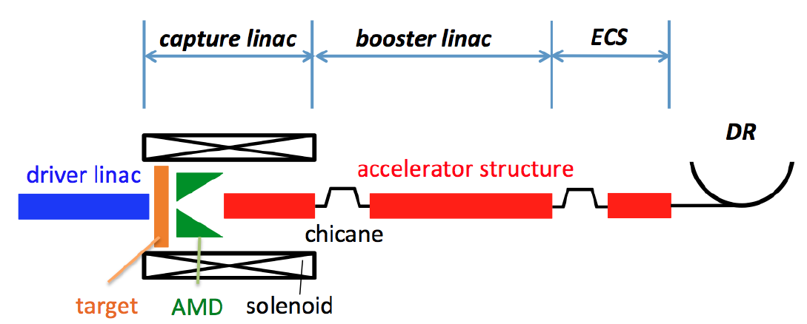
Special Problem of Sources Subgroup
Technology selection of the positron source
  Undulator (baseline)
  e-Driven (backup)
Parallel development through the Pre-Lab period would be undesirable from the viewpoint of budget and human resources
125GeV electron
3GeV electron from a dedicated linac

Slide 16
Choice of the Positron Production System
To follow the general timeline of the IDT-WG2 looks very tight in this respect
  “2021 Feb.: First draft of budget request (each region/lab.)”
  Impossible to select the technology by this time
  But should be selected by the start of Pre-Lab at the latest
  Next summer-autumn?
  Assign a sort of “priority”?
  How? Do we need a special committee?
Presumably, it would be reasonable to discuss about Pre-Lab plan and to create the list (Work Breakdown) for both schemes at least until February next year.

Slide 17
List of what should be done in Pre-Lab
This will be the most urgent subject of WG2 within this year
Separate tables for
  Electron source
  Positron source (undulator)
  Positron source (e-driven)
Eventually, the list must include
  Cost estimation
  Candidates of the partner (labs)
The following pages are examples (not even the first draft) created by myself
  Just to show what the tables look like
  IDT period is also listed. This is important for positron
  Tunnel construction period : some items can be postponed to this period

Slide 18
Electron Source

Slide 19
Undulator Scheme

Slide 20
e-Driven Source

Slide 21
Civil Engineering
Design choice of the positron source has a strong impact to the civil engineering (CE) of the whole system
CE is not our (sources subgroup) responsibility, but
We must give inputs to the CFS subgroup
The CE design must be ready to start tunnel construction by the end of year 4 of Pre-Lab.
This is the strongest reason that we have to decide the positron source as soon as possible
There is a team at KEK to discuss about the beamline for CFS (don’t know the official name) since the end of 2018
  K.Kubo (chair), N.Terunuma, H.Hayano, T.Okugi, T.Sanuki, S.Michizono, K.Yokoya
  2 designs are on-going, one for undulator scheme, the other for e-driven scheme (with later addition of undulator)
  The layout for undulator scheme done by ~February this year (more refinement needed for EDR, of course)
  The layout for e-driven has been nearly done

Slide 22
Civil Engineering for Undulator Scheme
Based on TDR, with the energy change 500→250 GeV
In addition, there have been tremendous number of small changes since TDR
  Mirror flip of whole layout
  Undulator length 147m → 231m
  Undulator moved downstream by ~160m to shorten the distance to the target for 125GeV beam
  Electron injector linac moved upstream in BDS tunnel
  Damping ring lattice changed for smaller horizontal emittance (~2/3)
  Turn-around lengthened a bit to relax the tight layout
  Numerous length adjustment
  And so on……….
Must write a compiled report

Slide 23
Civil Engineering for e-Driven Scheme
The design layout of e-driven scheme must take into account of the later upgrade (positron polarization) to the undulator scheme
There can be several possible strategies such as
  e-Driven source is installed in the main linac tunnel
    Undulator system replaces e-driven system at upgrade
    Undulator system is added at upstream of e-driven source at upgrade
  e-Driven source is placed in a separate tunnel
    The space for undulator source is reserved in the main linac tunnel
    No space reserved (undulator source is installed far upstream at the time of energy upgrade)
Our work so far adopted B1

Slide 24
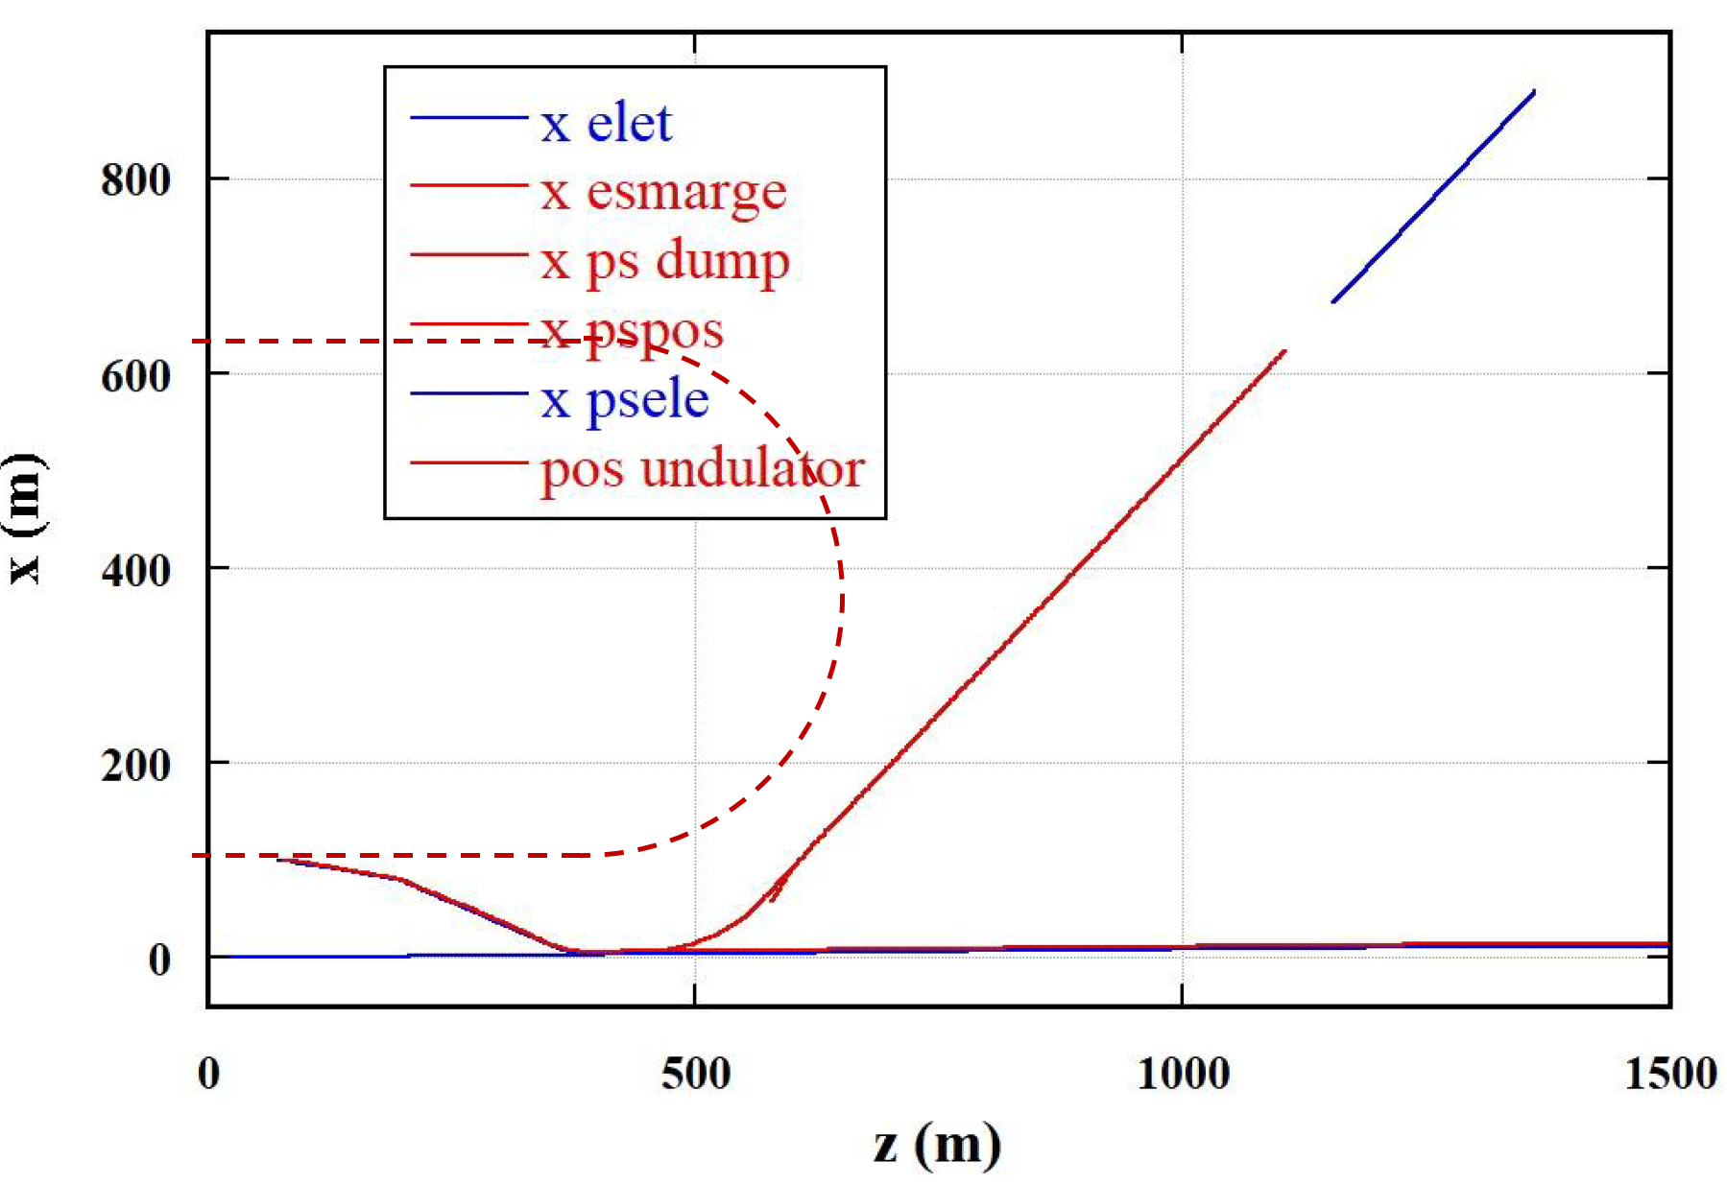
e-Driven Source Layout
Tentative, of course.
Angle 45 degrees is not essential (depends on the geography)
e+ line crosses the service tunnel here

Slide 25
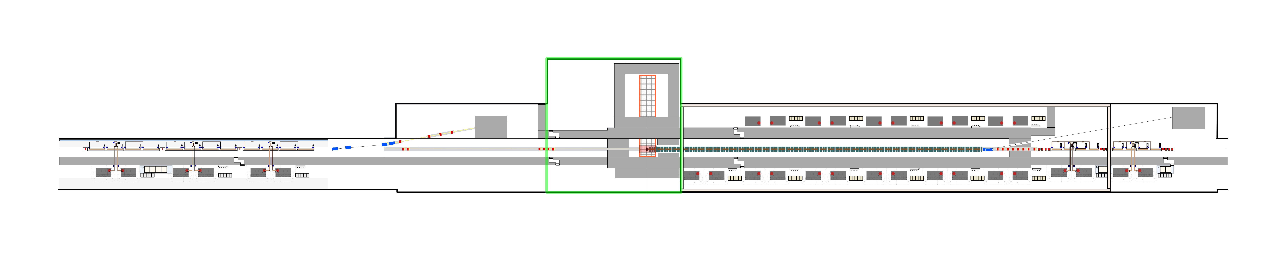
e-Driven Source
Here, only the e-Driven Source around the capture region is shown
Target area vertical shaft 5m x 25m, depth 40m
Capture area 17m x 153m, tunnel height 15m
Target replacement horizontally
RF source on both sides of the capture cavities
Target module
handling area
Target Module
15tクレーン設置のためのフレーム
□500の柱に□500の横渡し角パイプ
幅16.5m 長さ80mの領域に渡って。
Electron Driver
S-band TW, 3GeV
Positron capture linac
L-band SW
Positron booster linac
L-band TW
Beam Dump for
driver commissioning
Target area
Tunnel width 9.5m
Tunnel with 17.0m
Vertical shaft are from surface
25m x 25m, 40m deep
Tunnel width
17.0m
Tunnel width
9.5m
Tunnel length 153m (width 17m)
H.Hayano, 2020-0915

Slide 26
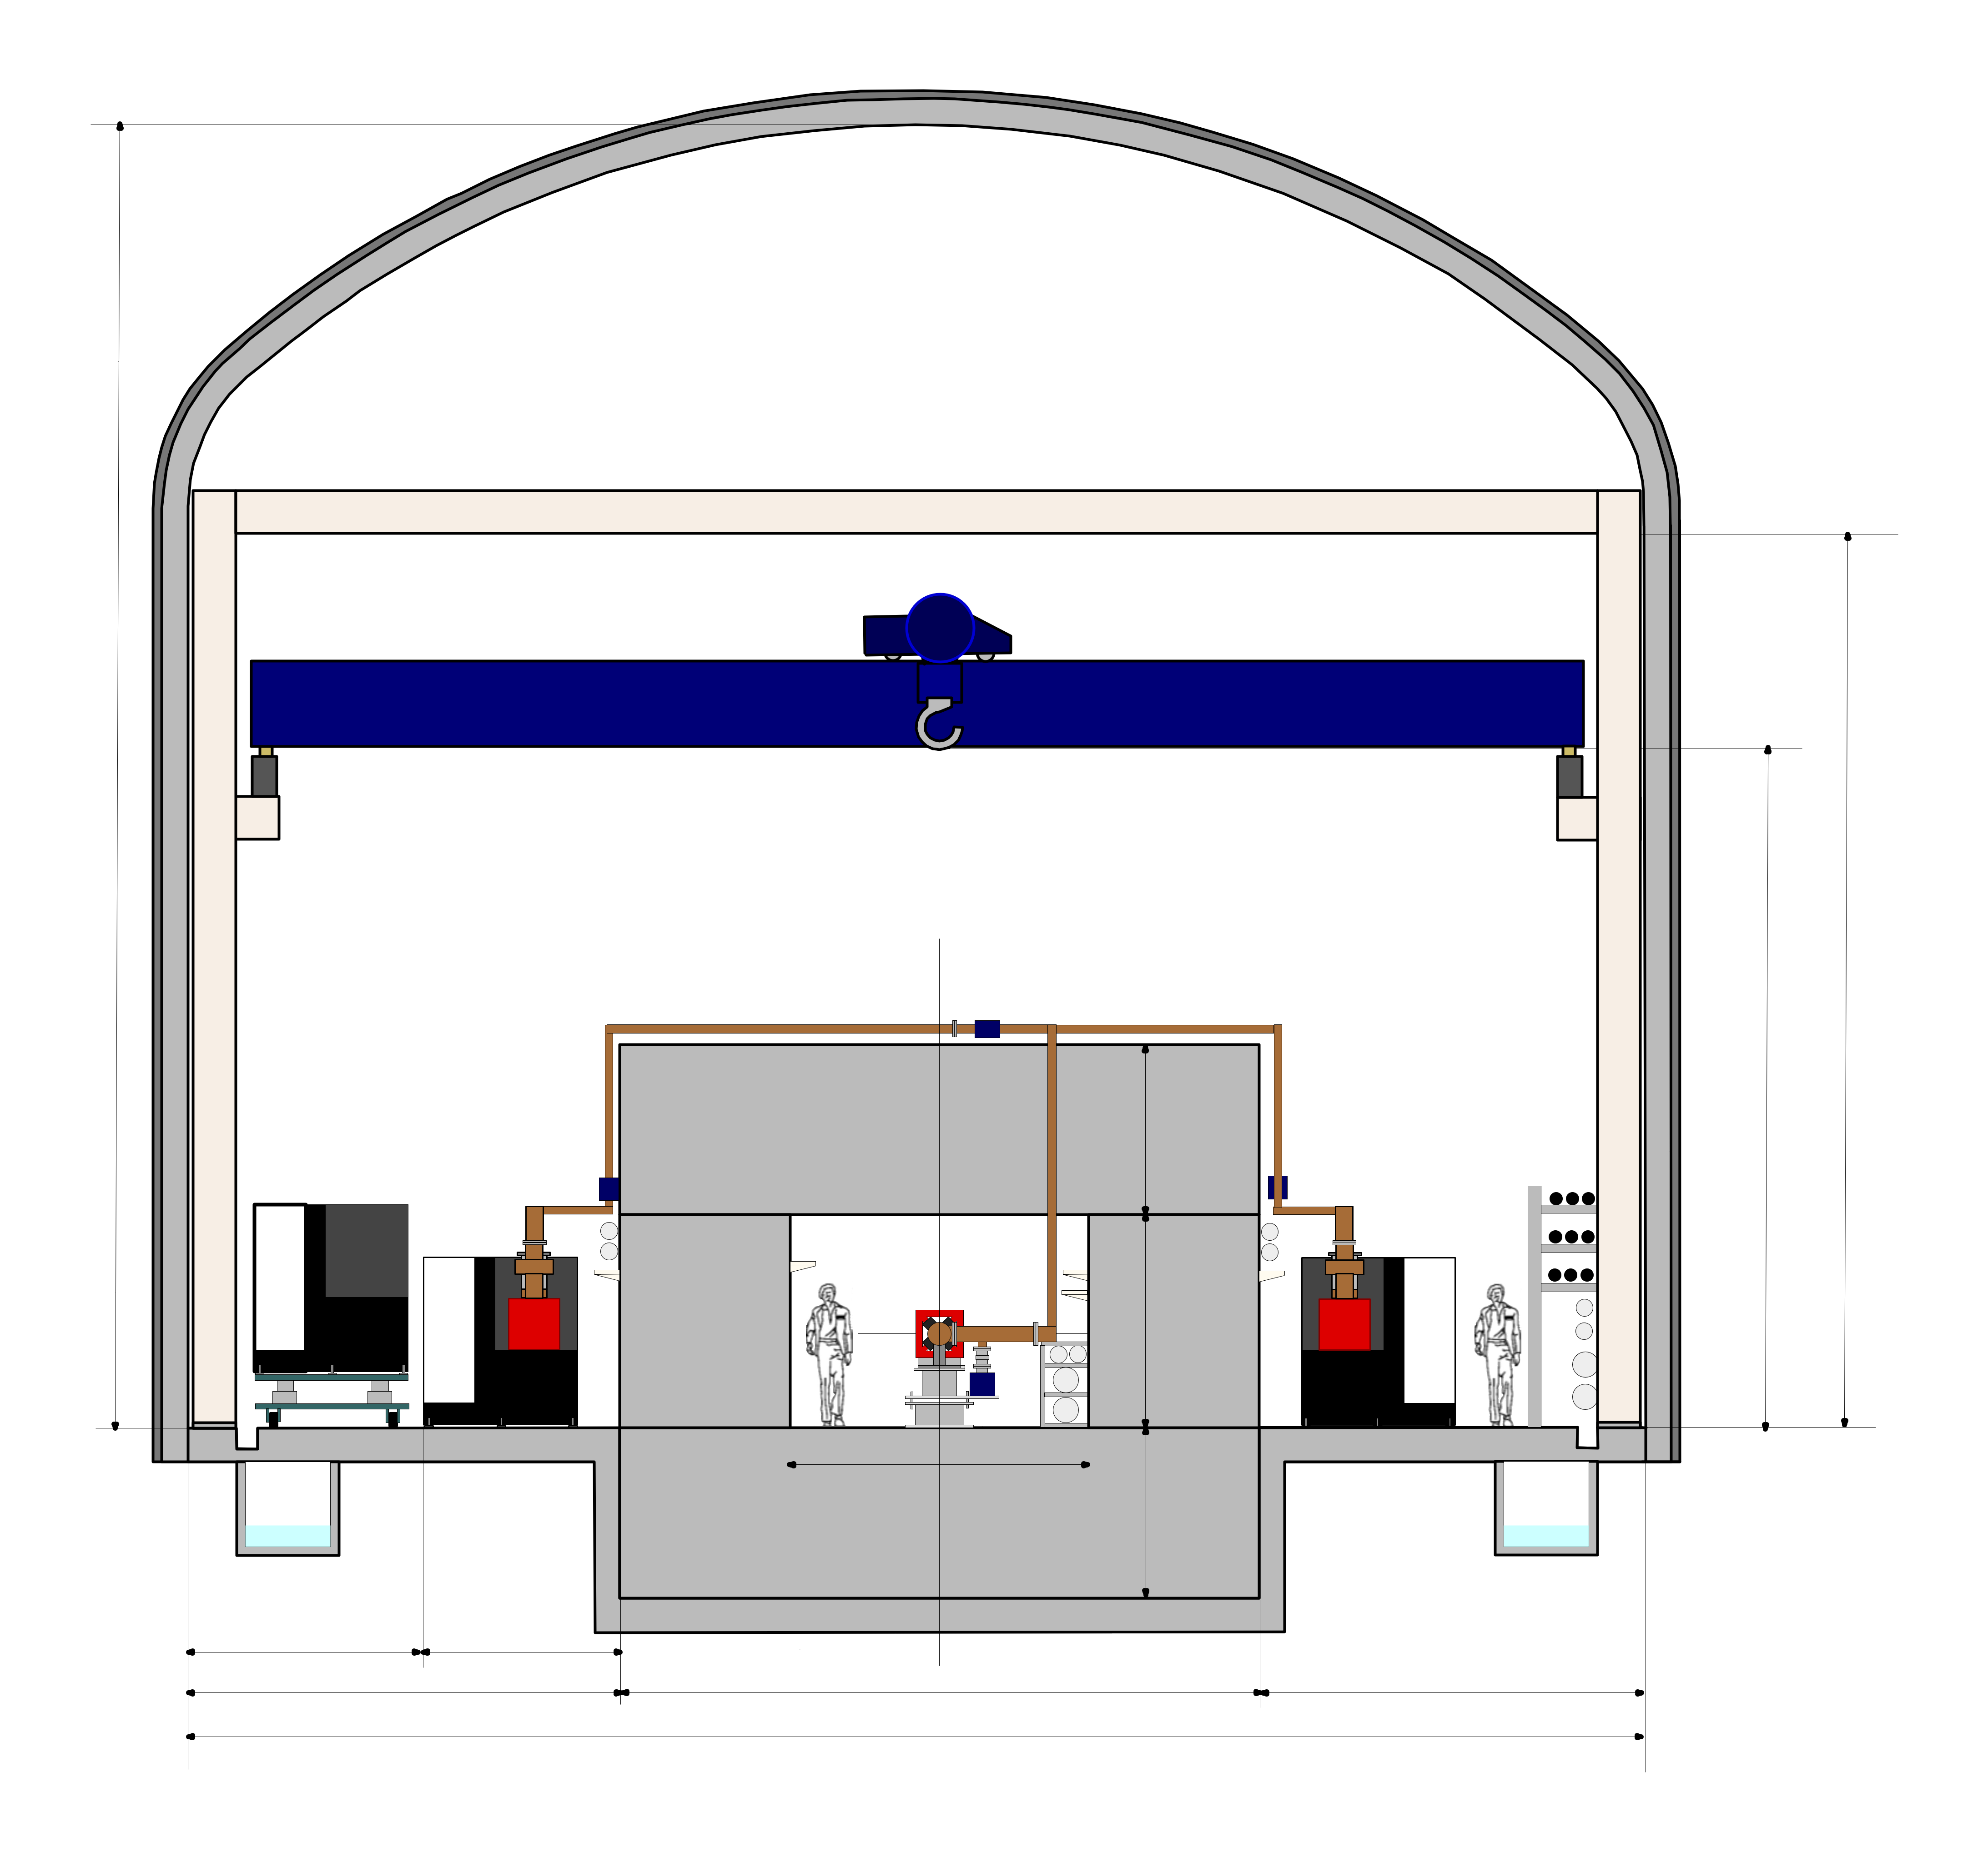
Tunnel Crosssection in Capture Section
L-band SW accelerating structure Unit
Sorry, in Japanese
クレーン設置用フレーム
□500mm鉄パイプとH鋼とで
組み上げる。
Capture Section 20t クレーン
15m
変調器・クライストロン用
一般温調冷却水ヘッダー管
10.5m
シールド天井の上で導波管分配の取り回しをする
8m
66kV, 6.6kV高圧ライン
変調器搬送
2m
一般温調冷却水母管
2.5m
加速管用精密温調冷却水母管
シールドの両側に変調器
クライストロンを配置し、
RFunitに両側から交互に
powerを供給する構成。
3.5m
2m
一般温調冷却水ヘッダー管
イオンポンプ
加速管用精密温調冷却水ヘッダー管
2.7m
5m
2.3m
7.5m
4.5m
17m
H.Hayano, 2020-0915

Slide 27
Summary
IDT, WG2 and Sources Subgroup established
IDT is a transitional organization to prepare ILC Pre-Lab to start in April 2022
Pre-Lab shall continue 4 years
The subgroups must create a “WBS”-like list for the 4-year plan of Pre-Lab by early next year
  The work just started
Sources subgroup must also make a plan for the “selection” or “priority assignment” of the positron schemes

