Slide 1
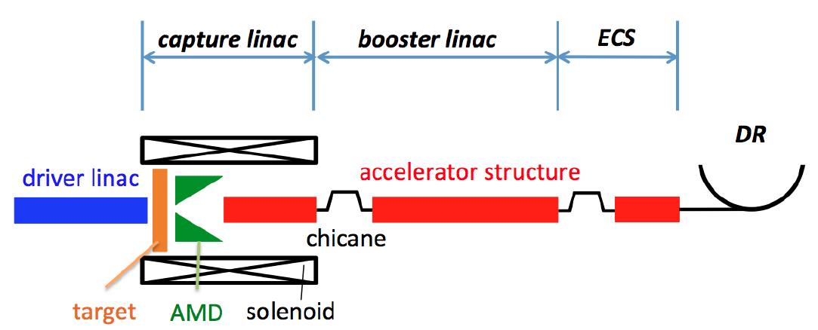
ILC E-driven e⁺ Source
R/D plan of
IDT era and Pre-Lab era
T. Omori (KEK)
AWLC2020, October 2020, fully virtual on Zoom

Slide 2
IDT era R/D plan (page 1)
2020 Autumn – 2022 Spring (1.5 years)
Major R and D Items
(1) Rotation Target Prototype
with Dummy Disk
(2) Numerical calculation and design of L-band
SW Acc Tube for Capture Linac
In addition, we will continue the design of whole system, the start-to-end simulation, radioactivation simulation, study of maintenance scheme, etc. These studies continue through all IDT and Pre-Lab eras.
(3) Numerical calculation of multi-bunch
beam loading of Capture Linac

Slide 3
IDT era R/D plan (page 2)
2020 Autumn – 2022 Spring (1.5 years)
(Detail of item 1) Rotation Target Prototype with Dummy Disk
Now on going: Vacuum and Rotation Test.
Rotation Target Prototype with No Disk
Preparation in on going:
Spring 2021, We will add Dummy Disk
Dummy Disk
Weight and Moment:
as same as the real target
No water channels in it

Slide 4
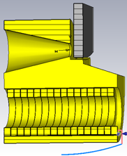
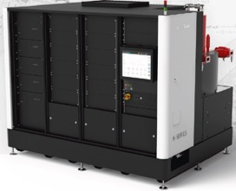
Pre-Lab era R/D plan (Page 1)
2022 Spring – 2026 Spring (4 years)
Major R and D Items
(1) Rotation Target Full Prototype
(2) Flux Concentrator (FC)
FC prototype and Power Supply
(3) Capture Linac Power unit
(a) L-band SW APS Acc. Tube (need special design)
(b) L-Band Klystron (need R and D)
(c) L-band Modulator (Commercial product)
L-band SW Acc. Tube
Flux Concentrator
L-band
Klystron and Modulator
Rotation Target

Slide 5
Pre-Lab era R/D plan (page 2)
2022 Spring – 2026 Spring (4 years)
First Step of R and D
(1) Rotation Target Full Prototype
Design Exists. A prototype exists but the target disk is dummy.
Full Prototype will be made, and it has the target disk with water cooling channels in it.
We will perform vacuum and rotation test of the target.
(2) Flux Concentrator (FC)
Design Exists.
We will make the FC prototype and Power Supply, and full current pulse operation test.
(3) Capture Linac Power unit
(a) L-band SW APS Acc. Tube (need special design)
(b) L-Band Klystron (need R and D)
(c) L-band Modulator (Commercial product)
We will make the design of the L-band SW APS Acc. Tube. and L-Band Klystron.
We will make high power test of the system with combination of (a), (b), and (c).

Slide 6
Pre-Lab era R/D plan (page 3)
2022 Spring – 2026 Spring (4 years)
Second Step of R and D
• Combination of (1) Rotation Target Full Prototype and (2) Flux Concentrator.
We will make rotation and vacuum test of the target with FC pulse magnetic field on the target disk.
• Add Solenoids on (3) Capture Linac Power unit
We will make high power test of the L-band SW Acc. tube with magnetic field of the solenoid.

Slide 7
Pre-Lab era R/D plan (page 4)
2022 Spring – 2026 Spring (4 years)
Third Step of R and D
• Combination of (1) Rotation Target , (2) Flux Concentrator, and (3) Capture
Linac Power unit
We will make comprehensive test run (without beam).

